Slide 1
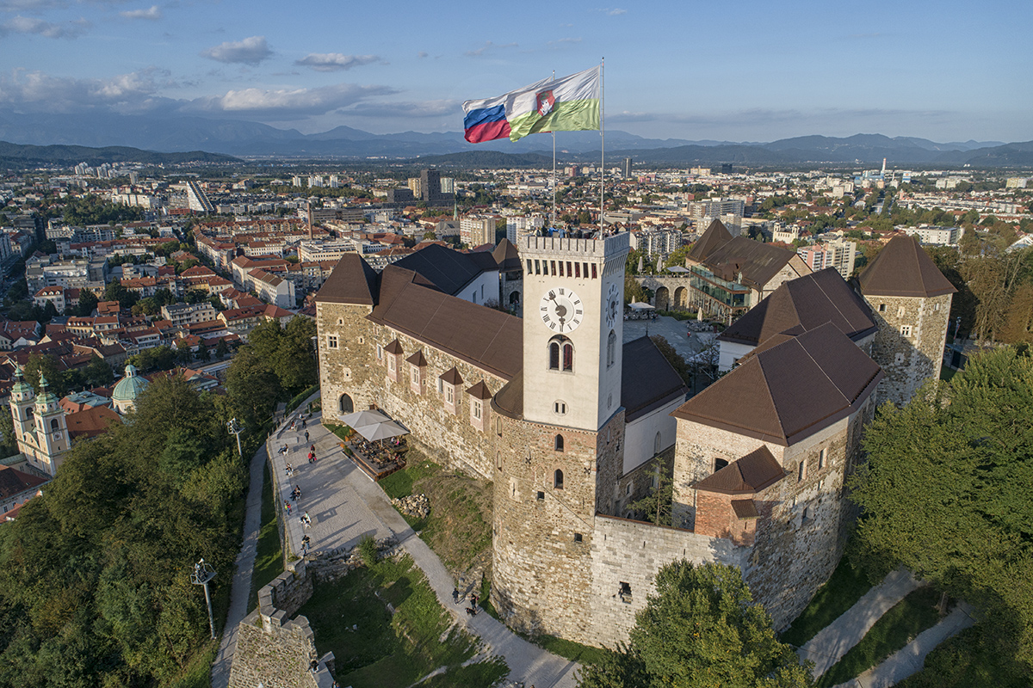


IPPOG Spring Meeting 2026
Ljubljana, Slovenia
Slovenian representative: Tadej Novak
Photo: Visit Ljubljana

Slide 2
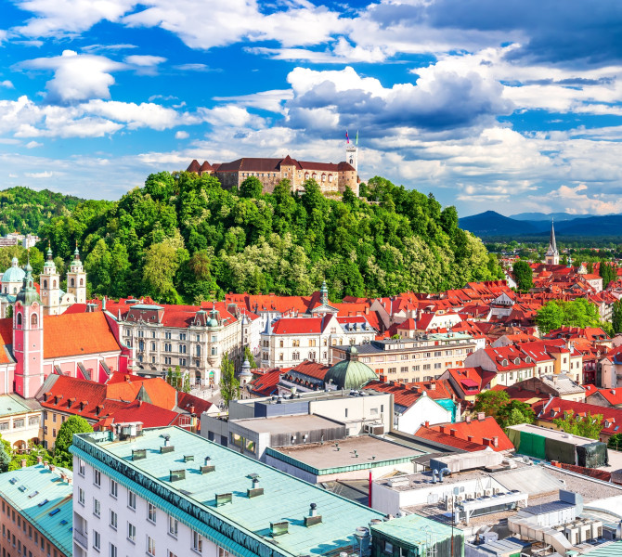
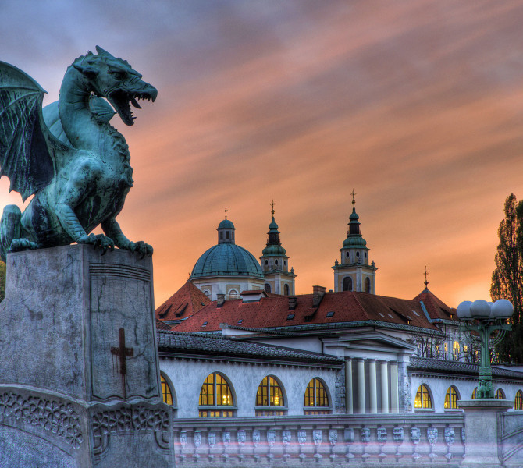
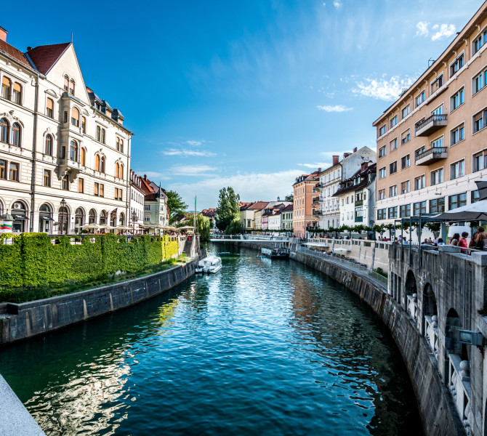
Ljubljana
Capital of Slovenia
One of Europe’s greenest cities
Distance: 20 min by foot from the venue, 10 min by bus
Weather: similar to Geneva
Hint: some of the best ice cream in Europe ☺
Photos: Visit Ljubljana

Slide 3
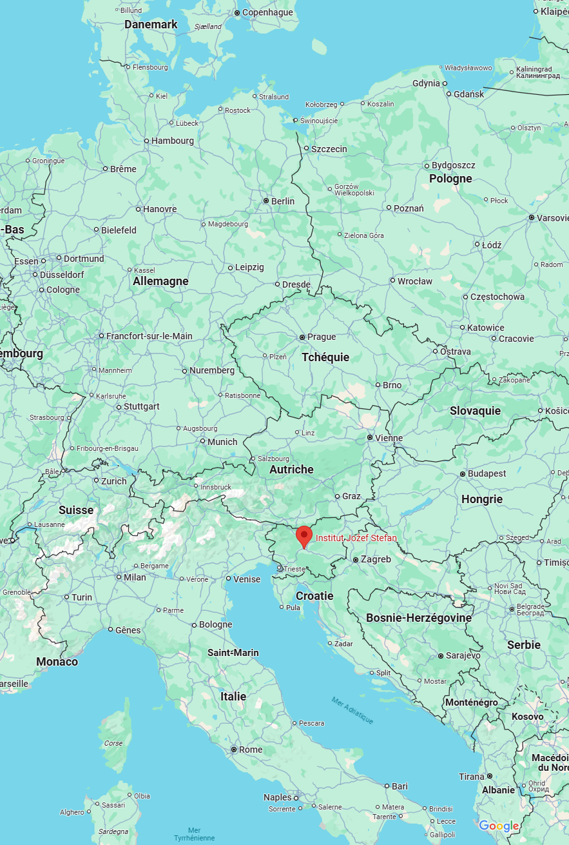


Getting to Slovenia
Night trains from Zürich etc*
Tickets: ÖBB / DB
Closest airport: LJU (12 € shuttle)
Backup: Zagreb (ZAG), Trieste (TRS)
All daily available!
*including Austria, Croatia, Hungary, Italy, Germany, Slovakia, Czechia

Slide 4
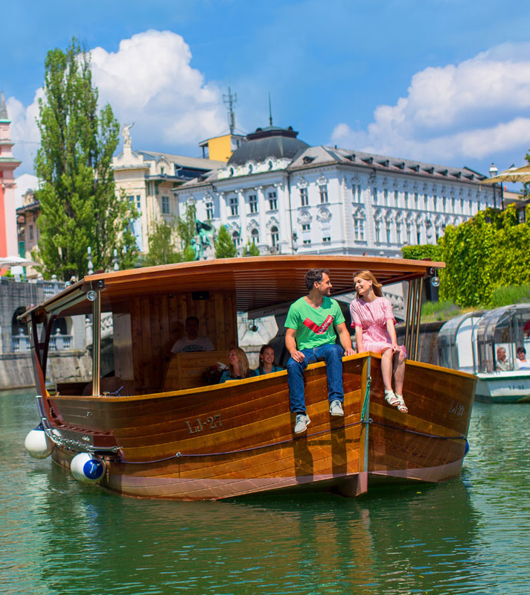
Accomodation
~ 4 000 hotel rooms (Ljubljana)
Price range: 100-150 €
Photo: Visit Ljubljana

Slide 5
When? (vote)
April 2026
MON | TUE | WED | THU | FRI | SAT | SUN
 |  | 1 | 2 | 3 | 4 | 5
6 | 7 | 8 | 9 | 10 | 11 | 12
13 | 14 | 15 | 16 | 17 | 18 | 19
20 | 21 | 22 | 23 | 24 | 25 | 26
27 | 28 | 29 | 30
May 2026
June 2026
MON | TUE | WED | THU | FRI | SAT | SUN
1 | 2 | 3 | 4 | 5 | 6 | 7
8 | 9 | 10 | 11 | 12 | 13 | 14
15 | 16 | 17 | 18 | 19 | 20 | 21
22 | 23 | 24 | 25 | 26 | 27 | 28
29 | 30
B
A
Temperatures: April 6°C / 17°C June 14°C / 25°C

Slide 6

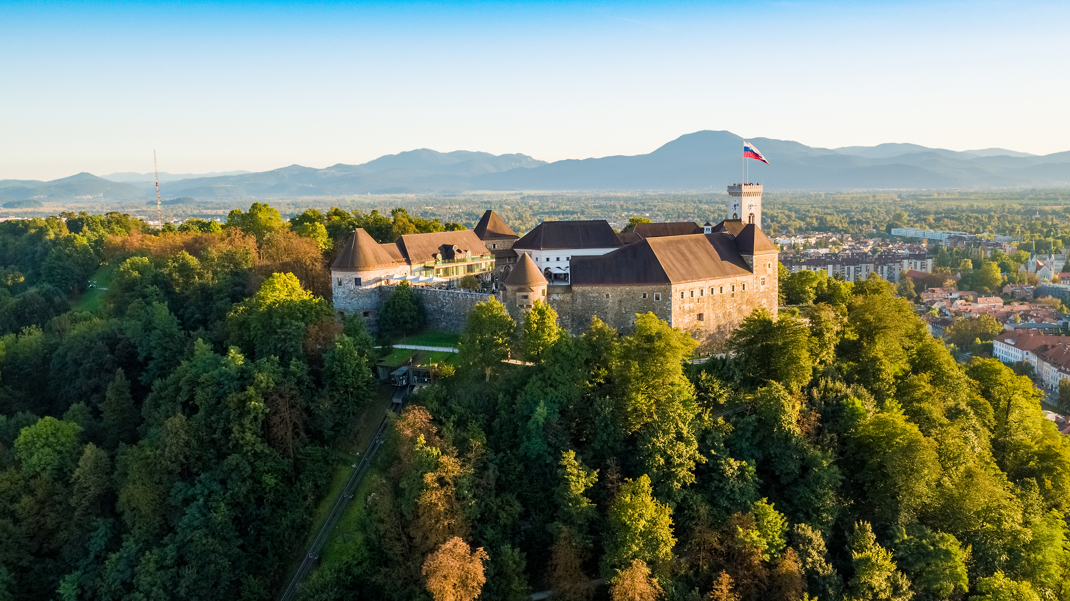
We look forward to welcoming you to
Ljubljana, Slovenia!
Photo: University of Ljubljana
Photo: I feel Slovenia

