Slide 1
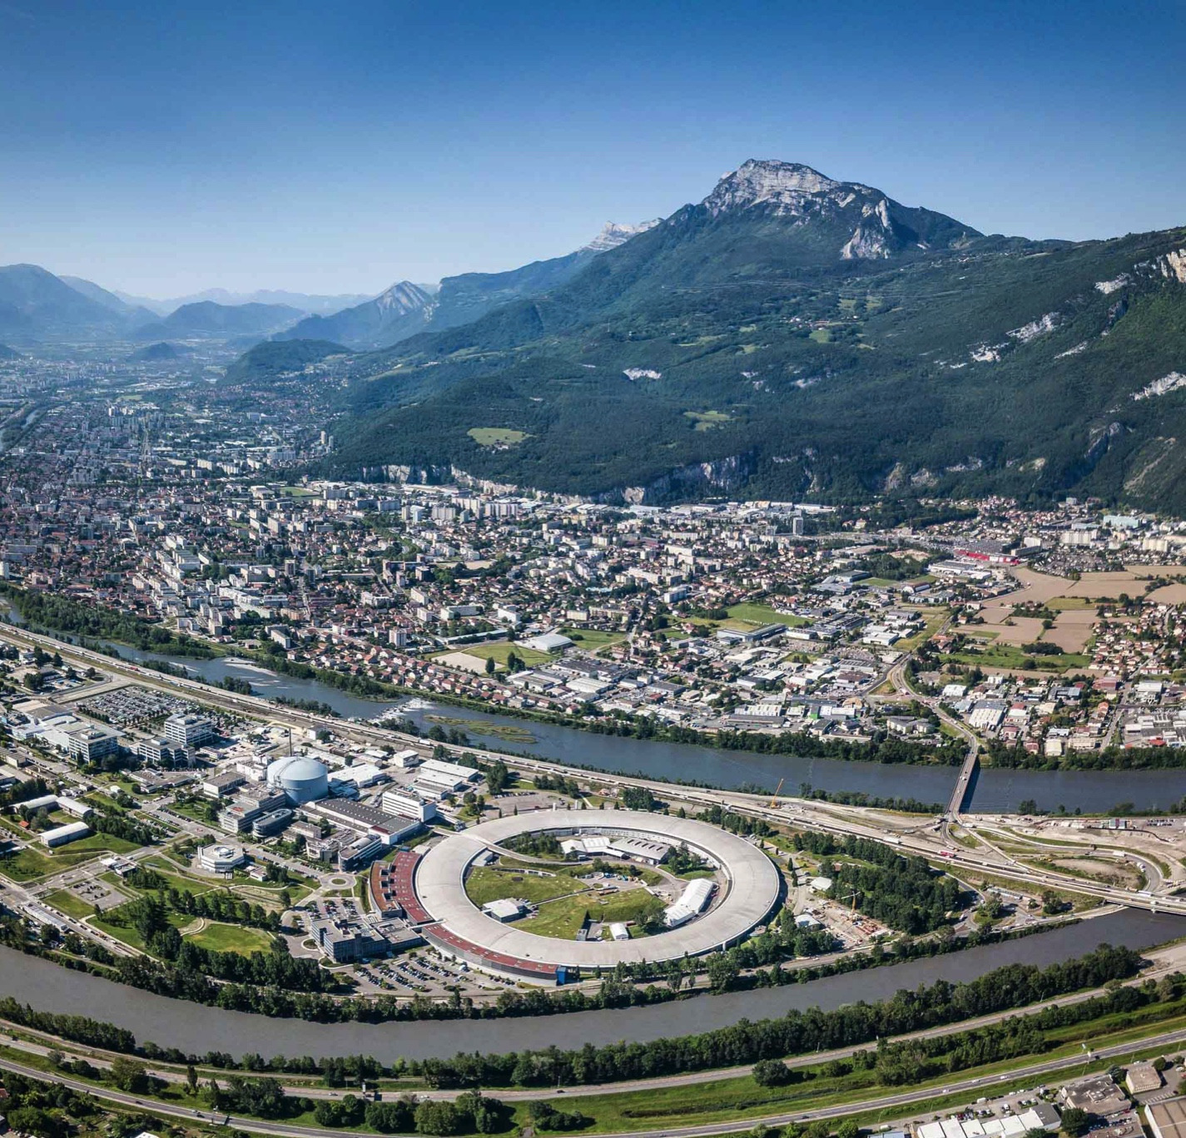























Material for discussion on LCC magnet multipole tolerances
-----------------
K. André, S. Liuzzo, P. Raimondi, S. White
PIONEERING SYNCHROTRON SCIENCE

Slide 2
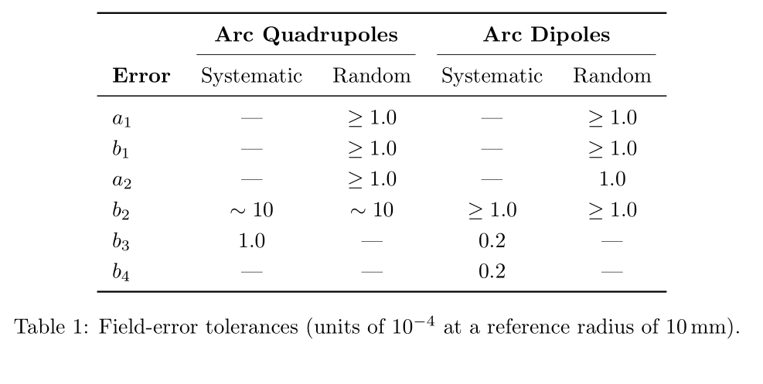
Summary table
Request on error on measurement 10e-4
What is considered in the random error ? Manufacturing error, measurement error ?
Criteria for a1/b1 (rand): weak orbit corrector
Criteria for b2 (syst): tune shift < 0.1
Criteria for b2 (rand): bb < 5%
Criteria for a2 (rand): emittance coupling ~ %
Criteria for b3 (syst): Δk2_{S[FD]} < 1%

Slide 3
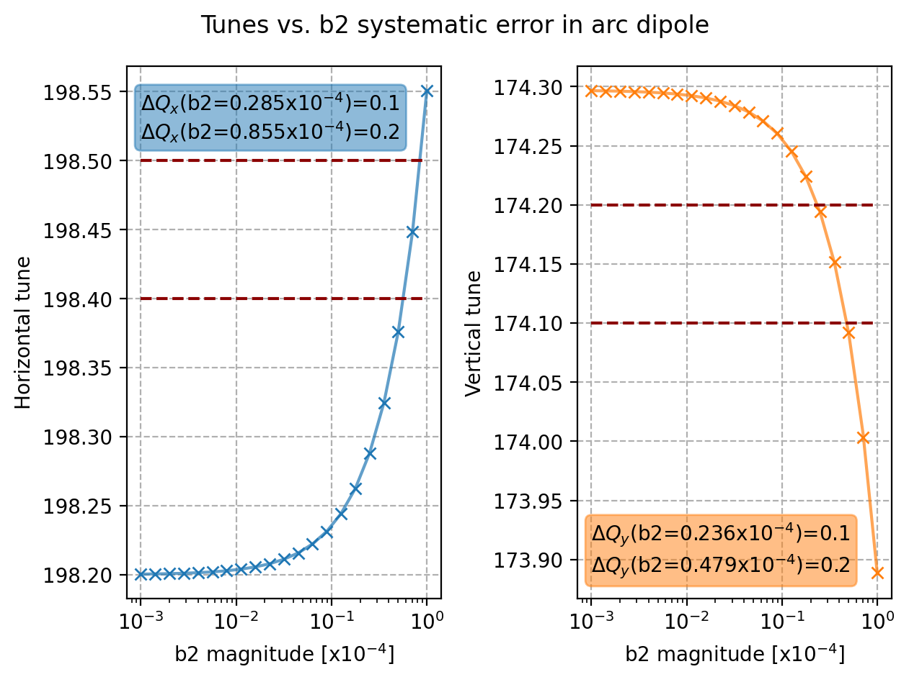
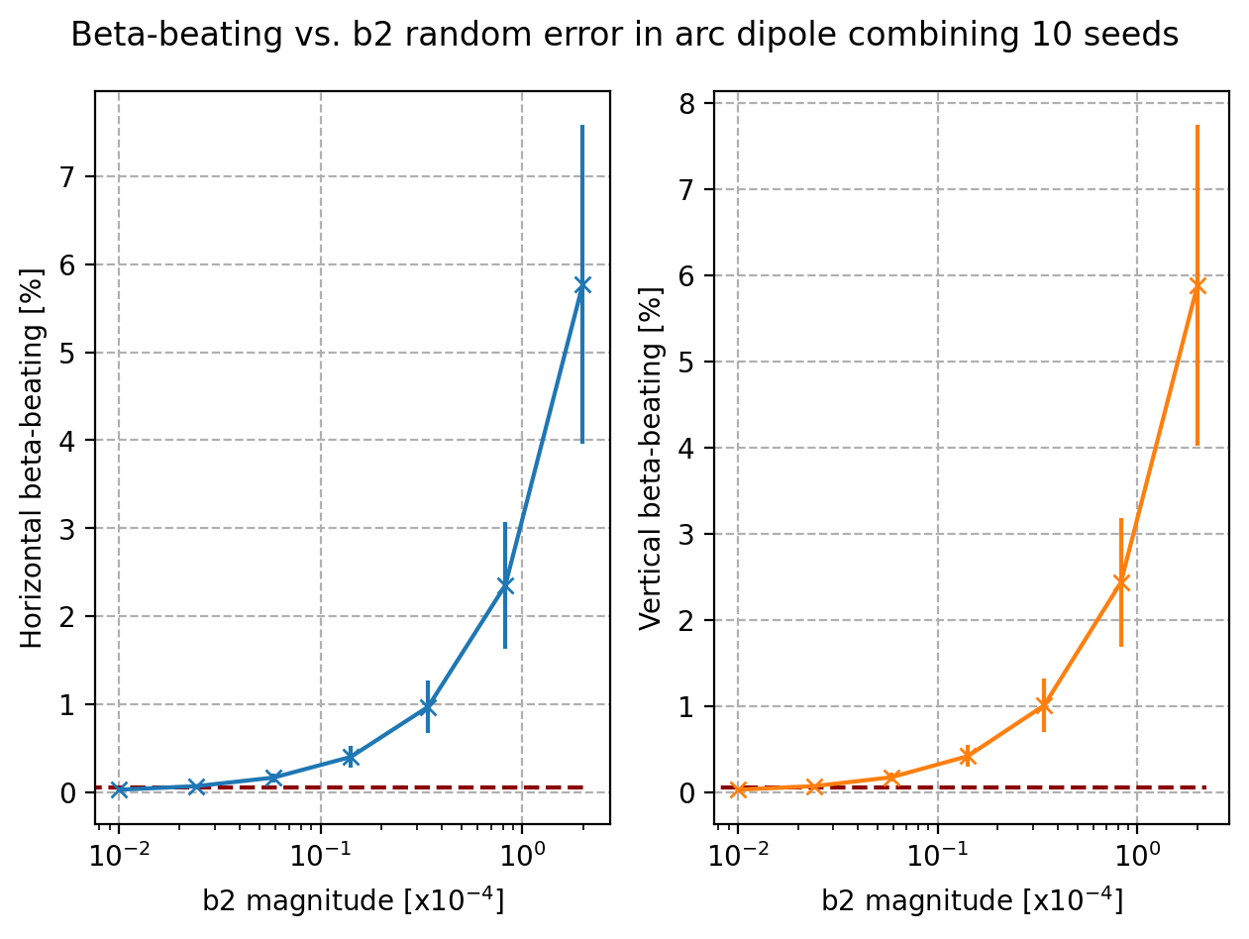
B2 in arc dipoles
Systematic tolerance: tune shift < 0.1
Random tolerance: bb < 5%

Slide 4
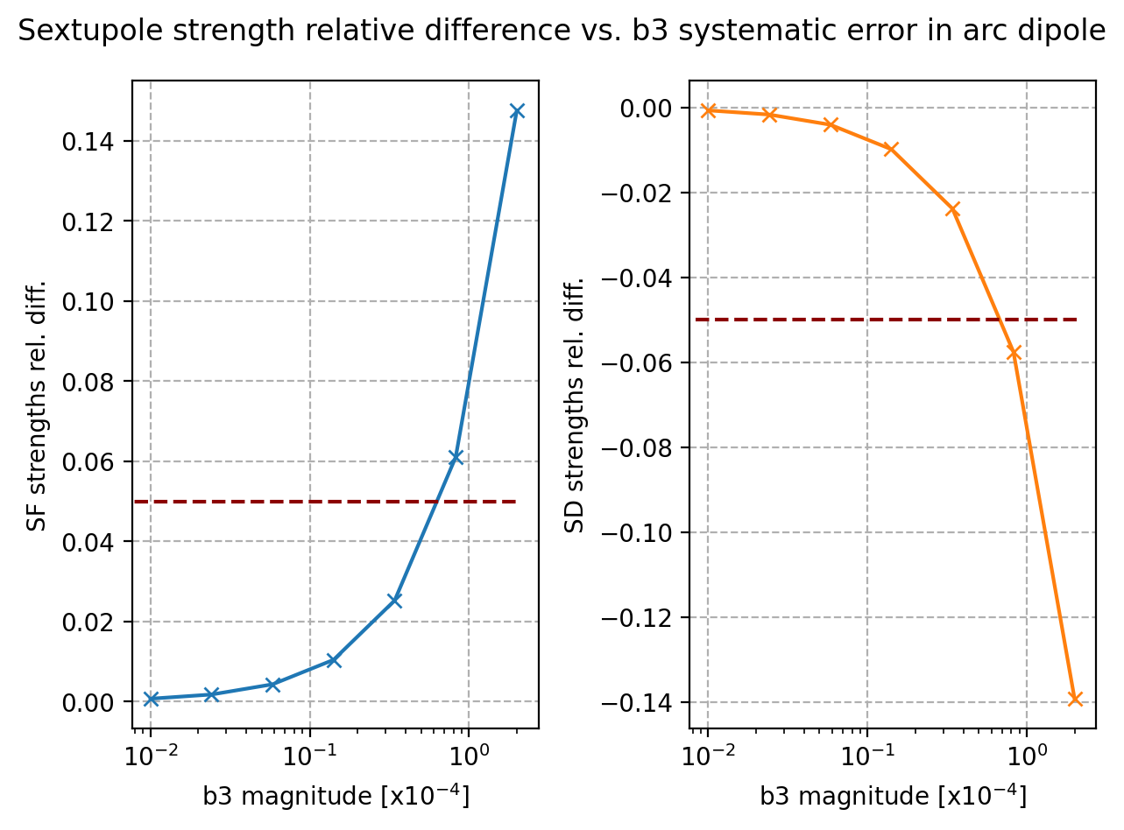
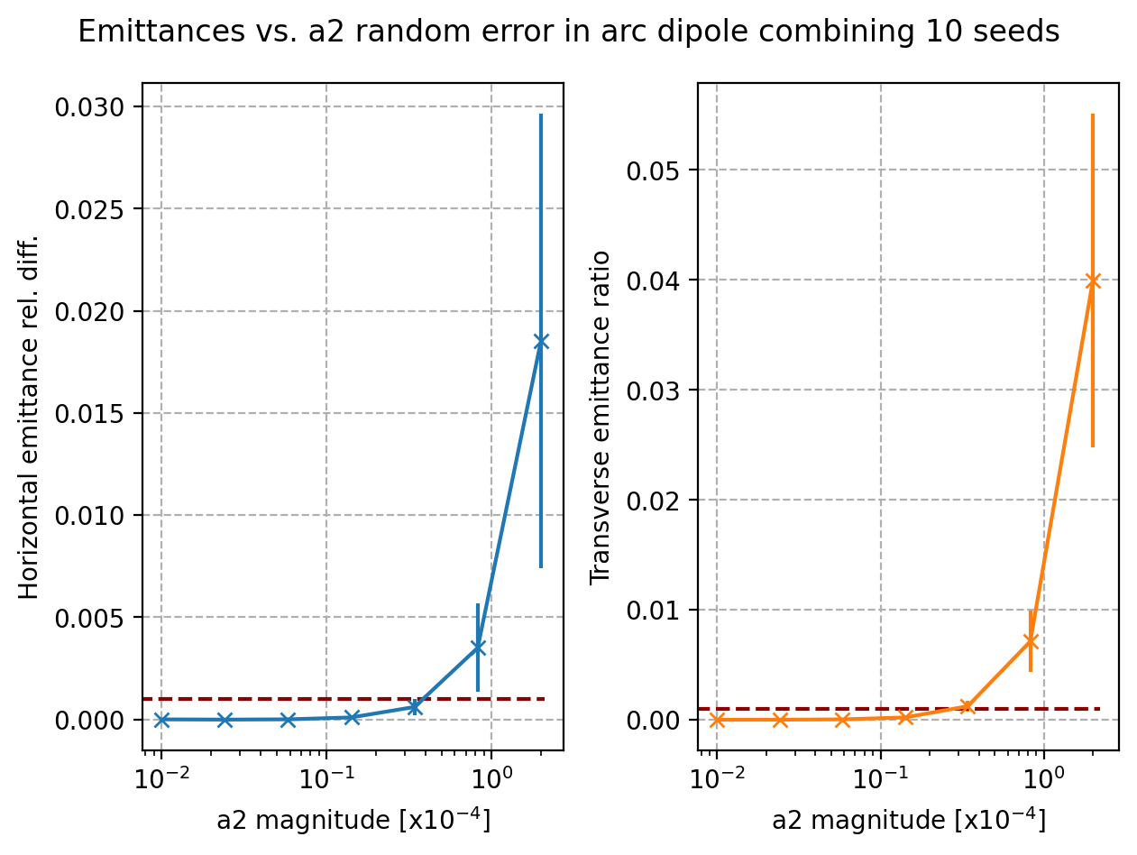
B3 & A2 in arc dipoles
Systematic tolerance: chromaticity correction requires less than 1% sextupole strength modif.
Random tolerance: hor. emittance growth < 1% and ver. emittance growth < some %

