Slide 1
HR_FFC01_01 tests at 4.5 K results
F. Mangiarotti, A. Baskys, V. di Capua, L. Fiscarelli, N. Gal,
C. Petrone, N. Vallis, G. Willering
2025.07.10
https://edms.cern.ch/document/3314632

Slide 2
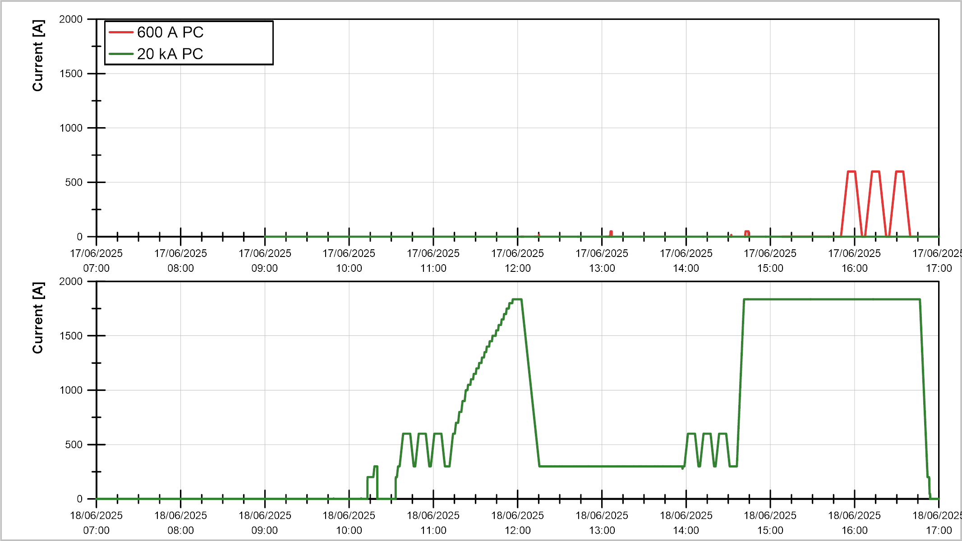
Powering overview:
Cool down 1, part 1
❷
❶
❶
❸
❹
❶ Protection checks
❷ Reference cycles
❸ VI measurements
❹ Holding current
❺ Trip due to lost Vtap
❻ AC loss cycles
❼ Quench
❽ Mag. measurements
❷
❷
❶

Slide 3
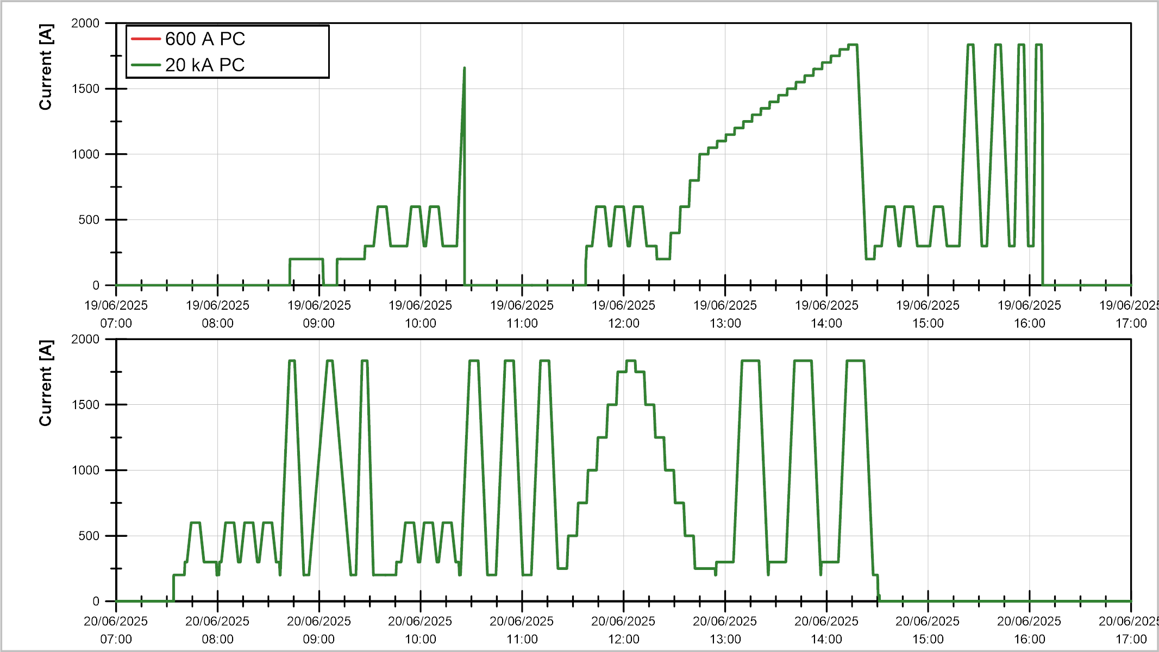
Powering overview:
Cool down 1, part 2
❸
❻
❺
❼
❷
❷
❷
❻
❽
❽
❶ Protection checks
❷ Reference cycles
❸ VI measurements
❹ Holding current
❺ Trip due to lost Vtap
❻ AC loss cycles
❼ Quench
❽ Mag. measurements
❷
❷

Slide 4
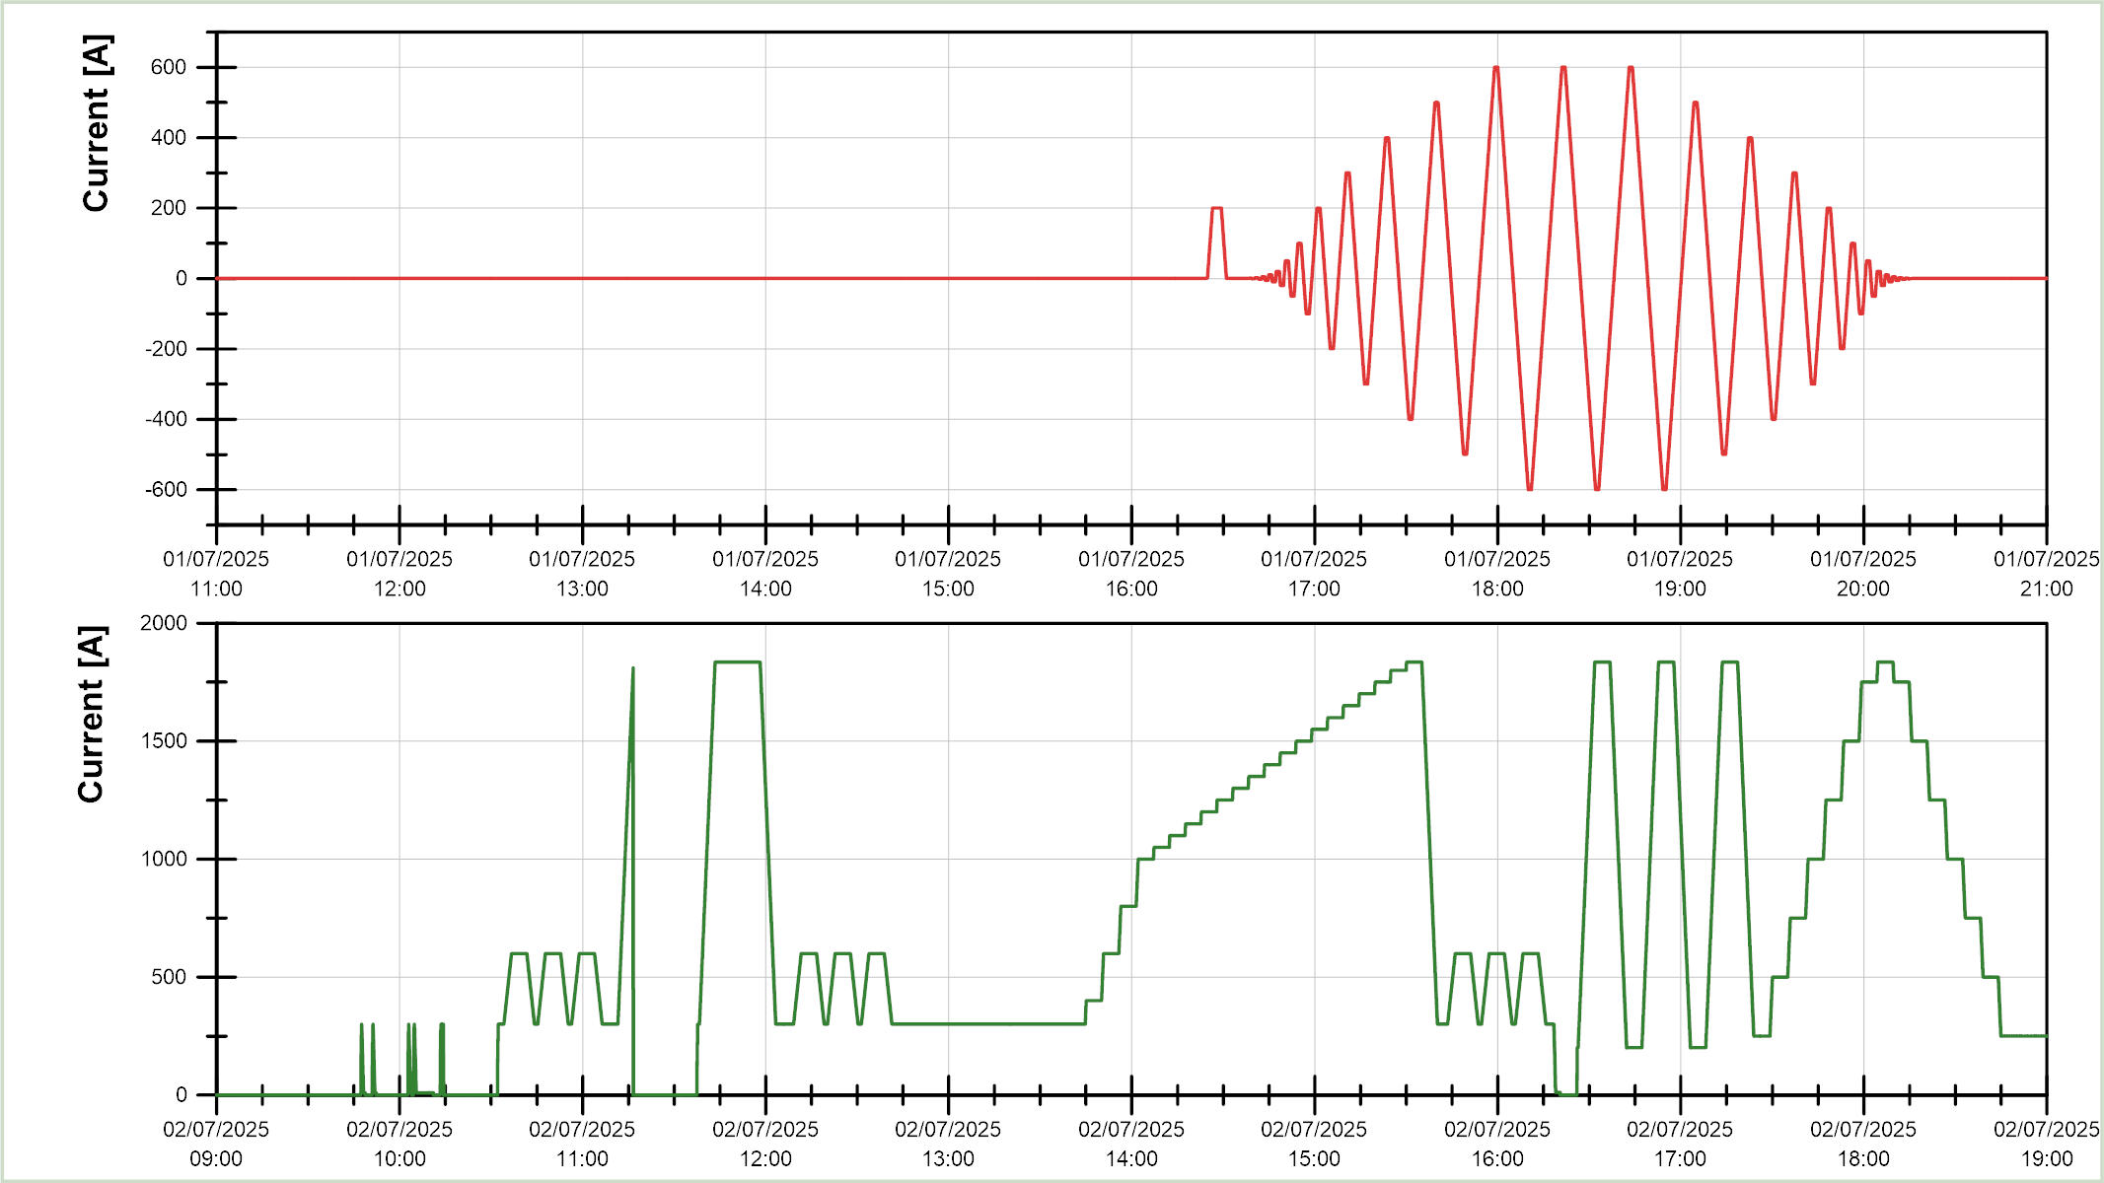
Powering overview:
Cool down 2
❽
❶
❶ Protection checks
❷ Reference cycles
❸ VI measurements
❹ Holding current
❺ Trip due to lost Vtap
❻ AC loss cycles
❼ Quench
❽ Mag. measurements
❼
❸
❽
❹
❷
❷
❷
❶

Slide 5
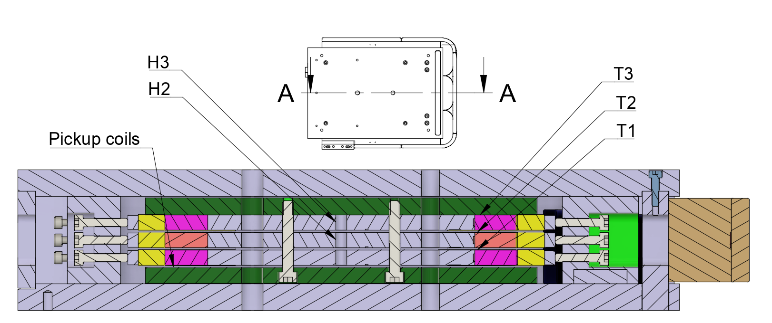
Magnet layout
DR3
DR2
DR1

Slide 6
Topics
Operation range
Quench detection and protection
V-I measurements
AC loss
Inductance
Splice resistance
Conclusion

Slide 7
Operation range

Slide 8
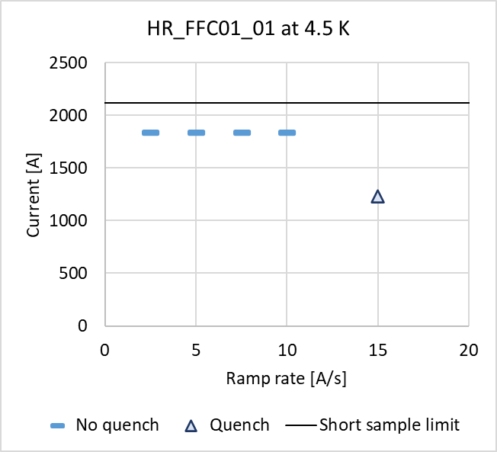
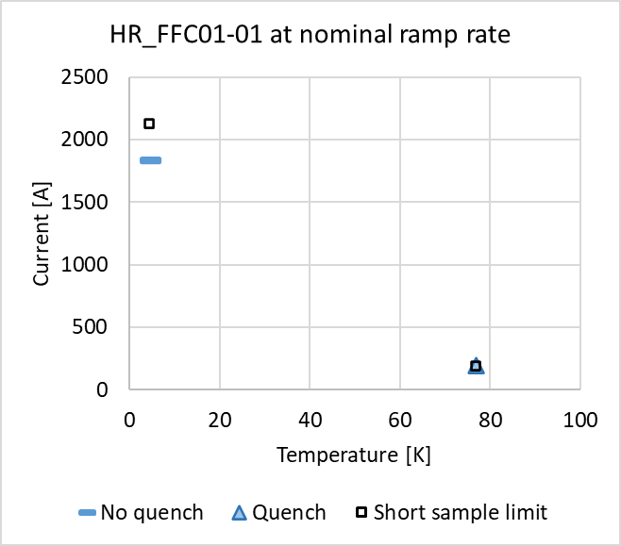
Ramp rate and temperature dependency
During ramp down, in DR2

Slide 9
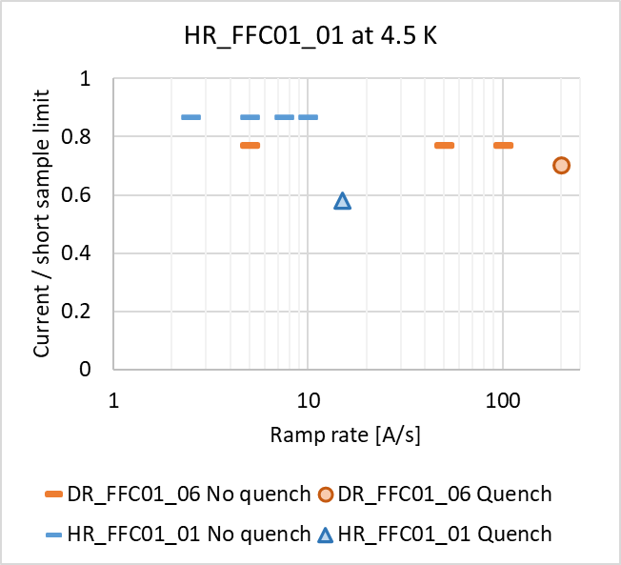
Comparison with double racetrack
DR quenched at much higher ramp rate, during ramp up, and at higher fraction of short sample limit.
Maybe the quench in HR was due to worse cooling conditions than in DR? See next slide for comparison of measured temperature during the high ramp rate cycles on both magnets.

Slide 10
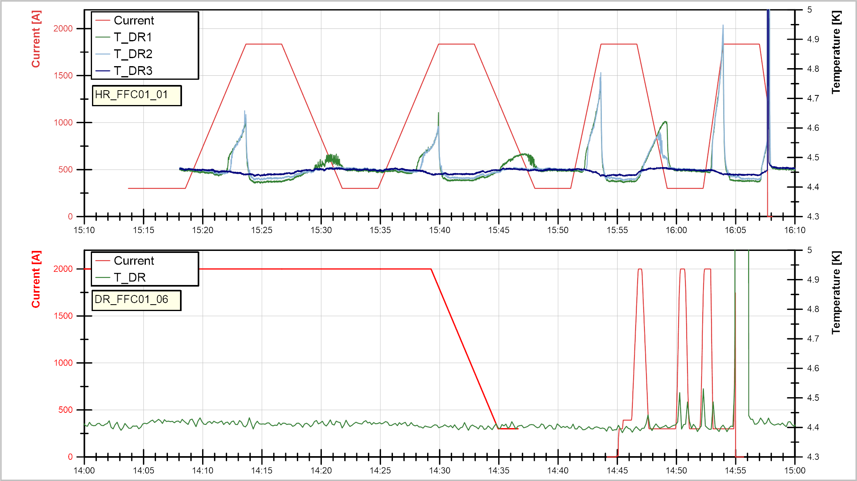
5 A/s
5 A/s
10 A/s
15 A/s
100 A/s
5 A/s
50 A/s
200 A/s

Slide 11
Quench detection and protection

Slide 12
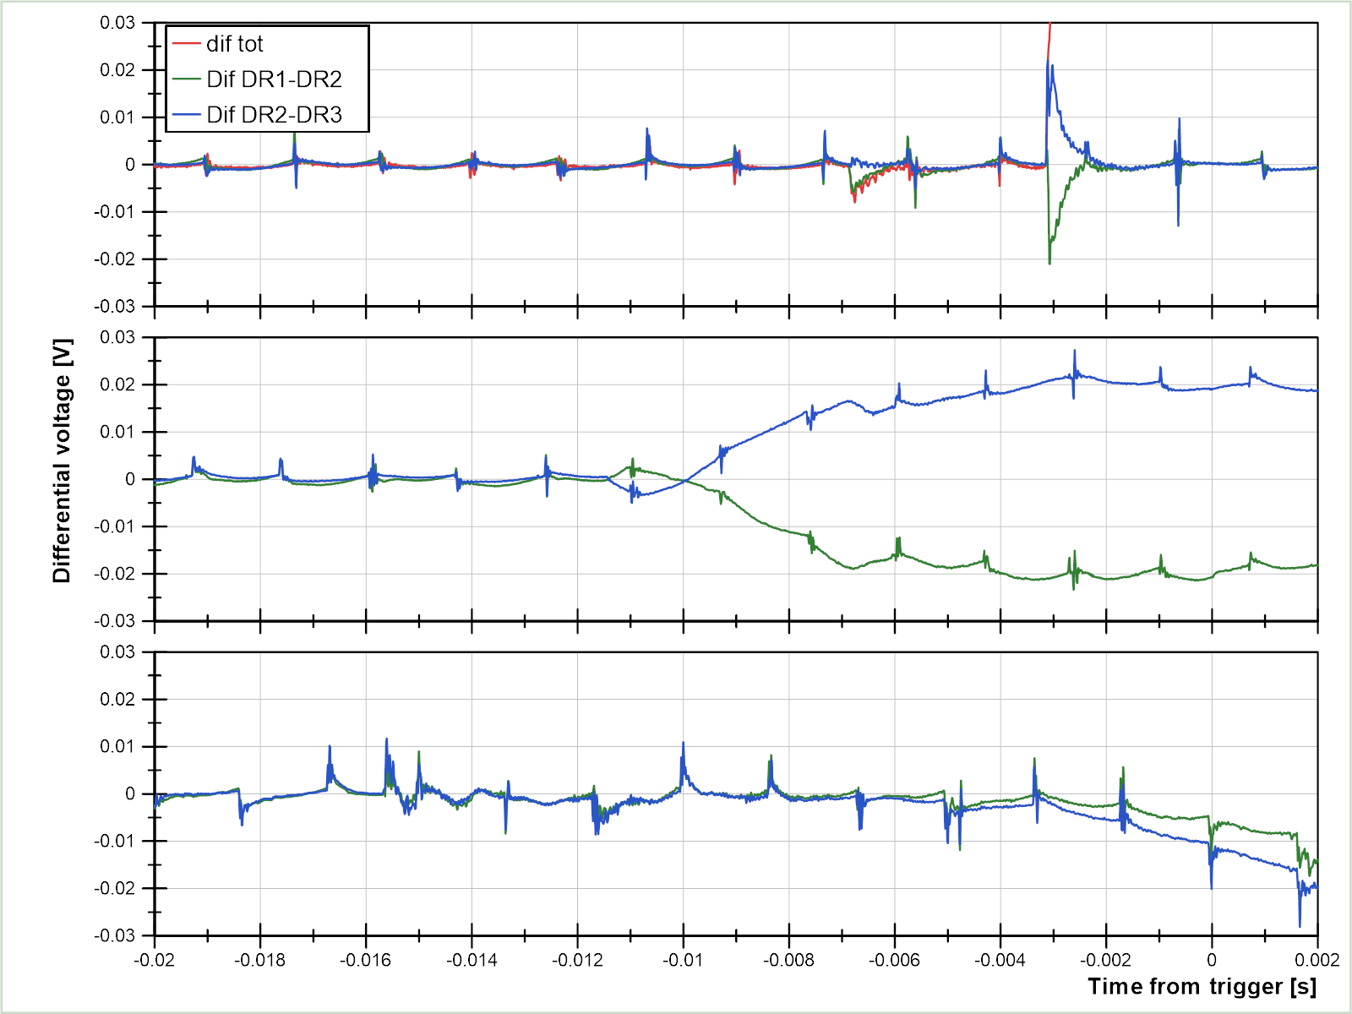
Quench detection
QD trigger at 5 mV, 3.2 ms
Trip CD1
QD trigger at 5 mV, 9 ms
Quench CD1
QD trigger at 5 mV, ~2 ms
Quench detection working as expected.
Validation time reduced at the end of CD 1 as no false trip was detected.
Quench CD2

Slide 13
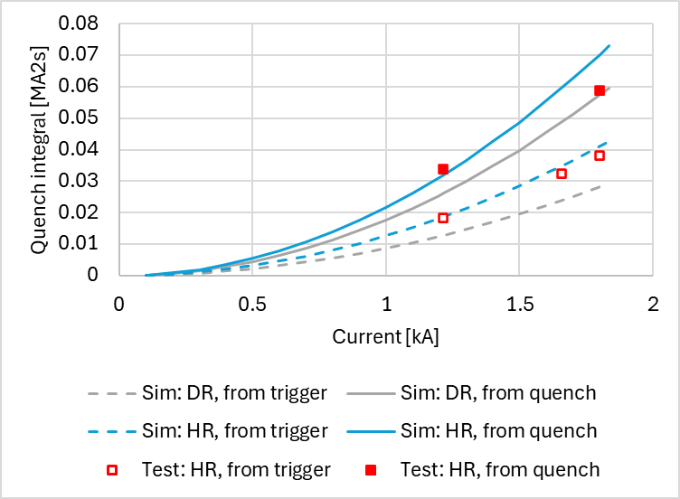
Quench protection
Perfect isolation
Perfect contact
Q CD2
Q CD1
Q CD2
Q CD1
Adiabatic hotspot temperature during both quenches expected < 160 K

Slide 14
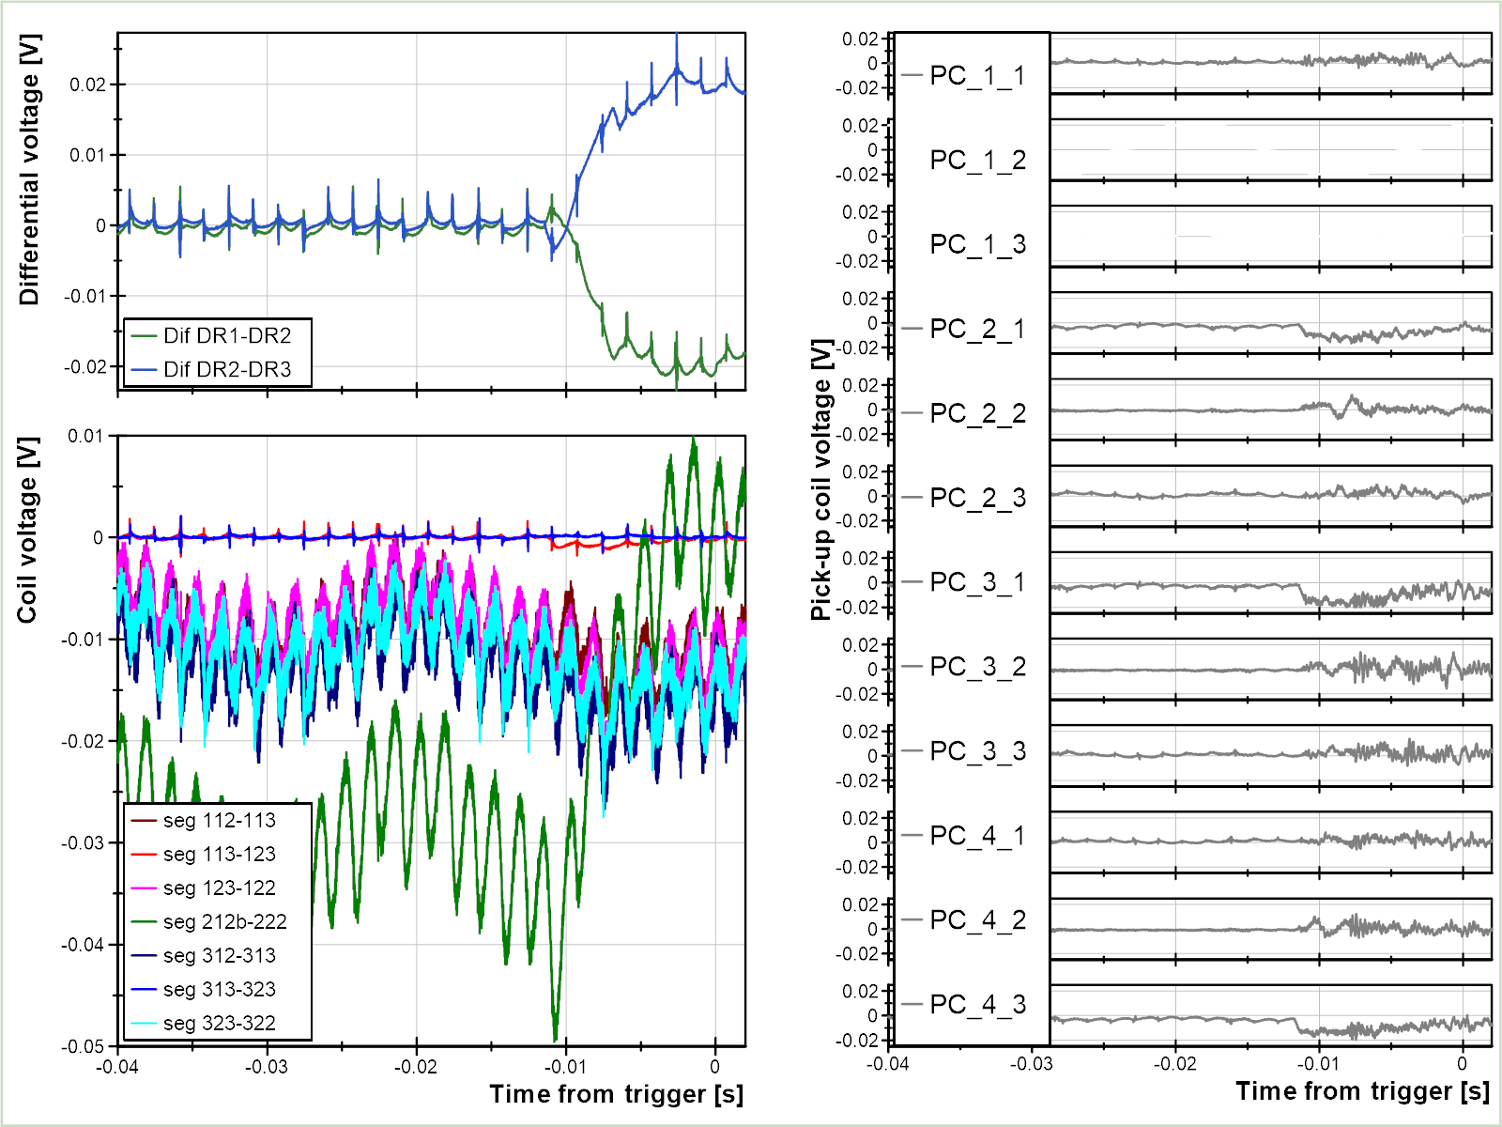
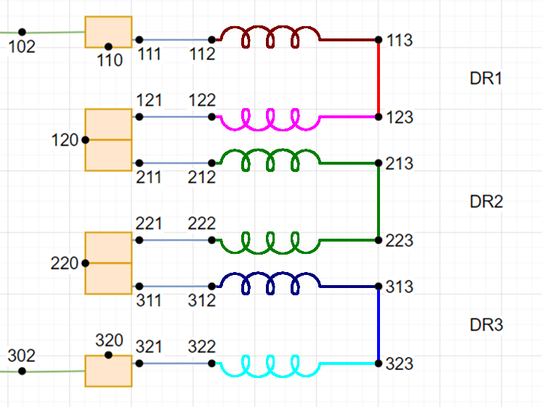
CD1 quench
Quench starts in DR2
Pick-up coils react to the quench

Slide 15
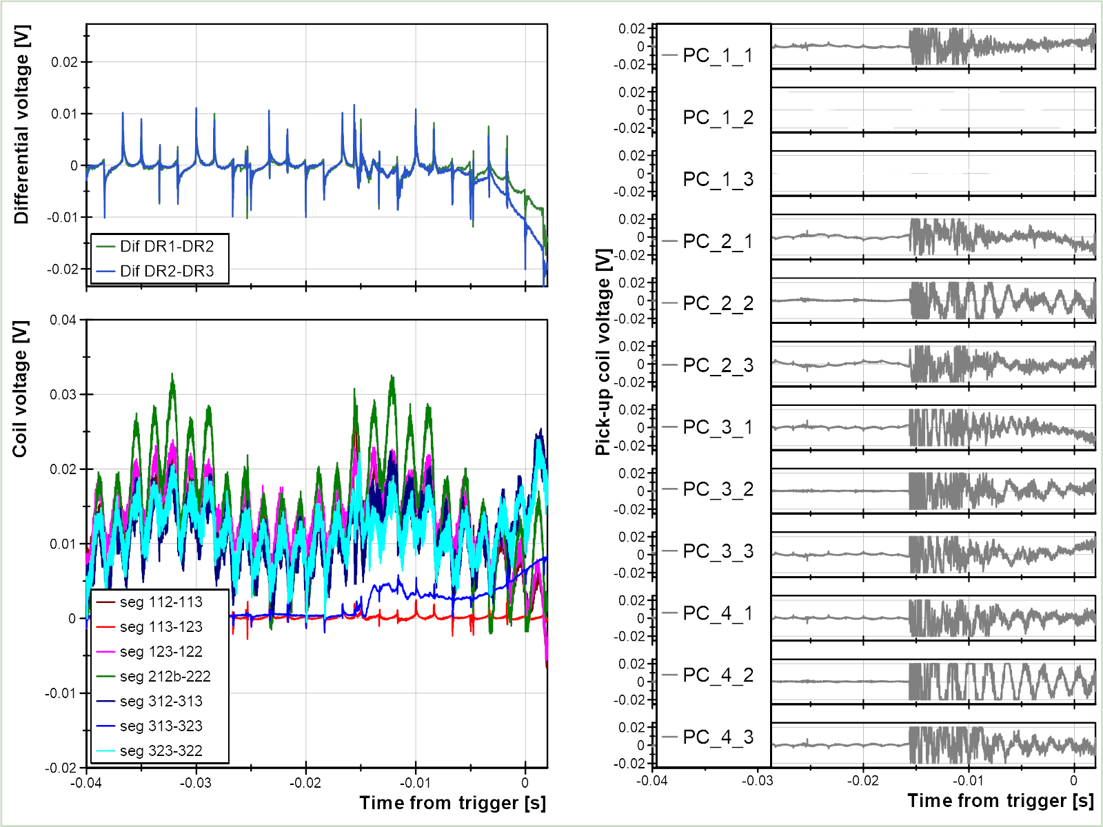
CD2 quench
Quench starts in DR3 layer jump
It seems to be mechanically induced
Pick-up coils react to the mechanical movement

Slide 16
V-I measurements

Slide 17
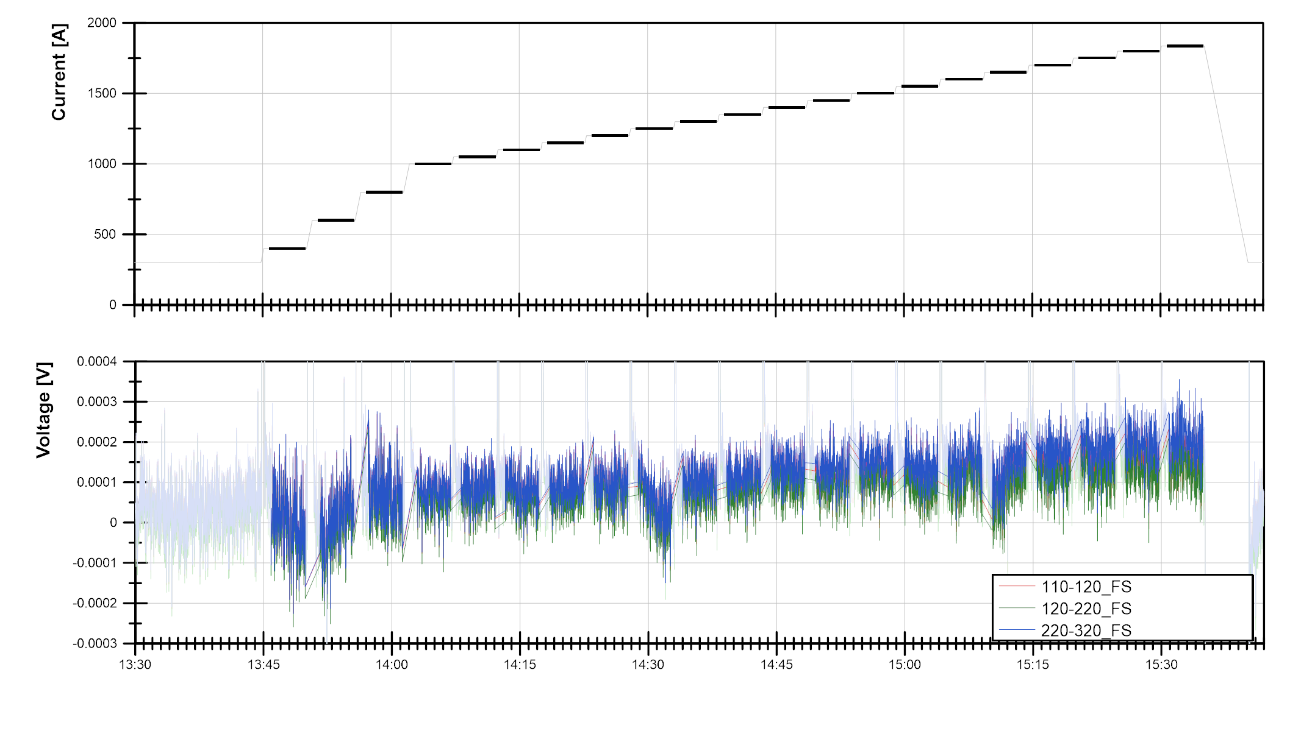

Slide 18
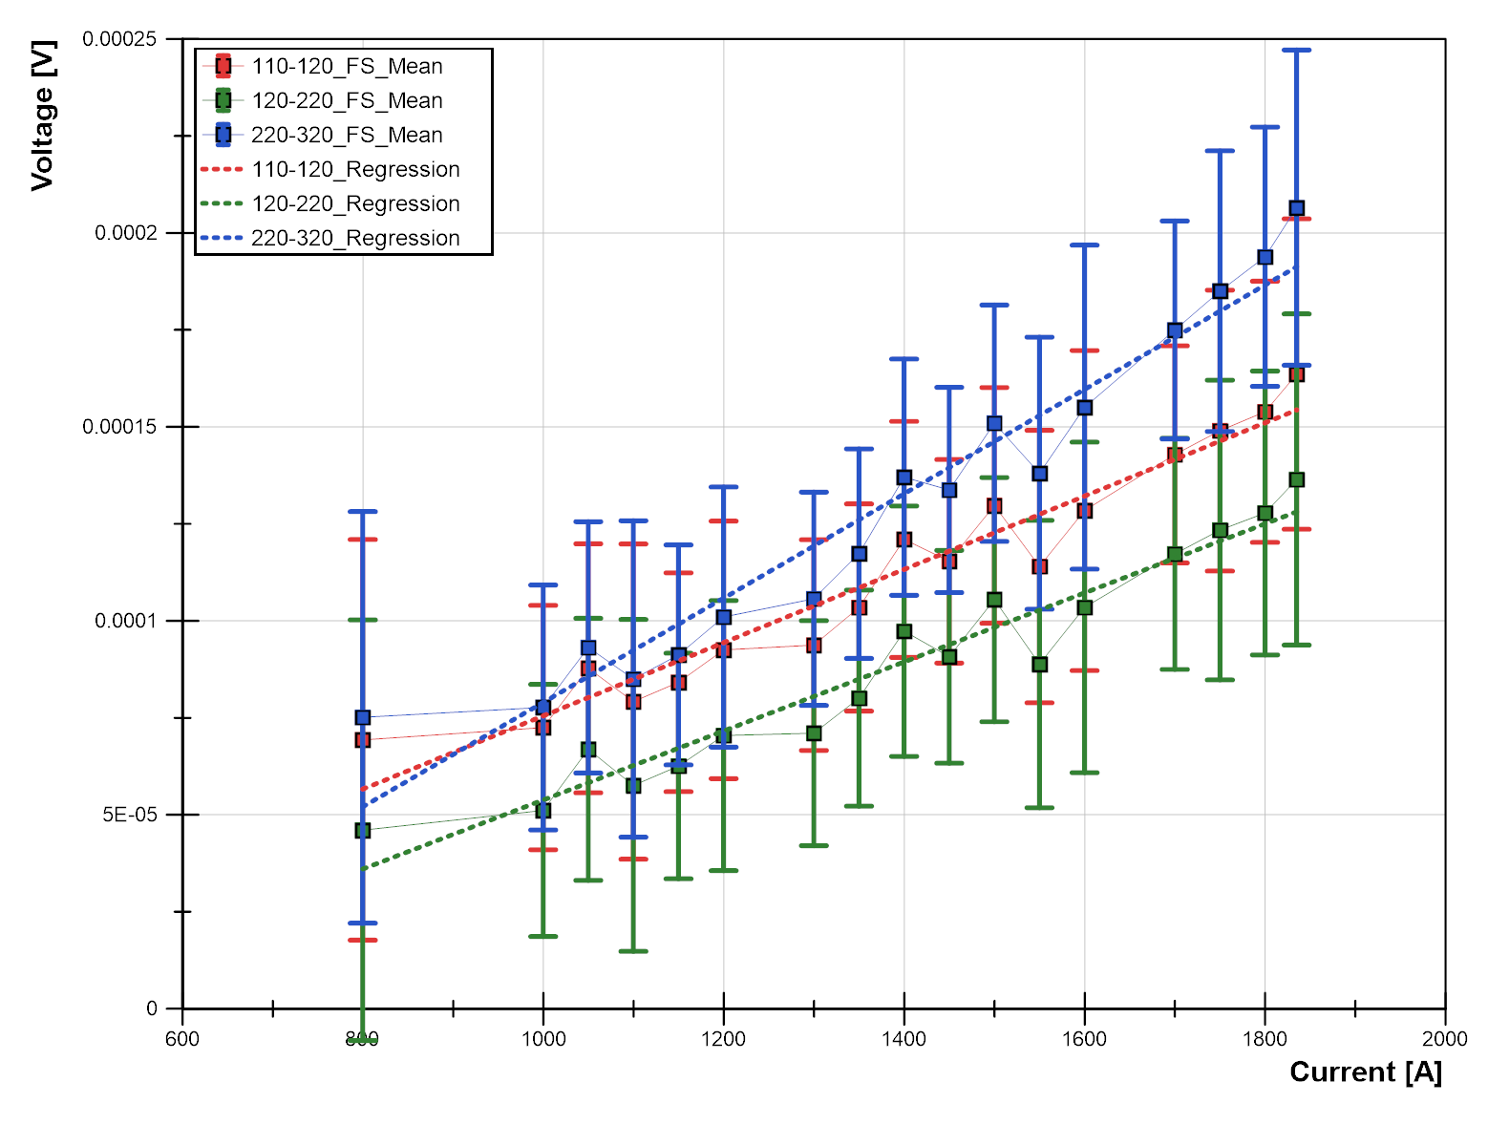
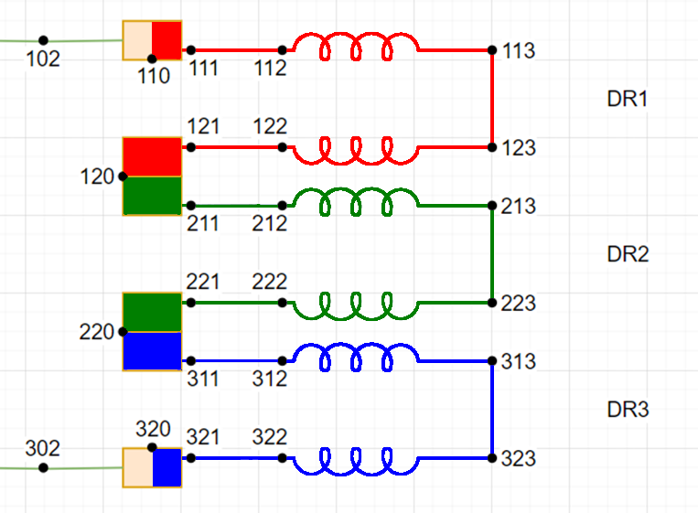
VI measurements
All measurements are done from copper to copper to avoid unknown current distribution effects
Measurement is very linear: no indication of SC-normal transition

Slide 19
AC losses

Slide 20
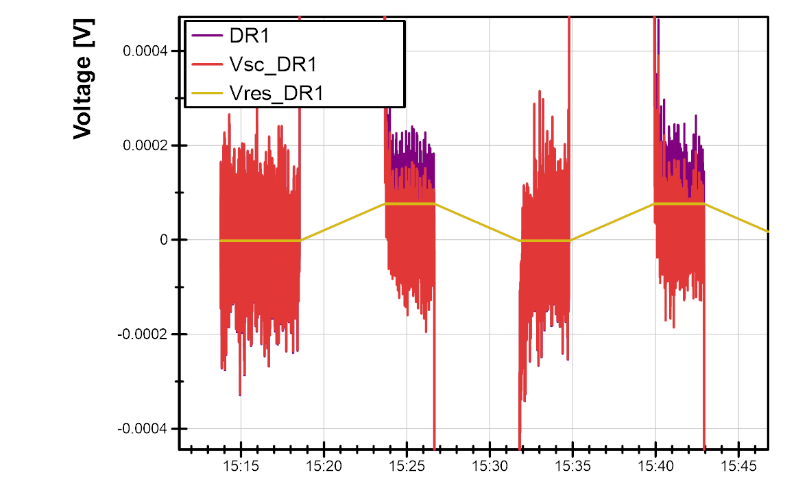
Resistive voltage compensation
To compensate the measured voltage (purple), I did a linear fit of the data after the decay is over. I applied that fit to the current to get the “resistive” voltage (orange), and the difference is the voltage to be used for AC losses (red)

Slide 21
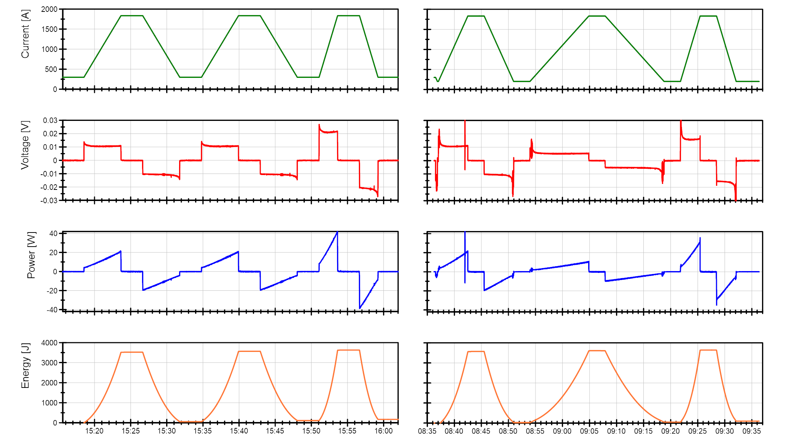
precycle
5 A/s
10 A/s
precycle
2.5 A/s
7.5 A/s
ΔE

Slide 22
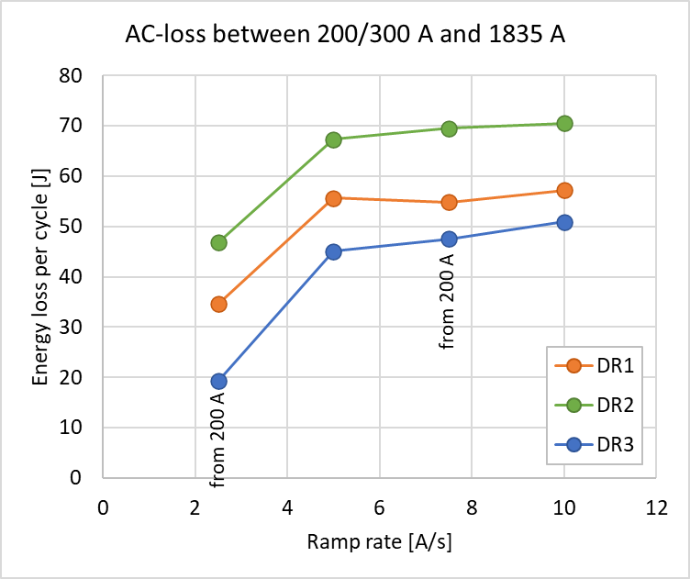
AC loss summary
Preliminary results summarized on the right
At lower ramp rate, the resistance effect is larger, so results are less reliable
New procedures to be investigated in the next magnet

Slide 23
Inductance

Slide 24
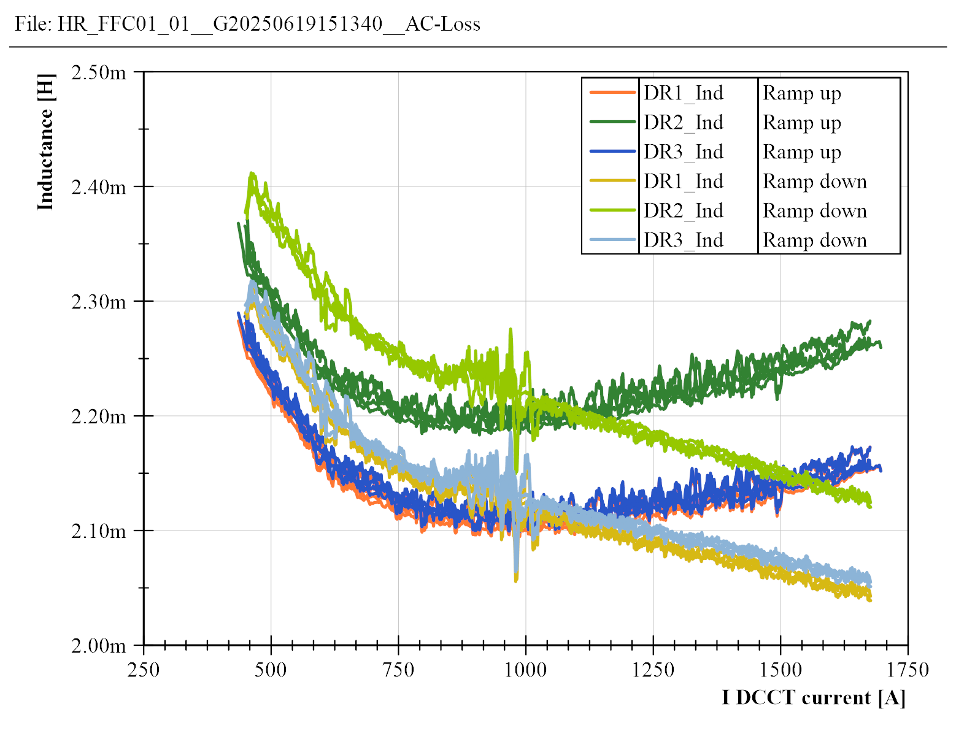
Inductance
Different behavior during ramp up or down
During the first ramp up, the inductance is a little bit higher
  Also observed after the quench
5, 10 and 15 A/s

Slide 25
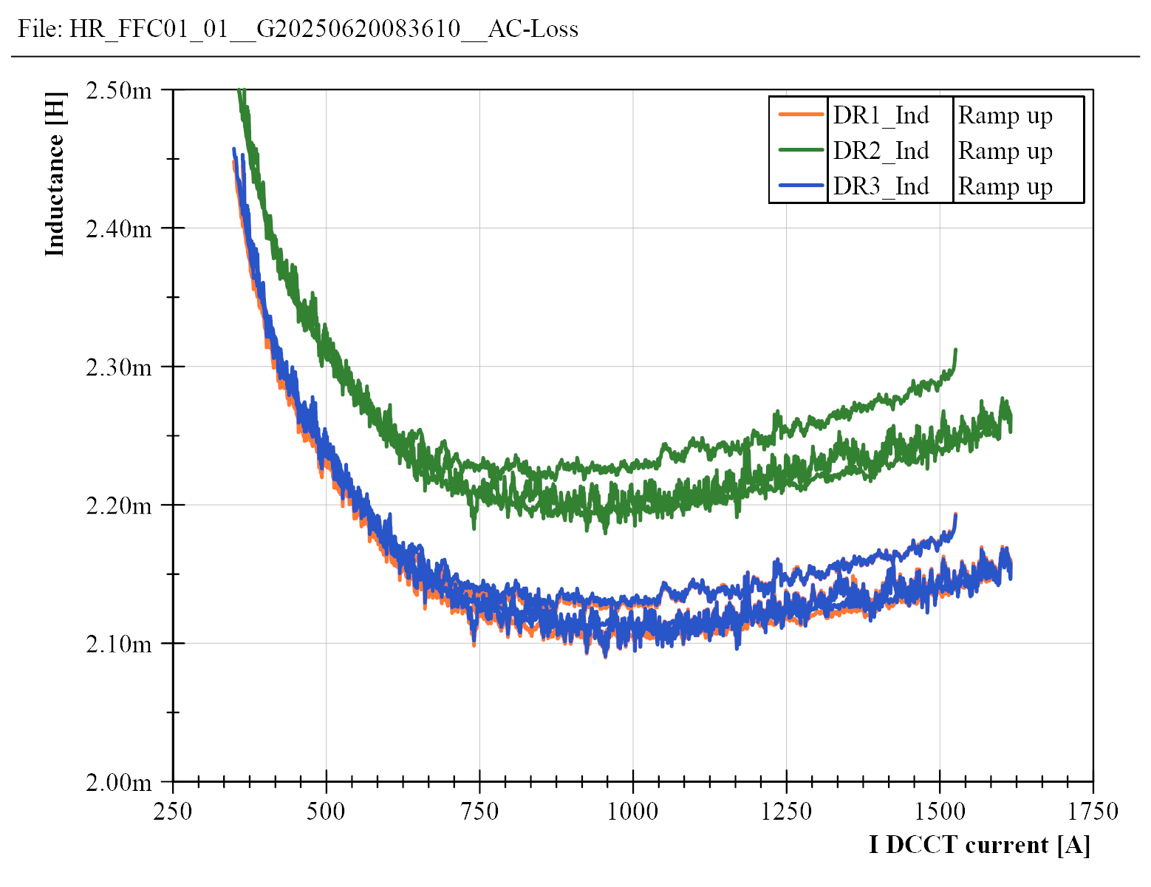
Inductance
Different behavior during ramp up or down
During the first ramp up, the inductance is a little bit higher
  Also observed after the quench
First ramp, 5 A/s
2.5 and 7.5 A/s

Slide 26
Splice resistance

Slide 27
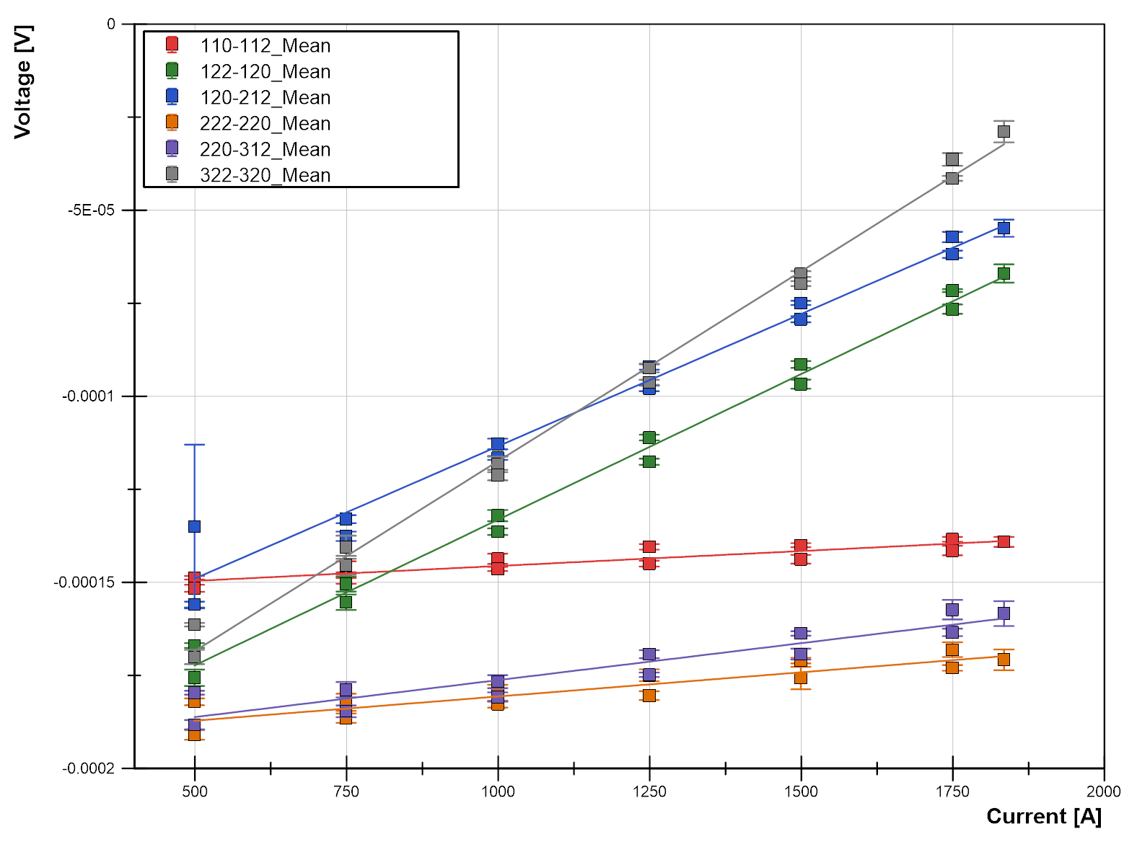
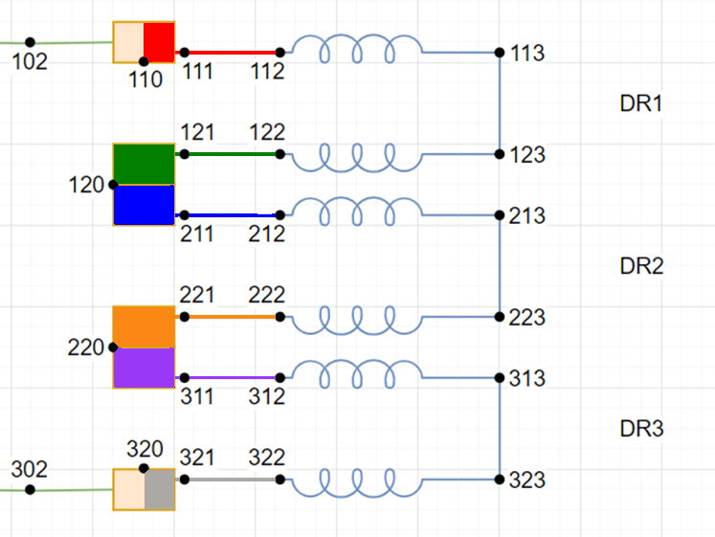
Splice resistance
102 nΩ
Splice Cu-HTS resistance measured during the magnetic measurements stair-step cycle
71 nΩ
78 nΩ
8 nΩ
20 nΩ
13 nΩ

Slide 28
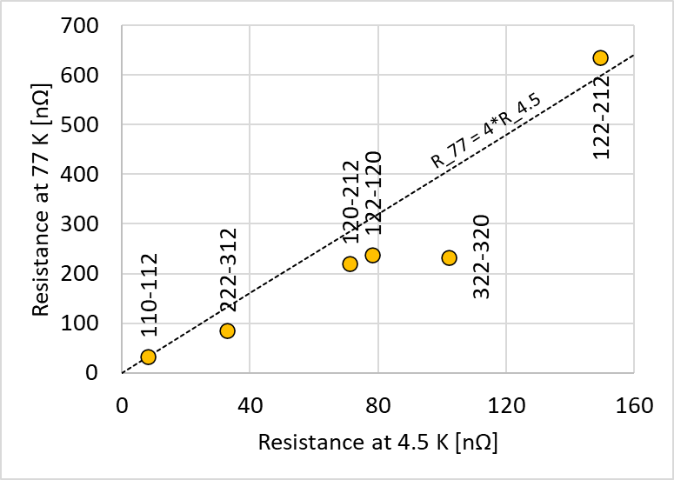
Splice resistance 4.5 K and 77 K
Splice | 4.5 K | 77 K | 77 K bis
110-112 | 8 | 33 | 35
122-120 | 78 | 634 | 238
120-212 | 71 |  | 221
222-220 | 13 | 85 | --
220-312 | 20 |  | --
322-320 | 102 | 232 | 227
Note: at 77 K sometimes the voltage taps are not exactly the same (e.g. 110-111 instead of 110-112)
At 4.5 K the resistance decreases by almost 4 times compared to 77 K

Slide 29
Conclusions

Slide 30
Conclusions
The magnet reached the nominal current (1835 A, 87% of short sample limit) without quench at 4.5 K
V-I measurements do not show a sc-normal transition in the magnet
0.2-0.5 K temperature rise during ramps – probably cooling in the magnet not very effective
Magnetic field, magnet inductance, splice resistance measured, and AC-loss estimated up to nominal current.
Two quenches registered:
  During a 15 A/s ramp down, at 1220 A in the middle coil – probably due to heating
  After thermal cycle, at 1800 A, in the top coil layer jump – probably due to mechanical motion

