Slide 1



INTERNATIONAL DUAL CAREER NETWORK
Spouse Welcome
18th March 2025

Slide 2

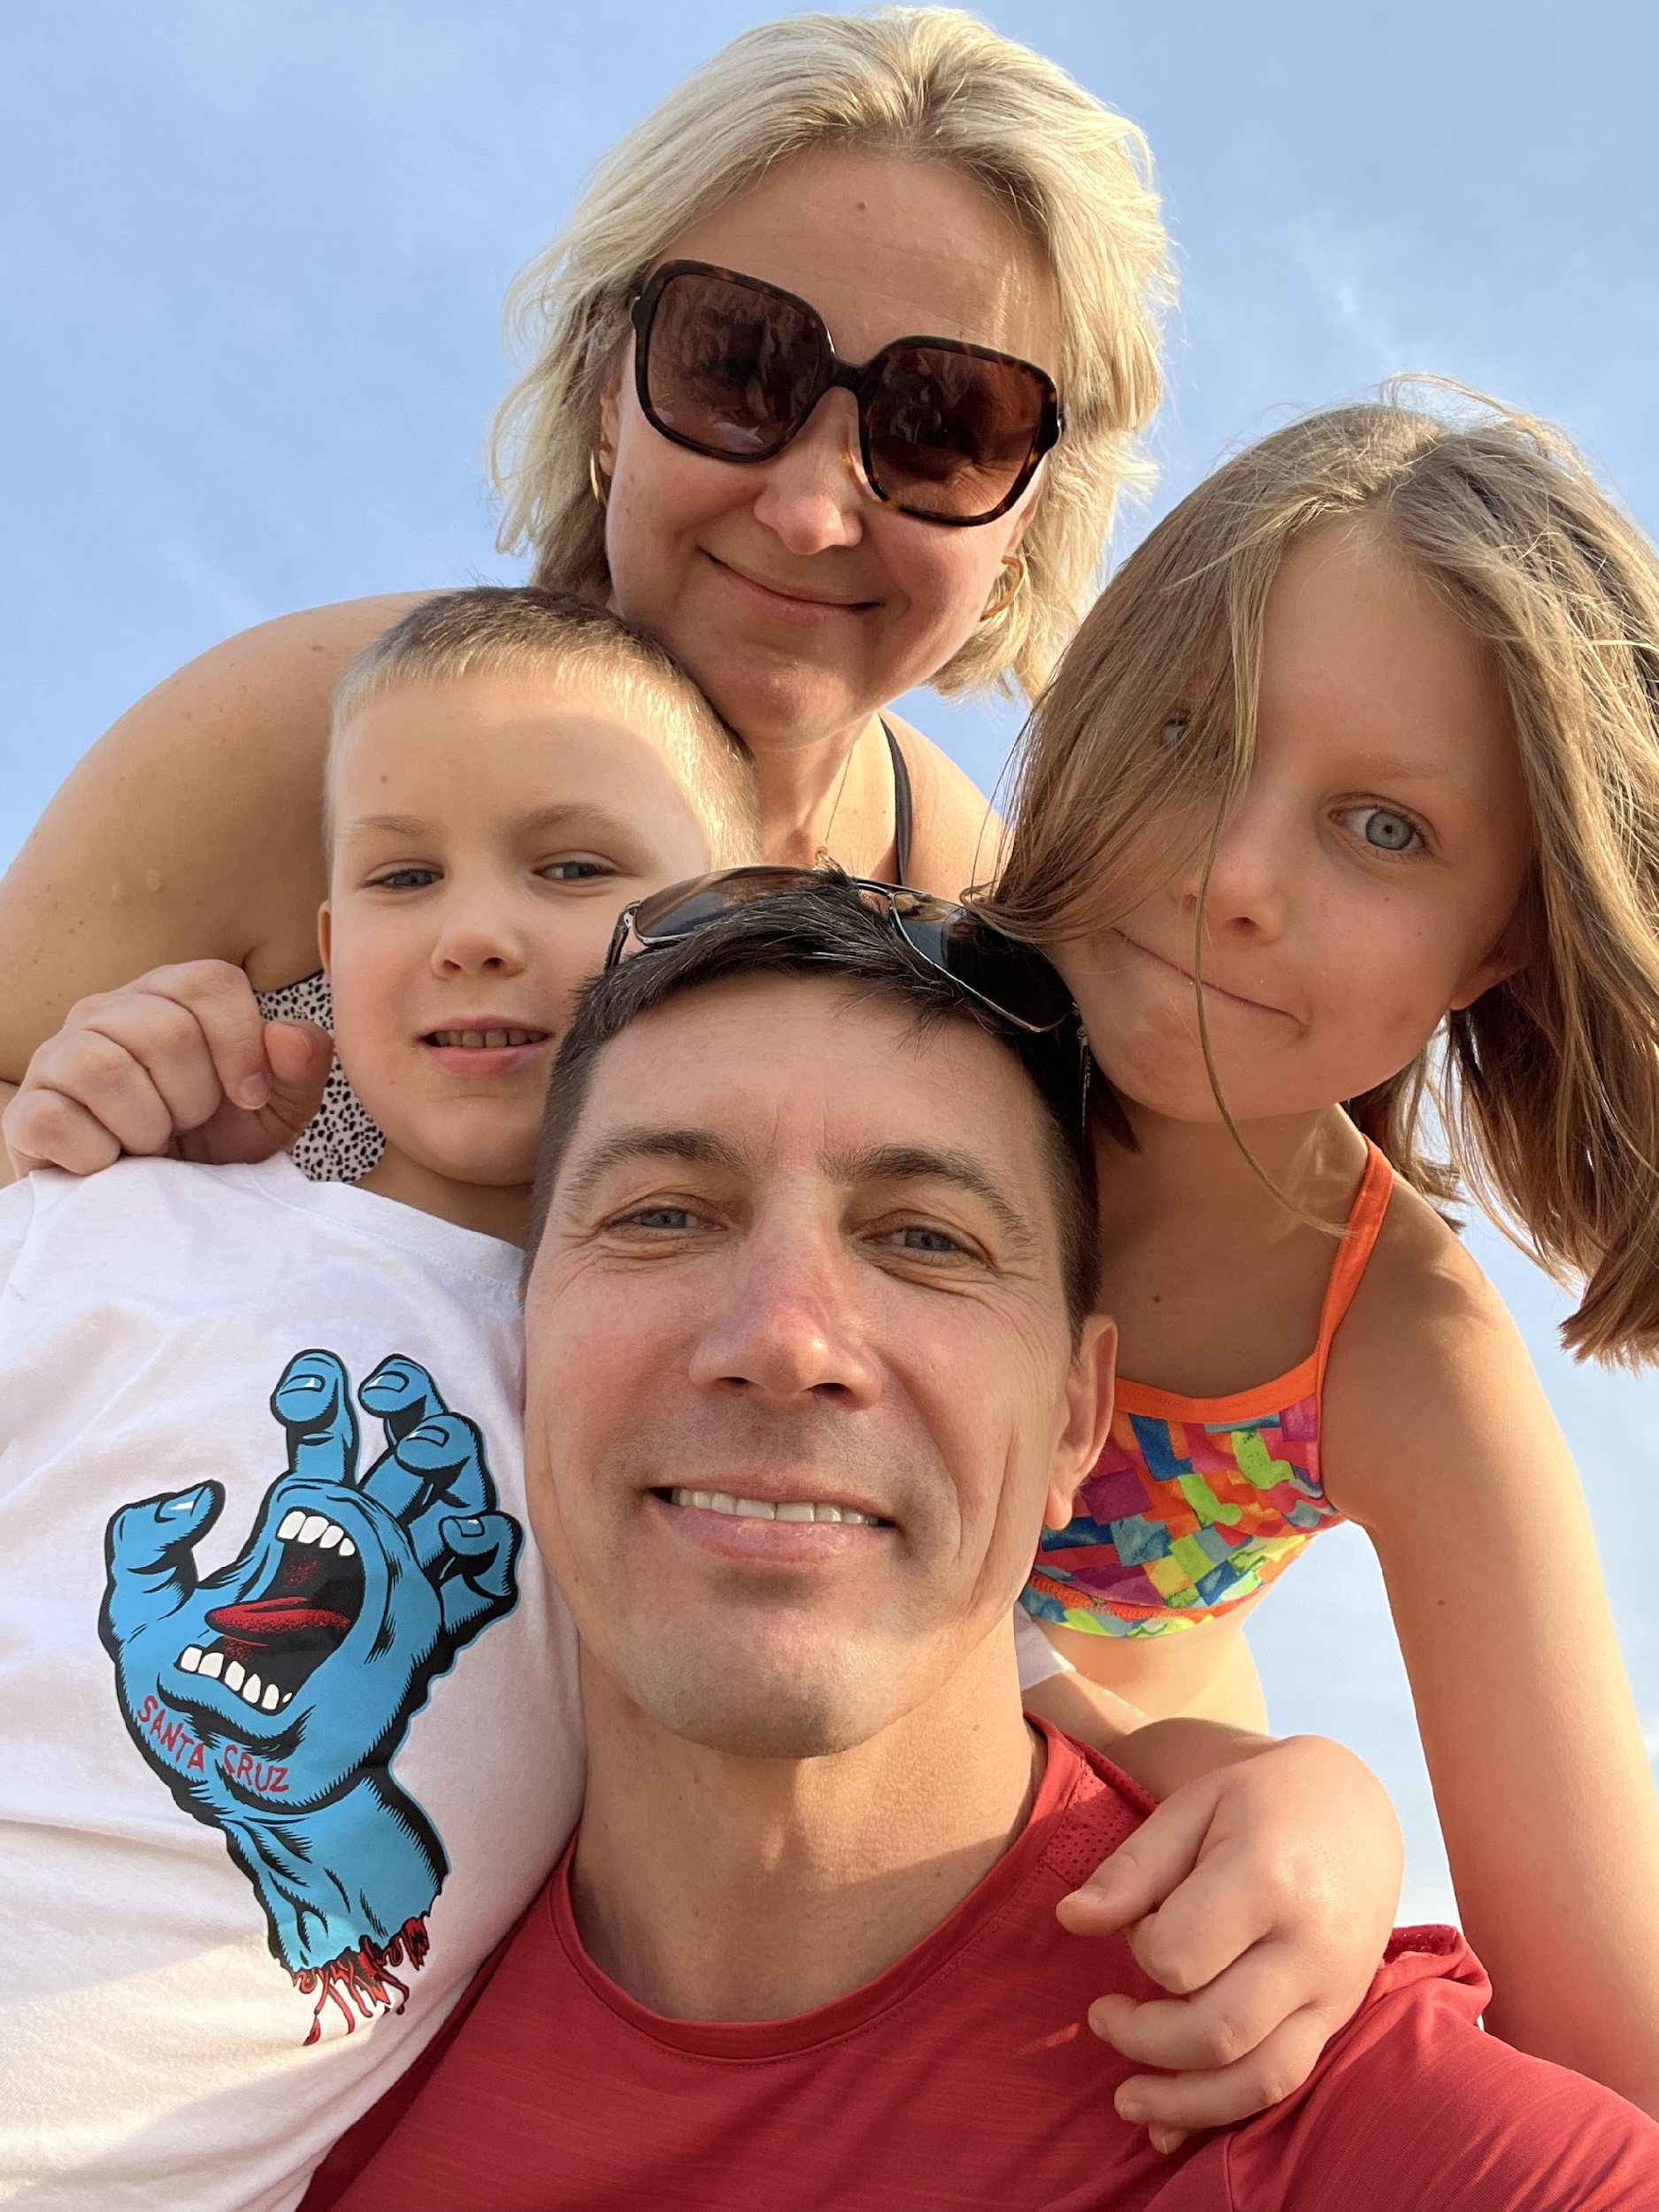


My Journey
Originally from Ukraine
15+ years in International Sales and Marketing
Sales, Marketing and Distribution across 10 markets
2013 - 2014
The first relocation
Good career development
2019 - 2023
The second relocation, UAE
Career is on hold, childcare and self employment
Since Sep 2023
Active job search
IDCN volunteering

Slide 3

IDCN Partner Member Profile
Young professional.
High education, good career development.
Open to explore new opportunities.
Speaks more than one language.
Followed spouse / partner in relocation.
Excited about the Swiss lifestyle.
Believes to be hired in about 6 month maximum.

Slide 4

IDCN Partner Member Profile
Maybe I need to
learn French?
Where to start?
Where to find the job?
Who could
guide me?
Maybe I need to
get local certification?
How do they do
networking here?
Why my CV
doesn’t work?
Why all is so
different here?

Slide 5
Why IDCN?
OUR
MISSION
Organisations that relocates eployees
(Corporate Members)
Partners and spouses of the relocated employees
(Partner Members)
Corporate
Events
Career
Mornings
Master
classes
IDCN & Volunteer Teams
Workshops
Goals towards inclusion, diversity, corporate social responsibility, environmental, social, and governance (ESG) standards, and sustainability initiatives.
IDCN is an association of multinational and local organizations that aim to support the professional integration by hosting a variety of professional and social networking events.

Slide 6
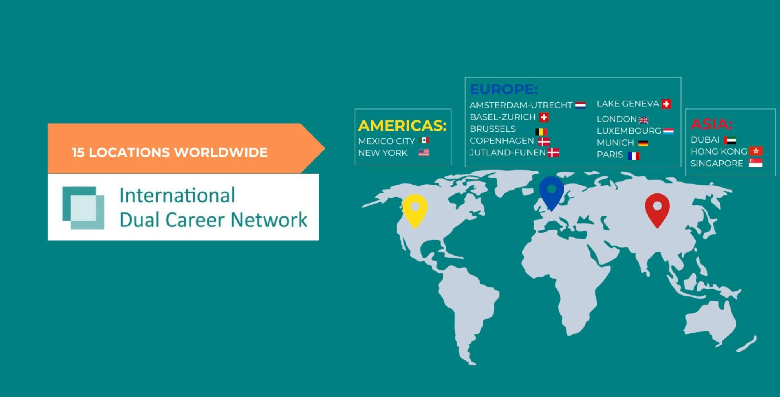
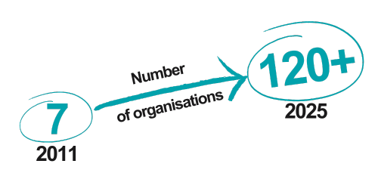

Slide 7
IDCN Lake Geneva, Key Metrics
Corporate Partners - 24
Partner Members - 487
Volunteers 2025 - 16
Employment rate – XX %

Slide 8























IDCN Lake Geneva Corporate Members

Slide 9

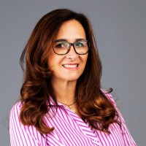

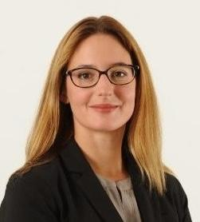
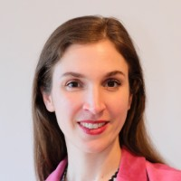

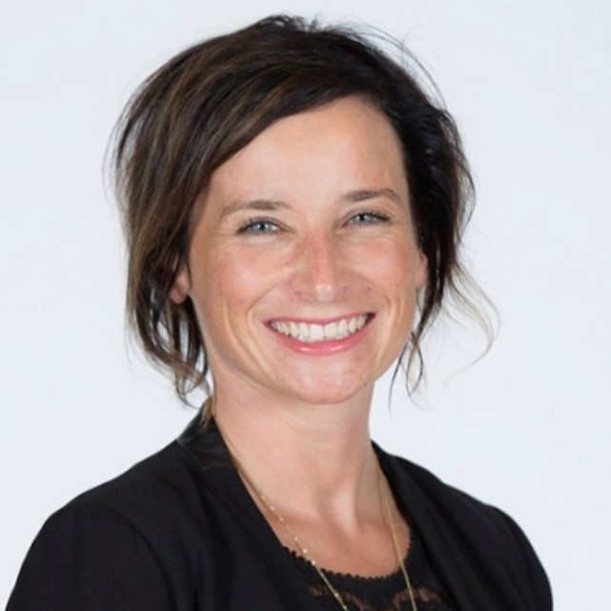

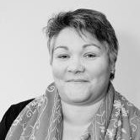

IDCN, Lake Geneva Steering Committee
Claudia Palm,
IDCN Network Lead
Provide guidance and advice to Partner Committee Office
Steering Committee meets quarterly
Louise Barrelet
Laurine Chiarini
Laetitia Santin
Anne Meylan

Slide 10
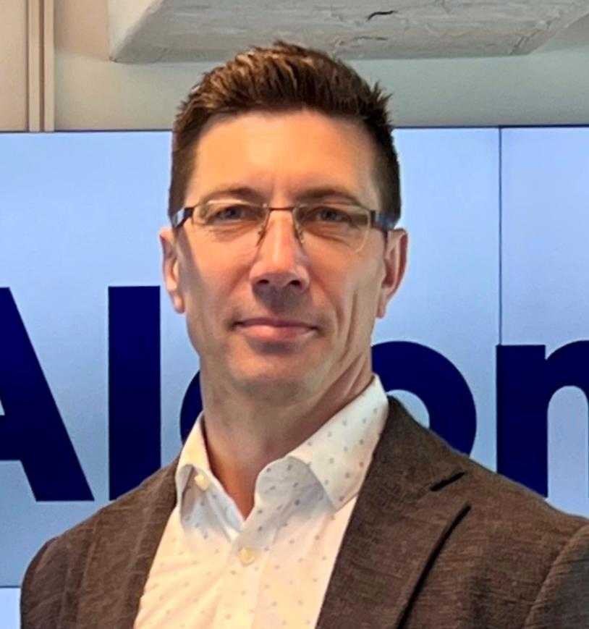

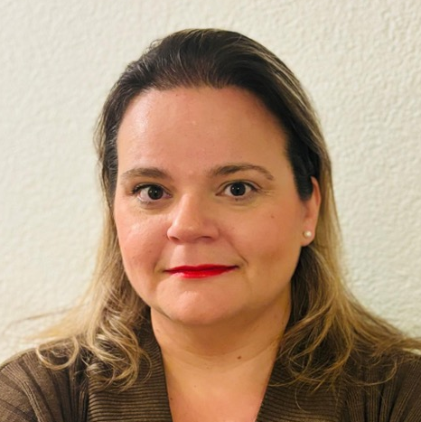
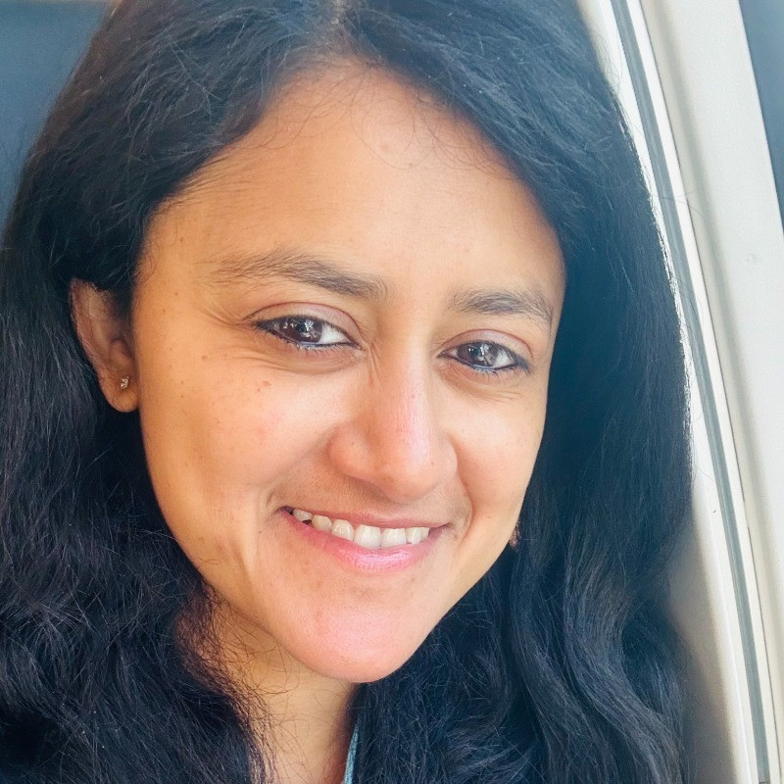

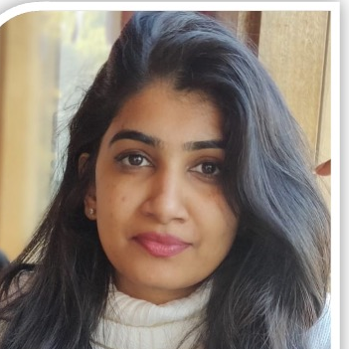
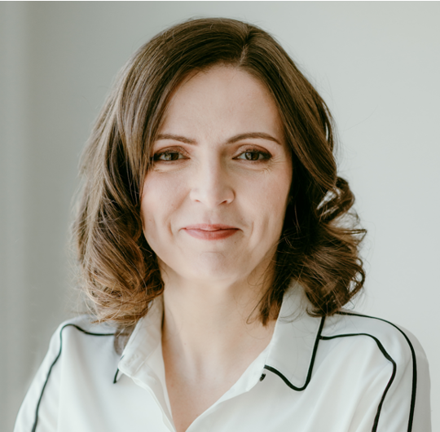
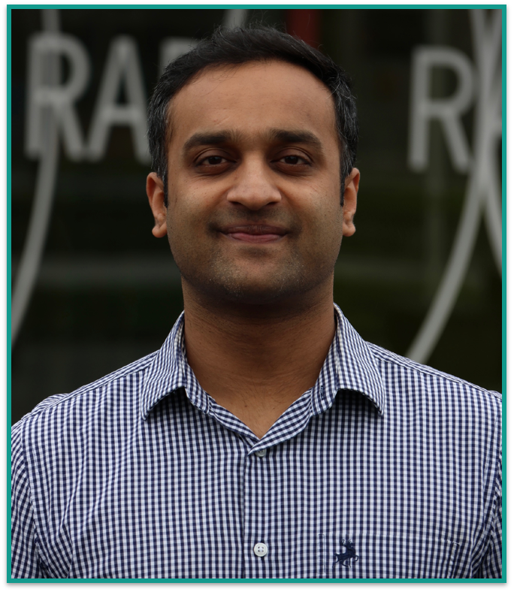
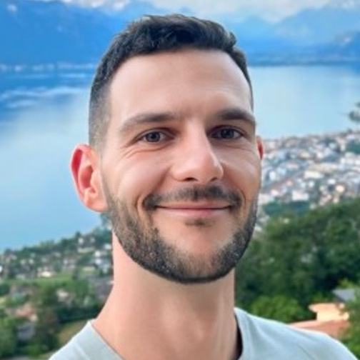
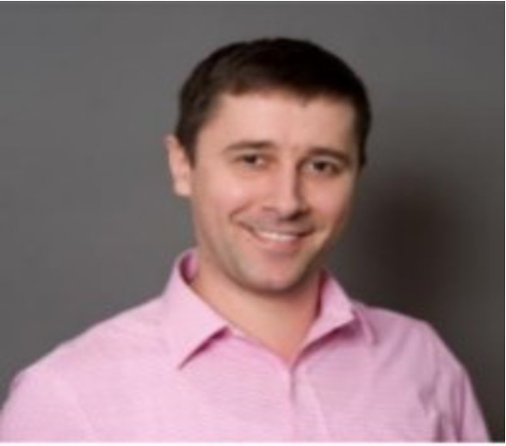
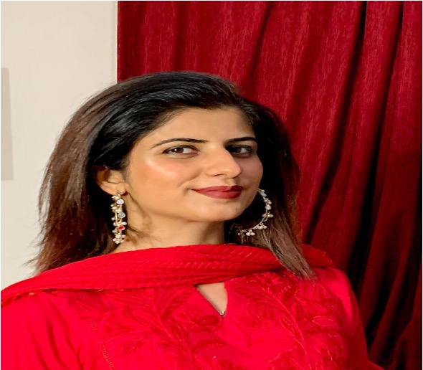
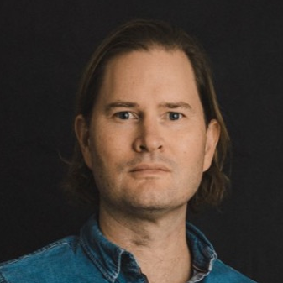
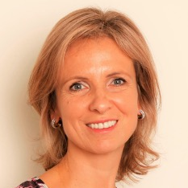
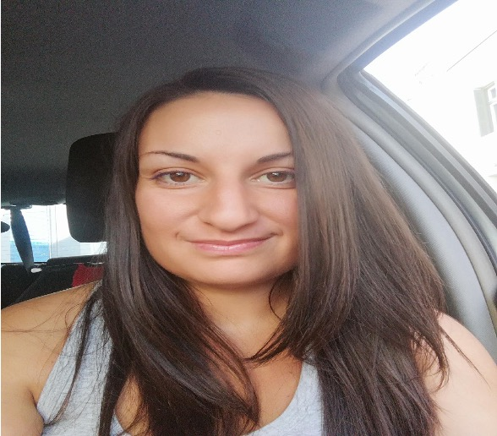
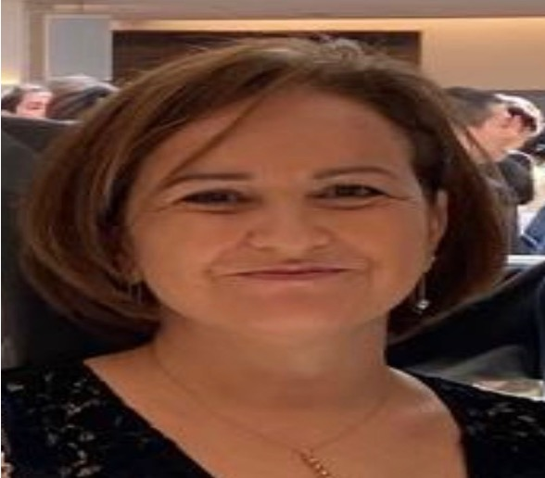
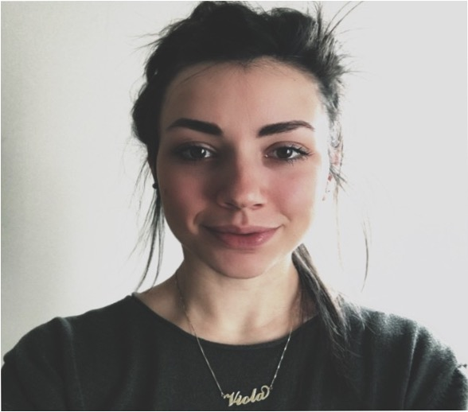
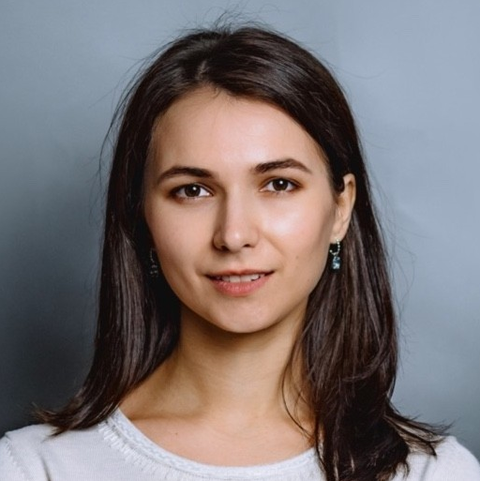
IDCN, Lake Geneva Organization Chart
Partner President
Mykhailo Kurochkin
Vice President
Vacant
Membership
Team Lead
Zoi Mavrogonatou
Events
Team Lead
Karnali Bose
Communications
Team Lead
Agnieszka Wiecek
Measurements
Team Lead
Anupama Nambiar
Newsletter Manager
Justyna Eroglu
Measurements
Backup
Parth Shah
Volunteer Manager
Ivo Dimitrov
Events Coordinator
Roman Andreyev
Events Coordinator
Momal Talha
Photographer
Diarmid Farquhar
Membership
Manager
Alexandra Dumont
Events Coordinator
Effie Zagari
Events Coordinator
Stephanie Capelani
Creative Designer
Vacant
Membership
backup
Vacant
Events Coordinator
Viktoria Begmat
Events Coordinator
Viola Crapuzzi

Slide 11
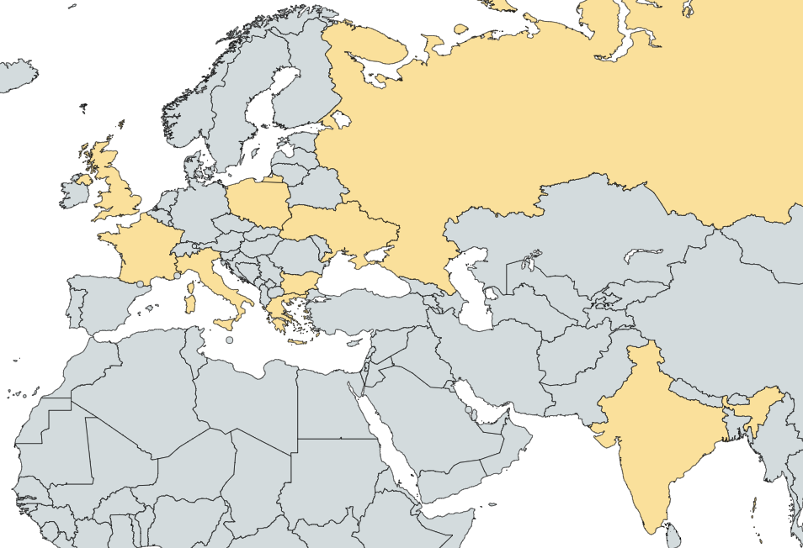
Our Volunteer Team Today
Volunteers
Countries
Work Experience
IDCN Service
  16
9
14
12

Slide 12
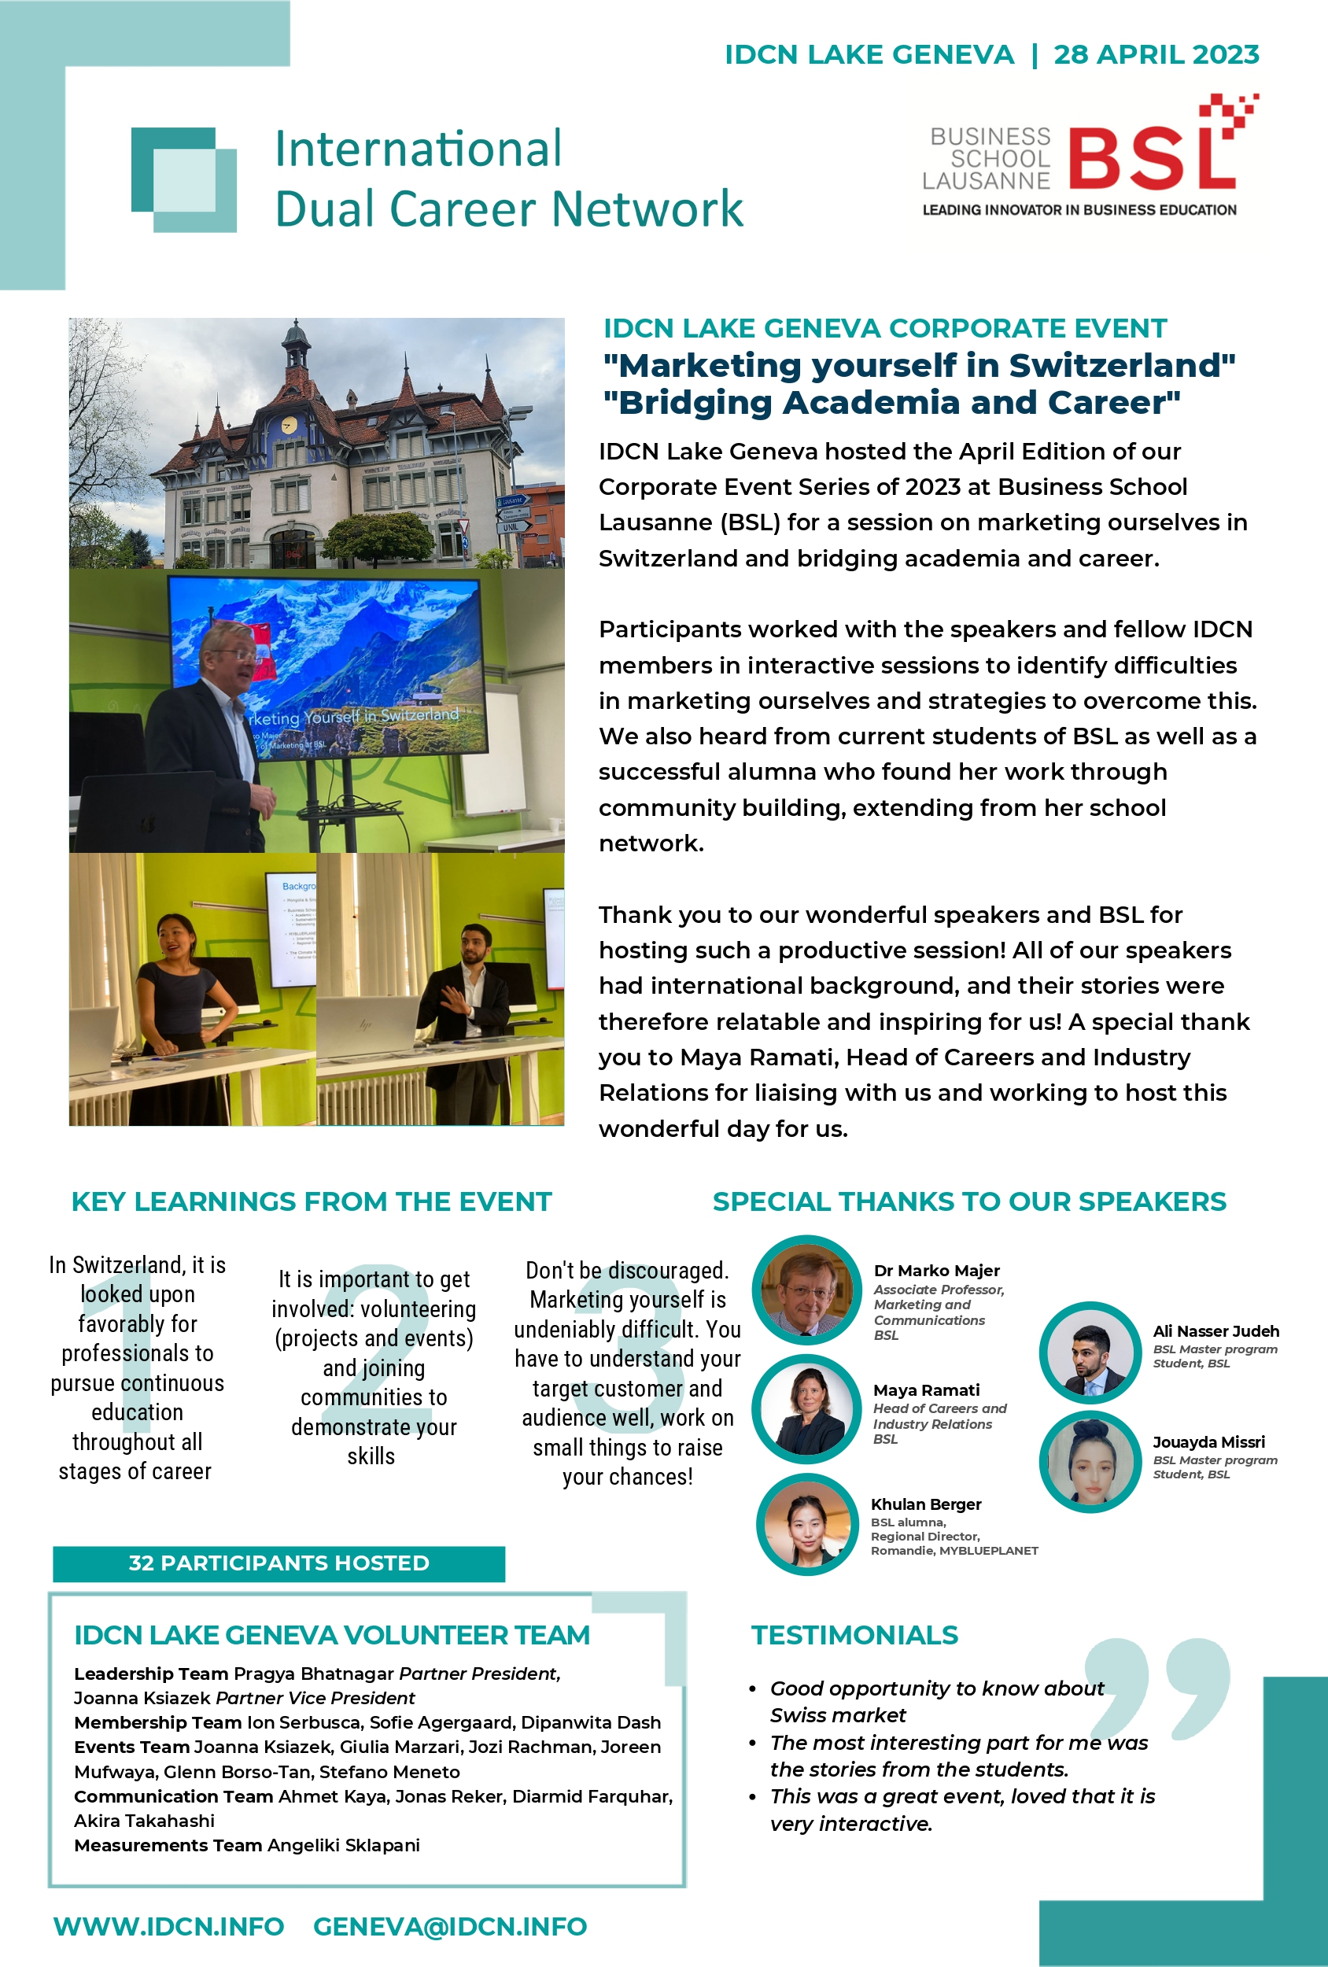
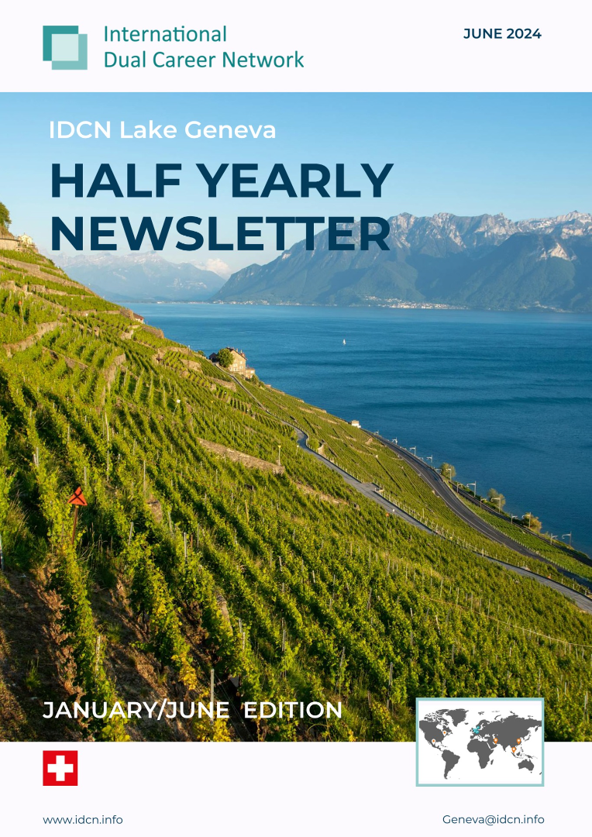
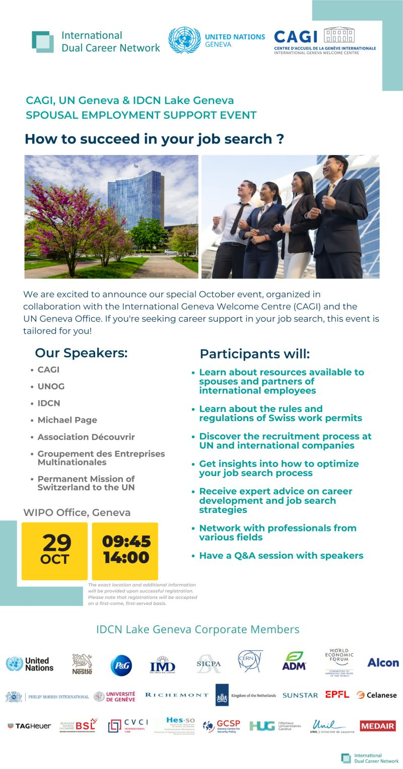
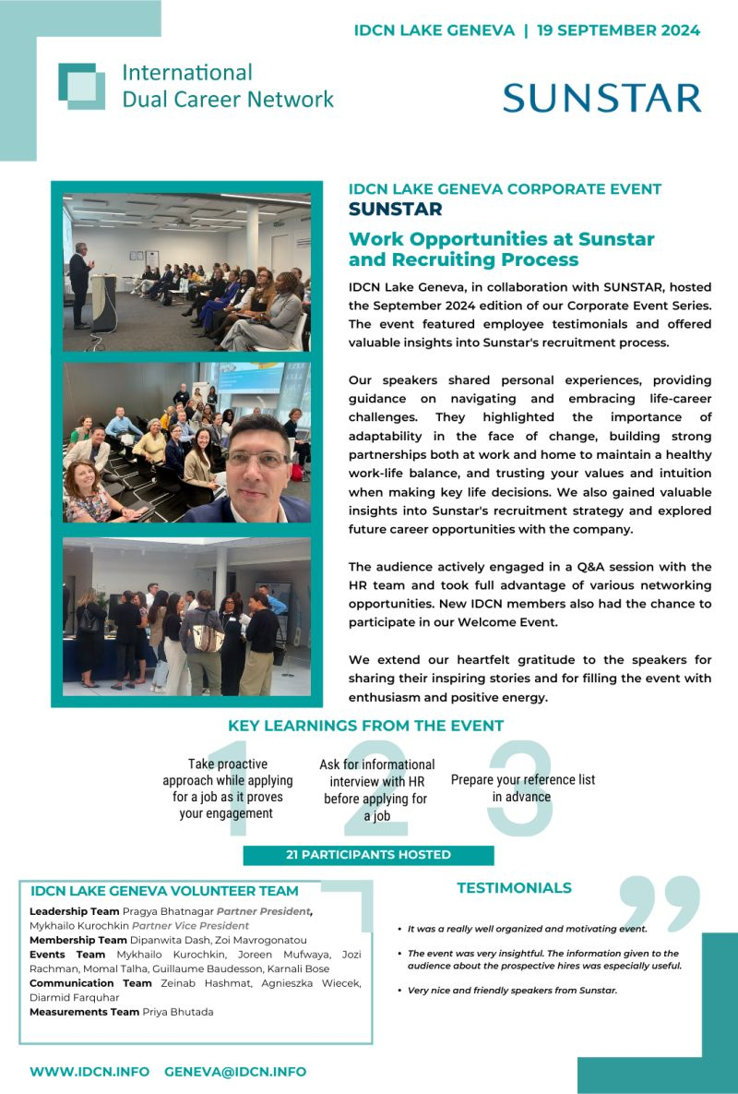
Newsletters, Posters, Success Stories
bi-annual report
success stories
published newsletters
event posters

Slide 13












IDCN Events Calendar 2024
2024
Jan
Feb
Mar
Apr
May
Jun
Jul
Aug
Sep
Oct
Nov
Dec
Career
Mornings
&
Corporate Events
Summer
Break
PMNL
October 29th
December 10th
September 19th
Awareness
Session
Awareness Session
Awareness Session
Awareness Session
Global Webinar
IDCN
Events
All Corporate Member Meeting
Welcome event
All Corporate Member Meeting
Masterclass
Masterclass
Global Webinar
Masterclass
Masterclass
Welcome Event + Training
Volunteer Training
Volunteer Picnic
Volunteer Christmas
Lunch

Slide 14


IDCN Events Calendar 2025 - Q1 & Q2 Plan
2025
Jan
Feb
Mar
Apr
May
Jun
Jul
Aug
Sep
Oct
Nov
Dec
Career
Mornings
&
Corporate Events
Summer
Break
Logo
Logo
Logo
March 18th
Date TBD
June 5th
Date TBD
Date TBD
Logo
February 6th
March 25th
April 11th
May 8th
Date TBD
Date TBD
Awareness
Session
Awareness
Session
Awareness
Session
IDCN
Events
All Corporate Member Meeting
All Corporate Member Meeting
Welcome Event + Training
February 20th
Masterclass
Global Webinar
Masterclass
Welcome Event + Training
Global Webinar
Masterclass
Masterclass
Volunteer Picnic
Logo
Volunteer Christmas
Lunch
Planning Corporate Event, CM is in discussion

Slide 15
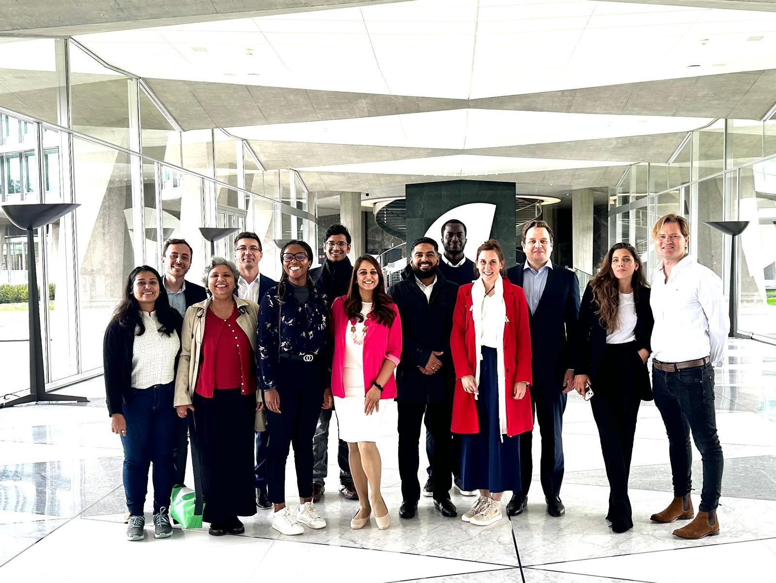
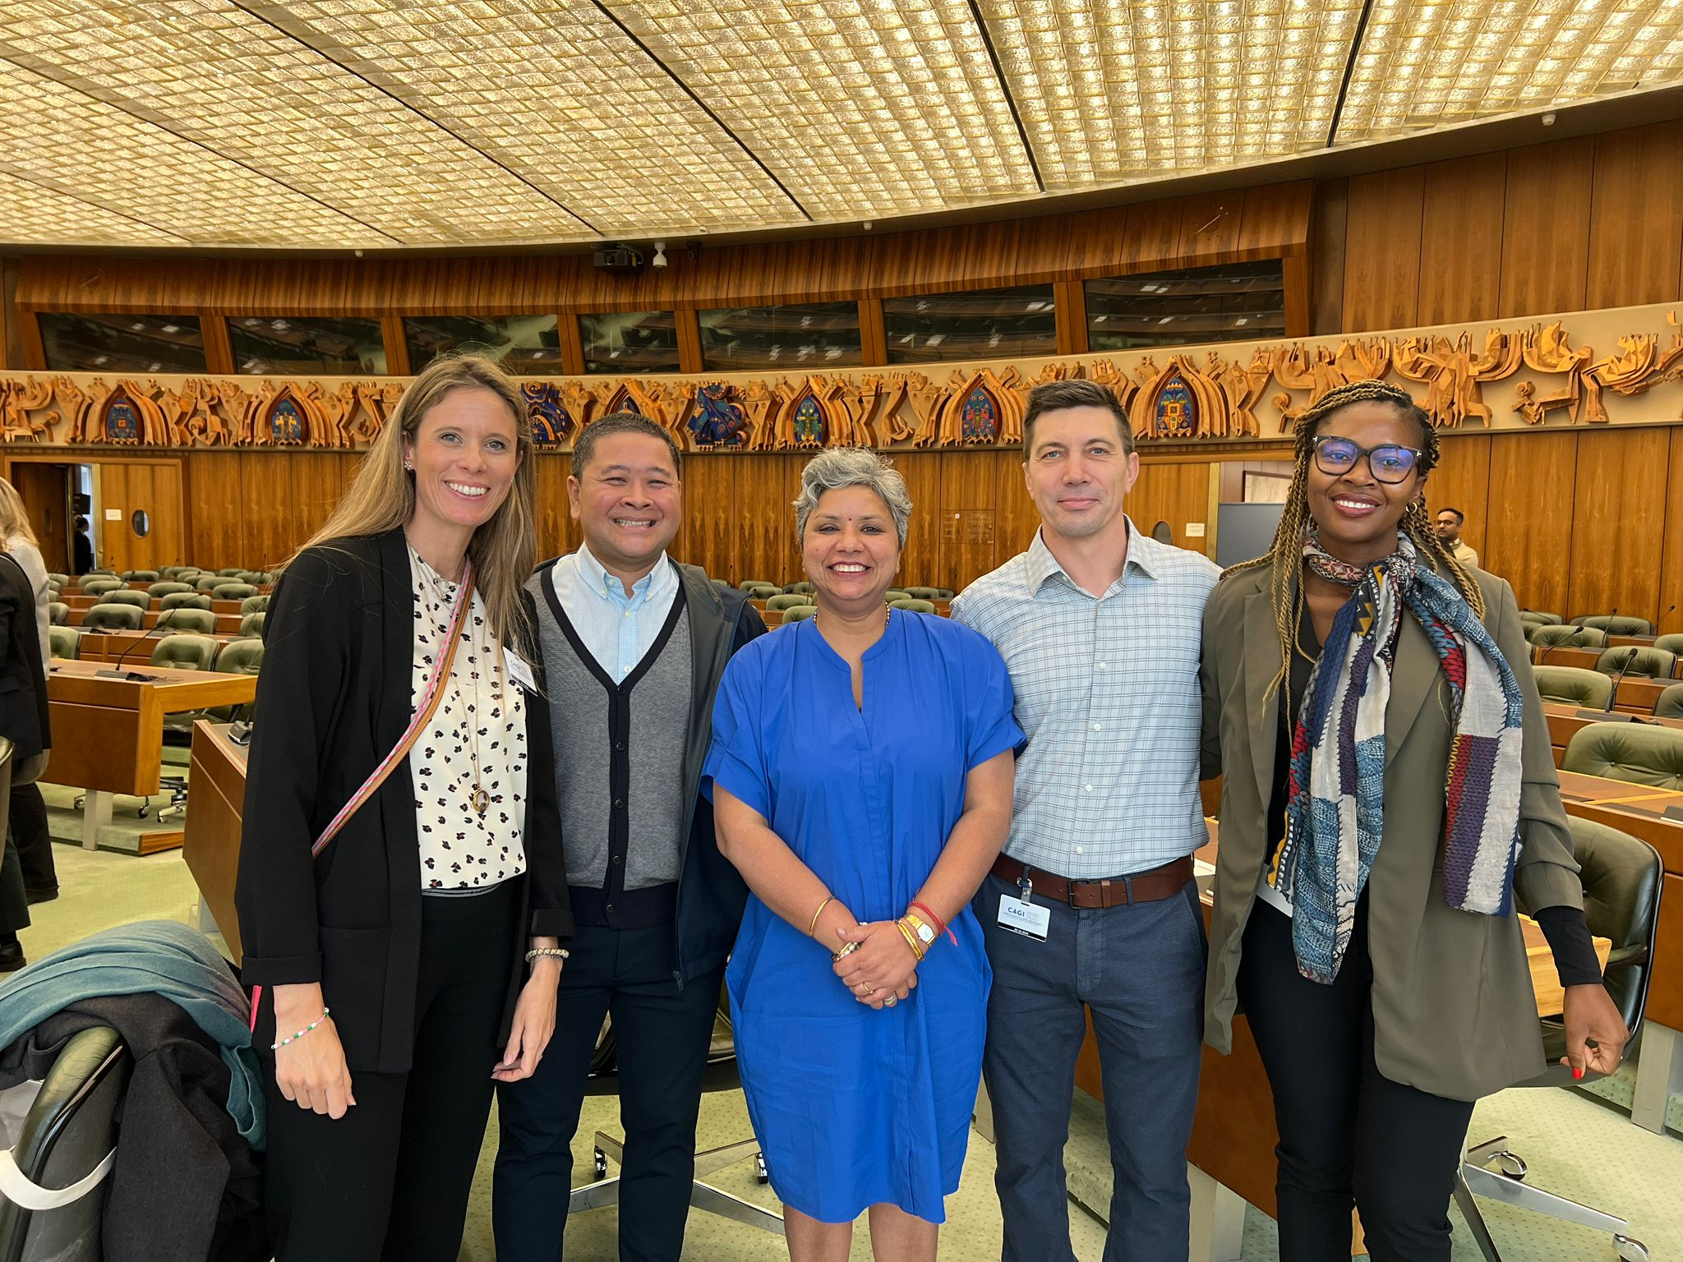
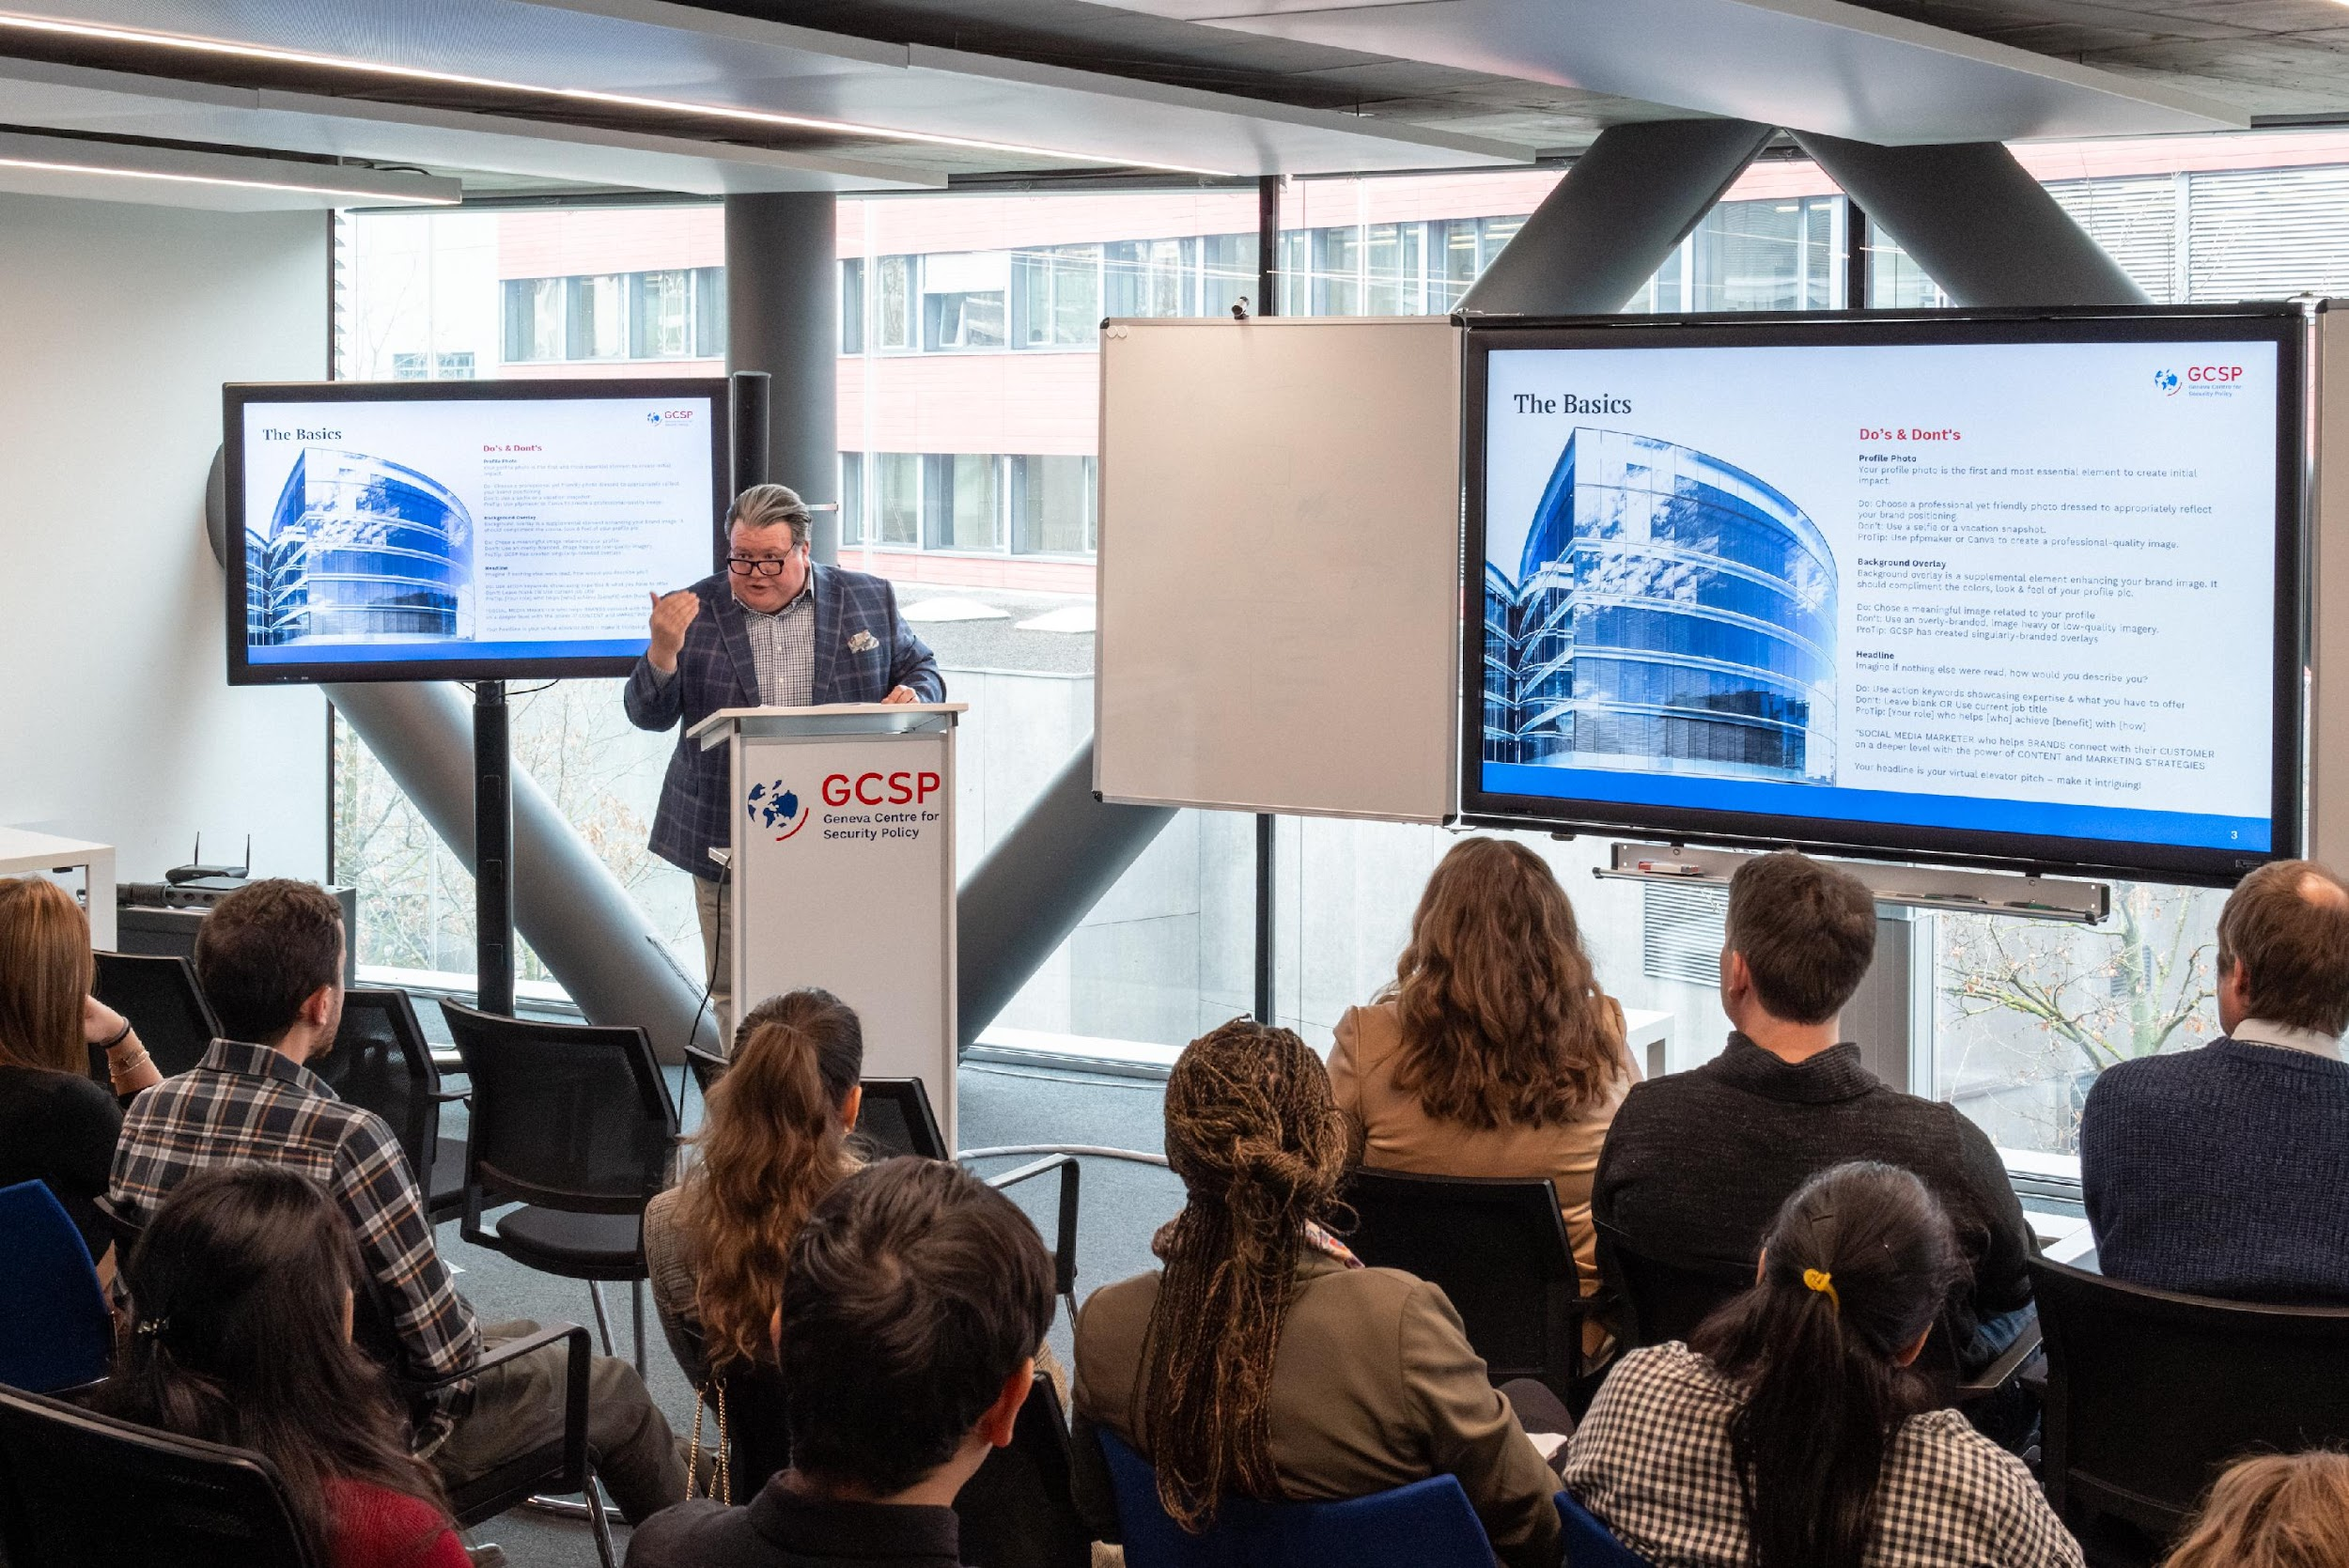
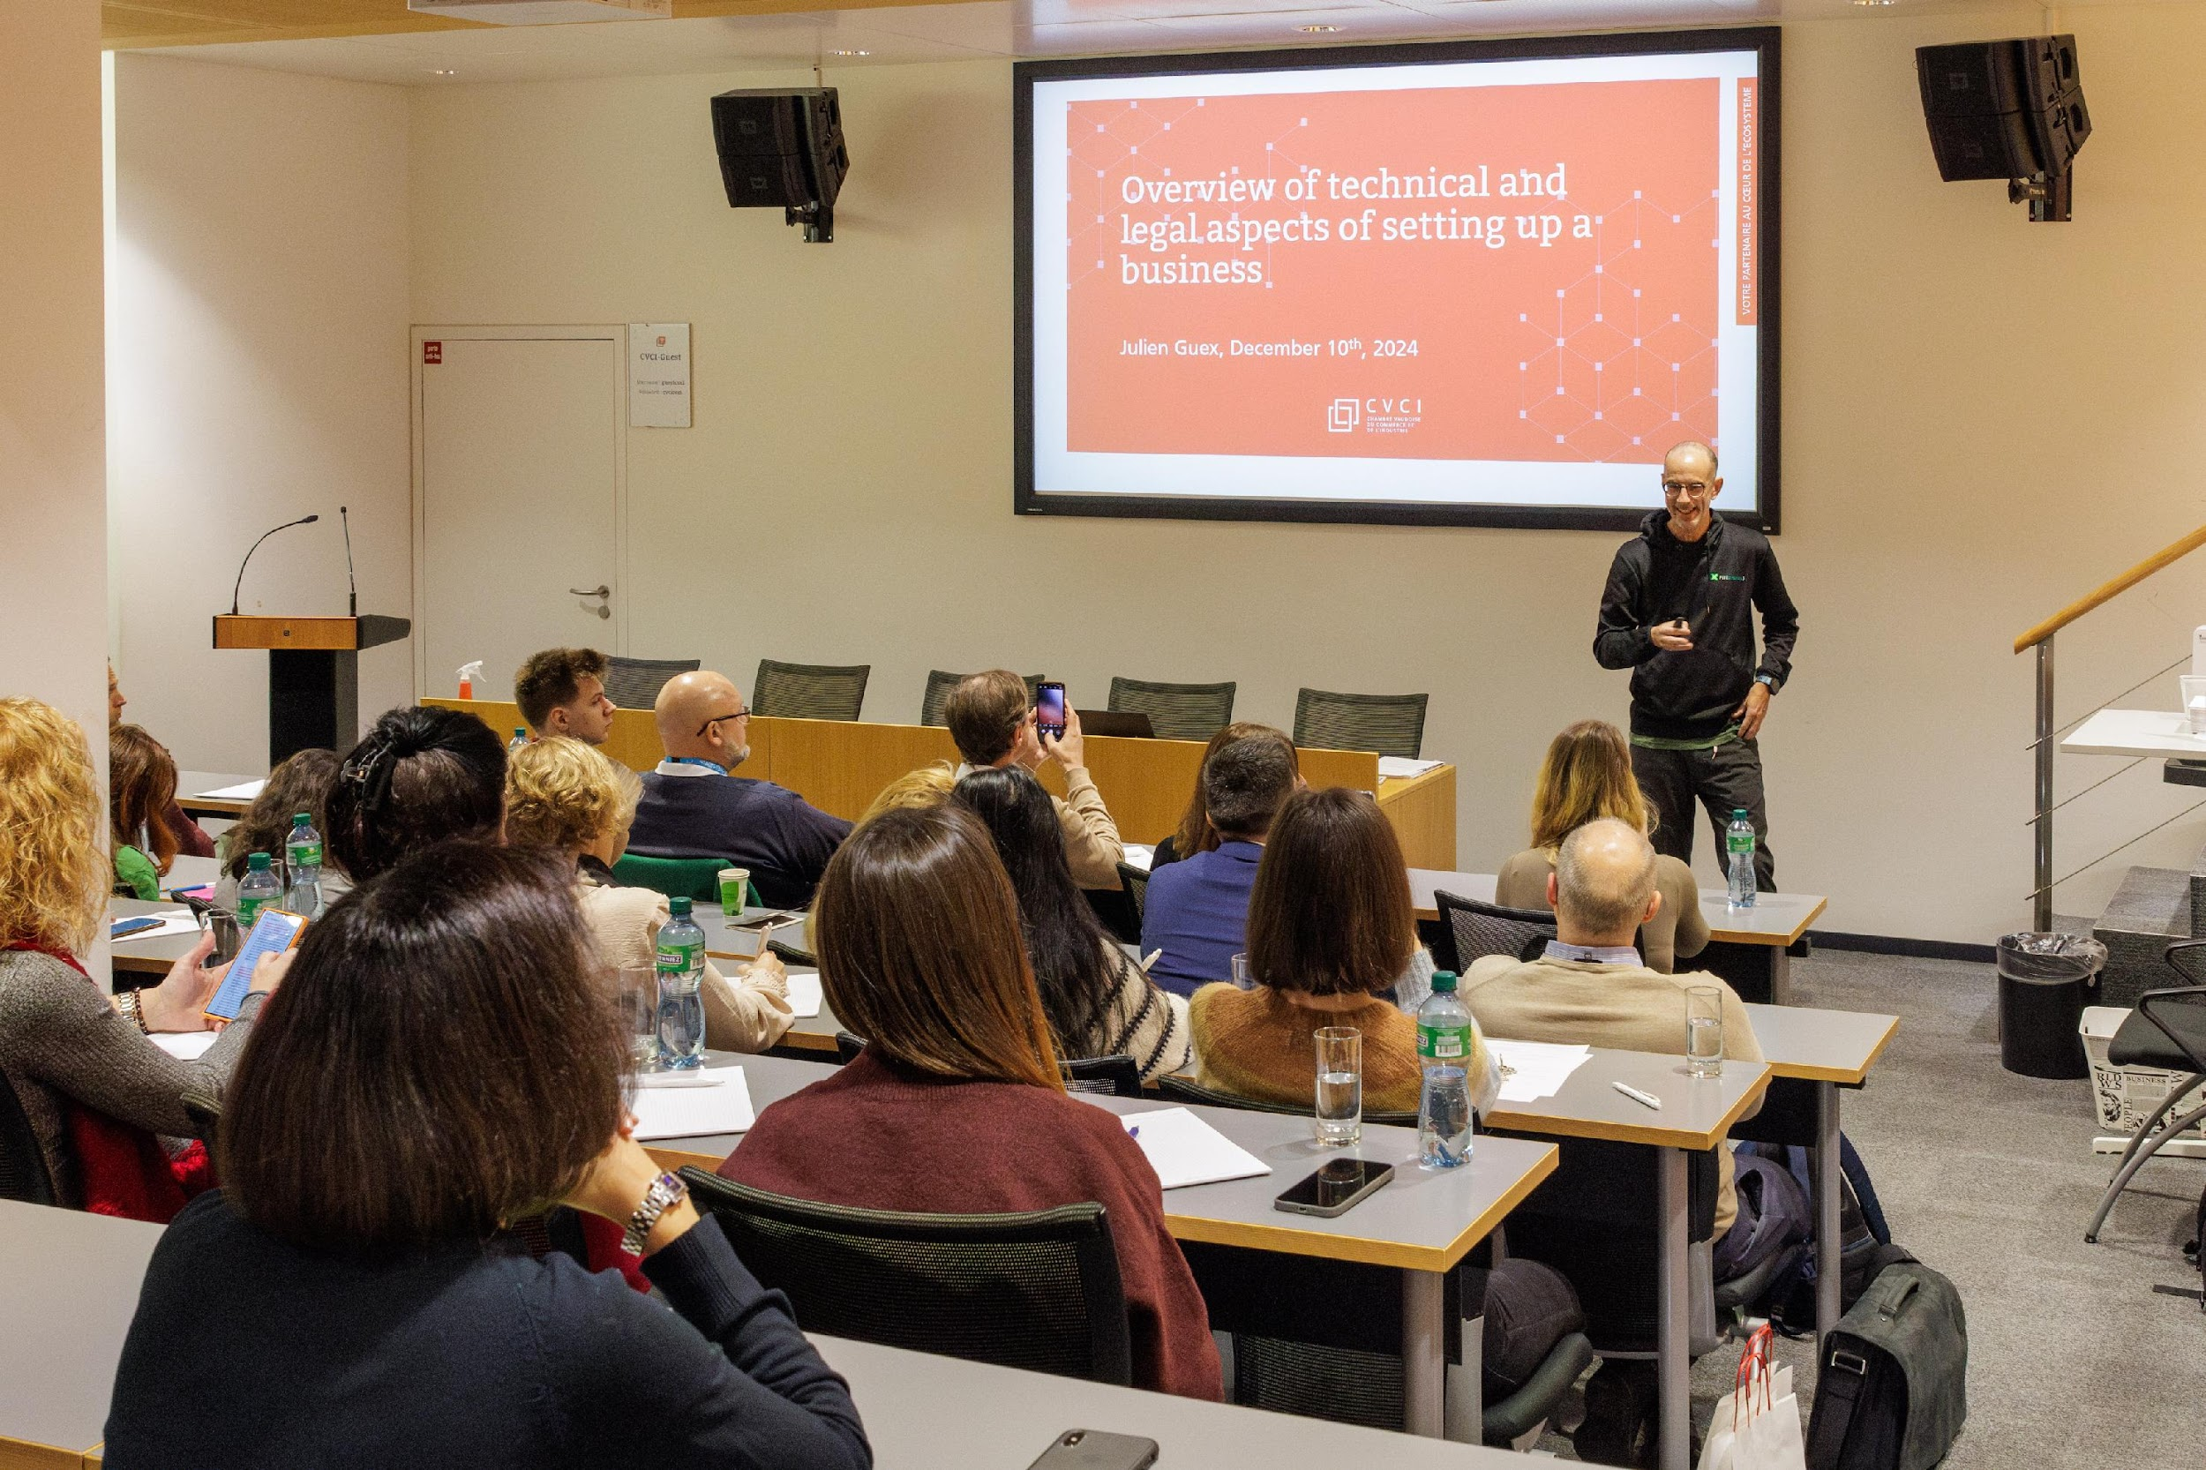
IDCN Lake Geneva Activities 2024
EXTERNAL EVENTS:
    Corporate Events
    Career Mornings
    Global Webinars
    Spouse Welcome

Slide 16
Events Topics 2024
Business creation in Switzerland
Work Opportunities at Sunstar and Recruiting Process
Employment in Switzerland
Unleash Your Potential: Discovering Nestlé's Recruitment Secrets
Driving Change through Careers in Public-Private
Partnerships
How to Bling your LinkedIn
How to Prepare to Competency-Based Interviews

Slide 17
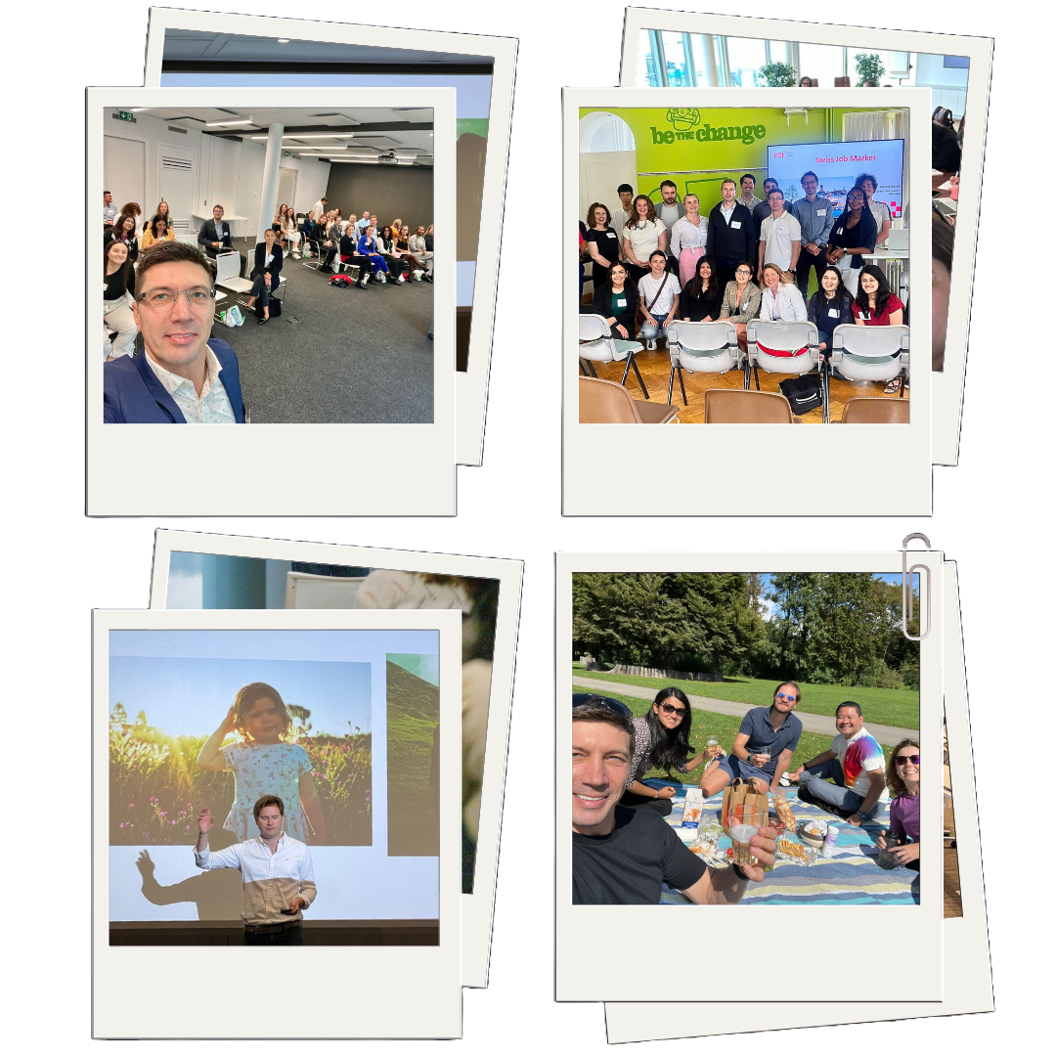
IDCN Lake Geneva Activities 2024
INTERNAL AND SOCIAL EVENTS:
    Masterclasses
    New Member Welcome Events
    Volunteer Picnic/Christmas Lunch
Notes:
Masterclass:
Partners Members shares their expertise with the IDCN members.
The activity follows the Corporate or Social events.
Social events:
Get-together activities to boost social network, volunteers' teambuilding and informal conversation about the ongoing professional and social integration.

Slide 18
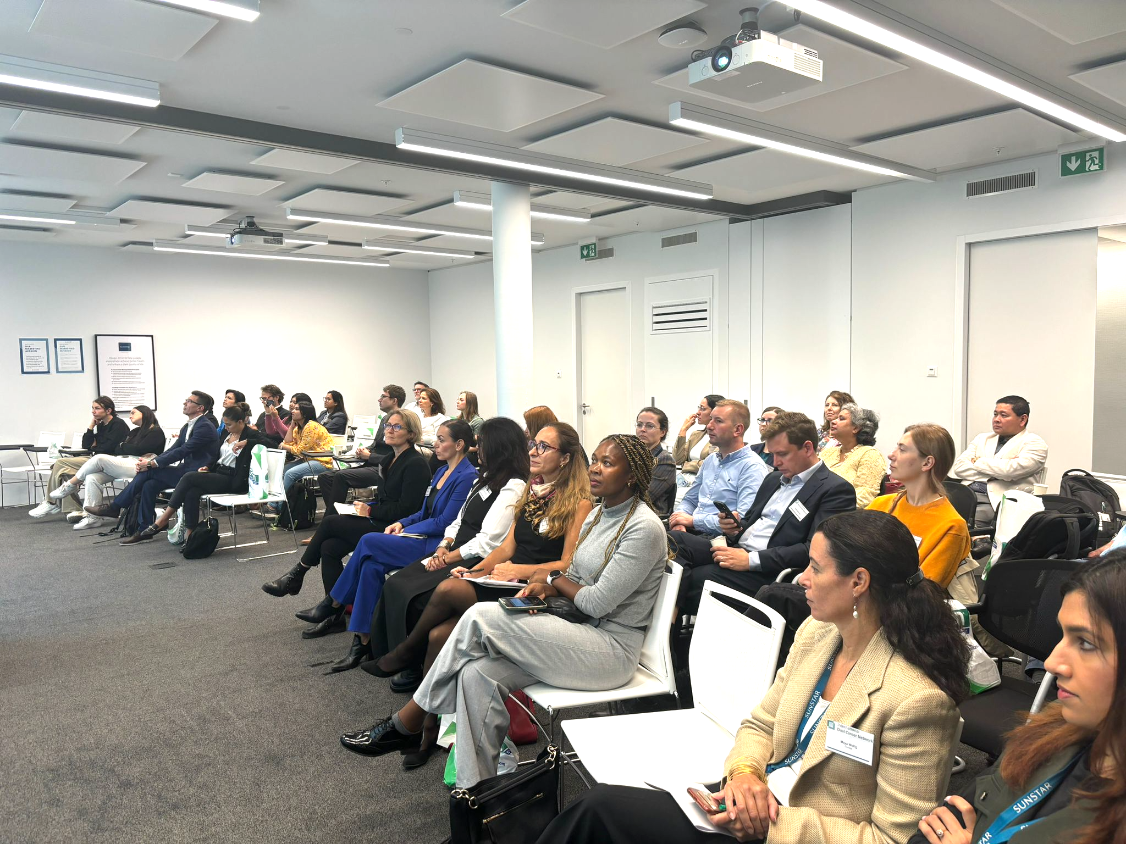
Welcome Events for new Partner Members
MAIN OBJECTIVES:
A warm, informative, and fun welcome sessions.
Presentation and recruiting of volunteers.
TIMING:
2-3 times a year.

Slide 19
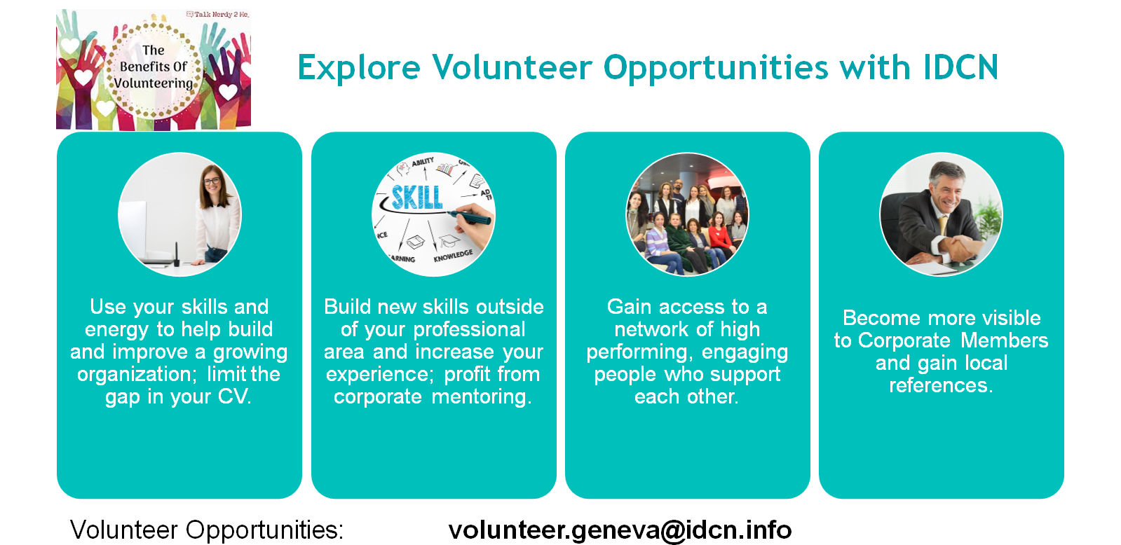

Slide 20

The Next Corporate Event
MARCH 25th, 2025
How to Succeed in Your Job Search

Slide 21
Thank you!

