Slide 1
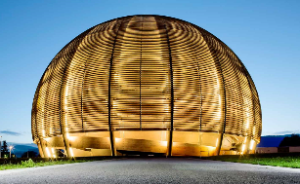
Spouse Welcome
March 2025

Slide 2


Slide 3
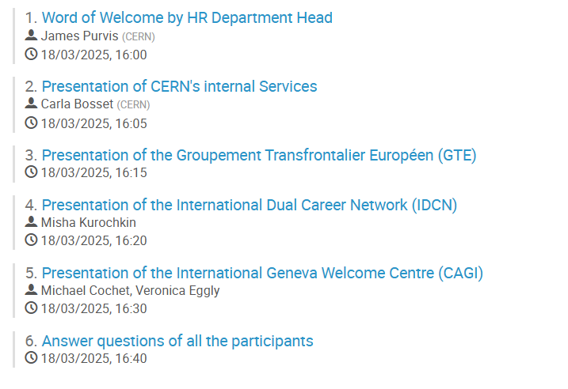
Agenda
Notes:
TO BE CHANGED

Slide 4
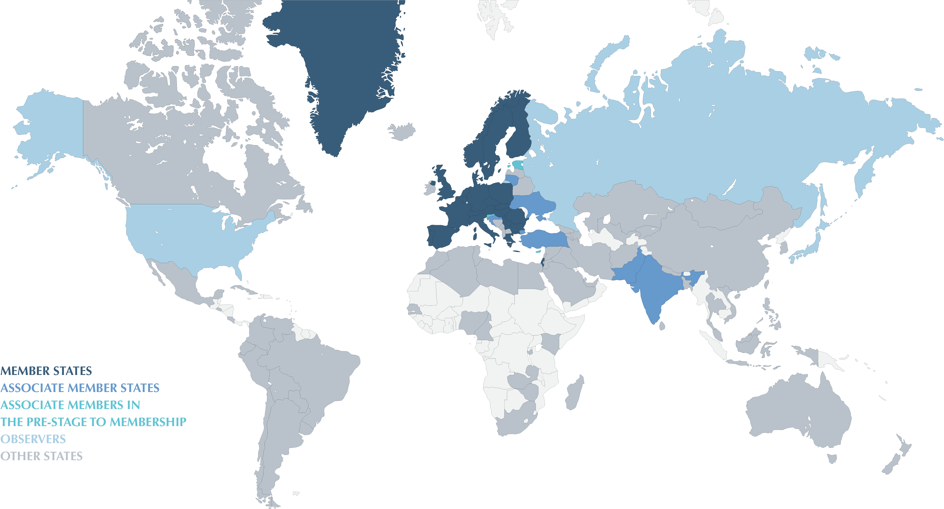
Introduction
https://home.cern/about/who-we-are/our-governance/member-states

Slide 5
The Installation Service
Removals
Tax-free importation of household goods and vehicles in Switzerland
Relocation services
Diplomatic privileges
Ariadna
CANEDO

Slide 6




Statutory body for Staff representation
  Staff Association delegates: Anthony GROSSIR and Anthony REY
CERN Clubs
President: Michael JAUSSI
CERN Welcome Club
President: Clara RAIMONDO
Vice-president: Sara CASTELLS
Crèche and school « Le Jardin des Particules »
  Headmistress: Roberta CAVIGLIASSO

Slide 7

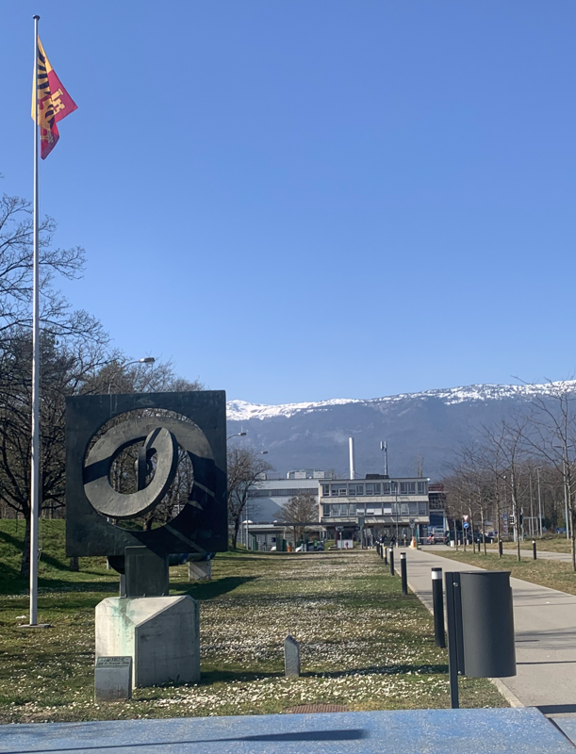
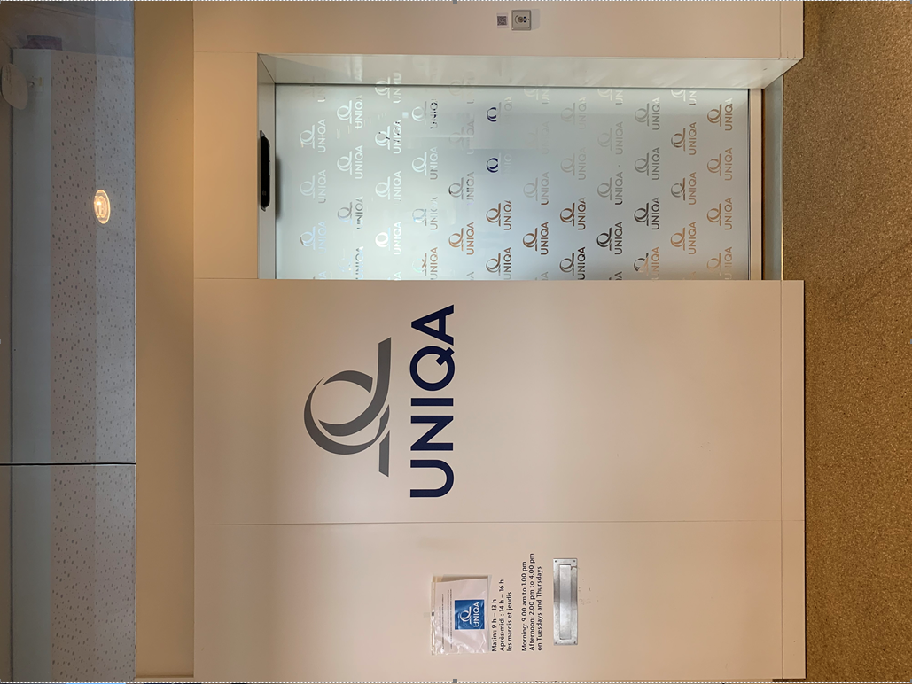
Bld. 55
Own mutual health insurance – CHIS
Compulsory for MPEs, students and for their families
Administrated by UNIQA
Bld. 63
Sandrine BAUDAT
Rebecca WOOD

Slide 8
The Social Affairs Service
Drop-in service
For members of CERN personnel and their families
Large variety of issues:
    Support in finding a childcare in Switzerland / France
    Help with taxations
    Questions you may have in your daily life…
Carla BOSSET
Sophie CHARPIE
Pascale PESSY

Slide 9



External networks
GTE
Groupement Transfrontalier Européen
IDCN
International Dual Career Network
Misha KUROCHKIN - Vice President
CAGI
International Geneva Welcome Centre
Michael COCHET- Head of Communications and cultural promotion Service
Veronica EGGLY- Deputy of Welcome Service, Welcome Programme specialist

