Slide 1
FCC-ee TDAQ - Intro
Stefano Franchelucci, Aimilianos Koulouris, Thilo Pauly, Steven Schramm, Anna Sfyrla, Rosa Simoniello, Thorsten Wengler

Slide 2
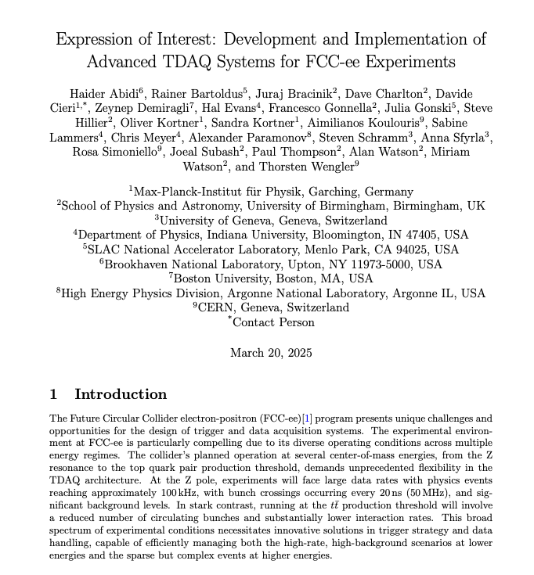
Today’s agenda – Introductions & plans
Based on already existing activities especially at University of Geneva, we submitted an EoI on TDAQ at FCC to the European Strategy process:
  Part of submission 95 on det. / system concepts
Different areas of interest among the signatories, the present group here is focussing on the TDAQ Architecture design
  What is the situation we will be dealing with, at different √s, considering both physics and beam induced background
  What are the implication and constraints on the design of both TDAQ systems and the required capabilities of the subdetector systems
    What is the current thinking of the detector systems on this?
  How to best contribute to our understanding of what is coming and what is needed

Slide 3
Discussions so far
Interactions with the subdetector communities
  First contacts have been made, but limited replies so far
  Propose a workshop on this topic mid-autumn
    a dedicated cross-detector meeting on readout-related topics
    aim to discuss with representatives of each community in advance
    ask the detector communities to prepare answers to the previously circulated questions
  We proposed to Felix Sefkow and Mogens Dam such a workshop
    Prepared by us
    Invitations by them as the relevant conveners
    They both agreed this is a good idea, need to decide on a date (your input?) in ~October

Slide 4
Discussions so far
Interactions with the subdetector communities – list of questions
  General
    What readout capabilities have already been demonstrated?
    What readout capabilities are currently assumed?
  Processing and triggering capabilities
    Can the sub-detector process all 50 MHz of incident beam crossings, and identify whether something of interest has taken place in that beam crossing?
    If the sub-detector can process all 50 MHz of incident beam crossings, can it also issue a single-subdetector trigger based on that information?
    If the sub-detector cannot process all 50 MHz of beam crossings, can it be externally triggered at the actual collision rate of O(200 kHz) to process its own data to identify whether something of interest has taken place? This would represent an externally-triggered sub-detector capable of performing a second-pass trigger, if needed.
    If the sub-detector cannot process the O(200 kHz) of events following an external trigger, can it accept any external triggers, and if so at what rate? These would be externally-triggered sub-detectors that can only be active for a subset of collisions in case of further trigger requirements, and which may be relevant for some FCC running modes.

Slide 5
Discussions so far
  Readout capabilities
    Is the sub-detector capable of reading out based on self-triggering at a 50 MHz rate?
    If not, is the sub-detector capable of reading out based on external triggers at a O(200 kHz) rate?
    If not, at what rate can the sub-detector be read out?
    Will the sub-detector perform a full readout or a regional readout?
  Readout assumptions
    Do you make any specific assumptions about how sub-detector readout will be performed?
    For tracking sub-detectors: does the considered material budget already include readout-related material?
  Readout volume
    What is the sub-detector occupancy for each of the signal/background/beam processes in each FCC running mode?
    What is the number of channels in the sub-detector, and the typical data size per channel?
    For the sub-detector, is it safe to assume at first order that the data volume is the (occupancy) x (number of channels) x (data size/channel), or are there particularities to be taken into account?
  Detector occupancy
    How is occupancy defined for the sub-detector? The total number of channels with any contribution, the number of channels above some threshold, or something else?
    If the occupancy includes some threshold, how is the threshold defined?
    If the occupancy includes some threshold, what fraction of channels containing signal contributions will be below that threshold?

Slide 6
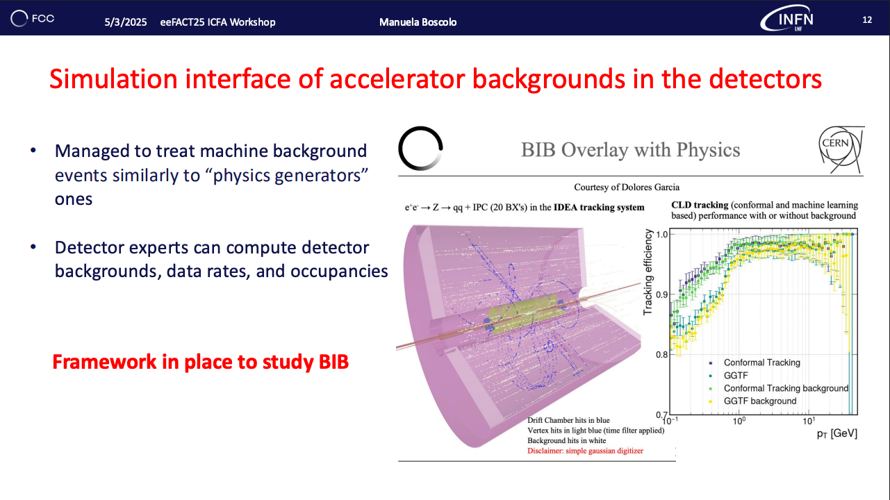
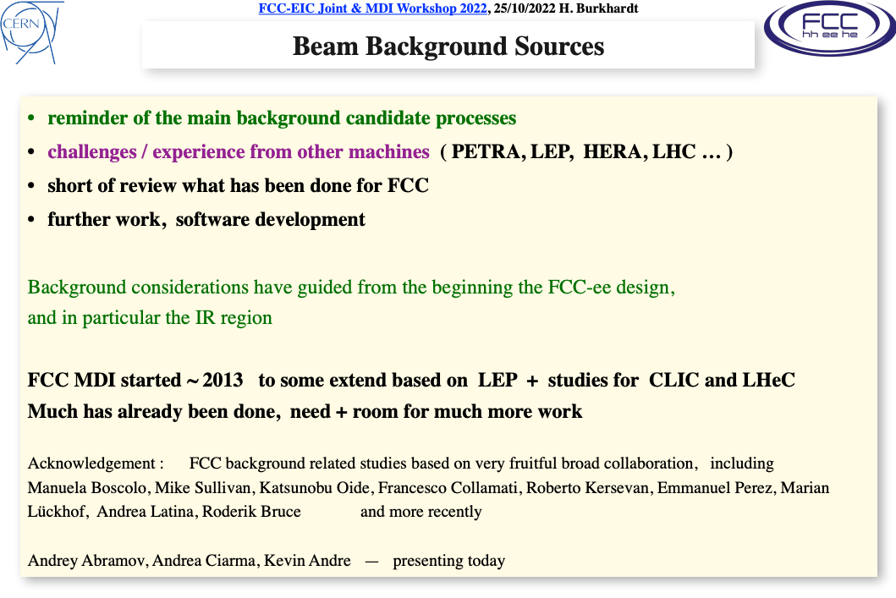
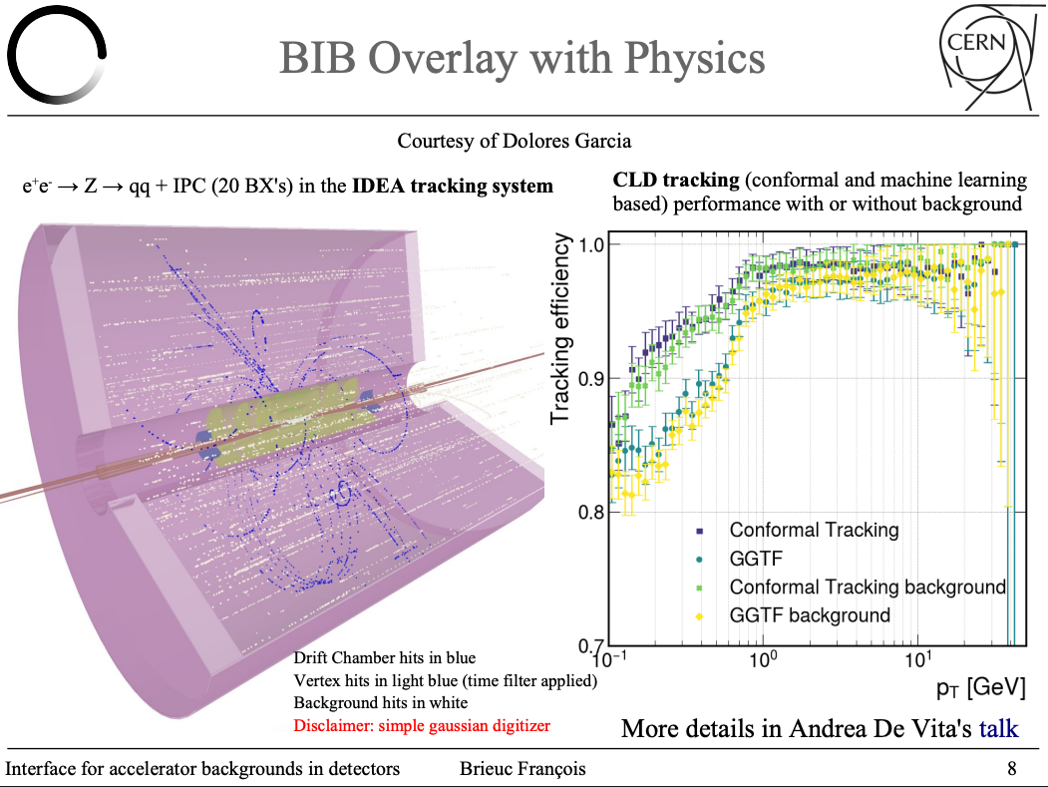
Discussions so far
Very interesting exchange with Helmut Burkhardt – beam induced BKGS
  Pointed out many of the ongoing activities on beam in induced background and related studies
With some very good news!

Slide 7
To conclude
Clearly our interests are closely coupled with the MDI activities and the machine detector interactions in general
  Our main interest would be to get up to speed with running realistic (as much as possible) simulation of BiB + Physics through the detector simulations
  Use as a basis to estimate data rates, throughput, subsystem constraints
    What would be the best way to go about this?
    Where could we contribute in the process, i.e. improving the simulation
Any comments welcome!

