Slide 1
Study for the installation of the vertical cryoline with the overhead crane in SD17
Lorcan QUAIN SOLIS
EN-HE-PO
02/07/2025

Slide 2
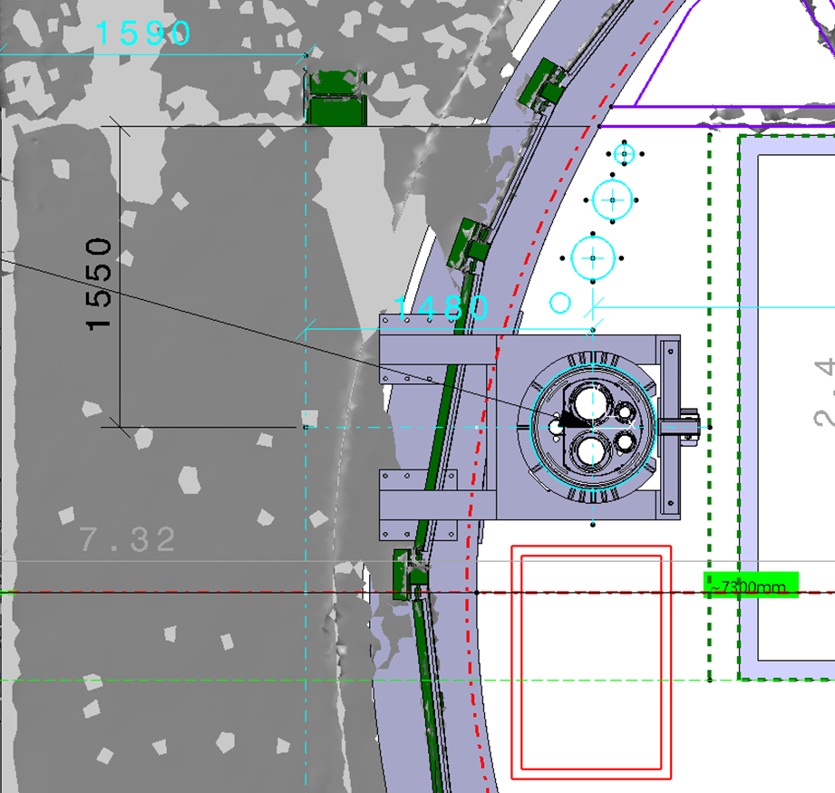
Measurements
Missing between 460 mm (measurements from last year) and 640 mm (on the 3D model) → add 700 mm at least

Slide 3
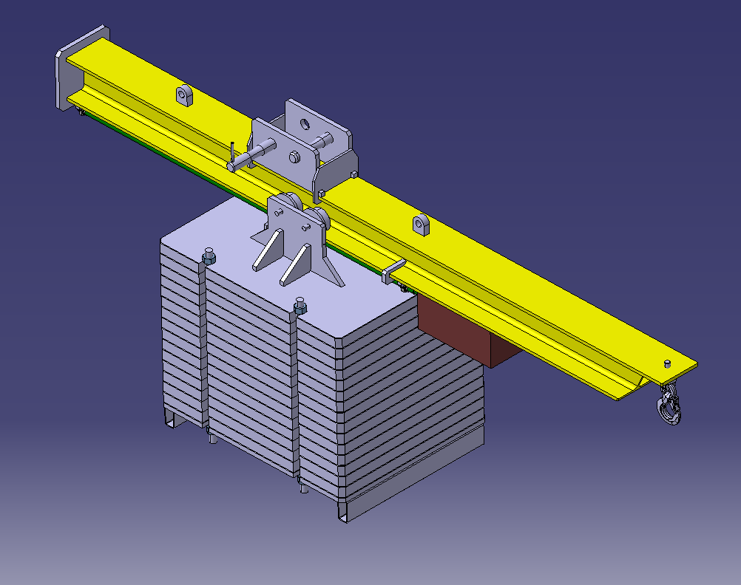
Use of a canne à pêche I
Normally, we can only lift 1/3rd of the capacity of the crane → small reach extension + long beam for the counterweight → 15 tons could be possible
0.8 m extra reach for 15 t + 2.4 m counterweight beam (3:1) for 5 t → 5 t for the beam and the mechanism
~ 100 k CHF

Slide 4
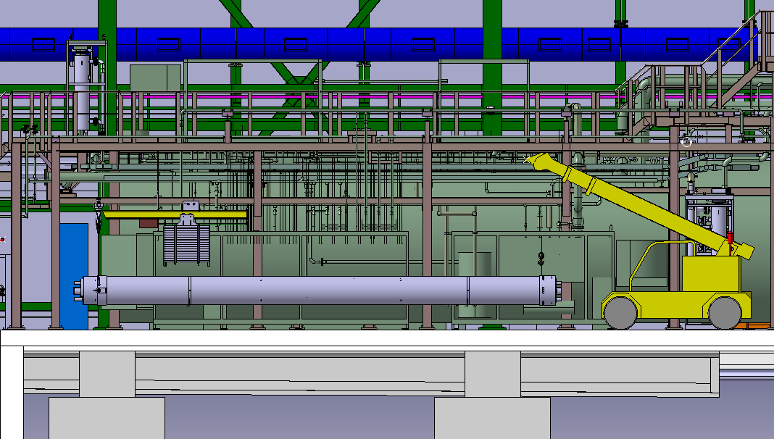
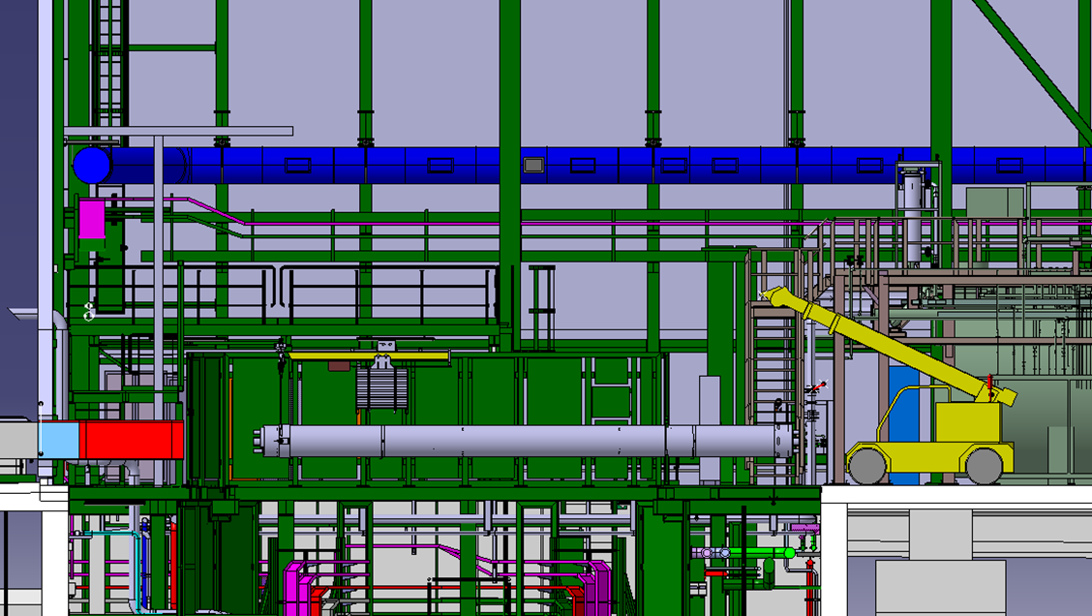
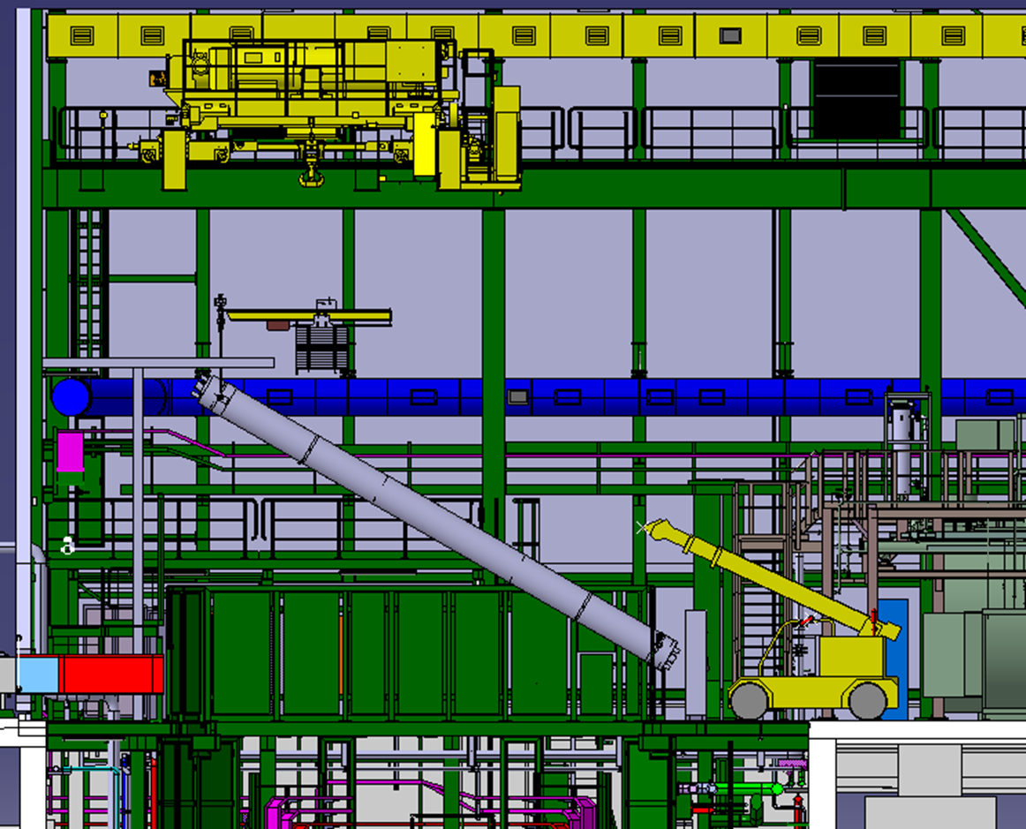
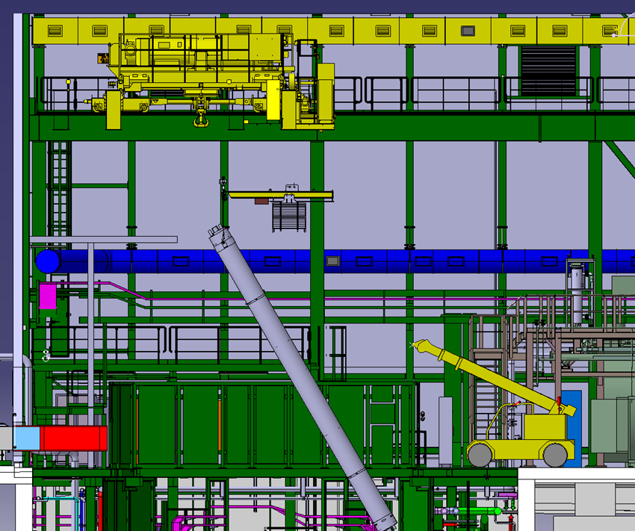
Installation of cryoline I

Slide 5
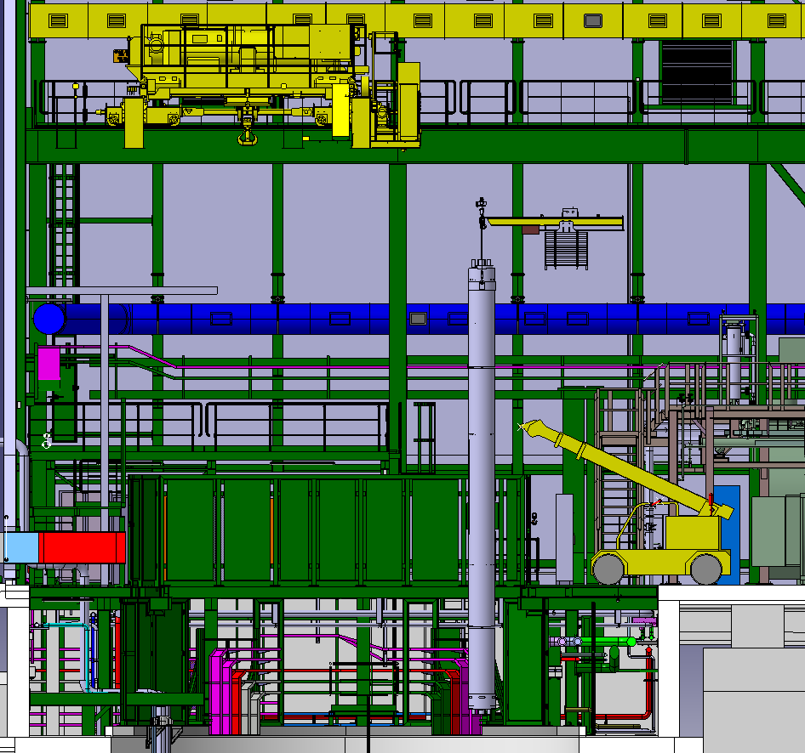
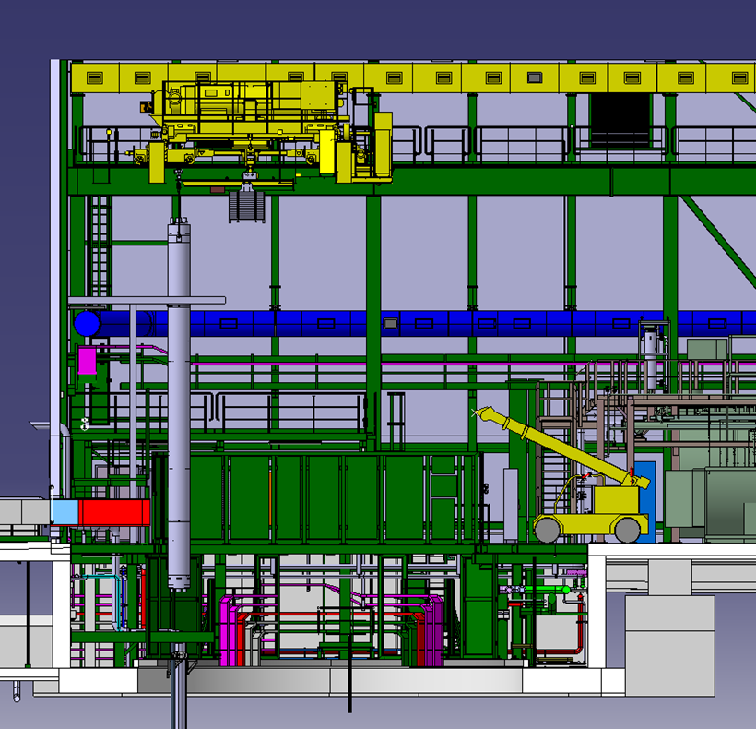
Installation of cryoline II

Slide 6
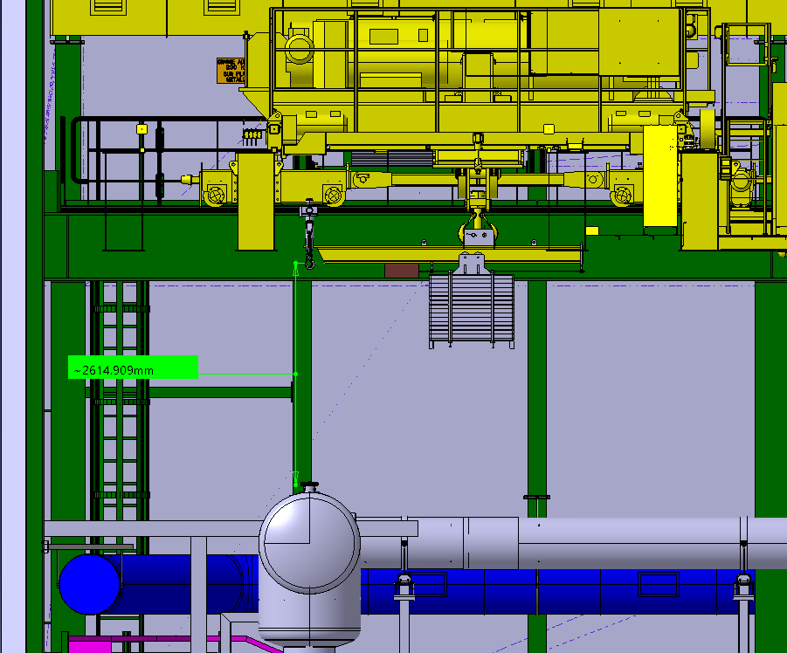
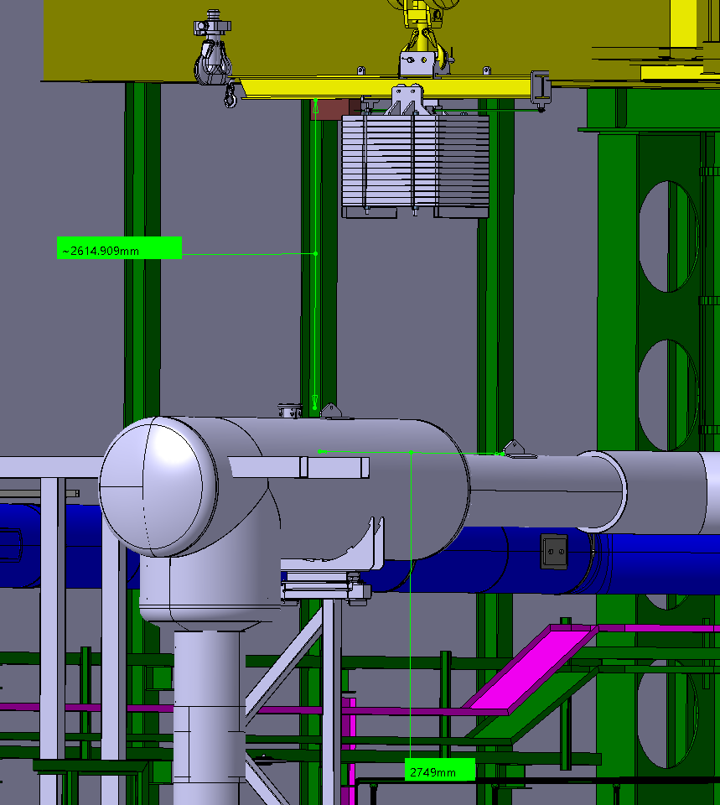
Installation of QPLG
There is sufficient height clearance

Slide 7
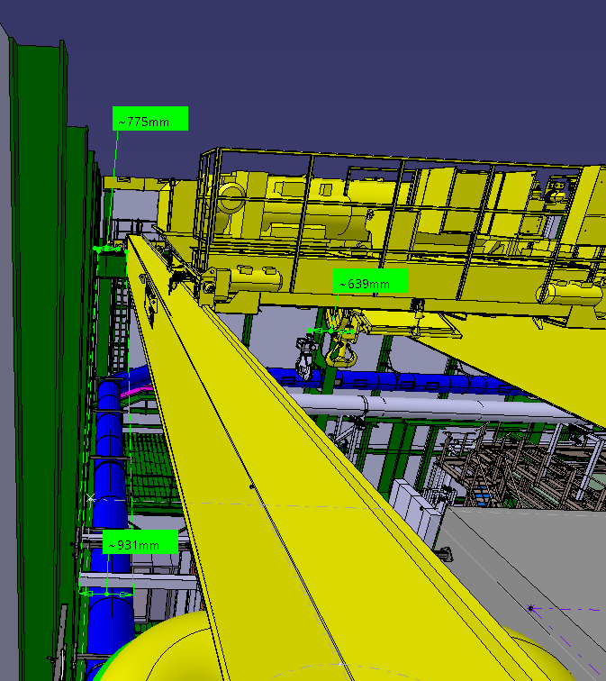
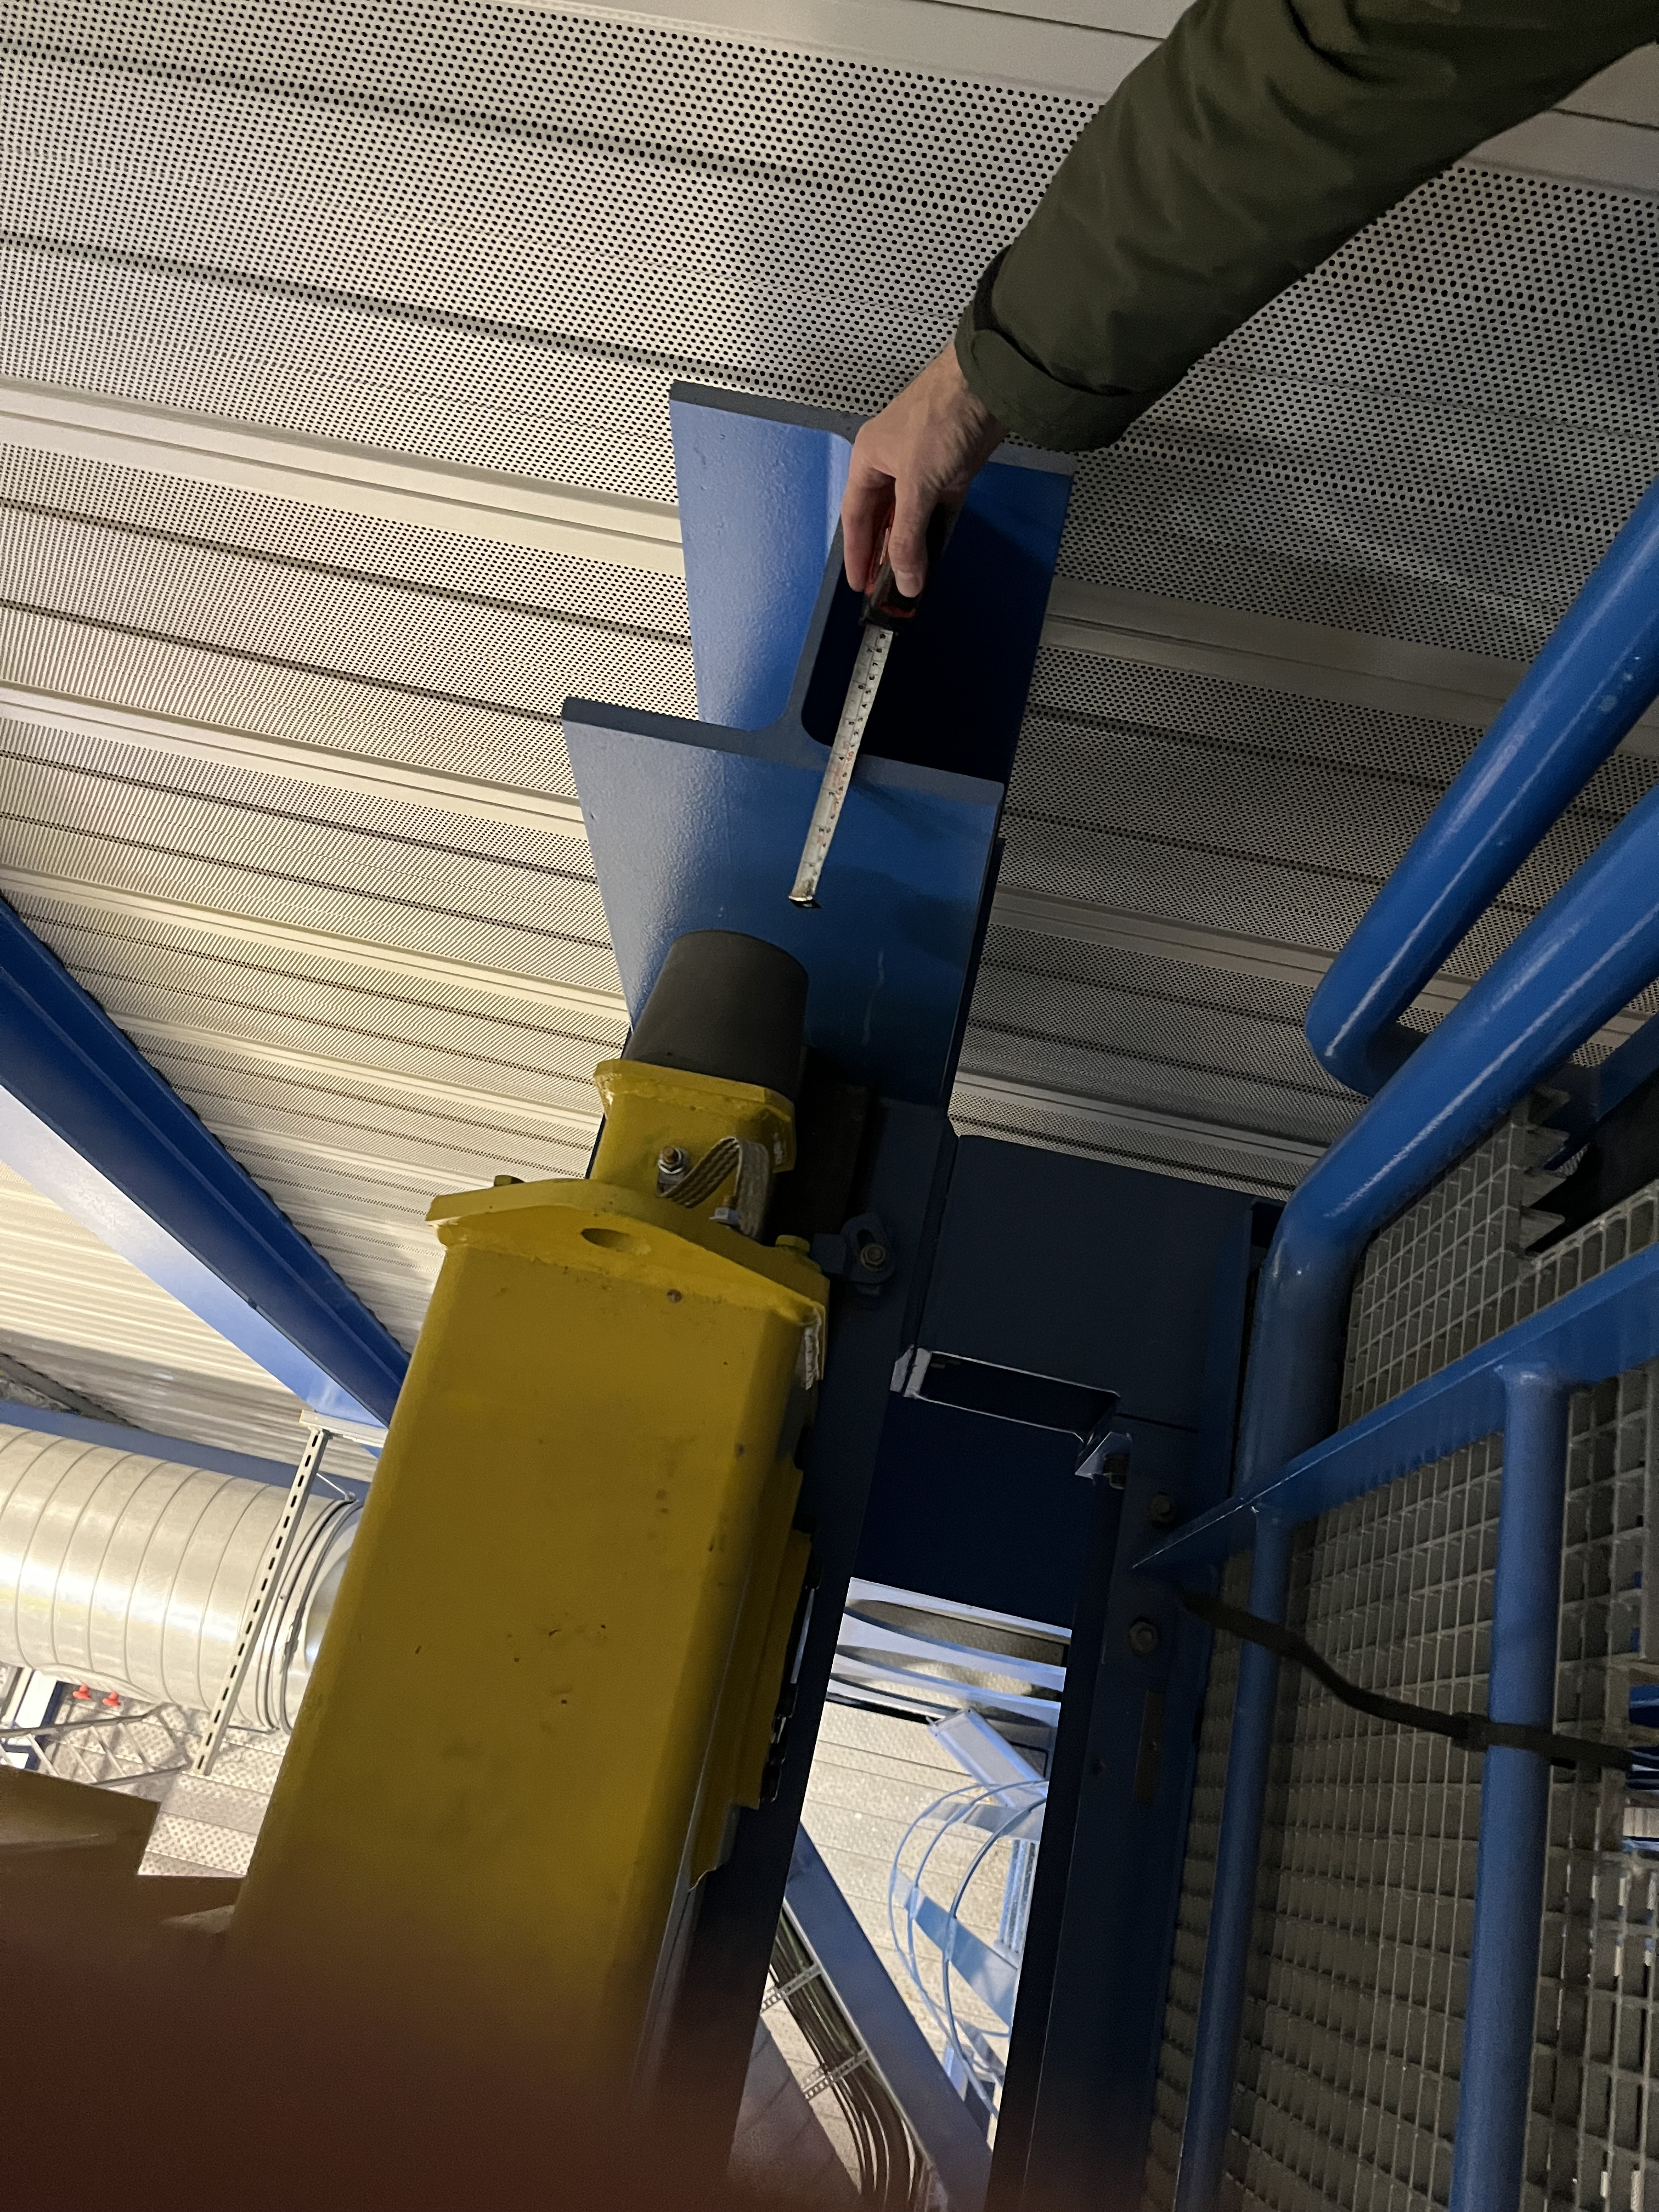
Modification of the façade I
Around 700 mm of extra reach required
931 mm from the wall → no interference
775 mm between axle and end of the beam → beam extension will only be required to install the displaced end-stop

Slide 8
Modification of the façade II
Requirements for this modification:
  Installation of scaffolding or mobile platform on the outside
  Creation of two holes in the façade to house the displaced end-stops
  Cutting of the existing end-stop
  Extension of the rail
  Extension of the beam (smaller profile probably)
  Installation of new displaced end-stop
  EN-HE part: extra power rail section and modification of the controls → ~ 5000 CHF
Crane out of service but probably no recertification required if it is temporary

Slide 9
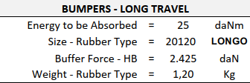
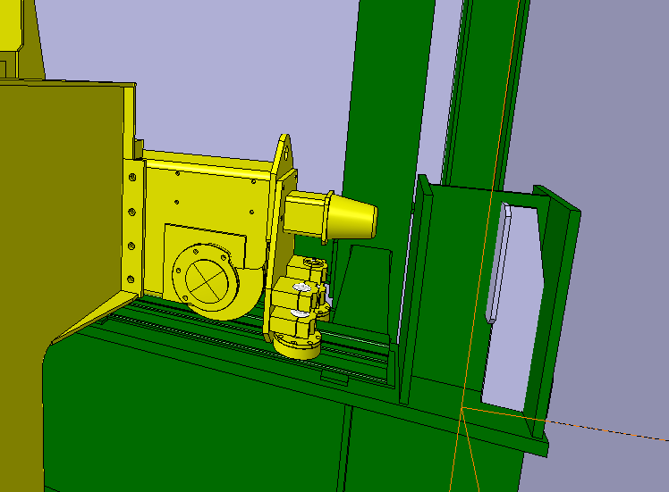
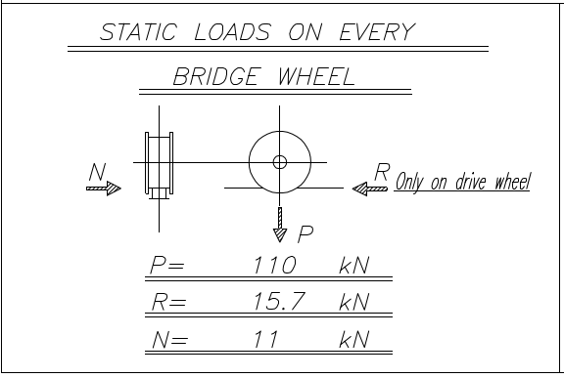
Loads on the extra beam
Longitudinal loads on the new end-stop
As one of the sides of the crane has special guides, these can transmit lateral loads (N).
An extra piece of rail will have to be installed on the new beam extension to withstand these lateral loads (not the vertical loads).
775
285
Add 750 mm of extra rail on the original beam (P forces) + add 300 mm of extra rail on new beam (N forces from the guides) + add end stop on the new beam
Total extra beam required: ~750 mm → could be optimised with a smaller bumper and a smaller end-stop

Slide 10
Comparison
Category | Lifting beam | Rail extension
Complexity | Medium | Medium
Easy of use | Complex | Easy
Risk | Medium | Low
Lead time | 5 months min. | ?
Usability after HL | Can be reused | None: temporary
Cost | 100 k CHF | ? Less probably

