Slide 1
Performance studies of small Straw Tracker prototypes
Speaker: Margarita Banchshikova
Supervisors: Katerina Kuznetsova, Giuseppe Pezzulo
Date: 05/08/2025

Slide 2
Content
Introduction
Different types of tracking detectors
Scintillating fiber trackers
Solid state detectors
Gaseous detectors
July Test Beam Data Analysis
Setup characteristics
MicroMegas data analysis
Timepix data analysis
MWPC tests
Setup
Gain value
Conclusion

Slide 3
Introduction
Objectives:
to get experience in operation of gas filled detectors and in corresponding data taking and analysis
to investigate performance of small straw tracker prototypes using muon beam data acquired at SPS H4 beam line in July.
Tasks:
Research on different types of tracking detectors.
Development of data processing technique for StrawTrackerRD setup using April Test Beam data.
July Test Beam data analysis (MicroMegas, Timepix, Straw Tracker prototype).
Tests for MWPC detector for IRRAD.

Slide 4
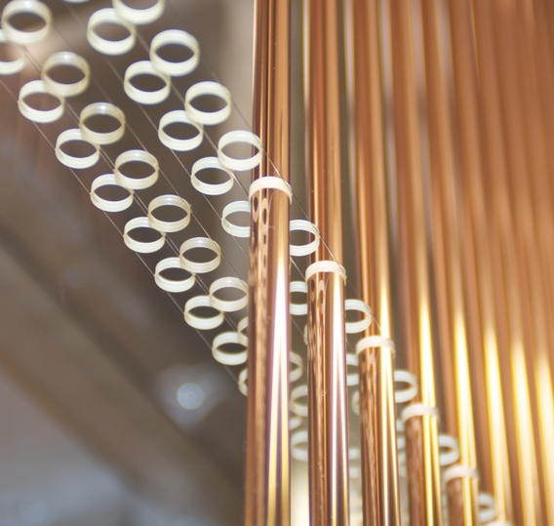
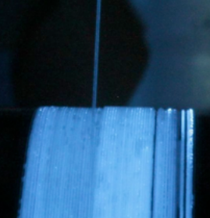
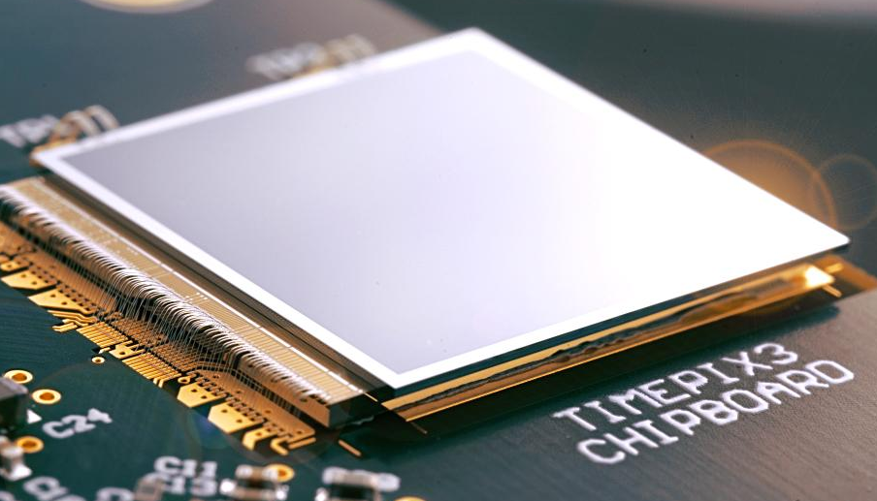
Different types of tracking detectors
Charged particles excite molecules of scintillators -> photons collection
Detectors based on ionization loses of charged particles
Scintillating
trackers
Solid-state
detectors
Gaseous
detectors
Fiber trackers
Pixel/strip trackers
MWPC
Drift Chambers
Straw
TPC
MM
GEM
The light is collected by SiPM/ PMT
Compact and fast trackers
High spatial resolution
Compact
Expensive
High spatial resolution
Compact
Can be of large area

Slide 5
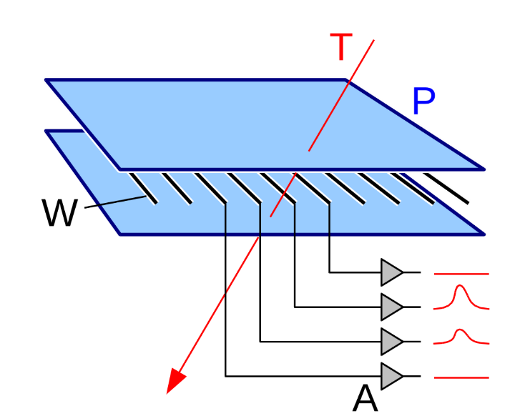
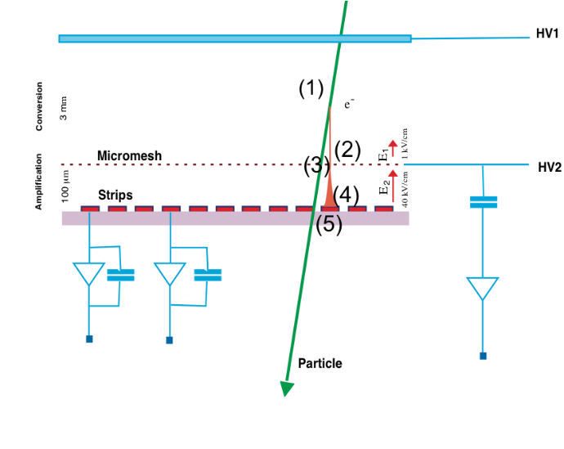
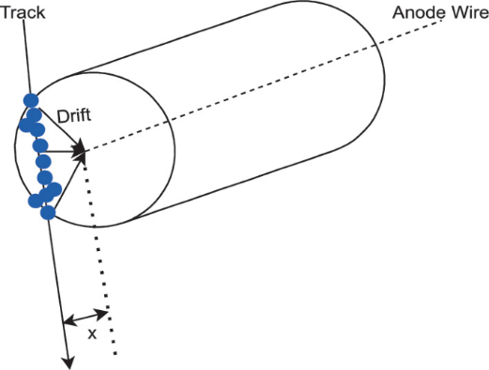
Gaseous detectors
General operating principle: a charged particle traverses a gas volume, producing ion-electron pairs. The electrons drift in the electric field and are amplified near thin wires or meshes, creating a detectable signal.
MWPC
MicroMegas
Straw
2 cathode planes and parallel array of anode wires.
Electrons drift toward wires, avalanche near the wire due to high electric field.
Position inferred from wire hit (or cathode strip)
Drift gap (few mm) and a thin amplification gap (~100 µm) separated by a micromesh.
Electrons drift to mesh, then undergo avalanche near the readout plane.
Gas gain is lower than in MWPC or straw.
Thin cylindrical tubes with central anode wire and cathode wall.
Electrons drift radially to the wire, where amplification occurs.
Coordinate derived from drift time.

Slide 6
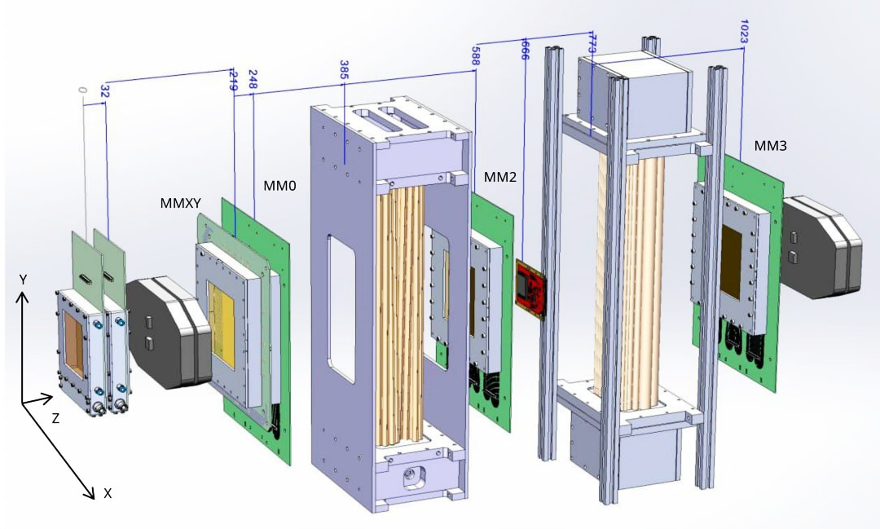
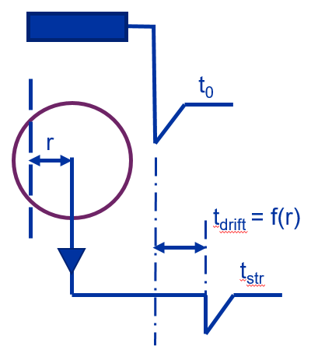
Test beam setup
MicroMegas 0
Reference tracking:
1. MicroMegas:
Ar/CO₂: 93/7%.
Readout: TIGER ASIC.
2. Timepix-4:
Pixel size: 55 um.
Number of pixels: 448 x 512.
Axis | MicroMegas ID
X | MM 0
X | MM 2
X | MM 3
Х (XY) | MM 4
Y (XY) | MM 5
Reference timing:
Scintillators:
Reference time measurements (t₀)
Straws:
Ar/CO₂: 70/30%.
Prototype 1: diameter – 10 mm.
Prototype 2: diameter – 5, 10, 20 mm.
Scintillator 1
Timepix
Scintillator 2
Straw tracker 1
Straw tracker 2
MicroMegas 4 and 5
MicroMegas 2
MicroMegas 3

Slide 7
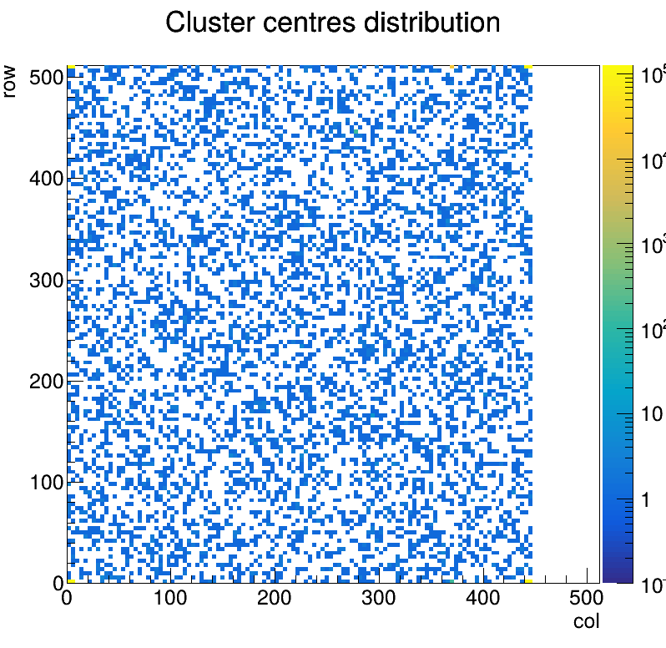
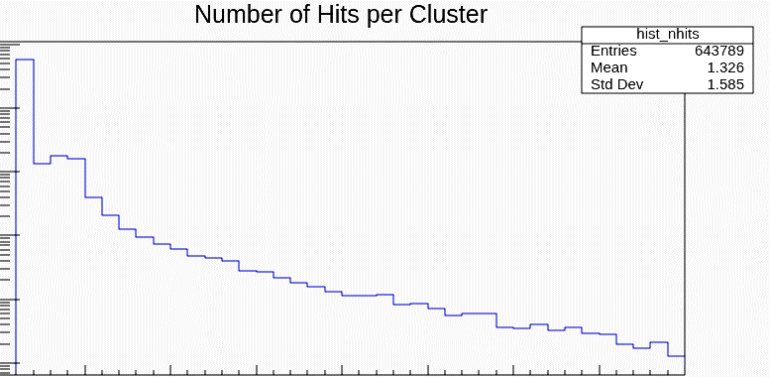
July Test Beam Analysis. Timepix Detector data
Digital pixels
Input number | Purpose | Pixels
1 | Scintillator coincidence | {2,508}, {6,509}, {443,510}, {447,511}
2 | Scintillator 1 | {0,508}, {4,509}, {441,510}, {445,511}
3 | Scintillator 2 | {0,0}, {4,1}, {441,2}, {445,3}
4 | STM-VMM | {2,0}, {6,1}, {443,2}, {447,3}
10⁵
10⁴
Masking digital pixels
10³
10⁶
10²
10⁵
Entries
10⁴
10
10³
10²
1
10
0
5
10
15
20
25
30
35
40
Number of hits

Slide 8
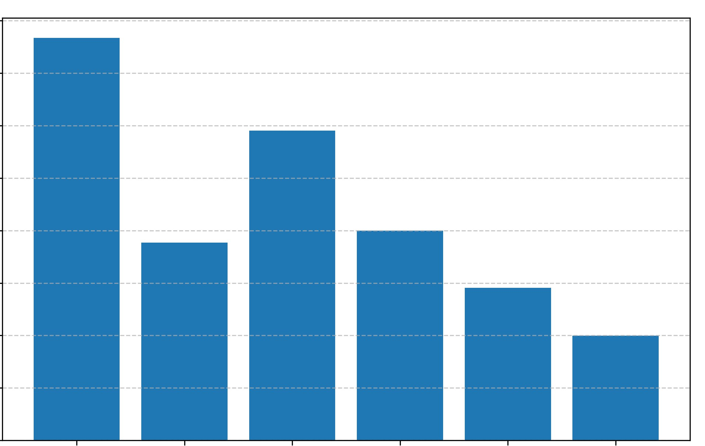
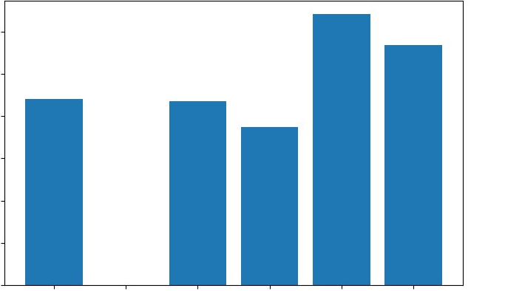
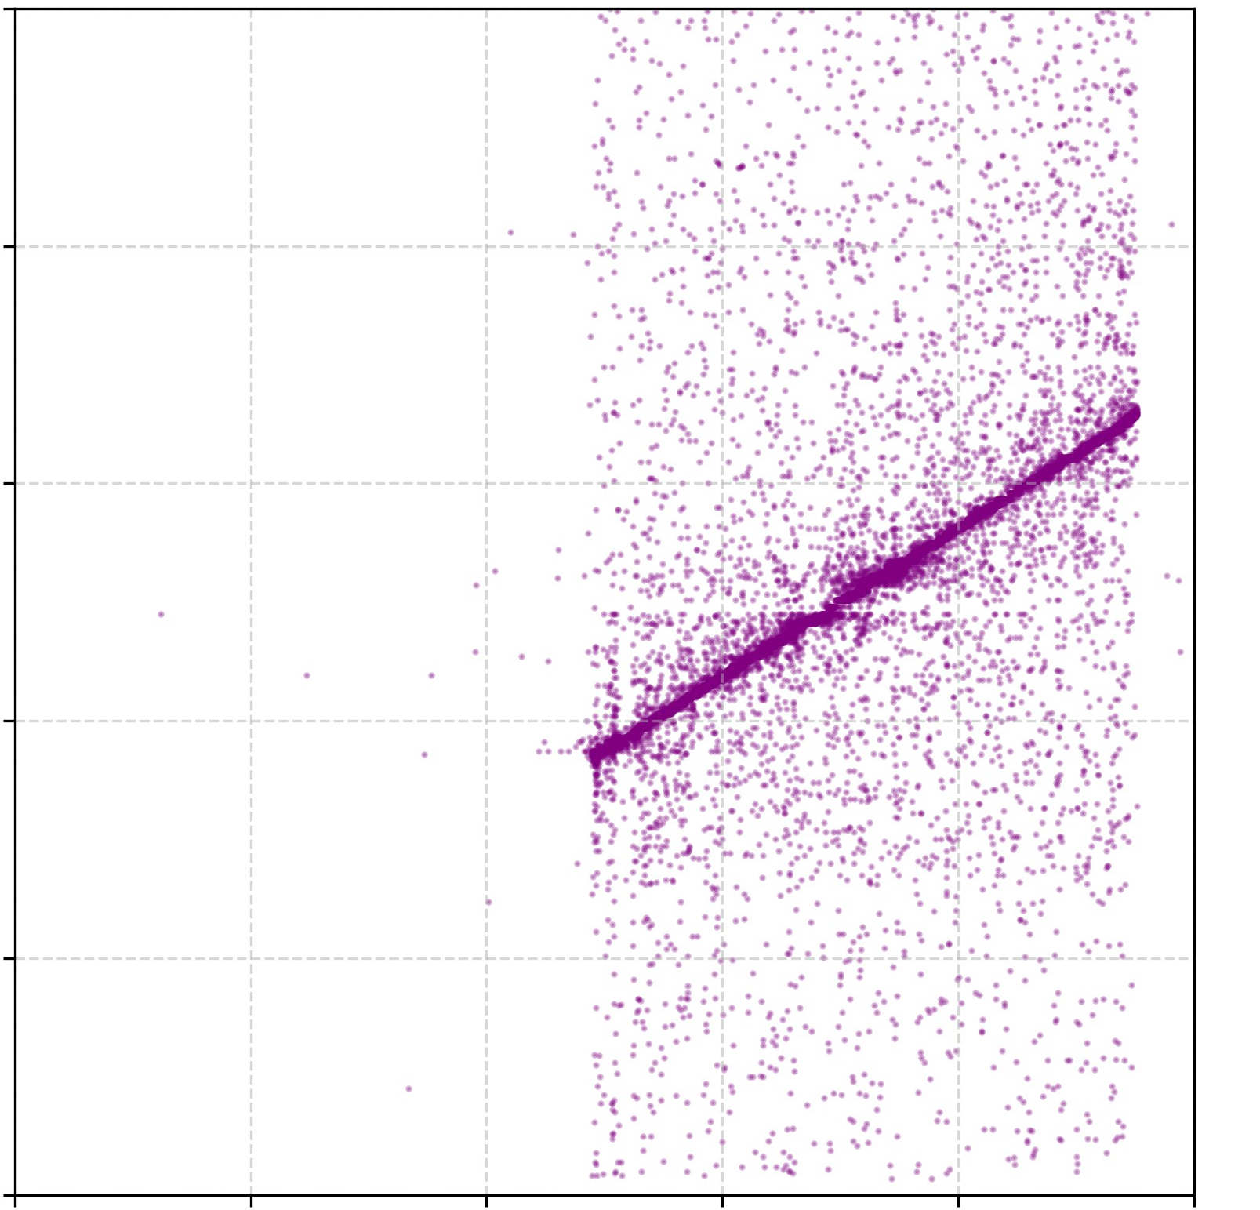
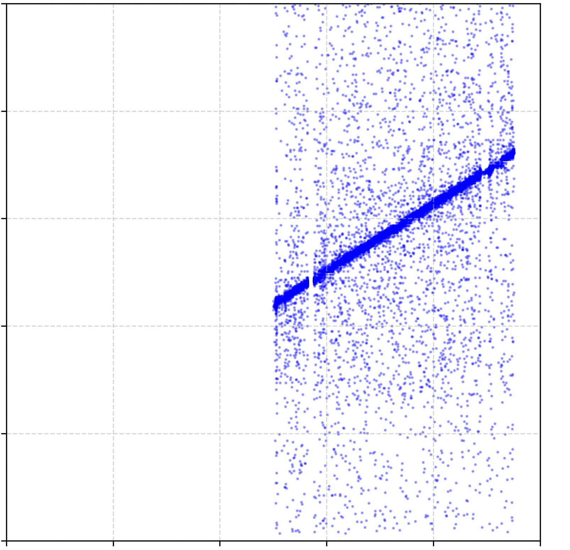
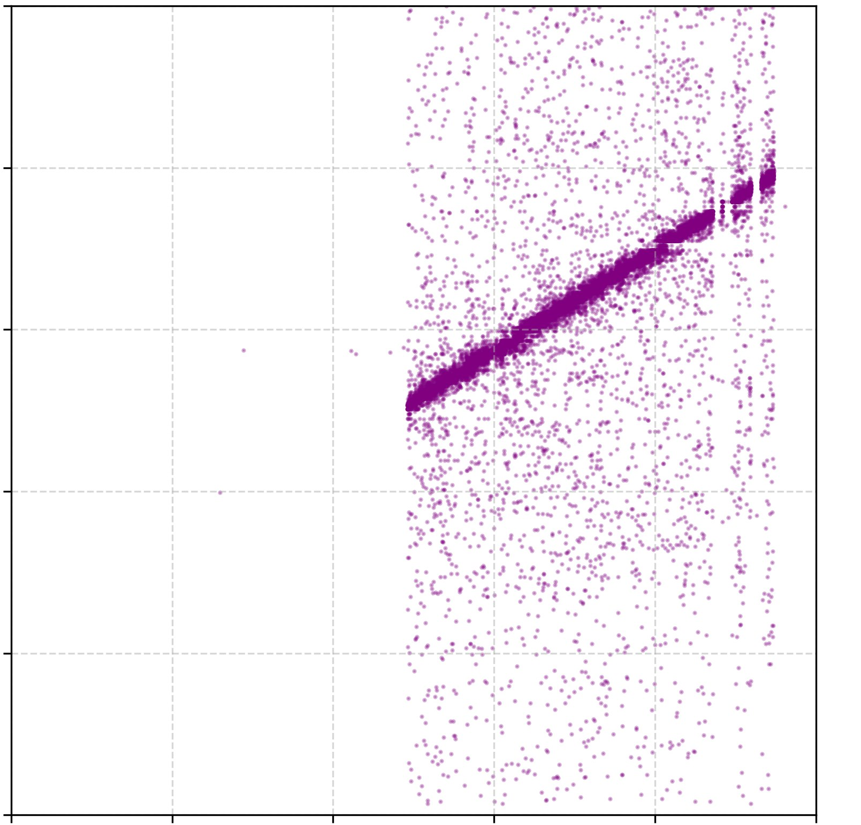
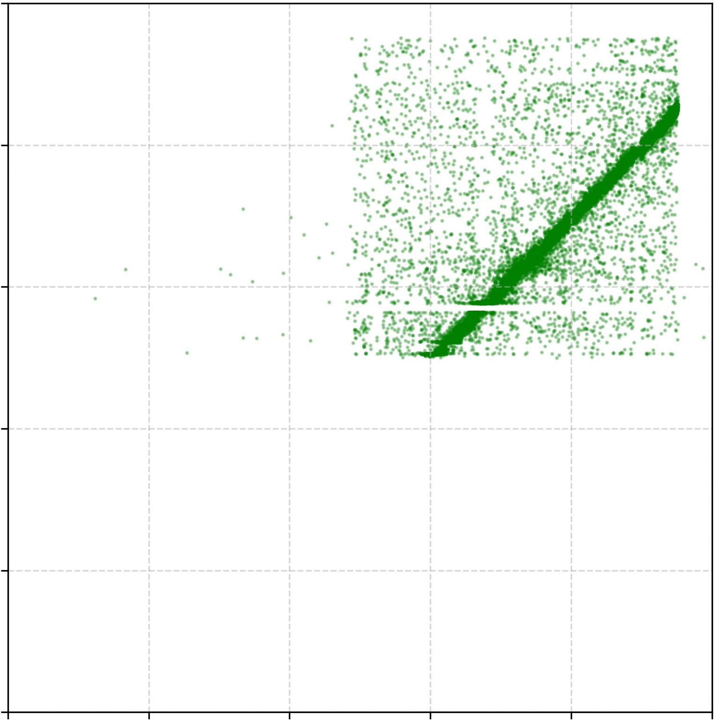
July Test Beam Analysis. MicroMegas data quality
10³
10³
Axis | MM ID | Readout area, cm² | Strip pitch, um
X | MM 0 | 3x3 | 250
X | MM 2 | 3x3 | 250
X | MM 3 | 3x3 | 250
Х (XY) | MM 4 | 10x10 | 400
Y (XY) | MM 5 | 10x10 | 400
200
350
175
MM planes per event
300
MM plane ID
150
250
125
Entries
200
Entries
100
150
75
100
50
25
50
0
0
0 1 2 3 4 5
0 1 2 3 4 5
Active detectors amount
Detectors ID
Correlation: MM 0 and MM 4
Correlation: MM 2 and MM 4
Correlation: MM 3 and MM 4
Correlation: MM 0 and MM 2
250
250
250
250
X coordinate (MM 2)
X coordinate (MM 4)
X coordinate (MM 4)
200
200
200
200
150
150
150
150
X coordinate (MM 4)
100
100
100
100
50
50
50
50
0
0
0
0
0 50 100 150 200 250
0 50 100 150 200 250
0 50 100 150 200 250
0 50 100 150 200 250
X coordinate (MM 0)
X coordinate (MM 2)
X coordinate (MM 3)
X coordinate (MM 0)

Slide 9
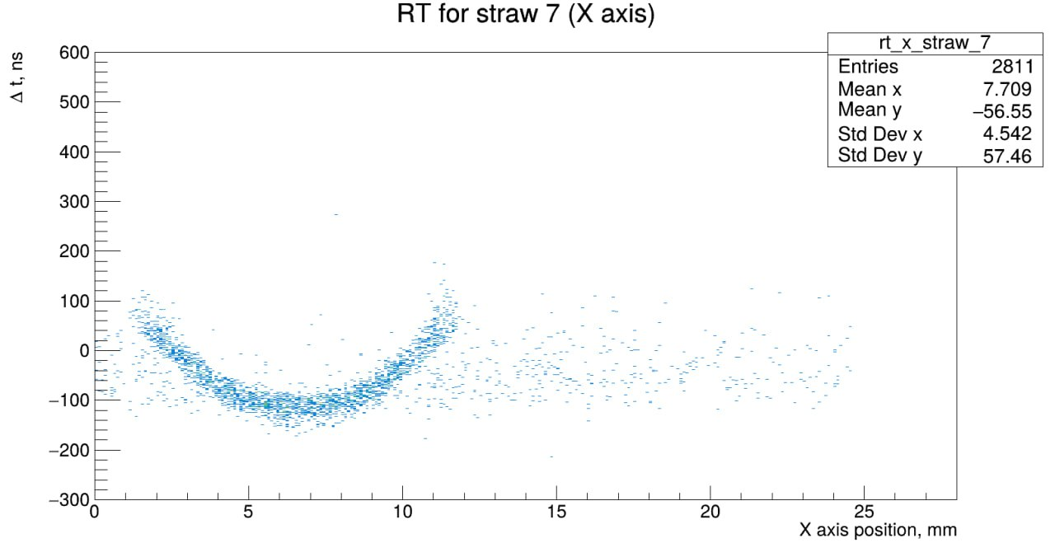
Prompt look at Straw Time vs Reference coordinate (Timepix only)
Future tasks:
Tracking with complete reference tracking system
Straw prototype data analysis
Knowledge and Skills Acquired:
PyROOT, Uproot
Basic definitions and concepts of accelerator physics
Timepix, MicroMegas, Straw detectors operation principles and features
Results interpretation
10 minutes of data tacking
Study to be continued…

Slide 10
Additional studies: MWPC for Beam Instrumentation
Goal: to investigate the uniformity of MWPC response.
Following studies were performed:
Source ⁹⁰Sr was moved along different quadrants on Top Plane and Bottom Plane of MWPC.
Several amount of such “spills” was taken for each quadrant.
Average signals over “spills” were calculated for each quadrant.
Charge values (sum) were determined for Vertical and Horizontal profiles of two planes in different quadrants.
Vertical profile charge values should correspond to Horizontal profile charge values.
Comparison between value of charge in corresponding quadrants was plotted.
Problem: at some point fired channel occurred;
Problem solution: fired channel was masked.

Slide 11
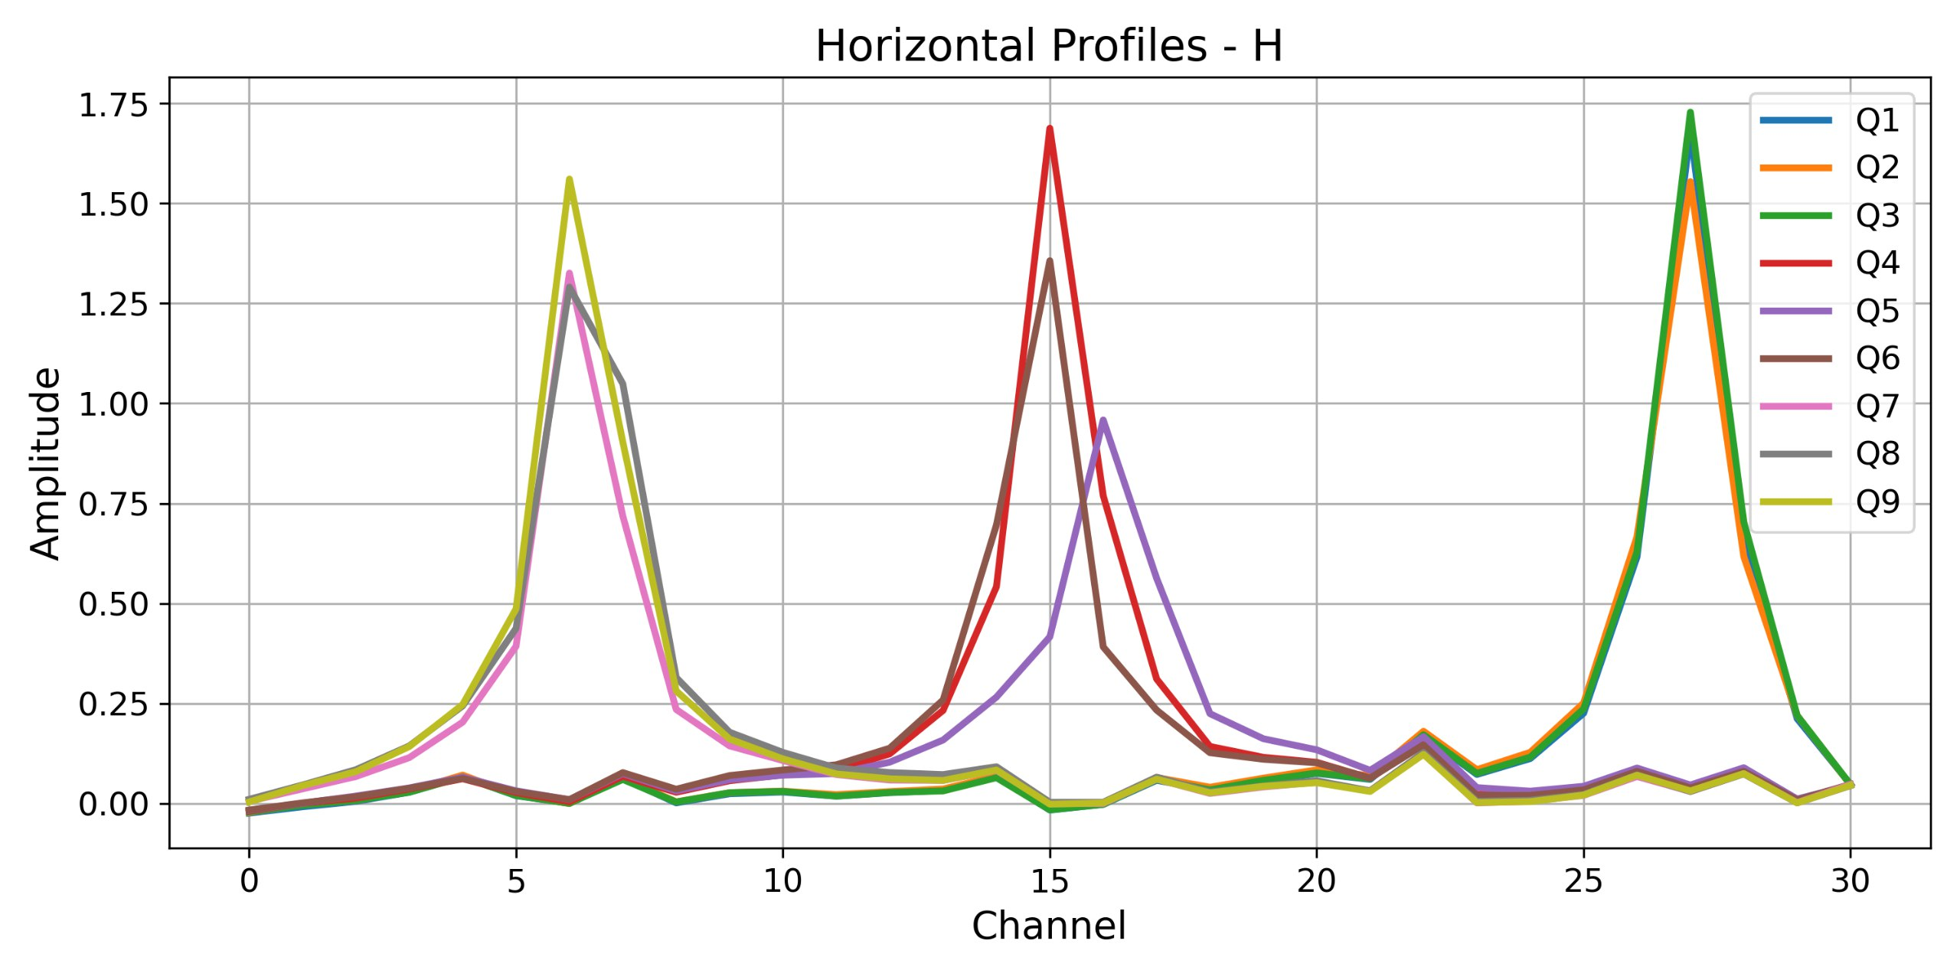
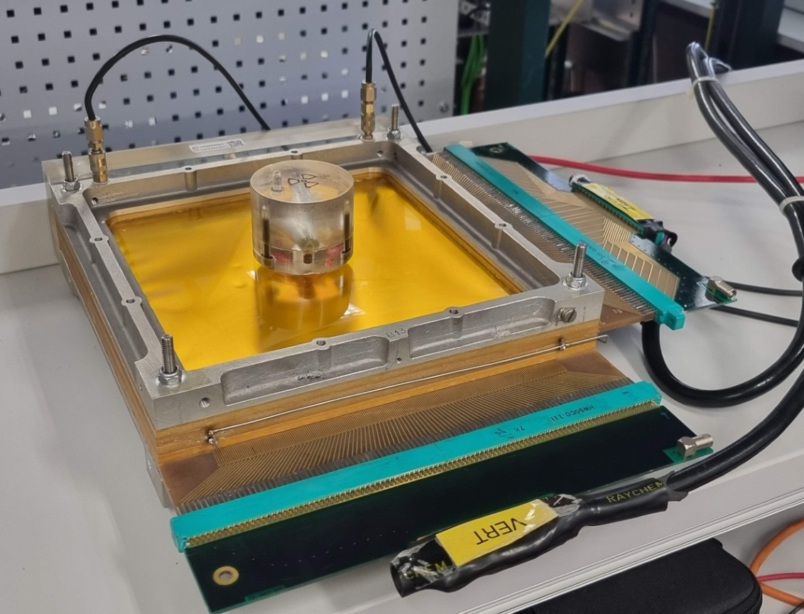
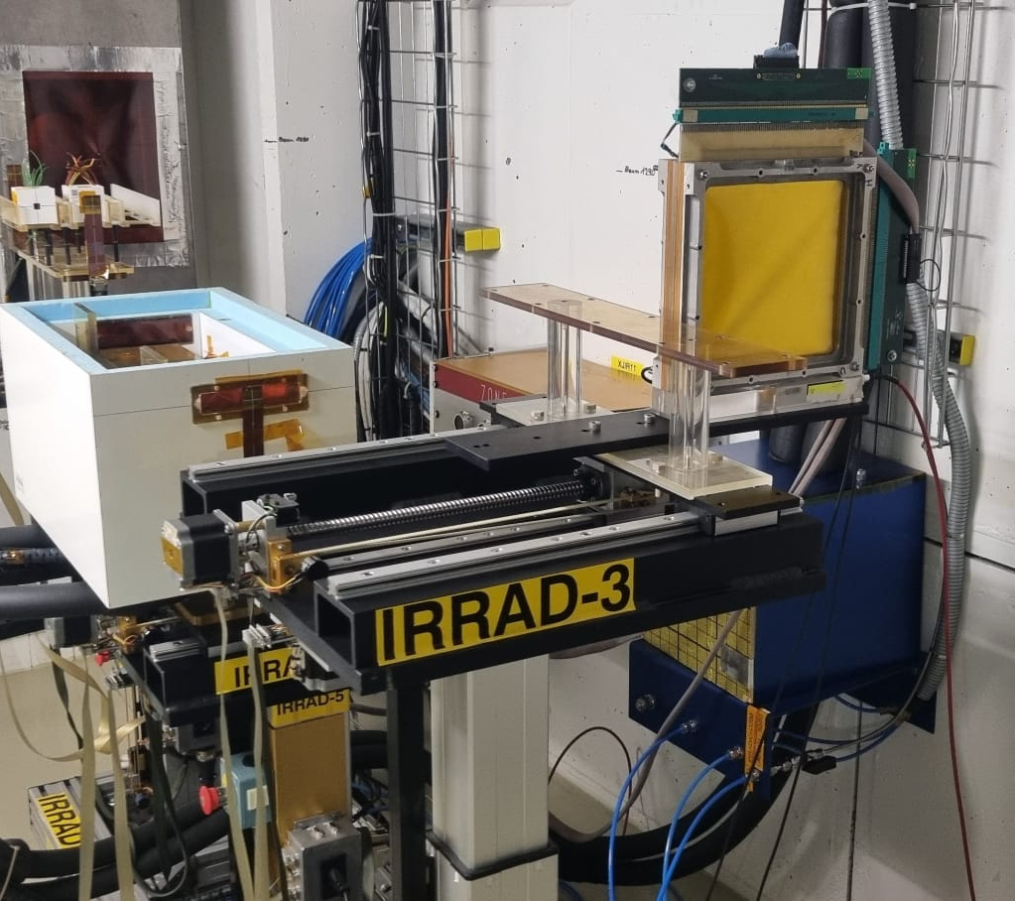
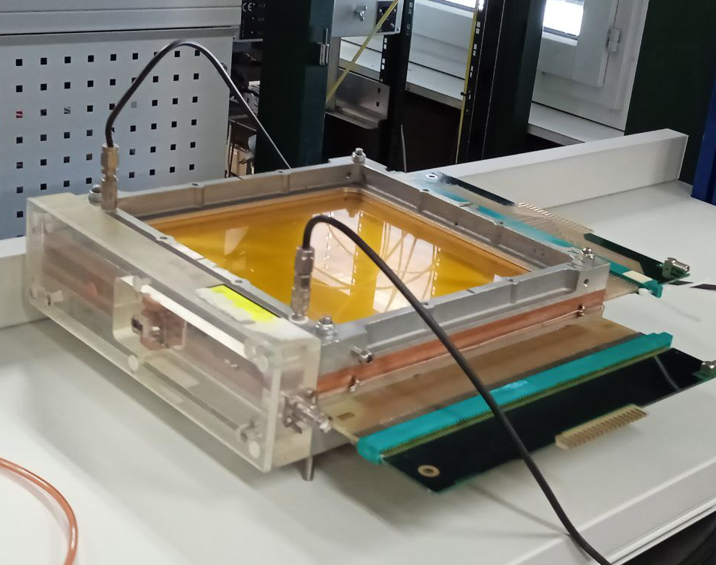
MWPC tests setup
Top Plane Map
2250 V, Horizontal profiles for Top plane
Bottom plane of BI MWPC with the source on it
Q9
Q8
Q7
Q6
Q5
Q4
Q3
Q2
Q1
Bottom Plane Map
Profile shape with fired channel
IRRAD MWPC
Bottom plane of IRRAD MWPC
Q3
Q2
Q1
Q6
Q5
Q4
Q9
Q8
Q7

Slide 12
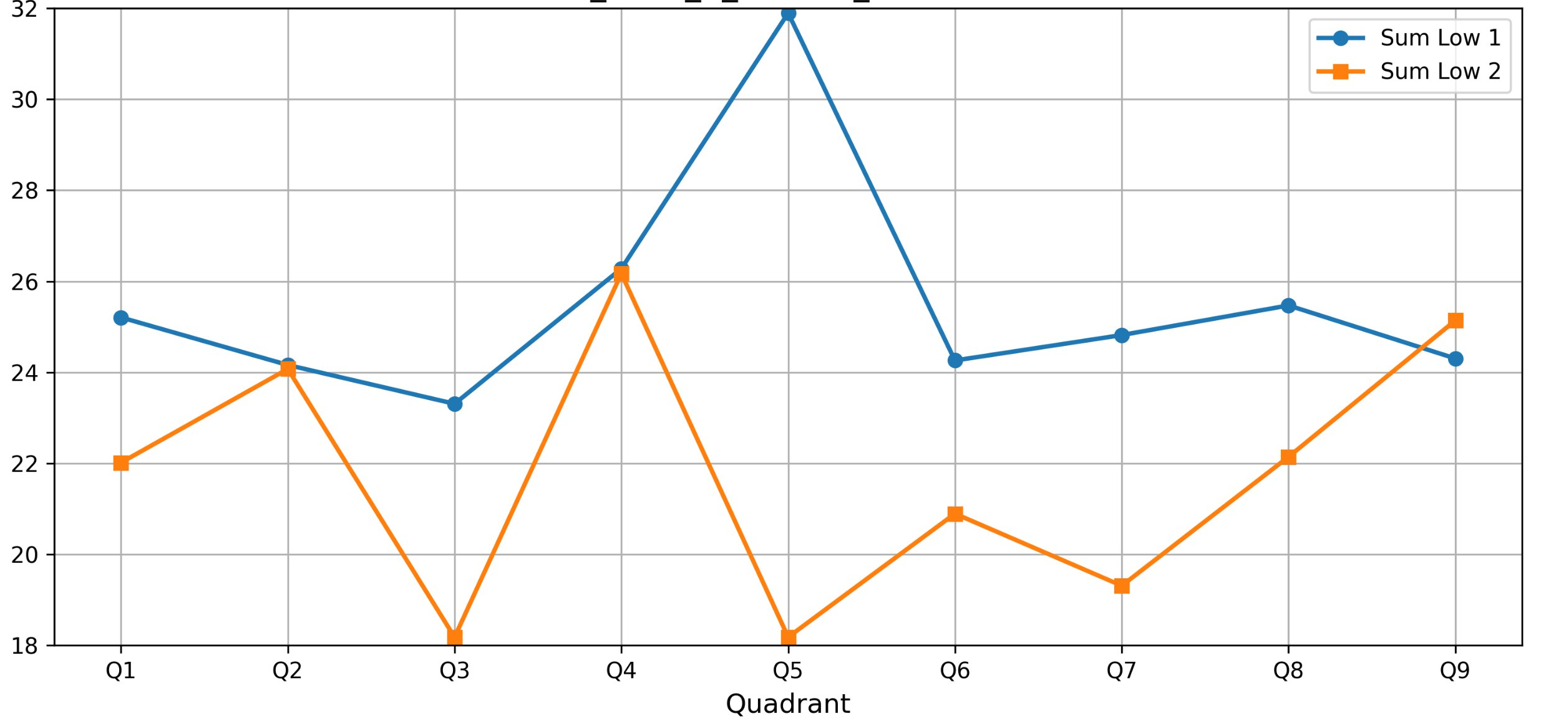
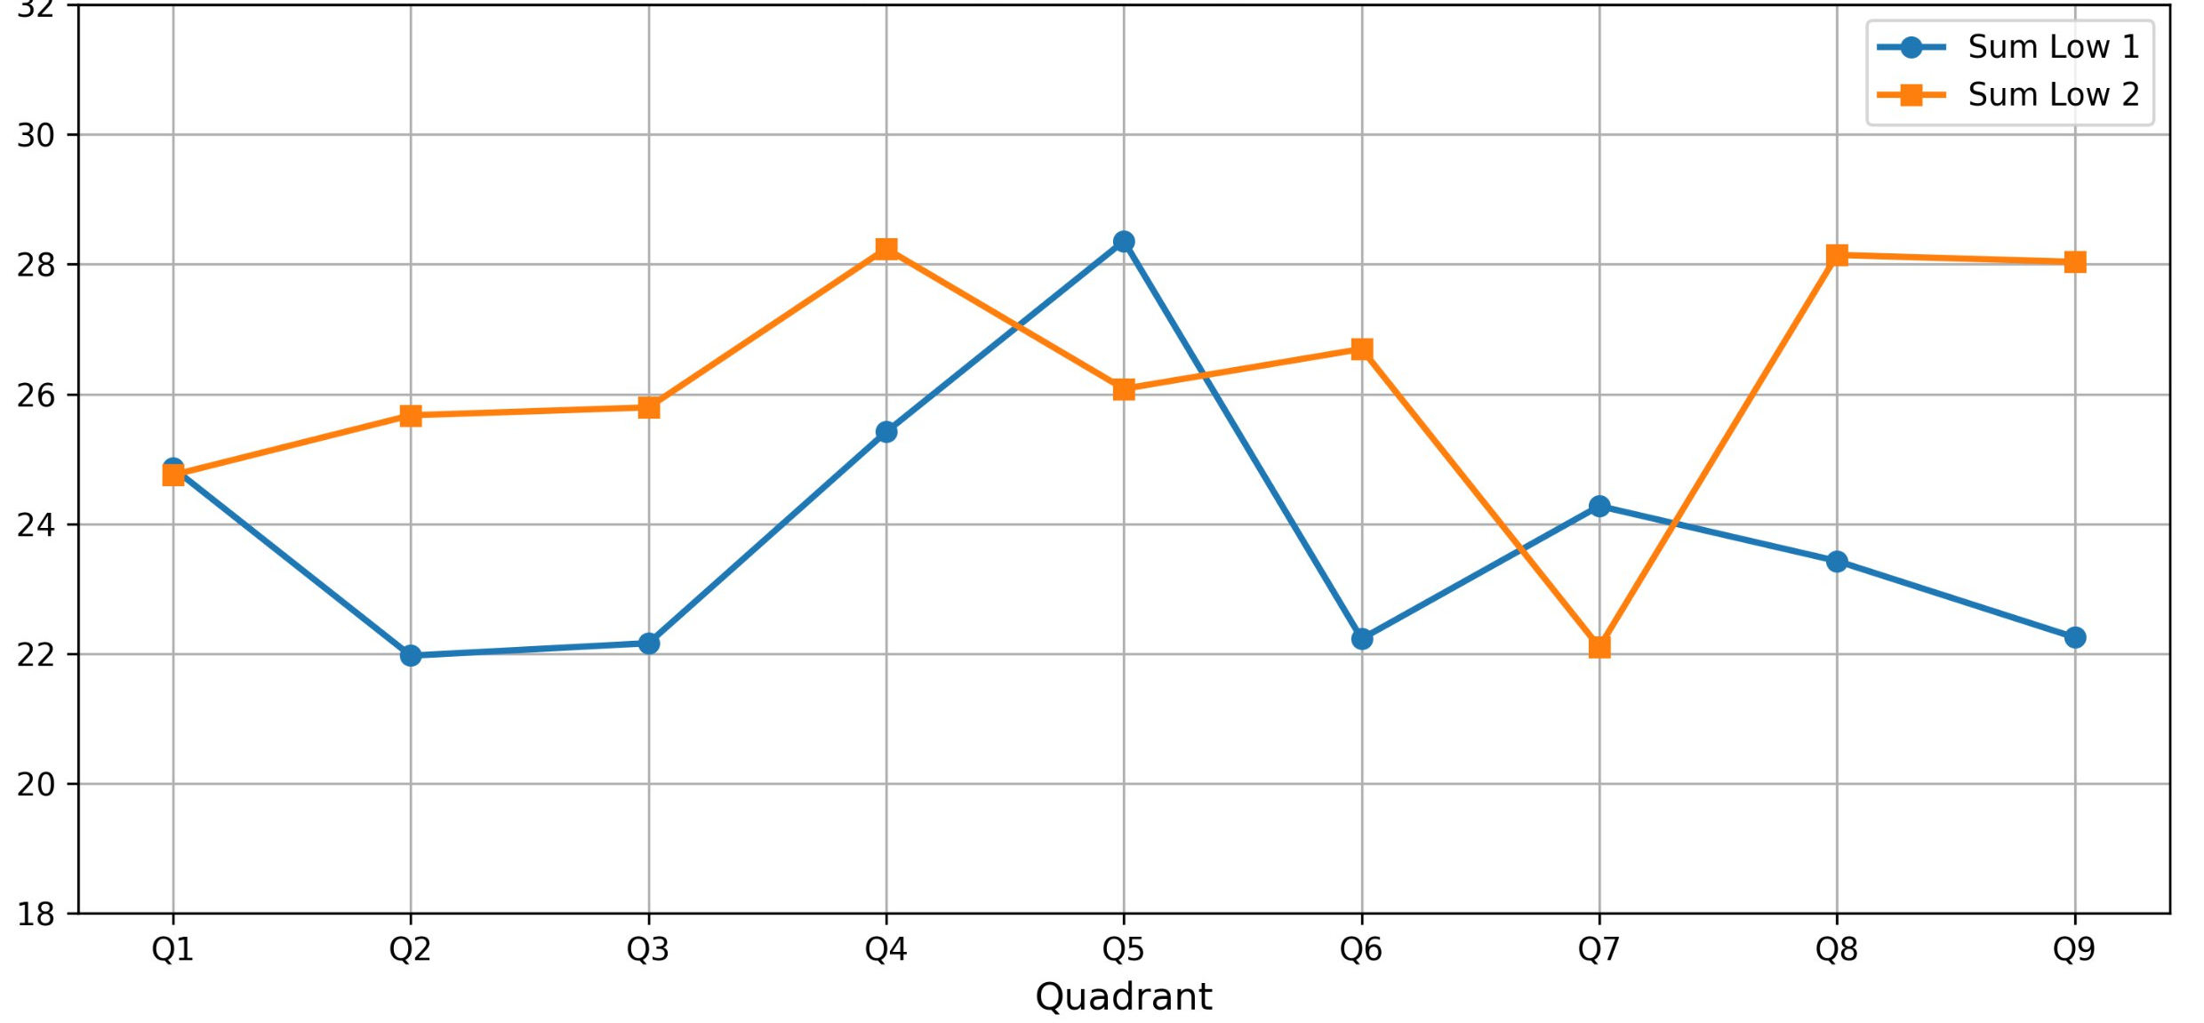
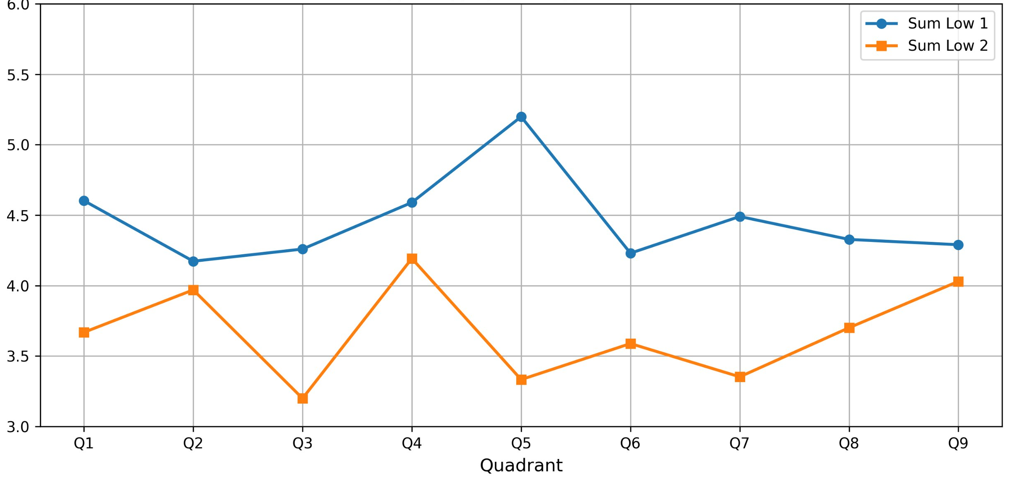
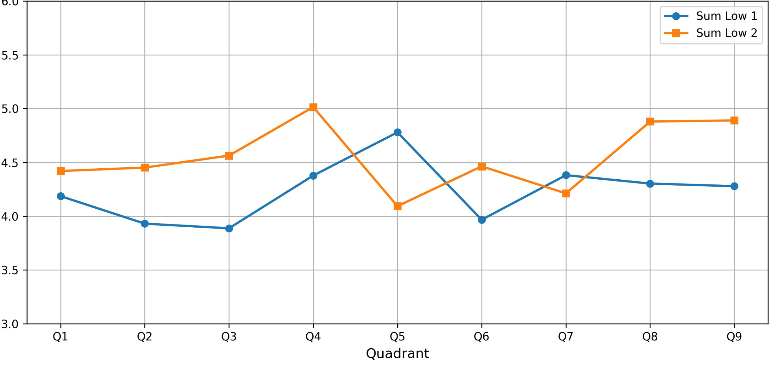
BI MWPC test. Results
*H – Top plane, V – Bottom plane
Source on the Bottom plane.
Bottom Plane vertical and horizontal profile charge
Source on the Top plane.
Top Plane vertical and horizontal profile charge
V charge
H charge
V charge
H charge
Applied voltage = 2650 V
V charge
H charge
V charge
H charge
Applied voltage = 2250 V

Slide 13
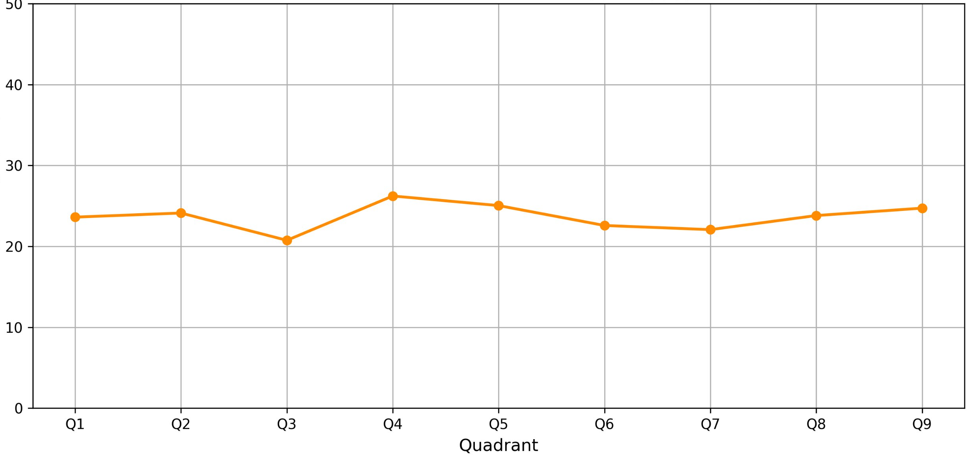
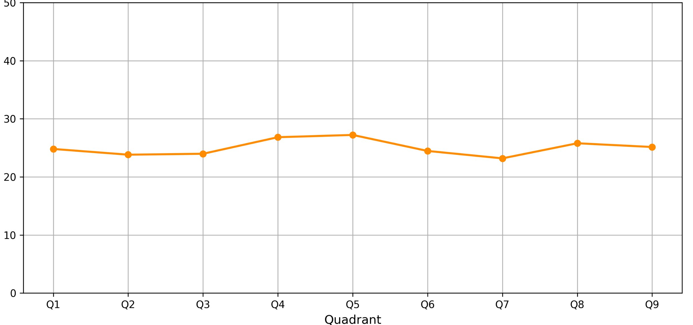
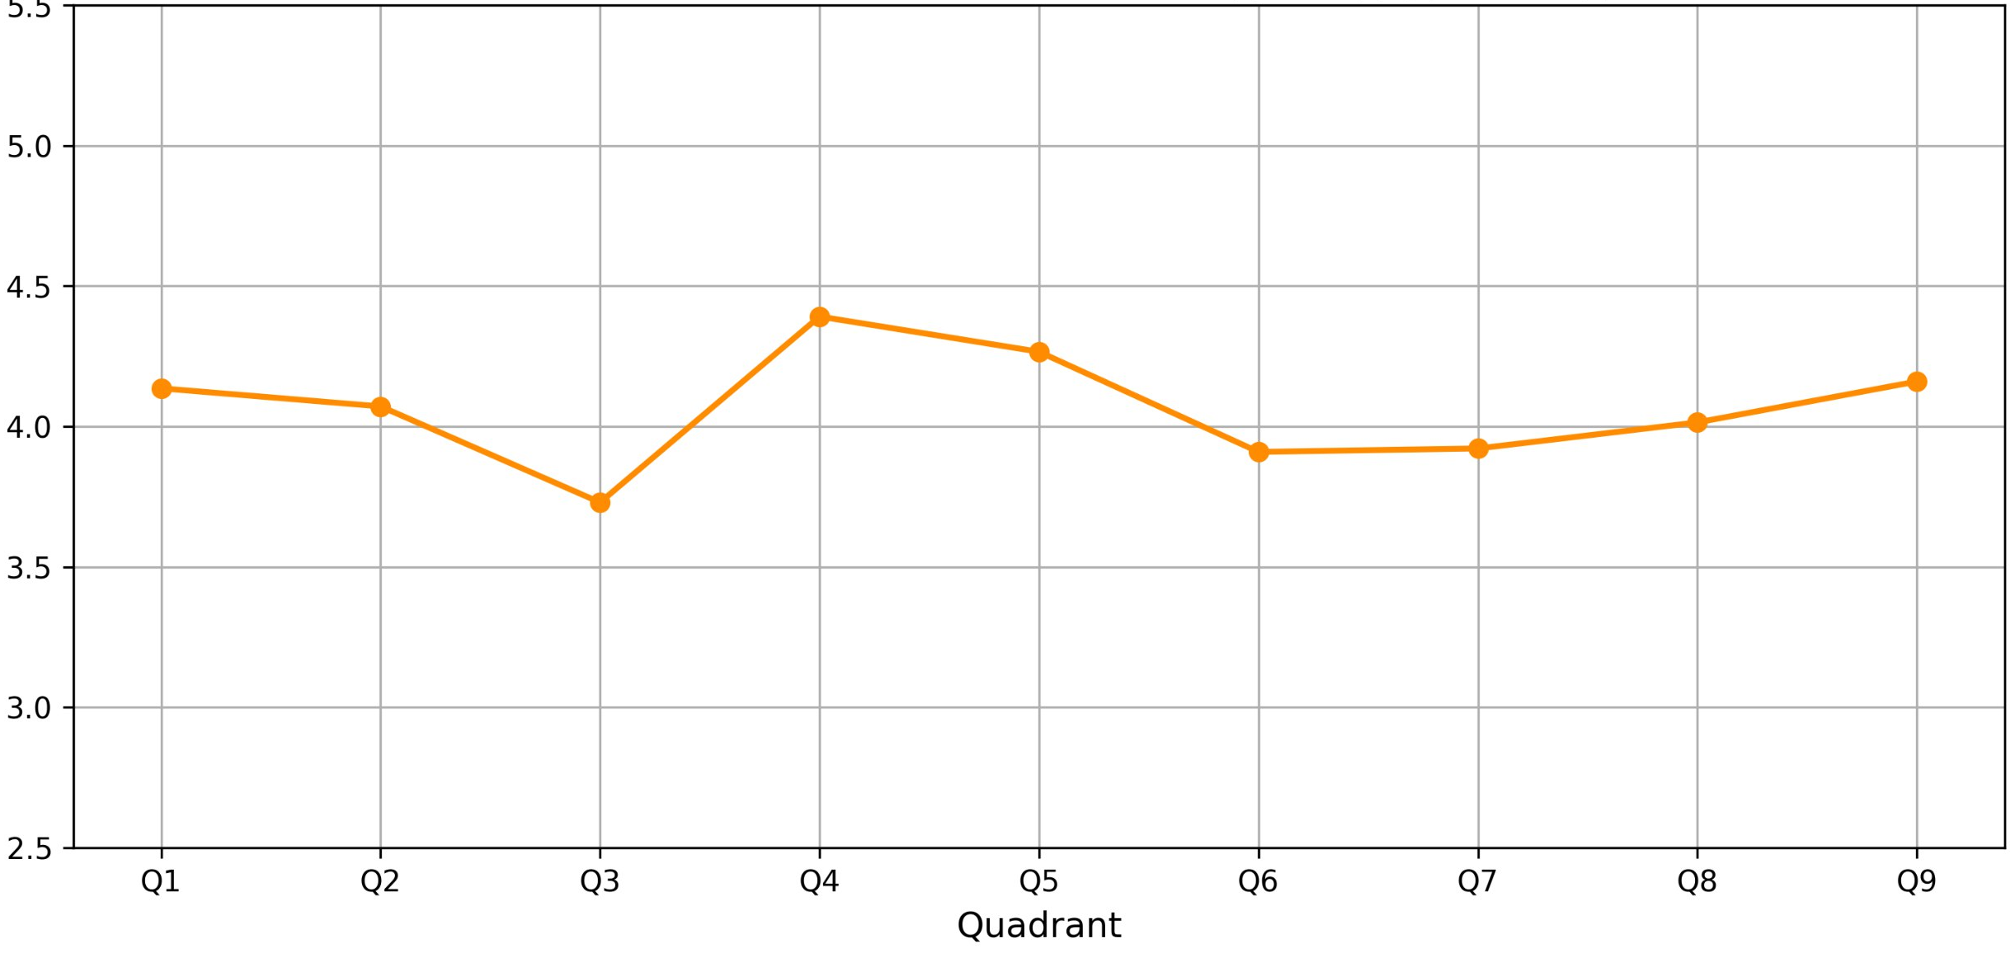
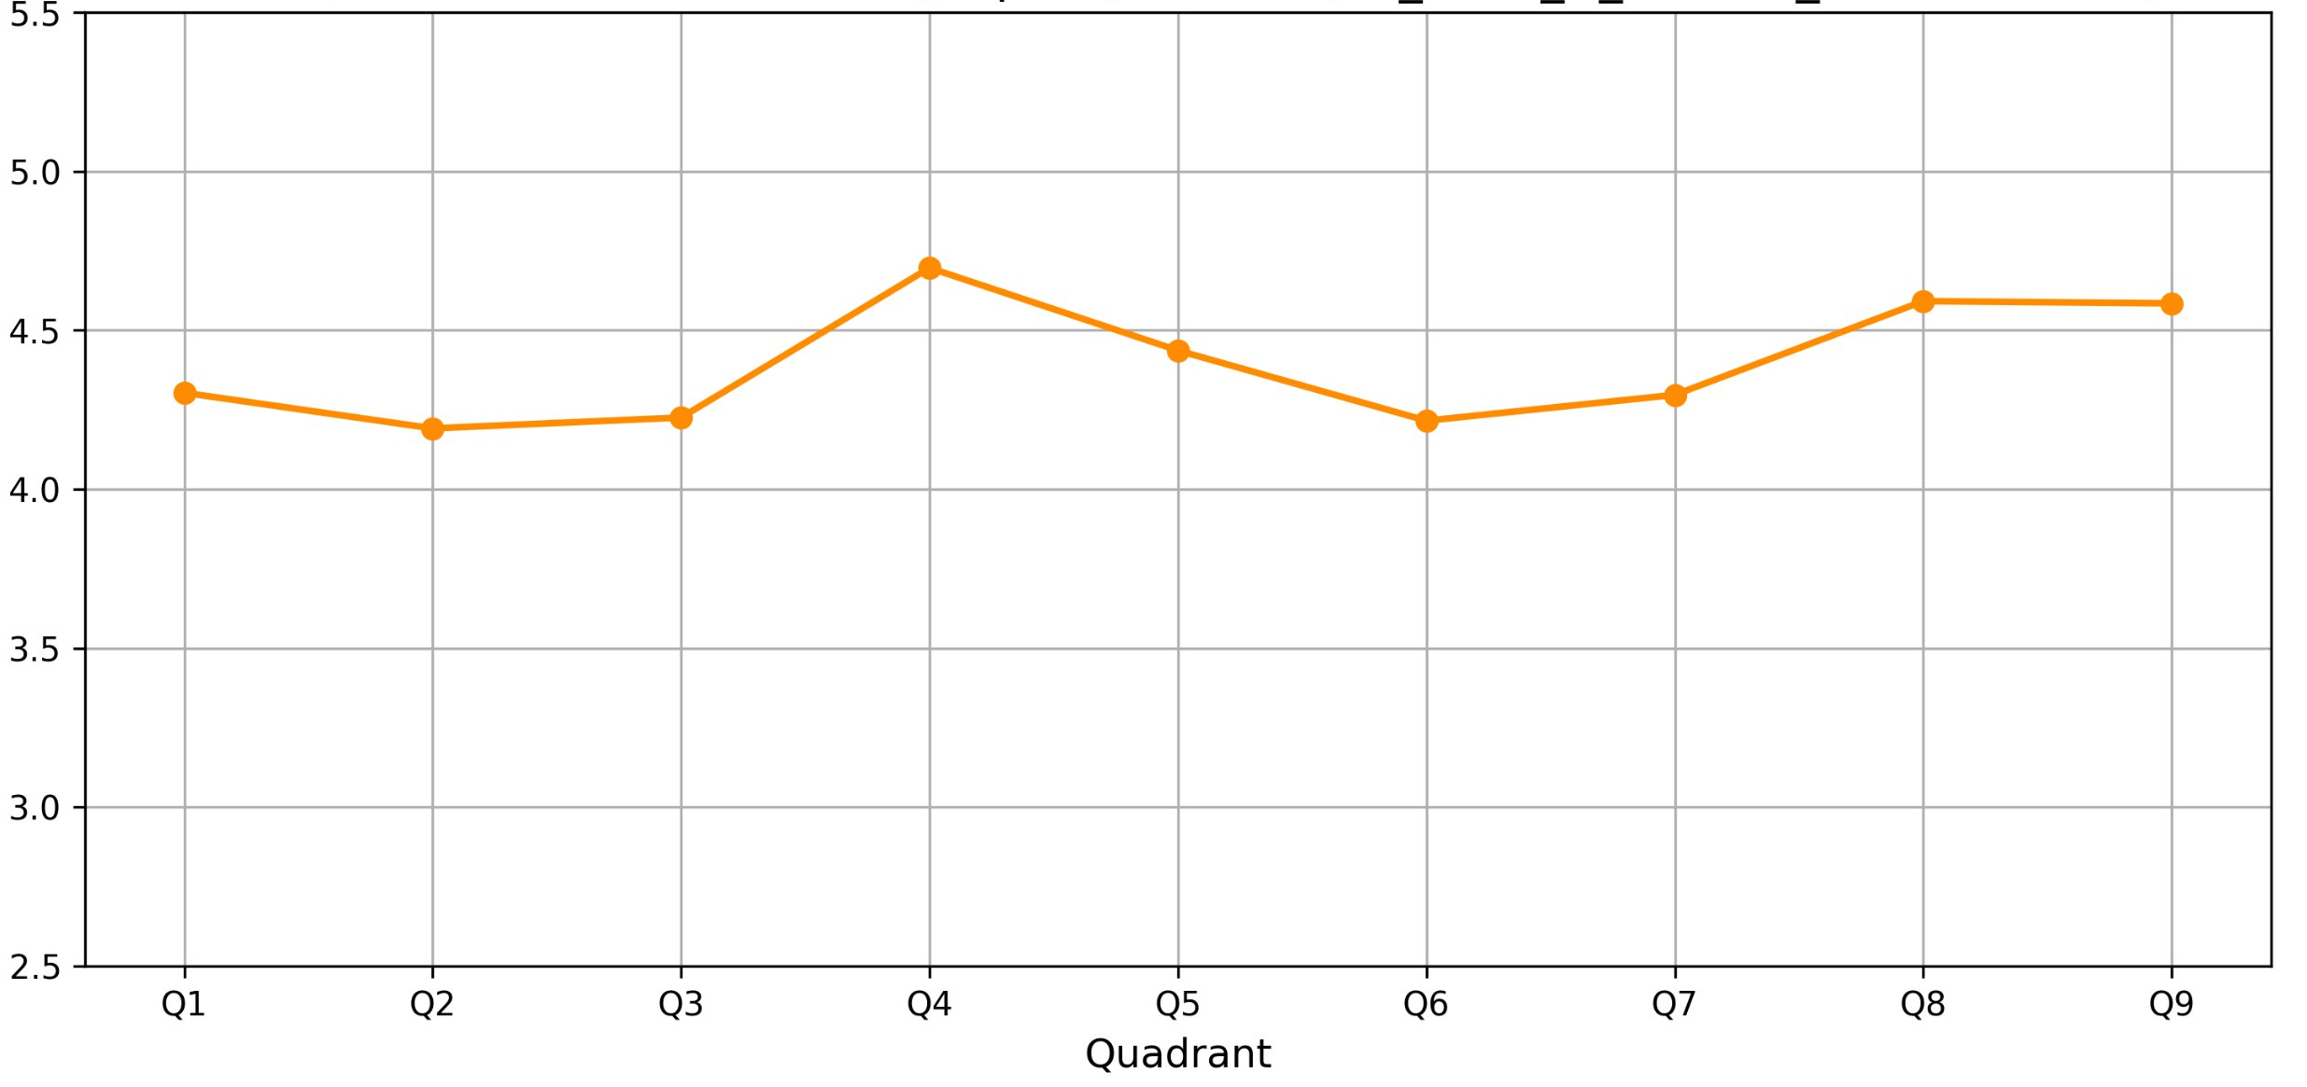
BI MWPC test. Mean values of charge
Source on Bottom plane.
Charge mean values
Source on Top plane.
Charge mean values
Applied voltage = 2650 V
Applied voltage = 2250 V

Slide 14
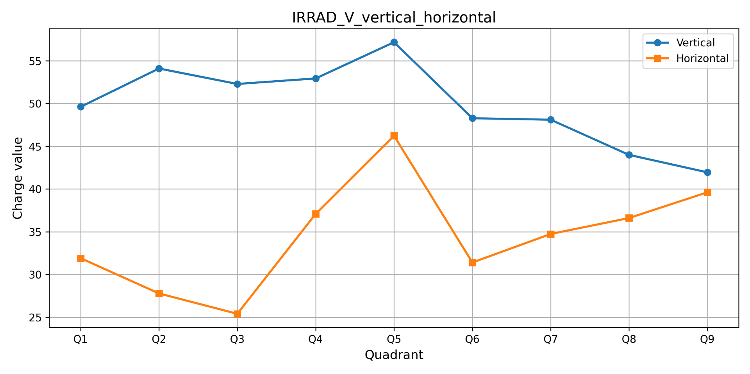
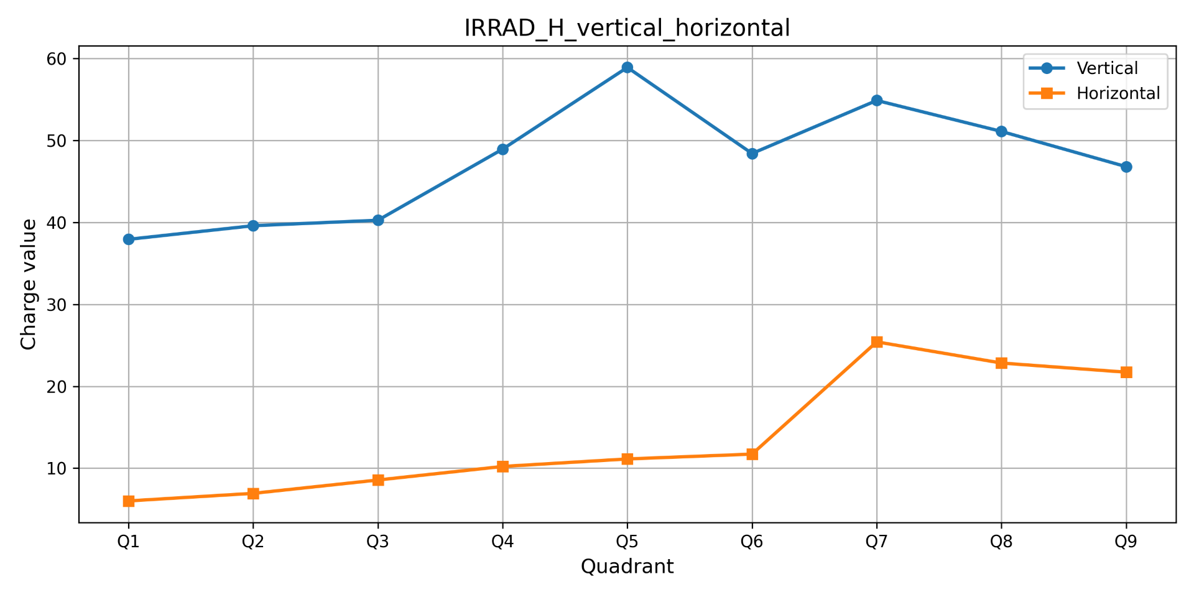
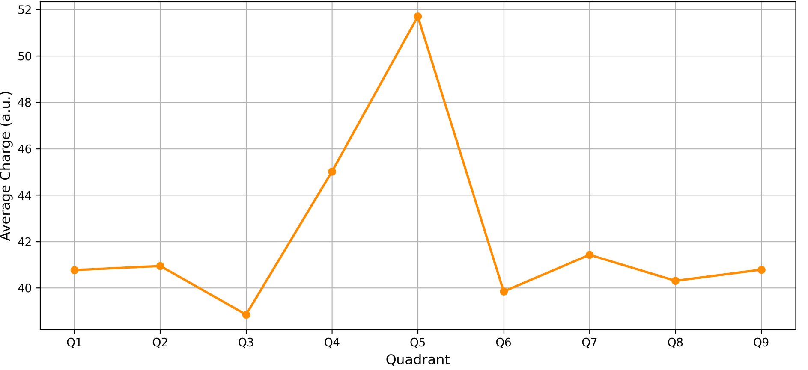
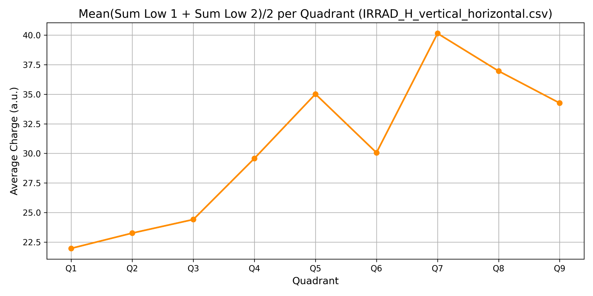
IRRAD MWPC test. Results
*H – Top plane, V – Bottom plane
Source on the Bottom plane. Voltage = 2750 V
Source on the Top plane. Voltage = 2750 V
Vertical and horizontal profile charge
Mean values of
Vertical and horizontal profile charge

Slide 15
Results
The repeatability and symmetry of the profiles indicate correct operation. It is noticeable that at higher voltage, we obtain higher signals — an amplification effect.
It was found that it is necessary to wait some time before starting measurements to obtain proper profiles => chamber needs time to stabilize.
Charge value varies from quadrant to quadrant.
Although coincidence of vertical and horizontal plane charge values in each quadrant was expected, it can be seen that in most cases the situation is not ideal.
Statistical error less than 1%.
Response in different points of MWPC is not the same.
The results will be discussed with our BI colleagues.
Data from IRRAD MWPC was acquired. The analysis will be included in final report.
Knowledge and Skills Acquired
MWPC operation principle.
Data analysis with python.

Slide 16

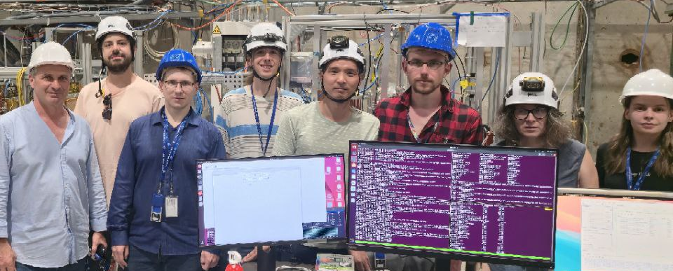
Acknowledgements
I thank my supervisors for their guidance, support, and encouragement throughout this work!
I am grateful to everyone who contributed to this work:
Katerina Kuznetsova
Giuseppe Pezzullo
Federico Ravotti
Aleksandr Lapkin
Sergey Romakhov
Dmitriy Sosnov
Jaroslaw Szumega
And the team!

Slide 17
Thank you for your attention!

