Slide 1


SUMMER STUDENT PRESENTATIONS: ELECTRICAL AND THERMAL TESTING FOR ATLAS-HGTD
Speaker: Michaela Lastovicka
Supervisors: Theodoros Manoussos, Dominik Dannheim

Slide 2
Objectives
Perform systematic electrical characterization of Low Gain Avalanche Diodes (LGADs) produced for the ATLAS High-Granularity Timing Detector (HGTD).
Measure key parameters from Quality Control Test Structures (QC-TS):
  Breakdown voltage (Vbd)
  Full depletion voltage (Vfd)
  Detector capacitance (Cd)
to assess fabrication quality across sensor wafers from IHEP-IME.
Investigate temperature dependence of Vbd on a full-size LGAD sensor from +20 °C to −40 °C.
  Develop relationship for calibration

Slide 3
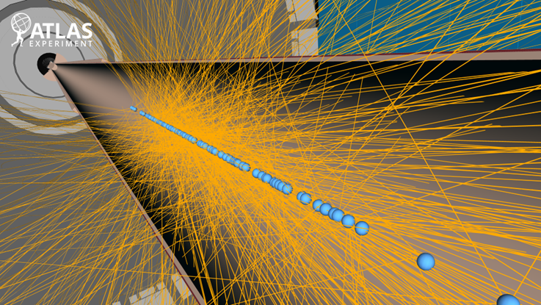
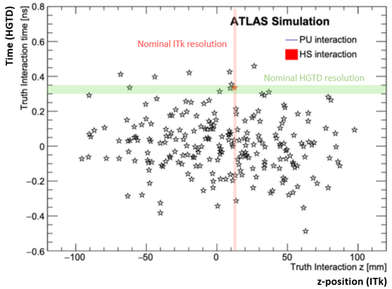
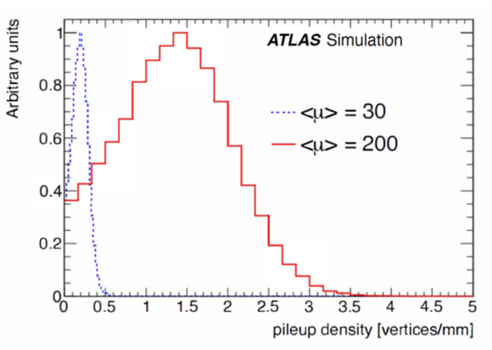
High Luminosity LHC & Motivation for HGTD
Operational from 2030
Pile-up <μ> = 200 interactions per bunch crossing (on average 1.6 vertices/mm)
Instantaneous luminosities up to 7.5×10³⁴ cm²s⁻¹
It is difficult to assign tracks to vertices
  By adding timing information, pile up rejection can be improved
Red → what ITK can do (50 um)
Plot shows not only spatial spread but also time → close in space but far in time
HGTD Technical Design Report (2020)
https://cds.cern.ch/record/2719855/

Slide 4
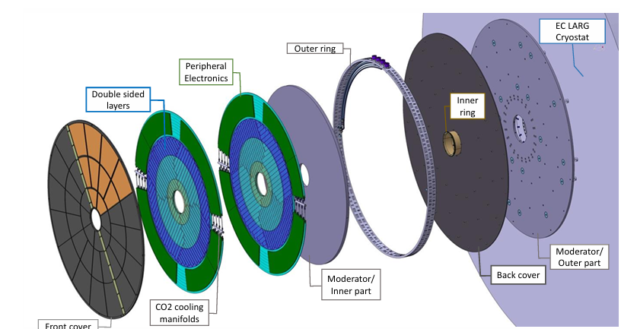
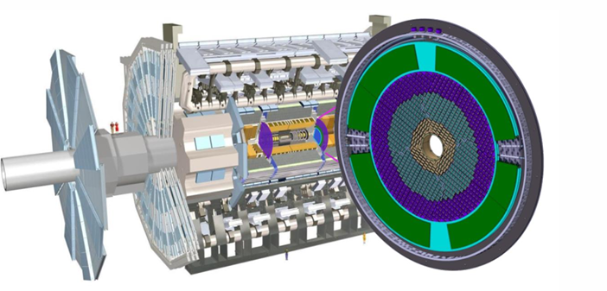
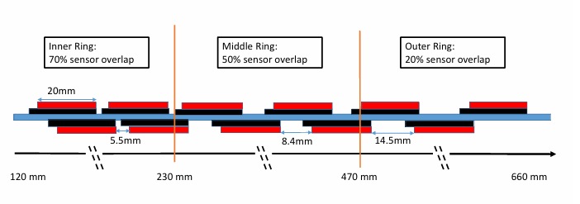
High Granularity Timing Detector (HGTD)
To mitigate pile up effects, HGTD will be developed
Placed between Inner Tracker (ITk) and Liquid Argon Calorimeter
Active area coverage: 2.4 < |η| < 4.0
8032 modules (2 LGAD sensors + 2 r/o ASICs each)
  6.4 m² of silicon sensors
Maximum fluence: 2.5×10¹⁵neq/cm² ; TID: 2 MGy
Operating temperature -30ºC (CO₂ dual phase cooling)
Per Track-time resolution: 35 ps (start) - 50 ps (end)
HGTD Technical Design Report (2020)
https://cds.cern.ch/record/2719855/

Slide 5
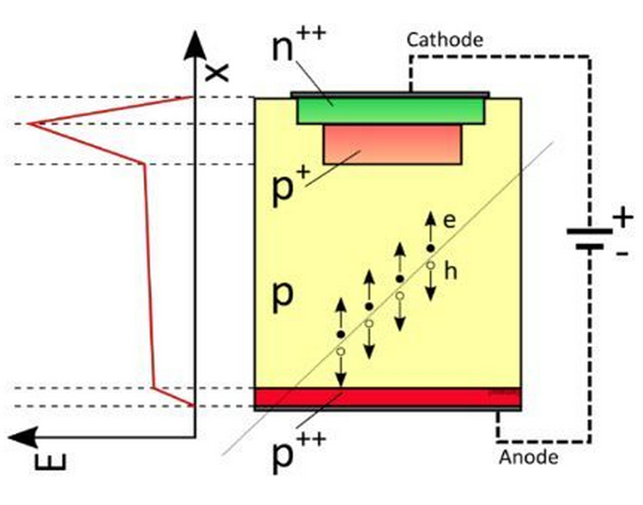
LGAD Principle
For this purpose, HGTD will employ LGADS.
Low Gain Avalanche Diodes (LGADs) are silicon sensors primarily designed to detect Minimum Ionizing Particles (MIPs)
MIP→ fast charged particle (usually a muon or pion) that deposits the minimum possible energy
Charged particle passes through the detector
2. It creates electron-hole pairs.
Gain Layer:
highly doped p-type (Boron) layer → signal amplification → thinner detectors + faster signal collection times + fast rise time + good S/N
3. Charge carriers are accelerated in the electric field
4. Charge deposition of MIPS used to detect particles
Image showing general LGAD schematic from Study of impact ionization coefficients in silicon with Low Gain Avalanche Diodes - CERN Document Server

Slide 6
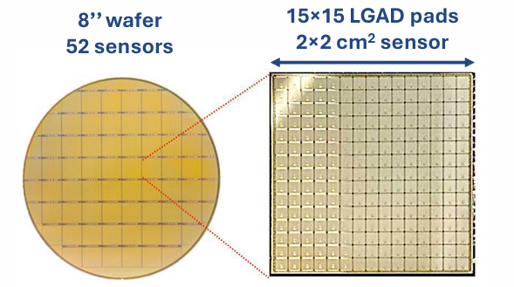
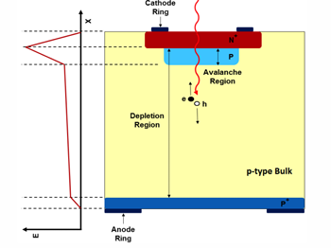
HGTD Sensors
The Sensor
15×15 pads
Pad size: 1.3 mm×1.3 mm
225 channels
Active thickness: 50 μm
Carbon-enriched gain-layer for radiation hardness
LGAD sensors requirements:
Hit-time resolution: 40 ps (start) - 70 ps (end)
Collected charge per hit: 10 fC (start) - 4 fC (end)
Hit efficiency: 97 % (start) - 95 % (end)

Slide 7
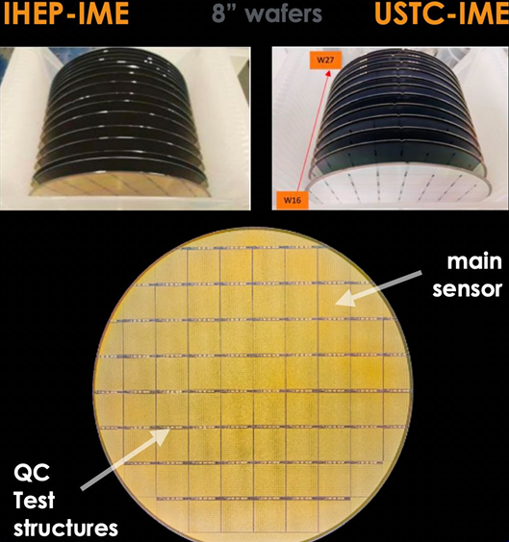
HGTD Sensor Production
Current focus of the work
O(600) 8” wafers to be produced for HGTD by IME (Chinese Academy of Science)
16000 sensors used in HGTD
Alongside the sensors, Quality Control Test Structures (QC-TS) will be produced.
The QC-TS are:
  Produced alongside each sensor
  Used to monitor fabrication quality
  Used to extract parameters not accessible on full sensors during the production
Process Quality Control (PQC) is done on QCTS and full sensors using a semi-automated probe-station
5-10 Structures are tested per batch → same positions

Slide 8
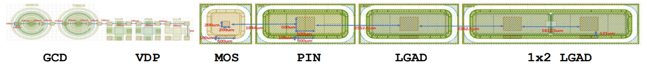
QC-TS
Pin Diode
I-V measurements
Like LGAD but no gain layer (gain =1)
Used to understand gain
Van der Pauw (VDP)
Resistance of n+,p-stop substrates and aluminium
1 x 2 LGAD
Study the properties of the inter-pad region
Gate-Control-Diodes
Purpose: Measure surface currents
Only used in initial measurements
  Showed that GCD design doesn’t allow for useful measurements of surface currents
Metal-Oxide-Semiconductor Capacitor
flat-band voltage (V_fb) and oxide thickness (t_ox)
LGAD
Same area as main sensor pad just longer
I-V → V_bd, I_meas at operational voltage
C-V → Gain layer depletion voltage, V_fd, C_d

Slide 9
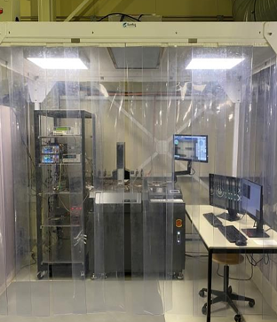
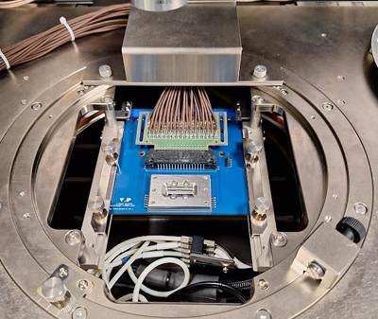
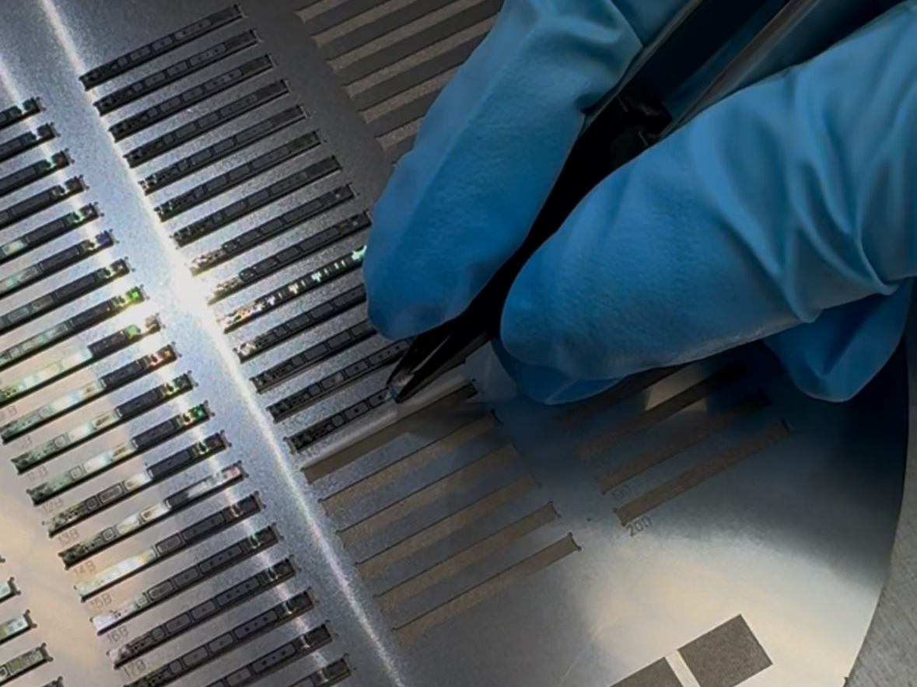
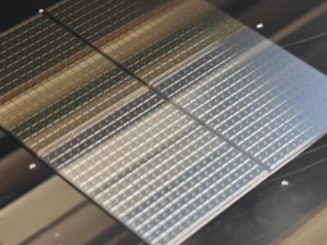
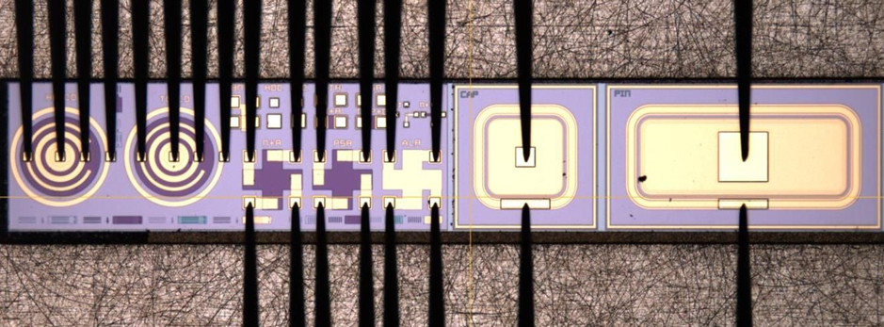
Quality control of Sensors using Test Structures
Probe Station setup at CERN
QC-TS Probe Card
Loading QC-TS on holder
Experiment Setup for PQC at CERN
I–V and C–V measurements performed on QC-TS
I-V done on every individual sensor too
Fully automated measurements
Full-size sensors require individual probe needles
Main Sensor
Probe-card measurement on QC-TS
This work analyses:
Production phase QC-TS → 8 wafers
Breakdown voltage and temperature relationship on a full size sensor

Slide 10
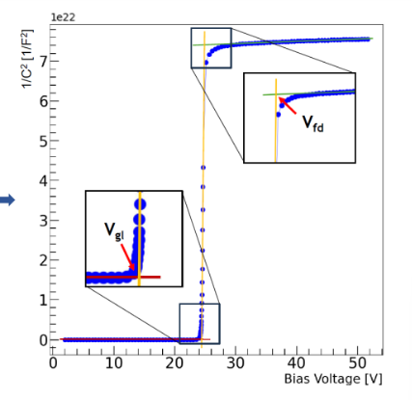
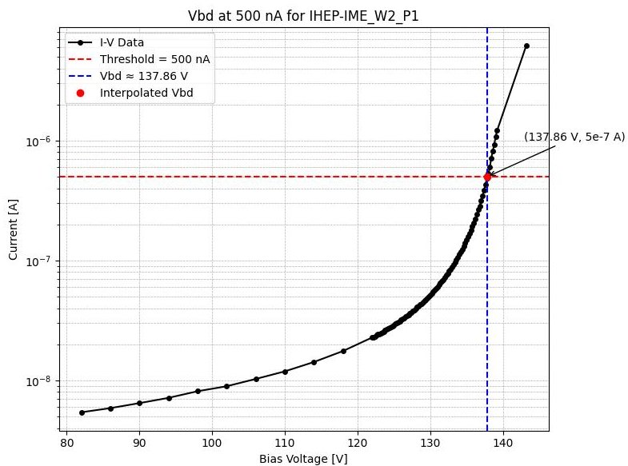
Parameter Extraction Methods
LGAD I-V
LGAD C-V
Plot I-V
Interpolating linearly
Find the Voltage at 500 nA
Plot 1/C²-V
Perform 3 fits on the linear sections of the graph
Find the voltage at the 2 intercepts
Extract Breakdown Voltage (Vbd)
Break-down → uncontrollable avalanche multiplication
Break-down of single-pad sensor defined as: V @ 500nA
Extracted parameters:
Gain-layer-depletion voltage (Vgl)
Full-depletion voltage (Vfd)
Detector capacitance (Cd) @ 50 V

Slide 11
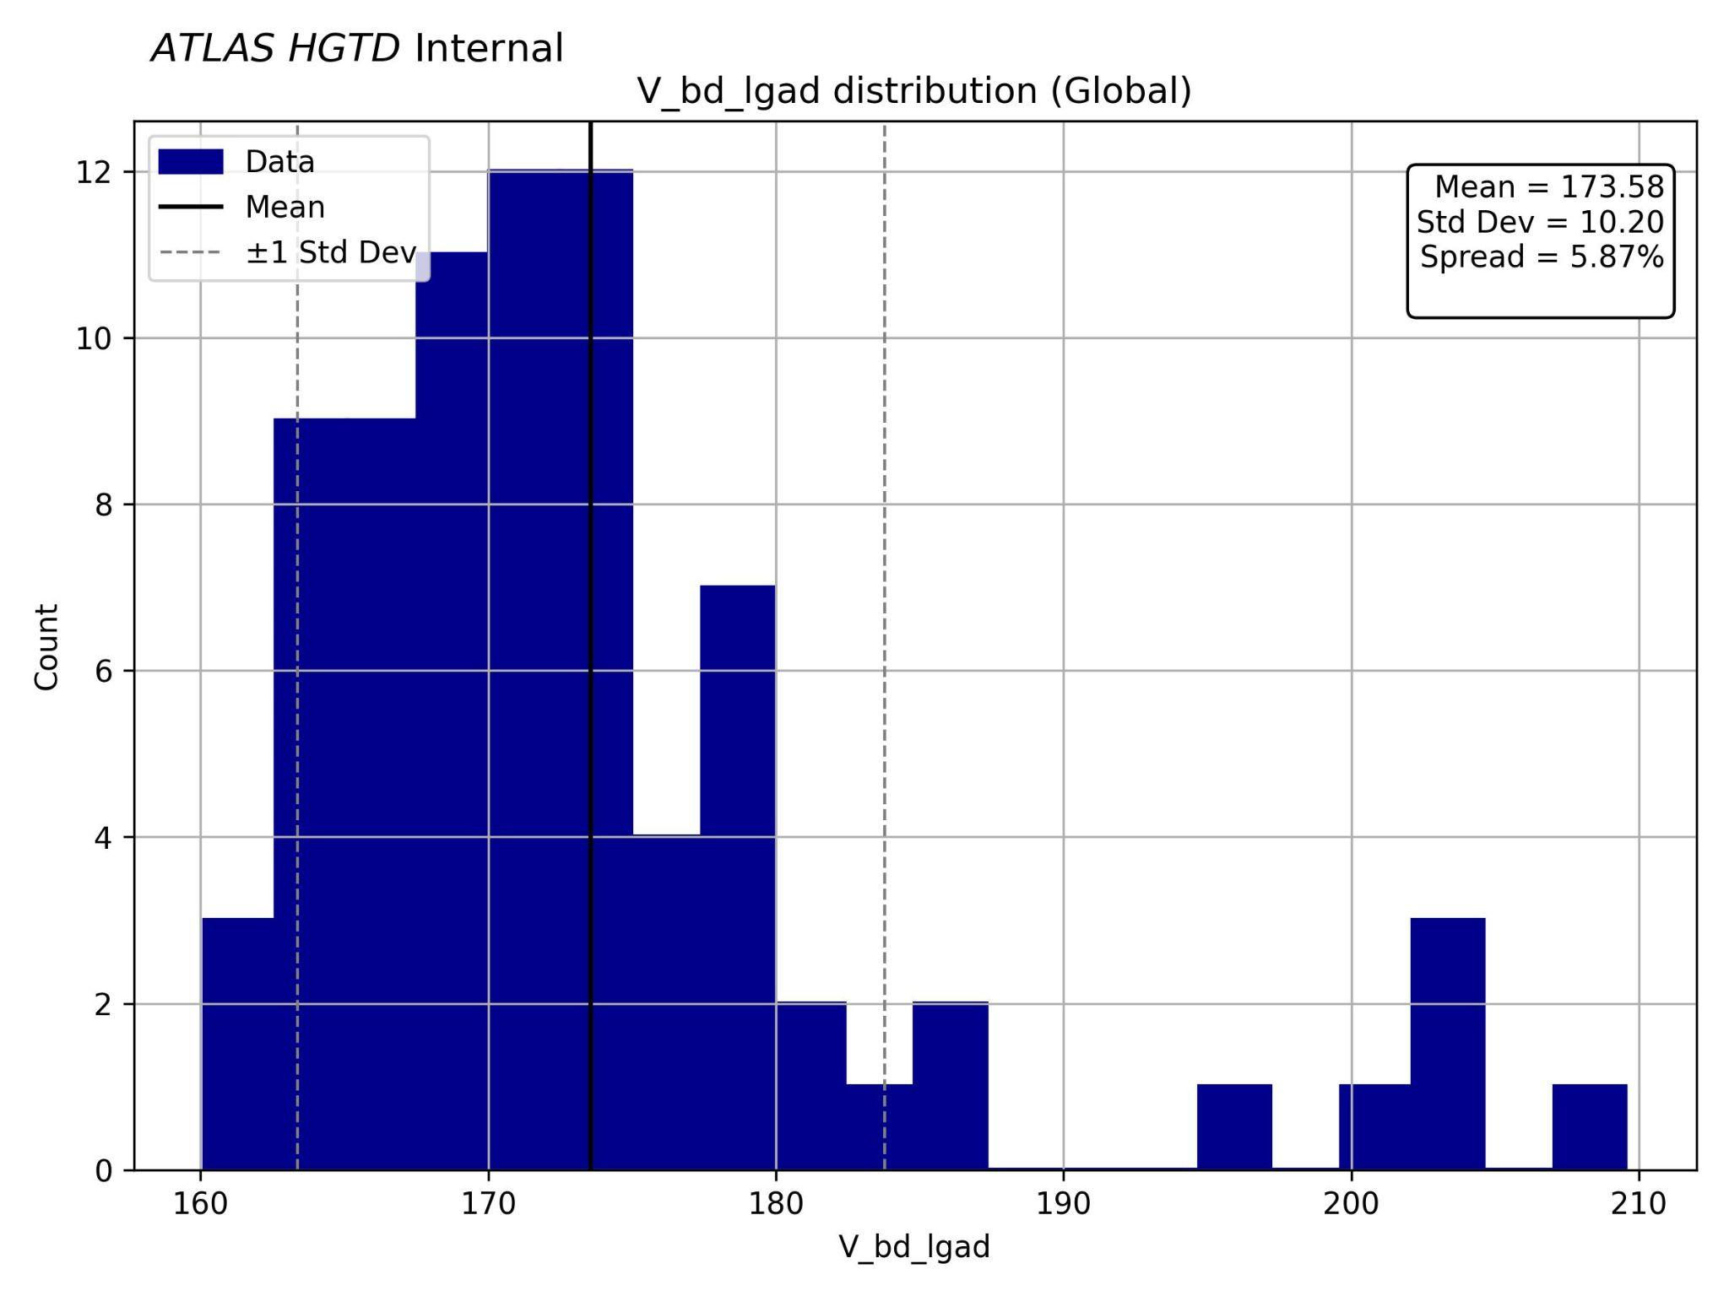
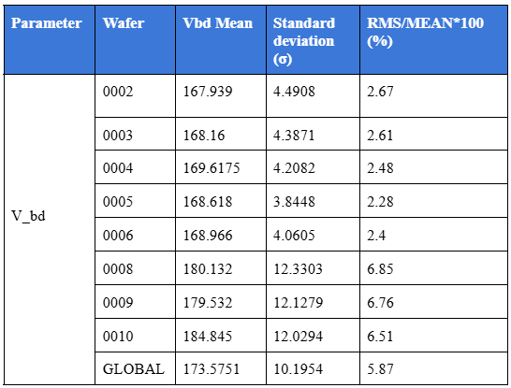
Electrical testing
V_bd global and per wafer
Single LGAD Measurement
Spread = RMS/MEAN
Outliers from Wafer 8: pos 44, 50; Wafer 9: pos 47, 50; Wafer 10 pos 47, 50
Vbd → Maximum voltage before avalanche multiplication
The spread is generally good and complies with the specification: < 8%

Slide 12
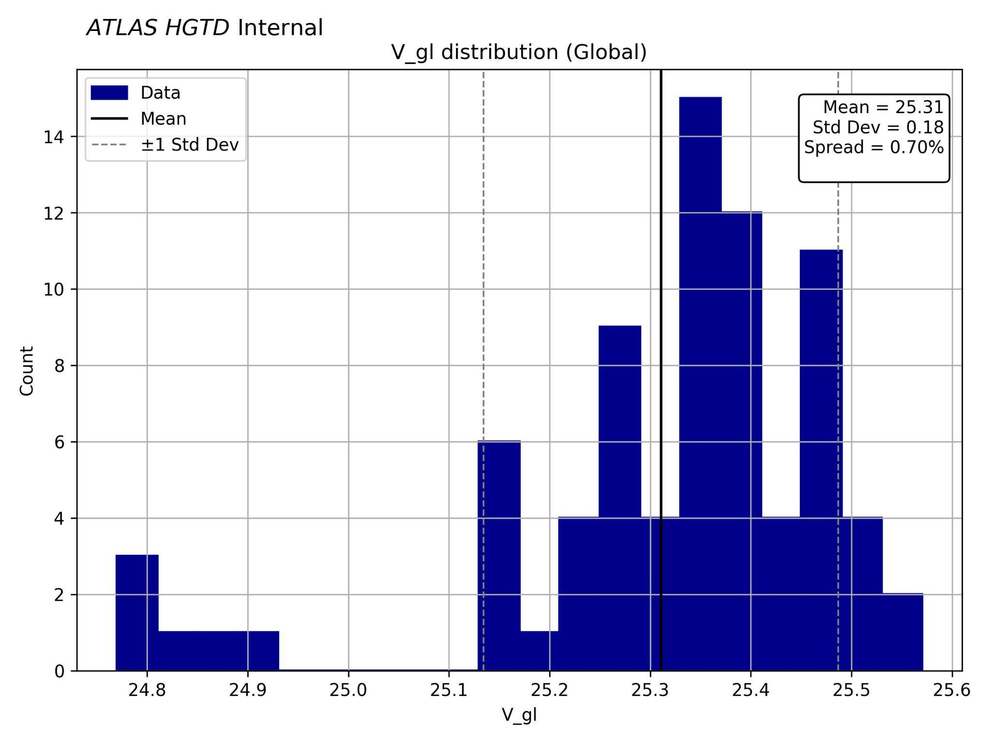
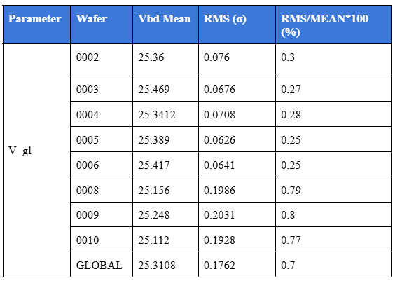
Electrical testing
V_gl global and per wafer
Single LGAD Measurement
Outliers from Wafer 8: pos 44, 50; Wafer 9: pos 47, 50; Wafer 10 pos 47, 50
Spread < 2% as required
If Vgl is too high → risk of early breakdown
too low → no gain
Same wafers and positions show anomalous results as for Vbd.

Slide 13
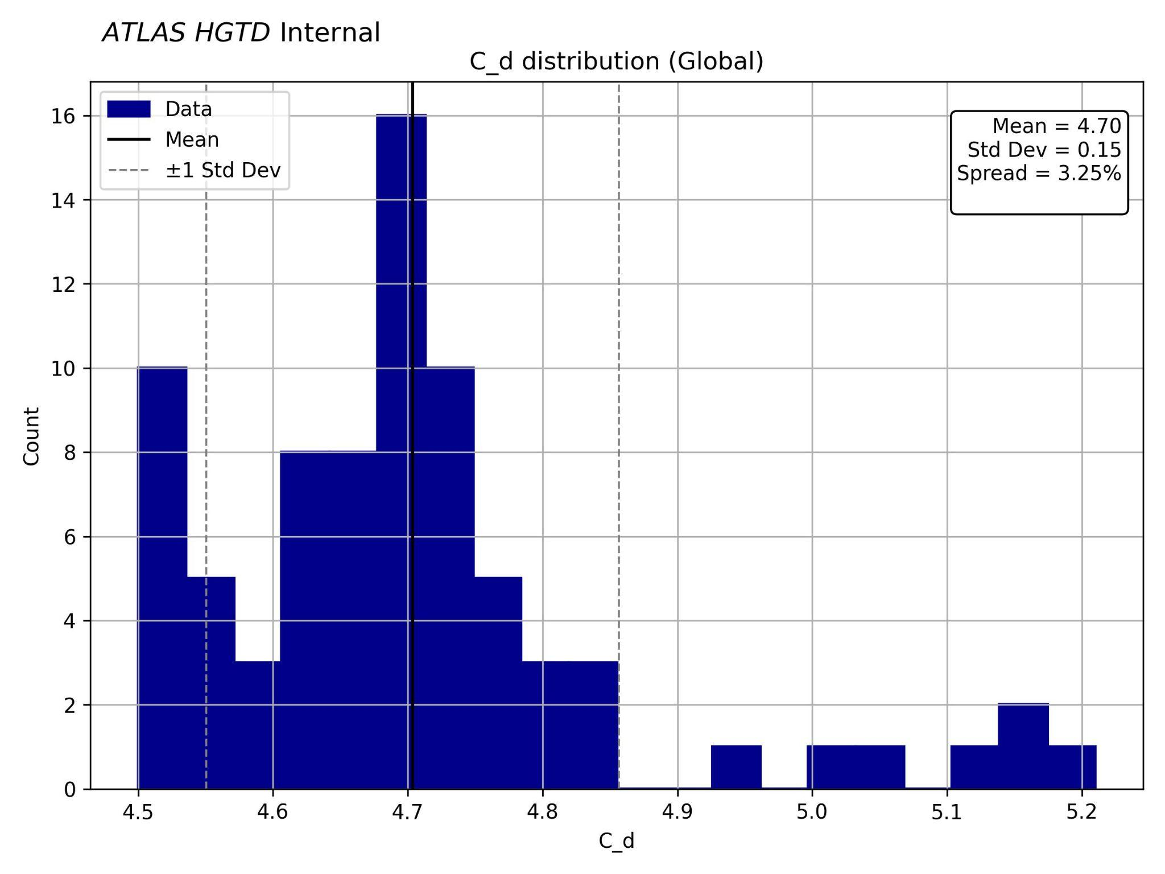
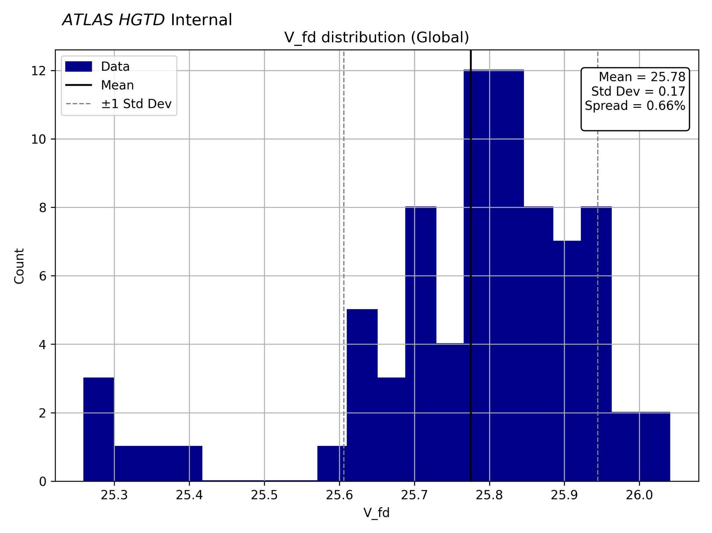
Other parameters
Single LGAD Measurement
Outliers from Wafer 8: pos 44, 50; Wafer 9: pos 47, 50; Wafer 10 pos 47, 50
2
Parasitic capacitance (200-300 nF) is orders of magnitude above the measured capacitance
Offset correction for the parasitic capacitance limits the achievable measurement precision for Cd
Very good uniformity → likely due to well-controlled doping and implant depth.
Outliers may have reduced doping levels or thinner active layers → consistent with outliers in other parameters

Slide 14
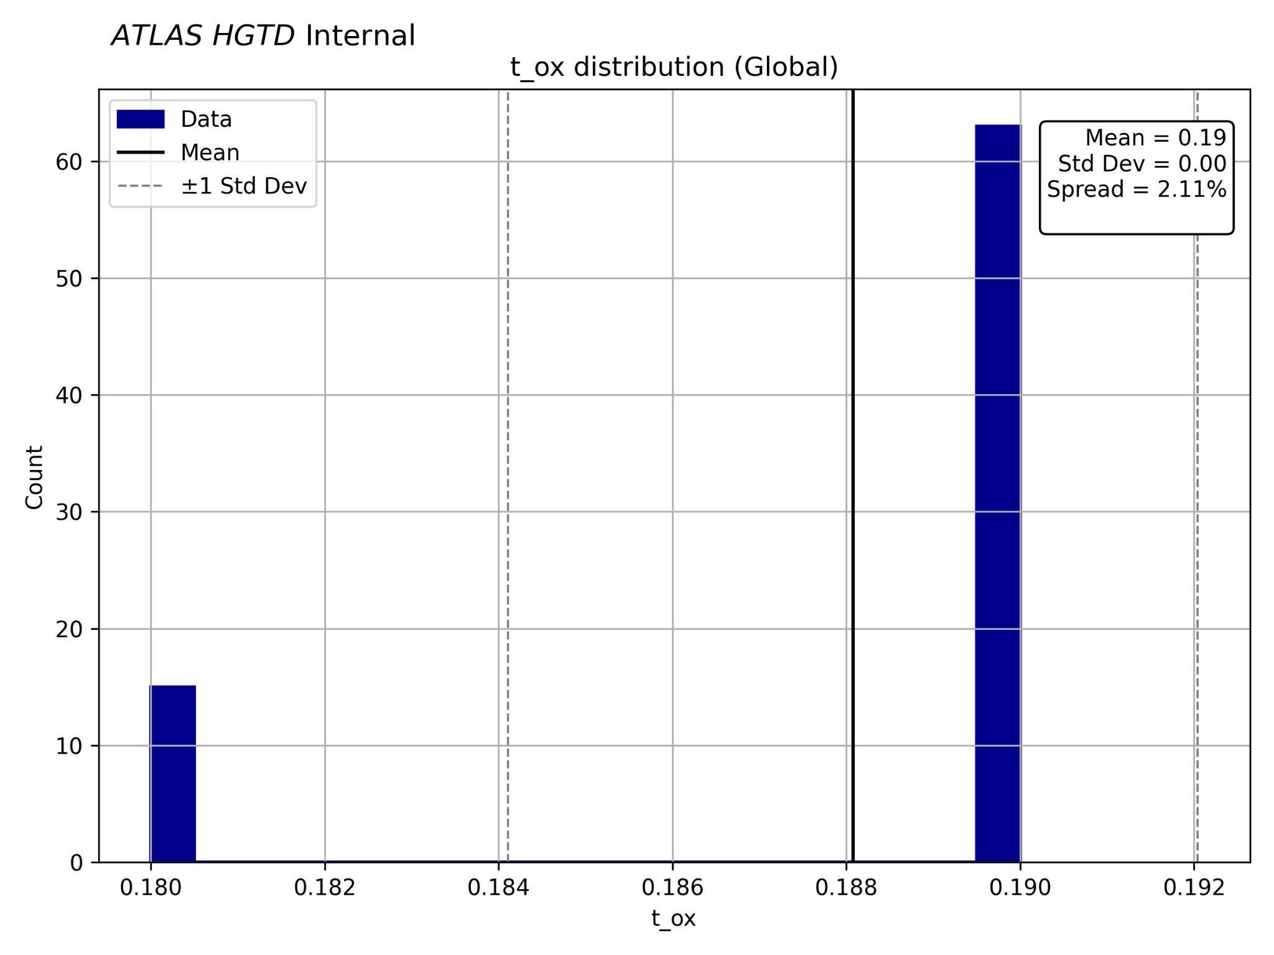
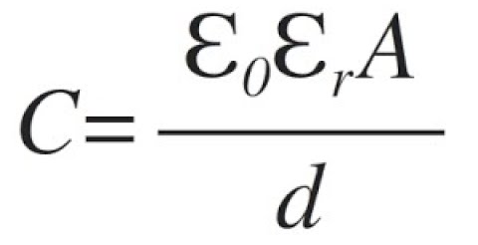
Oxide layer thickness
Metal-Oxide-Semiconductor (MOS) Capacitor Measurement
Uniform oxide layer thickness
Within expected range
Thinner oxide → higher parasitic capacitance

Slide 15
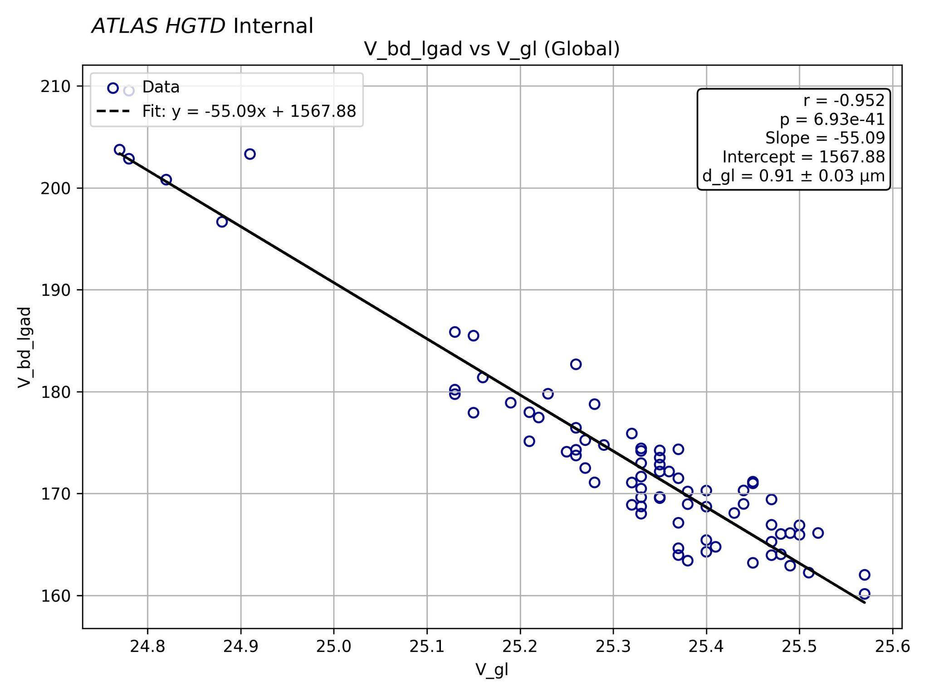

Vbd -Vgl Correlation
Vgl-Vbd correlations relate to gain-layer thickness:
Using an active layer thickness of 50 µm.
The error calculation was done by fitting the data to a Gaussian function using a least-squares method.
Fit shows dgl = 0.91 ± 0.03 with a correlation coefficient of -0.952 → strong negative correlation
Uniform gain layer
Outliers from Wafer 8: pos 44, 50; Wafer 9: pos 47, 50; Wafer 10 pos 47, 50

Slide 16
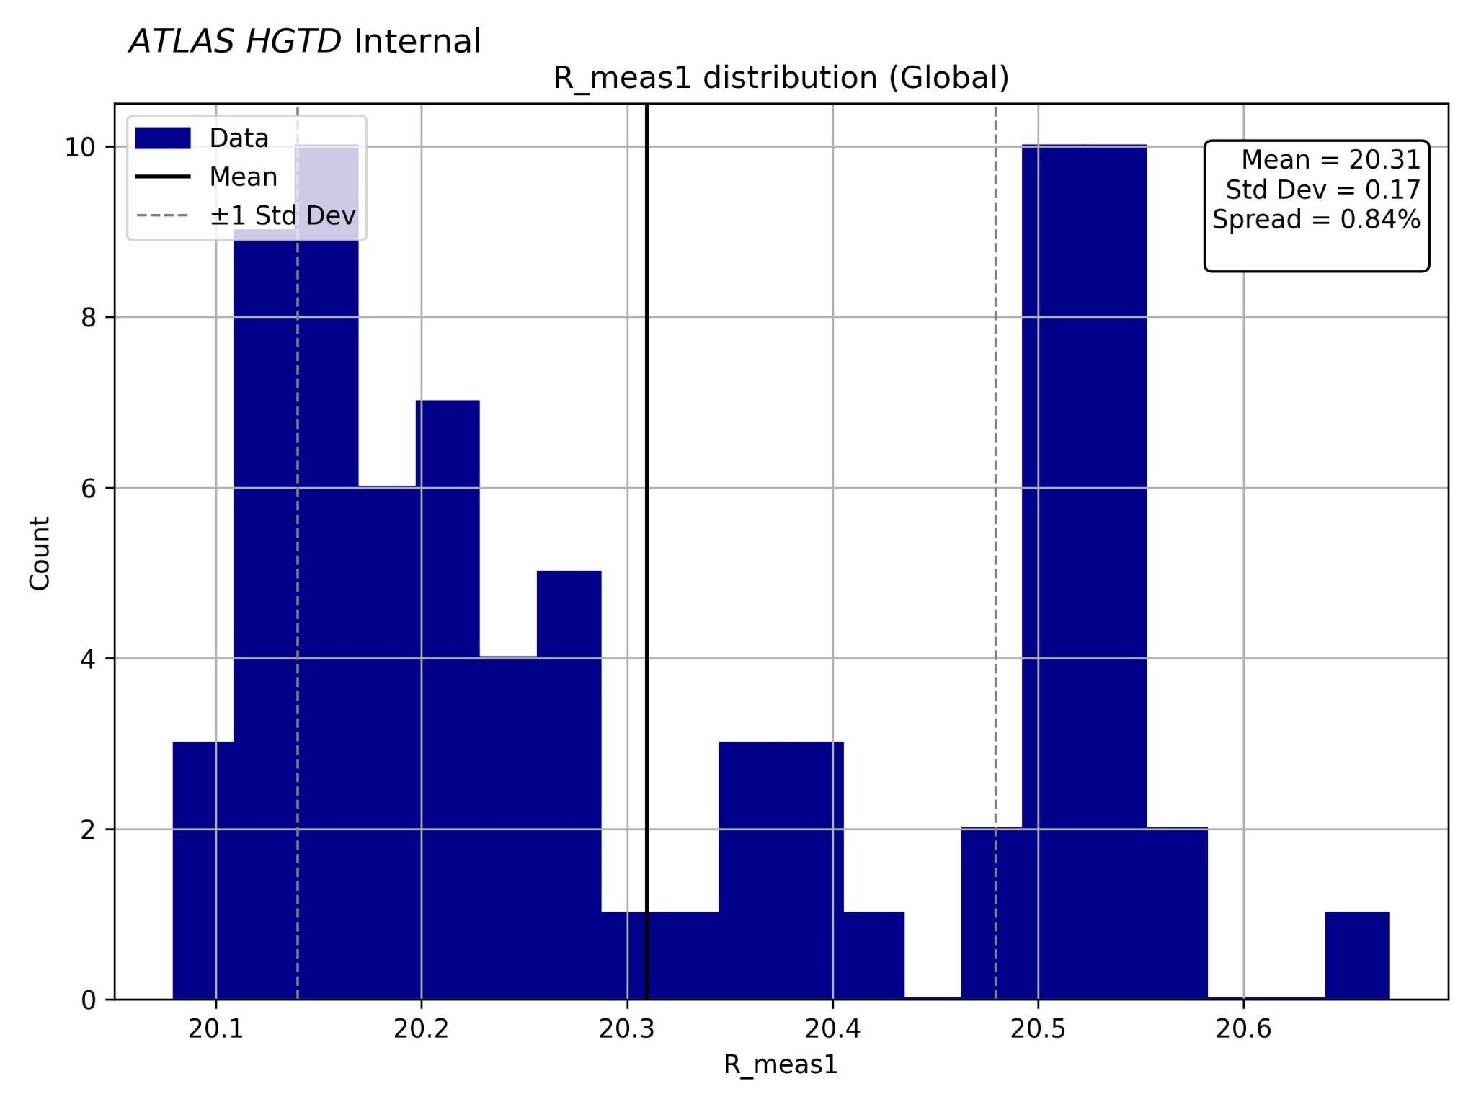
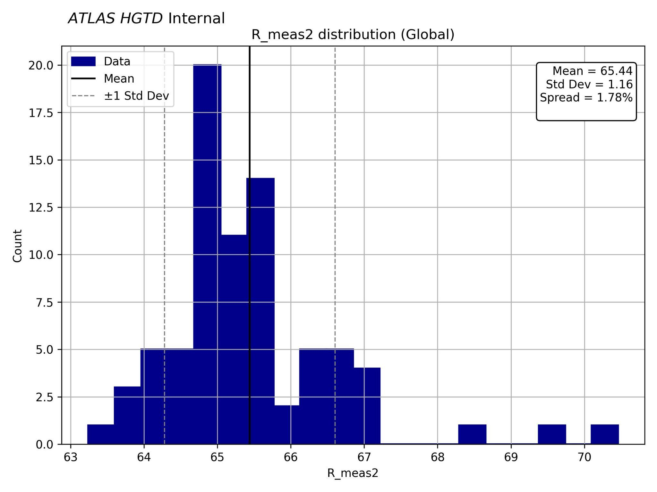
Resistor measurements
Van Der Pauw Structure Measurement
Resistor values are sensitive to the sheet resistance (Rs) of doped regions.
Checks how uniform the implantation and annealing steps were.
N+
P-stop
N-type materials usually have higher electron mobility than p-type (holes move slower).

Slide 17
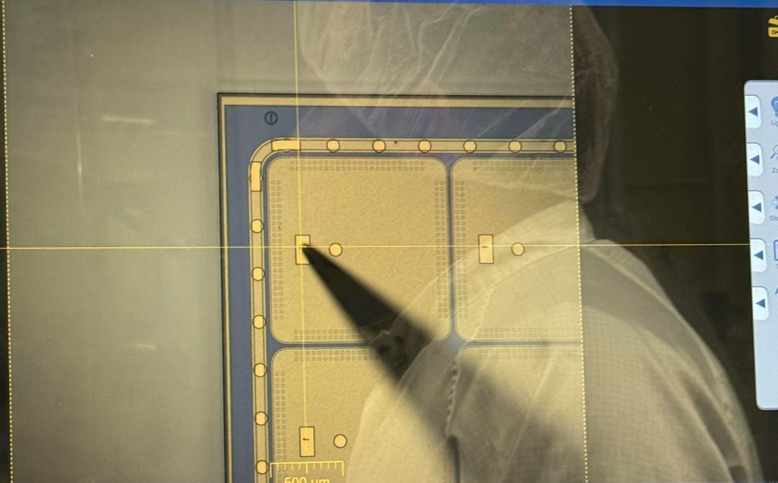
Temperature Measurements on a 15 x 15 Sensor
Single needle probe for sensor
HGTD operating temperature is -30°C
LGADs operate close to (but below) their breakdown voltage to achieve stable gain.
Need to establish a relation between Vbd and T
  Used as a correction for measurements done at other setups for data correlation purposes
Single channel

Slide 18
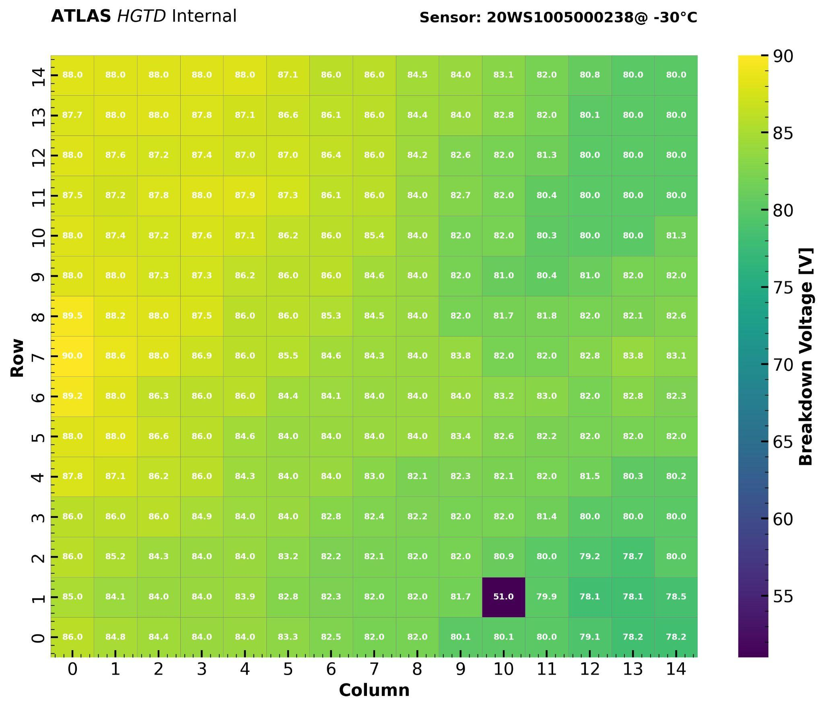
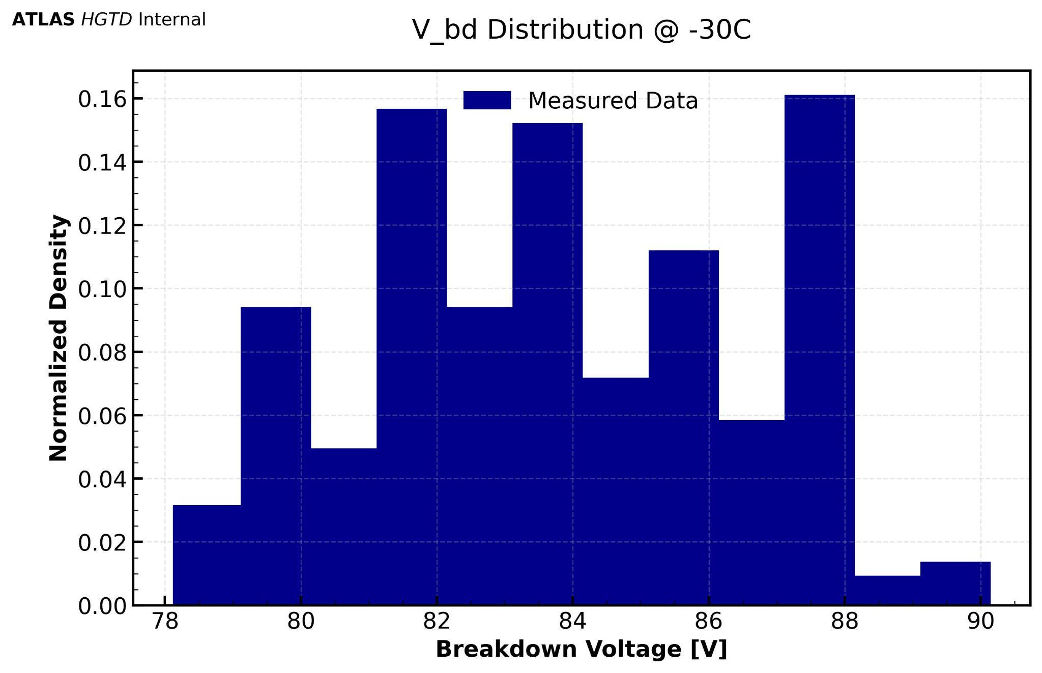
Vbd measurement @ -30°C
Heatmap of Vbds on 15x15 sensor @ -30°C
One underflow entry → early breakdown
Makes the sensor a “bad sensor”

Slide 19
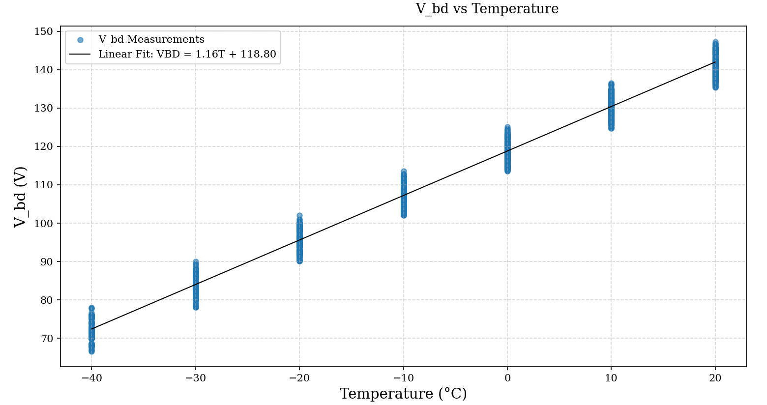
Vbd-Temperature Relationship
Linear fit with positive correlation.
For every 1°C increase in temperature, the breakdown voltage increases by 1.16 V.
Particle drift distance is shorter as T decreases, increasing the gain→ earlier avalanche multiplication → decreasing Vbd

Slide 20
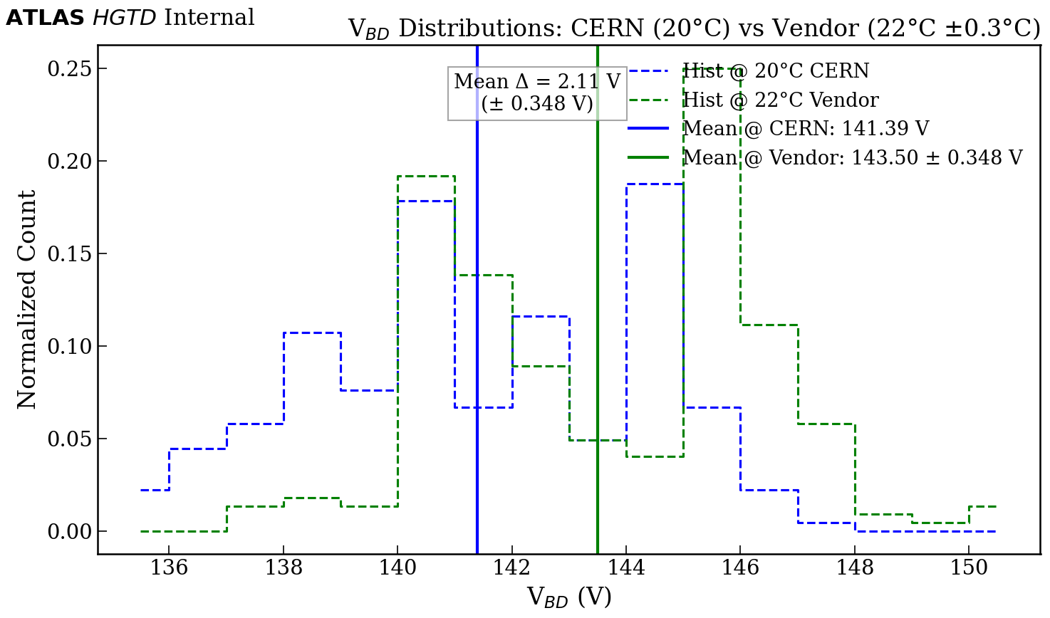
Use case for Vbd-T relationship
Expected difference in Means based on Vbd-T relationship = 2.32 V
Calculated difference in Means = 2.11 V
Calculated difference is within the uncertainty on the temperature measurement
Relationship is accurate and usable for bias tuning

Slide 21
Summary
80 QC-TS were electrically tested at 20 °C
One full-size sensor was tested between 20 °C and -40 °C
Measurements show generally uniform production quality and consistency, with a few outliers under investigation
  Outliers are from neighbouring test structures on the wafer
  Main sensors in that wafer area all also show high Vbd
Strong negative correlation for Vgl-Vbd indicating gain layer thickness uniformity.
Temperature scans showed a linear Vbd -T dependence, increasing ~1.16 V/°C, for bias tuning

Slide 22
THANK YOU FOR LISTENING

