Slide 1
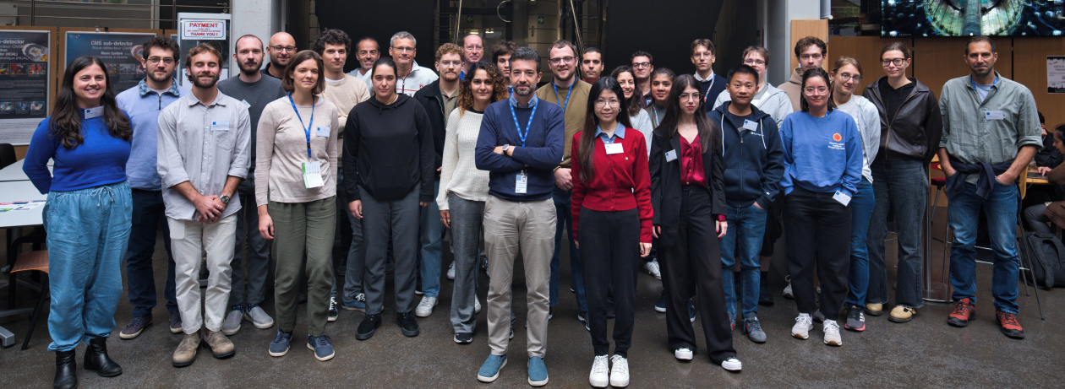
Presentations of TCT-School Participants
CERN, Geneva, Switzerland, 23.-25. September 2025

Slide 2
Organization of the school
Tuesday morning 23.10.2025 [40/S2-B01]
8:30 Welcome
8:35 Introduction to Lasers,
Raul Montero
9:20 Signal formation
Bojan Hiti
10:05 SPA – Single Photon Absorption
Marcos Fernandez Garcia
10:50 Group photo
11:00 Coffee Break
11:30 TPA – Two Photon Absorption
Michael Moll
12:15 TCAD simulations
Marco Mandurrino
Tuesday afternoon - Hands-on session 1
14:00 – 18:00
Tuesday evening – Dinner
19:30 at restaurant
Wednesday morning - Hands-on session 2
8:30 – 12:30
Wednesday afternoon - Hands-on session 3
13:30 -17:30
Thursday morning 25.9.2025 [28/S-029]
9:00 – 10:30 participants presentations
Coffee Break
11:00 – 12:00 Demonstration of data analyses; Question and answer session
12:00 – 13:00 Lunch Break
Thursday afternoon [visits]
13:00 – 14:20 Visit to “Antimatter Factory” (2 groups)
Niels Sorgenfrei - CERN
All lecture recordings are uploaded to the agenda

Slide 3
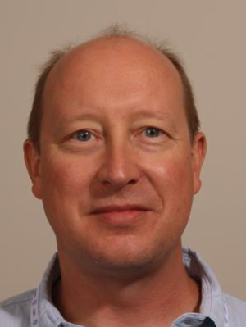
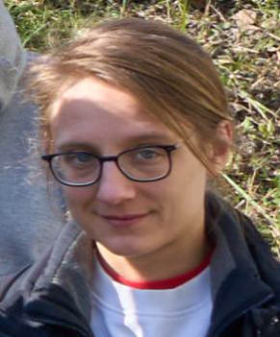
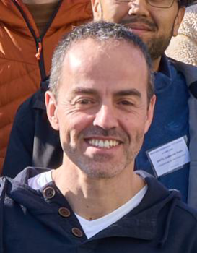
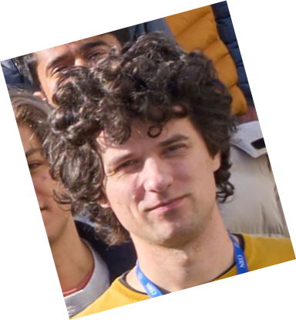
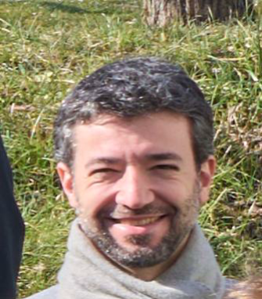
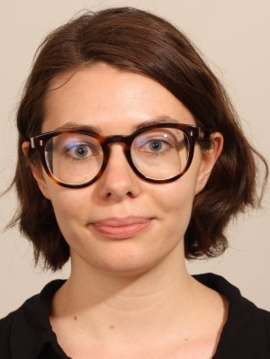
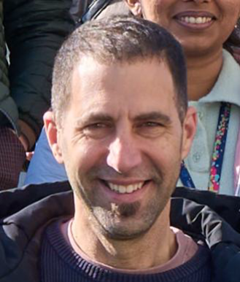
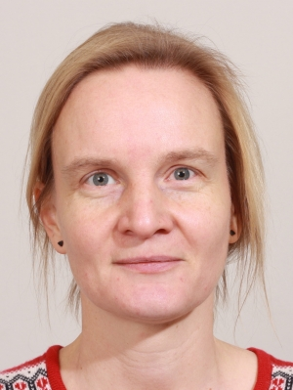
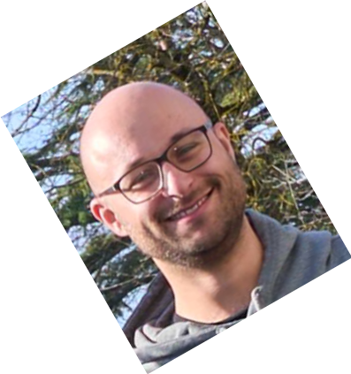
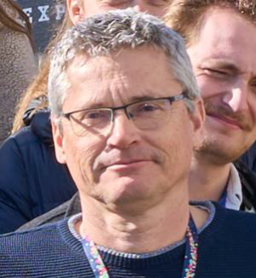
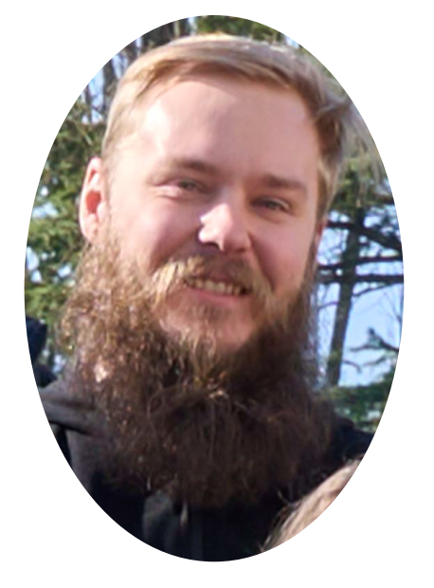
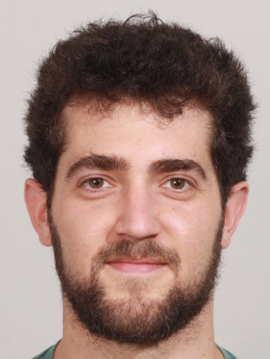
TCT-School tutors
CERN, Geneva, Switzerland, 23.-25. September 2025
Ruddy Costanzi, Leena Diehl, Marcos Fernandez Garcia, Bojan Hiti, Veronika Kraus, Marco Mandurrino,
Luca Menzio, Michael Moll, Raul Montero, Eva Sicking, Niels Sorgenfrei, Mika Vaananen

Slide 4
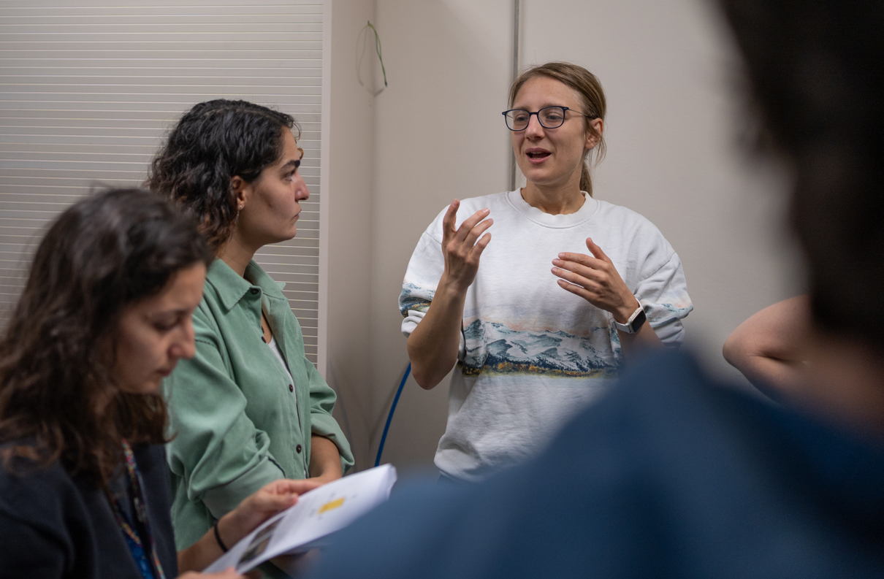
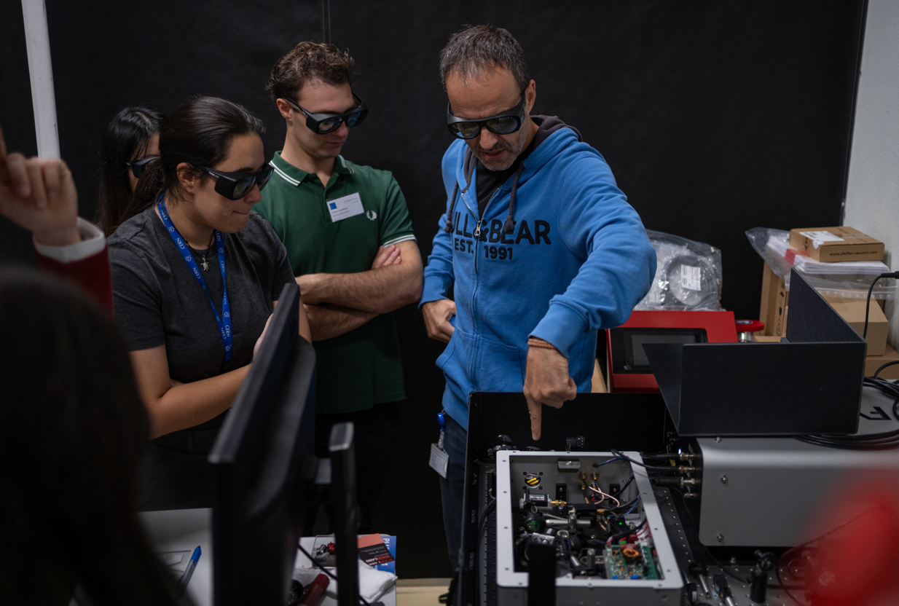
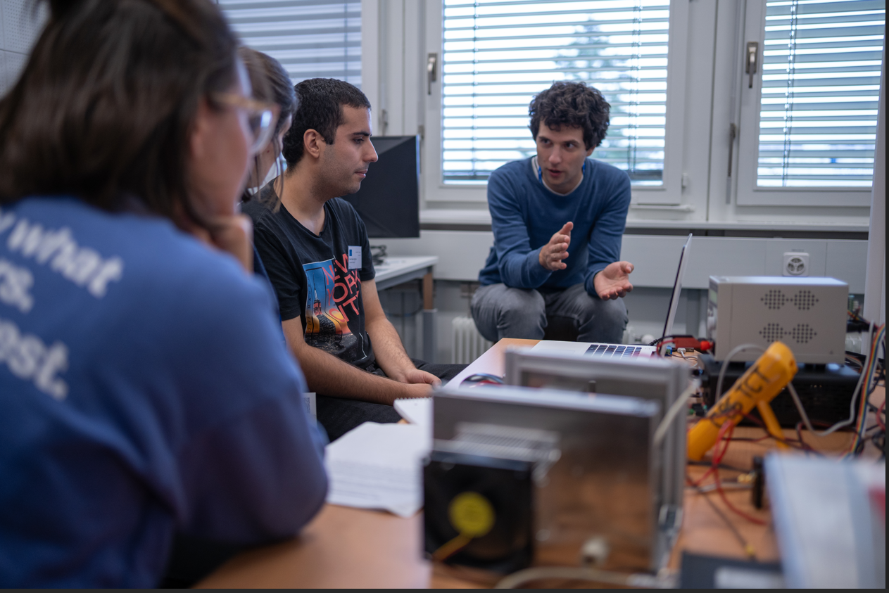
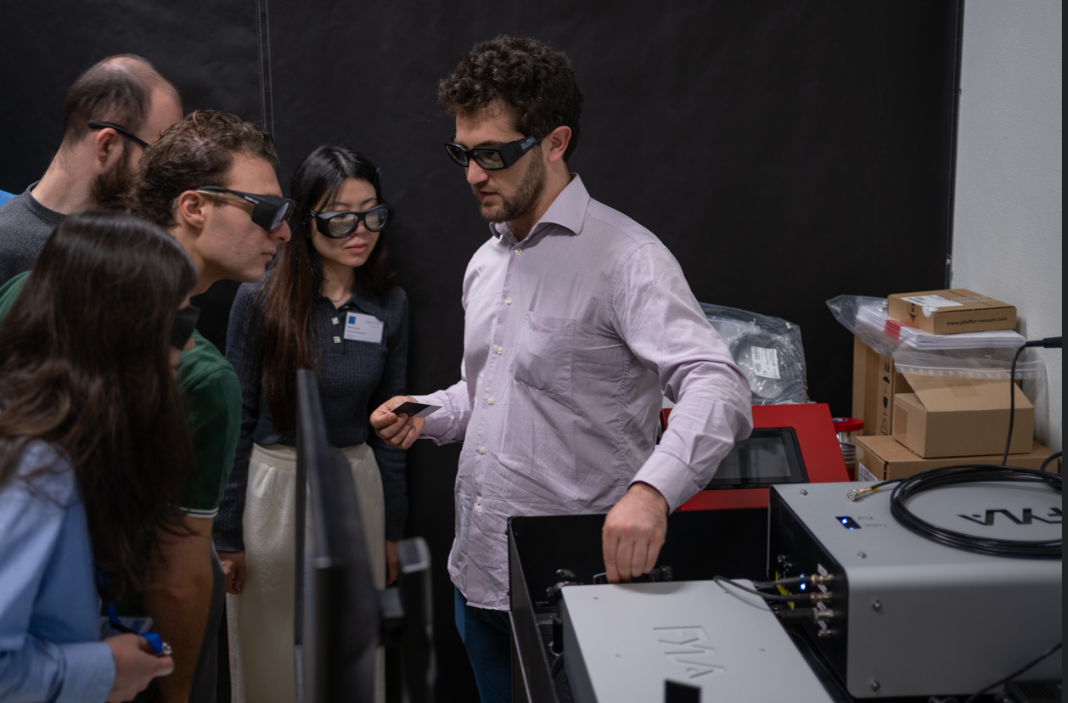
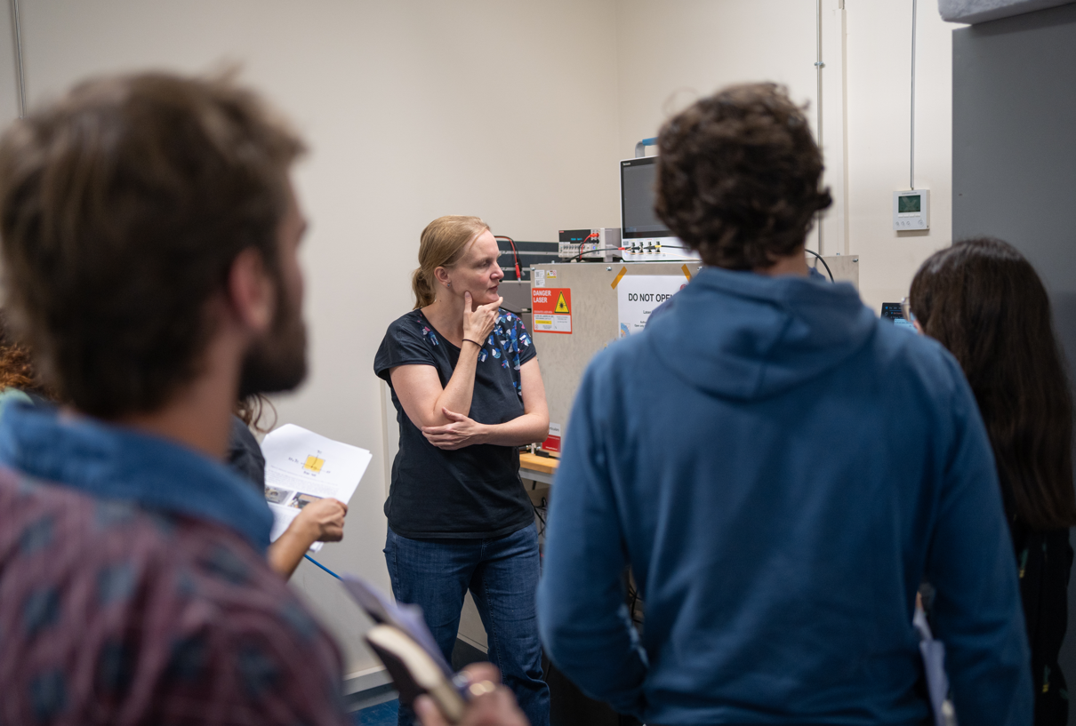
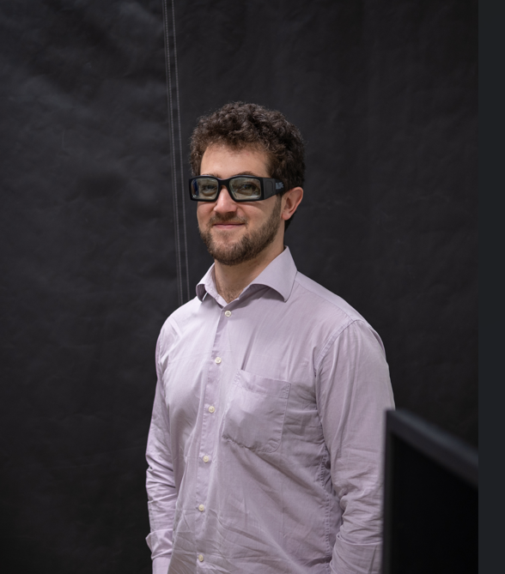
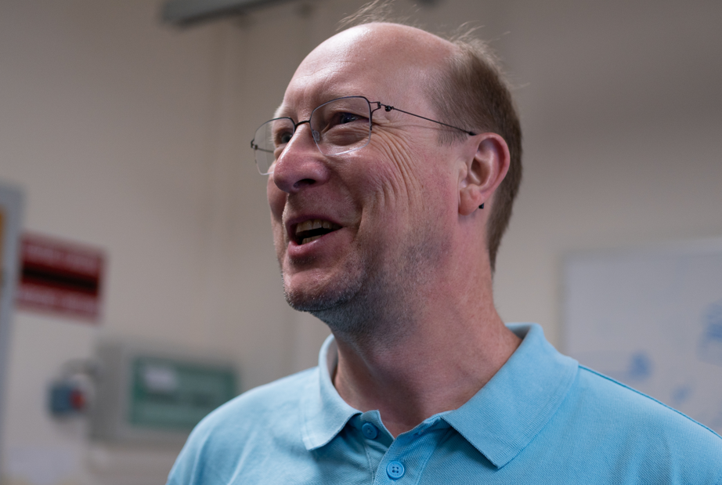
Photos … to be uploaded on CERN eos
We will share a link to the photos
For uploading your photos
For accessing the photos

Slide 5
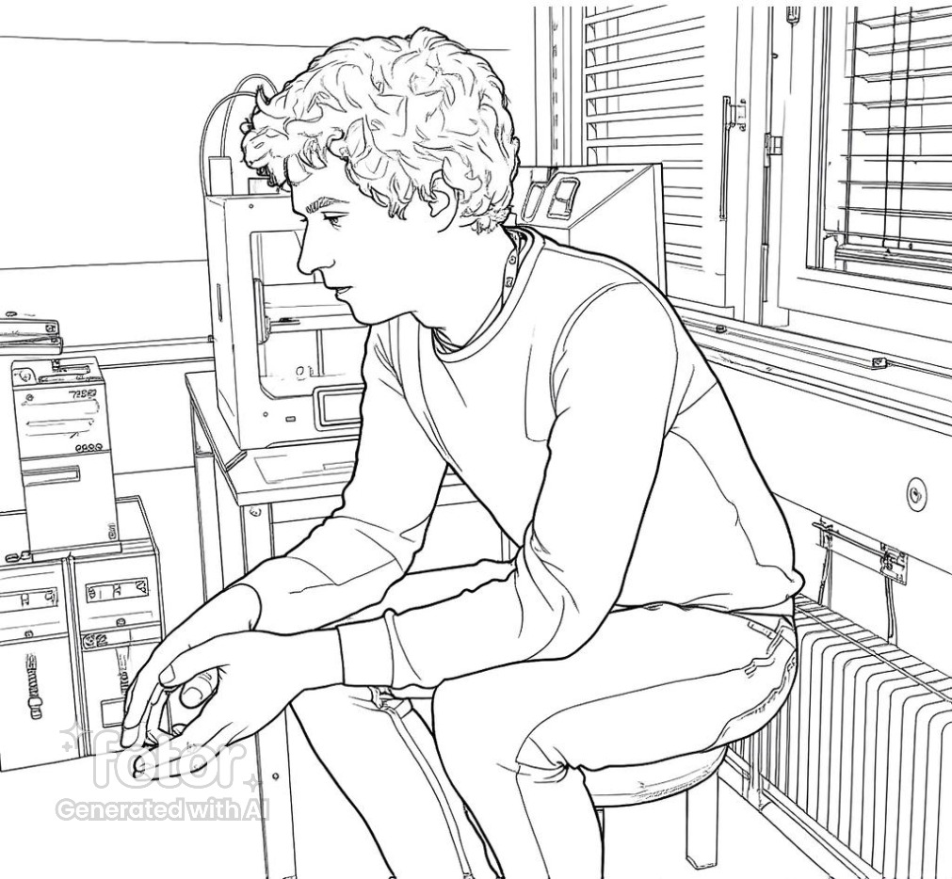
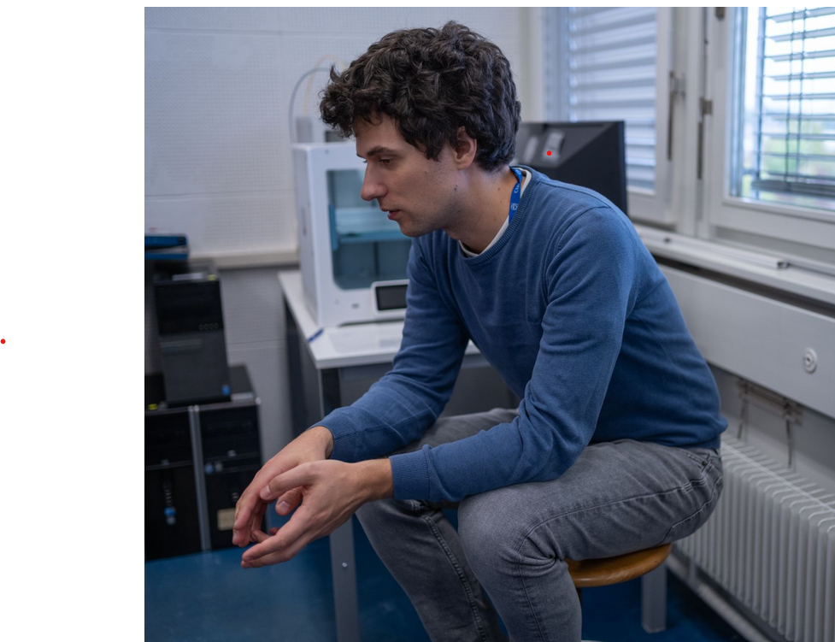
Now its time to look at your work

Slide 6
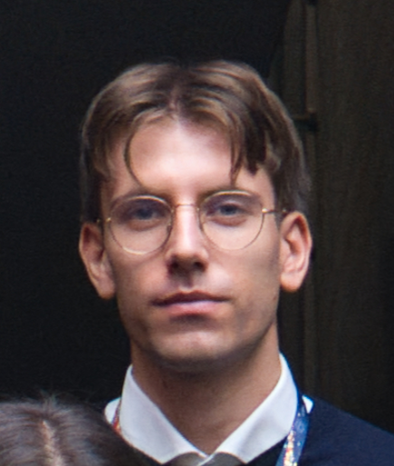
Alessandro Fondacci
Università and INFN Perugia (IT)

Slide 7
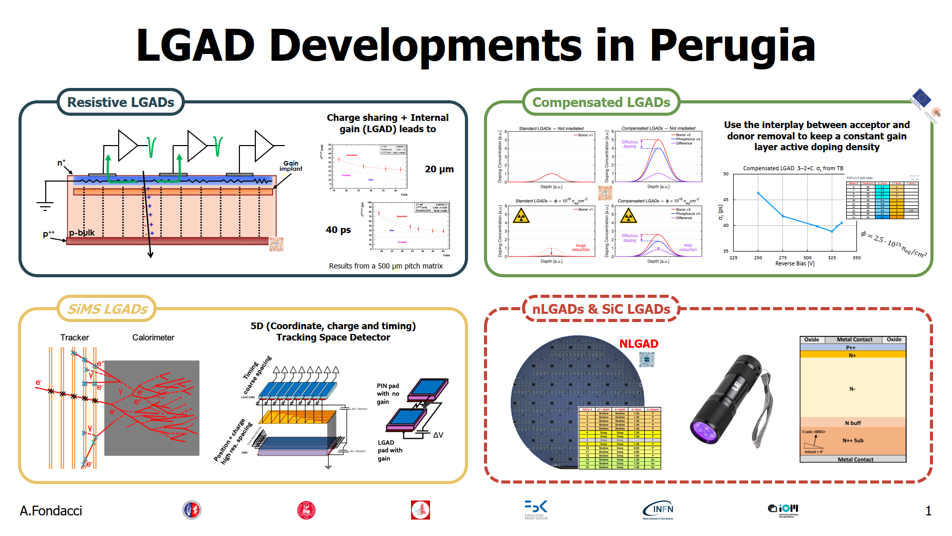

Slide 8
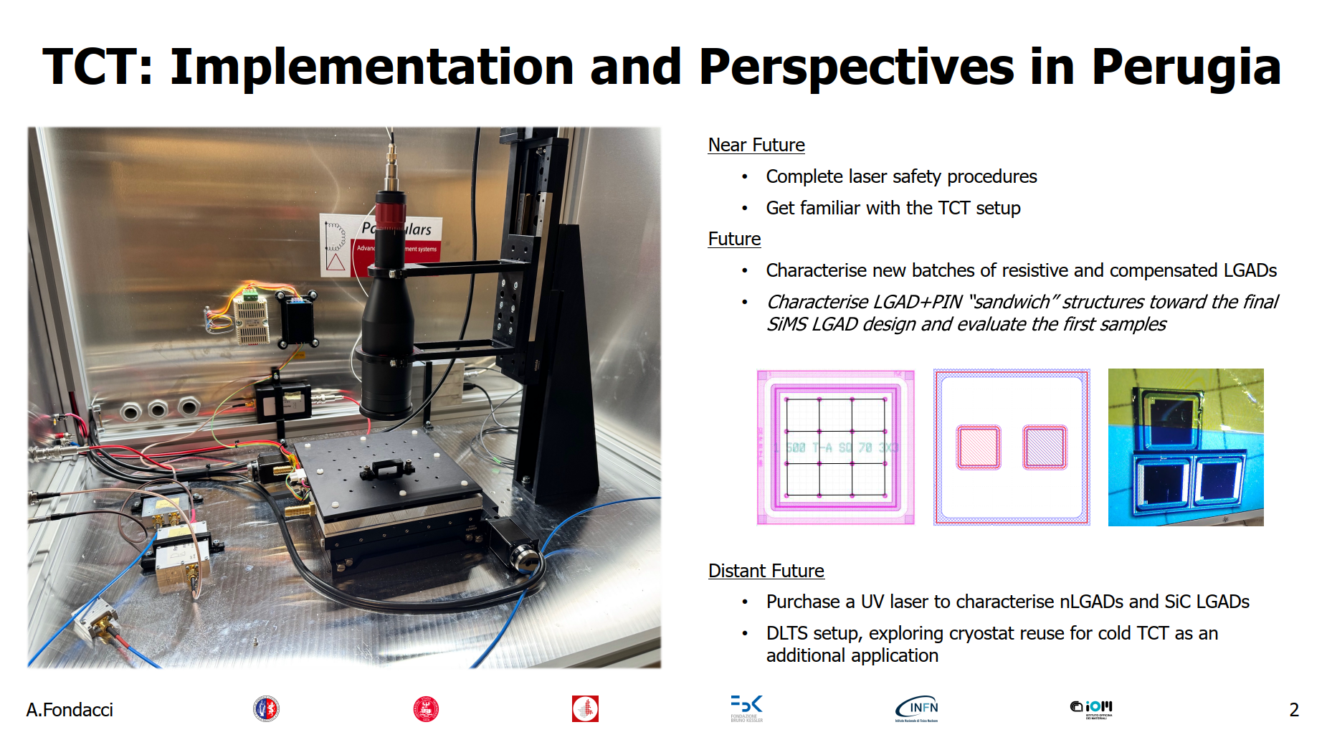

Slide 9
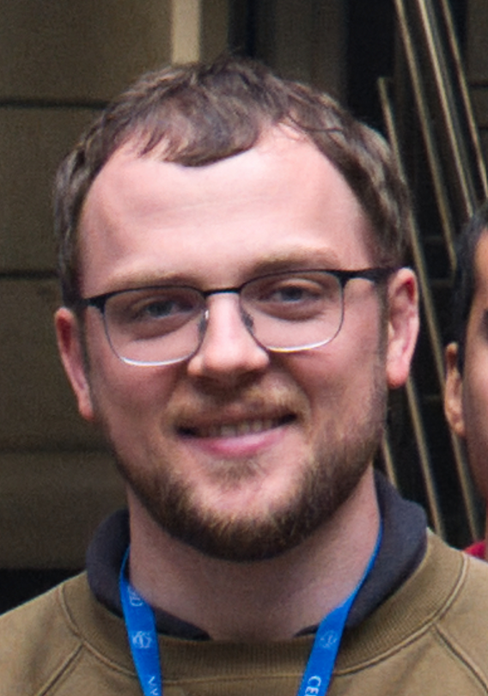
Andrew Gentry
New Mexico University

Slide 10



About Me
PhD student at the University of New Mexico
Expected grad. Spring ‘27
Supervisor: Sally Seidel
½ of my dissertation will be an analysis involving B-meson decays in ATLAS
½ of my dissertation is on silicon detector technology development for future colliders & beyond
Spending most of 2025 at SLAC doing detector work
Also at CERN for 6 weeks working w/ SSD Lab

Slide 11
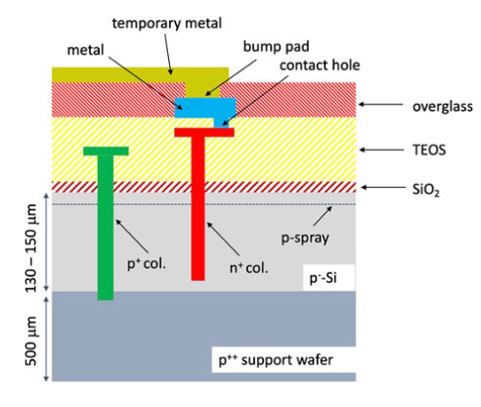
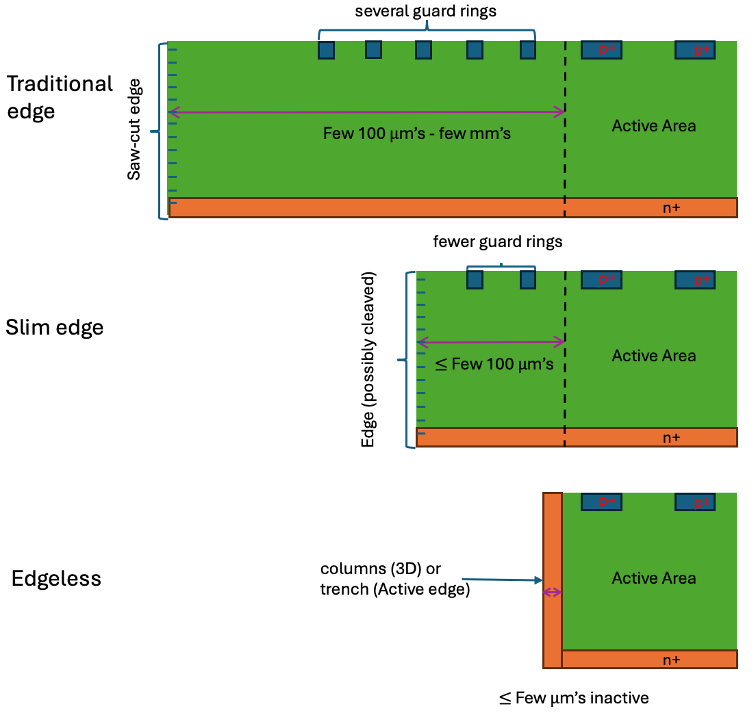
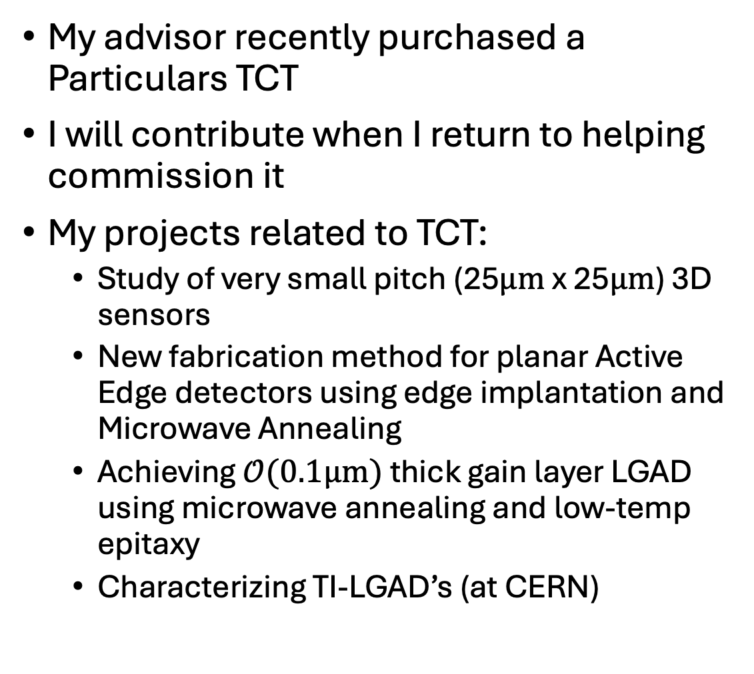
TCT – related projects
My advisor recently purchased a Particulars TCT
I will contribute when I return to helping commission it
My projects related to TCT:
Study of very small pitch (25$μm$ x 25$μm$) 3D sensors
New fabrication method for planar Active Edge detectors using edge implantation and Microwave Annealing
Achieving $𝒪(0.1μm)$ thick gain layer LGAD using microwave annealing and low-temp epitaxy
Characterizing TI-LGAD’s (at CERN)

Slide 12
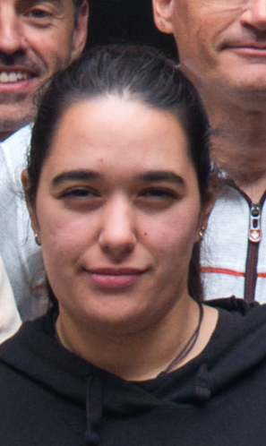
Carmen Torres Munoz
Universidad de Sevilla (ES)

Slide 13
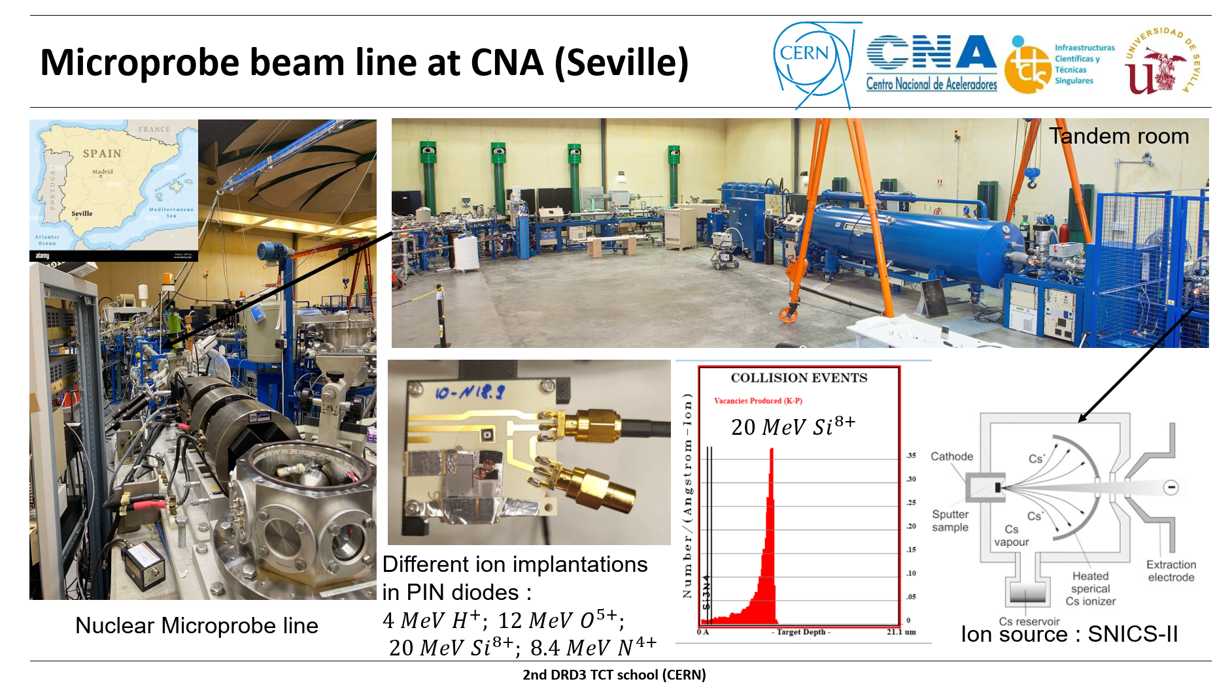

Slide 14
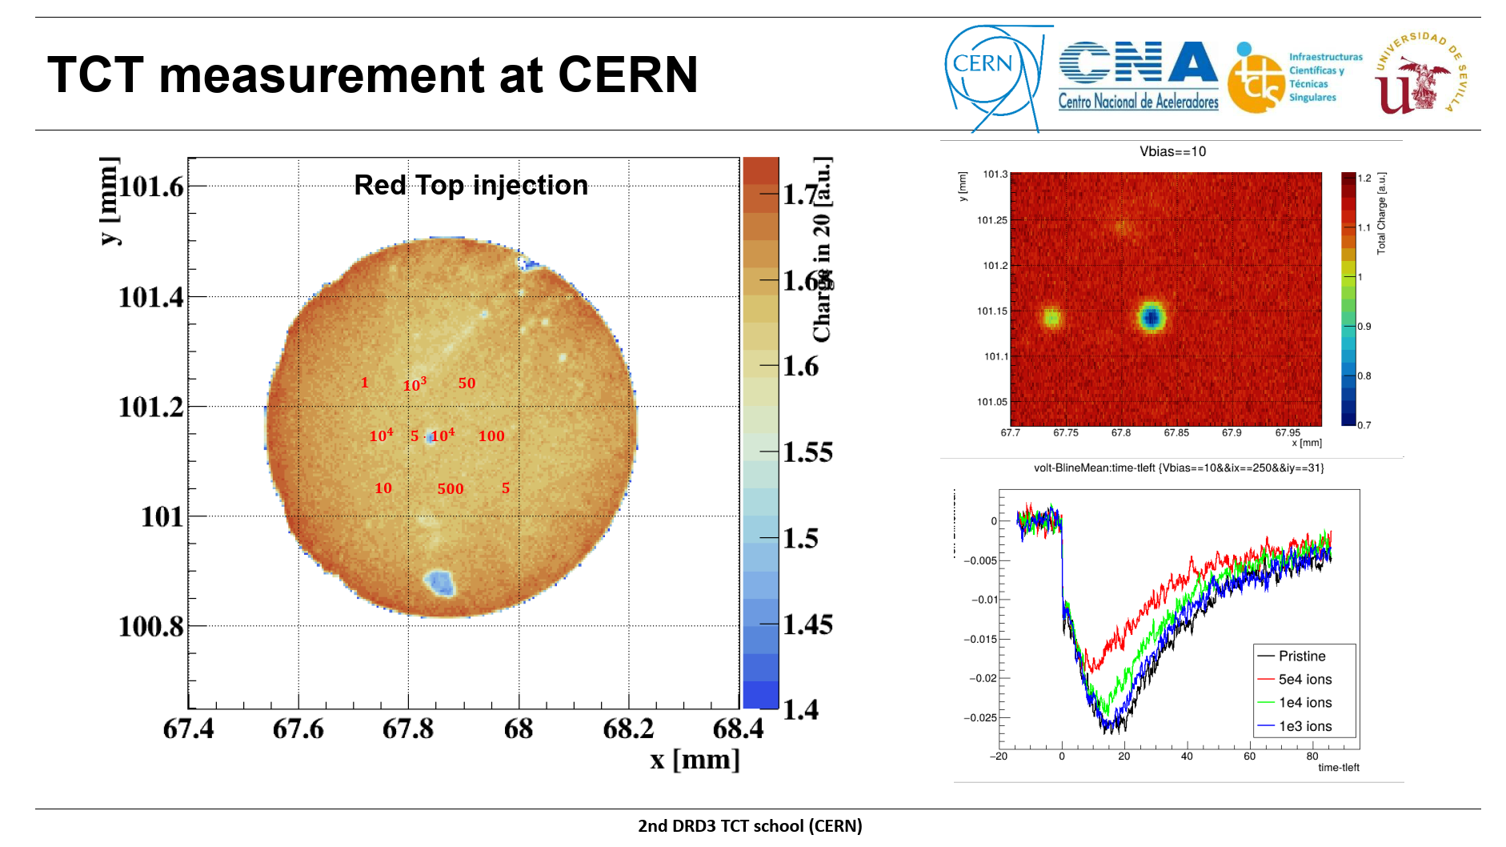

Slide 15
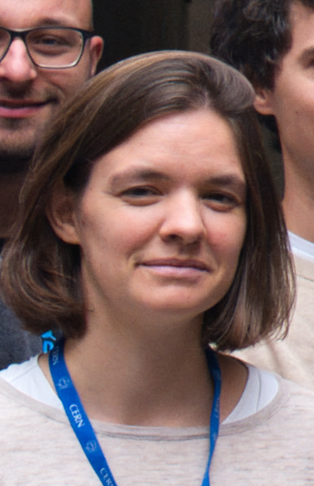
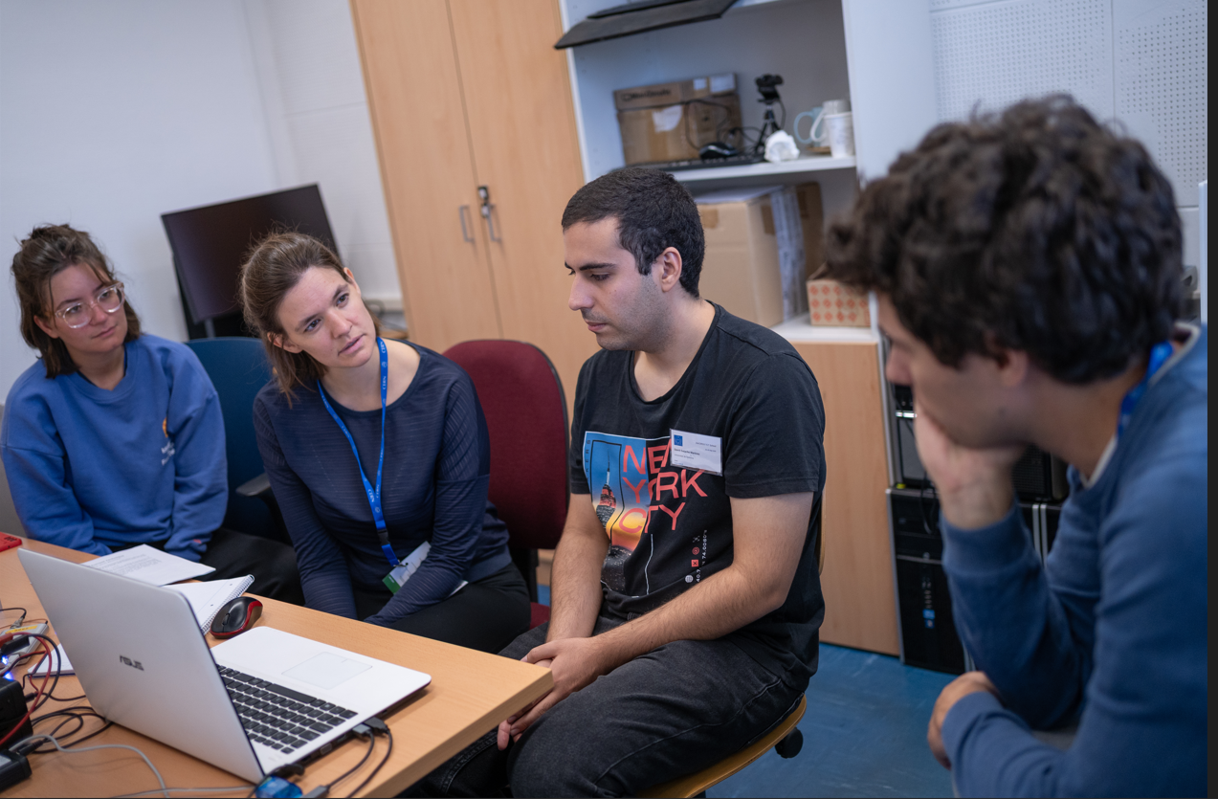
Cécile Marché
FYLA, Valencia (ES)

Slide 16
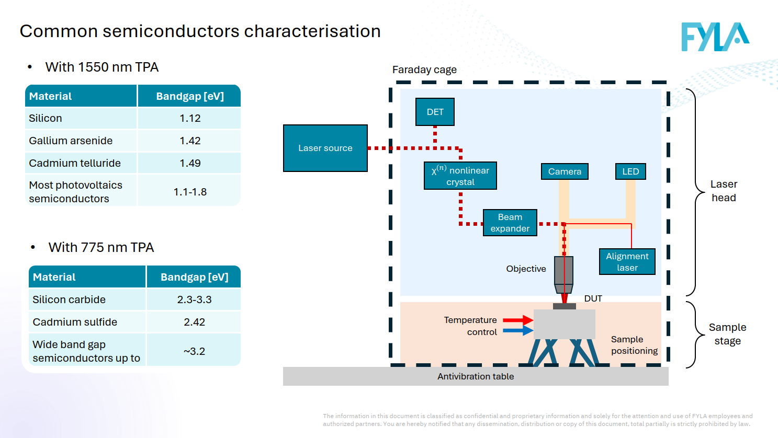

Slide 17
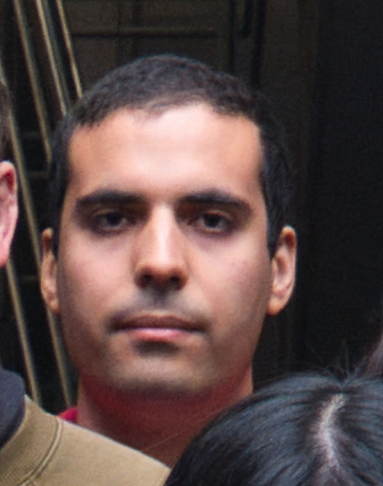
David Galacho Martinez
Universitat de València (ES)

Slide 18
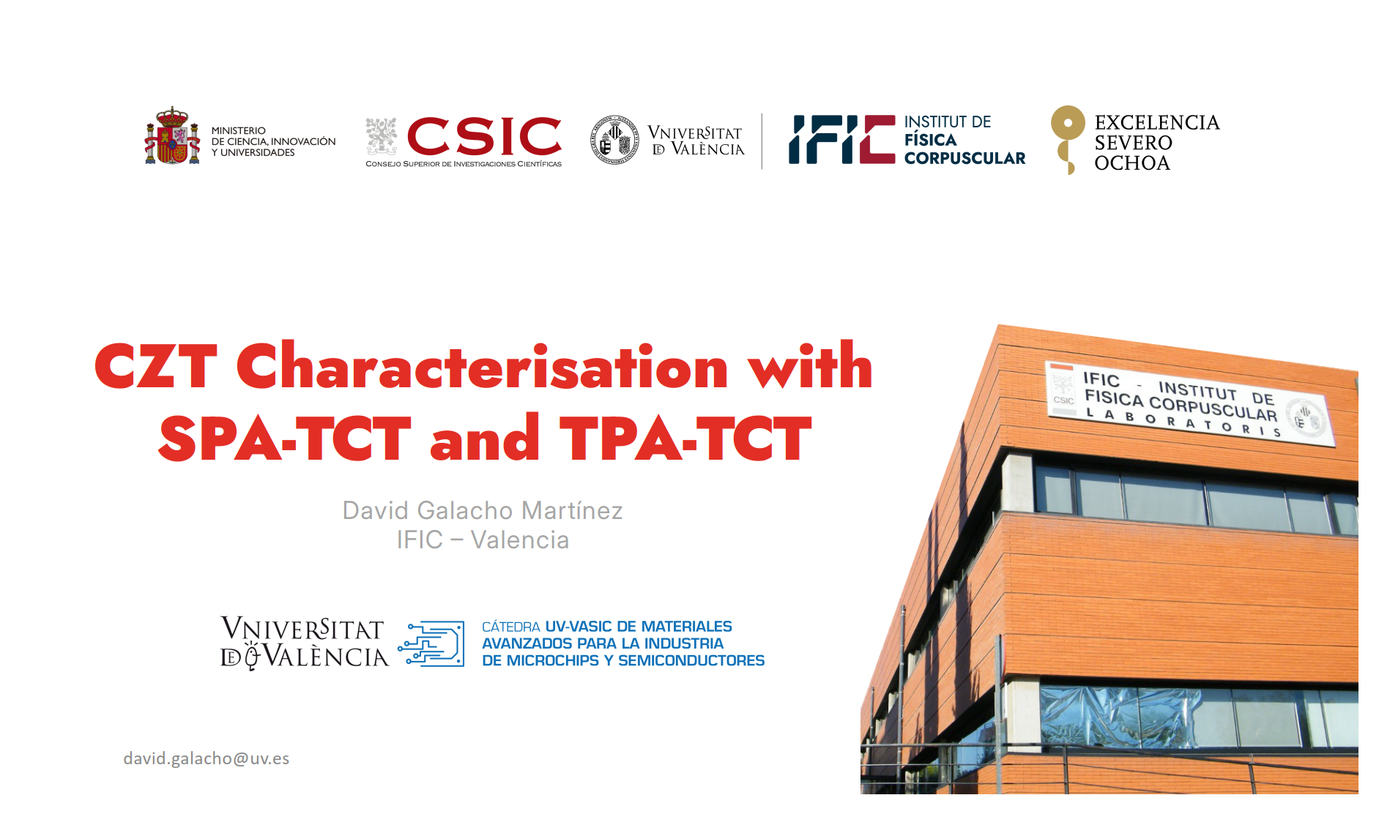

Slide 19
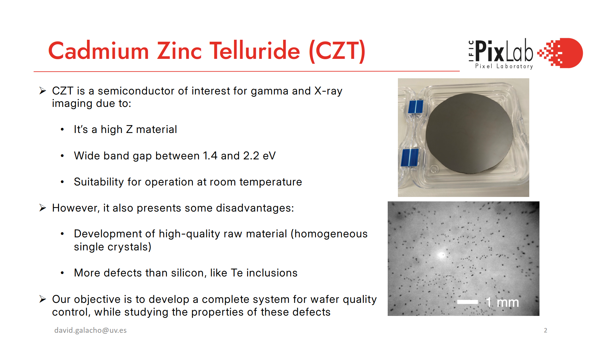

Slide 20
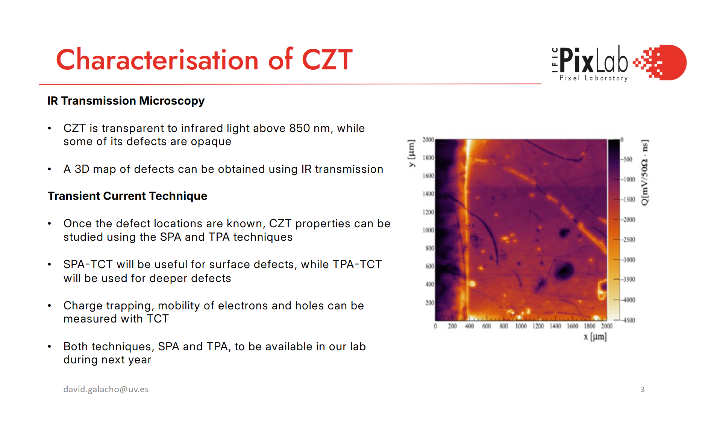

Slide 21
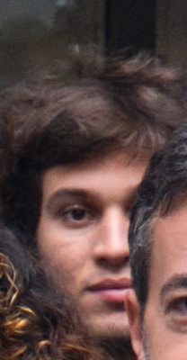
Dimitrios Xynis
National Technical Univ. of Athens (GR)

Slide 22
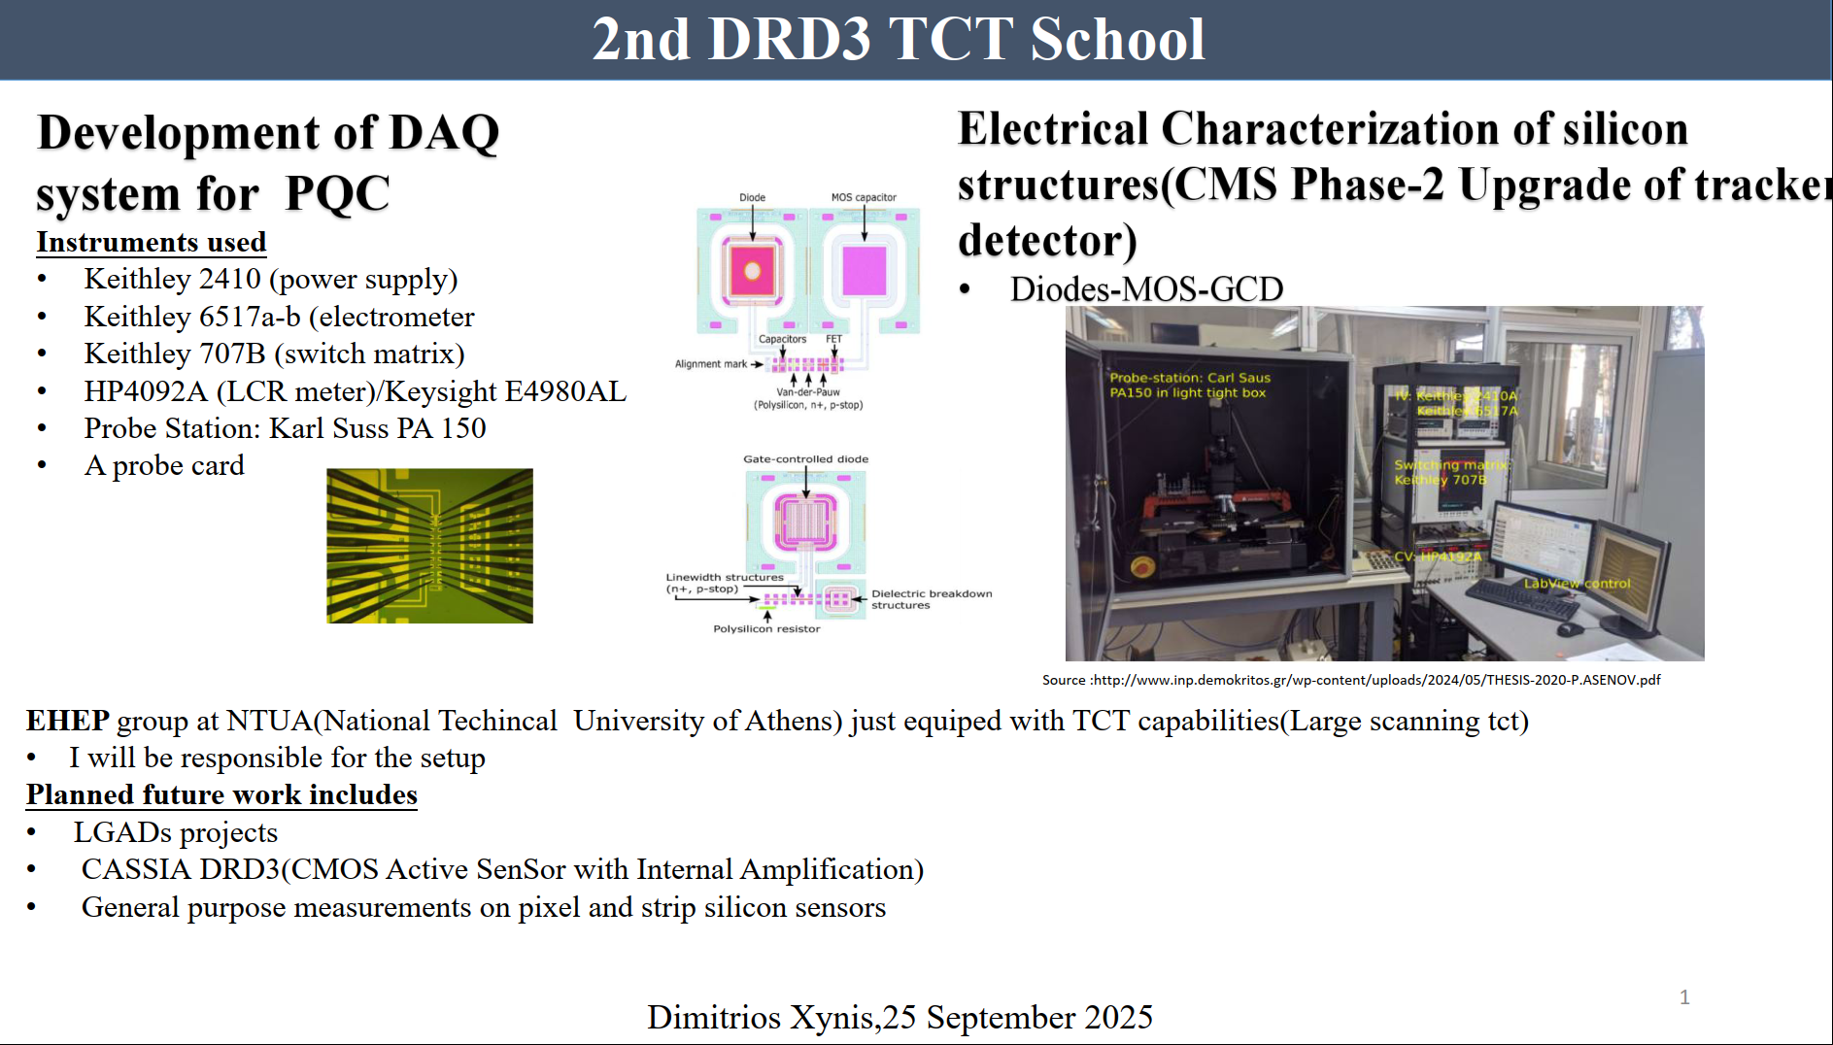

Slide 23
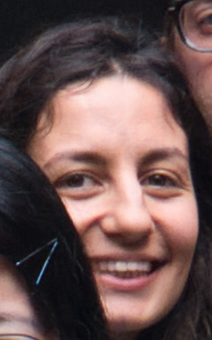
Evridki Chatzianagnostou
Nikhef National institute for subatomic physics (NL)

Slide 24


Slide 25
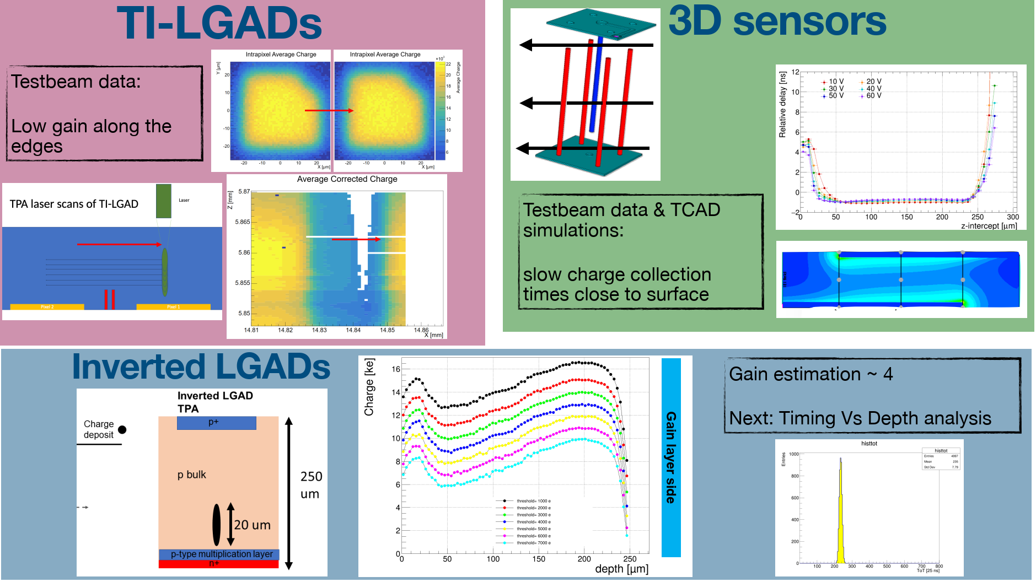

Slide 26
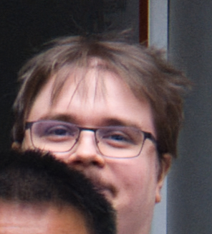
Henry Hiltunen
Lappeenranta-Lahti University of Technology

Slide 27
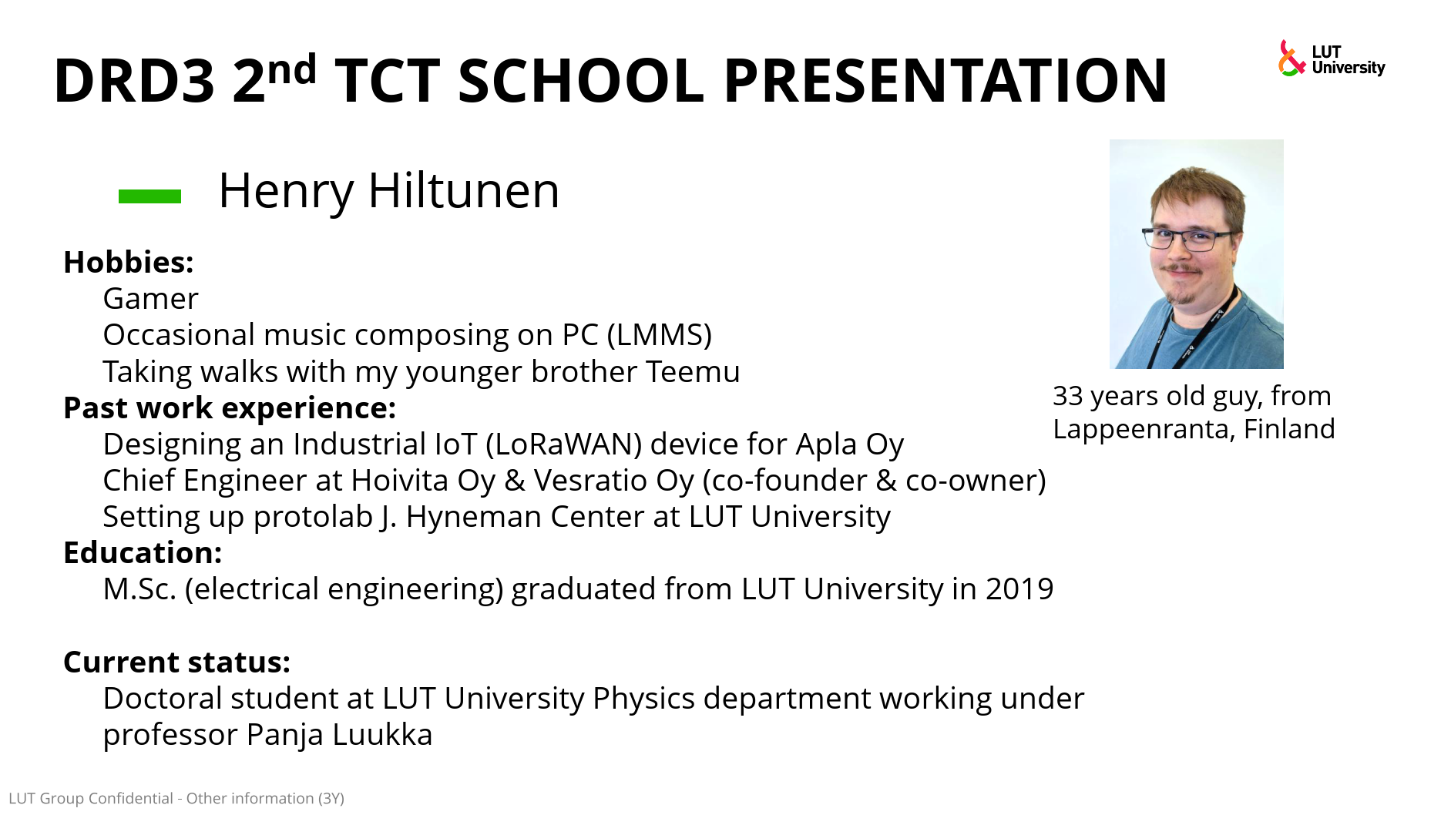

Slide 28
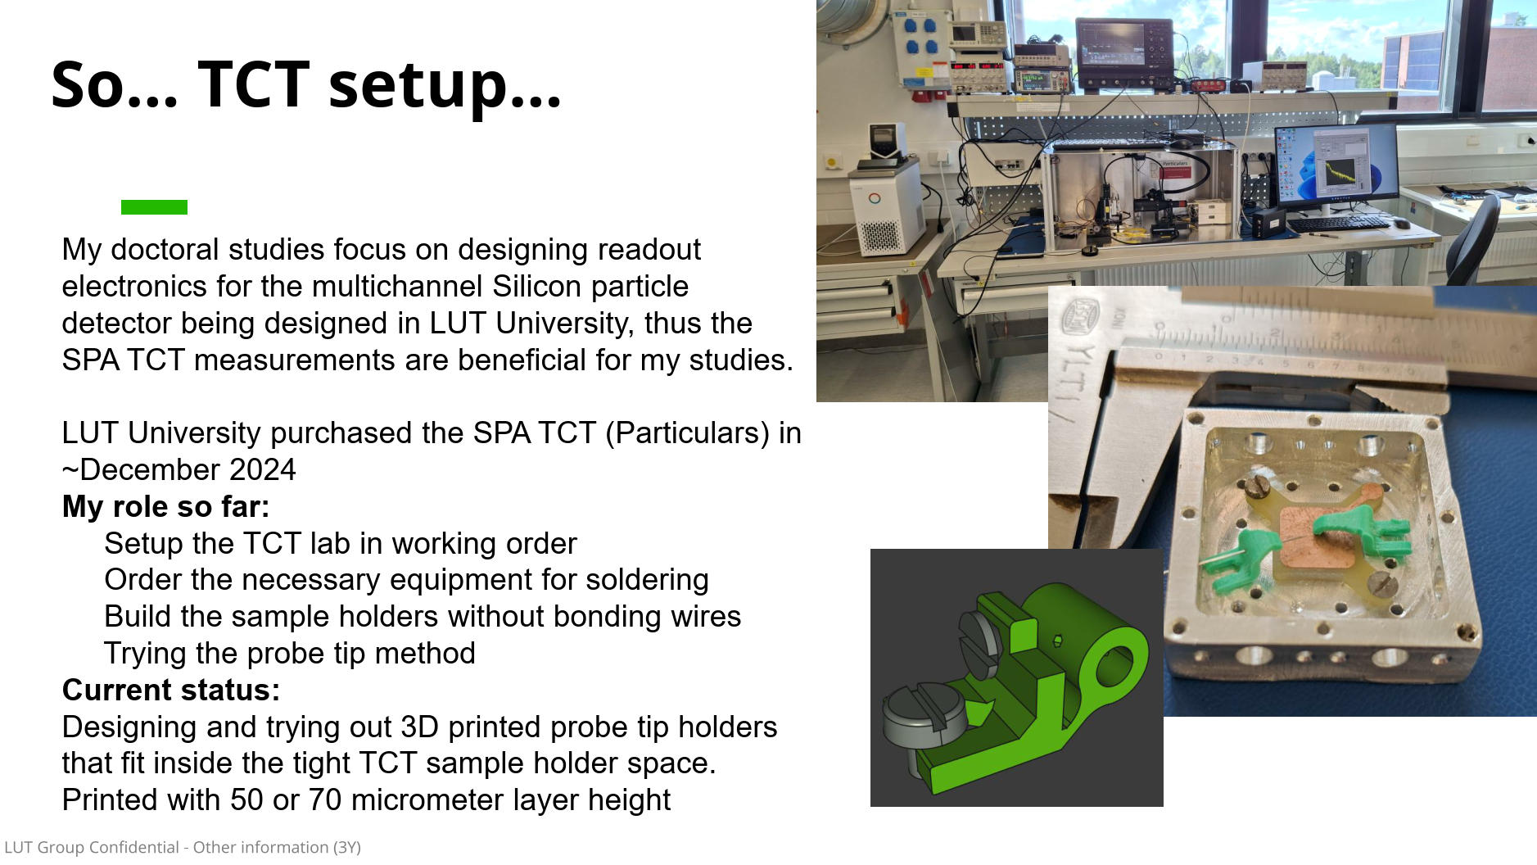

Slide 29
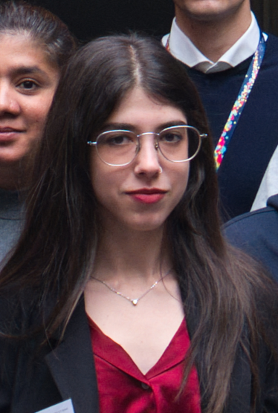
Ioanna Kalfa
CERN

Slide 30
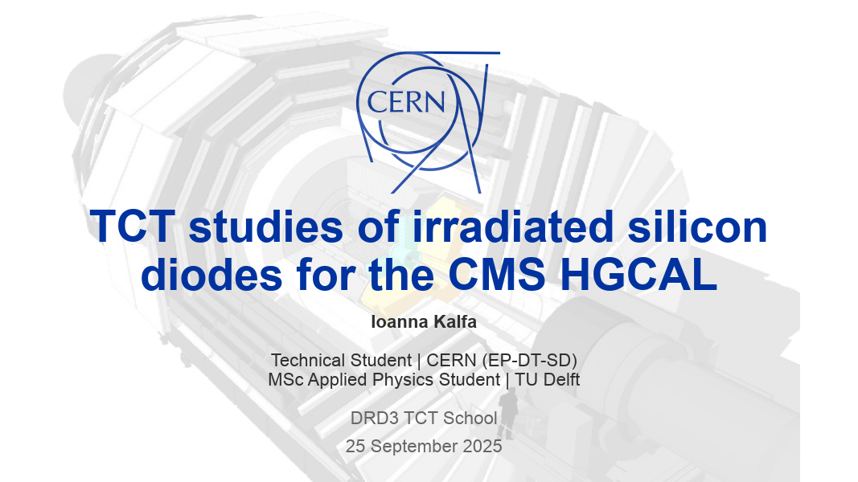

Slide 31
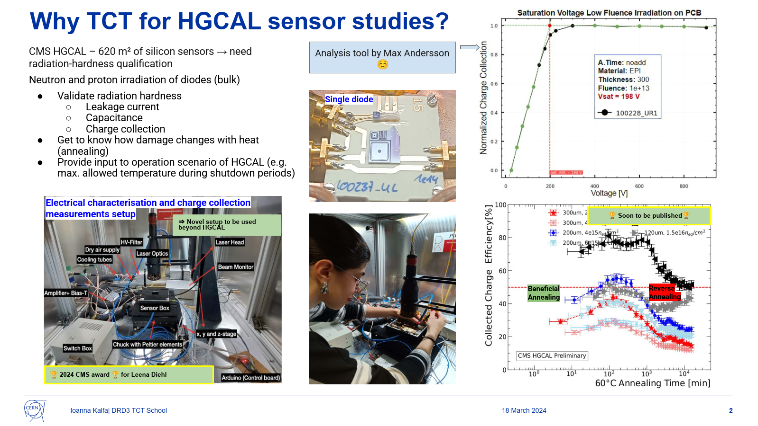

Slide 32
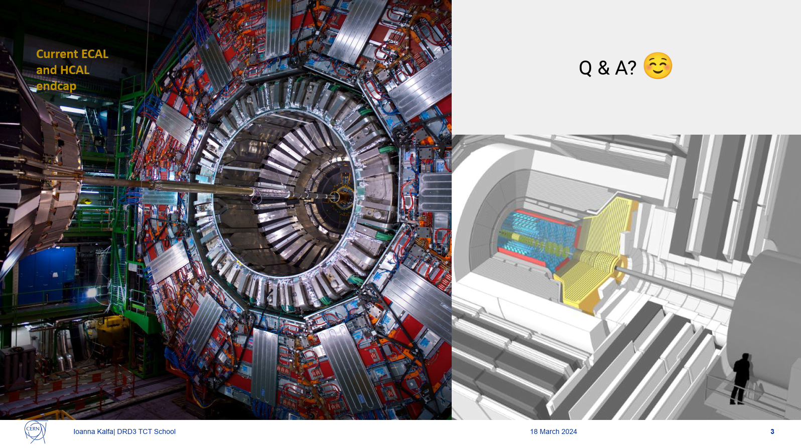

Slide 33

JACK JAMES ALEXANDER NICKSON
IMB-CNM, Barcelona (ES)

Slide 34


Slide 35


Slide 36


Slide 37


Slide 38

Jakub Bucko
Charles University (CZ)

Slide 39


Slide 40


Slide 41

Jixing Ye
Universita degli Studi di Trento and INFN (IT)

Slide 42




Small-Pitch 3D Pixel Sensors
MIP
Small-Pitch 3D pixel Sensor
Charge collection path are distorted at the surface and tip region.
How do we probe the in-pixel EF distribution both before and after radiation damage?
Charge collection process before irrad @ 100 V

Slide 43

Small-Pitch 3D Pixel Sensors
SPA to get the EF profile – a projection that includes all regions (i.e., the surface, the core, and the tip).
TPA to evaluate the EF distribution at different depth, corresponding to different regions (i.e., the surface, the core region, and the tip region at different depth)?
TPA at different depth of the core region to evaluate the influence of the surface and tip?
Electric field @ 100 V (2D)

Slide 44

Ludovico Massaccesi
University of Torino and INFN (IT)

Slide 45


Slide 46

Marta Adamina Krawczyk
Technische Universitat Munchen (DE)

Slide 47


Slide 48


Slide 49


Slide 50


Slide 51


Nikita Kramarenko
University of Helsinki

Slide 52

Alpha tct with Cdte/czt planar sensors

Slide 53










CZT TCT and spectra measurements with a tri-alpha source
1 mm collimator
A(t) ≈ 10 kBq
²³⁹Pu (5.16 MeV)
²⁴¹Am (5.49 MeV)
²⁴⁴Cm (5.81 MeV)
Integrating the waveforms yields:
we also measure LGADs…
Track Length
Deposited Energy

Slide 54

Owen Johnson
University of Tennessee Knxoville

Slide 55
Owen Johnson Department of Nuclear Engineering 25/09/2025

Slide 56


Diamond, Alpha Spectroscopy
Bias
Readout
Developing a sensor for Alpha spectroscopy
Using an undoped sample, but we modify the surface/bulk with laser induced graphitization and plasma-focused ion-beam etching
How do these processes affect charge carrier properties???
Gold Electrodes
Ground
~5 MeV Alpha Particles
Fig. 1: Charge injection with alpha particles
Fig. 2: Graphitic pads etched onto diamonds surface
Fig. 3: A Diamond mounted in a cryostat for temperature-dependent tests

Slide 57





TCT? Diamond Temperature Dependence
Fig. 4: Integrate the charge deposited and bin it in an MCA
Fig. 6: Normalized Oscilloscope traces from preamplifier
Fig. 7: Pre-amplifier Deconvolved traces
As the pre-amplifier integrates charge it begins decaying away to reset. IF you remove this decay you get total charge at that point, providing information on drift velocity, mobility, and charge trapping.
Fig. 5: Make CCE curves and fit Hetch equation to return ‘carrier-mobility lifetime product’

Slide 58

Parisa Rezaei Mianroodi
Glasgow University (GB)

Slide 59


Slide 60


Slide 61


Slide 62


Slide 63


Slide 64

Rebekka Wittwer
Universität Bern (CH)

Slide 65


Slide 66


Slide 67


Slide 68

Shuhui Huang
University of Cambridge (GB)

Slide 69


