Slide 2
Cryogenics for Gravitational Wave Detection
Torsten Koettig, CERN TE/CRG-CL
Contributions from R. Nawrodt, University of Stuttgart, Germany

Slide 3
Content
Detection principle
How to achieve sufficient sensitivity?
Future generations of GWD => towards Einstein Telescope
Noise limitations
Cryogenic approach

Slide 4
detection principle

Slide 5
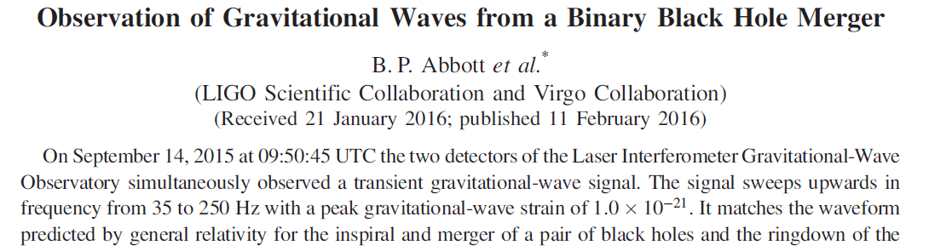
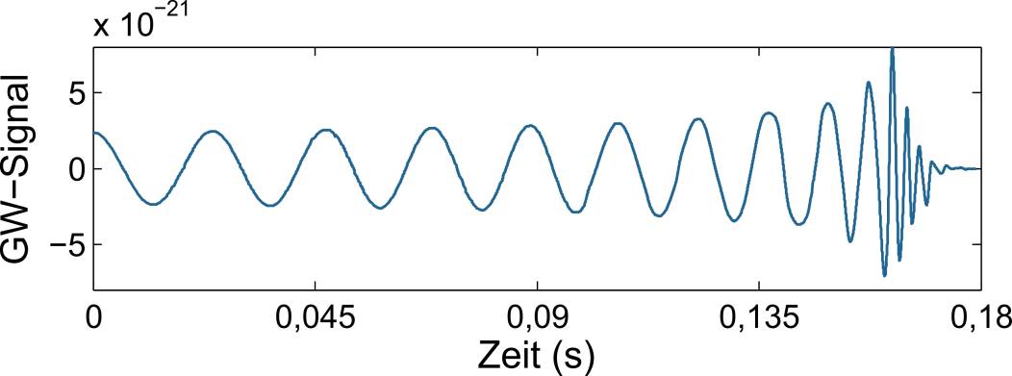
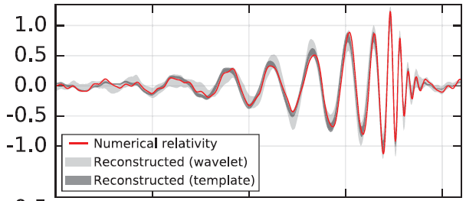
How should a GW signal look like?
Typical plot of an experimentalist what to expect
x 10⁻²¹
strength
[S. Kroker]
0.25
time (s)
0.45

Slide 6
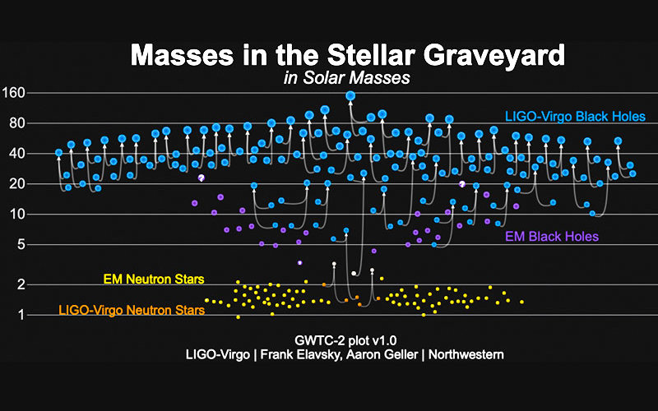
What signals have been detected so far?
This plot shows the masses of all compact binaries detected by LIGO/Virgo, with black holes in blue and neutron stars in orange. Also shown are stellar mass black holes (purple) and neutron stars (yellow) discovered with electromagnetic observations. Credits: LIGO/Virgo/Northwestern Univ./Frank Elavsky.

Slide 7
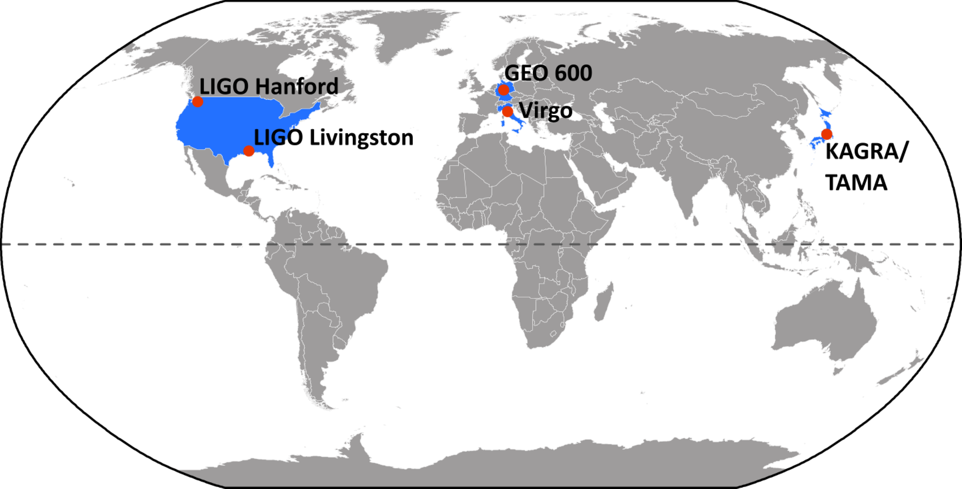
Currently available detectors
Source: R. Nawrodt, Thermal Noise in Precision Instrumentation, 2017

Slide 8
The „strength“ of gravitational waves
ΔL
L
h=ΔL/L
(„strength“ of a GW)

Slide 9
Michelson-based interferometers
proposed by R. Weiss in 1972

Slide 10
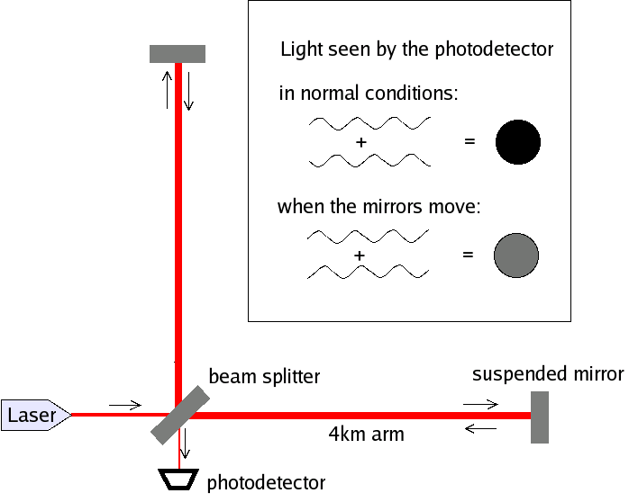
Michelson-based interferometers
Michelson-interferometer acts as a phase-to-amplitude converter
suspending test masses:
to create „free-fall“ on Earth
to decouple from seismic motion
accuracy needed:
L ~ km, h ~ 10⁻²¹ → ΔL = 10⁻¹⁸ m
L ~ distance earth – sun → ΔL = 10⁻¹⁰ m
L ~ distance sun – next star → ΔL = 10⁻⁵ m

Slide 11
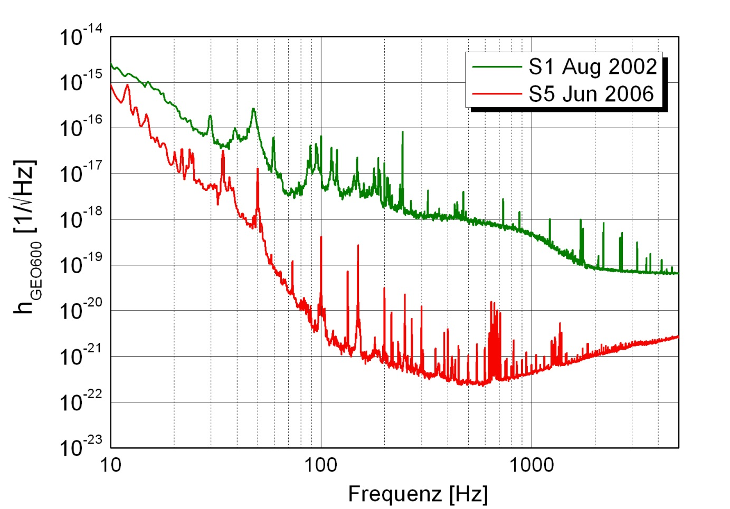
Sensitivity of modern detectors
Sensitivity of GEO600
Seismic
Quantum noise
Thermal
noise
Frequency (Hz)

Slide 12
Sensitivity of modern detectors - Seismic
Sensitivity of GEO600
Seismic
Frequency (Hz)

Slide 13
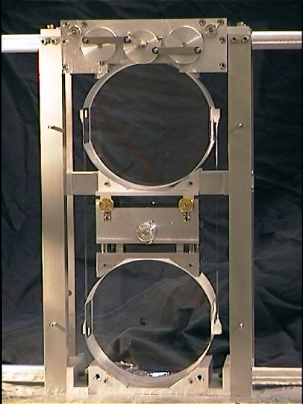
How to establish free-falling test mass on Earth?
free-fall for particles needed along the laser direction
idea: use of simple pendulum above resonance
free gift: seismic decoupling
free test mass
(with damping)
amplitude
pendulum
frequency

Slide 14
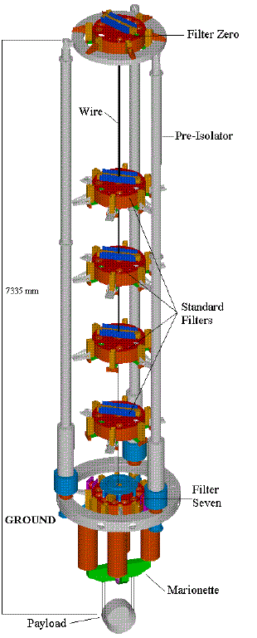
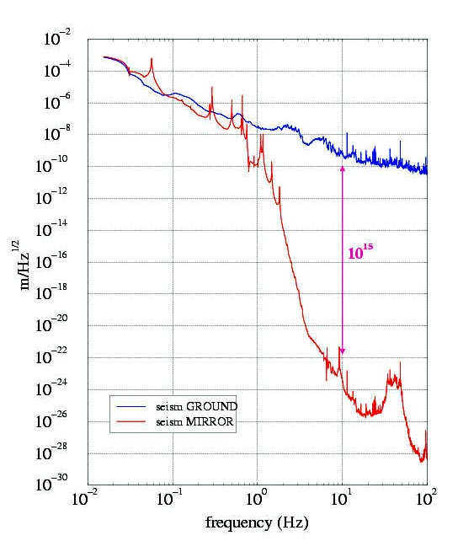
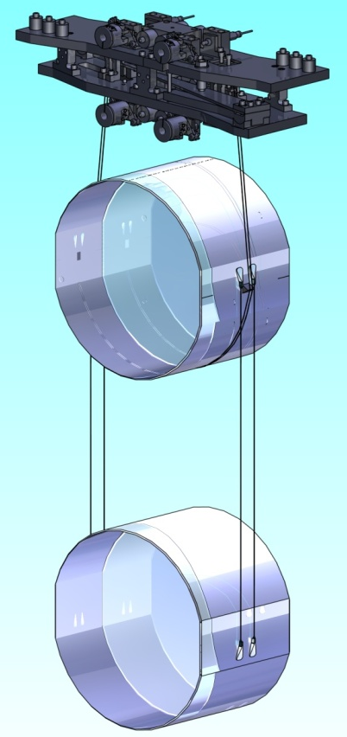
Seismic decoupling
Multi-stage suspensions allow better filtering

Slide 15
Sensitivity of modern detectors – Quantum noise
Sensitivity of GEO600
Quantum noise
Frequency (Hz)

Slide 16
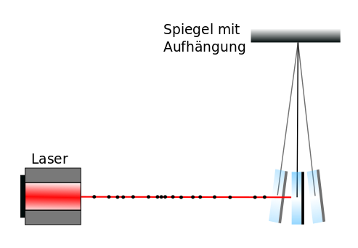
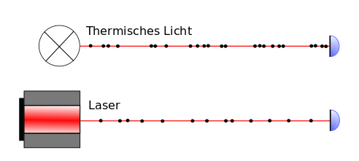
Quantum noise (2)
Two types:
Radiation pressure noise (low frequency)
=> active compensation, large mirror mass
Shot noise (high frequency)
=> Laser quality and power
Suspended
mirror
Thermal light

Slide 17
Sensitivity of modern detectors – Thermal noise
Sensitivity of GEO600
Thermal
noise
Frequency (Hz)

Slide 18
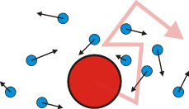
Thermal noise (2)
How stable are the arms of the interferometer?
  Optic elements, atoms at the surface fluctuate → Virtual length change
Brownian motion => noise

Slide 19
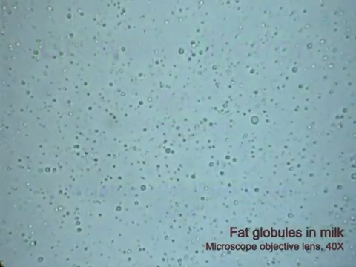
Thermal noise (3) example of Brownian motion

Slide 20
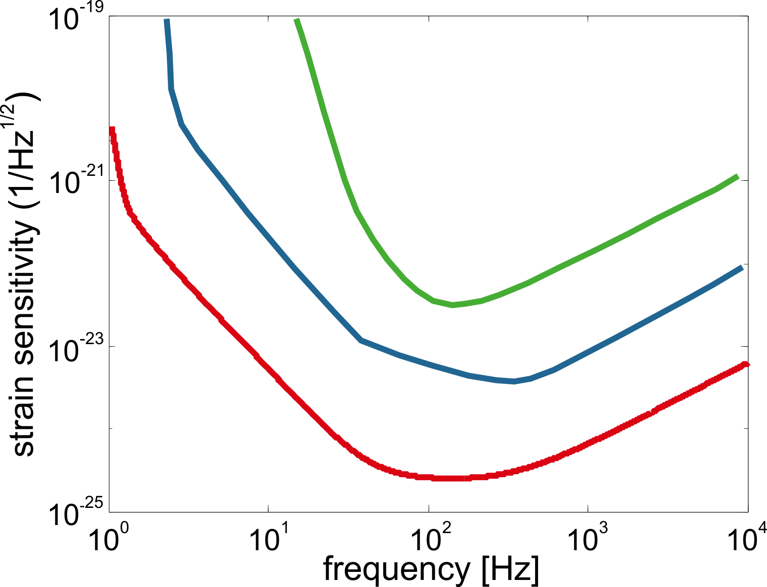
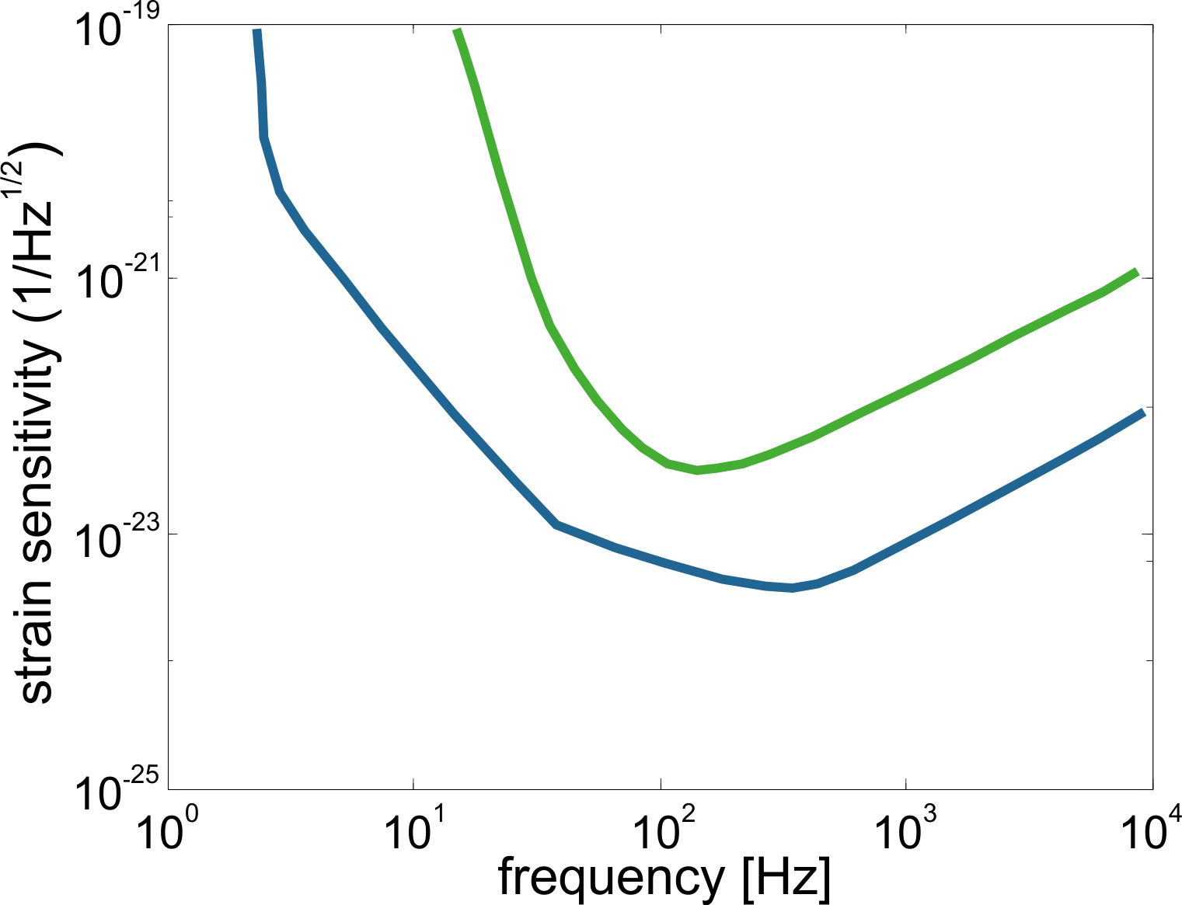
Goals for Advanced Detectors
Better decoupling from seismic
Much lower thermal noise from test masses and suspension
Lower quantum noise at all frequencies
1. Generation
2. Generation
3. Generation
Higher Laser power
Better decoupling by larger masses
Lower thermal noise

Slide 21
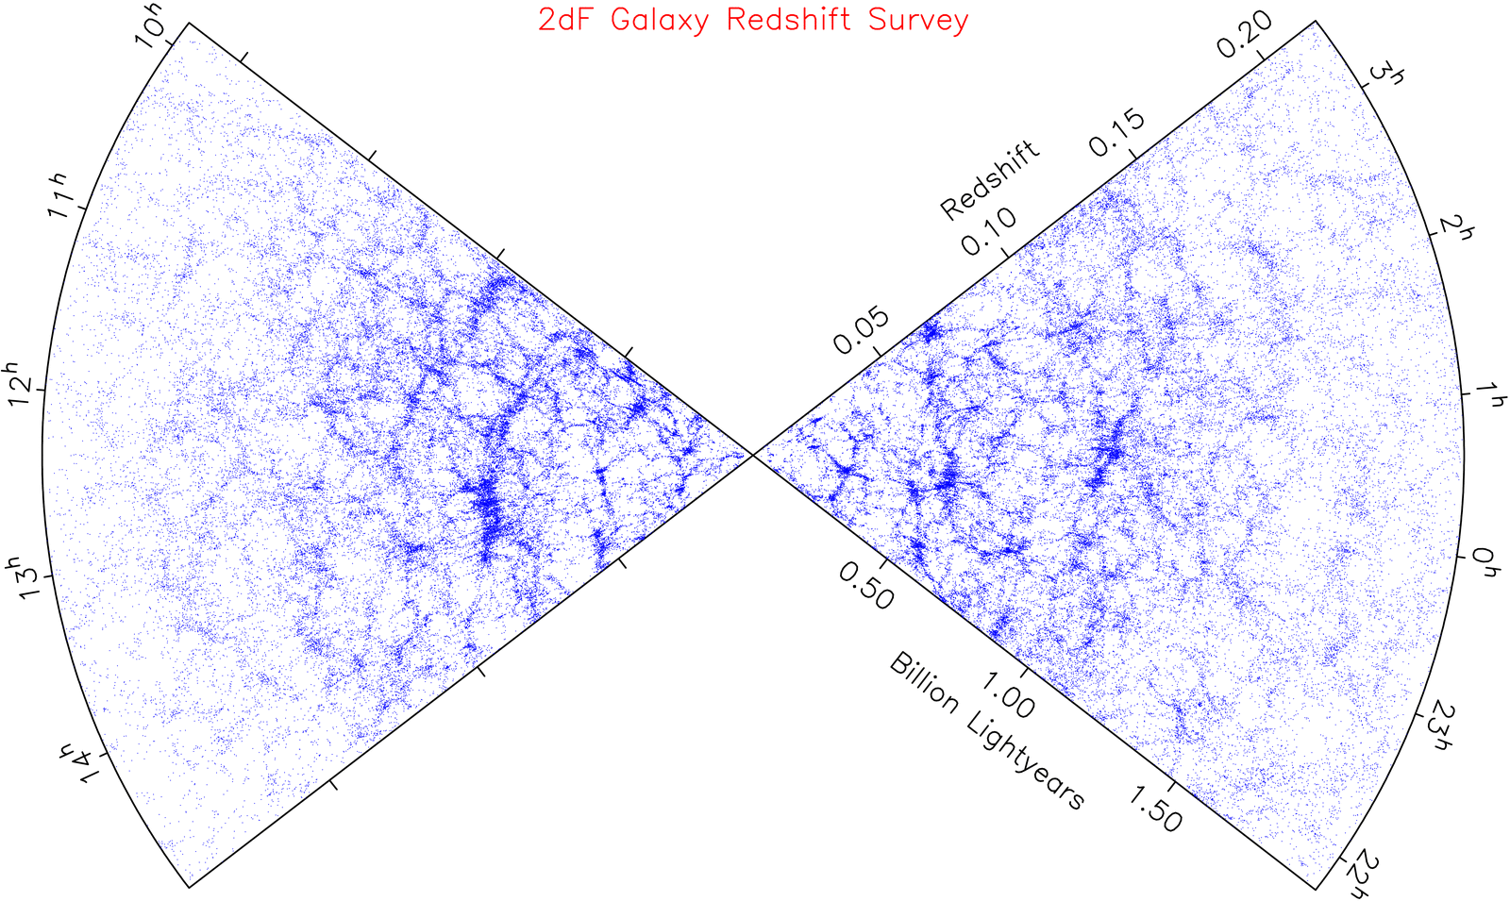
Where could we get?
GRB050509B
1ST GENERATION
aLIGO
AdV
KAGRA
Einstein Telescope
[G. Cagnoli, LMA)

Slide 22
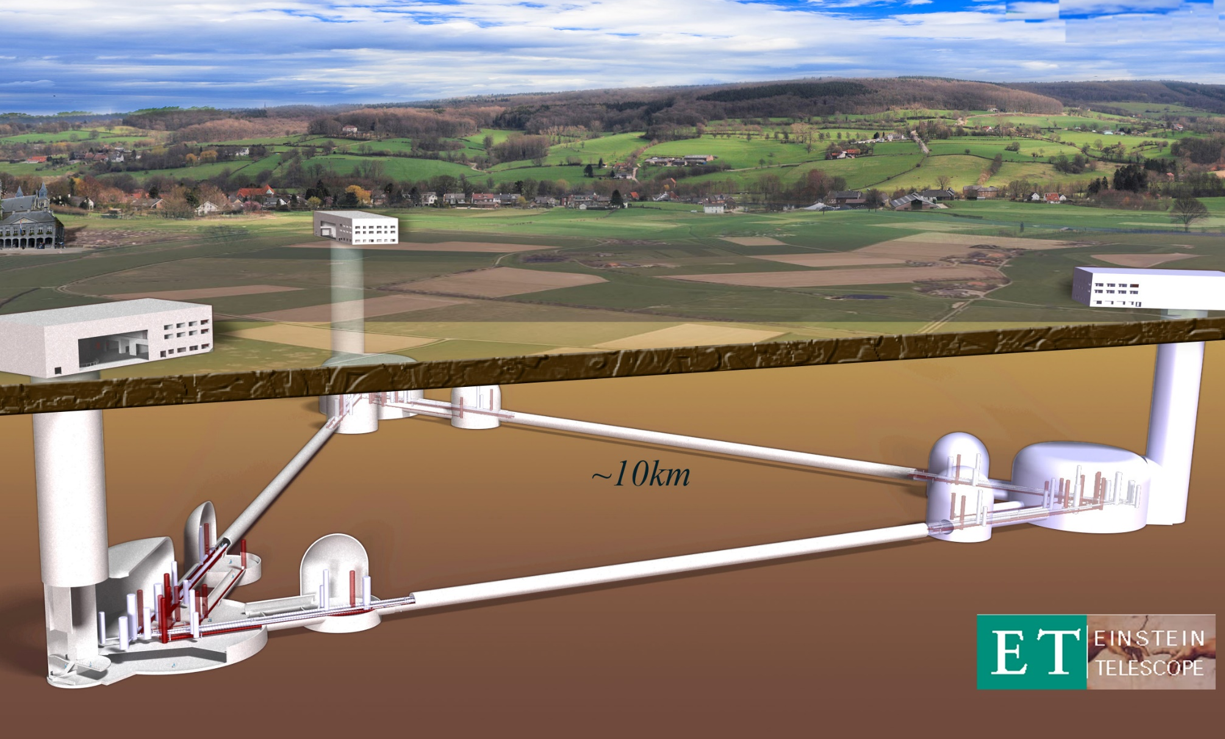
Planned ET Infrastructure
Technologies:
• Size: 10 km arm length
• Xylophone design: ET-LF, ET-HF
• ET-Low Frequency:
  Underground
  Cryogenics
  Silicon (Sapphire) test masses
  Large test masses (~ 200 kg)
  New coatings
  New laser wavelength
  Seismic suspensions
  Frequency dependent squeezing
• ET-High Frequency:
  High power laser
  Large test masses
  New coatings
  Thermal compensation
  Frequency dependent squeezing
Courtesy: P. Rapagnani, Cryogenics Einstein Telescope 3rd generation GW Interferometer

Slide 23
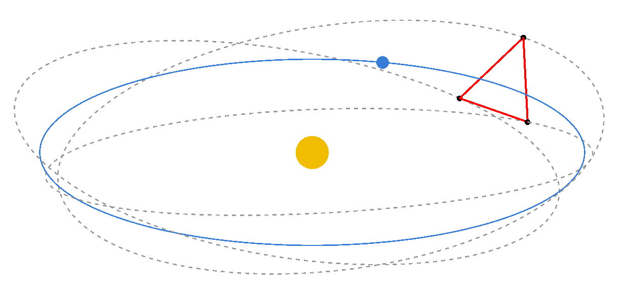
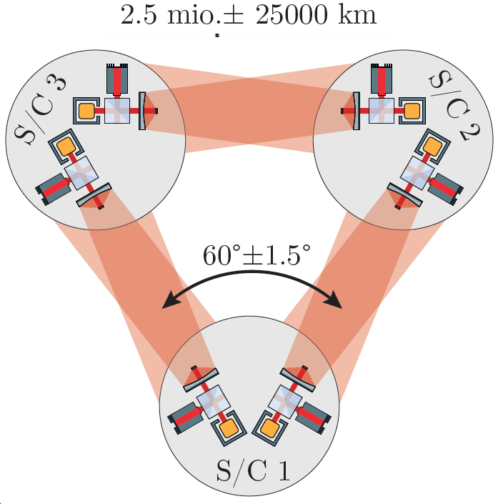
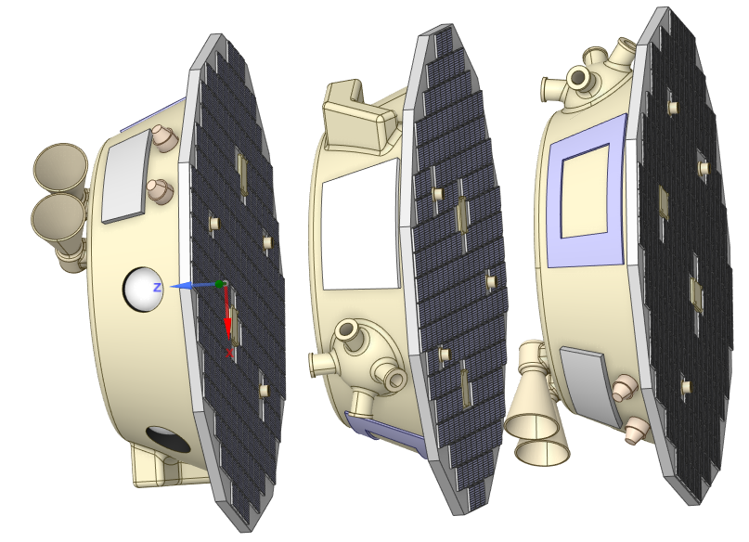
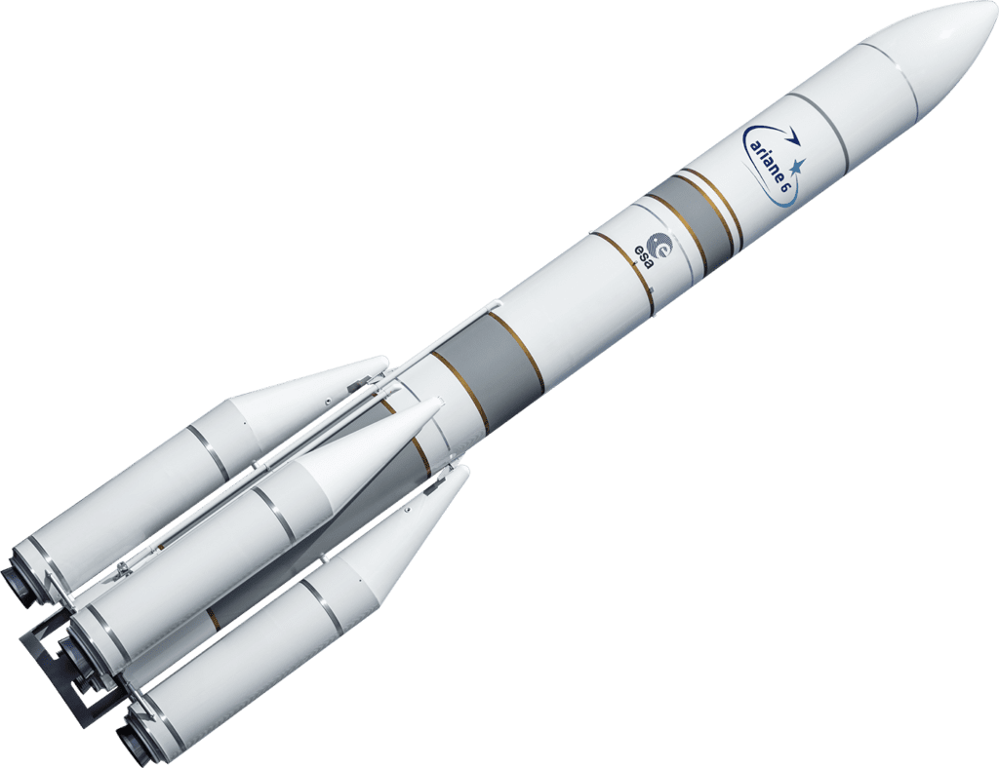
Going beyond => space mission for low frequency => LISA
LISA 20 deg. following Earth
Courtesy: C. Zanoni, Laser Interferometer Space Antenna, INFN, 11/2022
Will be launched with Ariane 6

Slide 24
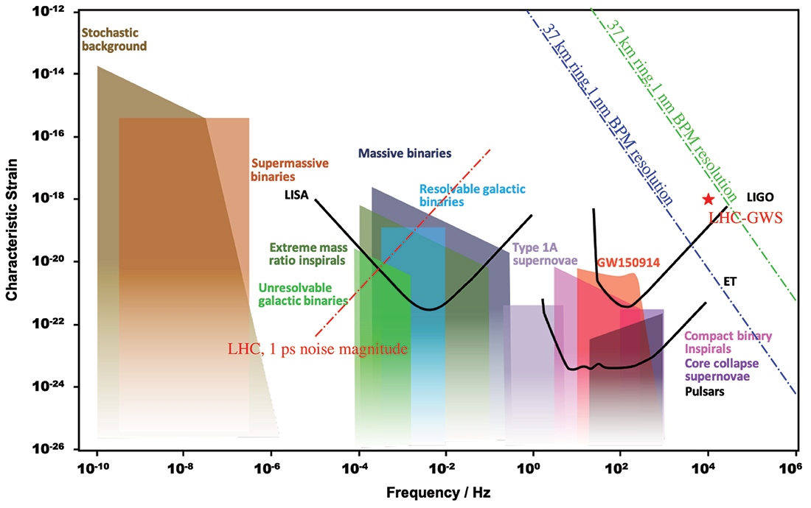
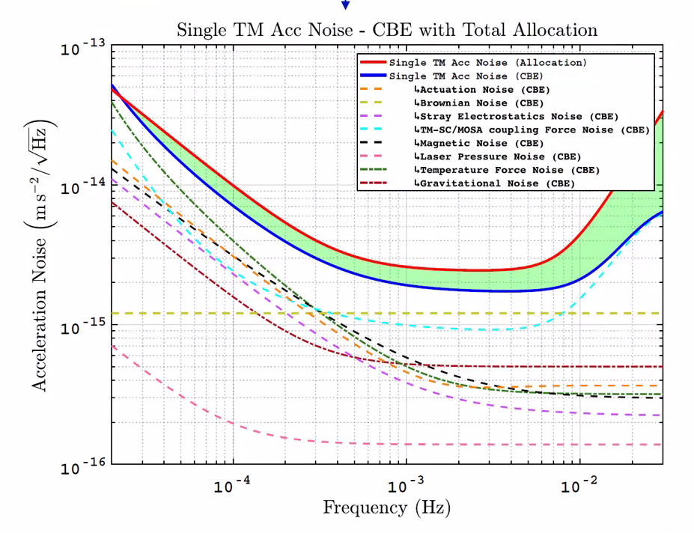
Going beyond => space mission for low frequency => LISA
Courtesy: C. Zanoni, Laser Interferometer Space Antenna, INFN, 11/2022
CERN courier: Sources and sensitivities GW sources (shaded) and detector sensitivities (lines), including those for the space-based interferometer LISA and the ground-based interferometers LIGO and the Einstein Telescope. Accelerator-based detection methods and sources are superimposed based on optimistic assumptions which require future confirmation. The LHC’s sensitivity to longitudinal synchrotron resonances, assuming 1 ps noise in the proton-bunch “travel time”, or its measurement (red line), is based on work by Suvrat Rao. The sensitivity of a 37 km ring with GW-antenna optics to transverse betatron resonances, assuming 1 pm (blue line) and 1 nm (green line) beam-position resolutions, is based on estimates by Katsunobu Oide, Giuliano Franchetti and Frank Zimmermann. The predicted strength of the LHC as a source of coherent “gravitational synchrotron radiation”, assuming all protons in a beam are contributing coherently (red star), is based on work by Pisin Chen. Credit: http://gwplotter.com / S. Rao et al. / K. Oide, G. Franchetti & F. Zimmermann / P. Chen.

Slide 25
Low thermal noise operation

Slide 26
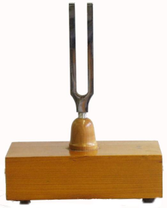
Fluctuation-Dissipation-Theorem
Dissipation
Heat bath
Macroscopic
vibration
Loss/friction φ
Microscopic
states
Fluctuation / noise
Large loss → large noise

Slide 27
A wonderful construction material at room temperature
Fused silica (amorphous high purity SiO₂-glass)
  Very strong (7 GPa breaking strength under tension)
  Easy to pull fibres, polish, weld
  Chemically (nearly) inert
  Available in large pieces
  Extremely low mechanical loss ~ 10⁻⁹ at room temperature

Slide 28
Thermal noise of optical components
Two types of thermal noise in opto-mechanical systems:
  driven by thermal energy (Brownian thermal noise)
  driven by temperature fluctuations δT
  δT → Δx, Δϕ
  coupling done via material properties (e.g. coefficient of thermal expansion α, thermo-optic coefficient dn/dT, etc.)
  Example: typical material α ~ 10⁻⁶ 1/K, δT = 1 K → ΔL/L ~ 10⁻⁶

Slide 29
Brownian thermal noise of optical materials
Fluctuation-dissipation-theorem tells us about the correlation between noise and loss:
S_{x}(ω,T) ~ T × φ
Two possible options:
  operate at low temperatures
  utilize low mechanical loss materials (widely unknown parameter)
  use a clever design

Slide 30
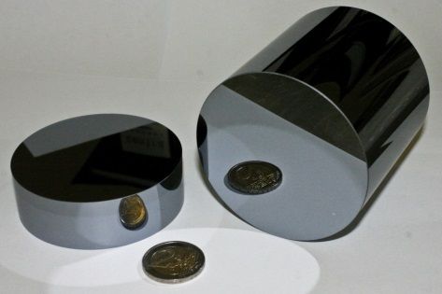
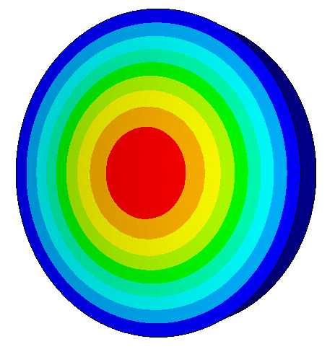
Measuring mechanical losses
Resonant modes
Sample
f₀
Amplitude
Amplitude
Δf
Time
Frequency

Slide 31
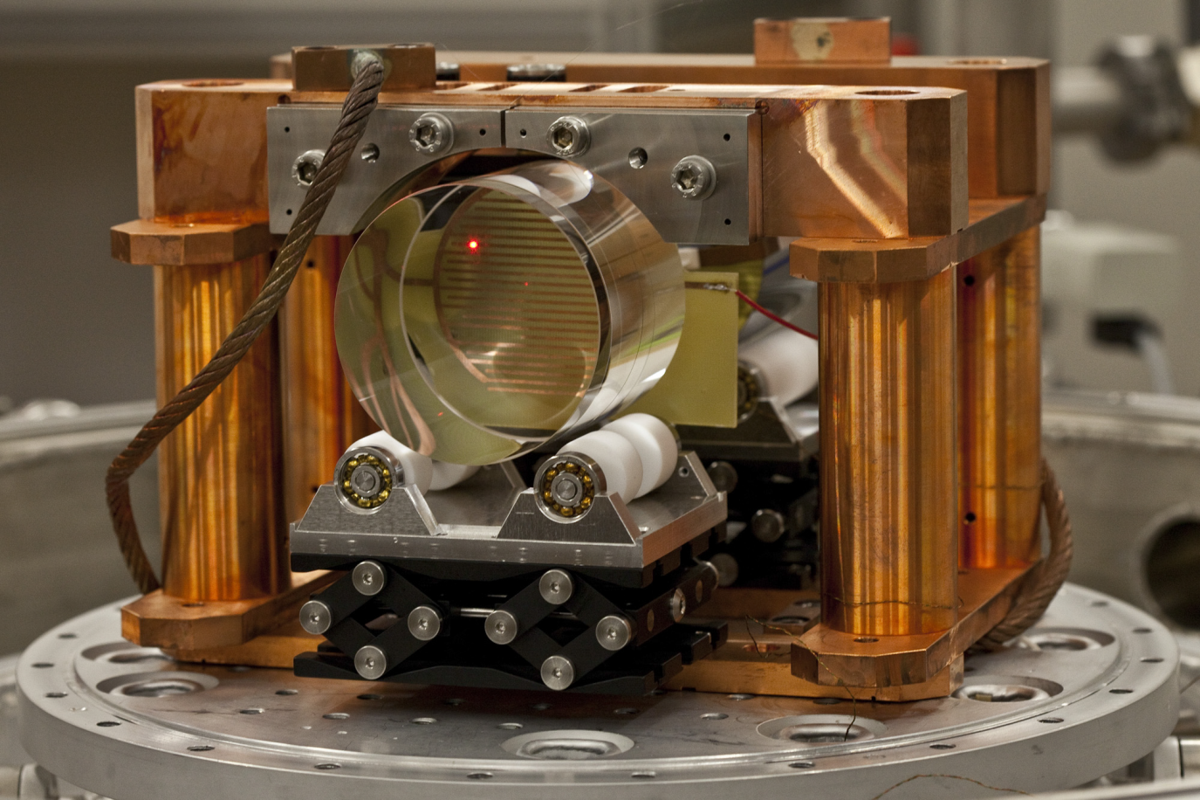
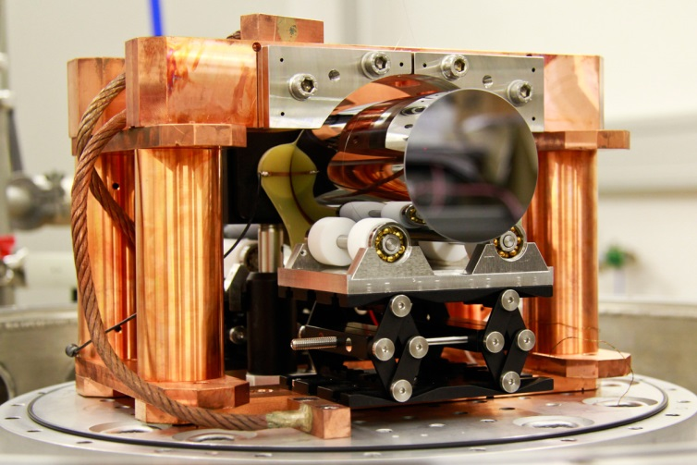
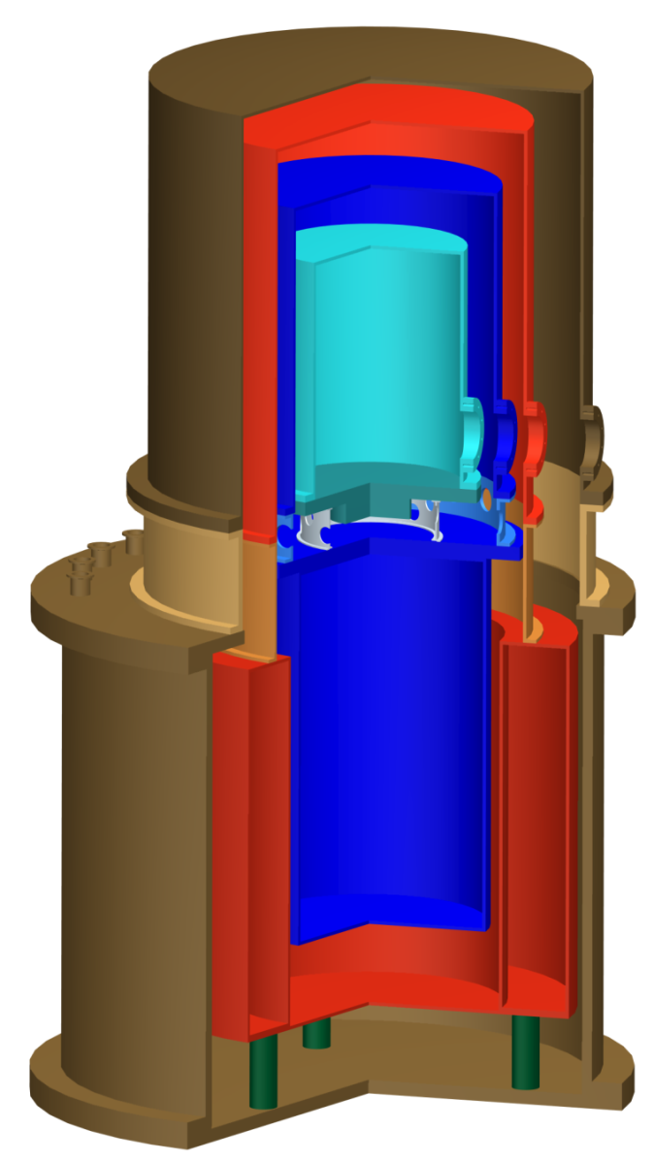
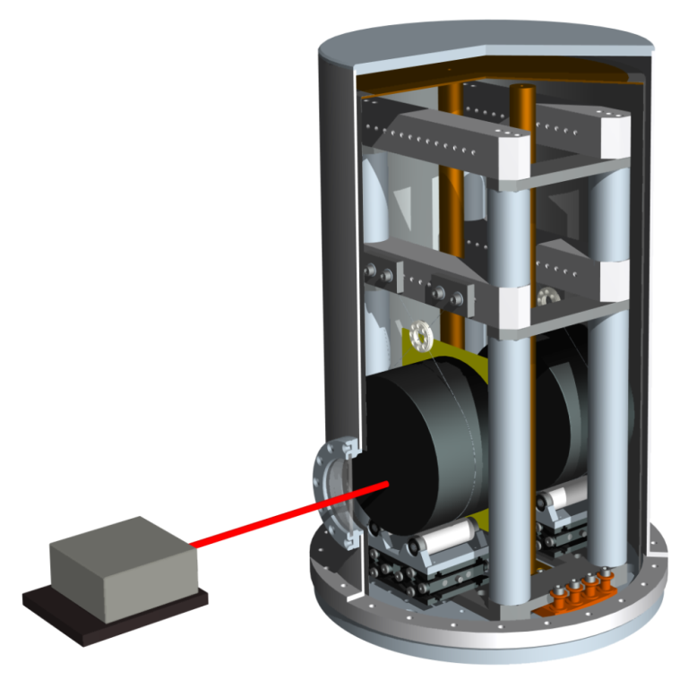
Measuring mechanical losses

Slide 32
Measuring mechanical losses
3.0
Si(100), ∅ 76,2 mm × 12 mm, 5.8 K, f₀ = 14886 Hz
2.5
data
Q = π × f₀ × τ
2.0
fit function
1.5
Amplitude (nm)
Q = 4.5 × 10⁸
1.0
φ = 2.2 × 10⁻⁹
0.5
0
0
1
2
3
4
5
6
7
8
Zeit (h)

Slide 33
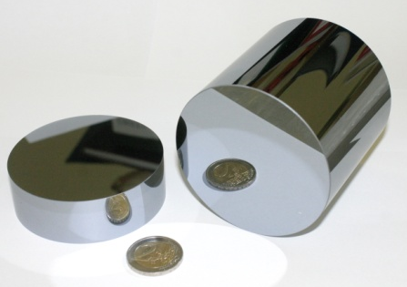
Temperature dependence of mechanical losses
S_{x}(ω,T) ~ T × φ

Slide 34
Coatings

Slide 35
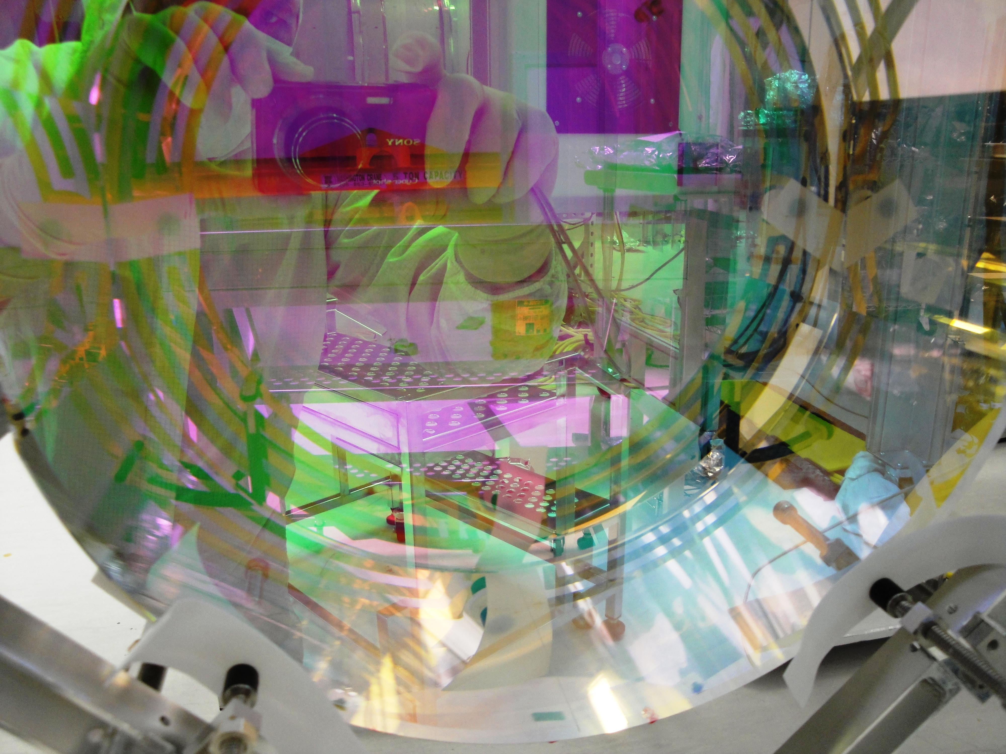
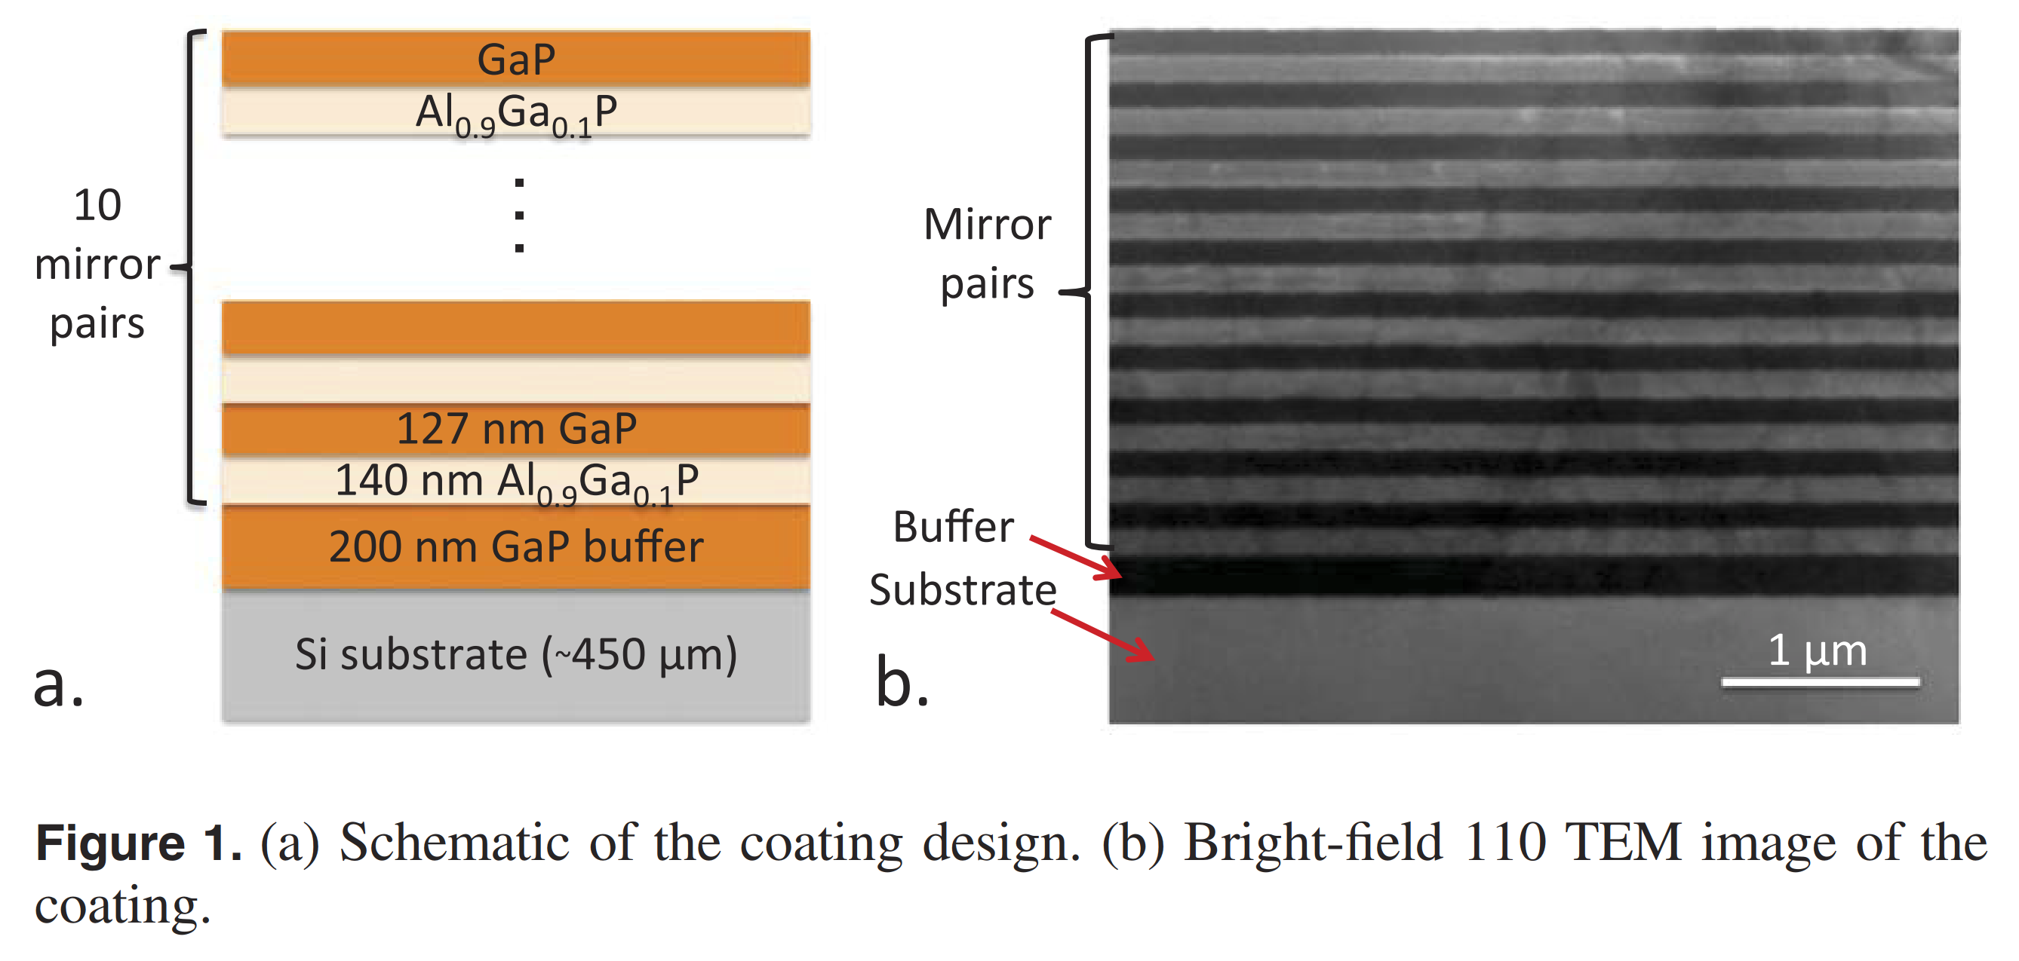
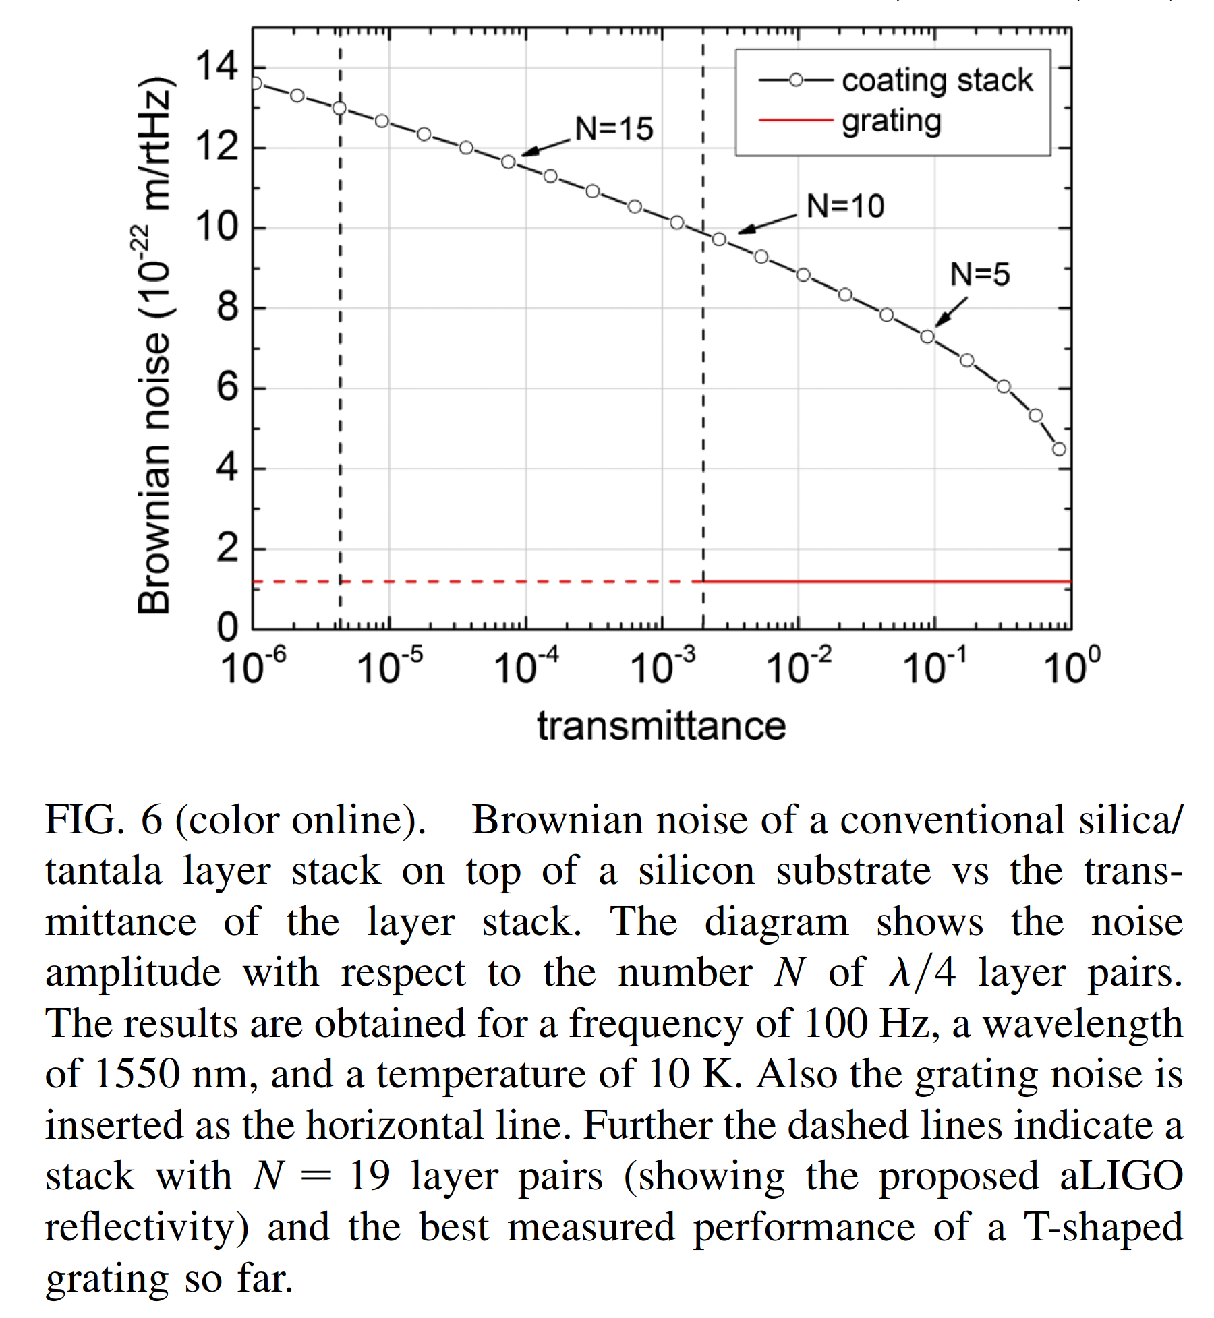
Reflective layers – coatings vs. wave guide structures
1 µm
Novel grating based reﬂectors that have been developed at the Institute for Applied Physics, University of Jena, Germany
a) Schematic of a coating design; b) Bright-field 110 TEM image of the coating
Source: Ligo collaboration, https://www.ligo.org/multimedia/gallery/opt.php.

Slide 36
suspension

Slide 37
Thermal noise of suspensions/mirror
Thermal noise = all noise forms that couple into phase shift
Cooling tasks:
Path along suspension
Bonding interfaces suspension to mirrors
Surface quality and stress influence to thermal conductivity, geometry effect
Thermal shield strategy
Cold baffles at ~ 4 K => no cryosorption at mirrors
Cooldown time
Recovery time
to cold source
to cold source
T~ 2-5 K
T~ 2-5 K
Noise sources:
stress in suspension
violin modes
fluctuations of suspension → change of centre of mass
Heat
flow
~1 W?
Heat
flow
~1 W?
Noise sources:
coating on mirrors => fct.(T)
bulk => fct.(T)
T~ 10-20 K
T~ 10-20 K
Beam splitter
End mirror
e.g. sapphire α=0 @ 18 K and 125 K

Slide 38
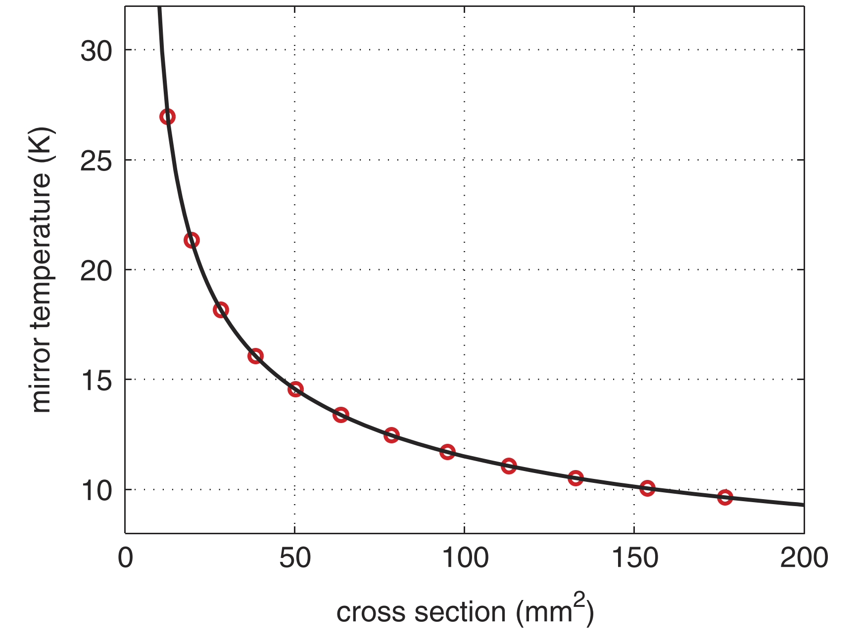
Thermal noise of suspensions/mirror
Suspension material and cross section sapphire vs. silicon
Calculated silicon mirror temperature vs. silicon suspension cross section
L=1 m, th. conductivity= fct.(T), T_{cold}= 4 K
to cold source
to cold source
T= 4 K
T= 4 K
Heat
flow
~1 W?
Heat
flow
~1 W?
T = 20 K ?
T= 10-20 K
Beam splitter
End mirror
Source: J Degallaix, et al., Class. Quantum Grav. 31 (2014) 185010 (13pp)

Slide 39
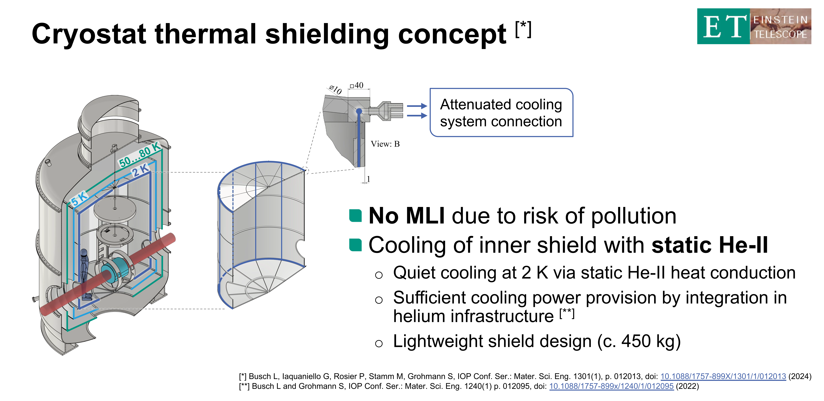
Some open points:
- Dealing with cooldown => one month?
- Loss of resonance conditions for the Laser
Q increases by factor 10 of Watt,
warm up inner shield by scattered light
Courtesy:
S. Grohmann, ICEC24, Geneva

Slide 40
Summary
Gravitational wave detection opens up a new field in astronomy
2nd generation detectors are deployed
3rd generation of detectors need cryogenics
Study of material properties at low temperatures
Cooling strategies with extremely low noise are required
Look on the general picture when suggesting cooling solutions

