Slide 1



Corso di Laurea Magistrale in Fisica
Tesi di Laurea Magistrale
POLARISED VECTOR BOSON SCATTERING AT THE LARGE HADRON COLLIDER
Studente: Giulia Gianoli
Relatore: Pietro Govoni
Correlatori: Raffaele Gerosa,
Giulia Lavizzari, Giorgio Pizzati
1/98

Slide 2

01
Info preliminari
02
Risultati ottenuti-SR
Overview
03
Risultati ottenuti-CR WZ
04
Risultati ottenuti-CR Low-mjj
05
Risultati ottenuti-Correzioni
Giulia Gianoli – Meeting Tesi Magistrale - 24/07/25
2/98

Slide 3
01 INFORMAZIONI PRELIMINARI
Giulia Gianoli – Meeting Tesi Magistrale - 24/07/25
3/98

Slide 4
01
DATASET UTILIZZATO
MONTECARLO (Simulati con madgraph, Run3-Summer22EE, formato file NanoAODv12)
SSWW EWK (LO) e SSWW QCD:
/WWto2L2Nu-2Jets_SS_noTop_EW_TuneCP5_13p6TeV_madgraph-pythia8+Run3Summer22EENanoAODv12-130X_mcRun3_2022_realistic_postEE_v6-v2+NANOAODSIM
/WWto2L2Nu-2Jets_SS_noTop_QCD_TuneCP5_13p6TeV_madgraph-pythia8+Run3Summer22EENanoAODv12-130X_mcRun3_2022_realistic_postEE_v6-v2+NANOAODSIM
SSWW POLARIZZATI (TT,TL,LL) :
/VBS-SSWW_PolarizationLL_TuneCP5_13p6TeV_madgraph-pythia8+Run3Summer22EENanoAODv12-130X_mcRun3_2022_realistic_postEE_v6-v3+NANOAODSIM
/VBS-SSWW_PolarizationTL_TuneCP5_13p6TeV_madgraph-pythia8+Run3Summer22EENanoAODv12-130X_mcRun3_2022_realistic_postEE_v6-v1+NANOAODSIM
/VBS-SSWW_PolarizationTT_TuneCP5_13p6TeV_madgraph-pythia8+Run3Summer22EENanoAODv12-130X_mcRun3_2022_realistic_postEE_v6-v3+NANOAODSIM
Giulia Gianoli – Meeting Tesi Magistrale - 24/07/25
4/98

Slide 5
01
DATASET UTILIZZATO
MONTECARLO (Simulati con madgraph, Run3-Summer22EE, formato file NanoAODv12)
WZ EWK e WZ QCD:
/WZto3LNu-2Jets_EW_TuneCP5_13p6TeV_madgraph-madspin-pythia8/Run3Summer22EENanoAODv12-130X_mcRun3_2022_realistic_postEE_v6-v2/NANOAODSIM
/WZto3LNu-2Jets_QCD_TuneCP5_13p6TeV_madgraph-madspin-pythia8/Run3Summer22EENanoAODv12-130X_mcRun3_2022_realistic_postEE_v6-v2/NANOAODSIM
TVX (TTWW, TTZZ, TTLL_MLL, TTLNu, TZQB):
/TTWW_TuneCP5_13p6TeV_madgraph-madspin-pythia8/Run3Summer22EENanoAODv12-130X_mcRun3_2022_realistic_postEE_v6-v2/NANOAODSIM
/TTZZ_TuneCP5_13p6TeV_madgraph-madspin-pythia8/Run3Summer22EENanoAODv12-130X_mcRun3_2022_realistic_postEE_v6-v3/NANOAODSIM
/TTLL_MLL-4to50_TuneCP5_13p6TeV_amcatnlo-pythia8/Run3Summer22EENanoAODv12-130X_mcRun3_2022_realistic_postEE_v6-v2/NANOAODSIM
/TTLL_MLL-50_TuneCP5_13p6TeV_amcatnlo-pythia8/Run3Summer22EENanoAODv12-130X_mcRun3_2022_realistic_postEE_v6-v2/NANOAODSIM
Giulia Gianoli – Meeting Tesi Magistrale - 24/07/25
5/98

Slide 6
01
DATASET UTILIZZATO
MONTECARLO (Simulati con madgraph, Run3-Summer22EE, formato file NanoAODv12)
TVX (TTWW, TTZZ, TTLL_MLL, TTLNu, TZQB):
/TTLNu-1Jets_TuneCP5_13p6TeV_amcatnloFXFX-pythia8/Run3Summer22EENanoAODv12-130X_mcRun3_2022_realistic_postEE_v6-v4/NANOAODSIM
/TZQB-Zto2L-4FS_MLL-30_TuneCP5_13p6TeV_amcatnlo-pythia8/Run3Summer22EENanoAODv12-130X_mcRun3_2022_realistic_postEE_v6-v2/NANOAODSIM
DATI (Run3-Summer22EE (E,F,G), formato file NanoAODv12)
MUON_RUN2022E/F/G-PROMPT:
/Muon/Run2022E-22Sep2023-v1/NANOAOD | /Muon/Run2022F-22Sep2023-v2/NANOAOD | /Muon/Run2022G-22Sep2023-v1/NANOAOD
EGAMMA_RUN2022E/F/G-PROMPT:
/EGamma/Run2022E-22Sep2023-v1/NANOAOD | /EGamma/Run2022F-22Sep2023-v1/NANOAOD | /EGamma/Run2022G-22Sep2023-v2/NANOAOD
MUONEG_RUN2022E/F/G-PROMPT:
/MuonEG/Run2022E-22Sep2023-v1/NANOAOD | /MuonEG/Run2022F-22Sep2023-v1/NANOAOD | /MuonEG/Run2022G-22Sep2023-v1/NANOAOD
Giulia Gianoli – Meeting Tesi Magistrale - 24/07/25
6/98

Slide 7
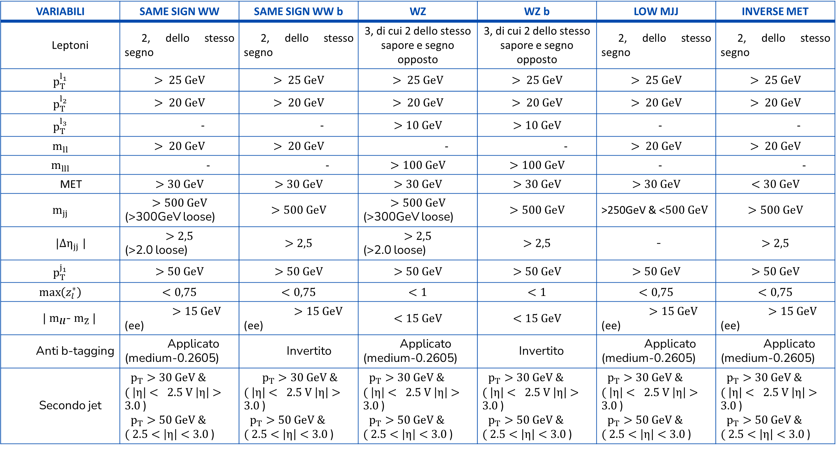
01
PRESELEZIONI APPLICATE
VARIABILI | SAME SIGN WW | SAME SIGN WW b | WZ | WZ b | LOW MJJ | INVERSE MET
Leptoni | 2, dello stesso segno | 2, dello stesso segno | 3, di cui 2 dello stesso sapore e segno opposto | 3, di cui 2 dello stesso sapore e segno opposto | 2, dello stesso segno | 2, dello stesso segno
$$p_{T}^{l_{1}}$$ | $$> 25 GeV$$ | $$> 25 GeV$$ | $$> 25 GeV$$ | $$> 25 GeV$$ | $$> 25 GeV$$ | $$> 25 GeV$$
$$p_{T}^{l_{2}}$$ | $$> 20 GeV$$ | $$> 20 GeV$$ | $$> 20 GeV$$ | $$> 20 GeV$$ | $$> 20 GeV$$ | $$> 20 GeV$$
$$p_{T}^{l_{3}}$$ | - | - | $$>10 GeV$$ | $$>10 GeV$$ | - | -
$$m_{ll}$$ | $$> 20 GeV$$ | $$> 20 GeV$$ | - | - | $$> 20 GeV$$ | $$> 20 GeV$$
$$m_{lll}$$ | - | - | $$>100 GeV$$ | $$>100 GeV$$ | - | -
MET | $$>30 GeV$$ | $$>30 GeV$$ | $$>30 GeV$$ | $$>30 GeV$$ | $$>30 GeV$$ | $$<30 GeV$$
$$m_{jj}$$ | $$>500 GeV$$ (>300GeV loose) | $$>500 GeV$$ | $$>500 GeV$$ (>300GeV loose) | $$>500 GeV$$ | >250GeV & <$500 GeV$ | $$>500 GeV$$
$|{Δη}_{jj}$| | $$>2,5$$ (>2.0 loose) | $$>2,5$$ | $$>2,5$$ (>2.0 loose) | $$>2,5$$ | - | $$>2,5$$
$$p_{T}^{j_{1}}$$ | $$>50 GeV$$ | $$>50 GeV$$ | $$>50 GeV$$ | $$>50 GeV$$ | $$>50 GeV$$ | $$>50 GeV$$
$$\max\left(z_{l}^{∗}\right)$$ | $$<0,75$$ | $$<0,75$$ | $$<1$$ | $$<1$$ | $$<0,75$$ | $$<0,75$$
$|$ $m_{ll}$- $m_{Z} |$ | $>15 GeV$ (ee) | $>15 GeV$ (ee) | $$<15 GeV$$ | $$<15 GeV$$ | $>15 GeV$ (ee) | $>15 GeV$ (ee)
Anti b-tagging | Applicato (medium-0.2605) | Invertito | Applicato (medium-0.2605) | Invertito | Applicato (medium-0.2605) | Applicato (medium-0.2605)
Secondo jet | $p_{T}>30 GeV \&$ $( \left|η\right|< 2.5 V \left|η\right|>3.0$) $p_{T}>50 GeV \&$ $( 2.5<\left|η\right|<3.0$) | $p_{T}>30 GeV \&$ $( \left|η\right|< 2.5 V \left|η\right|>3.0$) $p_{T}>50 GeV \&$ $( 2.5<\left|η\right|<3.0$) | $p_{T}>30 GeV \&$ $( \left|η\right|< 2.5 V \left|η\right|>3.0$) $p_{T}>50 GeV \&$ $( 2.5<\left|η\right|<3.0$) | $p_{T}>30 GeV \&$ $( \left|η\right|< 2.5 V \left|η\right|>3.0$) $p_{T}>50 GeV \&$ $( 2.5<\left|η\right|<3.0$) | $p_{T}>30 GeV \&$ $( \left|η\right|< 2.5 V \left|η\right|>3.0$) $p_{T}>50 GeV \&$ $( 2.5<\left|η\right|<3.0$) | $p_{T}>30 GeV \&$ $( \left|η\right|< 2.5 V \left|η\right|>3.0$) $p_{T}>50 GeV \&$ $( 2.5<\left|η\right|<3.0$)
Giulia Gianoli – Meeting Tesi Magistrale - 24/07/25
7/98

Slide 8
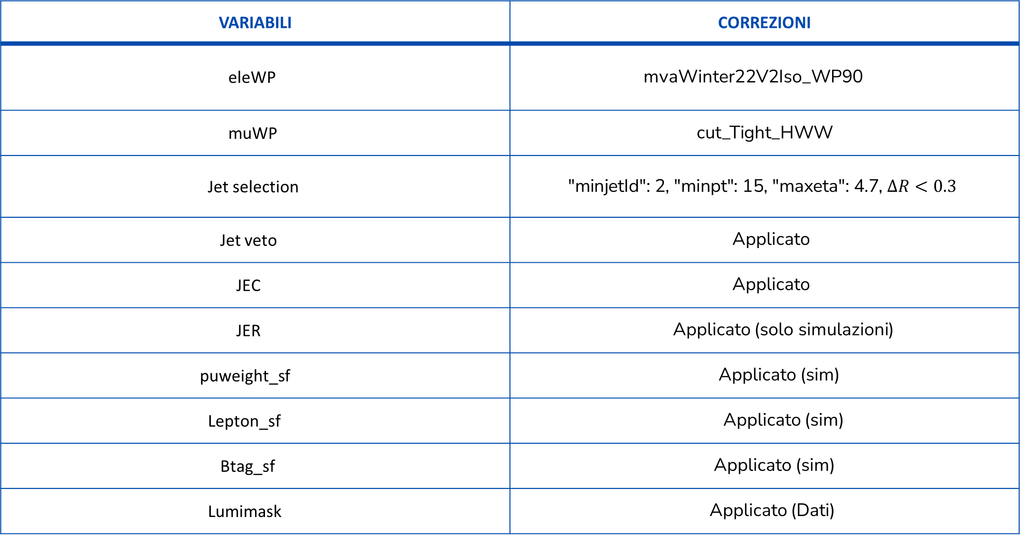
01
CORREZIONI APPLICATE
VARIABILI | CORREZIONI
eleWP | mvaWinter22V2Iso_WP90
muWP | $$\text{cut}\text{_}\text{Tight}\text{_}\text{HWW}$$
Jet selection | $\text{"}\text{min}\text{jetId}\text{": 2, "}\text{minpt}\text{": 15, "}\text{maxeta}\text{": 4.7}$, $ΔR<0.3$
Jet veto | Applicato
JEC | Applicato
JER | Applicato (solo simulazioni)
puweight_sf | Applicato (sim)
Lepton_sf | Applicato (sim)
Btag_sf | Applicato (sim)
Lumimask | Applicato (Dati)
Giulia Gianoli – Meeting Tesi Magistrale - 24/07/25
8/98

Slide 9
02 RISULTATI OTTENUTI-SIGNAL REGION
Giulia Gianoli – Meeting Tesi Magistrale - 24/07/25
9/98

Slide 10
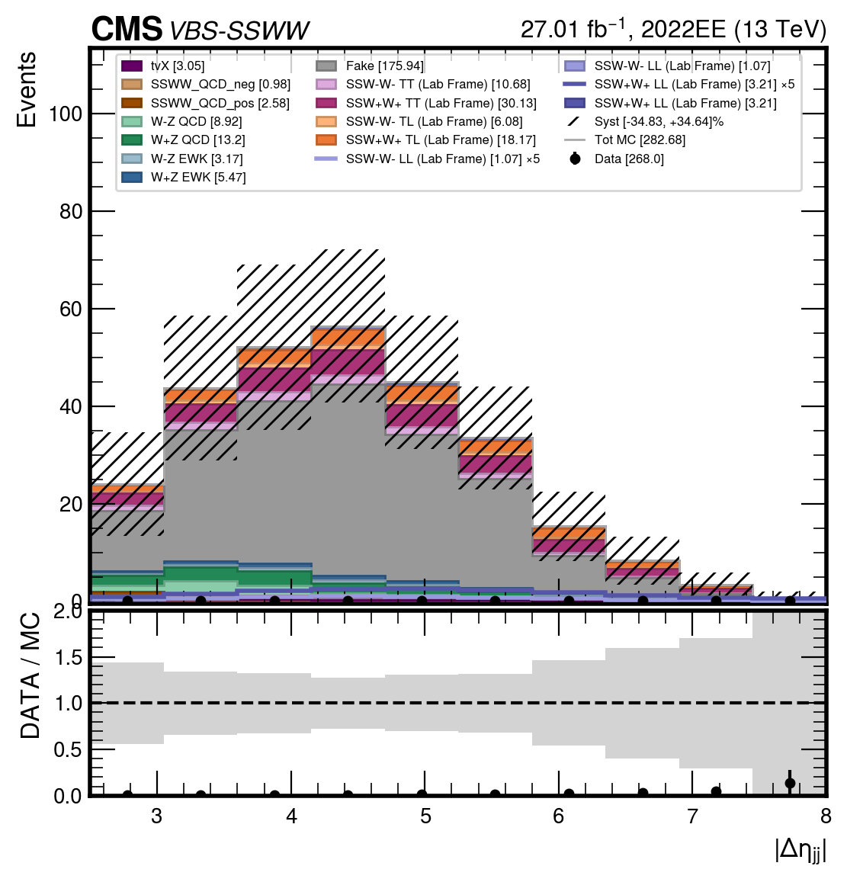
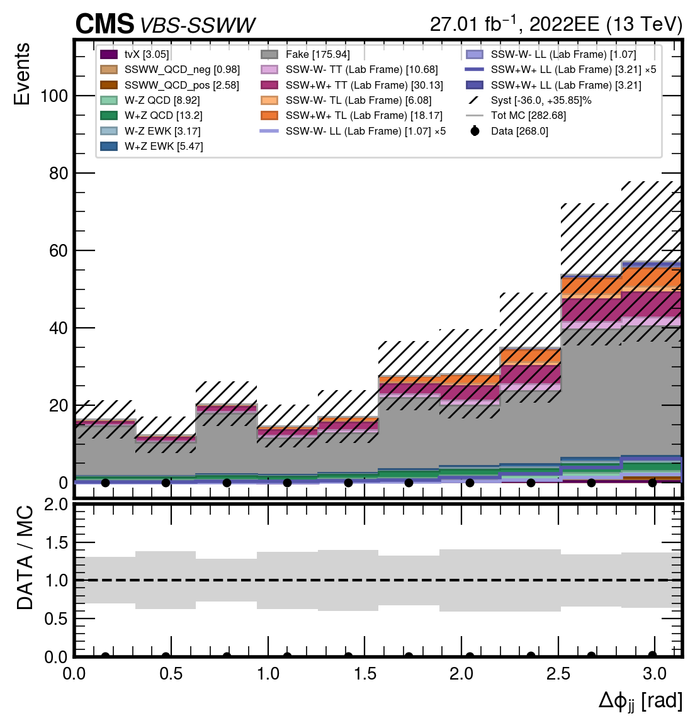



$$SIGNAL REGION SSWW$$
04
$$Δφ_{jj}$$
$$Δη_{jj}$$
Giulia Gianoli – Meeting Tesi Magistrale - 24/07/25
10/98

Slide 11
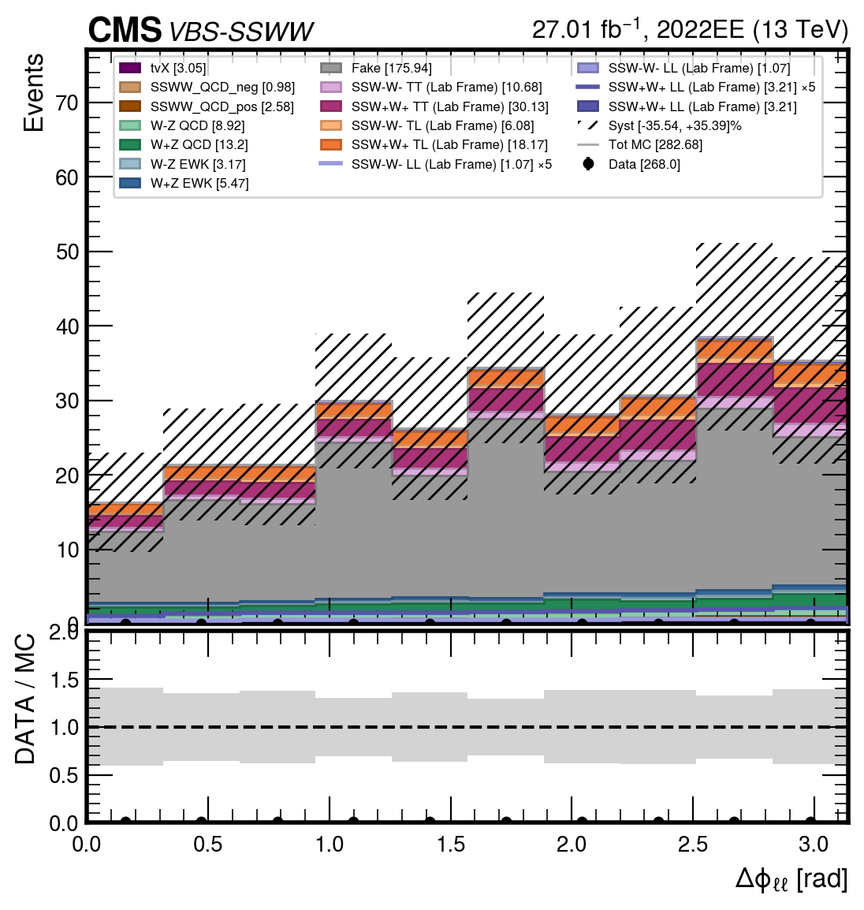
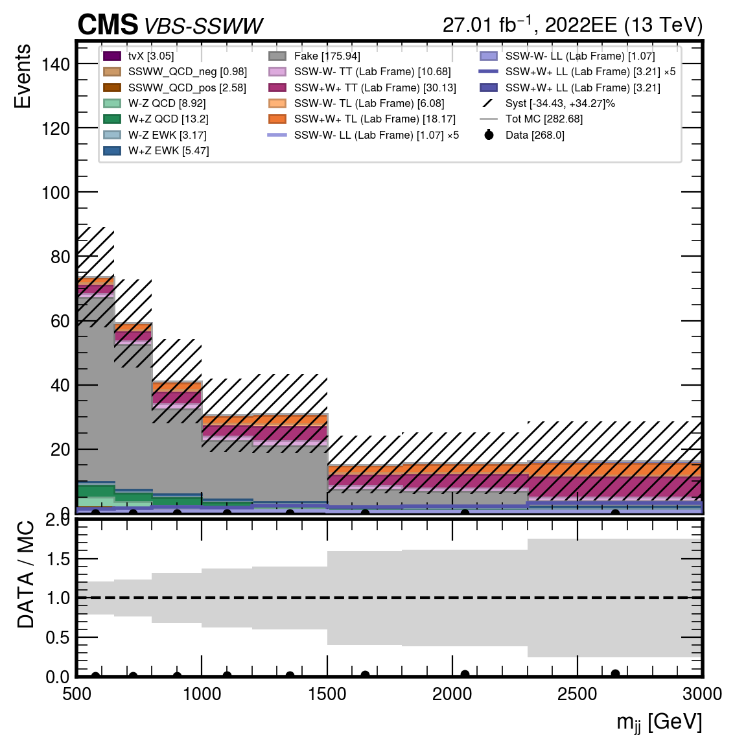


$$SIGNAL REGION SSWW$$
04
$$Δφ_{ll}$$
$$m_{jj}$$
Giulia Gianoli – Meeting Tesi Magistrale - 24/07/25
11/98

Slide 12
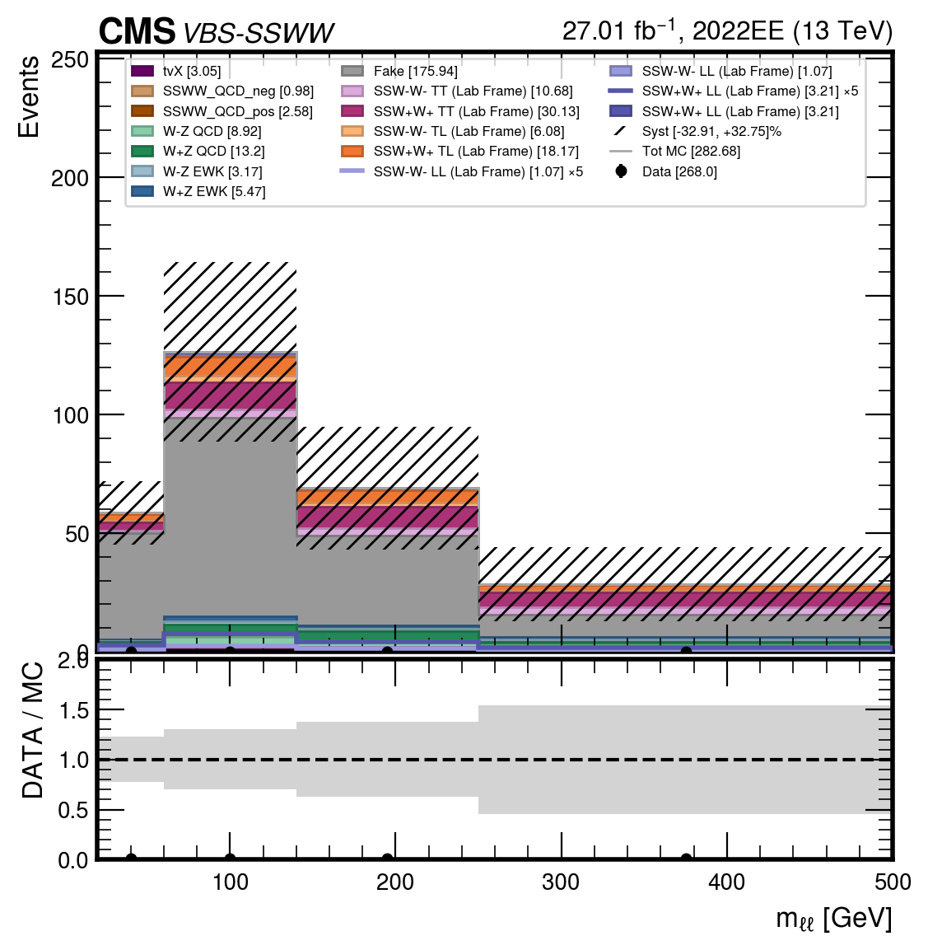
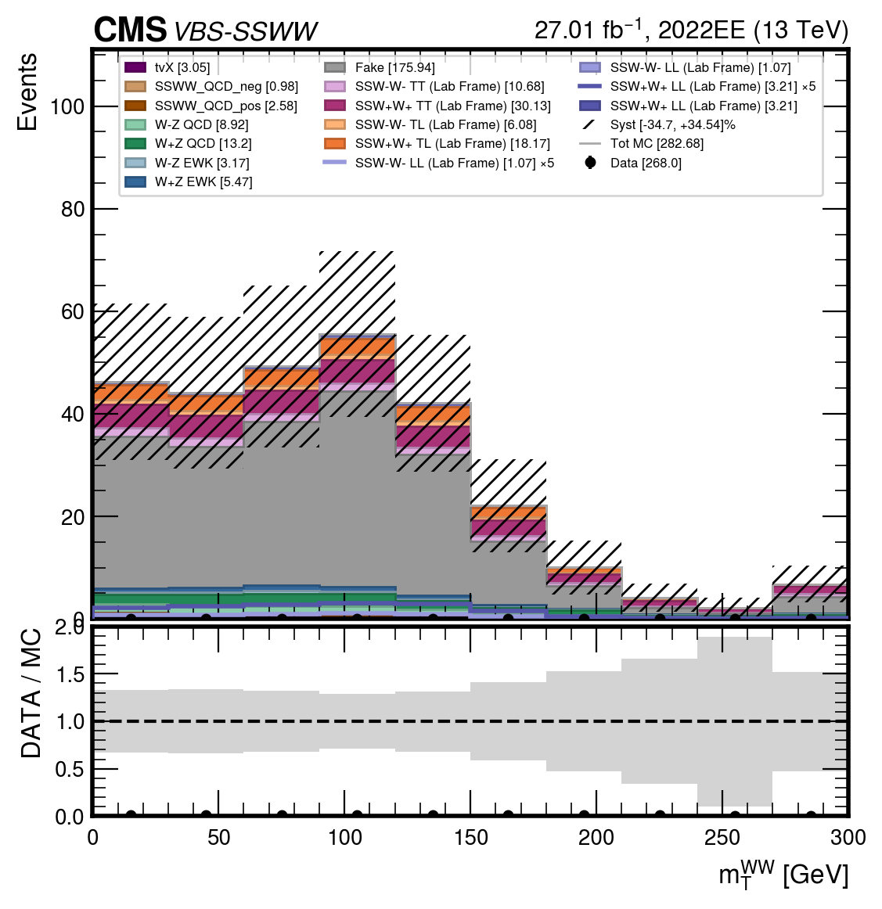


$$SIGNAL REGION SSWW$$
04
$$m_{ll}$$
$$m_{T}(WW)$$
Giulia Gianoli – Meeting Tesi Magistrale - 24/07/25
12/98

Slide 13
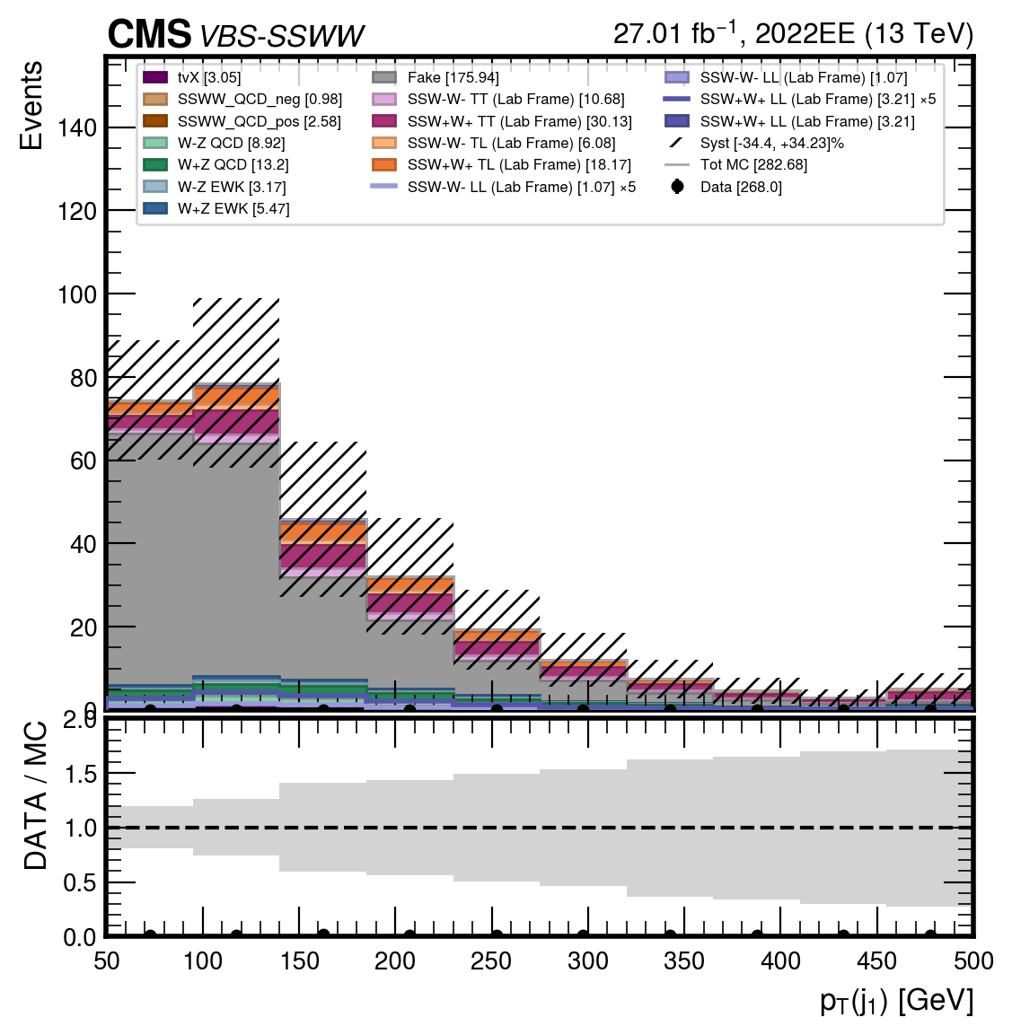
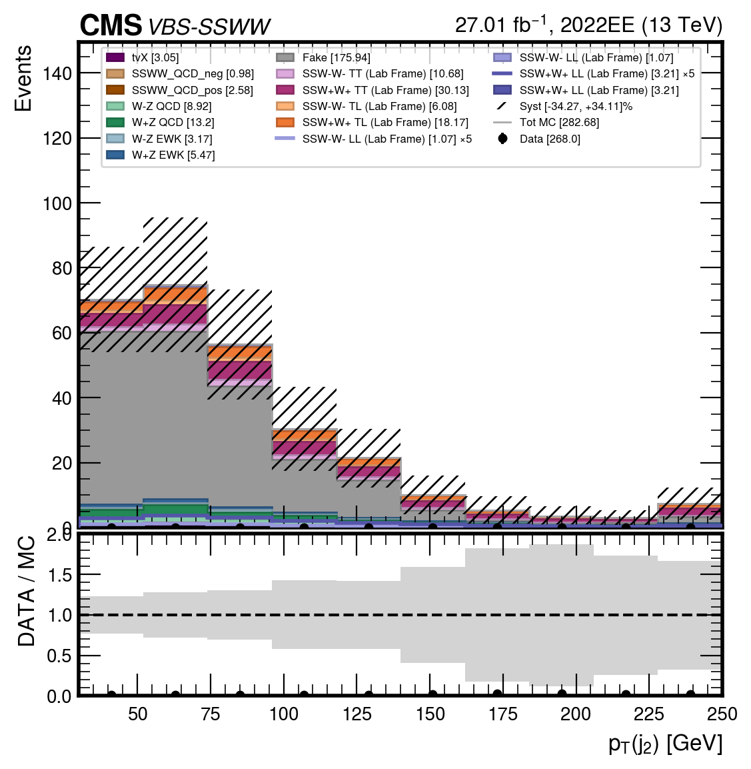


$$SIGNAL REGION SSWW$$
04
$$p_{T}{(j}_{1})$$
$$p_{T}{(j}_{2})$$
Giulia Gianoli – Meeting Tesi Magistrale - 24/07/25
13/98

Slide 14
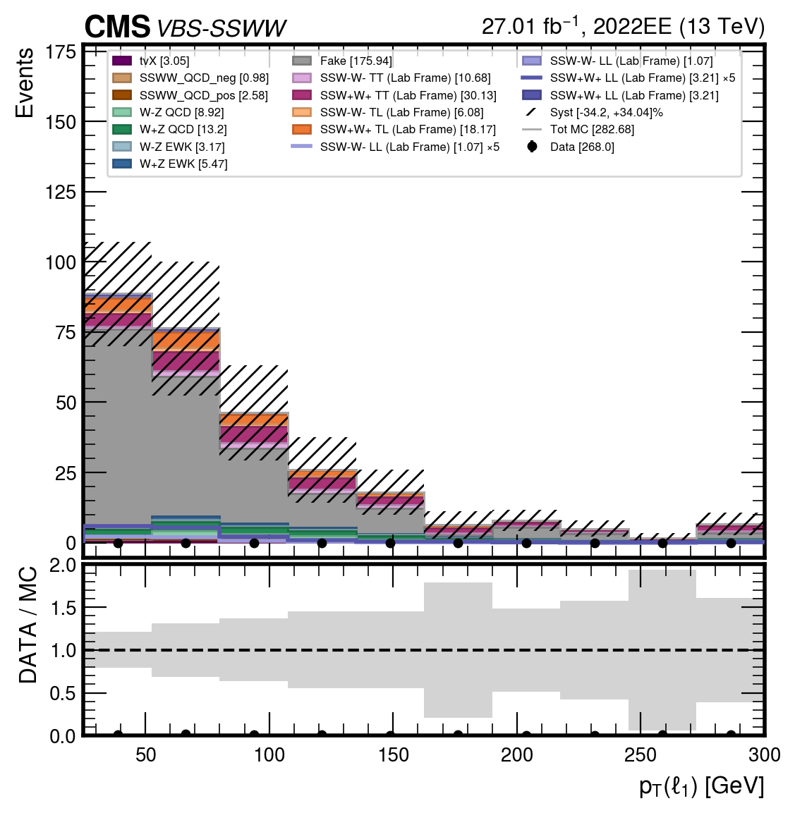
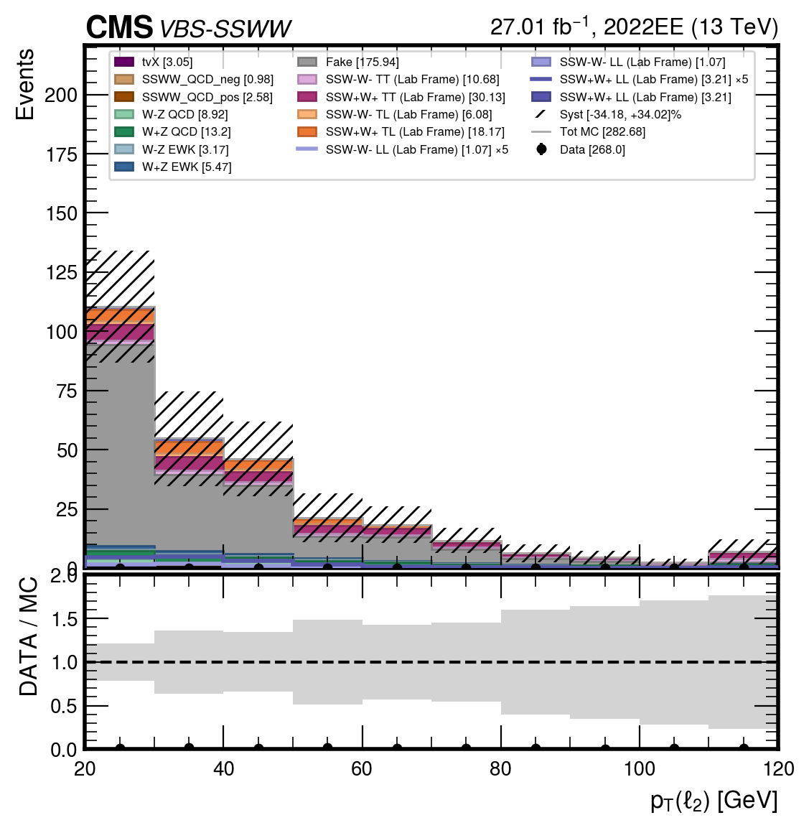


$$SIGNAL REGION SSWW$$
04
$$p_{T}{(l}_{1})$$
$$p_{T}{(l}_{2})$$
Giulia Gianoli – Meeting Tesi Magistrale - 24/07/25
14/98

Slide 15
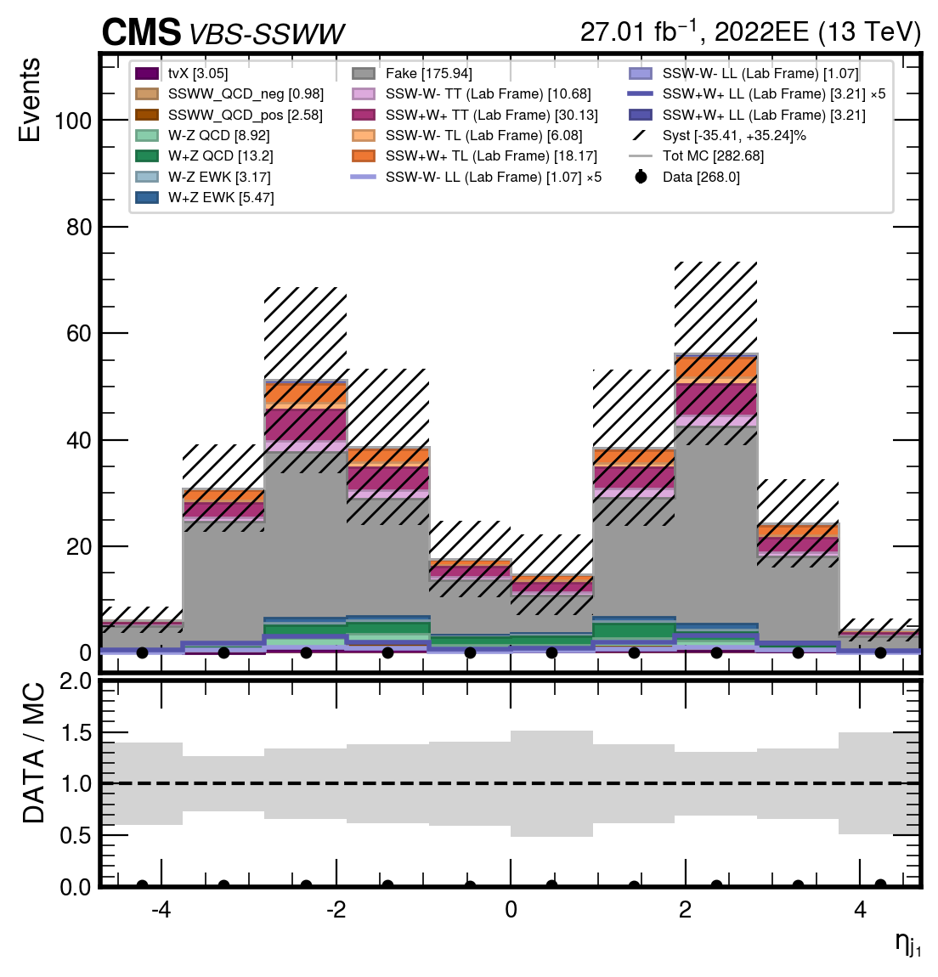
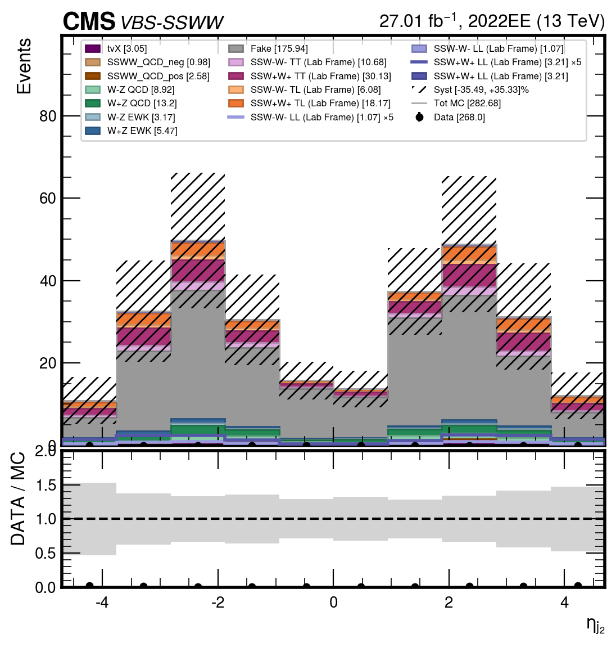


$$SIGNAL REGION SSWW$$
04
$$η_{j1}$$
$$η_{j2}$$
Giulia Gianoli – Meeting Tesi Magistrale - 24/07/25
15/98

Slide 16
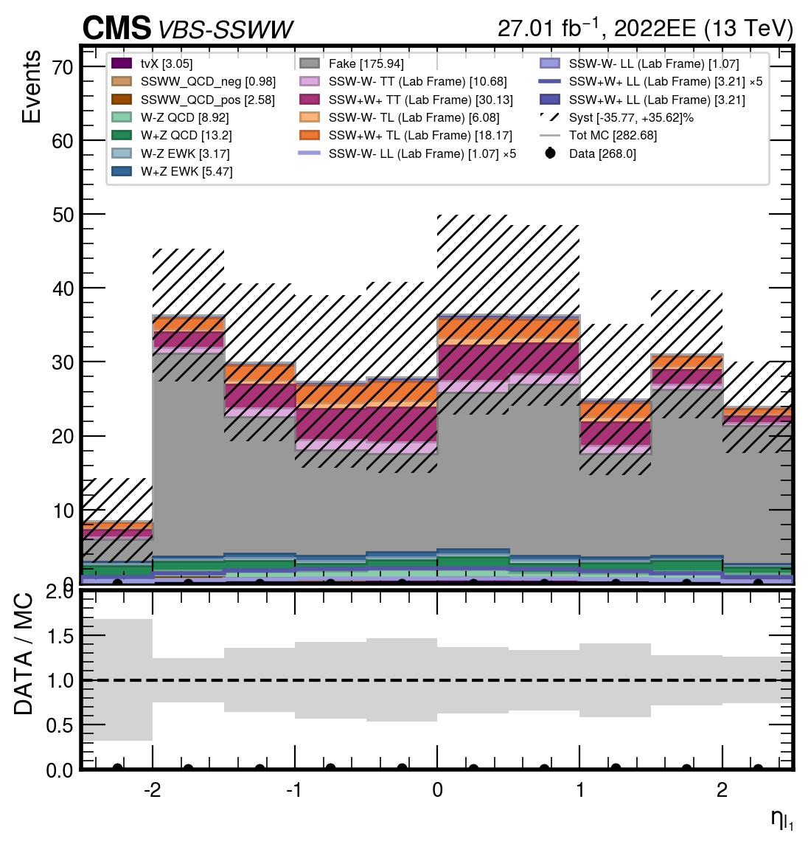
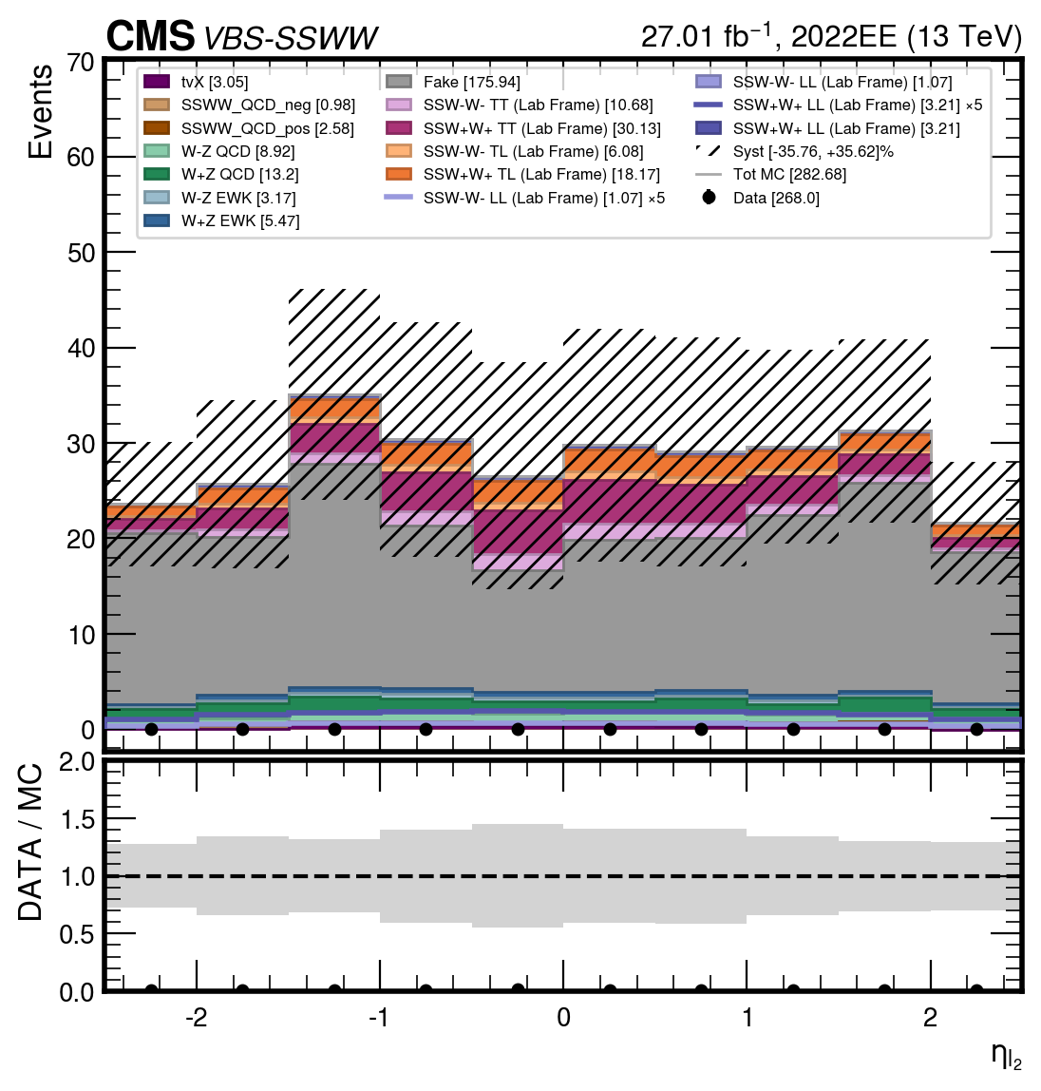


$$SIGNAL REGION SSWW$$
04
$$η_{l1}$$
$$η_{l2}$$
Giulia Gianoli – Meeting Tesi Magistrale - 24/07/25
16/98

Slide 17
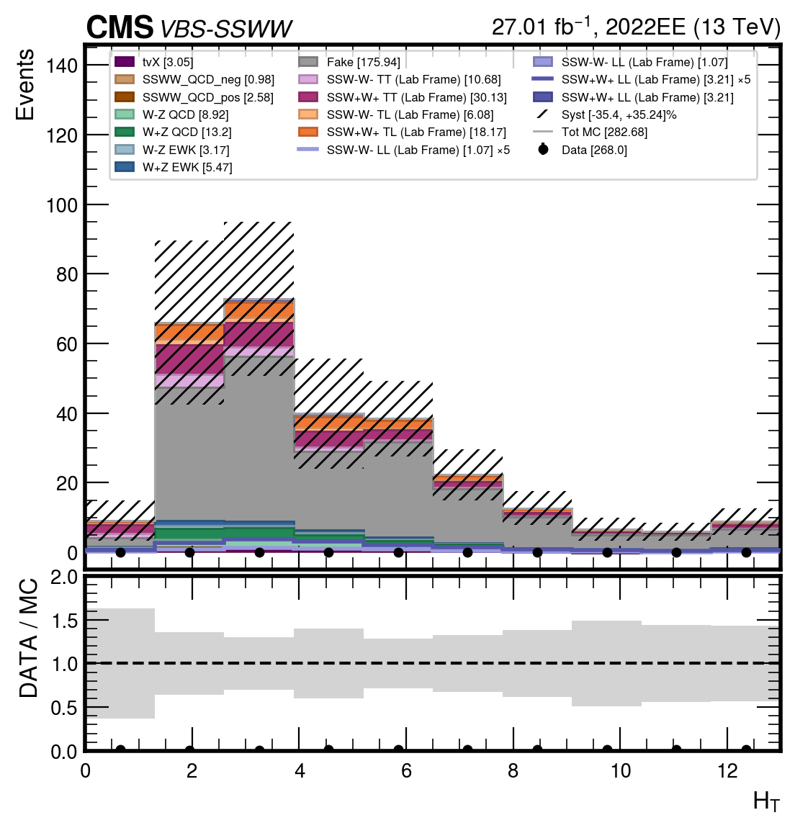
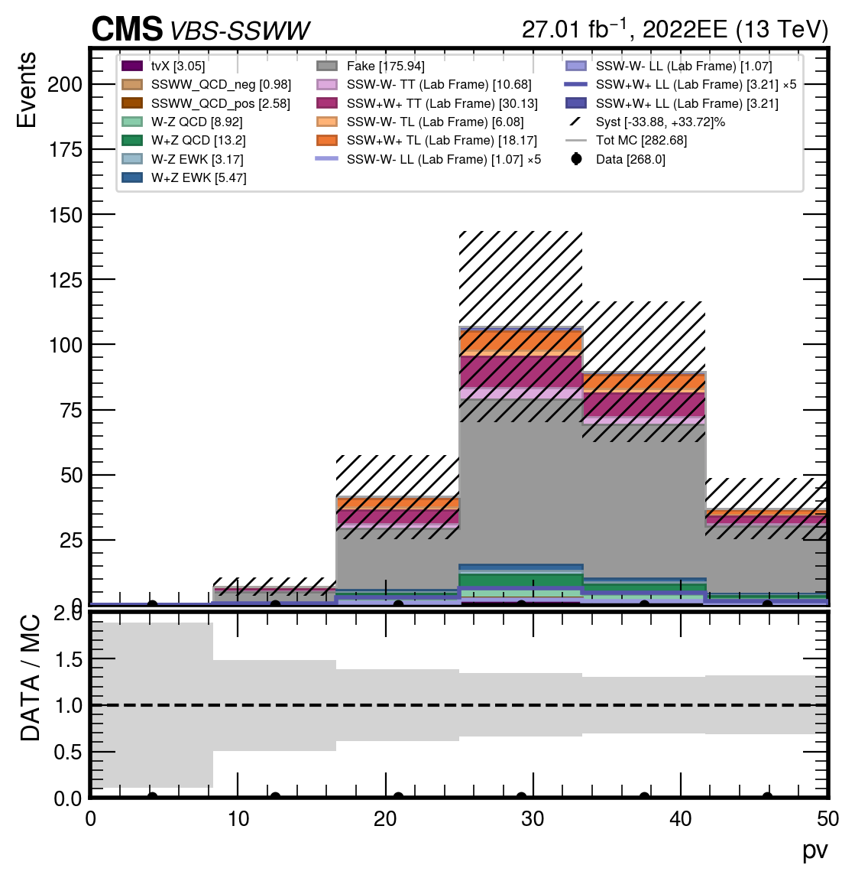


$$SIGNAL REGION SSWW$$
04
$$pv$$
$$Ht$$
Giulia Gianoli – Meeting Tesi Magistrale - 24/07/25
17/98

Slide 18
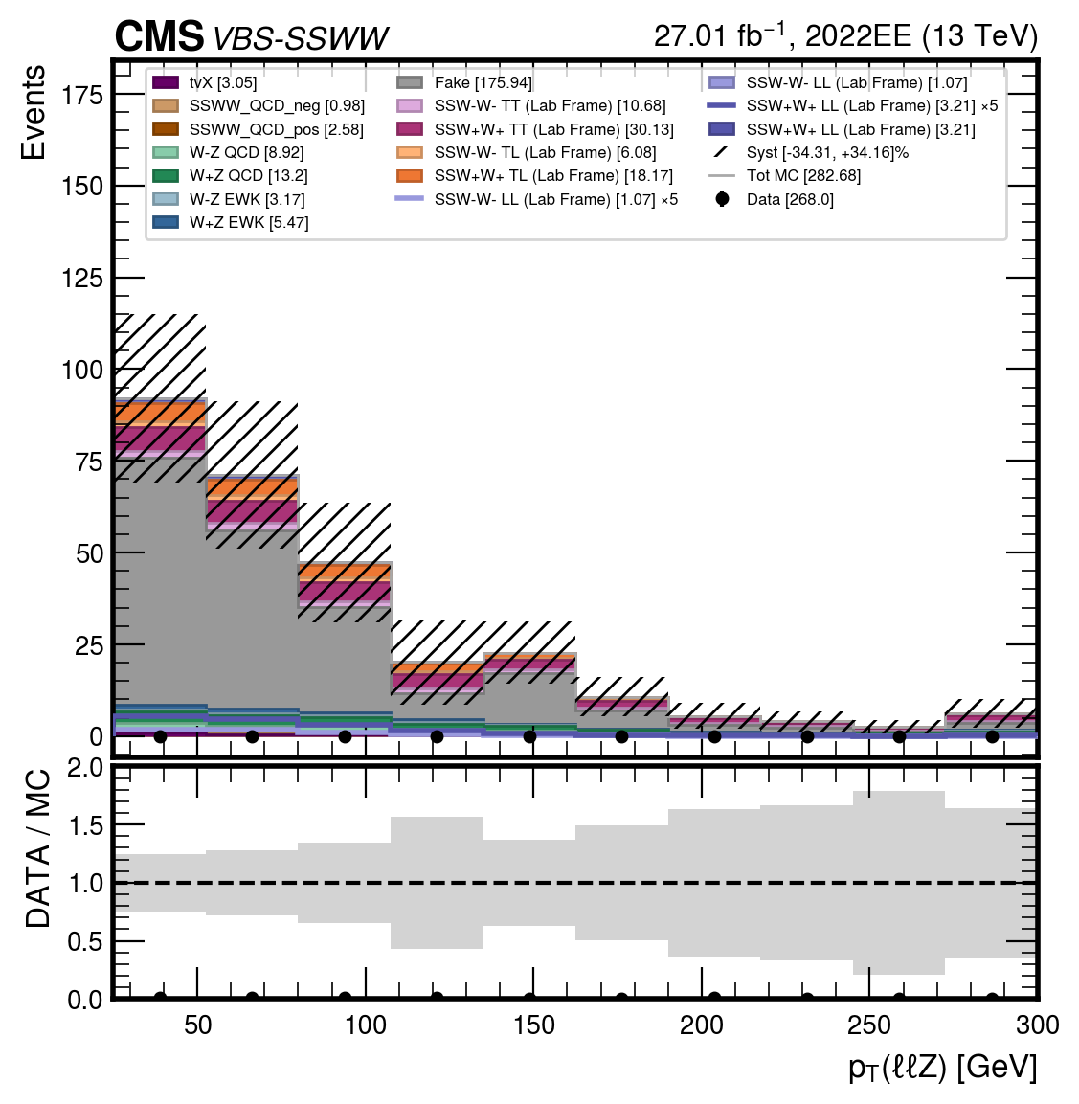

$$SIGNAL REGION SSWW$$
04
$$ptll$$
Giulia Gianoli – Meeting Tesi Magistrale - 24/07/25
18/98

Slide 19
02 RISULTATI OTTENUTI-SIGNAL REGION (loose)
Giulia Gianoli – Meeting Tesi Magistrale - 24/07/25
19/98

Slide 20
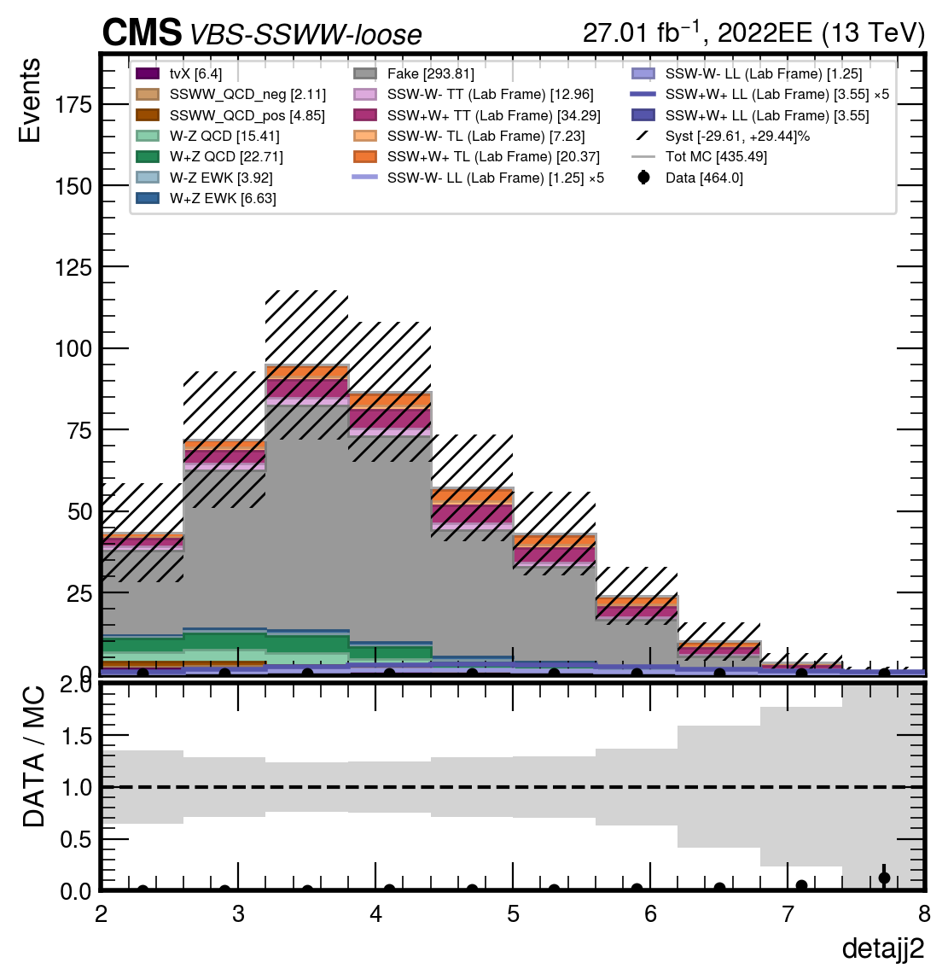
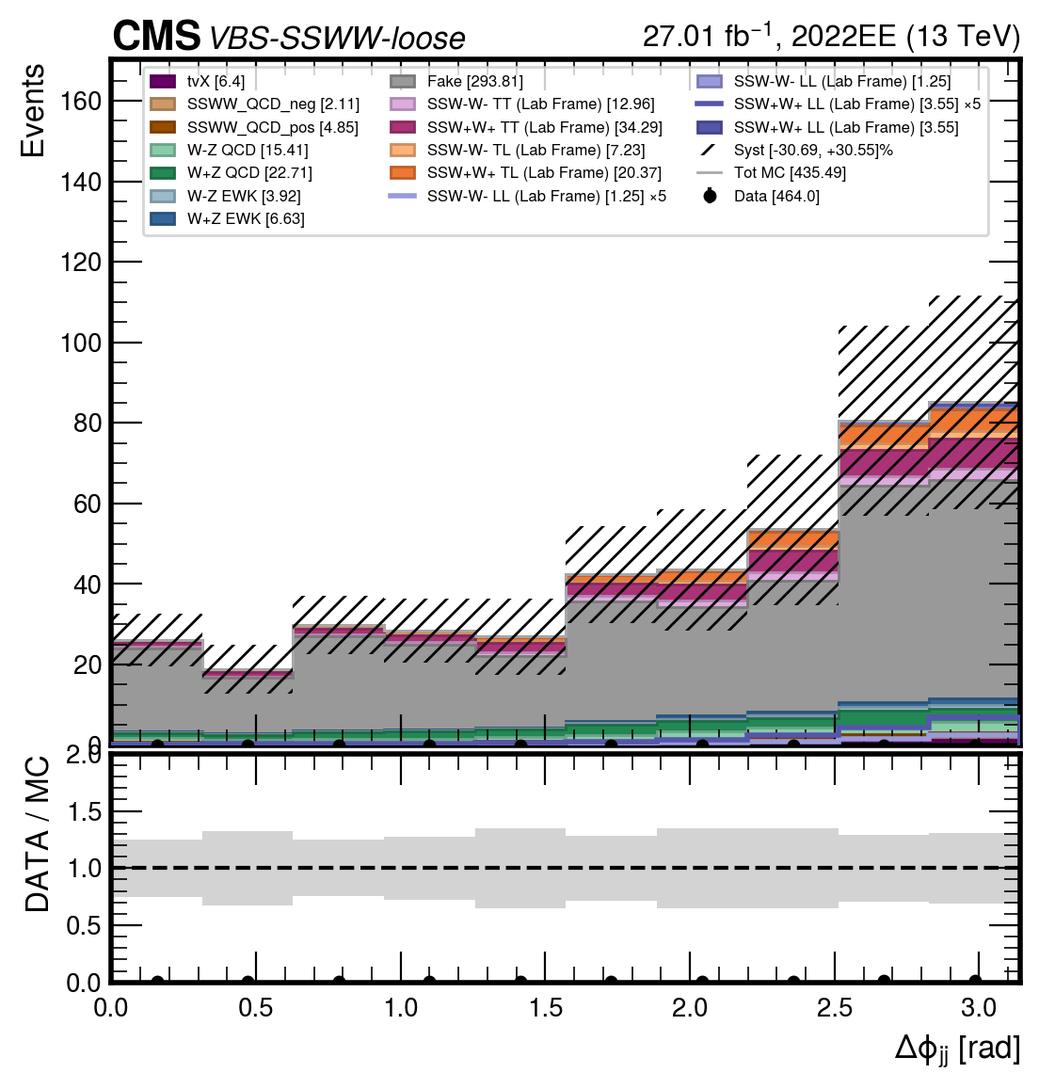

$$SIGNAL REGION SSWW (loose)$$
04
$$Δφ_{jj}$$
$$Δη_{jj}$$
Giulia Gianoli – Meeting Tesi Magistrale - 24/07/25
20/98

Slide 21
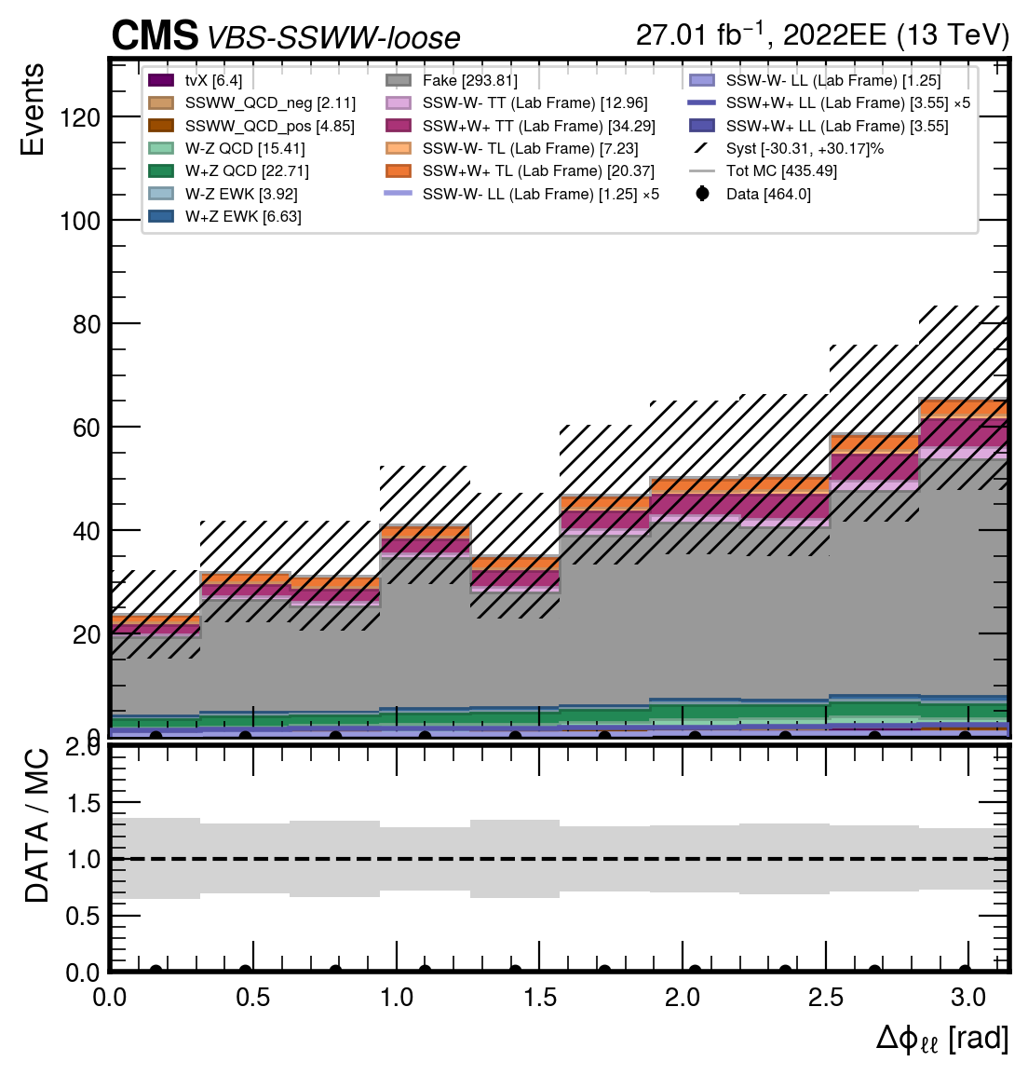
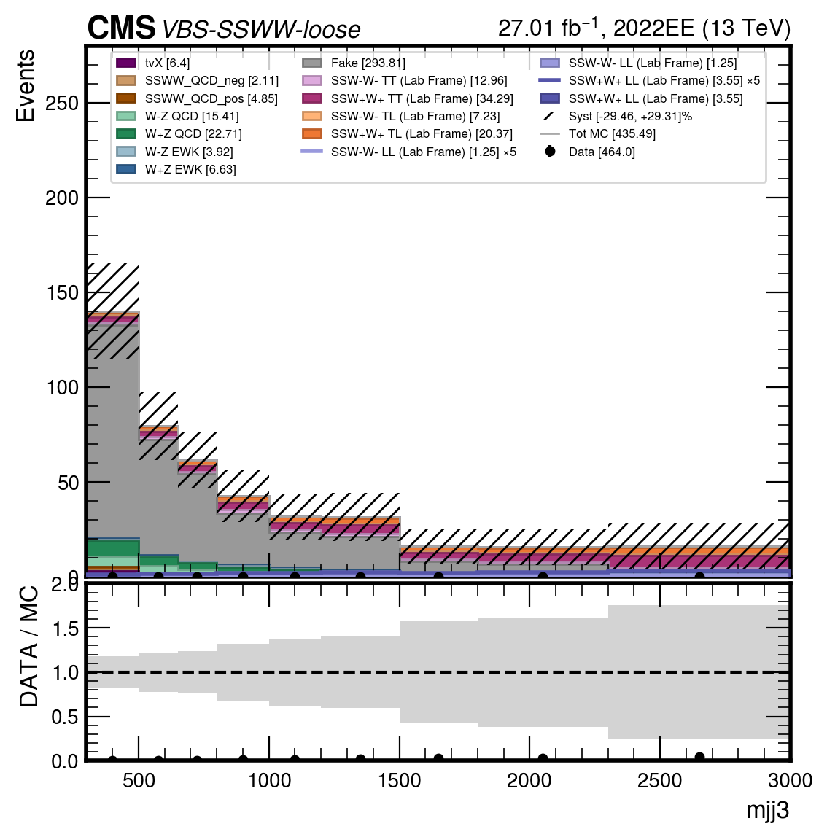
$$SIGNAL REGION SSWW (loose)$$
04
$$Δφ_{ll}$$
$$m_{jj}$$
Giulia Gianoli – Meeting Tesi Magistrale - 24/07/25
21/98

Slide 22
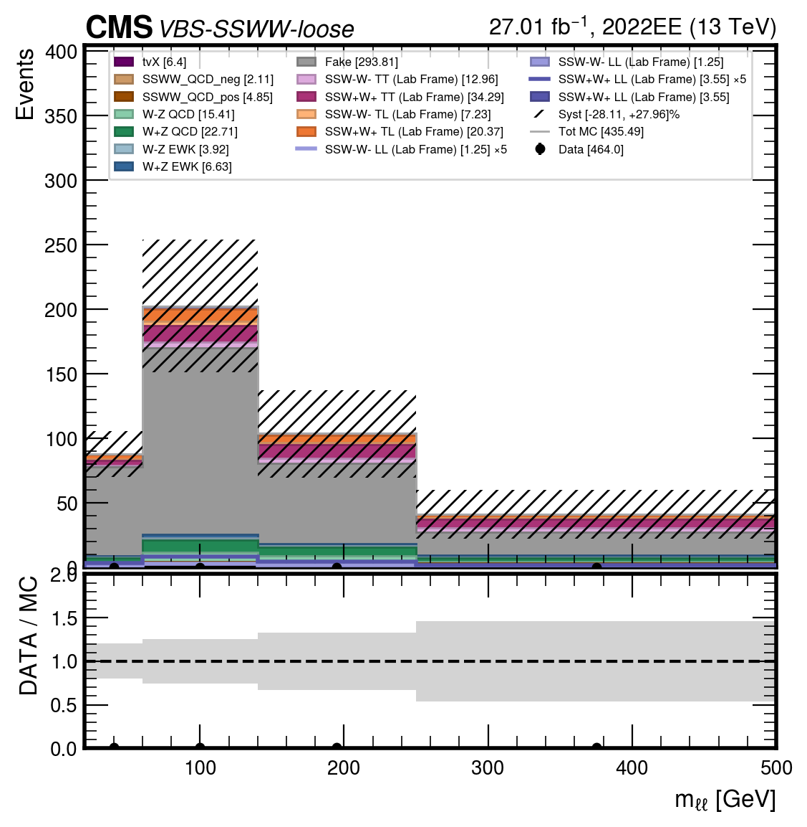
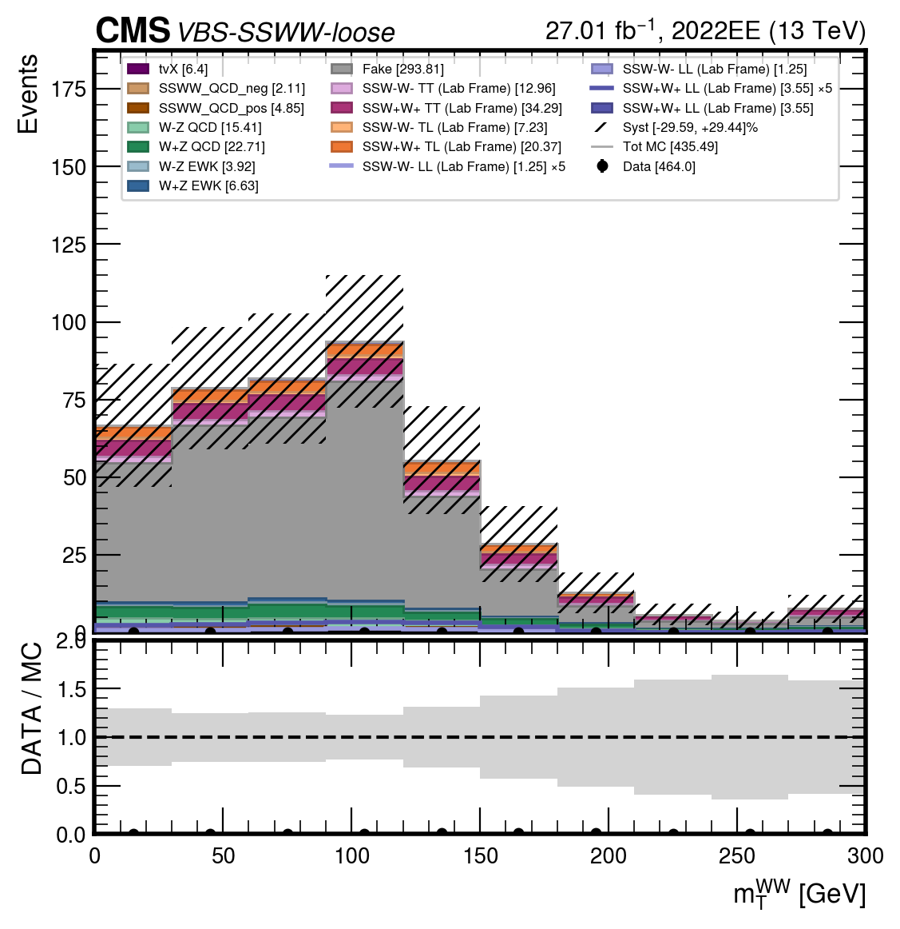
$$SIGNAL REGION SSWW (loose)$$
04
$$m_{ll}$$
$$m_{T}(WW)$$
Giulia Gianoli – Meeting Tesi Magistrale - 24/07/25
22/98

Slide 23
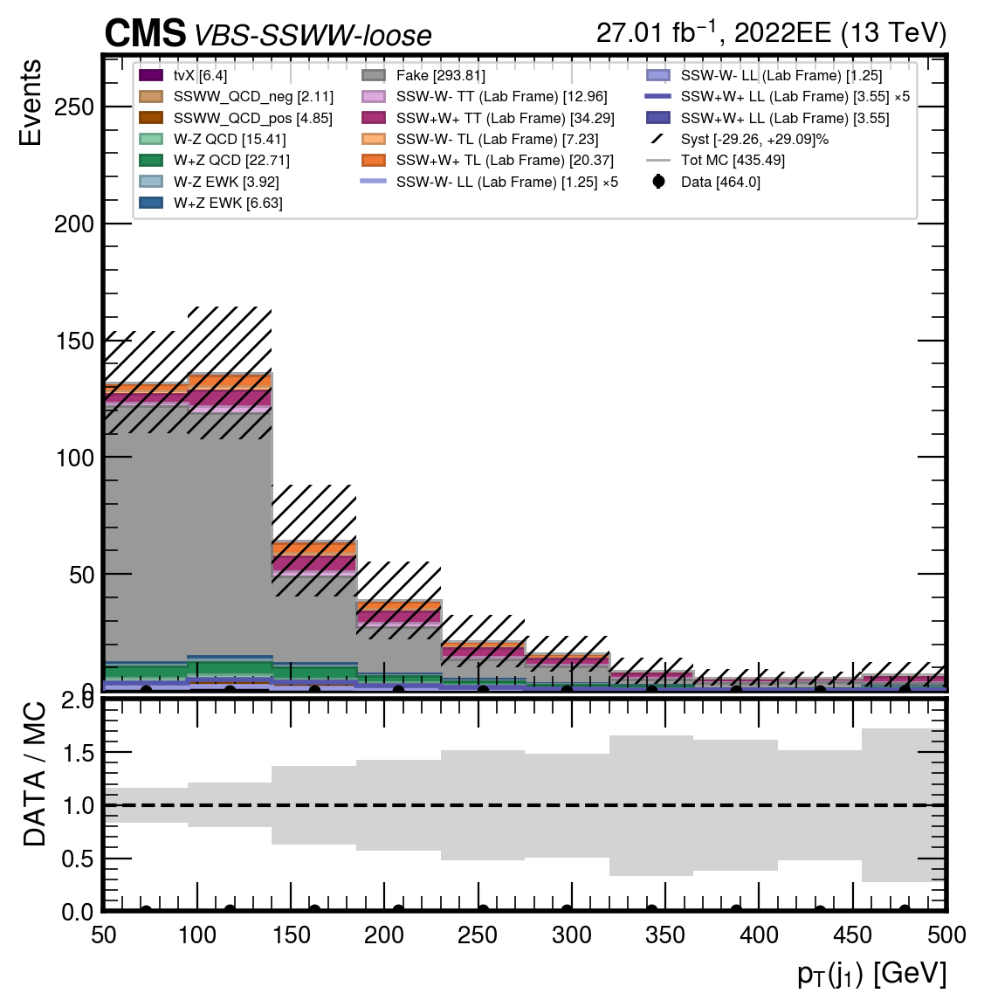
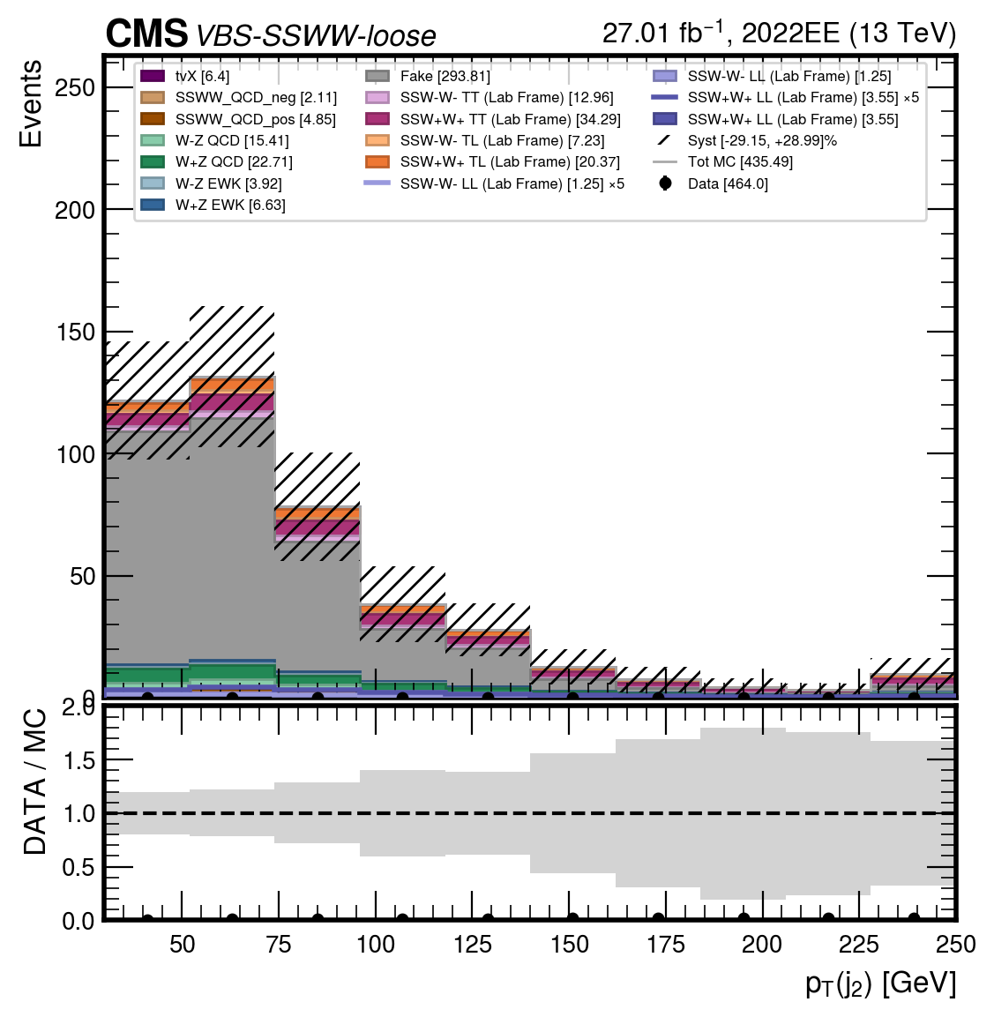
$$SIGNAL REGION SSWW (loose)$$
04
$$p_{T}{(j}_{1})$$
$$p_{T}{(j}_{2})$$
Giulia Gianoli – Meeting Tesi Magistrale - 24/07/25
23/98

Slide 24
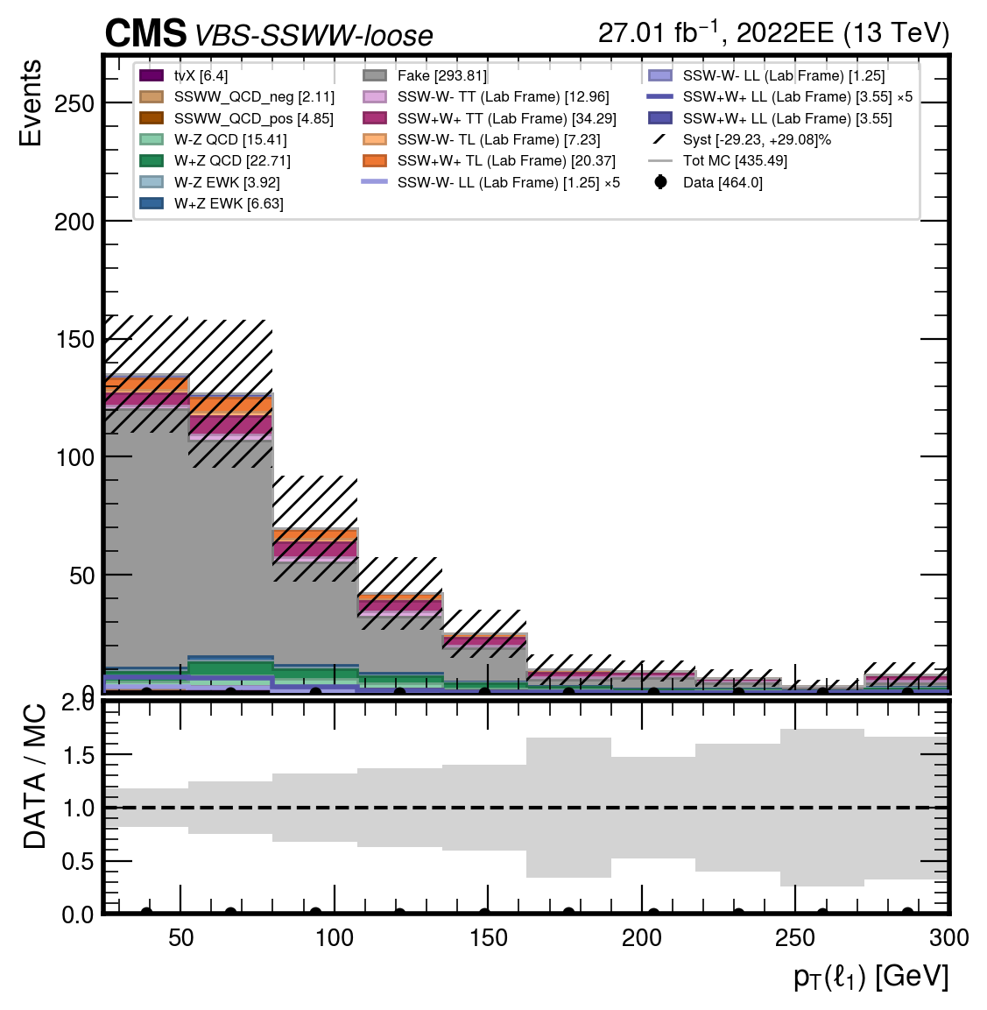
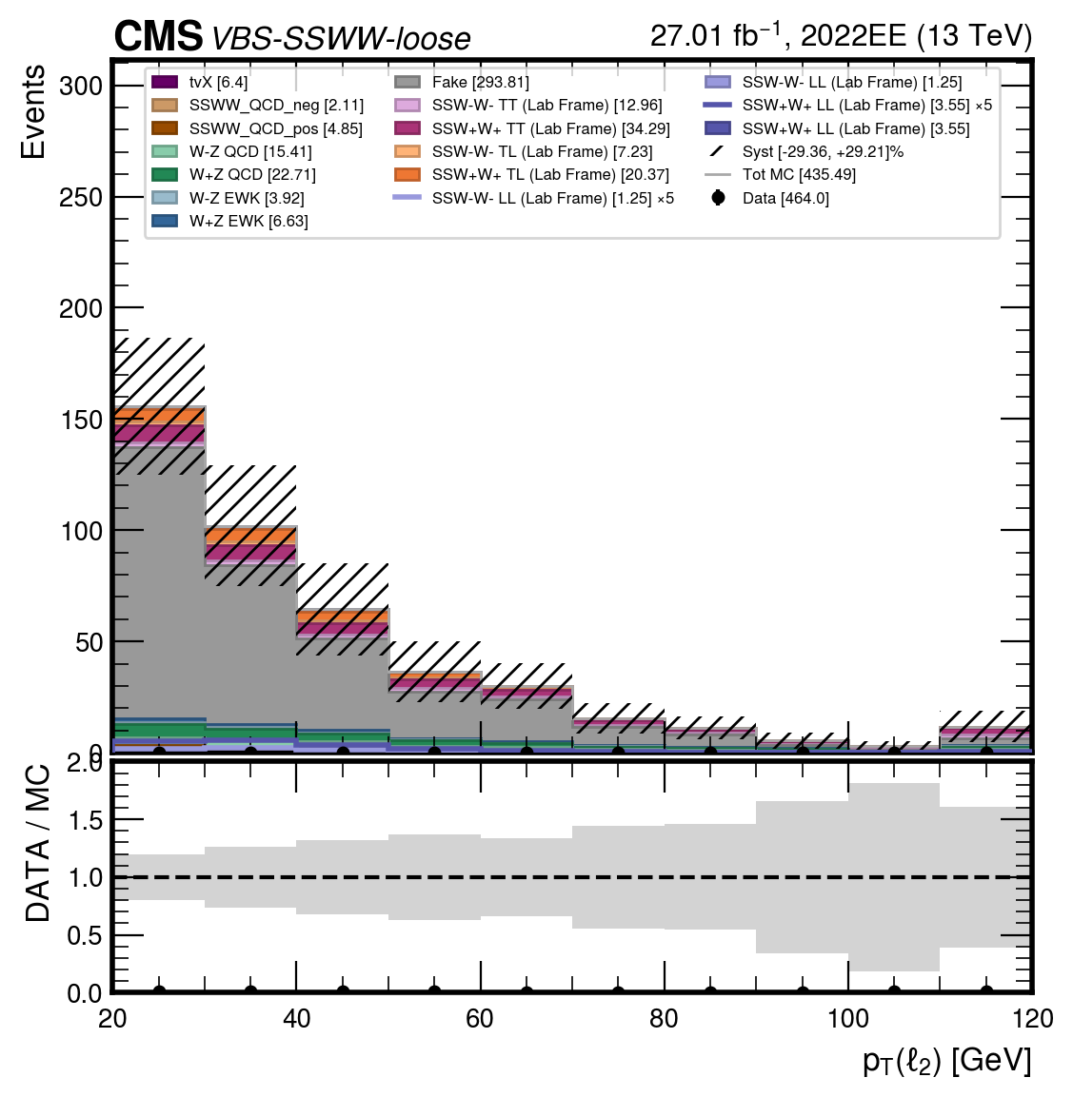
$$SIGNAL REGION SSWW (loose)$$
04
$$p_{T}{(l}_{1})$$
$$p_{T}{(l}_{2})$$
Giulia Gianoli – Meeting Tesi Magistrale - 24/07/25
24/98

Slide 25
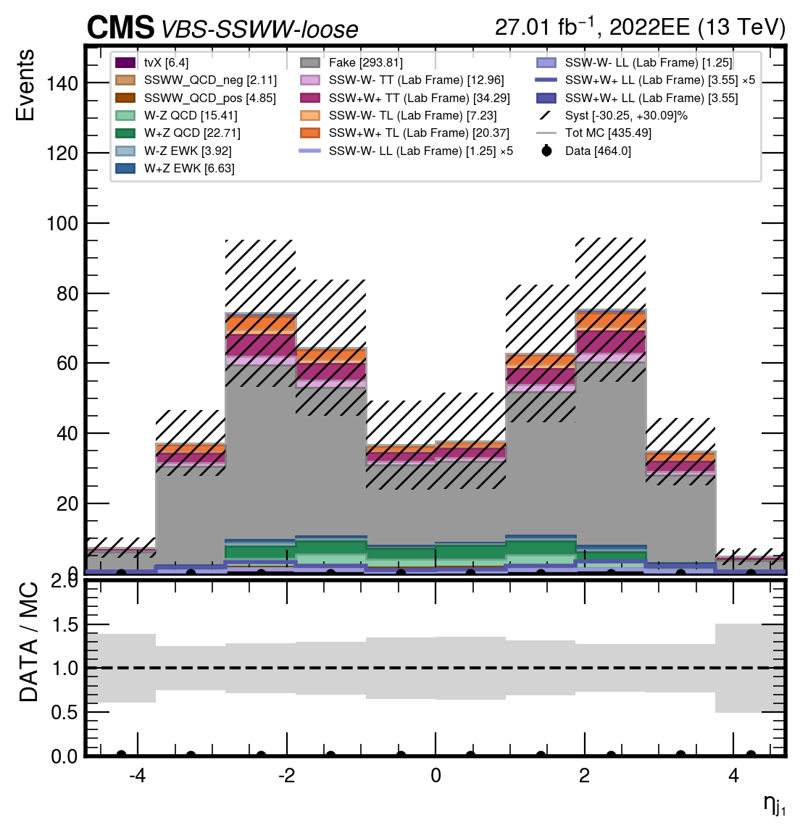
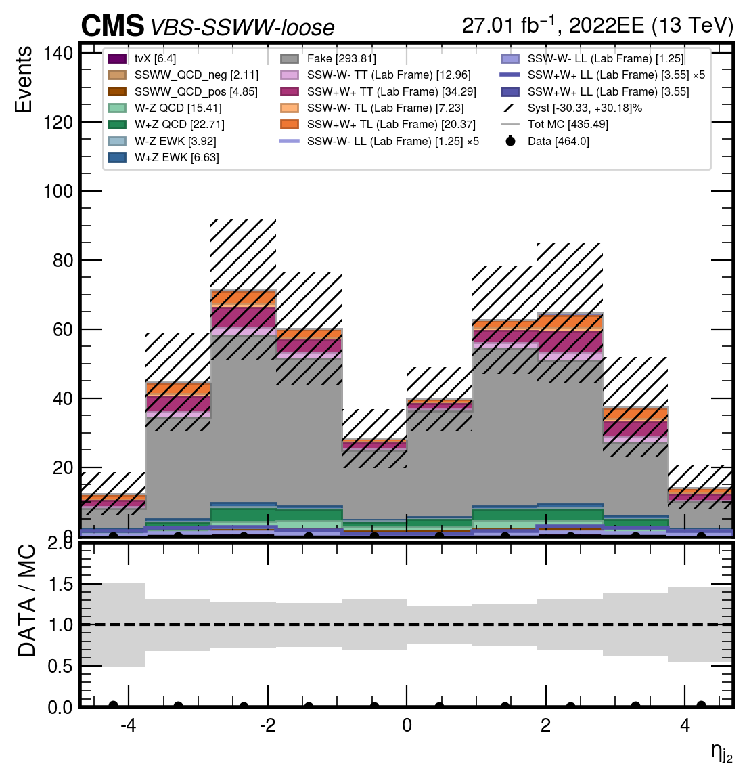
$$SIGNAL REGION SSWW (loose)$$
04
$$η_{j1}$$
$$η_{j2}$$
Giulia Gianoli – Meeting Tesi Magistrale - 24/07/25
25/98

Slide 26
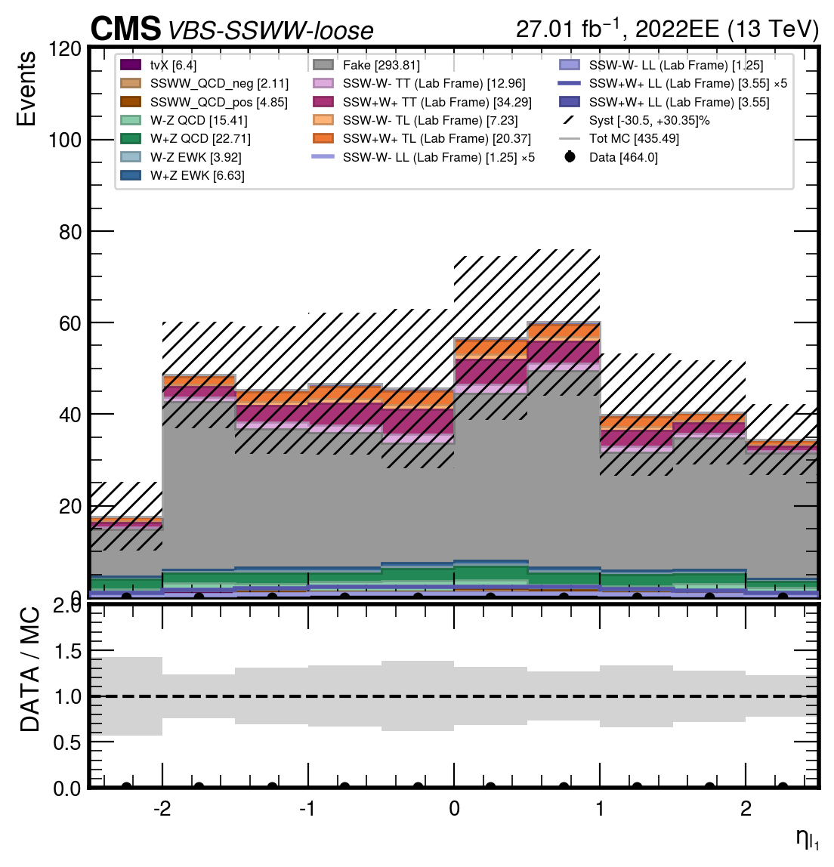
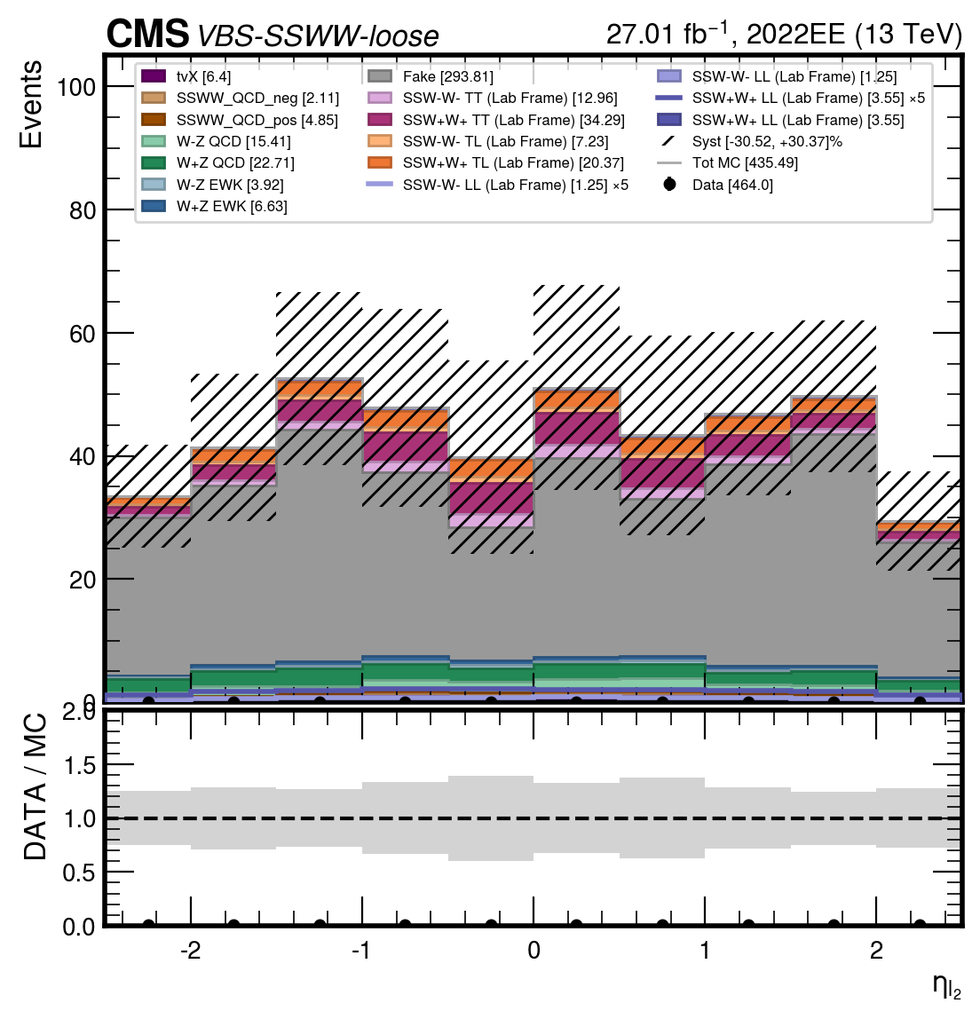
$$SIGNAL REGION SSWW (loose)$$
04
$$η_{l1}$$
$$η_{l2}$$
Giulia Gianoli – Meeting Tesi Magistrale - 24/07/25
26/98

Slide 27
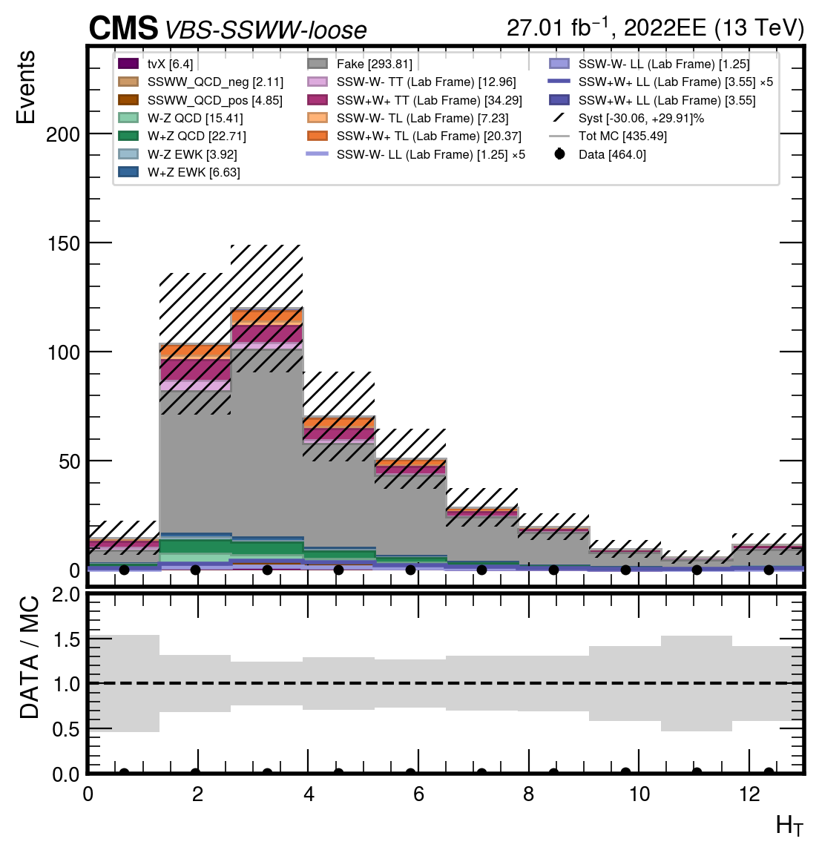
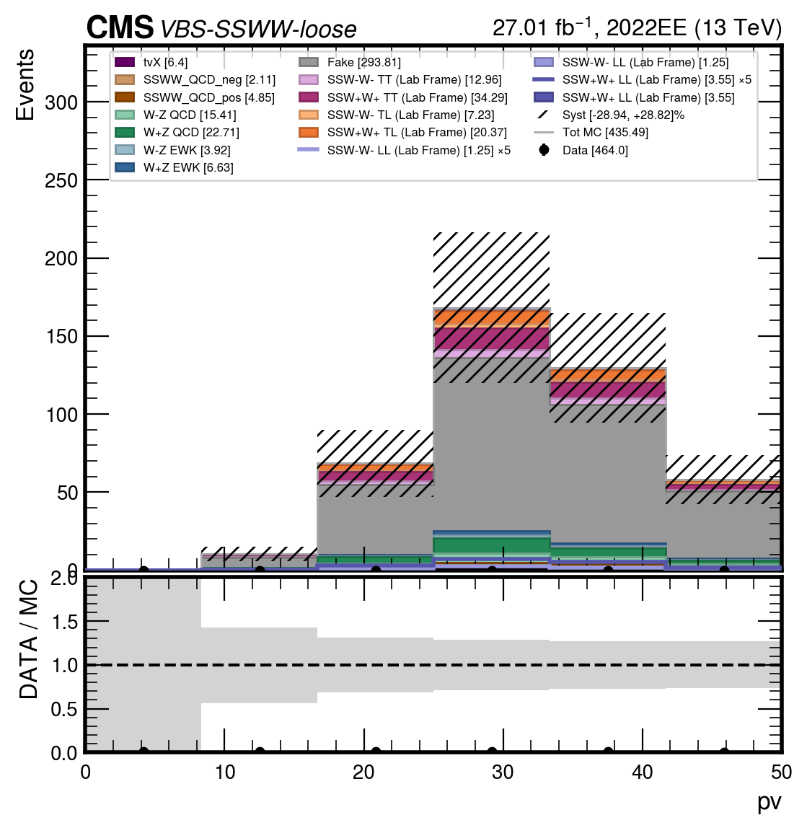
$$SIGNAL REGION SSWW (loose)$$
04
$$pv$$
$$Ht$$
Giulia Gianoli – Meeting Tesi Magistrale - 24/07/25
27/98

Slide 28
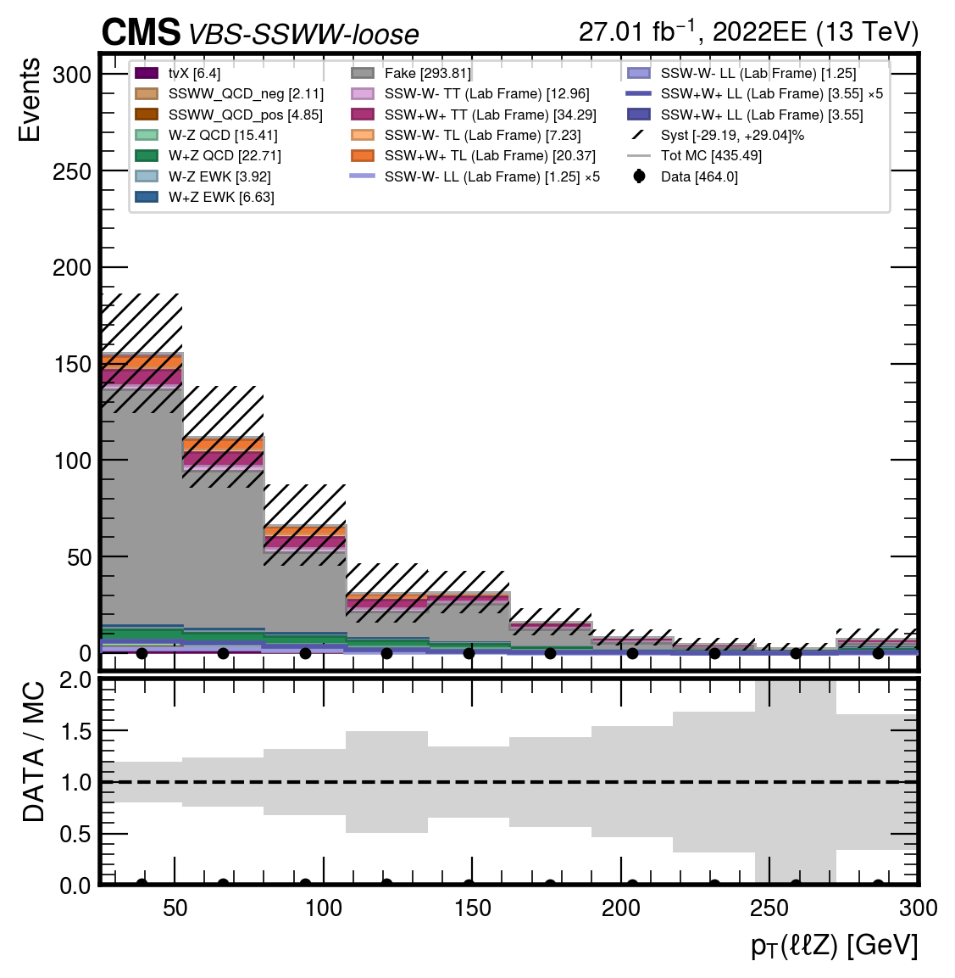
$$SIGNAL REGION SSWW (loose)$$
04
$$ptll$$
Giulia Gianoli – Meeting Tesi Magistrale - 24/07/25
28/98

Slide 29
03 RISULTATI OTTENUTI-CONTROL REGION WZ
Giulia Gianoli – Meeting Tesi Magistrale - 24/07/25
29/98

Slide 30
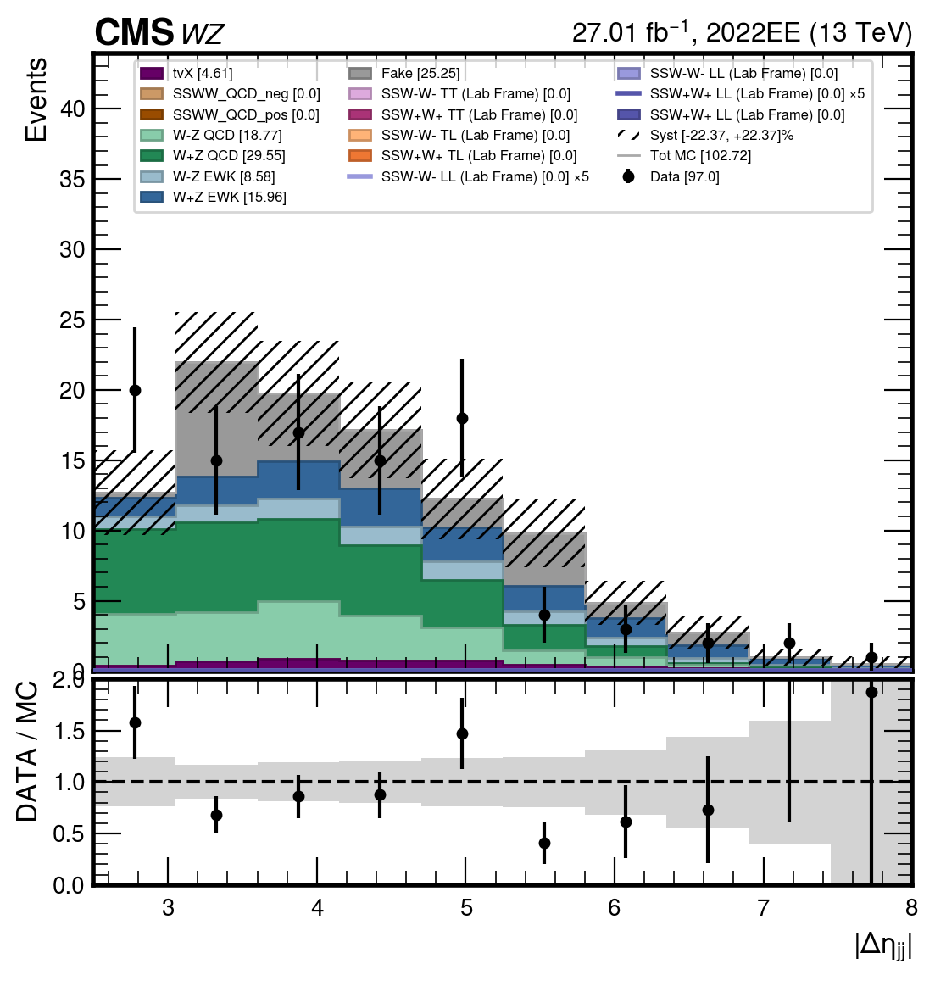
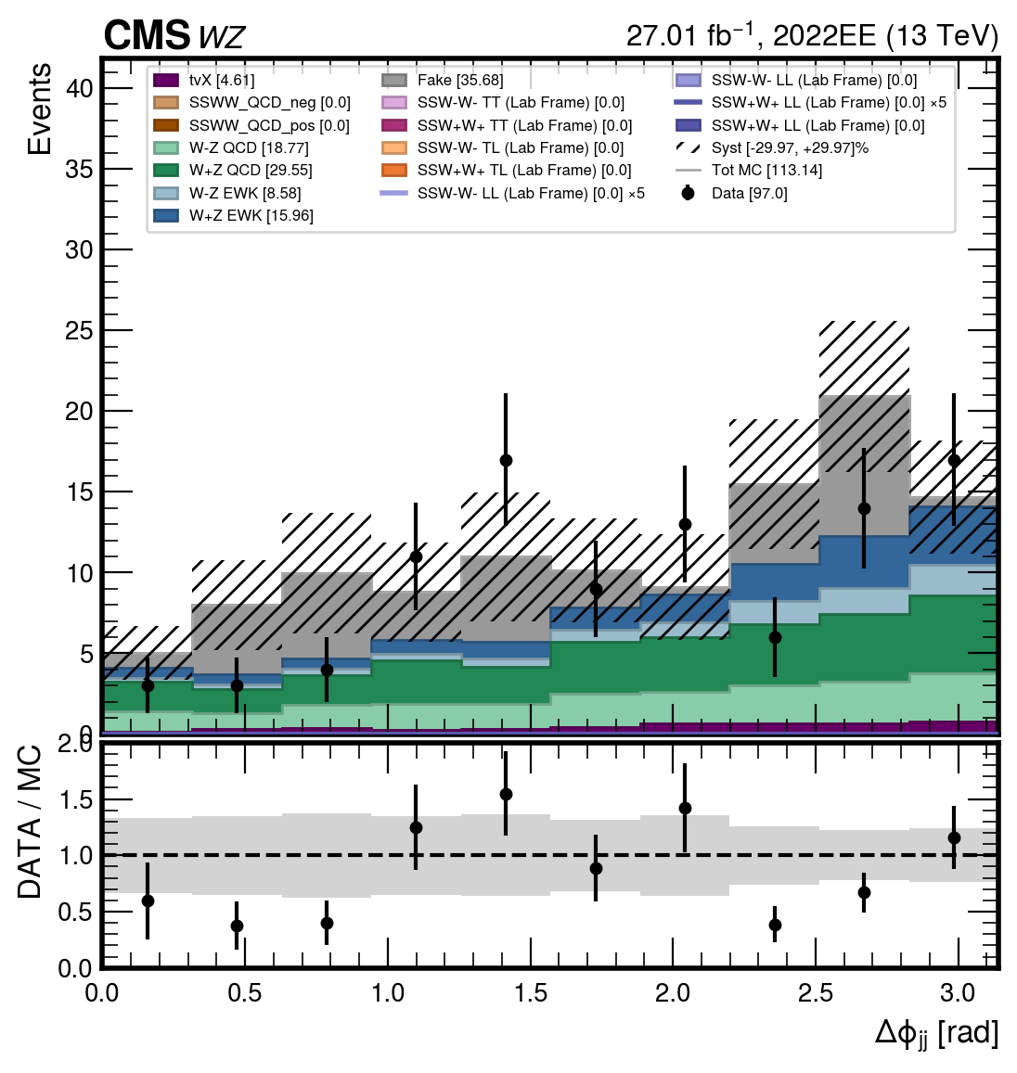


$$CONTROL REGION WZ$$
03
$$Δη_{jj}$$
$$Δφ_{jj}$$
Giulia Gianoli – Meeting Tesi Magistrale - 24/07/25
30/98

Slide 31
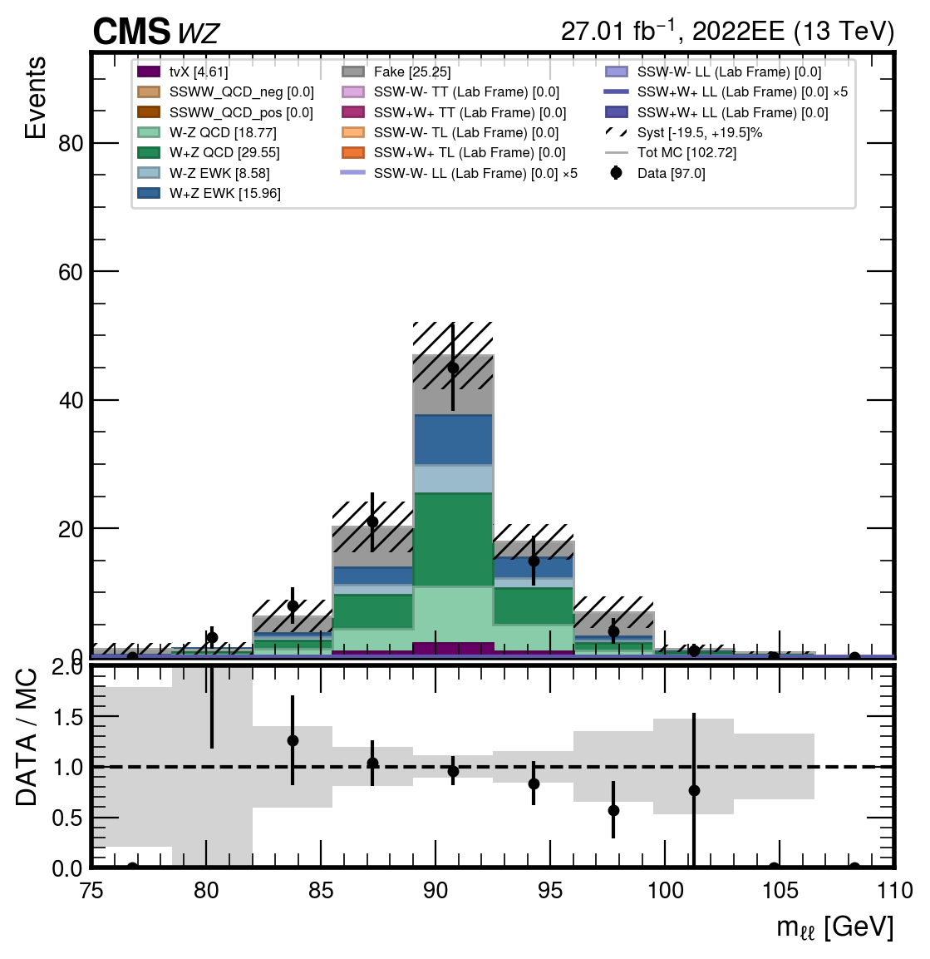
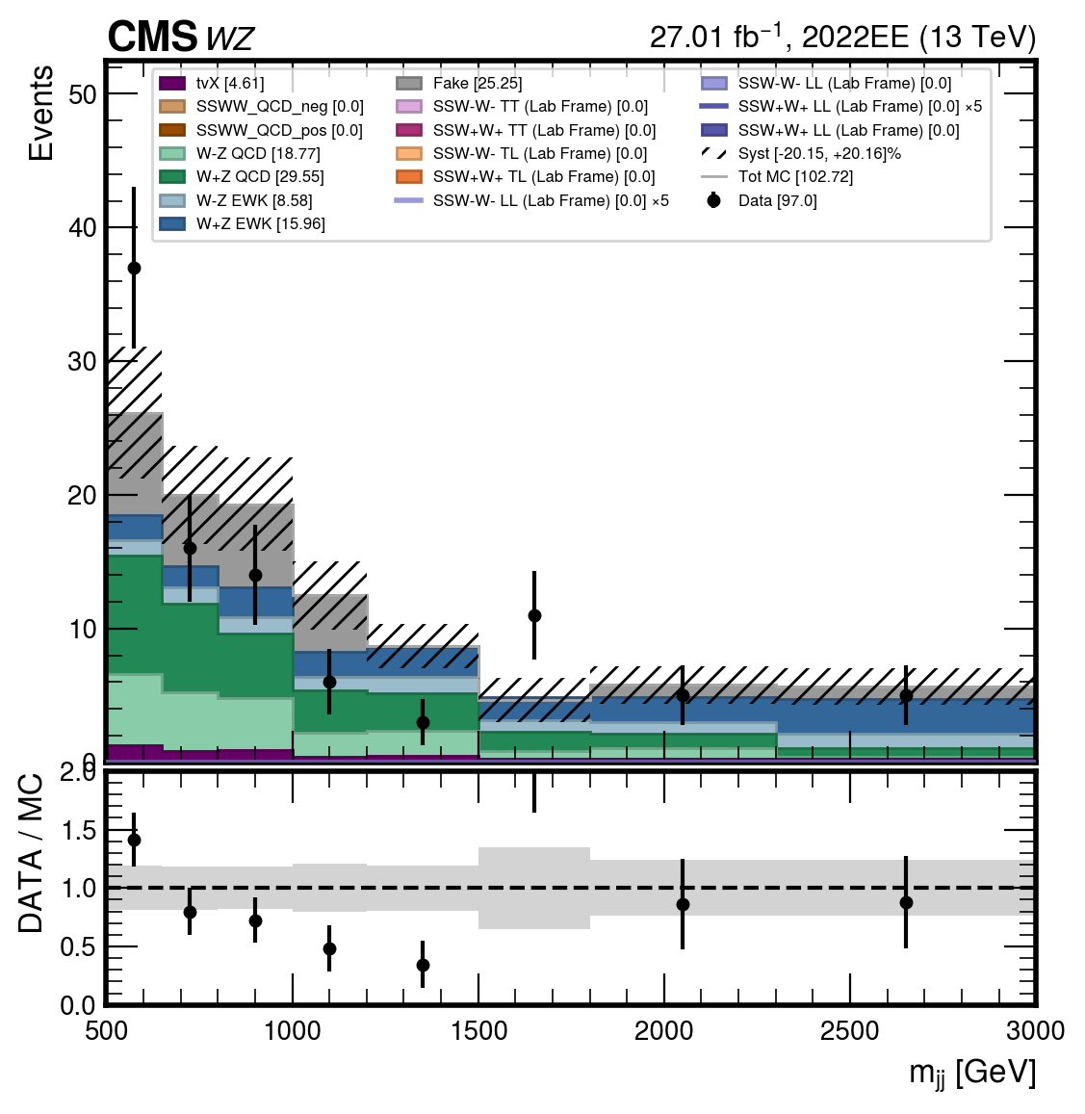
$$CONTROL REGION WZ$$
03
$$m_{ll}$$
$$m_{jj}$$
Giulia Gianoli – Meeting Tesi Magistrale - 24/07/25
31/98

Slide 32
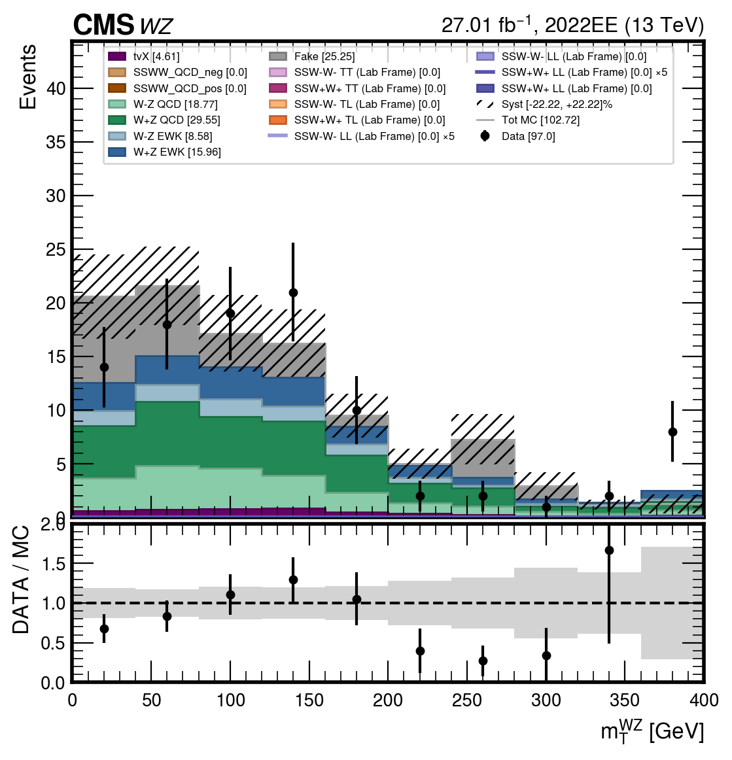
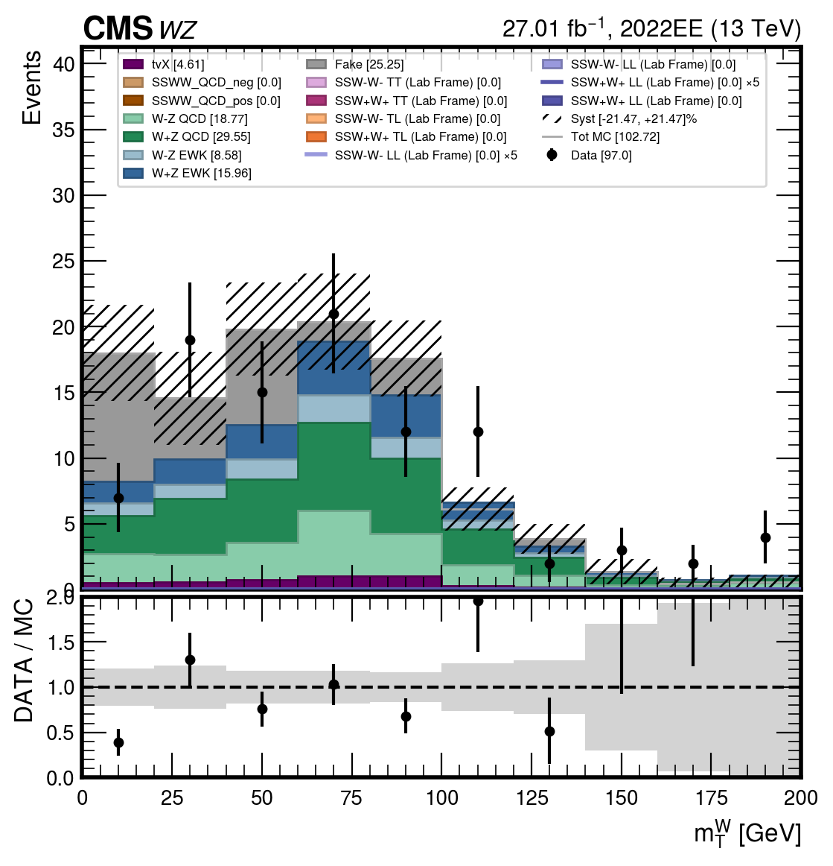


$$CONTROL REGION WZ$$
03
$$m_{T}(W)$$
$$m_{T}(WZ)$$
Giulia Gianoli – Meeting Tesi Magistrale - 24/07/25
32/98

Slide 33
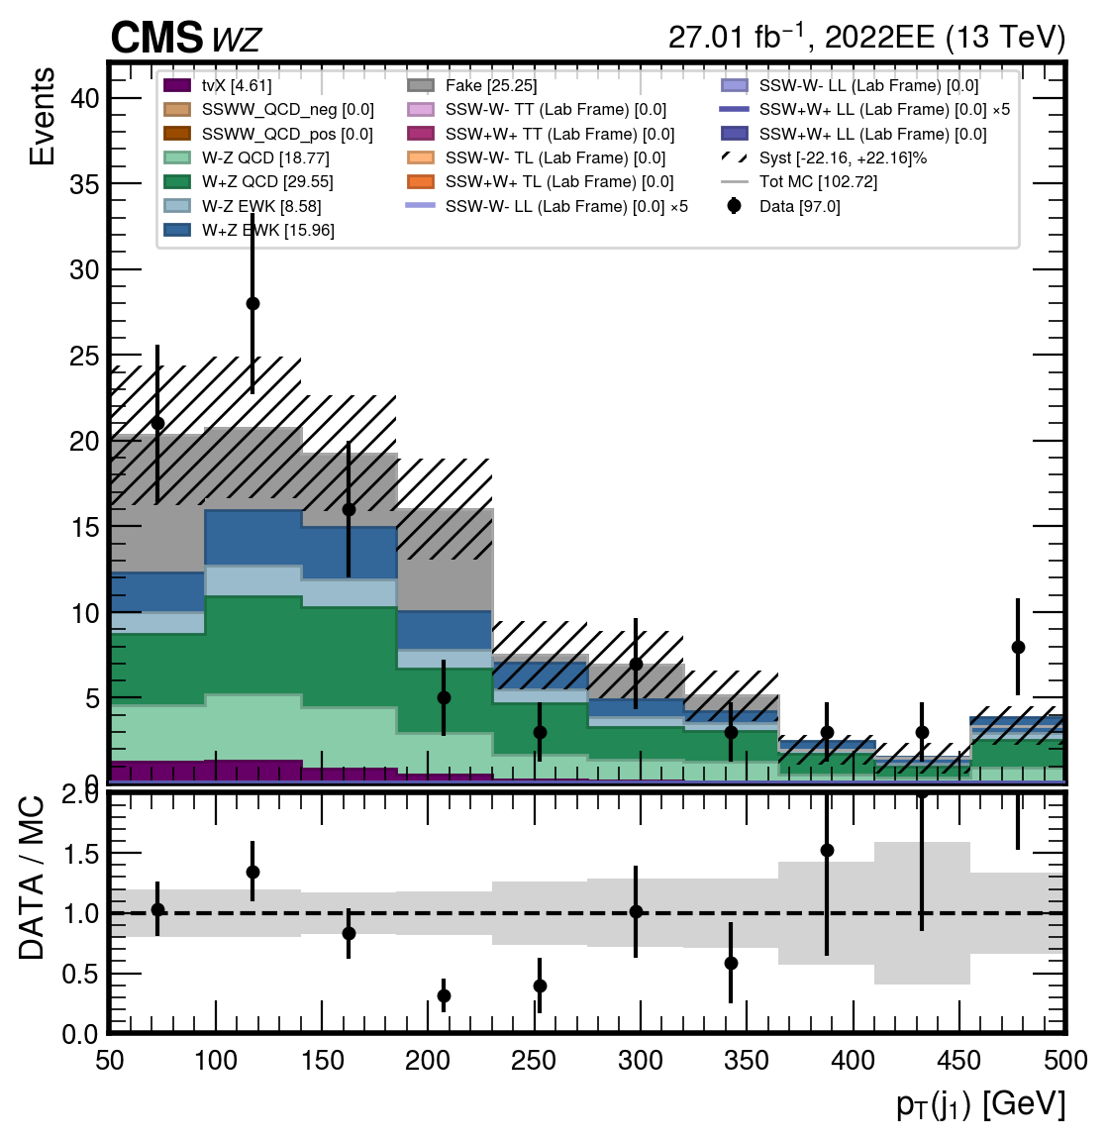
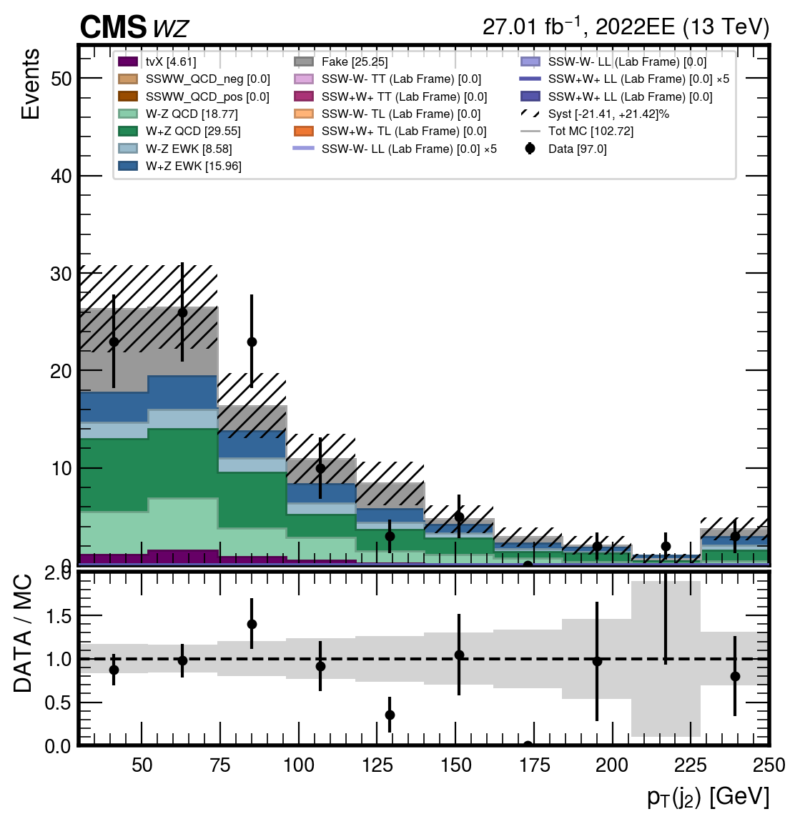
$$CONTROL REGION WZ$$
03
$$p_{T}{(j}_{1})$$
$$p_{T}{(j}_{2})$$
Giulia Gianoli – Meeting Tesi Magistrale - 24/07/25
33/98

Slide 34
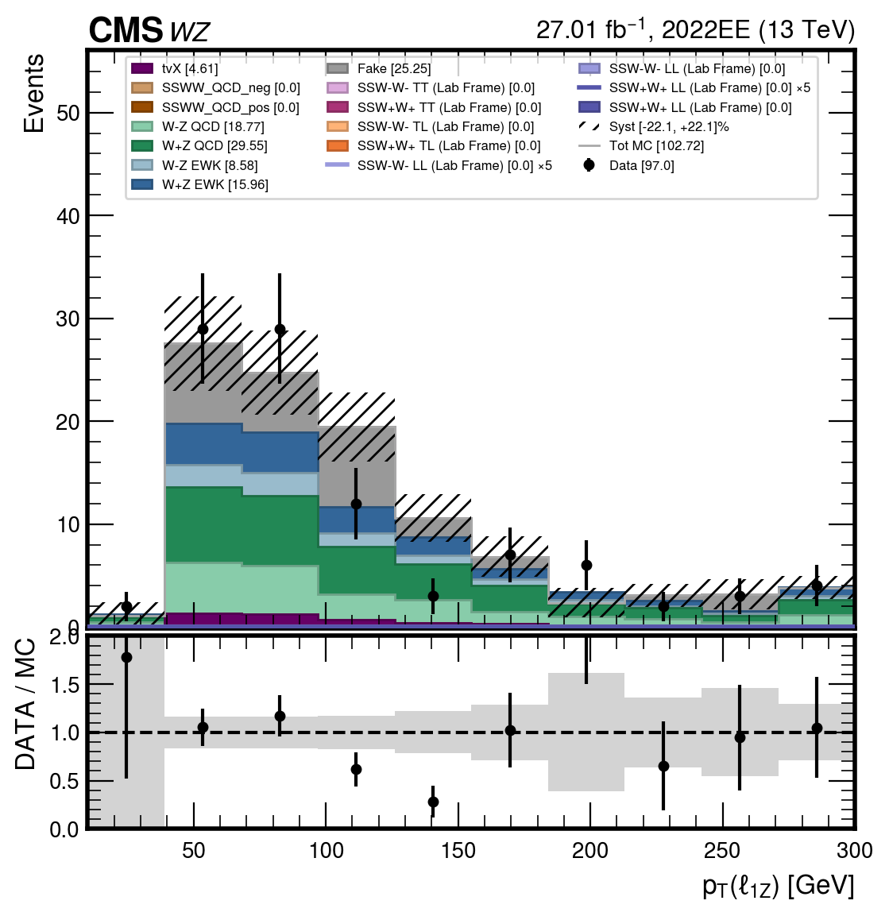
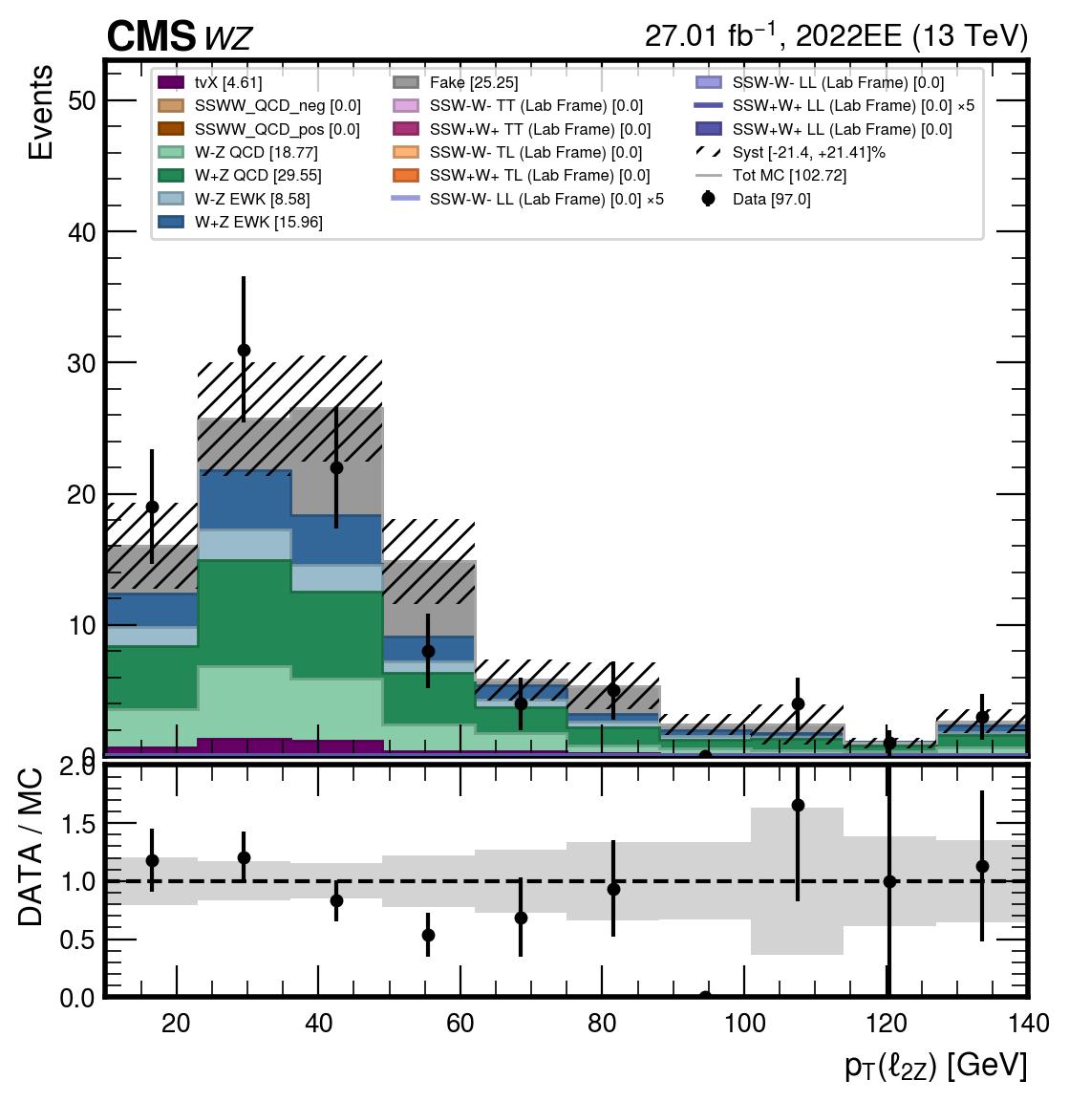


$$CONTROL REGION WZ$$
03
$$p_{T}{(l}_{1Z})$$
$$p_{T}{(l}_{2Z})$$
Giulia Gianoli – Meeting Tesi Magistrale - 24/07/25
34/98

Slide 35
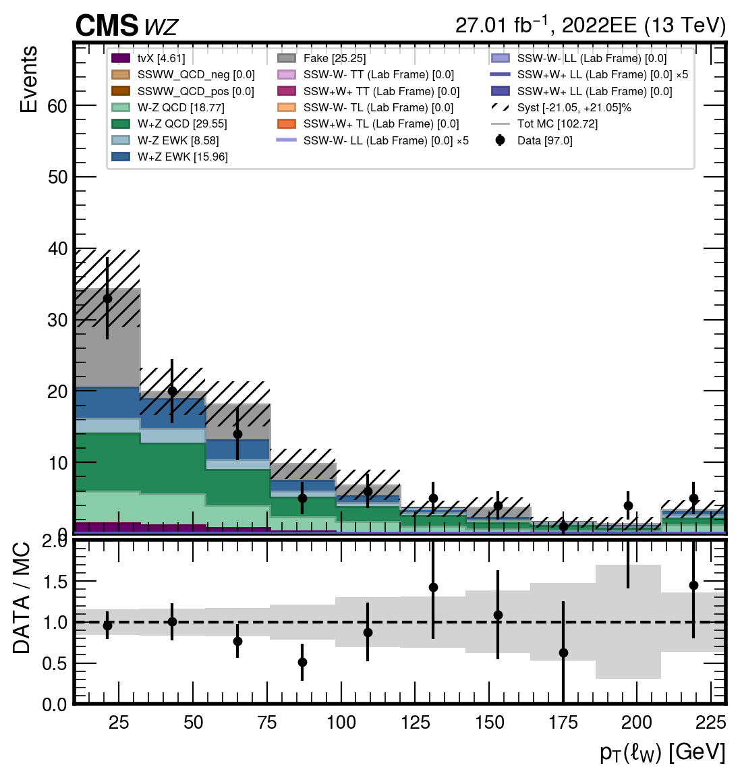
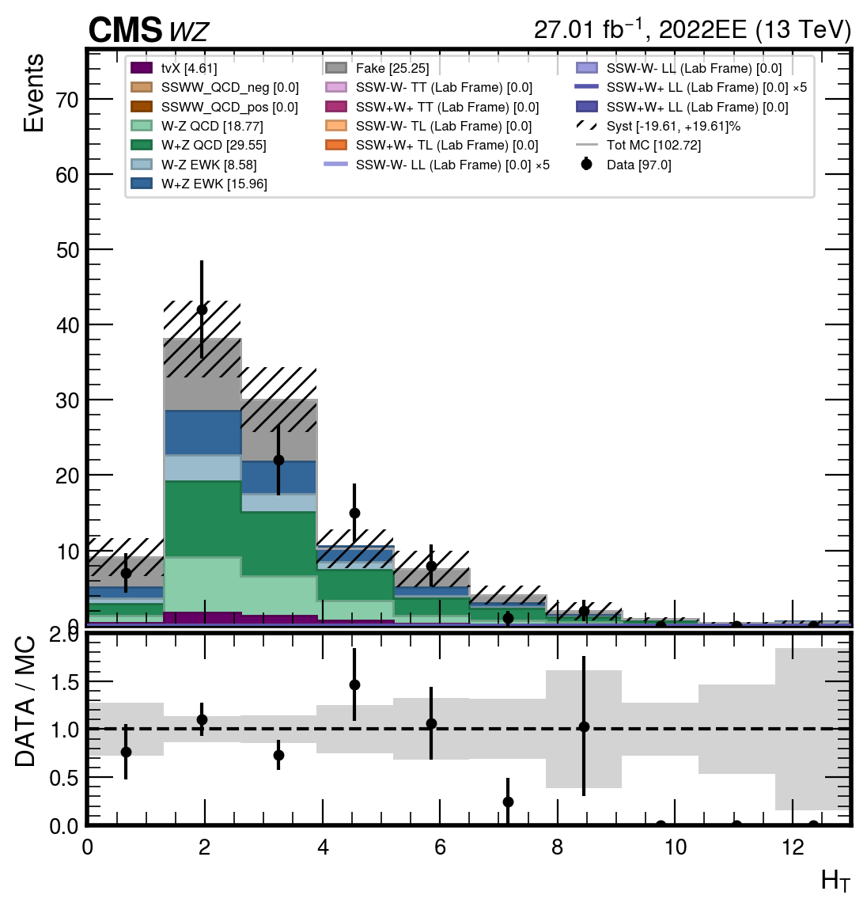


$$CONTROL REGION WZ$$
03
$$p_{T}{(l}_{3W})$$
$$Ht$$
Giulia Gianoli – Meeting Tesi Magistrale - 24/07/25
35/98

Slide 36
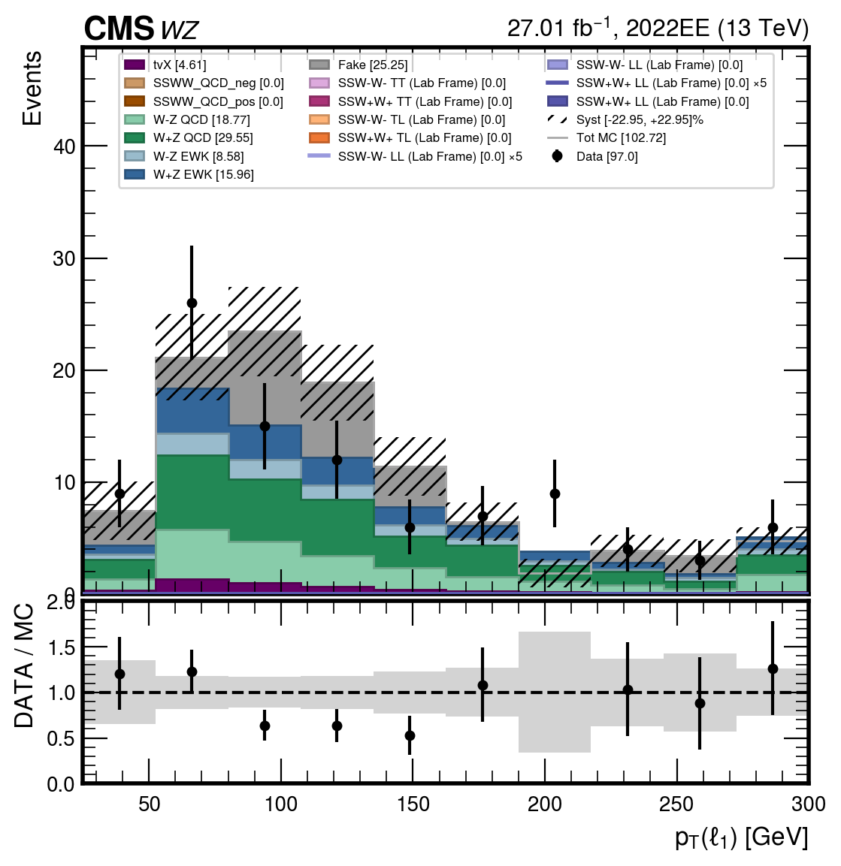
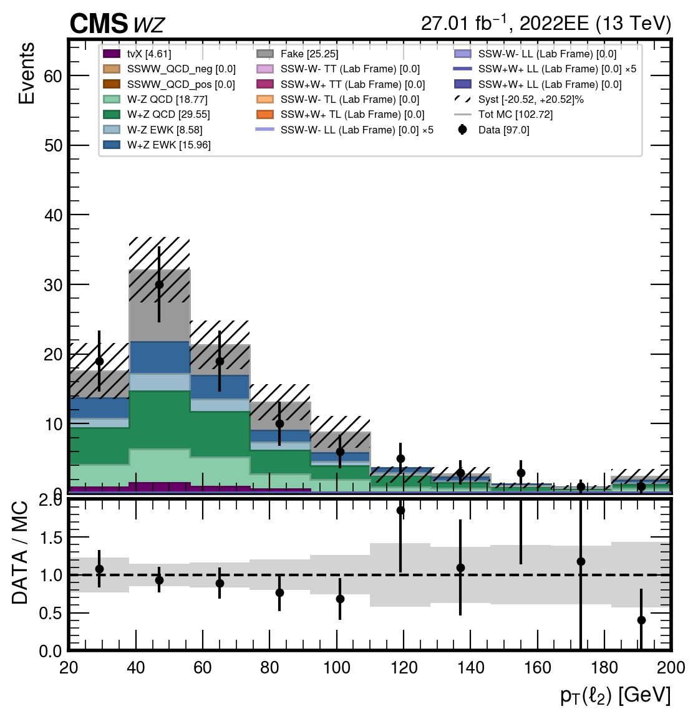
$$CONTROL REGION WZ$$
03
$$p_{T}{(l}_{1})$$
$$p_{T}{(l}_{2})$$
Giulia Gianoli – Meeting Tesi Magistrale - 24/07/25
36/98

Slide 37




$$CONTROL REGION WZ$$
03
$$p_{T}{(l}_{3})$$
$$nvp$$
Giulia Gianoli – Meeting Tesi Magistrale - 24/07/25
37/98

Slide 38


$$CONTROL REGION WZ$$
03
$$η_{j1}$$
$$η_{j2}$$
Giulia Gianoli – Meeting Tesi Magistrale - 24/07/25
38/98

Slide 39


$$CONTROL REGION WZ$$
03
$$η_{l1}$$
$$η_{l2}$$
Giulia Gianoli – Meeting Tesi Magistrale - 24/07/25
39/98

Slide 40




$$CONTROL REGION WZ$$
03
$$η_{l3}$$
$$η_{lW}$$
Giulia Gianoli – Meeting Tesi Magistrale - 24/07/25
40/98

Slide 41




$$CONTROL REGION WZ$$
03
$$η_{l1Z}$$
$$η_{l2Z}$$
Giulia Gianoli – Meeting Tesi Magistrale - 24/07/25
41/98

Slide 42


$$CONTROL REGION WZ$$
03
ptllZ
MET
Giulia Gianoli – Meeting Tesi Magistrale - 24/07/25
42/98

Slide 43
03 RISULTATI OTTENUTI-CONTROL REGION WZ (loose)
Giulia Gianoli – Meeting Tesi Magistrale - 24/07/25
43/98

Slide 44





$$CONTROL REGION WZ (loose)$$
03
$$Δη_{jj}$$
$$m_{ll}$$
Giulia Gianoli – Meeting Tesi Magistrale - 24/07/25
44/98

Slide 45


$$CONTROL REGION WZ (loose)$$
03
$$m_{T}(W)$$
$$m_{T}(WZ)$$
Giulia Gianoli – Meeting Tesi Magistrale - 24/07/25
45/98

Slide 46


$$CONTROL REGION WZ (loose)$$
03
$$p_{T}{(j}_{1})$$
$$p_{T}{(j}_{2})$$
Giulia Gianoli – Meeting Tesi Magistrale - 24/07/25
46/98

Slide 47


$$CONTROL REGION WZ (loose)$$
03
$$p_{T}{(l}_{1Z})$$
$$p_{T}{(l}_{2Z})$$
Giulia Gianoli – Meeting Tesi Magistrale - 24/07/25
47/98

Slide 48


$$CONTROL REGION WZ (loose)$$
03
$$p_{T}{(l}_{3W})$$
$$Ht$$
Giulia Gianoli – Meeting Tesi Magistrale - 24/07/25
48/98

Slide 49


$$CONTROL REGION WZ (loose)$$
03
$$p_{T}{(l}_{1})$$
$$p_{T}{(l}_{2})$$
Giulia Gianoli – Meeting Tesi Magistrale - 24/07/25
49/98

Slide 50


$$CONTROL REGION WZ (loose)$$
03
$$p_{T}{(l}_{3})$$
$$nvp$$
Giulia Gianoli – Meeting Tesi Magistrale - 24/07/25
50/98

Slide 51


$$CONTROL REGION WZ (loose)$$
03
$$η_{j1}$$
$$η_{j2}$$
Giulia Gianoli – Meeting Tesi Magistrale - 24/07/25
51/98

Slide 52


$$CONTROL REGION WZ (loose)$$
03
$$η_{l1}$$
$$η_{l2}$$
Giulia Gianoli – Meeting Tesi Magistrale - 24/07/25
52/98

Slide 53


$$CONTROL REGION WZ (loose)$$
03
$$η_{l3}$$
$$η_{lW}$$
Giulia Gianoli – Meeting Tesi Magistrale - 24/07/25
53/98

Slide 54


$$CONTROL REGION WZ (loose)$$
03
$$η_{l1Z}$$
$$η_{l2Z}$$
Giulia Gianoli – Meeting Tesi Magistrale - 24/07/25
54/98

Slide 55


$$CONTROL REGION WZ (loose)$$
03
ptllZ
MET
Giulia Gianoli – Meeting Tesi Magistrale - 24/07/25
55/98

Slide 56
03 RISULTATI OTTENUTI-CONTROL REGION WZb
Giulia Gianoli – Meeting Tesi Magistrale - 24/07/25
56/98

Slide 57



$$CONTROL REGION WZb$$
03
$$Δη_{jj}$$
$$Δφ_{jj}$$
Giulia Gianoli – Meeting Tesi Magistrale - 24/07/25
57/98

Slide 58


$$CONTROL REGION WZb$$
03
$$m_{ll}$$
$$m_{jj}$$
Giulia Gianoli – Meeting Tesi Magistrale - 24/07/25
58/98

Slide 59


$$CONTROL REGION WZb$$
03
$$m_{T}(W)$$
$$m_{T}(WZ)$$
Giulia Gianoli – Meeting Tesi Magistrale - 24/07/25
59/98

Slide 60


$$CONTROL REGION WZb$$
03
$$p_{T}{(j}_{1})$$
$$p_{T}{(j}_{2})$$
Giulia Gianoli – Meeting Tesi Magistrale - 24/07/25
60/98

Slide 61


$$CONTROL REGION WZb$$
03
$$p_{T}{(l}_{1Z})$$
$$p_{T}{(l}_{2Z})$$
Giulia Gianoli – Meeting Tesi Magistrale - 24/07/25
61/98

Slide 62


$$CONTROL REGION WZb$$
03
$$p_{T}{(l}_{3W})$$
$$Ht$$
Giulia Gianoli – Meeting Tesi Magistrale - 24/07/25
62/98

Slide 63


$$CONTROL REGION WZb$$
03
$$p_{T}{(l}_{1})$$
$$p_{T}{(l}_{2})$$
Giulia Gianoli – Meeting Tesi Magistrale - 24/07/25
63/98

Slide 64


$$CONTROL REGION WZb$$
03
$$p_{T}{(l}_{3})$$
$$nvp$$
Giulia Gianoli – Meeting Tesi Magistrale - 24/07/25
64/98

Slide 65


$$CONTROL REGION WZb$$
03
$$η_{j1}$$
$$η_{j2}$$
Giulia Gianoli – Meeting Tesi Magistrale - 24/07/25
65/98

Slide 66


$$CONTROL REGION WZb$$
03
$$η_{l1}$$
$$η_{l2}$$
Giulia Gianoli – Meeting Tesi Magistrale - 24/07/25
66/98

Slide 67


$$CONTROL REGION WZb$$
03
$$η_{l3}$$
$$η_{lW}$$
Giulia Gianoli – Meeting Tesi Magistrale - 24/07/25
67/98

Slide 68


$$CONTROL REGION WZb$$
03
$$η_{l1Z}$$
$$η_{l2Z}$$
Giulia Gianoli – Meeting Tesi Magistrale - 24/07/25
68/98

Slide 69


$$CONTROL REGION WZb$$
03
ptllZ
MET
Giulia Gianoli – Meeting Tesi Magistrale - 24/07/25
69/98

Slide 70
04 RISULTATI OTTENUTI-CONTROL REGION LOW-MJJ
Giulia Gianoli – Meeting Tesi Magistrale - 24/07/25
70/98

Slide 71




$$CONTROL REGION{ low m}_{jj}$$
04
$$Δφ_{jj}$$
$$p_{T}(ll)$$
Giulia Gianoli – Meeting Tesi Magistrale - 24/07/25
71/98

Slide 72


$$CONTROL REGION low{ m}_{jj}$$
04
$$Δφ_{ll}$$
$$m_{jj}$$
Giulia Gianoli – Meeting Tesi Magistrale - 24/07/25
72/98

Slide 73


$$CONTROL REGION{ low m}_{jj}$$
04
$$m_{ll}$$
$$m_{T}(WW)$$
Giulia Gianoli – Meeting Tesi Magistrale - 24/07/25
73/98

Slide 74


$$CONTROL REGION{ low m}_{jj}$$
04
$$p_{T}{(j}_{1})$$
$$p_{T}{(j}_{2})$$
Giulia Gianoli – Meeting Tesi Magistrale - 24/07/25
74/98

Slide 75


$$CONTROL REGION{ low m}_{jj}$$
04
$$p_{T}{(l}_{1})$$
$$p_{T}{(l}_{2})$$
Giulia Gianoli – Meeting Tesi Magistrale - 24/07/25
75/98

Slide 76


$$CONTROL REGION low{ m}_{jj}$$
04
$$η_{j1}$$
$$η_{j2}$$
Giulia Gianoli – Meeting Tesi Magistrale - 24/07/25
76/98

Slide 77


$$CONTROL REGION{ low m}_{jj}$$
04
$$η_{l1}$$
$$η_{l2}$$
Giulia Gianoli – Meeting Tesi Magistrale - 24/07/25
77/98

Slide 78


$$CONTROL REGION{ low m}_{jj}$$
04
$$pv$$
$$Ht$$
Giulia Gianoli – Meeting Tesi Magistrale - 24/07/25
78/98

Slide 79
05 RISULTATI OTTENUTI-CONTROL REGION INVERSE MET
Giulia Gianoli – Meeting Tesi Magistrale - 24/07/25
79/98

Slide 80



$$CONTROL REGION inverse MET$$
04
$$Δφ_{jj}$$
$$Δη_{jj}$$
Giulia Gianoli – Meeting Tesi Magistrale - 24/07/25
80/98

Slide 81


$$CONTROL REGION inverse MET$$
04
$$Δφ_{ll}$$
$$m_{jj}$$
Giulia Gianoli – Meeting Tesi Magistrale - 24/07/25
81/98

Slide 82


$$CONTROL REGION inverse MET$$
04
$$m_{ll}$$
$$m_{T}(WW)$$
Giulia Gianoli – Meeting Tesi Magistrale - 24/07/25
82/98

Slide 83


$$CONTROL REGION inverse MET$$
04
$$p_{T}{(j}_{1})$$
$$p_{T}{(j}_{2})$$
Giulia Gianoli – Meeting Tesi Magistrale - 24/07/25
83/98

Slide 84


$$CONTROL REGION inverse MET$$
04
$$p_{T}{(l}_{1})$$
$$p_{T}{(l}_{2})$$
Giulia Gianoli – Meeting Tesi Magistrale - 24/07/25
84/98

Slide 85


$$CONTROL REGION inverse MET$$
04
$$η_{j1}$$
$$η_{j2}$$
Giulia Gianoli – Meeting Tesi Magistrale - 24/07/25
85/98

Slide 86


$$CONTROL REGION inverse MET$$
04
$$η_{l1}$$
$$η_{l2}$$
Giulia Gianoli – Meeting Tesi Magistrale - 24/07/25
86/98

Slide 87


$$CONTROL REGION inverse MET$$
04
$$pv$$
$$Ht$$
Giulia Gianoli – Meeting Tesi Magistrale - 24/07/25
87/98

Slide 88




$$CONTROL REGION inverse MET$$
04
$$MET$$
$$ptll$$
Giulia Gianoli – Meeting Tesi Magistrale - 24/07/25
88/98

Slide 89
05 RISULTATI OTTENUTI-CONTROL REGION SSWWb
Giulia Gianoli – Meeting Tesi Magistrale - 24/07/25
89/98

Slide 90



$$CONTROL REGION SSWWb$$
04
$$Δφ_{jj}$$
$$Δη_{jj}$$
Giulia Gianoli – Meeting Tesi Magistrale - 24/07/25
90/98

Slide 91


$$CONTROL REGION SSWWb$$
04
$$Δφ_{ll}$$
$$m_{jj}$$
Giulia Gianoli – Meeting Tesi Magistrale - 24/07/25
91/98

Slide 92


$$CONTROL REGION SSWWb$$
04
$$m_{ll}$$
$$m_{T}(WW)$$
Giulia Gianoli – Meeting Tesi Magistrale - 24/07/25
92/98

Slide 93


$$CONTROL REGION SSWWb$$
04
$$p_{T}{(j}_{1})$$
$$p_{T}{(j}_{2})$$
Giulia Gianoli – Meeting Tesi Magistrale - 24/07/25
93/98

Slide 94


$$CONTROL REGION SSWWb$$
04
$$p_{T}{(l}_{1})$$
$$p_{T}{(l}_{2})$$
Giulia Gianoli – Meeting Tesi Magistrale - 24/07/25
94/98

Slide 95


$$CONTROL REGION SSWWb$$
04
$$η_{j1}$$
$$η_{j2}$$
Giulia Gianoli – Meeting Tesi Magistrale - 24/07/25
95/98

Slide 96


$$CONTROL REGION SSWWb$$
04
$$η_{l1}$$
$$η_{l2}$$
Giulia Gianoli – Meeting Tesi Magistrale - 24/07/25
96/98

Slide 97


$$CONTROL REGION SSWWb$$
04
$$pv$$
$$Ht$$
Giulia Gianoli – Meeting Tesi Magistrale - 24/07/25
97/98

Slide 98

$$CONTROL REGION SSWWb$$
04
$$ptll$$
Giulia Gianoli – Meeting Tesi Magistrale - 24/07/25
98/98

