Slide 1
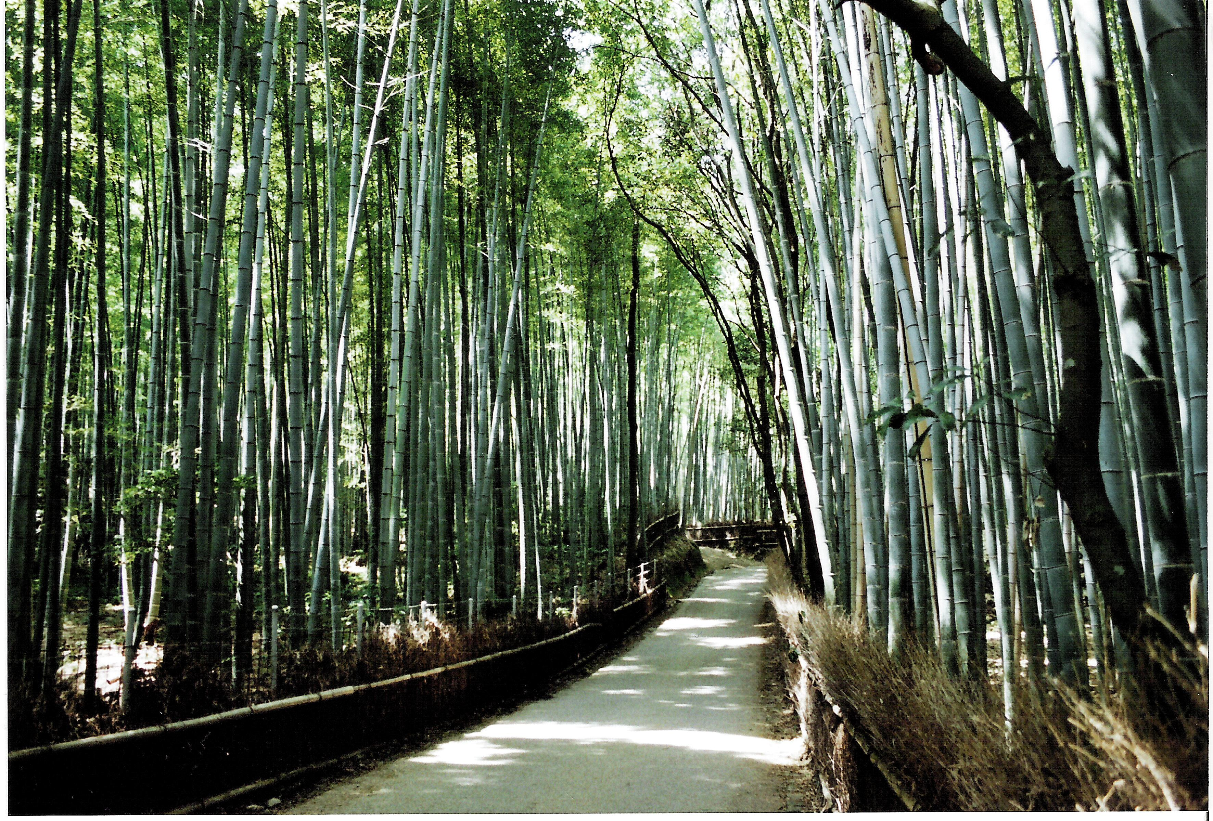

Introduction to
Particle Accelerators and CERN
Tatiana Pieloni Tatiana.Pieloni@epfl.ch
Laboratory of Particle Accelerator Physics

Slide 2
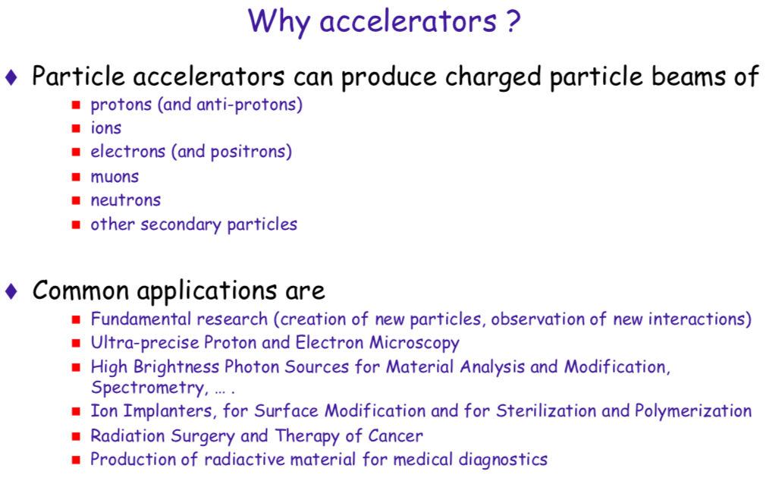

Slide 3

Accelerators and Their Use
Today: ~ 30’000 accelerators operational world-wide*
The large majority is used in industry and medicine
Les than a fraction of a percent is used for research and discovery science
Industrial applications: ~ 20’000*
Cyclotrons
Medical applications: ~ 10’000*
FFAG
Synchrotrons
*Source: World Scientific Reviews of Accelerator Science and Technology
A.W. Chao
Synchrotron light sources (e⁻)
Lin. & Circ. accelerators/Colliders

Slide 4
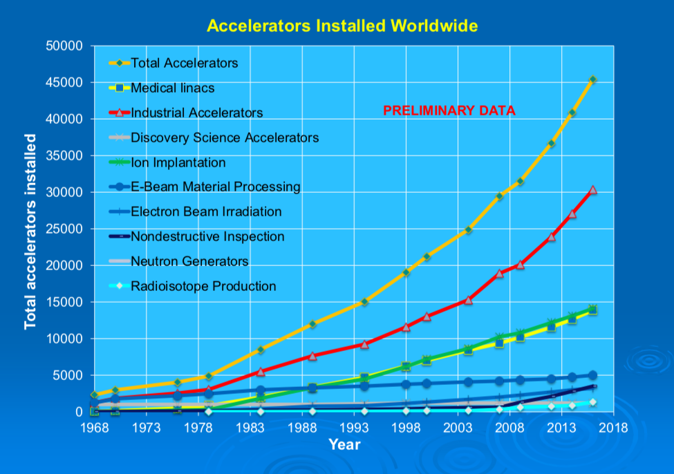
Dr. Robert W. Hamm, CEO R&M Technical Enterprises, Inc. Pleasanton, CA, USA
Presented to Accelerator-Industry Co-Innovation Workshop Brussels, Belgium ^{February 6, 2018}

Slide 5
Dr. Robert W. Hamm, CEO R&M Technical Enterprises, Inc. Pleasanton, CA, USA
Presented to Accelerator-Industry Co-Innovation Workshop Brussels, Belgium ^{February 6, 2018}

Slide 6
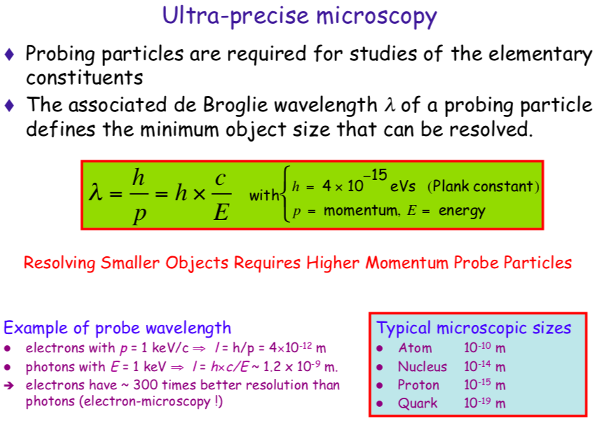

Slide 7
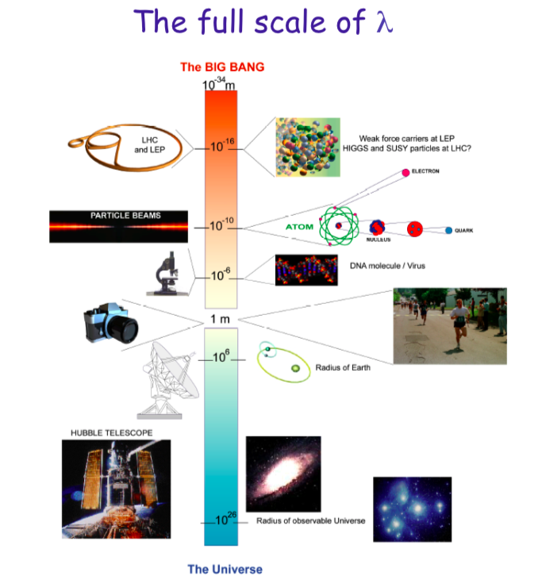

Slide 8
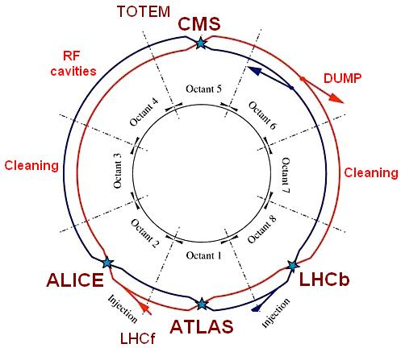
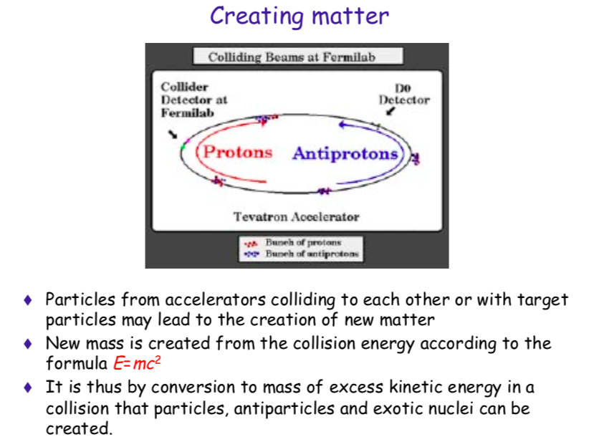
Creating Matter

Slide 9
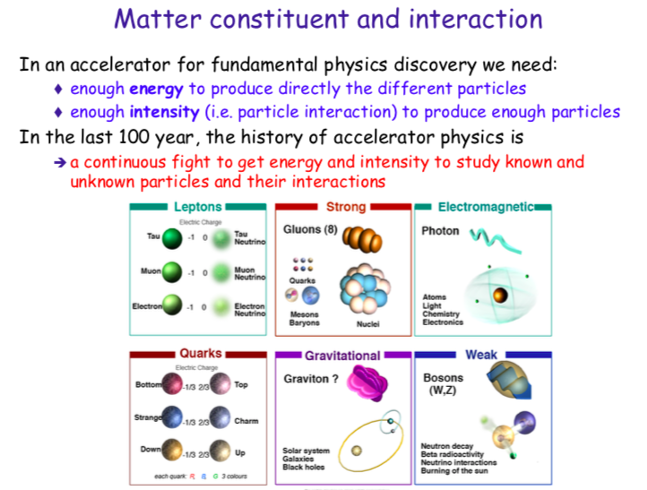
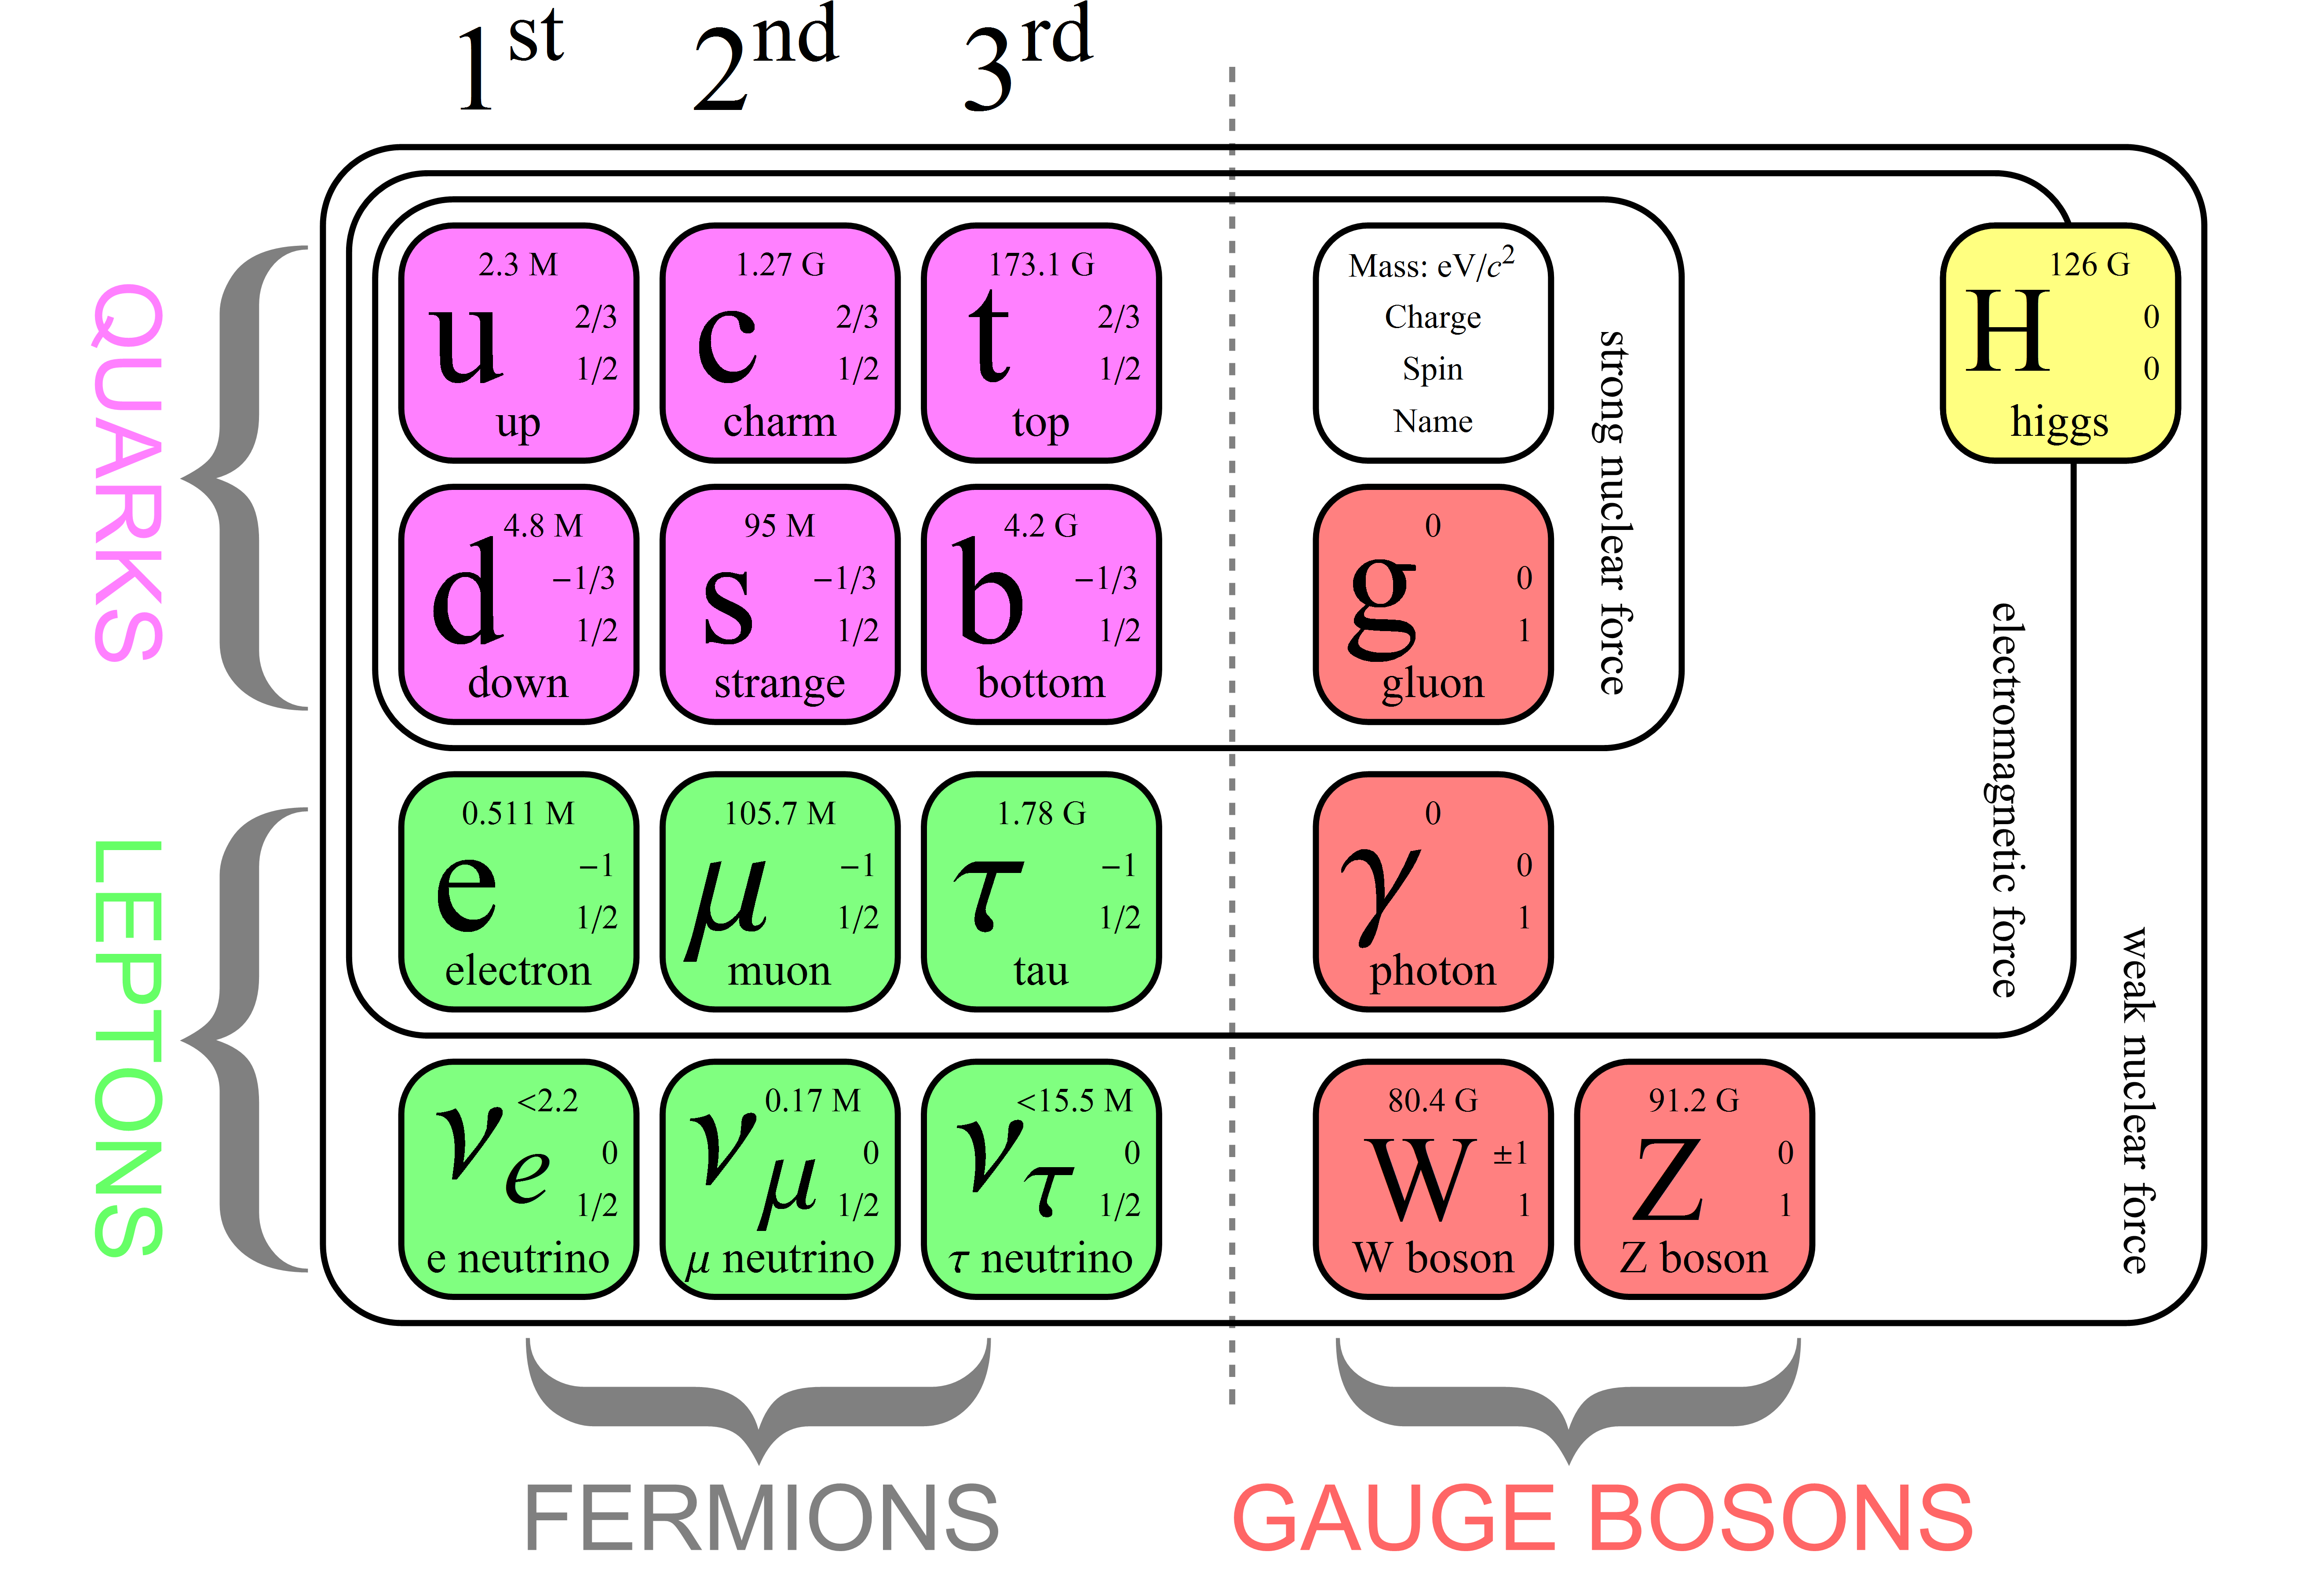

Slide 10
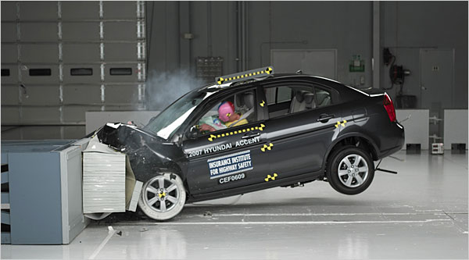
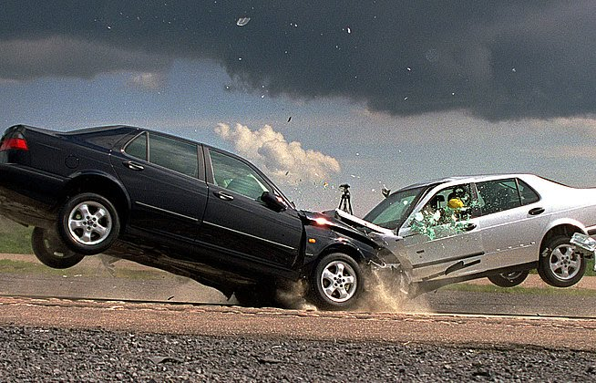
Physics Experiments: Fixed Target vs. Colliders
Fixed Target
Collider
Much of the energy is lost in the target and only part is used to produce secondary particles
All energy will be available for particle production

Slide 11
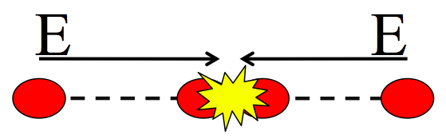
Physics Experiments: Fixed Target vs. Colliders
Fixed Target
Collider
Target
Particle
Beam
Much of the energy is lost in the target and only part is used to produce secondary particles
All energy will be available for particle production
7 TeV proton beam against fix target →115 GeV
7 TeV proton beam colliding → 14 TeV

Slide 12
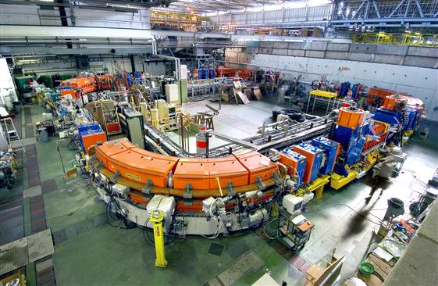
Accelerators in fundamental Particle Physics Research
High Energy → Acceleration
High Intensities → Guiding and focused particle beams
High Luminosity → Collision rate

Slide 13
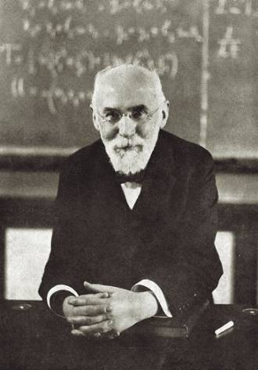
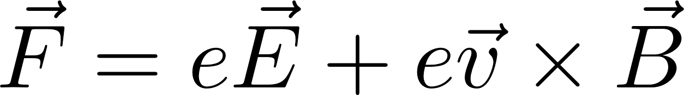
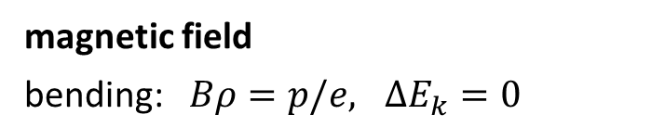
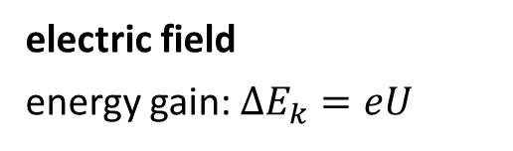
Lorentz Force
(charge = e)
electric field
energy gain: ${ΔE}_{k}=eU$
magnetic field
bending: $Bρ=p/e, {ΔE}_{k}=0$
H.A.Lorentz
1853-1928
-
N
+
S
path bending and acceleration of particles are fundamental mechanisms of each particle accelerator

Slide 14
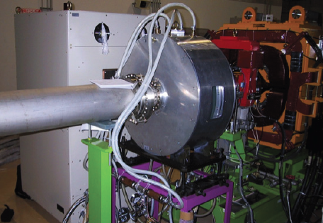
Accelerating Cavities→ Energy gain
Accelerating
Cavity

Slide 15
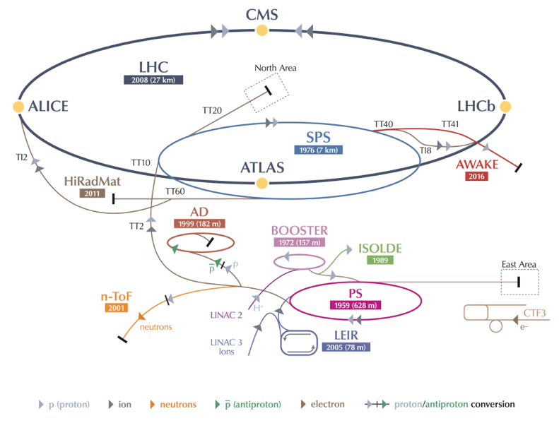
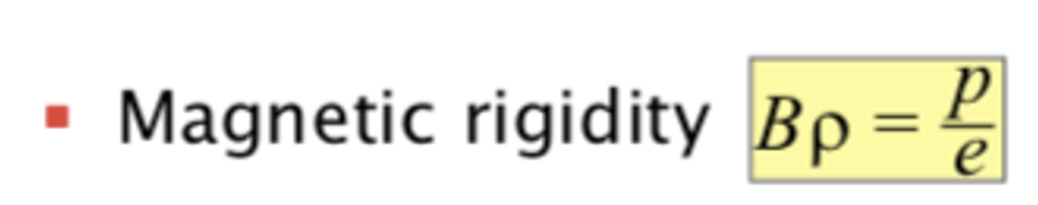
Acceleration
-> 7 TeV
-> 450 GeV
50 MeV-> 1.4 GeV
-> 25 GeV

Slide 16
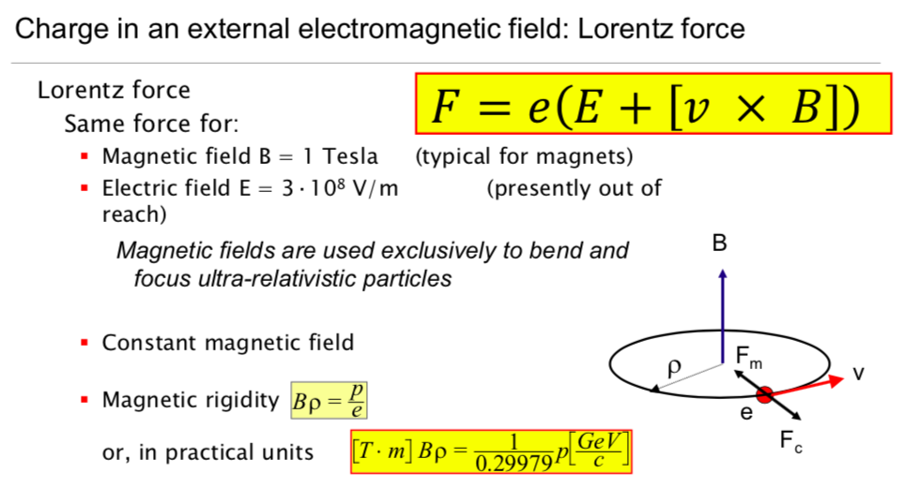
Guiding and focusing particles with the Lorentz force

Slide 17
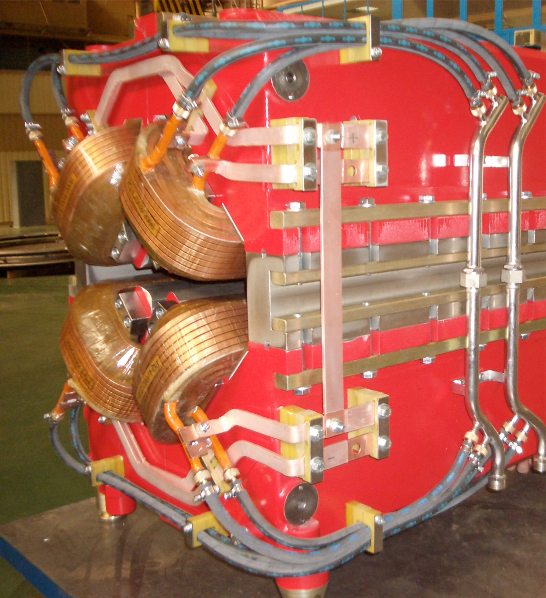
Charged Particles Guided and focused with electromagnetic Fields
Charged Particles are deviated in magnetic fields
Focusing particles,
a bit like light
Force on particles

Slide 18
Make Particles Circulate
Main Dipoles
Main Dipoles
Main Dipoles
Main Dipoles

Slide 19
Focusing the Particles
Main Dipoles
Main Dipoles
Main Dipoles
Quadrupoles

Slide 20
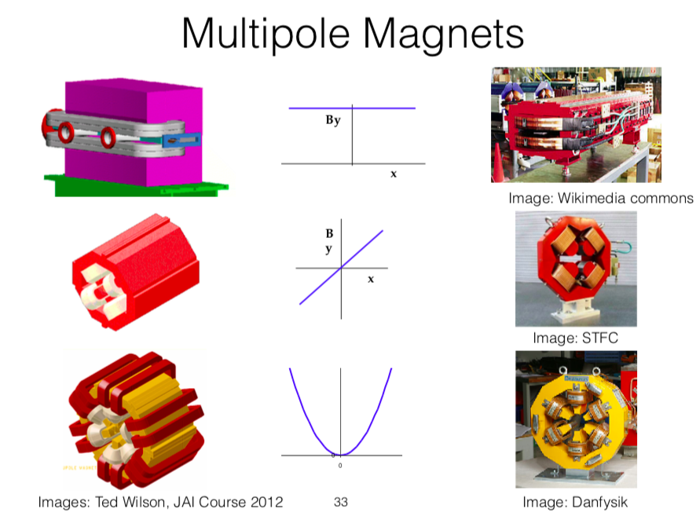
Magnets

Slide 21

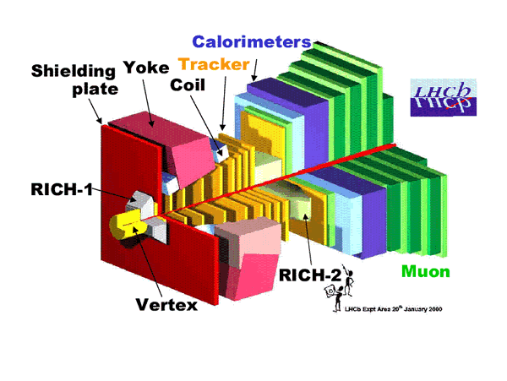

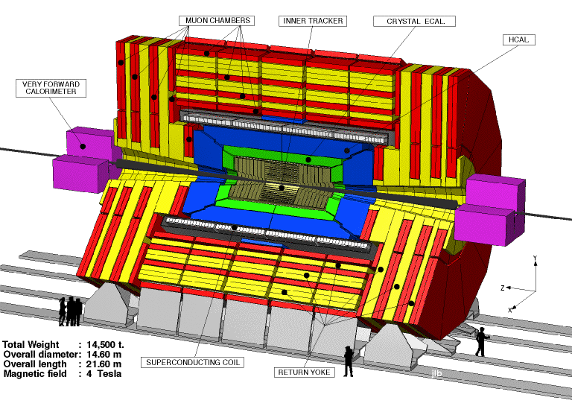
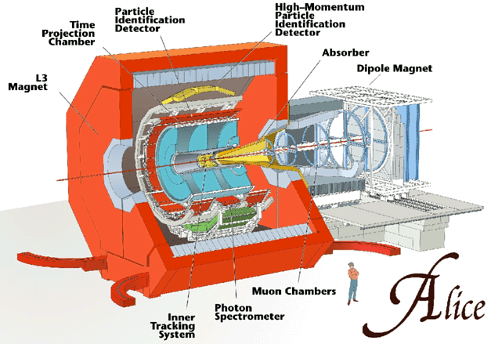
The Large Hadron Collider
27 Km length
Protons (10¹¹ppb) or heavy ions
Maximum ~14 TeV center of mass energy
10³⁴ Luminosity

Slide 22
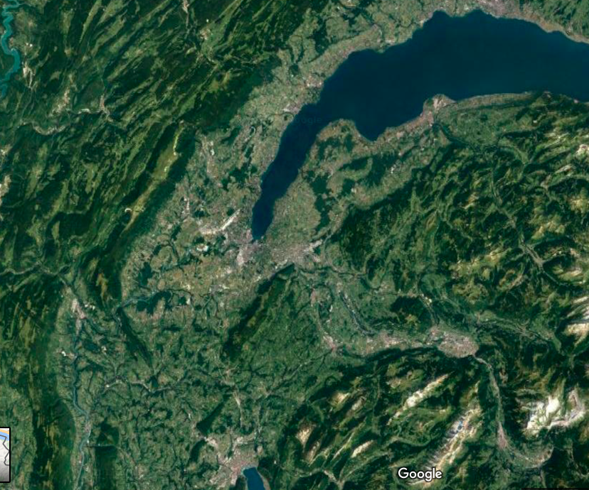


…and in the far Future?
The Future Circular Collider study
LHC
FCC-ee
Electron-positron collider
FCC-hh
~100 TeV center of Mass energy Proton collider
Muon Collider
FCC-hh
FCC-ee
New ideas and technological push is needed! NOT yet there!

Slide 23
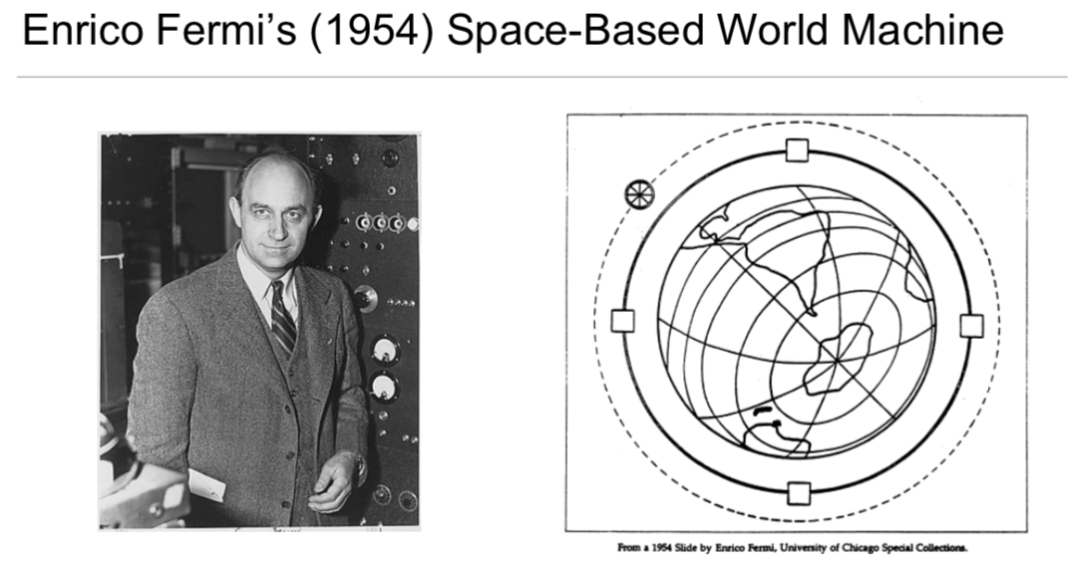
Are we thinking too BIG?

