Slide 2
HI-ECN3 Project: proposal for worksite safety organisation
M. Fraser (SY-ABT-BTP) & C. Ahdida (HSE-RP-AS) on behalf of the HI-ECN3 Project Team
CERN, Geneva, Switzerland, 4th July 2025
https://hiecn3.web.cern.ch

Slide 3
Content
Recent news
Project Master Schedule
Major LS3 Activities
Proposed Project Organisation for Execution Work
Proposed Safety Organisation (Cat 1)
Extra Slides
  Project Leader Mandate (Study Project to Project)
  Decabling scope / planning
  Dismantling scope / planning
  B754 scope / planning

Slide 4
Recent news
HI-ECN3 Study Project: PL mandate received, just in time for the start of works (see extra slides)
Project & Experiment Safety Support (PESS) process: Project Safety Requirements (PSR) draft EDMS #3094730 (version 4) being iterated as part of TDR design work
New ECN3 Access Shaft descoped: exploitation of existing material shaft in B911 deemed acceptable for SHiP installation
MTP25: budget will be reallocated to provide support for EROS and Safety Coordination
  A placeholder put in at 25 kCHF/year from 2026 to 2031: to be updated with EROS
Preparation for construction of B754: works started 12th May 2025
  Diversion of services, movement of B911 doors and enlarge road and car park
TT7 Shielding Recovery Project: works started 19th May 2025
  Supported by Joel BESSON (CERAP) as Safety Coordinator; excellent collaboration
Cable identification campaign carried out in YETS24/25:
  ~ 175 km maximum, DECs amended
SCE’s IRP Design Study for HI-ECN3: design on track for “frozen design” expected July 2025

Slide 5
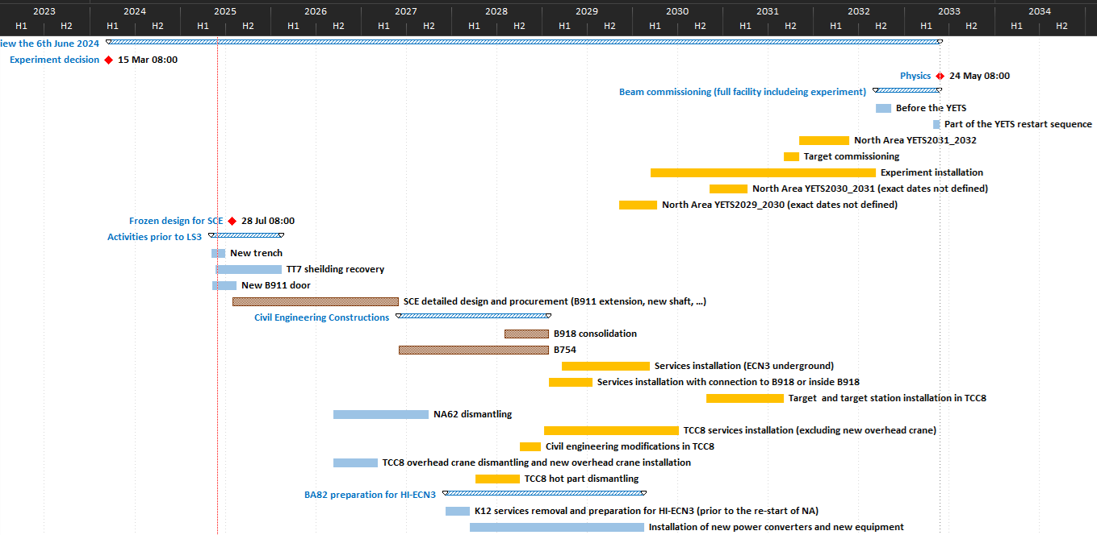
LS3 = HI-ECN3 Preparation Phase 1
Project Master Schedule (i)
Works Phase 1:
Preparation:
dismantling & civil engineering
Works Phase 2:
Installation:
BDF & SHiP experiment
Long Shutdown 3 (SPS)
TDR Phase
(Facility)
TDR
extension
LS4
Below freezing design for SCE!
(Detailed design from consultant before contractor Invitation to Tender)
July 2026
ECN3/TCC8 Dismantling:
Phase 1 = low dose rates
Phase 2 = high dose rates (TCC8 dismantling shifted for TCC2 planning)
BA82 worksite most likely coordinated by NA-CONS
(TBC)

Slide 6
LS3: HI-ECN3 Phase 1: Preparation (i)
LS3 activities in HI-ECN3 worksites under responsibility HI-ECN3 project:
  Underground in TCC8 / ECN3:
    Dismantling (Q4 2026 – Q3 2028)
      Refurbishment of ECN3 transfer table – PLAN#13941 WP4 Roberto RINALDESI
      Refurbishment of overhead crane in TCC8 – PLAN#13939 WP4 Roberto RINALDESI
      De-cabling campaign (~175 km) PLAN#13010 – Decabling PL – Christian BERNARD
      Beamline (low dose area: K12 beamline) – WP5 WPL = Francois BUTIN PLAN#13866
      NA62 experiment (low dose area) – NA62 Dismantling PL = Hans DANIELSSON (supported by Francois BUTIN)
      Beamline (high dose zone: NA62’s T10 target & K12 beamline) – WP4 Leader = Jean-Louis GRENARD PLAN#13866
      For more details: WP4 Coordination Meeting 18 Jun 2025 & WP5 Coordination Meeting 29 Apr 2025
    Civil engineering (Q4 2028)
      Excavation in ECN3 floor for SHiP spectrometer magnet – WP7.2 Leader = David RODRIGUEZ GOMEZ
      Scope to be discussed in more detail on completion of IRP Design Study this year
      For more details: WP7 Coordination Meeting 27 Mar 2025

Slide 7
LS3: HI-ECN3 Phase 1: Preparation (ii)
LS3 activities under responsibility of HI-ECN3 worksite coordination:
  Surface ECN3 (> Q3 2027):
    Civil Engineering: construction of new building (B754) for BDF Target Complex auxiliaries (inc. service cell) PLAN #13718
      WP4 = Jean-Louis GRENARD
      WP7 = Fernando PEDROSA
      WP7.2 = David RODRIGUEZ
      For more information see Target Complex Infrastructure Workshop 12 Jun 2025
  Smaller worksites (> Q3 2028):
    Surface B918: To be discussed on completion of TDR next year PLAN #13949
    Surface B920: To be discussed on completion of TDR next year
Installation of services & equipment in B754 the BDF/SHiP underground (> Q1 2029):
    To be discussed on completion of TDR next year, see WP7 Coordination Meeting 27 Mar 2025

Slide 8
LS3: HI-ECN3 Phase 1: Preparation (iii)
HI-ECN3 activities under the NA-CONS project coordination for planning and installation (inc. worksite safety in NA-CONS areas):
    TCC2: P4 Beam Stoppers (WP3 – Laurie NEVAY / Rui XIMENES) PLAN #13716
    TCC2: Exchange of T4 vertical bump magnet & installation of pulsed wobbling magnet (WP2 – Laurie NEVAY / Philip SCHWARZ) PLAN #14107
    TCC2: T4 VXSS & XTAX (WP3 – Laurie NEVAY / Miguel SANTOS), PLAN #12961, #12935 & #12932
    TCC2: H6/H8 and P4 beam line shift (WP2 – Laurie NEVAY / Miguel SANTOS) PLAN #NEWREQUEST in MTP’25
    TT83: P42 beam dump (WP3 – Rui XIMENES) PLAN #13870
    TT83: Two extra beam profilers on P4 BSGs (WP3 – Laurie NEVAY / Rui XIMENES) PLAN #14250
    TT83 (Post-LS3): P42 collimators (WP2 – Laurie NEVAY / Rui XIMENES) PLAN #13716: SRR prepared

Slide 9
LS3: HI-ECN3 Phase 1: Preparation (iv)
HI-ECN3 activities under the NA-CONS project coordination for planning and installation (inc. worksite safety in NA-CONS areas):
    P42: Replacement of P42 corrector magnets with laminated variants (WP2 Francesco VELOTTI) PLAN #14109 eventually not required
    P42: Installation of additional P42 BLMs (WP2 Christos ZAMANTAS) PLAN #13696
    P42 : Upgrade vacuum P42 on full beam line (WP2 Laurie NEVAY / Miguel SANTOS) PLAN #13658
    TDC85: P42 beamline reconfiguration (WP2 – Laurie NEVAY) PLAN #13840 workload to be assessed & optimized in LS3 vs YETS29/30 & 30/31 (operation starting in 2031)
    TDC85: Access system changes for post-LS3 operation with P42 dump (WP6 – Claudia AHDIDA) PLAN #14236
    BA82 (NA-CONS DPL – Thomas ZICKLER) PLAN #14015 dismantling of K12 power converters & installation of new equipment (BIS PLAN #14278, WIC, etc.)

Slide 10
End of LS3 (>2029) HI-ECN3 Phase 2: Installation
Installation of services & equipment in B754 the BDF/SHiP underground (> Q1 2029):
  PLAN activities were created on request of LS3C as placeholders:
      HI-ECN3 BDF target (WP3 – Rui XIMENES) PLAN #13714
      HI-ECN3 target station (WP4 – Jean–Louis GRENARD) PLAN #13710
      HI-ECN3 service building (WP4 – Jean–Louis GRENARD) PLAN #13718
      B918 adaptation for SHiP experiment Building 918 adaptation for SHIP experiment (WP5 – Francois BUTIN) PLAN #13949
  To be discussed in more detail on completion of TDR next year, see WP7 Coordination Meeting 27 Mar 2025
  For SHiP requirements, see recently draft document SHiP preliminary infrastructure requirements, layout and integration at ECN3 EDMS #3309666

Slide 11
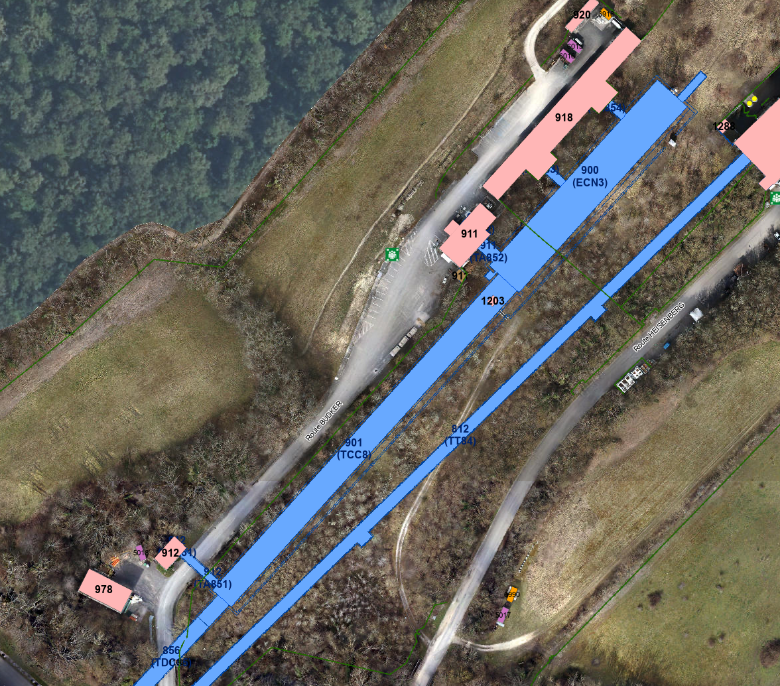

Proposal for main worksites: start LS3
Underground ECN3 / TCC8 (inc. B911 and B912 on surface): Cat 1
T10 target
K12 beamline
NA62 experiment
YDPZ01.851 = TDC85
Details:
TDC85 sector door closed (YDPZ01.851) to delimit upstream P42 beamline (NA-CONS worksite)
Access (controlled) to ECN3 via B911 (new door upstairs, PADMAD not used)
Access (controlled) to TCC8 and T10 target area via B912
Access control container installed in TCC8 to control access from TCC8 to ECN3 (blue wall removed)
TDC85-TCC8 sector doors to be closed, TG sector doors to be closed (south side towards EHN2 and BA82)
B918 has access control so can be zoned accordingly with flexibility needed for de-cabling, same for TG

Slide 12
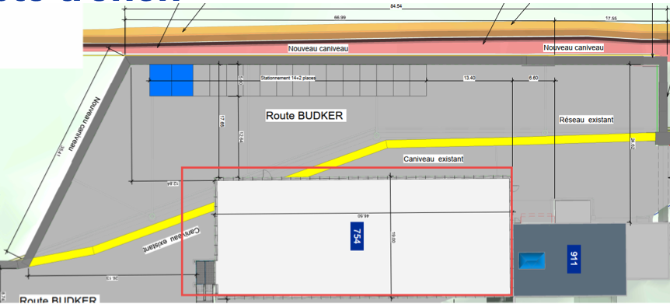
Proposal for main worksites: start LS3
Surface B754: Cat 1
B754
Details:
Extension of road and car park under construction today to create space for B754 worksite
Dismantling activities will be largely finished before B754 construction starts
However, careful scheduling needed to guarantee circulation of traffic to B911
Both worksites under the same Planning & Worksite Coordination by HI-ECN3 project

Slide 13
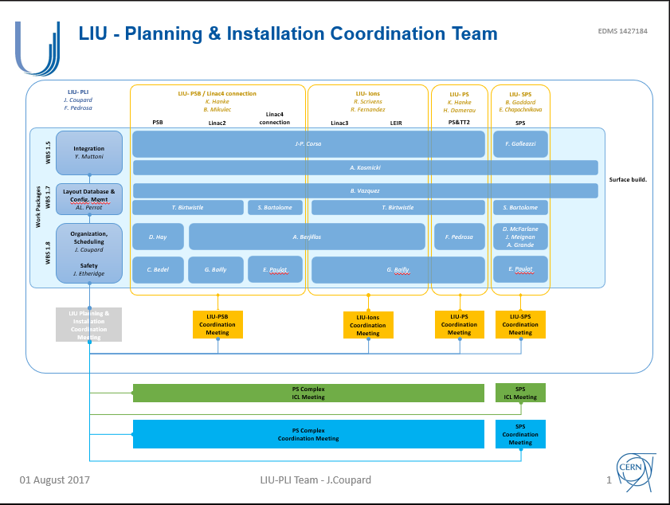
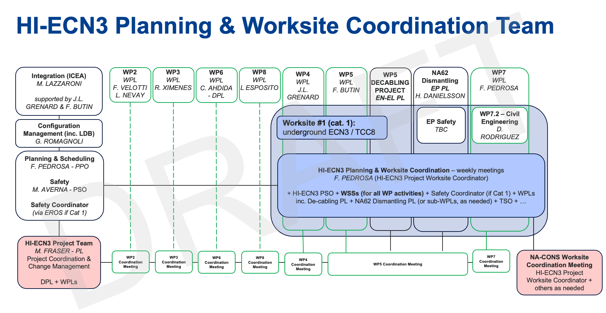
Proposal for Project Organisation for Execution
HI-ECN3 project will structure the coordination of execution phase similarly to LIU
  Propose two main worksites (independent and closed – most likely Category 1)
    Underground (TCC8 and ECN3) & Surface (new Building 754)

Slide 14
HI-ECN3 Planning & Worksite Coordination Team
DRAFT
Integration (ICEA)
M. LAZZARONI
supported by J.L. GRENARD & F. BUTIN
WP2
WPL
F. VELOTTI
L. NEVAY
WP3
WPL
R. XIMENES
WP6
WPL
C. AHDIDA
- DPL
WP8
WPL
L ESPOSITO
WP4
WPL
J.L.
GRENARD
WP5
WPL
F. BUTIN
WP5
DECABLING PROJECT
C. BERNARD
NA62
Dismantling
EP PL
H. DANIELSSON
WP7
WPL
F. PEDROSA
x
WP7.2 – Civil Engineering
D. RODRIGUEZ
Configuration Management (inc. LDB)
G. ROMAGNOLI
Worksite #1 (cat. 1):
underground ECN3 / TCC8
Planning & Scheduling
F. PEDROSA - PPO
Safety
M. AVERNA - PSO
Safety Coordinator
(via EROS if Cat 1)
HI-ECN3 Planning & Worksite Coordination – weekly meetings
F. PEDROSA (HI-ECN3 Project Worksite Coordinator)
+ WSSs (for all activities) + HI-ECN3 PSO + NA62 DEXSO + Safety Coordinator (if Cat 1) + EP Safety Coordinator + TSO? + WPLs + De-cabling PL + NA62 Dismantling PL + …
HI-ECN3 Project Team
M. FRASER - PL
Project Coordination & Change Management
DPL + WPLs
WP2
Coordination
Meeting
WP3
Coordination
Meeting
WP6
Coordination
Meeting
WP8
Coordination
Meeting
WP4
Coordination
Meeting
WP5 Coordination Meeting
WP7
Coordination
Meeting
NA-CONS Worksite
Coordination Meeting
HI-ECN3 Project Worksite Coordinator + others as needed
All worksites under single Planning & Worksite Coordination by HI-ECN3 project structure

Slide 15

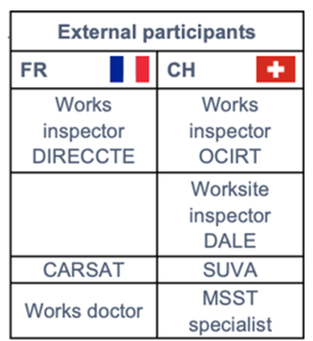
Proposed Safety Organisation
HI-ECN3
PSO
M. AVERNA
HI-ECN3 PROJECT LEADER
M. FRASER
DSO, TSO, RSO, other SSO, NA62 DEXSO, EP Safety
HSE/EROS
HI-ECN3 WP4 WPL
J.L. GRENARD
NA62 DISMANTL. PL
H. DANIELSSON
HI-ECN3
WORKSITE
COORDINATOR
F. PEDROSA
WP4
WSS
NA62
WSS
HI-ECN3 WP5 WPL
F. BUTIN
SAFETY
COORDINATOR
DECABLING PL
C. BERNARD
WP5
WSS
DECABLING
WSS
DECABLING
CONTRACTOR
WORKSITE #1 (CAT. 1):
Underground ECN3 / TCC8
TSO?

Slide 16
Comments & Questions
Worksites will be independent (closed) and > 4000 h = Cat 1
Do we need one PCTS per specific worksite?
  We would want to standardize the general input to the PCTS documentation with NA-CONS to make it easier for any contractors working on the different worksites.
Fernando will launch the “HI-ECN3 Planning & Worksite Coordination” preparation meetings soon to detail the worksite activities and plan them to minimise co-activity
  Please can Joel join these already to help us define the worksites and develop the PCTS(s)?
  WP4 already well advanced in Work PAcakge Analysis for dismantling
  WP5 will start the WPA exercise soon (NA62 already started to collect procedures)
  Scope of de-cabling now understood after Cable ID campaign in YETS24/25
We need to add NA62 DEXSO and EP Safety Coordinator to the Safety Organisation:
  EP activity treated like any other in the zone: under the HI-ECN3 Worksite Coordinator and HI-ECN3 PL, OK?
What is the approval process for the Safety Organisation?

Slide 18
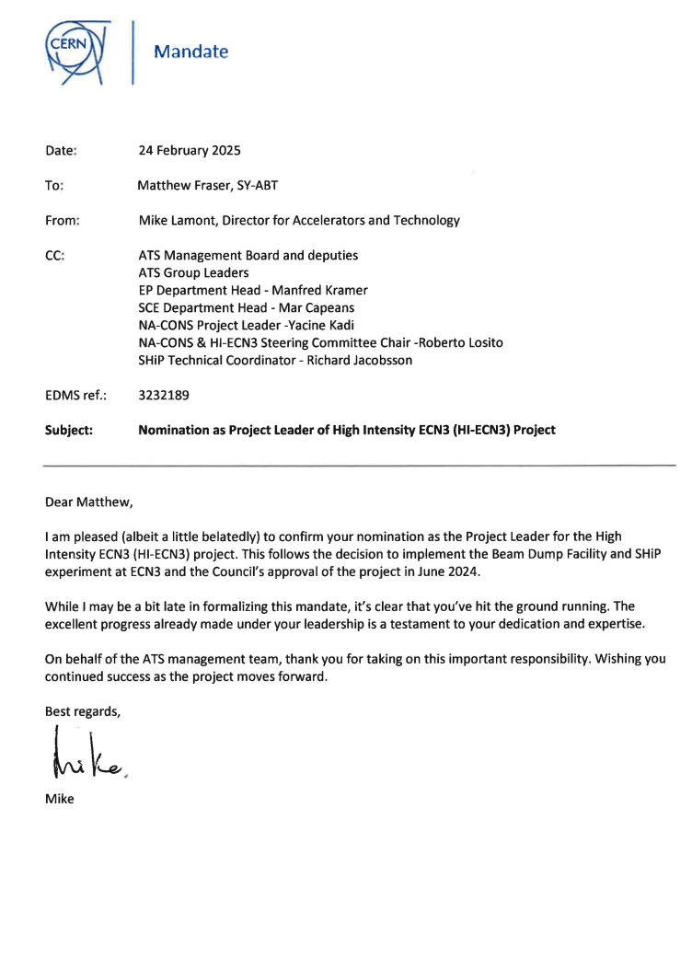
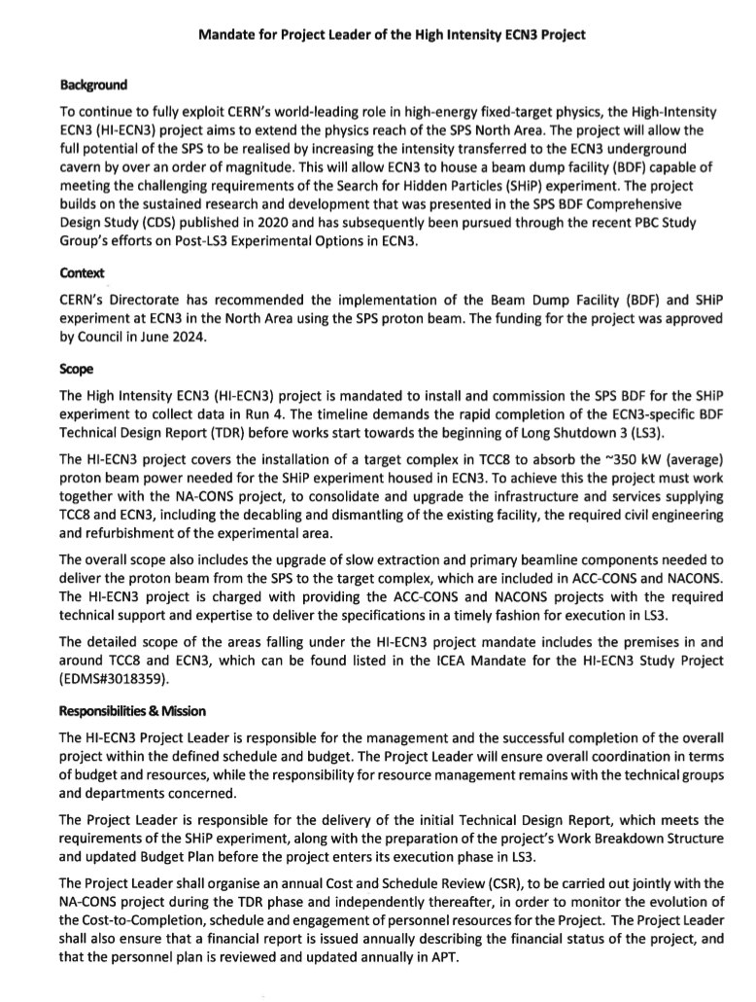
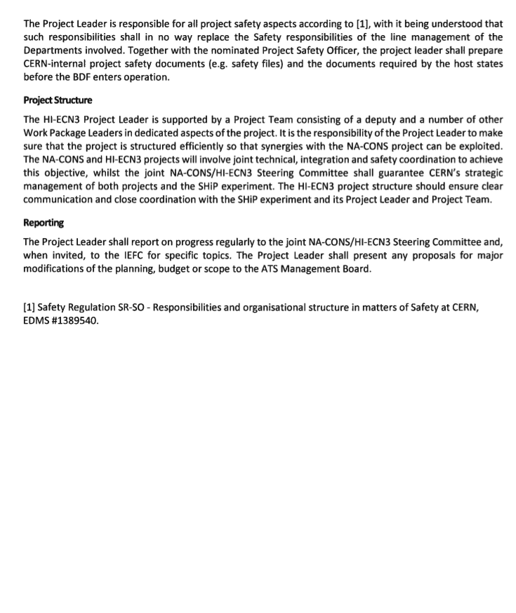
HI-ECN3 Project: mandate for PL
M. Lamont, Nomination as Project Leader of High Intensity ECN3 (HI-ECN3) Project, EDMS #3232189

Slide 19
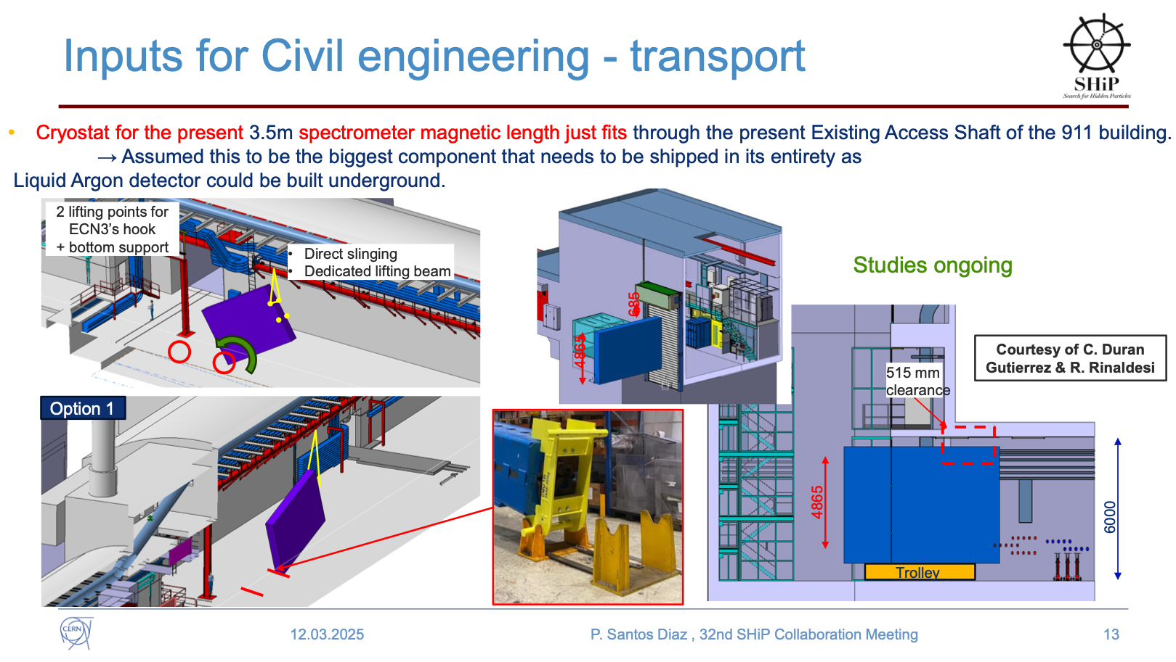
New ENC3 Shaft Descoped

Slide 20
HI-ECN3 Planning & Worksite Coordination Team
DRAFT
Integration (ICEA)
M. LAZZARONI
supported by J.L. GRENARD & F. BUTIN
WP2
WPL
F. VELOTTI
L. NEVAY
WP8
WPL
L ESPOSITO
WP5
WPL
F. BUTIN
WP3
WPL
R. XIMENES
WP6
WPL
C. AHDIDA
- DPL
WP4
WPL
J.L.
GRENARD
WP7
WPL
F. PEDROSA
WP7.2
WPL
D.
RODRIGUEZ
x
Configuration Management (inc. LDB)
G. ROMAGNOLI
Worksite #2 (cat. 1):
Surface B754
Planning & Scheduling
F. PEDROSA - PPO
Safety
M. AVERNA - PSO
Safety Coordinator
(via EROS if Cat 1)
HI-ECN3 Planning & Worksite Coordination – weekly meetings
F. PEDROSA (HI-ECN3 Project Worksite Coordinator)
+ WSSs (for all activities) + HI-ECN3 PSO + NA62 PSO + Safety Coordinator (if Cat 1) + EP Safety Coordinator + TSO? + WPLs + De-cabling PL + NA62 Dismantling PL + …
HI-ECN3 Project Team
M. FRASER - PL
Project Coordination & Change Management
DPL + WPLs
WP2
Coordination
Meeting
WP8
Coordination
Meeting
WP5
Coordination
Meeting
WP3
Coordination
Meeting
WP6
Coordination
Meeting
WP4
Coordination
Meeting
WP7
Coordination
Meeting
NA-CONS Worksite
Coordination Meeting
HI-ECN3 Project Worksite Coordinator + others as needed
All worksites under single Planning & Worksite Coordination by HI-ECN3 project structure

Slide 21
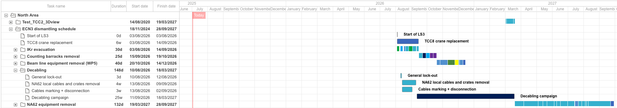
ECN3 Dismantling Schedule

Slide 22
Decabling - Organigramme, Manpower
Chef de projet HI-ECN3
Matthew FRASER
Responsable
HI-ECN3 WP5
François BUTIN
Autres activités
HI-ECN3 WPx
Pour le décâblage la structure reste standard. Les fonction support ne son pas représenter dans l’organigramme (Qualité, sécurité, etc.)
Actuellement nous sommes en attente du financement du WSS par le projet pour ce chantier (Demande faite dans le MTP 2025)
Chef de projet décâblage
Christian BERNARD
Superviseur de travaux décâblage
En attente de financement par le projet (MTP2025)
CTP S262
A nommer
Chef de chantier S262
Ricardo ESFORT
Chef d’équipe 1
6 personnes
Chef d’équipe 2
6 personnes

Slide 23
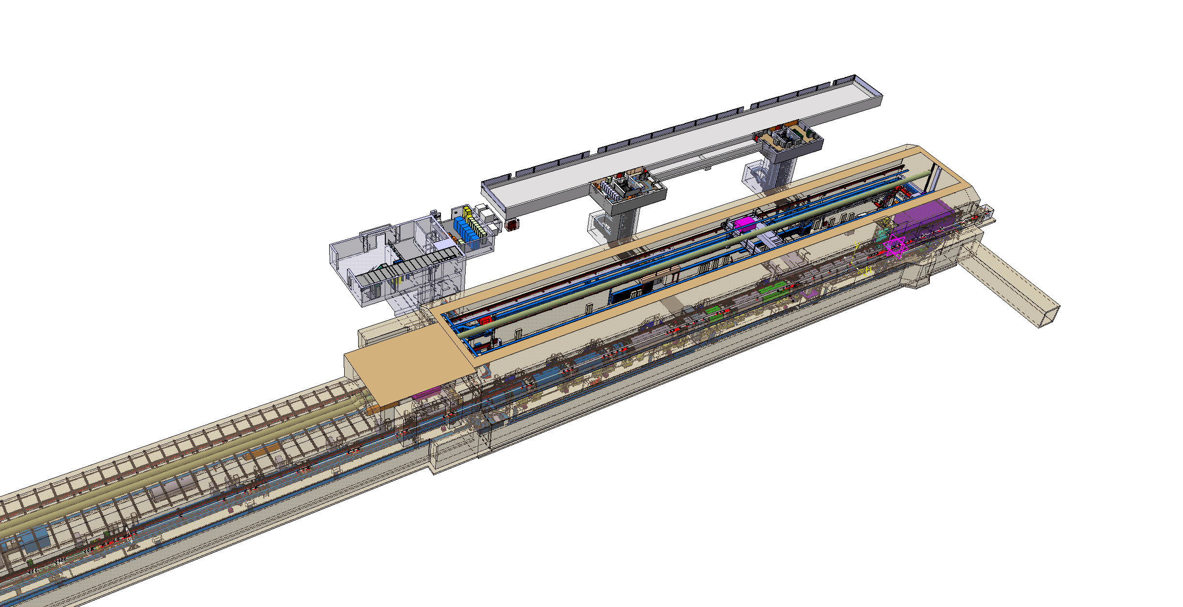
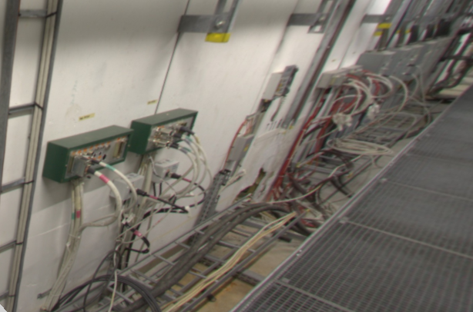
De-cabling: La zone de travail (B918, ECN3 et TCC8)
Besoin d’une base de chantier pour le contractant (env. 20 m2)
Surface
50 km
590 Câbles
Puits
25 km
500 Câbles
Actuellement dans les DEC’s :
871 câbles pour 146 km
Estimation (DEC’s + 20%) :
1050 câbles pour 175 km
Etat de la galerie 822 ?
Caverne
100 km
1000 Câbles

Slide 24
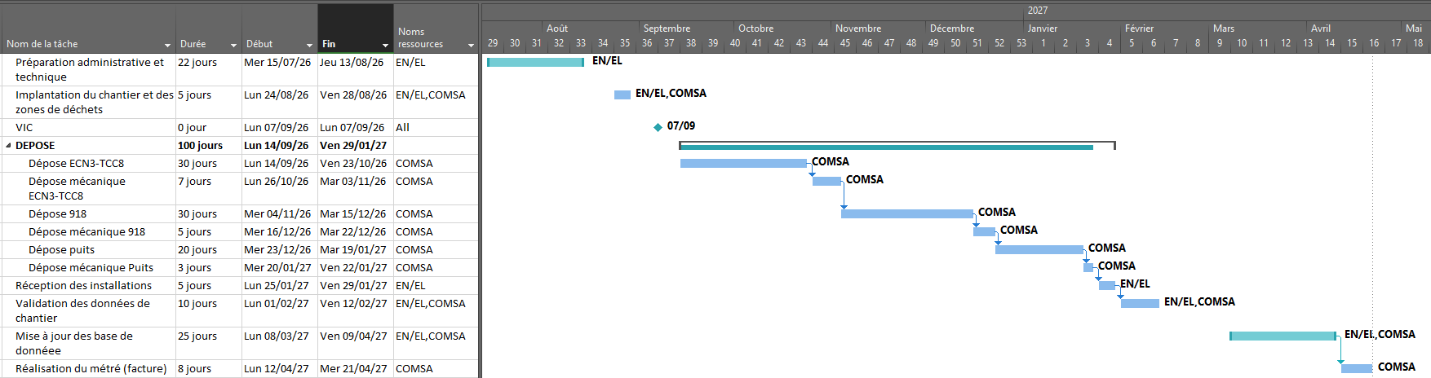
Decabling - Planning Estimatif
Le planning tient compte des éléments reçu à l’issue du YETS 24-25
Il manque des Demande d’Enlèvement de Câbles

Slide 25
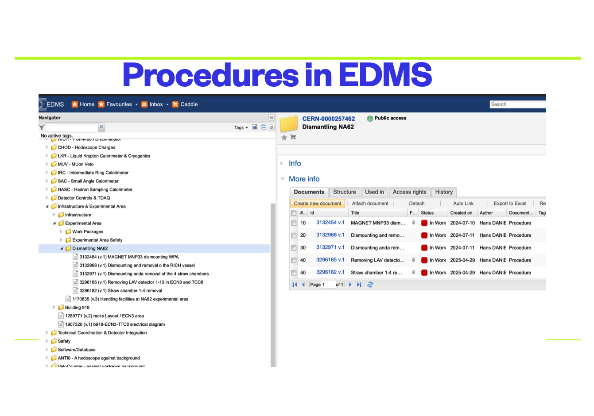
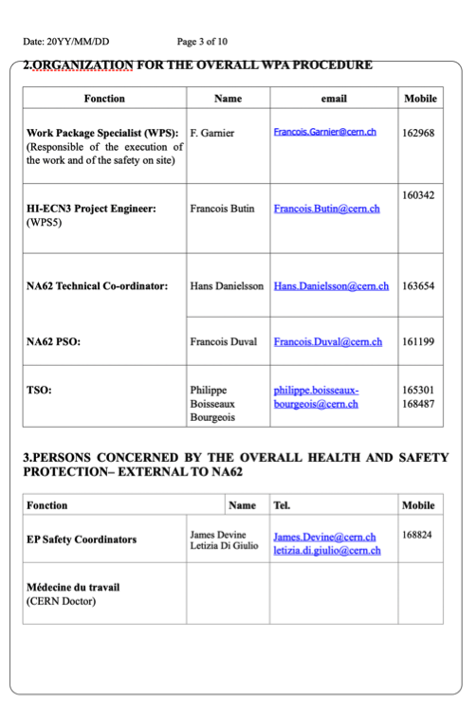
NA62 procedures

Slide 26
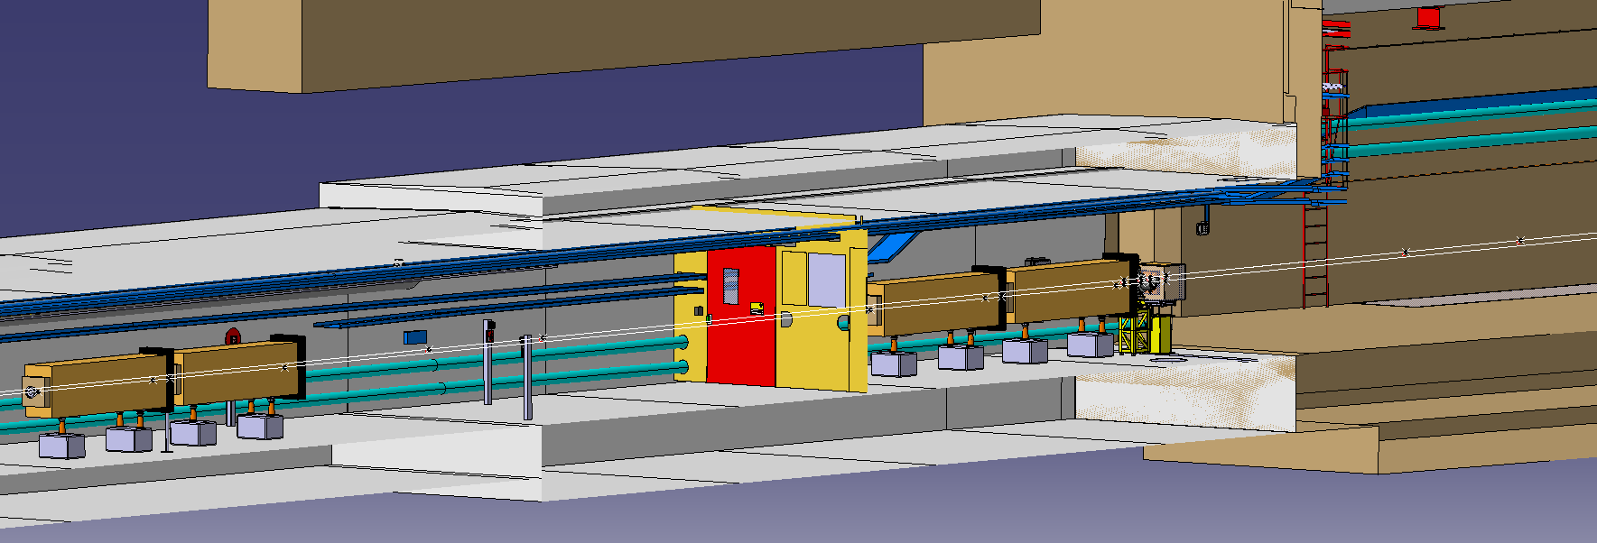
P42 beam line reconfiguration in TDC85

Slide 27
SCE timeline
IRP Design Study
Objective: one document summarising all SCE’s activities
CE study to be provided by June 2025
Document drafting is ongoing → Final version expected for Aug 2025
Information needed:
Iteration on 754 building’s integration → Missing loads and dimensions May 2025 → Final version June 2025
Full load map for TCC8 and ECN3 equipment → May 2025
Update of ECN3 experimental area layout and integration document → Jun 2025
Additional minor works if required: power converter B. 918, helium tanks, etc

