Slide 1
TCC8 target area dismantling
QUINQUIS Nicolas SY-STI-TCD
17/07/25

Slide 2
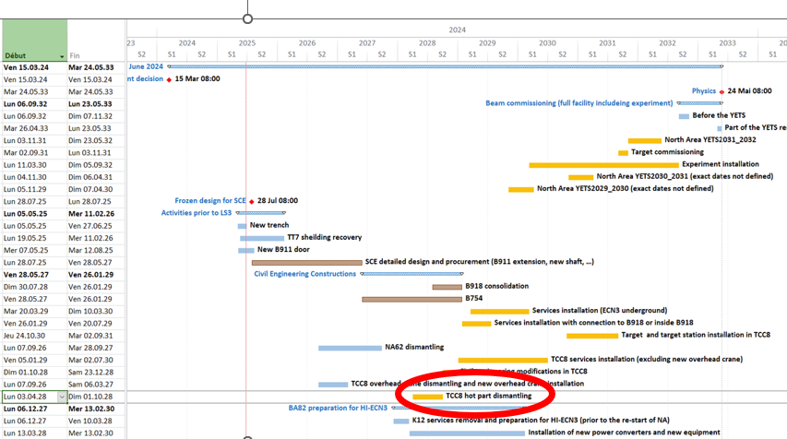
Scope of the “TCC8 Target area” dismanting

Slide 3
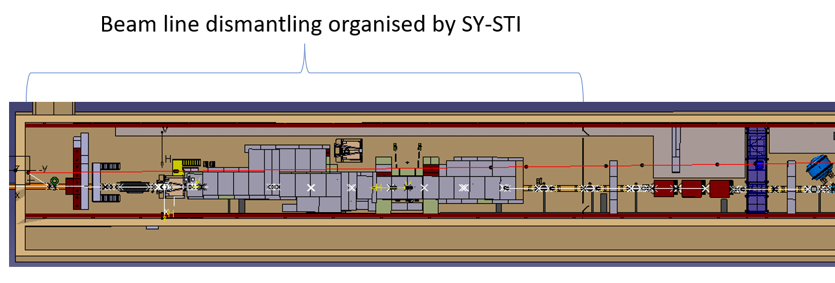
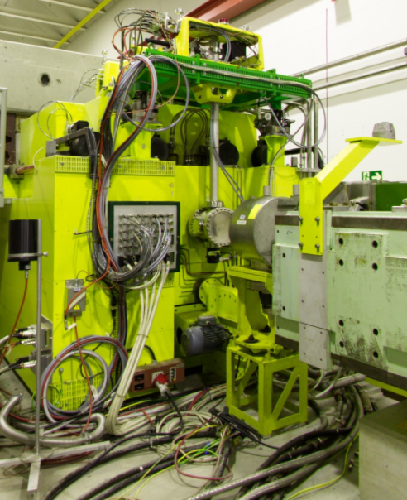

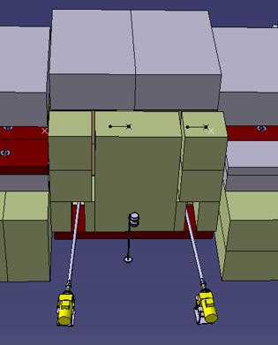
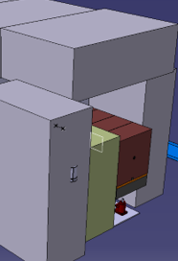
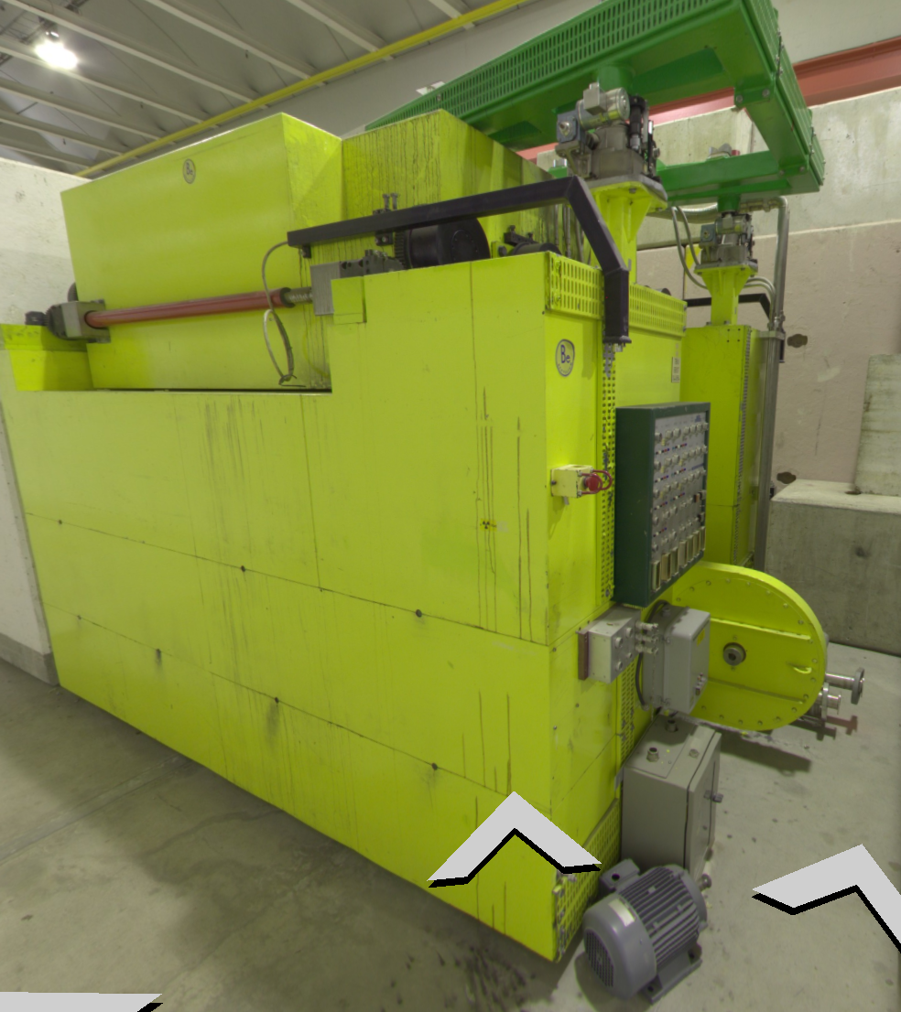
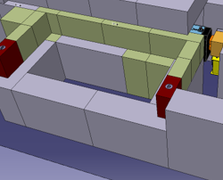
Scope of the “TCC8 Target area” dismanting
A.K.A radioactive part of TCC8 cavern
T10 target
TCX Blocks
Old XTAX storage bunker
Old T8 target
XTAX assembly

Slide 4
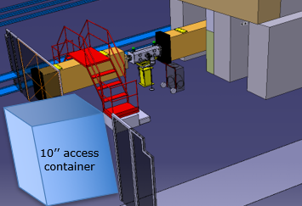

Scope of the “TCC8 Target area” dismanting
A.K.A radioactive part of TCC8 cavern
Prerequisite of this work :
Clear a path downstream to perform the evacuation of the equipments
Isolate the radioactive area where the dismantling will be performed : Avoid unnecessary co-activities or access of anyone from outside the worksite

Slide 5
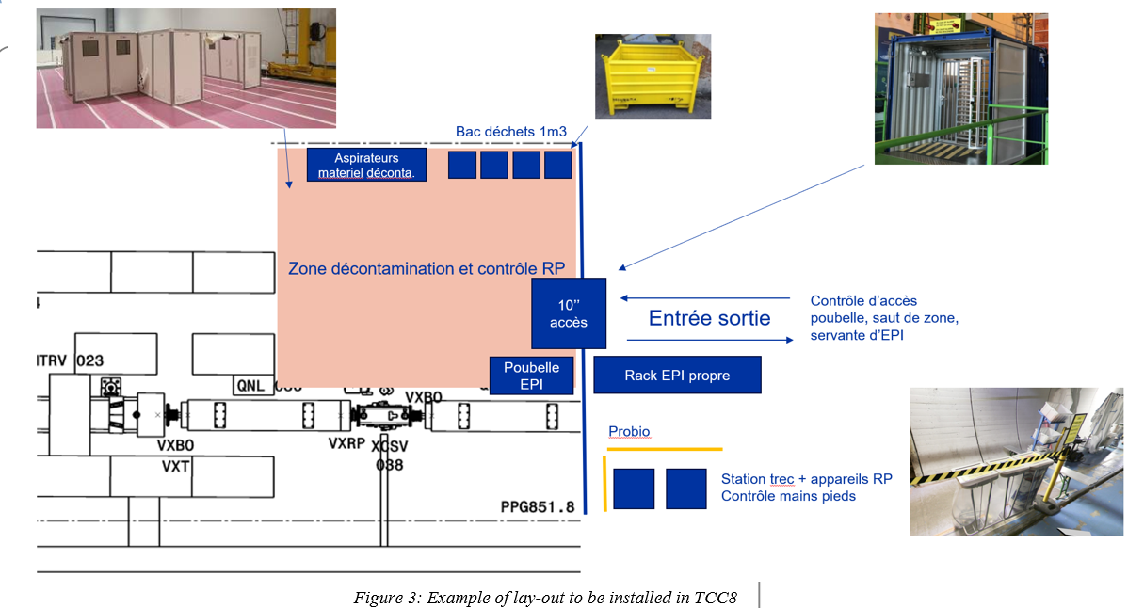
Scope of the “TCC8 Target area” dismanting

Slide 6
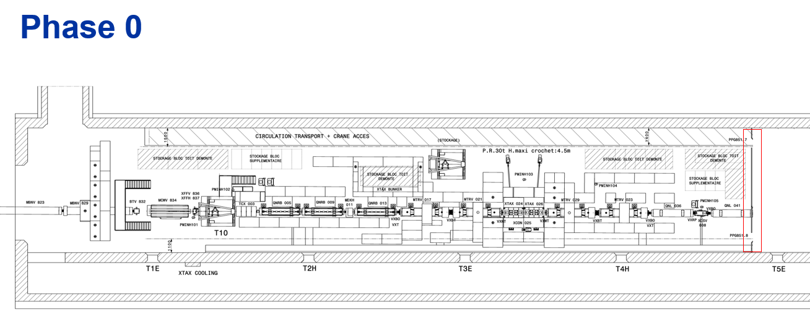
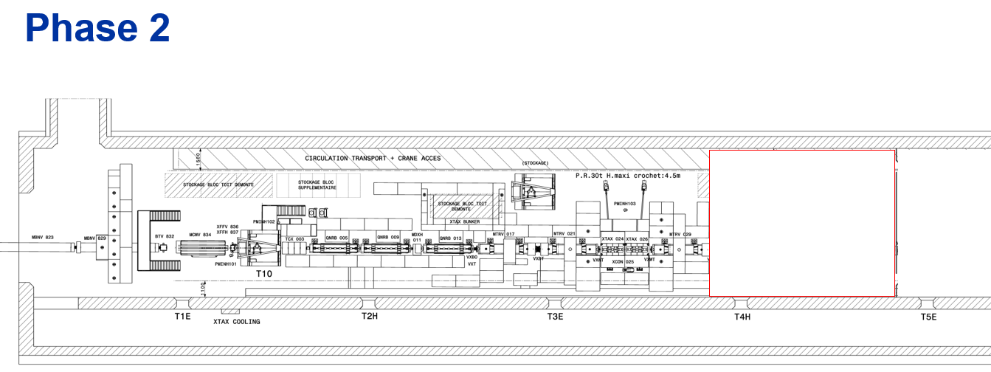
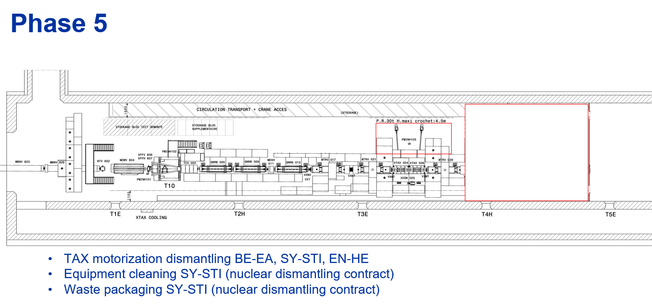
Dismantling stages scenario

Slide 7
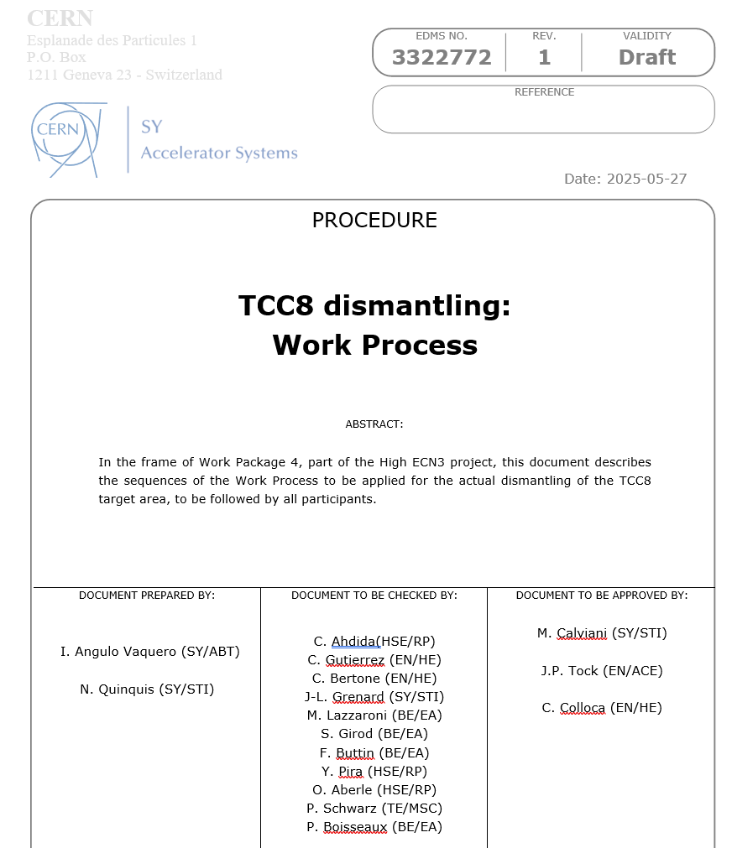
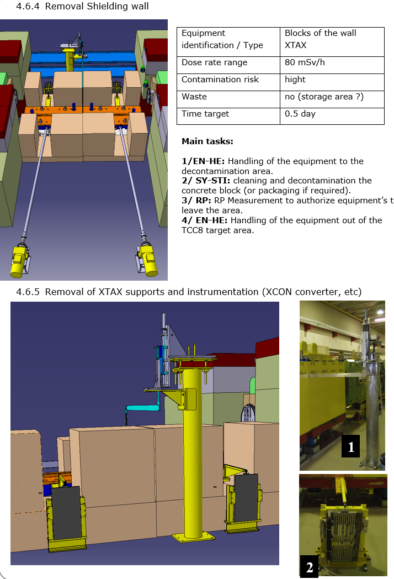
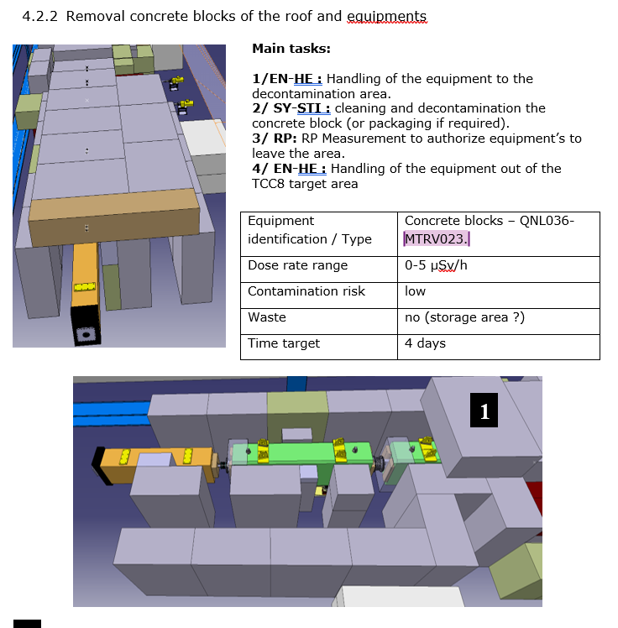
TCC8 dismantling work process

Slide 8
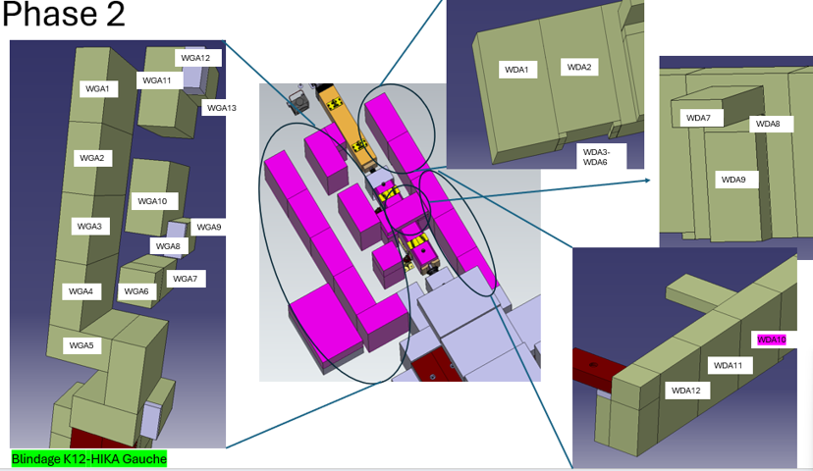
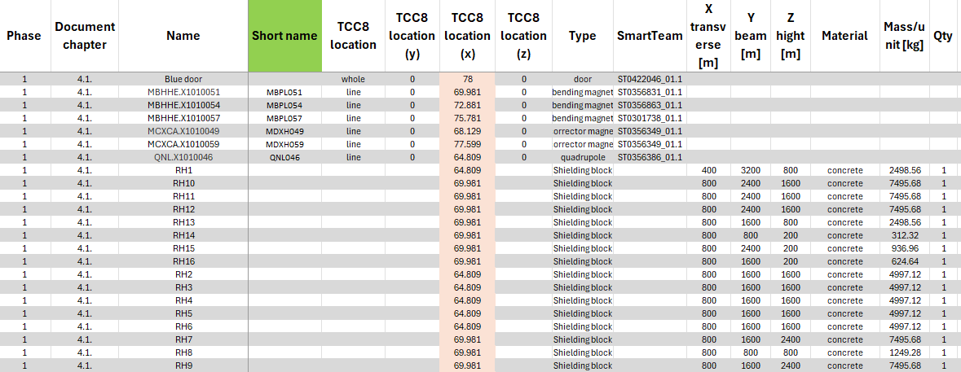

Inventory of items
Need to make sure this table is up to date
What is a waste ? (needed for the forcast for disposal in RWTC)
What is spare equipment ? (need to be treated with caution and not send to waste !)
What is going to be reused in the construction phase (storage to be found in TCC8)

Slide 9
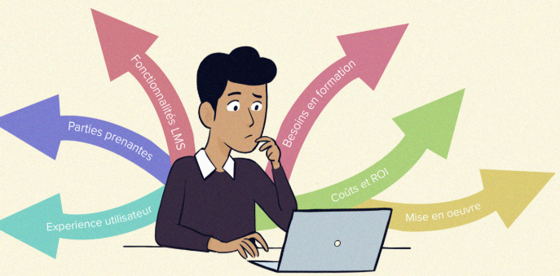

Dismantling stages scenario
Goal of this document :
Define and order each steps, define the resources needed and responsibility of the involved groups.
Tools and process preparation (eg : bunker for XTAX dismantling or loading, container for transport, etc)
Overview of this operation to prepare the work and dose planning, planning, ALARA comittee, etc.
Next steps :
To review and comments on the document from the involved groups :
➔ Action N.QUINQUIS: make the document accessible on onedrive to get comments from people listed on the first page.
➔ Need from SY-STI: clarify some process (disconnecting magnets : who, when, etc), waste&spare : make sure the list is up to date, missing steps ? Check and comment the time for each part.
To choose and to assess solutions for specific tasks on hot equipments (XTAX dismantling, target) : transport and RWM requirements => Handling process and containers needed => dismantling process.
➔ See next slide.

Slide 10
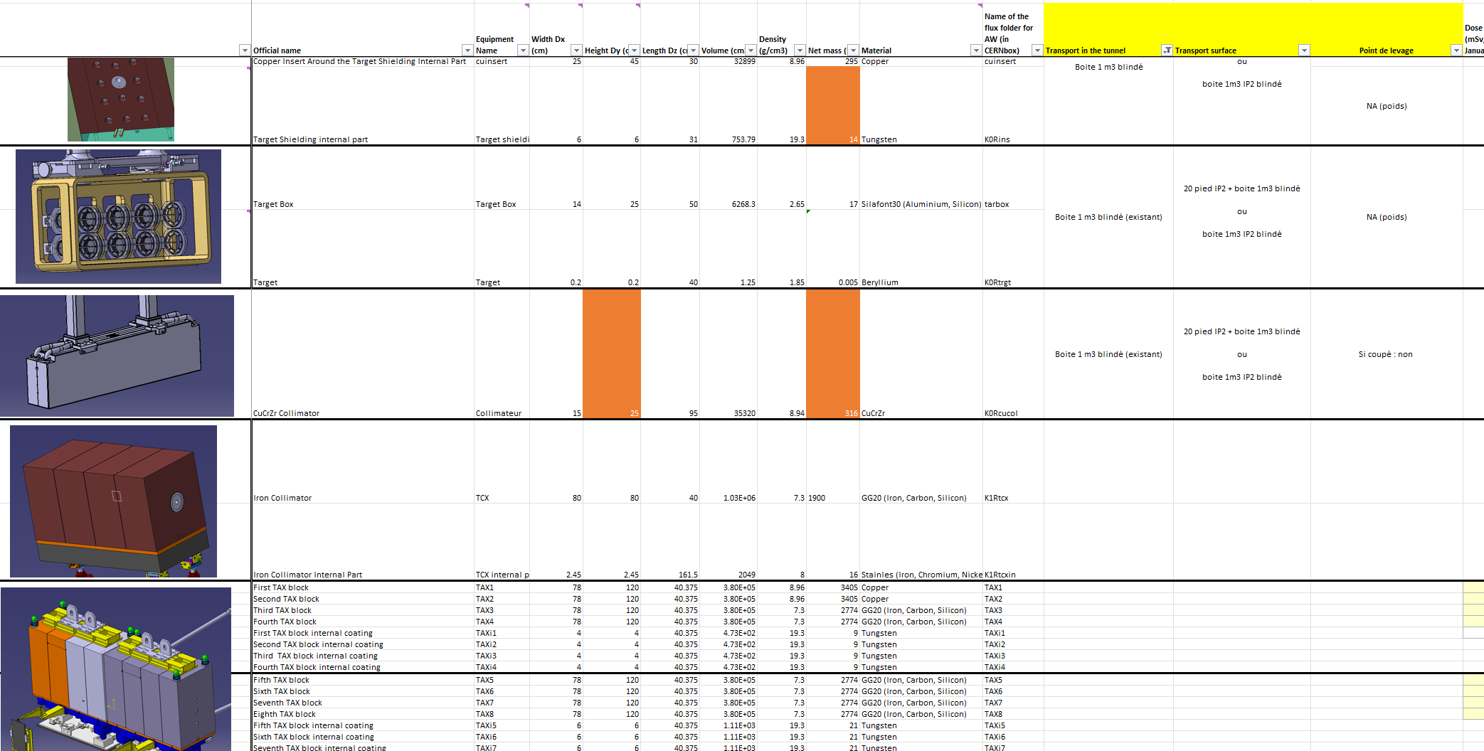
Hot items and tranport

Slide 11
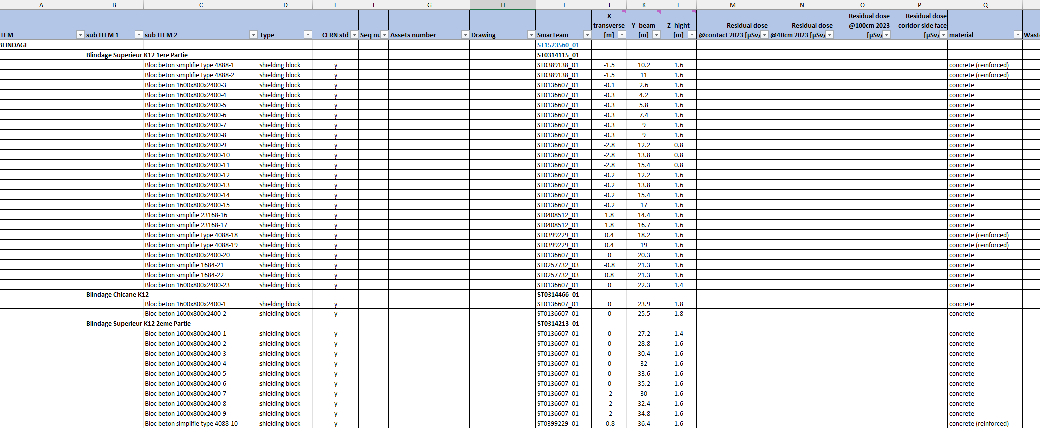

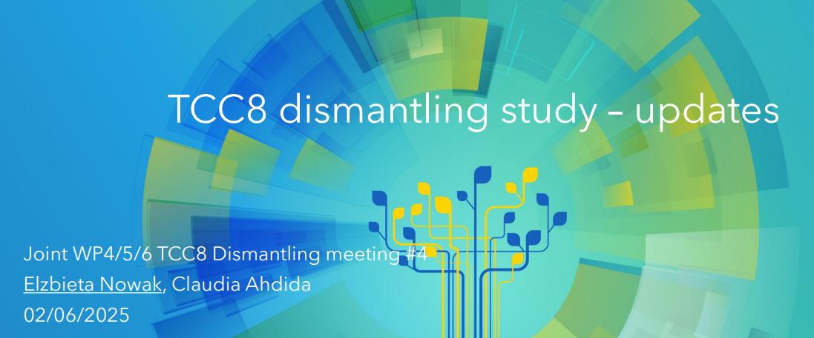

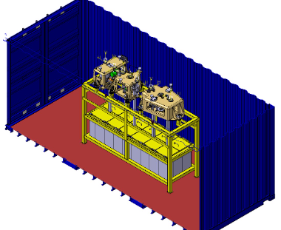
Preparation phase and methodology
BE-EA
List of the equipment in the area
HSE-RP
Inventory table
Simulation of dose rate and radioactivity of the equipments
HSE-RP
Categorize and detailed assessement on « hot » equipments (> 2 mSv/h)
HSE-RP
SY-STI
EN-HE
Gather requirements from radioactive transport and the RWTC for disposal of the radioactive waste.
Indico
SY-STI
EN-HE
Propose a methodology for transport (containers) and handling of equipments
30%

Slide 12


Preparation phase and methodology
SY-STI
EN-HE
Propose a methodology for transport (containers) and handling of hot equipments
30%
HSE-RP
Simulation of dose rate of containers and need for shielding.
0%
ALL CONTR.
Propose a (detailled) methodology for dismantling and handling equipments.
50%
Safety documents (Pdp, PPSPS, safety file, etc)
WdP, impact, ALARA C.
Procurement of tools, containers, services
Planning
Adapt resources, logistics, storage, etc

Slide 13
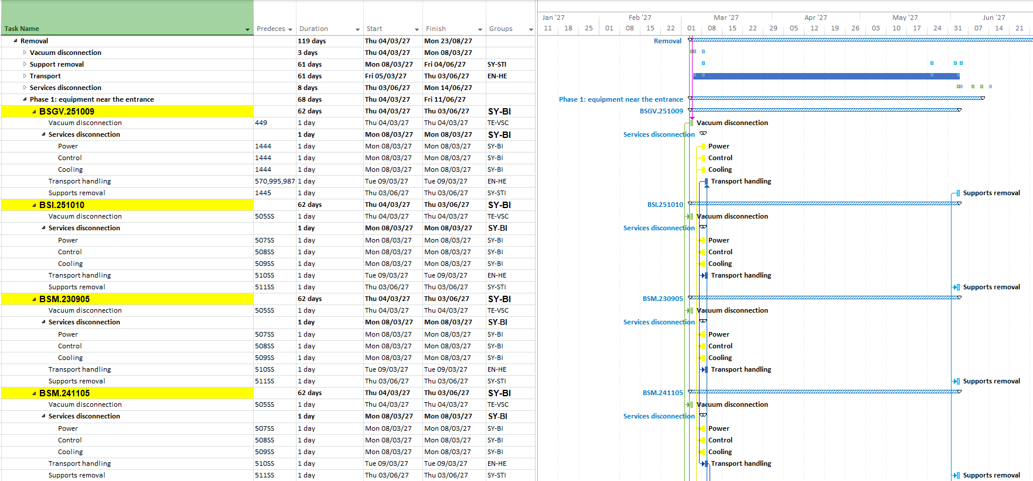
Dismantling schedule example:
Activities duration
Activities per magnet
* The connection between different elements it is done with the constrains of the activities e.g.: only 4 magnets can be transported per day or for the radioactive supports only 6 can be removed per day

Slide 14
Conclusion
Preparation is progressing well and we are on track.
Need a review of all contributors on the work process (missing steps, waste / spare, etc).
For all the main stakeholders (RP, EN-HE, SY-STI) experience earned from CTD worksite, IBDRS will help us in preparation and execution.
Part of the work may also help for the TCC2 refurbishment worksite.

