Slide 1
Fluidized Tungsten Update
Ben Suitters
10 July 2025

Slide 2
Contents
Rig Concepts and Costs
Material Testing
Erosion plans
Simulation Effort
Geometry options?

Slide 3
Development Rig
Based on original RAL flow rig, hardware for a new setup will be in the order of £300k+
Modular setups enable spreading of this cost over time
High pressure helium will be expensive
  Need to investigate effects of other gases
    Nitrogen? Argon?
    Air likely to cause problems of moisture etc due to high pressures
Instrumentation & control will be essential to understanding effects of parameters- a significant investment in this is necessary

Slide 4
End Goal
Low pressure, cold
Vacuum/pressure Lift
Feed control hopper
Control Gas
Downcomer
High pressure, cold
~4m
Closed loop gas recycler?
Driving Gas in
Medium pressure, hot
Low pressure, hot
Gas out
~2m
~2m
~2m

Slide 5



Pressure Gradient
$${\dot{m}}_{powder}$$
P_{atm}
P_{atm}
P_{atm}
P₈
P₈
P₇
P₇
P₆
P₆
P₅
P₅
P₄
P₄
h
h
P_{high}
P_{high}
P₃
P₃
P₂
P₂
P₁
P₁
${\dot{m}}_{gas}$ + ${\dot{m}}_{powder}$
$${\dot{m}}_{gas}$$

Slide 6
Single Discharge
Mechanical feeder, upgrade to gas controlled feeder (valveless flow)
Downcomer
~4m
P
P
P
P
P
Driving Gas in
P
P
P
P
P
P
P
P
P
Gas out
~2m
~2m
~2m

Slide 7
Whole circuit
Vacuum/pressure Lift
Feed control hopper
Control Gas
Downcomer
~4m
Closed loop gas recycler?
Driving Gas in
Gas out
~2m
~2m
~2m

Slide 8
Extras
Heat exchange
  Correlations exist which we can work off, but would be good to understand real world HX. How we do this is still WIP
Long term materials testing
  Continuous cycling over a long period will be useful to assess wear and compare against stand-alone erosion tests
  Sections of pipe from different materials
  Running at elevated temperature should be enabled

Slide 9
What do we need before a rig?
Physics demands on geometry, heating, etc
  Underway
Powder flow parameters
  …

Slide 10
Material Testing
We need to understand the powder equivalents of flow properties to have a first iteration of a design
  Viscosity ~ Internal friction, Specific energy
  Density ~ Compressibility, Permeability, Aeration, consolidation
  Wall friction
All with respect to the load applied
These parameters will vary greatly with powder manufacturing method, size, shape, surface texture, etc
Any contractor providing components for a rig will be better able to deliver if we can hand them this information
Measurement of actual powder is the only way forward

Slide 11
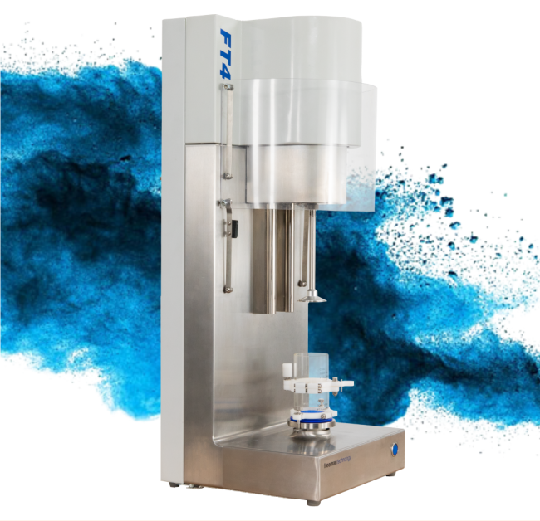
Royce Institute
Machines exist to test these parameters
Royce at Sheffield is able to do this
Contact has been made and hopefully we will be able to test in the near future
Low cost and impactful testing
  Cost to us should hopefully be materials only

Slide 12
Erosion
RAL Industrial placement student Will has now returned to University to complete his Master’s
He will be continuing work on erosion and will be attempting to develop knowledge of the development of wear over time
We are hopeful to have a Sheffield visiting researcher also working on this topic which will increase the depth of testing we are able to do and generalise the application of the research
Watch this space

Slide 13
Simulation
Discussions with Ansys lead us to prefer a Discrete Element Method solver over CFD
Significant particle densities, interparticle forces complicate the models
HPC requirements and GPU solve
Work in progress to assess the efficacy of this technique before deciding a way forward

Slide 14
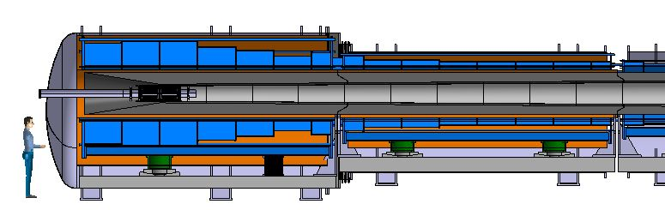
Target Geometry
Currently we have assumed a turnaround geometry
Could we use the split in the solenoids to reduce the bends in the pipe?

Slide 15
Target Geometry
Currently we have assumed a turnaround geometry
Could we use the split in the solenoids to reduce the bends in the pipe?
Difficult handling but maybe a much more simple system in operation

