Slide 1
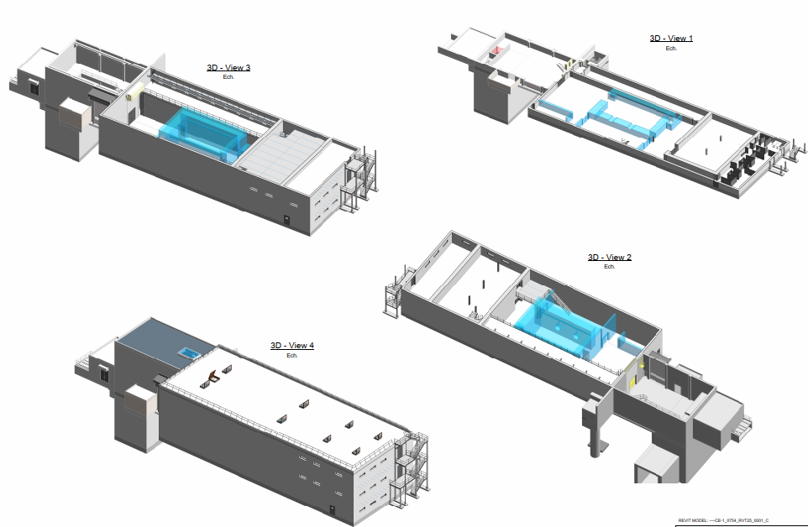
HI-ECN3 – B. 754
Under HI-ECN3 project, the existing CERN facility will be adapted for a new physics experiment named SHIP
  Scope
    Construction of a new nuclear facility for target manipulation.
      Surface: 800m2
      Concrete building
    Renovation of the current building.
    1m excavation on ECN3 cavern for future magnets.
    External works: concrete trench, parking, concrete slab, …
  Feasibility study going on
  Works 2027

Slide 2
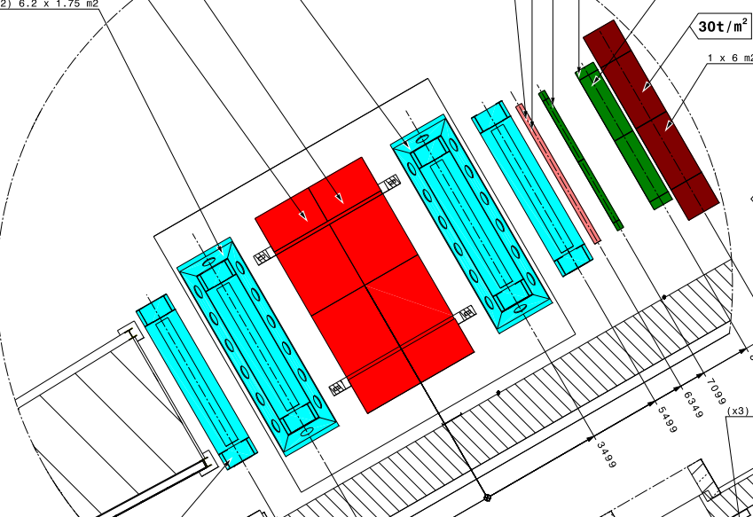
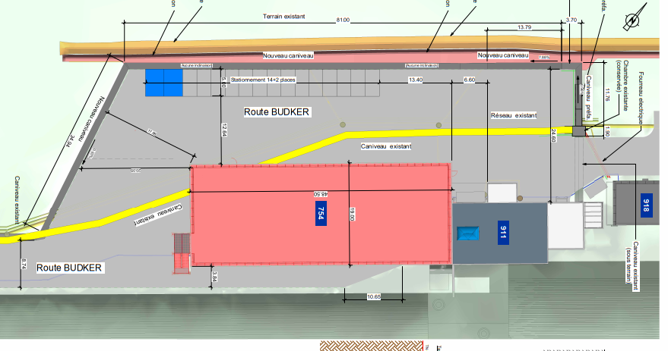
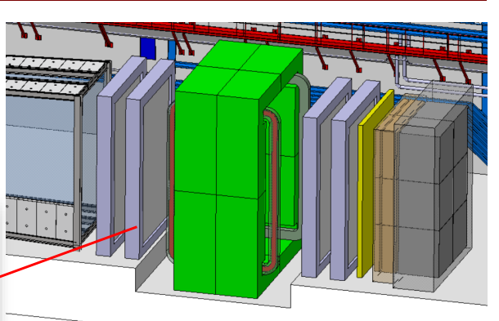
HI-ECN3 – B. 754
Under HI-ECN3 project, the existing CERN facility will be adapted for a new physics experiment named SHIP
  Scope
    Construction of a new nuclear facility for target manipulation.
      Surface: 800m2
      Concrete building
    Renovation of the current building.
    1m excavation on ECN3 cavern for future magnets.
    External works: concrete trench, parking, concrete slab, …

Slide 3
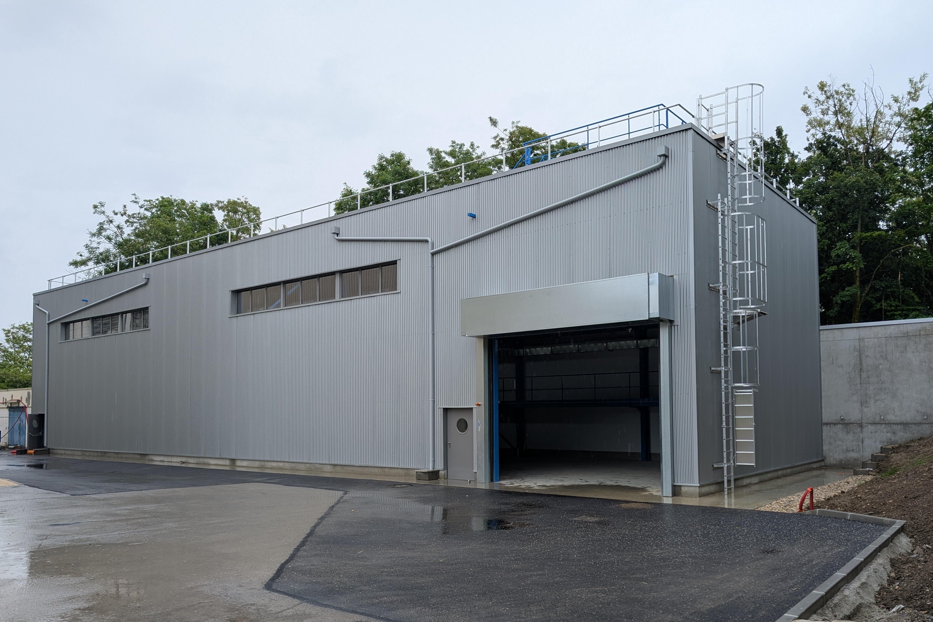
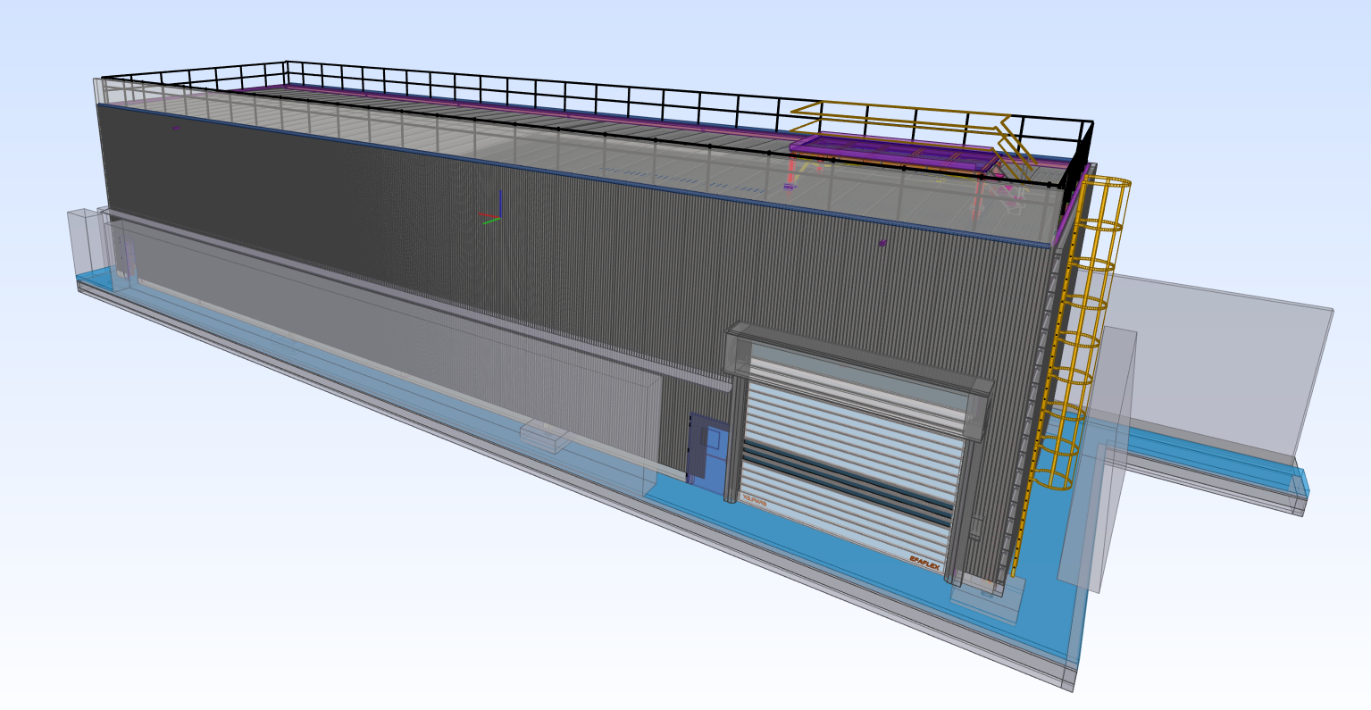
Building 697
Building for the storage of radioactive blocks from the CNGS dismantling
  Works finalised in March 2025
  Construction cost: 1M
  Surface: 400m2
  Concrete foundation and metallic structure

Slide 4
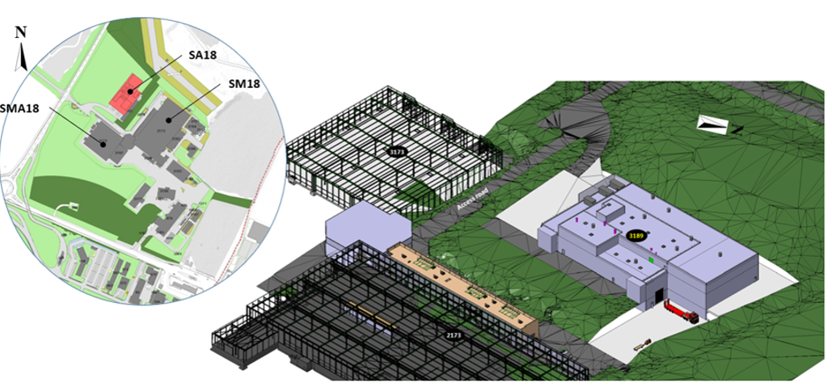
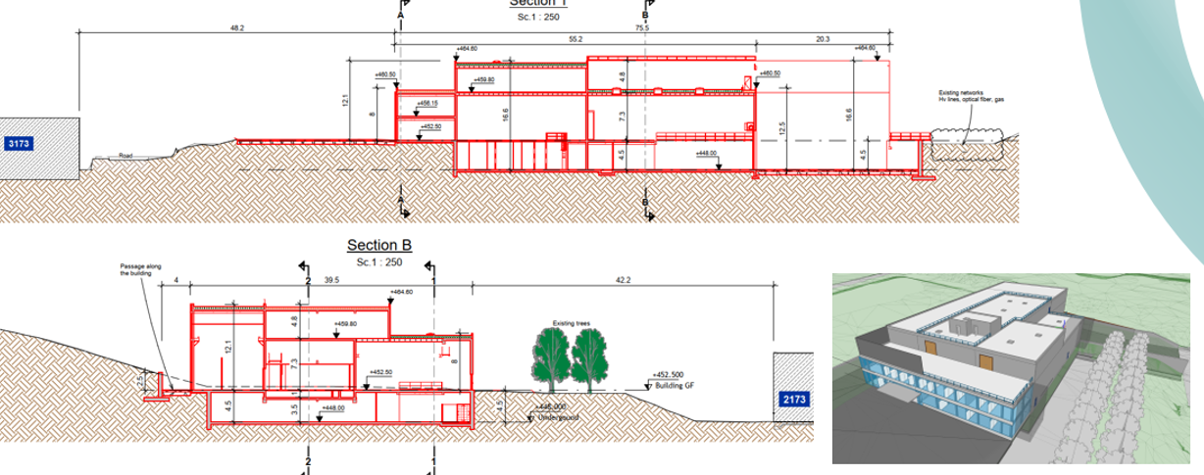
B.3189 New SRF Building
Courtesy of M. Manfredi
New machine building housing the user’s area, a large complex of cleanrooms, chemistry and thin film sputtering laboratories under a controlled and monitored environment.
  Tender design is ongoing
  Works: 2025-2026
  Surface: 6250m2

Slide 5
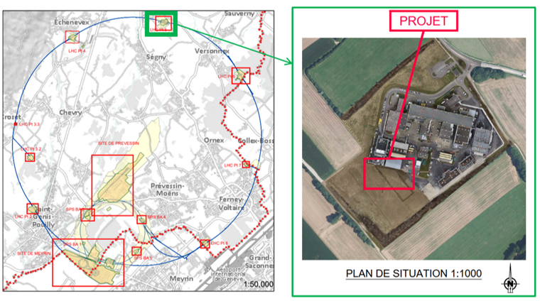
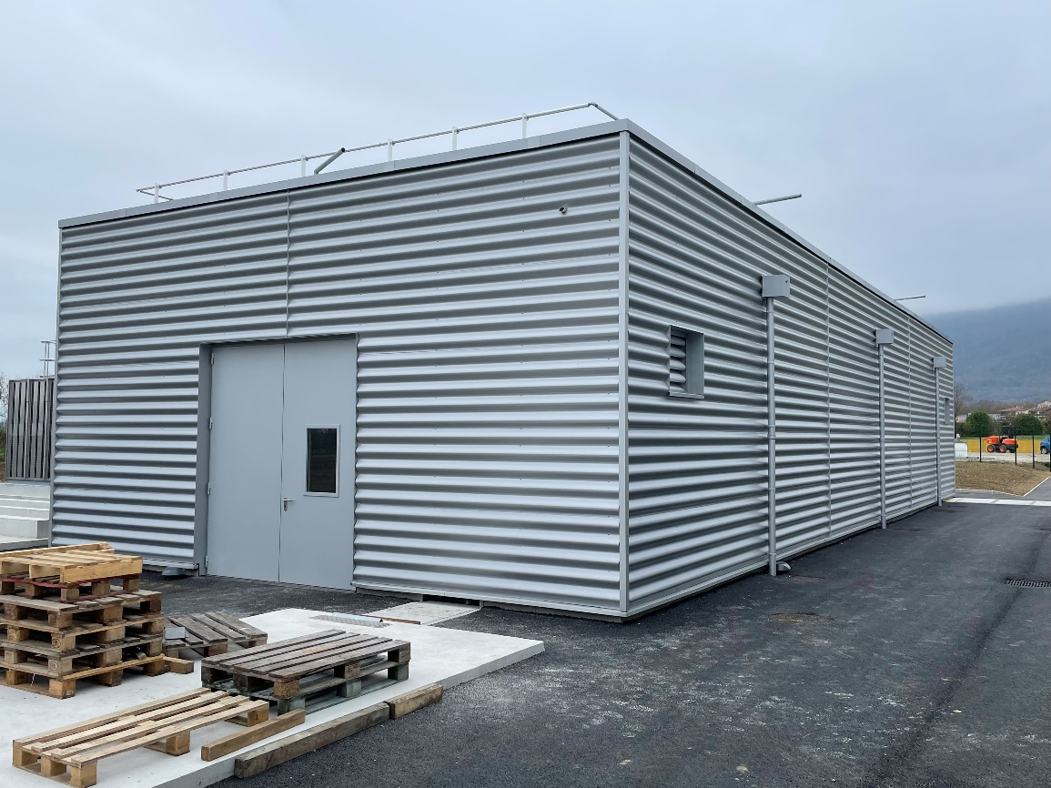
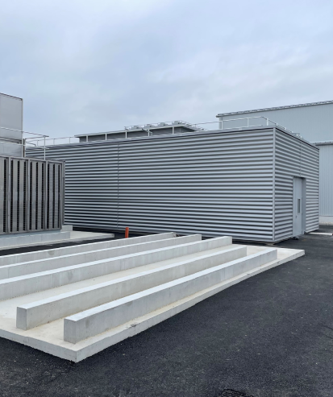
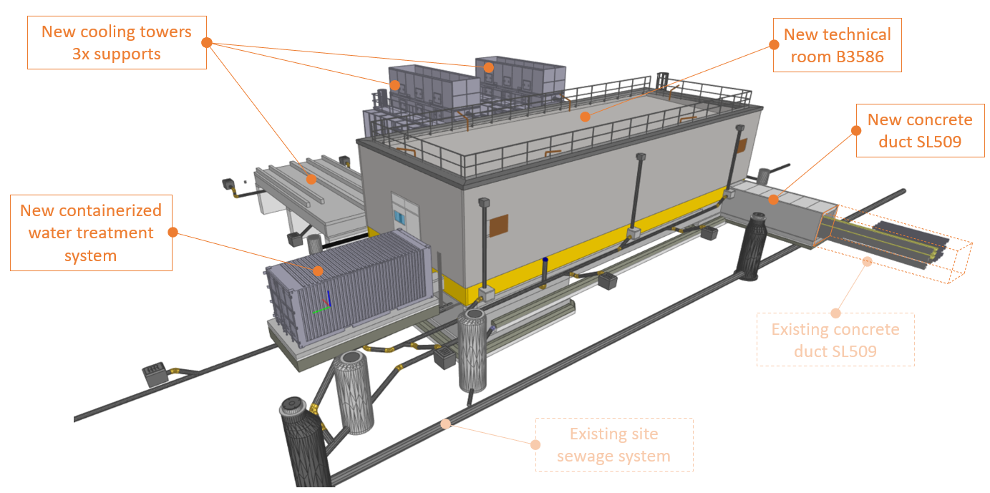
B.3586 (SF58) New cooling tower LHC5
Courtesy of M. Manfredi
Additional cooling capacity for CMS upgrade needing the construction of a new technical room, outdoor trenches, basements for four cooling towers and a water container.
  Works finalised in November 2024
  Construction cost: 2M
  Surface: 550m2
Project location
B.3586 (SF58) – New technical room for closed-circuit cooling towers
Support for future upgrade
Integration 3D model

