Slide 1
High Energy Physics Research in Bangladesh: Current Landscape, Challenges, and Path to Collaboration
Presented By-
Shamim Ahmed, Manager
BdREN
Event: ATCF9, University of Tsukuba, Center for Computational Sciences, Japan.
Date: 25 September 2025

Slide 2





Research Infrastructure Foundation: BdREN Network & HPC
Nationwide Connectivity
BdREN Data Center Capacity
Connects all public universities, research organizations, medical colleges and prominent private universities with a high-capacity 10/40 Gbps backbone network.
Global Research Connection
Linked to the Trans-Eurasia Information Network (TEIN) via Singapore's NREN (SingaREN) with a 1Gbps IPLC circuit.
Data Center Support
Comprehensive data center infrastructure with main Data Center (DC) and Disaster Recovery (DR) center to support research and educational institutions

Slide 3
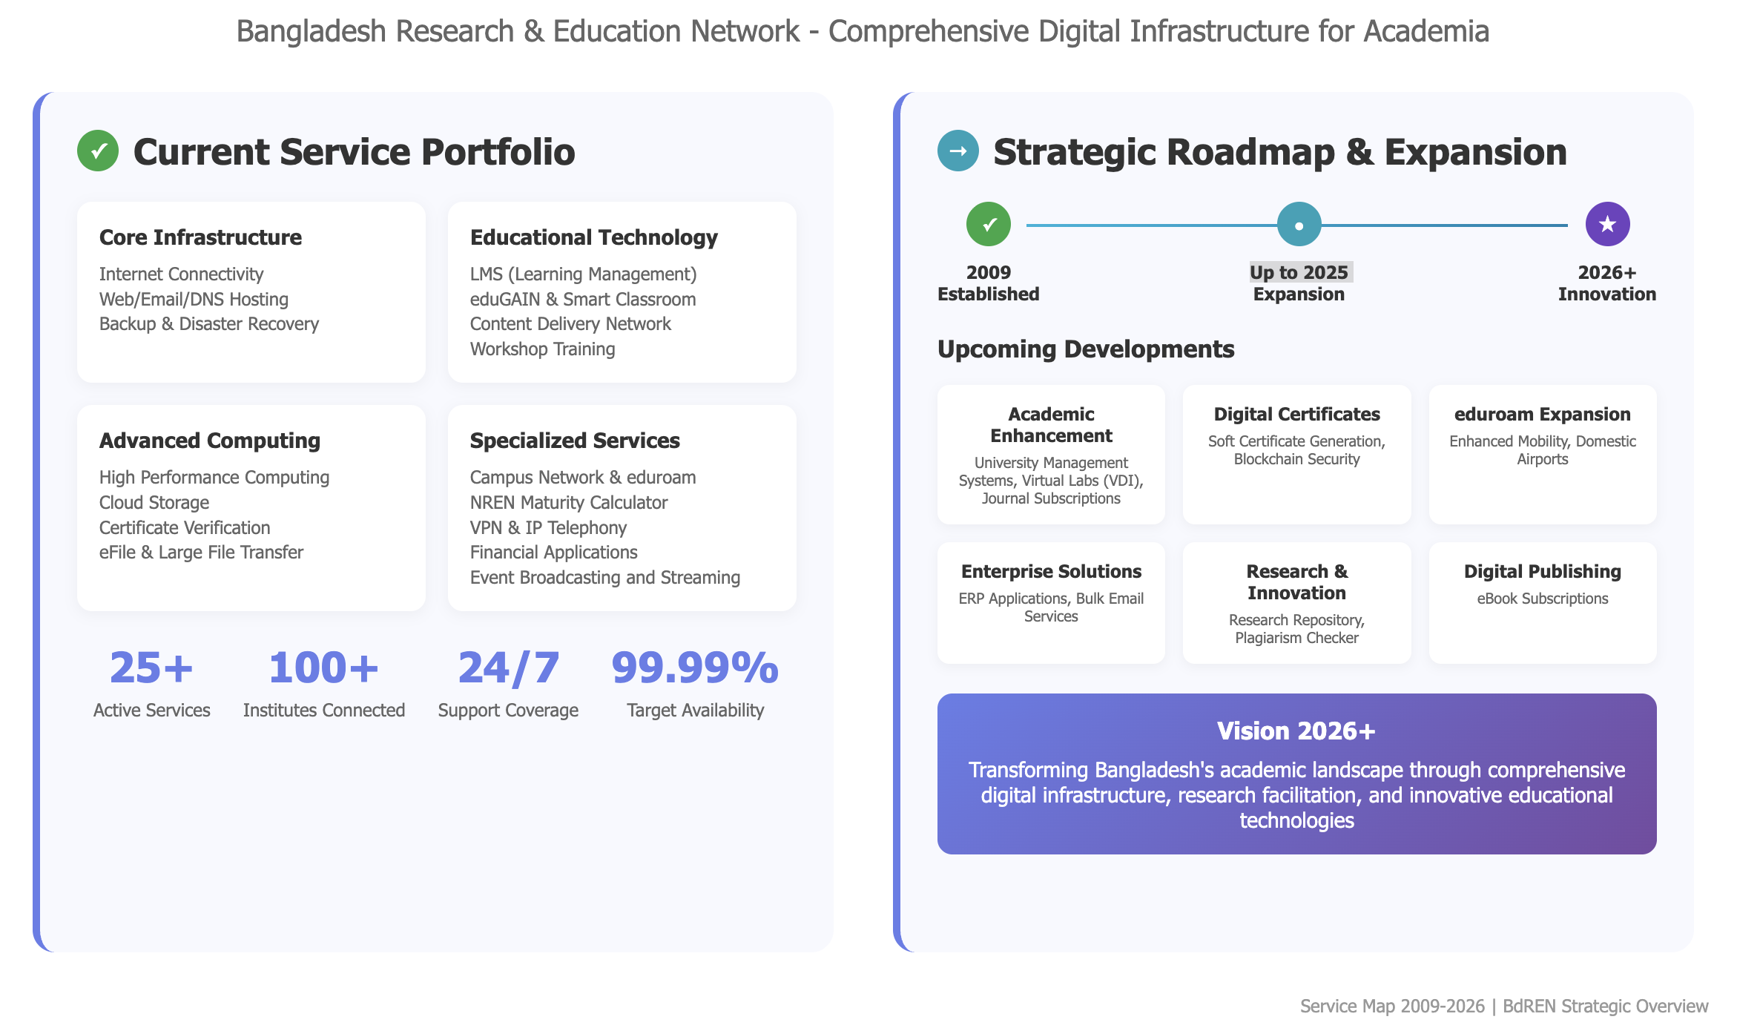
BdREN at a Glance

Slide 4
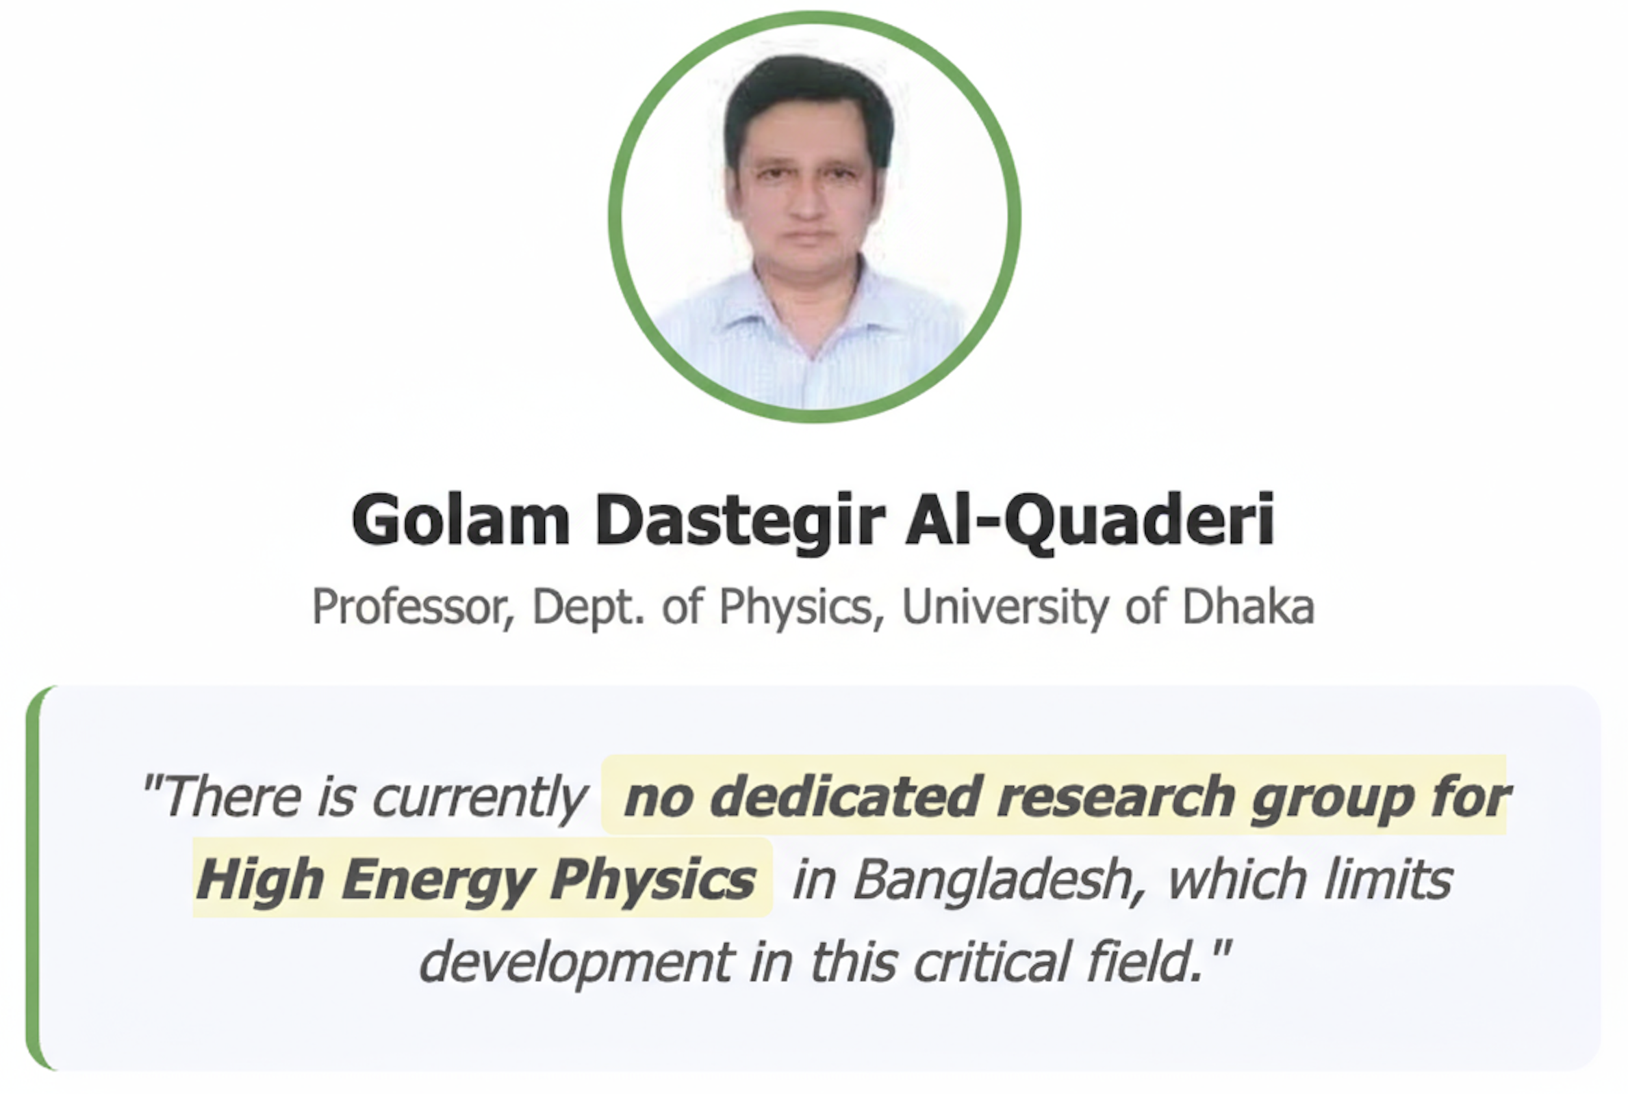
HEP in Bangladesh: A Critical Gap
A significant gap exists in High Energy Physics research, with no dedicated, active research groups in Bangladesh.
Some faculty members are engaged in collaborative research with international groups, though detailed information on these collaborations is not available.
Strong Bachelor, Masters and PhD programs in physics exist, but HEP-specific research is very limited.
Dedicated HEP infrastructure and laboratories are absent.
Several Bangladeshi universities have MoUs with CERN, but details of research activities and data access remain unclear.
A significant number of HEP theorist have left the field due to appropriate funding allocations , specially travel funds and scholarship for research students.
Professors from Bangladeshi universities have visited CERN for collaboration, but significant progress in HEP research within the country is yet to be achieved.

Slide 5




Challenges Facing HEP Research
Key Obstacles in High Energy Physics Development
Human Resources
Collaboration Gap
Limited coordination among existing HEP/Particle Physics experts
Critical shortage of specialized HEP researchers and experienced mentors
Funding Constraints
Brain Drain
Insufficient financial resources for HEP projects and infrastructure
Talented researchers migrating abroad for better opportunities

Slide 6
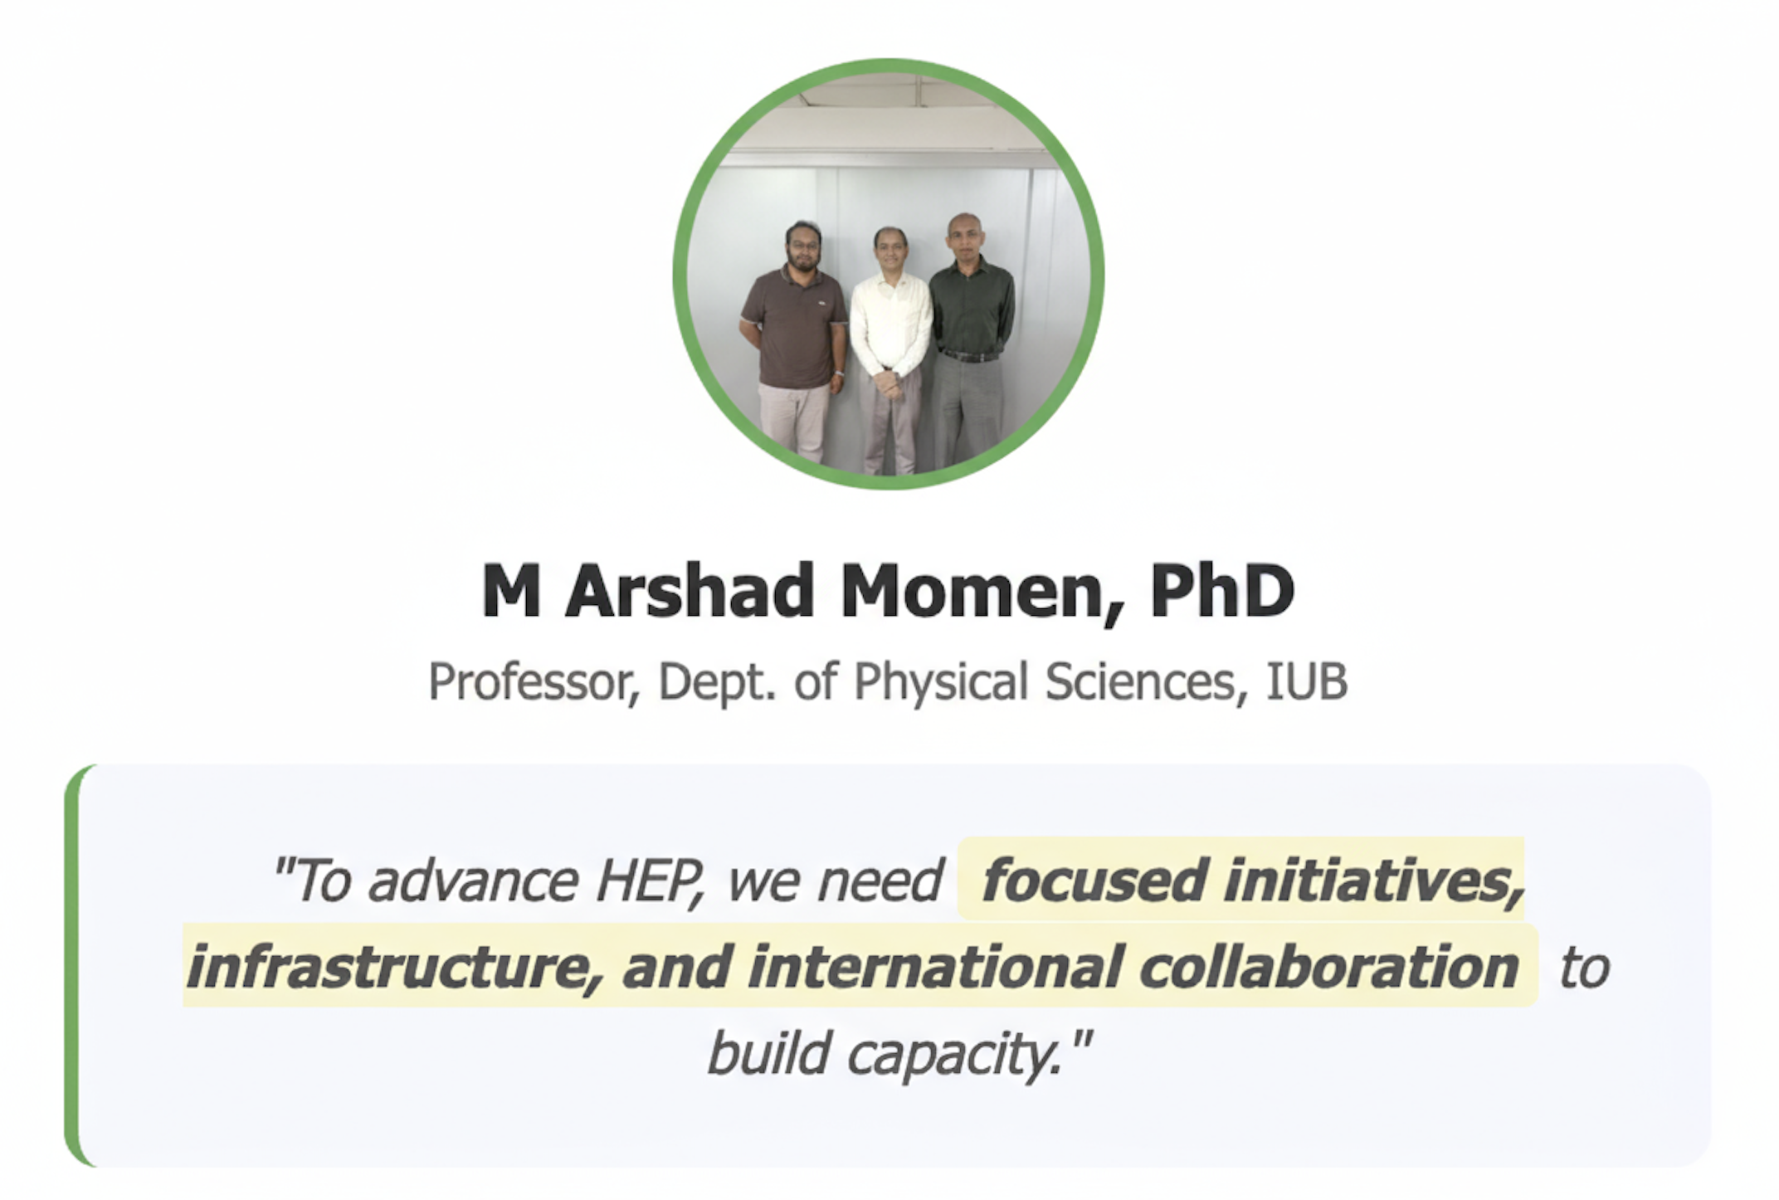
Strategic Vision for HEP Development
Goals include creating HEP research opportunities, workshops, and improving infrastructure.
Plan to foster national and international partnerships to develop Bangladesh’s HEP potential.
Plan to connect with the LHCONE.
Support the HEP community through funding from local and international projects.

Slide 7
Call for Collaboration
We invite support from the global HEP community, including partners here at the University of Tsukuba.
Especially seeking mentorship, training, joint research projects, and infrastructure assistance.

