Slide 1

KISTI-GSDC Report
Geonmo Ryu, Byungyun Kong
On behalf of KISTI-GSDC
25 September 2025 @ ATCF9

Slide 2

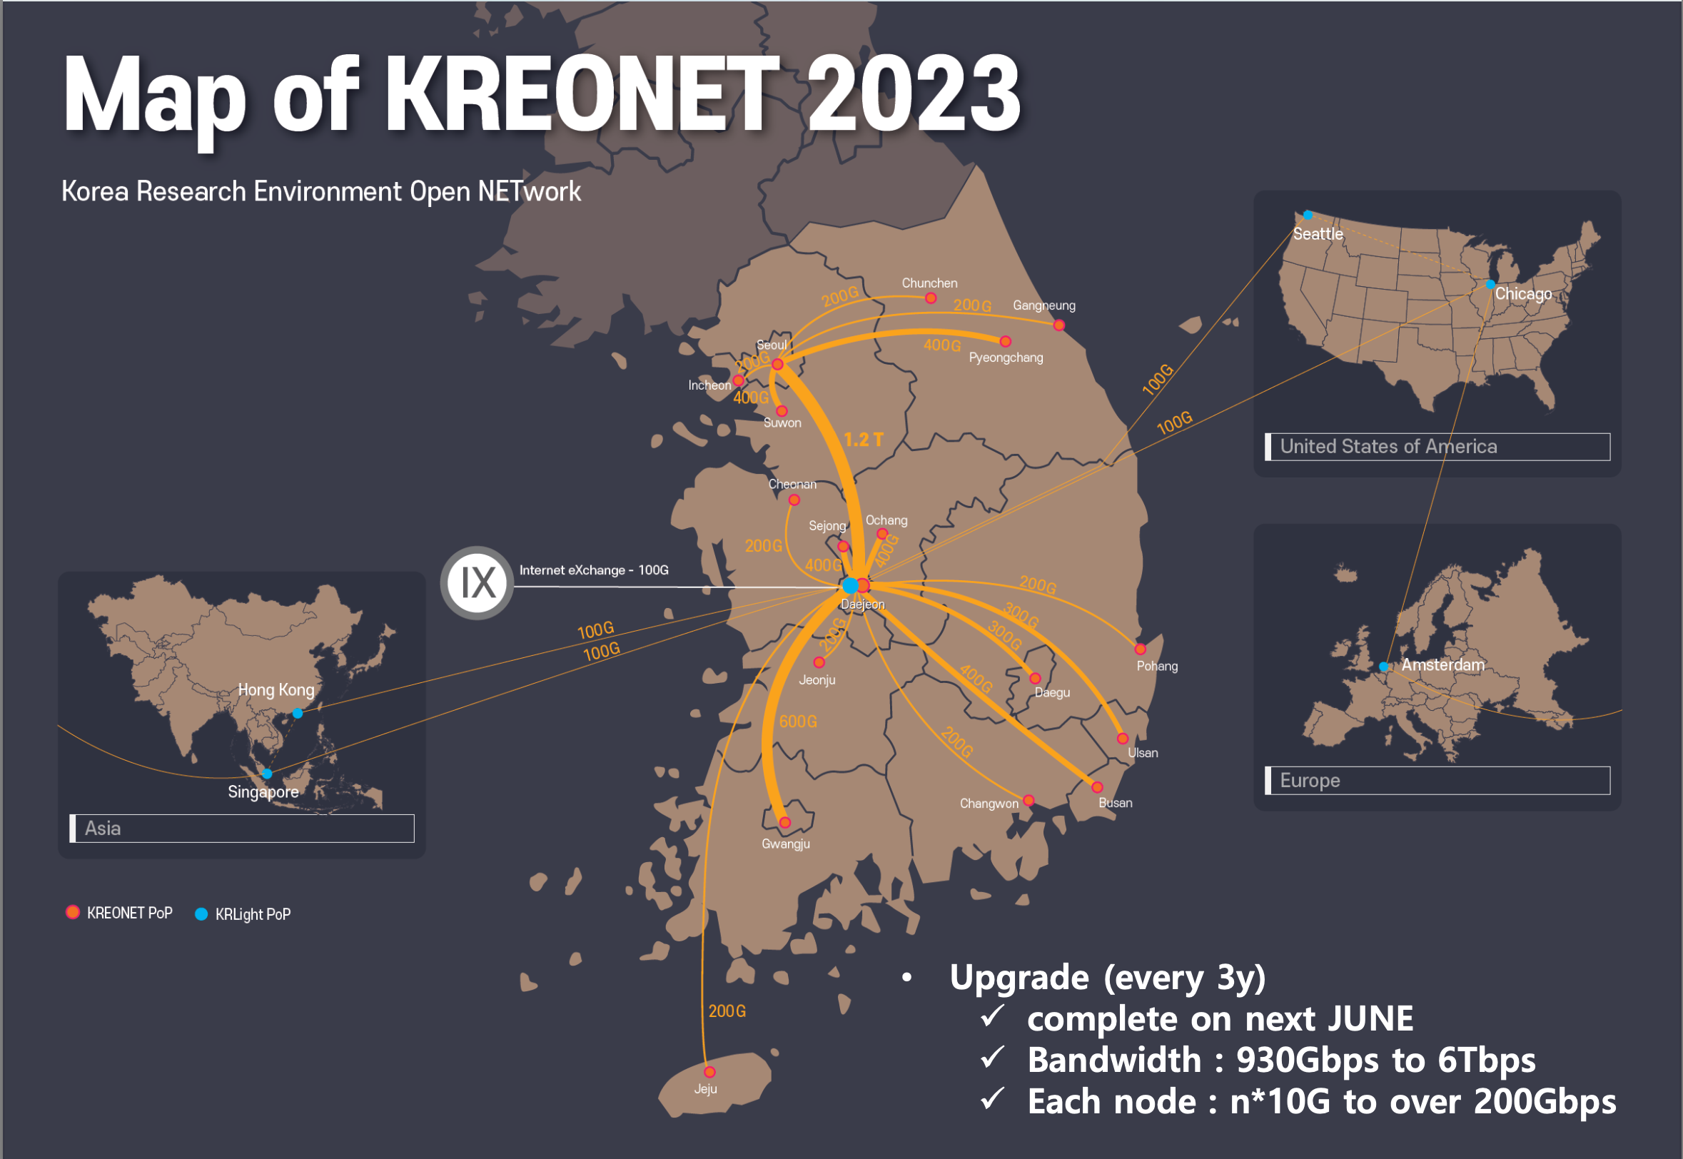
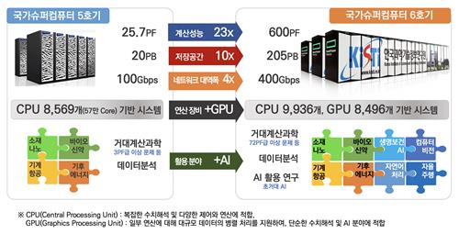
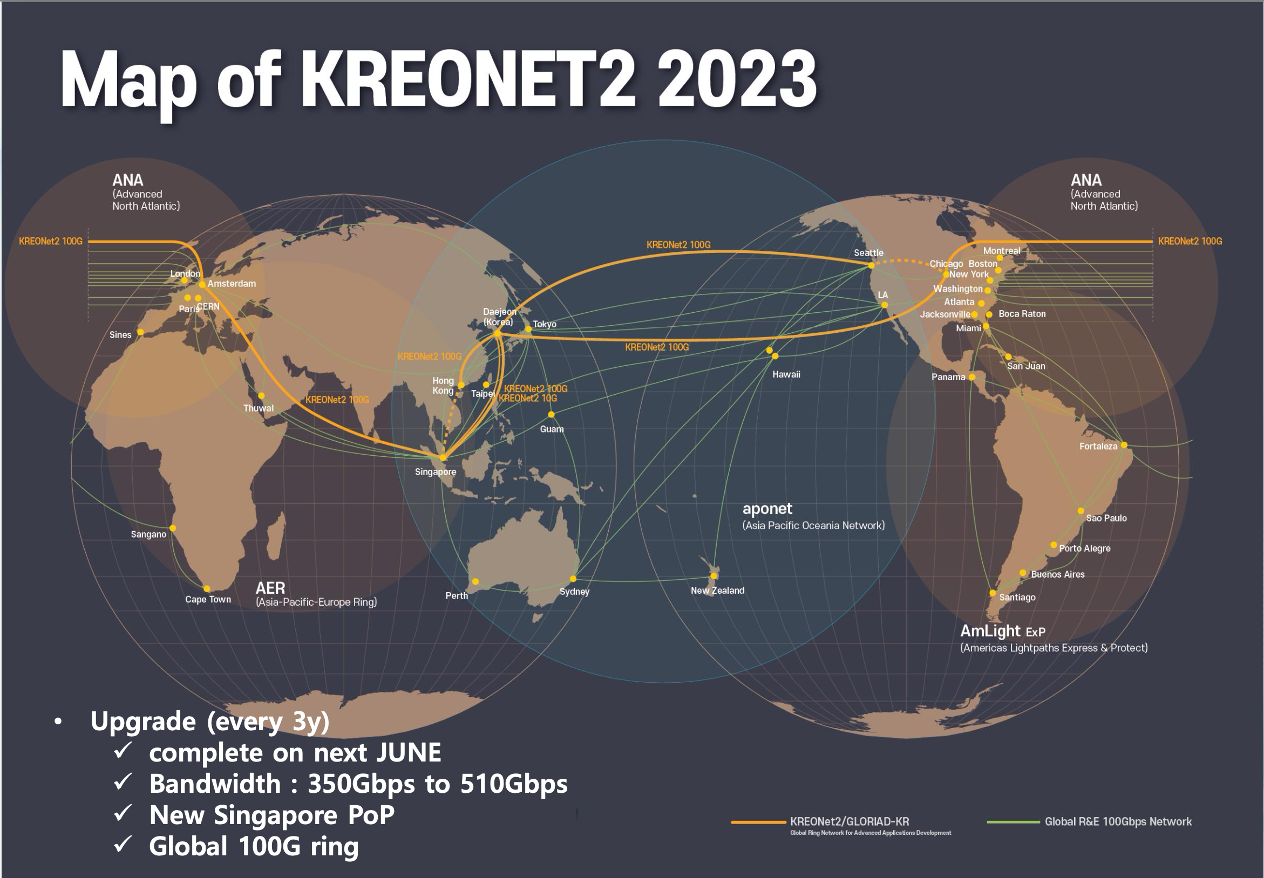
KISTI
Korea Institute of Science and Technology Information
Government-funded research institute founded in 1961 for national information services and supercomputing
National Supercomputing Center
  5th Supercomputer
    Nurion - Cray CS500 system
      25.7 PFlops at peak, ranked 11th of Top500 (2018) ⇨ 46th (Nov 2022)
    Neuron - GPU system, 1.24 PFlops
  6th Supercomputer (HANGANG)
    600 PFlops at peak, 8,496 GPUs
    Will start next year
  KREONet/KREONet2 - National/International R&E network
2

Slide 3







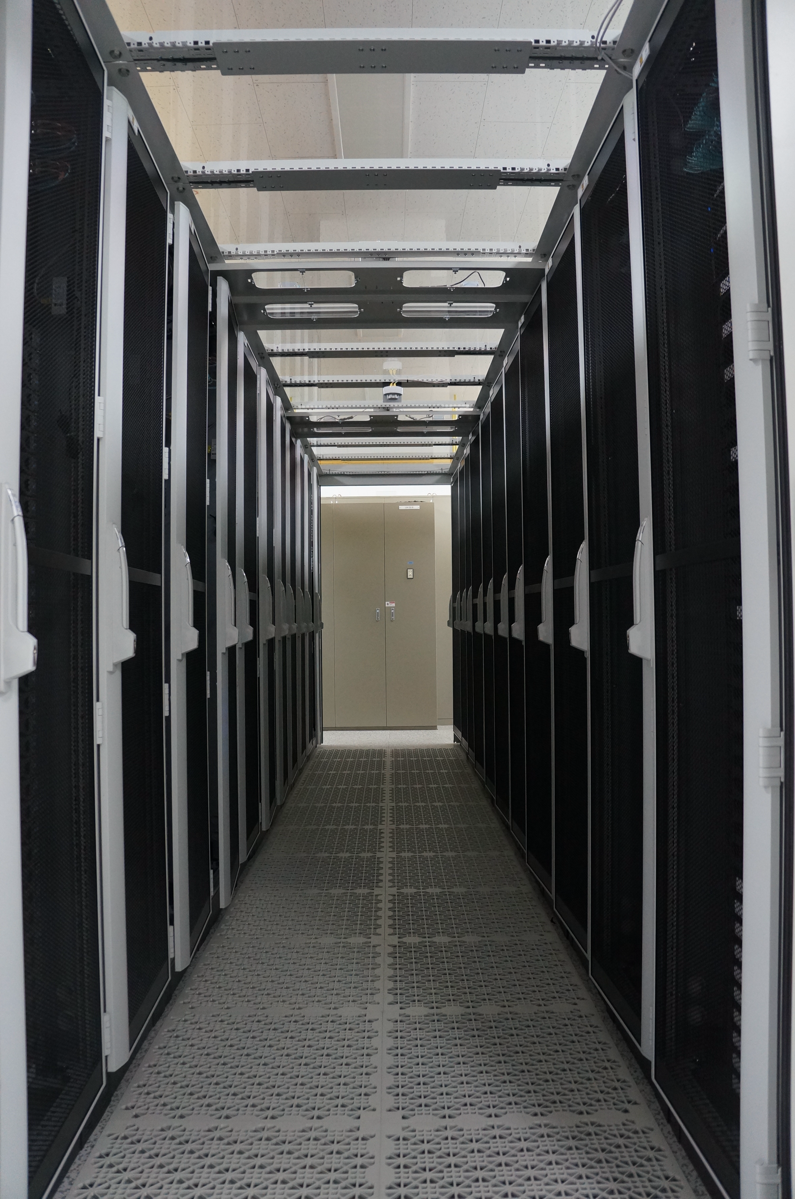
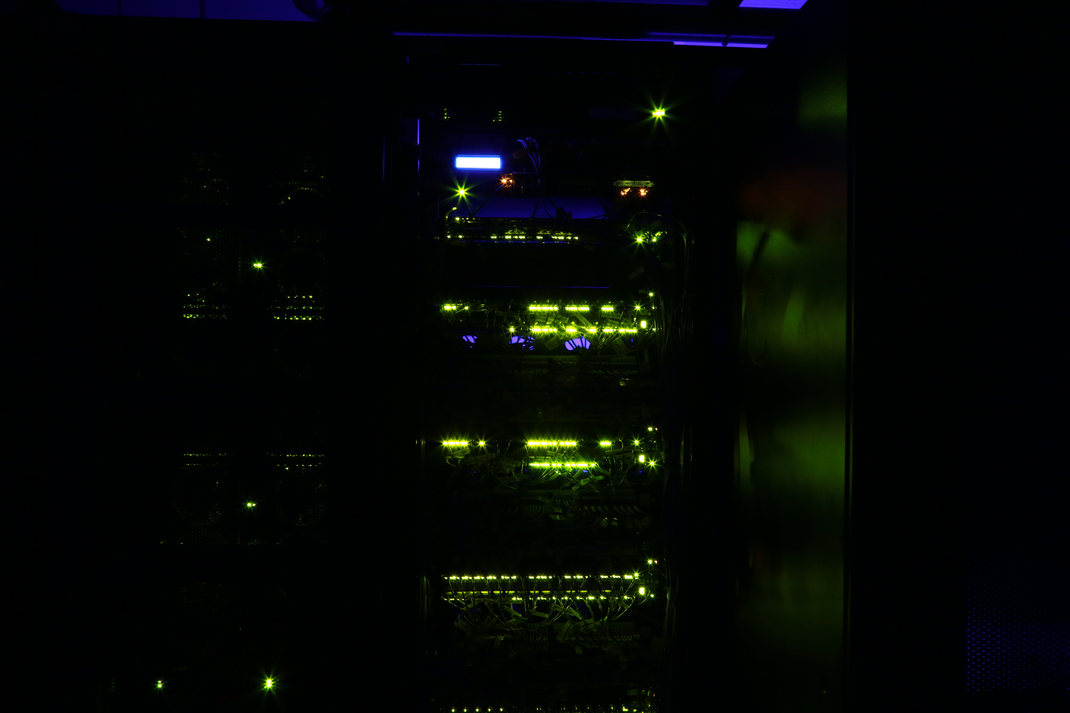
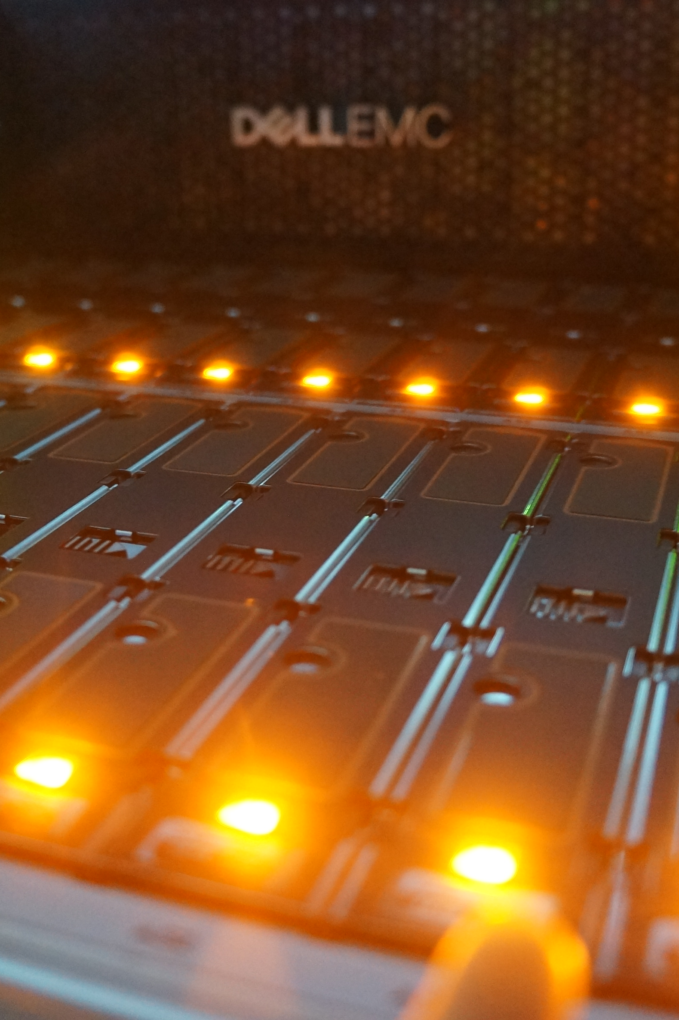
GSDC
Global Science experimental Data hub Center
Government-funded project, started in 2009 to promote Korean fundamental research through providing computing power and data storage
Datacenter for data-intensive fundamental research
  Preserving data from domestic or overseas large and complex scientific instruments as well as simulation-R&D activities
  Providing services based on technology development: distributed computing structure, high availability storage system, infra integrated management, disk-based custodial storage
Server
Network
Storage

Slide 4
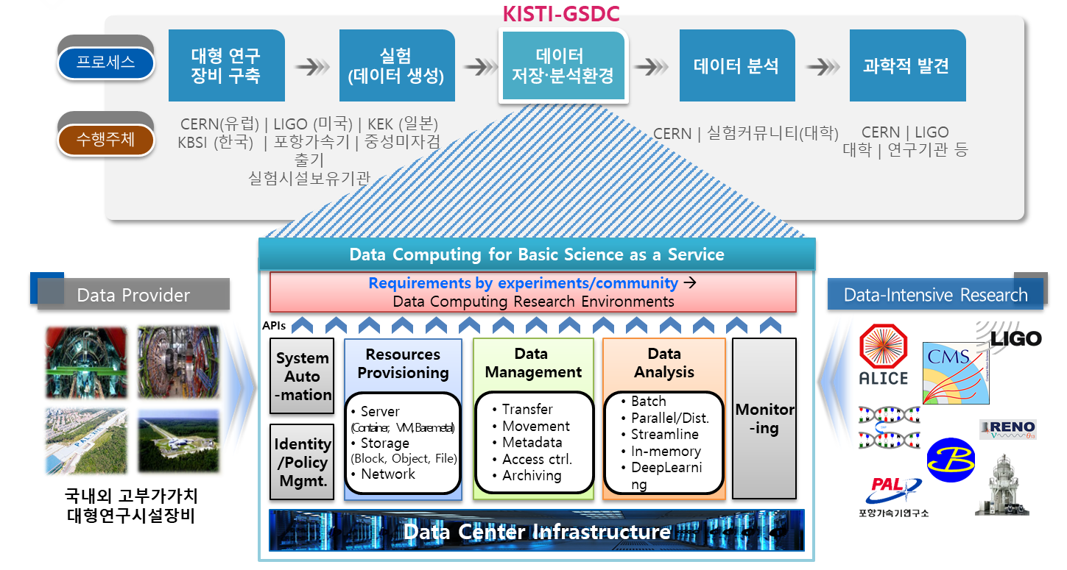
Role of GSDC for Data-intensive Research
Process
Constructing
Facility
Conducting
Experiment
Data
Comp. Env.
Analyzing
Data
Scientific
Achievement
CERN(EU) | LIGO (US) | KEK (JP)
TEM | PAL | RENO
Large-scale Facilities
Users | User Groups
Research Community
Subject
Domestic | Overseas
Large-scale Facility

Slide 5


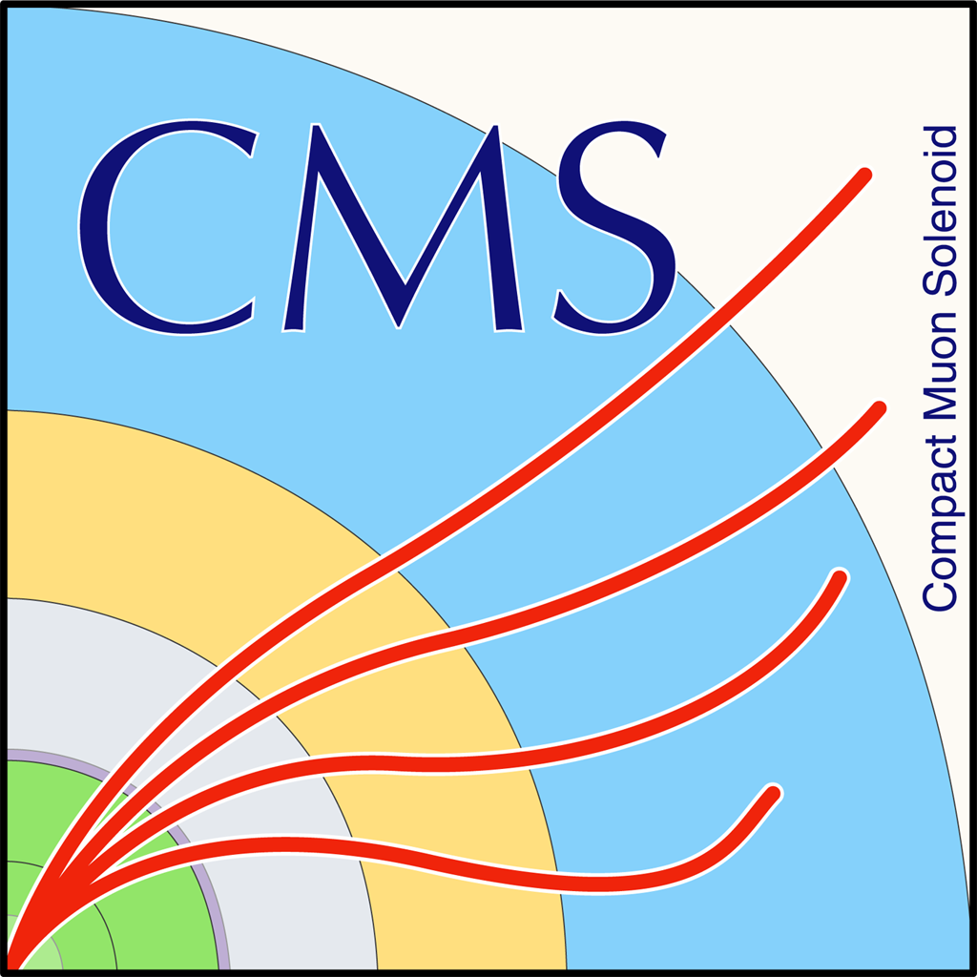






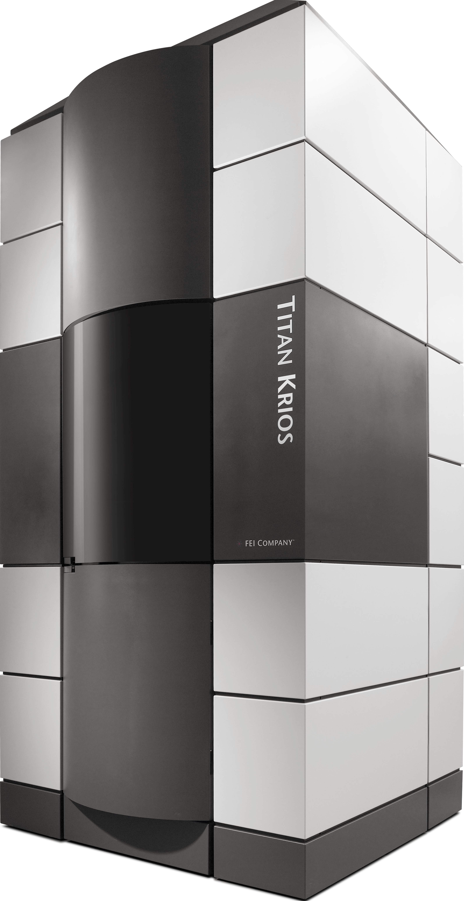
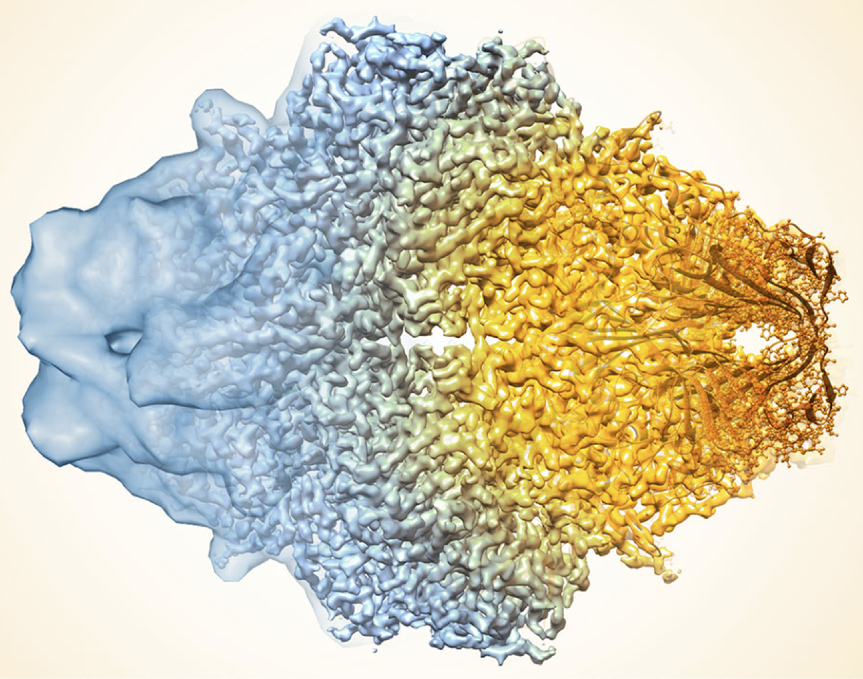
Supporting Experiments
Heavy-Ion Physics
WLCG Tier-1 (2014)
Elementary Particle Physics
WLCG Tier-2 (2018)
Elementary Particle Physics
Computing cluster
Astrophysics
LDG Tier-2 (2019)
Neutrino Physics
RAW Storage
Structural Biology using Cryo-EM/XFEL
Data Storage & Analysis Pipeline

Slide 6
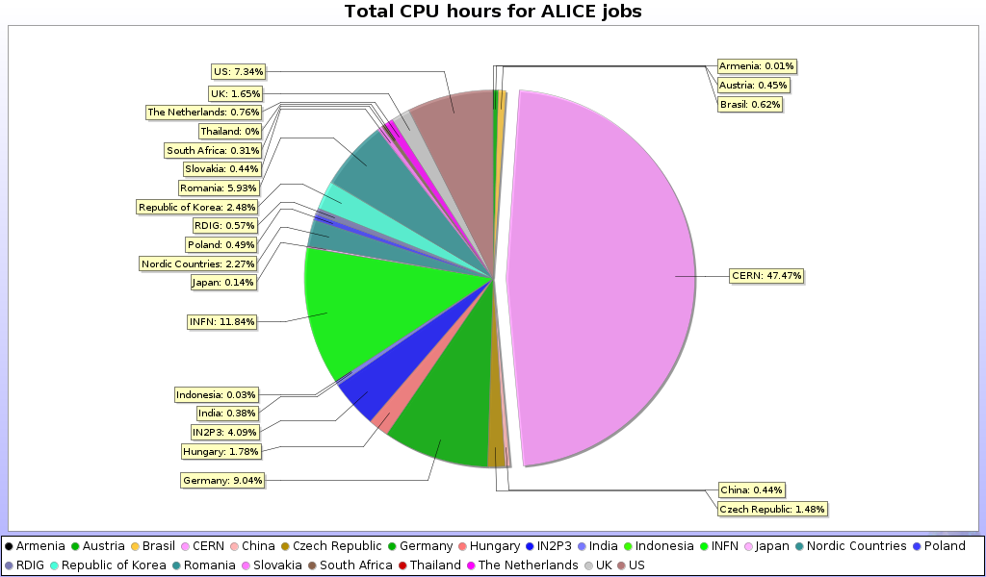
WLCG Tier-1 @ KISTI-GSDC
Flagship Service for Data-intensive Computing
A WLCG Tier-1 in Asia for the ALICE experiment
  Contributing about 10% of T1 resource requirements of ALICE
    More than 2% of total (T0+T1+T2+AFs) resource requirements of ALICE
    Availability/Reliability: 98.88% / 99.13% (2025)
CE
  HTCondor-based, whole-node submission enabled (for N-core jobs)
SE
  XRootD/EOS based disk storage
  Archival SE : CDS, the disk-based one powered by EOS
Networking
  LHCOPN : 20G dedicated link between Daejeon (KR) and Geneva (CH)
  LHCONE : 100G provisioned by KREONet connecting to EU, US and Asia (SG/HK)

Slide 7
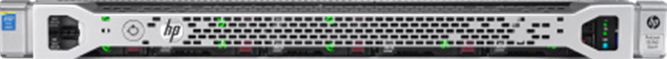
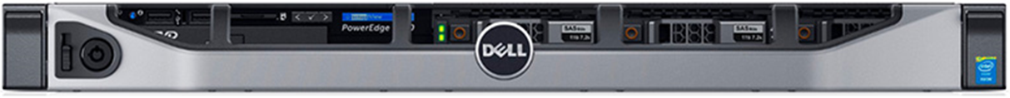
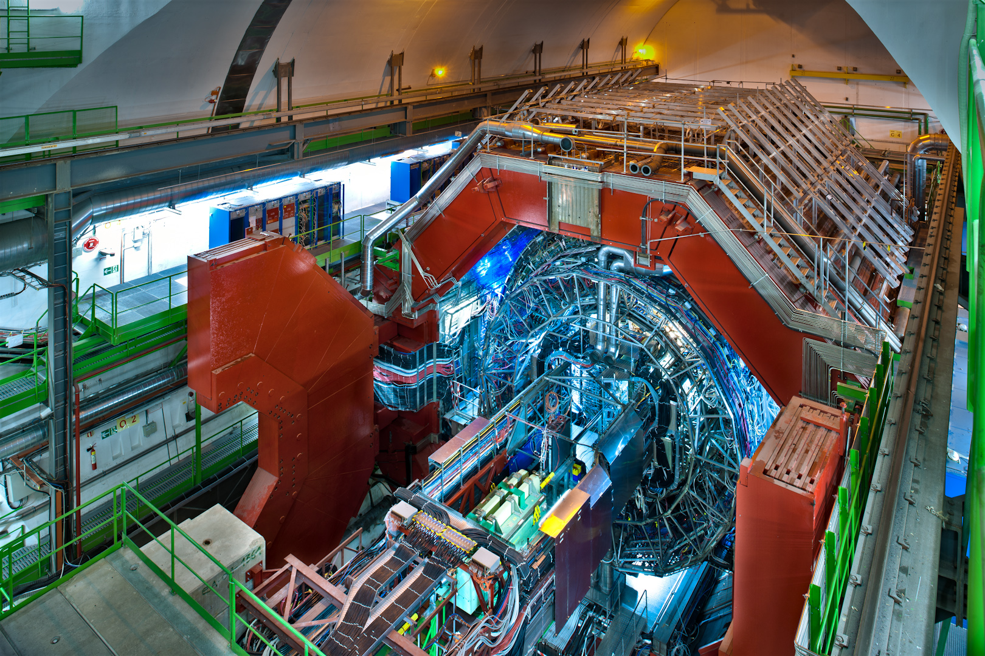
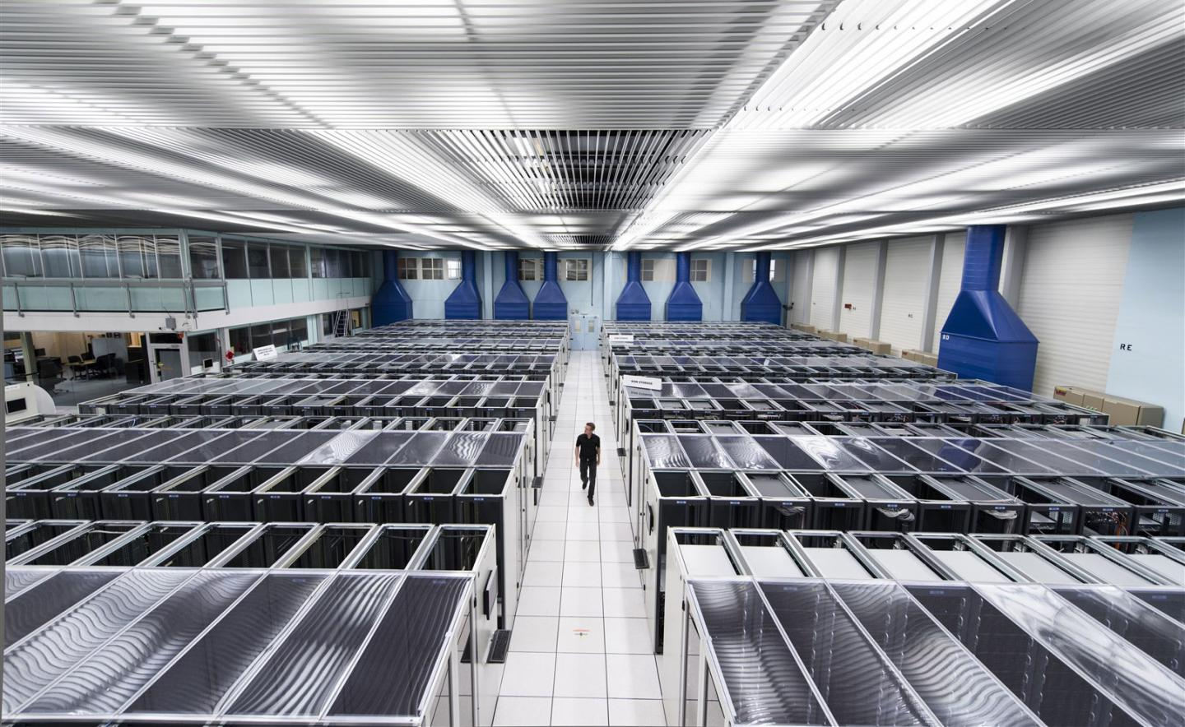
KISTI ALICE T1 Structure Overview
WLCG CRIC
publish
Accounting
Job
APEL
HTCondor
Data
Simulation
Organised Analysis
7,200 Core
statistics
CERN
Reconstruction
User Analysis
Job
Queue
HTCondor-CE
Job Broker
allocation
VO-Box
submission
CE
scheduling
Batch Cluster
HTCondor
query
collect
AuthN/AuthZ
BDII/Argus
read only
data i/o
80 PB
collect
collect
Erasure-Coded storage
Archival
Storage
Disk Storage
Detector
ALICE O2
O2 Buffer
real-time data transfer (> 25Gb/s required)
raw
processed
80PB/yr
archive
KISTI-CERN 20Gbps
EOS
~ 1EB
T0
0.75 PB
CDS
EOS EC Storage
8.55 PB
Usable = 15 PB
RAW = 22.8 PB
0.75PB disk will be added
on end of year
100Gpbs became a standard
Tape Library decommissioned
Nov. 2021

Slide 8
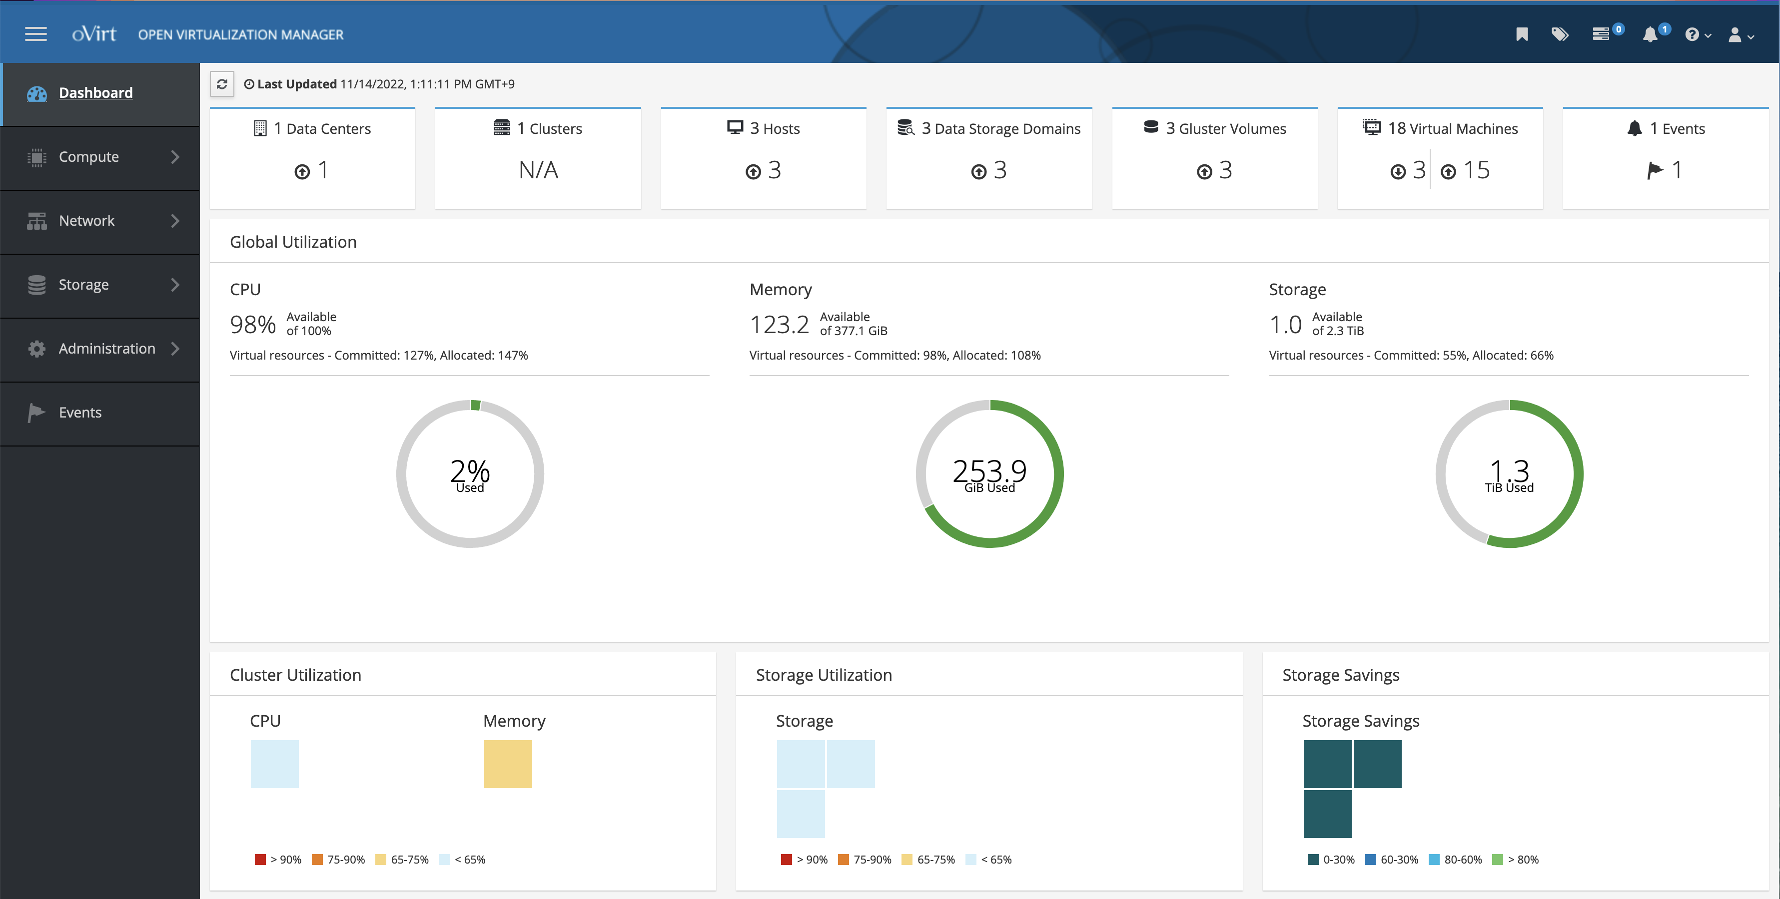
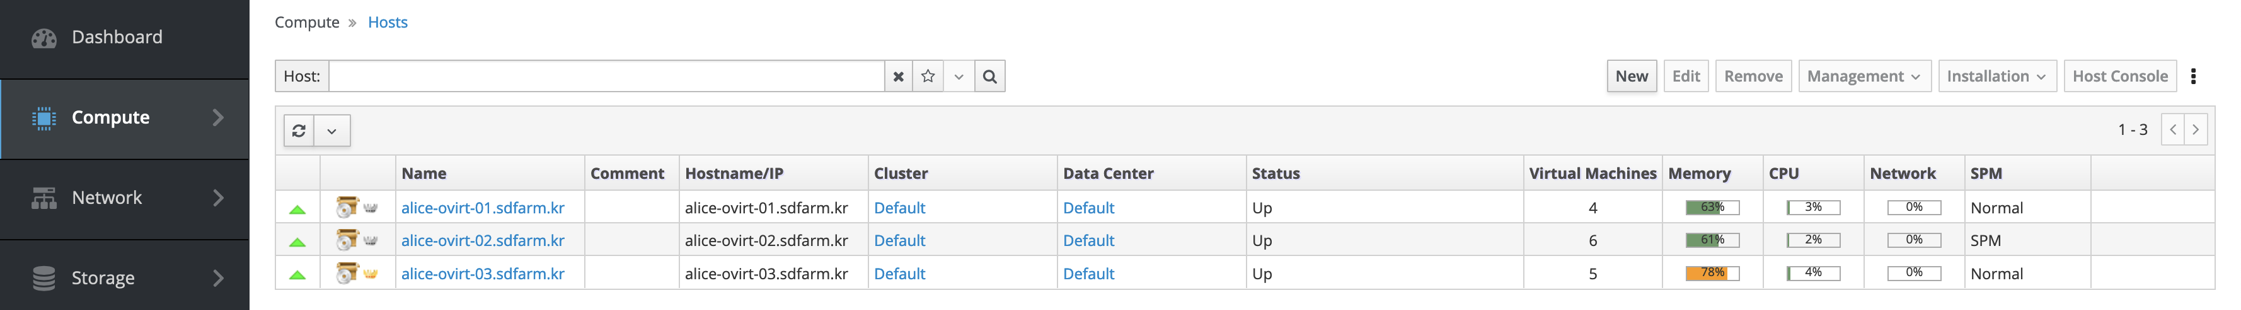
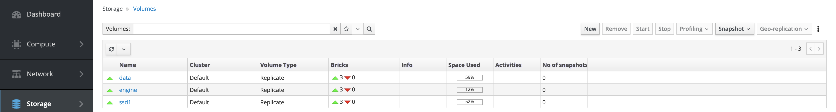
T1 Grid Services
Site Status
Many grid services running on VMs provided by oVirt cluster
  oVirt 4.3.8 + GlusterFS 6.10
  3 oVirt hosts with 384 GB of RAM and 2.3 TB of Gluster Storage
  (1.5 TB HDDs, 0.8 TB SSDs)
  Live migration & load-balancing
VMs for Grid services
  VOBOX for job submission
  Site-BDII & Argus (AuthN & AuthZ)
  3 Squid caches for CernVM-FS (Application provisioning,
  e.g. AliRoot, ROOT, GEANT4, etc.)
  APEL (WLCG Accounting)
  3 HTCondor-CEs (CE & Condor 24.0.8-1)

Slide 9
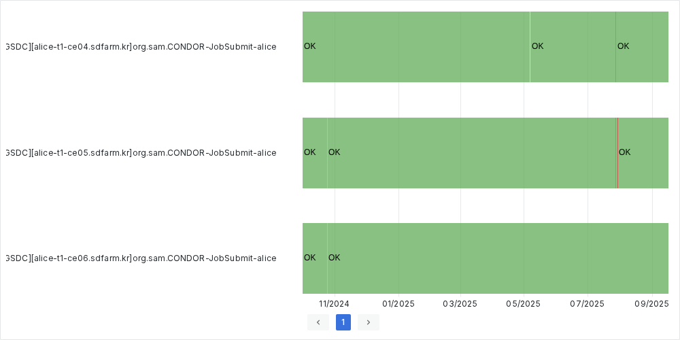
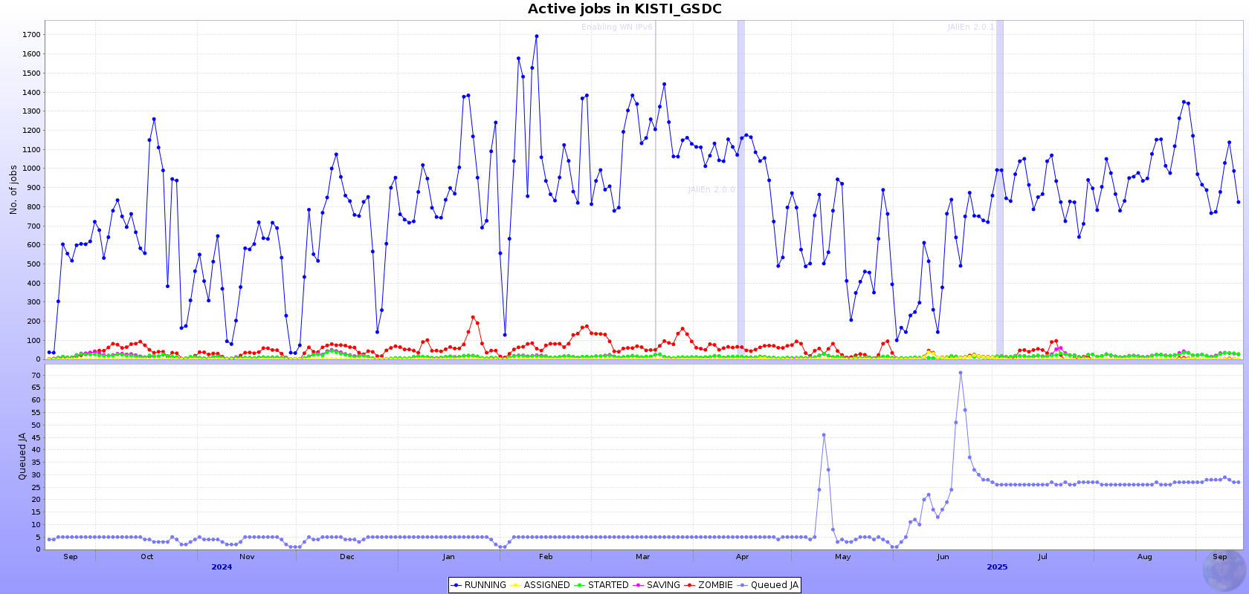
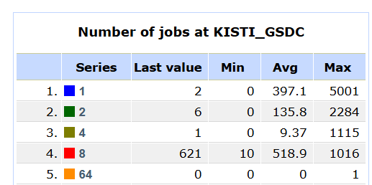
Computing Elements
VOBOX
  On the VOBOX machine, JAliEn CE and MonALISA are currently running.
  The new VOBOX container has successfully replaced the old VM.
Computing Resource
  Total: 73.6 kHS23 / Newer than 2020 : 50.8 kHS23
Pledge: 69 kHS23 (2025) / 72 kHS23 (2026)
Current Status
  Servers without a functioning web console have been excluded from the total count
Plan
  Add about 22.8 kHS06 this year by replacing old Worker Nodes
  New AMD servers prepared with 192 cores each (expected ~4–5k HS23 per server)
    HS23 benchmark values still require adjustment due to power limit factors
  Goal: phase out all equipment manufactured before 2020
HTCondor-CE Hostname | Number of Worker Nodes | HepScore 23 Benchmark score
alice-t1-ce04.sdfarm.kr | 12 | 21,029
alice-t1-ce05.sdfarm.kr | 35 | 27,524
alice-t1-ce06.sdfarm.kr | 55 | 25,092

Slide 10
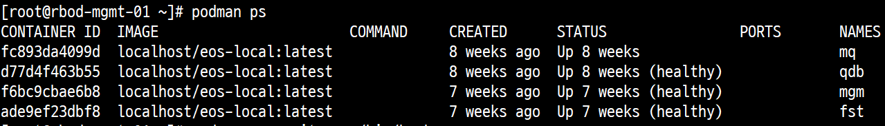
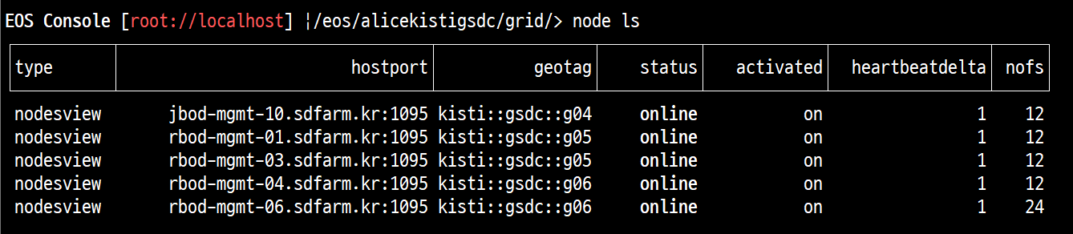
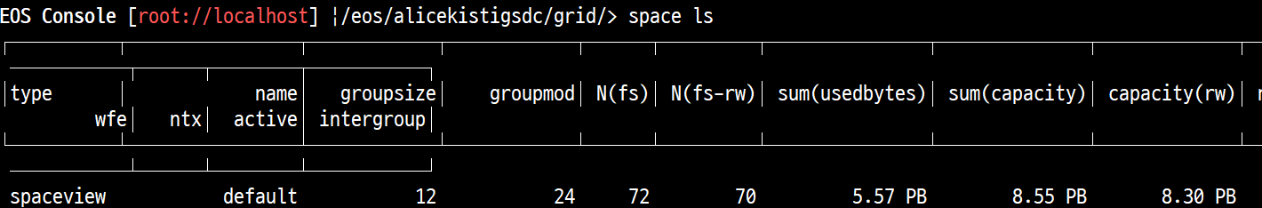
EOS Disk Status
Structure
  Running a container-based EOS server directly with podman
    Container Image: AlmaLinux 9.6
    5 EOS servers (v5.3.8)
      2x (MQ + MGM + QDB + FST) + 3x (QDB+FST)
      MGM DNS Round robin (eos-disk.sdfarm.kr)
Status
  Total : 8.55 PB (=7.597PiB)
  Used : 5.57 PB (=4.94PiB / 65.14%)
Plan
  Will be added more space on December
    + 0.75 PB ≒ 9 PB (2026 Pledge)

Slide 11
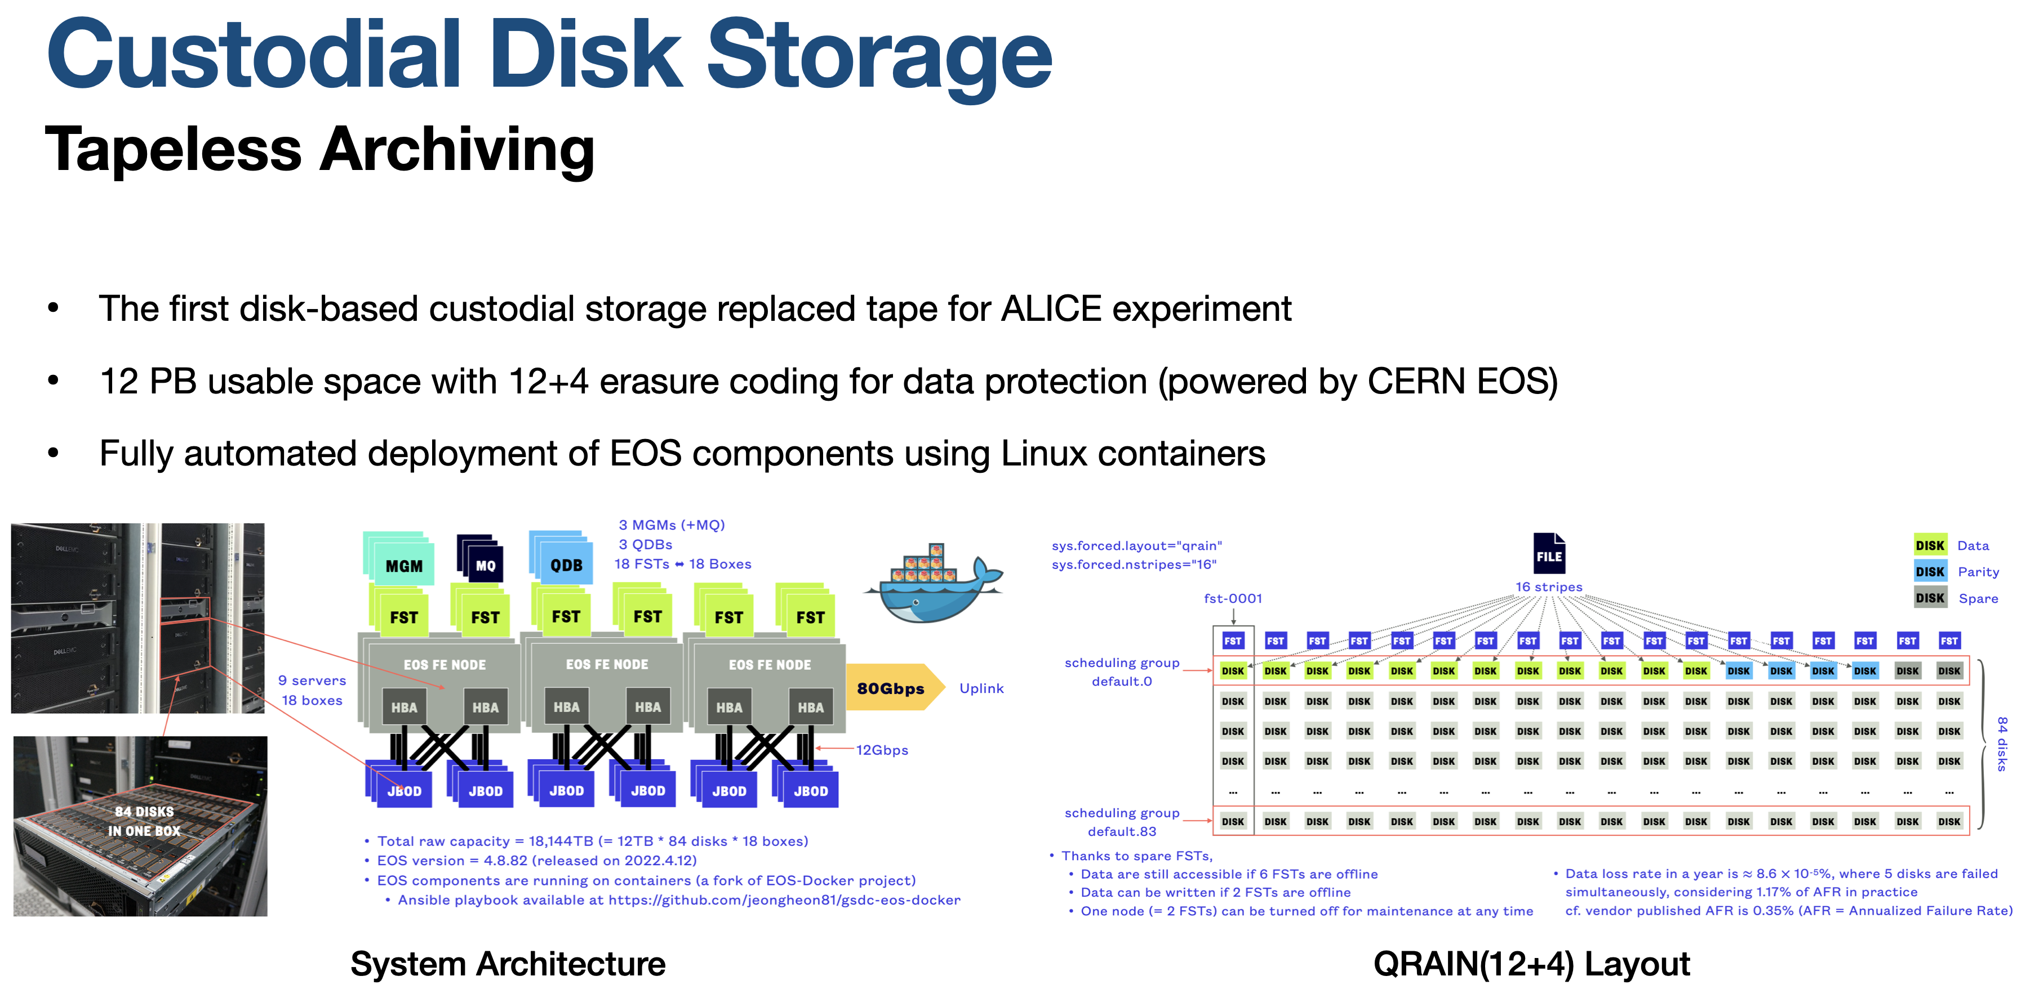
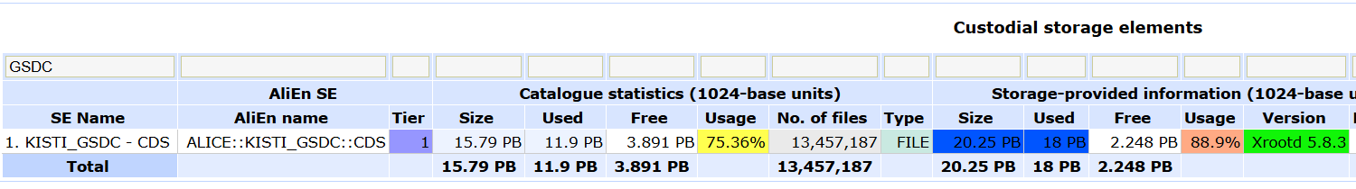
CDS Archving Storage
Structure
  Running a container-based EOS server directly with podman on 9x CentOS7 and 5x AlmaLinux9 hosts
    Container Image: AlmaLinux 9.6
    14 EOS servers (v5.3.17)
      3x (MGM) + 5x (QDB+FST) + 6x (FST)
    MGM DNS Round robin (eos-archive.sdfarm.kr)
Status (Installed / Usable after EC)
  Total : 22.80 / 15.2 PB (= 20.25 / 13.5PiB )
  Used : 20.28 / 13.5 PB (=18.01 / 11.99PiB) [88.9%]
Plan
  Replace old storage servers (maintenance expired) with new equipment
  Secure 15 PB usable capacity (2026 pledge)
  Slightly less total space, but improved stability

Slide 12
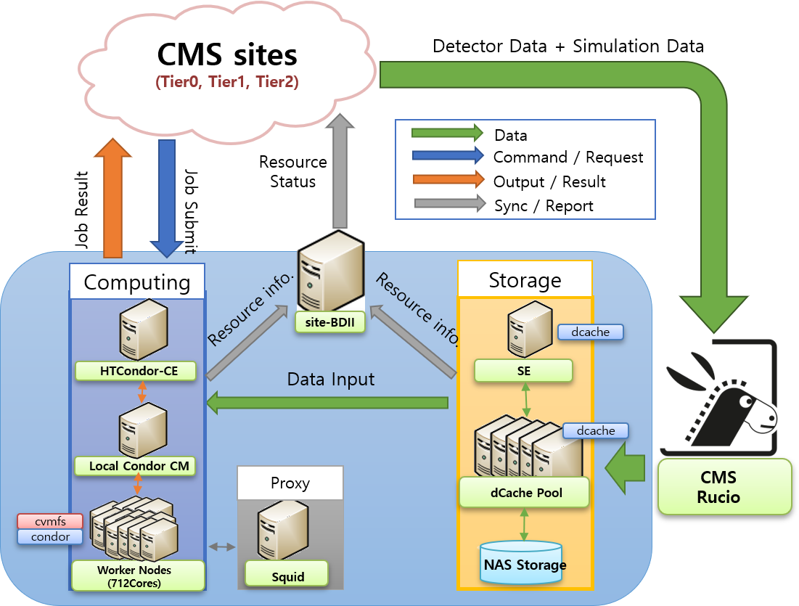
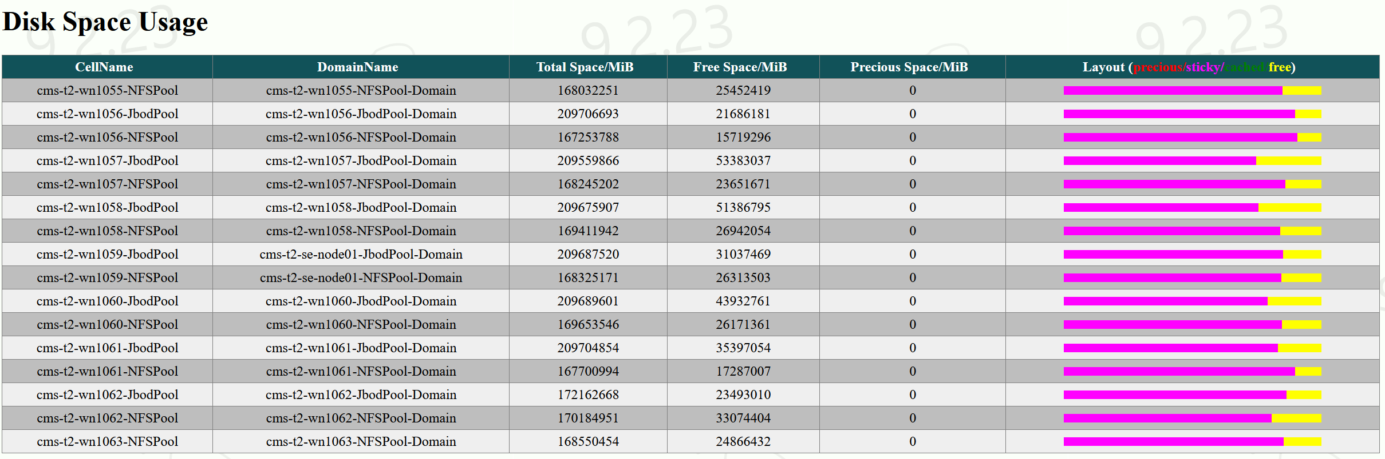
Structure of CMS Tier-2 @KISTI
Services run on BareMetal servers
  OS installation by Foreman
  Provisioning with Ansible
    Ansible Roles: https://github.com/orgs/gsdc/repositories?q=visibility%3Apublic+archived%3Afalse
Main Component
  Middleware : UMD5 (+ wlcg repo)
  CE : HTCondor-CE v23.0.28
  LRMS : HTCondor (2x CentralManager using HTCondor HA)
    46 WNs / 1,424 logical cores / 14.9 kHS06
    RAM 2,000MB per core
  SE : dCache v9.2 + XRootD PSS server for CMS AAA
    9 x dCache Pool Server (10Gbps)
      8 JBOD + 9 NFS Pools / 2819TiB (=3100TB)
    Protocol : XRootD (RO), WebDAV (RW)
  Report : 1x (site-BDII+APEL publisher)
  Cache : 2x Frontier-Squids
Network: Shared-100Gbps from GSDC to KREONET
One pool server has been replaced due to failure.

Slide 13
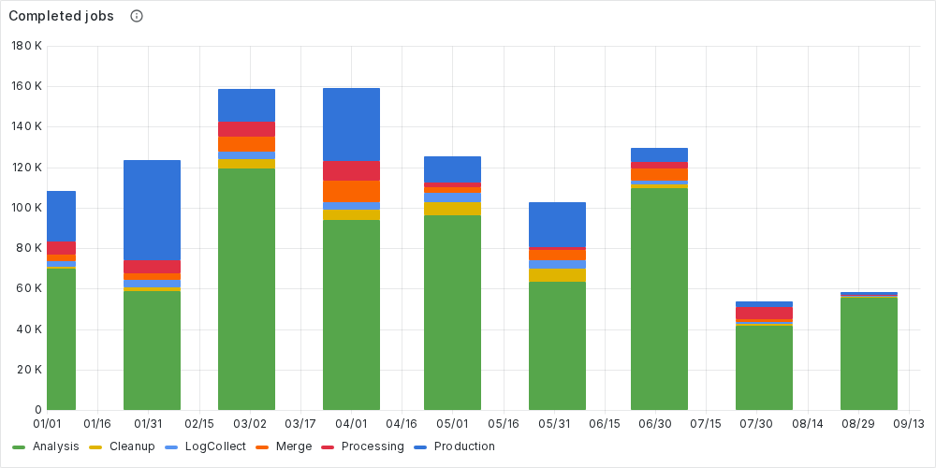
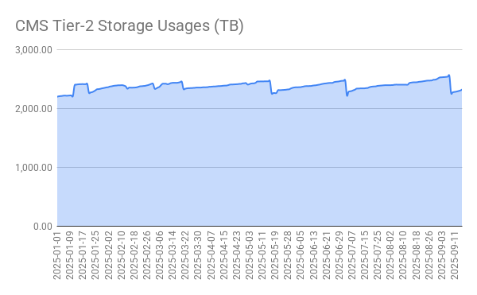

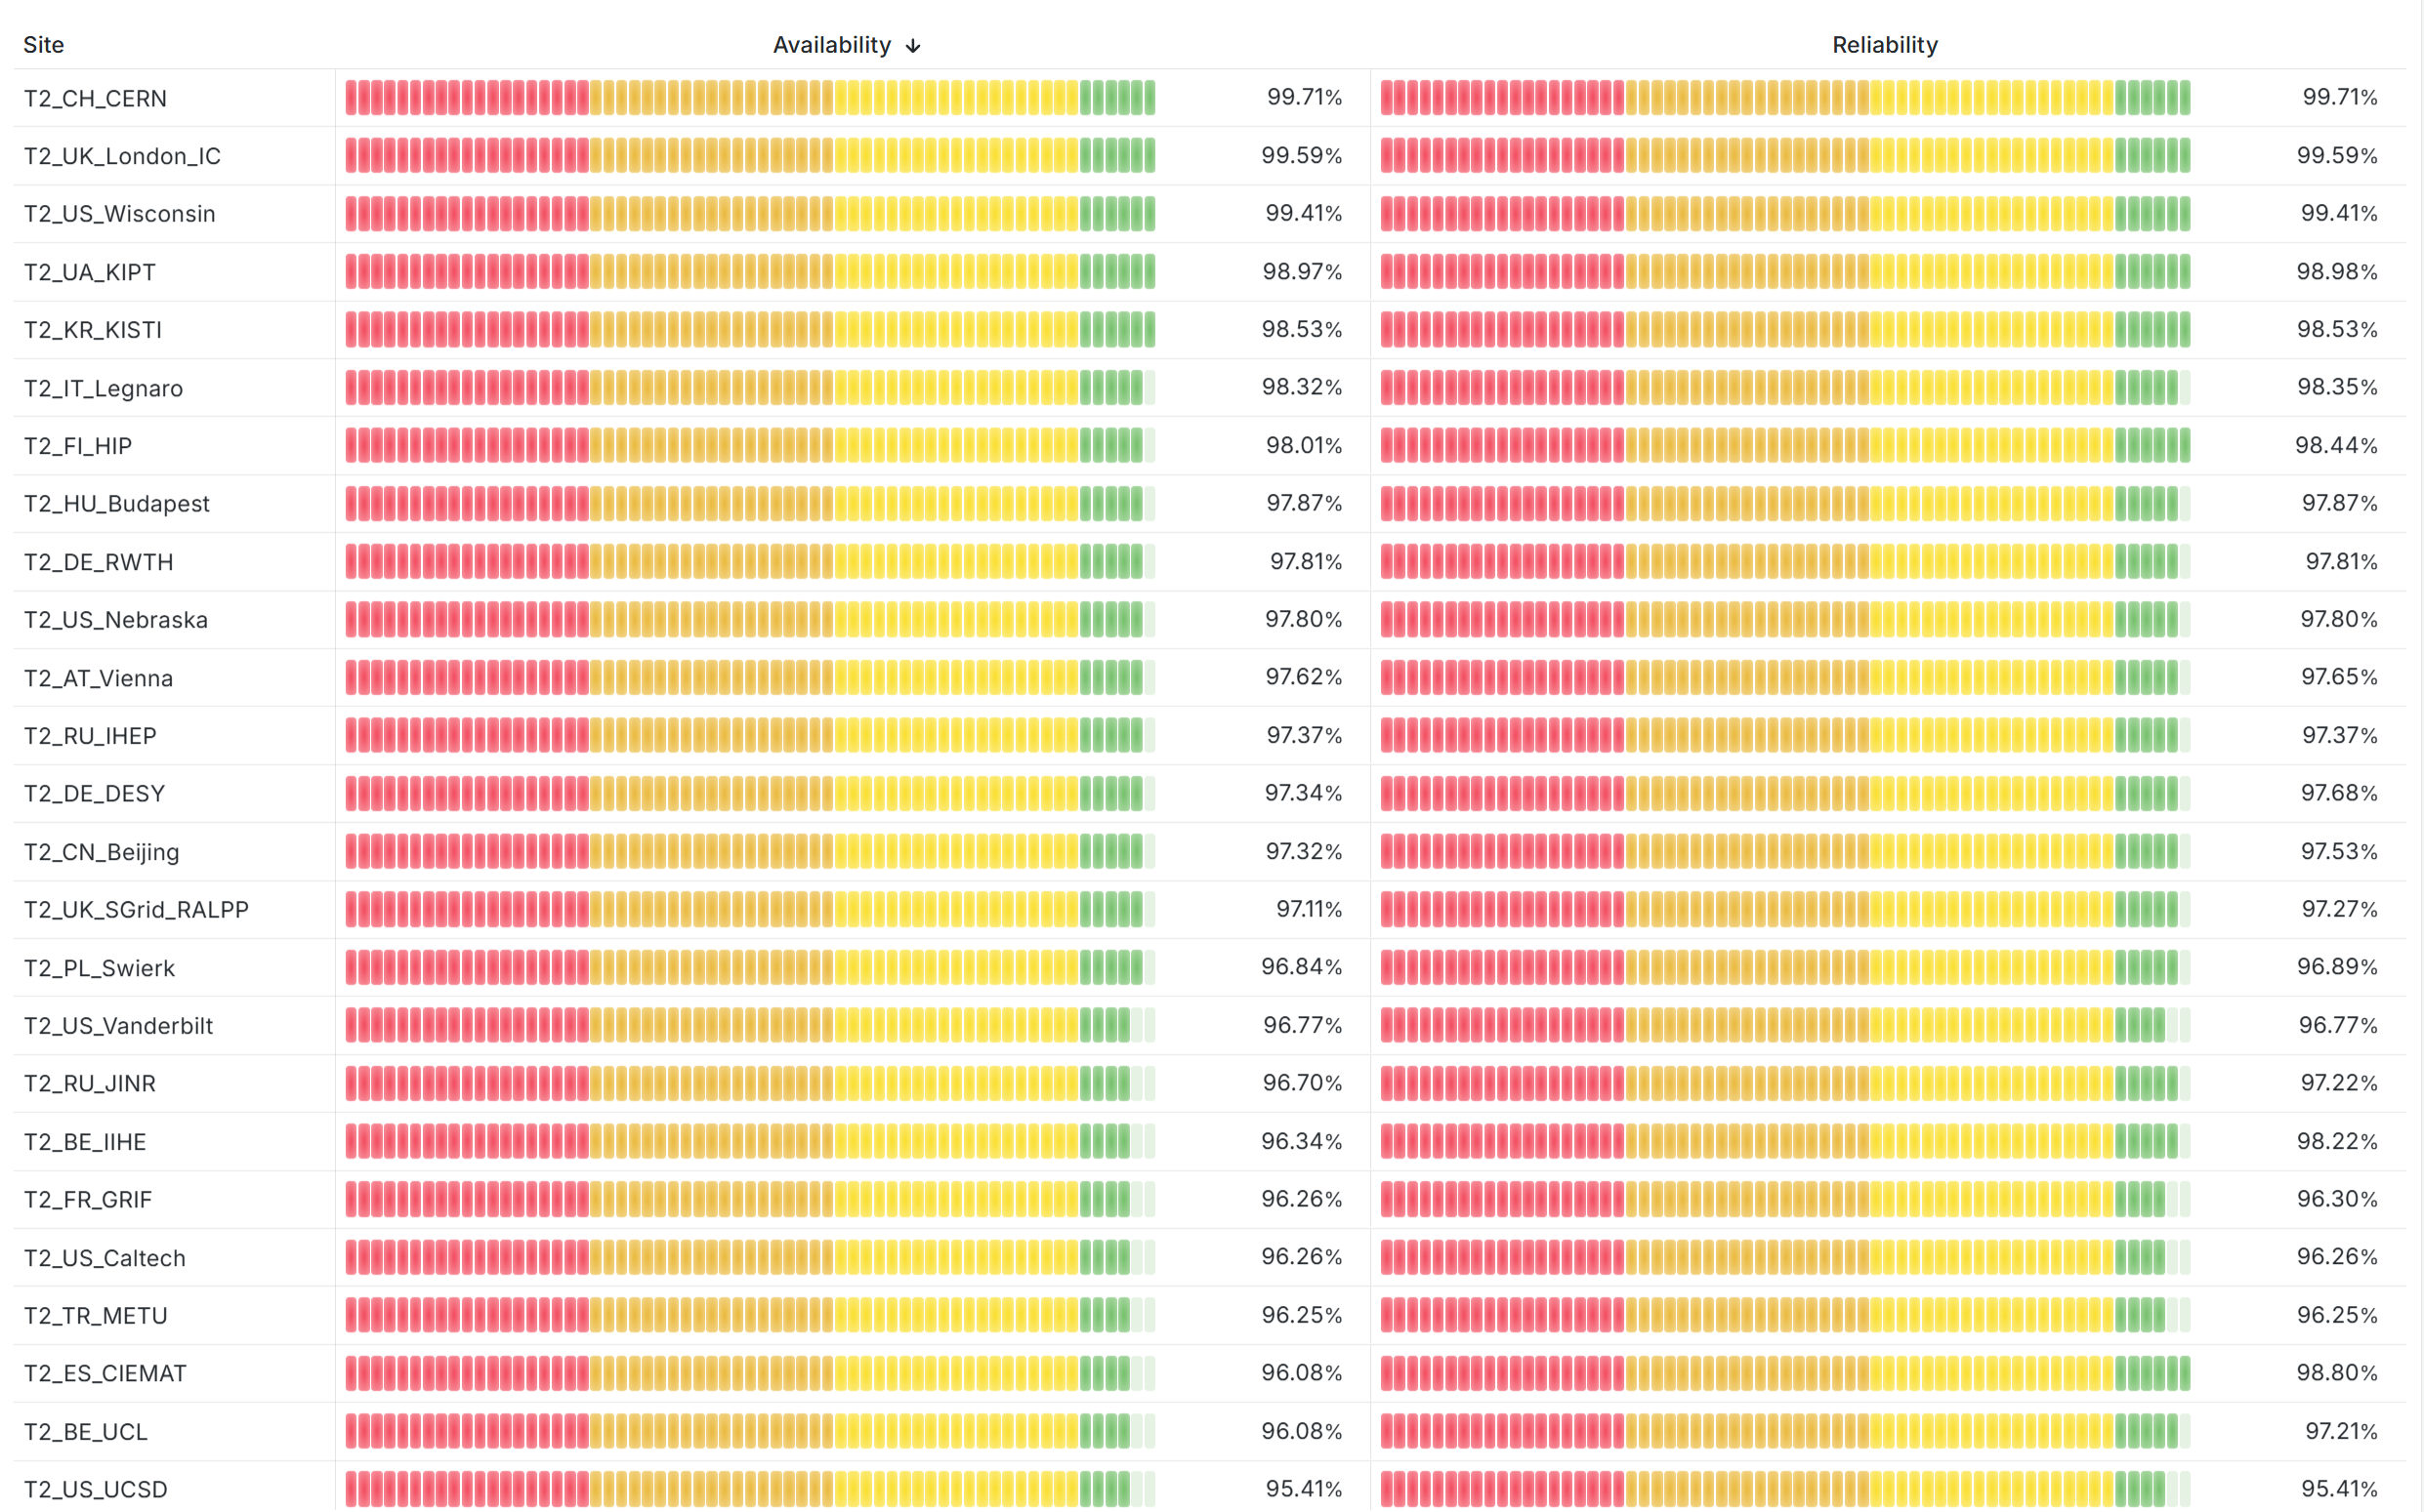
CMS T2 Present and Future
Site Status
  Computing Resource: 14.9kHS06
    1,018,899 jobs Completed
  Storage: 2,555/3,100TB (82.43%) [25-09-16]
  Availability/Reliability : 98.53%
Plans and Updates
  By the end of this year: Achieving the Resource Pledge
    Replacement of WN (from 15kHS23 → 48kHS23)
  Early next year: System architecture changes
    Managing resource-intensive services on bare metal
      Dedicated WN (CPU-intensive / 48kHS23)
      dCache Pool (Disk-intensive)
    Containerization of key services with IPVLAN, including:
      Zookeeper cluster using 3 servers
      Patroni cluster with 2 or more servers (zookeeper-backend) for PostgreSQL high availability
      Ephemeral WN / HTCondor-CE / HTCondor Central Manager
      dCache (Non-Pool)
      Frontier Squids / site-BDII / APEL Publisher
CMS Tier-2 Availability/Reliability

Slide 14
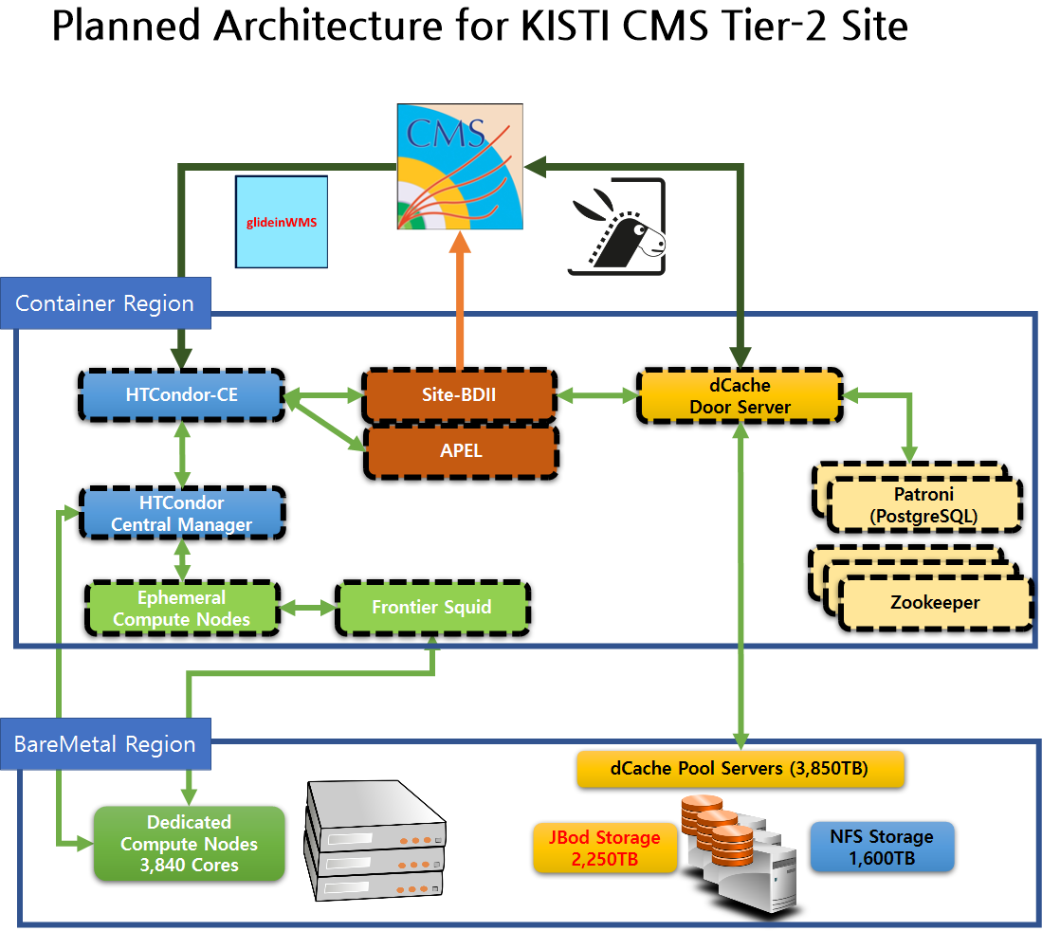
Future of KISTI CMS Tier-2
Site Features
  Pros
    No need to change the network configuration compared to when using existing bare metal
      Utilization of IPVLAN as the primary service network
      (minimizing overhead from overlay networks)
    No additional programs required for operations beyond Podman
    Custom agent and manager needed for container HA, but services can operate normally even without them
  Cons
    Every container instance must have a fixed IP address
    This IP must be manually registered in DNS
    There is no service support for persistent volumes, this must be taken into consideration
      APEL’s Accounting DB volume

Slide 15
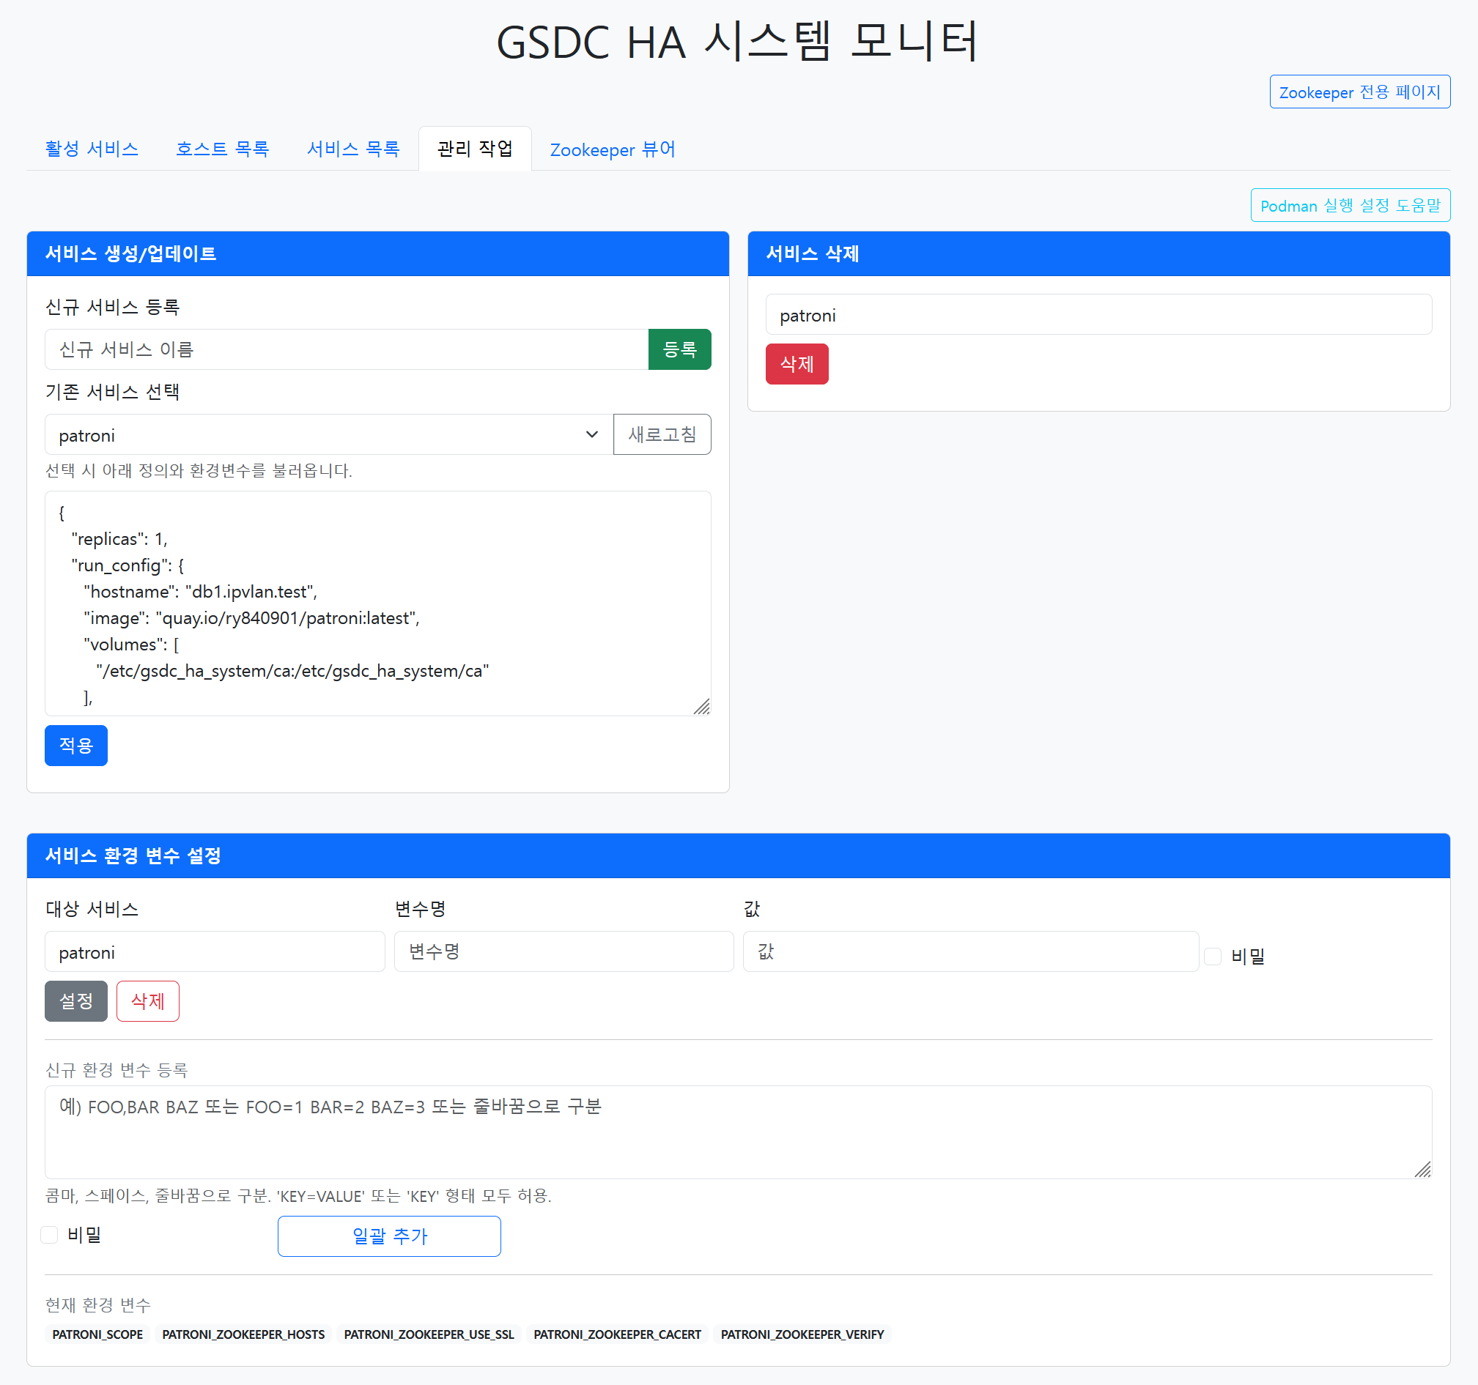
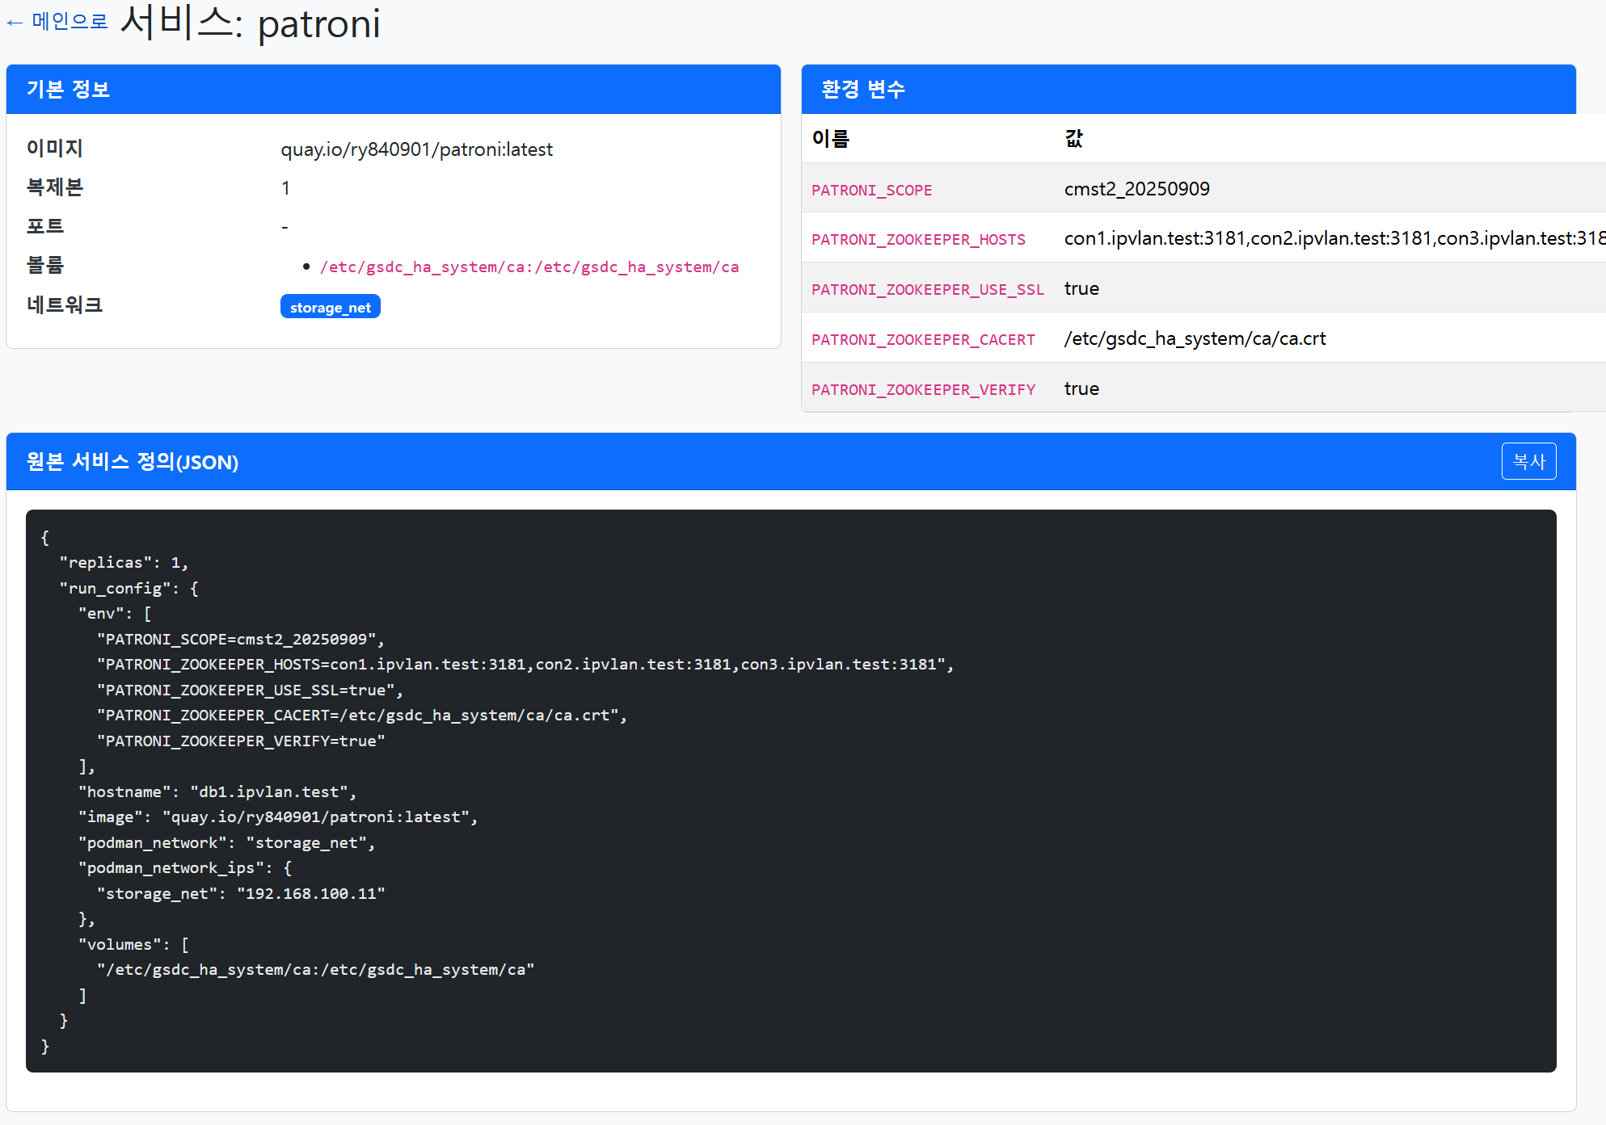
Developing for Service HA
(Zoo)Keeper-based container HA system
  Motivation
    k8s on IPVLAN requires extra CNI plugins, complex configuration
    dCache already uses ZooKeeper, but needs additional ETCD cluster
    Full k8s may be unnecessary for simple HA → develop a lightweight program
  Status
    Testing container restart on host failure
    Transitioning each containers into Pod to easy managing
  Limitation
    Bugs causing redundant container starts under network instability
    No real-time communication between host and agent

Slide 16
Summary
Site Infrastructure
  Core Services (CE, site-bdii, apel, vobox)
    ALICE Tier-1 (T1): Built on an oVirt VM cluster
    CMS Tier-2 (T2): Running on bare metal
  Storage System
    T1: EOS container instances using podman
    T2: dCache Pool with JBOD and NFS storage
  Worker Nodes (WNs)
    Running on bare metal
Current Status & Plans
  Sites are operating stably
  Resource replacement for WNs and storage planned by the end of the year
Ongoing Work
  Container Instances with IPVLAN Networking (T2)
    Work in progress to utilize IPVLAN for container instances
    Related software development progressing in parallel

Slide 17
Thank you

Slide 18
Backup

Slide 19
Operation Issues

Slide 20
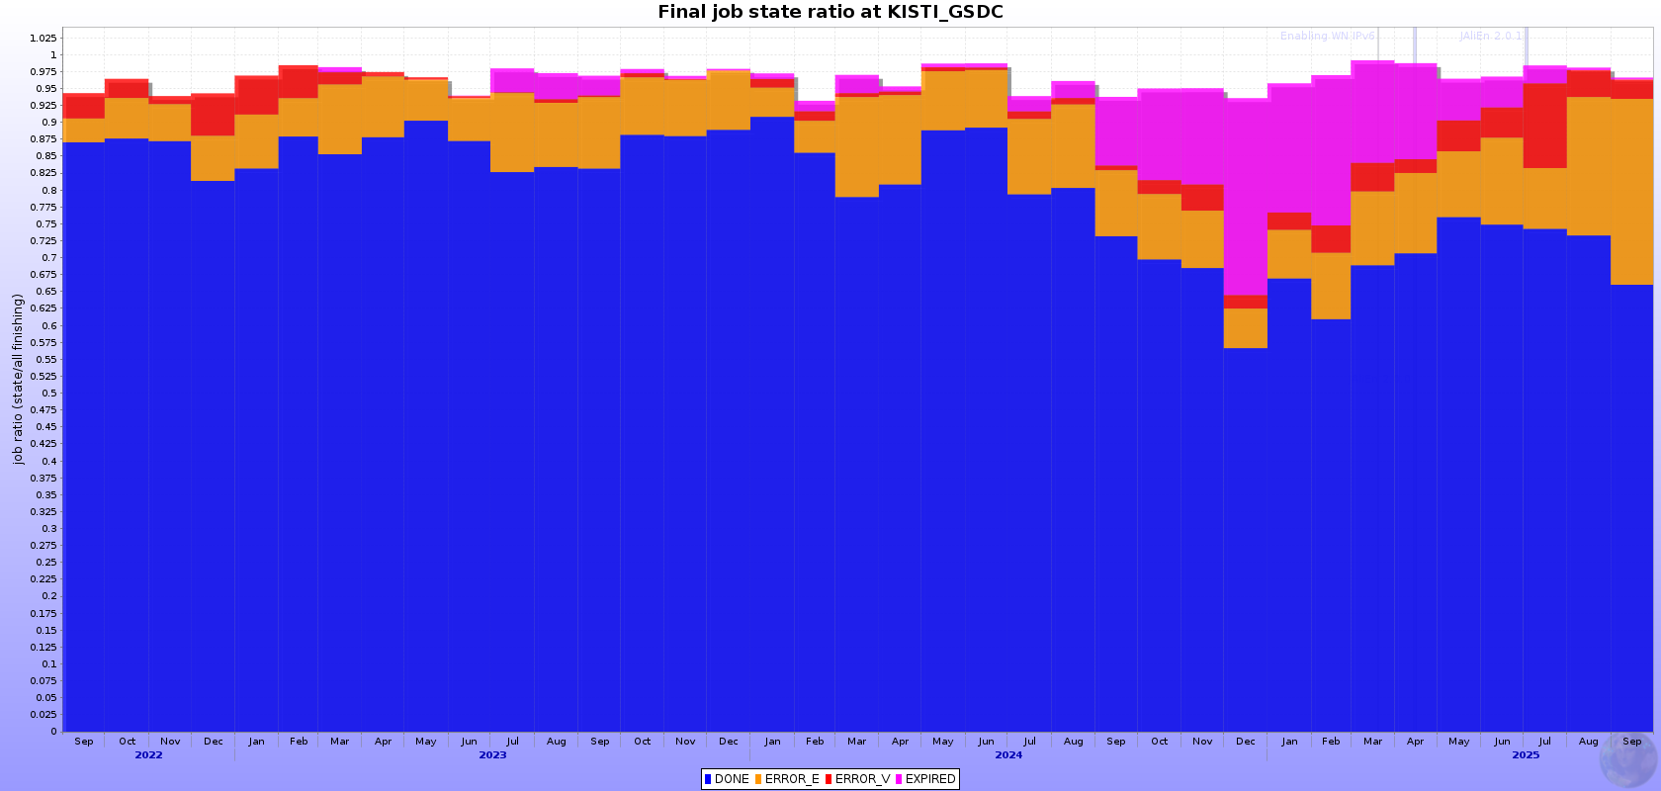
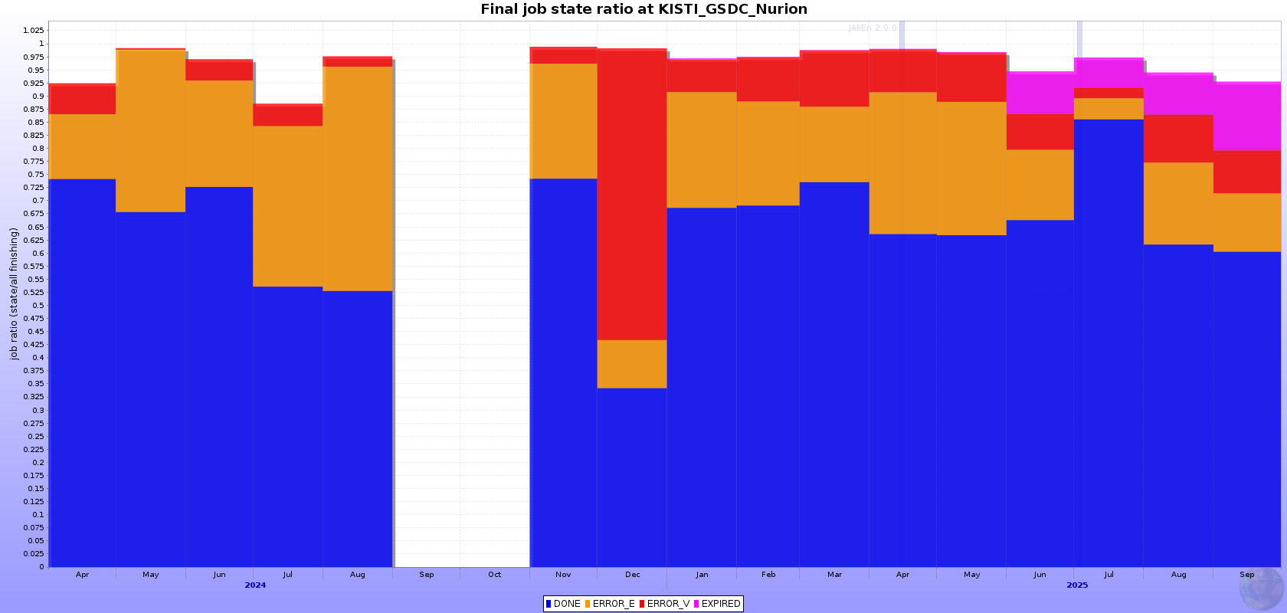
Computing Issues
(Resolved) EXPIRED jobs
(Ongoing) ERROR_E jobs?

Slide 21
Network mode | latency | Throughput perf. | Info
Host (native) | Reference | Reference | No isolcation
IPvlan | +30~60% ↑ | <5% loss | Not necessary promisc, DHCP is not works
Macvlan | +40~70% ↑ | <5% loss | Require promisc, DHCP is works
Overlay (VXLAN, etc) | +200~300% ↑ | 10~30% loss | encapsulation overhead is larghe

Slide 22
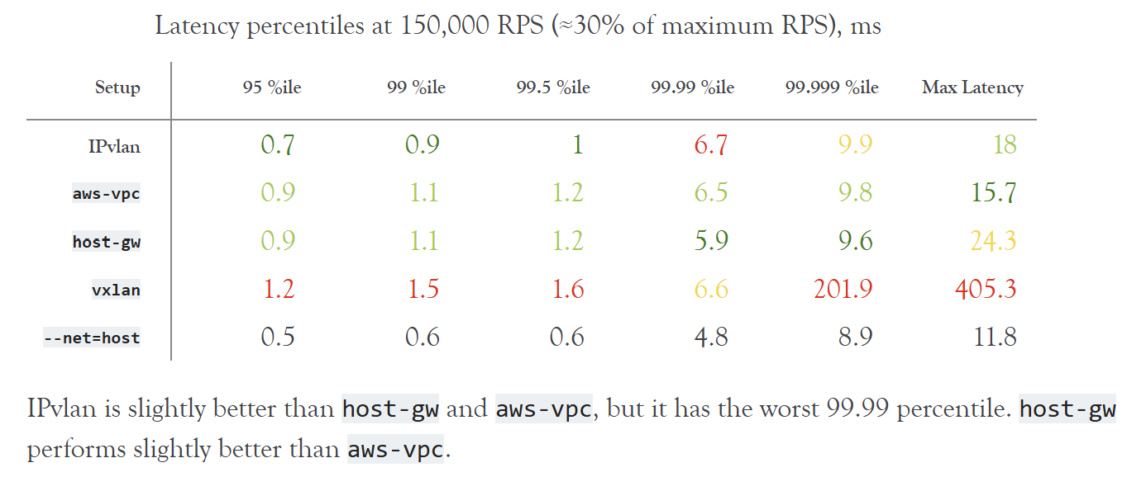
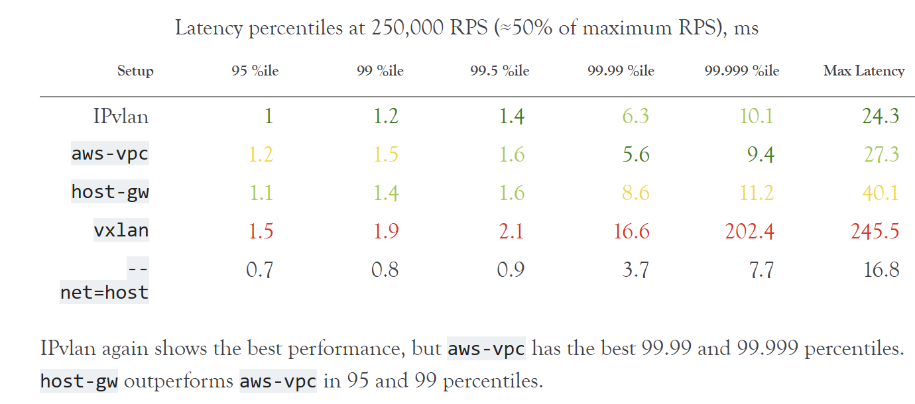
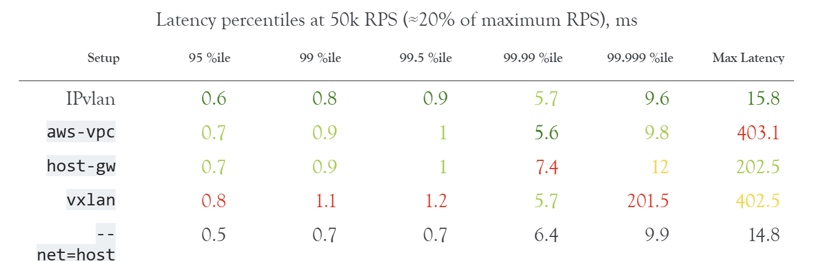
Comparison of Networking Solutions for Kubernetes — Comparison of Networking Solutions for Kubernetes 2 documentation
https://ranger.uta.edu/~jrao/papers/INFOCOM18.pdf

