Slide 1
LCC optics development
Pantaleo Raimondi & Marc Andre Jebramcik
Fermilab / CERN

Slide 2
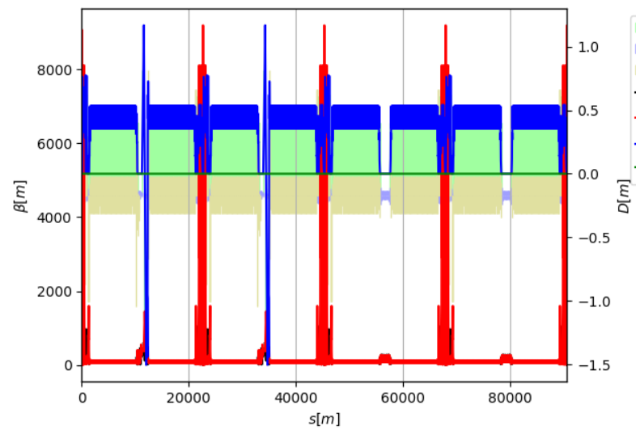
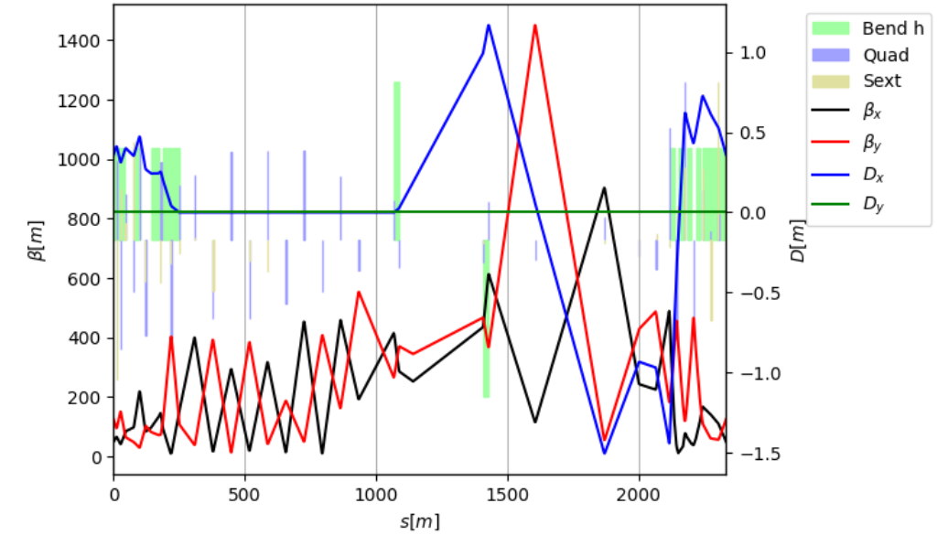
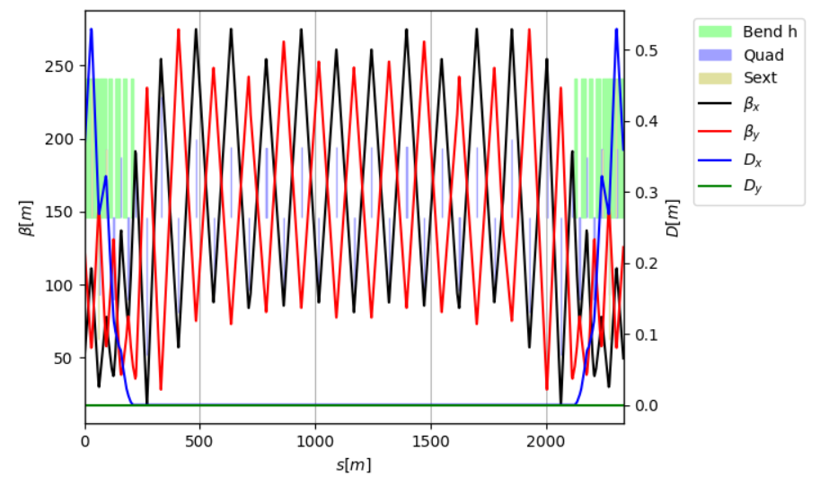
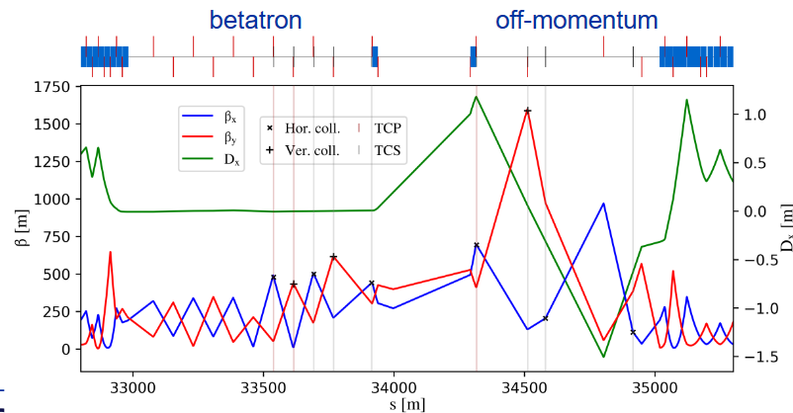
Work on the LCC insertions
M. Jebramcik
Intermediate solution → Insertion of GHC universal straight section in two consecutive straight sections
LCC straight sections are not yet adjusted to their respective function
Modified LCC lattice
“new” LCC straight
LCC
Besides linear optics, matching of Wx, Wy, ddx, sextupole RDTs (locally) + Survey matching with constant k0
2 Universal straights (injection & collimation)
Small chromaticity correction after insertion
GHC
This is a temporary solution allowing us to perform the basic studies.
Work on this version is discontinued…

Slide 3
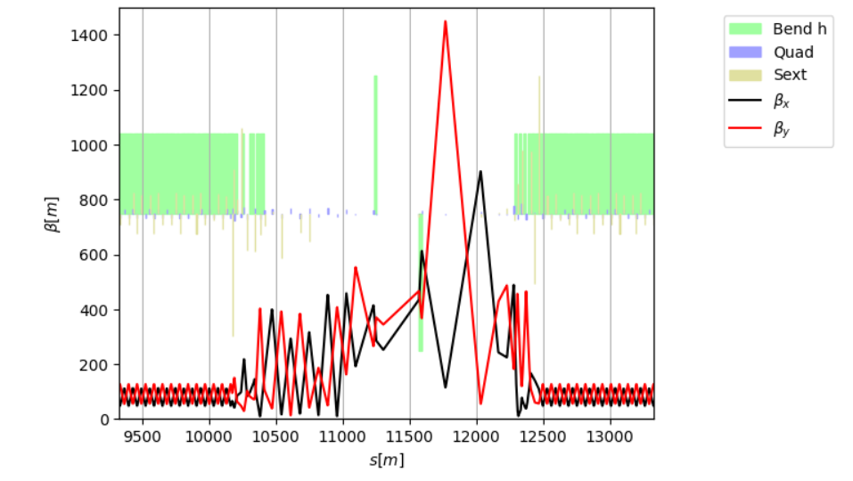
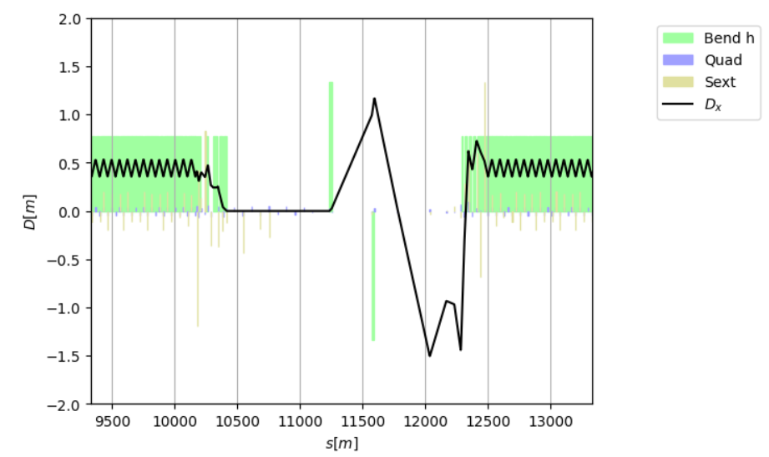
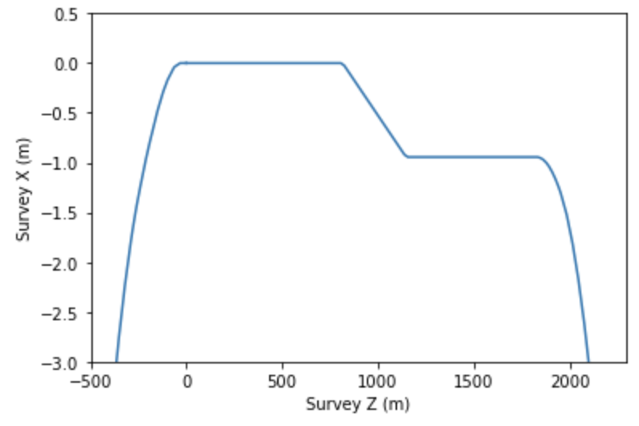
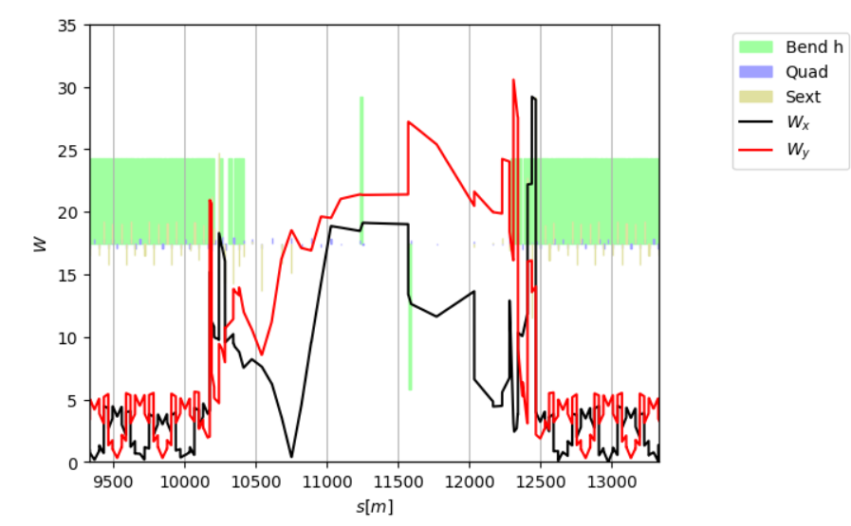
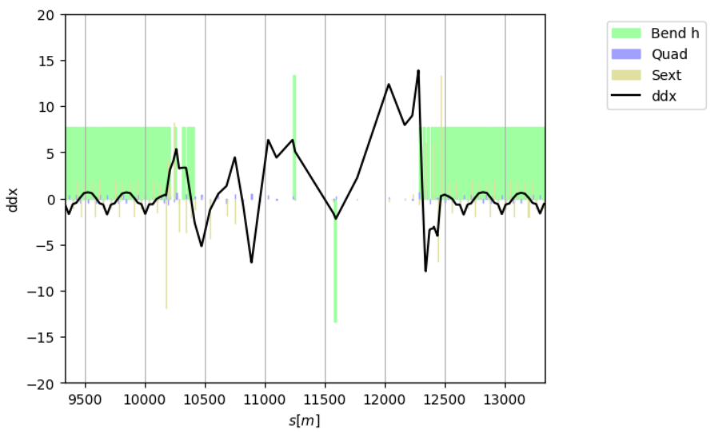
Matching with transparency conditions
M. Jebramcik
To maintain good MA and DA, the insertion has to be made transparent: linear optics, W functions and the second order dispersion function do not interrupt the natural periodicity of the arc that follows.
With the GHC following a different concept, additional chromatic sextupoles are required to tune the chromatic functions (W functions and second-order dispersion).
Survey
960mm separation in straight;
350mm separation start/end of arc.

Slide 4
Temporary LCC version
M. Jebramcik
A matching method to effectively insert any SSs with TCs has been developed
The LCC optic with 2 “universal” section can be used to have a rough check of some of the LCC performances:
  BeamBeam
  Collimation
  Injection
The LCC optics development are now focused on:
Finalize “standardized” arc cell
Finalize “specialized” straight sections
Continue to work on Beam Dynamics in particular to minimize the DA reduction due to quantum radiation

Slide 5
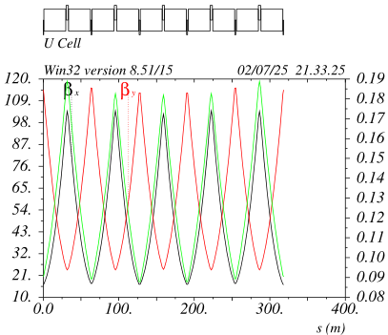
Optimized ARC cell layout with 4 sextupole families (all modes)
All dipoles have the same length
All sextupoles are upstream (downstream) of the quads in the first (second) half of the
The “FODO” cell in the middle is shorter (missing sextupole)
The relative beta-beating is large (~15%) and has to be corrected
There are 3 possibilities:
1) the middle quad has to run about 1.6% higher wrt to the other 4 QFs
2) the 2 center dipoles should be about 60cm longer
3) instead of lengthening the dipoles a drift space could be added
Now, the lattice files have option (1) implemented:
1 consistent dipole length
2 quads families (2 lengths QF/QD)
4 sexts families (2 lengths SF/SD)
1 quad-trim ~2% on 1 QF out of 5
SF1 SF2
SD1 SD2
ttbar
ttbar mux/muy 100/80

Slide 6
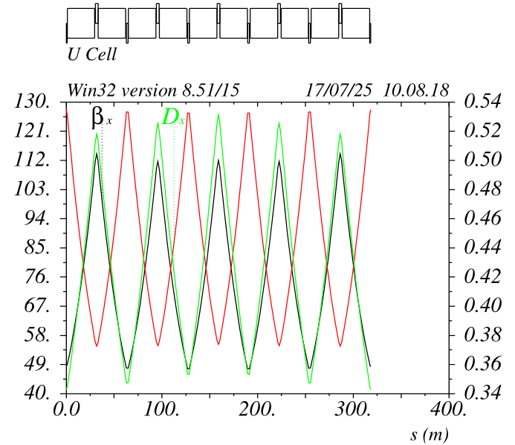
Optimized ARC cell layout with 4 sextupole families (all modes)
Emittance and alpha_c can be nearly continuously varied from Z mode values to ttbar ones
Ultimate emittance can be obtained by increasing mux ~110 (need 10% margin of Quads and 20% on sexts)
The optic is nearly “resonance free” and has flat bandwidth >+/-3% for any mux of interest
Z
Z mode mux/muy 50/40

Slide 7
Straight Section Construction
Straight Sections (SSs) are being optimized individually for the different uses:
- RF (R)
- Collimation (C)
- Injection ( I )
- Diagnostic (D)
SSs are being integrated in the lattice with transparency conditions (lin. Optics, W-functions etc.) in order to minimize:
- impact on machine parameters (energy loss, emittance, DA, MA etc.)
- requirements on the ARC hardware (in particular the sextupoles)
SSs are being built in this sequence:
- RF for ttbar, compatible for Z
- Collimation for ttbar, compatible with Z
- Injection
- Diagnostic
Basic FCC requirements are being implemented as much as possible
Iterations with stakeholders are progressing
Iterations based on hardware constraints and feasibility are progressing

Slide 8
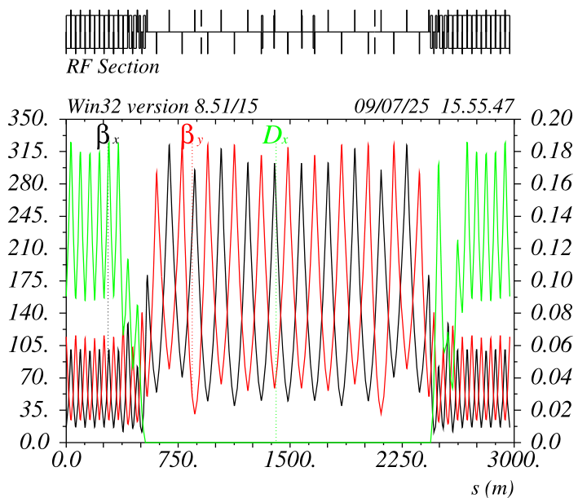
RF Section (R) ttbar& Z
The cell sequence is the one requested by the RF team, with the correct distance between the quads; however, the 800MHz sections are 12 (not 13)
To be checked with the stakeholders if ok
(LCC RF requirement for LCC are reduced wrt GHC)

Slide 9
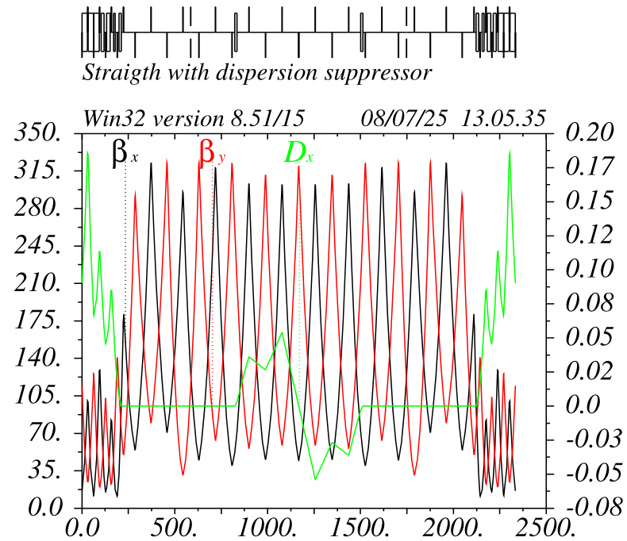
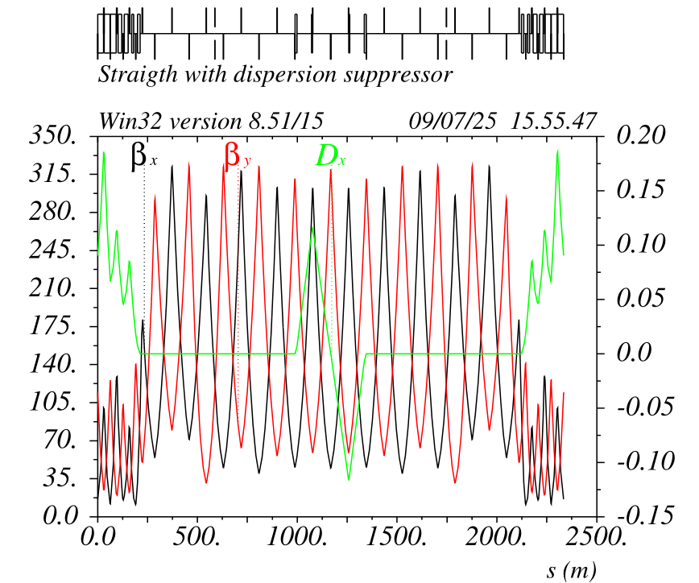
Dogleg (Beam Crossing) Section
2 dipoles dogleg
4 dipoles dogleg
First quick dispersion free dogleg was encompassing 7 quadrupoles
With 4 dipoles dogleg only 3 quads are involved, and the crossing angle is almost twice larger
This solution has been implemented for now
Still missing: Split of the central QD and move it toward the QFs, the layout will be similar for the other IRs (but quad weaker and larger separation (~10/15cm))
Removing the two inner dipoles causes the dispersion to leak. It can be matched in the DS, both linear and nonlinear optic. To be studied pros and cons.

Slide 10
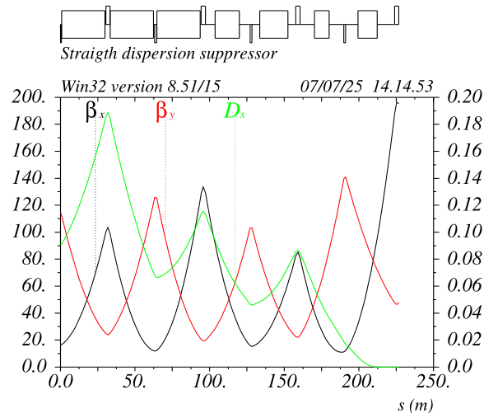
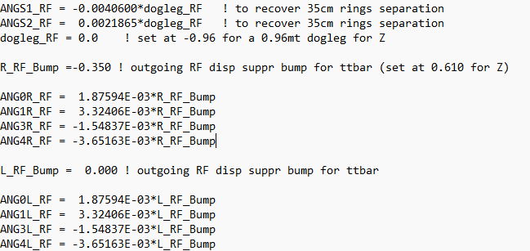
RF Section (R) ttbar
Four dipoles (~0.5-1.5mrad) are modified in the outgoing DS to separate the beams (by 0.35mt)
The ES/Septum/Etc requirements and other interference issues are being analyzed
The four dipoles delta_angles are determined by imposing: delta_x =-0.35 while keeping unchanged x’,dx,dx’.
No changes of optics are needed
For Z mode the deltas are rescaled imposing dx=0.61 and turning the center dogleg for dx=-0.96
ES 30-40mt long
Common QD increases outward angle by about 60%
Beam pipes should be separated at the QF level
No specific issues that are not present for GHC

Slide 11
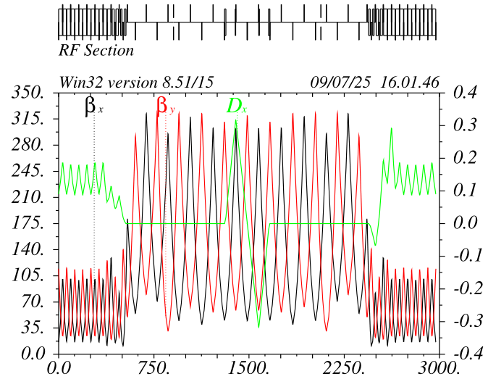
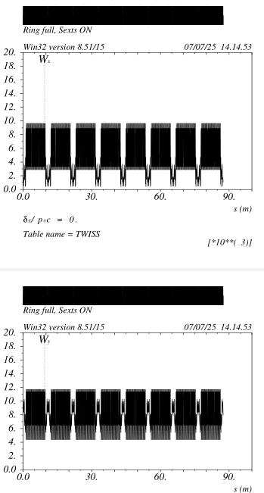
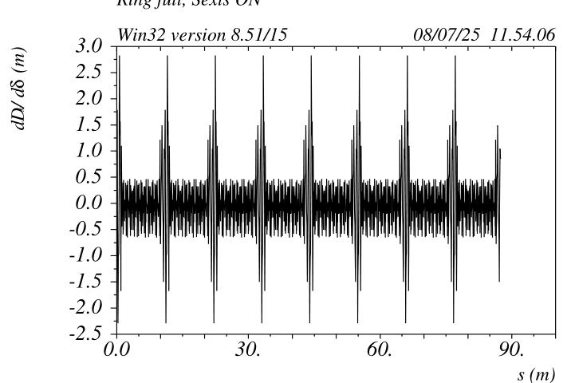
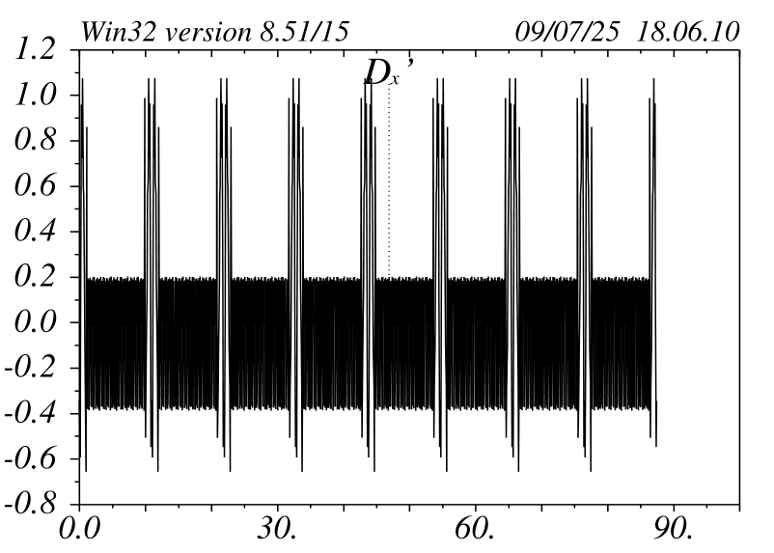
RF Section (R) Z and ttbar mode completed
Dipole changes cause just a ripple on ddx (natural is 0.2mt)
This does not affect the DA&MA but it could be studied how to reduce it
With doglegs
No doglegs

Slide 12
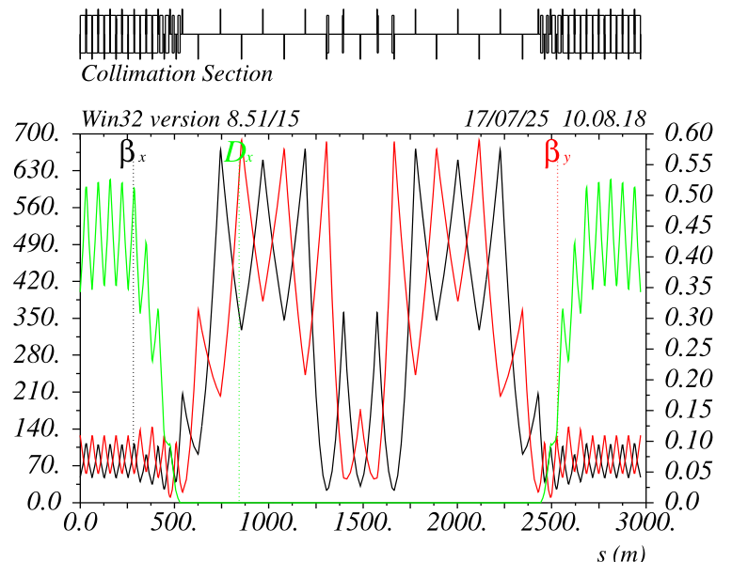
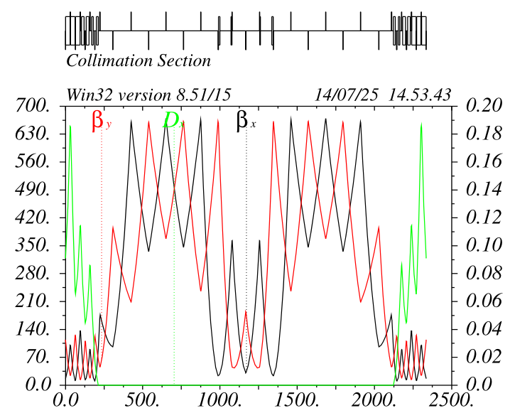
Betatron Collimation Section
Z mode
ttbar mode
Dedicated collimation section features two plateaus with high beta functions of ~660m
Plateaus are separated by 90 deg. phase advance in both planes (collimation of both planes)
Within plateaus, peaks of beta functions are separated by ~30deg phase advance (placement of TCSs)
Energy collimation not in dedicated collimation SS: Possible at the end of the FF or in the Injection section!

Slide 13
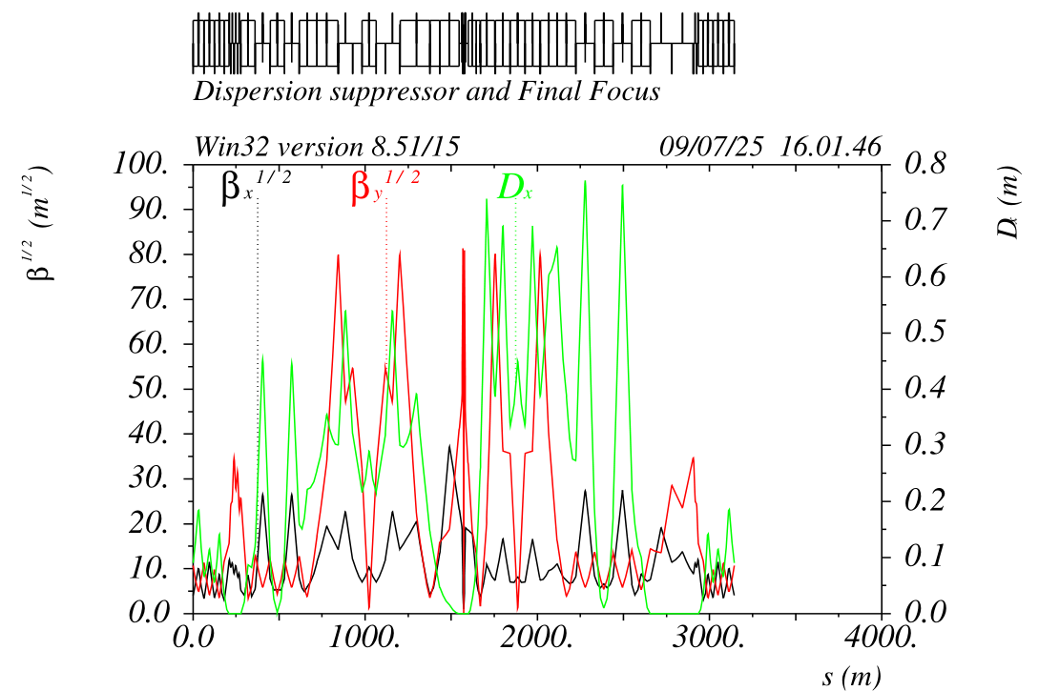
Energy Collimation all modes
Outgoing FF has a built-in 0.75mt dispersion peak at the very end. The energy collimation could be effective in this location (can be checked with Marc lattice)
In principle, the location could be effective in cleaning the debris from the collision and could be done after each IP
Collimator gaps should be in the range of +/-15mm@Z and +/-20mm@ttbar

Slide 14
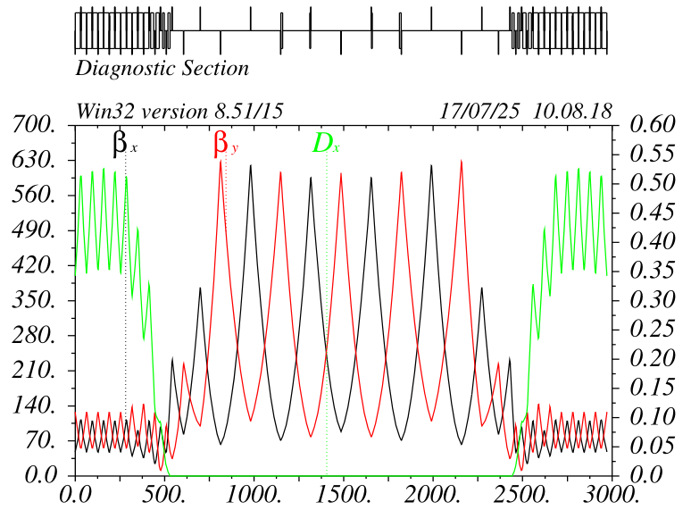
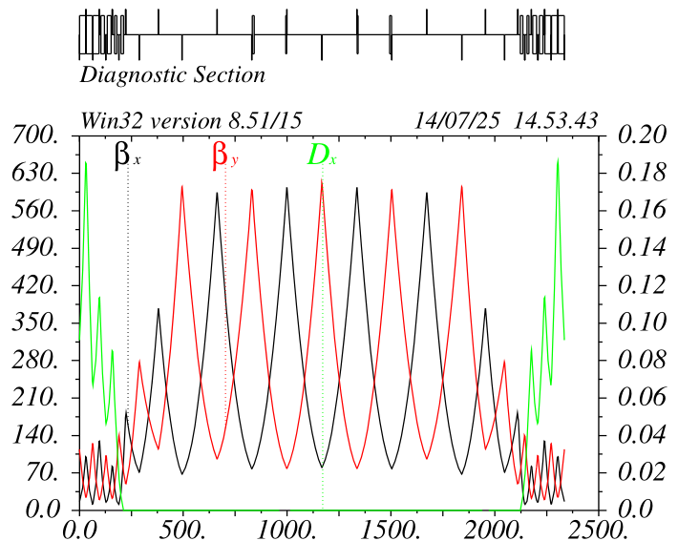
Diagnostic Section
This section could be used for specialized diagnostic and instrumentation
Jorg and his team are looking at the possibility to install the polarimeter here. Drifts between quads are ~160mt and the dogleg dipoles (~0.5mrad) can be placed just at the beginning of the drifts. A three-dipole chicane that allows for different fields at different energies is also conceivable.
All other stakeholders should have a look at this section (can be used for many things). Adjustment of optics and magnets positions are easy to implement, even after start of operations
Z mode
ttbar mode

Slide 15
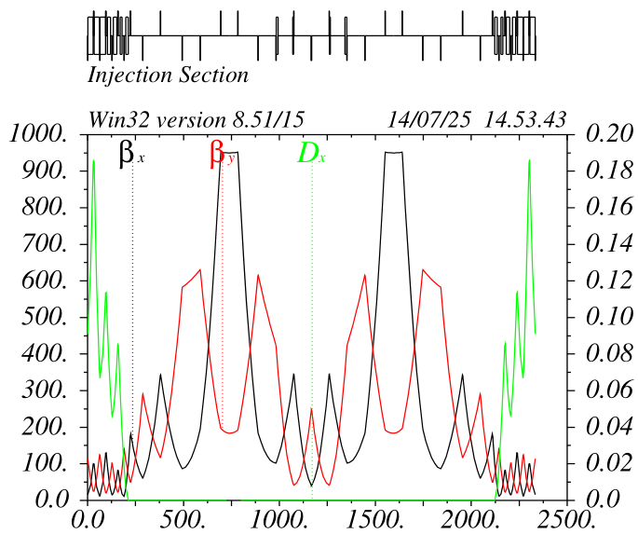
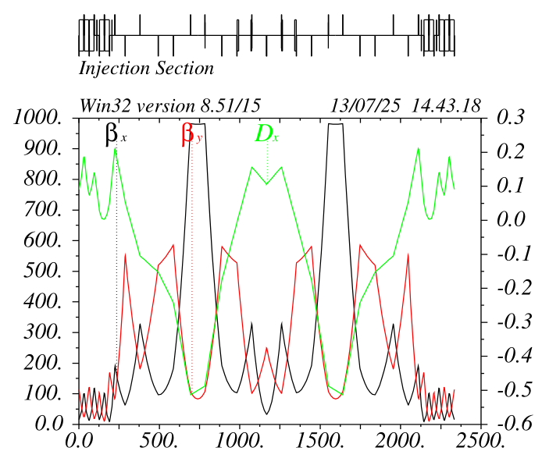
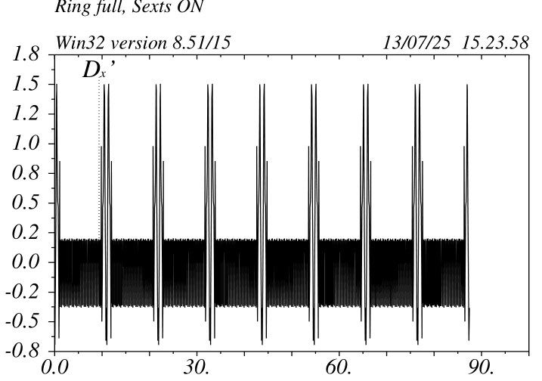
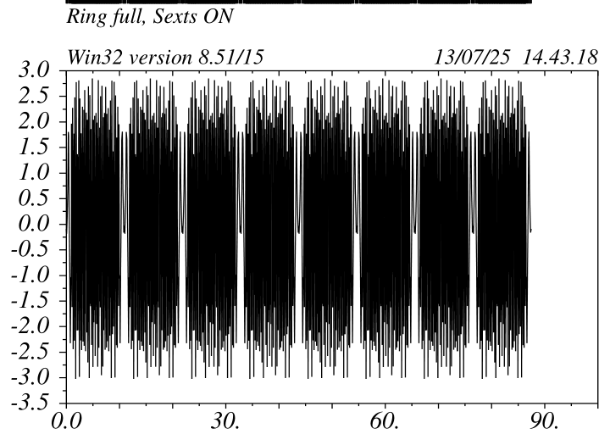
Injection Section (ttbar)
Injection section first guess design, is based on very well-established requirements:
Large betax, small betay and zero alfax/alfay @septum
Long drift spaces upstream of the septum (de-focusing quads support injection process)
Injection kickers create a “pi” bump with large R12s; however, it is desirable to have more than 2 kickers to be able to close the bump without changing quads
Dispersion can be added (see example), but a large second order dispersion is created. More studies are needed to minimize this effect. A satisfying solution will be inserted in the “official” lattice as soon as possible
ttbar mode
No disp at septum
0.5mt disp @ septum

Slide 16
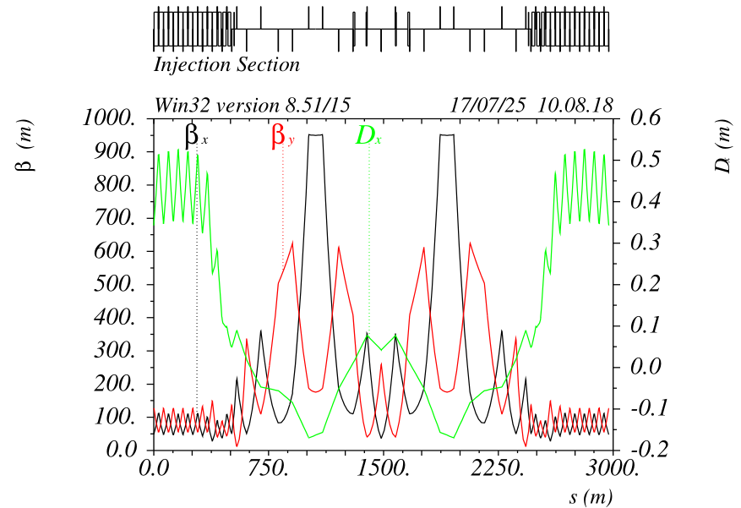
Injection section (Z)
For Z mode I was able to create ~0.16mt dispersion without creating a ddx ripple. For larger values the compensation could be done with sextupoles +> to be studied
It is anyway striking that in the arcs there is more than 0.5mt dispersion with small betas and it is very hard to have it pass through the dispersion suppressor
More studies and ideas are needed.
It would also be handy to look for flexible solutions that could allow to change the injection parameters during the run (e.g. betas and dispersion @ septum) for real-life optimization.
Z mode

Slide 17
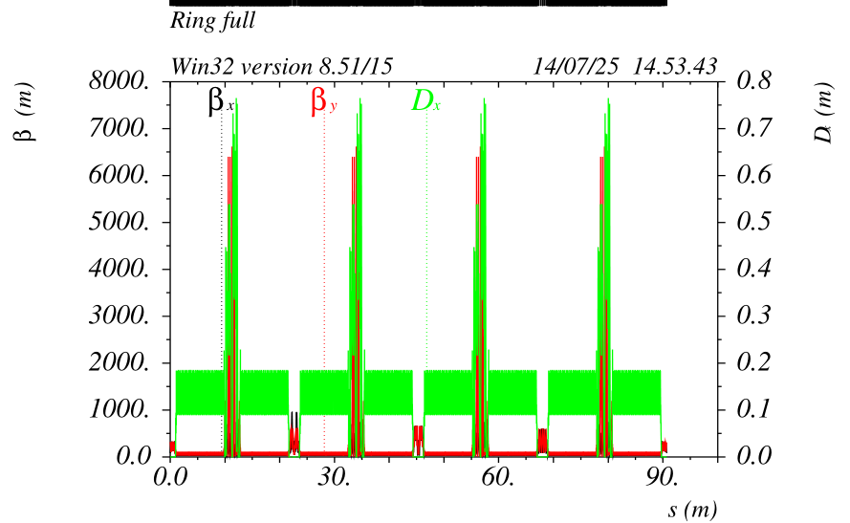
LCC with dedicated insertions
Insertions are interchangeable
No re-tuning of arc sextupoles is needed (except readjust chromaticity)
Insertions generate very similar chromaticities, about 3% @Z and 1.5% @ttbar, of the ARC chromaticity each.
Insertions have all integer phase advances mux=4 & muy=3 @ttbar and mux=3 & muy=3 @Z
ttbar

Slide 18
Final focus optimization
Another round of optimization for the FF optic is needed:
Remove horizontal stay clear bottleneck upstream (left side) of the FD? (to be checked if still there)
Decrease the horizontal emittance growth from the FF @ttbar
(reoptimize dipole in the FF and FF dispersion suppressor)
Reoptimize the FD to reduce the DA shrinkage due to quantum SR

Slide 19
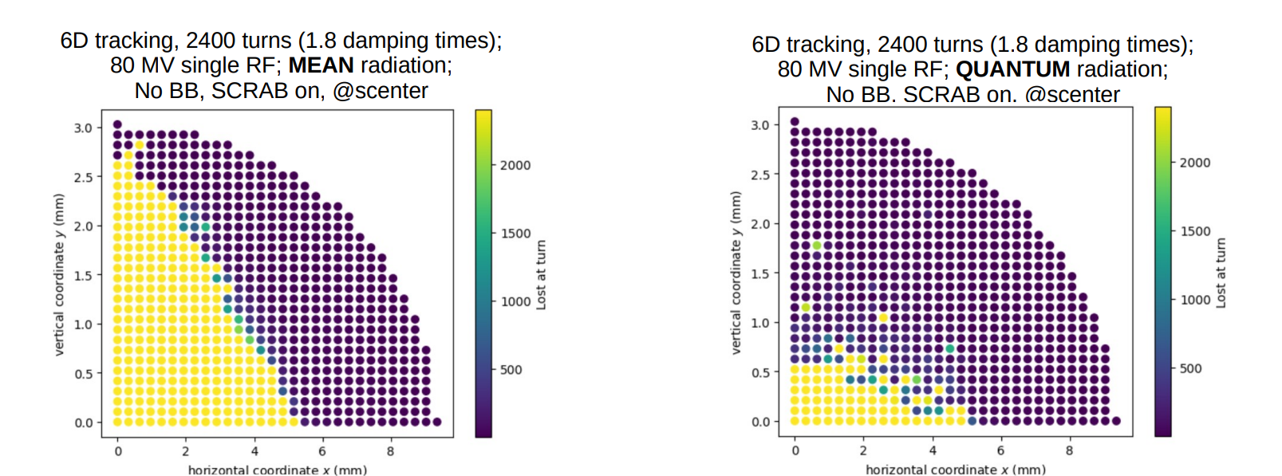
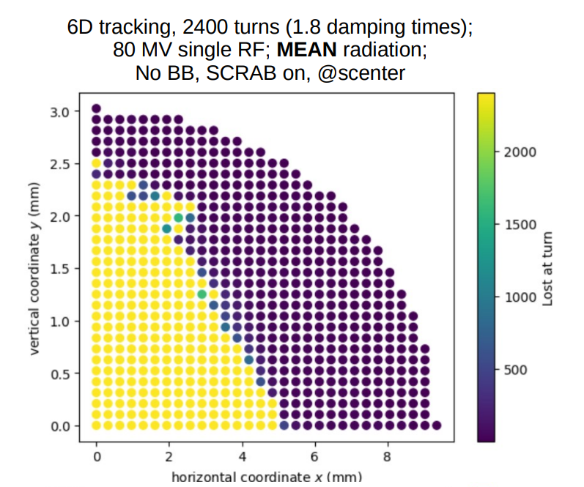
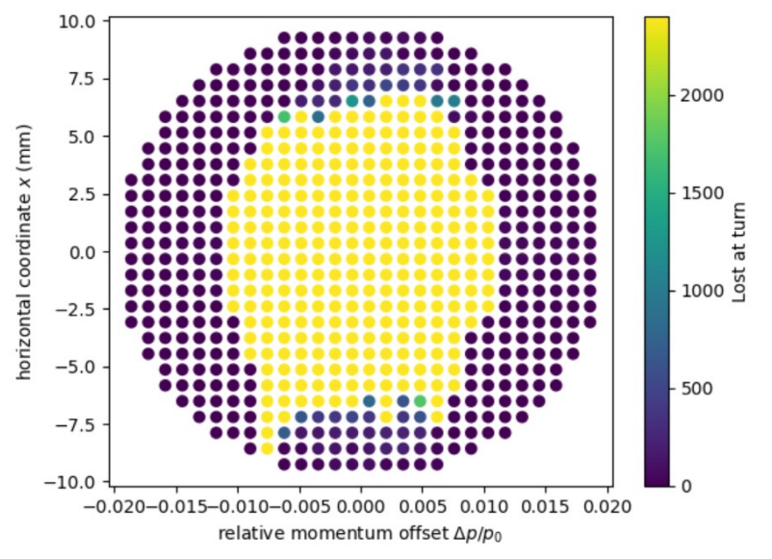
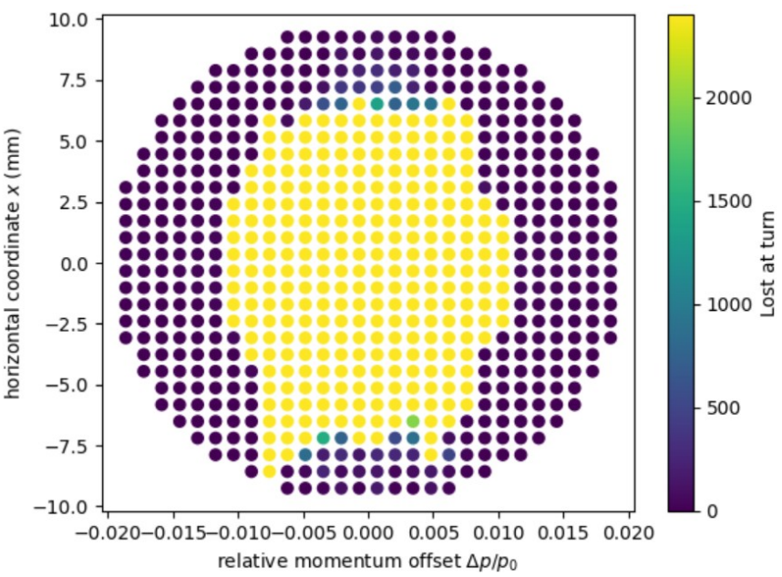
M. Jebramcik
DA shrinkage due to SR + Quantum Diffusion
LCC 92a 107
with two GHC straight sections
LCC 92a 107
- The DA and MA can be maintained, independently of the SS optics
- The larger offender on the vertical DA is the quantum radiation
Quantum diffusion causes vertical DA to break down

Slide 20
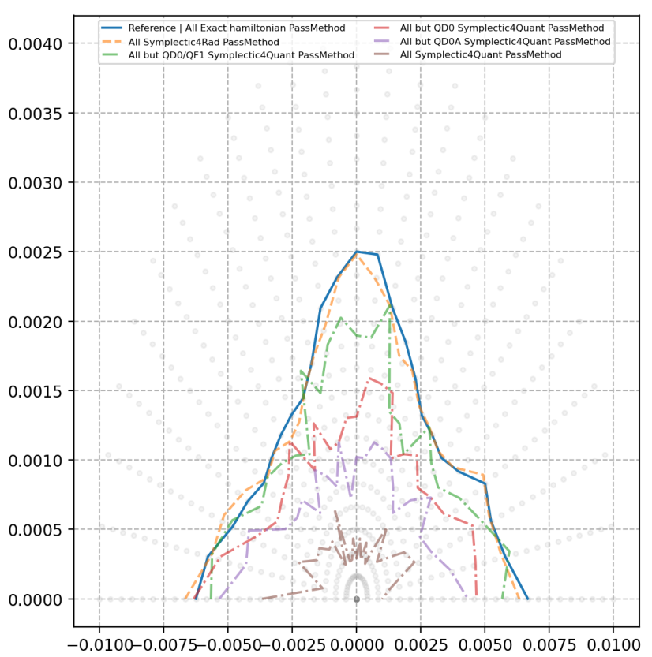
DA loss also visible in pyAT (Z)
Quantum LCC DA shrinkage (Z mode)
Kevin found the reason of the DA discrepancy from AT and Xsuite (need to enable another flag compute the quantum locally)
Now all codes (more or less) agree
Need another round of iterations to optimize the LCC FD (first guess is to use the GHC FD, Marc is working on it)
We will do:
a detailed study of the Local Momentum Acceptance (vs Jx&Jy as well) in the FD area
a detailed analysis of the beam energy evolution in the FD due to quantum radiation
Find the best compromise for the FD gradients, positions and lengths
K Andre

Slide 21
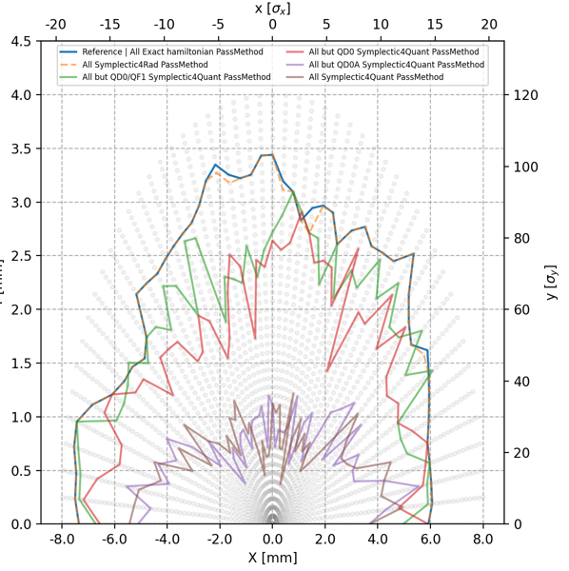
DA loss also visible in pyAT (ttbar)
Quantum LCC DA shrinkage (ttbar)
ttbar shrinkage is lower since the FD gradients and lengths are much more similar to the ones optimized by Oide
In any case most likely the best FD layout will be (like in the GHC) the one that will have the best compromise, while lengthening the FD magnets from:
- DA/MA reduction due to higher chromaticity
- reduced DA shrinkage due less quantum SR
Most likely the result will be a DA in the middle of the cases quantum off/on
K Andre

Slide 22
More ongoing activities and timelines (just to finalize the optic)
Reassessment of unwanted magnet multipoles
Survey is also being optimized (Marc, Riccaro, Gianni)
Need to finalize the optic in the straight section doglegs (split the central QD and move it toward the nearby QFs)
Iterations with stakeholder
Clean up and rationalize lattice files and matching routines
…
New round of optics files might become available in 1 month

