Slide 1
Simulations, Post-Processing and Visualisations of Detector Cooling Systems
Viren Bhanot, Yann Herpin, Youri Penders (EP-DT-DC) | 2025-10-27
PyHEP 2025 | https://indico.cern.ch/event/1566263

Slide 2
Disclaimer
This is NOT a ‘coding’ talk.
I don’t show much code.
This is a ‘How we use code’ talk.
We are NOT software engineers, not even Physicists.
Any and all advice is welcome!

Slide 3
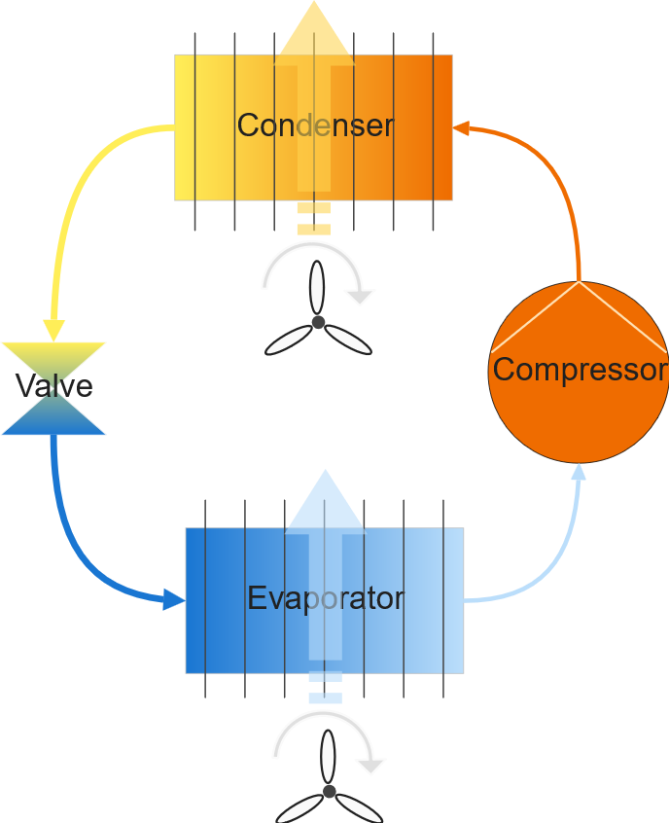
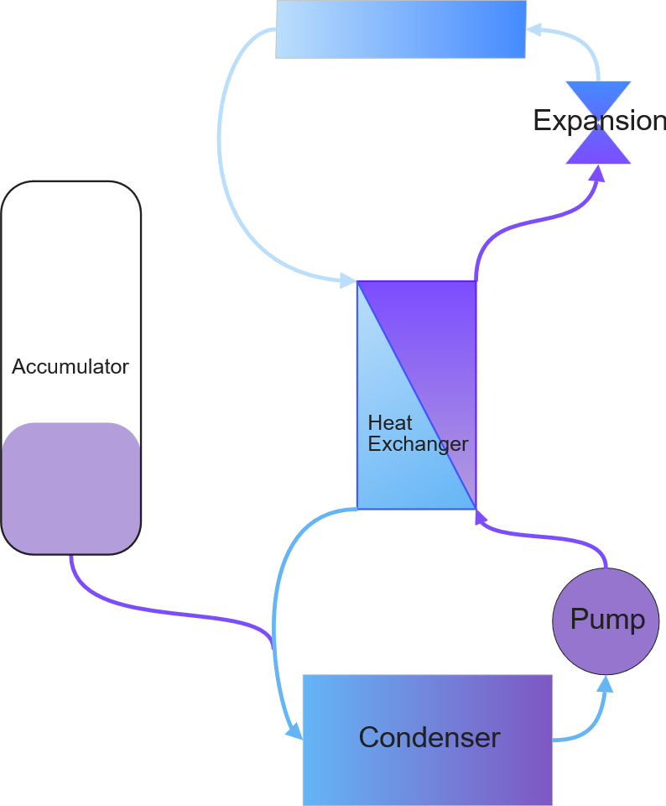
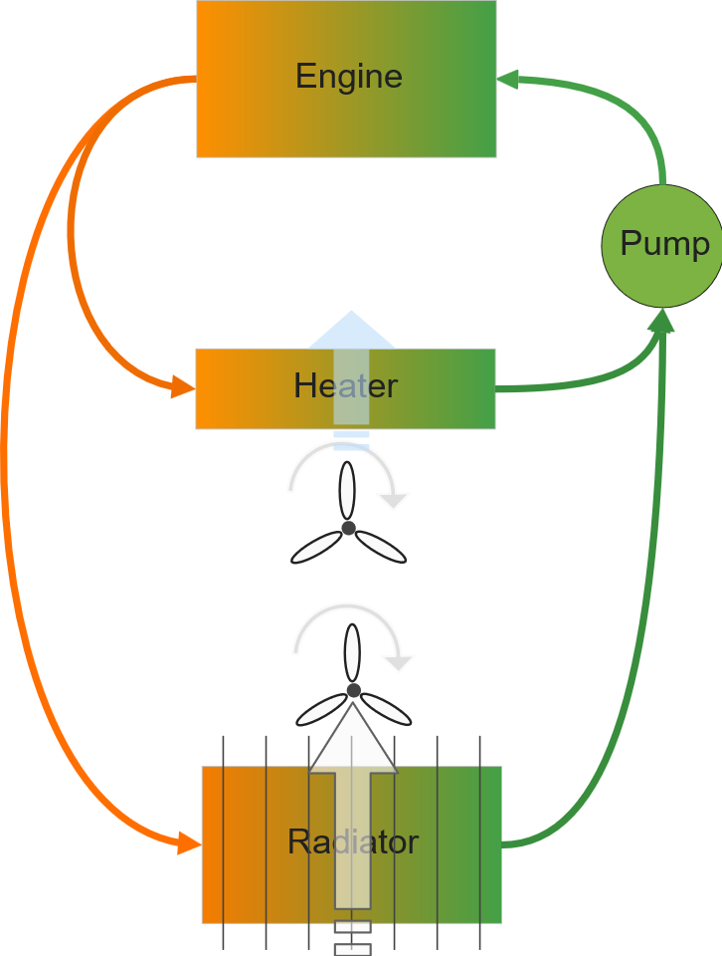
Cooling systems: An overview
Big tubes
Thermal gradients
Heavy compressors
Usually not oil-free
Oil free
Small tubes
Low power
Vapour Compression System
Liquid Cooling
Two-Phase Pumped Loops
(CO2-based)

Slide 4
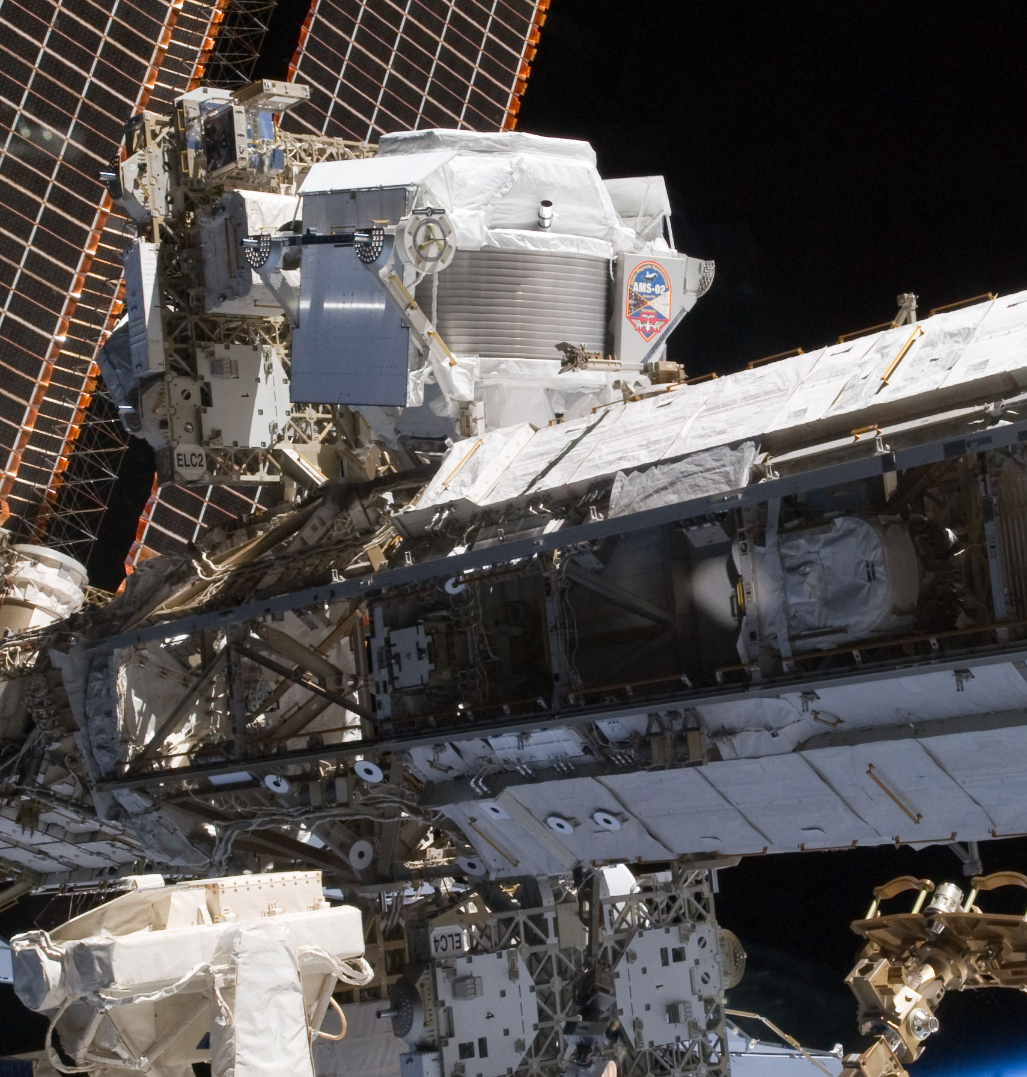
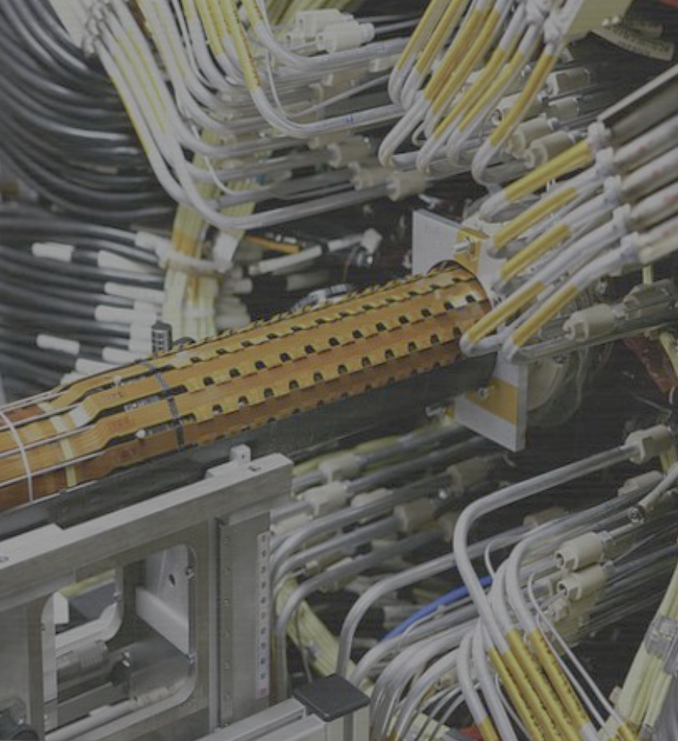
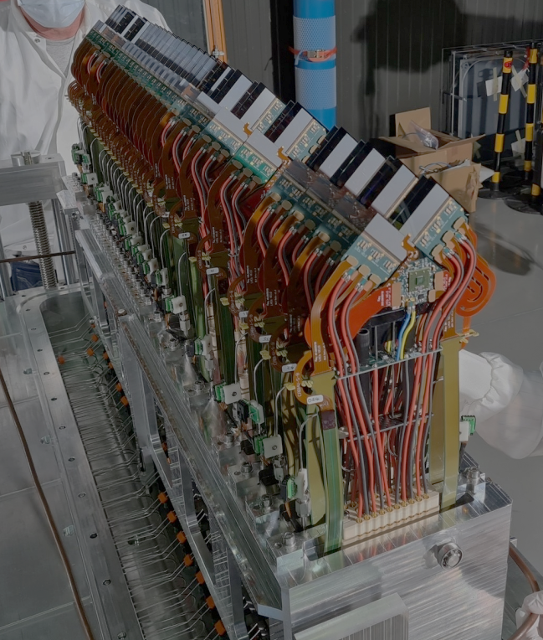
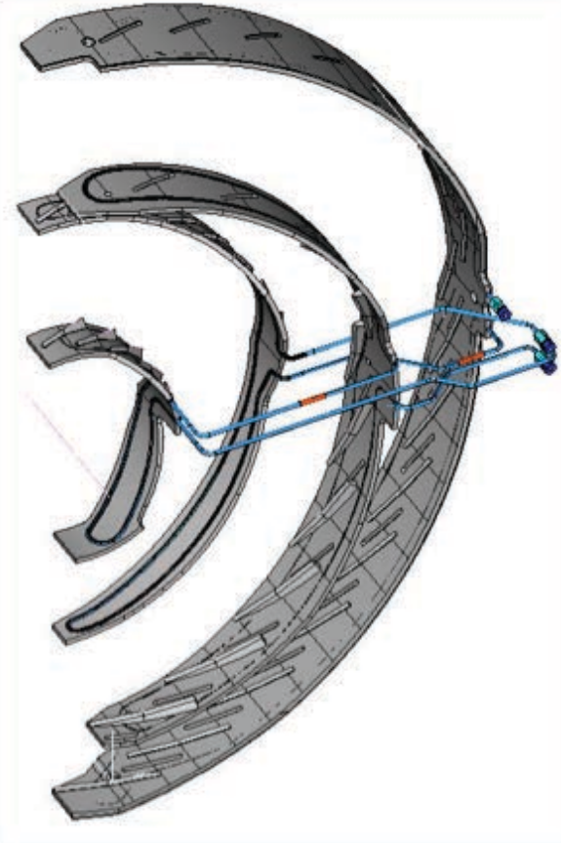
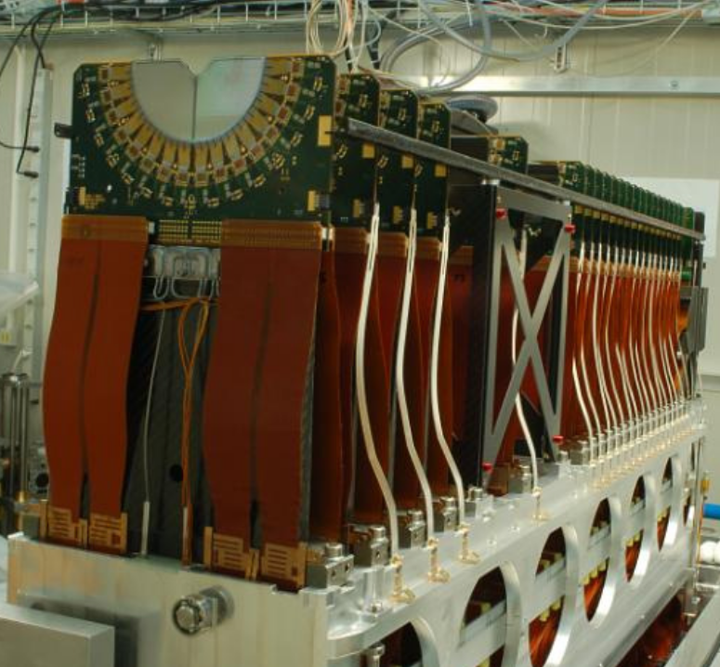
History of CO2 pumped loops at CERN
AMS-02 (2011)
ATLAS IBL upgrade (2014)
LHCb VELO + UT (2022)
LHCb VELO (2008)
CMS Pixel Phase-1 upgrade (2016)

Slide 5
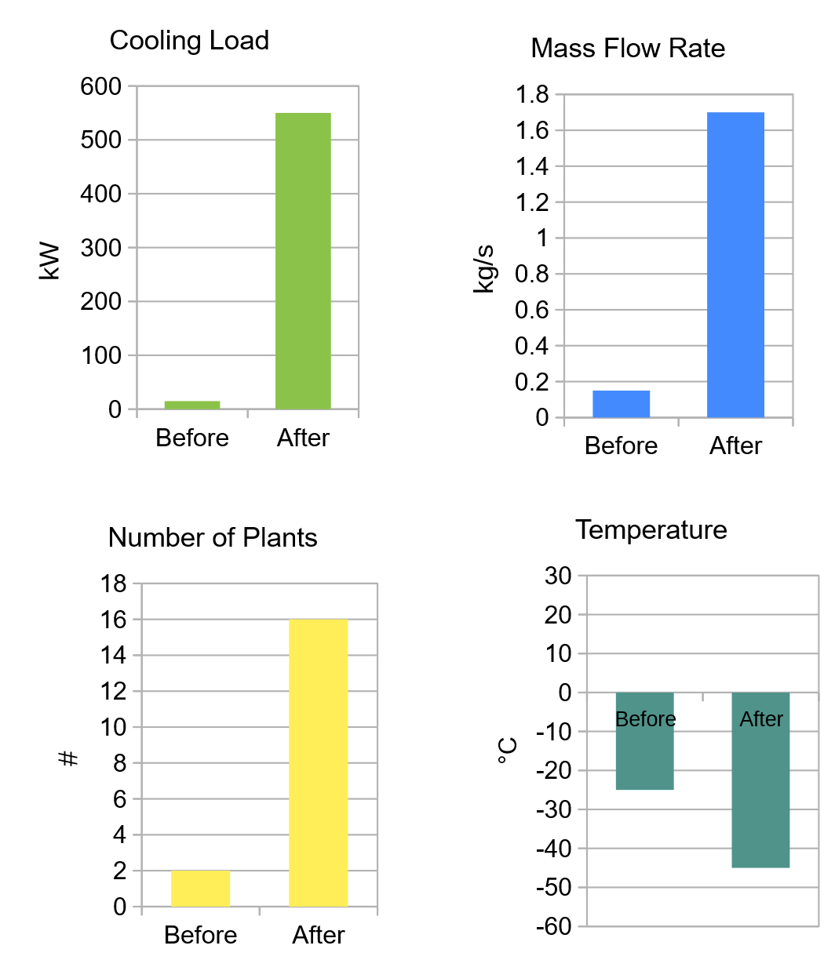
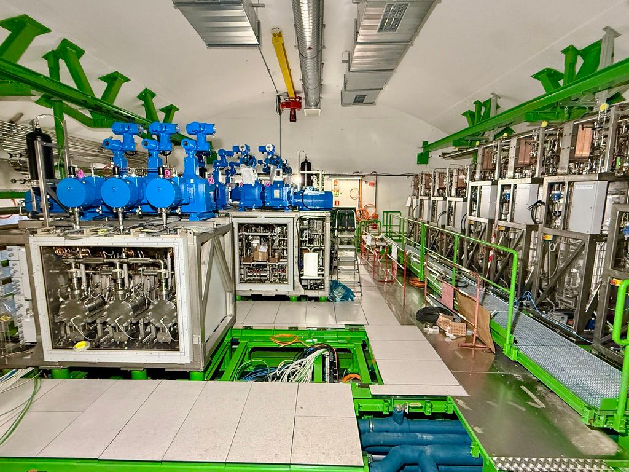
Phase-2 Hi-Lumi upgrade

Slide 6
Matlab to Python
Matlab for everything
  Rich history of helper functions / toolboxes / code
  Nice ODE solvers
  Amazing plotting library
  ‘Compact’ language
Not open-source/free
Timber→Matlab = Convoluted
  CSVs, intermediate steps…
Chance to learn something new
Slowly migrating to Python
  Pressure drop/Heat transfer correlations
  Valve equations
  Finite volume 1D modelling
  Plotting data
  Post-processing and data analysis
  Visualisation
Long road ahead…

Slide 7
Simulations
0D and 1D Finite Volume Modelling of control volumes.

Slide 8
Accumulator
Cooling
Reservoir with 2-phase CO2
Can be heated or cooled
  Heat → Evaporate → raise pressure
  Cool → Condense → lower pressure
Nuances: Safety valves, spray cooling, liquid in and out
Before: Homogeneous modelling
Now: Two-fluid model (vapour and liquid phases separate)
  Python with Scipy DAE solvers
Heating

Slide 9
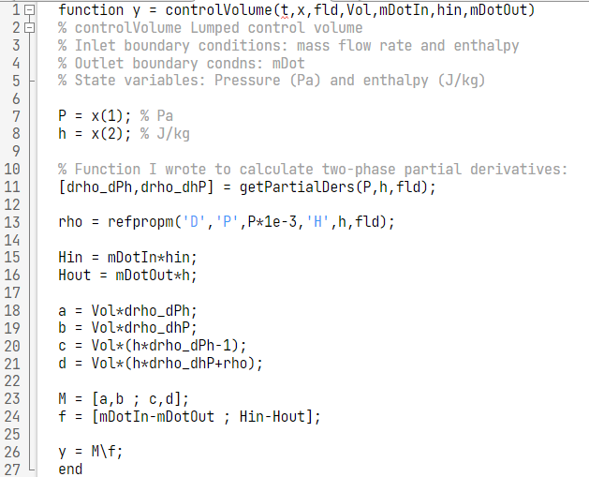
Homogeneous Model in Matlab
Very basic model:
  Mass balance
  Energy balance
  Pressure/enthalpy as state variables
y = A\B
  Backslash operator <3
Matlab
  ODE15s
  ODE15i (Implicit form)
  Progress plot while solving

Slide 10
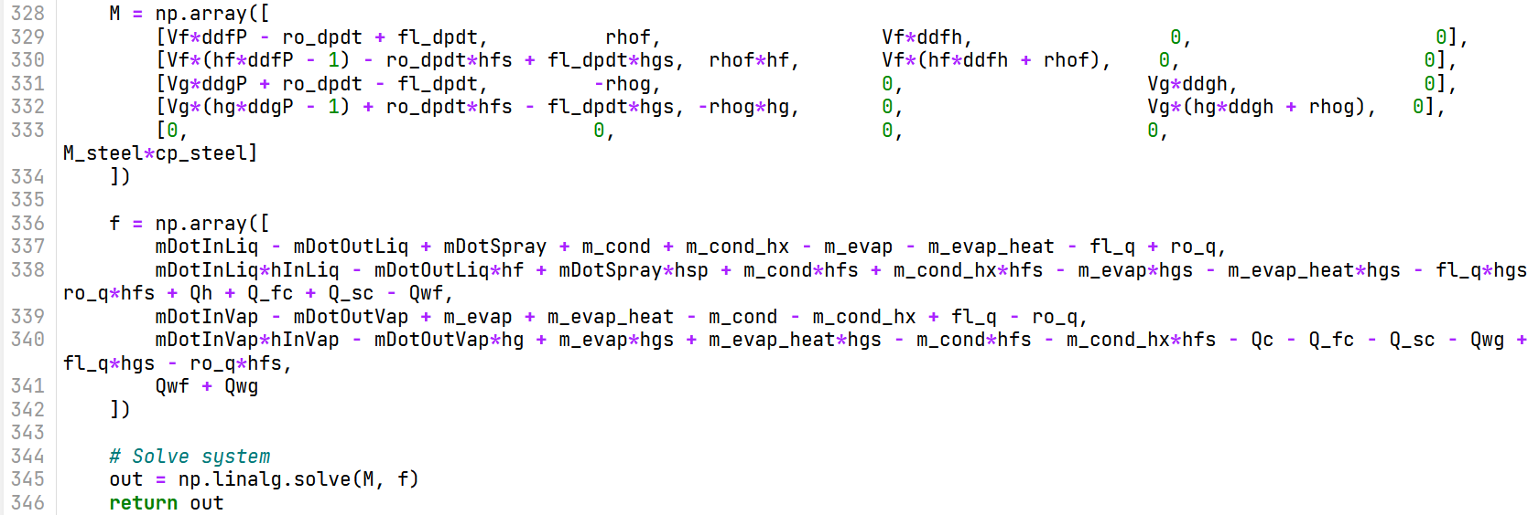
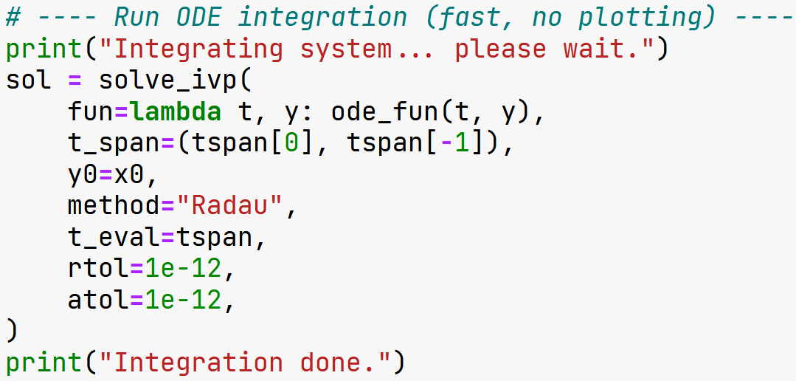
Two-Fluid Model
Scipy ivp problem
Nice DAE solvers (Radau etc.)
Model the liquid and gas phases separately
Flash evaporation and rain-out condensation
Heat transfer between phases

Slide 11
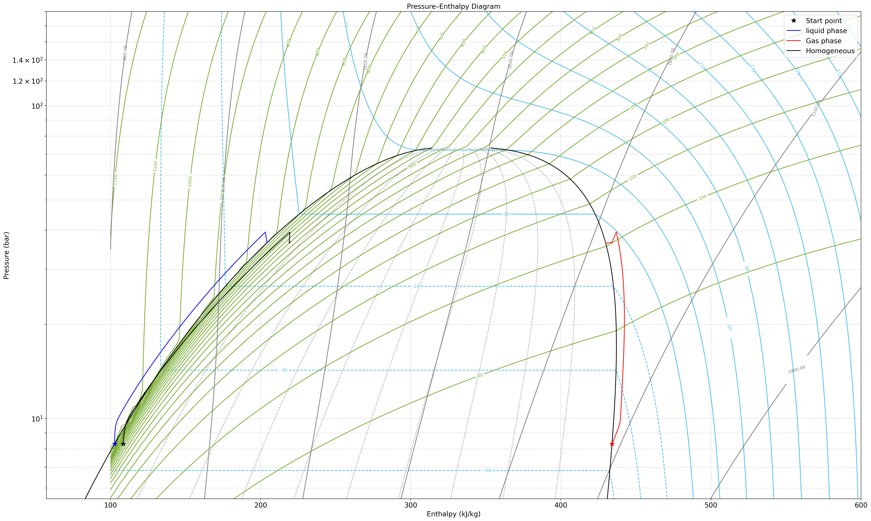
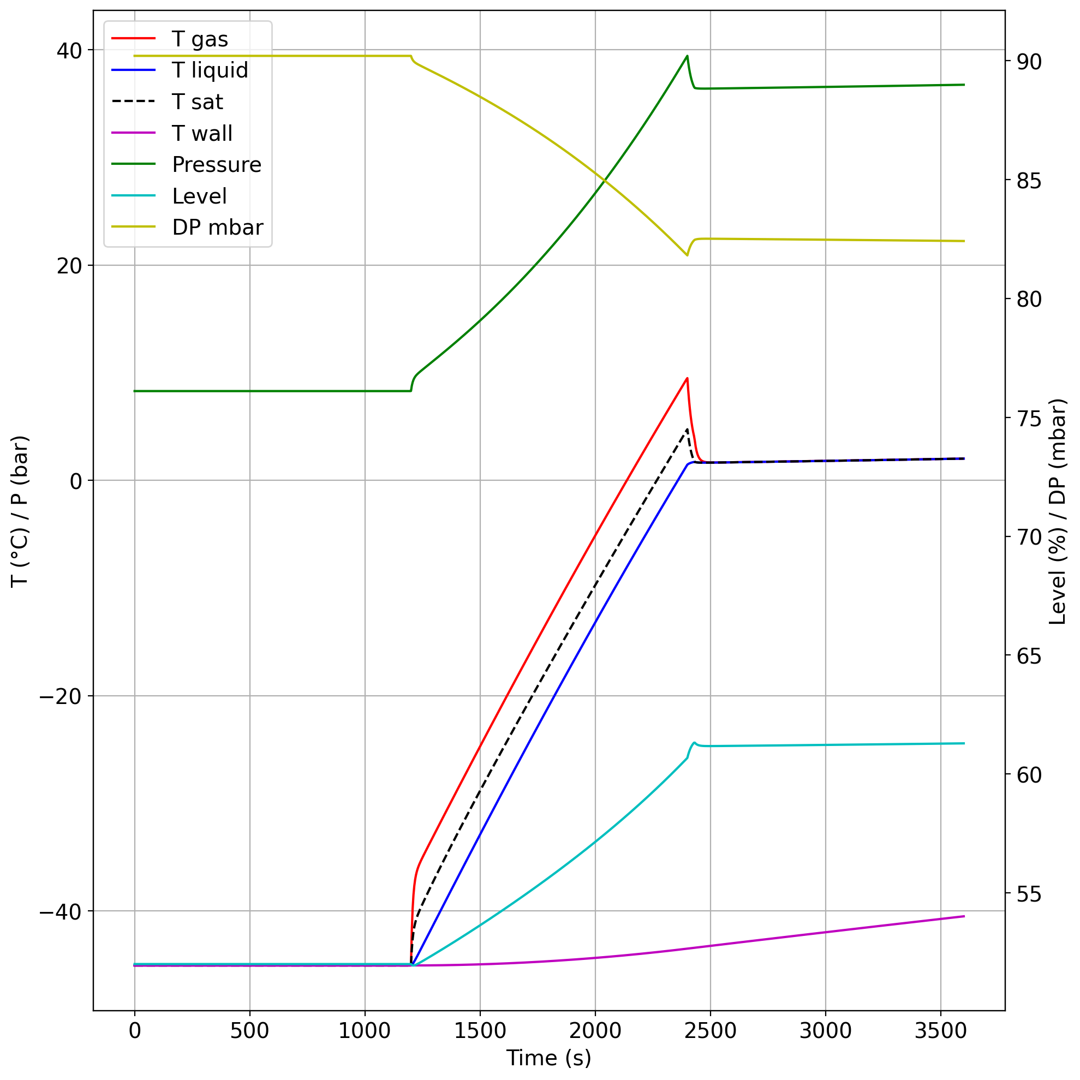
Rapid-pressurisation example

Slide 12
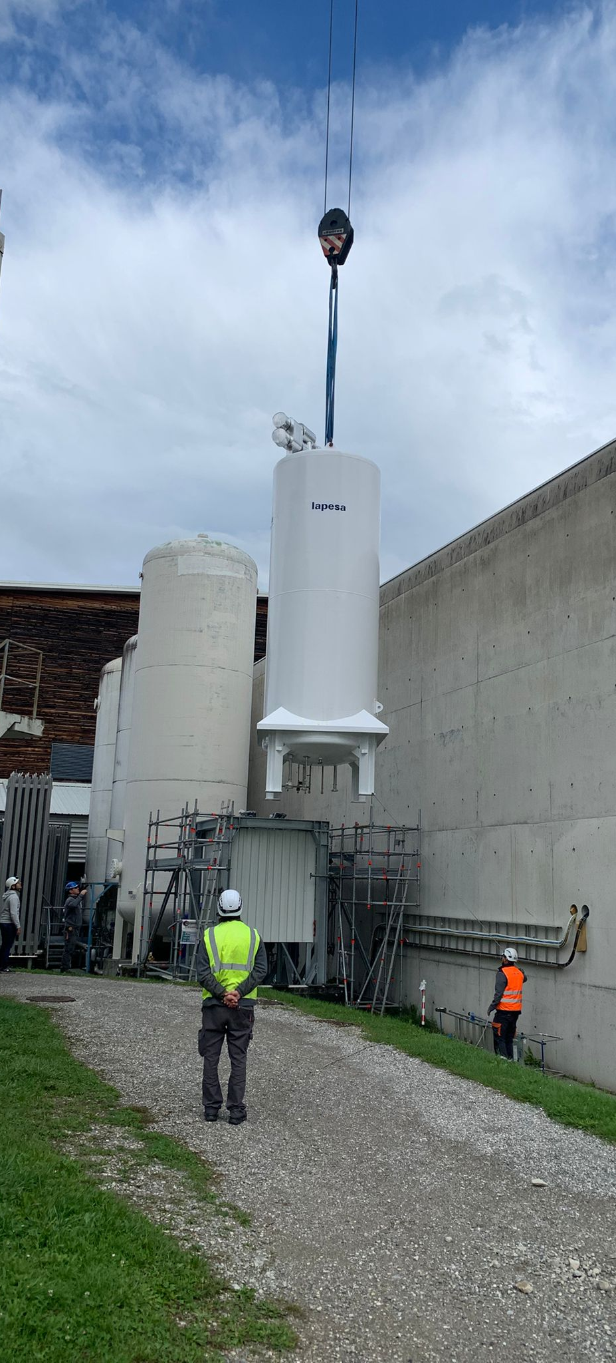
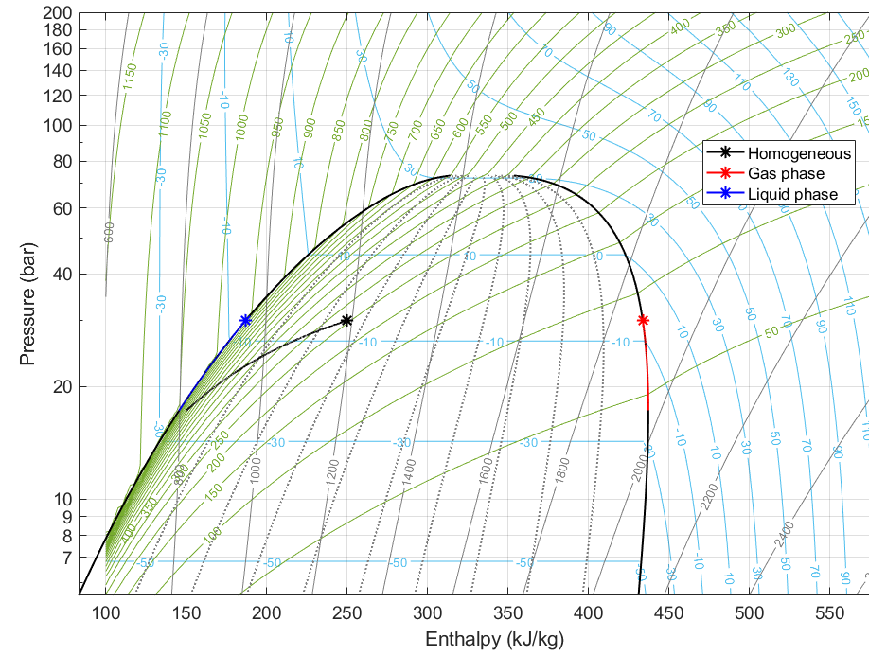
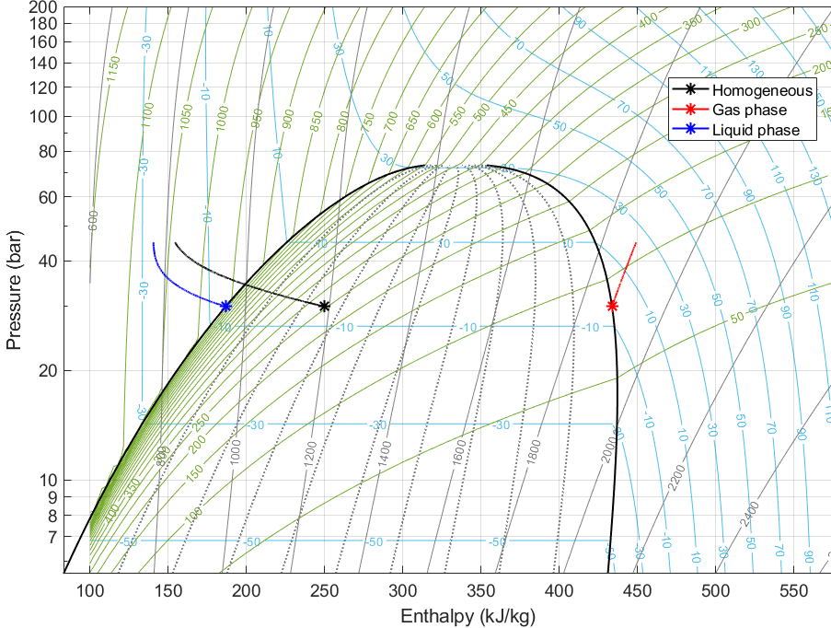


Safety valve flow
Gas flow out
0kg/s
Gas flow out
Homogeneous model
in equilibrium
Two-Fluid Model
Gas phase
at $T_{gas}$
0kg/s
Liquid phase
at $T_{liq}$
4,5 kg/s
at -45°C
4,5 kg/s
at -45°C
Liquid flow out to the underground
Flow in
from underground
Liquid flow out to the underground
Flow in
from underground
0kg/s
0kg/s

Slide 13
Data analysis and post-processing
Importing from NXCals, analysing test results, developing scans for systems…

Slide 14




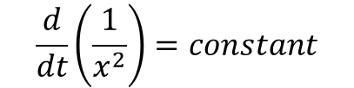
Scanning the pump
Pump curve data → slowly closing valve at pump outlet → pressure increase → measure mass flow
Pump not 100% efficient ⇒ mass flow not constant over full range
Valve
Pressure
$$Q=C_{v}\sqrt{∆P}$$
$$\frac{d(∆P)}{dt}=constant$$
Pressure
$$C_{v}∝x$$
Valve
$$\frac{d}{dt}\left(\frac{1}{x^{2}}\right)=constant$$
$$x=\frac{1}{\sqrt{at+b}}$$
Time
Time

Slide 15
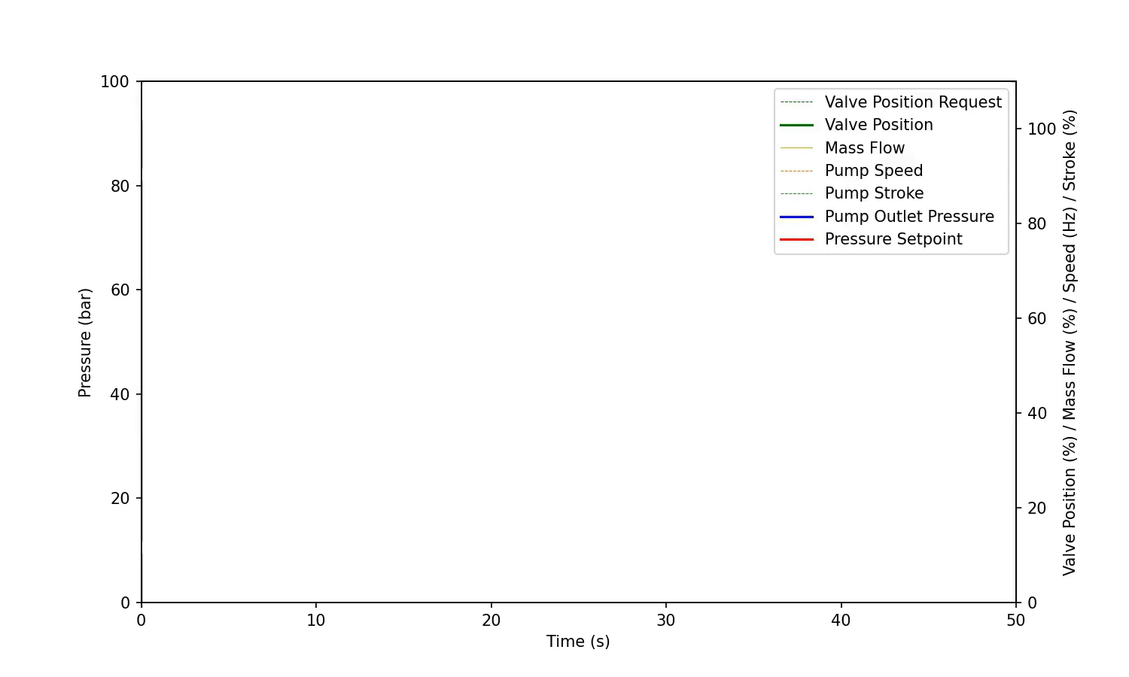
Developing auto-scan
Let’s simulate it before we do it.
Play around with coefficients/parameters
Estimate scan times/speeds
Get feedback from PLC logic/SCADA engineers

Slide 16
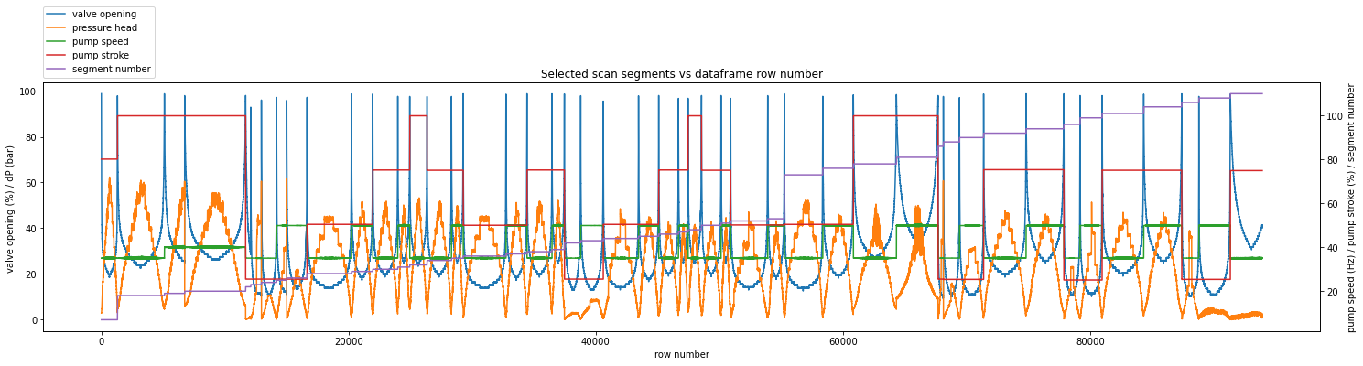
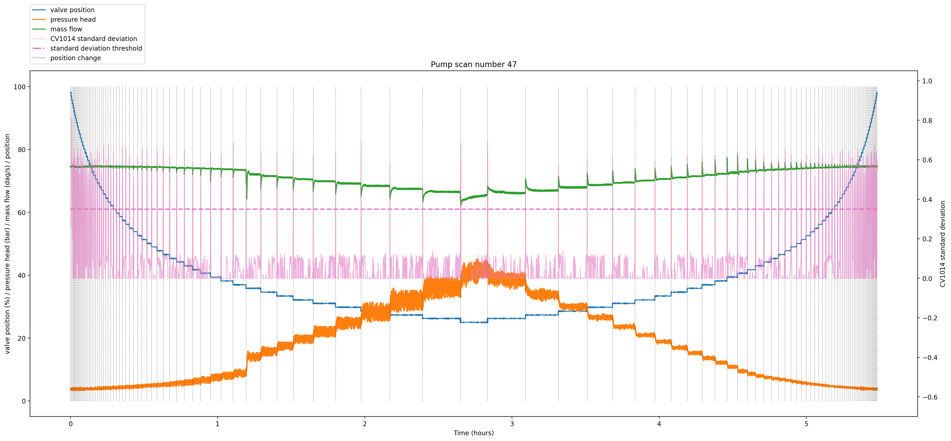
Data analysis

Slide 17
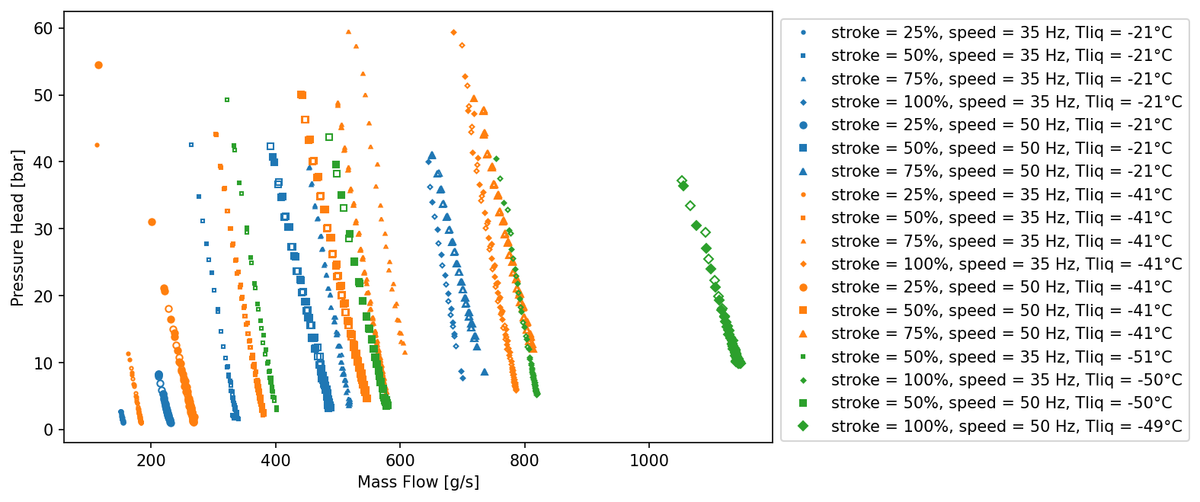
Overall pump curves

Slide 18
Visualisations

Slide 19
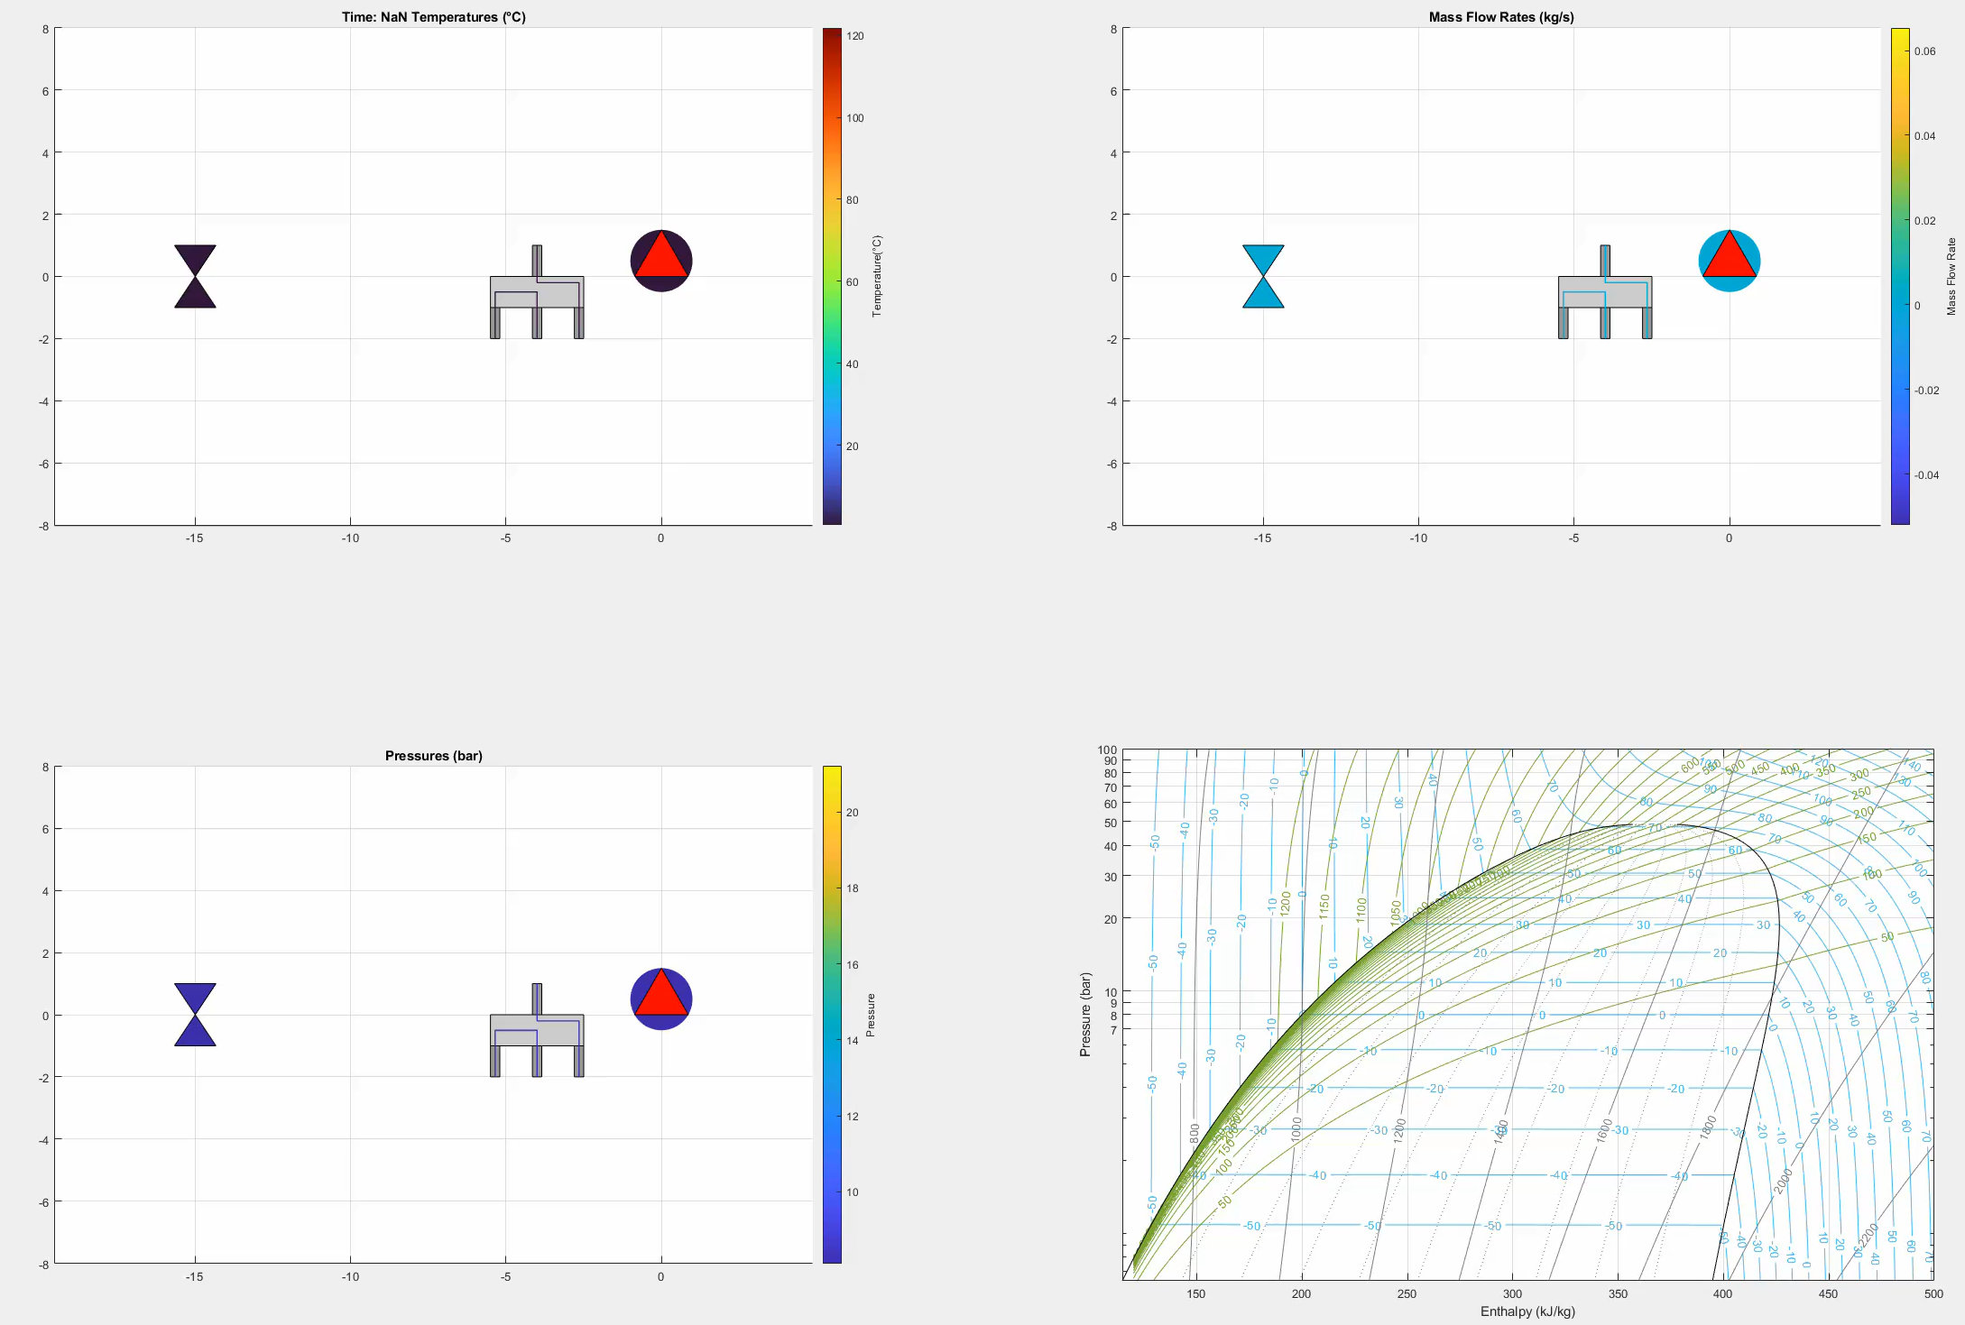
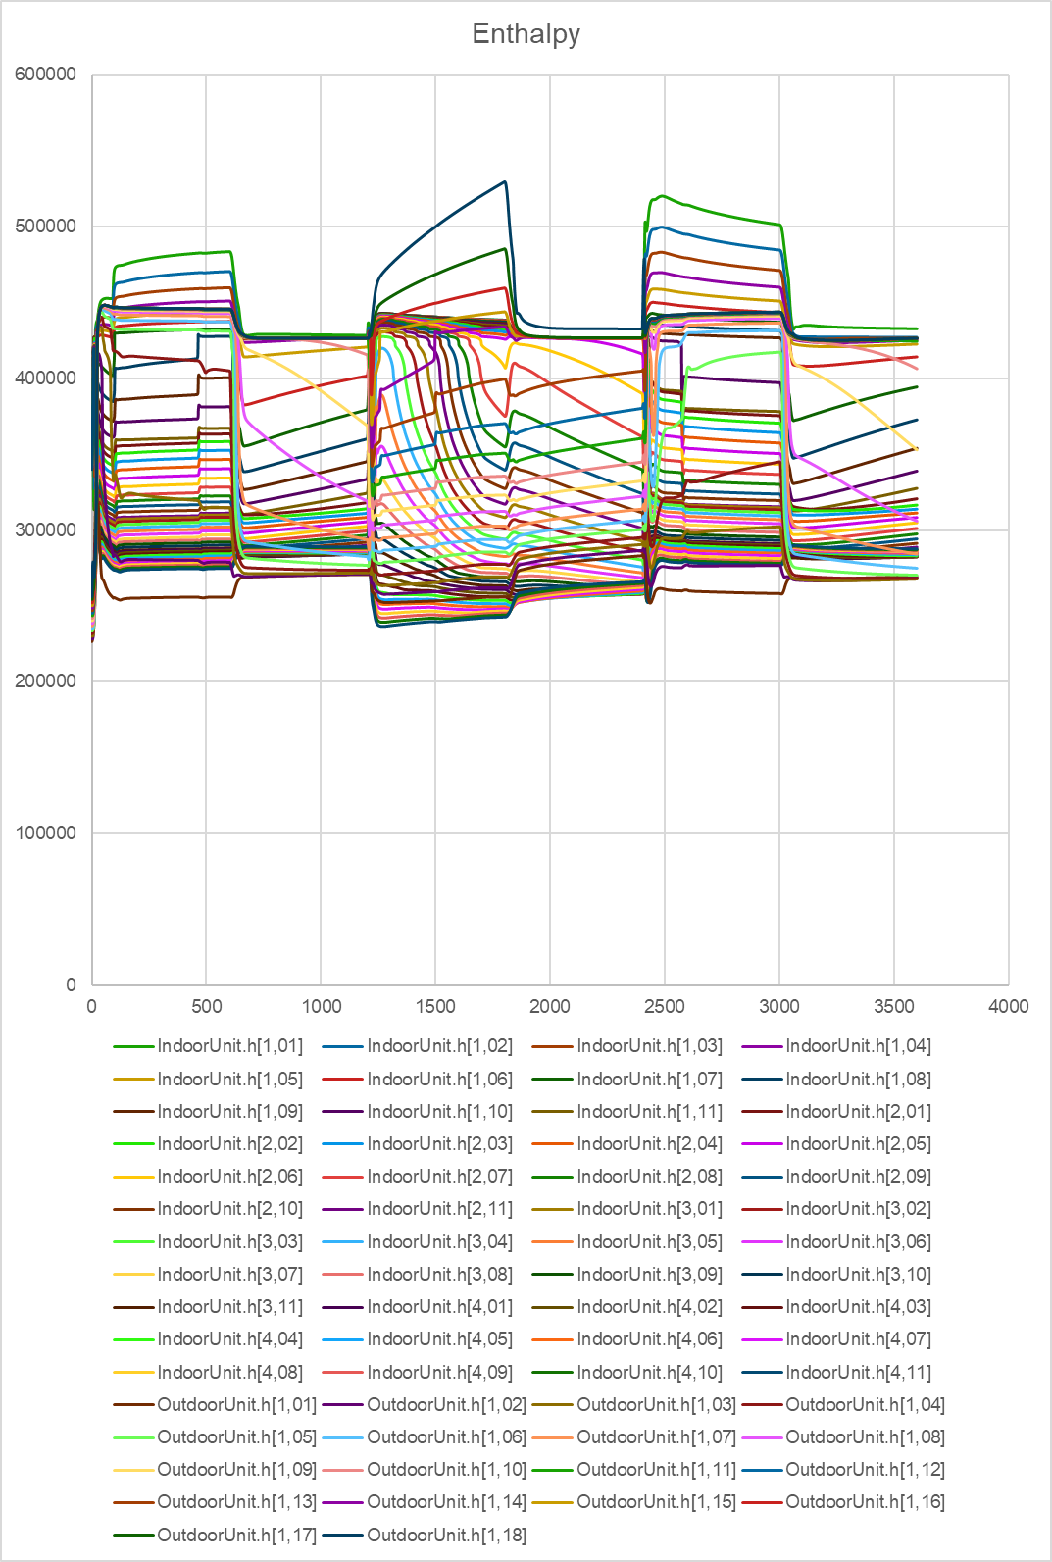
Glean: visualising thermofluid systems

Slide 20
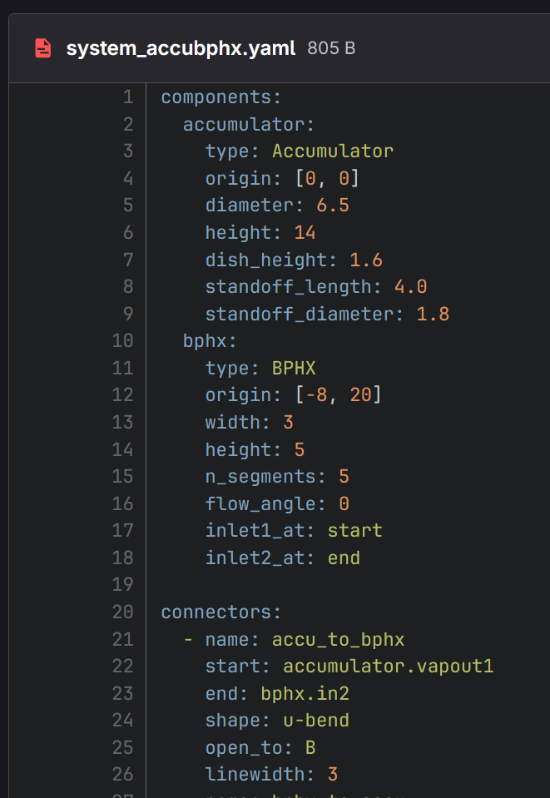
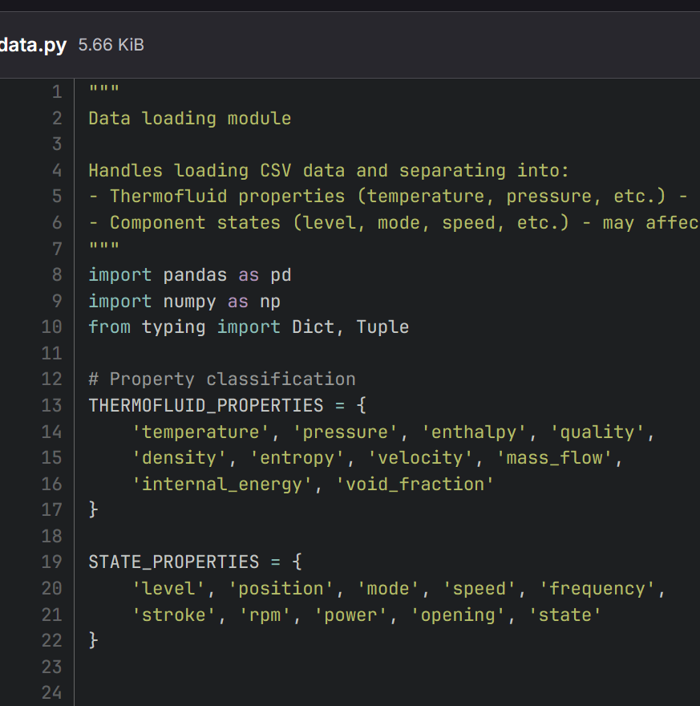
Python vs Matlab implementation
Matlab
Ad-hoc development of components.
No overall structure to workflow
Patch update = slow
Python
Modular development: data.py, geometry.py etc.
YAML to specify system schematic
  Components, positions, locations
  Data file column mapping
Each component is a class
Two types of properties
  Thermodynamic (Pressure)
  State (% opening, frequency etc.)

Slide 21
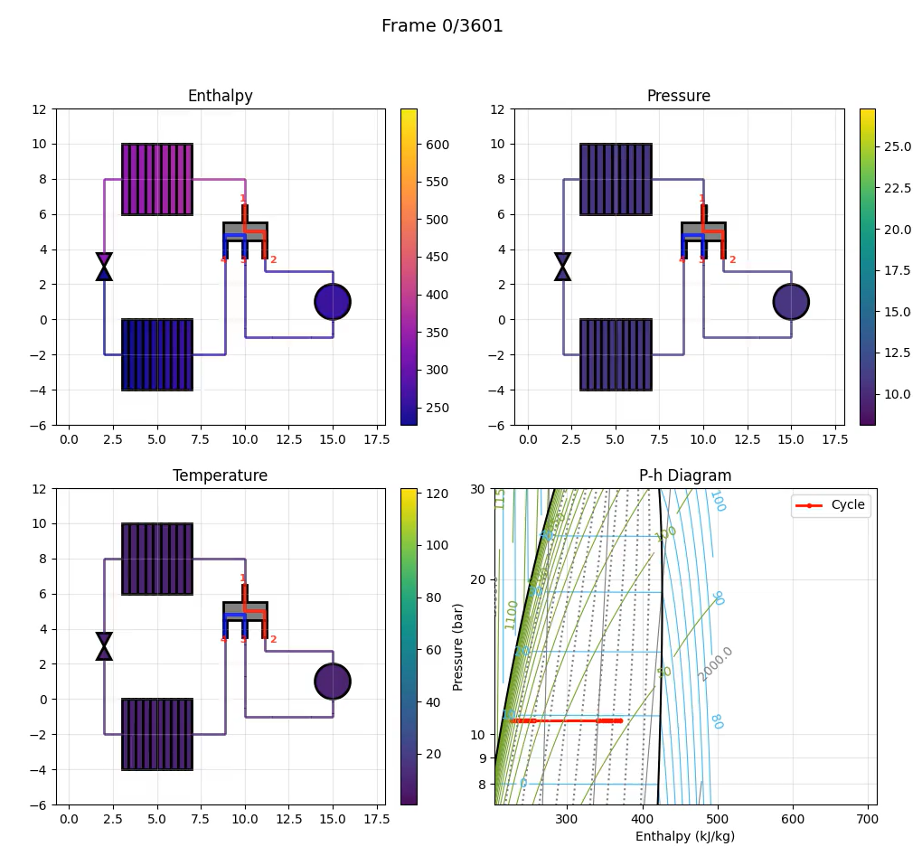
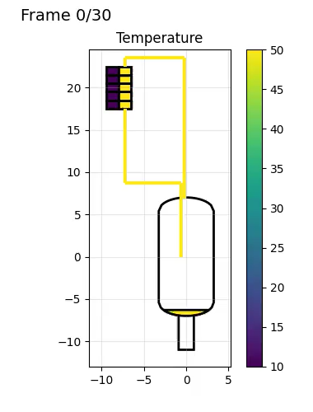
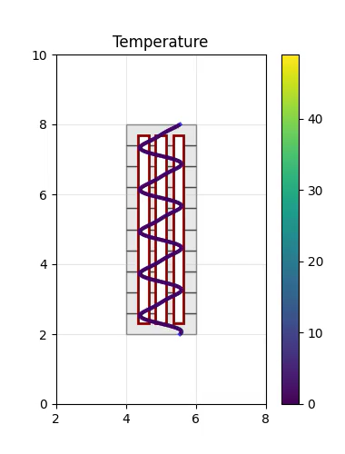
Python implementation

Slide 22
Repositories
Fizz: useful helper functions for CO2 analysis (P-h diagram, valve flow rates, plotting etc.
  https://gitlab.cern.ch/vbhanot/fizz
Glean
  Python: https://gitlab.cern.ch/vbhanot/glean
  Matlab: https://gitlab.cern.ch/CO2/glean
Auto-scan/Data-analysis: Only on Swan (CERN’s Jupyter running thingy with access to NXCals). Can share if you would like!

Slide 23
Reflections
Matlab
Python
Slow
One function per file = difficult to organize code
Everything is a matrix = easy but limiting
Array manipulation is world class (⇒ performance penalty)
<3 backslash operator
Slow
Many datatypes to learn (lists, tuples, dicts, dicts-of-dicts, np arrays, pandas…)
Easier to organise code. Modules are very useful
Numpy syntax is ugly.
Array manipulation less trivial
Matplotlib is amazing

Slide 24
Thank You.

