Slide 1
IQ Demodulation for EO-BPM
Daniel Harryman
04/07/2025
Acknowledgements:
Max Bosman, Stephen Gibson, Tom Levens, Thibaut Lefevre, Andreas Schloegelhofer, CLEAR operations team.

Slide 2
Setup and Theory
IQ Demodulation for EO-BPM

Slide 3
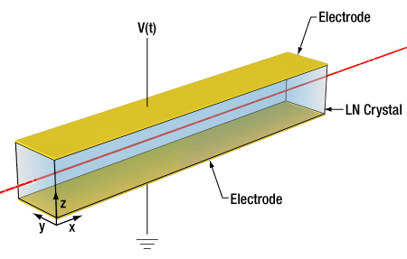
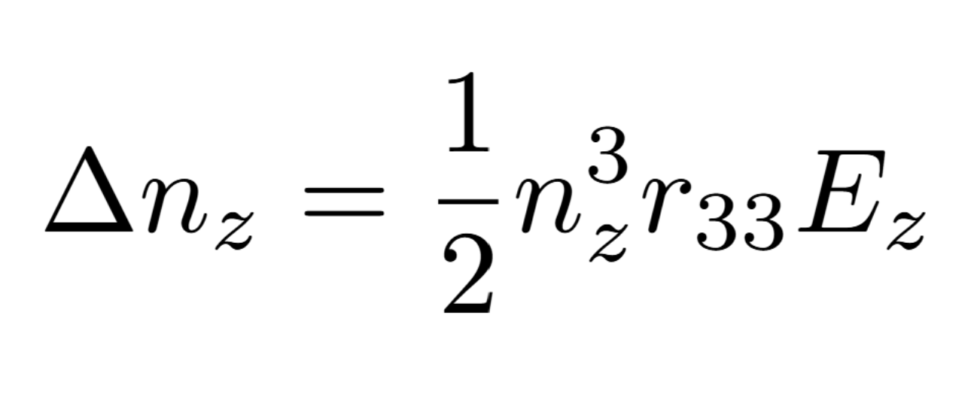
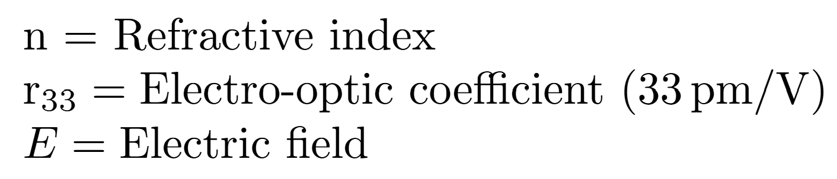
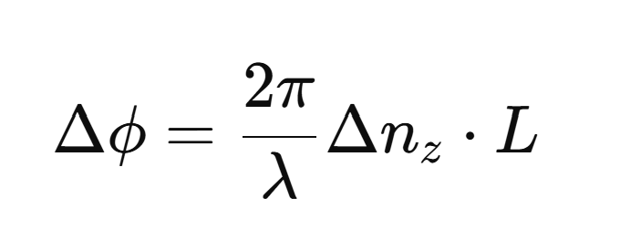
Concept and Theory
Birefringent lithium niobate crystals undergo a linear change in refractive index when subjected to an electrical field.
The change in refractive index induces a linear phase shift in a laser passing through the crystal.
This effect has a rapid time response. COTS modulators can have an analogue bandwidth >30GHz.
Notes:
$V_{\pi}= - \frac{\lambda g}{n_3^3 r_{33} L \Gamma}$
$\Delta \phi = - \frac{\pi L}{\lambda} n_3^3 r_{33} \frac{V}{g} \Gamma$

Slide 4





Concept and Theory

Slide 5
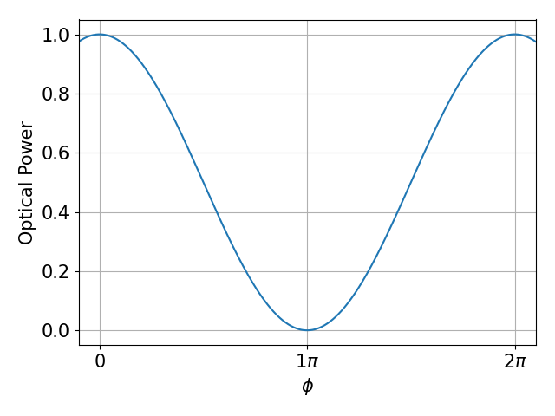

Sine Response
Large intensity change
Small intensity change

Slide 6
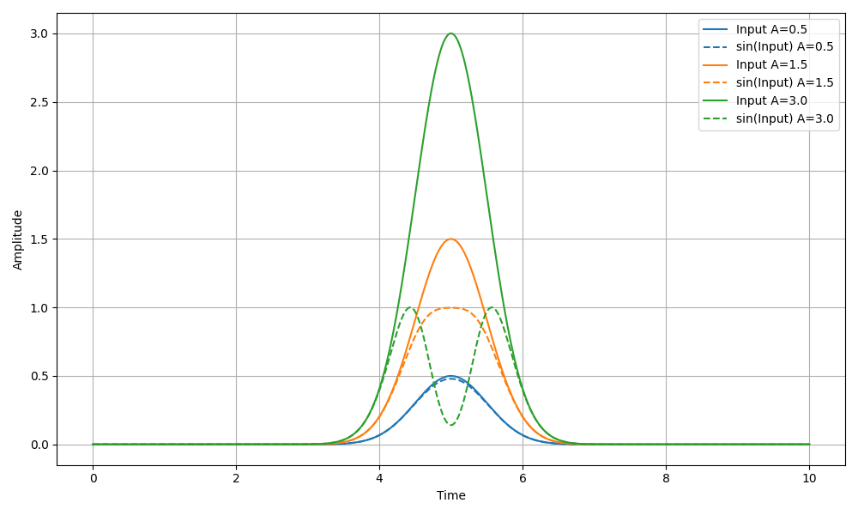
Sine Response
The sinusoidal response produces little distortion at low amplitudes.
At large amplitudes, the signal flattens the input pulse, and at very large amplitudes it inverts it.
All of this behaviour has been seen in the SPS.

Slide 7
Sine Response - IQ
Measure the same signal at two working points at the same time.
Allows you to know where on the function you are i.e. rising or falling slope.
Ideally both samples are 90 degrees out of phase so phase can be extracted with arctan.

Slide 8
Sine Response - IQ
Measure the same signal at two working points at the same time.
Allows you to know where on the function you are i.e. rising or falling slope.
Ideally both samples are 90 degrees out of phase so phase can be extracted with arctan.

Slide 9
Sine Response - IQ
Measure the same signal at two working points at the same time.
Allows you to know where on the function you are i.e. rising or falling slope.
Ideally both samples are 90 degrees out of phase so phase can be extracted with arctan. i.e.
x = arctan(sin(x) / cos(x))

Slide 10
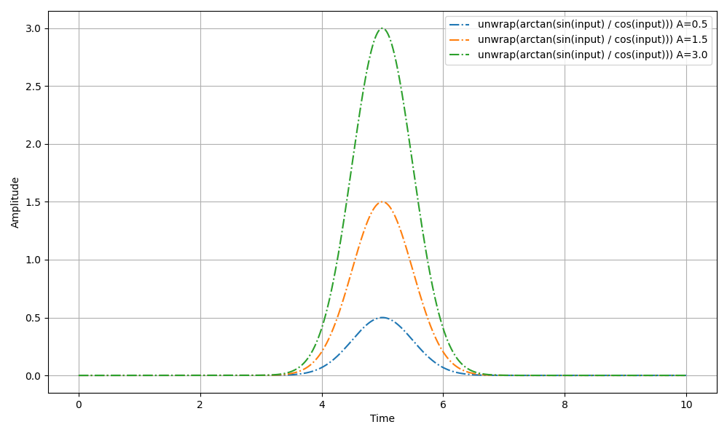
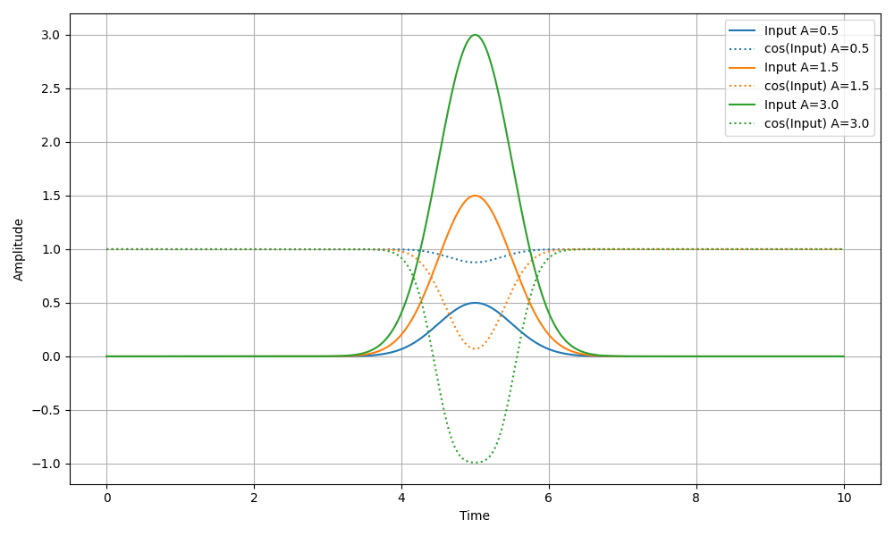
IQ Theory

Slide 11
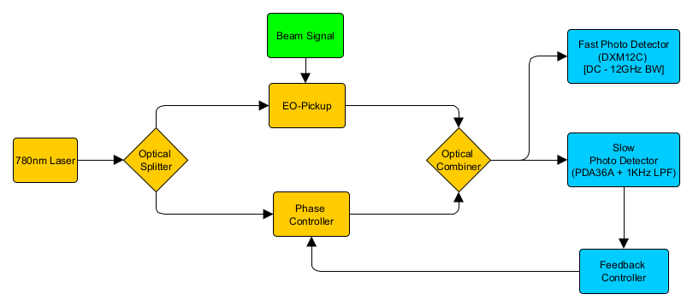
Experimental Setup for fixed initial phase
Side mode single WP configuration:
Feedback controller reads a DC voltage from the PDA36A + LPF.
The working point voltage is the DC voltage used as the feedback controller setpoint.
Bias voltage fed to the phase controller is updated to keep the DC level output from the slow detector fixed.
Different setpoint voltages produce different initial phases.

Slide 12
Optical System
Split signal here
Duplicate the rest of the system
Split signal here

Slide 13
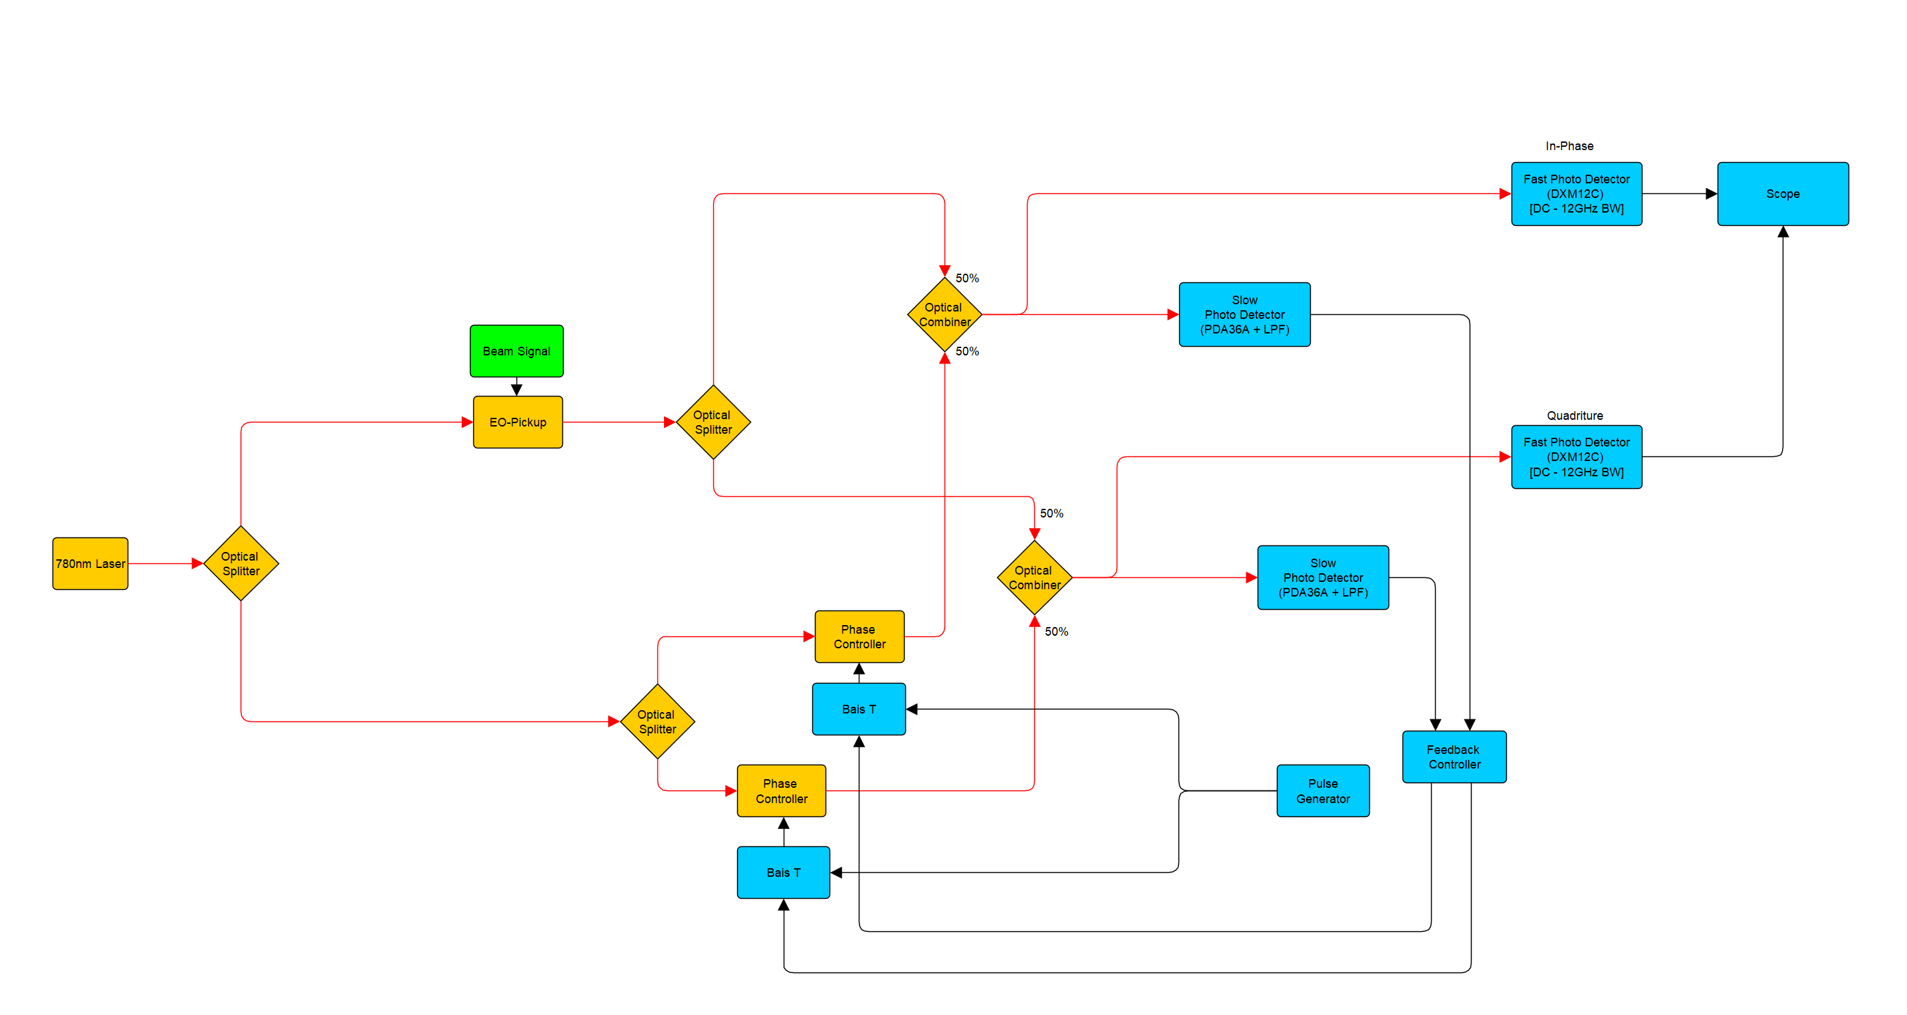
Optical System

Slide 14
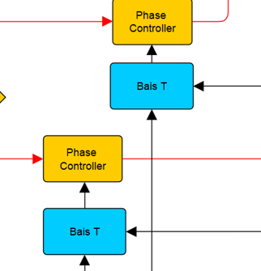
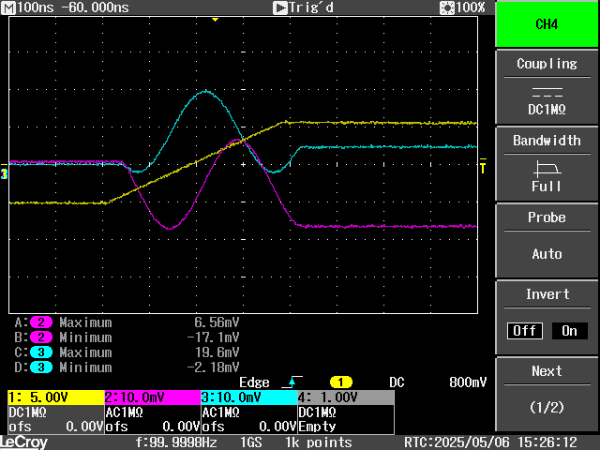
Feedback Controller and Bias T
DC level measured by slow detectors, feedback controller updated DC bias to keep this value fixed.
Bias T used for bias feedback control on the LF input, and system identification/calibration on the HF input.
Use ramp pulse to obtain min and max voltage spans and the initial phase for a specific fixed working point.

Slide 15
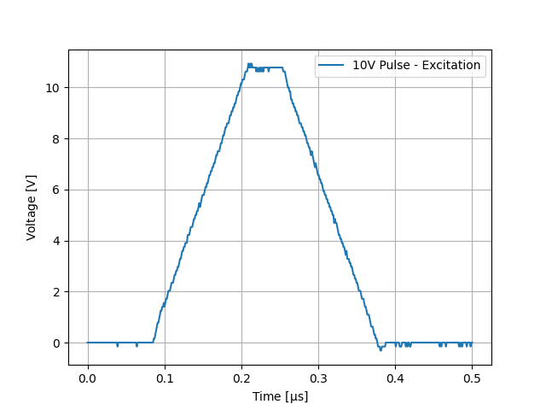
Analysis Steps
Injecting a signal into HF input of the bias T produces a similar effect as the beam will on the signal.
Example showing the analysis steps using a signal injection seen opposite, when both channels are set 90 degrees out of phase.
This process is used to confirm the analysis steps.

Slide 16
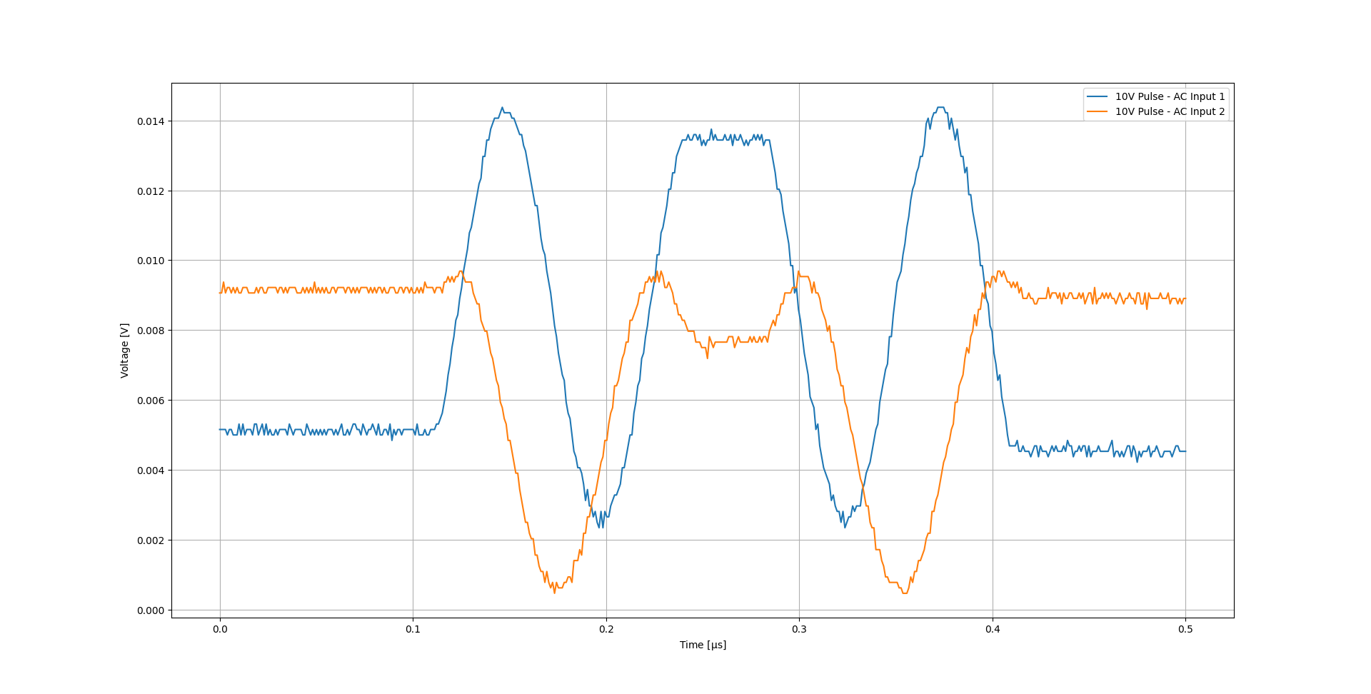
IQ Channels

Slide 17
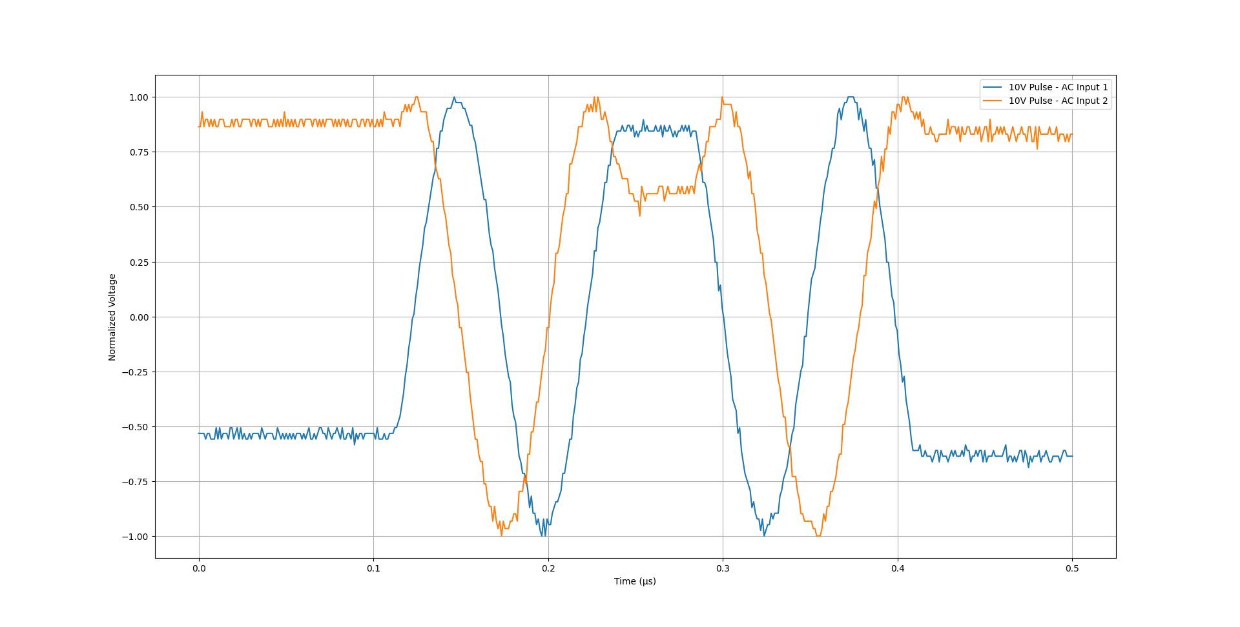
Normalised IQ Channels

Slide 18
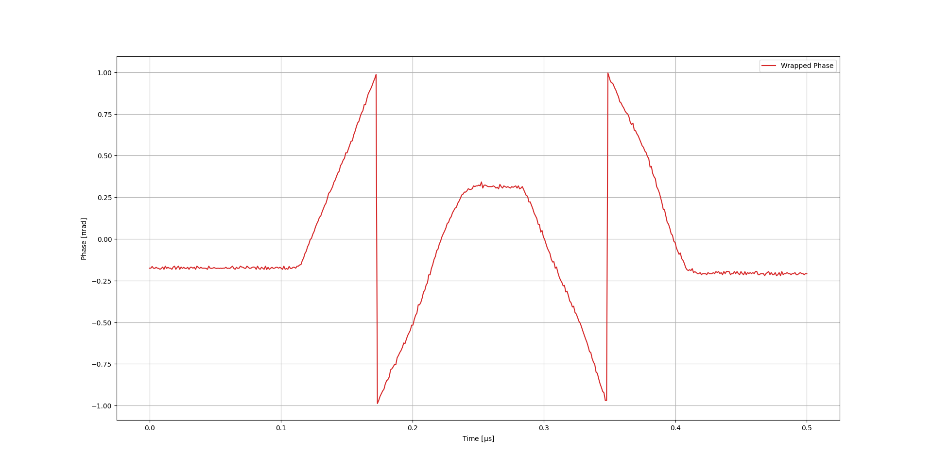
Phase Data IQ Channels

Slide 19
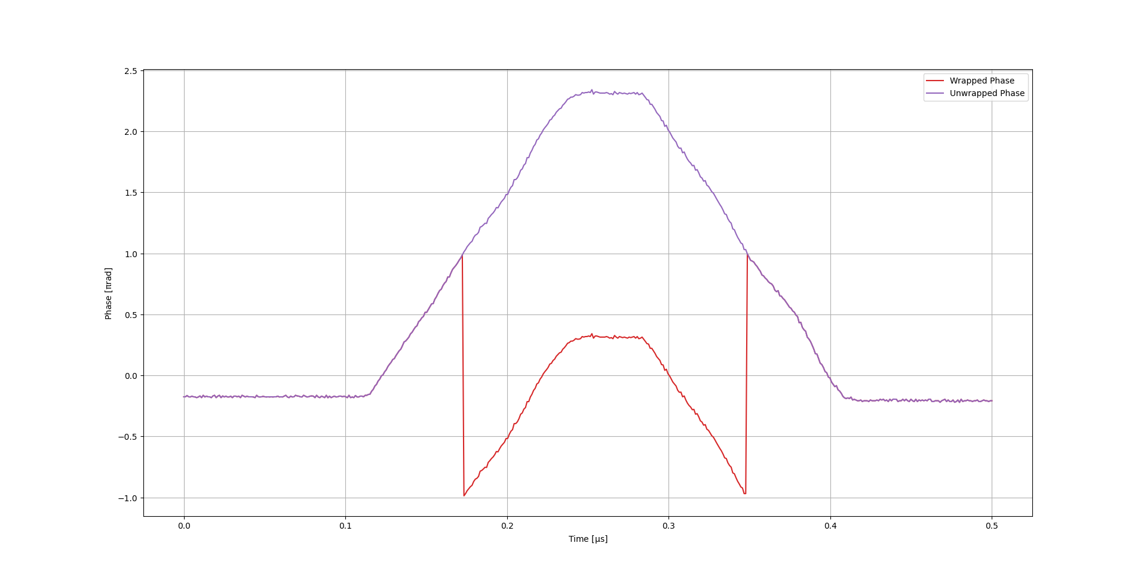
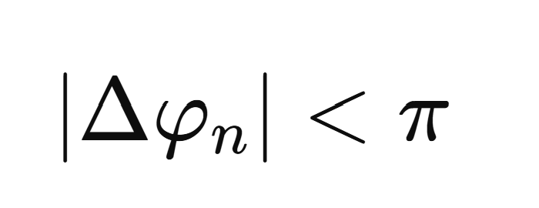
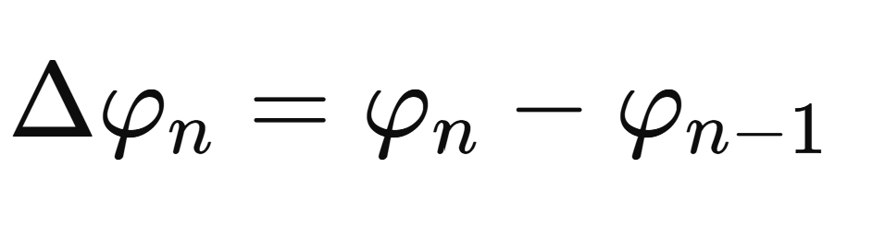
Phase Data IQ Channels
Where:
i.e. phase domain version of Nyquist criterion.

Slide 20
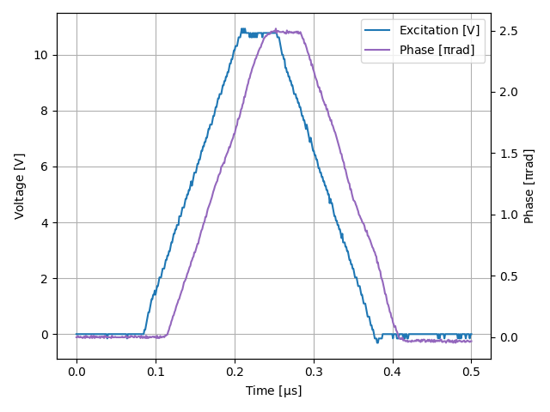
Phase Data IQ Channels
Plotting together this shows the two over rotated signals can be used to reconstruct the excitation signal.
Note that some distortion will appear on the processed phase as the excitation passes through the bias T.
Phase misalignment (not exactly 90 degree offset) will also produce some distortion.
Offset has been removed on phase signal as I channel is not at 0 degrees initial phase. This was intentional for feedback stability.

Slide 21
CLEAR Tests
IQ Demodulation for EO-BPM

Slide 22
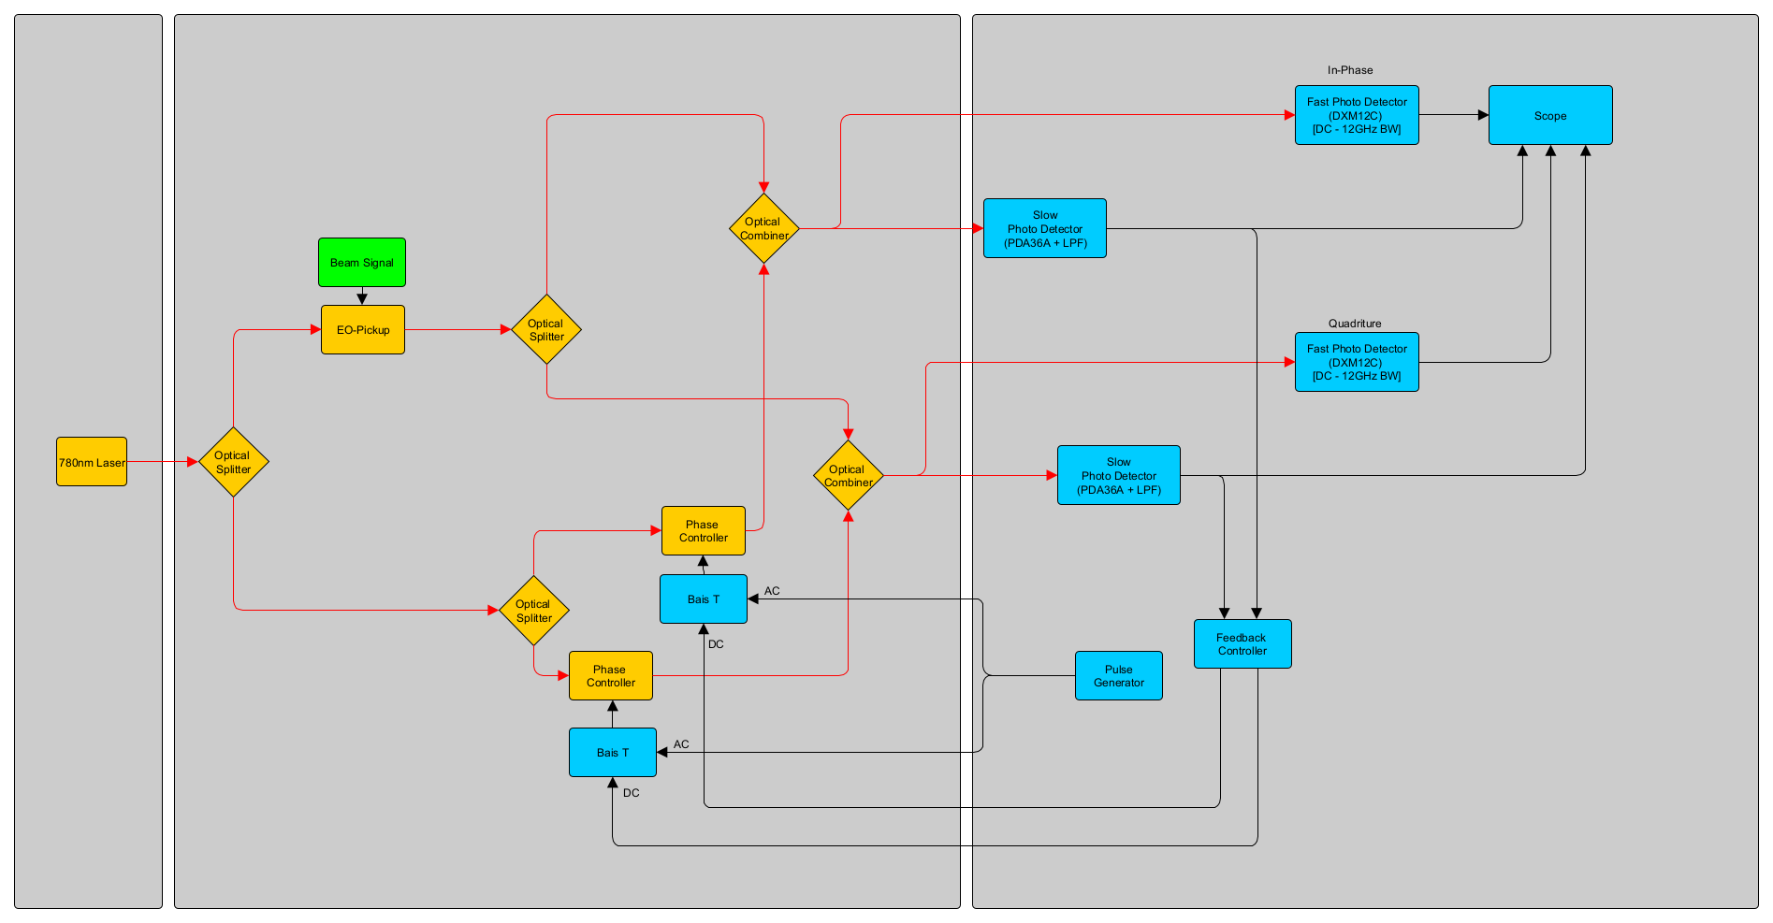
Laser Room
Accelerator Tunnel
Barracks/Rack Room

Slide 23
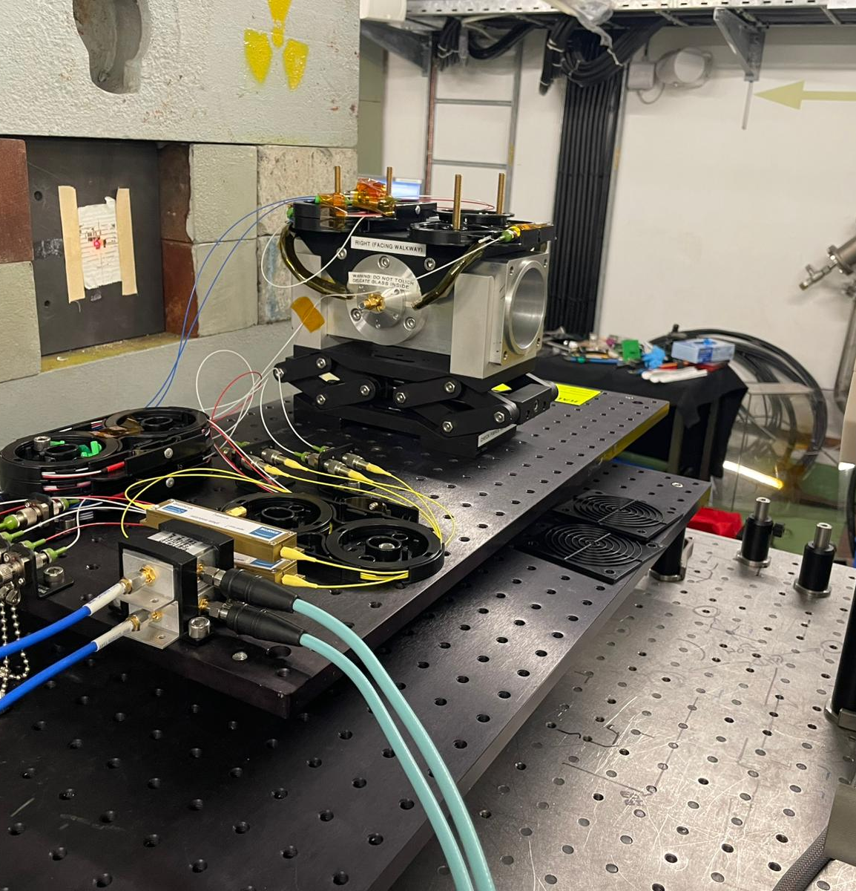
CLEAR Tests
Old HiRadMat test body mounted into CLEAR in air test stand.
IQ detector system connected to a single pickup. Beam position changes simulated by moving the BPM body on a linear stage.
Calibration ramps sent to both I and Q channels through the bias tees with every bunch.
Beam
Linear Stage movement

Slide 24
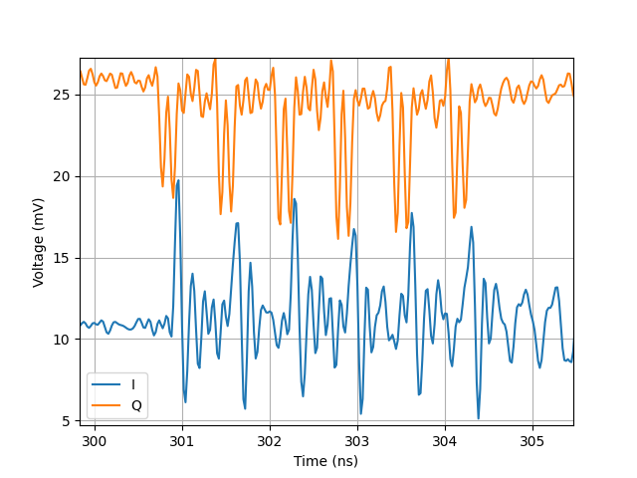
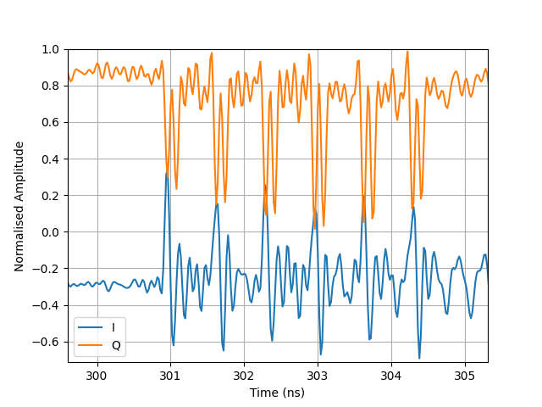
Signal Time Offset
Raw
This dataset is 1mm away from pickup.
All datasets show a 9-sample offset between the I and Q channels. Given the sample rate of 50GS/s this can be explained by differences in fibre + cable length. (~5cm)
All phase plots shift the Q channel by 9 samples to compensate.
Normalised and Time Offset

Slide 25
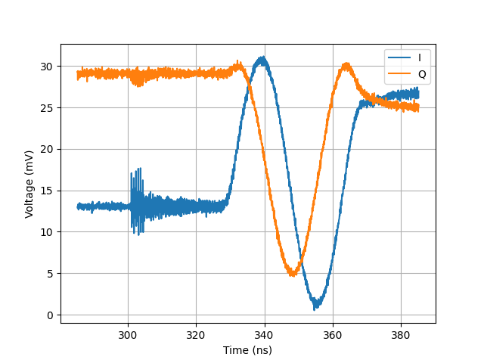
Example Multi-bunch Trace
This dataset is 10mm away from pickup.
Droop after ramp the result of bias tee response.
Bunch signal visible on I and Q channels.
Response to linear ramp used for shot-shot calibration.

Slide 26
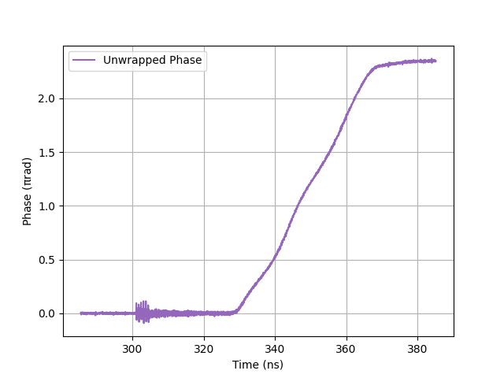
Example Multi-bunch Trace
Wobble in calibration response shows channel phase offset is not exactly 90 degrees
Bunch Signal
Visible

Slide 27
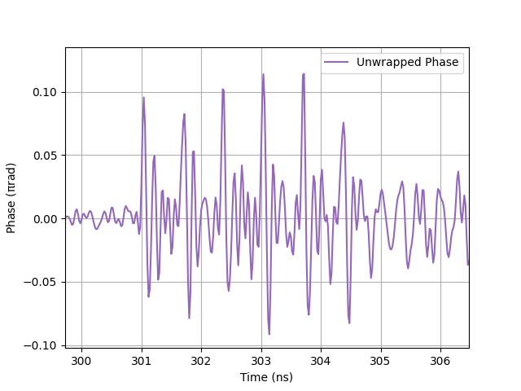
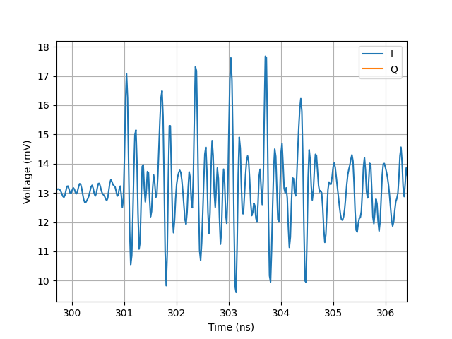
Example Multi-bunch Trace
Unwrapped phase data is very similar to I channel. Implies the signals are not high enough to cause an over-rotation in this trace. i.e. blue regime

Slide 28
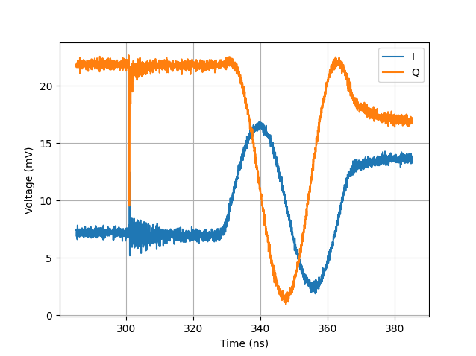
Example Single-bunch Trace
This dataset is 1mm away from pickup.
Shows that at very close range a large signal is possible, but not enough to cause an over-rotation in a single measurement.

Slide 29
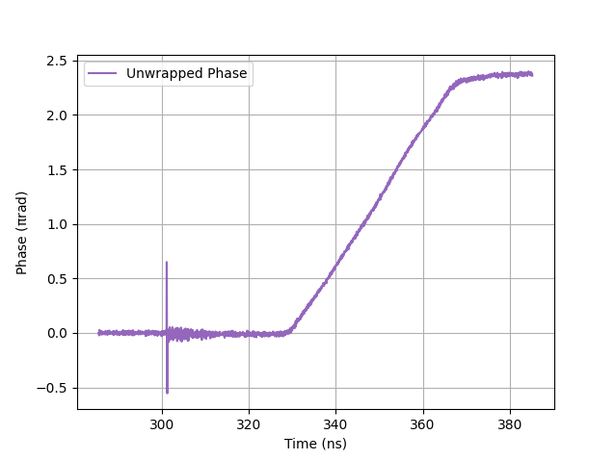
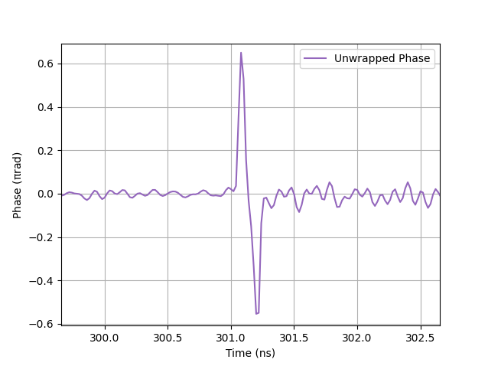
Example Single-bunch Trace
This dataset is 1mm away from pickup.

Slide 30
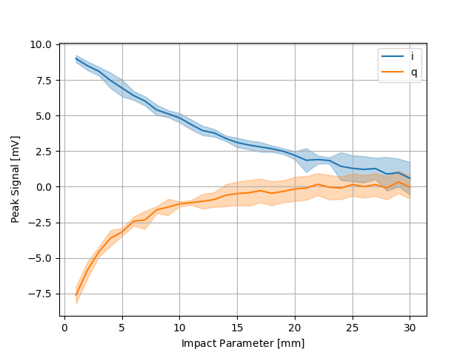
Position Scan
Peak signal from each trace baseline is plot vs impact parameter.
The blue I trace resembles what a typical EO-BPM readout response would be.
Expectation is that gradient is highest at low impact parameters.

Slide 31
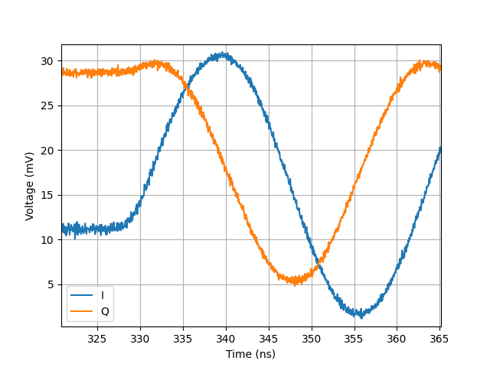
Position Scan
At low signal the I ramp response gradient is larger than the Q response.
This is seen at large impact parameters as the measured peak I signal is larger.
Note the Q signal is small but positive at large impact parameters. As matched by the response curve.

Slide 32
Position Scan
At high signal the I trace response gradient is lower than the Q response.
The highest gradient should be at the lowest impact parameter given a typical button BPM response.
For the I channel the gradient reduces, and the Q it increases. This is due to the response of the system.

Slide 33
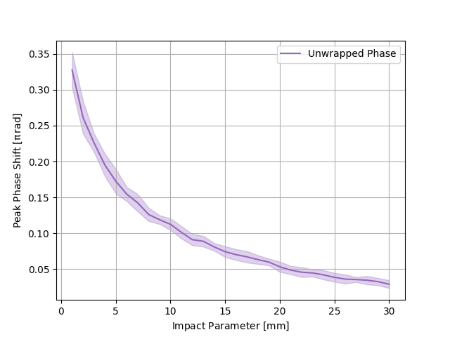
Position Scan
Processing the phase data from I and Q channels produces a button BPM impact parameter response you would expect.

Slide 34
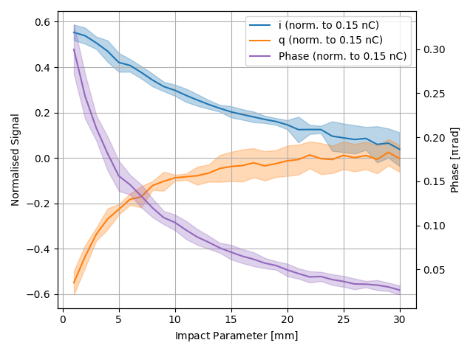
Position Scan
All of these are normalised to a bunch charge of 0.15nC.
Plotting all together shows how the IQ detection method can correct for the sinusoidal responses of the two channels.

Slide 35
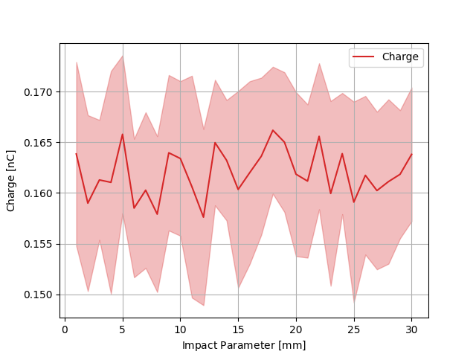
Position Scan
The bunch charge measured over the scan is presented here for completeness.

Slide 36
Implications and Conclusion
IQ Demodulation for EO-BPM

Slide 37
Modulator Length
All else being equal the total phase shift is linearly proportional to the length of the modulator.
Currently modulator length has been selected to balance enough phase shift at low signal while not giving too much to over-rotate at high signal.
This readout method shows that longer modulators can be used to greatly increase the dynamic range of the system as over-rotated signals can be recovered.

Slide 38
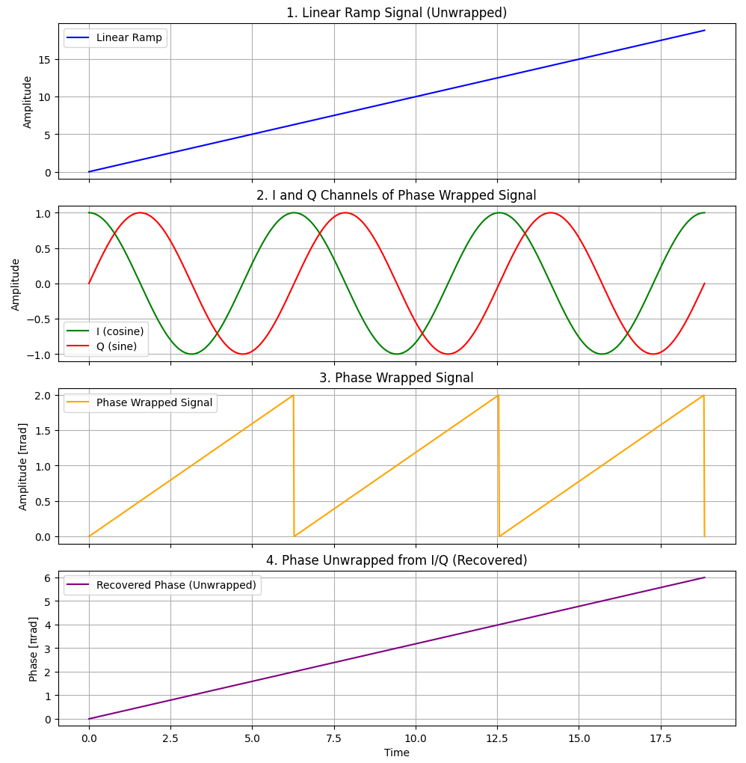

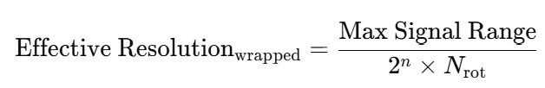
Folding Datasets and Bit Reuse
Using longer modulators and forcing an over rotation can greatly increase the resolution.
If sampling Linear ramp directly:
If measuring wrapped signal:
Remembering that to unwrap:

Slide 39
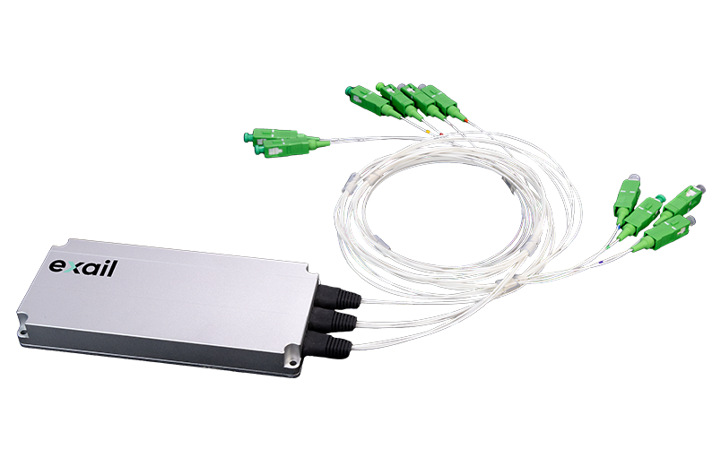
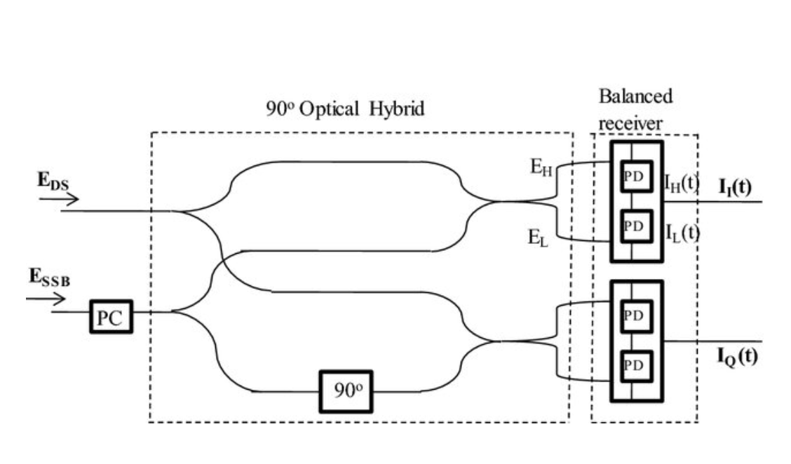
Conclusion
IQ readout technique has been proven sufficiently well using an EO-BPM pickup. Full benefits of the system could not be realised due to low charge during beam shift (working between blue and orange regions).
Installing this system into the SPS would make the system more complicated:
  8 splitters → 15
  3 COTS phase modulators → 6
  2 feedback controller units → 3
  3 fast detectors → 6
  3 slow detectors to → 6
  3 Scope channels → 6
Moving a system to 1550nm a COTS 90 degree optical hybrid can be purchased to reduce some of this complexity. This may also increase the natural stability of the system.

Slide 40
Questions?
IQ Demodulation for EO-BPM

