Slide 1

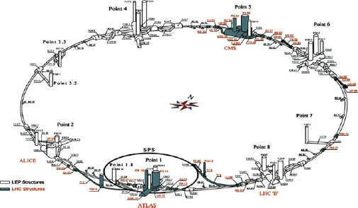


OMC activity

Slide 2
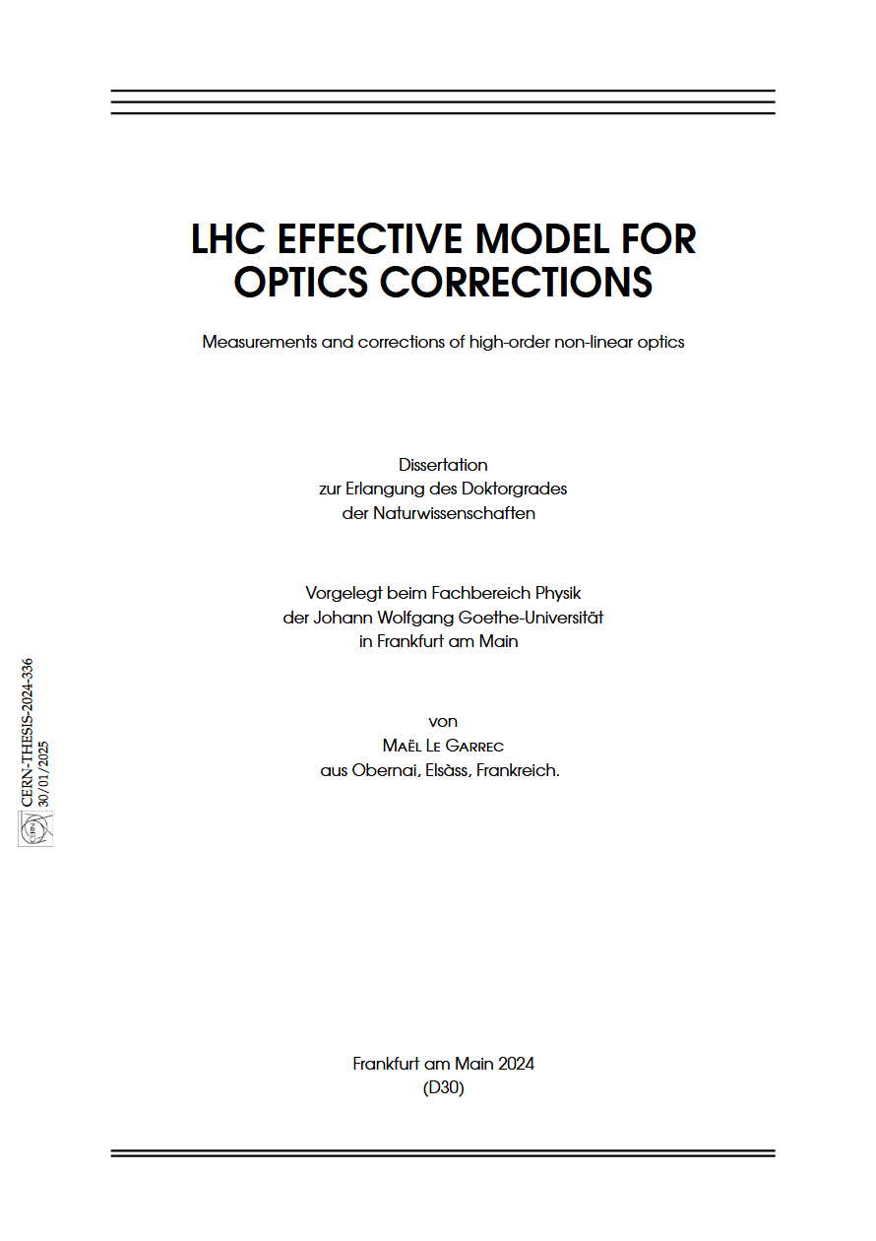
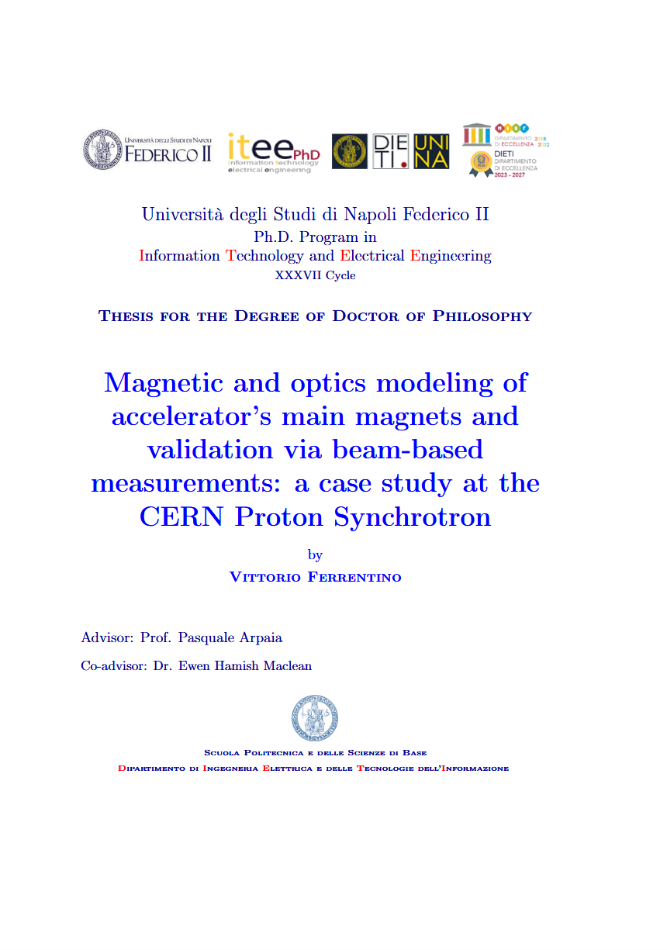
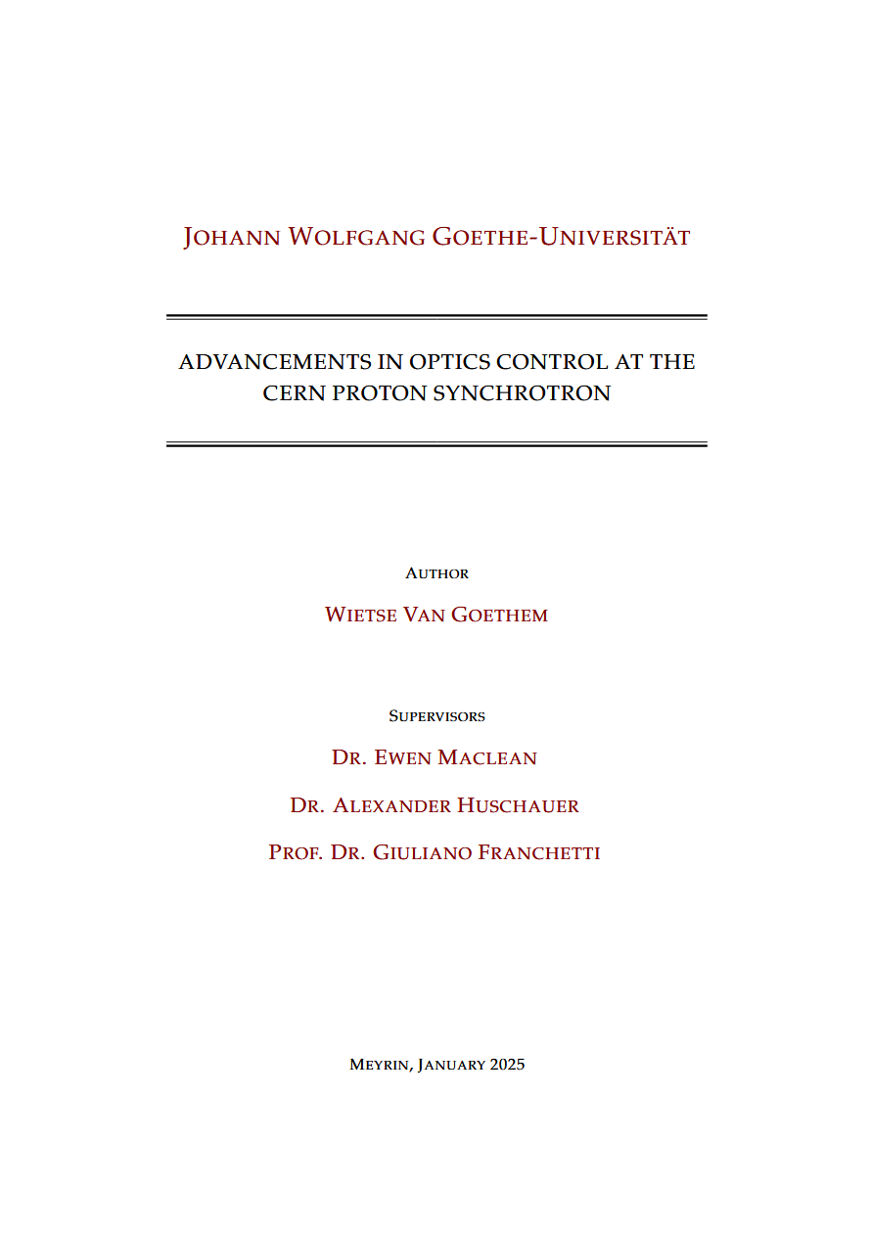
Theses:
Since last meeting 3 Ph.D. on OMC in LHC & PS successfully defended
Dr Mael Le Garrec, LHC Effective Model for Optics Corrections
Dr Vittorio Ferrentino, Magnetic and optics modeling of accelerator’s main magnets and validation via beam-based measurements: a case study at the CERN Proton Synchrotron
Dr Wietse Van Goethem, Advancements in optics control at the CERN Proton Synchrotron

Slide 3
IPAC
Review of linear and nonlinear optics measurements in the CERN LHC
https://indico.cern.ch/event/1548853/
Y.Angeles et al, WEPM001, High Luminosity LHC optics: machine development results
S.Horney et al, MOPM018, Energy sensitivity of the High Luminosity LHC optics at the end of the Beta* squeeze
S.Horney et al, MOPM019, Correction of Long-Range Beam-Beam Driven Normal Sextupolar Resonance Driving Terms
S.Horney et al, MOPM020, Investigation of octupolar resonances in the LHC
E.Maclean et al, WEPM008, 3Qy resonance correction at LHC injection
E.Maclean et al, WEPM010, Beam-based beam-beam benchmarking and correction
E.Maclean et al, FRYD2, Review of linear and nonlinear optics measurements in the CERN LHC
J.Dilly et al, WEPM012, Status of the CERN optics measurement and correction analysis tools
J.Dilly et al, WEPM013, Impact of the inner triplet polarity on the optics commissioning of the LHC in 2024 and 2025
J.Dilly et al, WEPM014, Impact of linear imperfections in the high luminosity LHC separation dipole magnets
P.Zisopoulos et al, WEPM108, Towards operational optics measurements with AC Dipole excitations in the CERN SPS
V.Souza et al, THPS078, Measuring single-pass dispersion in the LHC
(apologies if I missed any!)

Slide 4
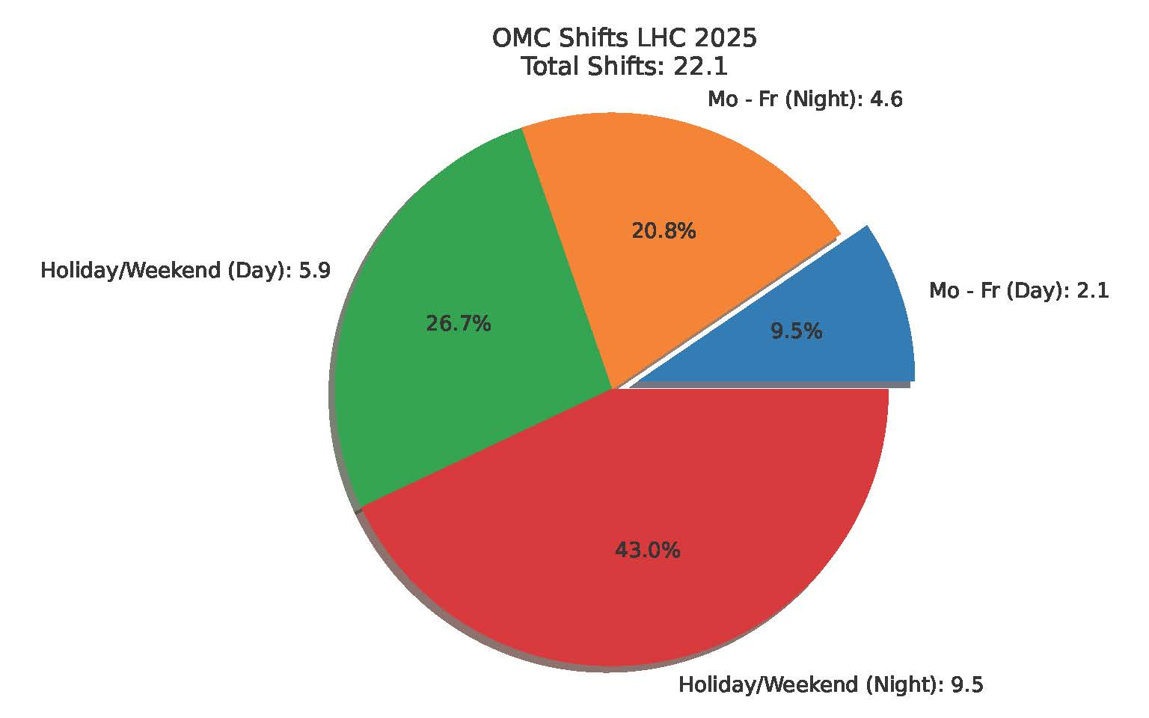
LHC commissioning
One of the toughest commissioning periods since 2010
PP optics
→ polarity swap in 2 IRs
→ first time doing operational commissioning with flat optics
→ smallest beta* & strongest ATS factors in operation
→ longest lumi-levelling squeeze = more global corrections
Multiple VDM cycles @ 24m and @ 50m
Multiple ion cycles PbPb, pO, OO
Was highlighted by Jorg/OP that during initial weeks of operation OMC accounted for about 30% of the machine time
Lots of long 12-18h shifts outside of work hours
Started 8th April, ended 28th June (with final PbPb still to do)
Huge thanks to everyone who participated!

Slide 5
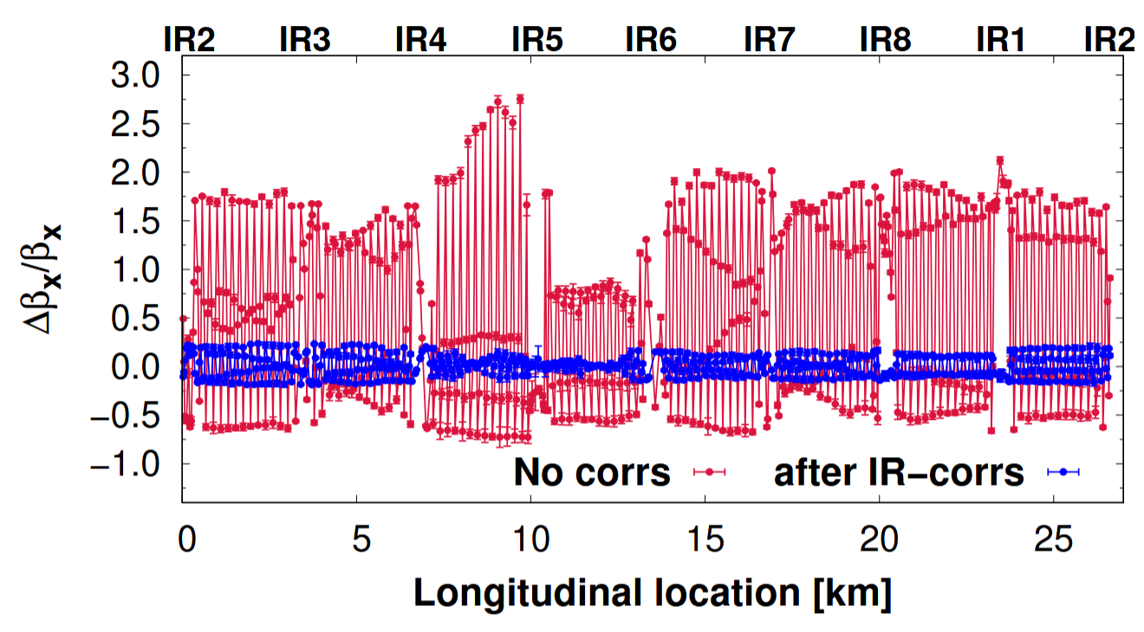
PP commissioning
Largest beta-beat measured yet in LHC = 275% !!

Slide 6
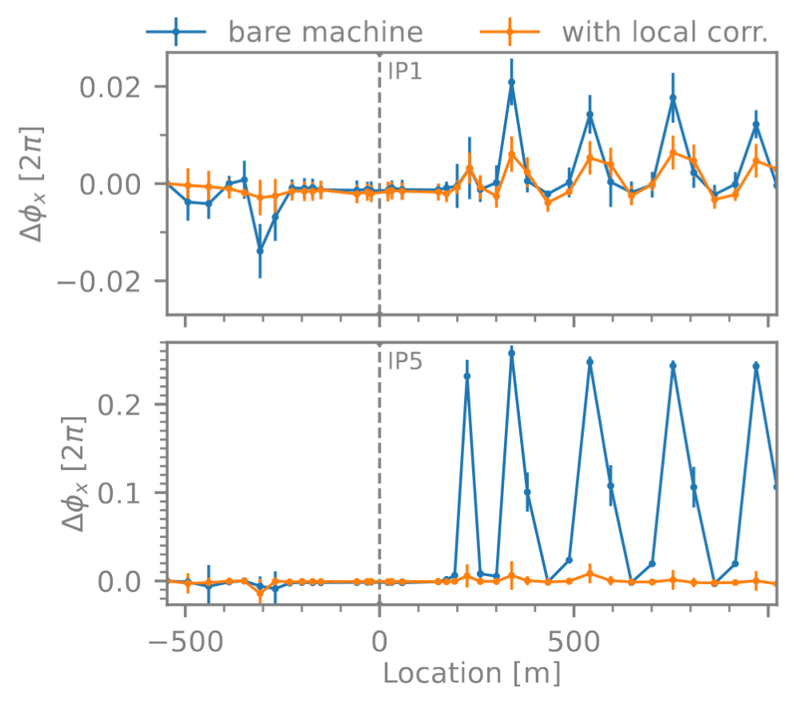
PP commissioning
Extrapolation of local coupling and local optics corrections for the polarity swap worked well in both IR1 and IR5
Substantially simplified commissioning, only some small iterations of local corrections were performed

Slide 7
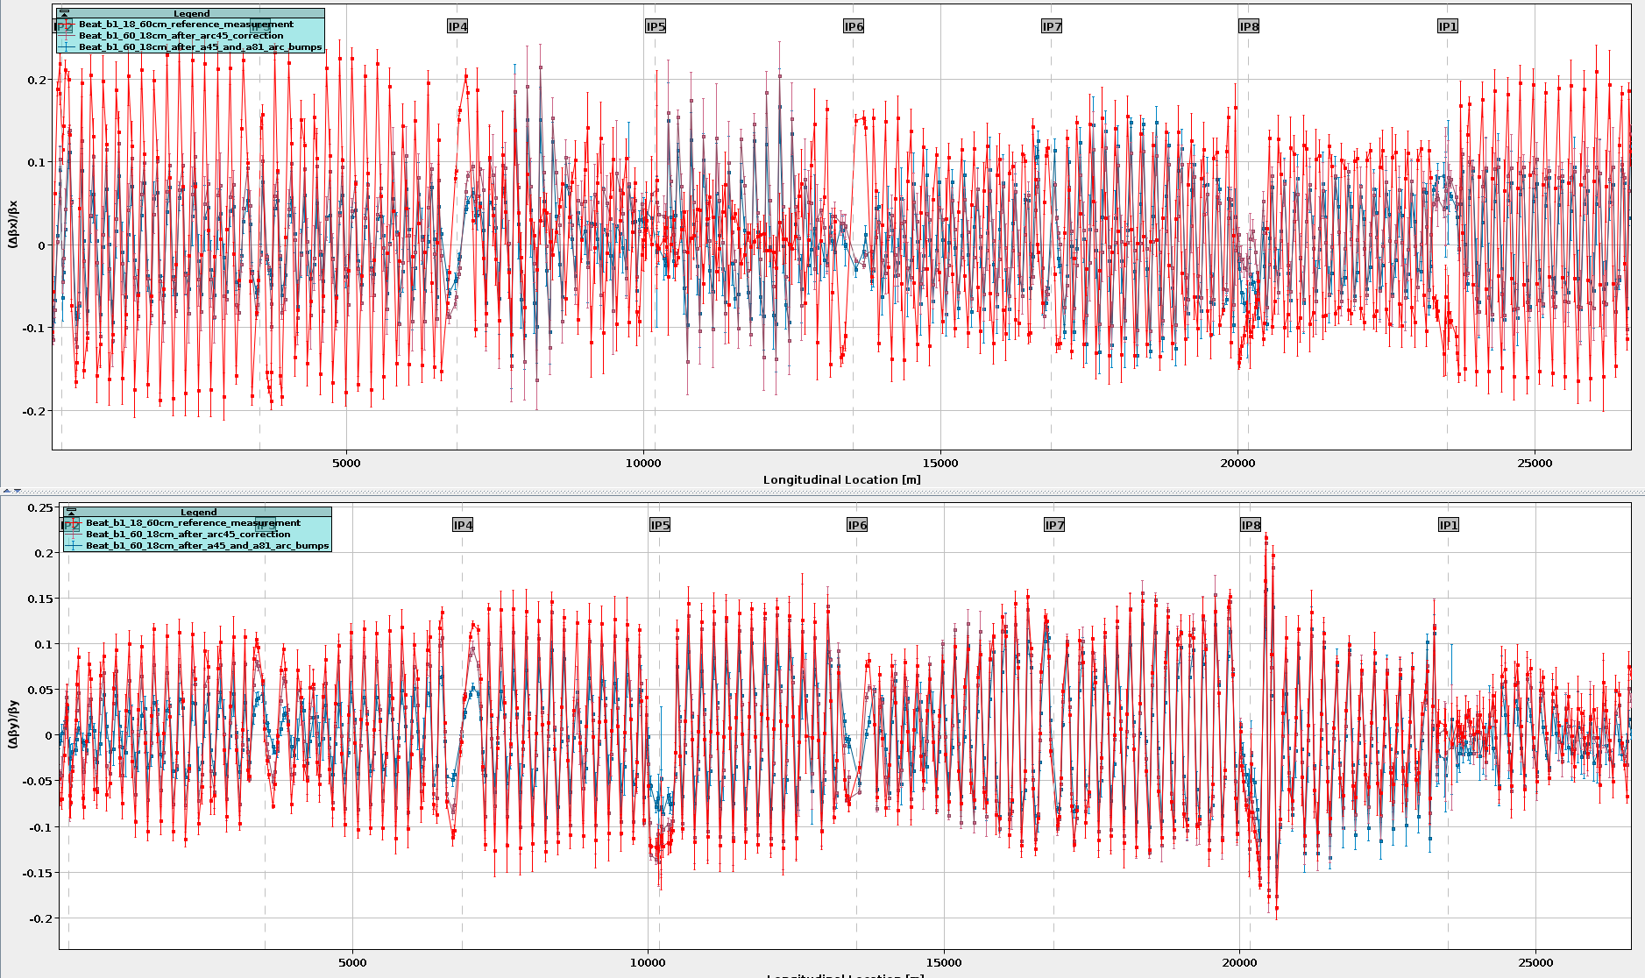
PP commissioning
Local arc-bump corrections prepared during YETS based on MD from 2024 worked well at end-of-squeeze

Slide 8
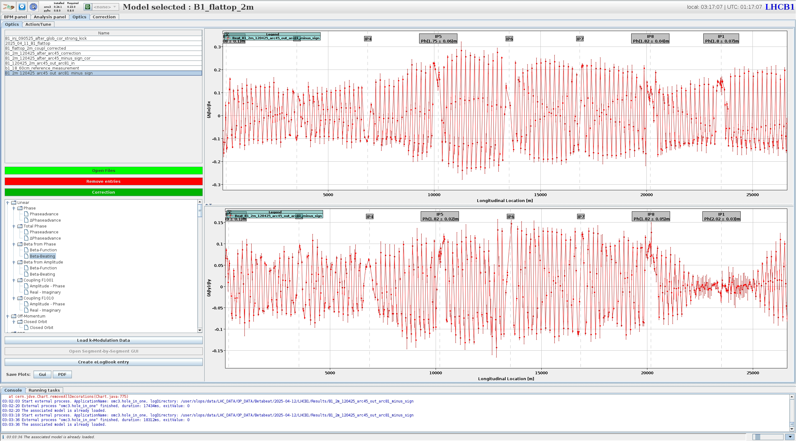
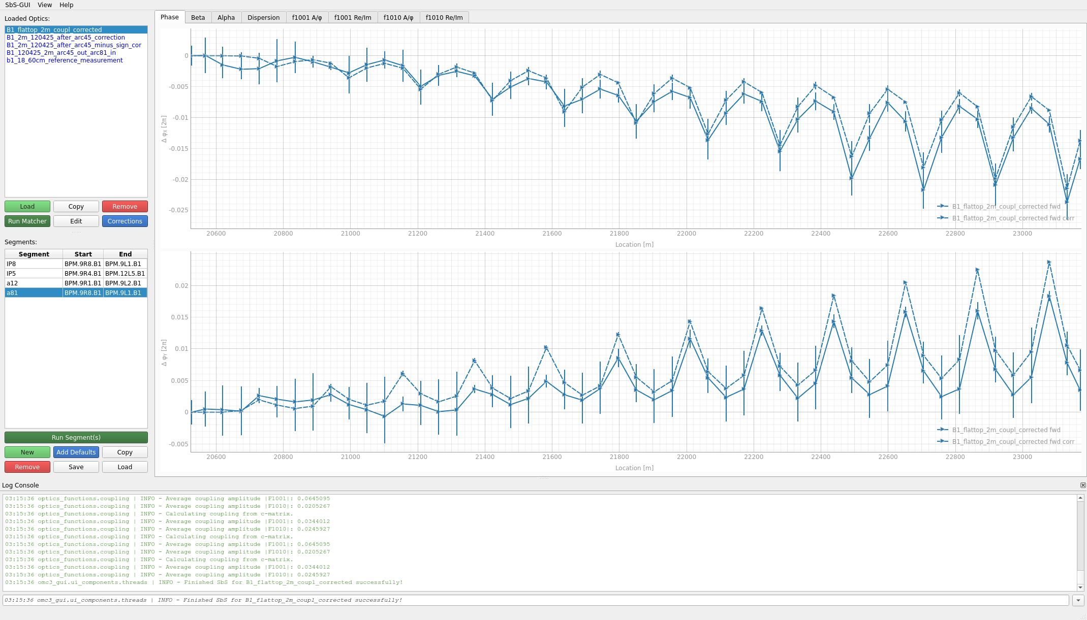
PP commissioning
Appeared to be large local errors in arcs at 2m also, but attempts to correct online with orbit bumps failed
SbS showed good match to systematic mispowering of MQ in ATS arcs → to be followed up

Slide 9
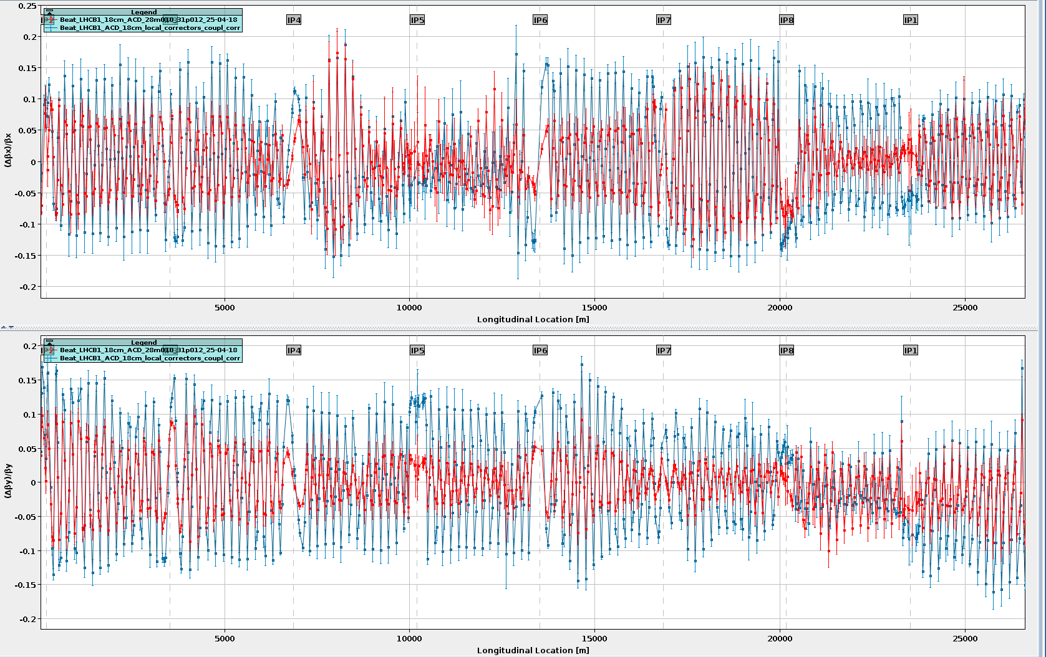
PP commissioning
Energy error issues re-appeared in-spite of specific attempts by OP to control during the commissioning period
13/04 vs 18/04
Was discovered that YASP FF was being based off of wrong variable that didn’t include settings coming from the energy FB
Hope is that this will now resolve it for the future

Slide 10
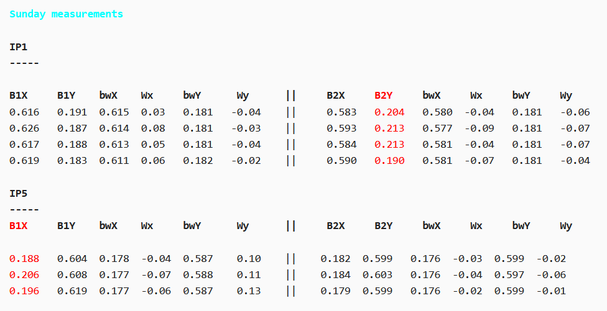
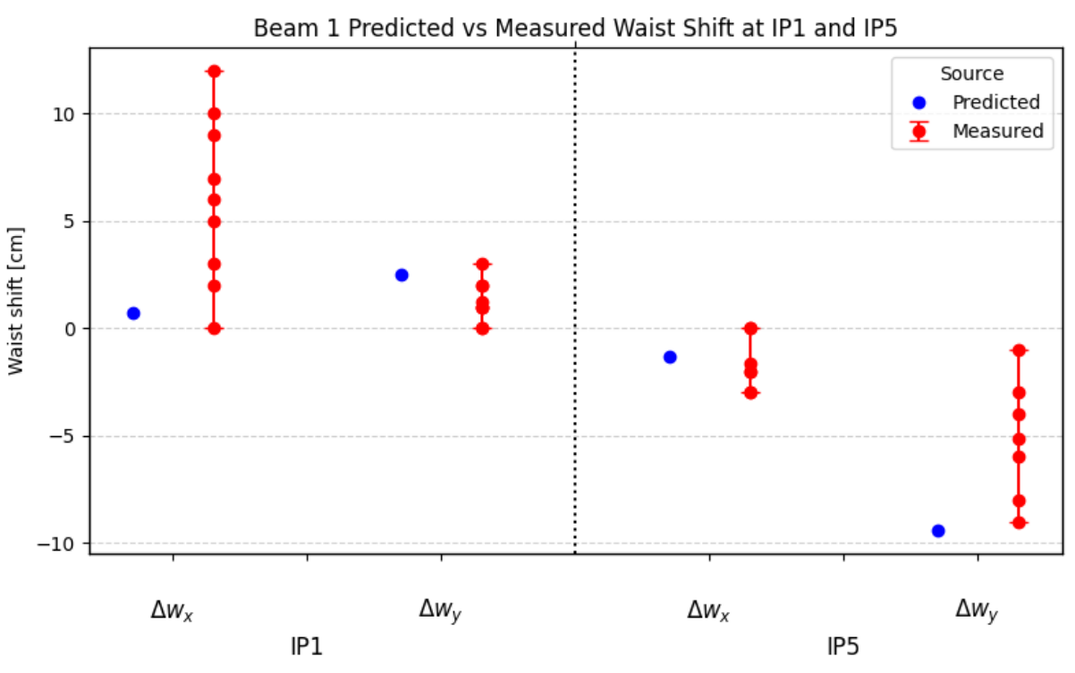
PP commissioning
While global corrections worked well at 18cm in terms of general beta-beating – found that beta* control in the 18cm planes was not fantastic
Study ongoing by summer student (Evan Root) to try and understand if this should have been expected from the correction or not

Slide 11
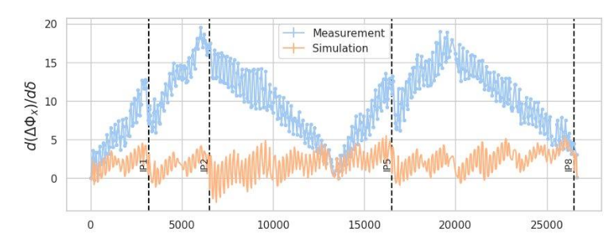
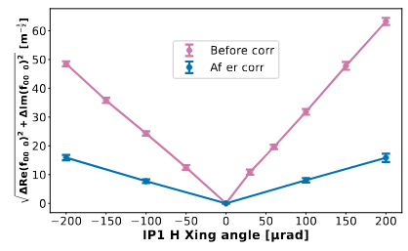
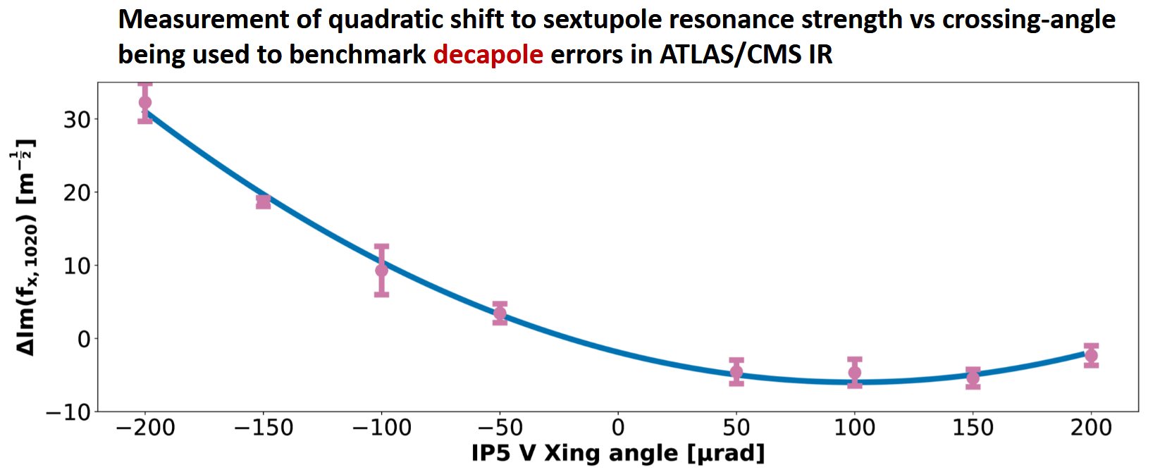
PP commissioning
Several very interesting results from nonlinear optics during commissioning too
A4 correction via RDT feed-down
Very large deviation from model of local chromaticity / chromatic phase shift at injection!

Slide 12
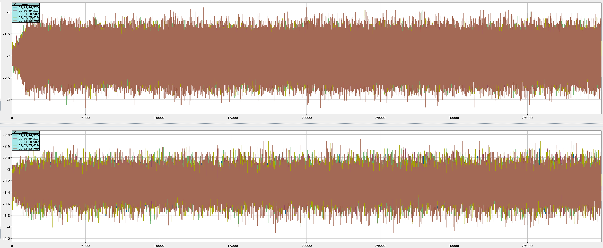
Multiturn
Automatic kick scheduling implemented in multiturn & used during commissioning
Multiturn application updated to allow easy ADT-ACD kicks
New settings with for ADT ACD tested at injection during commissioning. Should allow long-term large amplitude kicks & look very promising.

Slide 13
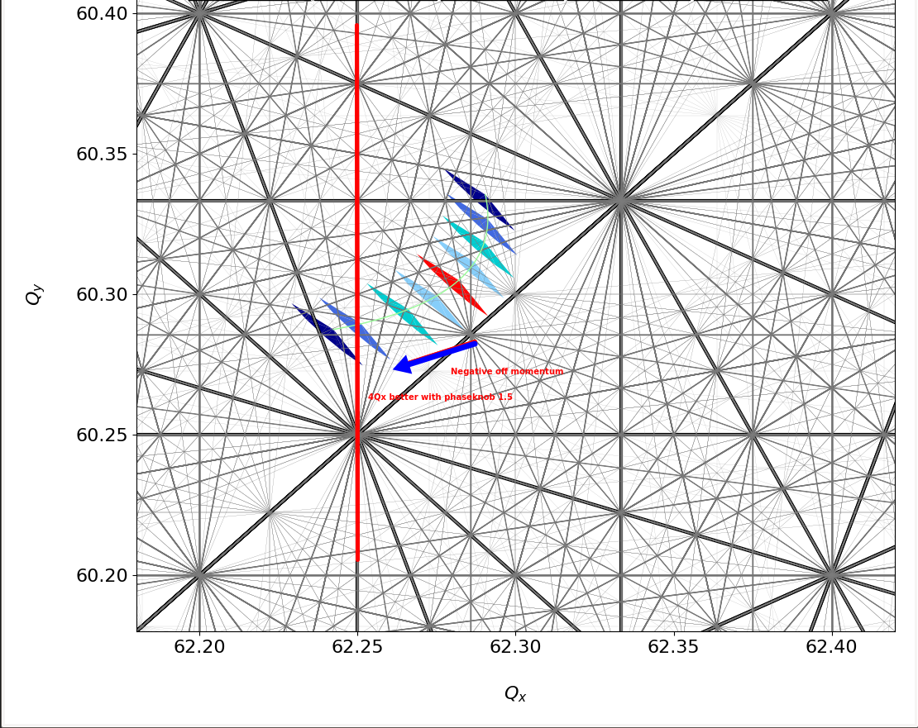
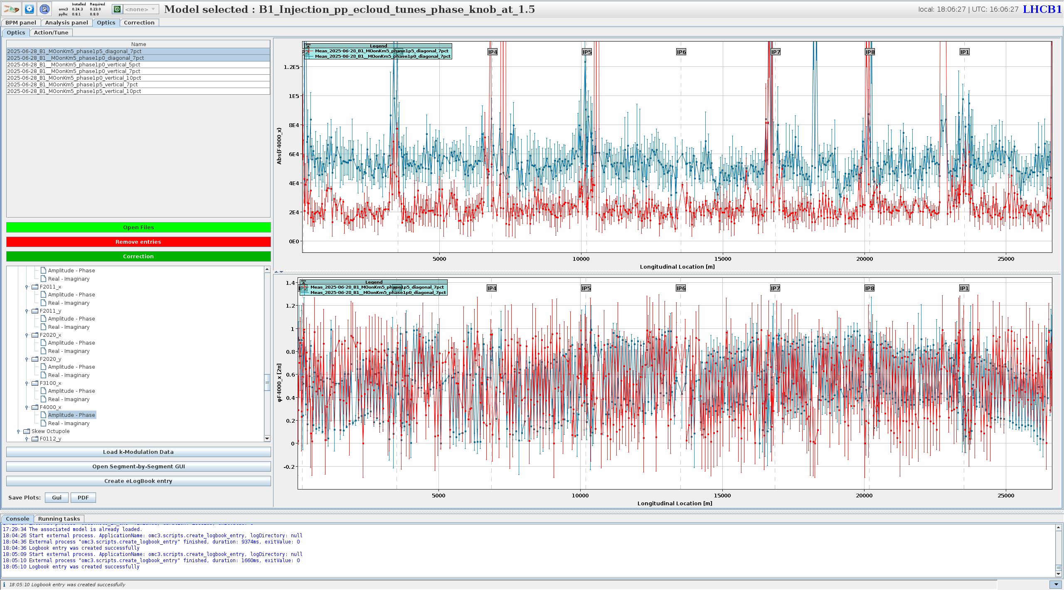
Hierarchy breaking at injection
With strong MO at injection, off-momentum collimator hierarchy was observed to be broken
Several optics interventions tried
Chromatic beta-beat was checked with MO powered, and no clear impact observed
Chromatic coupling was corrected, but no impact on hierarchy found
Proposed phase knob shift as means to understand if could be effect of RDTs – had a pronounced impact on the collimator hierarchy

Slide 14
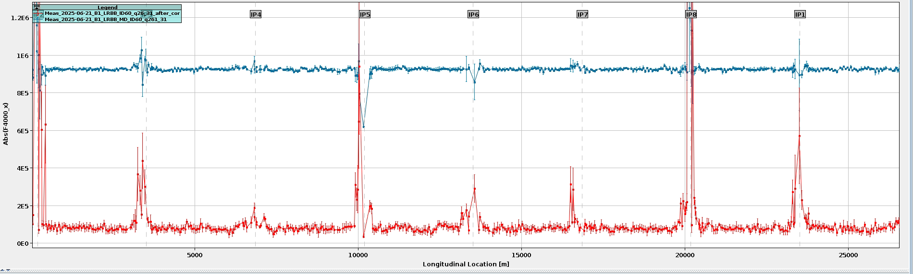
MD1
OMC supported IR7 collimation MD of Bjorn + cleaning MD of Dora/Massimo
→ both ended up more extensive than originally expected
OMC MD studing correction of LRBB RDTs using the IT corrector package was very successful
MCOX correction

Slide 15
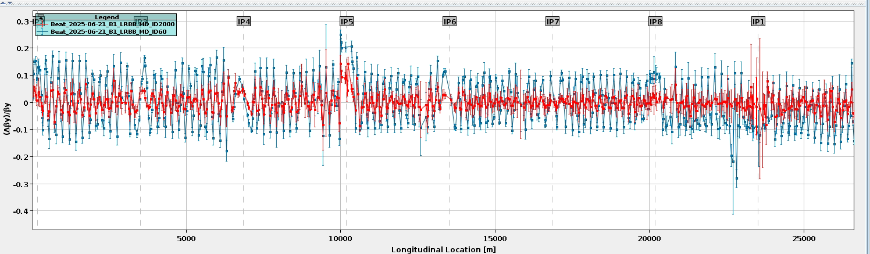
MD1
OMC supported IR7 collimation MD of Bjorn + cleaning MD of Dora/Massimo
→ both ended up more extensive than originally expected
OMC MD studing correction of LRBB RDTs using the IT corrector package was very successful

Slide 16
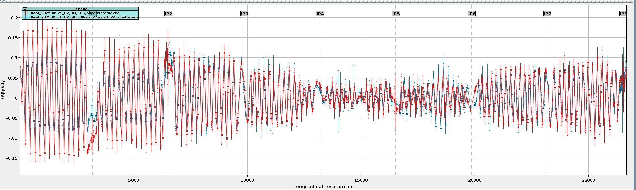
OO
Initially hoped that OO cycle at 5.3TeV could simply re-use the exisiting corrections from Pb
In practice seems that even this small energy change is enough to give non-negligible change to the optics – particularly at low-beta, so likely coming from change in IR errors
Found large beta*-beat so new globals implemented

