Slide 1
FCC-ee
LCC progress
LNO section meeting
2025-09-07
M. Jebramcik

Slide 2
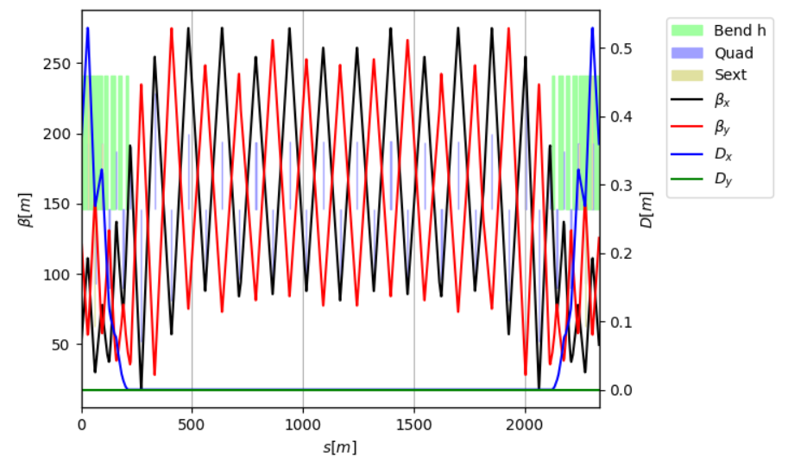
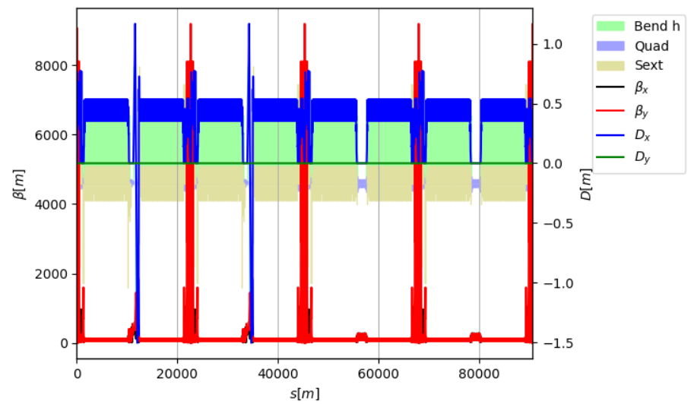
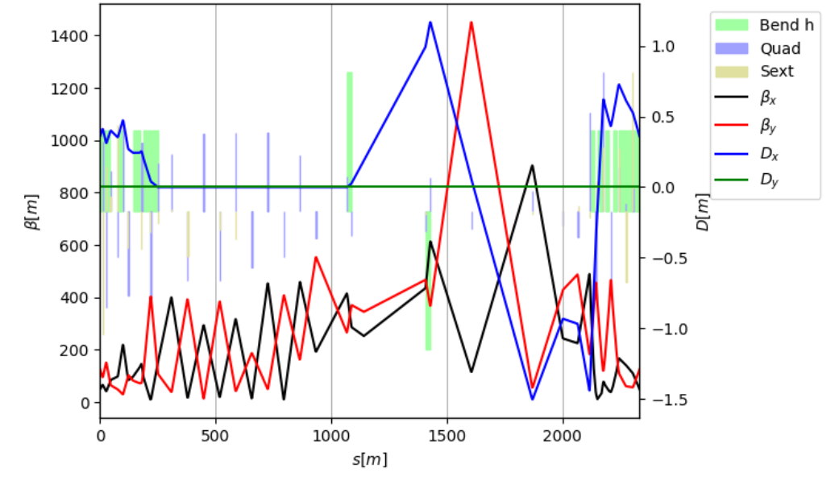
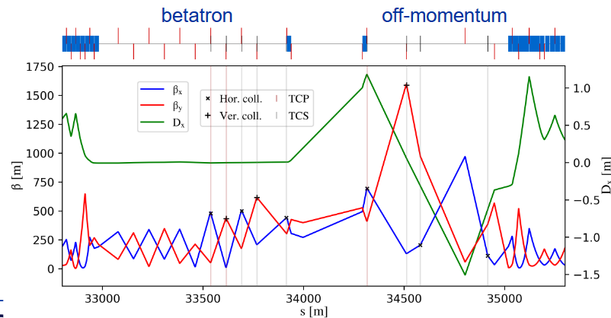
Activities regarding LCC lattice
M. Jebramcik
LCC straight sections are rather “basic”: FODO cells with some beam crossing. No collimation, no injection, promising (but not perfect) for RF
Tackling the issue at two fronts:
Pantaleo the quadrupole distance for the RF requirements and modified the DS for the correct separations. He started working on a collimation section (hopes that one could do momentum cleaning close to the SCRAB in the IPs)
Myself, I have created an LCC branch with Oide’s universal straight section matched into two straights. Idea here is NOT that this is eventually being used in our final design → Allows tests of injection, collimation…
“new” LCC straight
LCC
GHC
Modified LCC

Slide 3
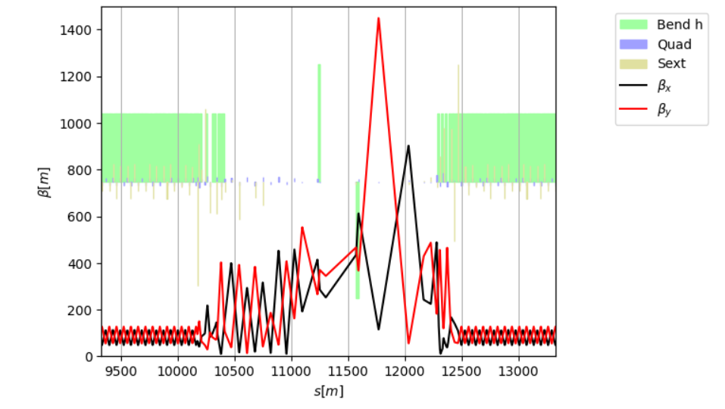
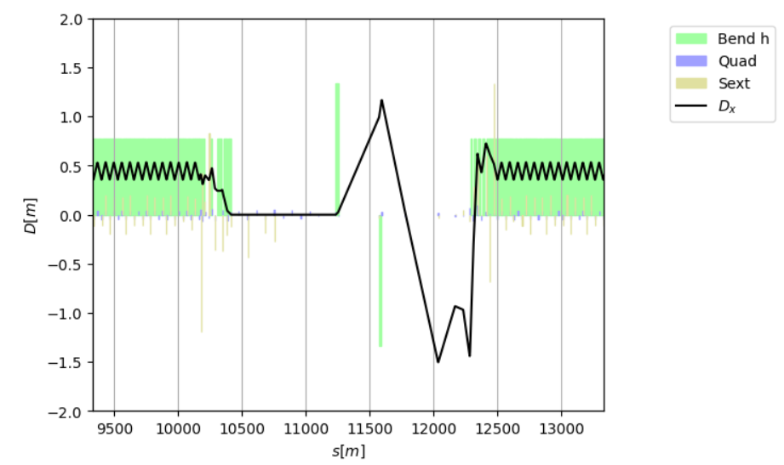
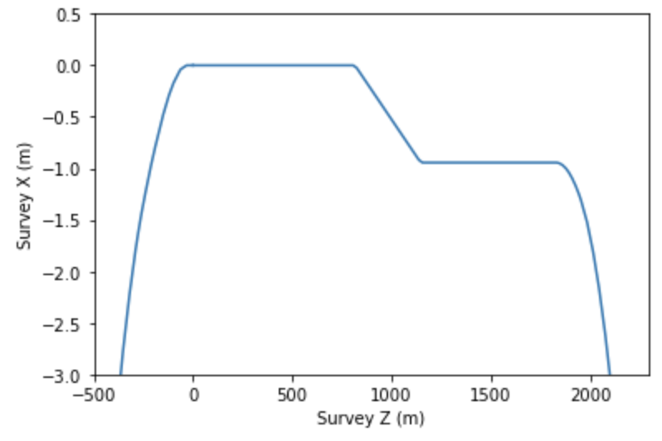
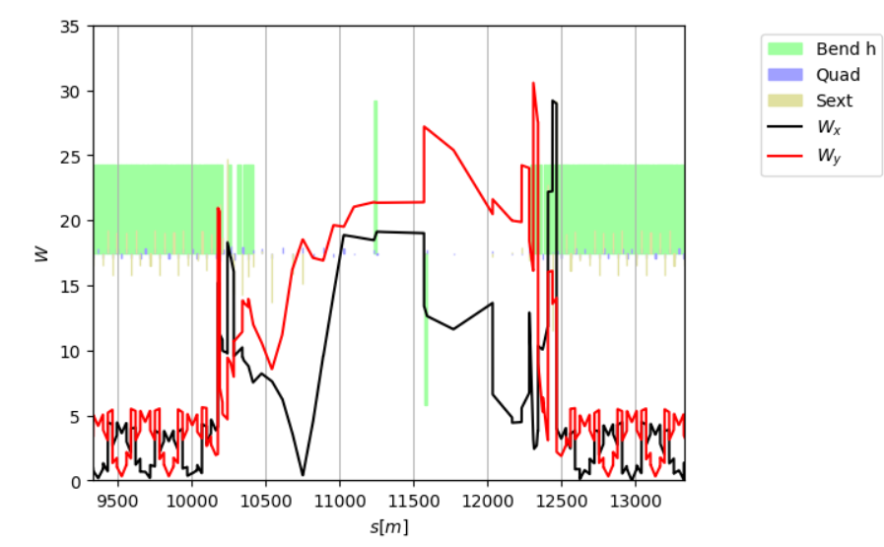
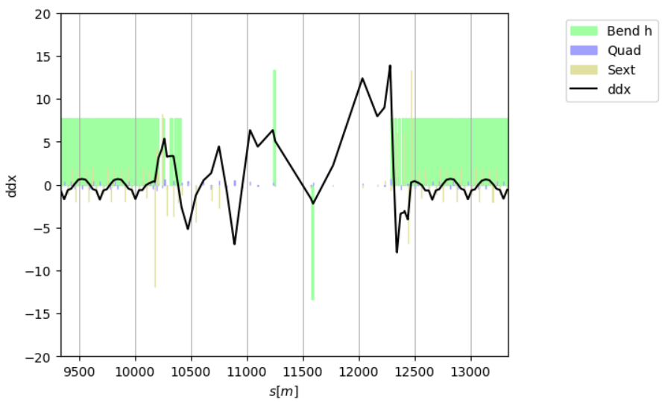
Matching with transparency conditions
M. Jebramcik
Besides linear optics, matching of Wx, Wy, ddx, sextupole RDTs (locally) + Survey matching with constant k0
960mm separation in straight;
350mm separation start/end of arc.

Slide 4
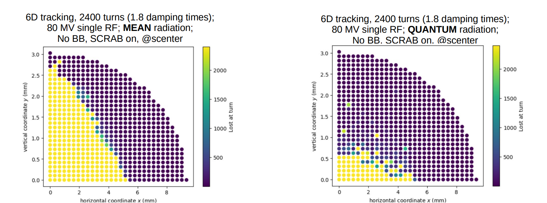
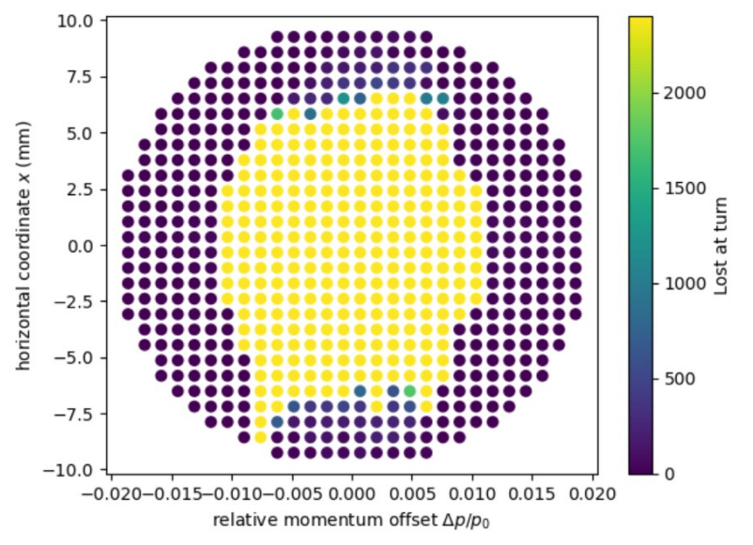
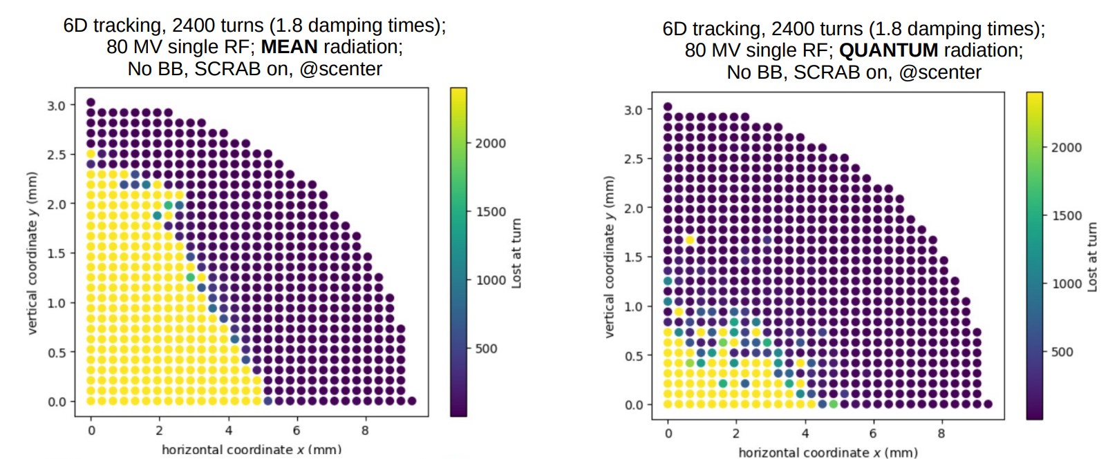
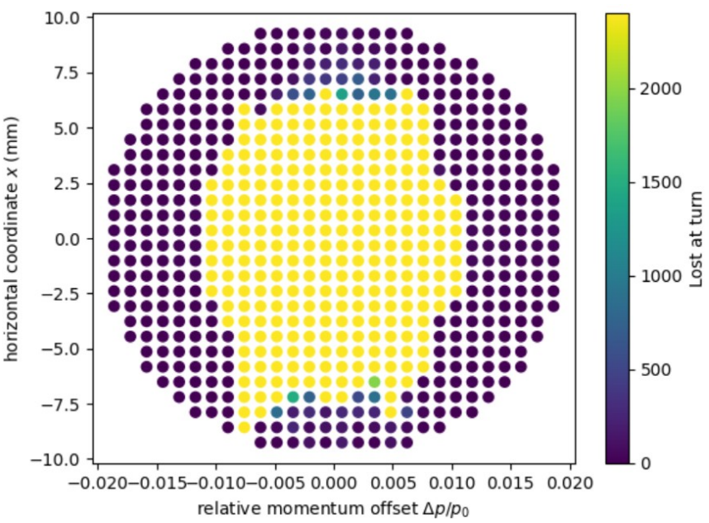
DA and MA before and after insertion
M. Jebramcik
LCC
92a 107
LCC
92a 107
Mod.

Slide 5
A lot of things on the plate
M. Jebramcik
LCC optics files not harmonized at this point in time – LCC non-linear optimization only available in pyAT on Zenodo → Kyriakos is tackling this. In addition, we have to agree on how to share “intermediate” optics versions.
It appears that collimation could improve by quite a bit compared to the GHC. Giacomo had a very basic first look. TCPs could(!) open from X: 9.5 σ_{x} → 13-14 σ_{x}; Y: 50 σ_{y} → 75-90 σ_{y}
Modified arcs: Pantaleo has reduced the number of quadrupole families for ttbar (no release yet). Same procedure for Z might be pending. → Medium term: We will need to provide a “representative” FODO cell (with photon-stopper placement…) to SY-STI
Inner and outer arc still have the same path length → Will chat with Riccardo tomorrow. Want to stick to the LHC concepts here.
SR with quantum is a big problem right now since it also holds back the collimation study → If the DA breakdown is real, then we might end up modifying the doublet? (Pantaleo mentioned current doublet is result of a DA-vs-MA study)
LEIR: Sadly(!), I will take over Felix’s LEIR responsibilities. SY-ABT is looking at some slow extraction from LEIR to a proposed HEARTS experiment (ESPP submission?).

Slide 6
Thank you for your attention.

