Slide 1
ATLAS RPC
FOAM TECHNIQUE STUDIES
Weekly Report
Presenter: Ahmet Renklioğlu
ON BEHALF OF ATLAS RPC FOAM TEAM

Slide 2
Repairs Performed to Date Using the Resin Technique,
Test Results of the Performance and Analysis
Status of the Sectors Where Injections Were Performed
Test Results
# Injections until YETS 24/25 | 601
# Injections in YETS 24/25 | 409
# of Injections | 1010
# Fully Repaired Layers before YETS 24/25 | 166
# Fully Repaired Layers after YETS 24/25 | 337
# Fully Injected Layers to be excluded from performance analysis due to known reasons | 11
# of injected layers to be considered for performance analysis (for the injections before YETS 24/25) | 155
%
Analysis of Test Results

Slide 3
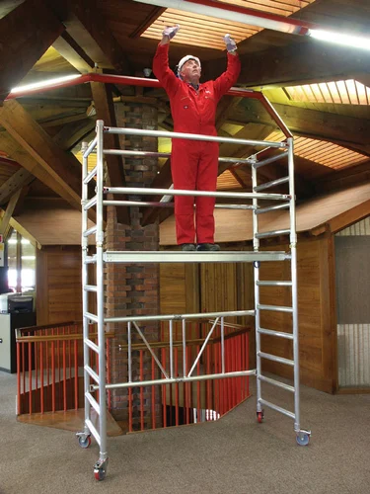
Statistics and a Preliminary Outlook for LS3
# of Injections | 1010
# Remaining Boxes to Inject | 3400
# of Avarage Injections in YETS 24/25 per week per team (2 people) | 17
# Weeks to Complete with Average Performance (1 team) | 200
# Weeks to Complete with Average Performance (2 team) | 100
# of Injections (wrt best 3 week) in YETS 24/25 per week per team (2 people) | 23.45
# Weeks to Complete with Best Performance (1 team) | 145
# Weeks to Complete with Best Performance (2 team) | 72.5
Is it Possible to Apply the Resin Technique to Every Sector?
The biggest problem is reaching the boxes!
Can some platforms be installed in the sectors during LS3?
After having the platforms, each sector could be repaired in 2 weeks with two teams.
Sectors that are visiually inspected in TS1

Slide 4
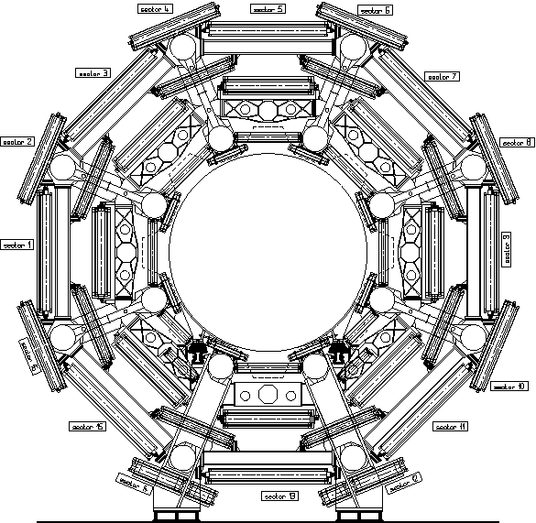
Sectors We Need Platform to Inject Resin
Sectors We DON’T Need Platform to Inject Resin

