Slide 1

ExcavatED materials management STRATEGY
Grant agreement No 951754
Grant agreement No 951754
Luisa ULRICI, CERN, HSE/ENV

Slide 2
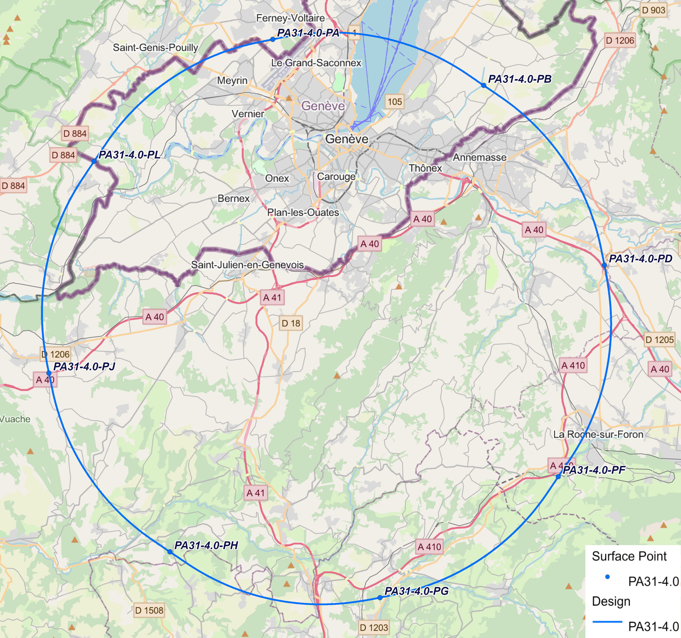
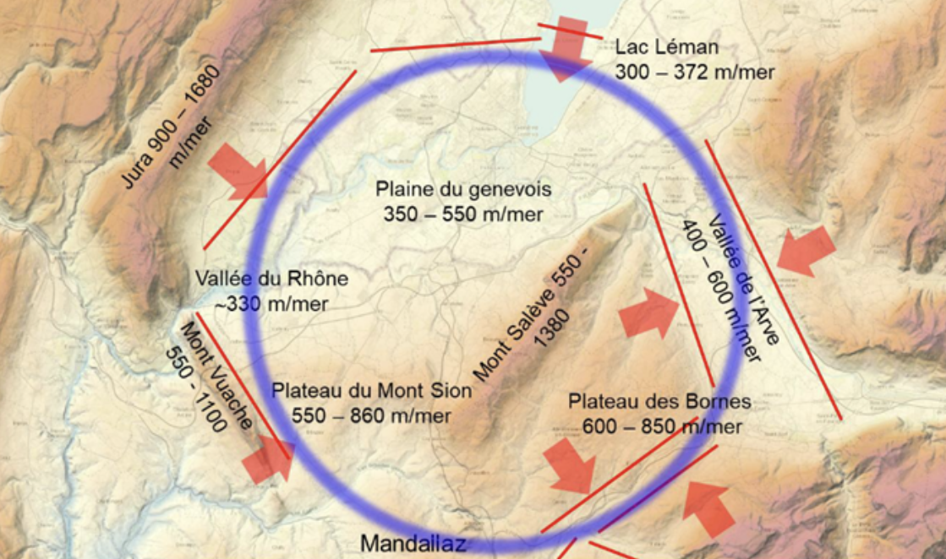
Management of excavated materials: rationale
Luisa ULRICI - CERN
Excavated Materials (MATEX):
6.3 Mm³ material (in-situ)- about 16.4 Mt
95% heterogeneous sedimentary molasse, 3% limestone, 2% moraine
Average composition of Molasse
30 to 50% clay
10 to 15% silt
10 to 15% sand, with a grain size of between 63 μm and 4 mm
15 to 20% sandstone particles larger than 4 mm.
Schematic view of the location of the FCC infrastructures
Today no known industrial-scale re-use for the molasse

Slide 3
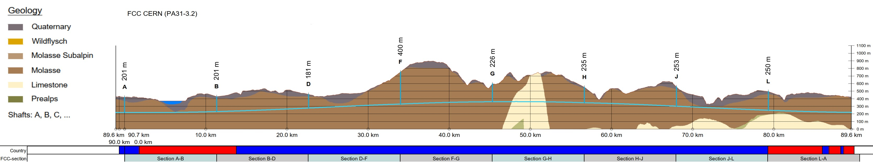
The reuse of excavated materials
Luisa ULRICI - CERN
The degree of actual reuse depends largely on the geochemical, mineralogical and geotechnical properties of the excavated materials.
The choice of the tunnelling method is of particular importance. It influences the particle size distribution and on anthropogenic contamination.
Possible presence of geogenic anomalies (hydrocarbons and heavy metals) also impacts the re-use possibilities.
Risk management: subsurface investigations at regular intervals along the tunnel path and with increased frequency at geotechnically unknown regions are compulsory.
To avoid the creation of temporary surface storage, the results of geochemical, mineralogical and geotechnical analysis should be available as soon as possible - preferably via online-analyses in the underground during tunneling.

Slide 4
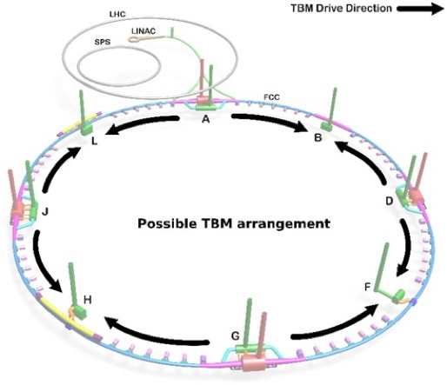


Provisional reference scenario for the Tunnel Boring Machines (TBM)
Luisa ULRICI - CERN
“Fair-share” principle: each state manages the equivalent mass of MATEX excavated on its territory, based on the vertical projection of the border FR/CH
Material excavated in France and Switzerland, based on vertical projection of border, including bulk factor¹.
84%
16%
The starting point of each TBM is also the exit point of the excavated materials
Experimental sites (PA, PD, PG, PJ) will probably host:
Excavated material temporary storage (capacity for a few weeks, depending on the excavation rate).
Local first treatment to allow for safe transport to the reuse facility.
Installations to identify and sort the materials according to the pollution and reuse potential.
¹Bulk factor: 1.3

Slide 5
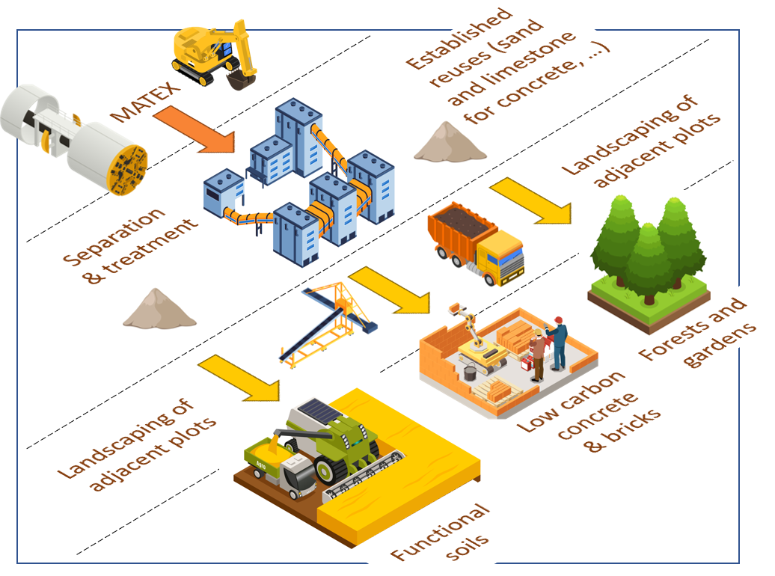
Innovative ideas for the reuse of excavated materials from FCC: from waste to functional soil
Luisa ULRICI - CERN
Real-scale innovation project: OpenSkyLab
International competition “ Mining the Future” launched in 2022 with the support of the EU Horizon 2020 grant agreement 951754
Purpose: Find innovative solutions for the excavated materials (molasse) reuse. «From waste to opportunity »
http://miningthefuture.web.cern.ch/
https://home.cern/news/news/engineering/winner-mining-future-competition-announced
Proposed innovative ideas:
separation of materials in view of increasing the re-use potential,
reuse via soil engineering for agriculture, renaturation and forestry
reuse for construction components (bricks, concrete)
The priority for FCC is to propose a large-scale re-use of excavated materials as reconstructed functional soil for many applications

Slide 6
Reuse of excavated materials
In line with the current Host States regulations concerning excavation material management,
a strategy was defined including reuse cases:
• within the project (worksite roads, embankments);
• in earthwork (backfilling of quarries and mines and renaturation) and development projects;
• sand/ limestone fraction in concrete production
• transformation of the molasse into a reconstituted soil
• use of a part of the molasses as technical materials (isolation panels, bricks).
Estimate of reuse quantities:
40% refill of quarries (∼ 7.5 Mt)
25% reconstituted soil (∼ 4 Mt)
30% deposit (∼ 5 Mt)
5% other reuse
Ongoing and future work:
Demonstration of the reuse processes
Specific management plan and transport ways
Identification and agreements with final reuse actors

Slide 7
Thank you for your attention.
This project has received funding from the European Union's Horizon 2020 research and innovation programme under the European Union's Horizon 2020 research and innovation programme under grant agreement No 951754.
Grant agreement No 951754
7

