Slide 1

A platform for developing quality-managed processes for constructing soil from geological excavation materials
Christiana Staudinger¹, Corentin Pueyo², Luisa Ulrici², Maha-Deeb Collet³, Pascal Boivin³, Ali Kanso⁴, Gaylord Machinet⁴, Maha Chalhoub⁵, Philippe Bataillard⁵, Samuel Coussy⁵, Charles Cartannaz⁵ , Noémie Dubrac⁵, Markus Marchhart⁶, Hannes Pavetits⁷, Hans-Peter Kaul¹, Olivier Duboc^{1,} Johannes Gutleber²
¹University of Natural Resources and Life Sciences (BOKU), Vienna, Austria, ²CERN, Geneva, Switzerland,
³University of Applied Sciences of Western Switzerland (HEPIA), Geneva, Switzerland, ⁴Microhumus, Vandoeuvre-les-Nancy, France, ⁵French Geological Survey (BRGM), Orléans, France, ⁶Business Engineering for Control Centers GmbH , Vienna, Austria, ⁷Pavetits Consultancy, Soral, Switzerland

Slide 2
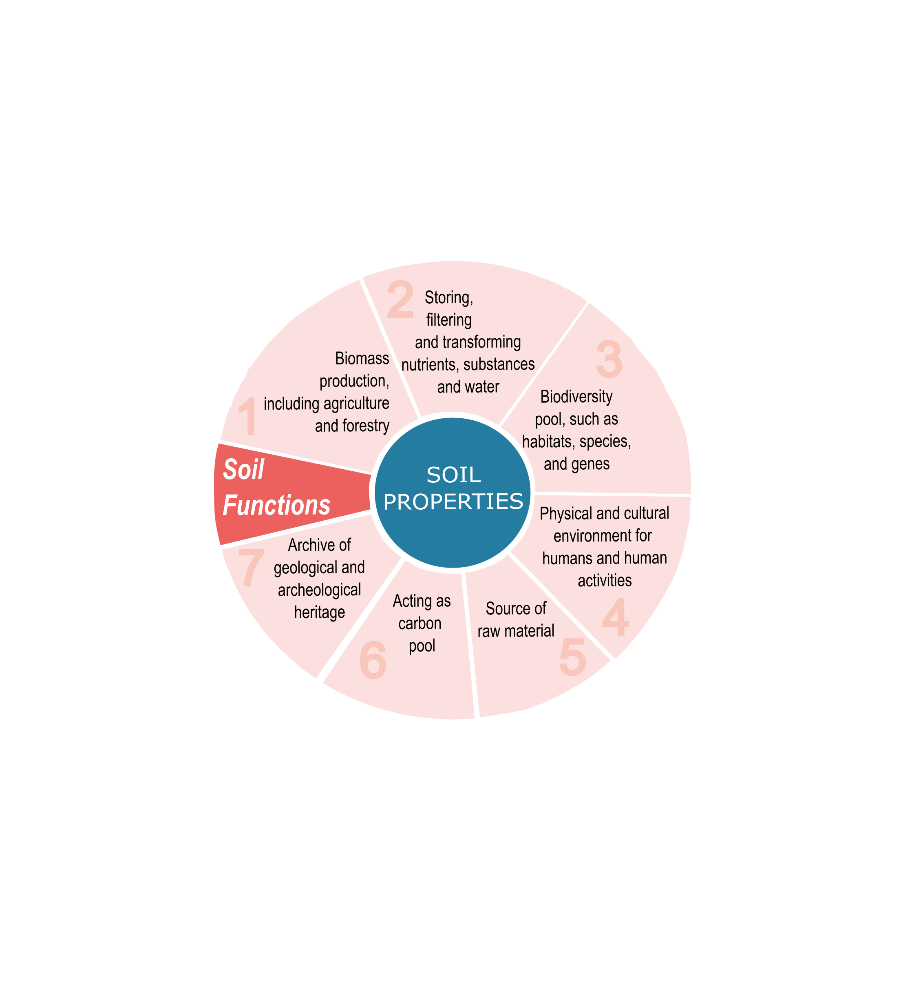
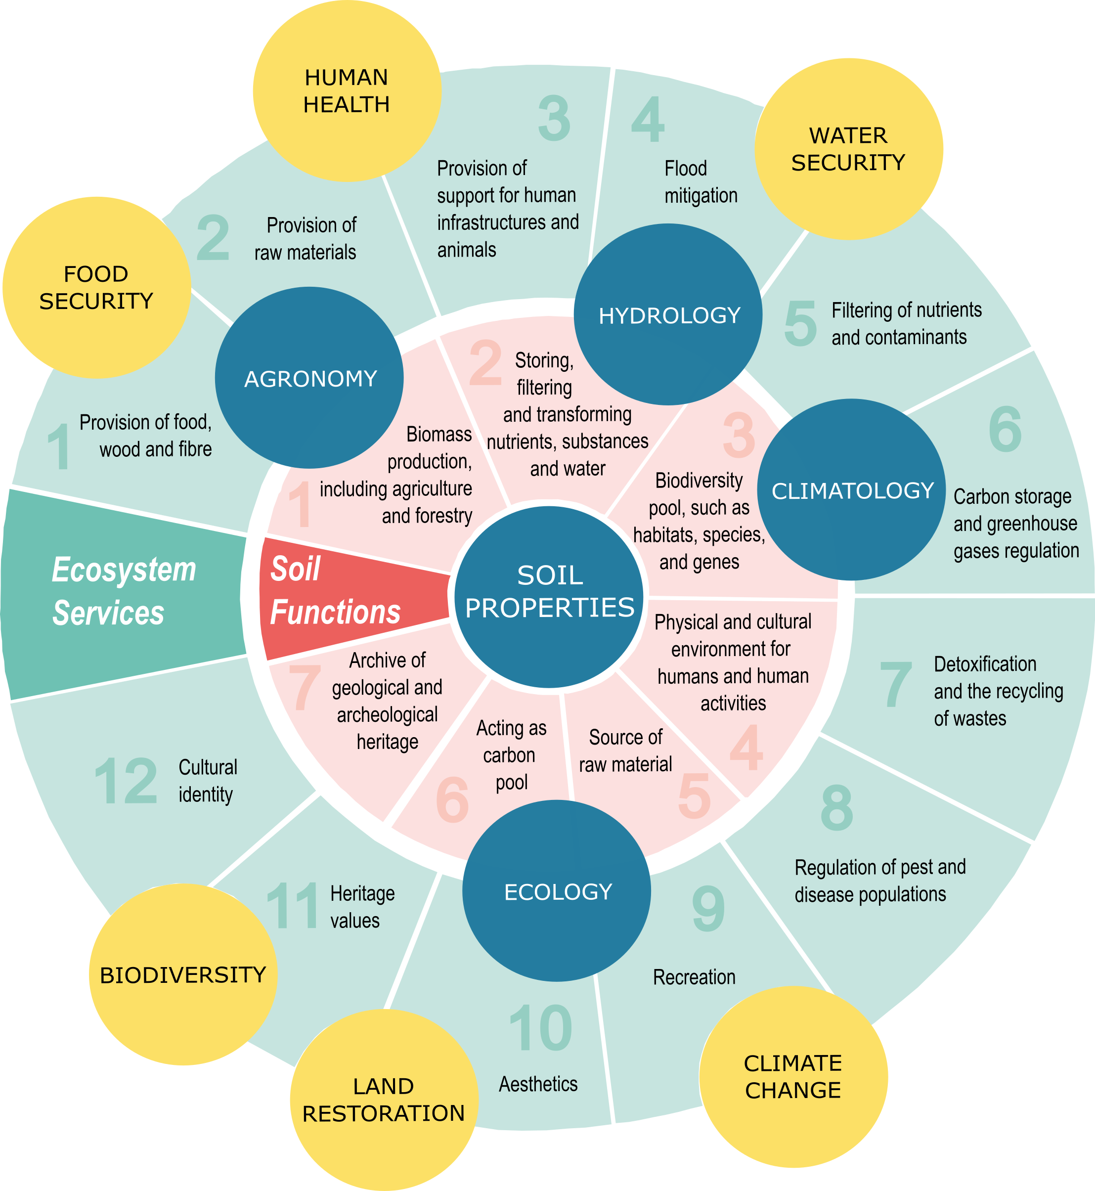
Soils provide important ecosystem services
Natural soils are a non-renewable resource, with an average global geological rate of soil formation¹ of 0.01 mm y⁻¹.
The European Commission has defined seven key soil functions as part of its soil protection and environmental policy, which are related to ecosystem services and SDGs as defined by the UN².
Fundamental soil properties form the basis of soil functions³:
  Chemical: mineralogy, soil organic carbon, pH, EC, cation exchange capacity (CEC), available water and nutrients.
  Physical: texture (sand, silt, clay and coarse fragments), bulk density, temperature, soil porosity and air permeability, hydraulic conductivity and infiltration.
  Biological: activity and abundance of soil biota.
Soil structure and aggregation are key determinants of soil functionality.
¹ Banwart et al., 2019, ² EC, 2006, ³soil parameters assessed in OSL

Slide 3
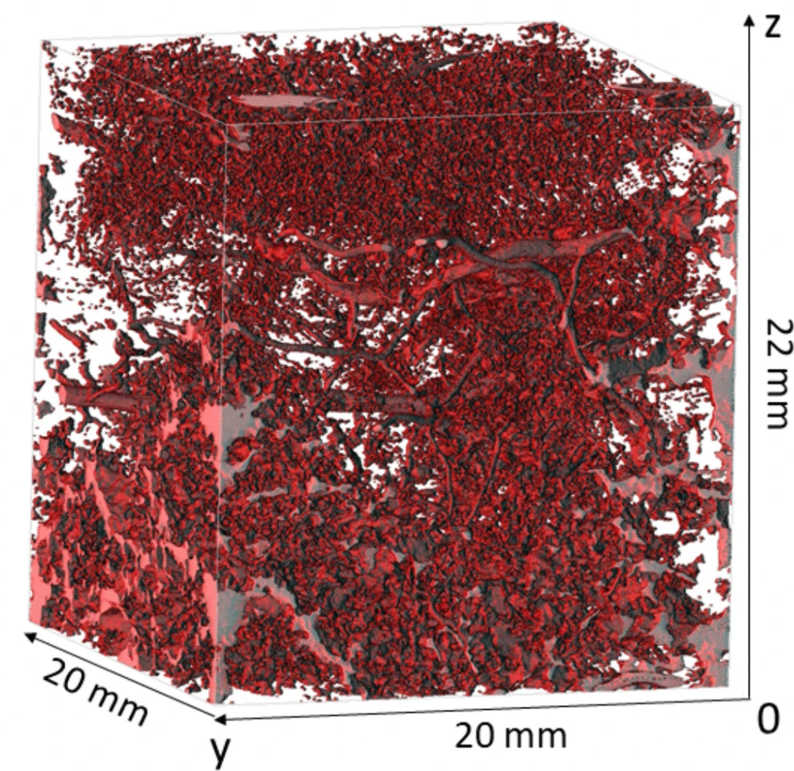
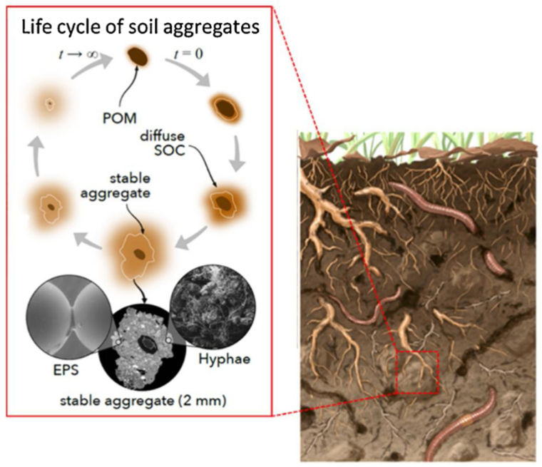
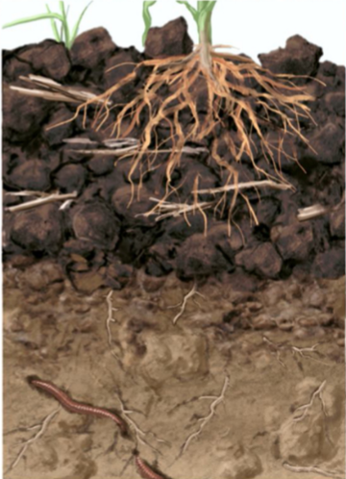
Soils provide important ecosystem services
µCT scan of soil porespace⁴
Natural soils are a non-renewable resource, with an average global geological rate of soil formation¹ of 0.01 mm y⁻¹.
The European Commission has defined seven key soil functions as part of its soil protection and environmental policy, which are related to ecosystem services and SDGs as defined by the UN².
Fundamental soil properties form the basis of soil functions³:
  Chemical: mineralogy, soil organic carbon, pH, EC, cation exchange capacity (CEC), available water and nutrients.
  Physical: texture (sand, silt, clay and coarse fragments), bulk density, temperature, soil porosity and air permeability, hydraulic conductivity and infiltration.
  Biological: activity and abundance of soil biota.
Soil structure and aggregation are key determinants of soil functionality.
For a certain target environment, which soil construction workflows result in a rapid and stable acquisition of soil functionality?
Natural and managed soil structure⁵
natural
agricultural
¹ Banwart et al., 2019, ² EC, 2006, ³soil parameters assessed in OSL, ⁴ Heckova et al., 2025, ⁵ Or et al., 2019

Slide 4
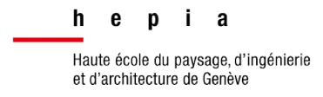







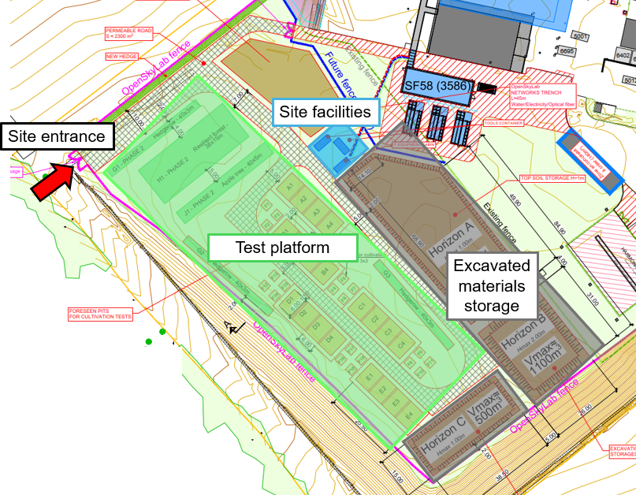
A collaboration between academia and industry
Site at Cessy provided by CERN
(1 ha, France, 2024-2028)
Quality-managed approach to the development of soil construction and monitoring of pedogenic processes during first 4 years → predict future outcomes
Documentation of a process for soil construction from molasse for different use cases and plant species
Optimisation of mixing techniques and inoculation techniques
Pedological study showed heteregeneous anthropogenic soil with 40% of coarse elements, topsoil moderated fertility, poor drainage capacity → Ideal site for the experiment

Slide 5
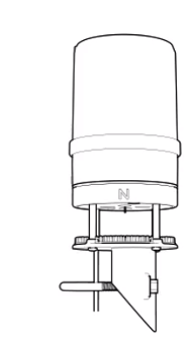
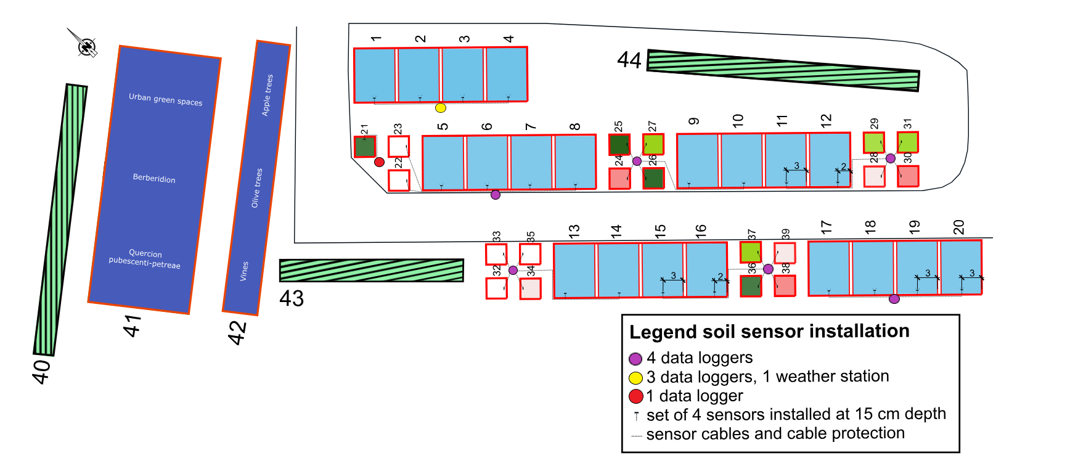
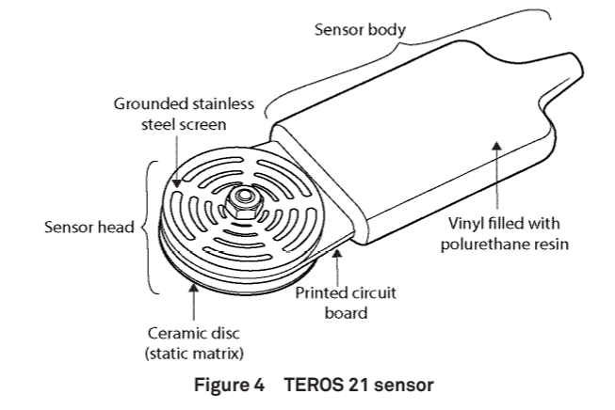
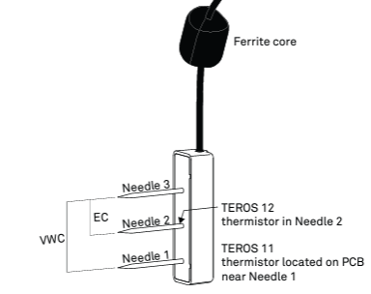
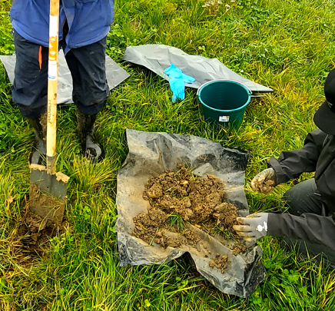


Automated field monitoring
ATMOS 41
Atmospheric monitoring station
TEROS 21
Temperature, water potential
+
+
+
Manual sampling
Drone imaging of plant cover
Cameras
Developed by M. Marchhart/H. Pavetits : OpenSkyView field monitoring system
TEROS 12
Temperature, bulk EC, moisture

Slide 6

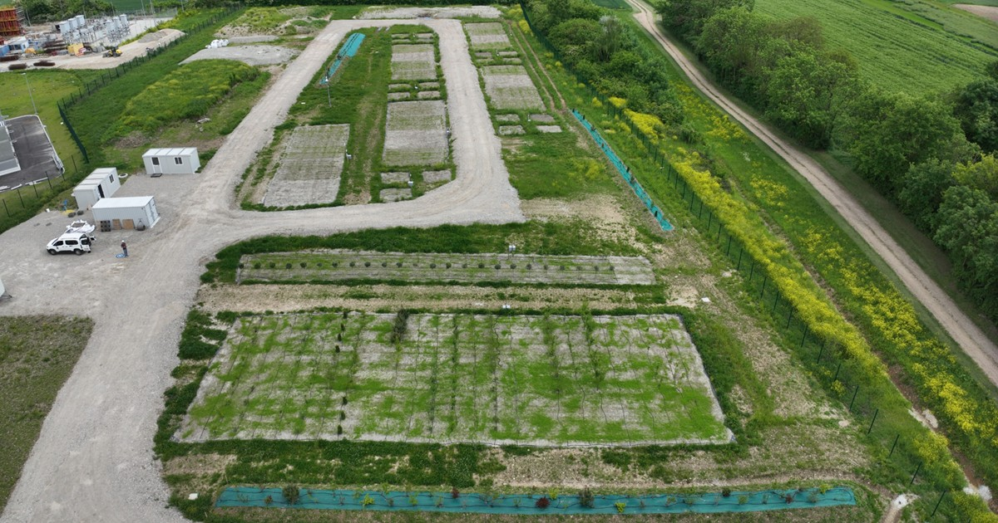
A platform to develop soil construction processes
OpenSkyLab, Cessy, France:
Replicated plots: to test for repeatability of soil construction procedure, account for spatial heterogeneity of site.
Plant nursery plots: within plot replication to evaluate which shrub and tree species/genotypes are best adapted to molasse-based soils.
Elevated hedgerows to test whether molasse can be used as a support material for landscape features.
Replicated plots
Elevated hedgerows
Plant nursery plots
OSL, May 2025
Aim: characterise the gradual acquisition of soil functions in molasse-based constructed soils
→ predict the possible reuse of constructed soils in various scenarios

Slide 7
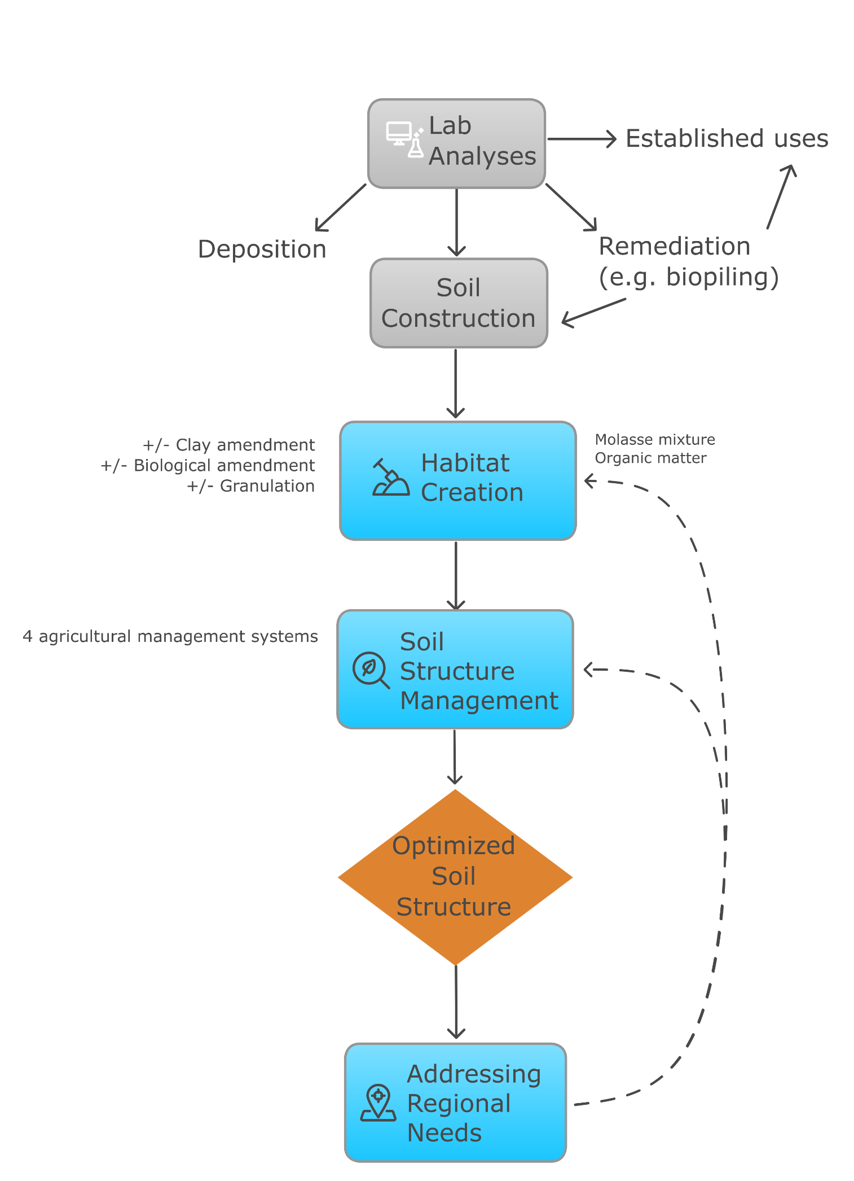
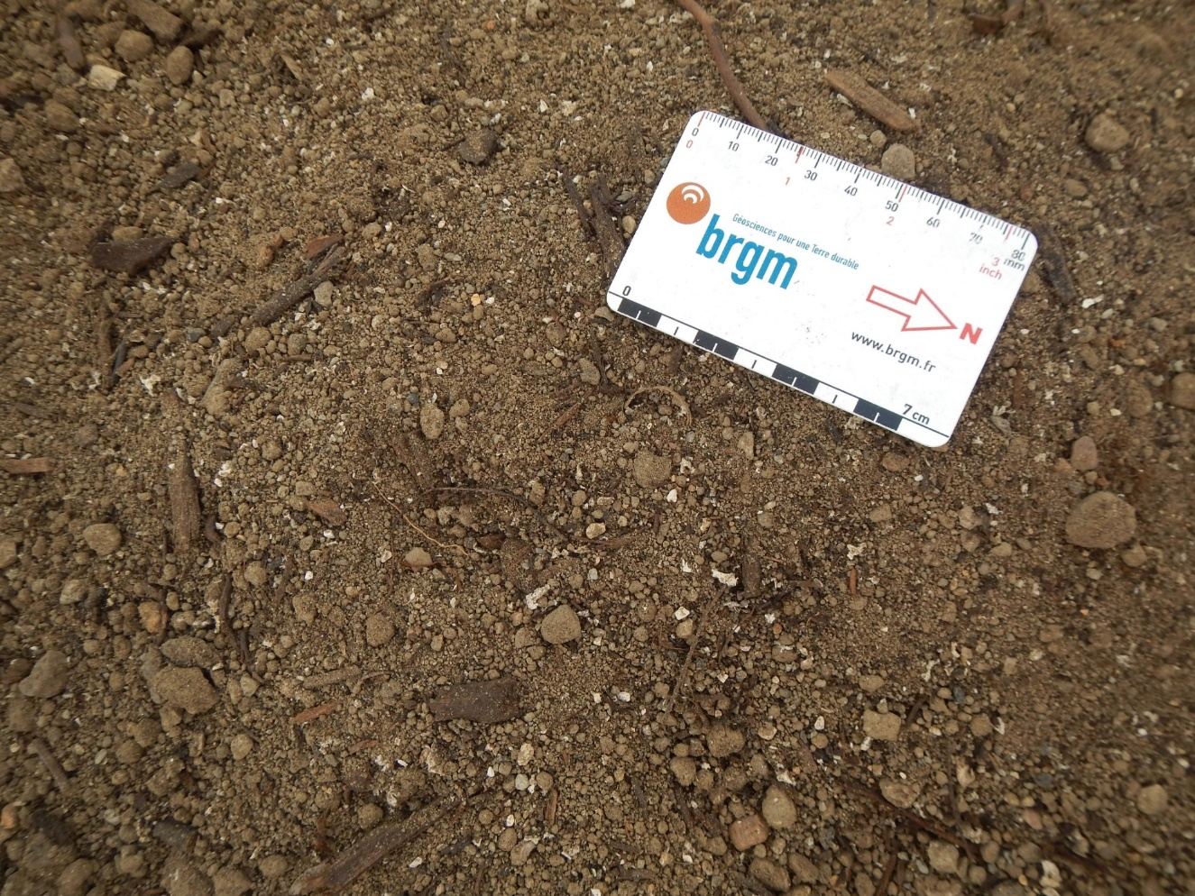
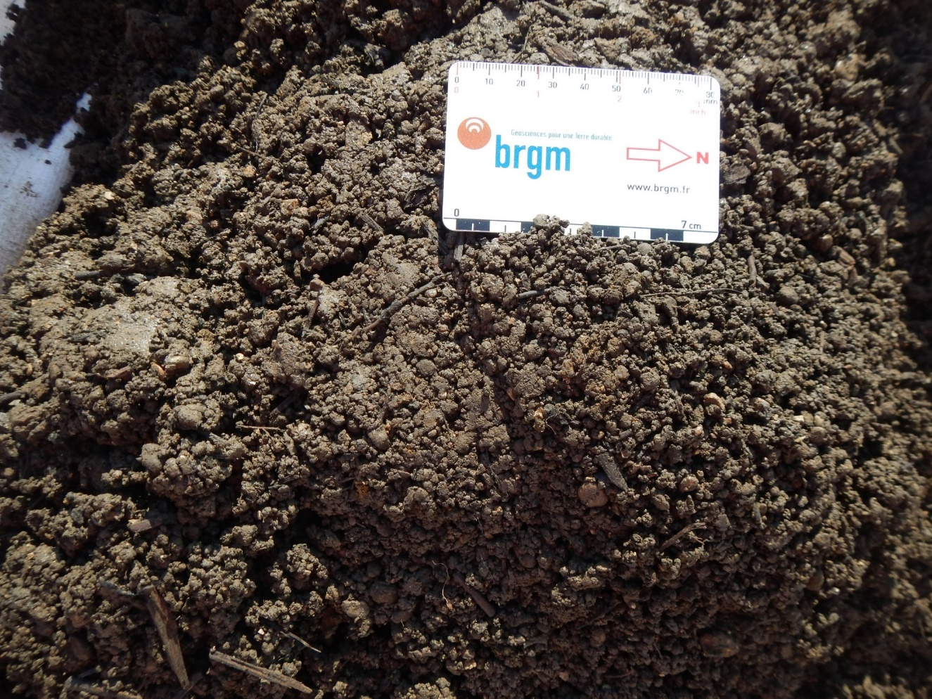
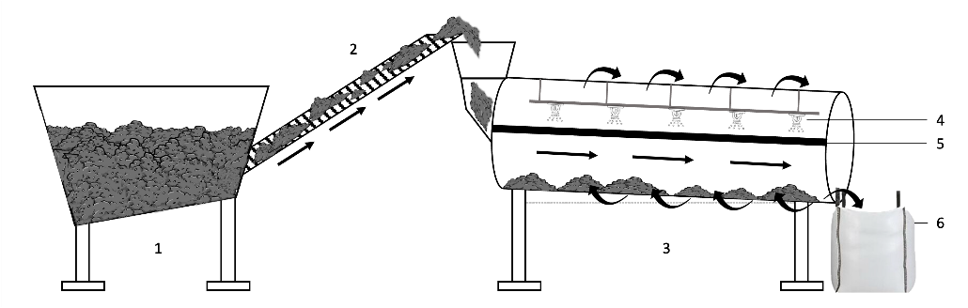
Engineering plant-soil systems in the OSL
The process of engineering plant-soil systems based on molasse excavation materials aims at addressing current and future regional needs and involves two major steps:
1) Habitat creation → designing soils for specific target applications.
  Molasse mixture to optimise soil texture
  Organic matter (compost) addition for enhanced nutrient content, biological activity, physical properties and pH buffering
  +/- clay amendment: locally sourced by-product
  +/- biological amendment: biopile, soil transplant
  +/- granulation method
2) Soil structure management → enhancing early pedogenesis (structure formation) in constructed soils.
Luisa Ulrici
Ab-initio (soil) structure generation

Slide 8
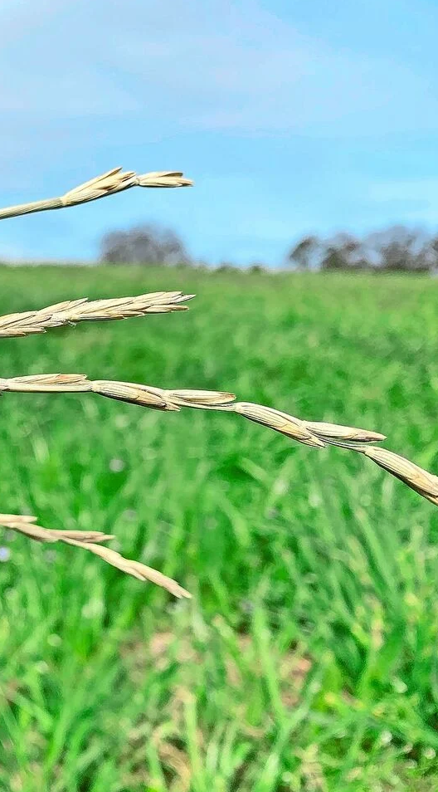
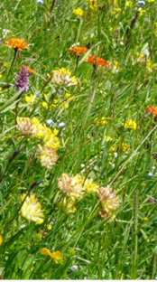
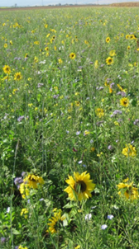
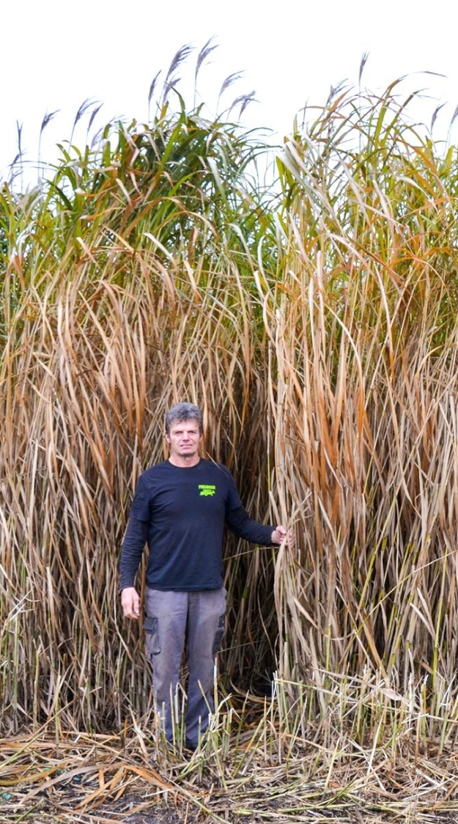
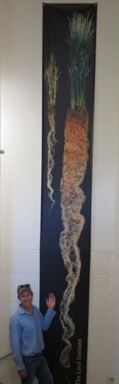
Management systems to enhance soil structure
  Physiological requirements for chosen plant species
    Alkaline conditions
    Elevated carbonate content
    Low nutrient availability
    Intermittent droughts
  Rationale
  Functional soils are a highly sought-after resource, their development is slow and takes years. This study assesses the impact of different agricultural management practices (perennial versus annual) on the early functionality of constructed soils.
  Expected outcome
  Documented, application-specific soil management processes for accelerated soil structure formation and the closing of nutrient cycles within the first years after installation.
Miscanthus
Perennial wheat
Pasture
Cover crop rotation
perennial
annual

Slide 9
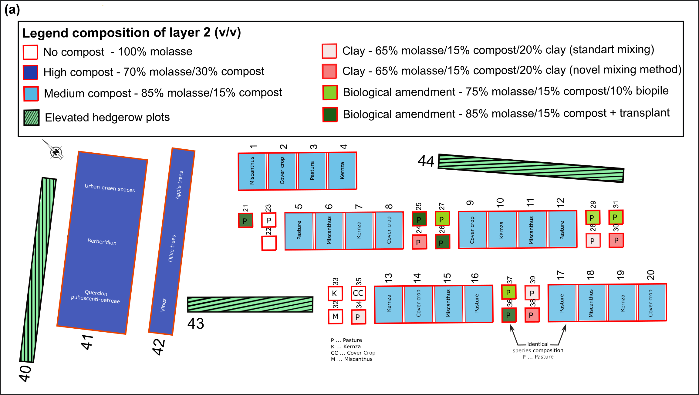
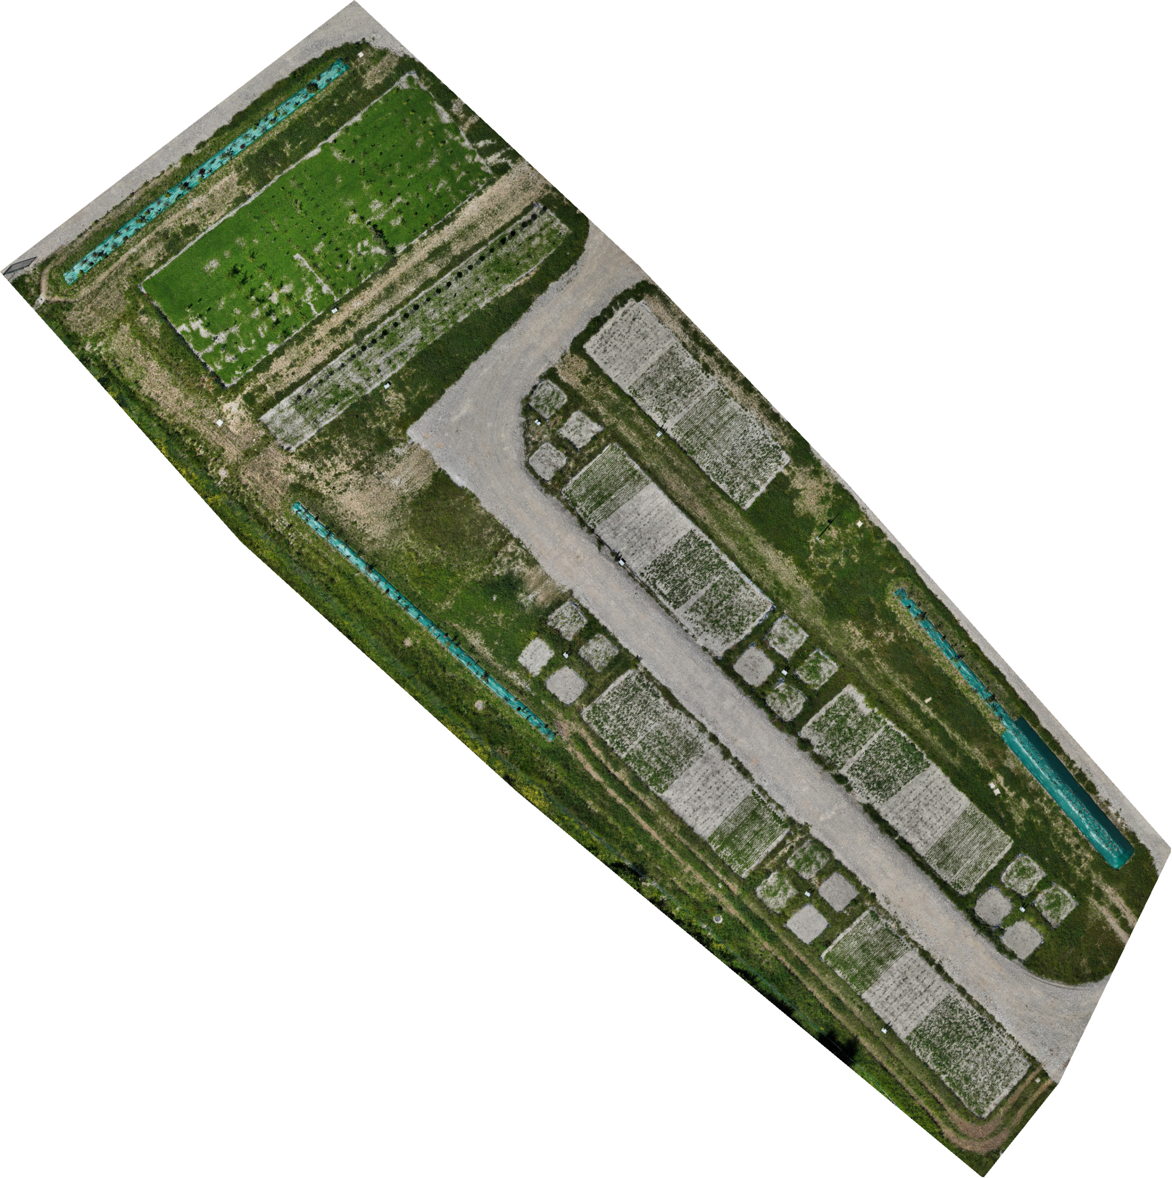
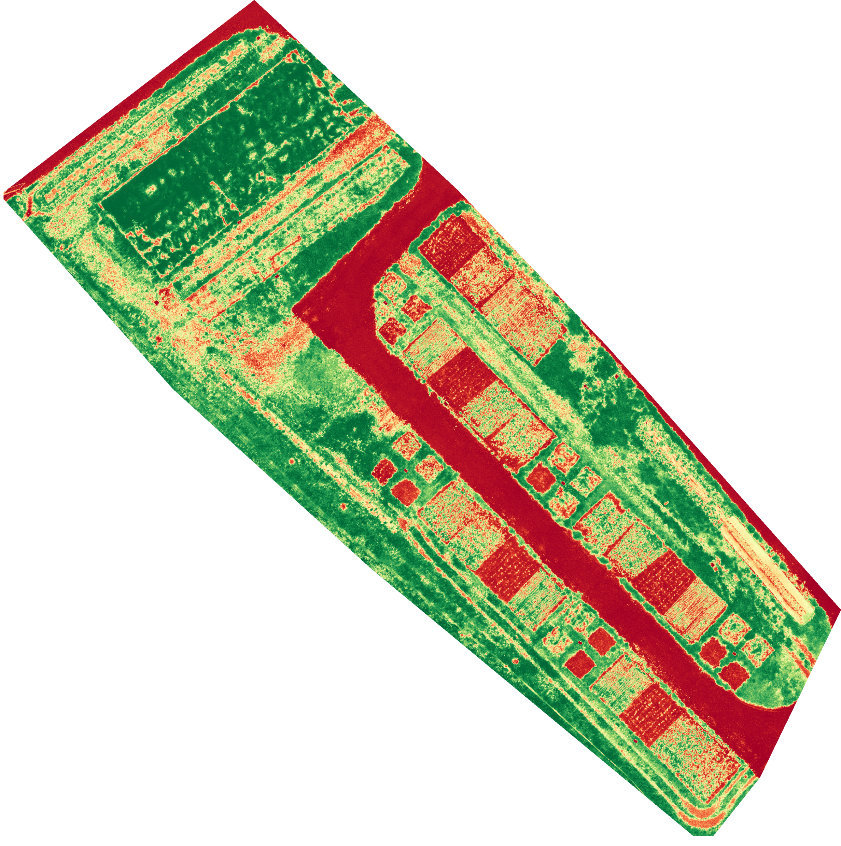
Multispectral drone imaging
orthomosaic
NDVI
Drone mapping: 30/05/205

Slide 10
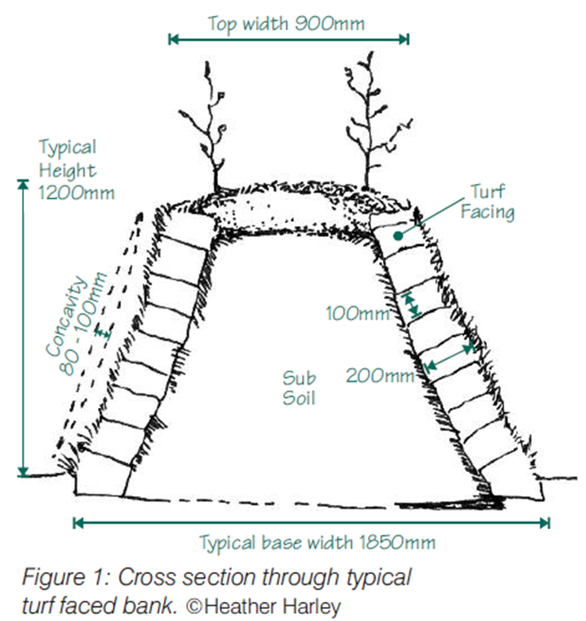
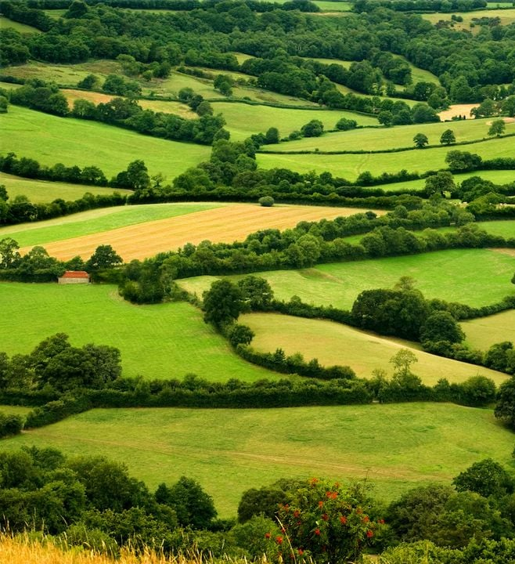
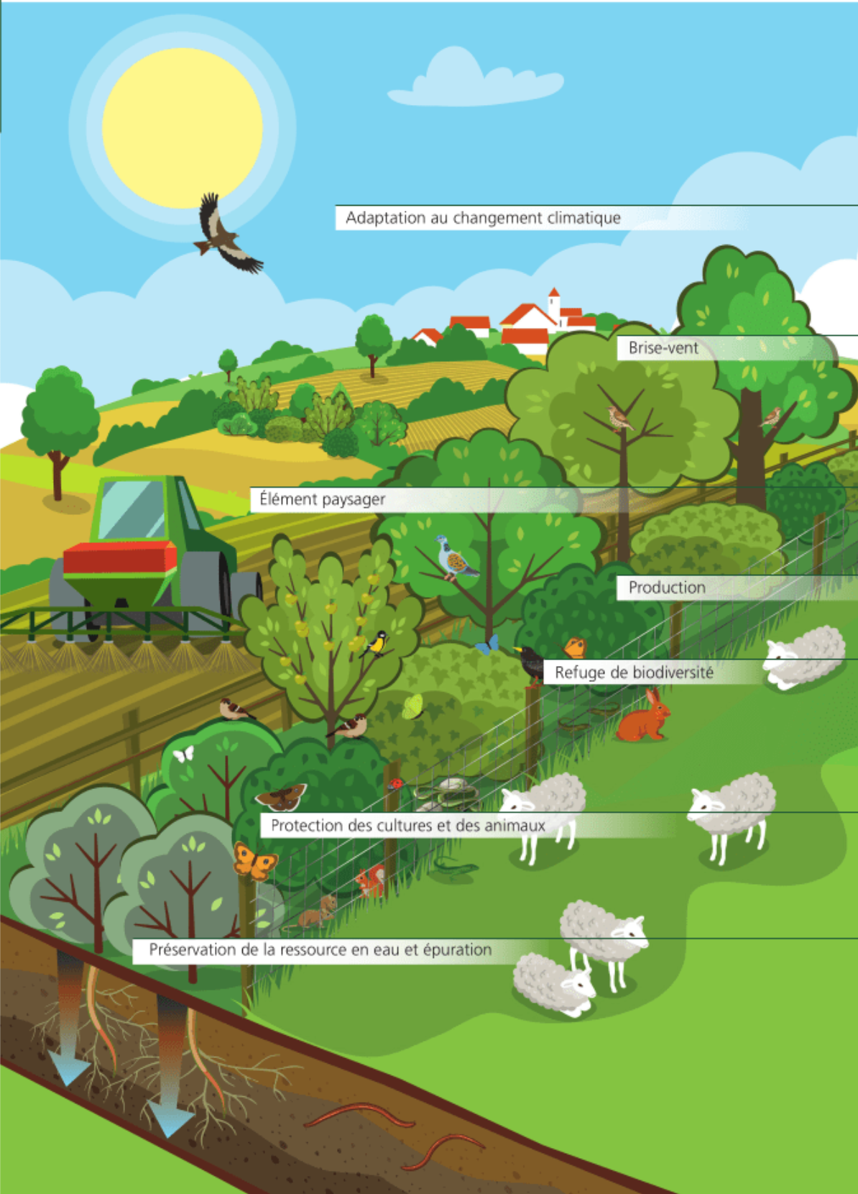
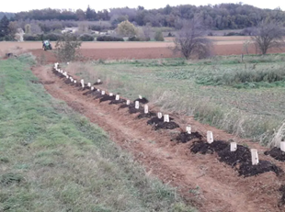
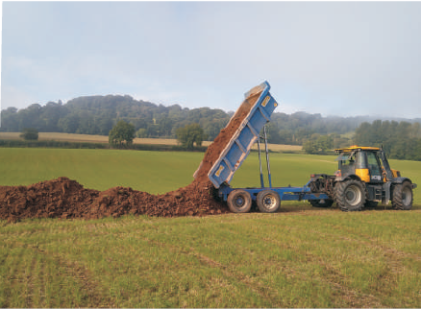
Shapes of hedgerows, benefits and drawbacks
  Definition
  A row of bushes, trees and plants usually growing along a bank bordering a country land or between fields. Size limits for classification depend on country (min 20-25 m length, 1 row of trees to 5 or 25 m width).
  Benefits
  Soil erosion mitigation
  Beneficial microclimate: flood and drought prevention
  Biodiversity: e.g. long-term habitat for wild bees
  Pest control
  Carbon stock: 1 km of hedge stores 600 – 800 kg C for up to 20 years
  Timber, fuel, fruits → local economy, improved self-sufficiency
  Drawbacks
  Cost of installation
  Loss of arable land
  Maintenance costs
  Limited access of heavy machinery
Main functions of hedgerows¹
EU‘s Common Agricultural Policy and national funding programmes²
¹ Office Français pour la Biodiversité (OFB), 2023, ² EC, 2023, image credit: Devon Hedge Group, Francois Bourdet.

Slide 11

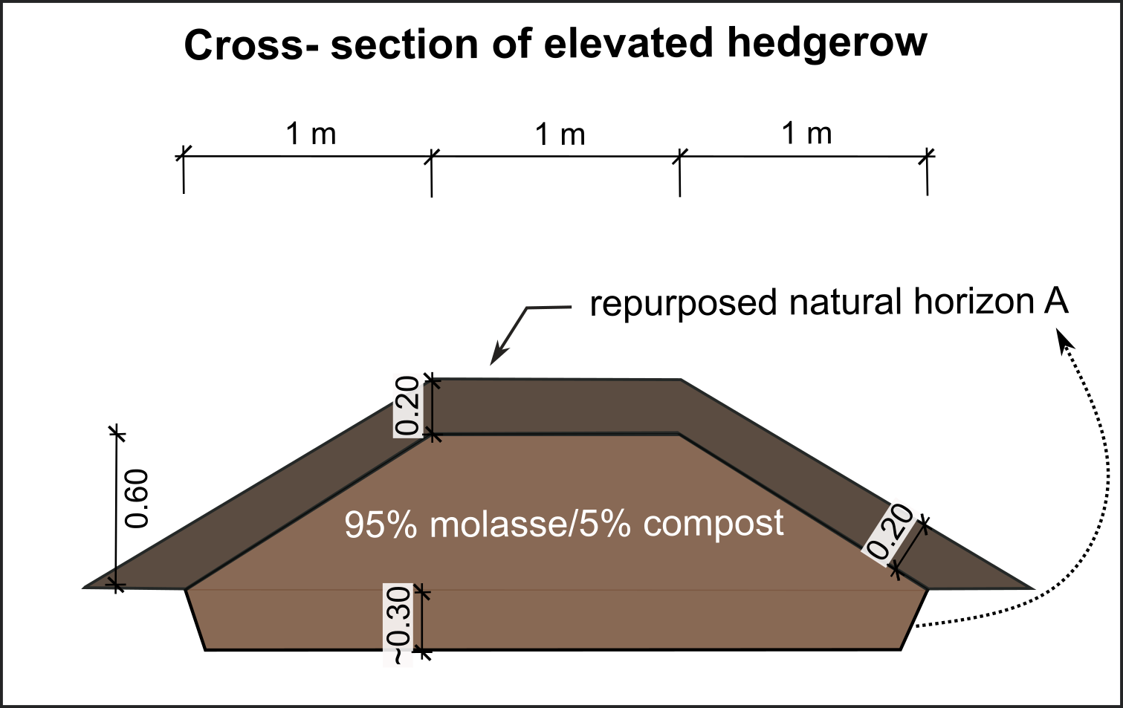
Elevated hedgerows in the OSL
Multispectral drone imaging
of hedgerows (NDVI)
  Construction
  Trapezoid cross-sectional area covered by repurposed natural topsoil. Average depth of horizon A in Lac Léman region: 30 cm.
  Plant species
  Ornamental, nectar producing species (plot 40)
  Locally adapted species mixture recommended by the French chamber of agriculture for mitigating pests in arboriculture, horticulture and for field crops (Auxil’haie), supplemented with:
    Legume species (atmospheric N-fixation)
    Species with complementary root traits potentially allowing for root growth across layers.
  Expected outcome
  Propose a landscape feature with variable species composition as a tool to:
  Mitigate erosion and direct nutrient flows
  Enhance ecosystem connectivity
  Increase climate resilience of agroecosystems
Plot 40
Plot 43

Slide 12
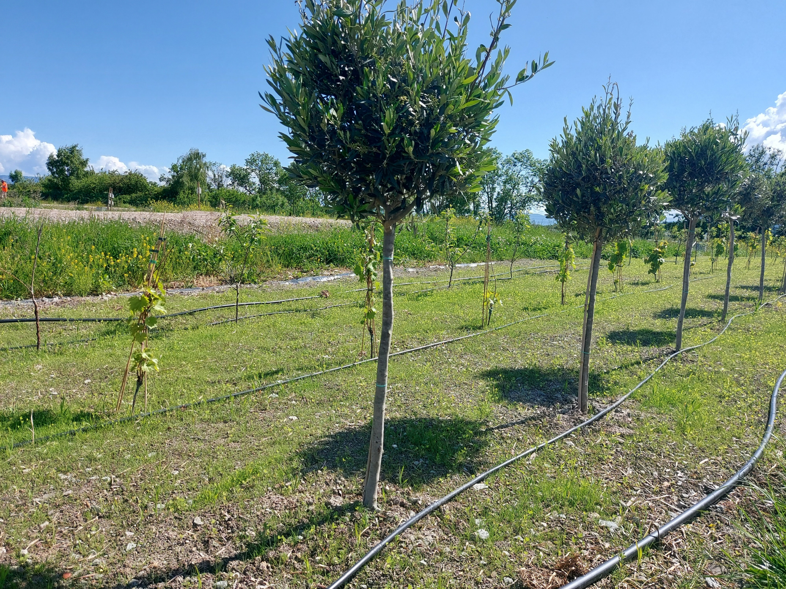
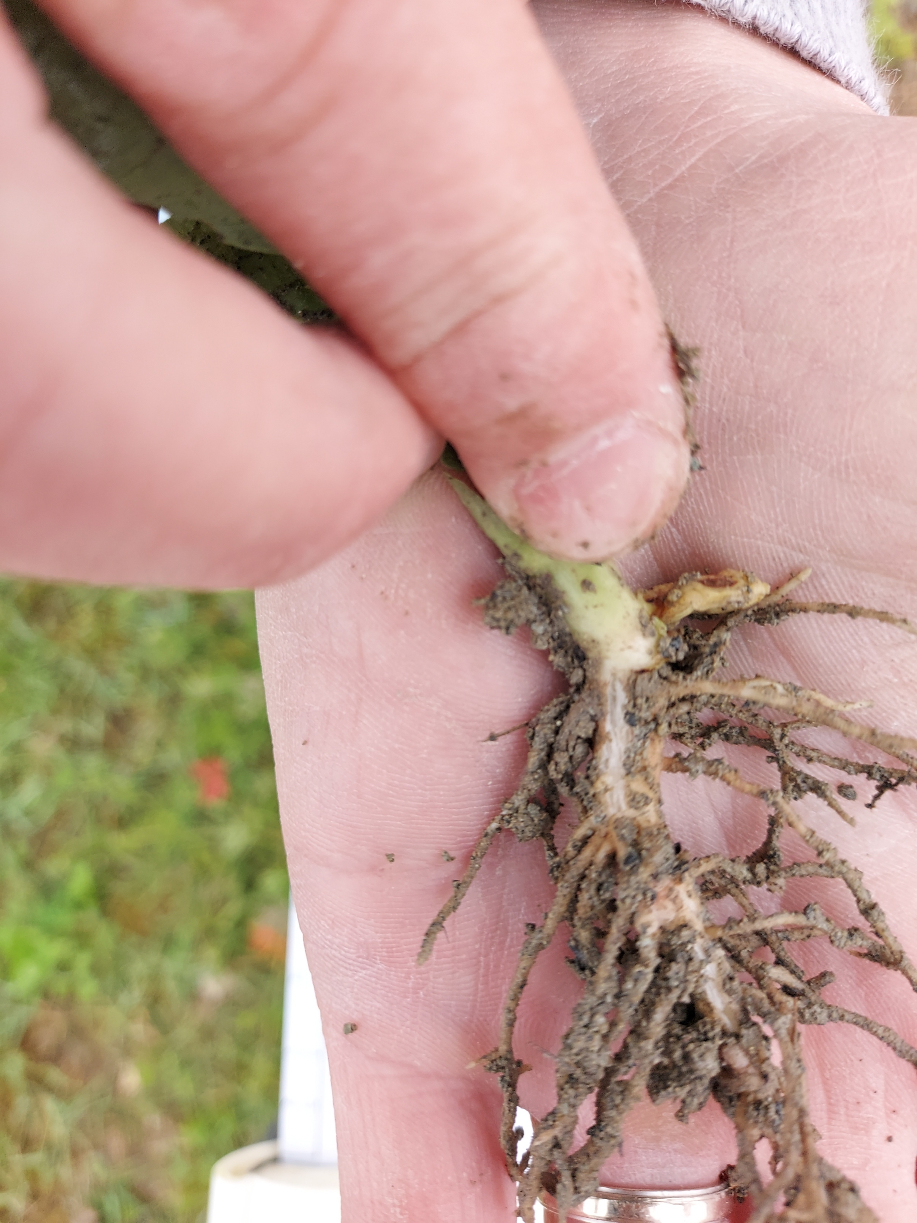
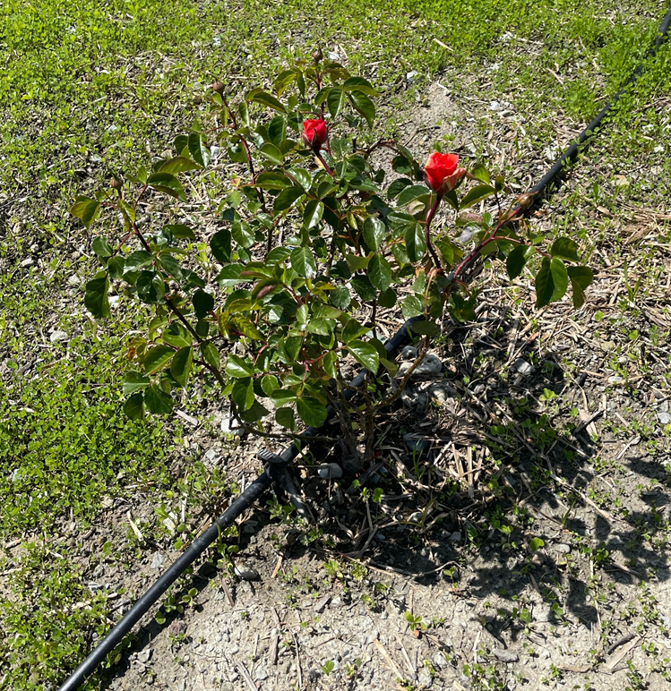
Current state
Five recipes for molasse-based soils have been developed.
All modalities exhibit so far positive results regarding plant growth (30 days after seeding).
Continuous data acquisition operational, including soil sensor data and drone imaging.
July milestone: first comprehensive soil sampling campaign, visit of 60 soil scientists and practitians
Vicia faba, 30 days after seeding, presenting functional root nodules, 10 cm max. rooting depth
OSL, Plant nursery plot, May 2025.

Slide 13
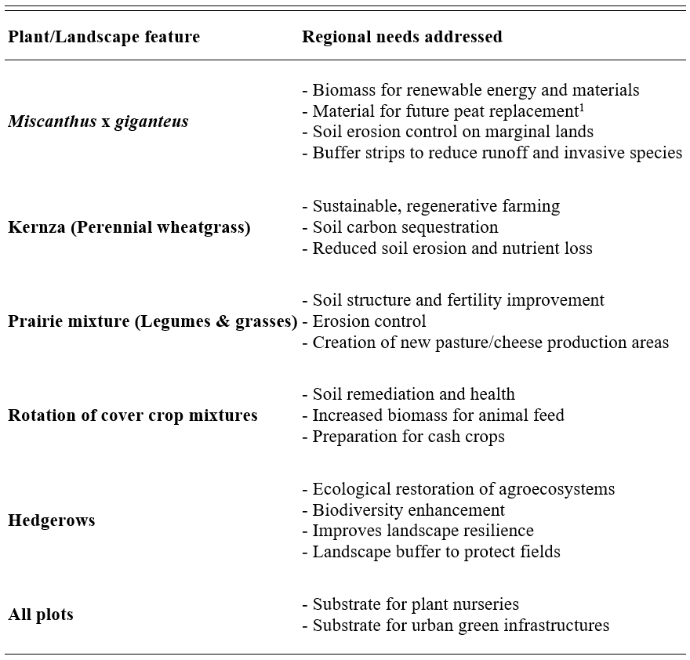
Conclusions
The OpenSkyLab collaboration aims at:
Developing quality-managed processes for the construction of functional plant-soil systems created from molasse minerals addressing potential regional needs
Demonstrate legal and regulatory compliance
Develop guidelines for optimal soil management
A reuse of molasse material as functionalised soil along roadsides, as support for elevated hedgerows, has potential to valorise important volumes and create beneficial outcomes for the region in terms of biodiversity, climate resilience, regional independence^{1,2}.
The creation of new terrestrial surfaces may contribute to C sequestration and could lead to further agronomic, or forestry uses.
A successfully developed industrial-scale reuse pathway for molasse materials is of value for construction projects beyond the “FCC-region”.
¹ Montgomery et al., 2020, ² OFB, 2023

Slide 14

Thank you for your attention!
14
This project has received funding from the European Union's Horizon 2020 research and innovation programme agreement No 951754.

Slide 15
References
15
Banwart, Steven A., et al. Soil functions: connecting earth's critical zone. Annual Review of Earth and Planetary Sciences 47 (2019): 333-359.
European Commission. (2006). Thematic Strategy for Soil Protection.
European Commission. (2023). Approved 28 CAP strategic plans (2023-2027), p. 79.
Haas, Maximilian, et al. Integrated stratigraphic, sedimentological and petrographical evaluation for CERN’s Future Circular Collider subsurface infrastructure (Geneva Basin, Switzerland-France). Swiss Journal of Geosciences 115.1 (2022): 16.
Heckova, P., Koestel, J., Klement, A., Kodesova, R., & Snehota, M. (2025). Soil structure dynamics in constructed Technosols for bioretention cells: X-ray microtomography study. Journal of Soils and Sediments, 25(2), 591-608.
ILF. Feasibility Study Cost, December 2024
Keesstra, Saskia D., et al. The significance of soils and soil science towards realization of the UN sustainable development goals (SDGS). Soil Discussions 2016 (2016): 1-28.
Montgomery, Ian, et al. Hedgerows as ecosystems: service delivery, management, and restoration. Annual Review of Ecology, Evolution, and Systematics 51 (2020): 81-102.
OFB. (2023). L’essentiel sur la haie. Comprendre pour agir.
Or, D., Keller, T., & Schlesinger, W. H. (2021). Natural and managed soil structure: On the fragile scaffolding for soil functioning. Soil and Tillage Research, 208, 104912.
Scalenghe, R., & Ferraris, S. (2009). The first forty years of a Technosol. Pedosphere, 19(1), 40-52.
Stolte, Jannes, et al., eds. Soil threats in Europe. Luxembourg: Publications Office, 2015.

Slide 16
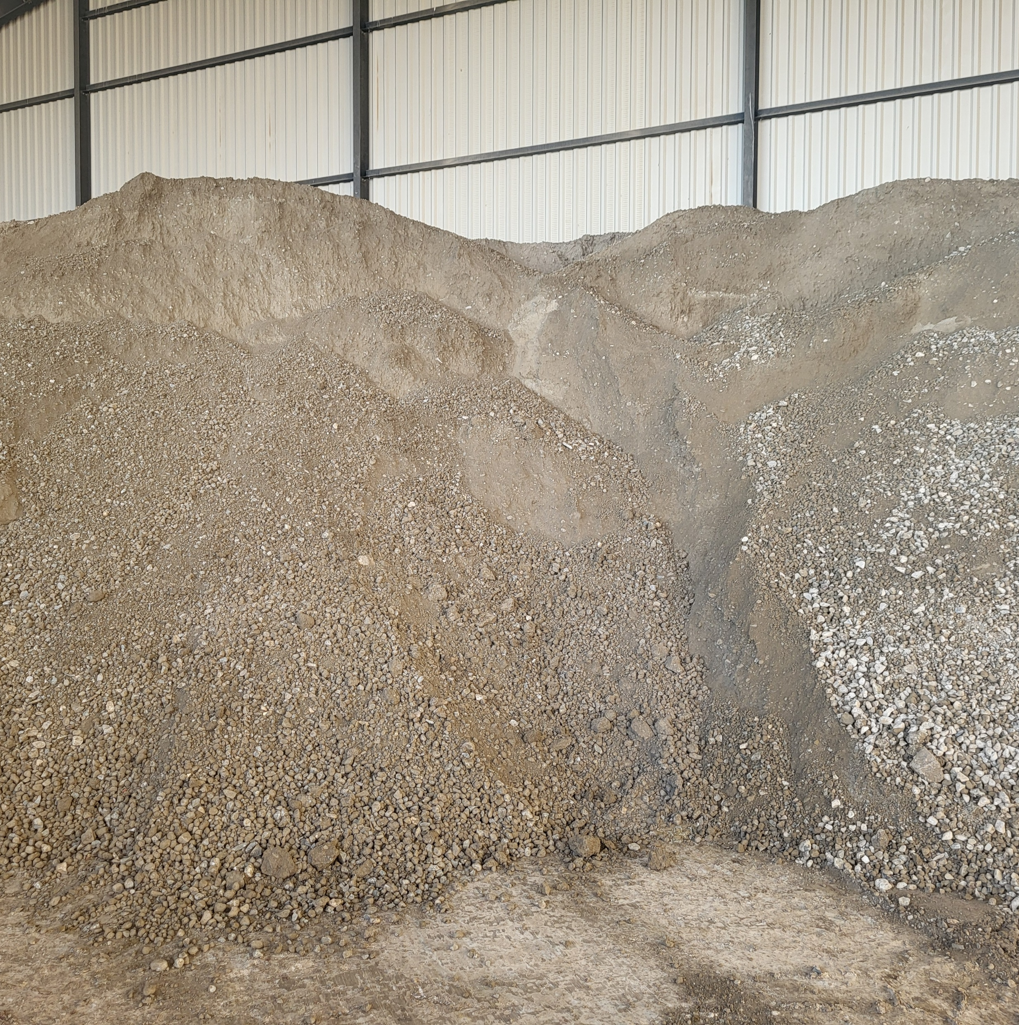
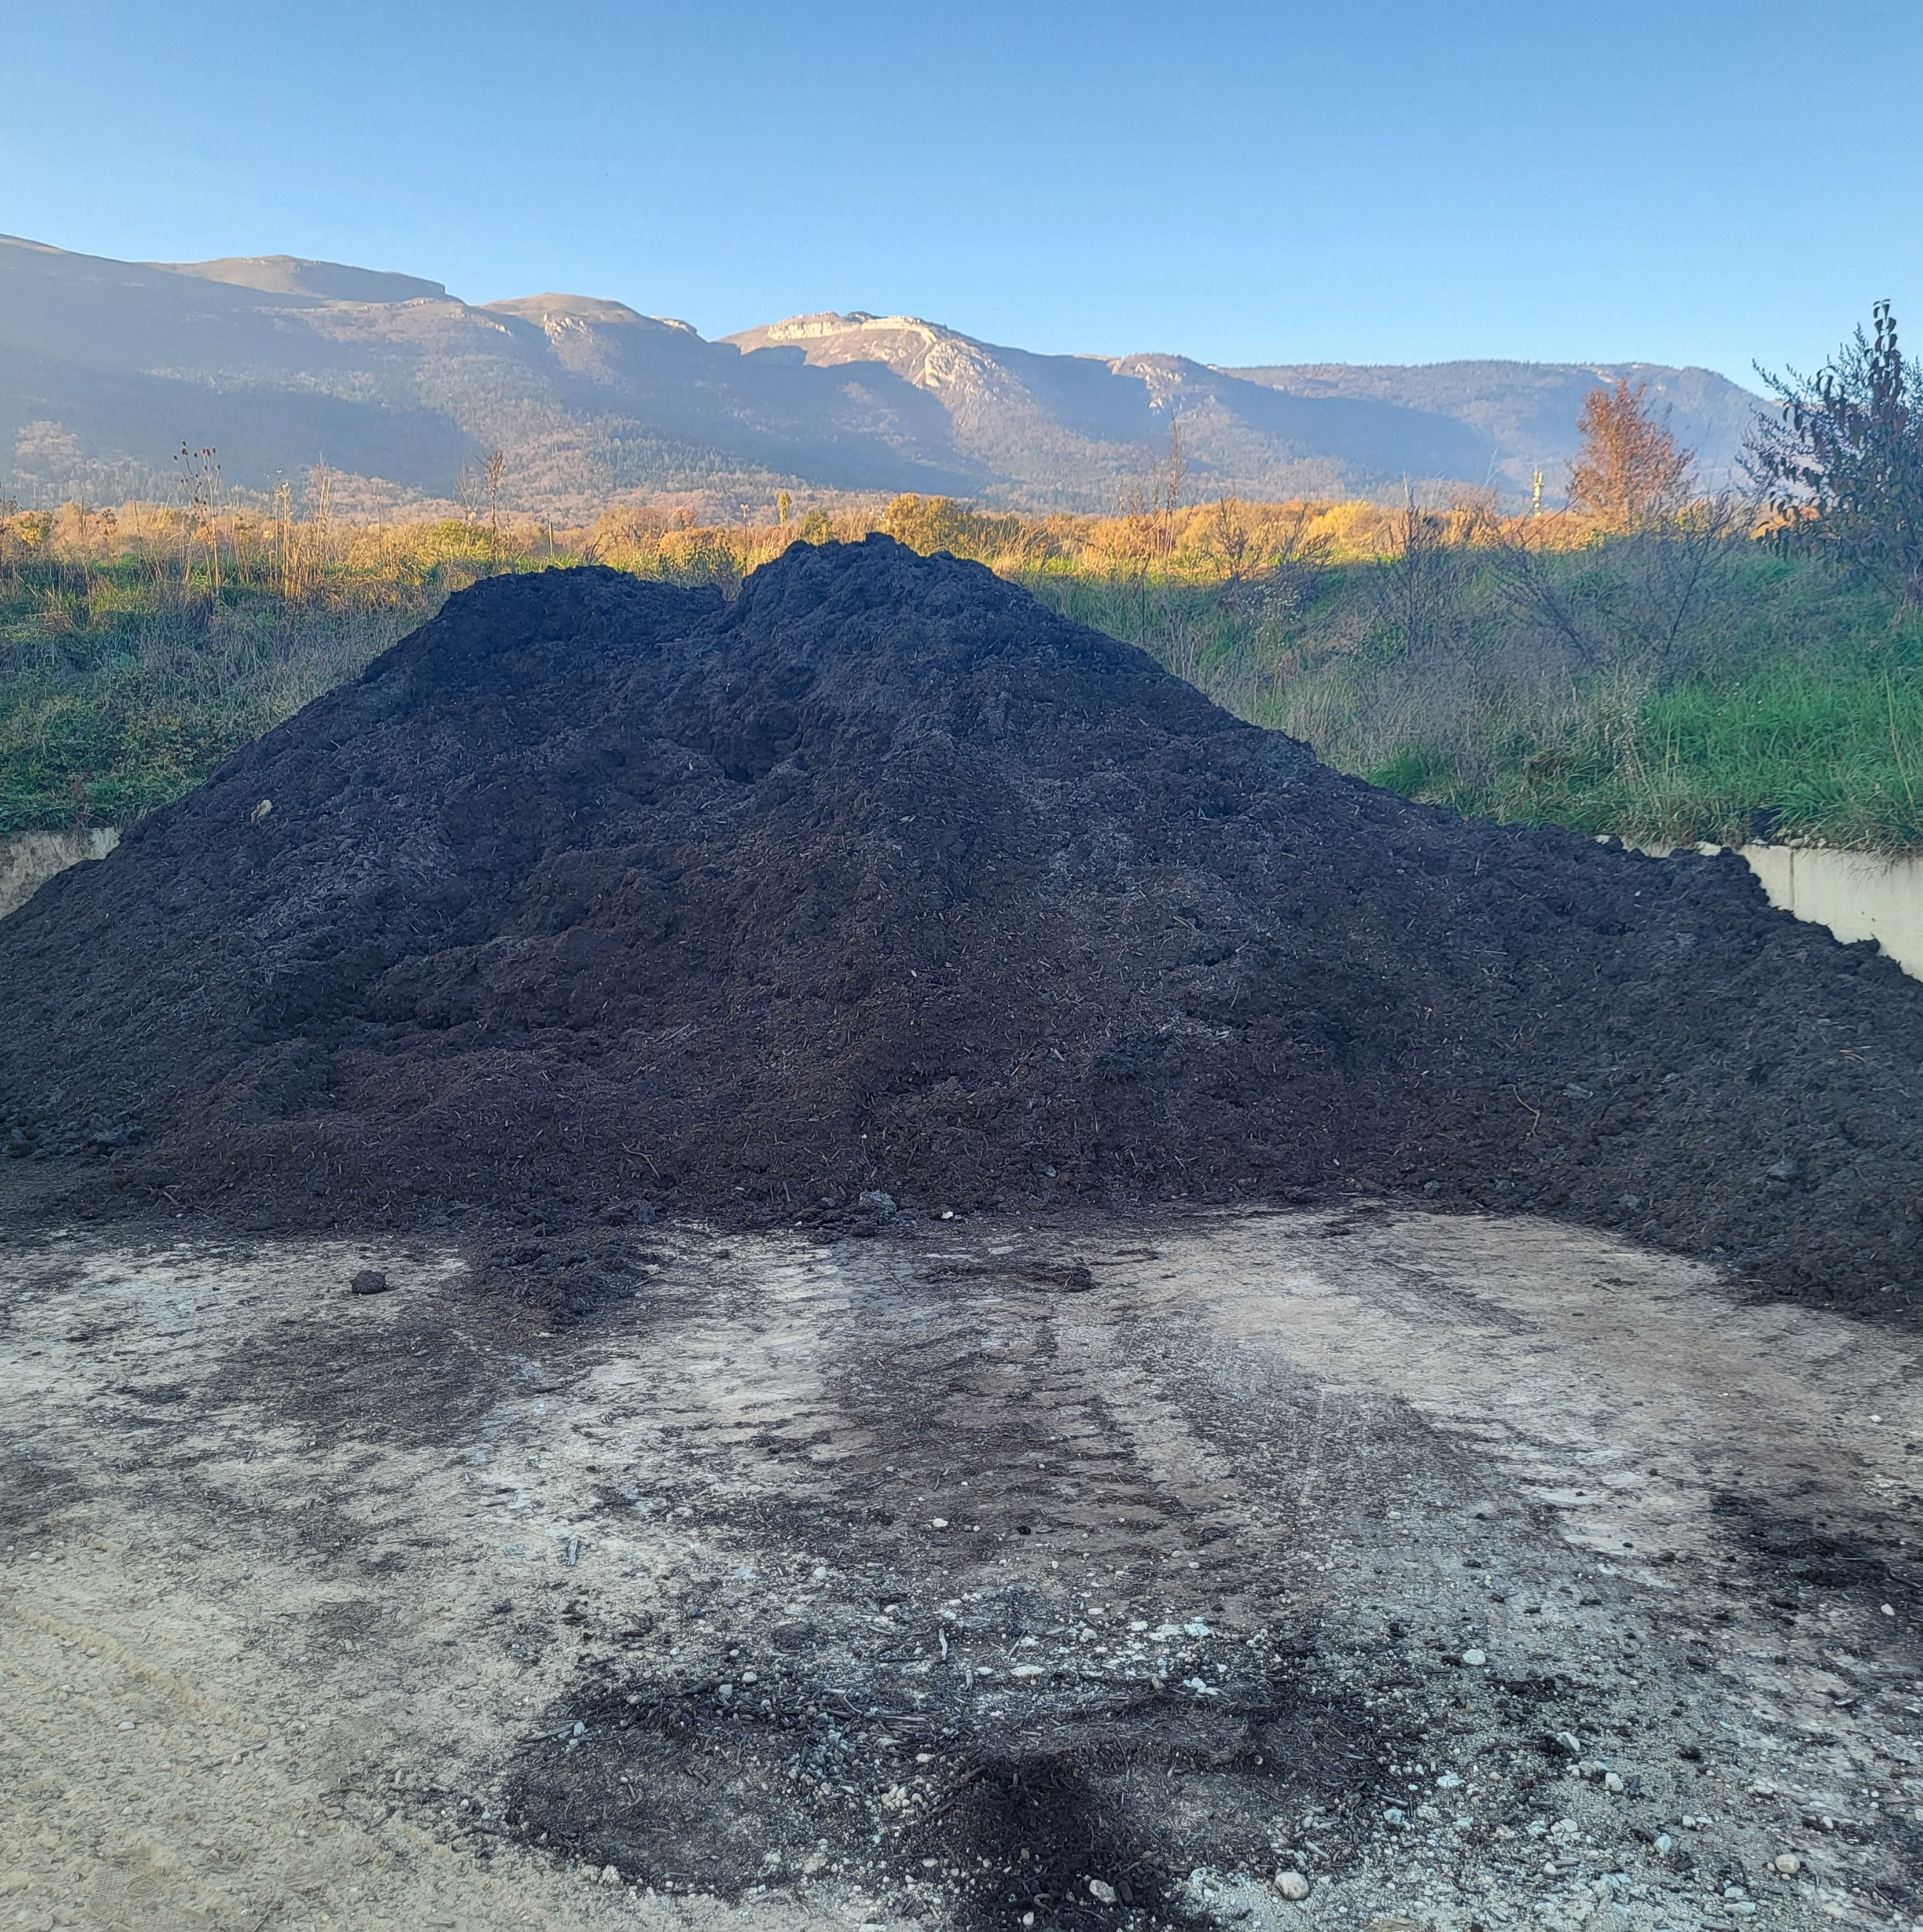
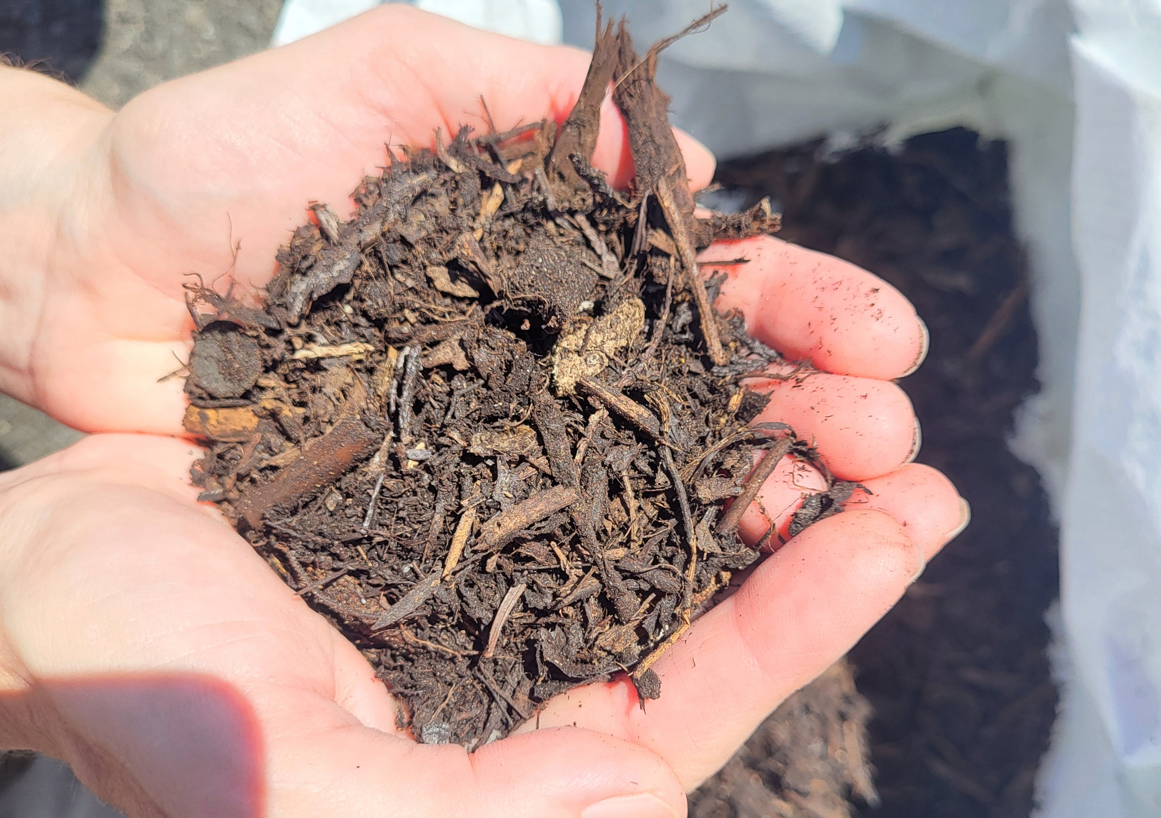
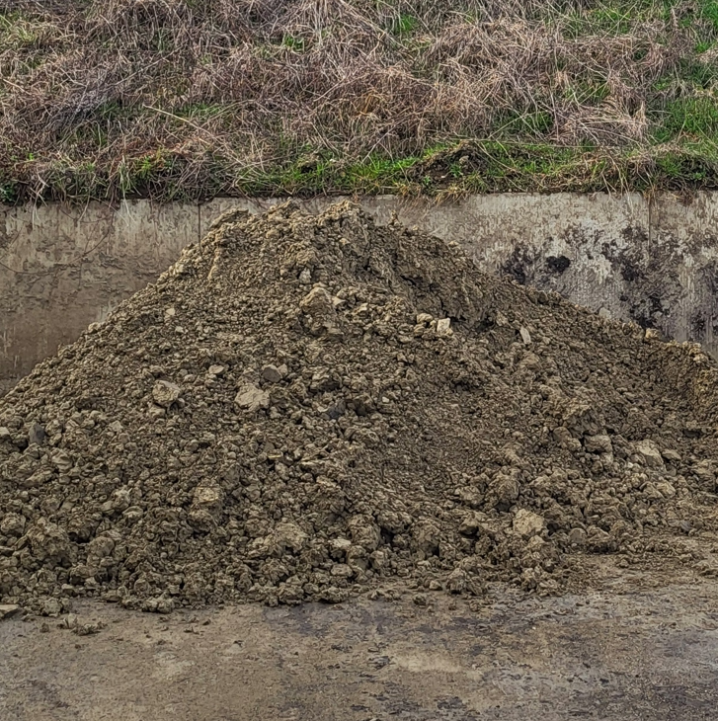
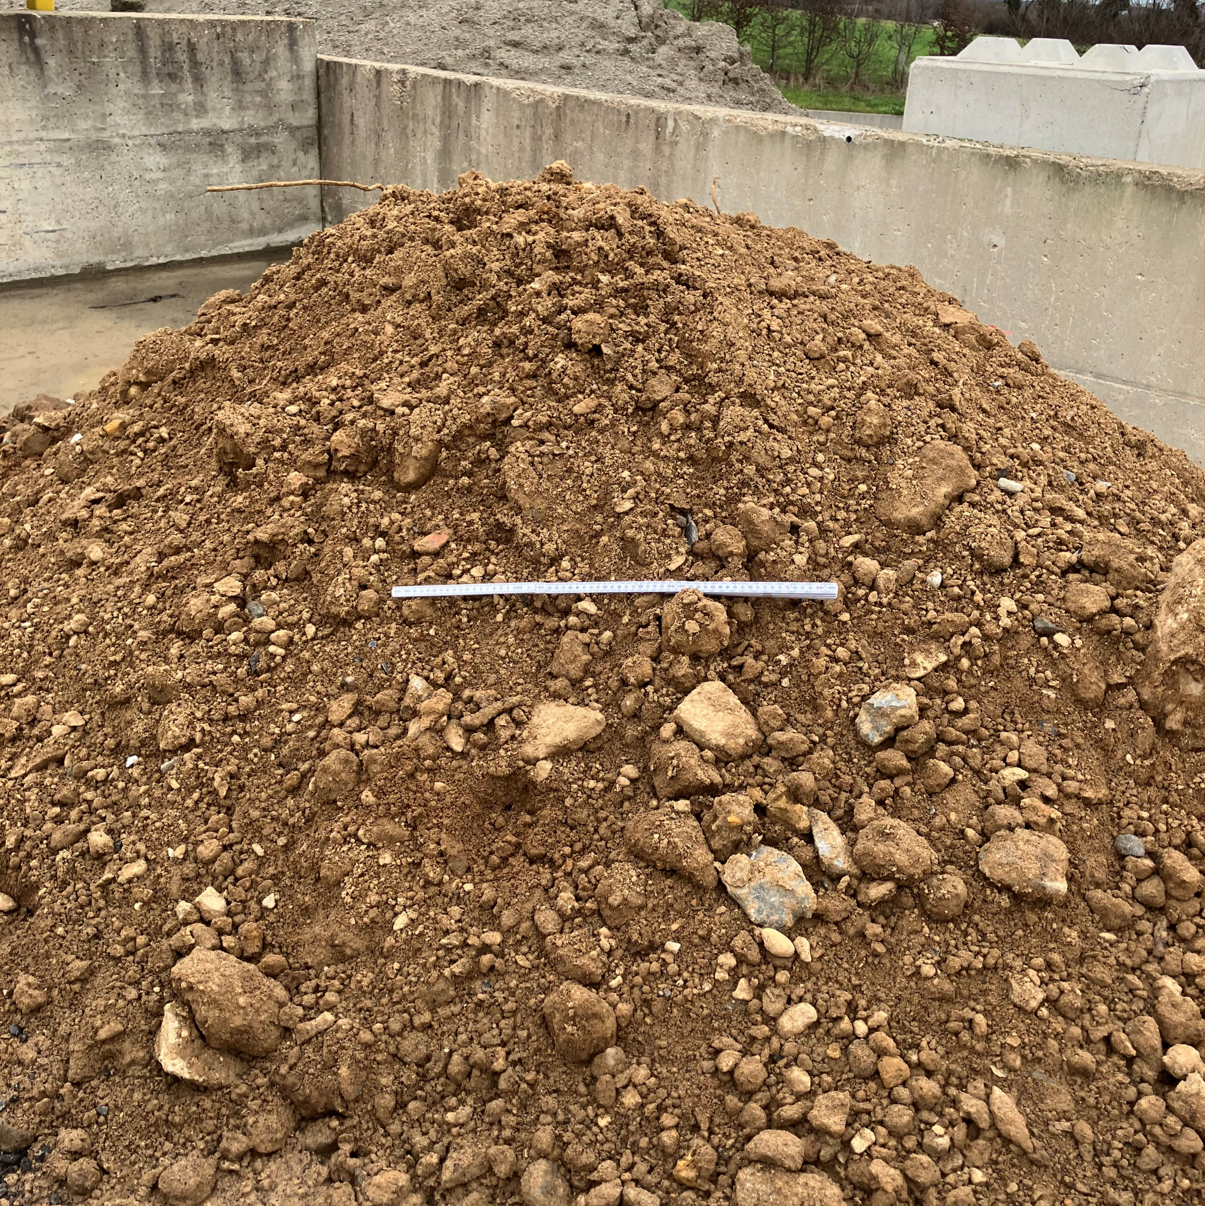
Selected materials for substrate composition
Molasse
2 different types of molasse,
providing a representative sample of the region’s geology
Compost
Improve physical, chemical, biological properties
Substrate mixes
Clay
Mineral amendment and test of a novel mixing technique developed at BRGM to form stable soil granulates
Biopile
Improve biological activity by using depolluted materials

