Slide 1


TwinRISE: Use cases
Th, 2025/07/10, online meeting
Julian Gethmann, Erik Bründermann, Christina Widmann, Giovanni De Carne, Anke-Susanne Müller
for the KIT team
Karlsruhe Institute of Technology (KIT), Institute for Beam Physics and Technology, Germany

Slide 2
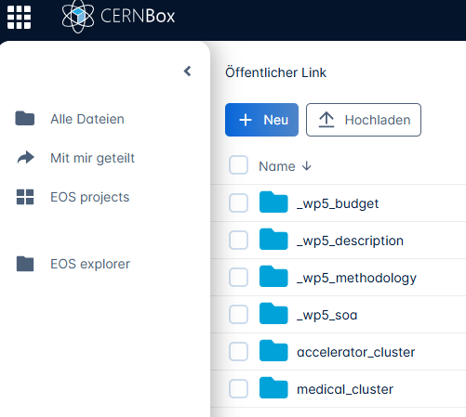
Status
  Erik started some online discussions bi-lateral, tri-lateral (Adnan, Adrian, Sabrina, Carsten)
  and E-Mails (Hayg, Anne-Marie, Cyril, Aurélien, Carine, Guillermo)
  From next week onwards Erik‘s calendar is getting much more free and more intense communication planned
  Inputs such as the WP2/WP5 surveys and some slides in the WP5 folder, but not yet from all interested parties https://cernbox.cern.ch/files/link/public/UyctCUebiGjGFcJ
  Currently two themes
      Accelerator Cluster
      Medical Cluster

Slide 3

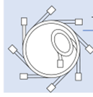
Can we derive a good story line?
Where do you find yourself?
From the Use+case+survey
  Very heterogeneous background and access to compute resources and level of detail
Thoughts
  Avoid that the only common theme is the word „digital twin”
      Independent groups, only networking for exchange
  Find a common story line
  May be the two cluster should have a transition area
Accelerator Operation
Medical Application
1.2.4 Energy-informed
Independent of particles
1.2.4 Physics-Informed (electrons)
Particles
Independent electrons protons ions

