Slide 1
Medical Applications at CERN
Austrian Teachers Program, November 18, 2011
Hartmut Hillemanns
Hartmut.hillemanns@cern.ch

Slide 2

Index
CERN & fundamental research characteristics
Research results for health that strongly impacted society
How research can help society meet challenges ahead
  Health
  Molecular biology

Slide 3

CERN…
Seeking answers to questions about the Universe
Advancing the frontiers of technology
Training the scientists of tomorrow
Bringing nations together through science

Slide 4
Particle, Astro-Particle & Nuclear Physics research characteristics
Large projects requiring long and Intensive R&D and Prototyping
  Source of innovation
  Source of new technologies and expertise
  Existing technologies pushed to the limits
Highly collaborative international open science environment offering top quality education from apprentice to post-doctoral
  Shared research results
World standard institutions (centres of excellence) with high tech laboratories for:
  Accelerator elements, Vacuum technologies, magnets
  Particle detectors
  Electronics & IT
  Super-conductivity and Cryogenics
  Mechanics & surface Treatments

Slide 5
CERN
the world largest particle physics laboratory
where scientific knowledge and technology
are transferred to industry and society
Research
Technology
Training
Collaboration

Slide 6
Fundamental research and its impact on society
Research results have contributed to the development of major applications that strongly impacted society
  Health: Devices to assist clinicians in diagnostic and therapy
  Information and Communication Technology: WWW, A fundamental change in dealing with digital information
Technology developments motivated by the current research programme can help society meet challenges
  Health
    Defeating cancer
  Molecular biology
    Providing biologist an insight on the fundamental mechanisms of Life
  Information society
    The seed of IT’s next generation
  Sustainable energy and environment
    Improved energy collection production and management

Slide 7
Index
CERN & fundamental research characteristics
Research results for health that strongly impacted society
How research can help society meet challenges ahead
  Health
  Molecular biology

Slide 8
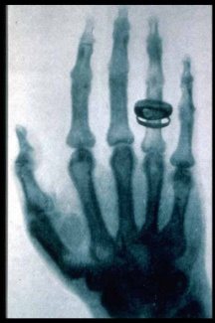
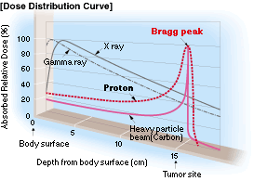
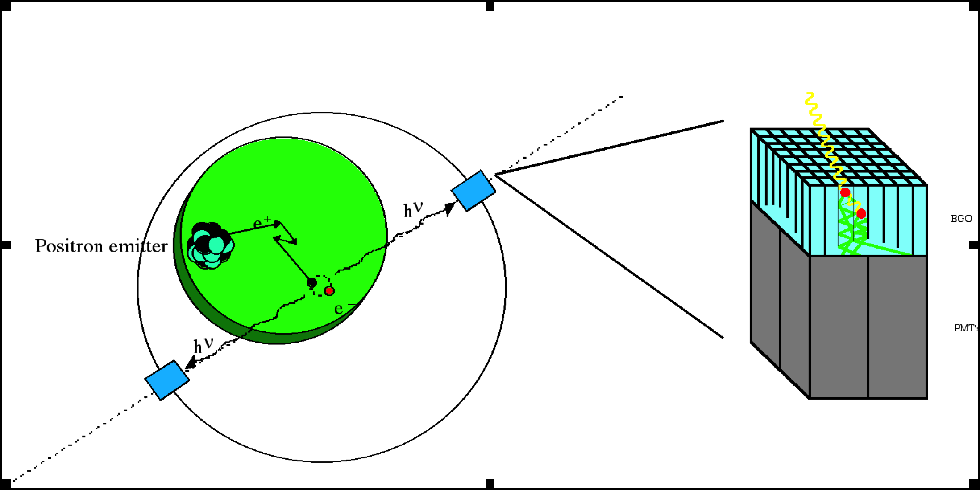
Physics and Medicine : a century of collaboration
Technology and instrumentation for diagnosis and treatment:
PET
(functional)
Radio/particle Therapy
X-Ray
(Morphological)

Slide 9
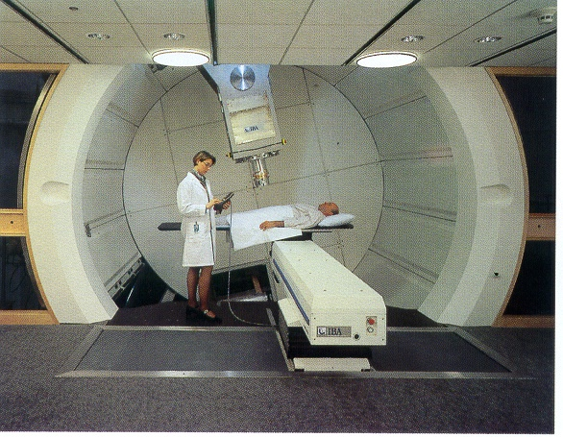
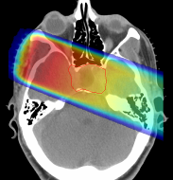
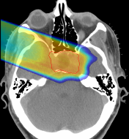

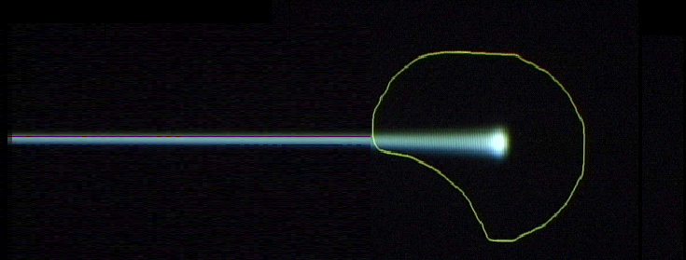
Hadron Therapy
28 cm
200 MeV
protons
480 MeV
carbon ions
tumour
target
charged hadron beam
that loses energy in matter
Hadron beams provide new treatment opportunities for deep-seated tumours.
Hadron beams are more effective than X-rays in destroying tumours while sparing healthy tissues nearby.
Courtesy of IBA
X rays
protons or
carbon ions
Photons
Protons
GSI

Slide 10
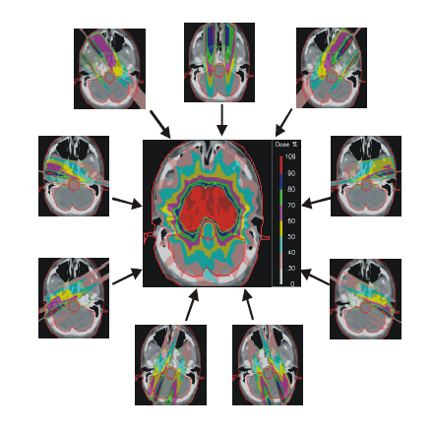
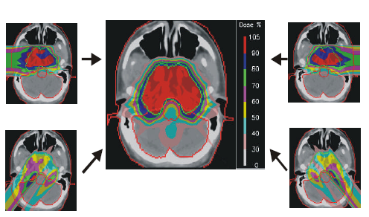
Protons are quantitatively different from X-rays
9 X-ray fields 4 proton fields
PSI
  Carbon ions deposit in a cell 24 times more energy than a proton producing not reparable multiple close-by double strand breaks
  Carbon ions can control radio-resistant tumours

Slide 11
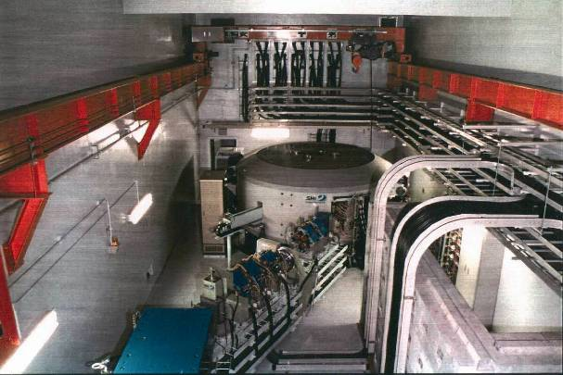
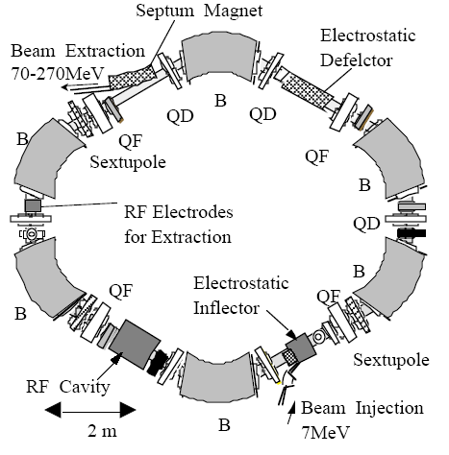
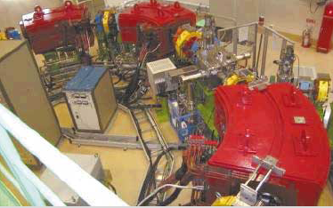
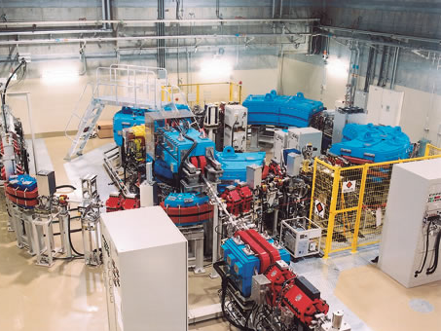
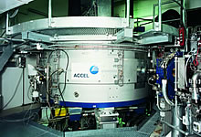
Protontherapy: a mature market…
IBA
Hitachi
Mitsubishi
Accel (Varian)

Slide 12
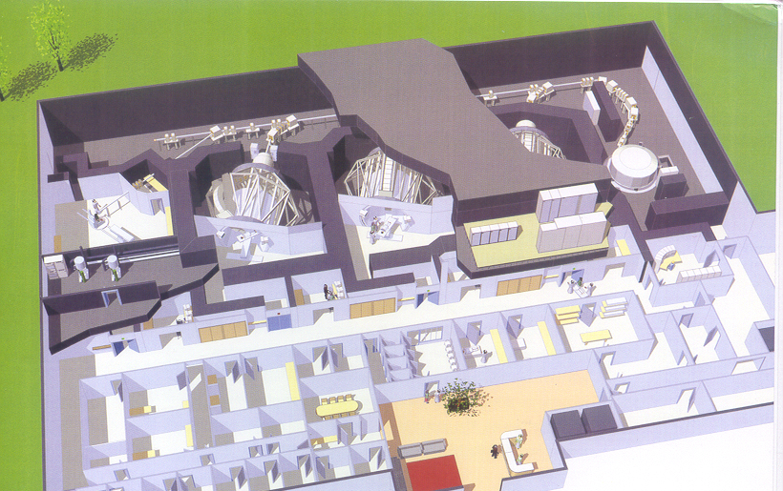
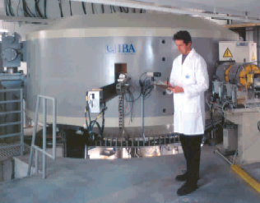
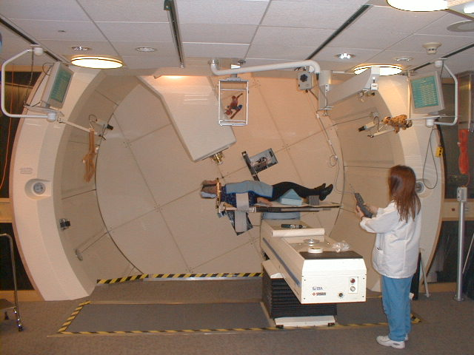
Cyclotron solution for protons by IBA - Belgium
gantry
IBA
Five companies offer turn-key centres for 100 M€.
If proton accelerators were ‘small’ and ‘cheap’,
no radiotherapist would use X rays.
Ugo Amaldi Tera foundation

Slide 13
Radiotherapy is the main user of Linear accelerators
CATEGORY OF ACCELERATORS | Number in use (2005)
High Energy acc. (E >1GeV) | ~ 120
Synchrotron radiation sources | > 100
Medical radioisotope production | ~ 200
Radiotherapy accelerators * | > 7500
Research acc. including biomedical research | ~ 1500
Acc. for industrial processing and research | ~ 1500
Ion implanters, surface modification | > 7000
Total | > 17500
* Linacs used in radiotherapy represent 40% of all running accelerators:
France, Germany, Italy: 4 units per million inhabitants
Switzerland: 11 units per million inhabitants
Finland: 14 units per million inhabitants
Notes:
13

Slide 14
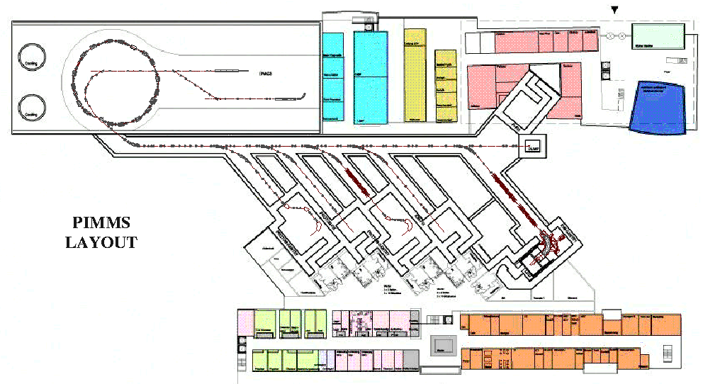
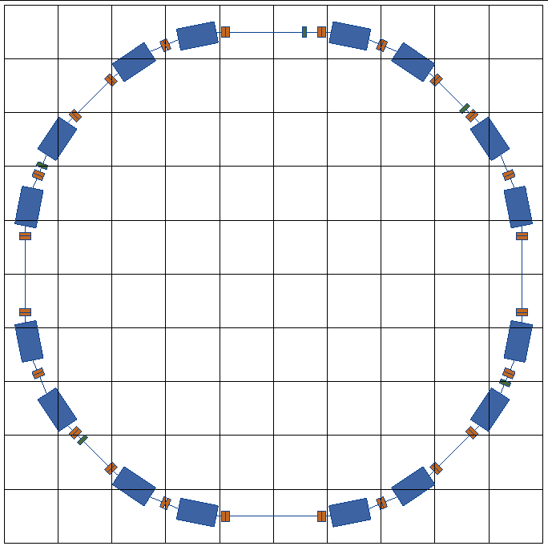
Hadron therapy: PIMM Study at CERN in 1996 - 2000
CERN–TERA–MedAustron Collaboration for optimized medical synchrotron
(protons and carbon ions)
Project leader: P. Bryant
linacs for
carbon ions
and protons
400 MeV/u synchrotron
p
p
p
C
C
RF cavity
Resonance sextupole
Sextupole horiz. chromaticity
Sextupole vert. chromaticity
Betatron
core
Circumference C = 76.84 m
Tune horizontal Q_{x} = 1.67
Tune vertical Q_{z} = 1.72
Sextupole vert.
chromaticity
16 Bending Magnets
3 extraction systems:
betatron core
1/3 resonance
RF knock-out
Sextupole horiz. chromaticity
Electrostatic septum
Injection septum
Extraction septum

Slide 15
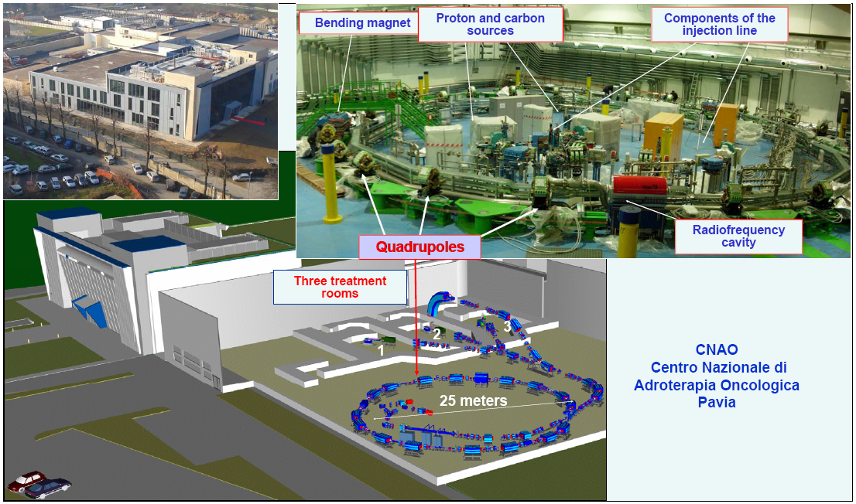
CNAO: The Hadron facility in Pavia
Beams ready:
end 2008

Slide 16
The site of HIT the Heidelberg Ion Therapy
A € 100M project with gantry for beam rotation
Collaboration with GSI and SIEMENS for the
Construction of the facility
First beam extracted in 2007
First patient: October 2008
High Energy Beam Transport Line
Ion-Sources
Quality
Assurance
Synchrotron
LINAC
Gantry
Treatment halls

Slide 17
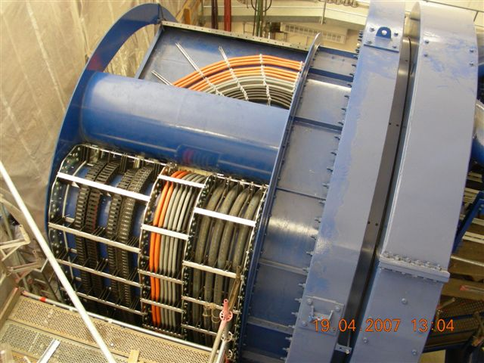
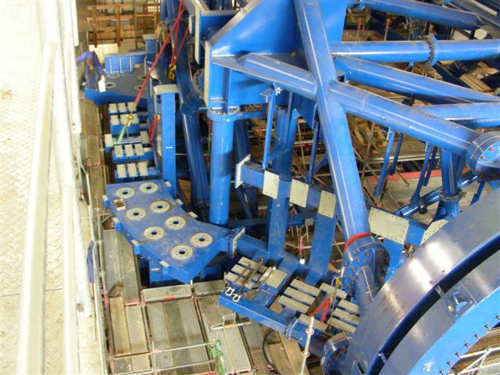
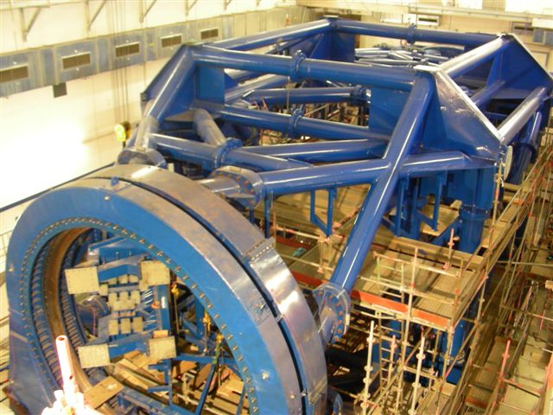
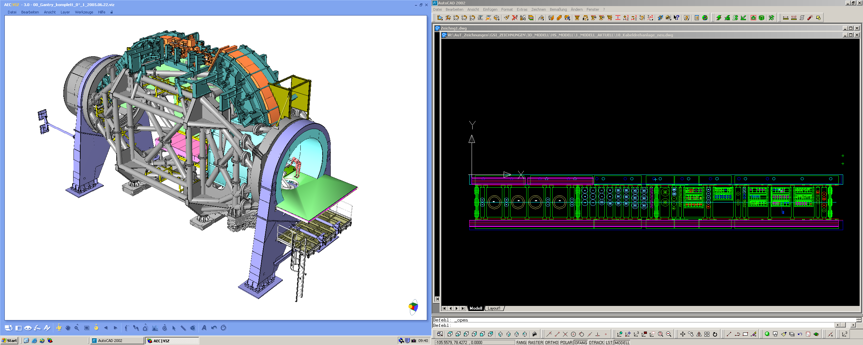
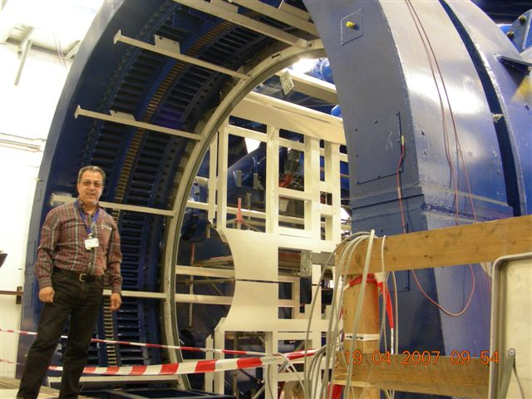
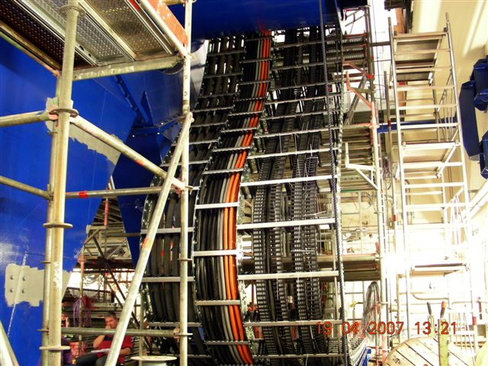

Heidelberg ion gantry: 600 tons and 400 kW
1. Rotation at 21.04.2007

Slide 18
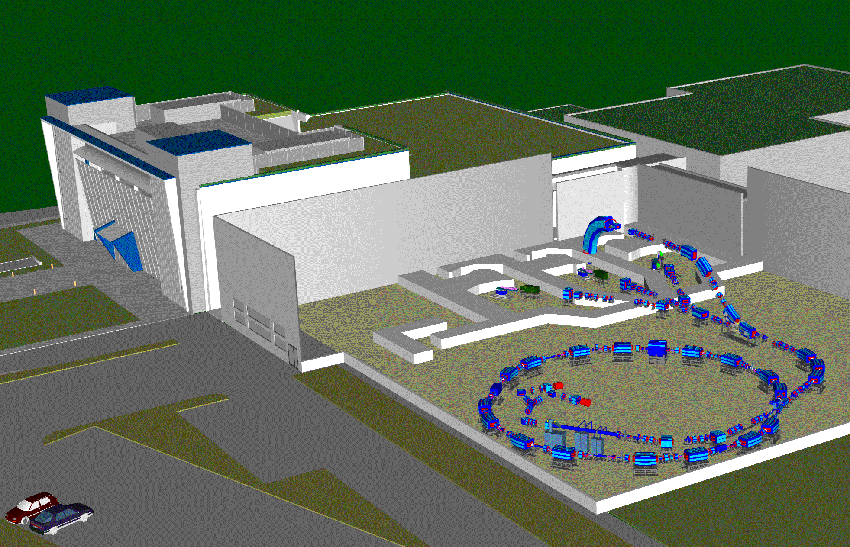
Science to Health: Hadron Therapy
Technology
Complex accelerator technology in combination with precise imaging systems developed for PP constitute the infrastructure for hadron therapy centers.
(ex. PIMMS Design Study (published in 2000))
Health care
Protons and ions have proved to be extremely efficient to treat deep seated tumors without damaging healthy tissue.
Effective also for radio resistive tumors
Impact
  CERN has contributed to the construction of CNAO (Padova, Italy) which is close to commissioning.
  In 2008: CERN has started a collaboration with MedAustron for the construction of a hadron therapy center in Austria.
  Construction costs for the infrastructure of such center is approximately 120 Million EUR. Annual running costs 15 Million EUR.
Notes:
18

Slide 19
Science to Health: Radiopharmaceuticals
Technology
  Isotopes produced in reactors and accelerators
  Advanced accelerator technologies developed in PP enable large scale production and secure supply
Health care
  Medical isotopes instrumental for:
  accurate diagnostics through medical imaging
  cancer therapy
Business impact
Strong increase in demand expected. Market for diagnostic and therapeutic isotopes forecasted a 10% annual growth and should reach 4.5 Bn Euros in 2020.
Year: | 2005 | 2010 | 2015 | 2020
Diagnostic (M EUR) | 987 | 1589 | 2559 | 4121
Therapeutic (M EUR) | 89 | 143 | 230 | 372
Source: Frost & Sullivan
Notes:
19

Slide 20
Physics and Medicine : a century of collaboration
Technology and instrumentation for diagnosis and treatment:
PET
(functional)
Radio/particle Therapy
X-Ray
(Morphological)

Slide 21
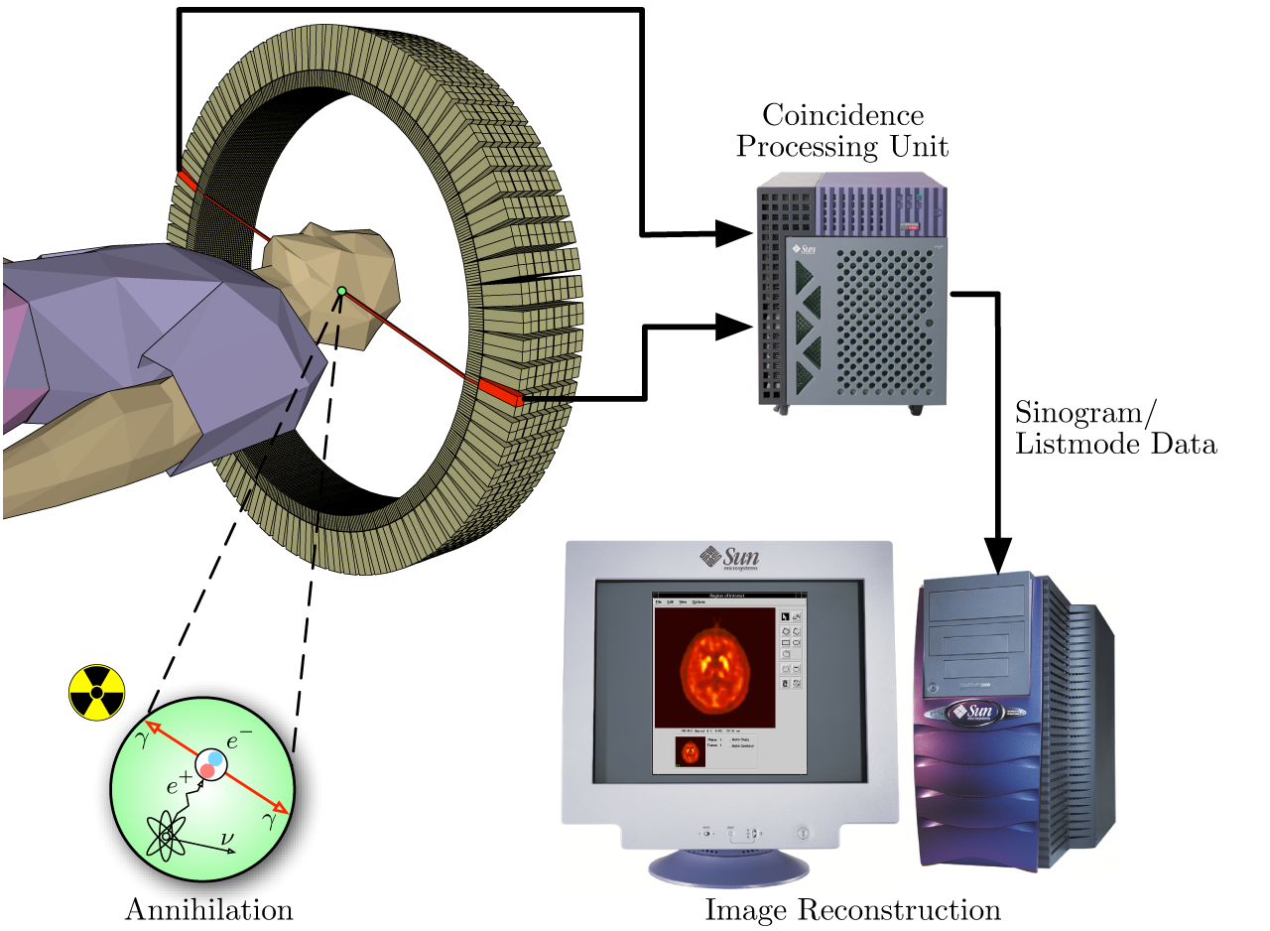
PET (Position Emission Tomography)

Slide 22
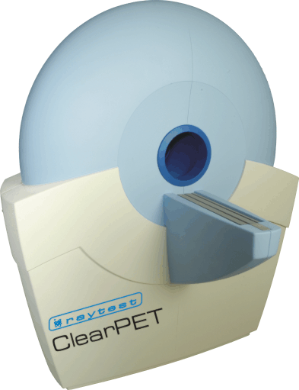
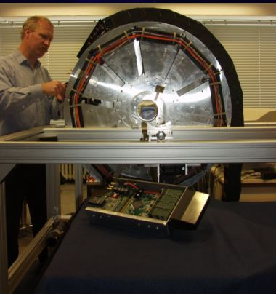
PET: a key device for functional imaging
Generalized use of PET technologies across multiple domains of medical diagnostics
  Neuro-sciences
  Cancer treatment planning
  Small animal PET for drug discovery
Dedicated PET:
  Mammography,
  Brain devices
Whole-body PET/CT market
Year | Mio $
2004 | 880
2005 | 985
2010 (est.) | 1870
Crystal Clear Collaboration: Small animal PET for in-vivo drug screening
Notes:
22

Slide 23
PET technologies
Radiopharmaceuticals
  Tracers: functional specificity
    Most popular: FDG (Fluorodesoxyglucose)
  Markers: attached to tracer to generate γγ (511 keV) signal
    Ex: ¹⁸F, ¹¹C
  α-therapy
Detectors
  Photo-converting material (Matrices of mono crystals), ex: LSO, LYSO, GSO
Electronics
  Photo-multipliers
  Avalanche Photo Diodes (APD)
  In the future Single Photon Avalanche Photo Diodes (SPADS) (Higher Gain)
Software
  Sinograms for image reconstruction

Slide 24
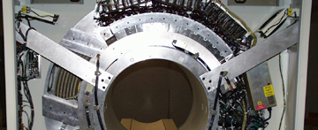

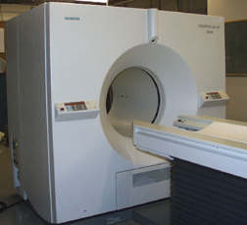

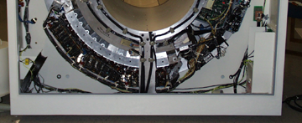


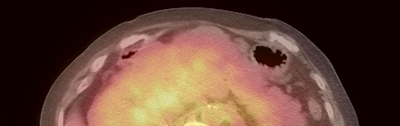
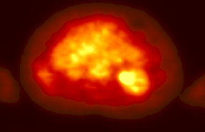
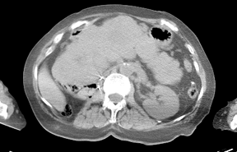
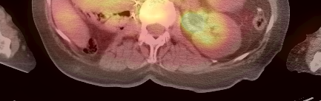
Software to combine modalities: Image fusion: PET + CT
SMART scanner
ECAT ART
Somatom
AR.SP
PET + CT
from University of Pittsburgh & Siemens

Slide 25
Physics and Medicine : a century of collaboration
Technology and instrumentation for diagnosis and treatment:
PET
(functional)
Radio/particle Therapy
X-Ray
(Morphological)

Slide 26
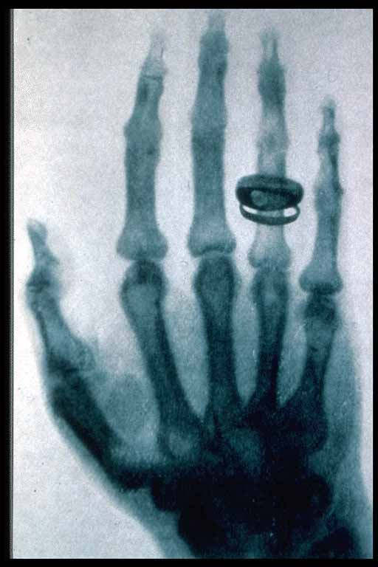
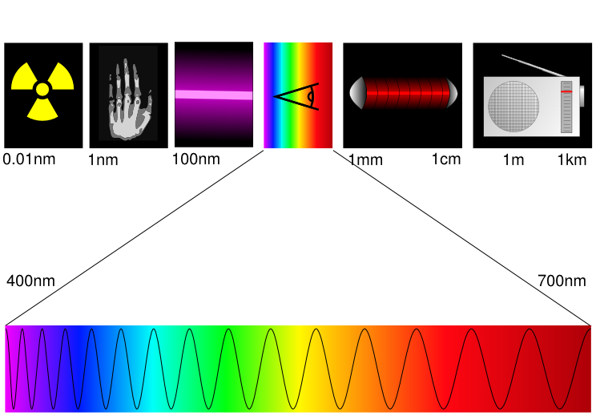
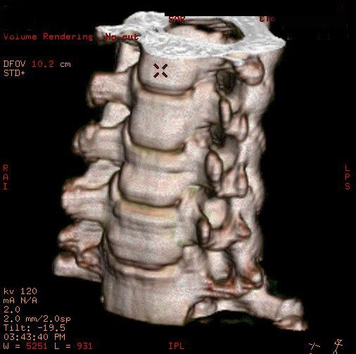
X Rays to CT
Since 1895, 30 – 100 kEV
Originally: Sensitive film
Today: Digital radiography, Computed tomography (3D)
Röntgen
Radiofréquence
Courtesy GE

Slide 27
Index
CERN & fundamental research characteristics
Research results for health that strongly impacted society
How research can help society meet challenges ahead
  Health
  Molecular biology

Slide 28
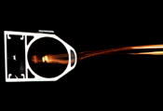
How can current physics research programme benefit society?
CERN tenders European industry for the procurement of all the main elements (or their constituents) of the accelerator and an important part of the experiments.
  HEP very challenging requirements can greatly enhanced many different industrial processes
  Industry acquires new technologies and know-how through procurement contract with CERN
  Impact of procurement to industry
  Financial:
    For 1 Euro invested in purchasing technology goods, more than 3 Euros are generated in companies
  Knowledge transfer:
    Context: 629 High Tech supplier projects, ~1Bn Euros, 178 survey respondents, No companies with orders < 20 kEuros):
  Results:
    38% developed new products
    17% opened a new market
    14% started a new business unit
Vacuum chamber
Hood clamshell tool in elastomer
Example of a new product developped at CERN to detect
Leaks in vacuum, used by the food processing industry

Slide 29
How can current physics research programme benefit society (2)?
The LHC with its extremely challenging operational conditions has been the source of many new technical innovations and has pushed many detector technologies to their limits.
  Particle physics today has an extensive portfolio of generic and well established detector technologies covering many different technology domains such as photodetectors, gaseous detectors, solid state detectors, scintillators, related readout electronics and data processing.
  HEP portfolio matches multiple product needs in many applied physics and industrial application domains such as medical imaging, life science, homeland security and others.
  Whereas particle detectors for HEP have to meet best possible performance at affordable costs, products from industry have to meet advertised features and customers’ needs using robust and proven technologies at the lowest possible production costs resulting in two different technology transfer schemes:
    New products / applications: PET scanners, World Wide Web
    New technology in existing industrial products (illustration in the following slides):
      Super-conducting technologies to reduce device size and energy consumption
      Very fast counting and very sensitive micro-electronics to enhance device performances

Slide 30
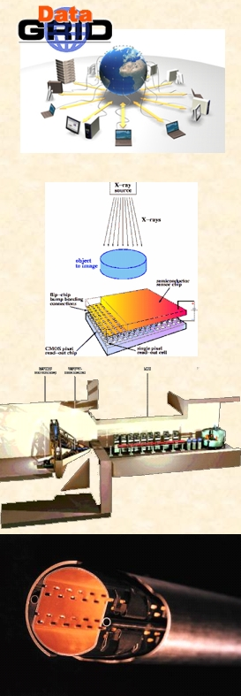
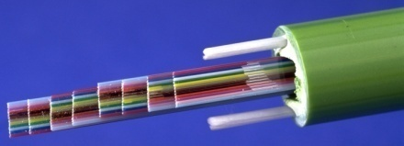
Potential of CERN technologies in non-HEP application domains
Material
Mechanics
Cryogenics
Detectors
Vacuum
Technology
Electronics
IT
Accelerator
Magnets
Detectors
✓
✓
✓
Health & Lifesc.
✓
✓
Electronics
Therapy /
Isotopes
✓
✓
✓
✓
✓
Energy Storage
✓
✓
✓
Renewable Energy
✓
✓
✓
Energy & Environment
Thermal Insulation
✓
✓
Nuclear Waste treatment
✓
✓
✓
✓
✓
Eng.
Industrial processes
✓
✓
✓
✓
✓

Slide 31
Index
CERN & fundamental research characteristics
Research results for health that strongly impacted society
How research can help society meet challenges ahead
  Health
  Molecular biology

Slide 32
Health: Defeating cancer
Results from the current research programme can contribute significantly to meet this challenge by enabling:
  More compact hadron / proton therapy device using super-conducting technologies and small adjustable (3D) beams:
    To reduce weight in order to install device on gantry ➔ enhanced flexibility (3D) to optimise beam effect
    To reduce size in order to lower costs and make device affordable to a larger community
  More accurate and more timely diagnostics device using LHC very front-end electronics for:
    CT: To reduce doses and enhance contrasts ➔ opportunity for screening
    Integrated PET-CT: To support 4-D measurement in order to take into account the breathing cycle ➔Better tumour localisation in moving organs ➔ Optimisation of treatment planning
    Time of Flight PET: To improve image and monitor uptake ➔ localisation of tumour activity
    PET + MRI: To replace CT ➔ Radiation dose suppression
    In-beam PET: to monitor on-line the dose deposited and provide feedback data to therapy device

Slide 33
Super-conducting cyclotron directly installed on a Proton Gantry
gantry
IBA
Standard cyclotron: 200 Tons, 230 MeV protons, 3 T
MIT is designing a super-conducting Nb3Sn synchrocyclotron,
9Tesla, 250 MeV protons, pulsed bunches, cryogen free
(Cryocoolers), weight < 35 Tons on a gantry
Standard gantry characteristics: > 100Tons, 10m diameter

Slide 34
LHC detector technologies and electronics can help Health
Applications in Medical and Molecular Imaging:
PET
CT
X-Ray
SPECT
MRI
Examples
Solid State
detectors
Microstrip
Pixel
A-Si:H
What the LHC needs
Gaseous detectors
MWPC
FGLD
GEM
Performance
  High sensitivity for small tumor detection
  High specificity to avoid unnecessary biopsies and wrong diagnostics
  Ultra fast Signal Analysis
  High Spatial Resolution
but also
  Compactness
  Low cost
  Mature technology
  Liability
  Flexibility in use
Calorimeter
Scintillating crystals
Scintillating fibers
Detector & electronic
technologies
Radiation hard, fast and high precision measurement of:
  Energy
  Momentum
  Time
Photo detectors
HPD’s
Pixel
SiPM/SPAD
Readout electronics
Single photon counting
HPTDC timing
Discriminators

Slide 35
LHC electronics for spectral CT to enhance contrast and reduce dose
A paradigm shift: from current mode CT to counting mode CT
Current mode CT
  Limited contrast
  No information on X-ray energy
  High dose
    Restricted use for screening
    Limited access to preventive health care market
Counting mode CT
  High contrast
  Tissue decomposition through colour mode
  Up to 10 times lower dose
    Opportunity for screening
    Access to preventive health care
Courtesy GE
Courtesy Rabin Medical Center, Israel
Notes:
35

Slide 36
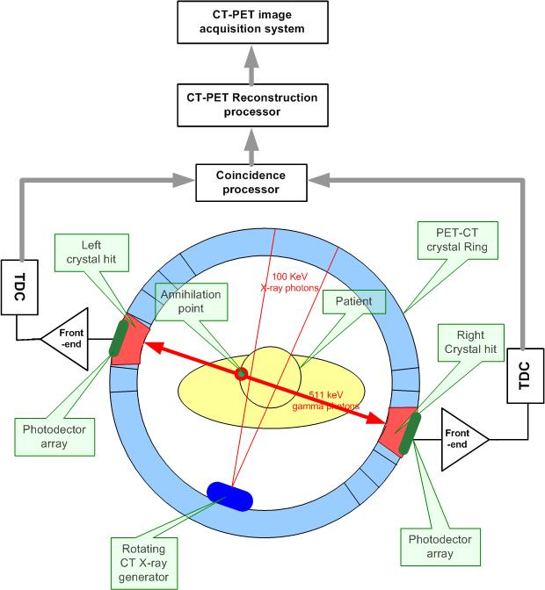
Integrated PET-CT for 4-D functional imaging
PET-CT integration to multimodal system
  PET and CT event data acquisition using the same detector heads
3-D and time synchronization
  PET and CT events time stamped throughout the examination
  3-D image reconstruction over examination time
Advantages
  Morphological and functional images are fused taking into account the breathing cycle
  Enriched image information through merging morphological and functional images in the same reference system
  Reduced complexity in cross-modality calibration

Slide 37
Time Of Flight PET to improve image quality
Improve image quality through background reduction:
  Discriminate random coincidences
  Exclude events outside target zone
“True” annihilation point
Reconstructed axis
Arrival time difference of photons Δt=t_{A} – t_{B} depends on position of annihilation point
TOF: use time stamp information of incident photons to reconstruct annihilation point and to define target zone
Detector A
Detector B
e⁻
e⁺
t_{A}
d_{A}
t_{B}
d_{B}
Without TOF
Advantages:
  Improved contrast
  Shorter reconstruction time
  Less dose for patients
d_{rec}
With TOF
d_{rec}

Slide 38
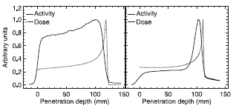
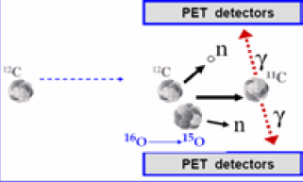
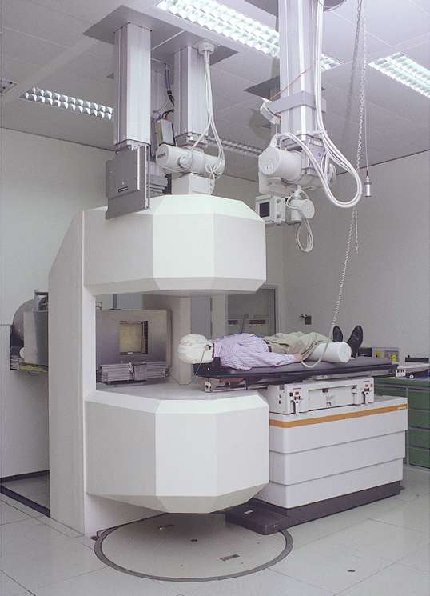
In beam Time Of Flight PET for treatment planning and monitoring
Courtesy K.Parodi
Utilisation of in-beam TOF PET in hadron therapy facilities to monitor treatment online
  Carbon ion beam will induce ¹¹C after collision with cell DNA
  ¹¹C is a β⁺ emitter which can be used for online PET imaging
  ¹¹C activity profile correlated with dose profile: measure β⁺ profile to reconstruct “true” dose profile and check against planning
protons
Carbon ions
β⁺ Activity profile
Dose profile
PET Camera
In beam-PET offers a unique tool to control the precision of the irradiation profile as well as the treatment plan in real-time
Time Of Flight PET:
  Reduce background
  Minimize time to reconstruct the data
LHC detector front-end electronics can open the path to industrial solutions:
  Crystal readout with APD’s and SiPMs
  Ultrafast counting electronics
Carbon Beam

Slide 39
PET – MRI to substantially reduce dose delivered to patient
"The development of combined PET/CT scanners has allowed major expansion of molecular imaging," Michael Welch, co-director of the Division of Radiological Sciences at the Washington University School of Medicine (St Louis)
  PET scanning requires a very small dose for patient
But: the addition of CT to PET means a substantial increased radiation dose for the patient.
Solution: Replace CT with MRI
  No additional radiation dose to patient
  High contrast morphological information
Challenge
  Development of PET electronics compatible with high magnetic field of MRI
LHC detector front-end electronic can open the path to an industrial solution
  Crystal Read-out: APD, SiPM

Slide 40
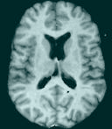
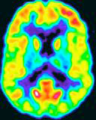
PET Functional imaging: PET - MRI
"The development of combined PET/CT scanners has allowed major expansion of molecular imaging," Michael Welch, co-director of the Division of Radiological Sciences at the Washington University School of Medicine (St Louis)
High dose rate for CT
PET/CT mostly not really simultaneous
Functional & morphological imaging
Low dose rate for PET
Key parameter | MRI | PET
Anatomical detail | Excellent | Poor
Spatial resolution | Excellent | Compromised
Clinical penetration | Excellent | Limited
Dose rate | Excellent | low
Sensitivity | Poor | Excellent
Molecular imaging | Limited | excellent
LHC detector front-end electronics can open the path to industrial solutions:
  Crystal readout with APD’s and SiPMs
  Compatible with high magnetic fields in MRI
Courtesy U. Pietrzyk, FZJue;ich

Slide 41
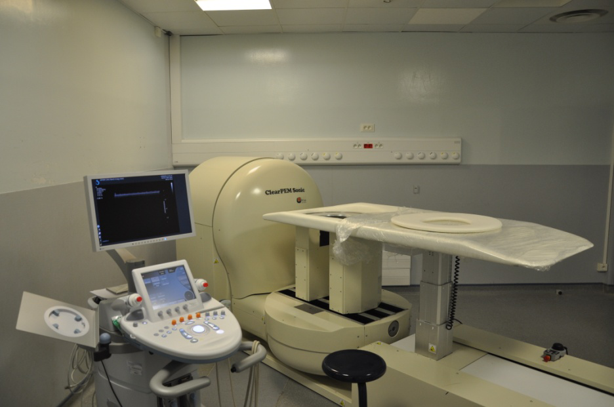
ClearPEM-Sonic: Introduction
High risk of breast cancer at some point of life, 2nd cause of cancer death amongst women
  Very good survival rates if detected at an early stage
But available techniques (Xray, US, MRI, wholebody PET/CT) all have disadvantages
Room for another technique, ClearPEM-Sonic, that combines:
  ClearPEM, a dedicated mammography PET → METABOLIC information
  SupersonicImagine Aixplorer,
    a 3D ultrasound and elastography system → MORPHOLOGIC and STRUCTURAL information
…. an imaging modality that improves the quality of breast cancer diagnosis

Slide 42





ClearPEM-Sonic: the machine
A dedicated mammography PET:
  Breast exams with patient in prone position
  Plates rotate around the breast
  Plates can be rotated for axillary exams
Two prototypes in operation
  ICNAS – Coimbra (ClearPEM)
  Hopital Nord – Marseille (ClearPEM-Sonic)
Technology
  6144 LYSO:Ce crystals in 192 matrices
  APD readout on both sides of each crustal
  Fast Front-End readout with dedicated ASICs

Slide 43
US system: Elastography Principle
    injects a focalized beam that moves with supersonic speed through the tissue
    this long focused pulse creates Dynamic Radiation Force that generates transient Shear Waves
    this Shear Wave front is altered by different tissue stiffnesses
    this information is captured with Ultrafast ™ imaging
→ user-independent, real-time, quantitative method
2 ms
12 ms
17 ms
The principle of elastography
Shearwave propagation around a lesion

Slide 44




ClearPEM-Sonic: Proof of Concept
Elastography
Fused Image
Full-body PET
  Agar-Agar / Gelatin phantom with lesions (developed by Dang JUN from Brussels University, see his talk)
  First image taken with SSI AIXplorer in elastographic mode, second image taken with full-body PET (IPO)
  Reconstructed images (courtesy Dang JUN) show it is possible to match both images using fiducial markers and the magnetic positioning system

Slide 45
Index
CERN & fundamental research characteristics
Research results for health that strongly impacted society
How research can help society meet challenges ahead
  Health
  Molecular biology

Slide 46
Advanced accelerator and detector techniques to probe molecules in cells
Molecular biology is in great need of technologies from fundamental research to unravel the mechanisms of life
  Advanced simulation tools to build an accurate model of a living cell
  Synchrotron light sources (accelerators) to image complex molecules
  Very fast, very sensitive read-out electronics to capture intra and inter cellular ions and molecule exchanges using fluorescence imaging techniques
  Complex analysis techniques to exploit the huge amount of data generated by micro-arrays assays
The intrinsic structure of a complex protein molecule has been determined
by reconstructing scattered synchrotron radiations (Spring 8, Japan)

Slide 47

Applications of fast counting read-out electronics to spectroscopic imaging
Single photon counting electronics allows extremely low dose rate imaging and access to spectroscopic information enabling new imaging applications
  Life Science
  Time resolved diffraction measurements at synchrotrons with unprecedented dynamic range and speed
Medicine
  First experiments in spectral X-ray imaging
    Starting with small animal CT
    Aiming for CT for preclinical studies in the coming years
    Ultimate aim is colour X-ray CT for mammography and
    whole-body
Material Science
  Improved thickness gauging and material determination
  Environmental Monitoring
  Radiation monitoring instruments (area radiation monitoring, object monitoring, personal dosimetry)

Slide 48



High-resolution X-ray Radiography
Image of a daisy (almost transparent to X-rays)
Polychromatic source is used. Single photon counting permits ultra-high contrast imaging after correction for spectral hardening
Institute of Experimental and Applied Physics, Prague

Slide 49


Confocal laser scanning microscope
A laser beam passes through a light source aperture and then is focused by an objective lens into a small (ideally diffraction limited) focal volume within a fluorescent specimen. A mixture of emitted fluorescent light as well as reflected laser light from the illuminated spot is then recollected by the objective lens.
A beam splitter separates the light mixture by allowing only the laser light to pass through and reflecting the fluorescent light into the detection apparatus. After passing a pinhole, the fluorescent light is detected by a photodetection device (a photomultiplier tube (PMT) or avalanche photodiode), transforming the light signal into an electrical one that is recorded by a computer.
Notes:
The detected light originating from an illuminated volume element within the specimen represents one pixel in the resulting image. As the laser scans over the plane of interest, a whole image is obtained pixel-by-pixel and line-by-line, whereas the brightness of a resulting image pixel corresponds to the relative intensity of detected fluorescent light. The beam is scanned across the sample in the horizontal plane by using one or more (servo controlled) oscillating mirrors. This scanning method usually has a low reaction latency and the scan speed can be varied. Slower scans provide a better signal-to-noise ratio, resulting in better contrast and higher resolution. Information can be collected from different focal planes by raising or lowering the microscope stage. The computer can generate a three-dimensional picture of a specimen by assembling a stack of these two-dimensional images from successive focal planes.
Confocal microscopy also provides a substantial improvement in lateral resolution and the capacity for direct, noninvasive, serial optical sectioning of intact, thick, living specimens with a minimum of sample preparation.^{[3]} Because CLSM depends on fluorescence, a sample usually needs to be treated with fluorescent dyes to make objects visible. However, the actual dye concentration can be low to minimize the disturbance of biological systems: some instruments can track single fluorescent molecules. Also, transgenic techniques can create organisms that produce their own fluorescent chimeric molecules (such as a fusion of GFP, green fluorescent protein with the protein of interest).

Slide 50
Single photon counting and imaging with microchannel plate
The front end NINO read out a pixelated micro channel plate
Signal from NINO are “time stamped” by the HPTDC
Following signal processing is performed in FPGA by user
HPTDC
To
computer
NINO
Pixelated anodes

Slide 51
Molecular imaging: Fluorescence Lifetime Imaging
Fluorescence imaging
  Each visible photon quanta is detected and counted in a pixel or correlated with its time stamp
Single quanta detectors for visible photon
  Photomultiplier
  Microchannel plate
  Hybrid Photo detector
  Single Photon Avalanche Diode (SPAD)
Benefits
  Very sensitive to various interactions between fluorescent molecules and cell environment
  Ultra-high Time Resolution - 25 ps
  Ultra-High Sensitivity - down to the single photon level

Slide 52
Conclusions
Basic research has a strong impact on technology developments and innovation
Technology developed for science have major repercussions on the global community
Technology developed for science is a source for Industry that leads to important business prospects
Fundamental science accelerates the industrial process and improves daily life
Many issues, including funding are limiting the impact of public research to industry and society
Notes:
52

