Slide 1
Chiller Asset Registry
EXPERIMENT | GAS SYSTEM | MODULE | PART (MODEL) | ASSET | URL From EAM Light
ATLAS | TGC | MIXER | HCXGXCU00006 (RE630) | HCXGXCU00006-LDLCK1944-12-0004 | Asset HCXGXCU00006-LDLCK1944-12-0004
 |  | LIQUIFIER | HCXGXCU00007 (UNISTAT 905) | HCXGXCU00007-HB503006 | Asset HCXGXCU00007-HB503006
 | RPC | HUMIDIFIER | HCXGXCU00005 (MC 250) | HCXGXCU00005-LDCN24000962 | Asset HCXGXCU00005-LDCN24000962
CMS | FGR | - | HCXGXCU00001 (UNISTAT 915) | HCXGXCU00001-HB402152 | Asset HCXGXCU00001-HB402152
 |  |  | HCXGXCU00003 (MINISTAT 125) | HCXGXCU00003-HB437402 | Asset HCXGXCU00003-HB437402
 | RPC | HUMIDIFIER | HCXGXCU00002 (RE104) | HCXGXCU00002-LDLCK0861-05-0188 | Asset HCXGXCU00002-LDLCK0861-05-0188
 | SF6 Prototype | - | HCXGXCU00004 (XT 280) | HCXGXCU00004-LDLWP534-11-0002 | Asset HCXGXCU00004-LDLWP534-11-0002
LHCb | RRS | - | HCXGXCU00008 (IN 1590 XTW) | HCXGXCU00008-LDS230010928 | Asset HCXGXCU00008-LDS230010928
 | LOCATION | PART (MODEL) | ASSET | URL From EAM Light
SPARES | WORKSHOP (164) | HCXGXCU00005 (MC 250) | HCXGXCU00005-LDLWM118-14-0126 | Asset HCXGXCU00005-LDLWM118-14-0126
 |  | HCXGXCU00005 (MC 250) | HCXGXCU00005-LDS170001033 | Asset HCXGXCU00005-LDS170001033
 | ATLAS STORE (SGX1) | HCXGXCU00007 (UNISTAT 905) | HCXGXCU00007-HB212172 | Asset HCXGXCU00007-HB212172
 |  | HCXGXCU00006 (RE630) | HCXGXCU00006-LDLCK1944-15-0003 | Asset HCXGXCU00006-LDLCK1944-15-0003
 | CMS STORE (SGX5) | HCXGXCU00003 (MINISTAT 125) | HCXGXCU00003-HB574274 | Asset HCXGXCU00003-HB574274
 |  | HCXGXCU00005 (MC 250) | HCXGXCU00005-LDCN24001691 | Asset HCXGXCU00005-LDCN24001691
 | LHCb (SG8) | - | - | -

Slide 2
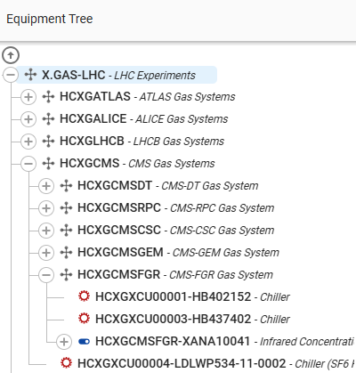
Chiller Asset Registry

