Slide 1
IR Analyzer Asset Registry
EXPERIMENT | GAS SYSTEM | MODULE | FUNCTIONAL POSITION | PART (MODEL) | ASSET | URL From EAM Light
ATLAS | RPC | ANALYSIS 1 | HCXGATLRPCAN-XANA9119 | HCXGXANA00002 (XEGP) | HCXGXANA00002-EMXEA10105285091 | Asset HCXGXANA00002-EMXEA10105285091
 | MMG | ANALYSIS 1 | HCXGATLMMGAN-XANA9119 | HCXGXANA00002 (XEGP) | HCXGXANA00002-EMXEA1015285122 | Asset HCXGXCU00007-HB503006
CMS | FGR | - | HCXGCMSFGR-XANA10041 | HCXGXANA00001 (BINOS 100) | HCXGXANA00001-EM120982118175 | Asset HCXGXANA00001-EM120982118175
 | CSC | ANALYSIS 2 | HCXGCMSCSCANL2-XANA92XX | HCXGXANA00002 (XEGP) | HCXGXANA00002-EMXEA06102965242 | Asset HCXGXANA00002-EMXEA06102965242
 | RPC | ANALYSIS 1 | HCXGCMSRPCAN-XANA9119 | HCXGXANA00001 (BINOS 100) | HCXGXANA00001-EM1206102965243 | Asset HCXGXANA00001-EM1206102965243
 |  |  | HCXGCMSRPCAN-XANA91192 | HCXGXANA00001 (BINOS 100) | HCXGXANA00001-EM1210103429920 | Asset HCXGXANA00001-EM1210103429920
LHCb | RI2 | ANALYSIS 1 | HCXGLHCBRI2AN-XANA9116 | HCXGXANA00003 (XEGK) | HCXGXANA00003-EMXEK09604796726 | Asset HCXGXANA00003-EMXEK09604796726
 | LOCATION | PART (MODEL) | ASSET | URL From EAM Light
SPARES | WORKSHOP (164) | - | - | -
 |  | - | - | -
 | ATLAS (SGX1) | - | - | -
 |  | - | - | -
 | CMS (SGX5) | HCXGXANA00001 (BINOS 100) | HCXGXANA00001-EM1205102933135 | Asset HCXGXANA00001-EM1205102933135
 |  | - | - | -
 | LHCb (SG8) | - | - | -

Slide 2
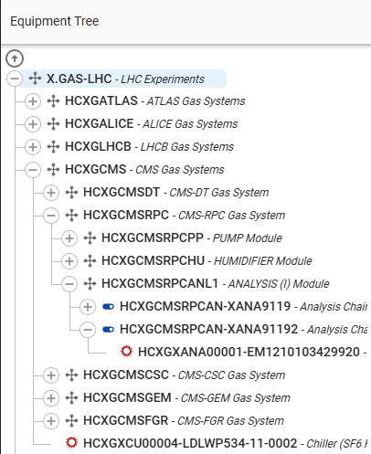
IR Analyzer Asset Registry

