Slide 1
WRAP Isolde synoptic
Ugo iacona

Slide 2
Outline
Isolde Synoptic
WRAP
WRAP implementation
Future features

Slide 3
Isolde Synoptic
Synoptic:
High-level overview of the accelerator's structure and/or operational parameters
Schematic representation that summarize:
  Layout of the accelerator
  Key components and their operational status
  Path in use
  Our uses:
  Needs to monitor many devices while we send beam to an experiment
  Minimize downtime due to a device failure
  Give an intuitive way to monitor the complex

Slide 4
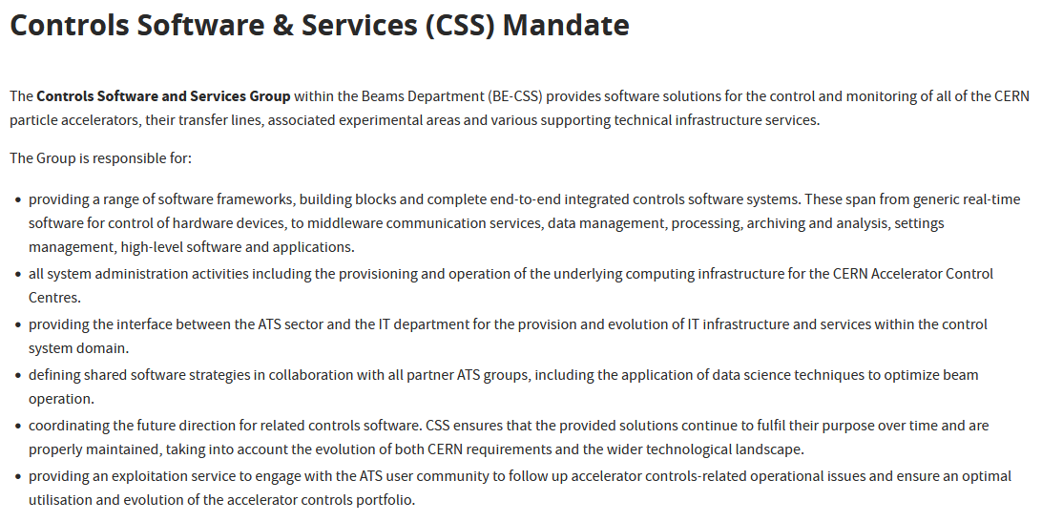

WRAP
Operation of CERN’s accelerator complex: many devices need to be controlled
Over 500 custom Graphical User Interfaces (GUI) have been developed using Java Swing, Java FX and Python
High maintenance cost, particularly considering the global evolution of the GUI technology landscape
The new Web-based Rapid Application Platform (WRAP) provides a centralized, zero-code, drag and drop means of GUI creation
Wrap is a Web-based Rapid APplication development framework for CERN’s controls infrastructure

Slide 5
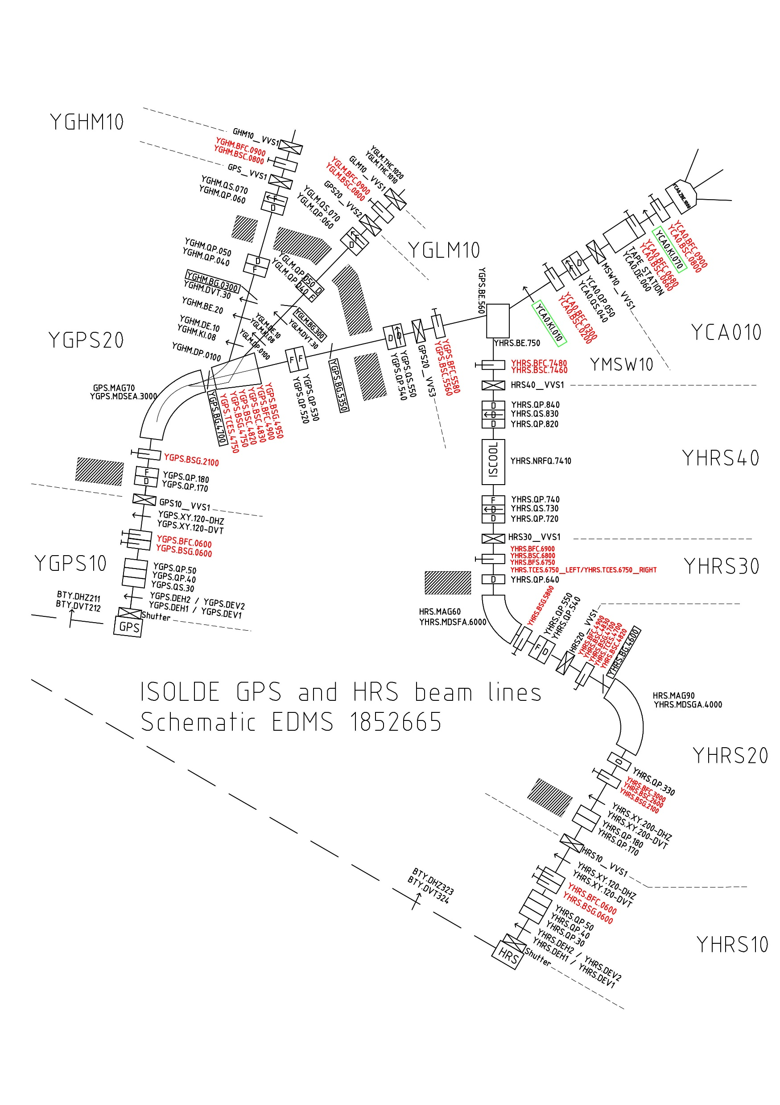
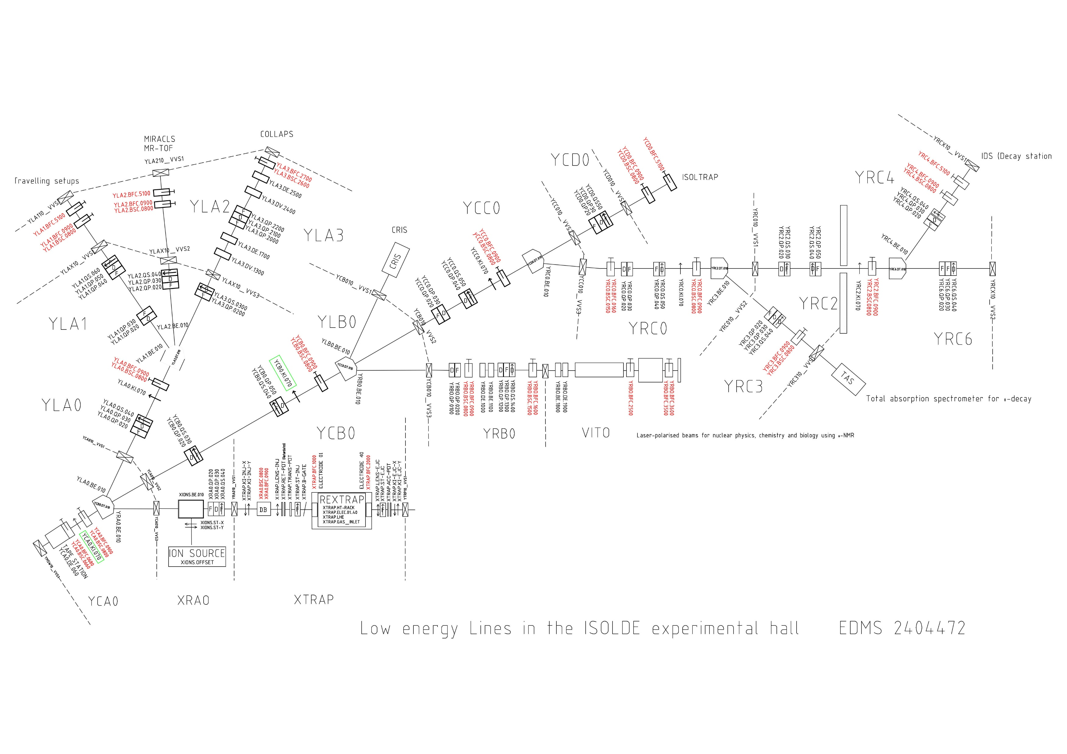

Slide 6
LA1
LA2
LA0
GHM10
GHM20
LA3
GLM10
GLM20
LB0
CRIS
GPS
GPS10
GPS20
CA0
CC0
CD0
ISOL TRAP
MSW
CB0
RC4
HRS
HRS10
HRS20
HRS30
HRS40
RC2
RC0
RC6
RC3
TAS
RB0
VITO
RA0

Slide 7
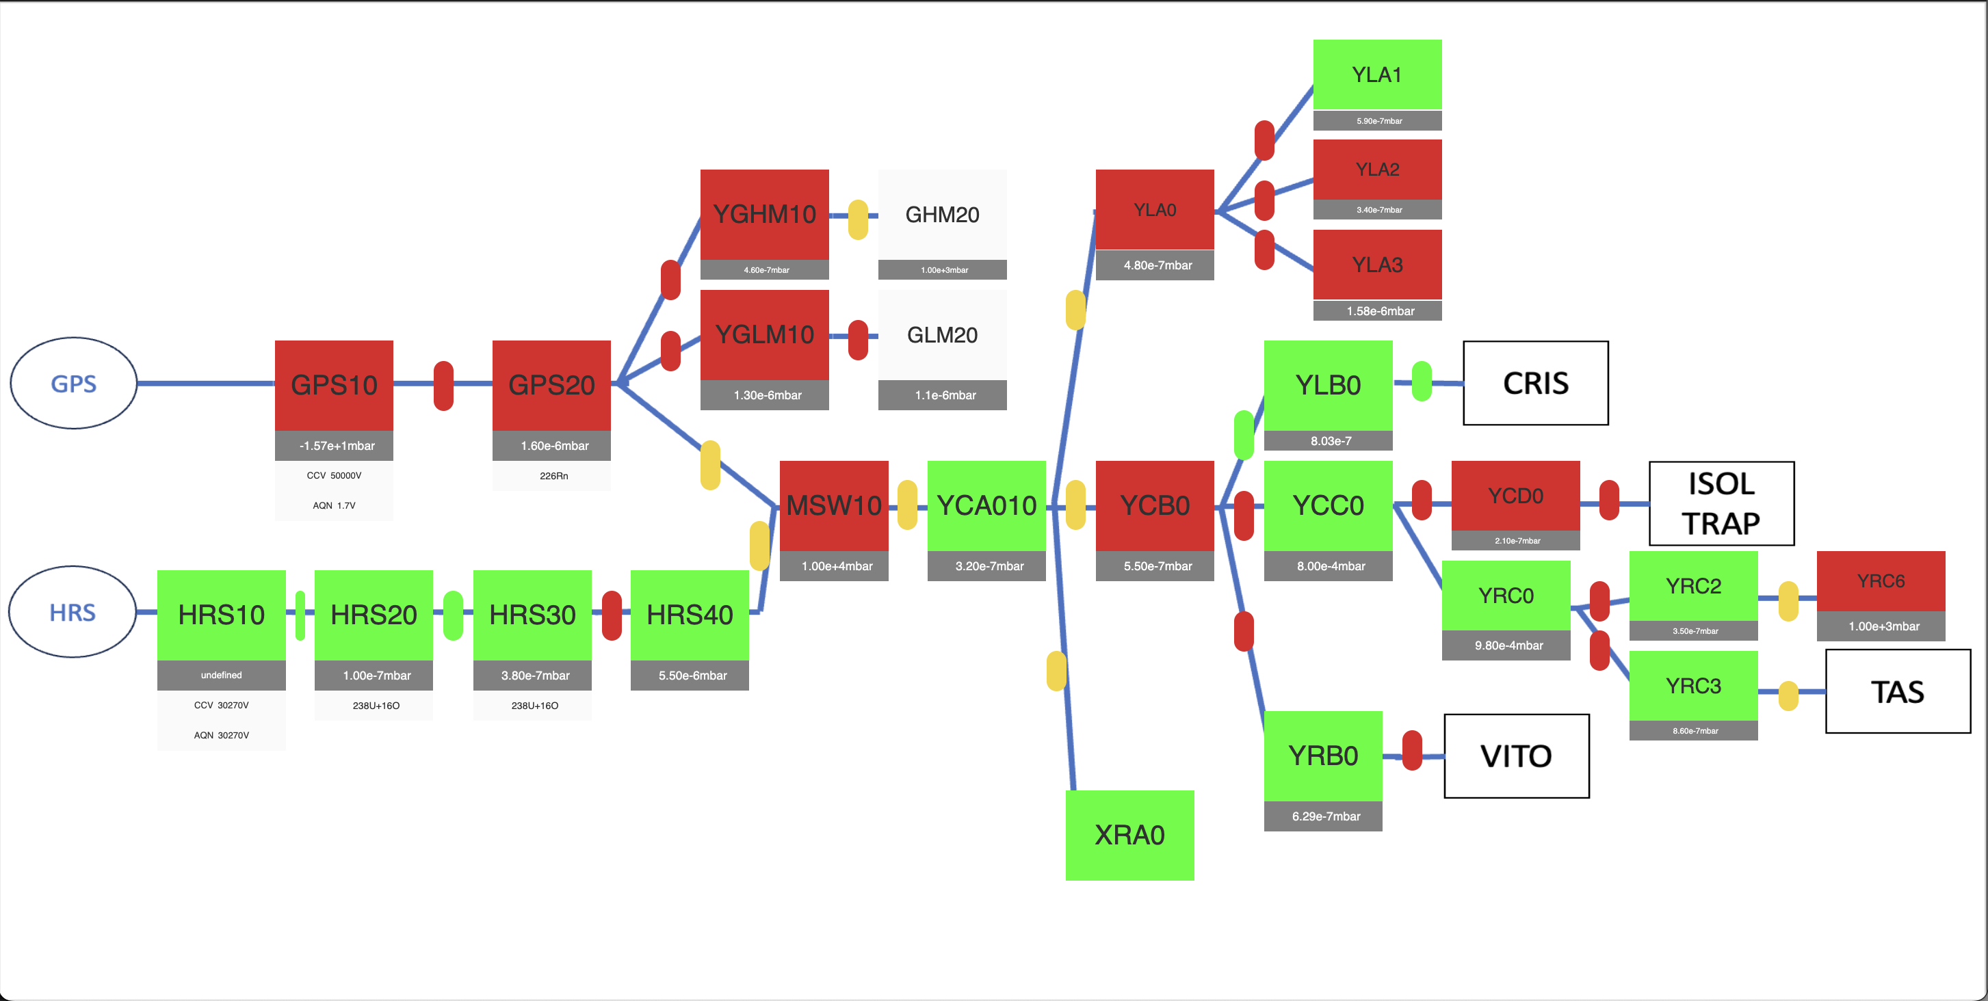

Slide 9
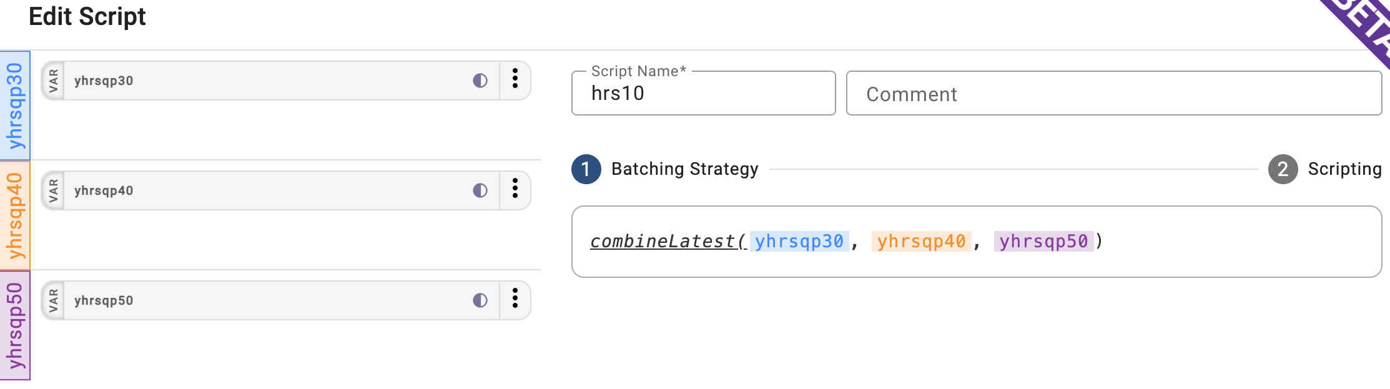
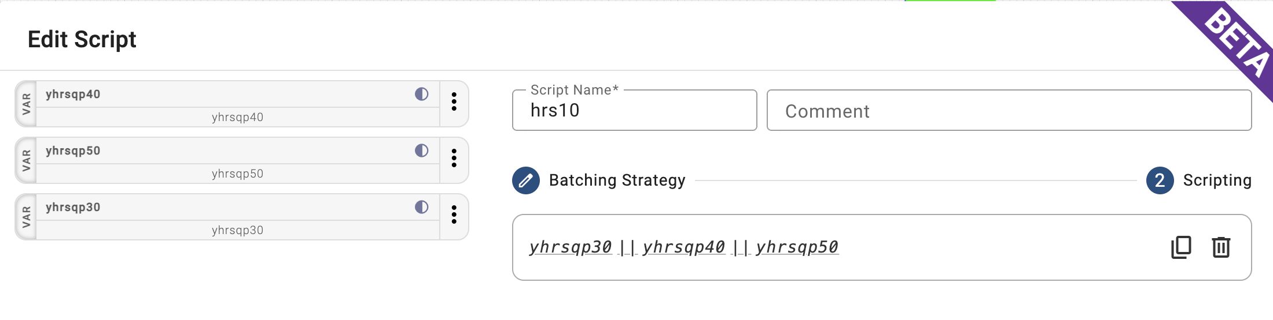

Slide 10
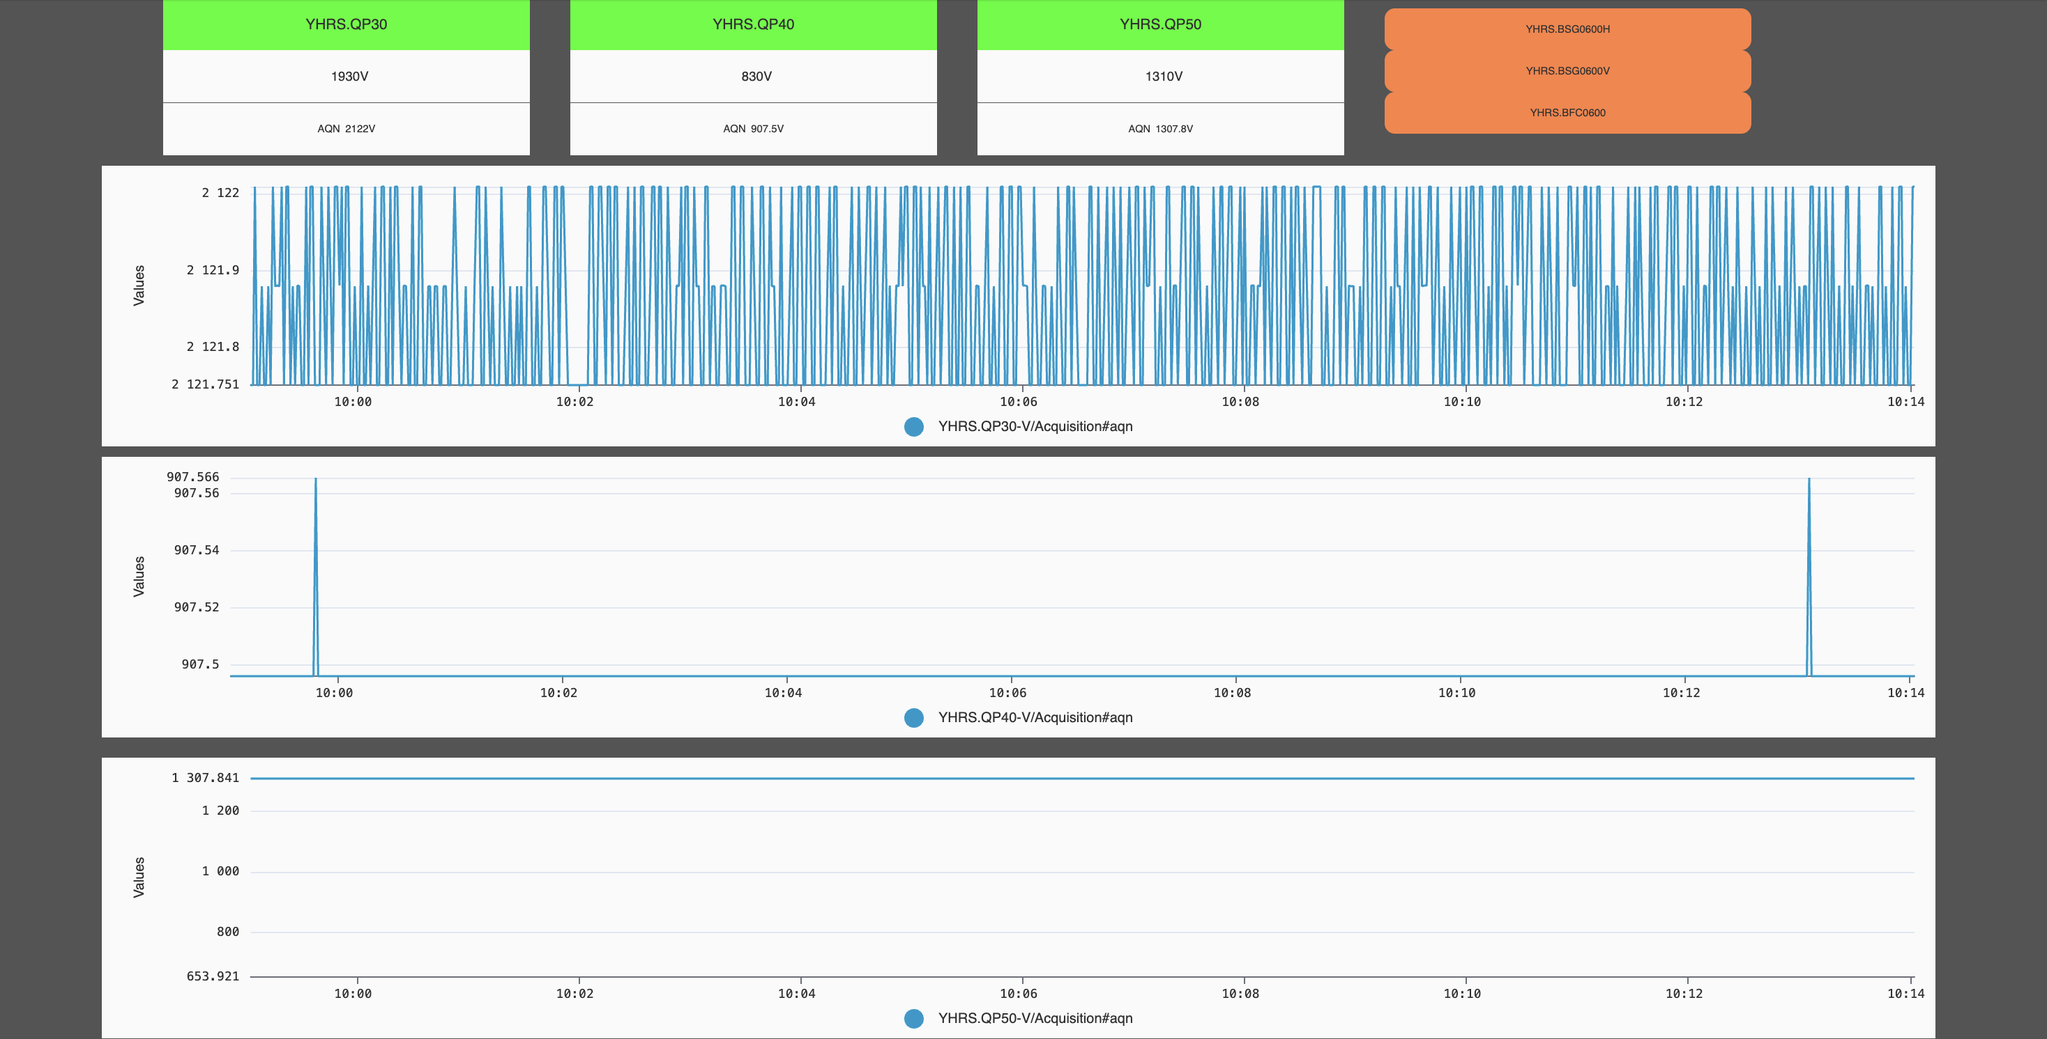

Slide 11
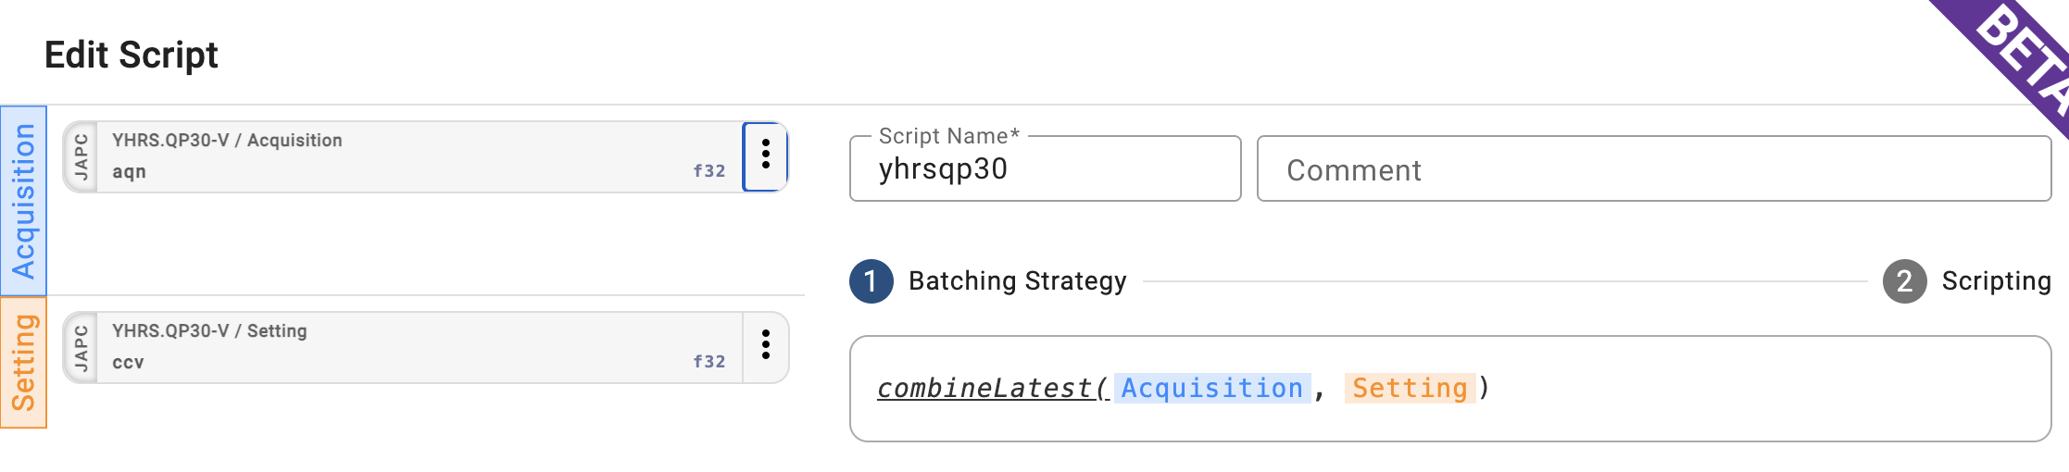
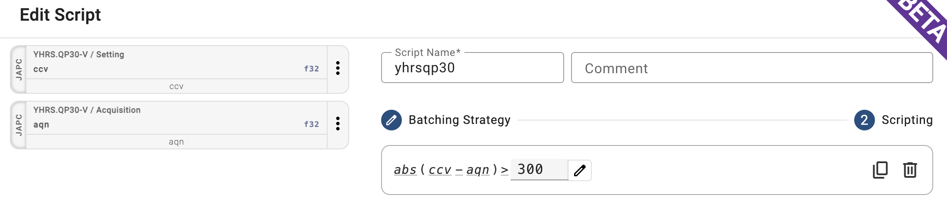

Slide 12

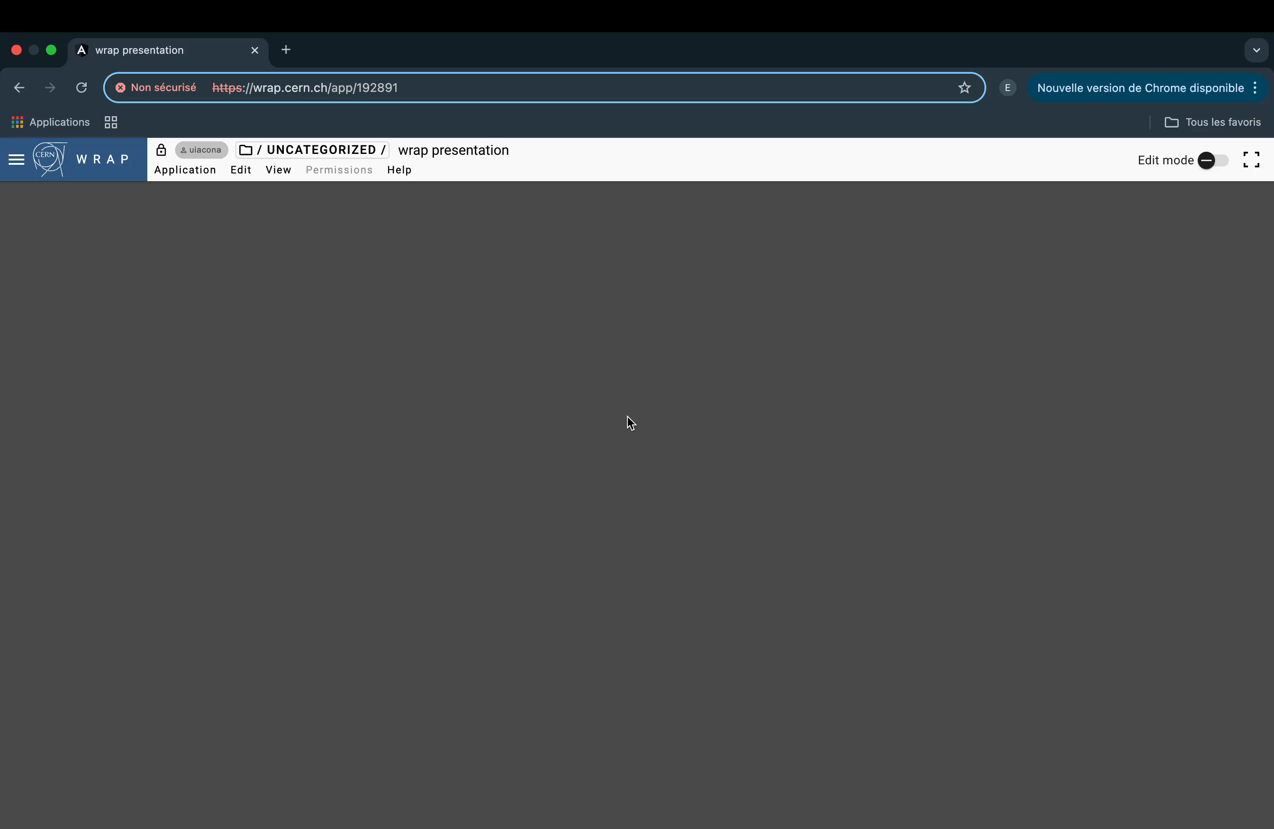

Slide 13
Future Features
Can be used on a mobile phone
Change the defference between CCV and AQN
Highlight the path taken by the isotope.
  Create a menu for the diferents paths
  Can also be used by the LINAC
    Include the combination of LINAC and ISOLDE paths

