Slide 1
ALICE 3 Installation
A.Tauro, C. Gargiulo, E. Laudi, W. Riegler
11.7.2025

Slide 2
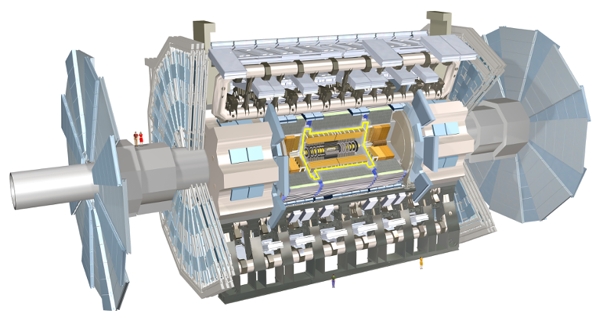
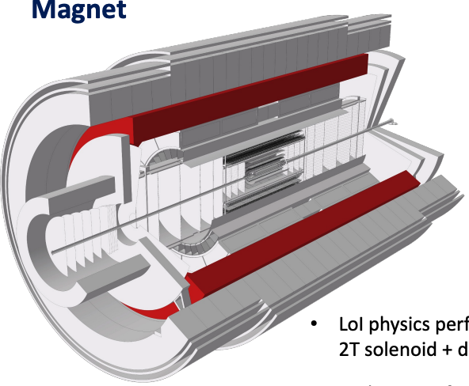
ALICE 3 magnet vs. ATLAS central solenoid
ATLAS
Sol.: 2.3 x 5.3 m
ALICE 3 (v2)
Sol.: 2.5 x 7.5 m
ALICE 3 solenoid: similar diameter but longer than ATLAS central solenoid
Notes:
ATLAS solenoid: 2.56 x 5.8 m
ALICE 3 solenoid (V1): 3.2 x 7.5 m

Slide 3
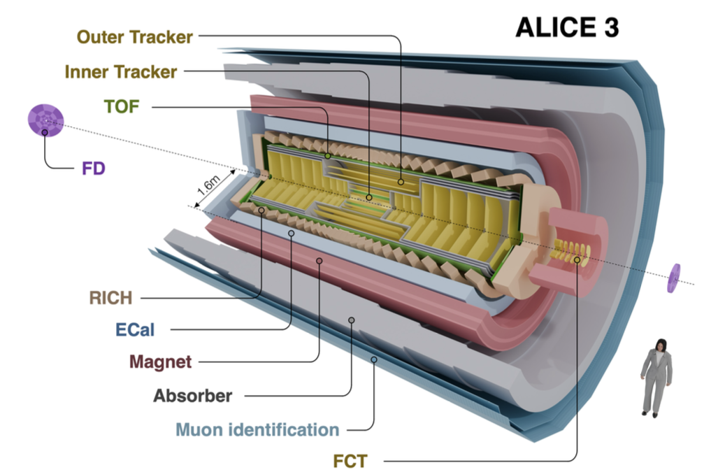

Slide 4
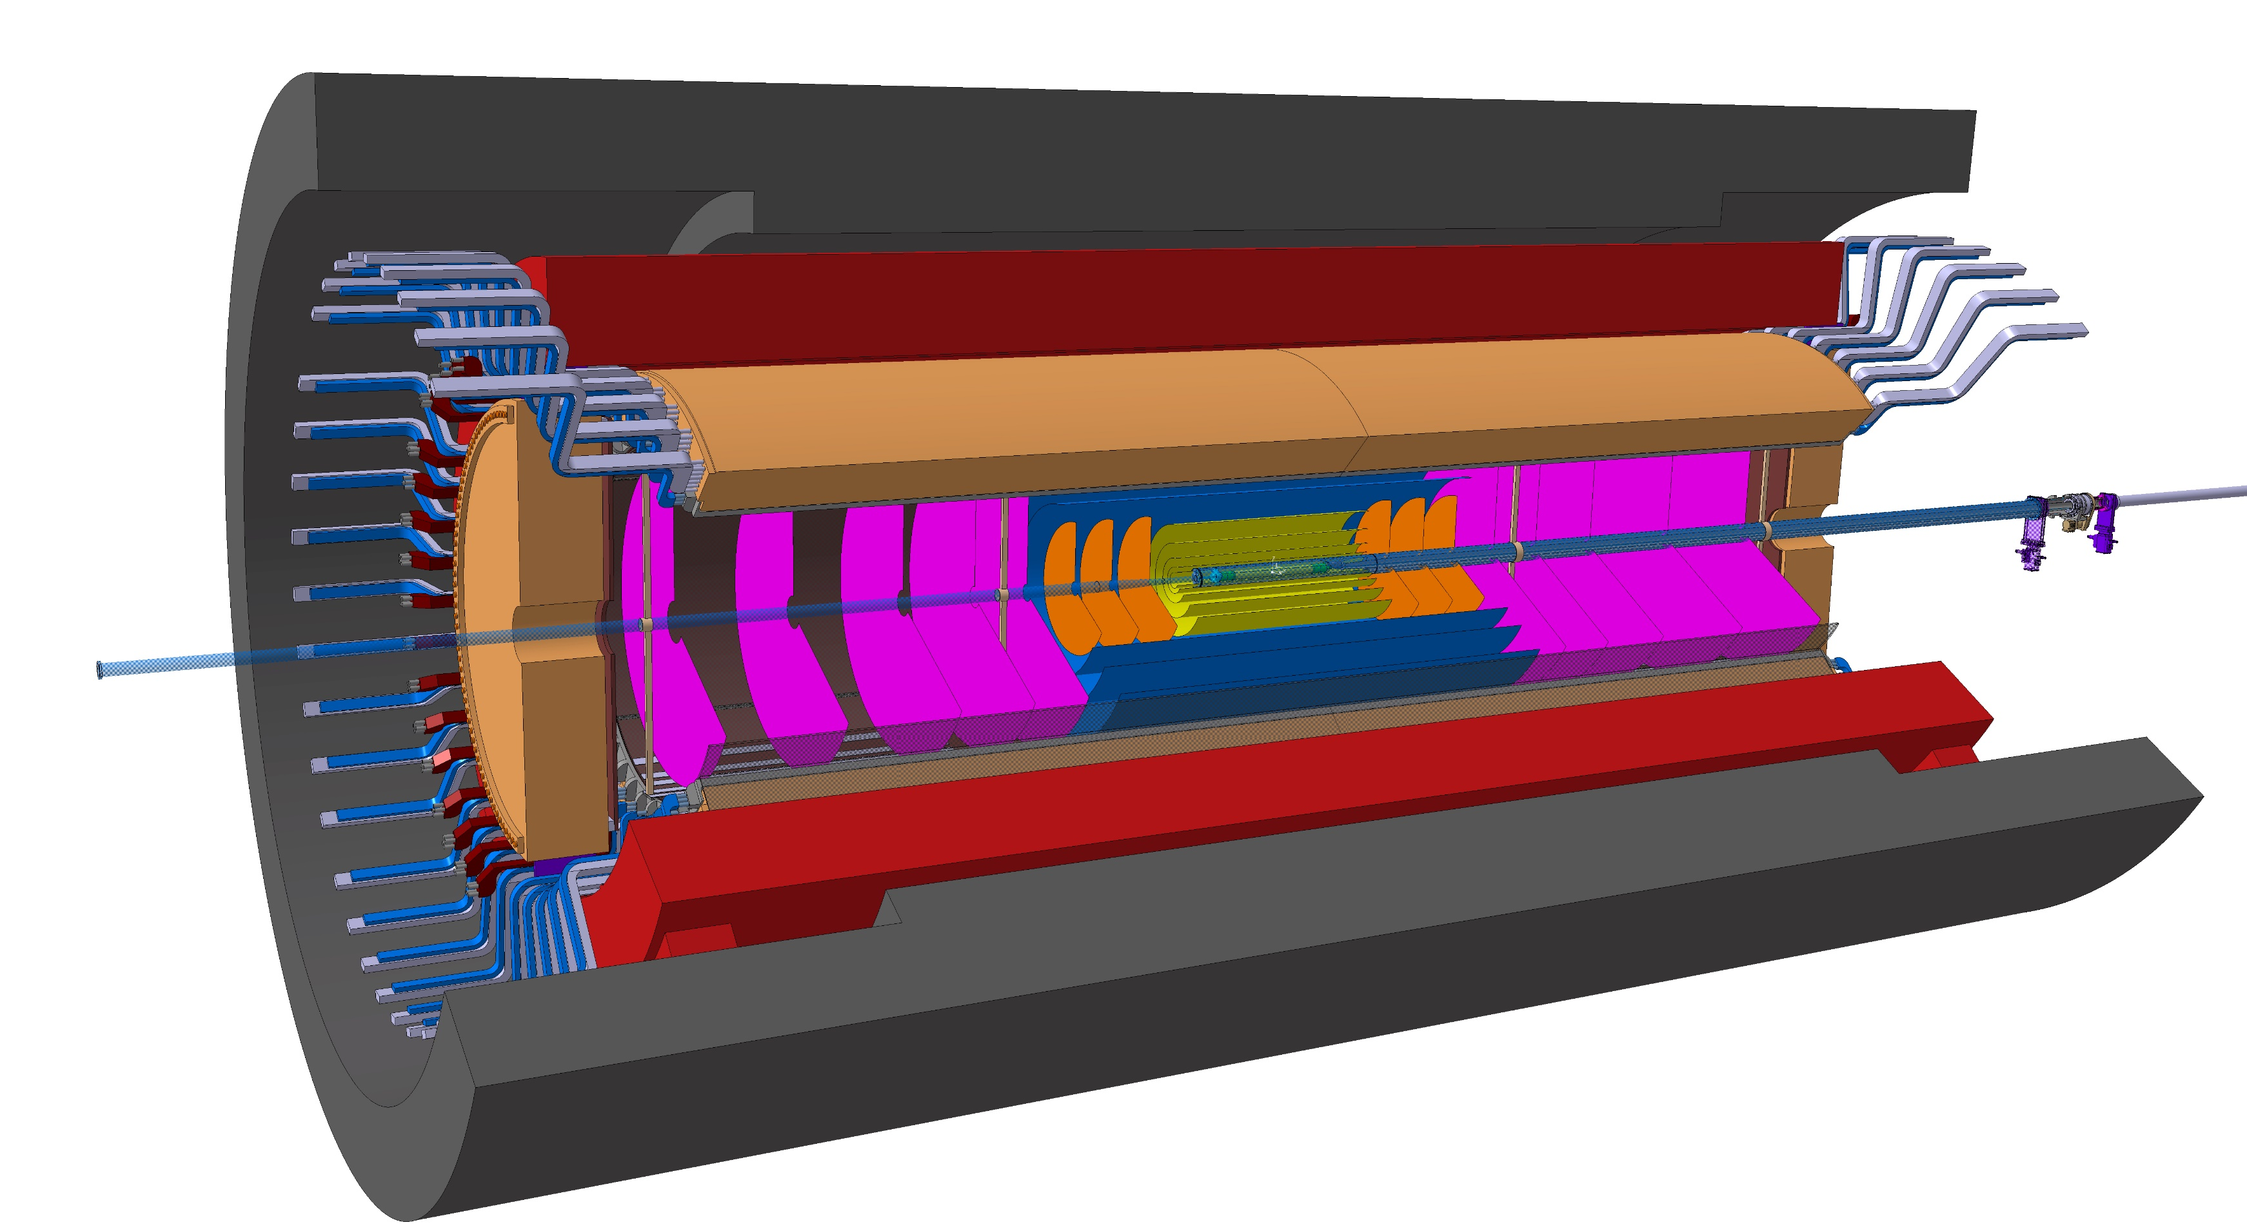
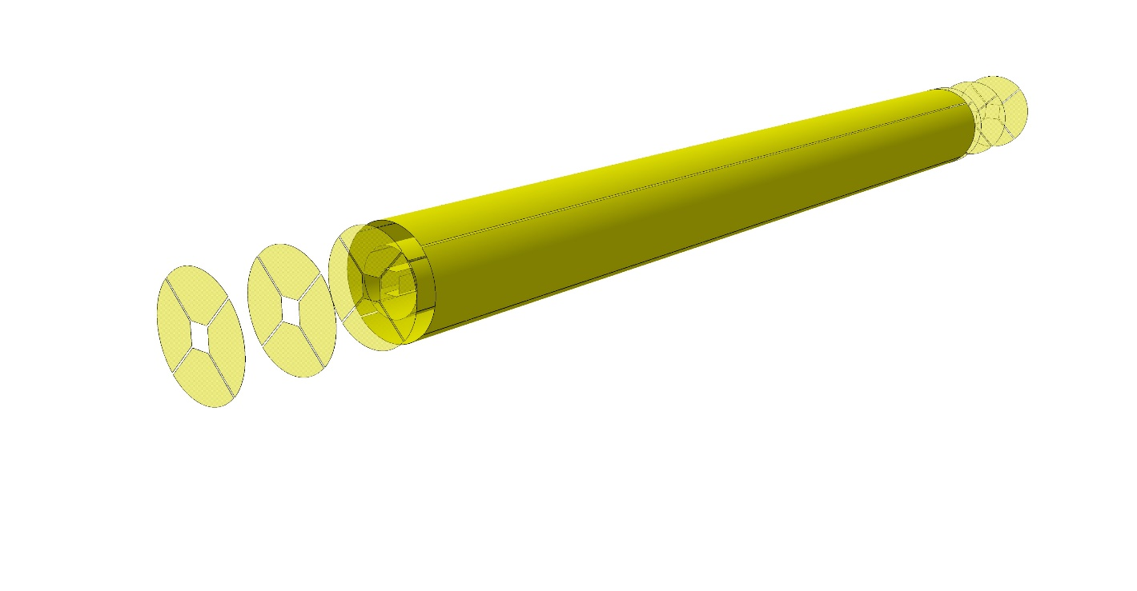
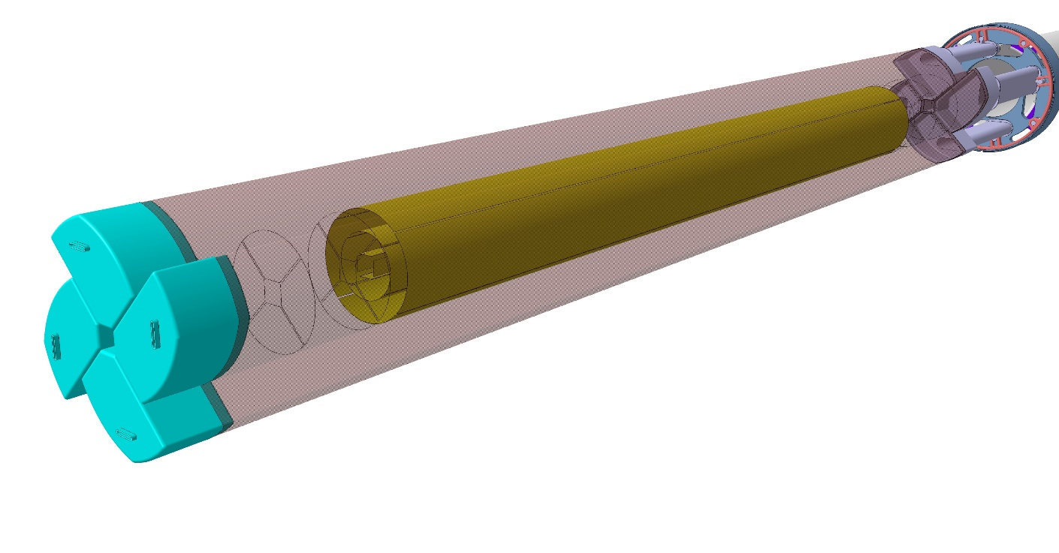
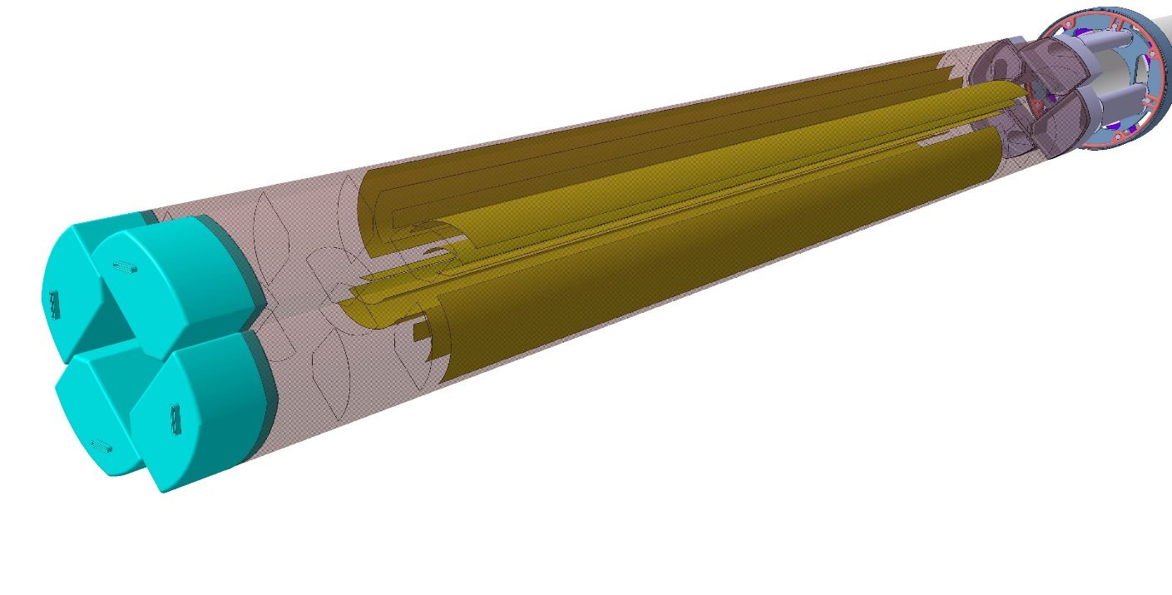
ALICEƎ
Layout
4
ABSORBER
MAGNET
RICH
TOF
IRIS
IR= 5mm, 700mm
retractable Vertex inside beampipe
OUTER TRACKER LAYERS - DISKS
INNER TRACKER LAYERS - DISKS

Slide 5
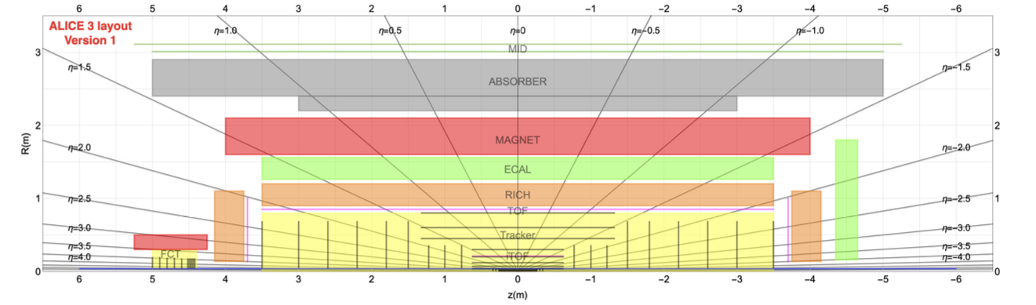
Original Version with ECAL

Slide 6
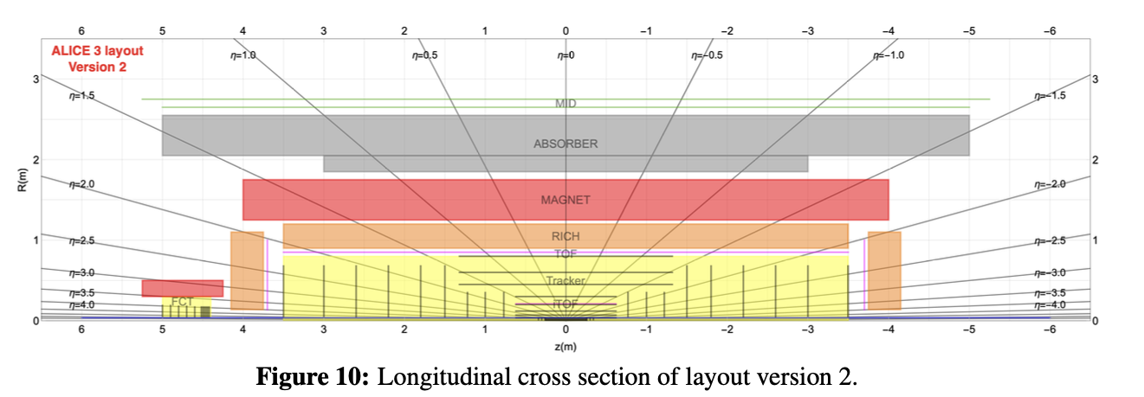
Original Version without ECAL

Slide 7
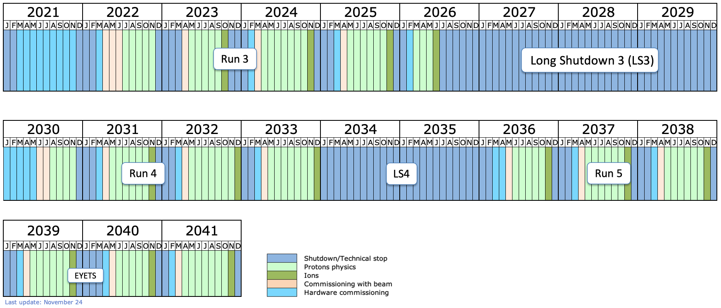
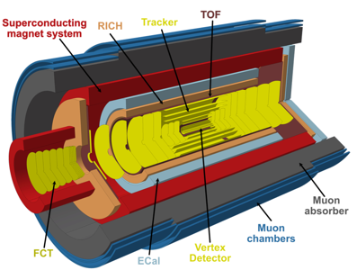
Today
ITS3
FOCAL
8.5 years from today

Slide 8
Challenge:
Before Run1: ALICE1 Construction only
Run1+Run2: ALICE1 Operation + ALICE1 Data Analysis + ALICE2 construction
Run3: ALICE2 Operation + ALICE(1+2) Data Analysis + LS3 Upgrades Construction + ALICE3 Construction
ALICE3 opportunity:
Full exploitation of the LHC with the most advanced technology.

Slide 9
ALICE1 Installation
Engineering only for large structures.
Very limited engineering of services (EUCLID, 0.5 designers).
Partial engineering of installation procedures.
Numerous installation tools with only limited global integration.
Access to Silicon tracker only in long shutdowns with major opening activity.
Partial decoupling of planning & area management (TS) and ALICE (EP) activity – major adjustment of responsibilities and hierarchy during installation process.
Delays were ‘always’ with
service installation
waiting for detectors to arrive at P2.
Typical vibe:
wait 5 years for the detector,
install it in 5 days
take 1 year for commissioning

Slide 10
ALICE2 Installation
Engineering team: Corrado & Elisa from
‘satellite & space background’
Planning and P2 management: Arturo
Massive ‘investment’ in design personnel.
CAD tools allowed design of services.
Engineered installation sequences with procedures.
Significant testing on mockups.
Central tracker and installation tooling design that allows servicing in a YETS.

Slide 11
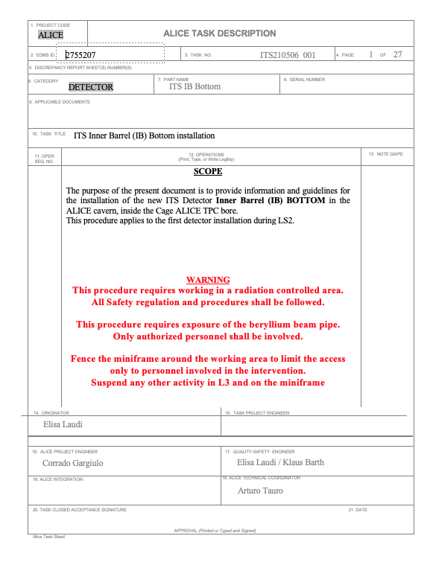
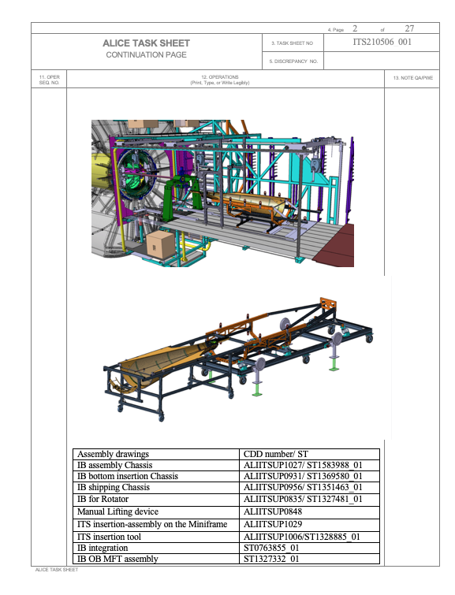
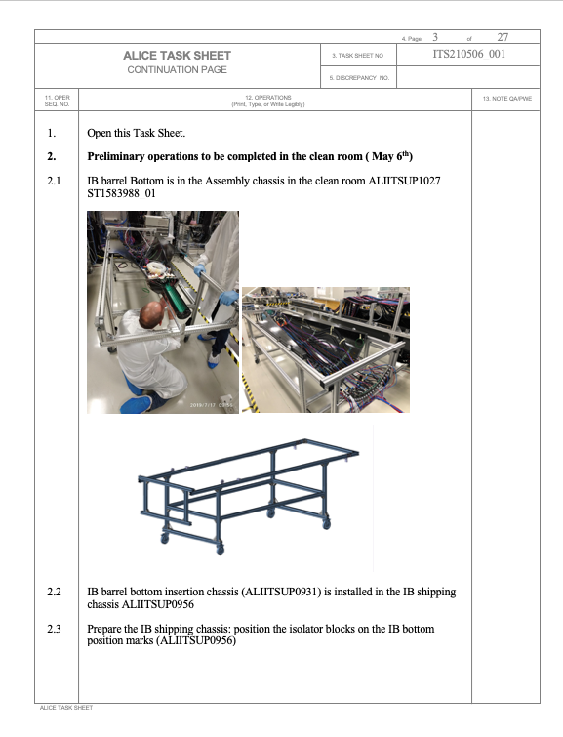
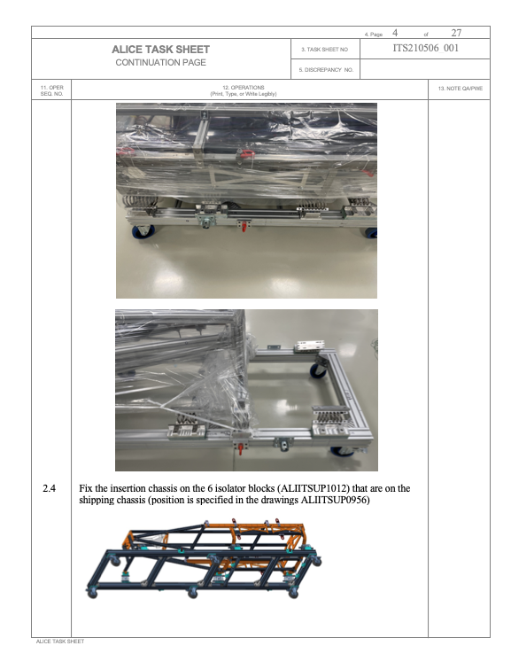
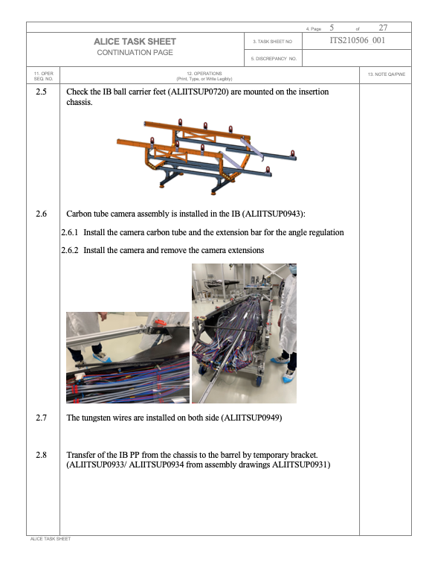

Slide 12
ALICE3 Installation
Take the approach even one step further:
In addition to the global mechanics i.e.
major support structures,
magnet,
service galleries,
global service routing
etc.
, the detector mechanics and installation tooling would also follow a global unified design and possibly centralized construction.
The modularity also allows for fast extraction and installation during YETS and also delayed installation in case of delays of ‘a few’ components.

Slide 13
ALICE3 Overall
Full exploitation of the LHC physics potential. ‘Post LHC machines’ might be quite far in the future.
ALICE3 in LS4 is an excellent opportunity to make one more step in precision QGP physics and pp physics that is complementary to the general purpose experiments.
CERN should have all the interest to support the ALICE/LHCb upgrades in LS4. There is no way we can do only detector R&D between now and the FCC project.
ALICE technology specifically is the perfect development path towards detectors for future e+e- Higgs factories.
ALICE 50kHz PbPb collision rate, with 1000-2000 tracks per collision.
FCCee @ Z-pole, 50-100kHz of Zs with only a few tracks.
→ readout speed, architectures similar
Low radiation load, precision spectroscopy of low momentum tracks …

Slide 14
ALICE3 Installation
We are confident that ALICE3 can be installed during an LS4 of two years,
if the detectors are delivered at P2 on time, tested and pre-commissioned.
Magnet and service installation are during the 1st year are of course critical.
Corrado on the overall concept
Arturo on the magnet and the schedule

