Slide 1
ALICE background issue

Slide 2
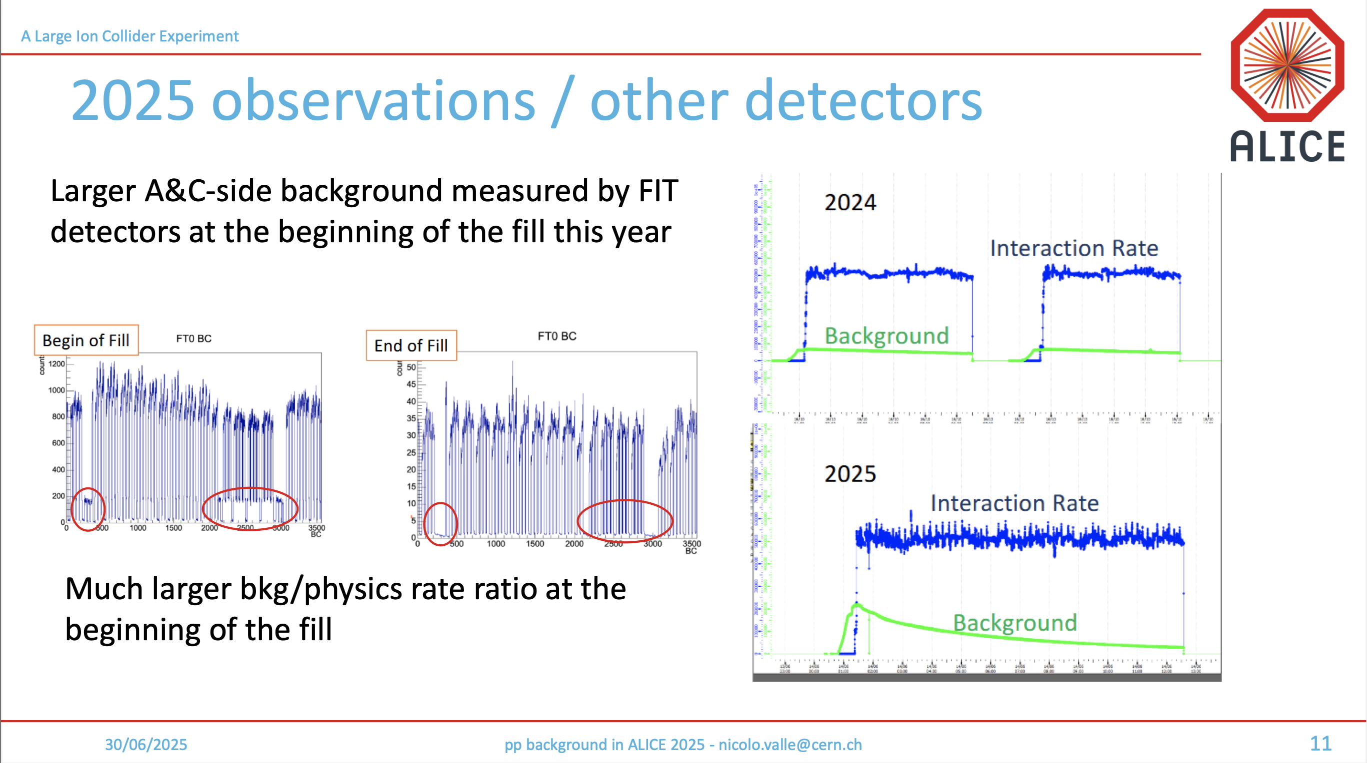
ALICE background
ALICE observes an unusually large background coming from beam-gas scattering, especially at the start of fills
See LHC Background Study Group meeting: https://indico.cern.ch/event/1561451/

Slide 3
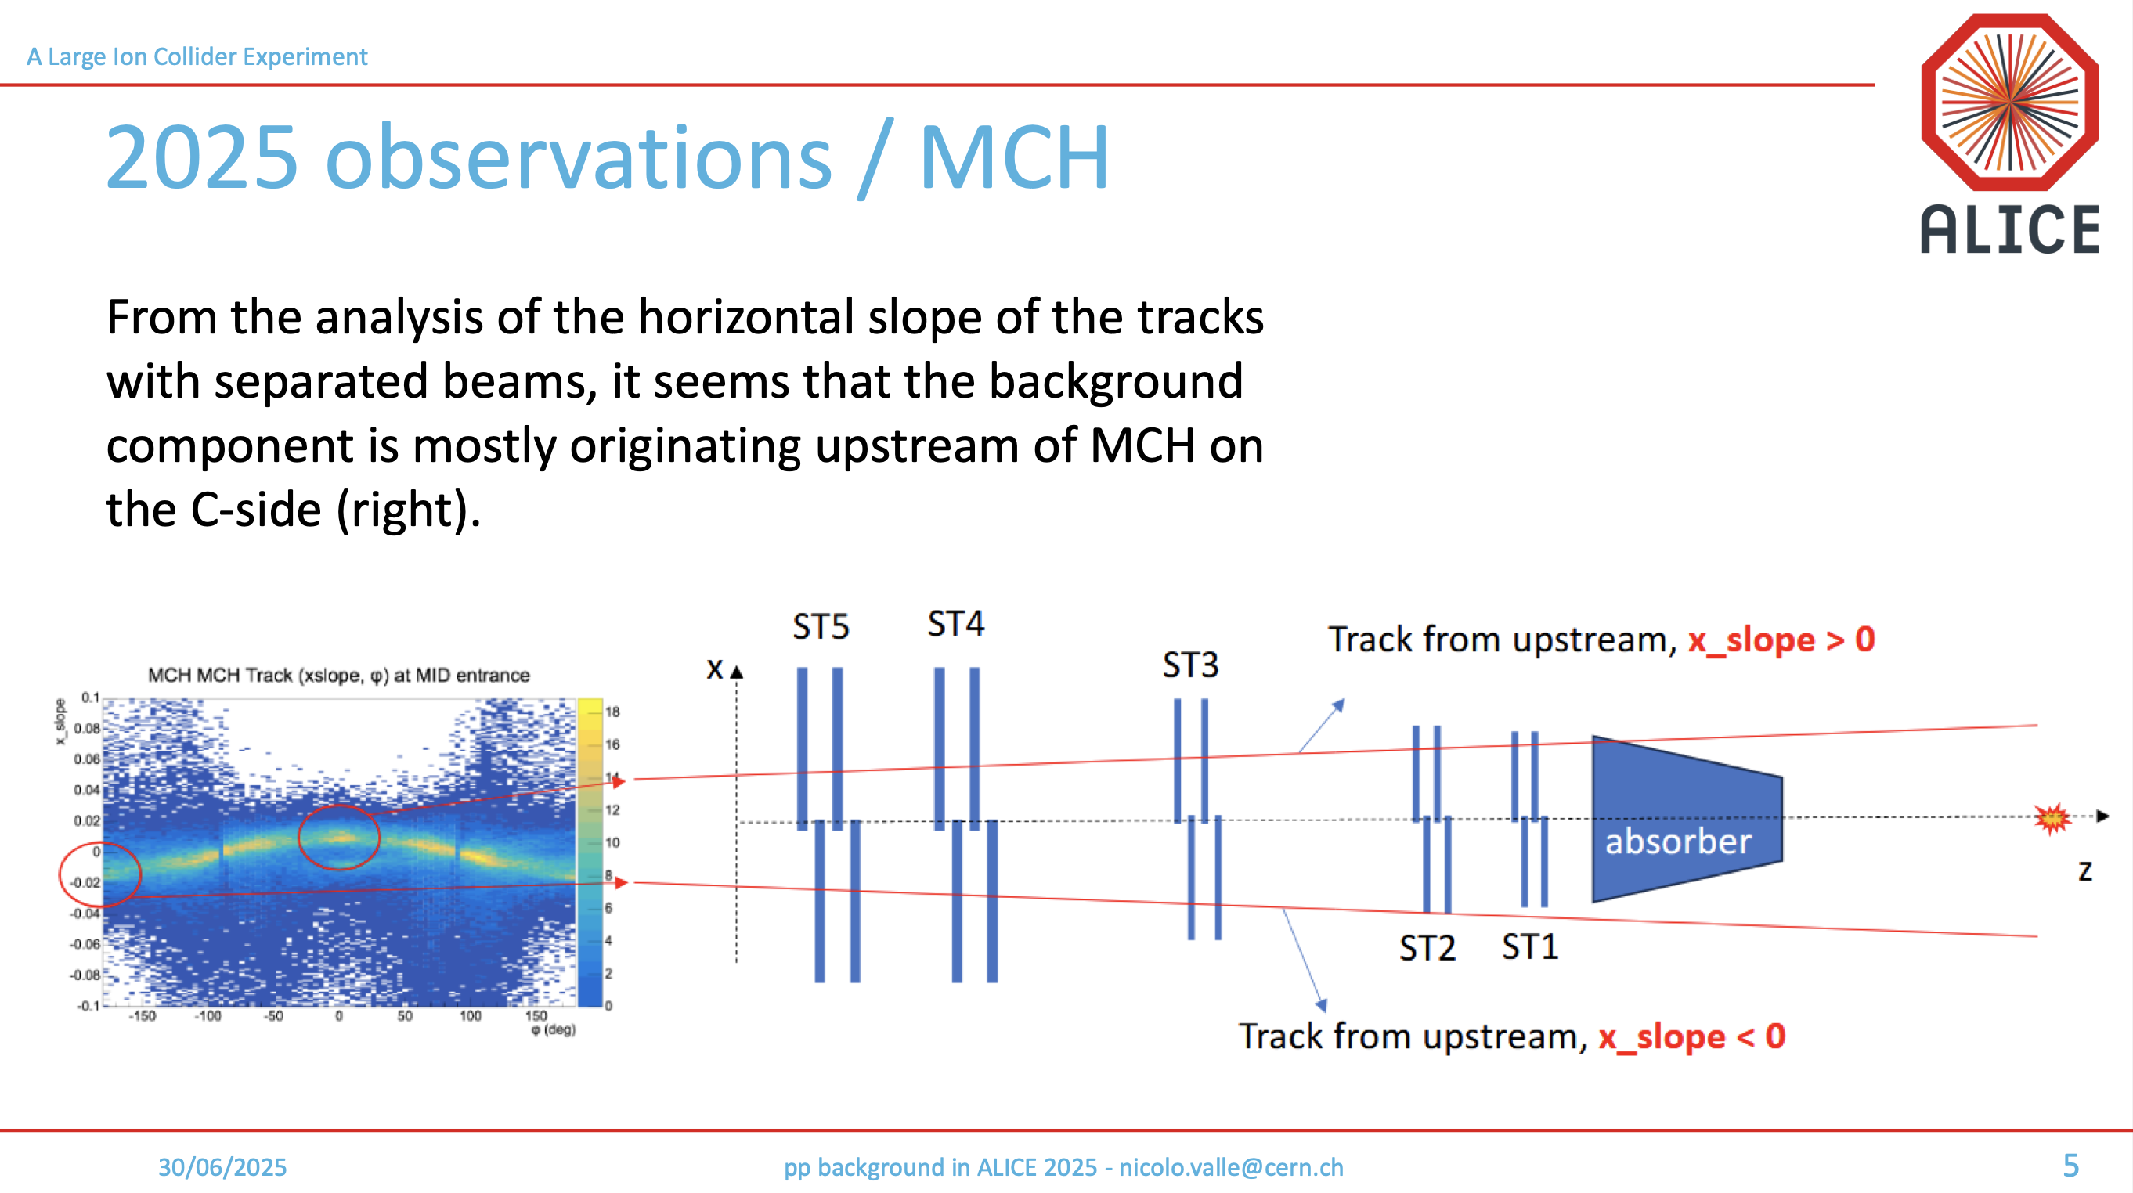
ALICE background
ALICE observes an unusually large background coming from beam-gas scattering, especially at the start of fills
  Seems to come mostly from the right side

Slide 4
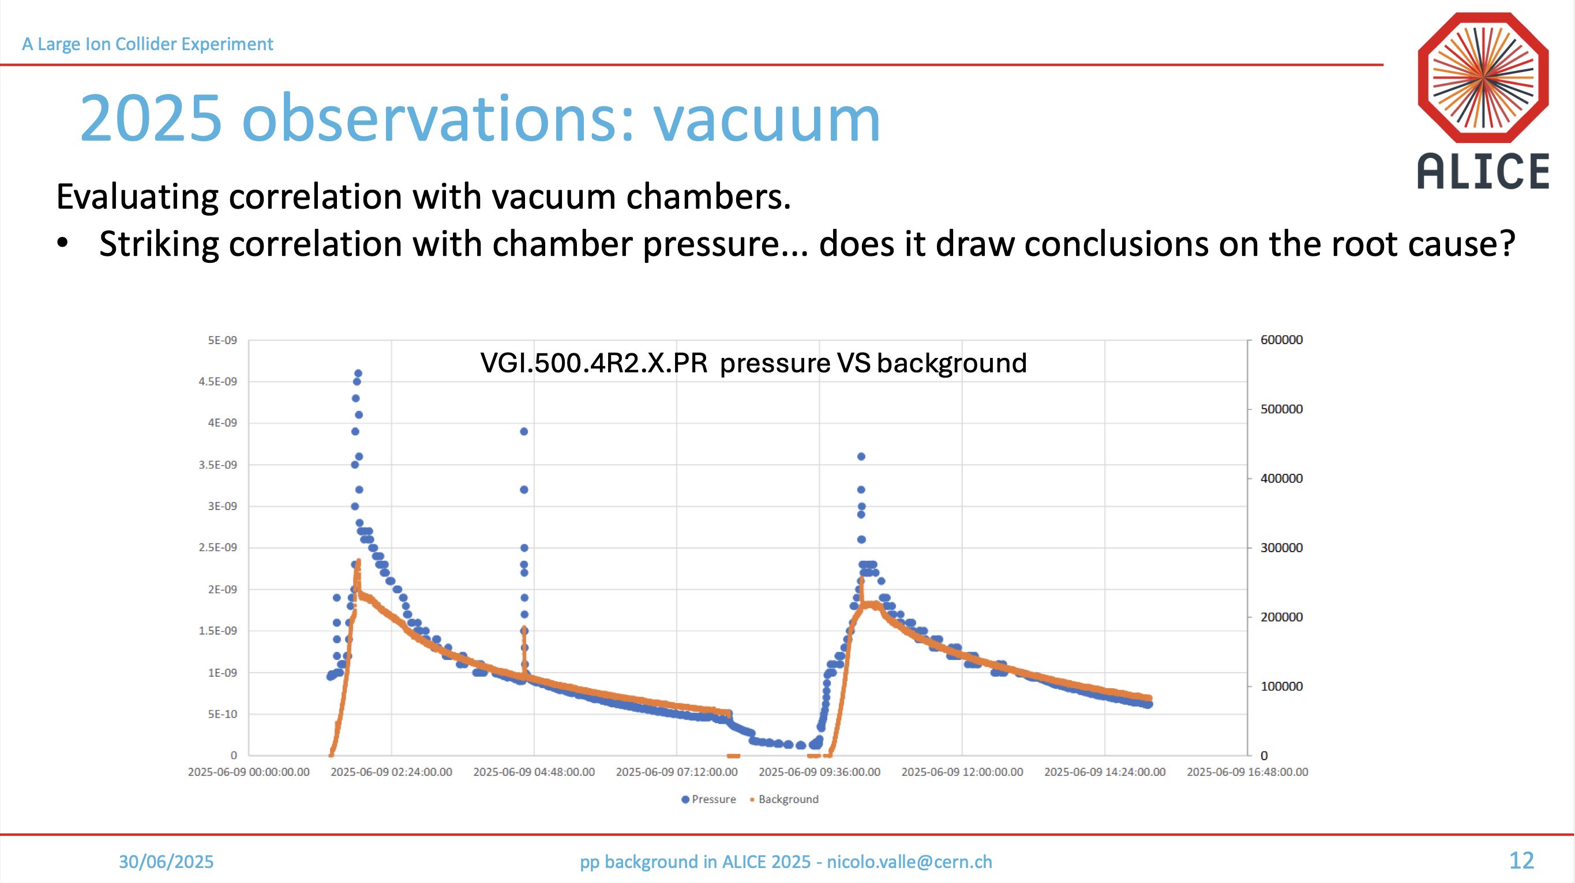
ALICE background
ALICE observes an unusually large background coming from beam-gas scattering, especially at the start of fills
  Seems to come mostly from the right side
  Correlates with pressure in two-beam 800 mm chamber that was opened during the YETS
See LHC Background Study Group meeting: https://indico.cern.ch/event/1561451/

