Slide 1
Observations on ALICE background
L. Mether

Slide 2
Background
The 800 mm two-beam chambers are known since Run 1 to be prone to electron cloud build-up
  See e.g. Gianni’s talk at LBS #24, 2012
  At that time the chamber was in pure StSt
  NEG inserts were installed in LS1 to reduce SEY, desorption yield and to increase the local pumping speed
The observed dynamic pressure rise left and right of IP2 seems largely compatible with electron cloud
  Other sources, such as beam-induced heating, cannot be excluded
Some features are not well understood
  Increase in pressure between injection and stable beams, at different parts of the cycle

Slide 3
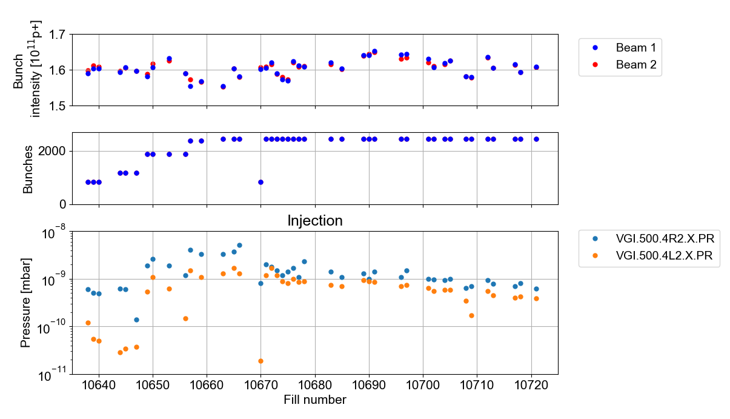
Pressure evolution at injection
During the intensity ramp-up, the steps in number of bunches from 1200 to 1900 and 1900 to 2400 lead to clear steps in the dynamic pressure at injection

Slide 4
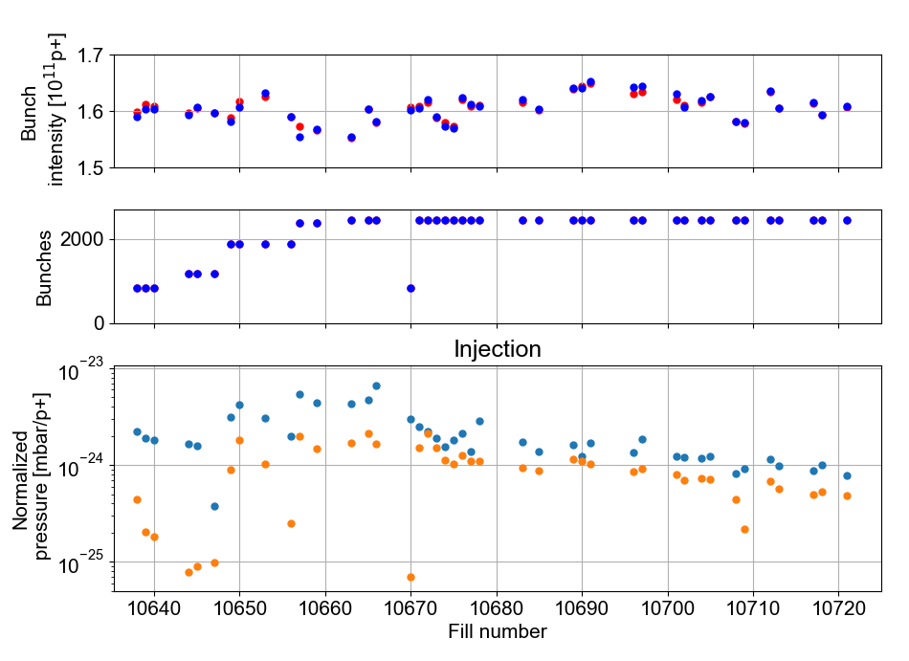
Pressure evolution at injection
During the intensity ramp-up, the steps in number of bunches from 1200 to 1900 and 1900 to 2400 lead to clear steps in the dynamic pressure at injection
…and the normalised pressure
  Not just the intensity, the gap length matters
With fixed number of bunches, the conditioning of the pressure is evident

Slide 5
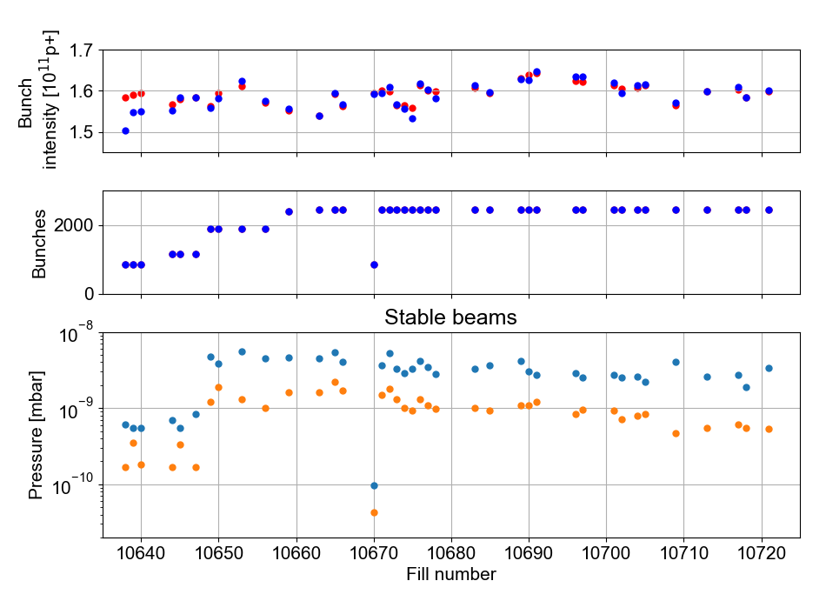
Pressure evolution at stable beams
At the start of stable beams, a very large step in the dynamic pressure occurs when going from 1200 to 1900, while the last step is hardly visible

Slide 6
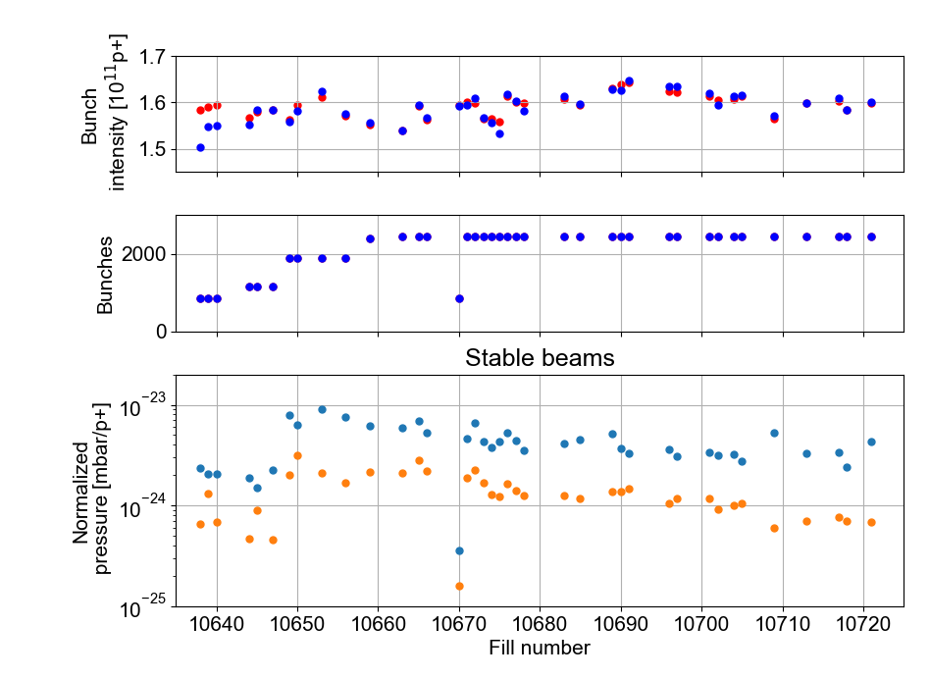
Pressure evolution at stable beams
At the start of stable beams, a very large step in the dynamic pressure occurs when going from 1200 to 1900, while the last step is hardly visible
…again, the step occurs also in the normalised pressure
With fixed number of bunches, the conditioning of the pressure is evident, but slower than at injection

Slide 7
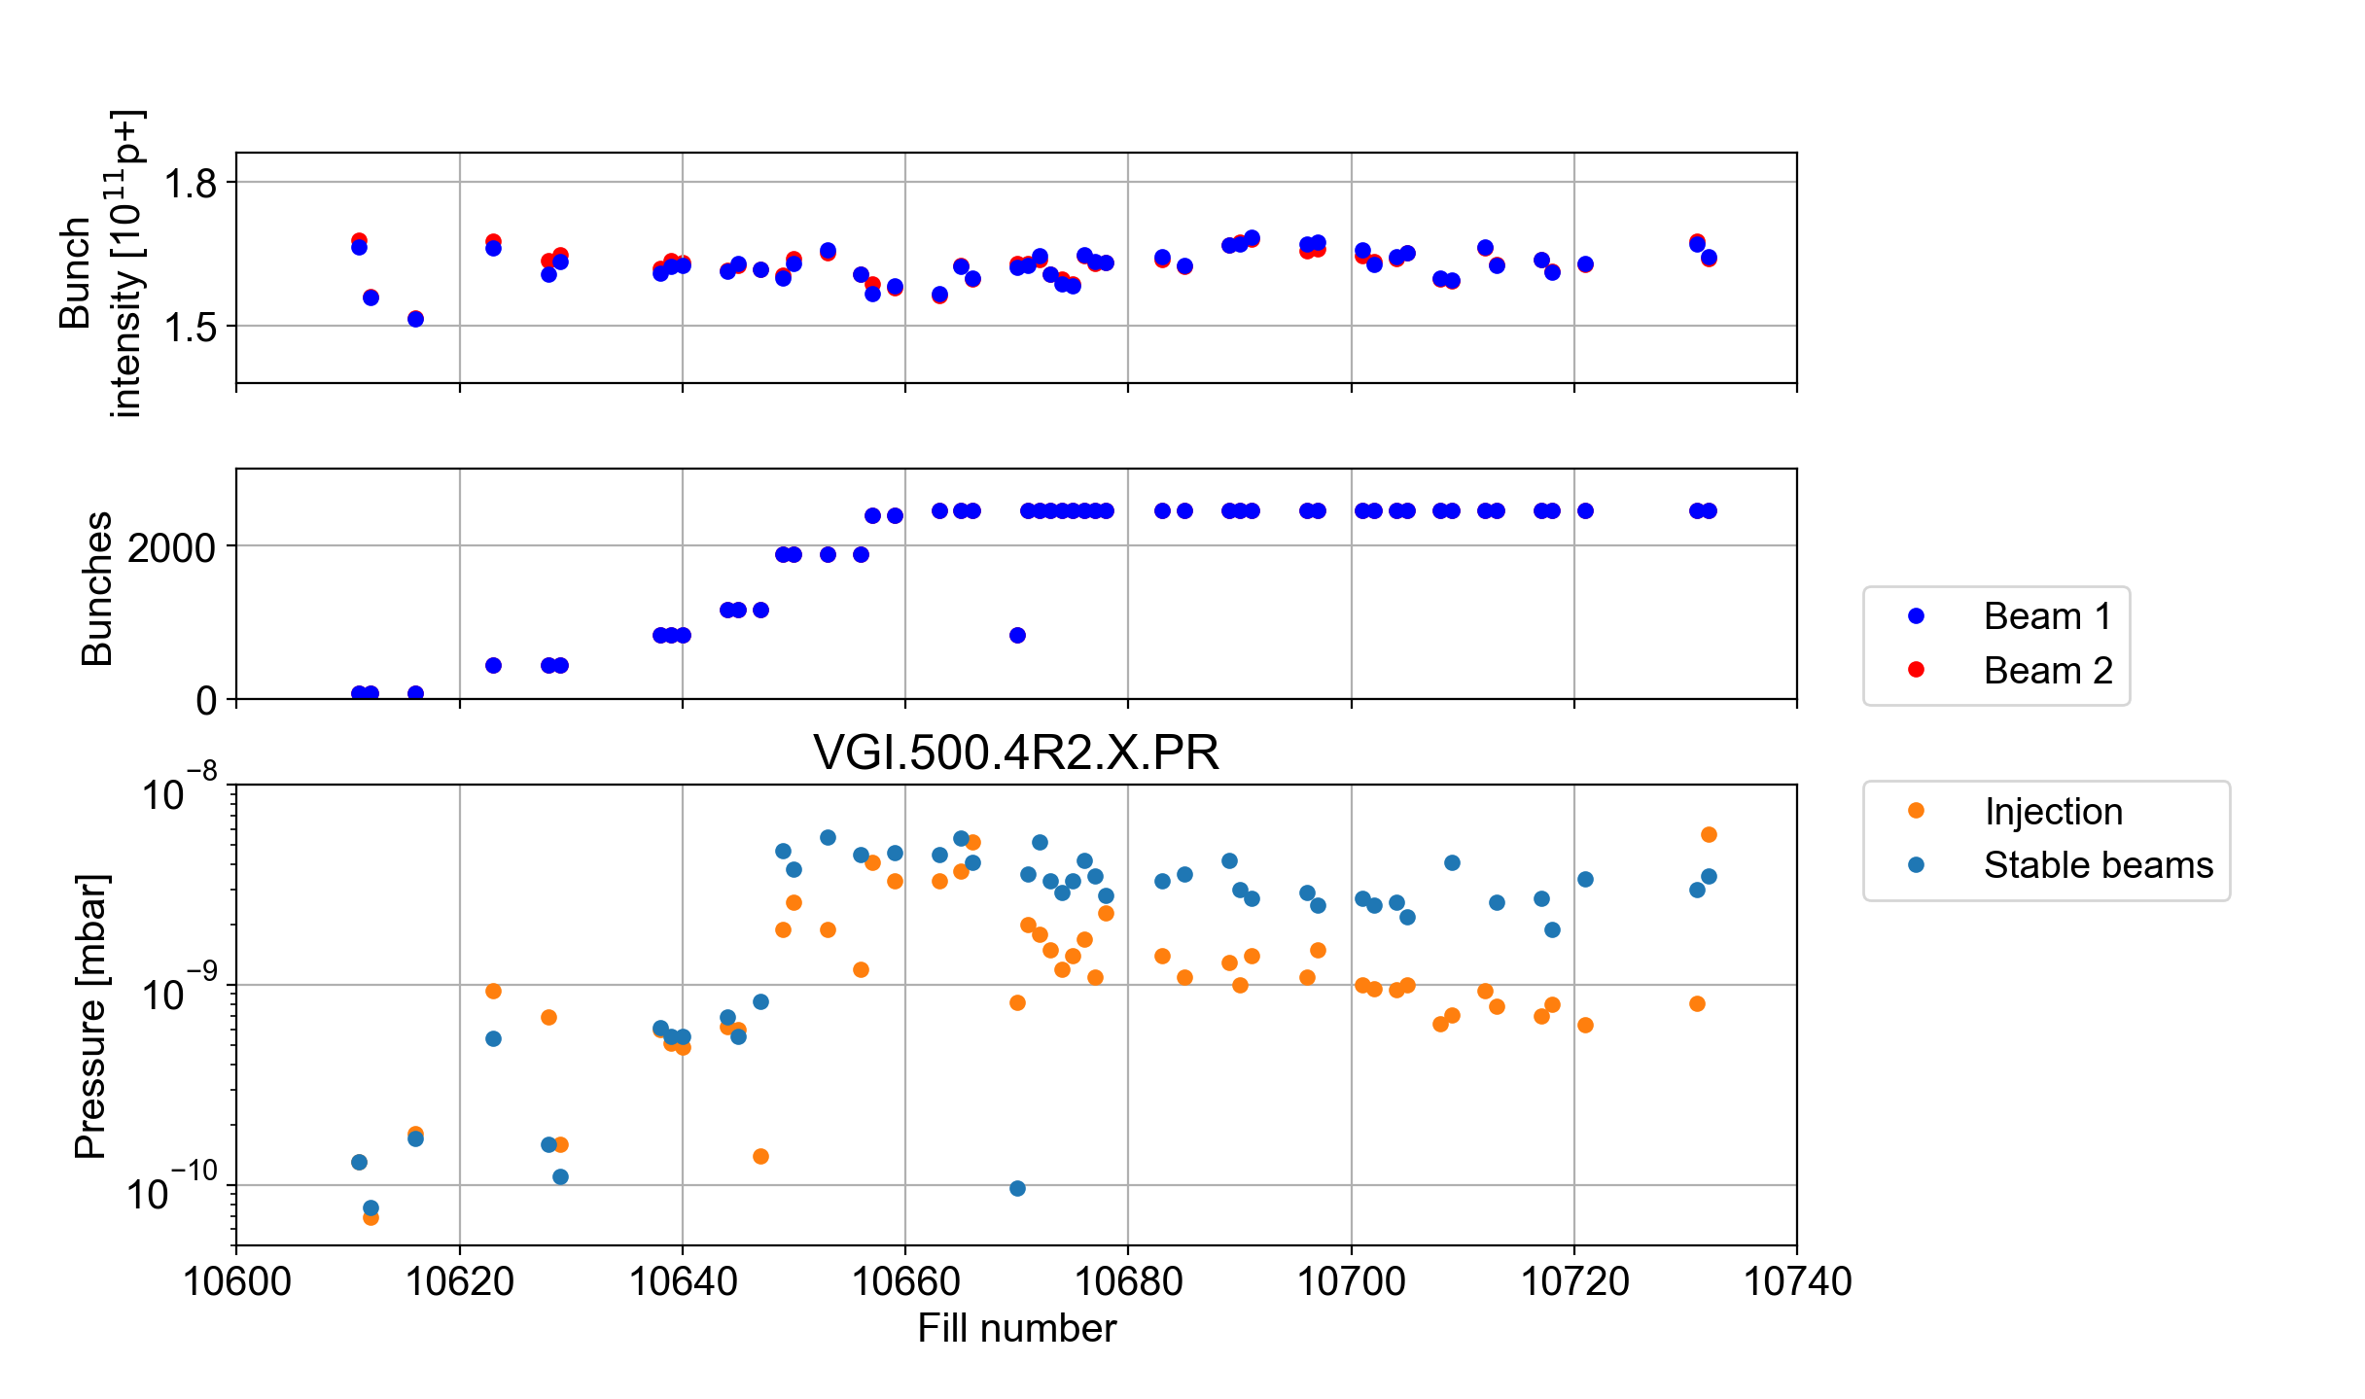
Comparison: injection vs stable beams
For the first fills with full beam, the pressures at injection and stable beams are essentially equal

Slide 8
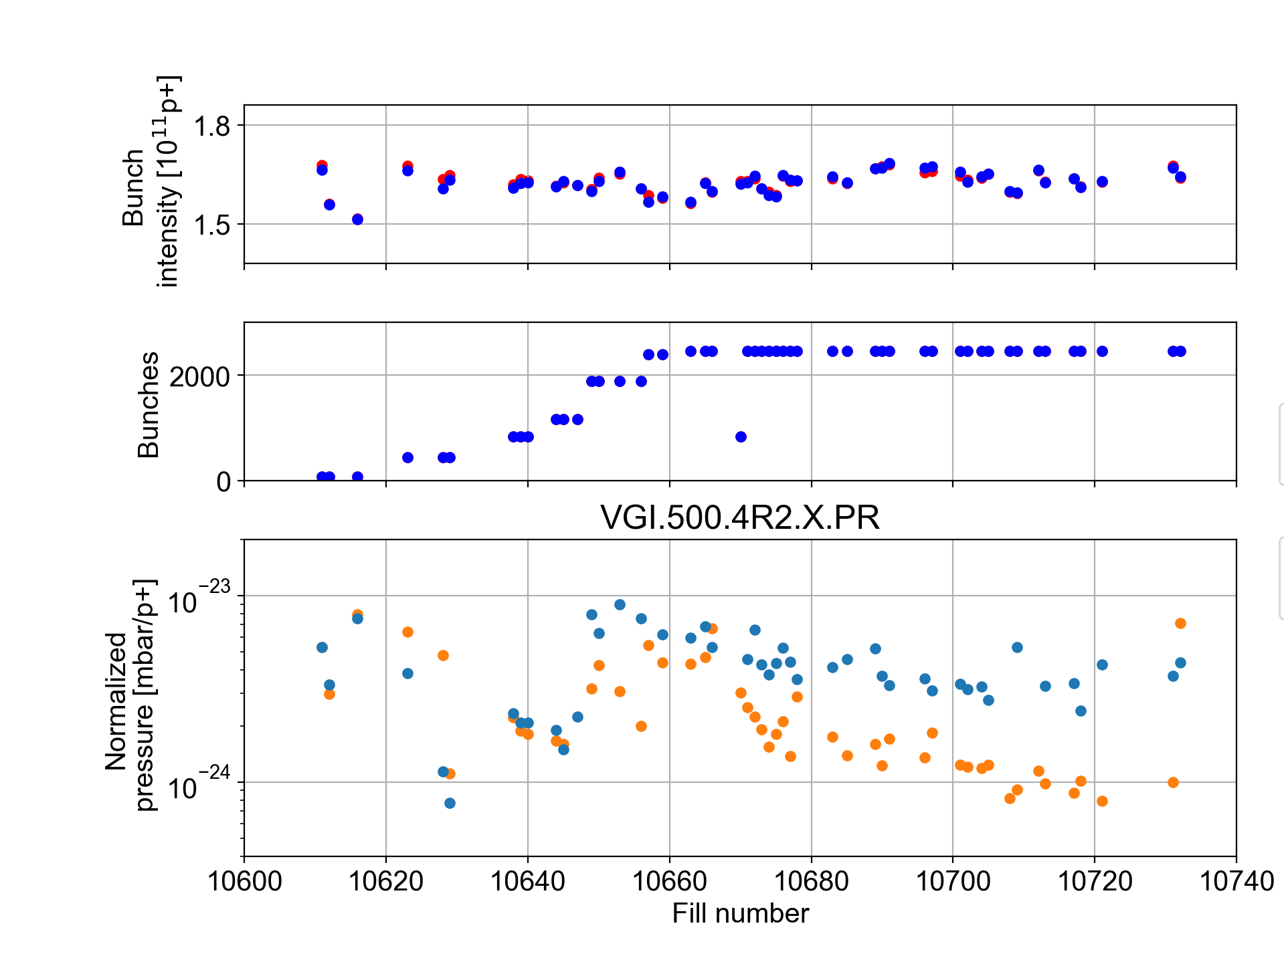
Comparison: injection vs stable beams
For the first fills with full beam, the pressures at injection and stable beams are essentially equal
The pressure at injection seems to condition faster than the one at stable beams

Slide 9
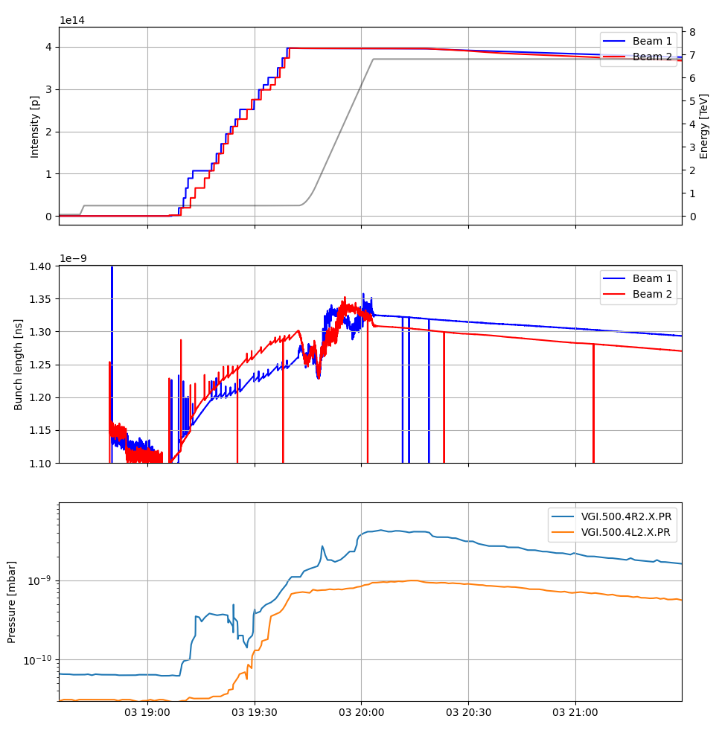
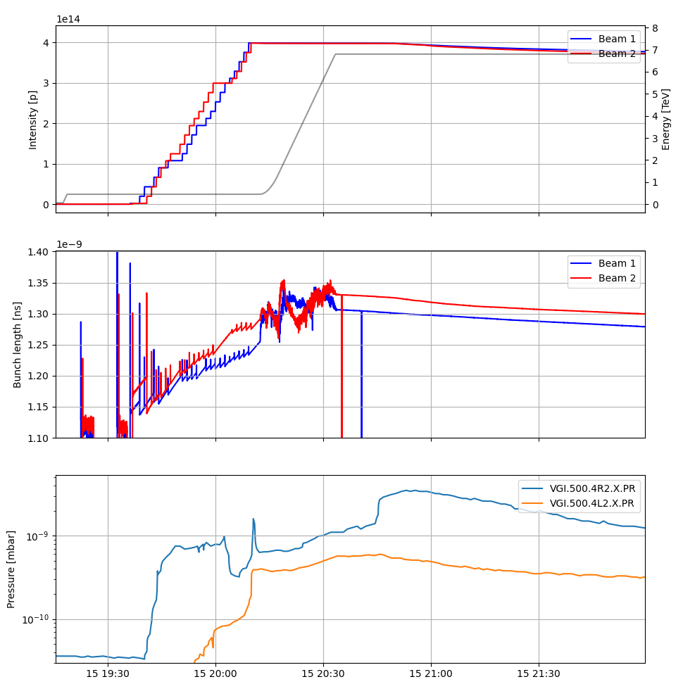
Pressure step during ADJUST/SQUEEZE?
Looking at individual fills, the largest step in pressure seems to occur at different stages of the cycle
  Usually, either during the ramp or during adjust/squeeze
  Are there different sources of pressure rise at different times in the cycle?
Fill 10685: 03.06.25
Fill 10721: 15.06.25

Slide 10
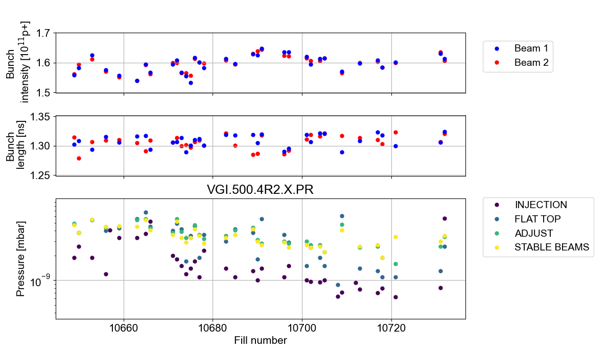
Pressure step during ADJUST/SQUEEZE?
Looking at the evolution over the year, it seems that the pressure rise at other times of the cycle conditioned faster
  The pressure rise during adjust/squeeze becomes more apparent

Slide 11
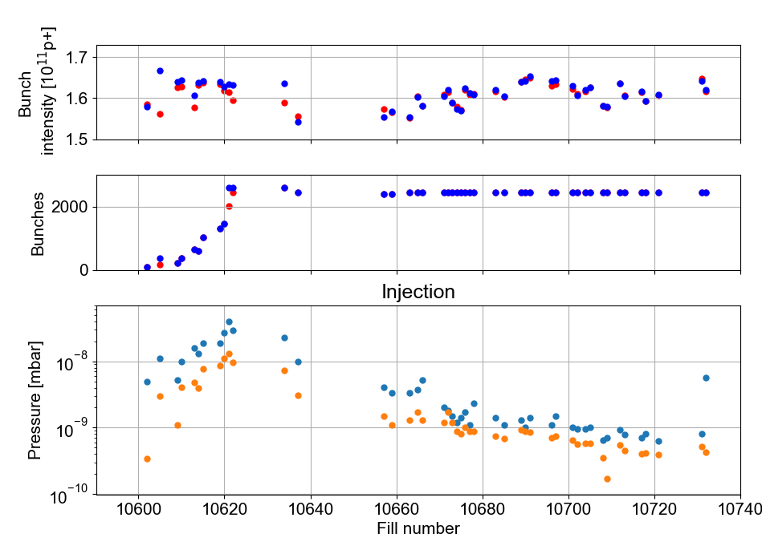
Scrubbing at injection
Pressure difference for operational filling scheme with 4x36b and scrubbing scheme with 2x72b is a factor 2-3
Scrubbing
Operation
2x72b
4x36b
4x36b

Slide 12
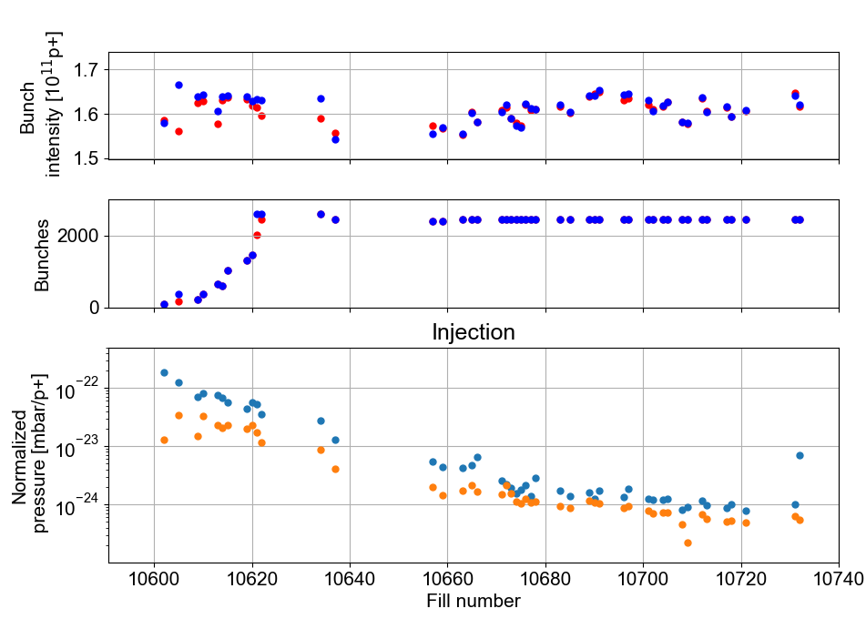
Scrubbing at injection
Pressure difference for operational filling scheme with 4x36b and scrubbing scheme with 2x72b is a factor 2-3
Pressure rise conditioned by more than an order of magnitude since the end of scrubbing
  Pressure at injection, even with 4x72b, ≲ pressure at flat top
Scrubbing is not an effective mitigation
2x72b
4x36b
4x36b

Slide 13
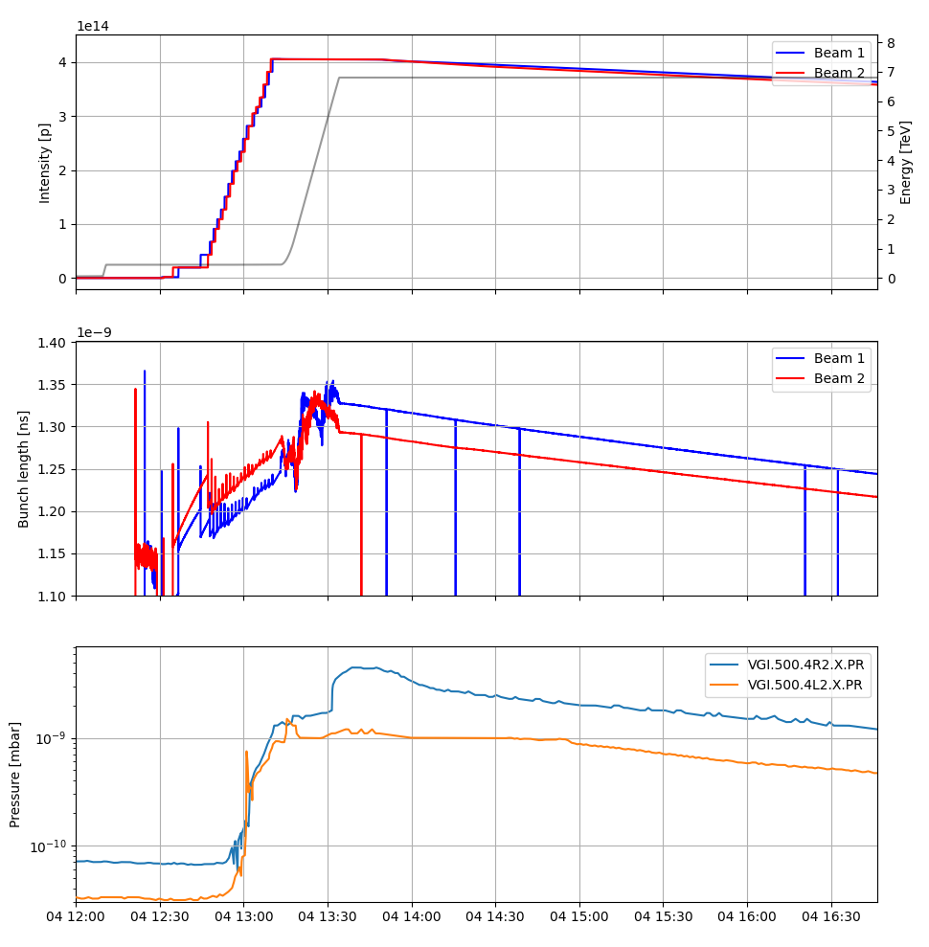
Correlation with bunch length?
In individual fills, there is no apparent correlation between pressure steps and changes in the bunch length

Slide 14
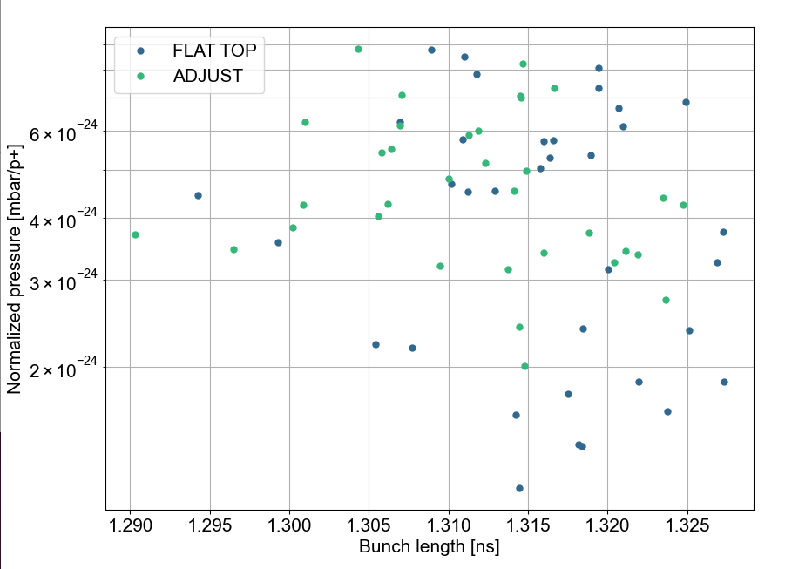
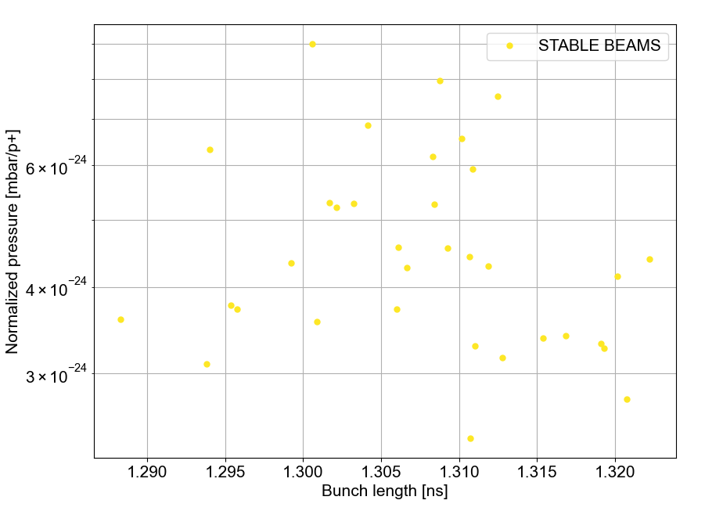
Correlation with bunch length?
The “steady state” pressure may show a mild correlation with bunch length at start of flat top and adjust
  No apparent correlation observed at stable beams

Slide 15
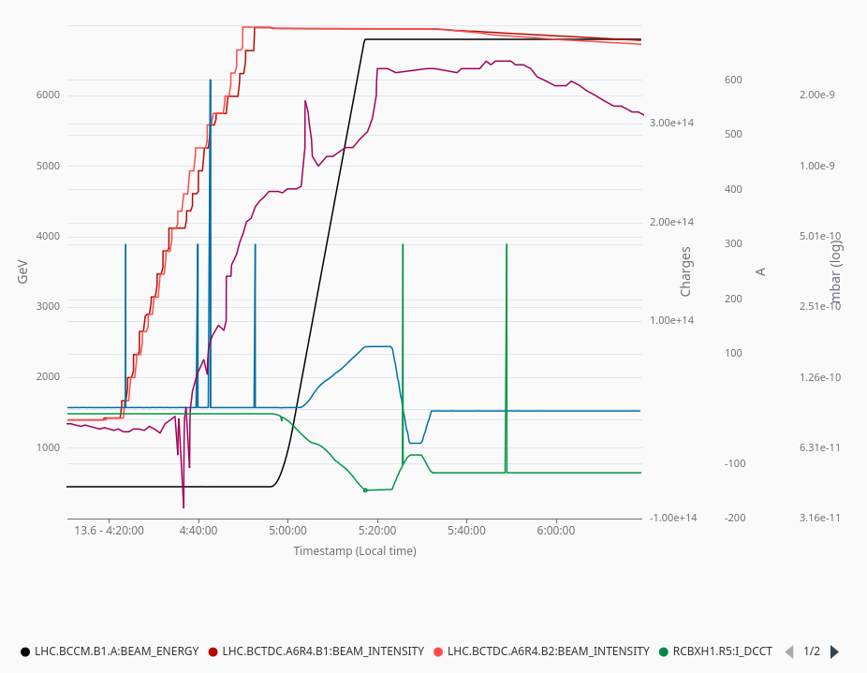
Correlation with separation bump?
During the ramp, a separation bump is put in place
  Increases distance between the two beams in the horizontal plane in the ID800
  Corresponds to a roughly 1 mm shift of the beam positions
The bump is partially collapsed again during adjust
In some fills, the main pressure step occurs during the plateau of the corrector current

Slide 16
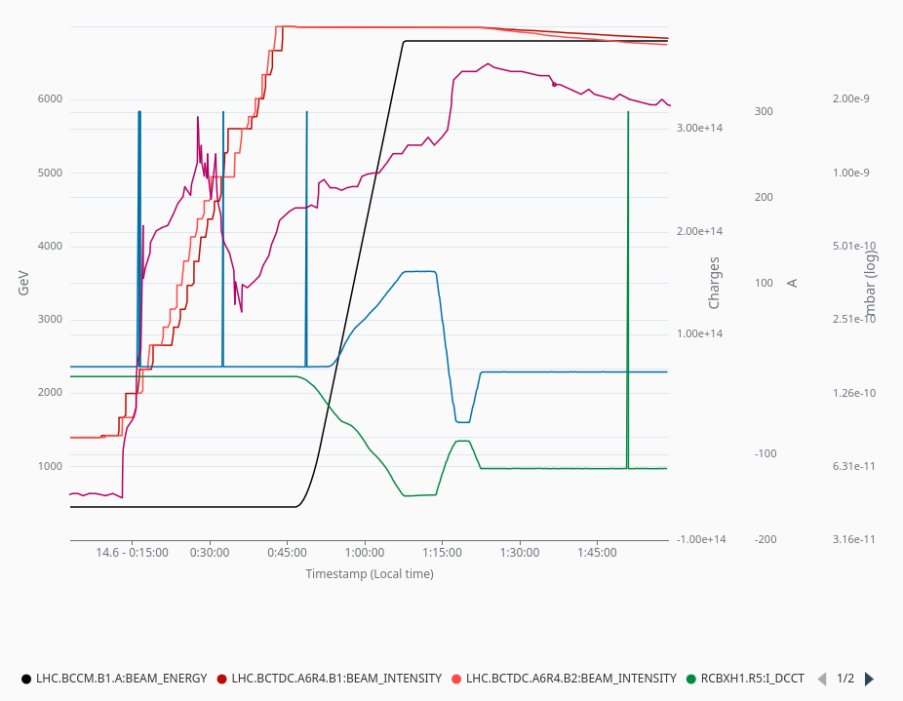
Correlation with separation bump?
During the ramp, a separation bump is put in place
  Increases distance between the two beams in the horizontal plane in the ID800
  Corresponds to a roughly 1 mm shift of the beam positions
The bump is partially collapsed again during adjust
In some fills, the main pressure step occurs during the plateau of the corrector current
  …in others, during the ramp-down

Slide 17
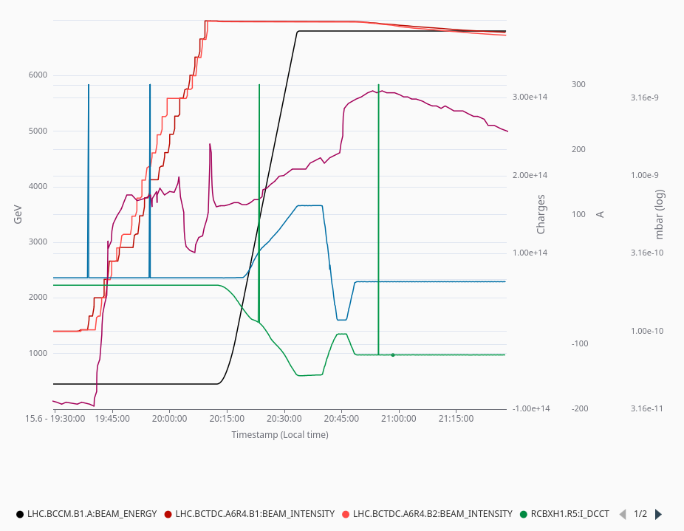
Correlation with separation bump?
During the ramp, a separation bump is put in place
  Increases distance between the two beams in the horizontal plane in the ID800
  Corresponds to a roughly 1 mm shift of the beam positions
The bump is partially collapsed again during adjust
In some fills, the main pressure step occurs during the plateau of the corrector current
  …in others, during the ramp-down
  …or during the second plateau

Slide 18
Conclusions
Sudden pressure rise is observed at different parts of the cycle in different fills
  The pressure appears to condition at a different pace in different parts of the cycle
  In the latest fills, pressure rise after arrival at flat top is most apparent (TBC in coming fills)
Scrubbing at injection is not promising for mitigating the pressure rise at flat top
  The pressure rise at injection has decreased by > an order of magnitude since the scrubbing run, and is not predicted to be higher than the pressure rise at flat top even with the full scrubbing beam
  The pressure rise at injection is not necessarily caused by the same mechanism as the one at flat top
To move forward, we need to try understand the source of the pressure rise at flat top
  No strong correlation observed with sudden changes in bunch length
  The separation of the beams is changed during the ramp and after the squeeze, but the pressure rise does not correlate with a specific moment in this procedure. More work is needed to exclude any impact.

Slide 20
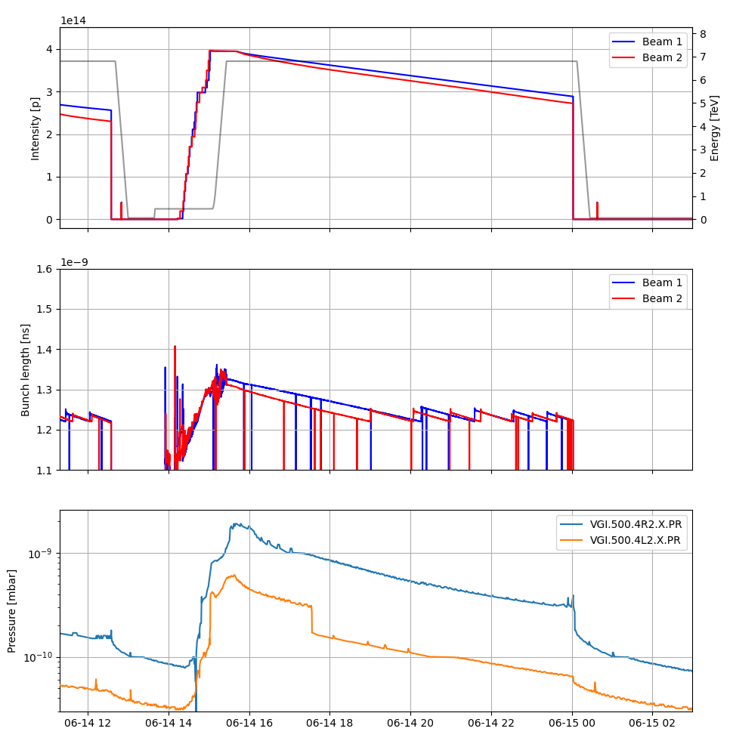
Jump in reading?
At pressure values around 3e-10 mbar, a sudden step systematically occurs (on left and right)
  A systematic of this type of gauge?

