Slide 1
ESG WG3
Role of national labs, strategy implementation
Toward the final recommendations
which will be presented and drafted for Ascona
Members of WG3 :
Jim Clarke (STFC Daresbury), Beate Heinemann (DESY), Jorgen D’Hondt (Nikhef), Ulrich Husemann(DESY)
Klaus Kirch (PSI), Ben Kilminster (CH), Achille Stocchi (IJClab)
Thanks for all the important contribution from the directors
of the large “national” laboratories LDG chaired by Mike Seidel

Slide 2
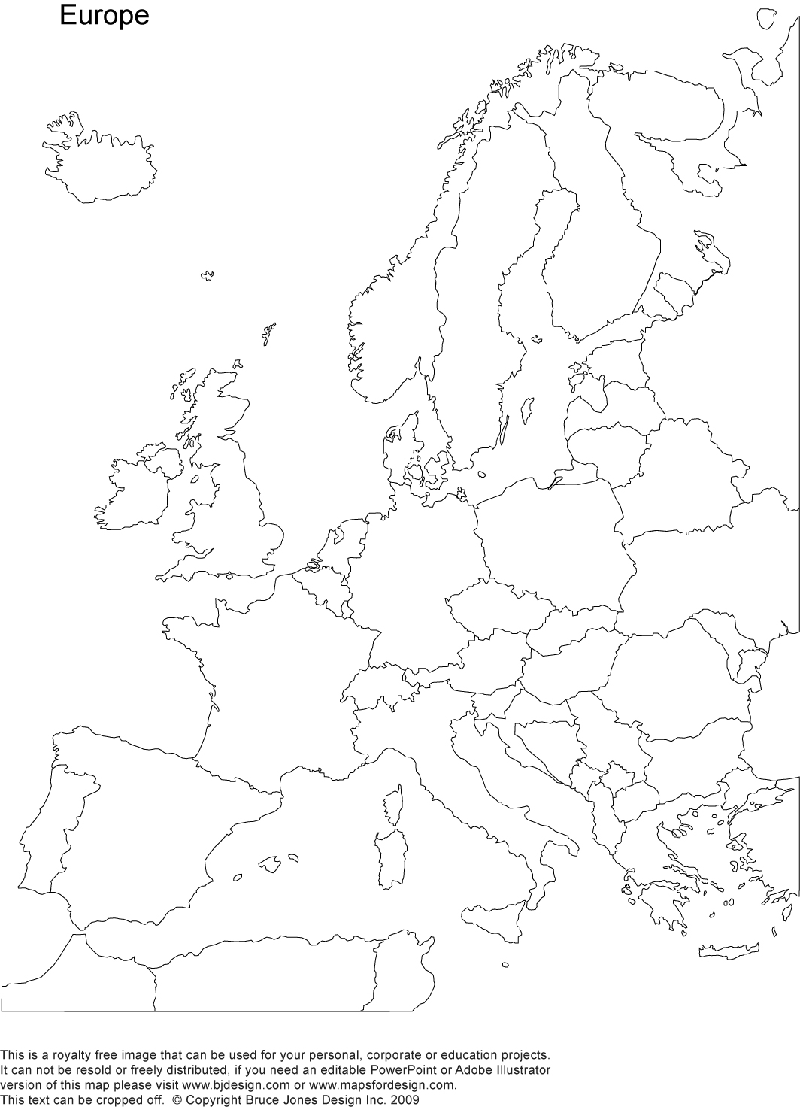
LDG in the landscape of particle physics projects
Large Particle Physics Laboratory Directors Group (LDG) : CIEMAT (Spain), DESY (Hambourg-Germany), Daresbury (UK), IJCLab (Orsay-France), IRFU (Saclay-France), LNF (Frascati-Italy), LNGS (Gran Sasso-Italy), Nikhef (Amsterdam-Neederlands), PSI (Zurich-Switzerland), RAL (UK), and CERN.
Membership in the LDG is based on clear criteria, including:
A national leadership role in particle physics
Strong participation in particle physics researches
Accelerator or particle physics facility R&D, construction, and infrastructure
Detector R&D, construction, and infrastructure
Example of the LDG strengths in Appendix
DL
Nikhef
DESY
RAL
IJCLab
IRFU
PSI
CERN
CIEMAT
LNGS
LNF
The LDG enjoys formal recognition:
LDG chair is a member of the Strategy Secretariat, all the LDG directors are ESG
In the previous European Strategy (ESPP2020), the Accelerator Roadmap, under LDG responsibility.
In the following, when referring to the general role of Large European laboratories—not necessarily limited to current LDG members—we will use the term Large Particle Physics Laboratories (LPPLs). Furthermore, any LPPL meeting the membership criteria may in future become a member of the LDG.

Slide 3
Strengthen connexions of LDG
in the landscape of particle physics projects
We tried in the last years to further strengthen connections between various LPPL/LDG laboratories with the aim of more common developments and/or participation to projects, we should go further on that through the implementation of some concrete actions as : memberships in PAC, organizing specific workshop… (opened to other LPPL labs)
For an optimal strategy implementation, it is essential to strengthen collaboration between CERN and the LPPL/LDG. Two factors can be pointed out and they are particularly important:
The highly skilled workforce at LPPLs can deliver work in a cost-effective manner. National laboratories often leverage CERN funding to secure additional national support.
Developments at LPPLs in accelerators, detectors, and infrastructures frequently benefit other scientific fields beyond HEP, creating a win–win situation that fosters cross-disciplinary synergies.

Slide 4
General considerations — preliminary to formulating any proposals
When LDG initiates an action, we must ensure from the outset that it has sufficient resources to achieve its objectives and intended impact.
There must be a general agreement between LDG, the oversight bodies, and CERN assuring that is indeed the case.

Slide 5
MASTER
PLAN
major collider(s)
@CERN
scientific diversity
@Laboratories
R&D test facilities
@Laboratories
project collaborations
with various WPs
project collaborations
with various WPs
international
coordination
R&D and testing
enabling
technologies
R&D collaborations
led by (large) laboratories
international
coordination
validation
project
implementation
physics beyond colliders
oversight & steering
joint responsibility to resource load this overall European plan

Slide 6
LDG oversight in the landscape of particle physics projects
PROPOSALS
Major collider at CERN
Oversight and coordination led by CERN
LPPLs engaged in the future flagship collider implementation at CERN with their expertise and capacity through well defined work packages, including potential in-kind contributions, with subsequent delegation of responsibilities to LDG
As a consequence, we propose to implement new shared infrastructures in the LPPL (e.g., CHART PSI-ETH, which was explicitly set to work with/for CERN future colliders)
These shares infrastructures could serve also Physics Beyond Colliders activities and other disciplines (easier if some are based/shared @LPPL)
Example : Vacuum (also for ET), (S)RF cavities, HTS …

Slide 7
LDG oversight in the landscape of particle physics projects
PROPOSALS
Physics beyond collider (PBC) projects in Europe
(based on the success of the PBC initiative)
Coordination and steering committee under the auspices of LDG to implement our shared European ambition in the context of scientific diversity in particle physics where discoveries could come from…
We should move from PBC@CERN → PBC@Europe. The definition of the perimeter of the PBC should thus include the activities related to accelerators that are not part of the main collider programme at CERN and the other LDG laboratories.
Possibly to extend to , nuclear physics, astroparticle physics, neutrino physics for projects that would benefit from the know-how and experience available in LDG laboratories as HEP/accelerator physics laboratories.
The LDG Workshop is fixed in 18/19 February 2026 at DESY will discuss PBC@Europe
Though this coordination we could :
Further help the sharing of technologies, infrastructures, and expertise, as well as the capabilities for developing and building complex apparatus.
Identify common development lines to monitor, creating direct synergies, including theory (also for strategical vision)
We also aim to set explicit actions to facilitate the staff exchange/mobility to work on the PBC projects

Slide 8
LDG coordination of European R&D programs
Accelerator R&D Roadmap
Focus on developing technologies to realise new particle physics accelerator projects or to upgrade existing ones
Oversight and steering led by LDG, reinforced with respect to the past with strong coordination allowing to take into account top-down considerations (to minimize parallel efforts and to use laboratory resources most efficiently)
Implementation of the portfolio is shared across LPPLs
PROPOSALS
In the previous strategy five pillars were defined and are still continuing in the next couple of years:
Magnets, ERL, Muons, Plasma and general RF.
The proposal is for the next round to move towards a more project oriented roadmap, with focus/priority on critical feasibility aspects mainly for the PLAN A and (for a while) PLAN B projects.
The LDG Workshop is fixed in 18/19 February 2026 at DESY to also discuss the Accelerator R&D Roadmap

Slide 9
LDG coordination of European R&D programs
PROPOSALS
R&D for enabling technologies
R&D collaboration on enabling technologies are established and coordinated under the leadership of the LDG.
Some Example :
Energy efficiency of HEP facilities from design to operation and decommissioning.
Some comment : This might be a good topic to get resource loaded from, for example, Horizon Europe programmes)
Computing for HEP Roadmap
Some comment : not a green field with several initiatives ongoing, to better think how LDG could help
…

Slide 10
R&D Test Facilities
Test (beams) facilities are important for advancing all detector R&D. The existence of these facilities is feeding also other disciplines in the LPPL
For that it exists EURO-LABS a well working network taking an overview and enabling role ( https://web.infn.it/EURO-LABS/ )
→ LDG should strengthen the links and participation to EURO-LABS
→ The coordination between large labs is important to make sure that there are continuous resource for the test beam facilities as well as a continuous access.

Slide 11
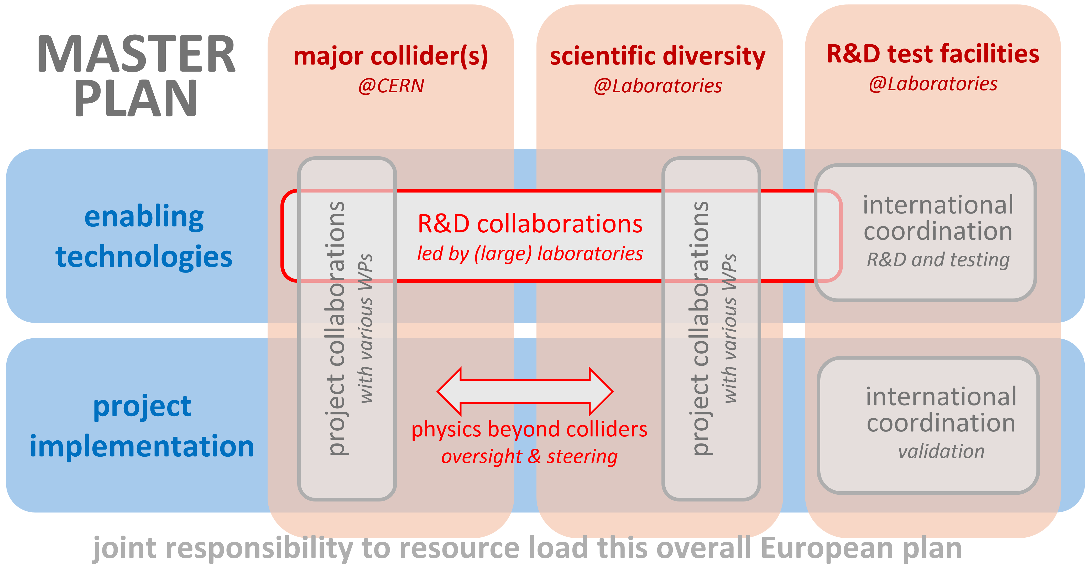
We are ready to draft the recommandations
and to finalise the proposals in Ascona

Slide 12
Appendix
Example of the LDG strengths

Slide 13
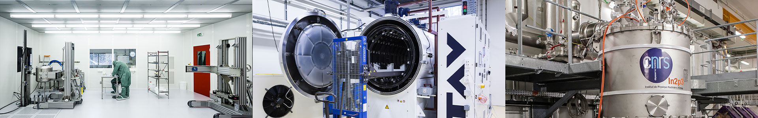
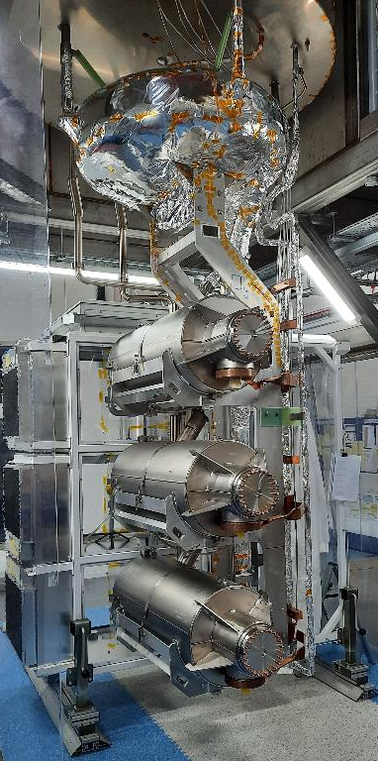
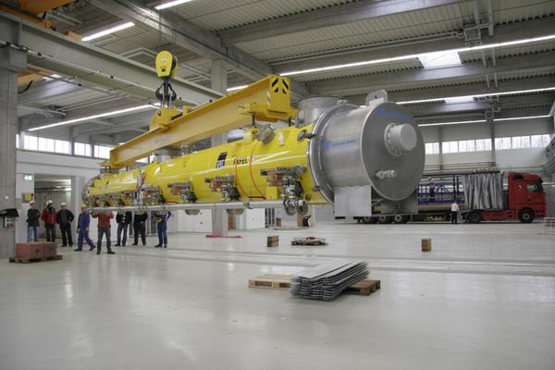
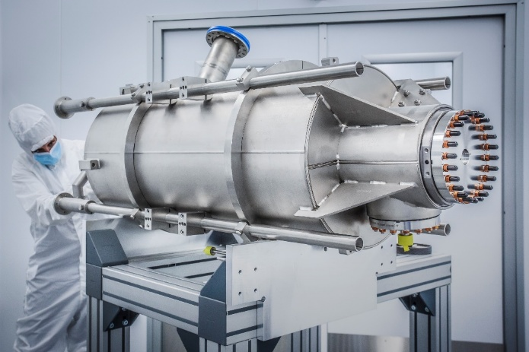
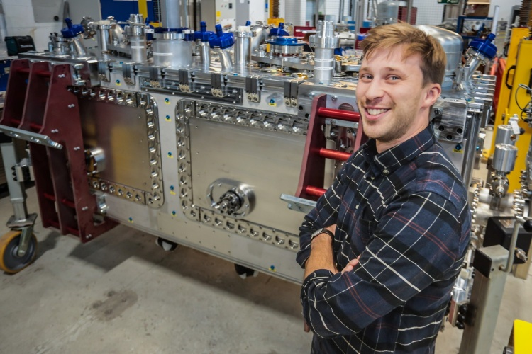
accelerator-based experiments
non-collider experiments
test beam or irradiation facilities
detector R&D facilities
accelerator R&D facilities
Example of the LPPL strengths
Daresbury Laboratory
SupraTech (S. Bousson bldg.)
IJCLab (IN2P3)
Preparation and validation of SRF cavities and cryomodules (cleanrooms, chemical etching, RF testing, cryogenic systems, and cryostats).
Superconducting RF Expertise and Facilities
SRF cavity rinsing and testing
Full cryomodule integration capability
HL-LHC crab cavities
PIP-II cryomodules
ESS cavities
Intense R&D for advanced thin film SRF cavities
DESY
Large scale infrastructure SRF development and test

Slide 14
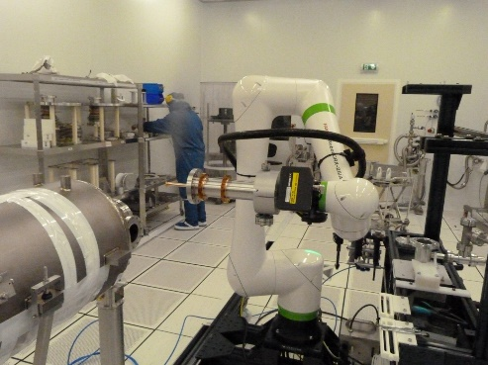
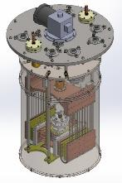
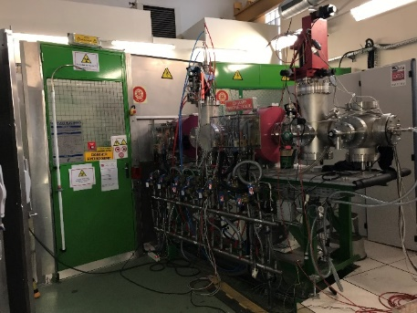
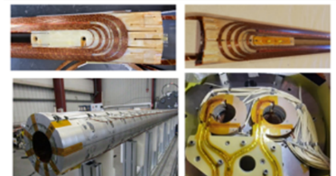
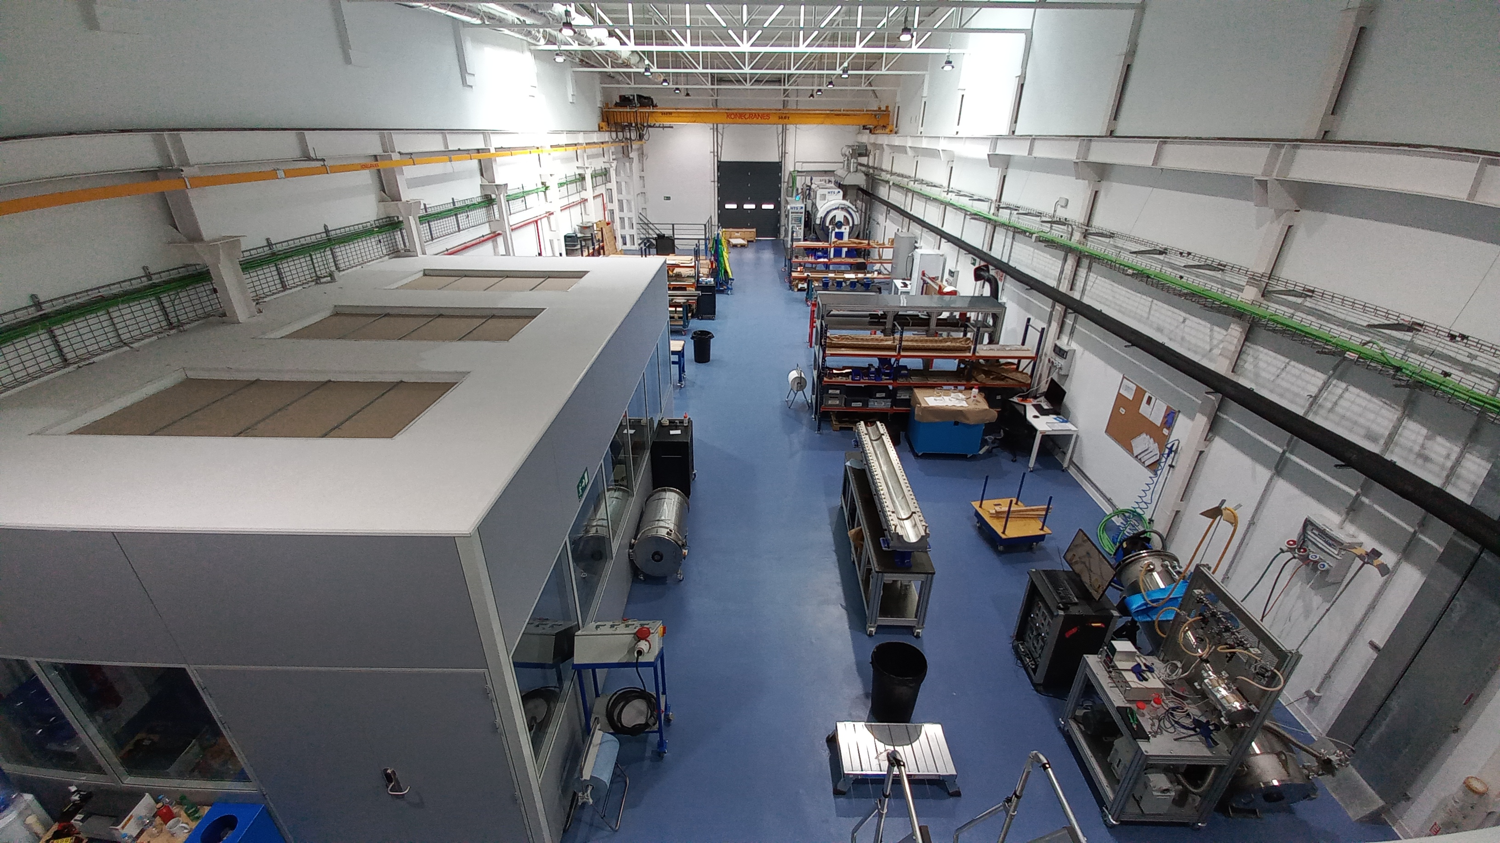
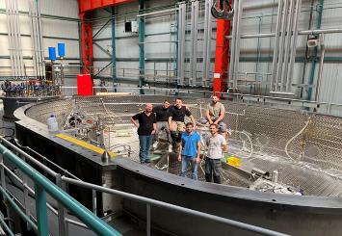
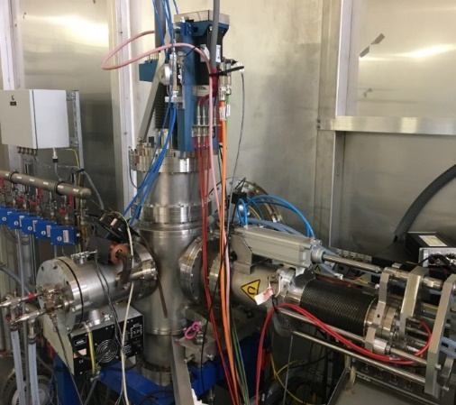
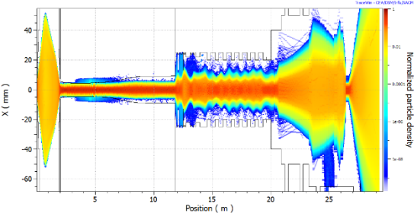
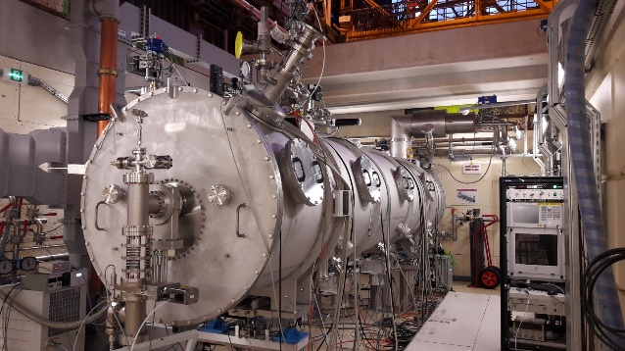
Example of the LPPL strengths
accelerator-based experiments
non-collider experiments
test beam or irradiation facilities
detector R&D facilities
accelerator R&D facilities
IRFU (CEA)
Synergium : Infrastructure for cryogenic, magnetic and accelerator developments
Clean rooms for assembly of cavities and cobot [F]
Magnet winding workshop [H]
Pulsed Heat Pipe R&D [D]
Quadrupole magnets for HL-LHC [H]
High intensity ion sources test bench [A]
CIEMAT
Beam dynamics code suite simulation [A]
Magnet assembly hall for HL-LHC and FCC
Large SC magnets test bench [B]
Test station for superconducting RF cryomodules [E]
Diagnostic development platform [G]

Slide 15
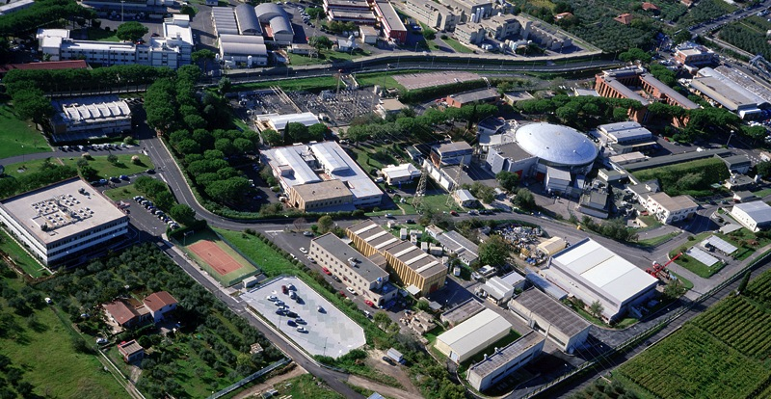
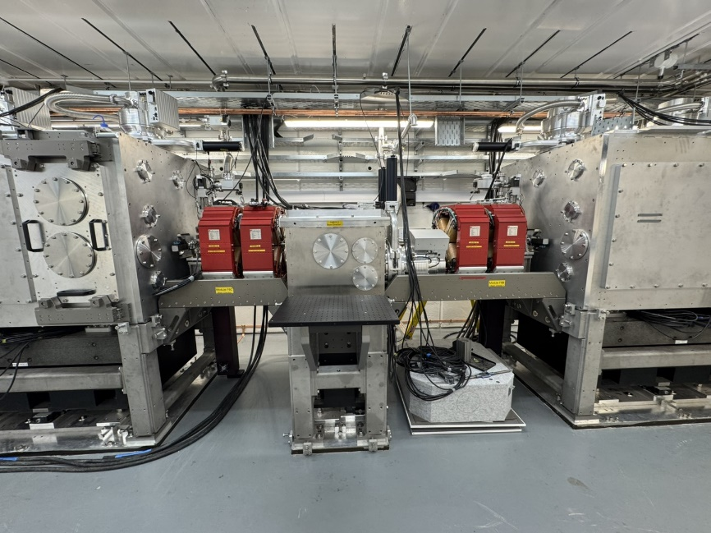
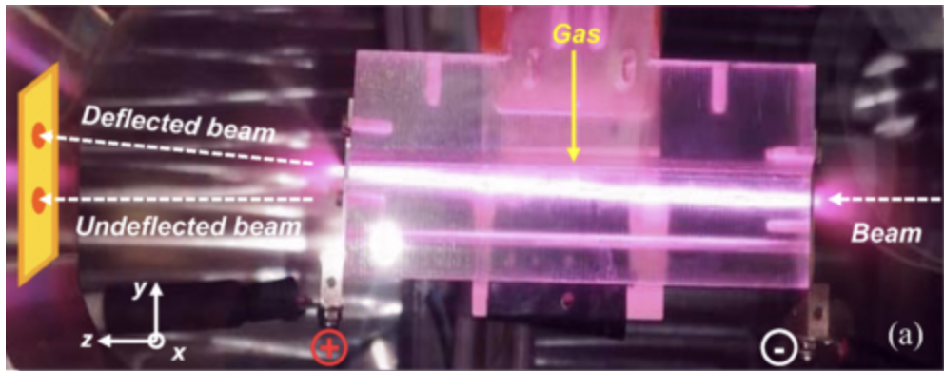

accelerator-based experiments
non-collider experiments
test beam or irradiation facilities
detector R&D facilities
accelerator R&D facilities
Example of the LPPL strengths
Daresbury Laboratory
Laboratori Nazionali Frascati (LNF)
LNF hosts 2 accelerator complexes
SPARC_LAB:
200 MeV photoinjector+TW Laser development of PWLA
Several photon’s beam lines
DAΦNE complex:
Φ-factory collider
Beam Test Facility e± beams from the LINAC in 2 exp. halls
DAΦNE-light:
synchrotron light lab.
5 beamlines from IR to X
DAΦNE-light
LINAC
DAΦNE
BeamTestFacility
FLAME
LASER
EuPRAXIA
site
SPARC
LINAC
CLARA Accelerator Test Facility
Easy access to experiments in shielded hutch
Flexibility; supporting wide range of experiments
Open calls for competitive access to beamtime
Integration of high power laser
LNF is project headquarters

Slide 16
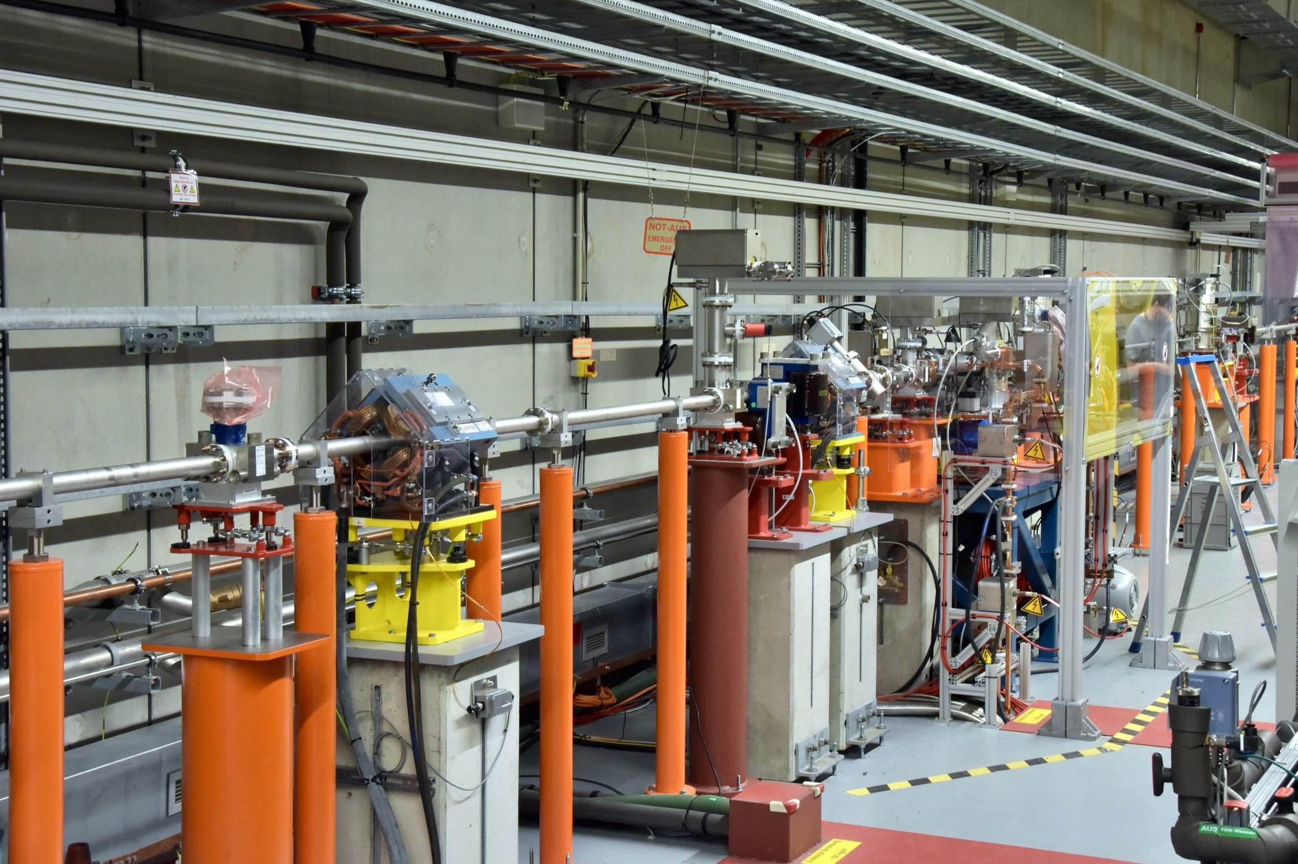
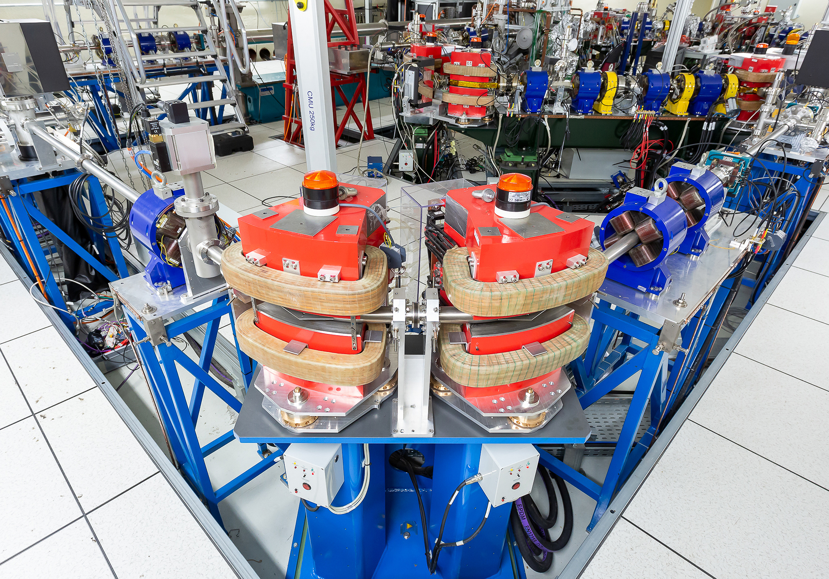
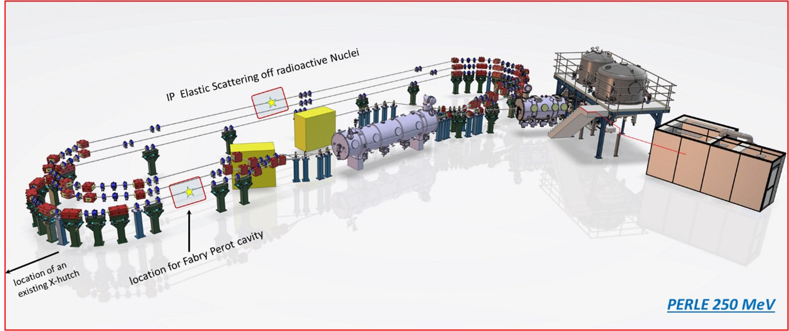
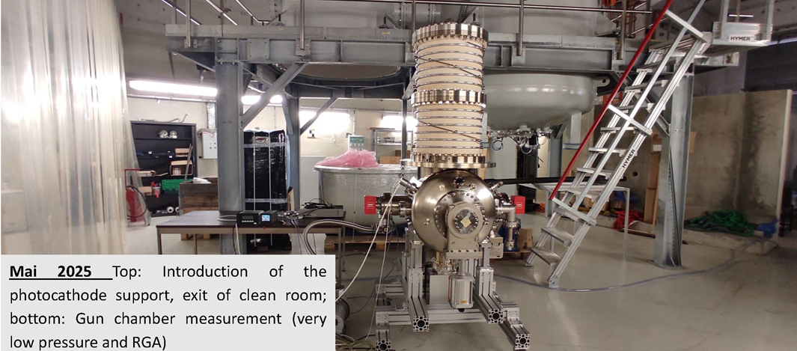
accelerator-based experiments
non-collider experiments
test beam or irradiation facilities
detector R&D facilities
accelerator R&D facilities
Example of the LPPL strengths
DESY
IJCLab(IN2P3)
ThomX –home made accelerator : a compact X-ray source, combining a low-energy electron ring (50MeV) with a laser to produce high-intensity using inverse Compton scattering.
Very powerful infrastructure for the research of novel acceleration technologies, including beams, Lasers etc., focused towards plasma based acceleration technologies
PERLE is a multi-turn, energy recovery linac (ERL) to demonstrate high-power, continuous-wave operation. (LHeC, FCC testbed). In construction

Slide 17
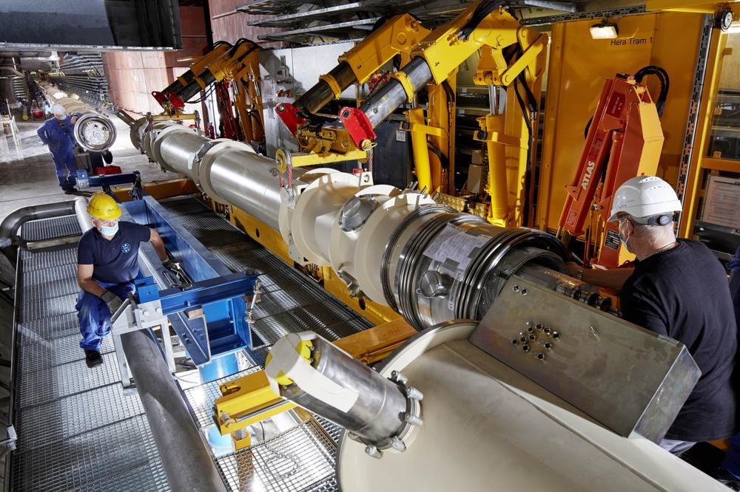
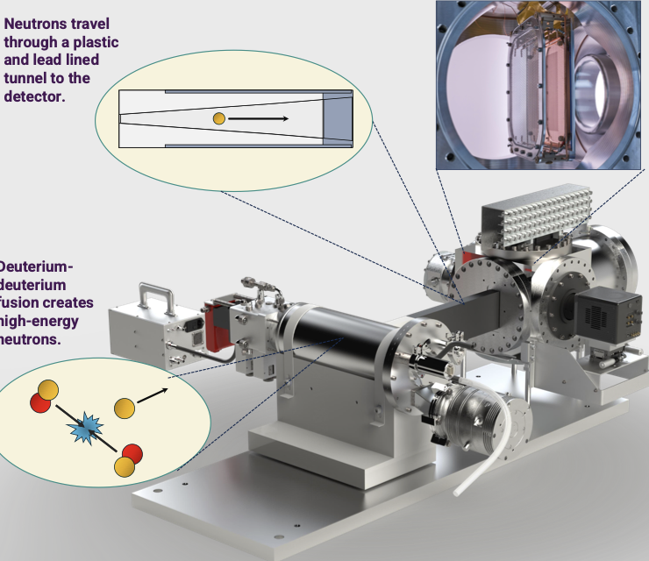
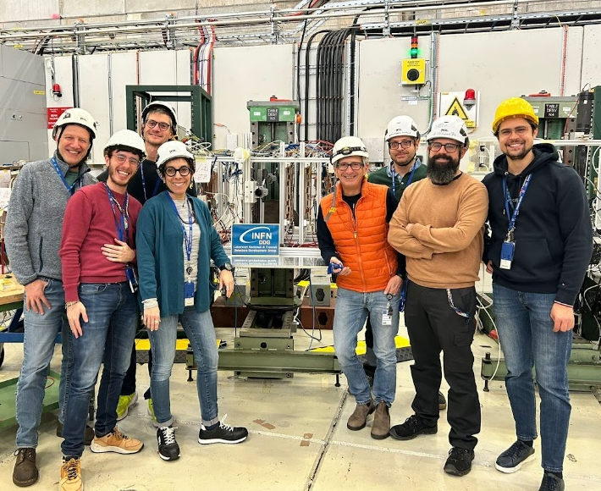
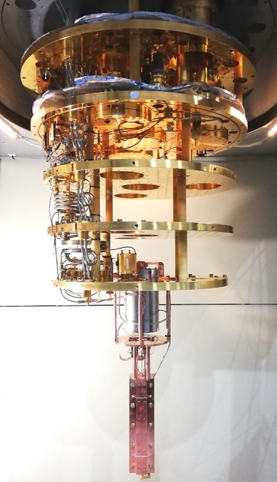
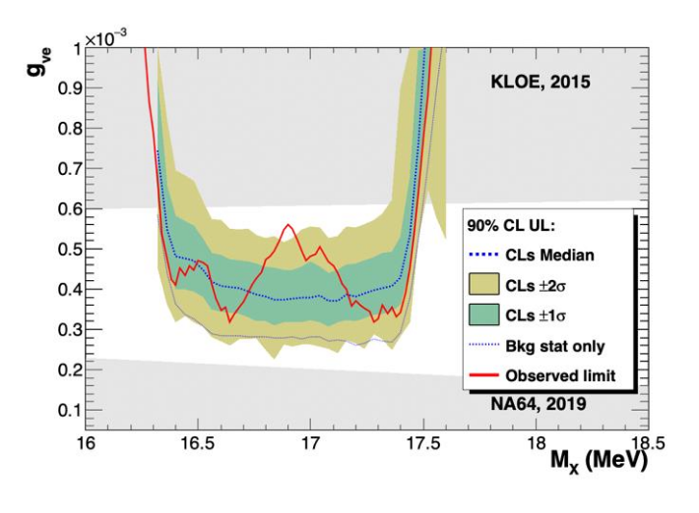
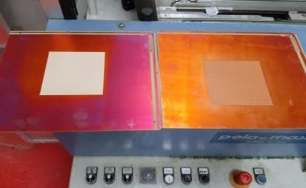
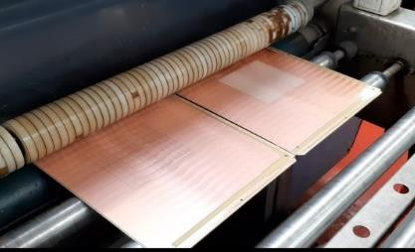
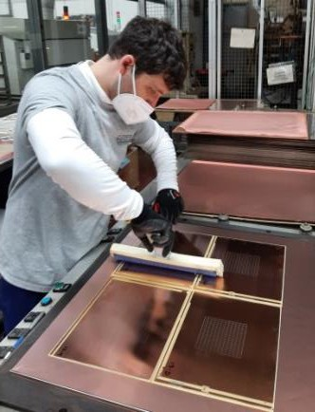
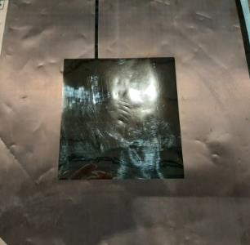
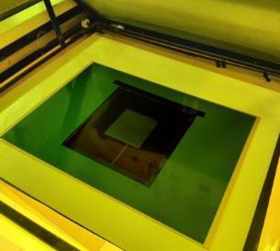
accelerator-based experiments
non-collider experiments
test beam or irradiation facilities
detector R&D facilities
accelerator R&D facilities
Example of the LPPL strengths
LNF
Fundamental physics experiments
Positron Annihilation into Dark Matter Experiment PADME@BTF
Finuda magnet for Light Axion Search with Haloscope
FLASH to probe the existence of cosmic axions of masses ~10⁻⁶ eV
Installing a superconducting magnet
in the ALPSII experiment at DESY
Rutherford Laboratory
QUAX
ALPS II: axion search experiment with intl. participation running
Future ambition: BabyIAXO, MADMAX, LUXE
Provision of test beam for 400+ users / year
On campus science : MIGDAL experiment: at the ISIS neutron source on-campus
PADME

Slide 18
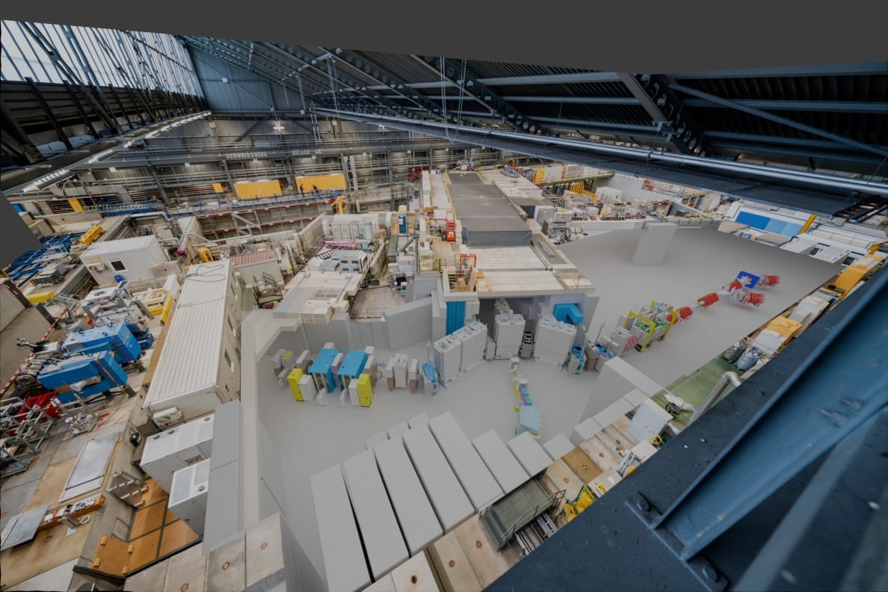
accelerator-based experiments
non-collider experiments
test beam or irradiation facilities
detector R&D facilities
accelerator R&D facilities
Example of the LPPL strengths
PSI
Muon rare decays,
and also PIONEER
@PSI ring cyclotron.
PSI inhouse particle physics - New High Intensity Muon Beams (HIMB)
Intensities of surface muons to 1E10/s (e.g. used to feed the Mu3e experiment), MEG.
HIMB is part of the IMPACT upgrade project at PSI https://www.psi.ch/impact that also includes a new production facility for radio isotopes.

Slide 19
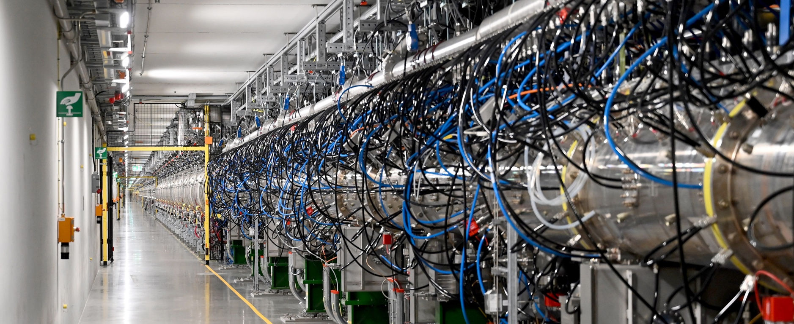
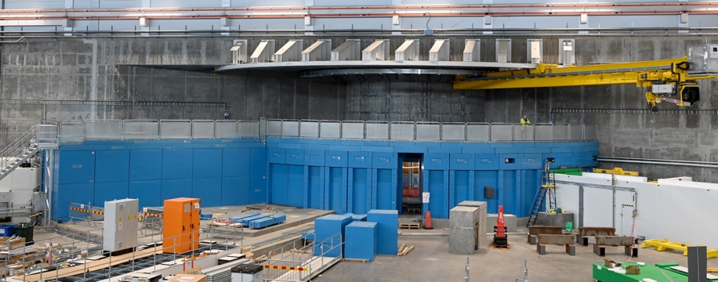

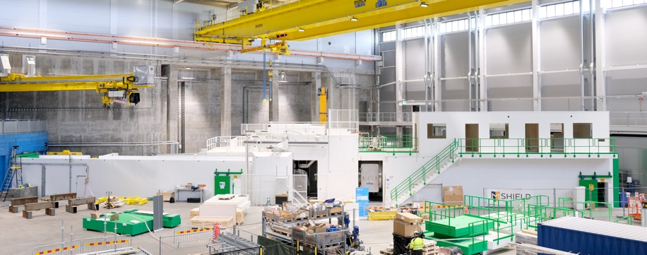
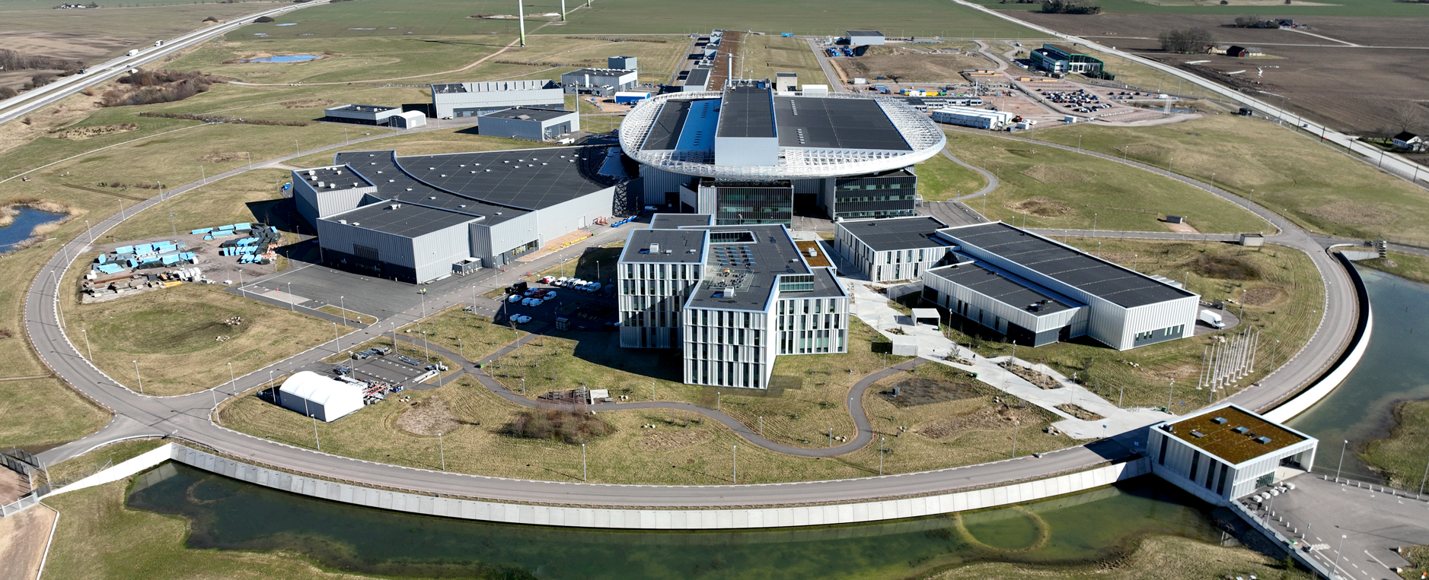
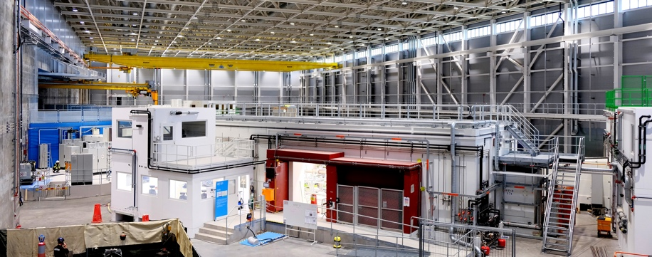
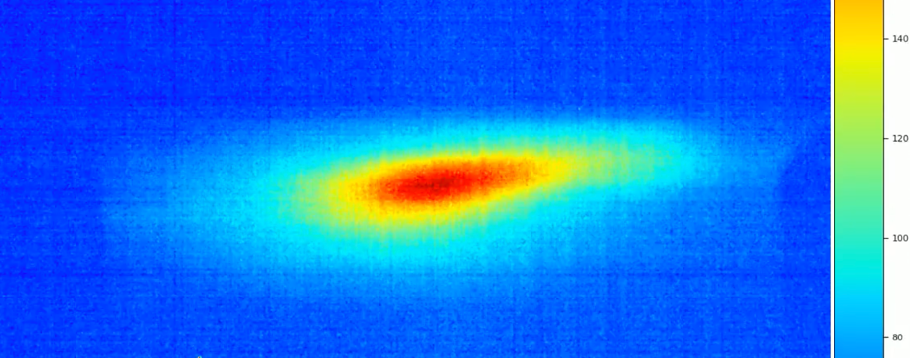
LDG core accelerator technologies strongly contribute to ESS
ESS
Fundamental Physics with neutron from end 2027:
Neutron Electric Dipole Moment, Neutron Decay, Neutron-AntiNeutron Oscillations, The Neutron as A Quantum Wave, Neutron-Bound Beta Decay

Slide 20

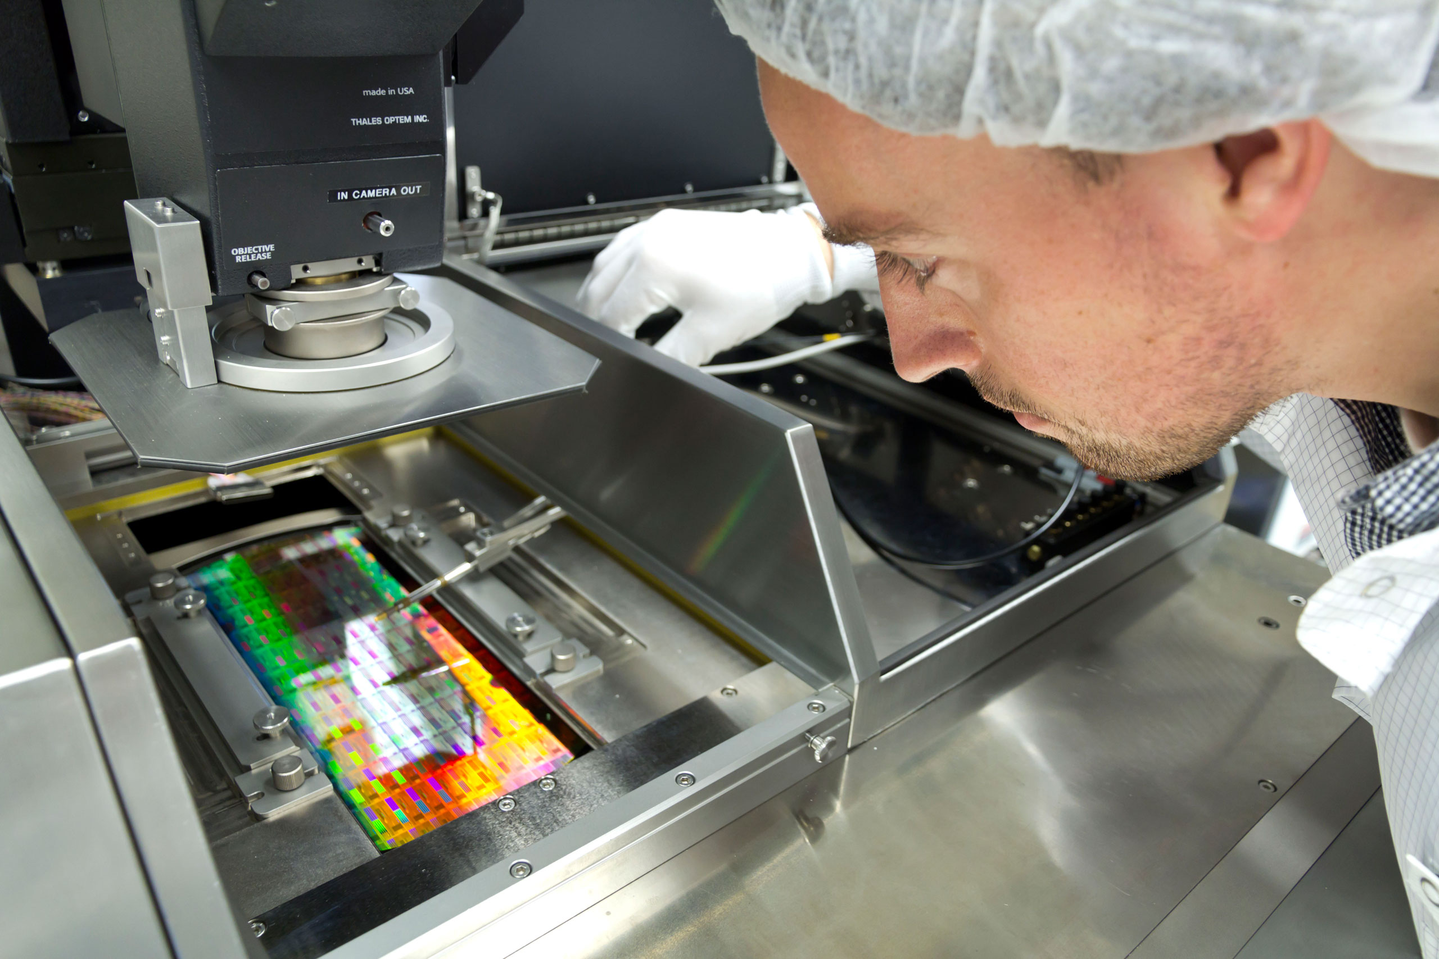
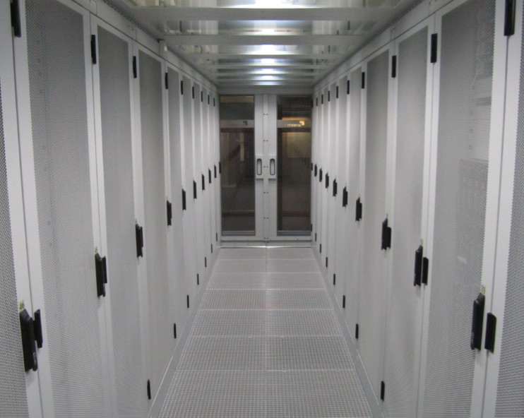

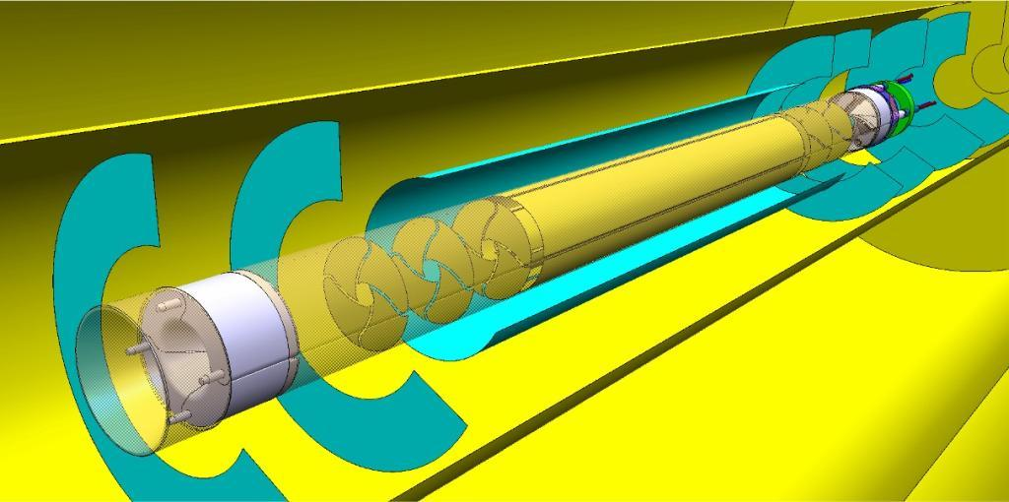
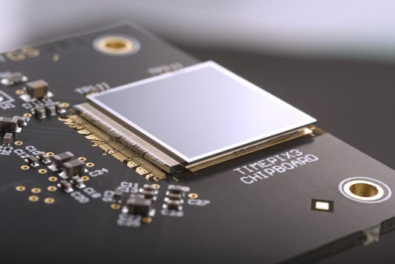
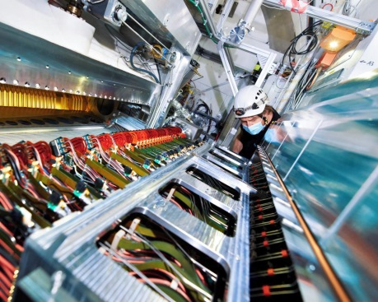
accelerator-based experiments
non-collider experiments
test beam or irradiation facilities
detector R&D facilities
accelerator R&D facilities
Example of the LPPL strengths
lifecycle of detector technology
Nikhef’s key asset: Nikhef master the entire life cycle of detector technology
from conceptual design to tier-1 data processing
All stages are brought together under one roof, enabling integrated, end-to-end detector development.
R&D
data processing
conceptual design
electronics
construction

Slide 21
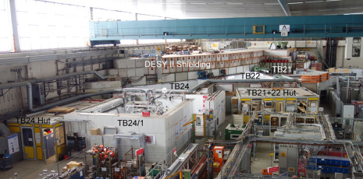
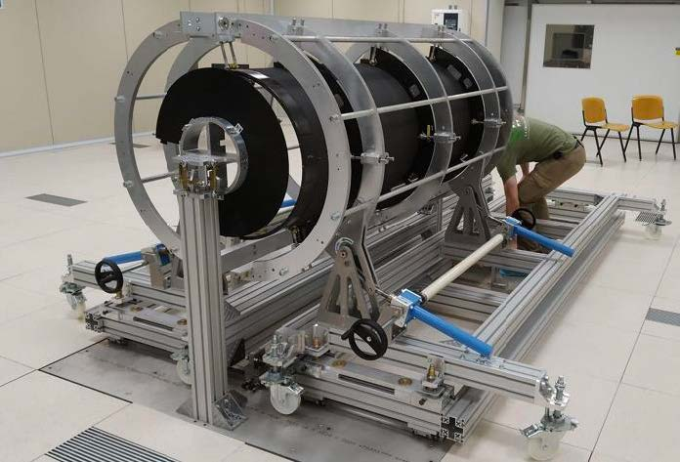
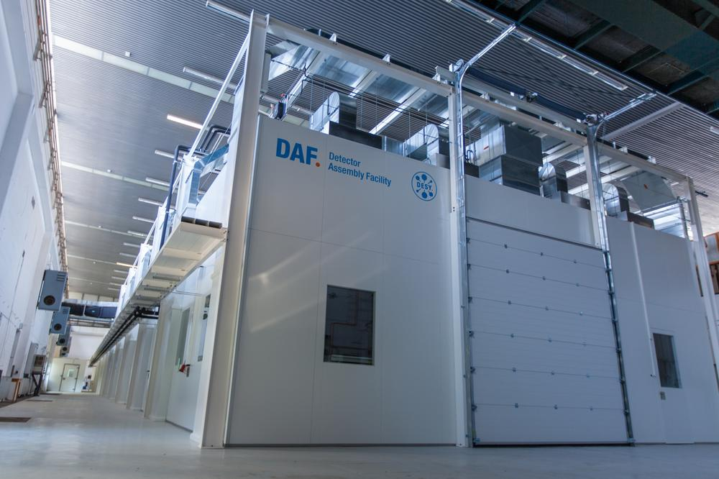
accelerator-based experiments
non-collider experiments
test beam or irradiation facilities
detector R&D facilities
accelerator R&D facilities
Example of the LPPL strengths
LNF
DESY
Advanced detector development/ construction/ testing at DESY
NEW LNF CLEAN ROOM COMPLEX
DDL
Clean Room
ATLAS ITK
Clean Room
ATLAS ITK
Climatic Chamber
Lab
nTOF
The DESY test beam experimental areas
ATLAS skeleton in the detector assembly facility
ATLAS ITK Mechanical Support for the integration of the Endcap @LNF
The detector assembly facility at DESY

Slide 22
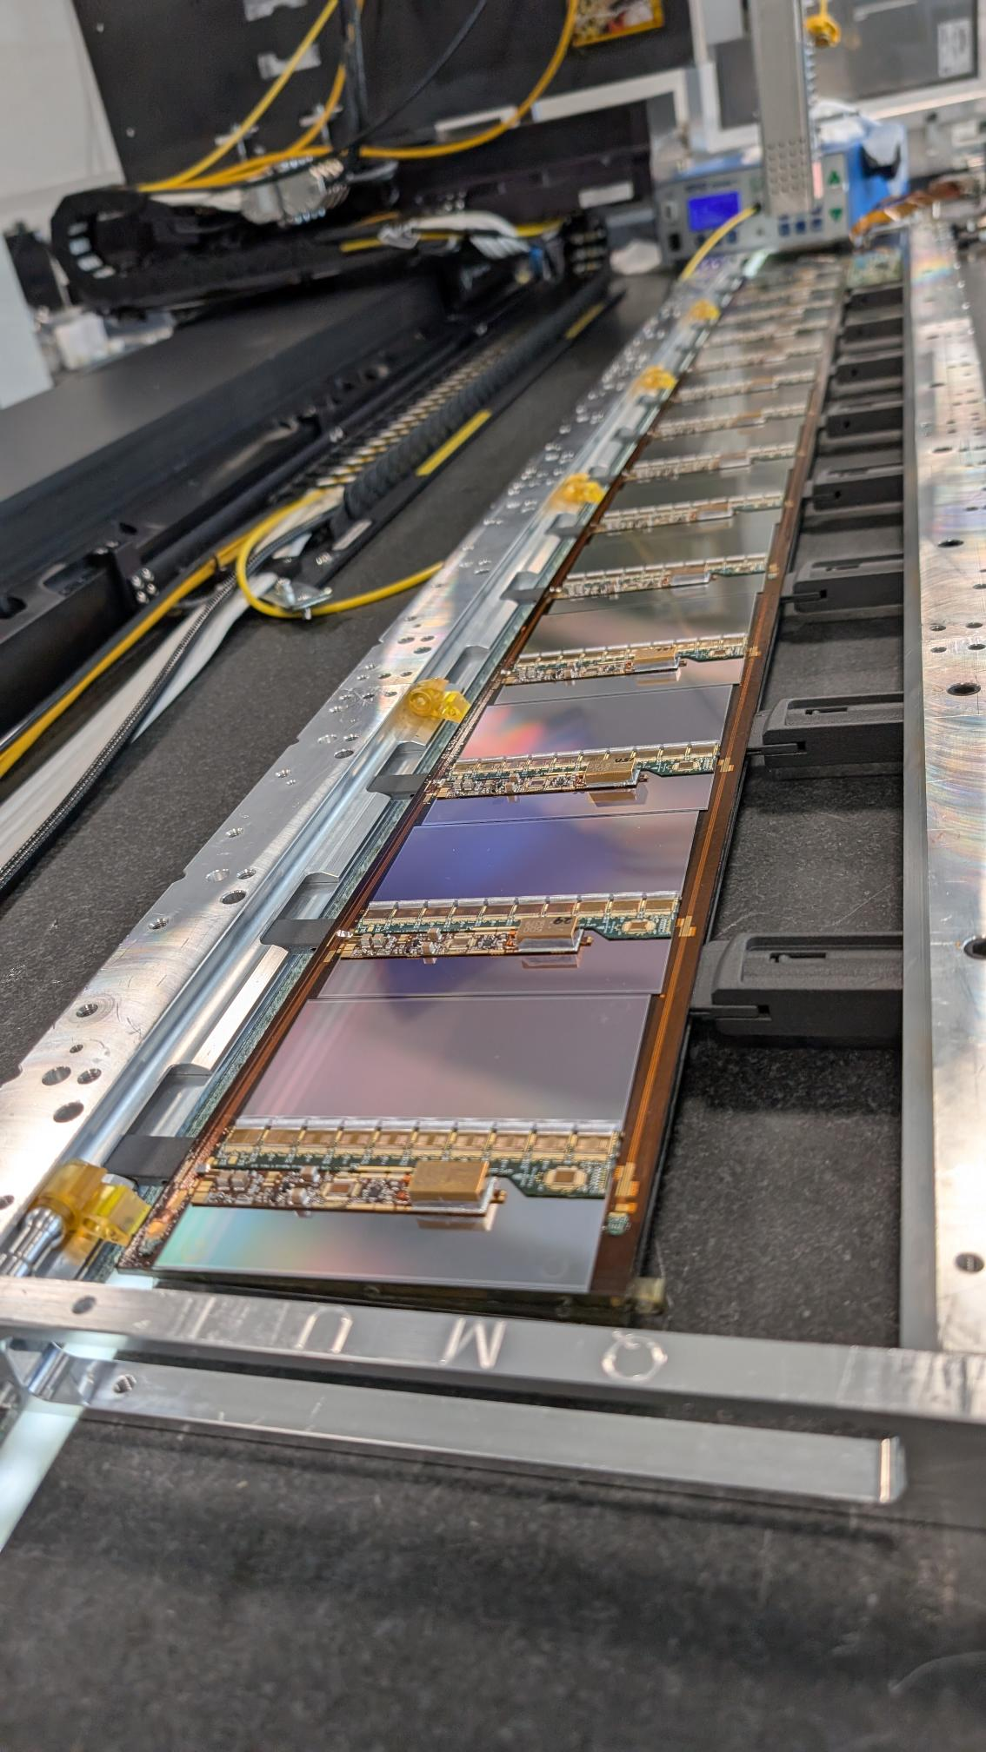
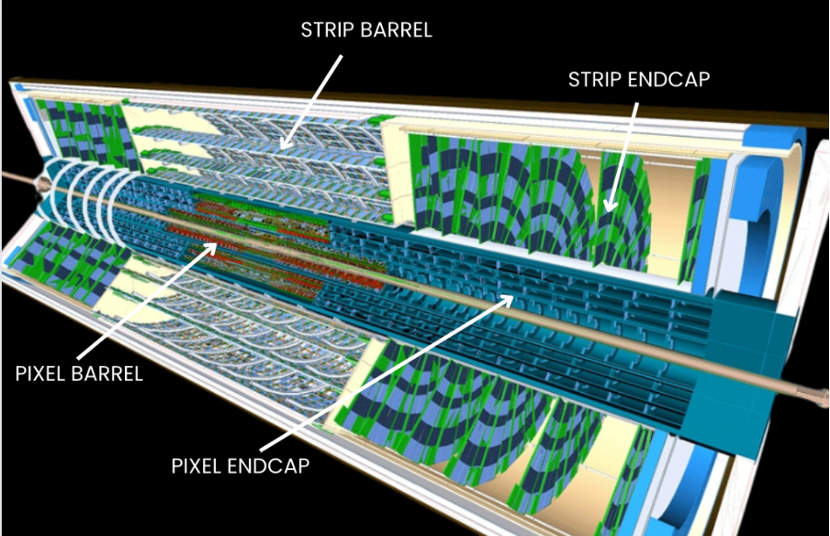



accelerator-based experiments
non-collider experiments
test beam or irradiation facilities
detector R&D facilities
accelerator R&D facilities
Example of the LPPL strengths
Rutherford Laboratory
Particle physics detector design/construction/analysis
Silicon detectors (ITk dominantly at present); calorimetry; readout
Software, Grid computing (Tier 1+2); hardware and software triggers
R&D: silicon; FPGA; Liquid O, quantum technologies
ATLAS, CMS, LHCb, Hyper K, DUNE, XLZD, LZ, AION, DarkSide, EIC
Rutherford Laboratory
CIEMAT
Operating underground lab
NE of England
~ 0 radon; low cosmic ray
Candidate site for XLZD, quantum experiments and quantum computing research
Cryolab for SiPM calibration for DUNE

Slide 23






LNGS Experiments
accelerator-based experiments
non-collider experiments
test beam or irradiation facilities
detector R&D facilities
accelerator R&D facilities
Example of the LPPL strengths
COSMIC SILENCE
EXIT
CRESST
LEGEND-200
GEMINI
COSINUS
CUORE
LUNA-400
LVD
GINGER
Strategy Double Beta Decay and DarkMatter @LNGS
CUPID
BELLOTTI IBF
CYGNO
CUPID R&D
Considering 3/4 big experiments on DBD and DM with other R&D activities on smaller experiments LNGS are practically fully committed until 2040.
This strategy is complementary and synergic with future study at the accelerator facilities.
BOREXINO
LIME/CYGNUS
DS20K
VIP
XENONnT
SABRE
CRYOPLATFORM
DAMA/LIBRA
STELLA
ENTRANCE
Running
Construction/Commissioning
Decommissioning
CUPID
LEGEND1000
LEGEND200
CUORE
2025
2027
2029
2031
2033
2035
2037
2039
2041
2043
2045
2047
XENONnT
XENON
DS20k
DS20k
Darwin/XLZD???

