Slide 1
The TypeScript Revolution
Jakob Miesner and Pal Kerecsenyi

Slide 2
What is TypeScript

Slide 3

TypeScript
JavaScript superset with types
  Algebraic Typing
Developed by Microsoft
Compiled to plain JS

Slide 4
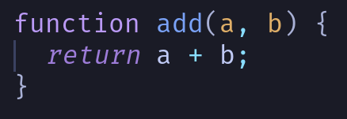
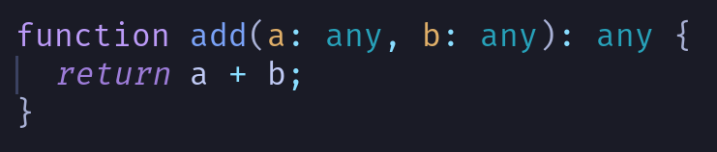
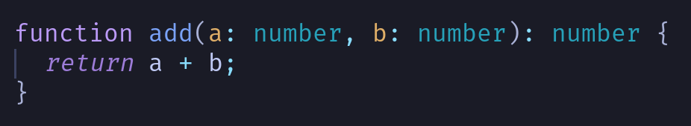

Slide 5
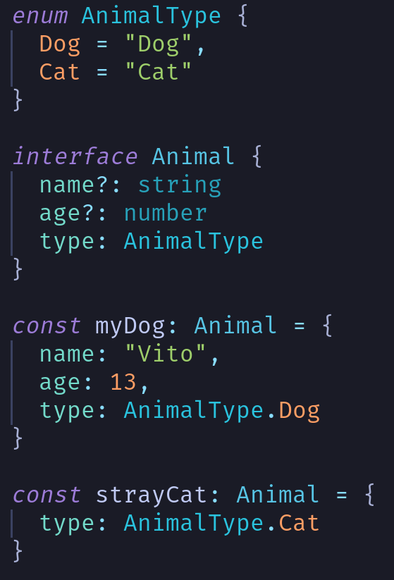

Slide 6

Why Switch?

Slide 7
Why Switch?
Better readability
  Team has a high fluctuation

Slide 8
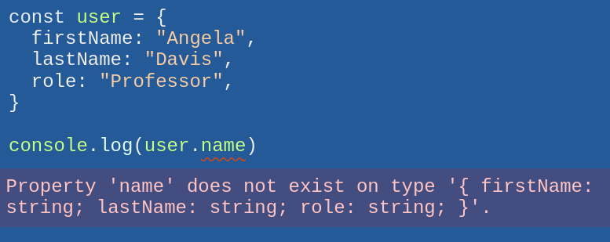
Why Switch?
Better readability
  Team has a high fluctuation
IDE support

Slide 9
Why Switch?
Better readability
  Team has a high fluctuation
IDE support
So good, that PropTypes were dropped

Slide 10
Examples

Slide 11
propTypes

Slide 12
propTypes
Comparable to TS
  Specifically only on the level of React components
Deprecated 8 years ago and fully removed in React 19
However: propTypes + eslint = somewhat decent type checking in the IDE

Slide 13
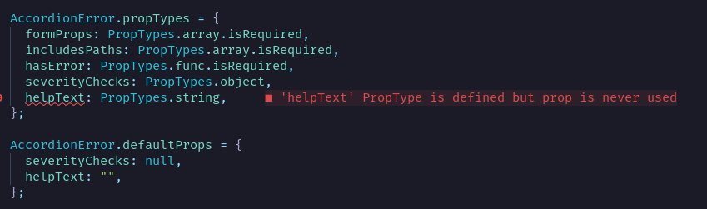
✅ Unused props

Slide 14
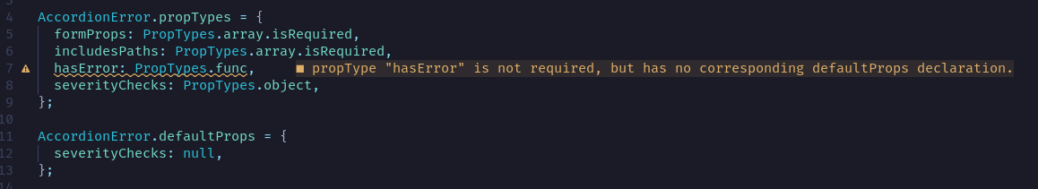
✅ No default value for optional props
(this is only a warning; it won’t cause the build to fail)

Slide 15
✅ Undeclared props

Slide 16
Problems with this configuration
But eslint will fail to catch many serious errors.
It’s also not very helpful to IDEs, making onboarding (including for external contributors) take longer.

Slide 17
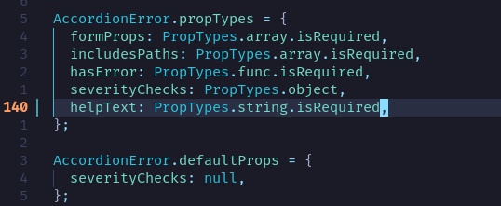

❌ Selecting an incorrect type

Slide 18
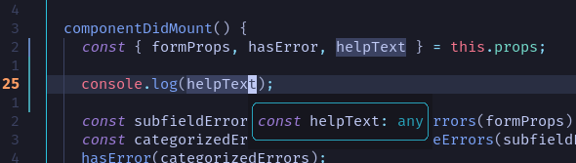
❌ Proper IDE hover

Slide 19
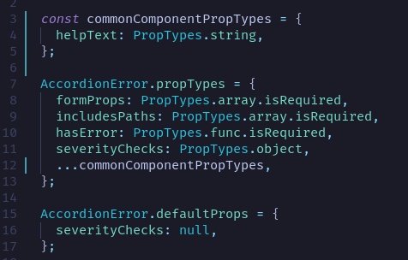
❌ More complex propTypes structures
“No default value” error no longer being raised :(

Slide 20
What about runtime checks?
The original idea behind propTypes
However, runtime errors are not fatal, so we don’t treat them too seriously
The system is not strict enough to force us to use correct props
Also: runtime checks have a performance impact but we disable them in prod

Slide 21
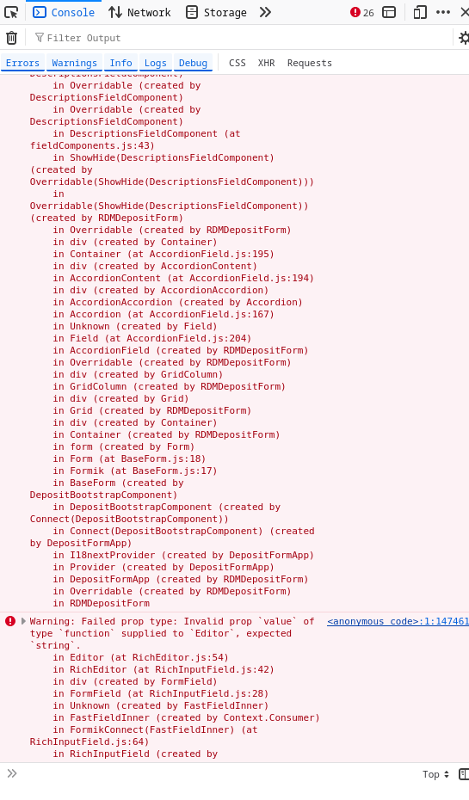
Example with CDS
Simply loading the deposit form = 26 runtime errors
Even if we fixed all of them, it’s still not a strong guarantee of correctness

Slide 22
Manual Typechecking

Slide 23
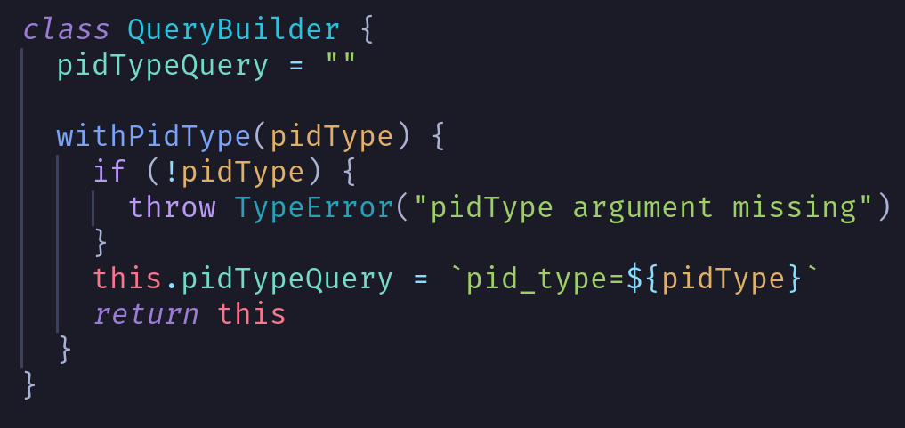

Slide 24
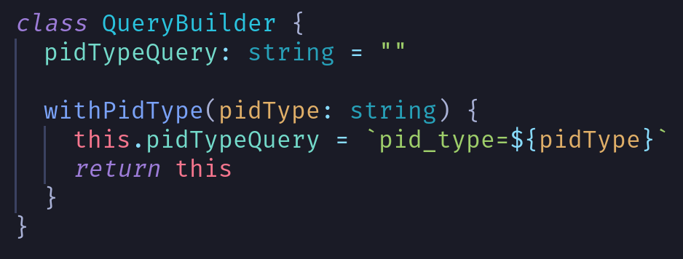

Slide 25
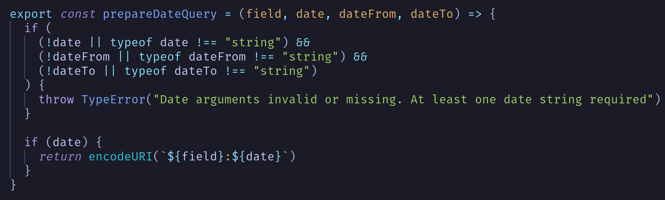

Slide 26
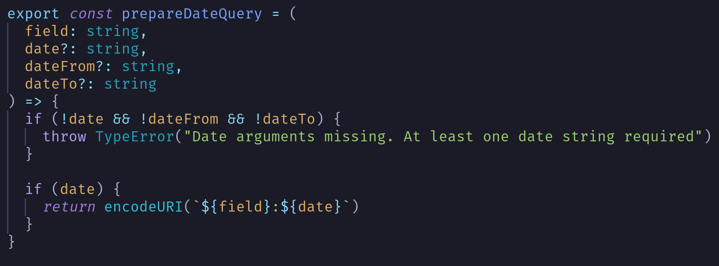

Slide 27
ILS-Config

Slide 28
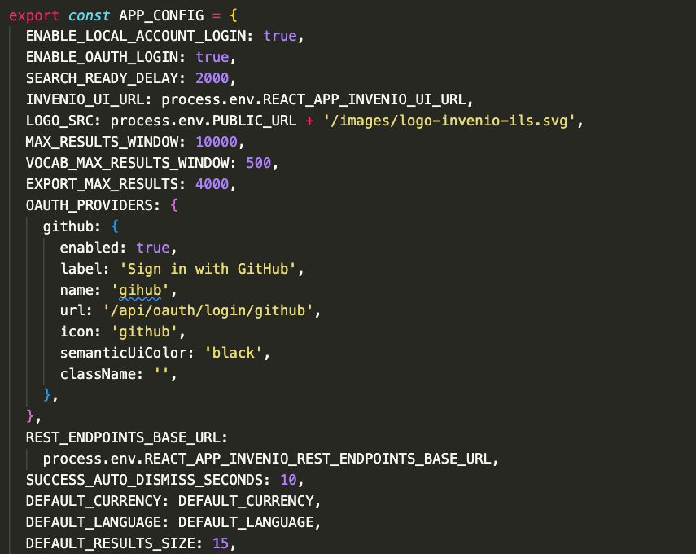
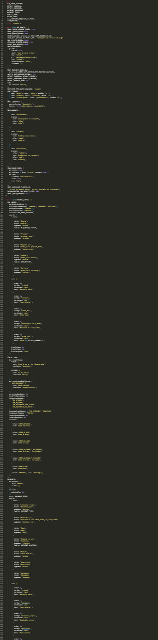

Slide 29
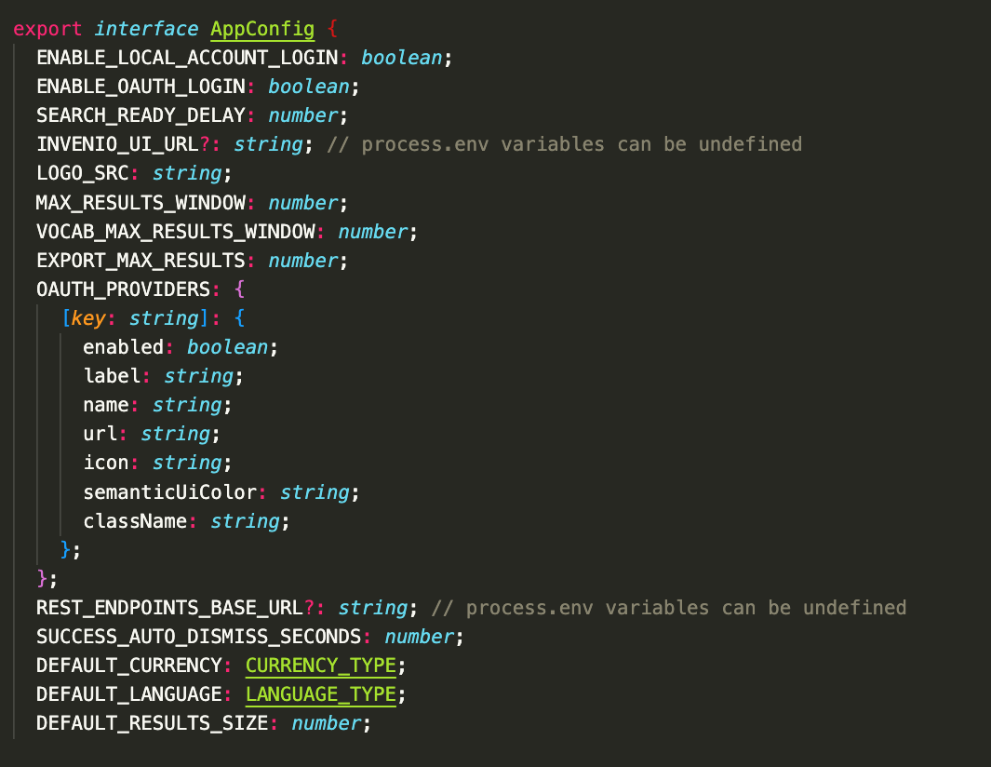

Slide 30
.metadata or not

Slide 31

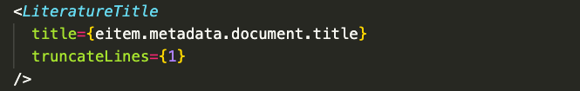

Slide 32


Slide 33
Redux

Slide 34
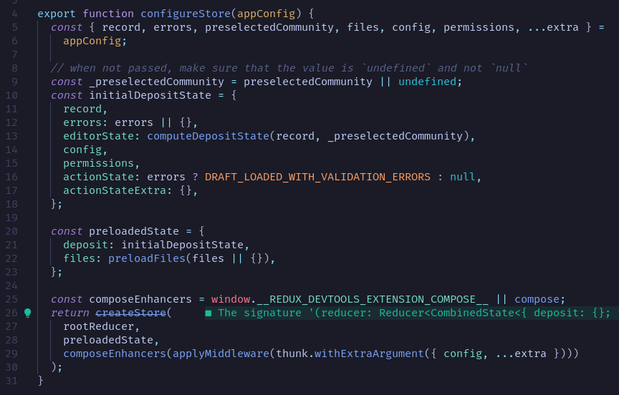
The current state of things
Example from invenio-rdm-records
Leaves many questions:
What is in the record? Where does it come from?
What does computeDepositState return?
Not impossible to find answers, but takes a lot of time and reading.

Slide 35
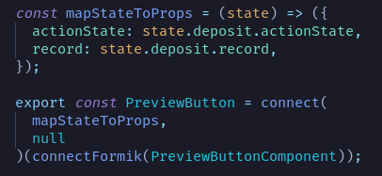
Another example
How do we know what’s in state?
Takes time and mental capacity to research this

Slide 36
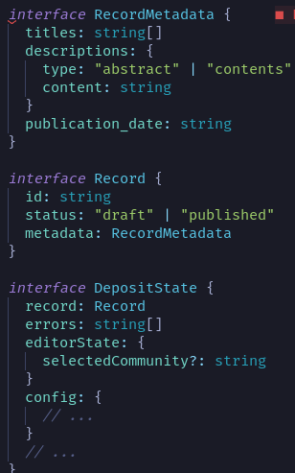
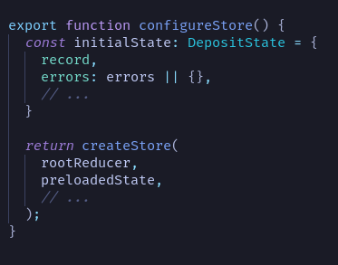
How this could look
Create a global typed connect() function to enforce correctly typed props on all state-consuming components
Add types to all reducers

Slide 37
Implementation

Slide 38
How to implement
Not all files have to be converted immediately!
TS easily supports mixing vanilla JS and TS files
Slowly over time we can “type” more files and gain more benefits, e.g. better IDE autocomplete
Start with low-level smaller frequently-used utility libraries
“Bottom-up” approach
E.g. react-overridable has total ~100 lines of code
  Relatively trivial structure typing wise
  Dependent packages do not also have to be in TS
Notes:
Pal

Slide 39
Side note: TypeScript packaging
Source code in repository
src/
  components/
    Accordion.tsx
    …
  index.ts
package.json
tsconfig.json
.gitignore
  Contains:
  dist/
  node_modules/
  etc…
Dist code in NPM archive
dist/
  components/
    Accordion.jsx
    Accordion.d.ts
    …
  index.js
  index.d.ts
package.json
.npmignore
  Contains:
  src/
  etc…
tsc
(TypeScript Compiler)
Notes:
Pal

Slide 40



Side note: TypeScript packaging
Regular JS!
TypeScript
Just the types
Notes:
Pal

Slide 41
Challenges

Slide 42
Problem 3: Learning curve
TS is a “typed superset” (most JS is inherently valid TS)
Not a new programming language, just some additional features
Will likely reduce mental load in long run
Notes:
Jakob

Slide 43

Challenges
New language
Defining standards
Maintaining types in two (?) systems
Inconsistent codebase while migration is ongoing
surely more

Slide 44
Thank you! :)

Slide 45
Technical details
TypeScript integrates with Webpack using ts-loader
  Common industry-standard pattern
Possibly just adding a few lines of code to invenio_assets/assets/build/webpack.config.js
Also need to add a tsconfig.json to each Invenio module where we want to use TS
  Could use a similar approach to .eslintrc.yml with a single common configuration
  Sets precise behaviour of tsc:
    Target version of JS
    Specific rules (e.g. whether to allow implicit default imports)
    “Strict mode”
Need to enable built-in eslint rules for TS

Slide 46
Auto-generating API types
Already use Marshmallow schemas!
Build OpenAPI defs from schemas: github.com/marshmallow-code/apispec
Build TS interfaces from OpenAPI: github.com/openapi-ts/openapi-typescript
Add a single CLI command to run in one step
Also: manually create interfaces for data passed via Jinja template
  declare global { interface Window { INVENIO_CONFIG: ... } }

