Slide 1


FOS Humidity Update
9 JULY 2025
Simon Connell, Xola Mapekula, Doomnull Unwuchola, Loan Truong, Matthew Connell, Abdool Sattar Cassim, Bongani Maqabuka, Leerothodi Leeuw

Slide 2
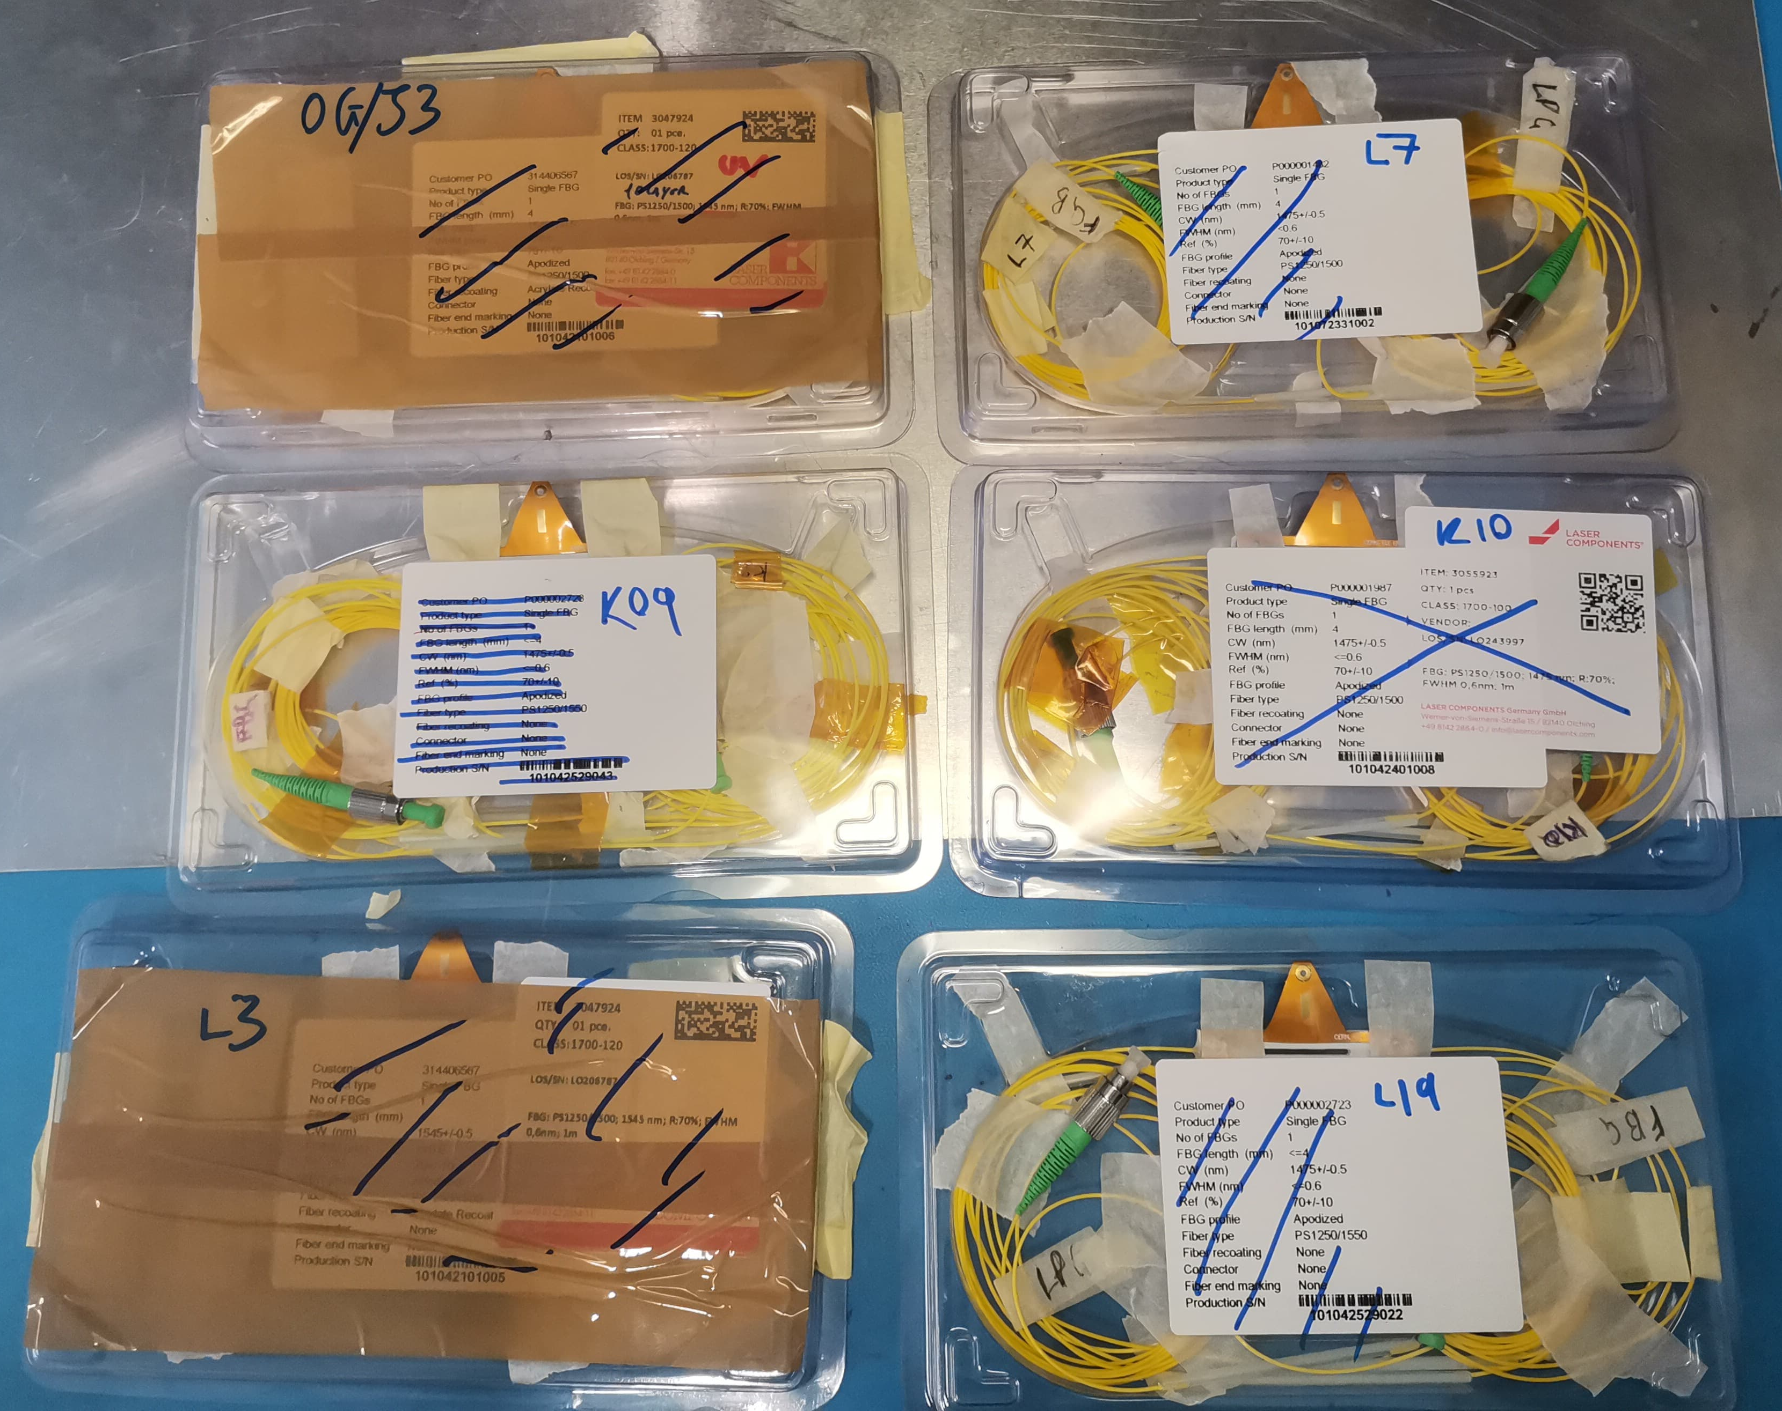
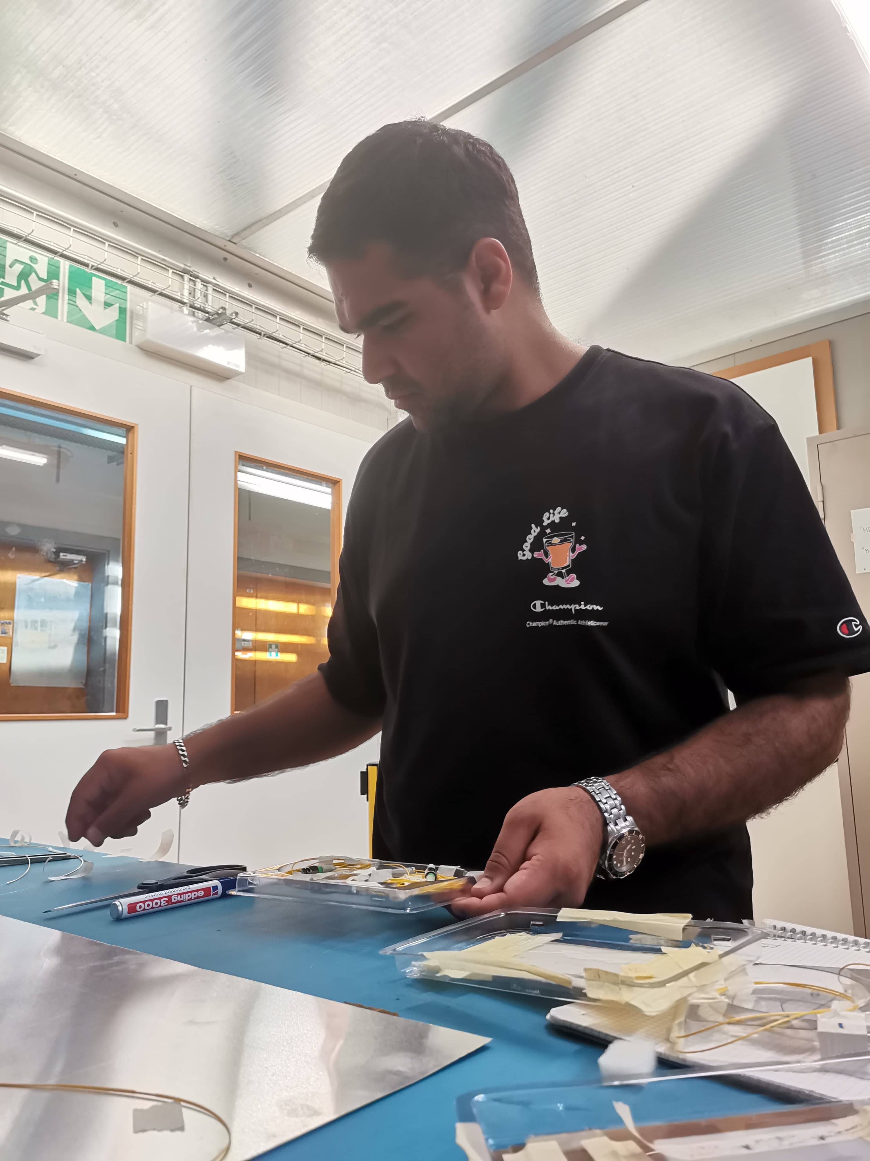
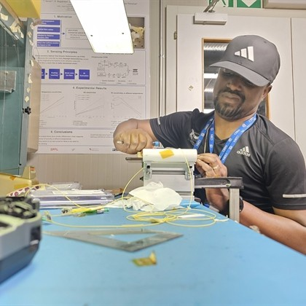
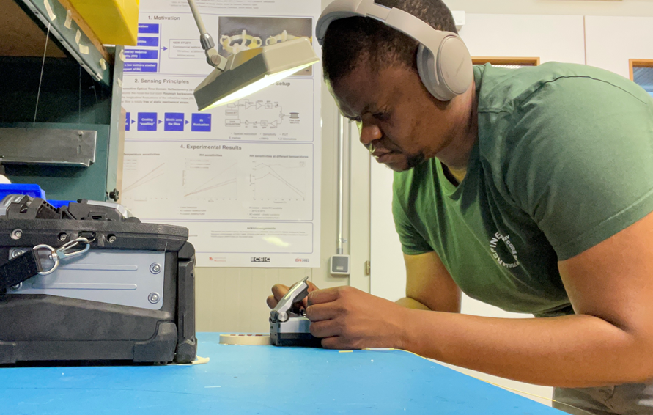
Key Points
  6 FOS packages being sent to Valencia
  Ongoing R&D in lab – results to follow
  Assembly procedure is being updated: https://edms.cern.ch/ui/file/2956801/1.2/FOS_Protocol__Package_Assembly.pdf
  Pepe: Will FOS team be present at Nikhef and DESY to splice and test packages with OTDR and Integrator ?

Slide 3
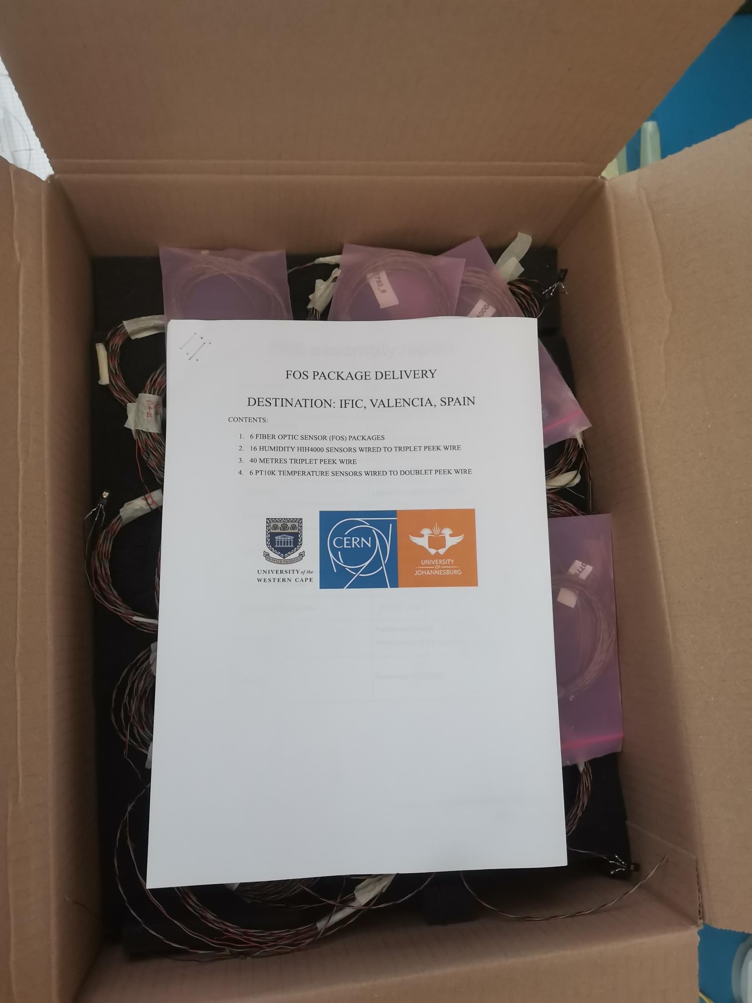
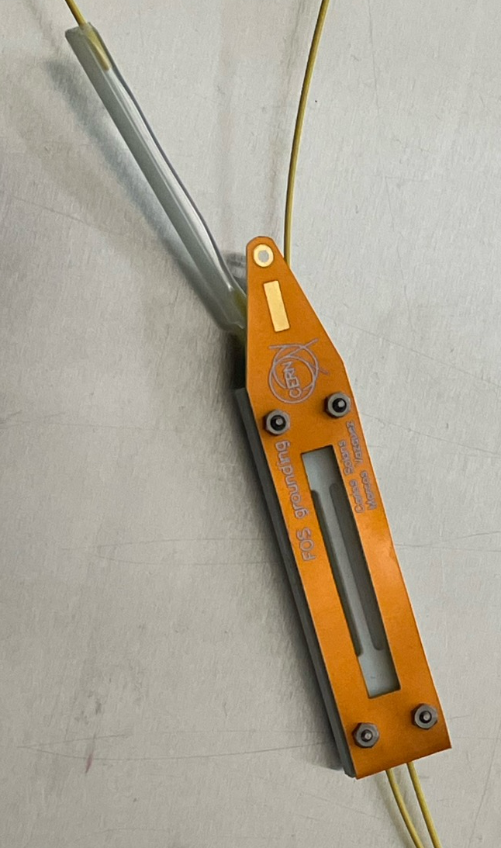
IFIC Delivery
  Delivery of FOS material to Valencia:
    6 FOS packages
    16 HIH
    6 Pt10k
    40m additional PEEK wire
    Each FOS package supplied with OTDR spectra and full spectrum showing FBG and LPG

Slide 4
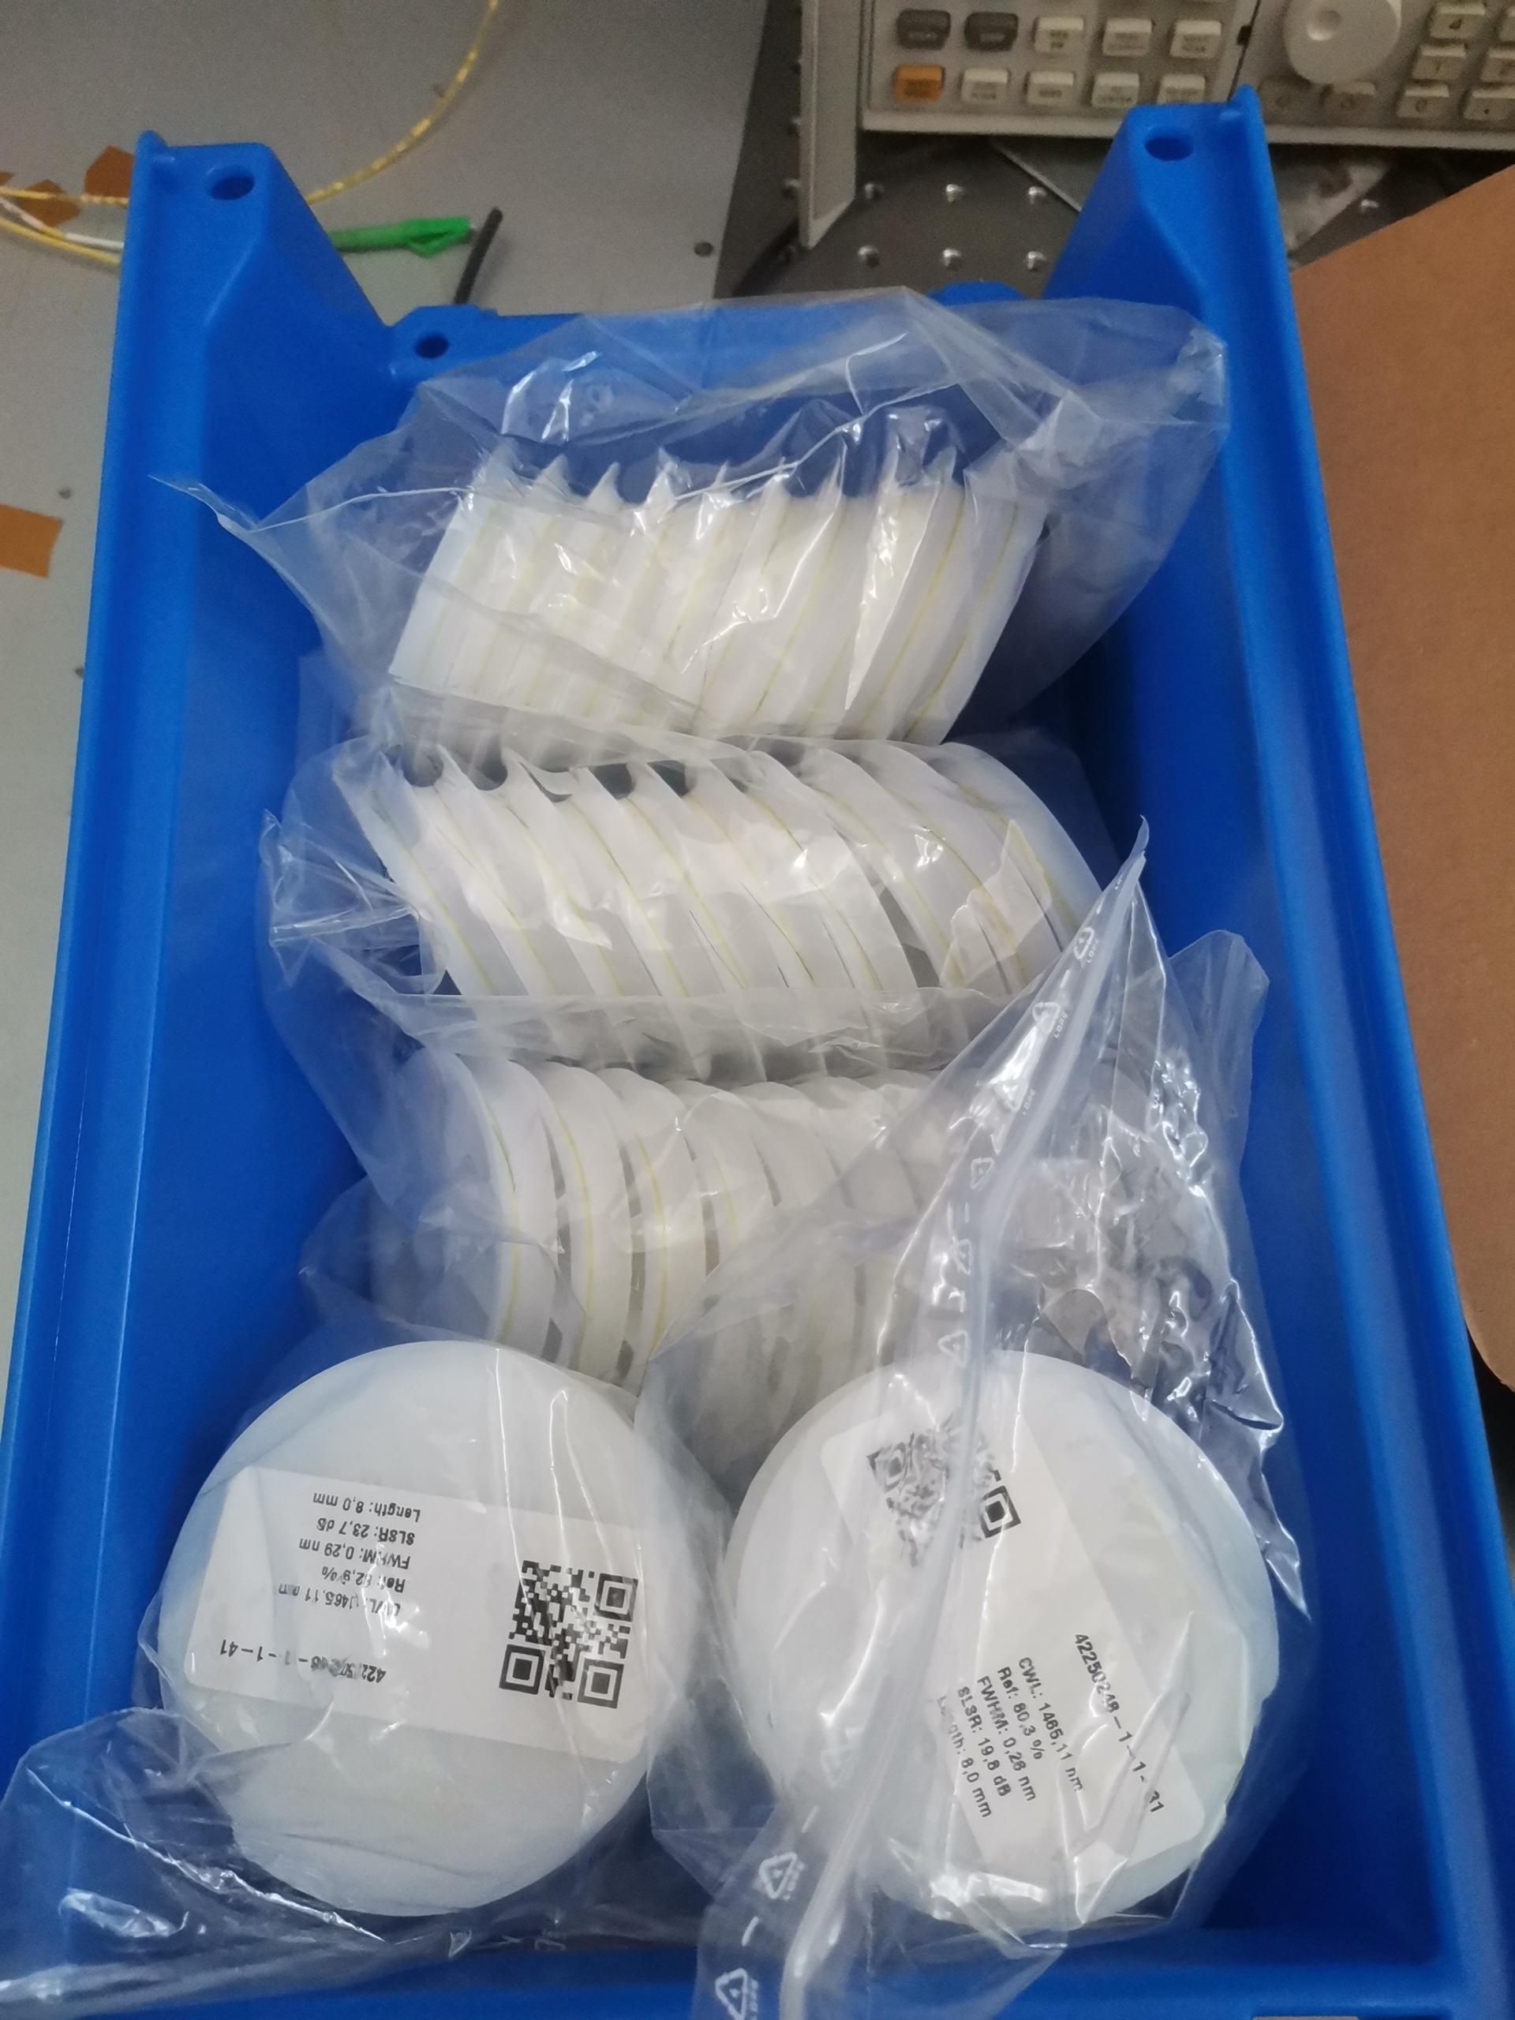
More RAD HARDS!
  Saved by Carlos !
  Carlos was able to procure a large shipment of Rad Hard FBG based on the Fujikura QA type.
  We are now able to manufacture to correct specification

Slide 5
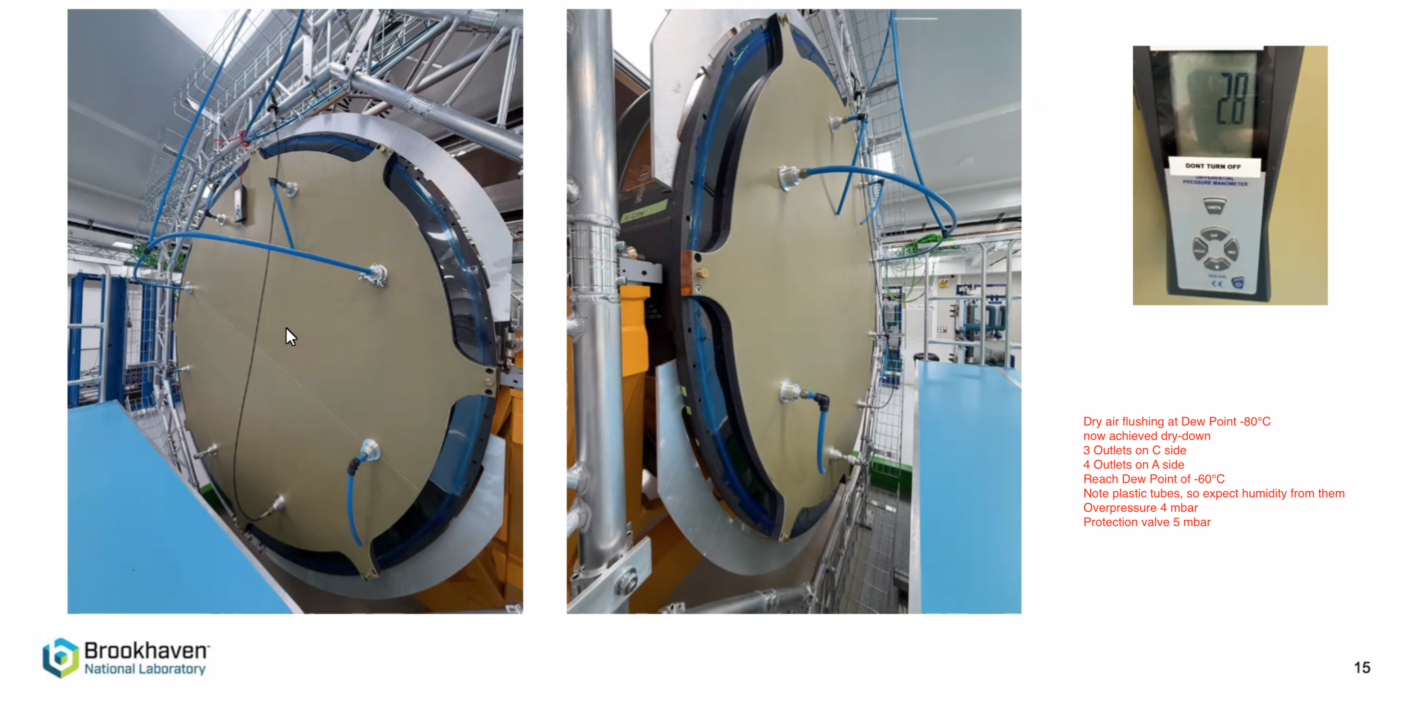
Dry Down
  FOS Group ready to bring Interrogator and participate

Slide 6
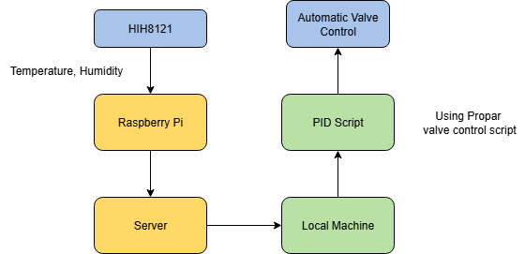
PID sensor
  Included an HIH8121 sensor to be used for PID control

Slide 7
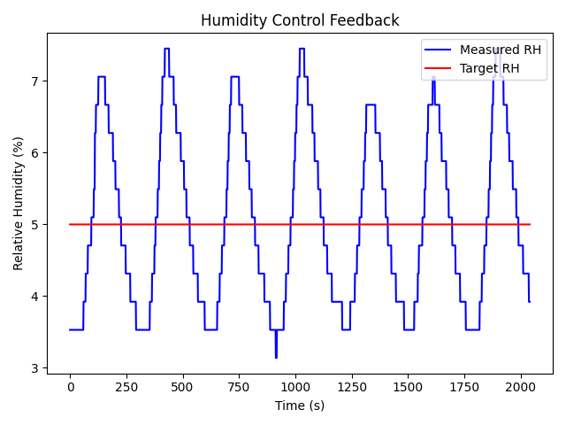
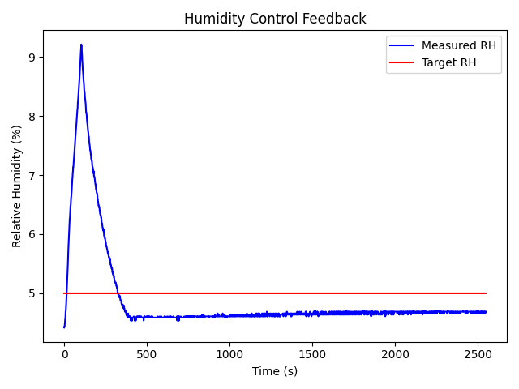
PID sensor
  Compared to previous attempts, code developed to work better
  Need to configure parameters to fully reach set humidity point
  Before
  After

Slide 8
PID sensor – Next Steps
  Do test and compare hih4000 to hih8121 – if hih8121 performs poorly, will install a hih4000
  Make a fully python script to do RH tests automatically without need for valve software – nearly complete

Slide 9
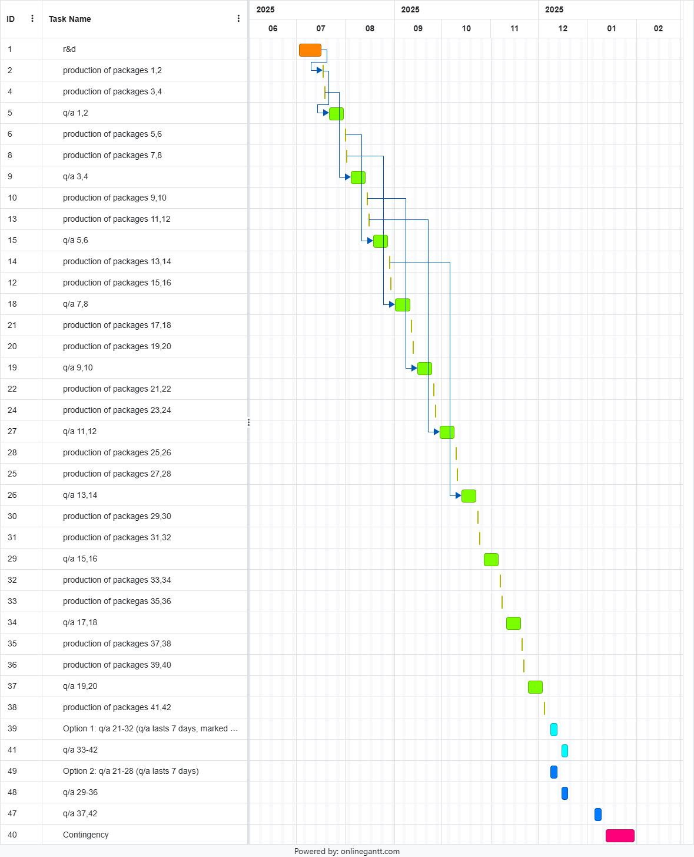
Production Schedule
Blocks of 10 WD (2 Week)
  2 WD production, 8 WD QA
  Production always happen in the same week day
  Production rate (2-4 /block) will exceed QA capability (2/block)
10 blocks to complete production (42 units): 1 Dec 2025
  24 packages still pending QA
Completion of QA
  Baseline: May 2025 with the same rate
  Opportunity 10 at the time: finish production Dec 2025
  Opportunity 7 at the time: finish production Feb 2025
Xola Mapekula

Slide 10
Thank You

