Slide 1
FCC-ee Collimators Thermal Update
Richard Cowan, Stefano Marin
14th July 2025

Slide 2
Collimator Thermal Checks
Conditions for Z pole:
Continuous beam – 18 minute lifetime
  Steady state simulation
Accident condition – reduced lifetime
  5 minute lifetime applied for 10 seconds
  Transient simulation applied AFTER previous steady state
Accident condition – beam impact on primary collimator

Slide 3
Collimator layout – Point F
Primaries
Graphite
First Secondaries
TZM
Second Secondaries
TZM
Momentum collimators (downstream)
TCP_V
TCP_H
TCS_H1
TCS_V1
TCS_H2
TCS_V1
a
a
b
a
b
a
a
b
a
b
b
b

Slide 4
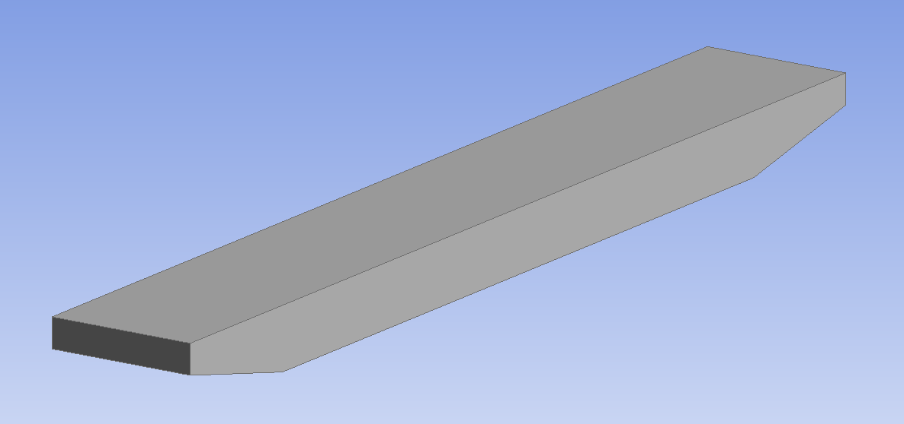
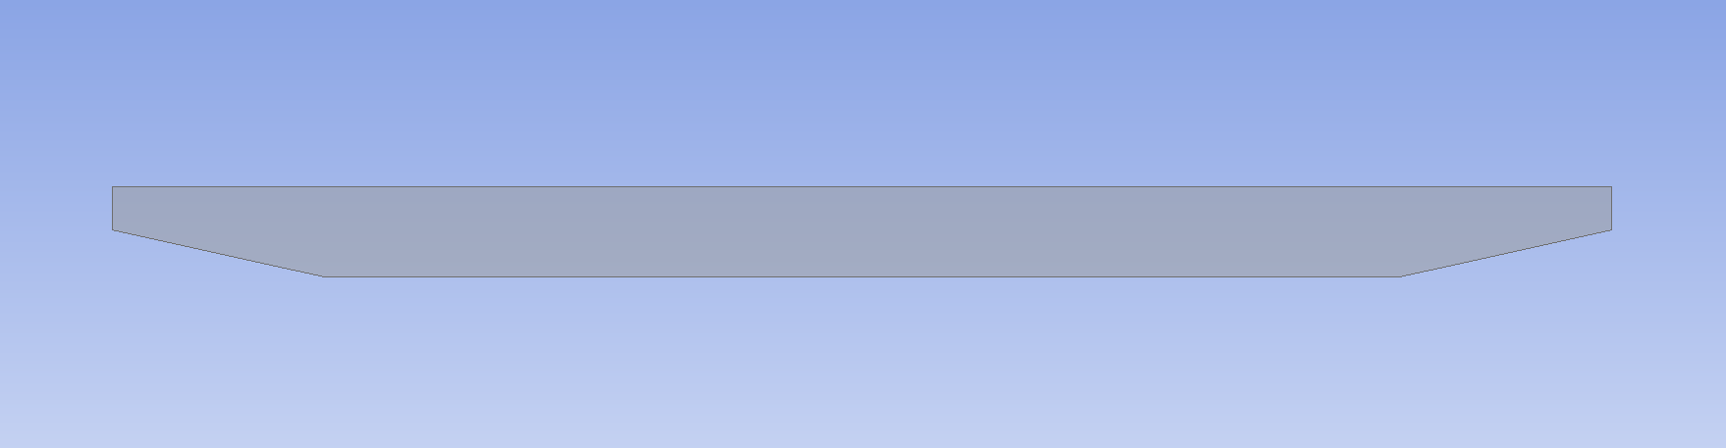
Collimator Design
Simplistic design
25 or 30 cm jaw length (P or S)
SGL R7550 Graphite or TZM material
12.5° taper
  Stops after 6cm taper length (to be changed in next iteration)
Cooling by convection on back surface
  Using Dittus-Boelter HTC correlation for 0.5m/s flow: 2000W/m²/K calculated from 1cm thick pipe on back surface
Only betatron collimators modeled
Beam
Beam

Slide 5
Collimator layout – Point F Halo
Primaries
Graphite
First Secondaries
TZM
Second Secondaries
TZM
Momentum collimators (downstream)
TCP_V
TCP_H
TCS_H1
TCS_V1
TCS_H2
TCS_V1
a
a
b
a
b
a
a
b
a
b
b
b
Particle locations for Halo:
50% on TCP_Va and
50% on TCP_Ha
(1um impact param)

Slide 6
Effects of Steady State Halo – 18 minute lifetime
Convection temperature: 25°C
Findings:
Primary collimators and second secondary collimators well cooled
First set of secondary collimators receive most of shower.
Maximum temperature from steady state on H1b jaw at 161°C.
Shower should not overheat well cooled collimators.

Slide 7
Effects of Transient short-lifetime Halo – 5 min lifetime
Input Temperature is Steady State - 18min lifetime
Findings:
Most power deposited on first secondary collimator set again maximum 7kW on TCS_H1b.
TZM has sufficient heat capacity to resist large changes in temperature.
Maximum temperature on H1b collimator at 291C.
Primary Collimators very under-loaded – possibility of increasing density / changing to metal? (TZM, W, Ti, Cu, etc)?

Slide 8
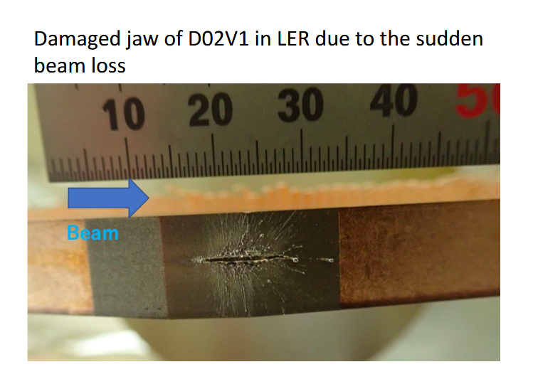
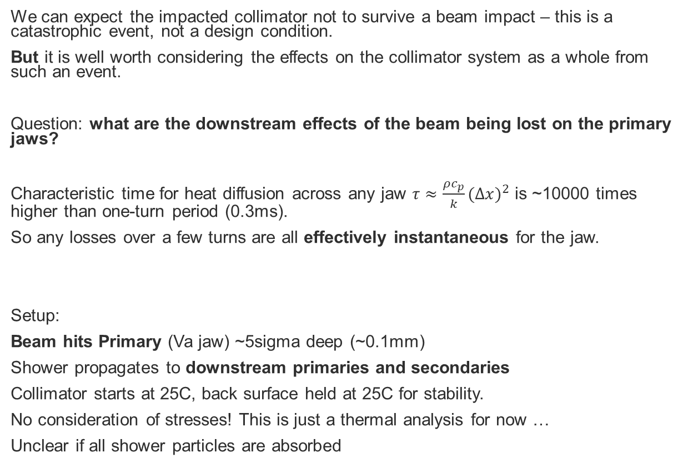
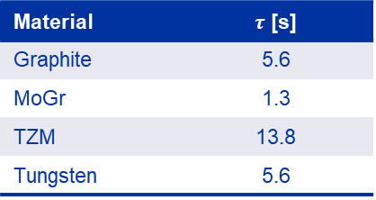
Attempting to simulate a SKEKB-style Impact
We can expect the impacted collimator not to survive a beam impact – this is a catastrophic event, not a design condition.
But it is well worth considering the effects on the collimator system as a whole from such an event.
Question: what are the downstream effects of the beam being lost on the primary jaws?
Characteristic time for heat diffusion across any jaw $τ≈\frac{ρc_{p}}{k}{(∆x)}^{2}$ is ~10000 times higher than one-turn period (0.3ms).
So any losses over a few turns are all effectively instantaneous for the jaw.
Setup:
Beam hits Primary (Va jaw) ~5sigma deep (~0.1mm)
Shower propagates to downstream primaries and secondaries
Collimator starts at 25C, back surface held at 25C for stability.
No consideration of stresses! This is just a thermal analysis for now …
Unclear if all shower particles are absorbed
Material | $τ$ [s]
Graphite | 5.6
MoGr | 1.3
TZM | 13.8
Tungsten | 5.6
(from T. Ishibashi, Collimator Issues, 2022-12-14, The 26th KEKB Accelerator Review Committee)

Slide 9
Collimator layout – Point F Catastrophic Impact
Primaries
Graphite
First Secondaries
TZM
Second Secondaries
TZM
Momentum collimators (downstream)
TCP_V
TCP_H
TCS_H1
TCS_V1
TCS_H2
TCS_V1
a
a
b
a
b
a
a
b
a
b
b
b
Particle locations for Impact:
100% on TCP Va
(~100um impact param)

Slide 10
Mechanics of catastrophic beam impact?
Depending on the horizontal beam dynamics during a few turns, we have multiple scenarios:
If the beam hits the same spot on the collimator:
Beam tunnels through collimator almost immediately and mainly deposits somewhere else
  On secondaries?
  Close to interaction point? (serious damage to experiment possible)
If the beam impact position moves horizontally faster than the collimator gets out of the way (i.e. melts/vaporises):
Beam scrapes deeper into primary collimator and deposits over multiple turns
  Majority of beam will impact on primary collimator and cause shower
  Potentially requiring replacement of large parts of collimation system for a beam impact
Something else?

Slide 11
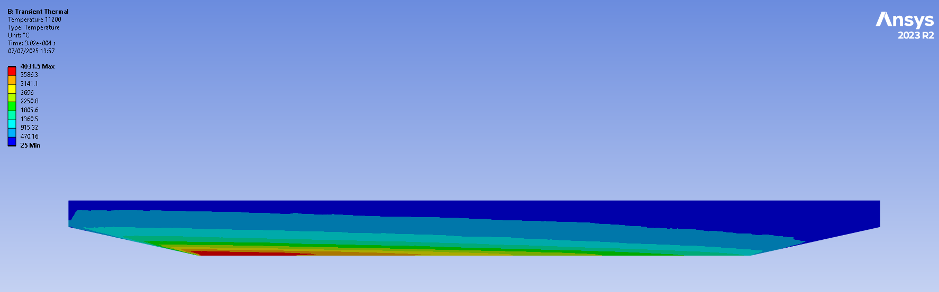
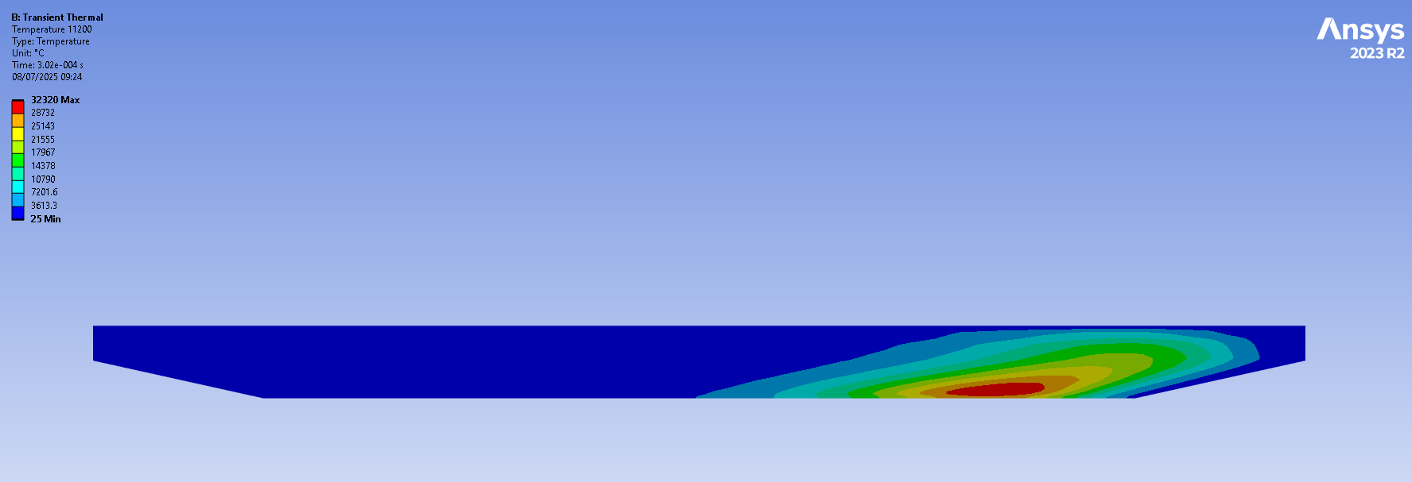
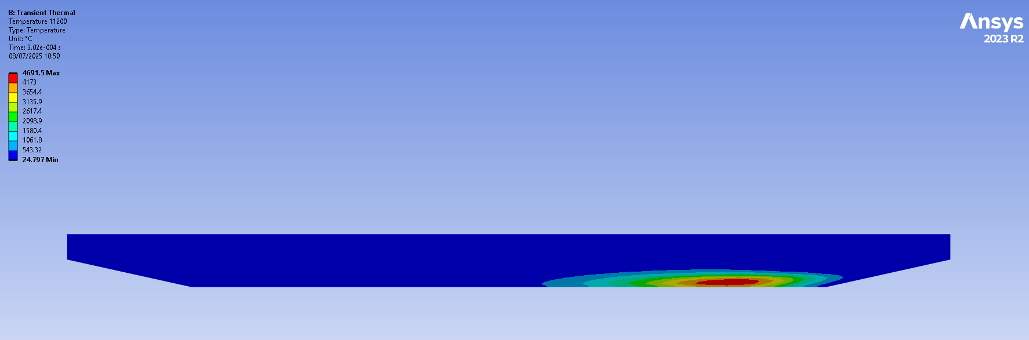
Deposition locations
Other primaries (immediately downstream of impacted jaw):
Deposition on jaw surface, rising downstream
First set of secondaries:
Concentrated in upstream edge of entire jaw
Second set of secondaries:
Concentrated in upstream edge of jaw surface

Slide 12
Catastrophic Beam Impact – Downstream effects
TCP_Vb (other jaw)
Full primary impact can shower to secondaries causing serious temperature increase.
Even partial impact (10% of beam) could require replacement of 3 collimators
It is not sufficient to isolate losses from such an instability to PF, the collimation system will not survive
Impacted primary jaw (TCP_Va)
TCS_H1
TCS_V1
TCS_H2
TCP_H
TCS_V2

Slide 13
Catastrophic Beam Impact – Downstream effects
Full primary impact can shower to secondaries causing serious temperature increase.
Even partial impact (10% of beam) could require replacement of 3 entire collimators
It is not sufficient to isolate losses from such an instability to PF, the collimation system will not survive
Impacted primary jaw (TCP_Va)
TCS_H1
TCS_V1
TCP_Vb (other jaw)
TCS_H2
TCP_H
TCS_V2
100% of beam

Slide 14
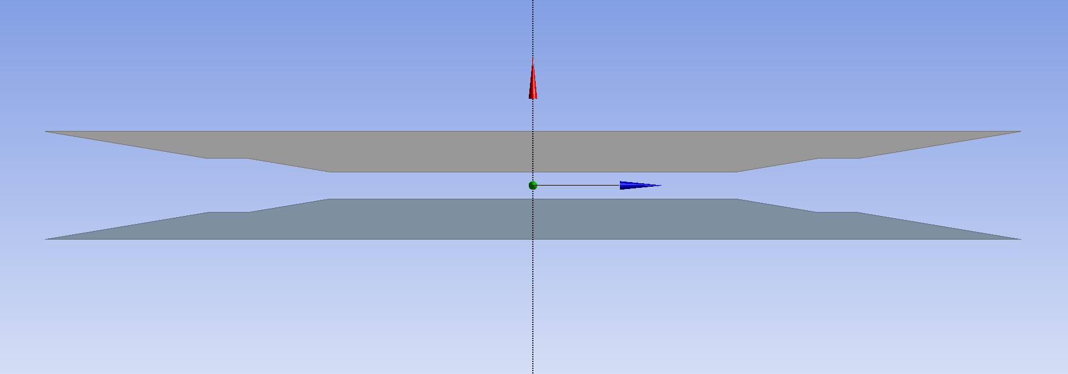
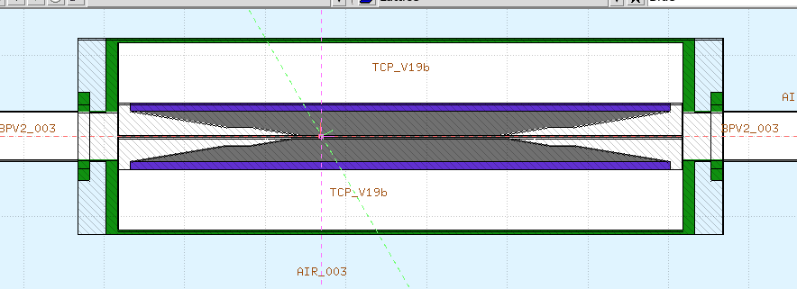
Takeaways and next steps
Takeaways:
Halo heating is acceptable at current level
Full-beam fast impacts cannot be sustained, not just by the primary collimator, but by PF collimation system as a whole
Next steps:
Fully define accident scenarios that MUST be survived
Stresses in halo cases – needs a thorough pass
Material changes?
Where does the beam (and its shower) truly impact?
  Using new optics!
  Primary, Secondaries, Tertiaries, Masks?
Collimator design update – longer tapers for impedence improvement and BPM locations

Slide 15
Thanks!

