Slide 1
Predictability of β* and waist corrections at very low β* (Update)
Evan Navar Root
7/1/2025

Slide 2
Overview
18cm global correction tested in B1 on 24/4/2025 and 27/4/2025
Several waist shifts caused by correction in IP1 and IP5. Particularly large horizontal shift in IP5
Testing if MAD-X can predict the waist shift and Beta* beating caused by the correction

Slide 3
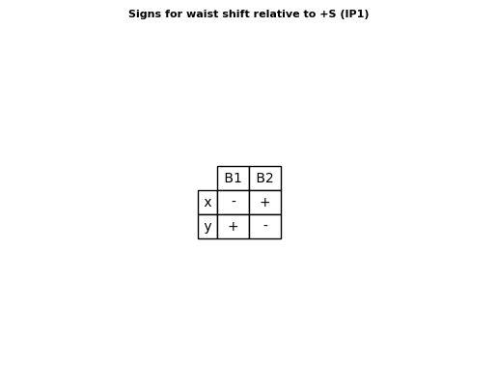

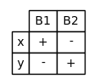
Waist Shift Sign
To read the tables below, the top column is the beam and the left is the plane. The sign of the corresponding box is the sign between the predicted and measured waist shift (e.g if the box has a “-” then to compare predicted vs. measured shift you have to multiply the predicted by -1). Note: The waist shift measurement sign is always relative to the Foc->Def direction. So a shift towards the Foc Quad is a negative waist shift in the measurement.

Slide 4
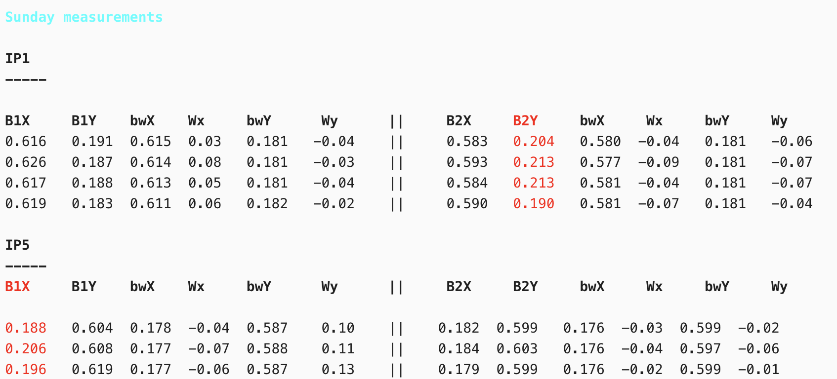
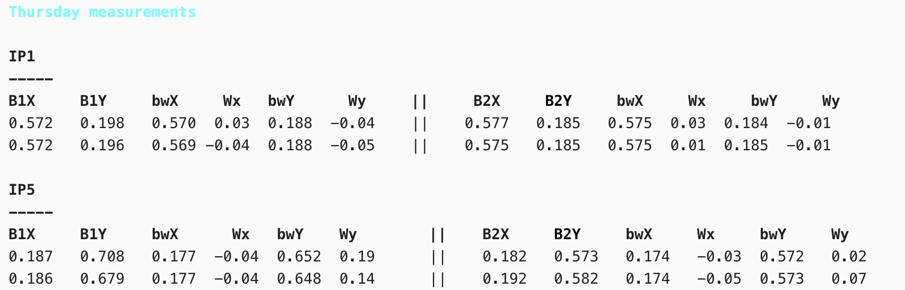
Data table
This is the table from the logbook use to get all the measured data. Logbook entry 28/4/2025.

Slide 5
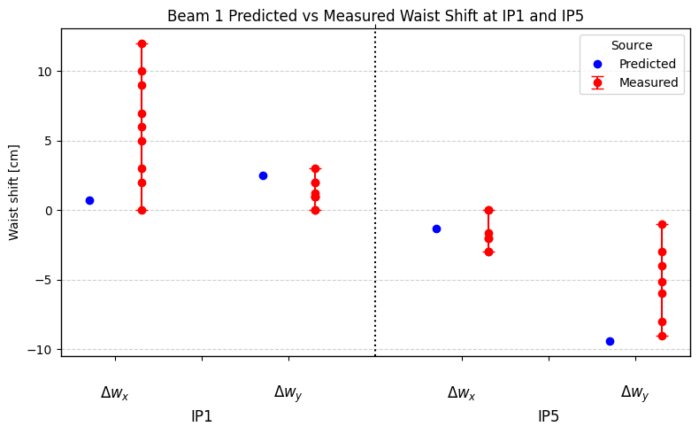
IP1 & IP5 waist shift Beam 1
Predicted vs Measured waist shift in B1, with the measured showing the spread of data.

Slide 6
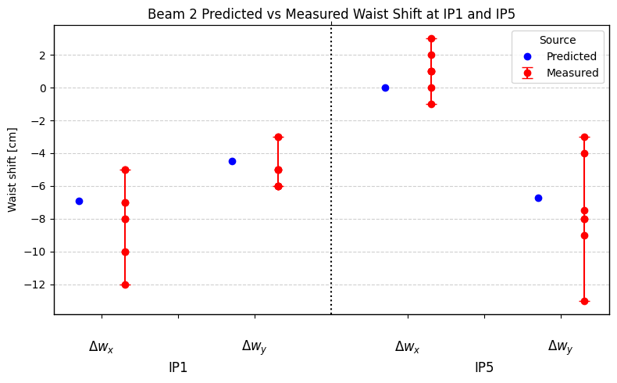
IP1 & IP5 waist shift Beam 2
Predicted vs Measured waist shift in B2, with the measured showing the spread of data.

Slide 7
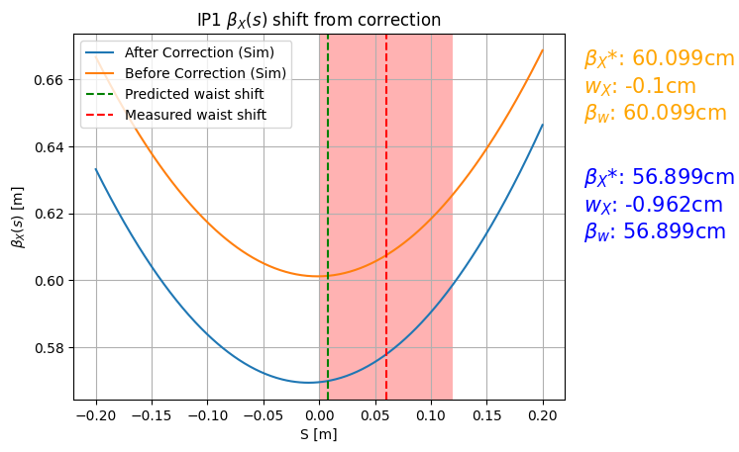
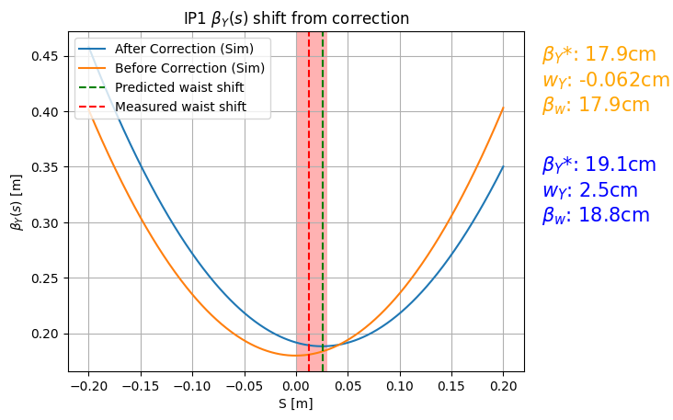
B1 IP1 Waist shift X & Y
Graphed shift in beam 1 simulated β from global correction along with the waist shift in IP1. IP is at S = 0

Slide 8
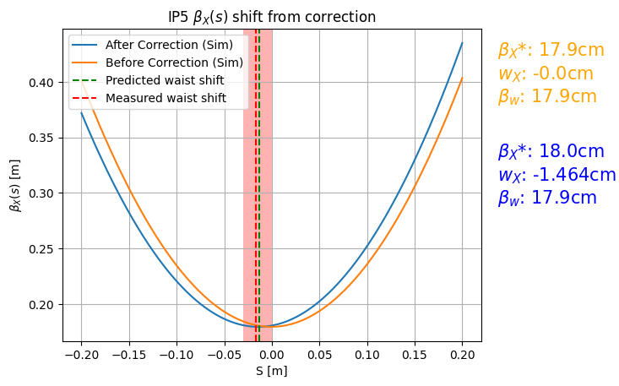
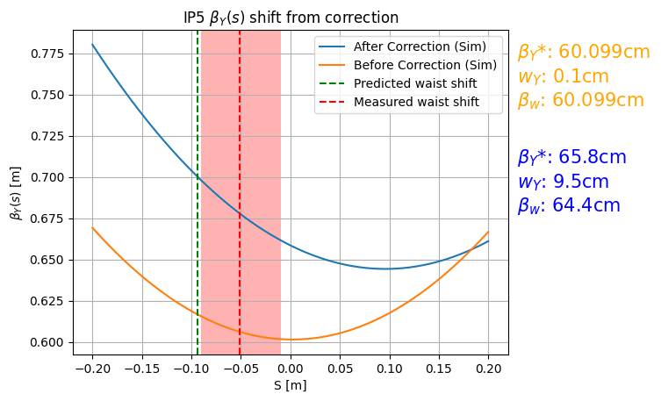
B1 IP5 Waist Shift X & Y
Graphed shift in beam 1 simulated β from global correction along with the waist shift in IP5. IP is at S = 0

Slide 9
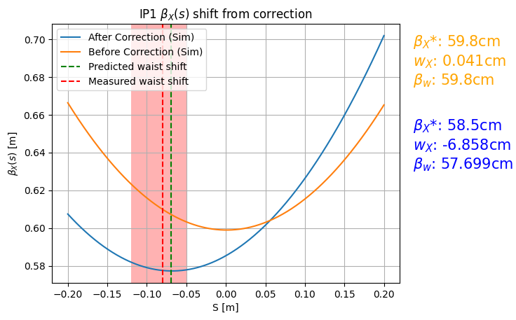
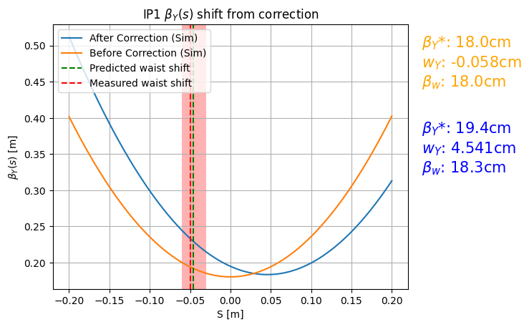
B2 IP1 Waist shift X & Y
Graphed shift in beam 2 simulated β from global correction along with the waist shift in IP1. IP is at S = 0

Slide 10
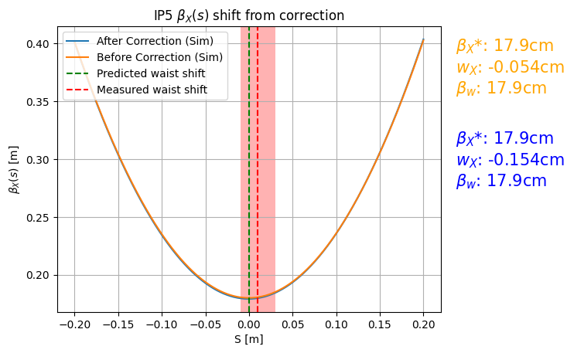
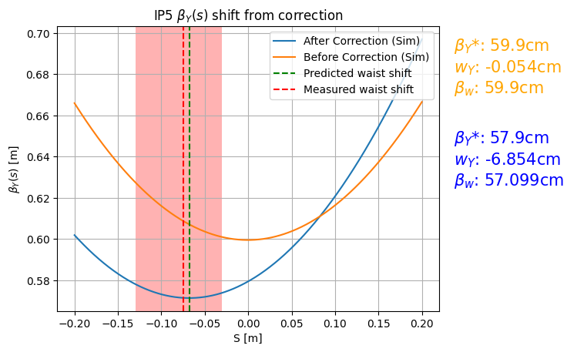
B2 IP5 Waist Shift X & Y
Graphed shift in beam 2 simulated β from global correction along with the waist shift in IP5

Slide 11
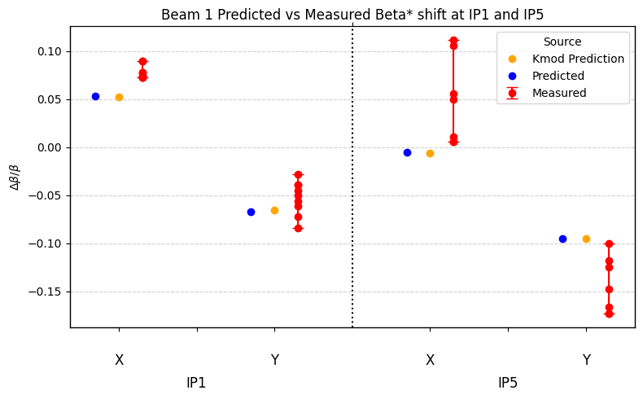
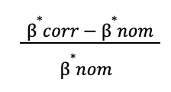
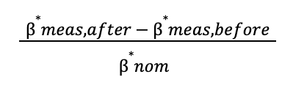
B1 Predicted vs Measured β* shift in IP1 and IP5
vs

Slide 12
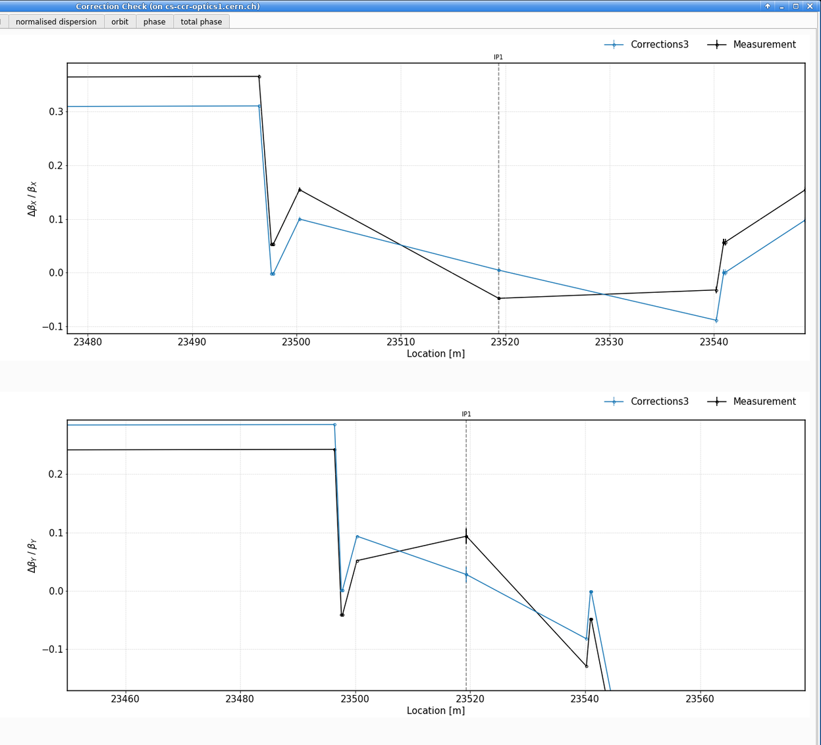
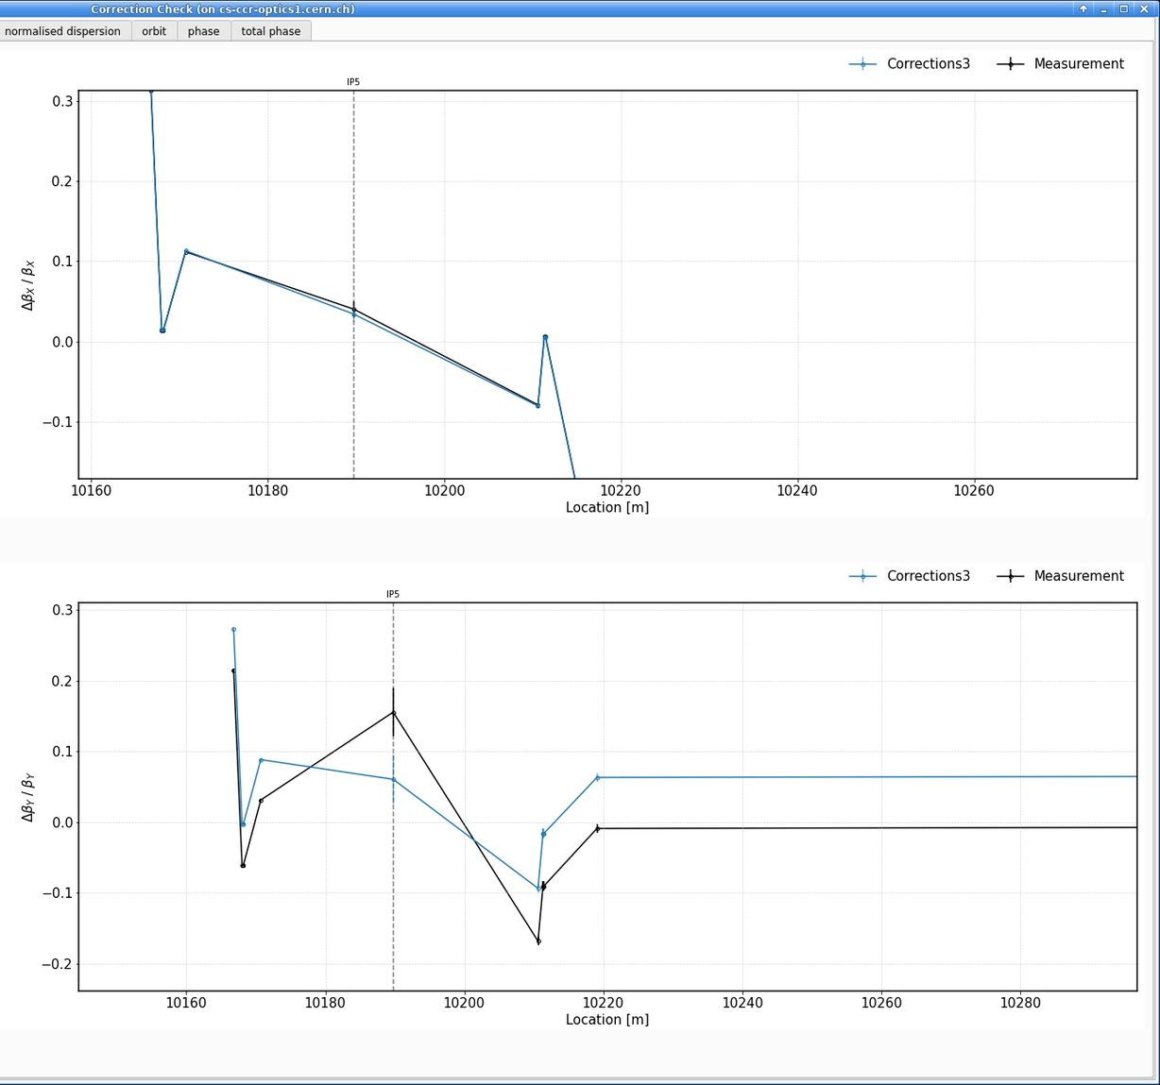
B1 Kmod β* Beating in IP1 and IP5

Slide 13
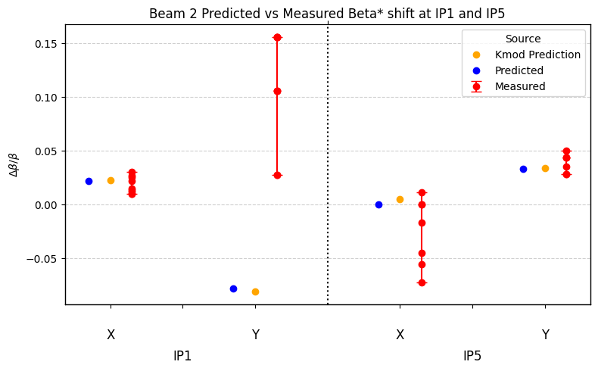
B2 Predicted vs Measured β* shift in IP1 and IP5
vs

Slide 14
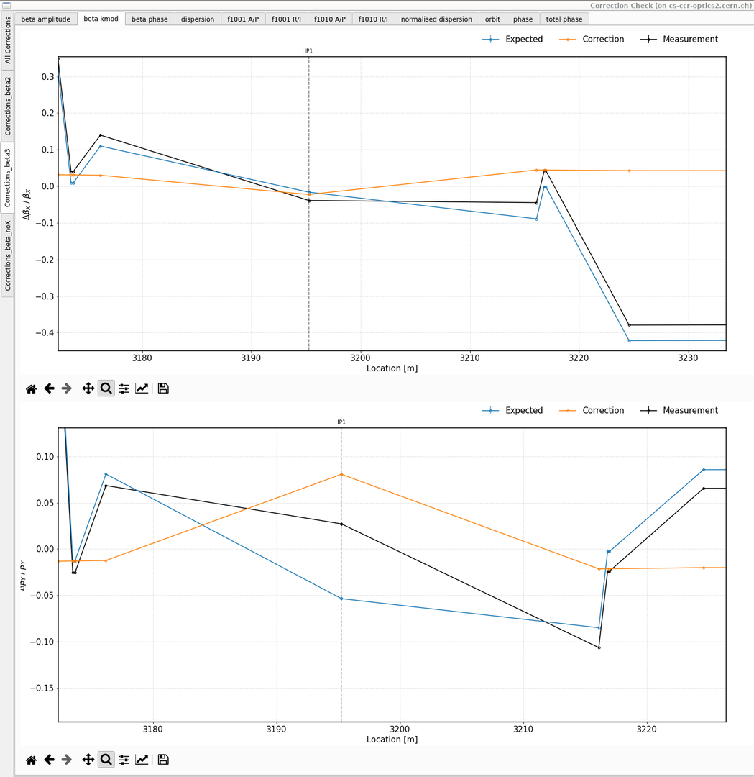
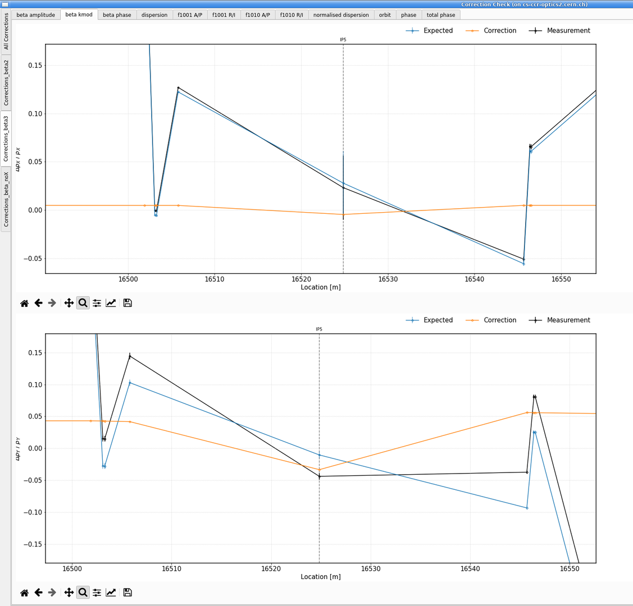
B2 Kmod β* Beating in IP1 and IP5

Slide 15
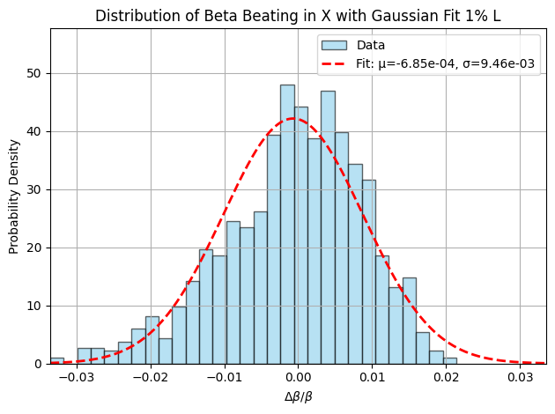
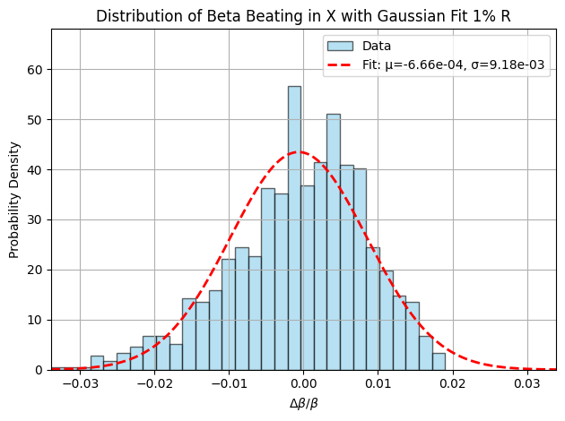
Additional Study
Study how changing k to create beta beating at the center of the quadrupoles affects the waist in an IP in simulation.
Added a random Δk with a gaussian distribution to induce 1%, 2%, 5%, 10% beta beating.

Slide 16
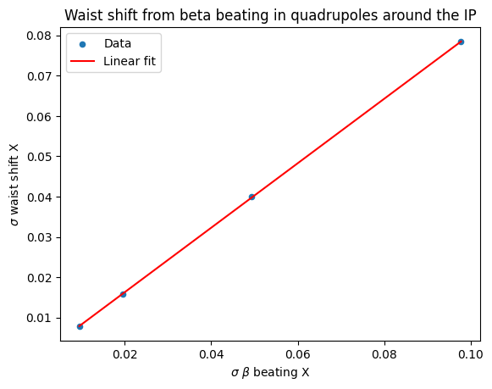
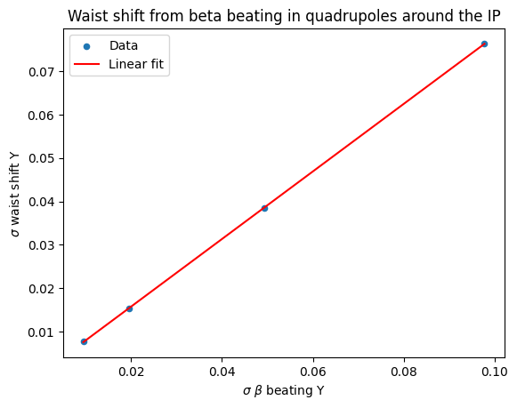
Waist shift summary over 4 tests

Slide 17
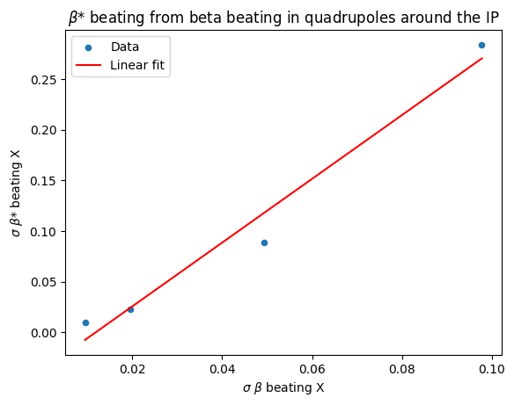
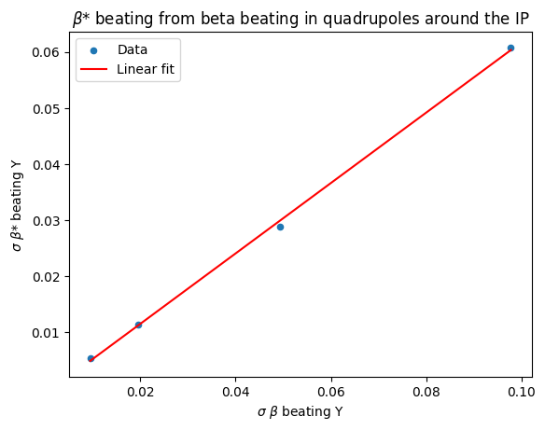
β* beating summary over 4 tests

Slide 18
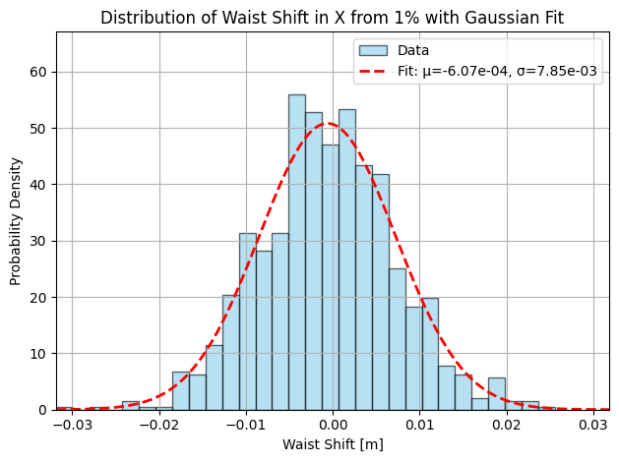
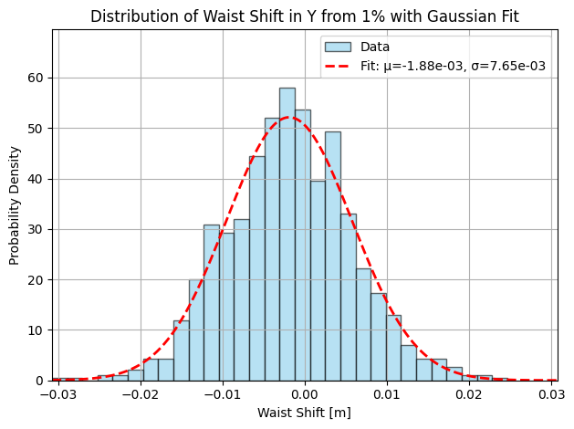
Waist shift from 1% beating in Quad

Slide 19
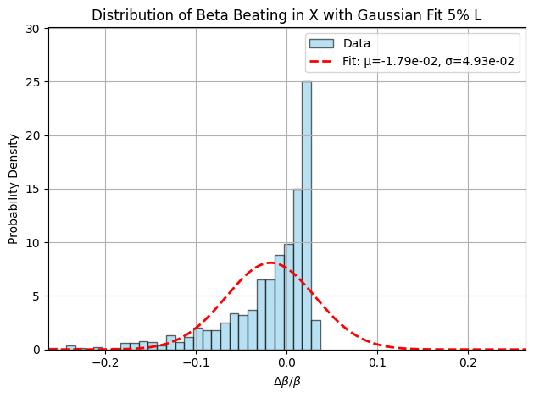
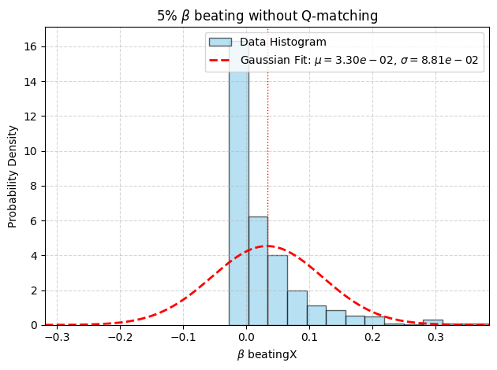
5% β beating with and without Q matching

Slide 20
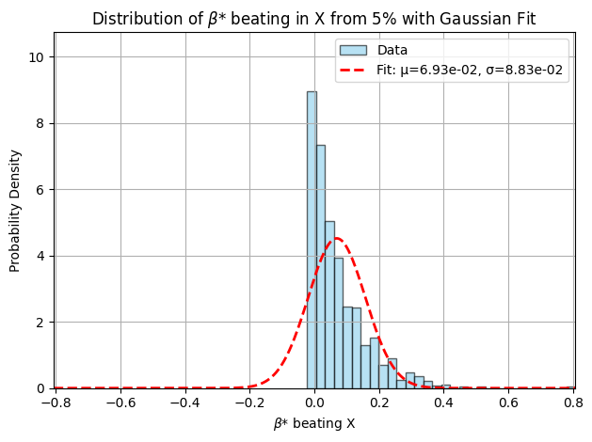
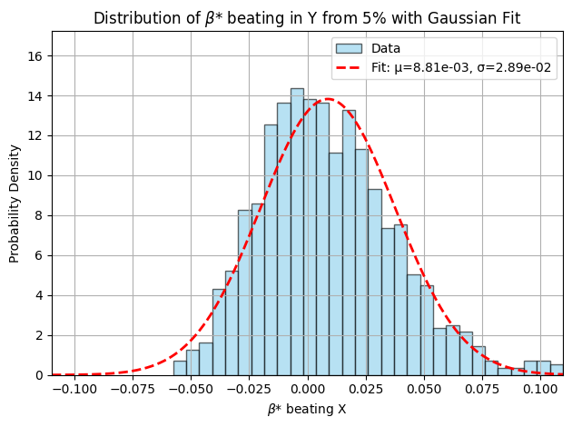
β* beating in from 5% beating in Quad

Slide 21
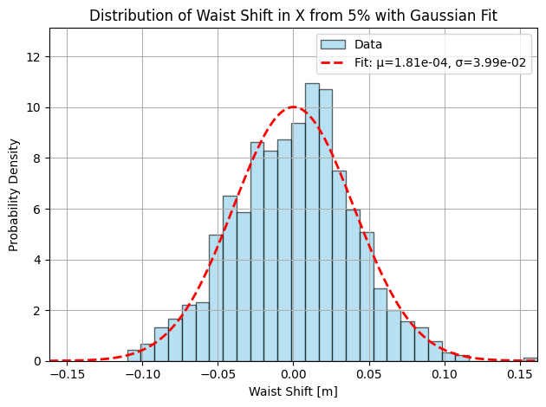
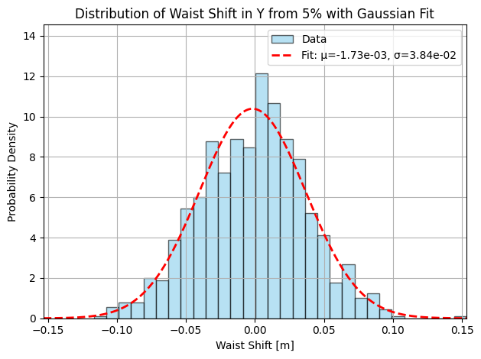
Waist shift from 5% β beating

Slide 22
Summary
MAD-X simulations vs measurements show good agreement in the waist shifts within the measurement error.
Agreement becomes less consistent when looking at the beta* beating in IP1x B2 and IP5y B1, the areas where we saw the worst β* beating.
Additional studies will have to be done to find out the cause of the disagreement between simulation and measurement in these IPs
In simulation, there is a linear relationship between the β beating at the center of the quadrupole and the waist shift and β* beating

Slide 23
Thanks for your attention

Slide 24
Backup slides

Slide 25
1% β beating in quad

Slide 26
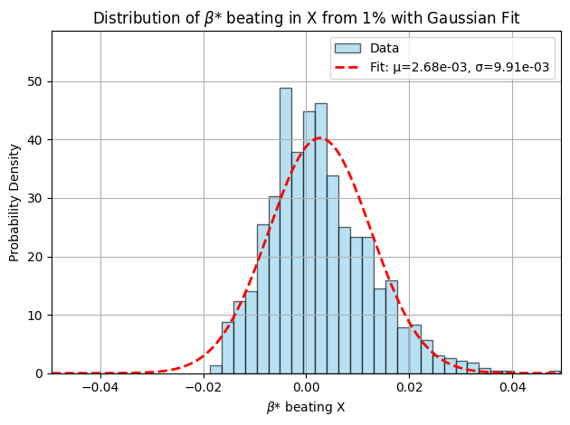
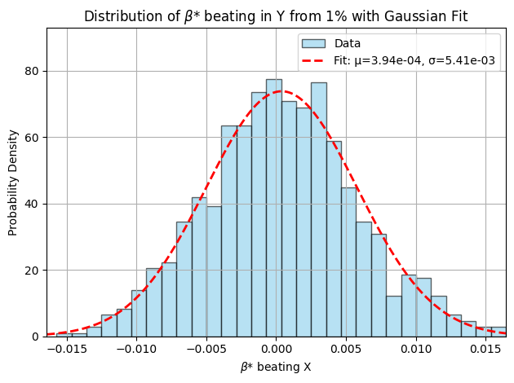
β* beating in from 1% beating in Quad

Slide 27
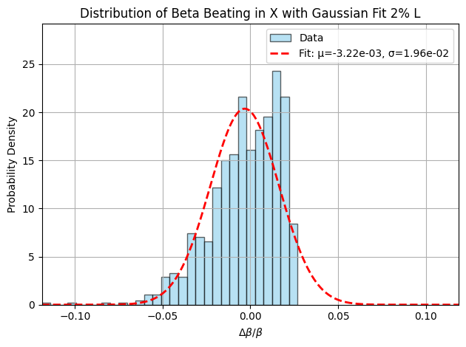
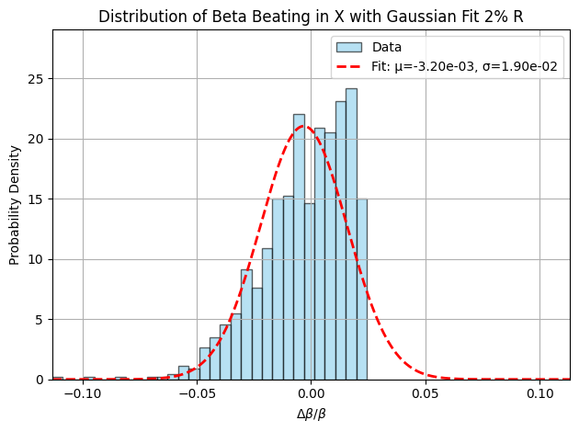
2% β beating in Quad

Slide 28
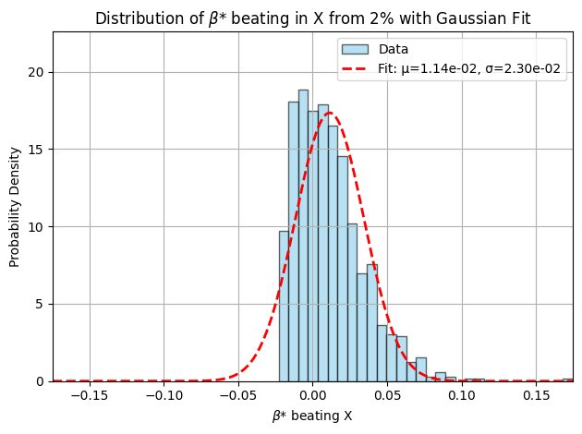
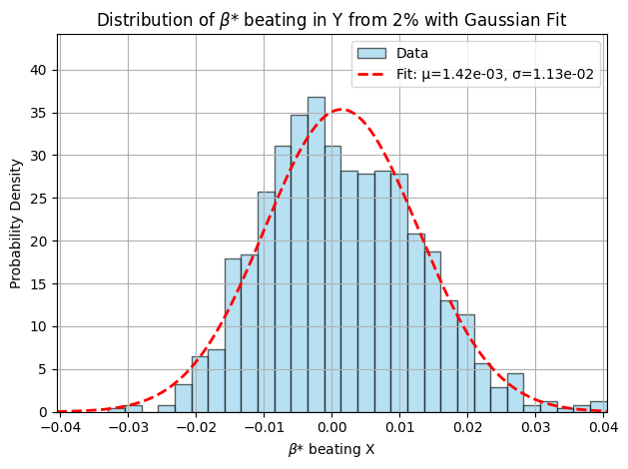
β* beating in from 2% beating in Quad

Slide 29
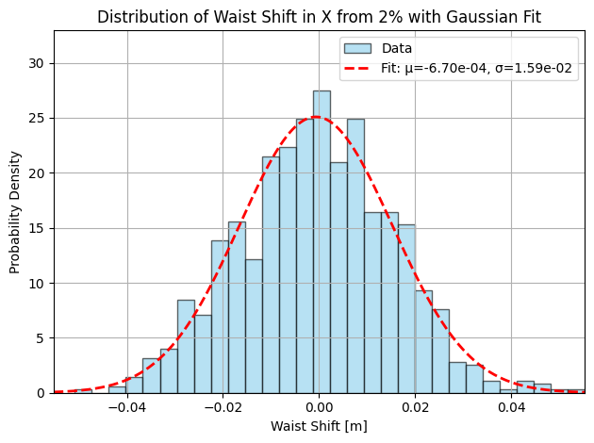
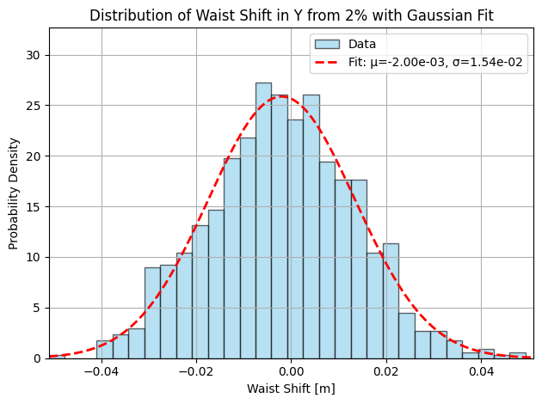
Waist shift from 2% β beating

Slide 30

5% β beating in Quad

Slide 31
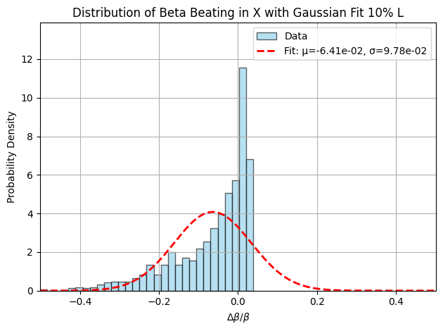

10% β beating in Quad

Slide 32
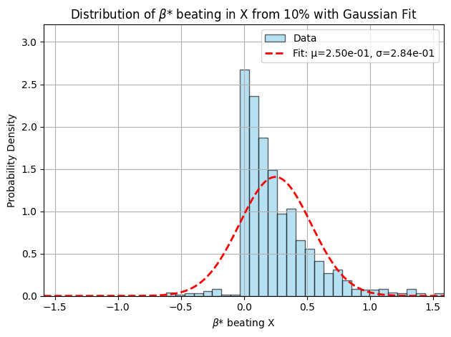
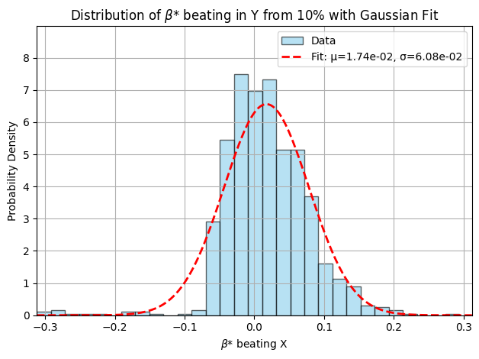
β* beating in from 10% beating in Quad

Slide 33
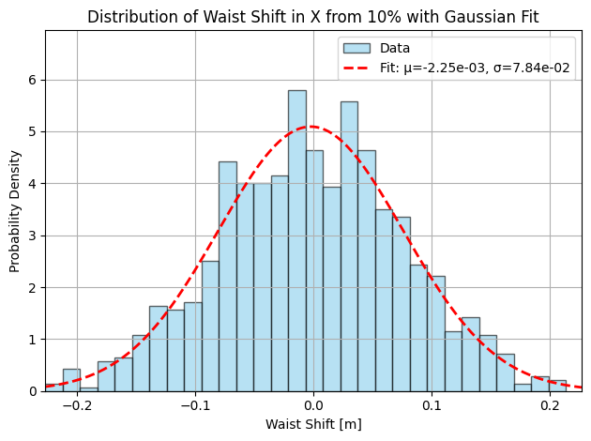
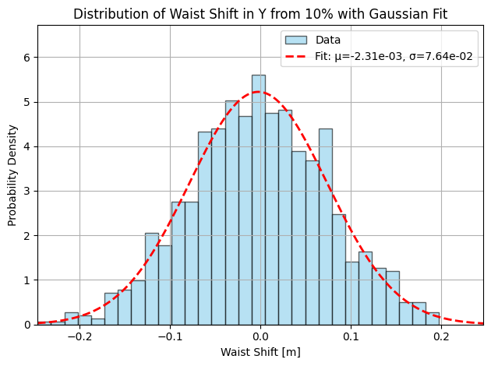
Waist shift from 10% beta beating

Slide 34
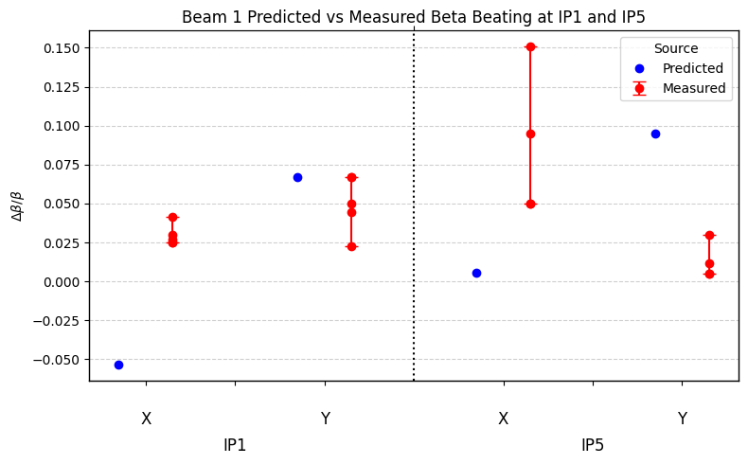
B1 Predicted vs Measured Beta*Beating in IP1 and IP5
Agreement between predicted and measured beta* beating is not good in beam 1.

Slide 35

B2 Predicted vs Measured Beta* Beating in IP1 and IP5
Agreement between predicted and measured beta* beating is better in beam 2.

