Slide 1
Off-Momentum Optics from 2025 Commissioning - UPDATED

Slide 2
Overview
Previous Presentation Summary
https://indico.cern.ch/event/1565777/contributions/6595301/attachments/3098658/5489845/OMC2025_04_07_2025_offmom_commissioning.pdf
Updates

Slide 3
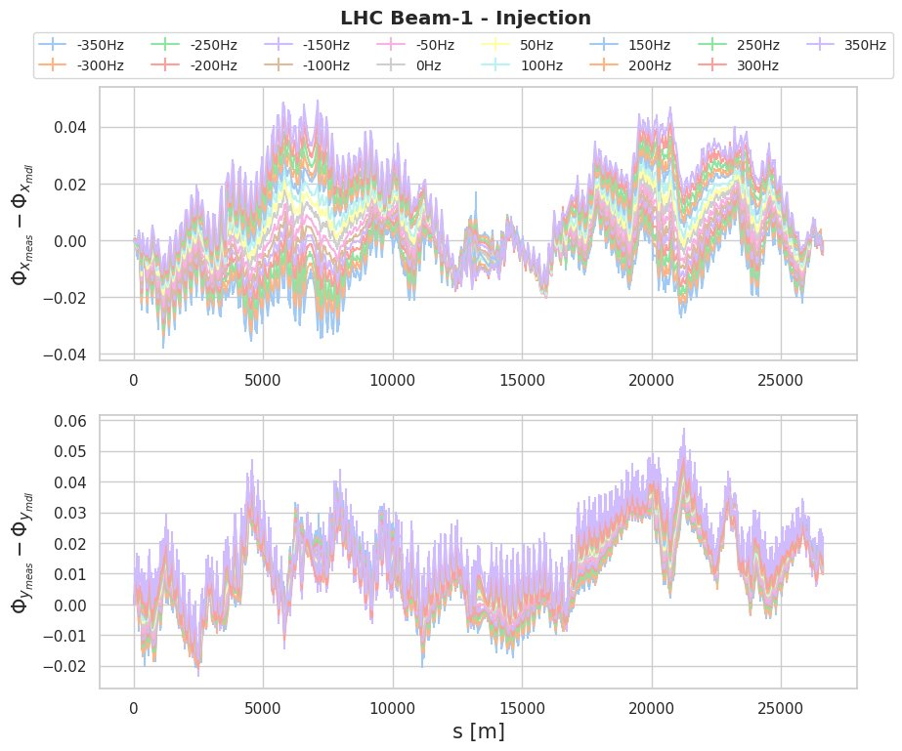
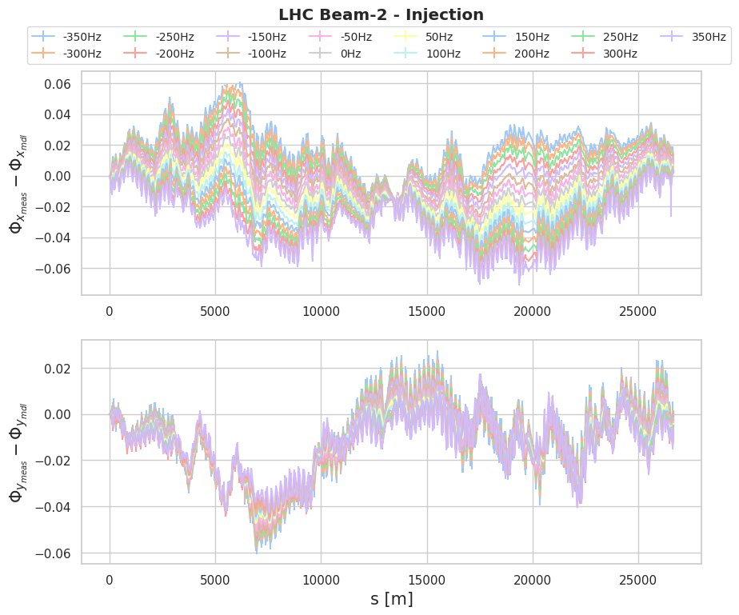
Chromatic Total Phase
Relevant horizontal phase variation with energy
Data: measured total phase – model total phase.

Slide 4
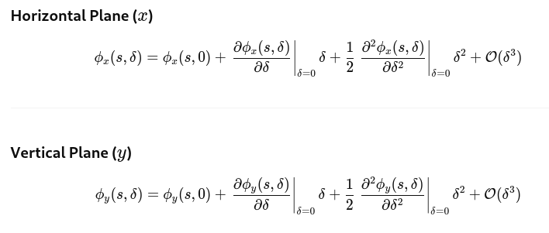
Chromatic Total Phase
Chromatic Total Phase («local chromaticity») could be defined as the variation of the phase with energy.
The approach has been identical to the previous case:
Phase measured at each BPM at different δs.
Fit with a second order polynomial function.
Linear and second order chromaticit total phase have been retrieved.

Slide 5

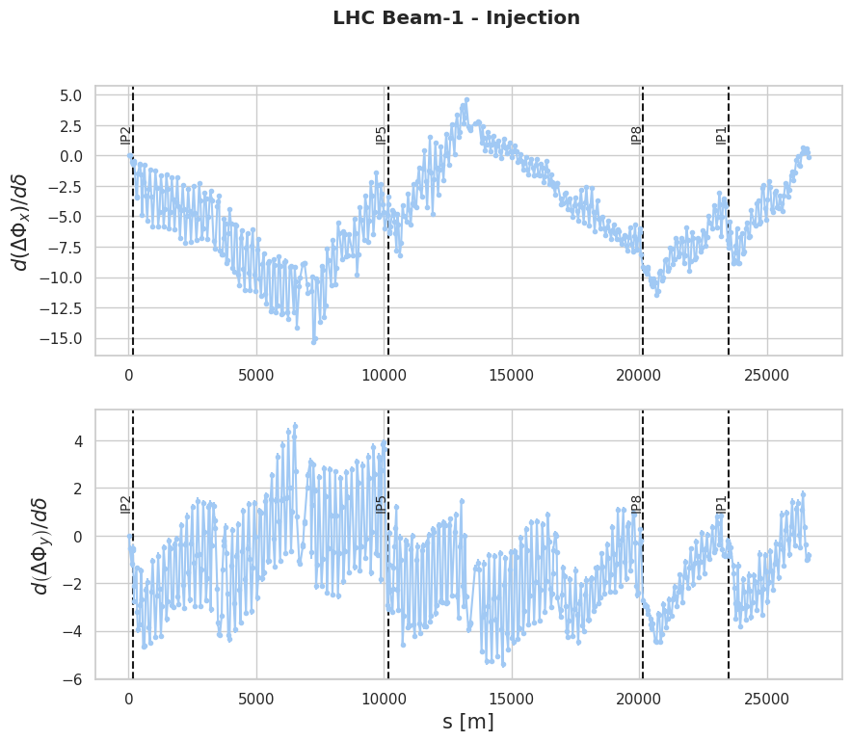
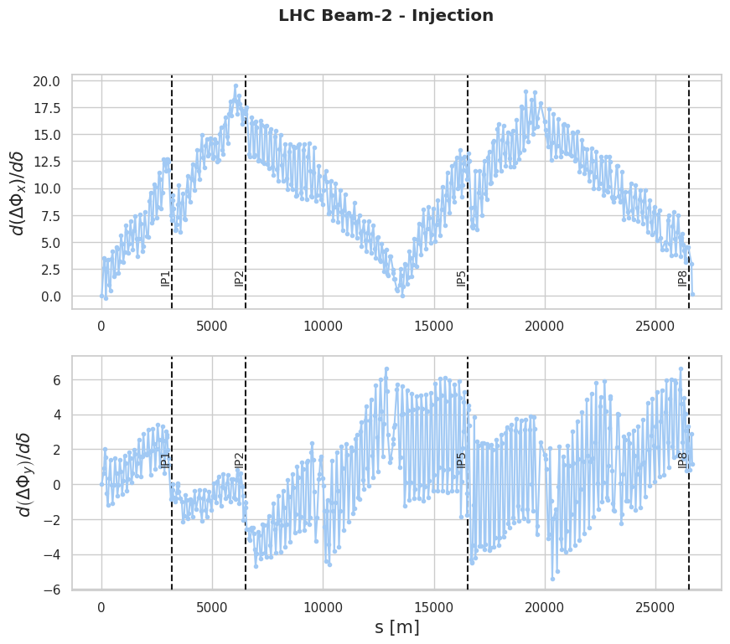

Chromatic Total Phase
Result: linear chromatic total phase $→$ clear different pattern for x and y plane.

Slide 6
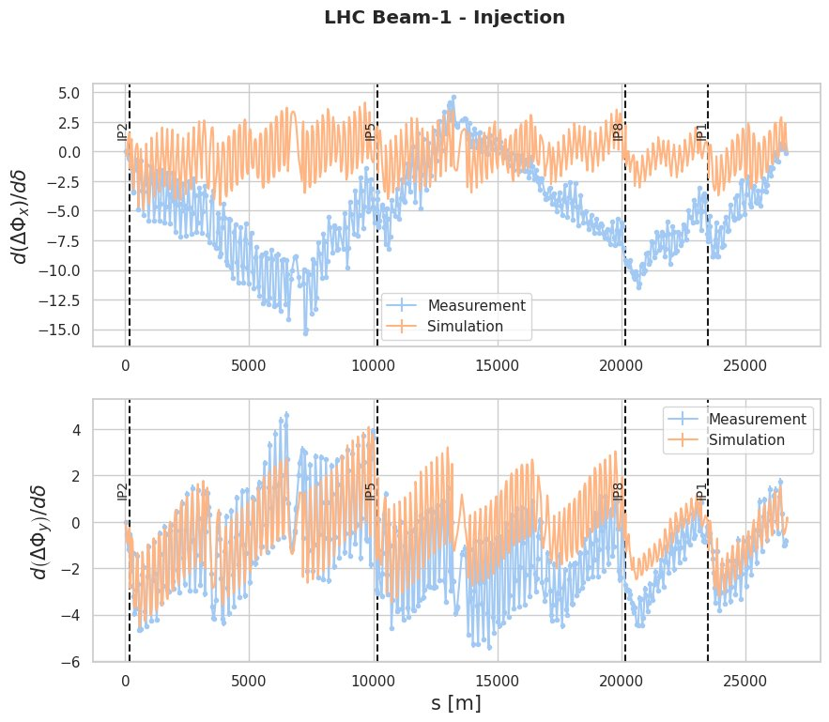
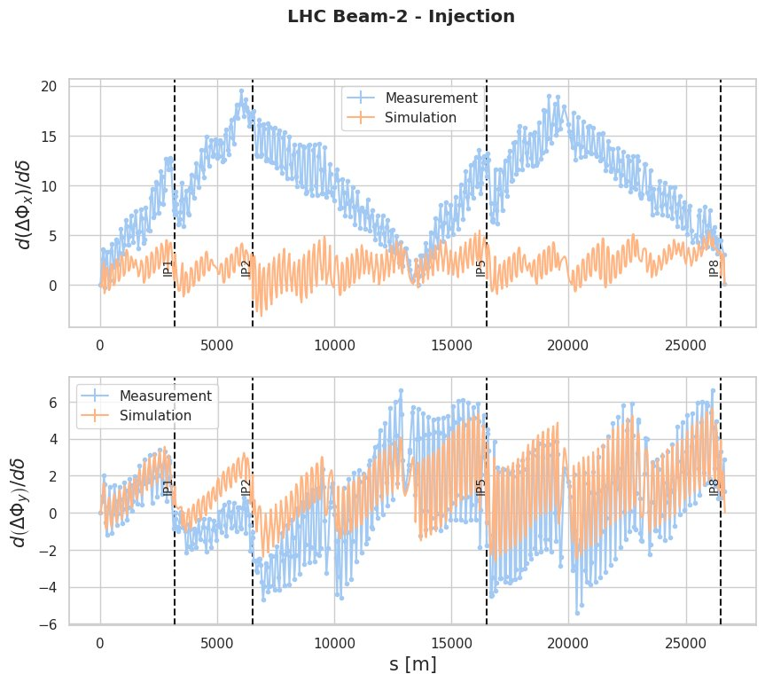

Chromatic Total Phase
Simulations have been performed to check on those differences $→$ to be investigated
Model path: /afs/cern.ch/work/m/mstefane/public/2025/Commissioning/2025-Large_dpp/Simulation/model2025.madx

Slide 7
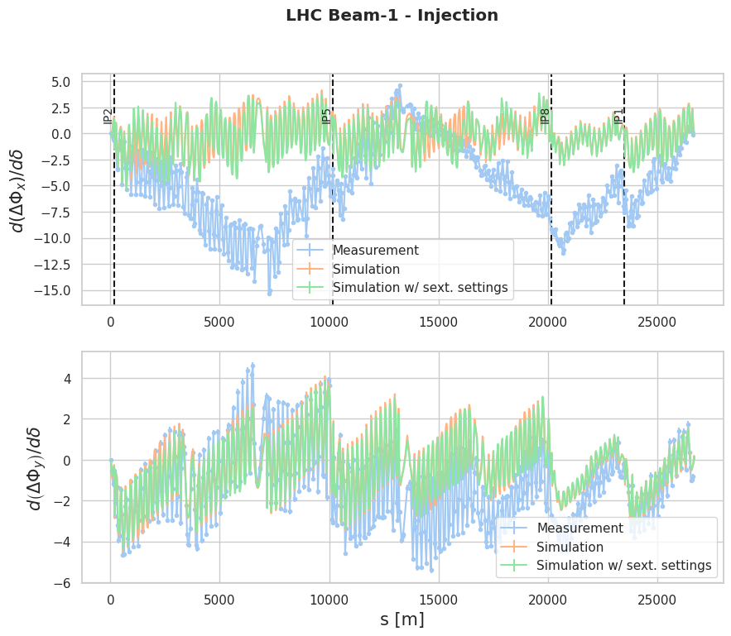
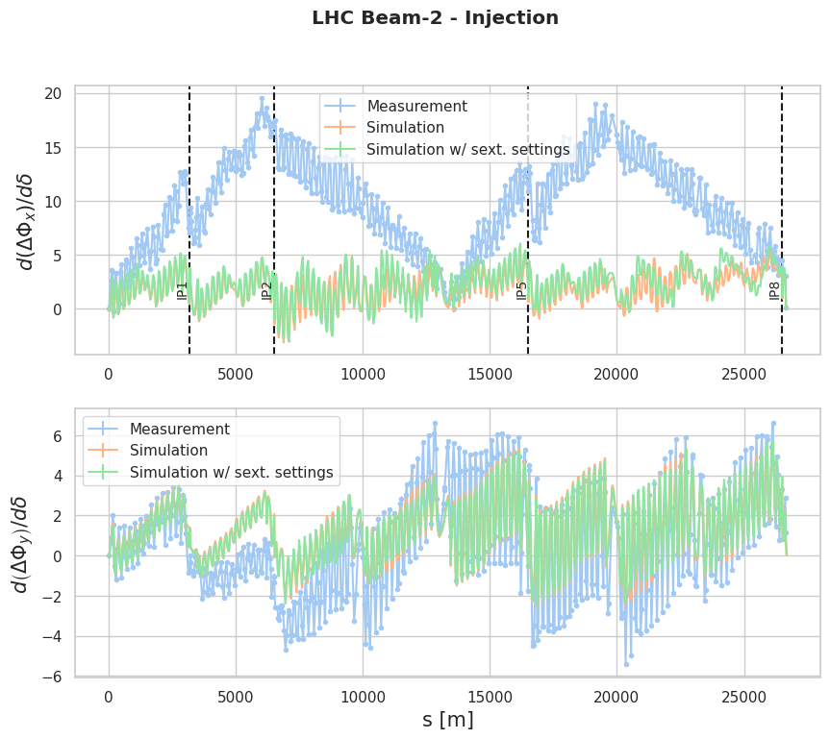
Chromatic Total Phase - UPDATES
The sextupole settings have been updated to the ones at the time of the measurement to check their effect on the simulation. This does not seem to explain the differences with respect to the measured «local chromaticity».
Local pattern is better matched, still not catching the greater modulation.

Slide 8
Thanks for your attention

Slide 9
Backup slides

Slide 10
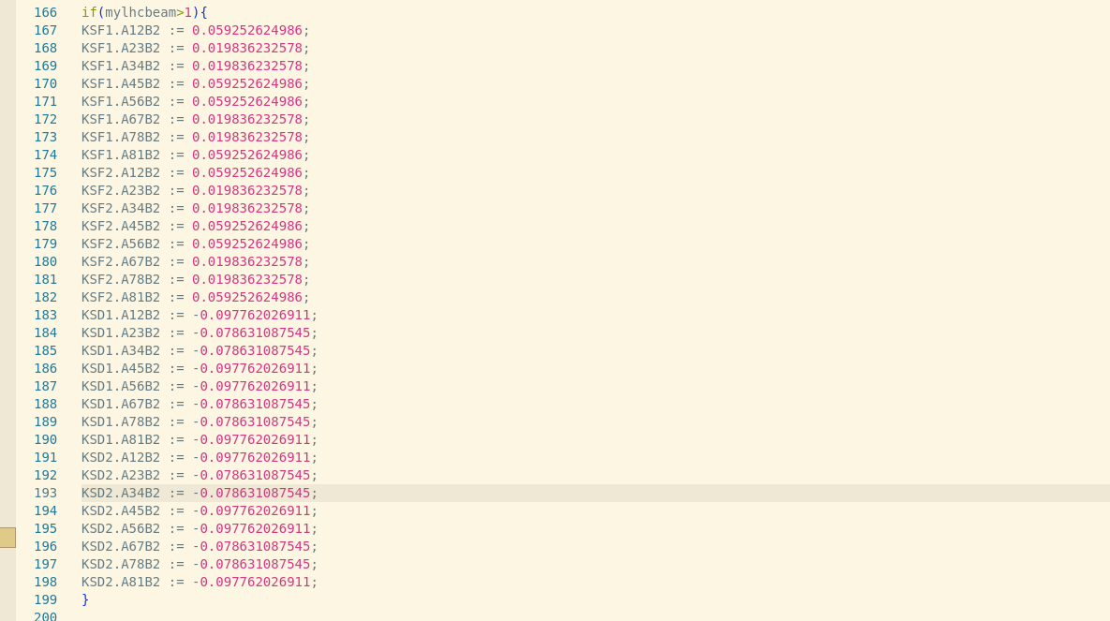
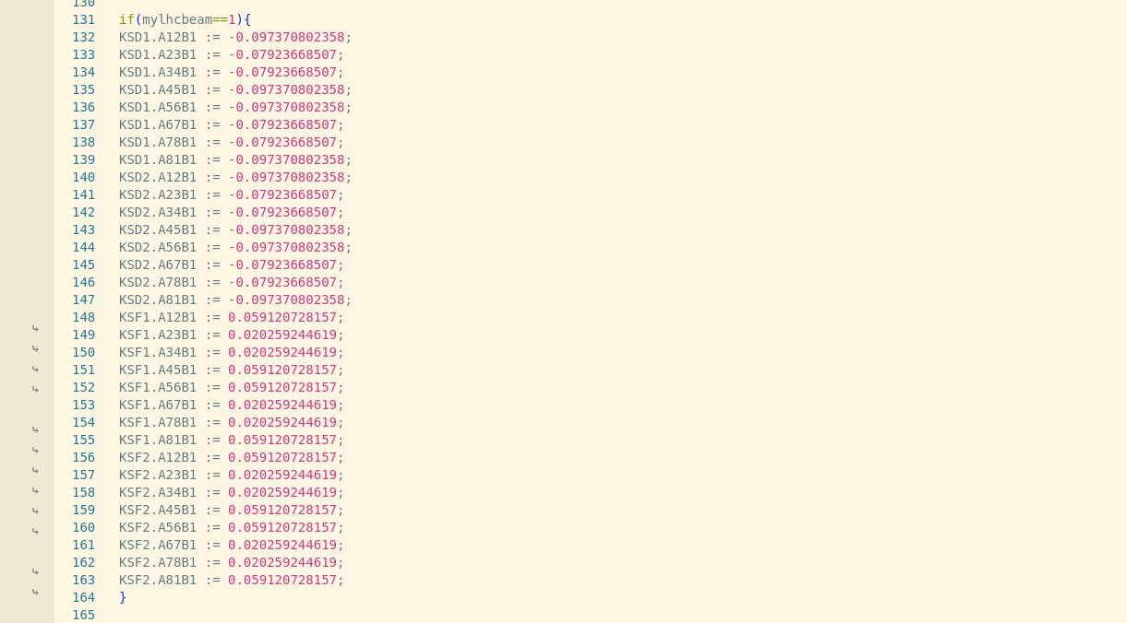
New MS settings

Slide 11
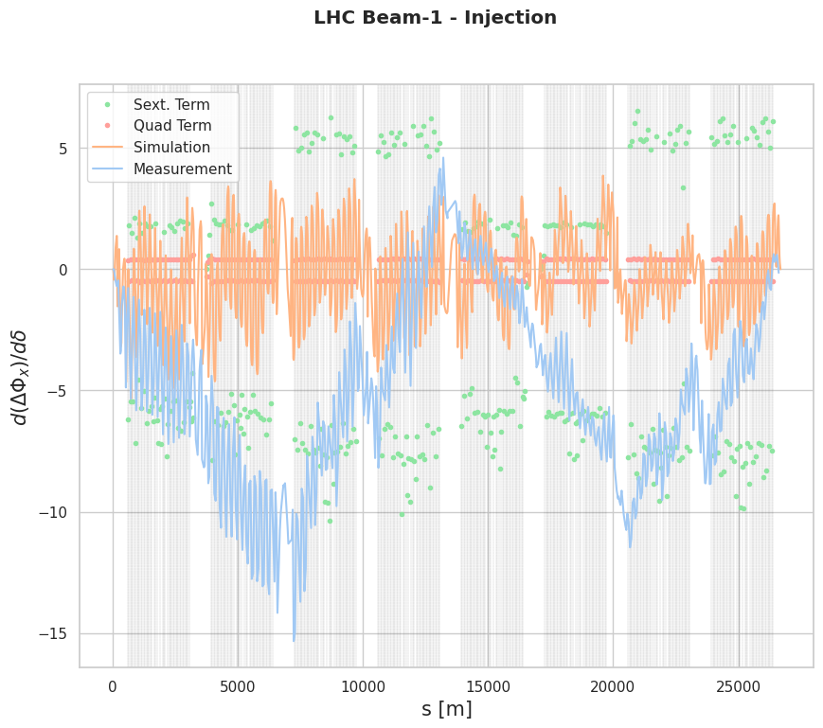
notes

