Slide 1
Weekly Update
Beam matching for helical FOFO muon cooling channels
Rithika Ganesan
07.16.2025

Slide 2
Goals from last week
Characterize (partial) procedure for matching with a solenoidal lattice
In-depth RF cavity studies
Investigate beam loss in the matching section
07.16.2025

Slide 3
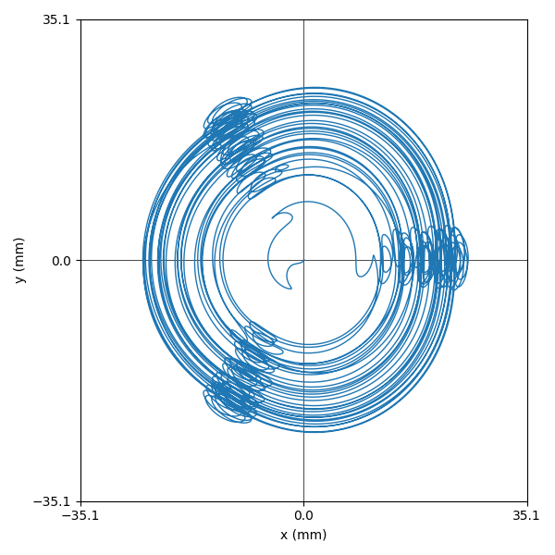
Matching study
Agenda
How do we…
Construct a lattice of solenoids that can generate this trajectory?
Find the ideal initial conditions to allow the trajectory?
Construct an appropriate matching section?
07.16.2025

Slide 4
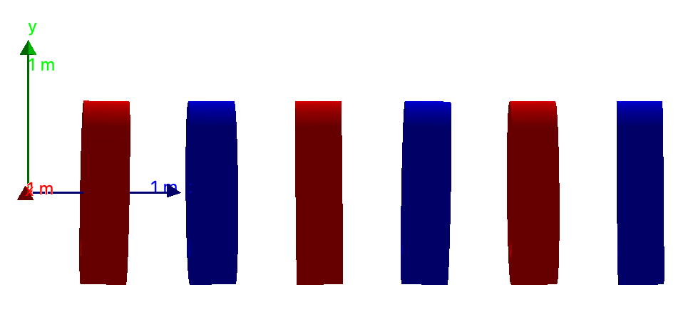


Test setup: extended lattice
Finding a helical orbit
5x
Z (mm)
500
1200
1900
2600
3300
4000
Pitch (${}^{o}$)
1
1
1
1
1
1
Roll (${}^{o}$)
0
120
240
0
120
240
07.16.2025

Slide 5
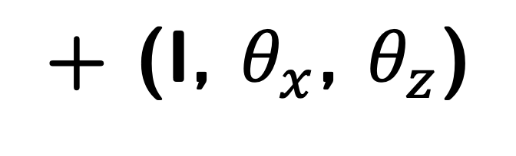
Matching study
Agenda
How do we…
Construct a lattice of solenoids that can generate this trajectory?
Find the ideal initial conditions to allow the trajectory?
Construct an appropriate matching section?
(x, y, z, px, py, pz)
+ (I, $θ_{x}$, $θ_{z}$)
07.16.2025

Slide 6
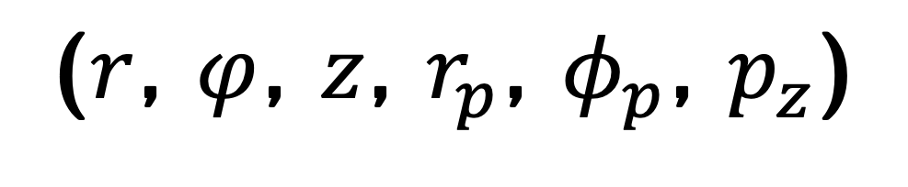
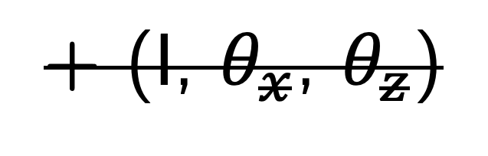
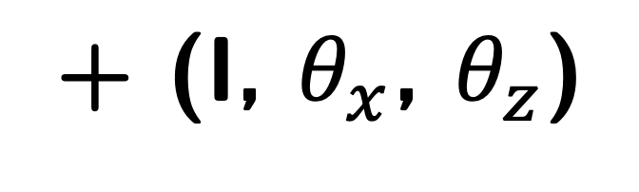
Matching study
Agenda
How do we…
Construct a lattice of solenoids that can generate this trajectory?
Find the ideal initial conditions to allow the trajectory?
Construct an appropriate matching section?
(x, y, z, px, py, pz)
+ (I, $θ_{x}$, $θ_{z}$)
($r$, $φ$, $z$, $r_{p}$, $φ_{p}$, $p_{z}$)
+ (I, $θ_{x}$, $θ_{z}$)
07.16.2025

Slide 7
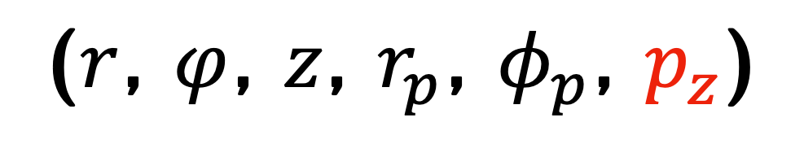
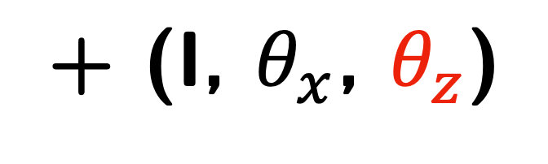
Matching study
Agenda
How do we…
Construct a lattice of solenoids that can generate this trajectory?
Find the ideal initial conditions to allow the trajectory?
Construct an appropriate matching section?
(x, y, z, px, py, pz)
+ (I, $θ_{x}$, $θ_{z}$)
($r$, $φ$, $z$, $r_{p}$, $φ_{p}$, $p_{z}$)
+ (I, $θ_{x}$, $θ_{z}$)
07.16.2025

Slide 8
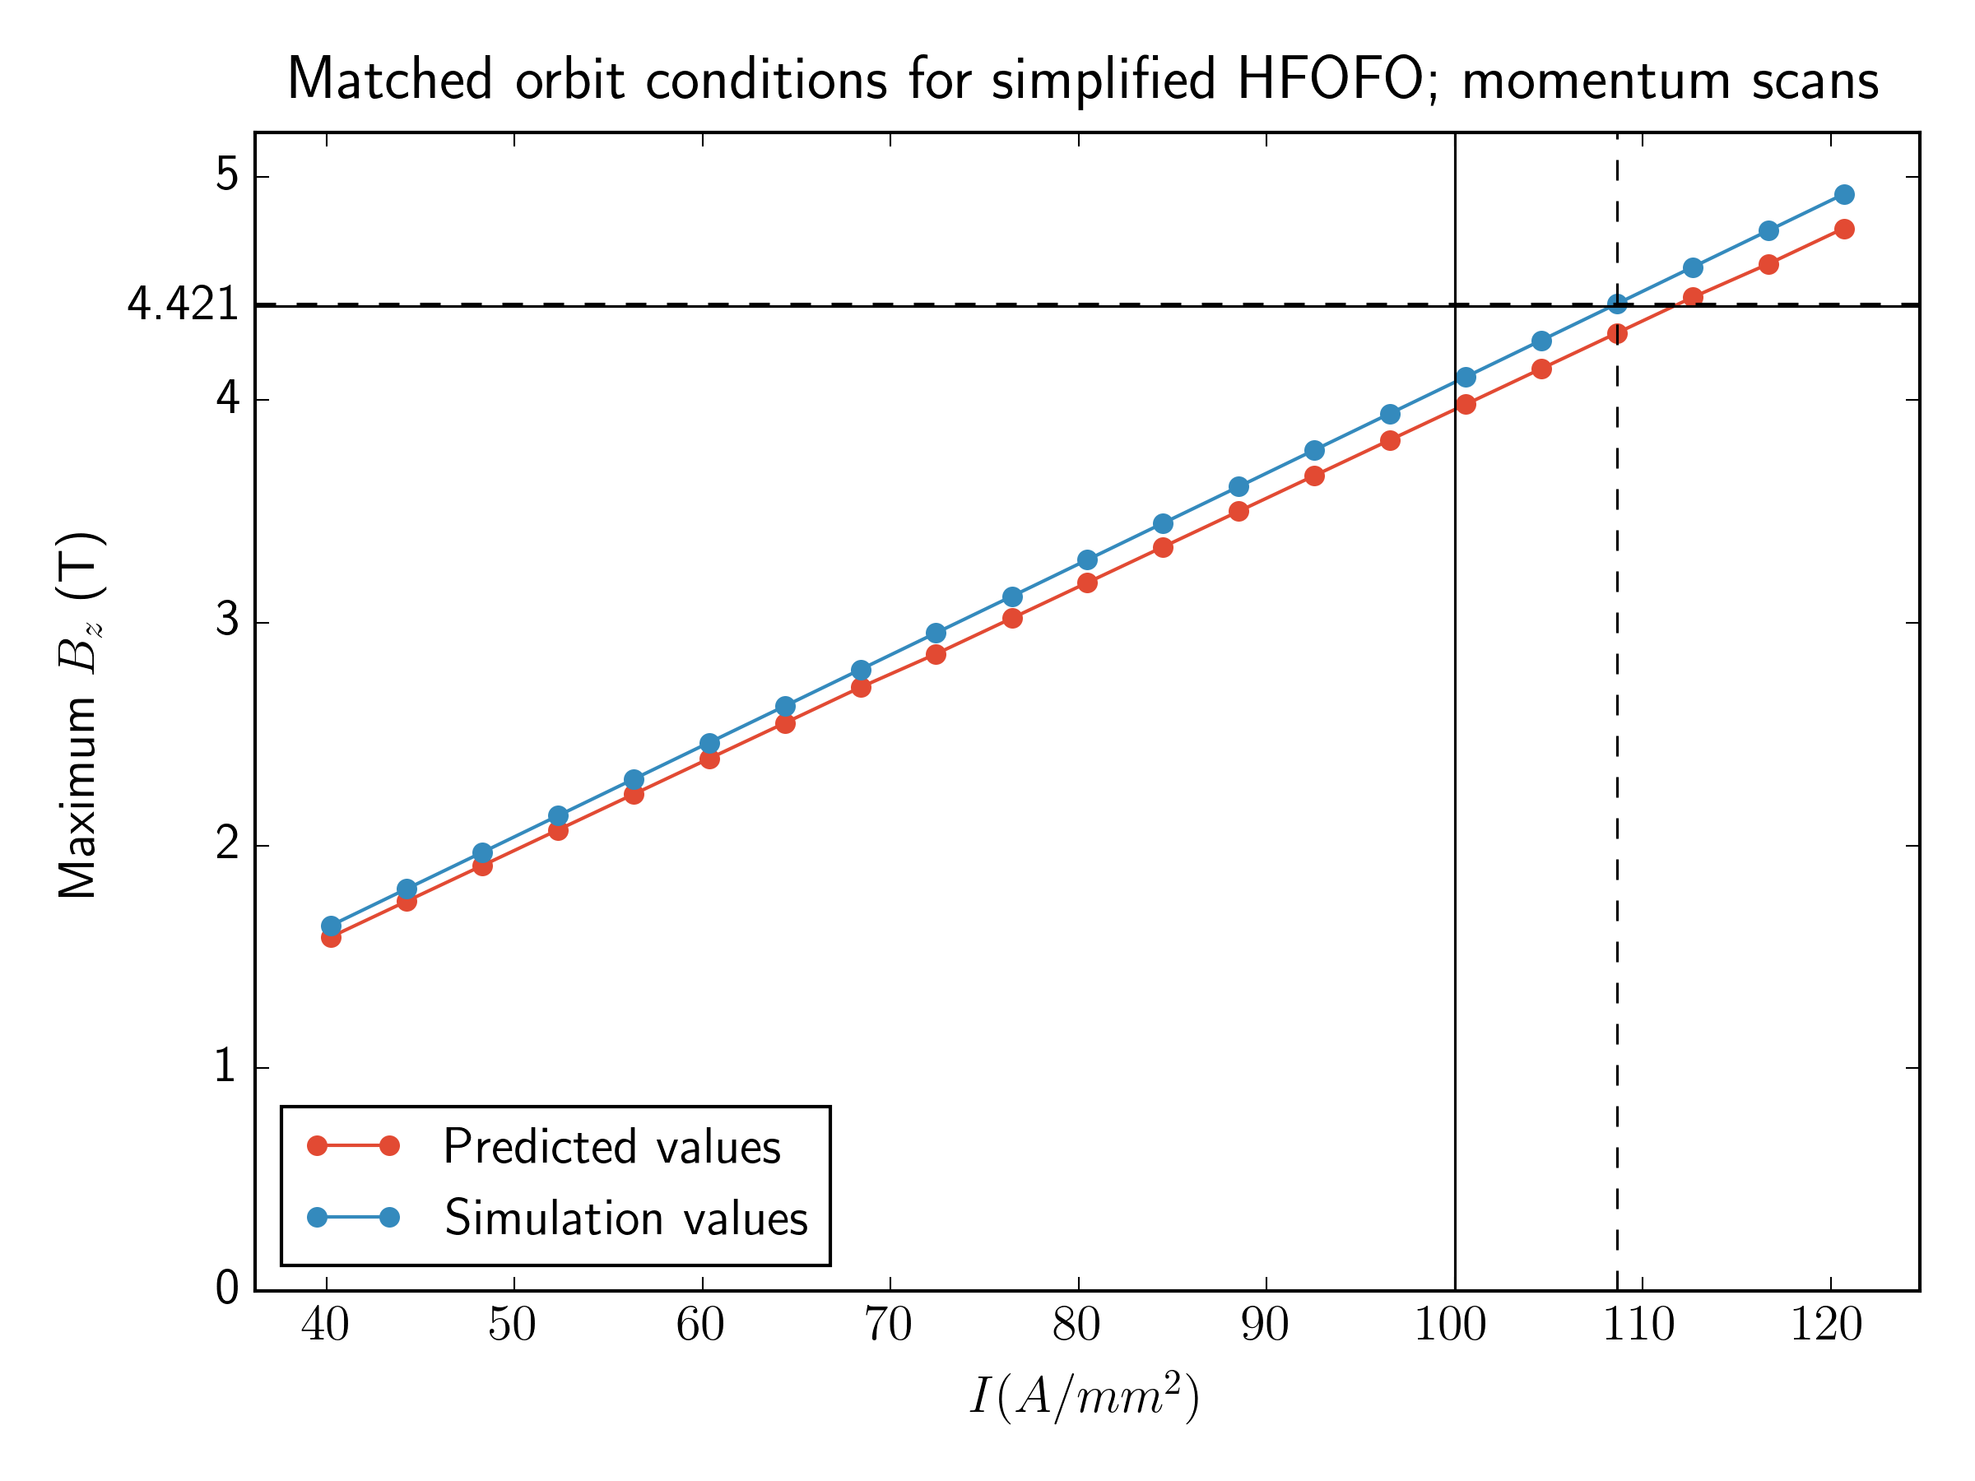
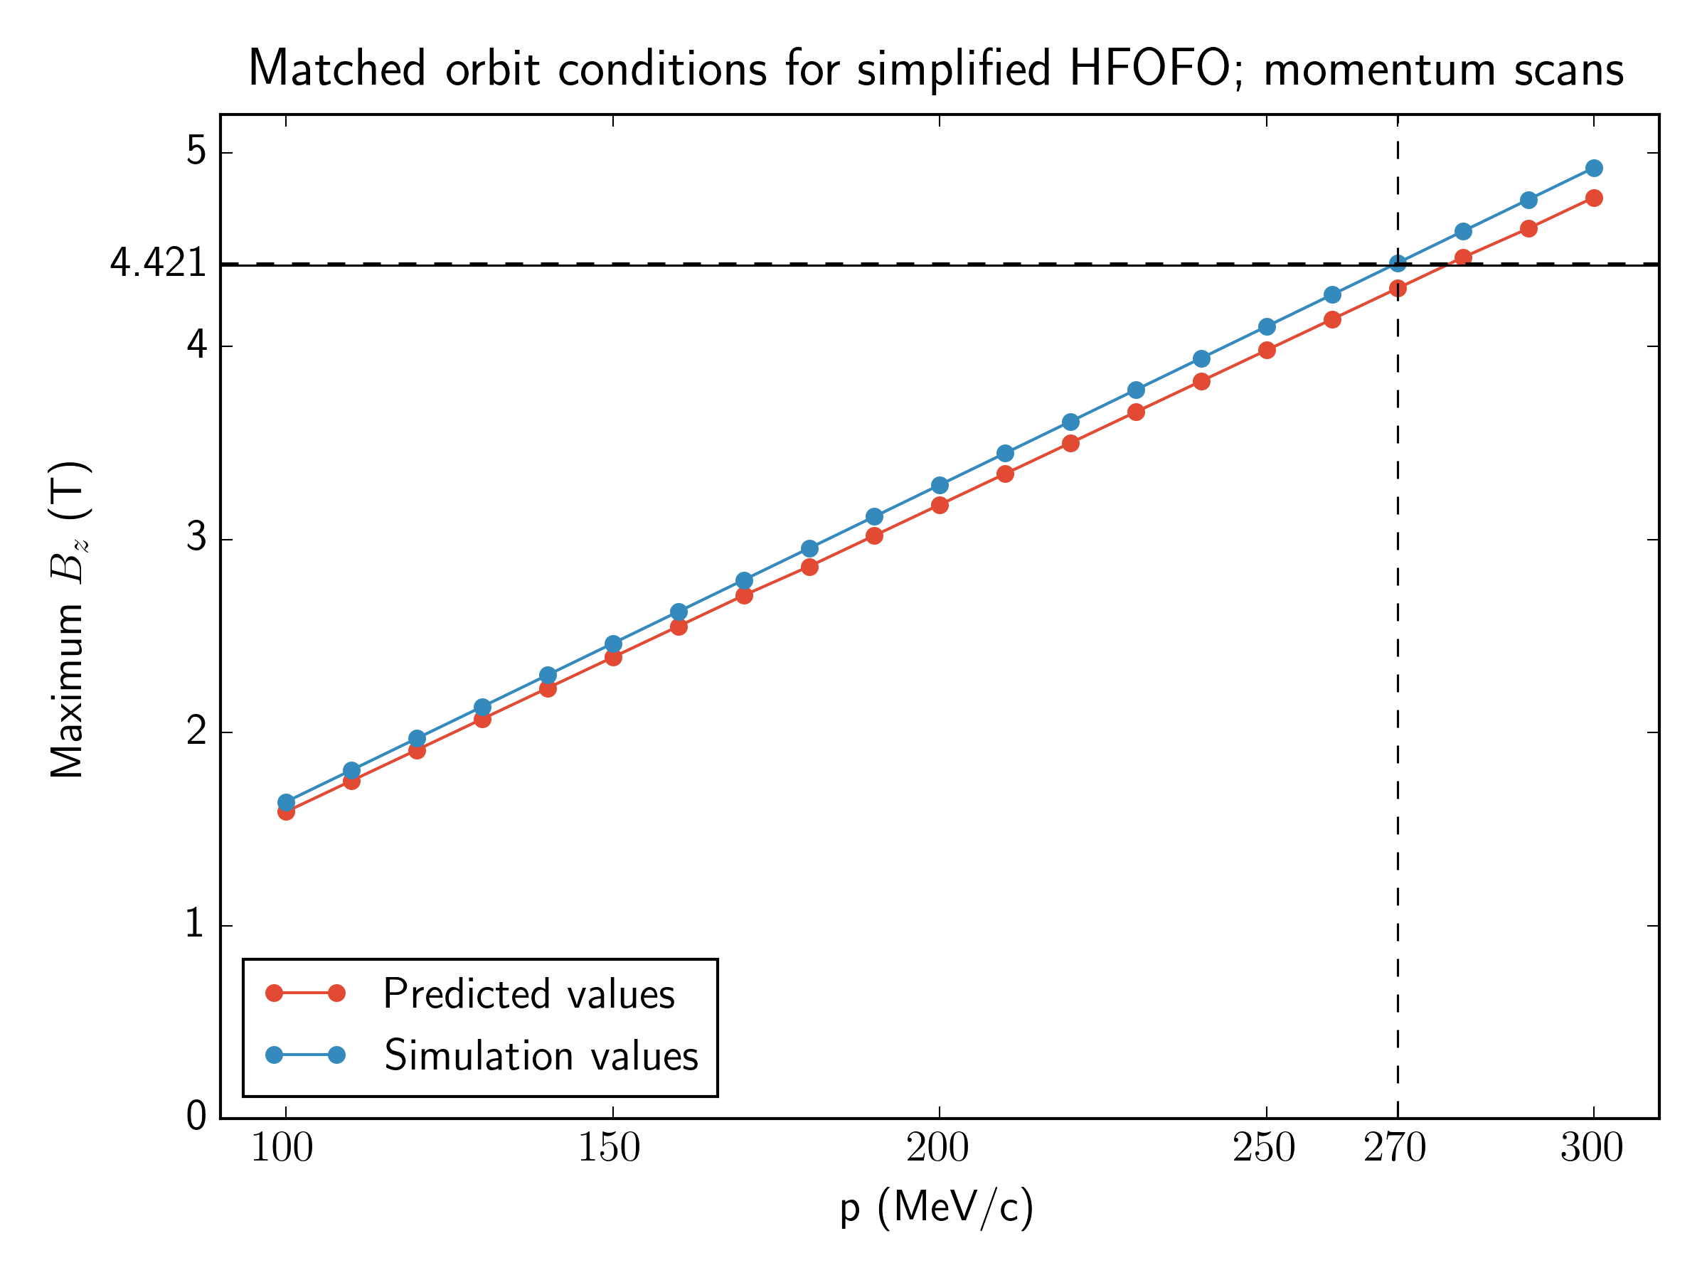
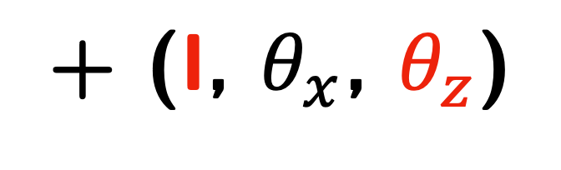

B-field values for different initial momenta
Finding lattice parameters
Relationship between solenoid currents and pz
($r$, $φ$, $z$, $r_{p}$, $φ_{p}$, $p_{z}$)
+ (I, $θ_{x}$, $θ_{z}$)
07.16.2025

Slide 9
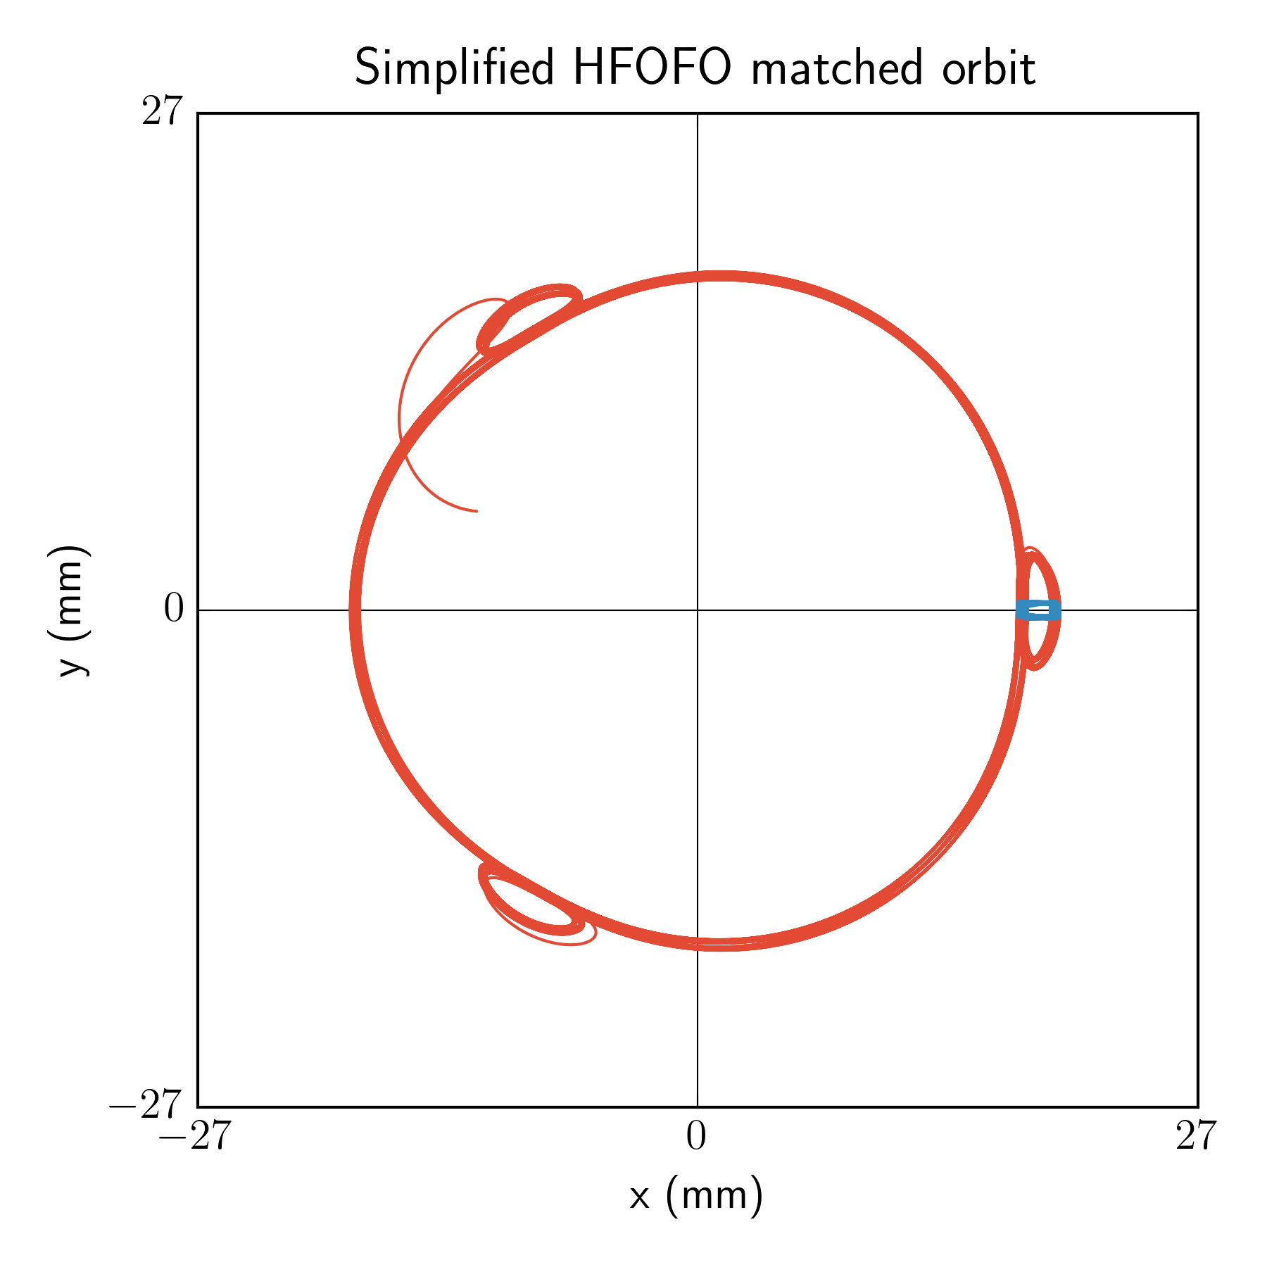
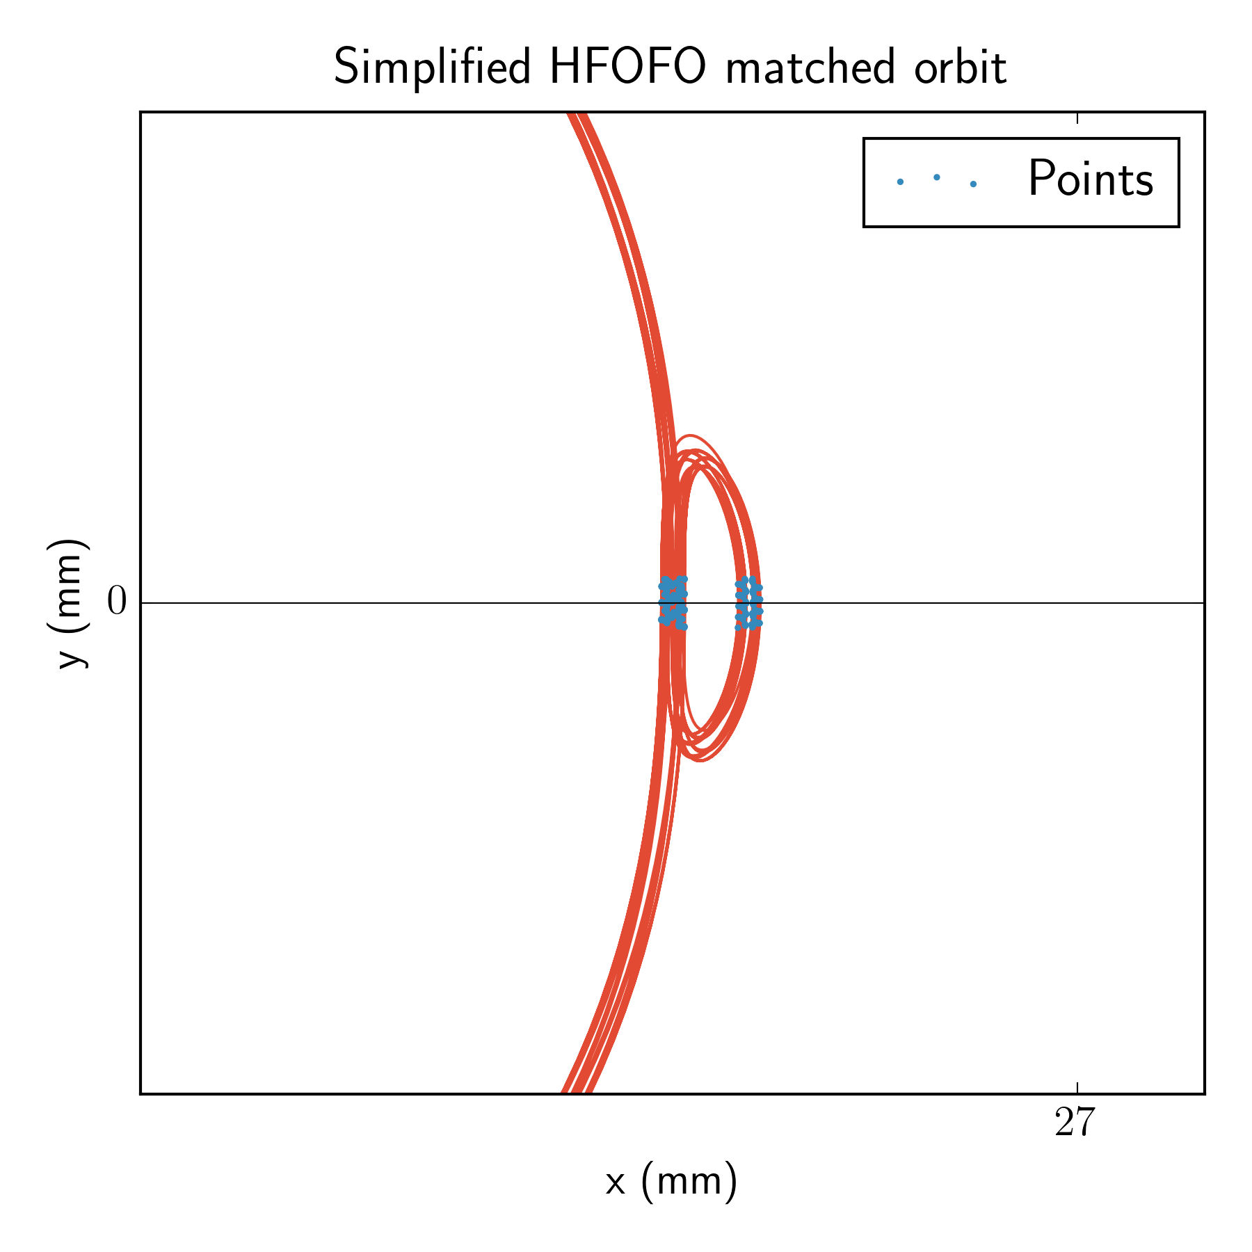
$φ$ in the transverse plane: simplified HFOFO
Finding initial conditions
07.16.2025

Slide 10
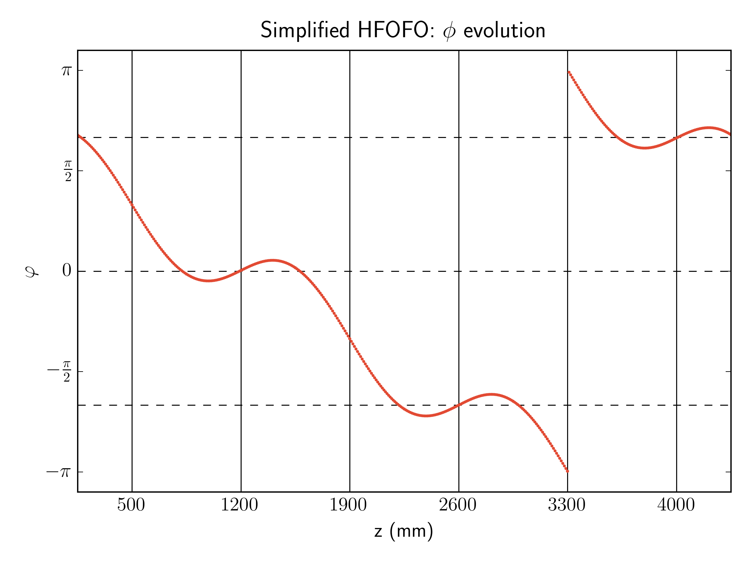
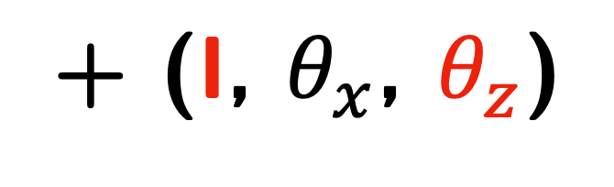
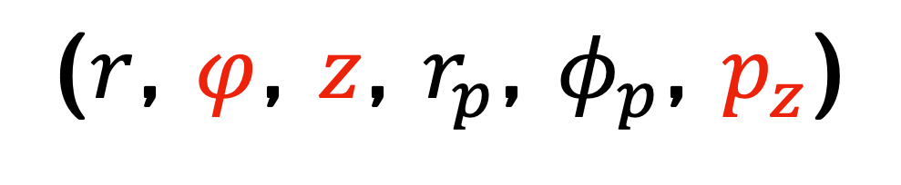
$φ$ in the transverse plane: simplified HFOFO
Finding initial conditions
($r$, $φ$, $z$, $r_{p}$, $φ_{p}$, $p_{z}$)
+ (I, $θ_{x}$, $θ_{z}$)
07.16.2025

Slide 11
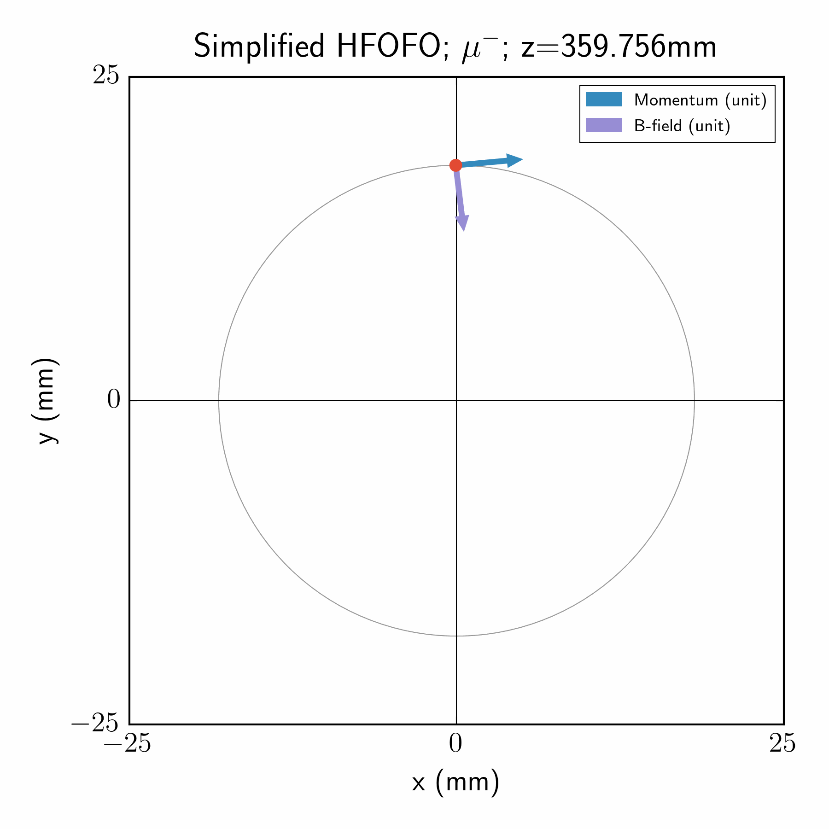

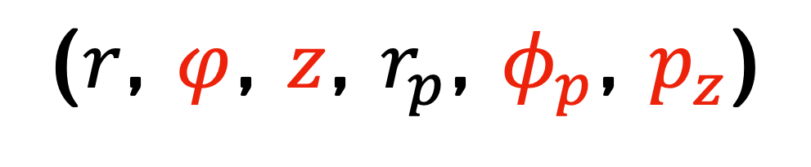
$φ_{B}$ in the transverse plane: simplified HFOFO
Finding initial conditions
($r$, $φ$, $z$, $r_{p}$, $φ_{p}$, $p_{z}$)
+ (I, $θ_{x}$, $θ_{z}$)
07.16.2025

Slide 12
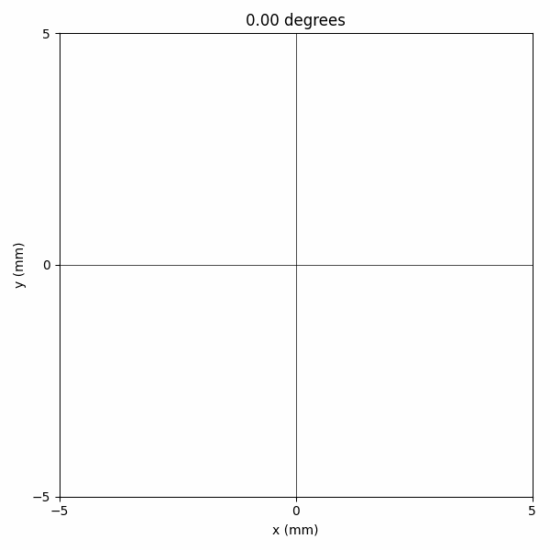


$φ_{B}$ in the transverse plane: simplified HFOFO
Finding initial conditions
($r$, $φ$, $z$, $r_{p}$, $φ_{p}$, $p_{z}$)
+ (I, $θ_{x}$, $θ_{z}$)
07.16.2025

Slide 13
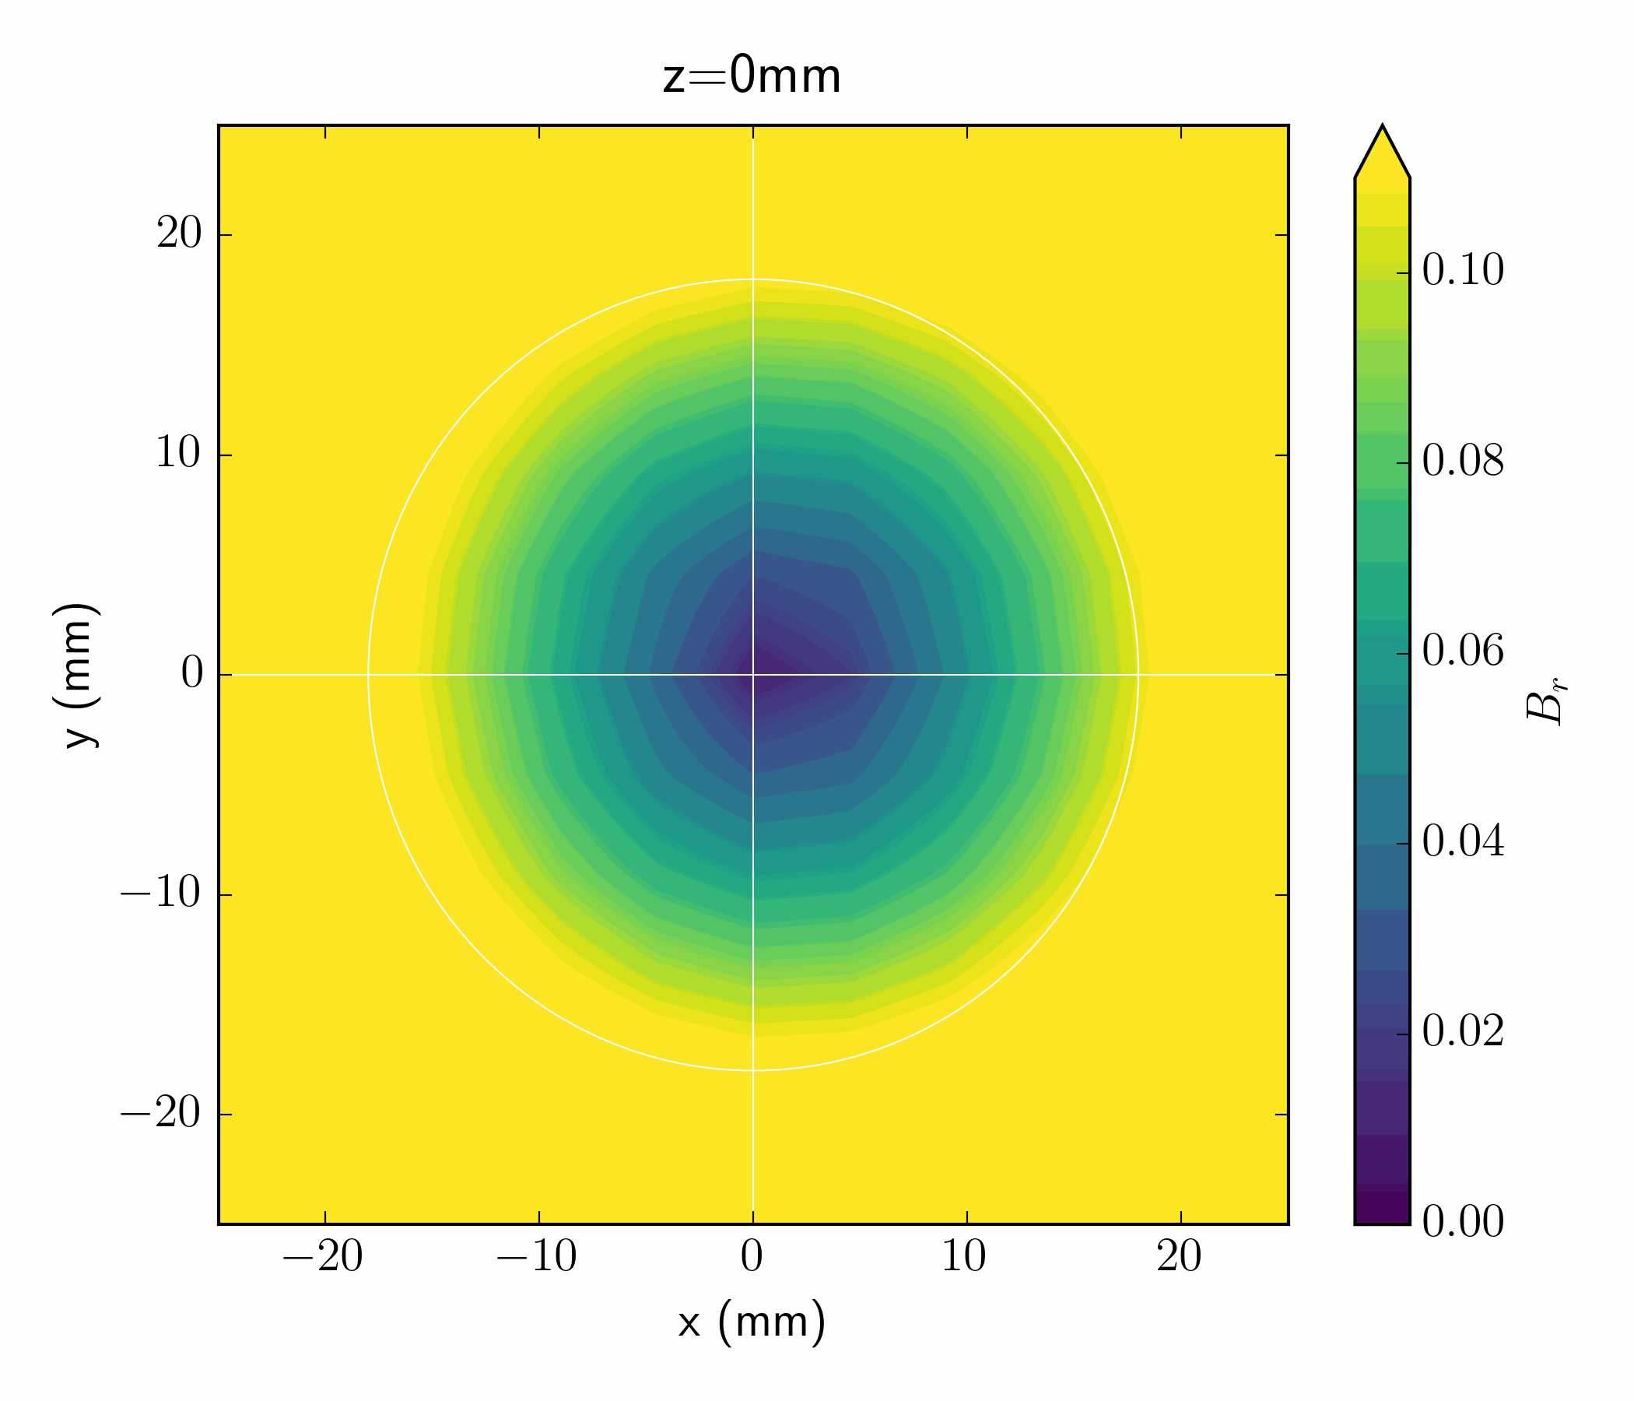
Transverse B-field radial component

Slide 14
Matching study
Agenda
How do we…
Construct a lattice of solenoids that can generate this trajectory?
Find the ideal initial conditions to allow the trajectory?
Construct an appropriate matching section?
07.16.2025

Slide 15
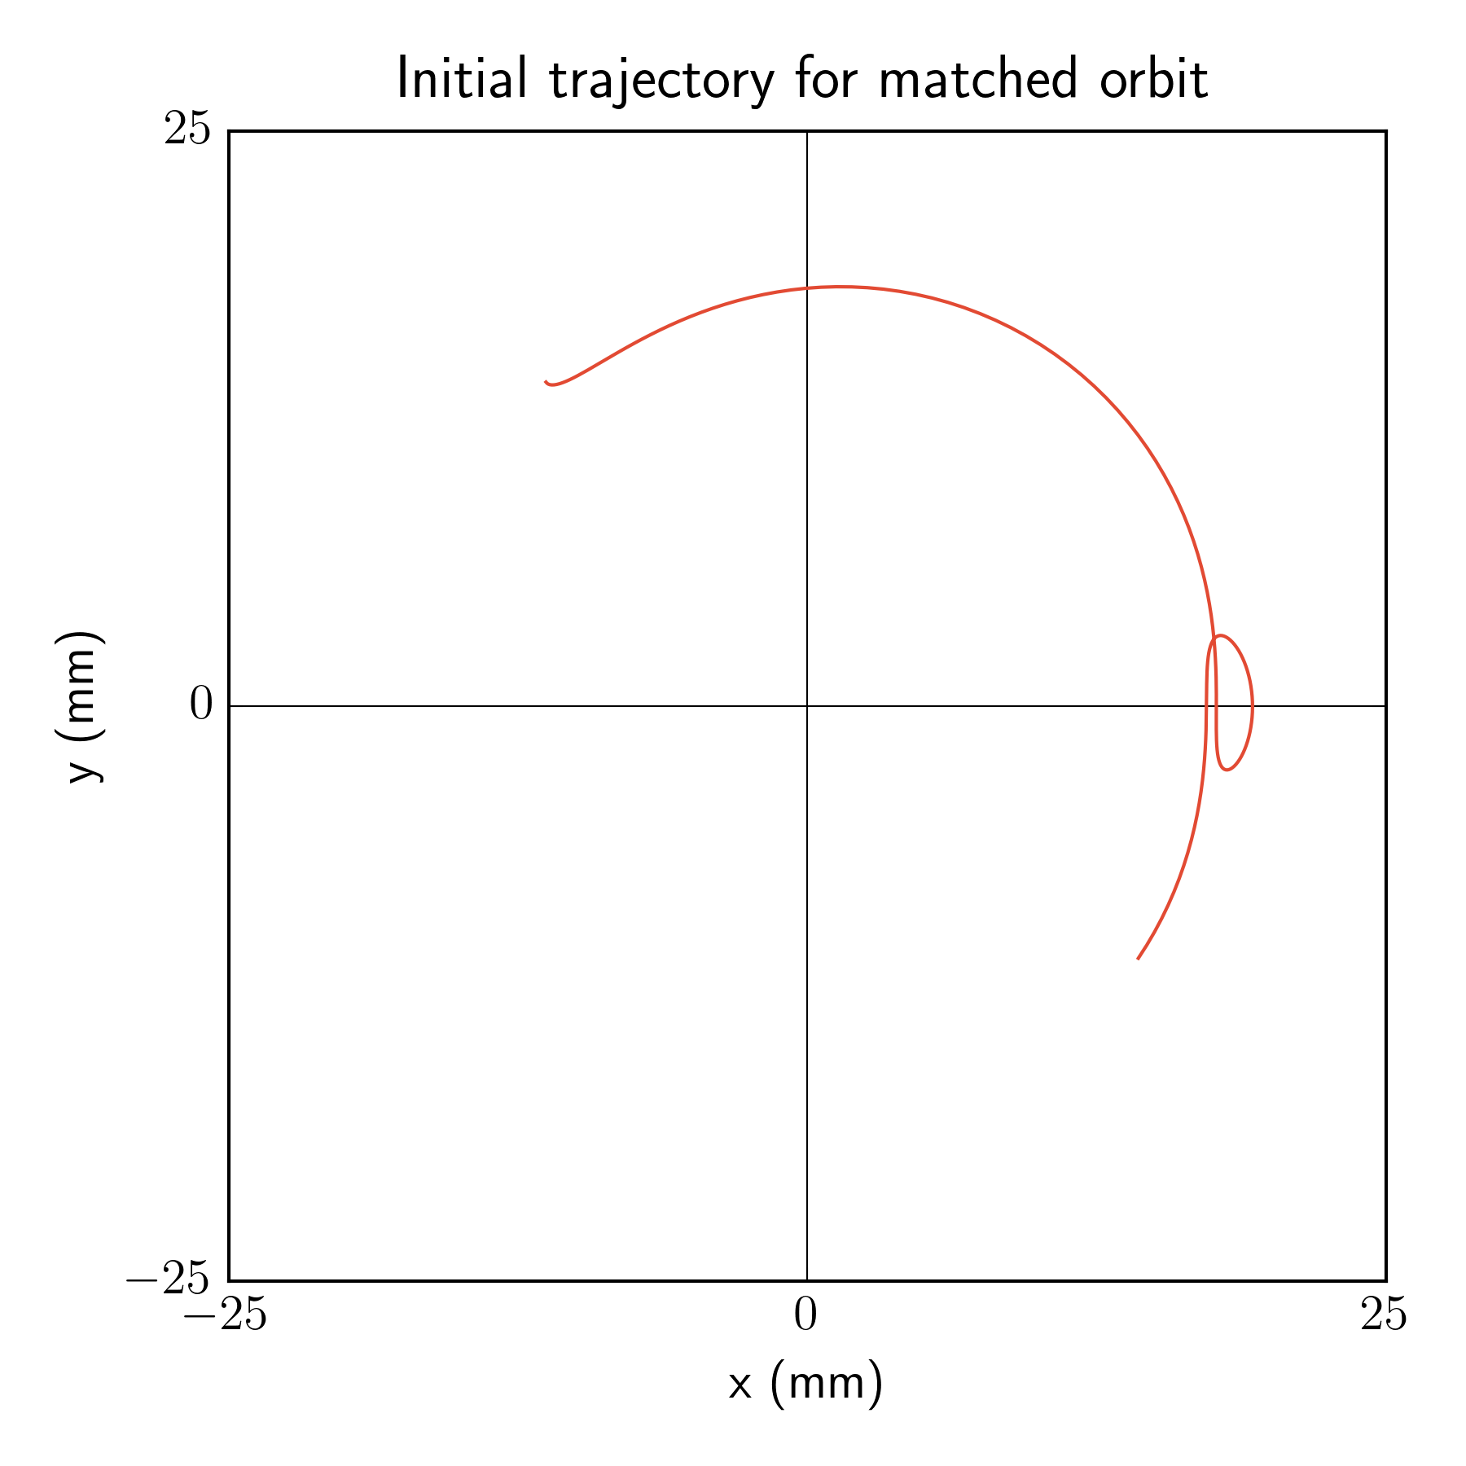
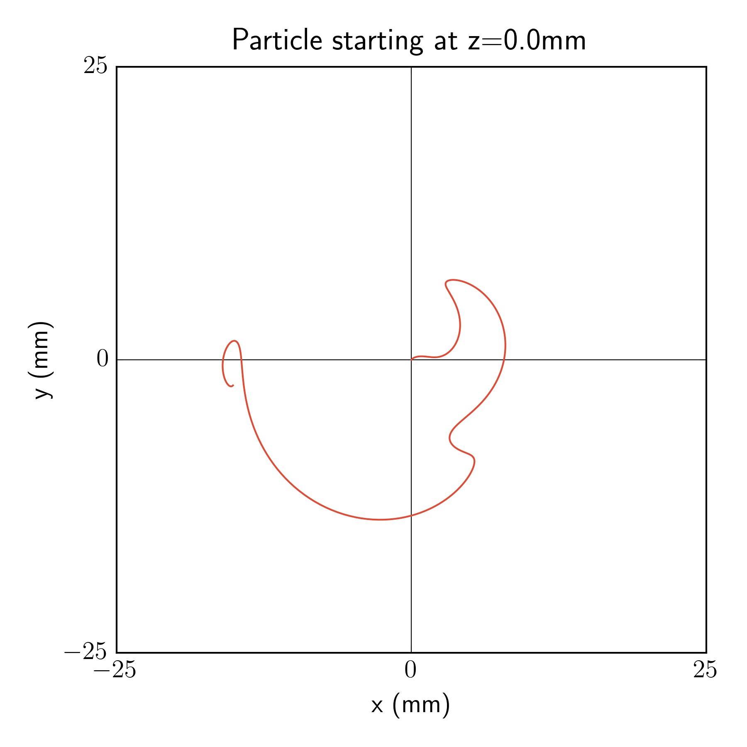
Adding a period upstream
Finding matching parameters
07.16.2025

Slide 16
Goals for next week
Characterize (partial) procedure for matching with a solenoidal lattice
In-depth RF cavity studies
Investigate beam loss in the matching section
07.16.2025

