Slide 1
Spare MKP-L (SPS injector kicker)
Impedance validation
Carlo, Giorgia, Miguel

Slide 2


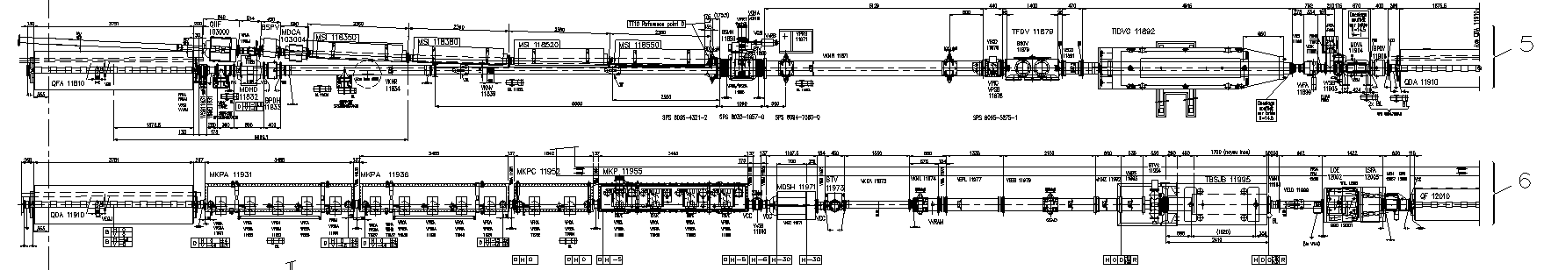
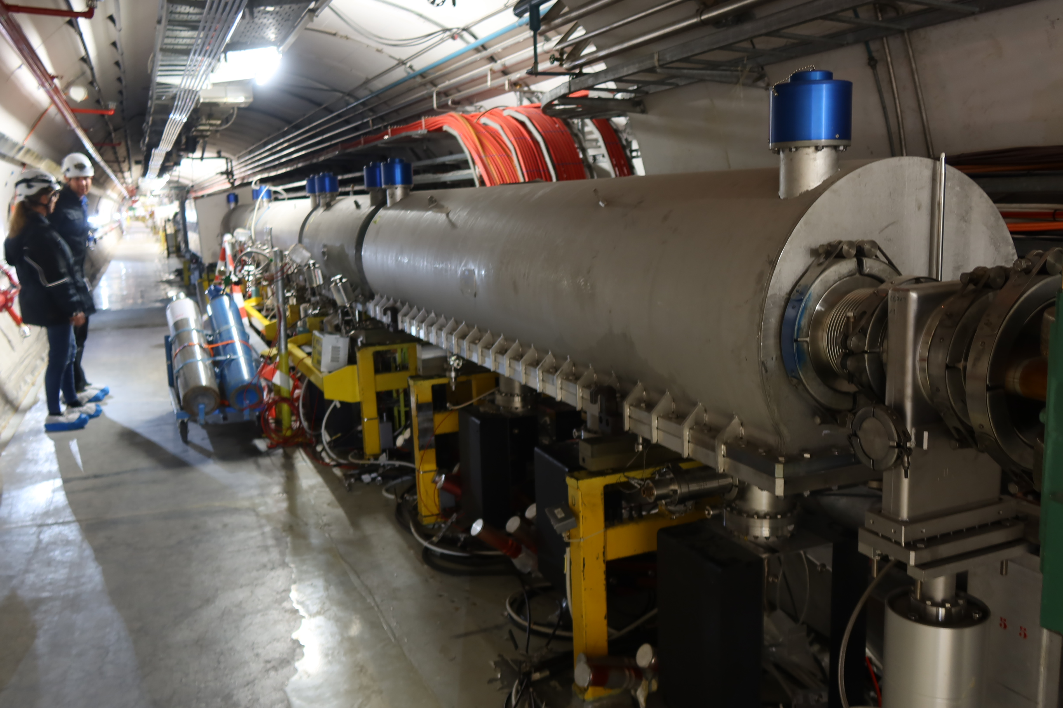
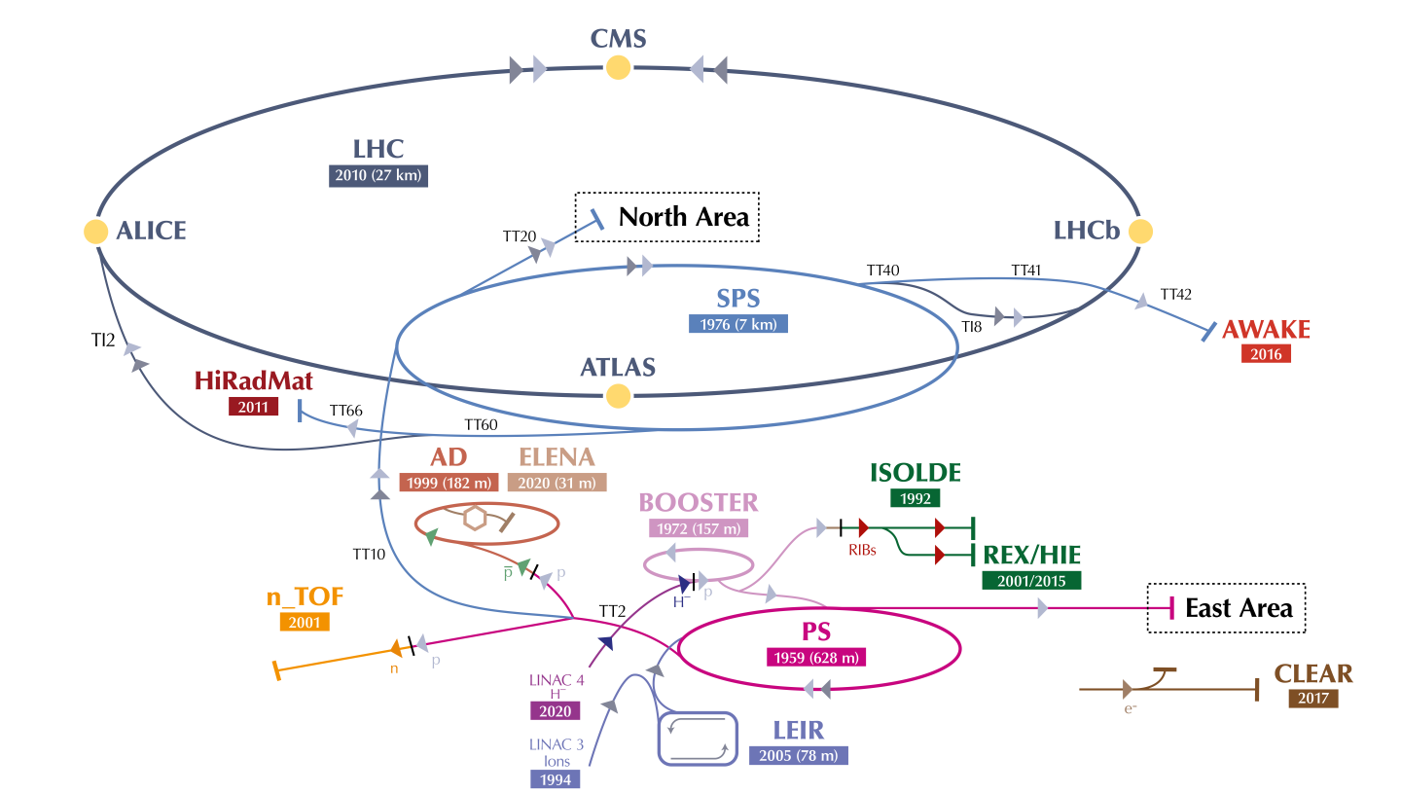
Introduction: MKP-L magnet
MKP-S = Small aperture ⇒
lower broadband impedance
MKP-L = large aperture ⇒
more affected by EM fields ⇒ higher broadband impedance if ferrites not shielded
Injected beam coming from PS
MKP-S
MKP-L
#4
Circulating beam in SPS
Injected + circulating beam
#1
#2
#3
The MKPs are the injector kicker magnets of the SPS
There are 4 magnet modules in the tank, of ∼0.7m long each

Slide 3
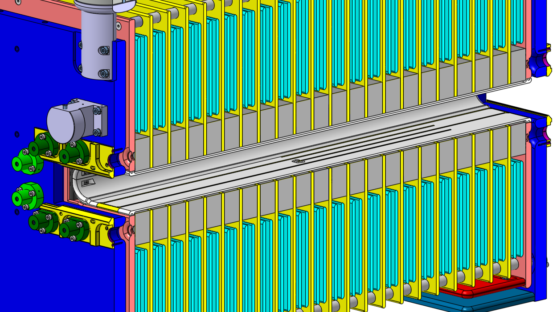
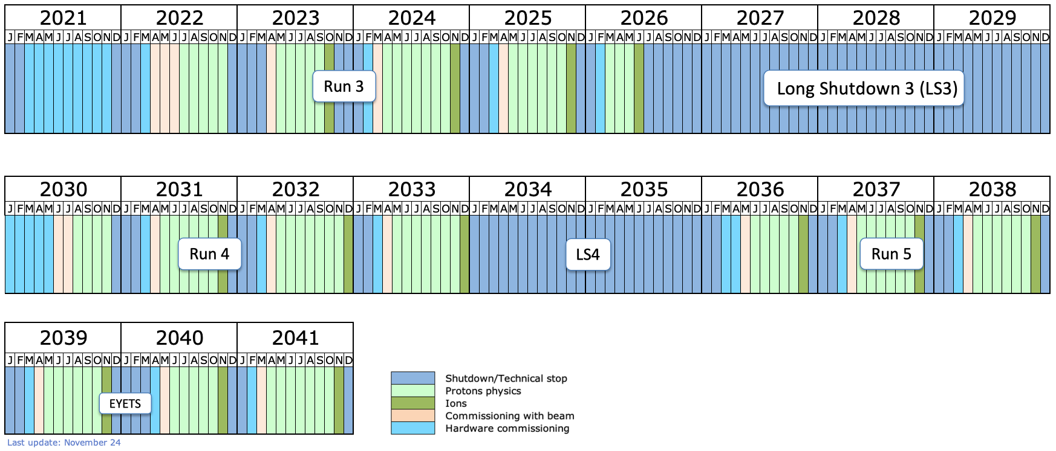
Low impedance MKP-L
Beam
A low impedance MKP-L was built and installed in the SPS in December 2022, and is working successfully since then, showing significant less heating
The low impedance MKP-L includes a ceramic beam screen with conductive fingers to carry the image current of the beam
Other minor modifications were done to improve HV performance
Silver fingers (dark)
Alumina chamber (grey), coated with Cr₂O₃
The spare MKP-L is being finished, and its beam coupling impedance has been validated
Low impedance MKP-L installed
Old MKP-L taken out
Refurbished to low impedance, will be the spare MKP-L

Slide 4
Impedance measurements
Stretched wire through the magnet aperture, terminated with 315 Ω resistors
Measurement procedure:
On two modules, before inserting beam chamber
  Longitudinal impedance
On each of the four modules, with the new beam chamber:
  Longitudinal impedance
On the full assembly, with the four modules inside the tank
  Longitudinal impedance
  Transverse impedance (displaced single wire)

Slide 5
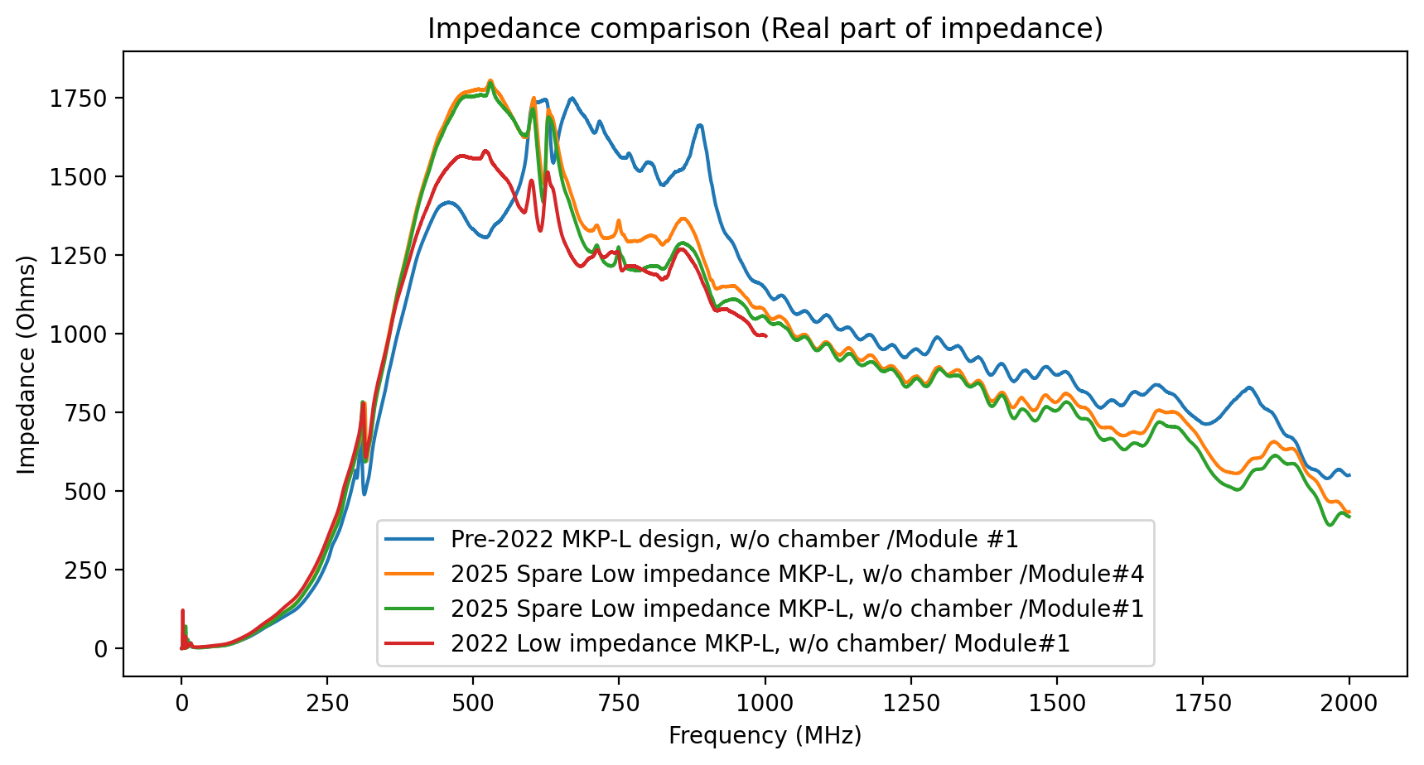
Longitudinal impedance without chamber
Modules installed in 2022 vs present spare (before and after refurbishing)
Does not include other design modifications
Old MKP-L module, as it came out from the machine in 2022 (when low-imp MKP-L was installed) (measured on the 10 March 2025)
New module 4, for spare MKP-L, without chamber (measured on the 12 march 2025 )
New module 1, for spare MKP-L, without chamber (meas on the 14th march 2025)
Module 1 of the low imp. MKP-L (now installed in the SPS), w/o the chamber, (measured on august 2022)

Slide 6
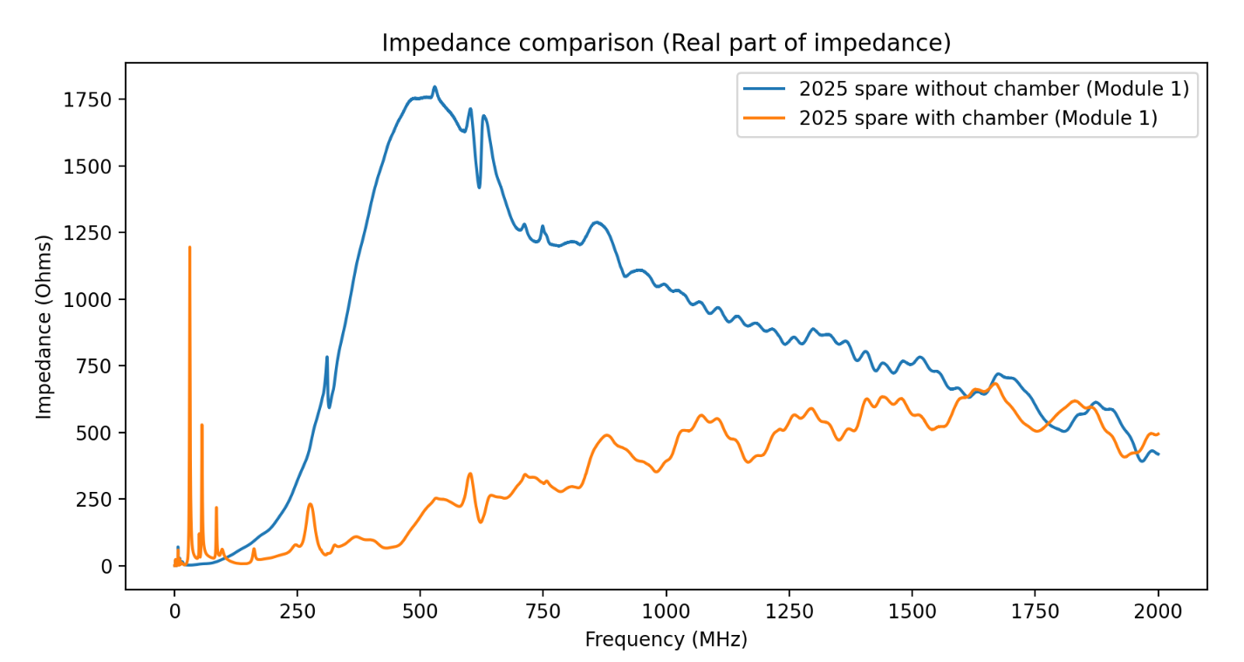
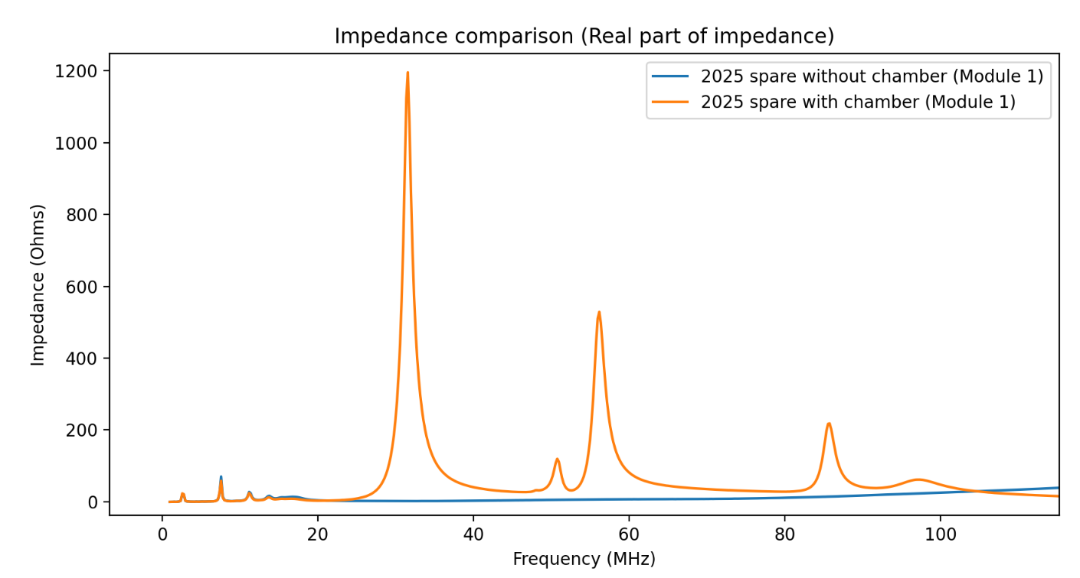
Longitudinal impedance with vs without chamber
Zoom at low frequencies: the conductive fingers of the chamber create a resonance, that must be kept away from 40MHz (beam harmonic)

Slide 7
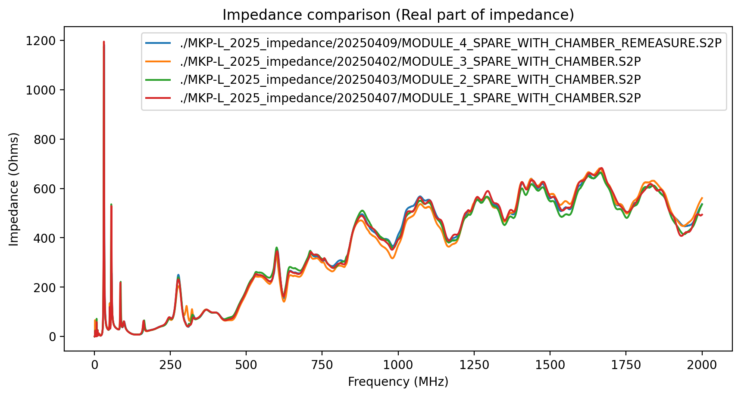
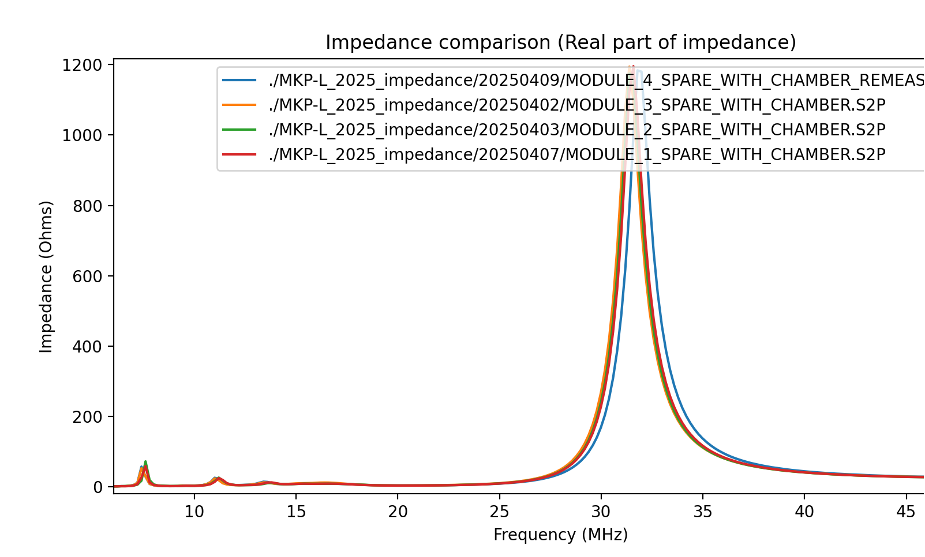
Longitudinal impedance with chamber
Comparison of each module
Zoom at first resonance: far enough from 40MHz

Slide 8
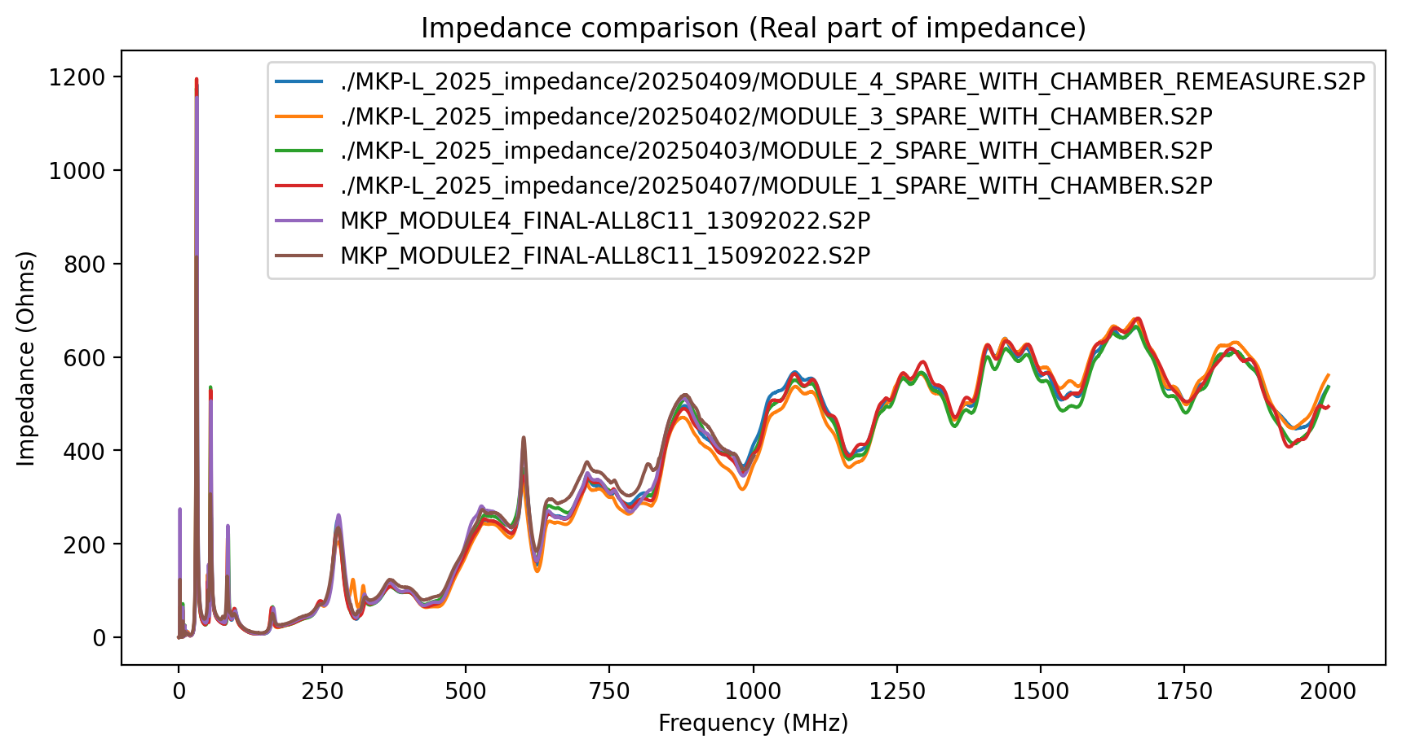
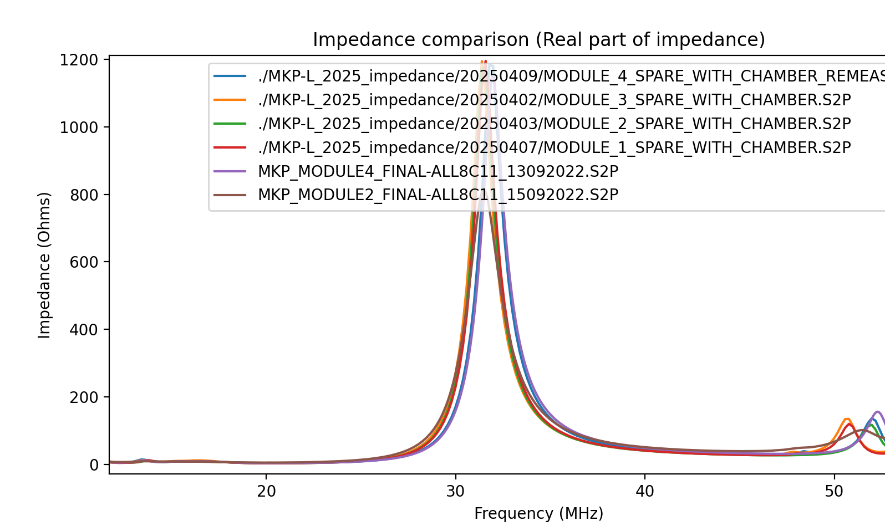
Longitudinal impedance with chamber
Comparison of each module.
+ 2 modules from the installed MKP-L shown
Zoom at first resonance: far enough from 40MHz

Slide 9
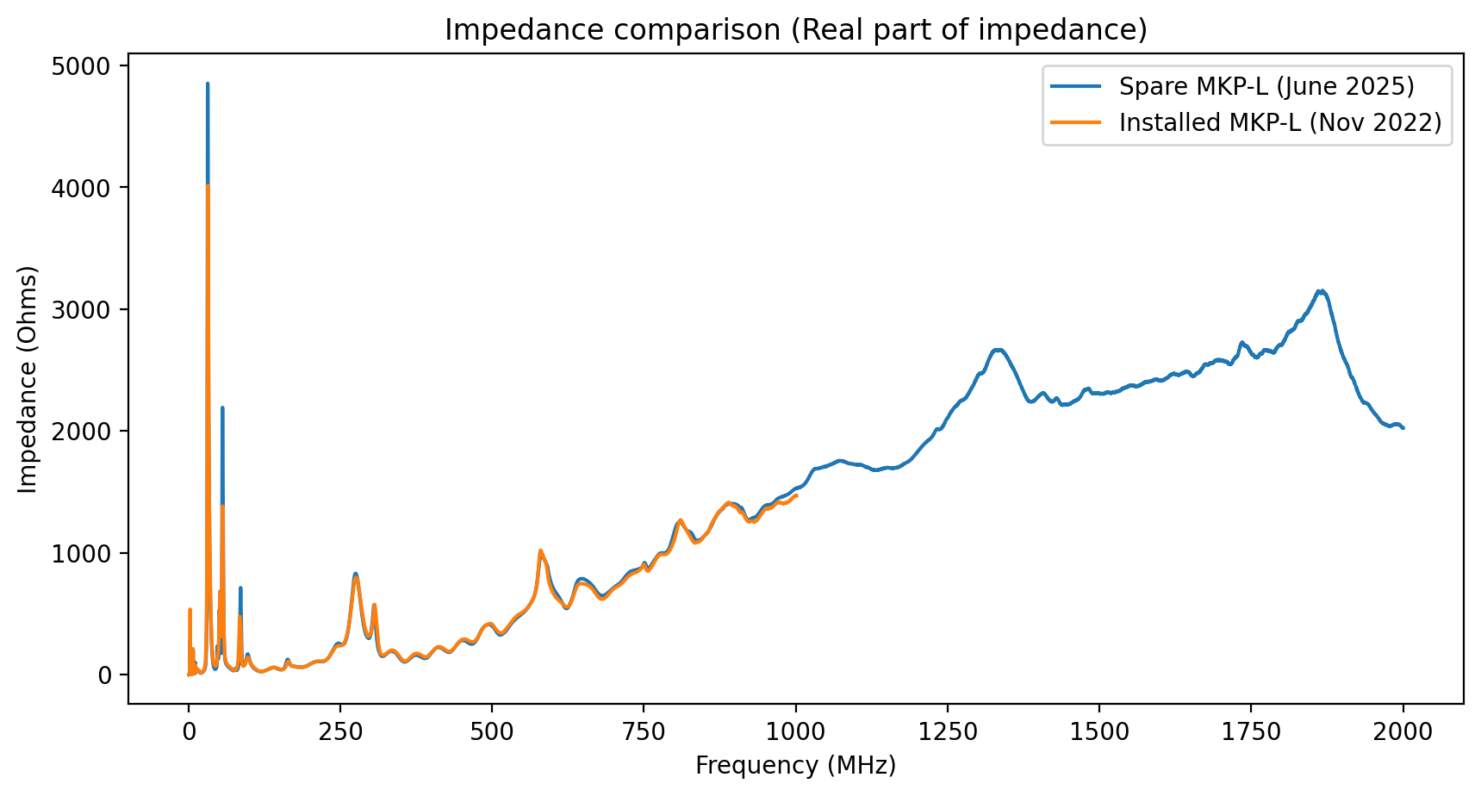
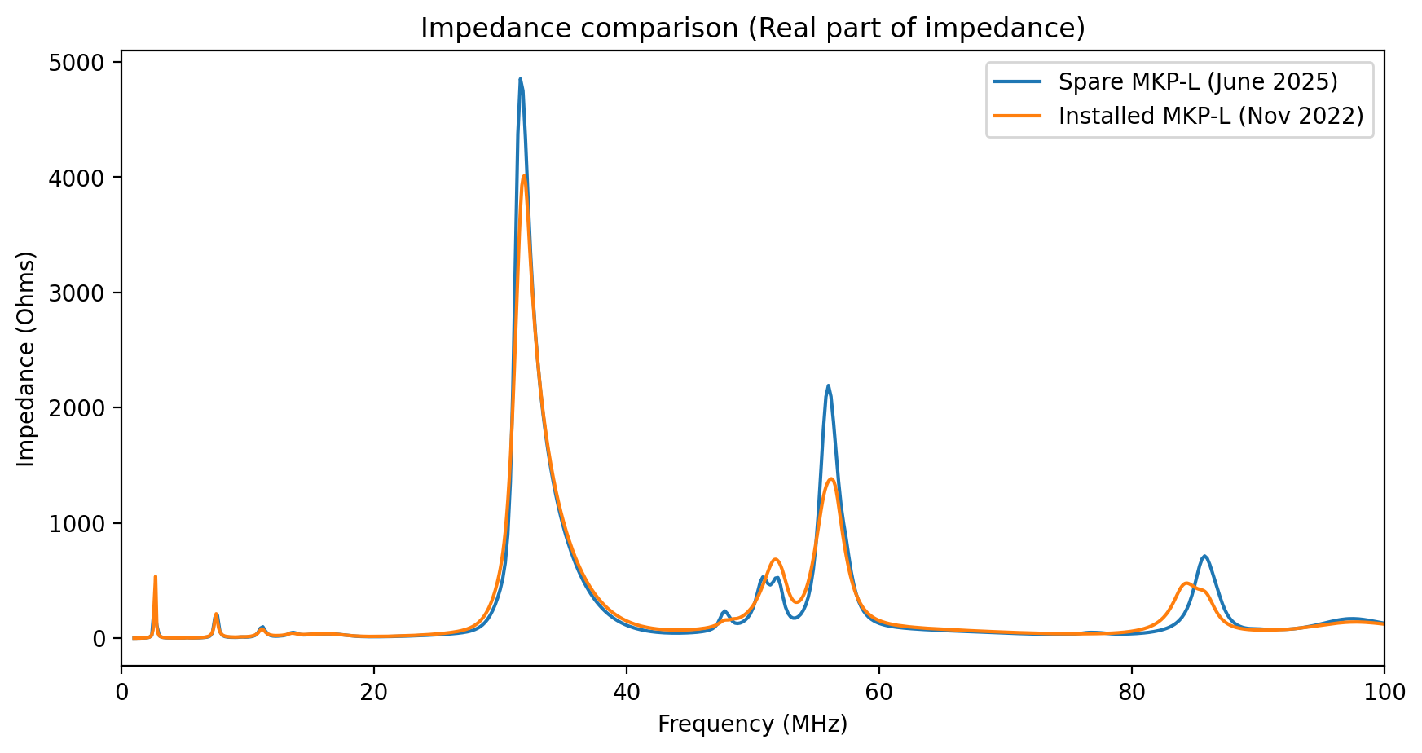
Longitudinal impedance full assembly
(four modules with chamber in tank)
Installed low-impedance MKP-L vs new spare
Zoom in low frequencies

Slide 10
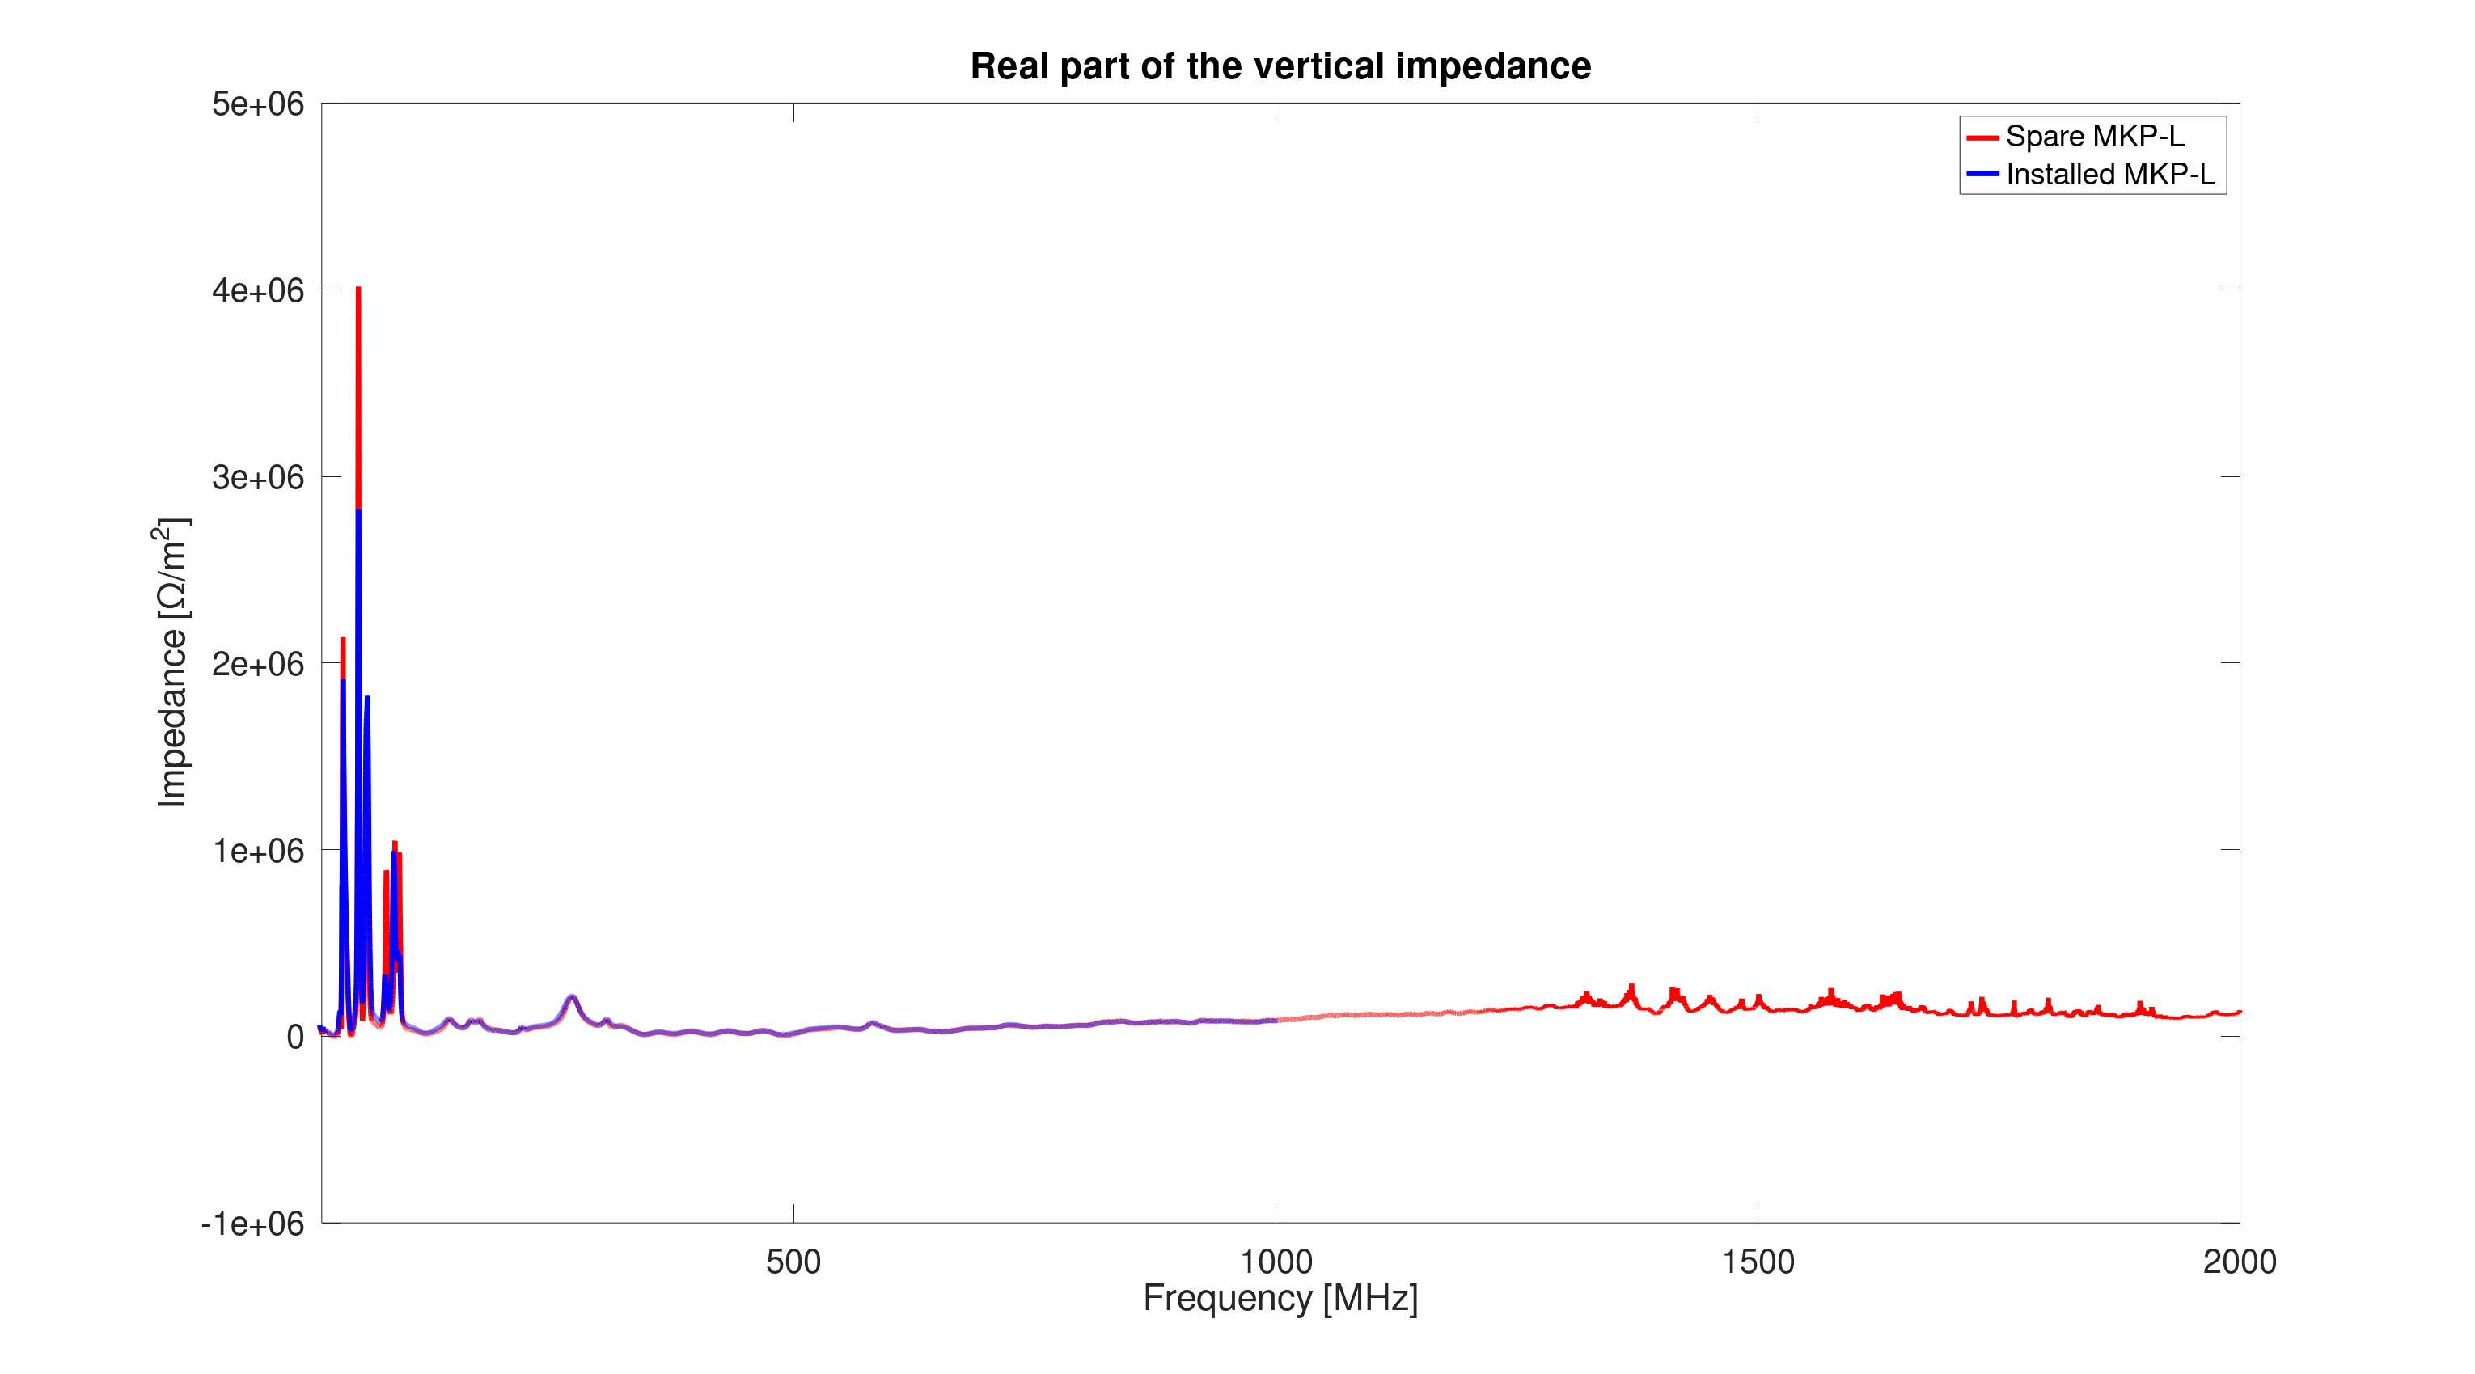
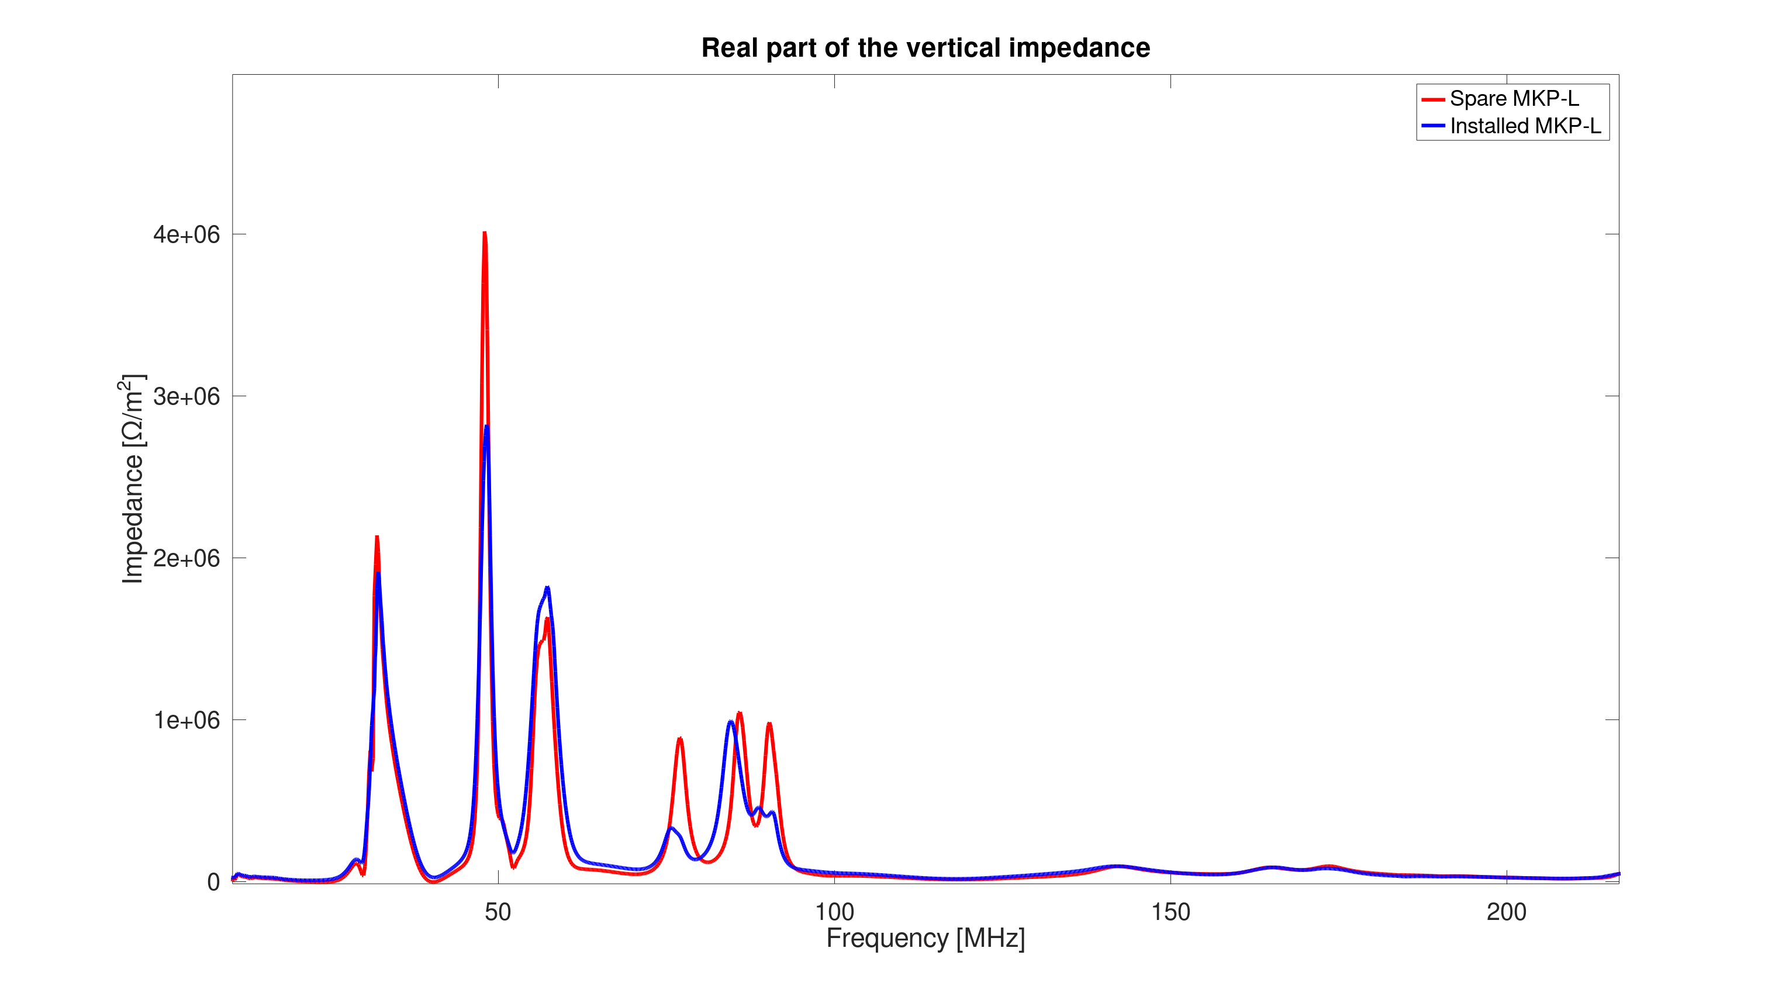
Transverse impedance full assembly. Vertical plane
(four modules with chamber in tank)
Installed low-impedance MKP-L vs new spare
Zoom at low frequencies

Slide 11
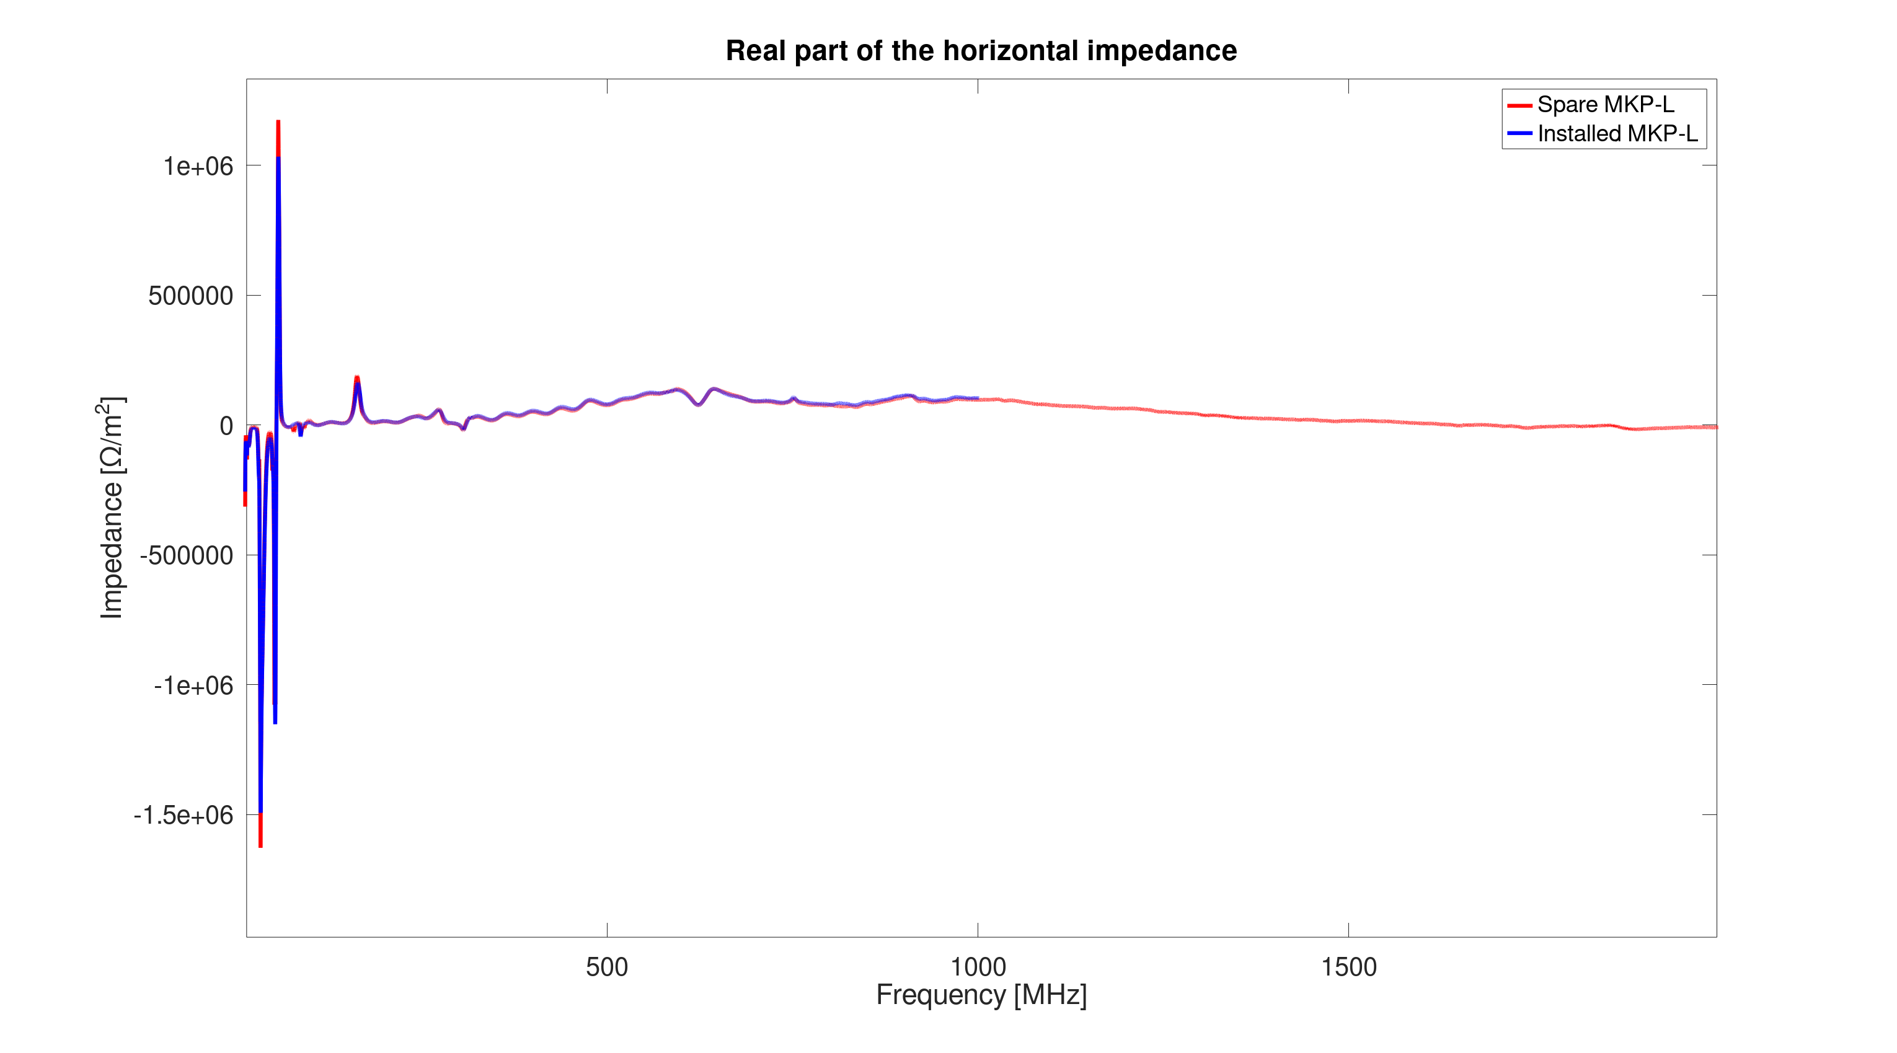
Transverse impedance full assembly. Horizontal plane
(four modules with chamber in tank)
Installed low-impedance MKP-L vs new spare

Slide 12
Conclusions
The impedance measurements of the new spare MKP-L align very well with the measurements of the low-imp MKP-L, that is now installed in the SPS (since 2022)
Since the low-imp. MKP-L is performing adequately, with low heating, a good performance of the spare MKP-L (if ever installed) is expected

