Slide 1
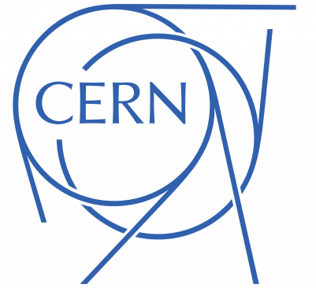
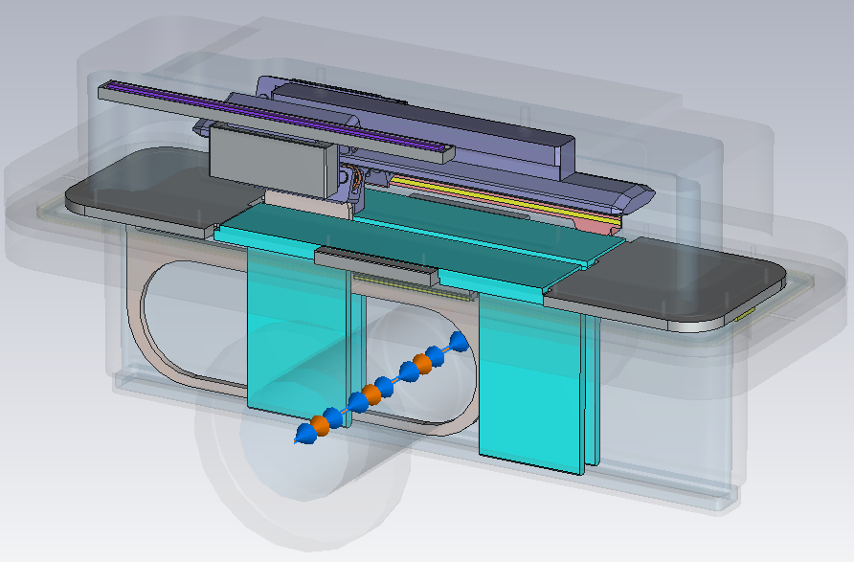
HL-LHC Wire Scanner CST Model
SY-RF-BR
Comment from Coating Team
Bake-out of the wire scanner will be done at 150 ºC.
NEG activation temperature is at 180 ºC. This may change the surface resistivity of the coating.
Another possible coating material?
→ Titanium? (higher activation temperature)
RF absorbers → $R_{s}=50 Ω$ NEG coated ceramic (alumina)
More info: 96th IWG and 98th IWG Meetings
101st IWG Meeting
15.07.2025
H. Bursali

