Slide 1
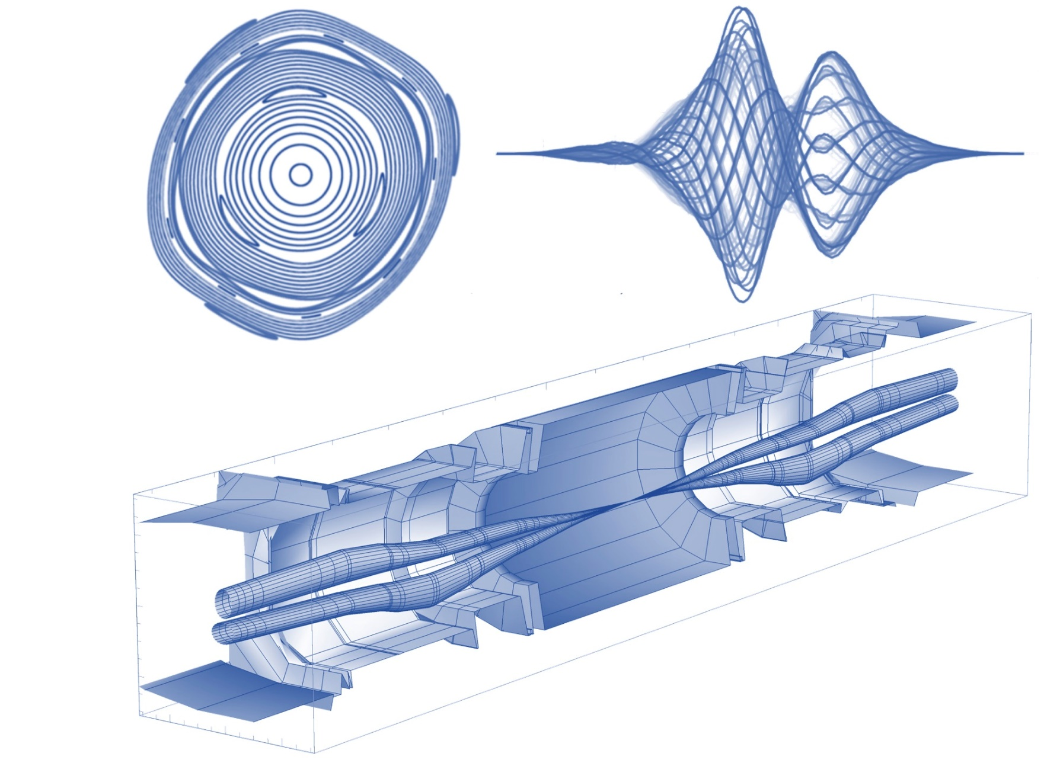



CTPPS Roman Pot – Impedance Studies for HL
Leonardo Sito, Benoit Salvant, Joanna Swieszek, Carlo Zannini, C. Antuono, N. Mounet
With the support of:
PPS team: N. Minafra, D. Druzhkin, J. Baechler, J. J. Hollar, M. Deile.
FOS team: G. Breglio, S. Buontempo, F. Fienga, V.R. Marrazzo
101st Impedance Working Group
CERN, Geneva, Switzerland
15 July 2025

Slide 2
Outline
CTPPS Roman Pots
1.1 Introduction
1.2 PPS2: upgrade for HL LHC
Longitudinal Impedance Studies
2.1 Introduction and preliminary studies
2.2 Longitudinal Impedance Study
2.3 Power loss study
2.4 Thermal study
Transverse Impedance Studies
Conclusions

Slide 3
Outline
CTPPS Roman Pots
1.1 Introduction
1.2 PPS2: upgrade for HL LHC
Longitudinal Impedance Studies
2.1 Introduction and preliminary studies
2.2 Longitudinal Impedance Study
2.3 Power loss study
2.4 Thermal study
Transverse Impedance Studies
Conclusions

Slide 4
CTPPS Roman Pot – What an acronym!
CTPPS Roman Pots
CMS
TOTEM
Precision
Proton
Spectrometer
«Roman» →
Technique used for the first time by CERNRome group in the 70s
A «parasitic» subdetector for:
Proton tracking
Time detection (time-of-arrival)
Beam profile

Slide 5
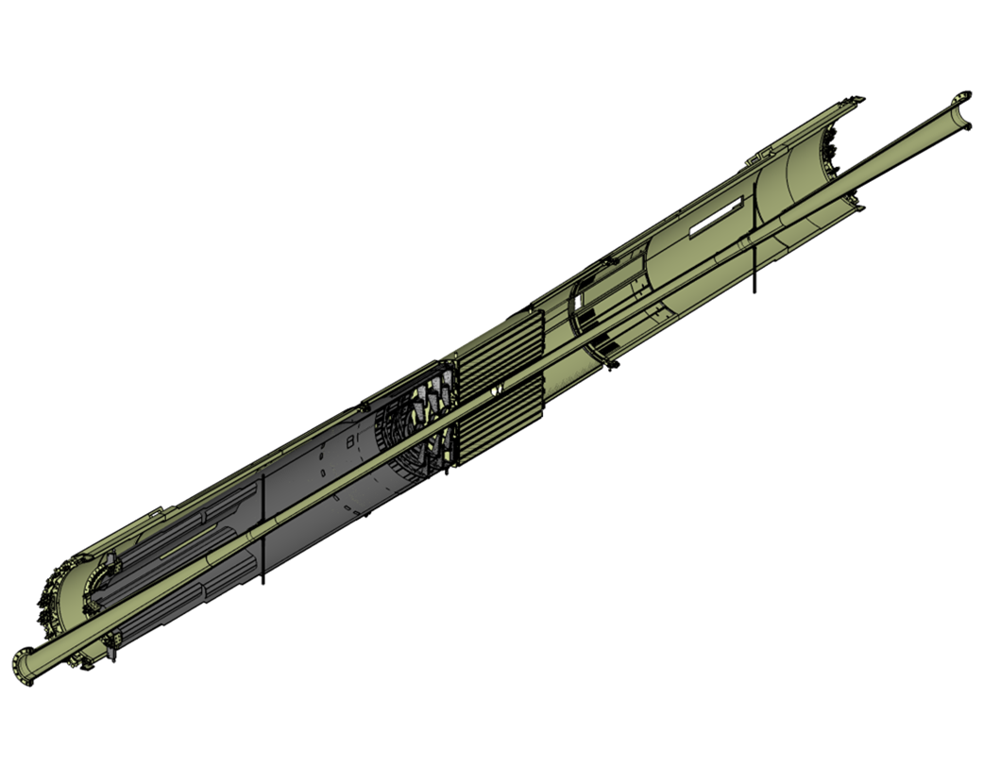
CTPPS Roman Pot – What an acronym!
In IP5 the closest detectors are:
In the context of forward physics:
Intercept particles that after “collision” have been only slightly deflected
Barrell Pixel Tracker
Need of silicon detectors that can go as close as possible to the beam!
Forward Pixel Tracker
In general:
«Thin» vessel (pots) hosting detectors, electronics and cooling
Pots connected to the beam vacuum chamber with bellows
IP
CMS
TOTEM
CMS Central Beam Pipe
This allows moving the detector in respect to the beam
From 40 mm = Parking
Up to 1 mm = Operational

Slide 6
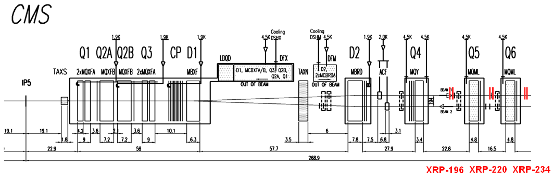
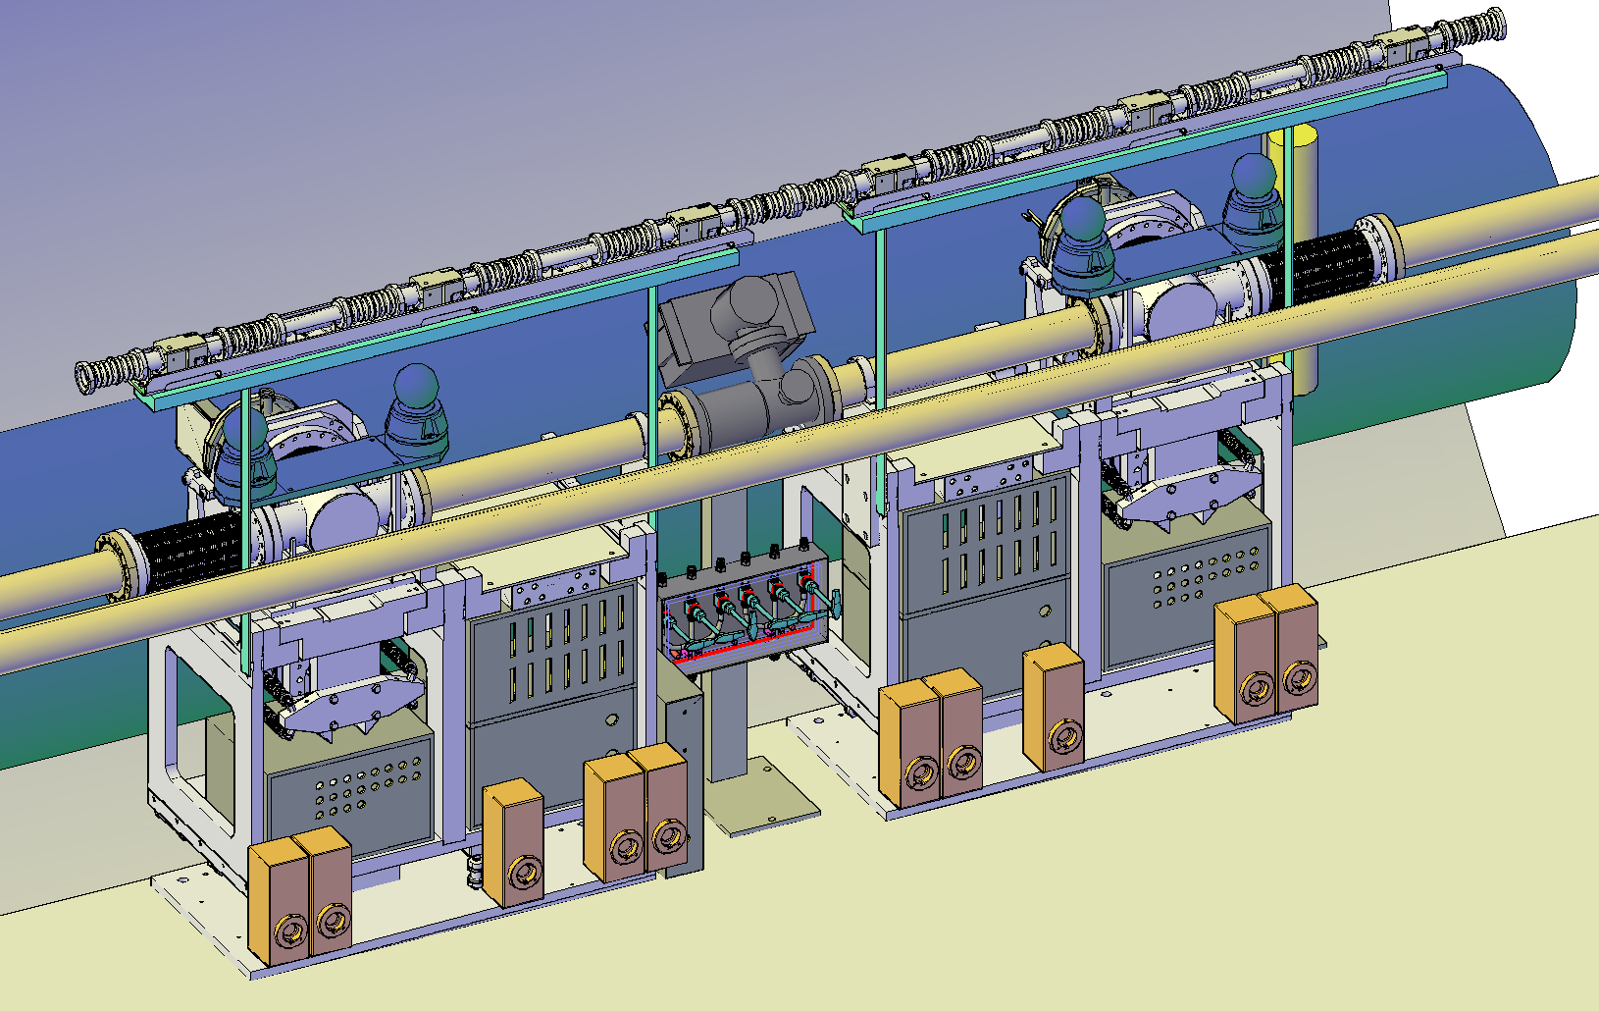
CTPPS Roman Pot – PPS2
PPS are installed on both sides of IP5 and have (are) run (running) sucessfully during Run 2 and Run 3
PPS2 is the upgraded version of PPS for running from Run 4 to Run 6
→ Need for an update of the devices and an impedance study for the HL beam parameters
3 stations on each side with 2 horizontal pots
4th pot station at 420 under discussion
(XRP-220 also has a pair of vertical pots used only for alignemnt)
https://edms.cern.ch/document/2915345/0.2

Slide 7
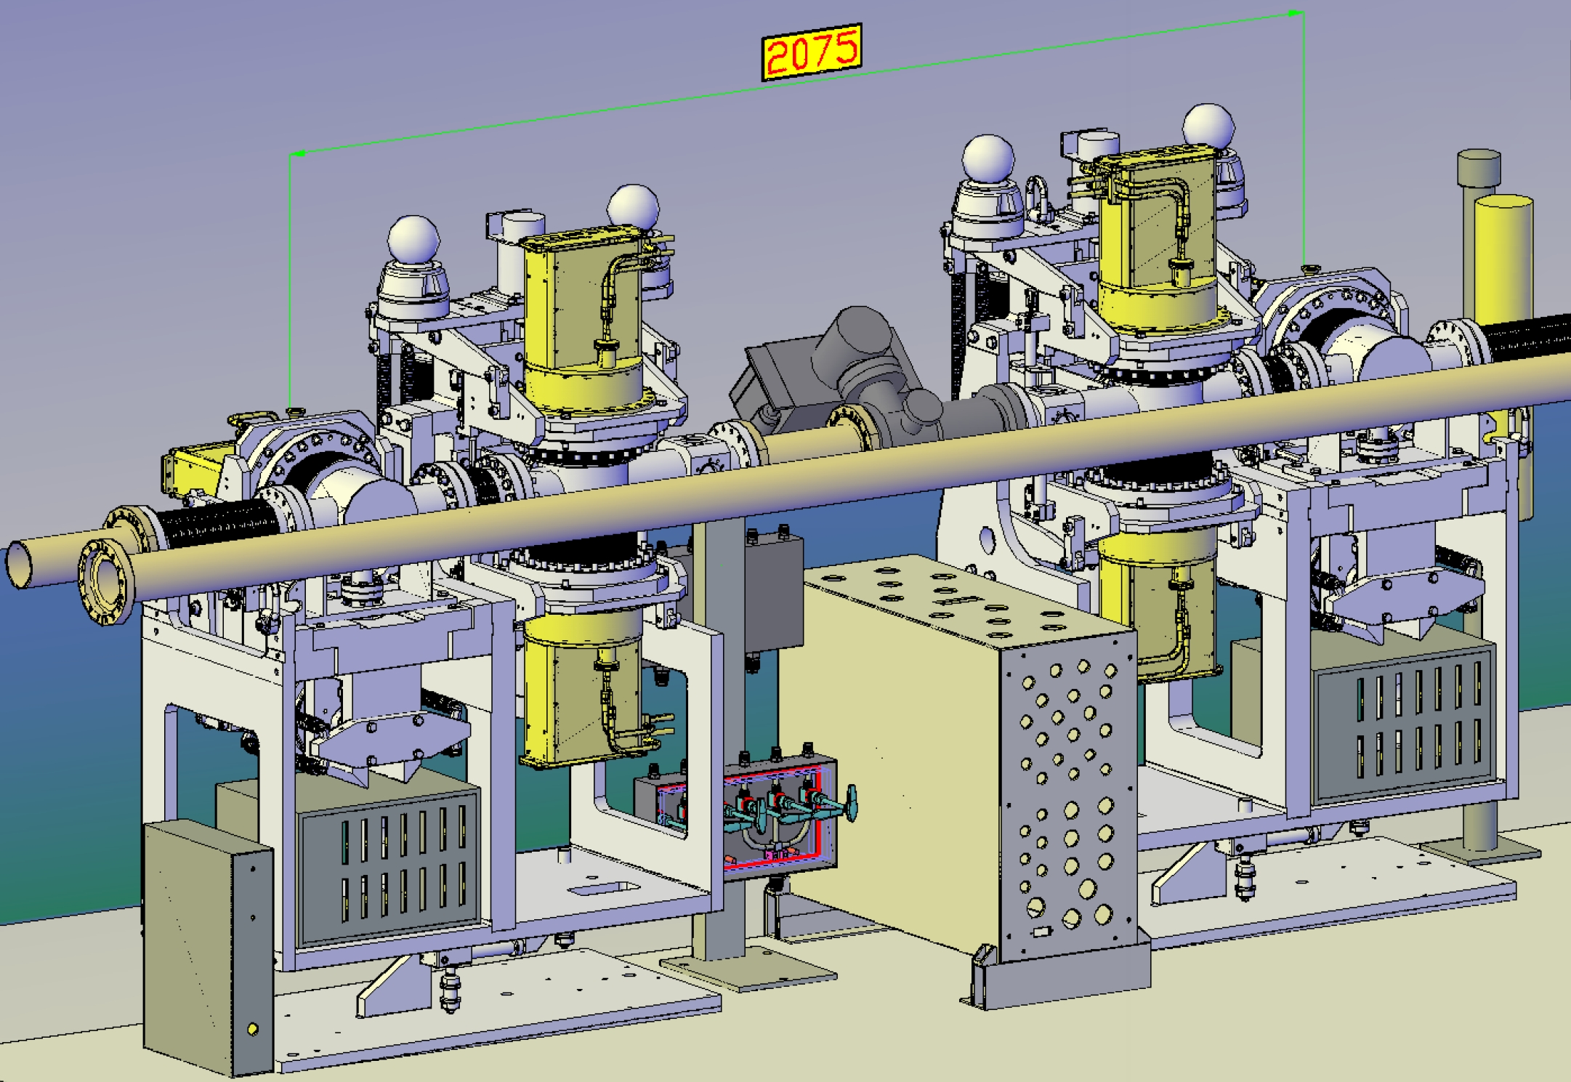
CTPPS Roman Pot – PPS2
PPS are installed on both sides of IP5 and have (are) run (running) sucessfully during Run 2 and Run 3
PPS2 is the upgraded version of PPS for running from Run 4 to Run 6
→ Need for an update of the devices and an impedance study for the HL beam parameters
3 stations on each side with 2 horizontal pots
4th pot station at 420 under discussion
(XRP-220 also has a pair of vertical pots used only for alignemnt)
https://edms.cern.ch/document/2915345/0.2

Slide 8
Outline
CTPPS Roman Pots
1.1 Introduction
1.2 PPS2: upgrade for HL LHC
Longitudinal Impedance Studies
2.1 Introduction and preliminary studies
2.2 Longitudinal Impedance Study
2.3 Power loss study
2.4 Thermal study
Transverse Impedance Studies
Conclusions

Slide 9
The need for a new Impedance Study
In HL LHC there is the need to also account for how the increase in beam intensity and decrease in bunch length will affect:
  Dissipate power (Beam-Induced Heating).
  Instabilities.
The impedance study included:
Pots already installed in the LHC (horizontal, vertical and box pots)
Pots that are under study for PPS2 (external groove)
General Procedure
Modelling
Longitudinal Impedance
Measurements
Transverse Impedance
Model Order Reduction
      Computation in CST
      Power Loss computation with BIHC
      Power Loss map
      Thermal Calculations
Mesh Convergence
Stretched wire
Probes
Computation in CST
Stability study
Consistency Check

Slide 10
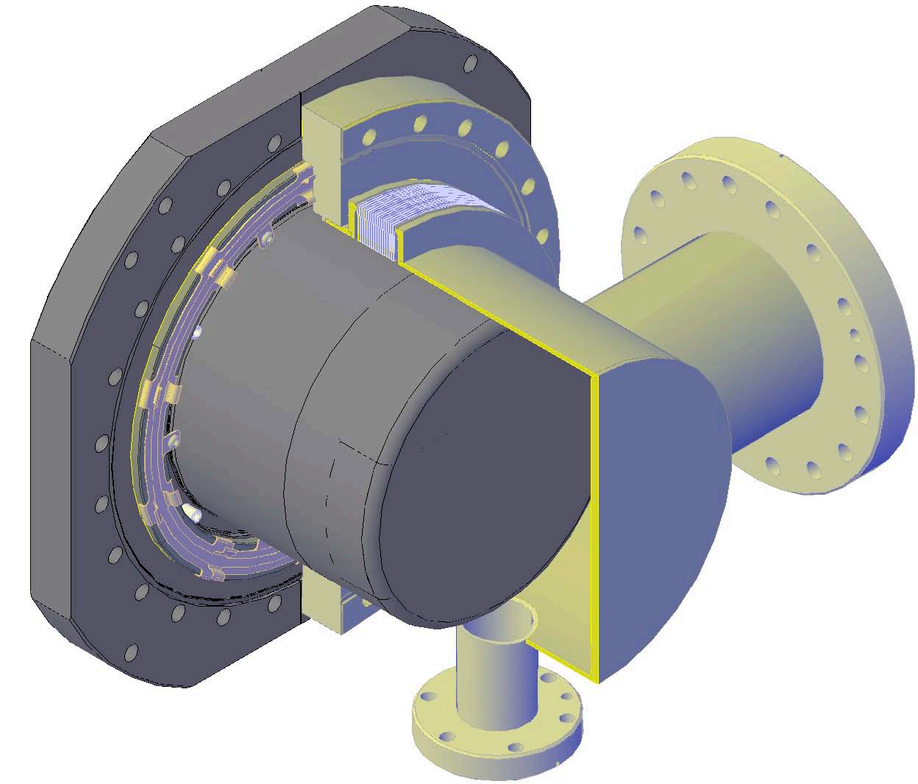
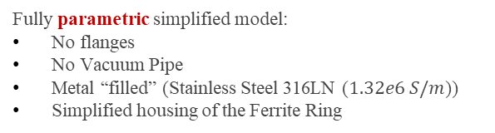
Modelling and Model Order Reduction
The model used for EM simulations is a simplified version of the complete ones.
Stainless Steel 316LN
Compressed bellow
Ferrite (TT2-111R) ring
And
Springs
Beam Pipe
Fully parametric simplified model:
No flanges
No Vacuum Pipe
Metal “filled” (Stainless Steel 316LN ($1.32e6 S/m$))
Simplified housing of the Ferrite Ring
Courtesy of D. Druzhkin
Vacuum Pipe
V4 Horizontal, Operational Position

Slide 11
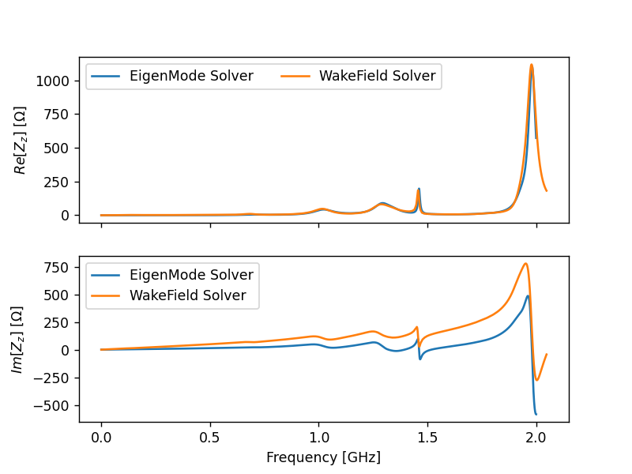


Consistency Check
Preliminary:
Mesh consistency study (check convergence of the mesh)
Model consistency study (check agreement with two solvers: Eigenmode and Wakefield)
Eigenmode solver: frequency domain solver ($f_{n}$, $Q_{n}$, $R_{n}$).
$Z= \frac{R_{n}}{1+jQ_{n}(\frac{f}{f_{n}}−\frac{f_{n}}{f})}$
Wakefield solver: time domain solver (Impedance as FFT of Wake field)
Results are consistent and consistent with previous studies by Nicola Minafra and Lorenzo Teofili.
https://cds.cern.ch/record/1557361
https://cds.cern.ch/record/2715363
V4, Distance beam-pot $1mm$

Slide 12
Outline
CTPPS Roman Pots
1.1 Introduction
1.2 PPS2: upgrade for HL LHC
Longitudinal Impedance Studies
2.1 Introduction and preliminary studies
2.2 Longitudinal Impedance Study
2.3 Power loss study
2.4 Thermal study
Transverse Impedance Studies
Conclusions

Slide 13
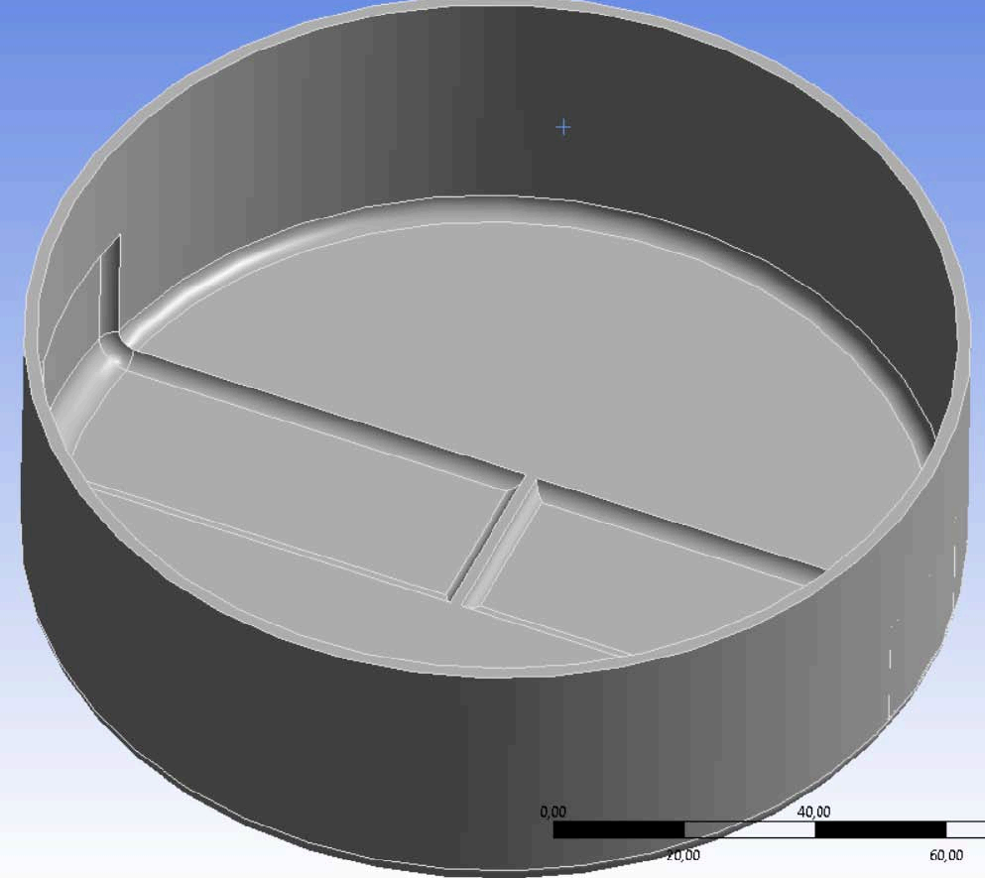
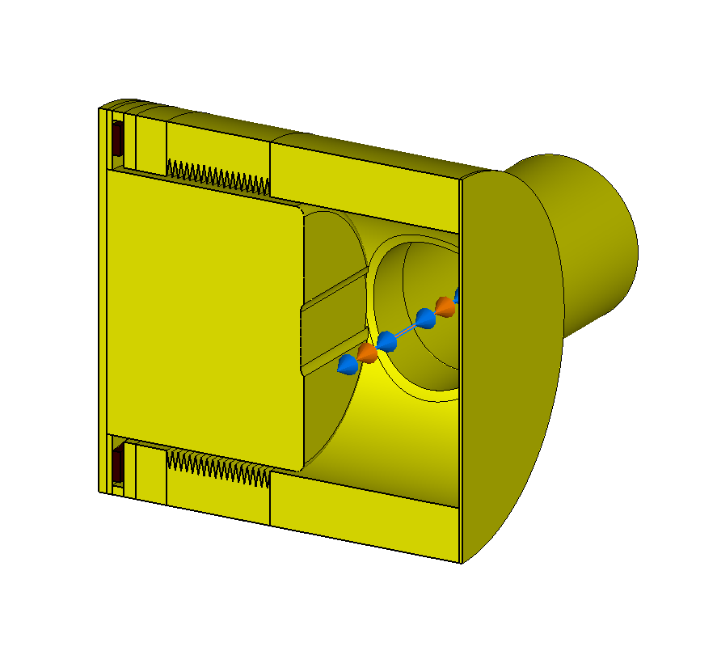
Studied Models for the HL LHC upgrade
https://edms.cern.ch/document/2915345/0.2
The models studied are:
  V4: No outer groove on the pot surface
  V5.3: Large outer groove on the pot surface
  V6: Narrow outer groove on the pot surface
Inner grooves for mechanical stability (where the detector are located)
V4, Garage Position
V5.3, Garage Position
V6, Garage Position

Slide 14
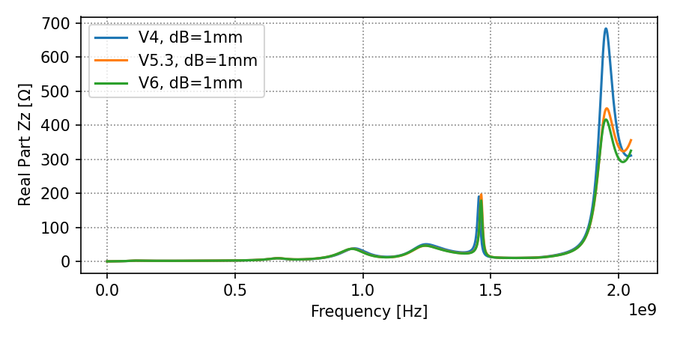
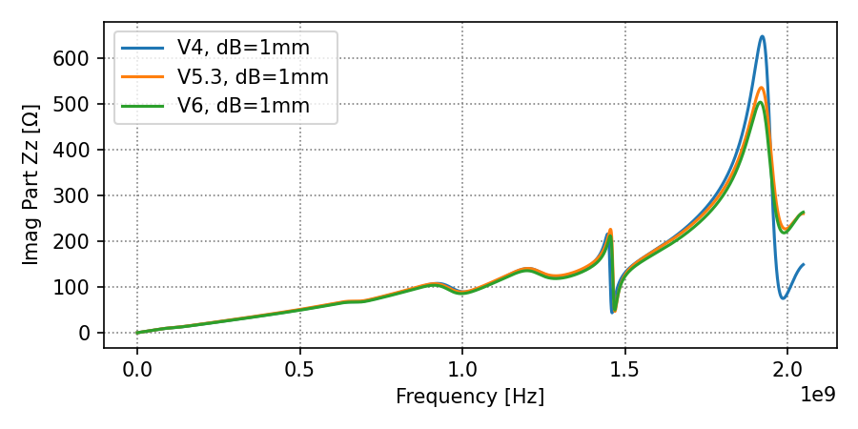
Longitudinal Impedance - Comparison
Comparison of the models:
Beam-pot distance: 1 mm.
V5.3 and V6 have a lower last peak (around 2 GHz)
V5.3 and V6 have modes below 1.4 GHz at lower frequencies.
V4, Garage Position
V5.3, Garage Position
V6, Garage Position

Slide 15
Outline
CTPPS Roman Pots
1.1 Introduction
1.2 PPS2: upgrade for HL LHC
Longitudinal Impedance Studies
2.1 Introduction and preliminary studies
2.2 Longitudinal Impedance Study → Measurements
2.3 Power loss study
2.4 Thermal study
Transverse Impedance Studies
Conclusions

Slide 16
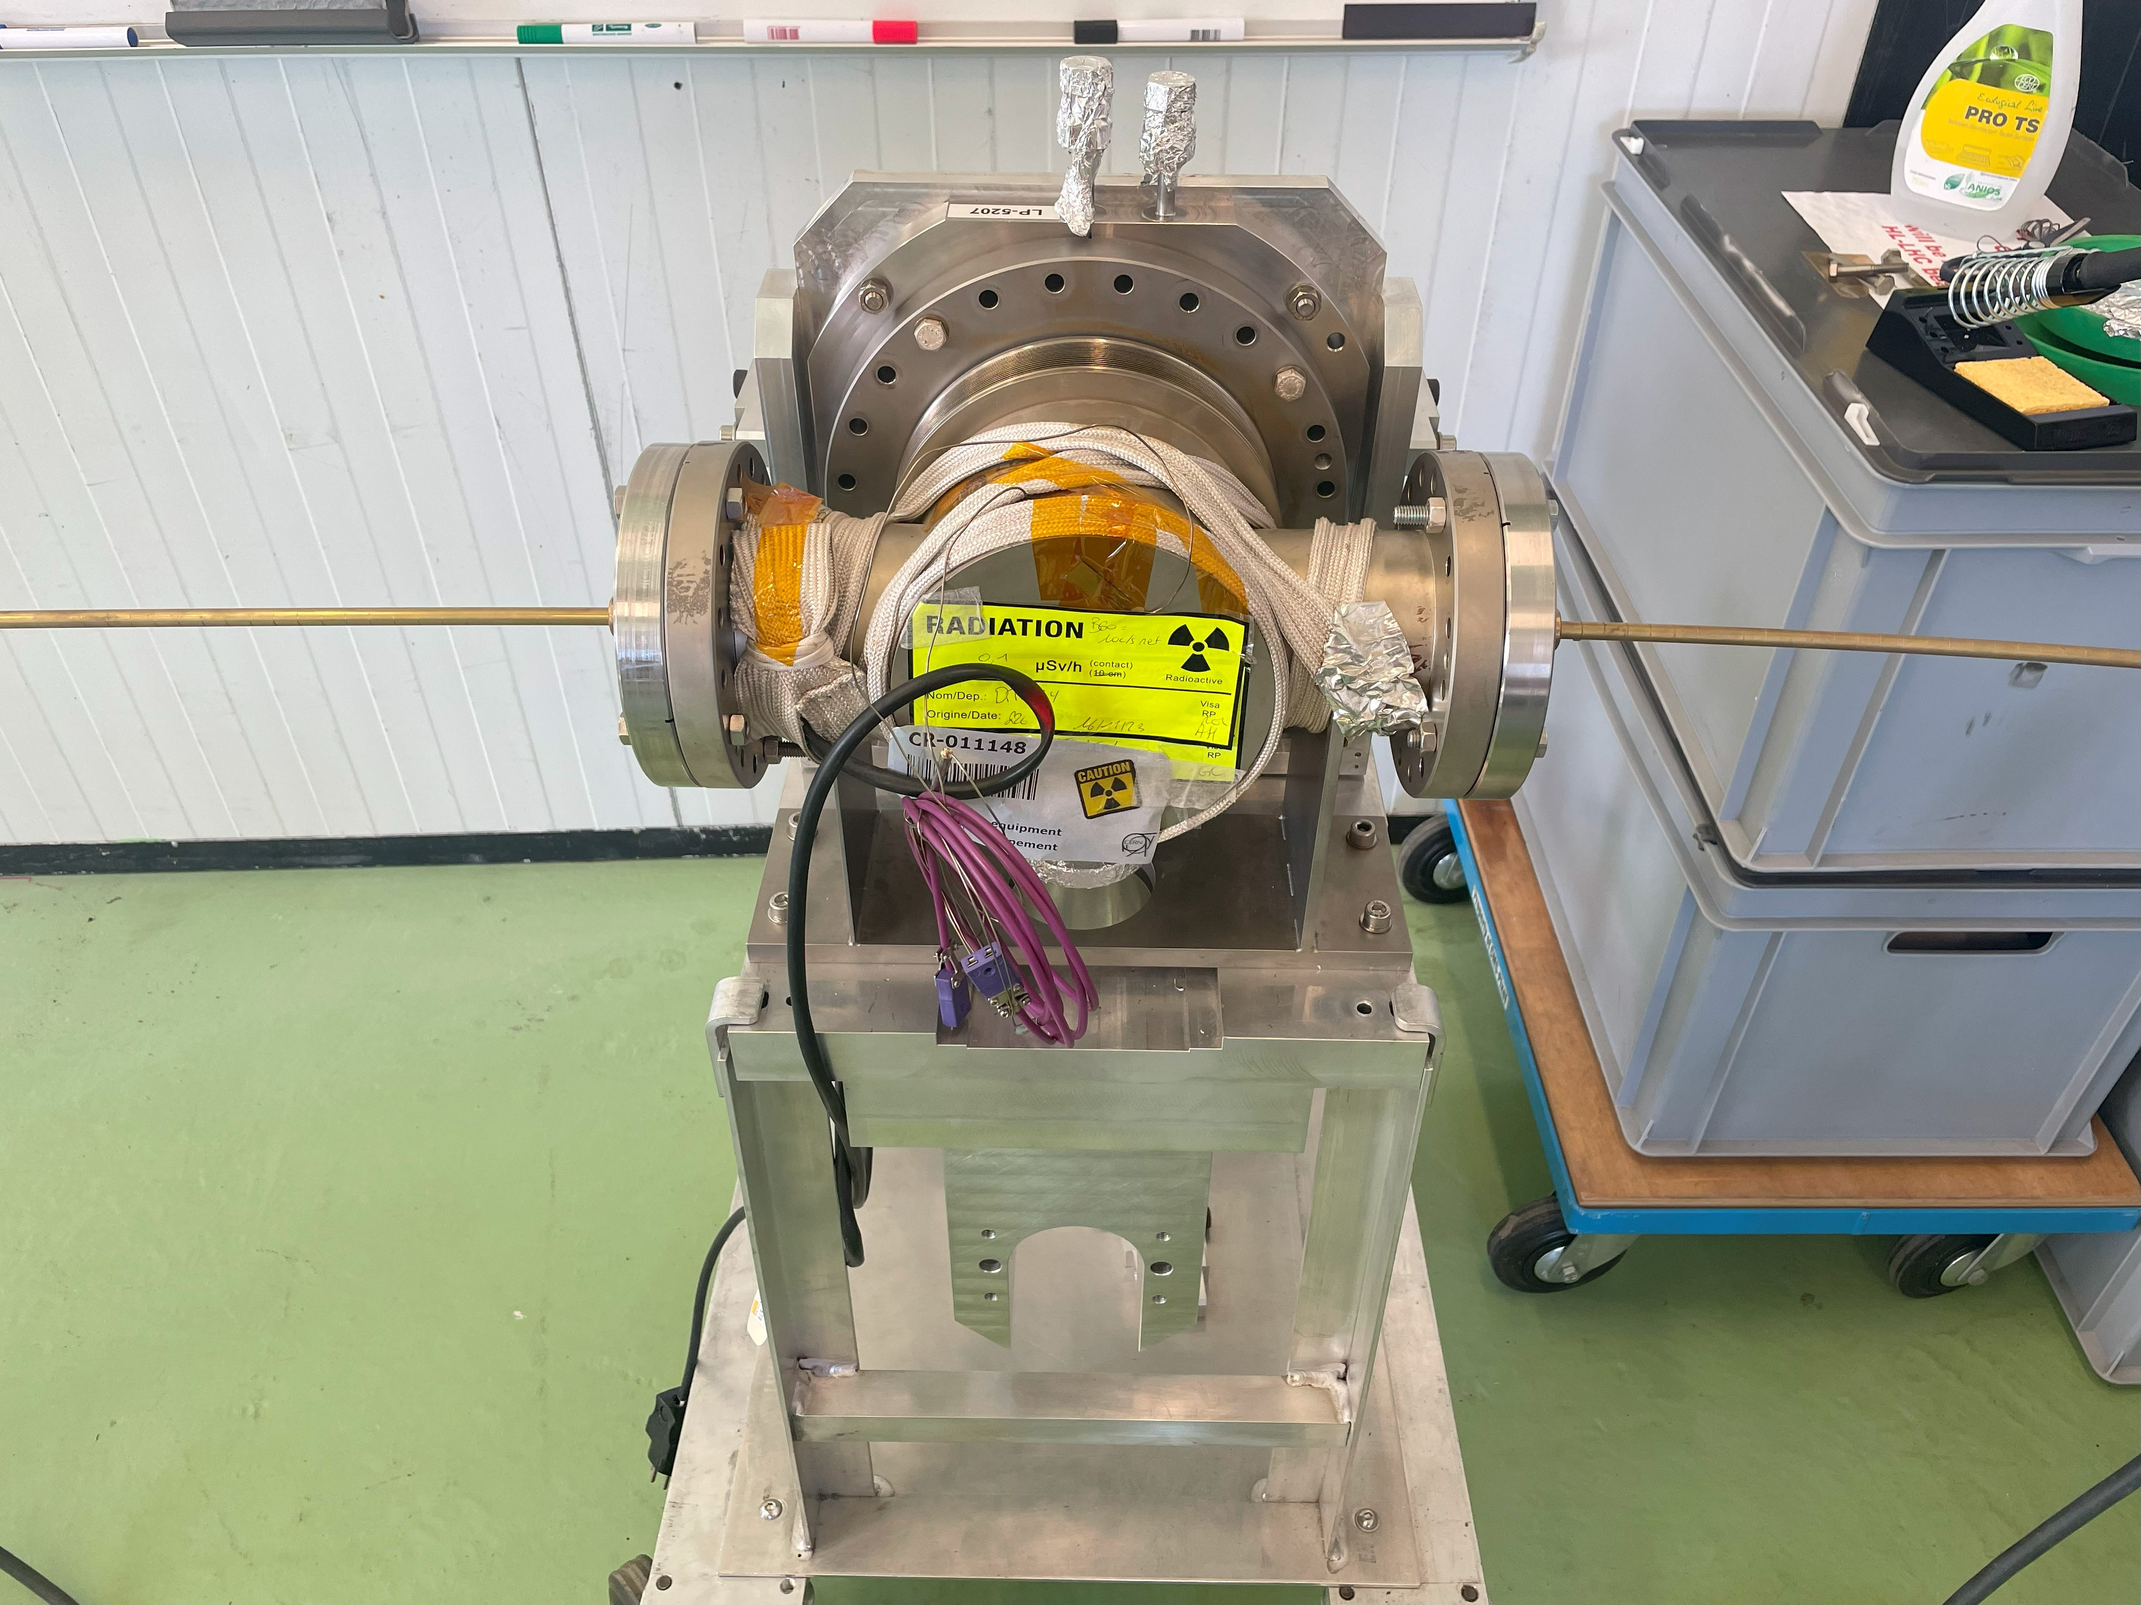
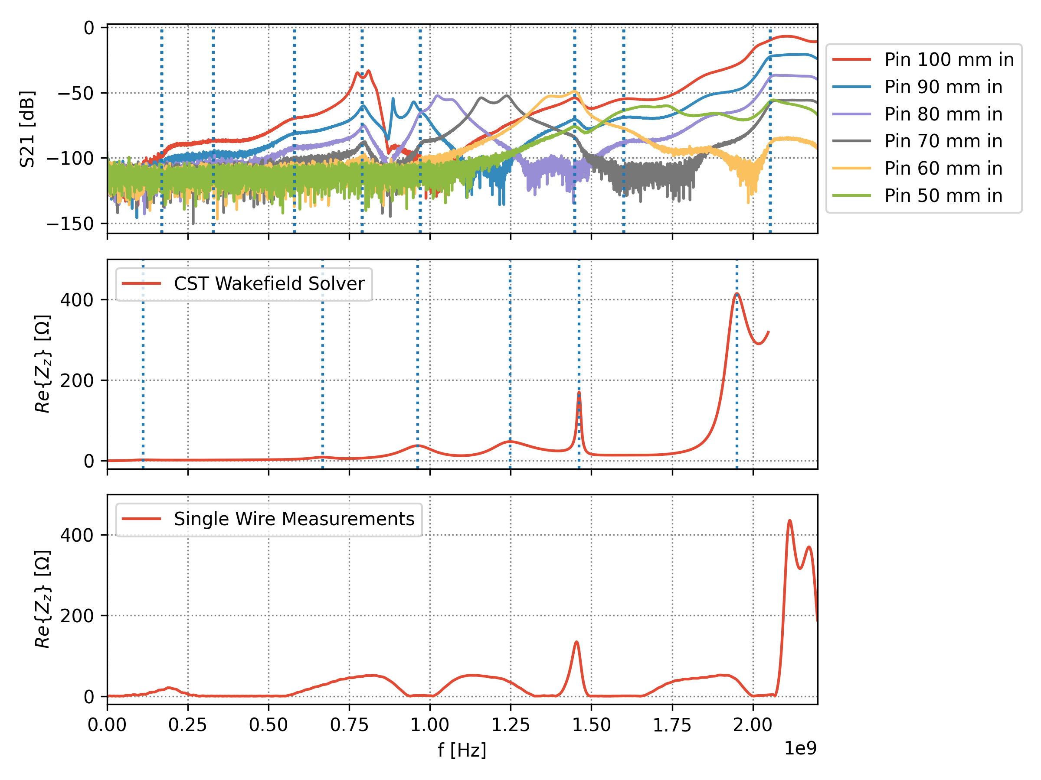
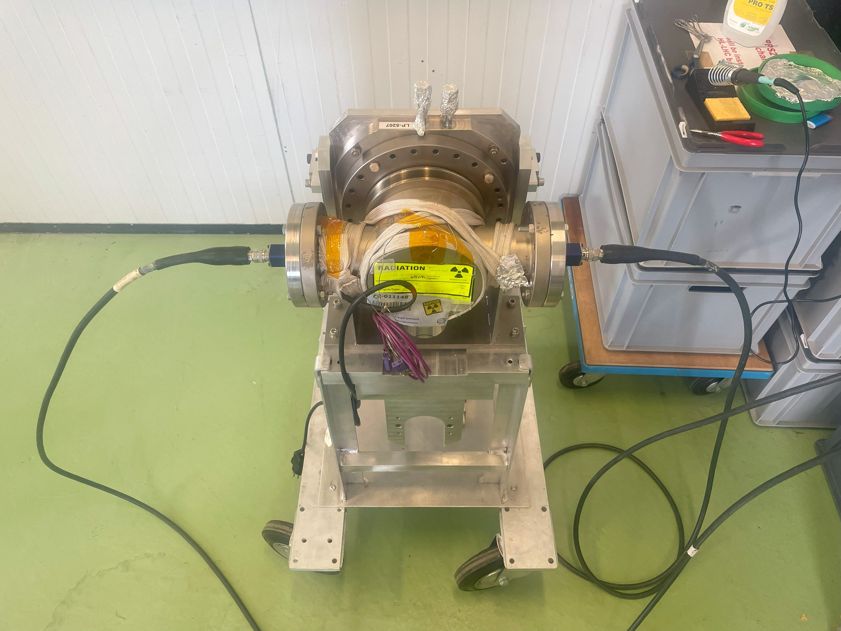
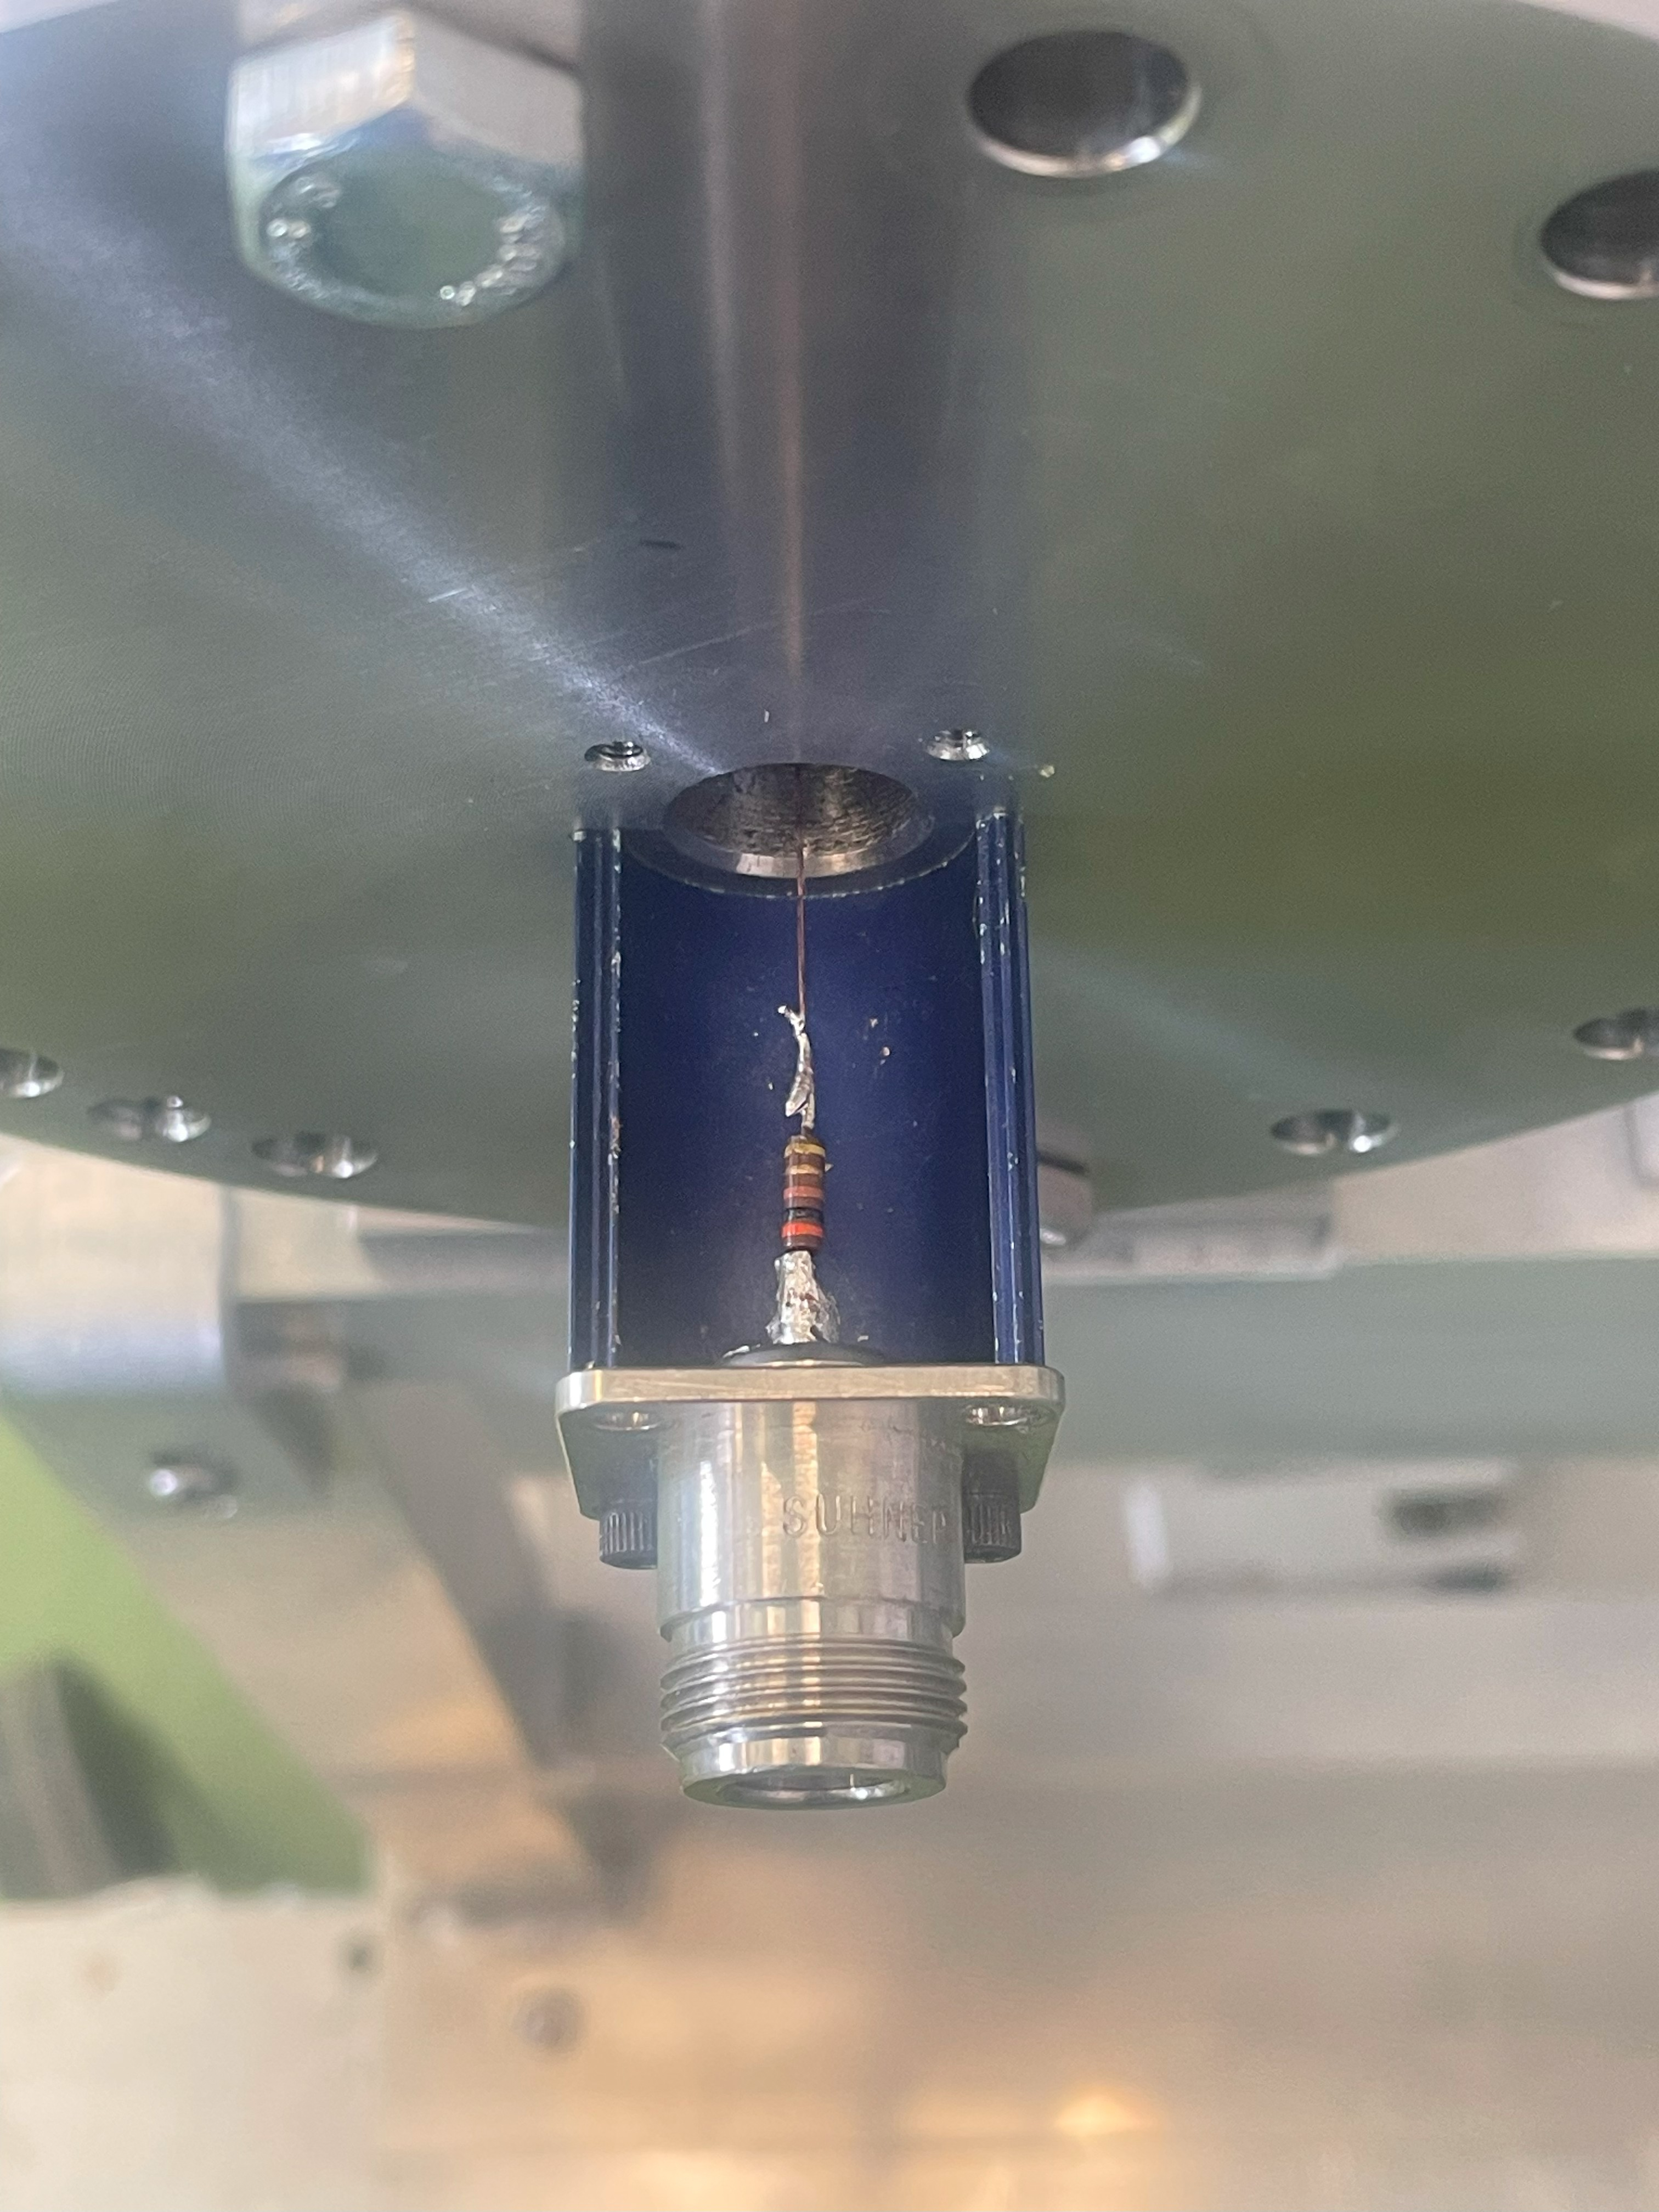
Longitudinal Impedance - Single Wire Measurements of Version 6
Operational Position – 1 mm
In backup also 3.3 mm, 7.7 mm, and 40 mm

Slide 17
Outline
CTPPS Roman Pots
1.1 Introduction
1.2 PPS2: upgrade for HL LHC
Longitudinal Impedance Studies
2.1 Introduction and preliminary studies
2.2 Longitudinal Impedance Study
2.3 Power loss study
2.4 Thermal study
Transverse Impedance Studies
Conclusions

Slide 18
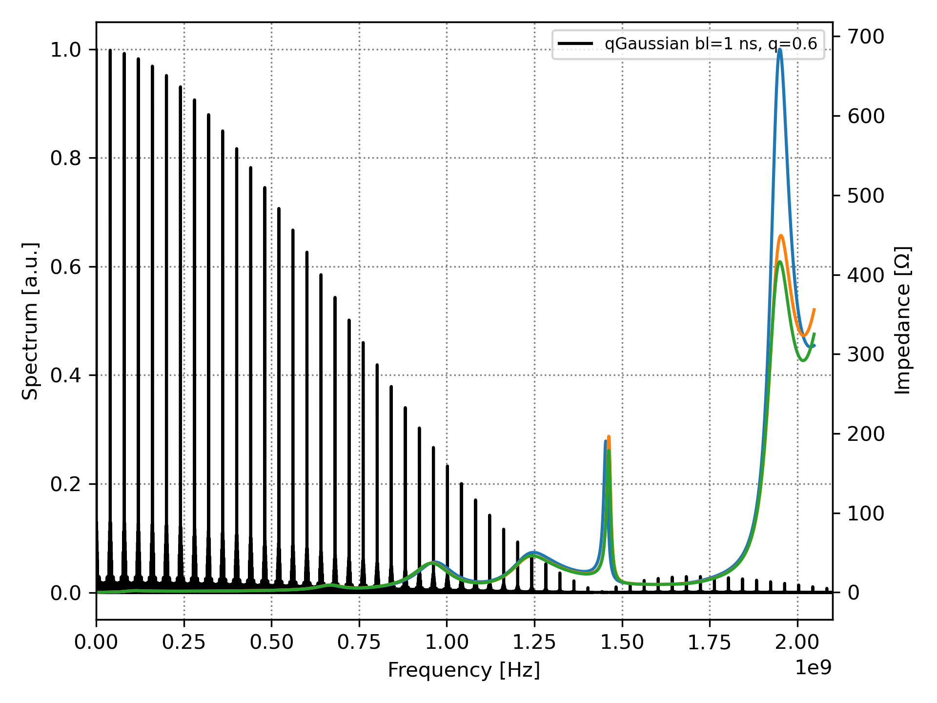
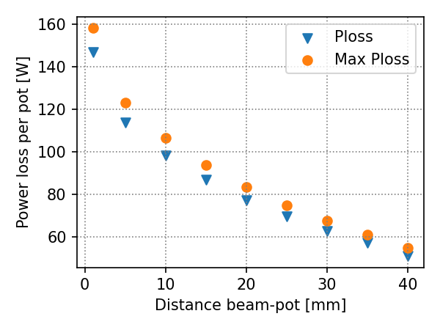
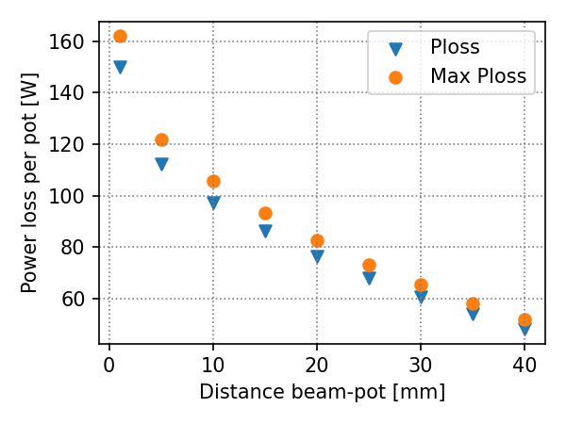
Power loss computations - BIHC
Varying the distance between beam and the top side of the pot:
Simulations of power lost were performed with:
25ns_2748b_2736_2258_2374_288bpi_12inj
2.3e11 ppb
qGaussian with 1 ns bunch length
V4
V5.3 or V6

Slide 19
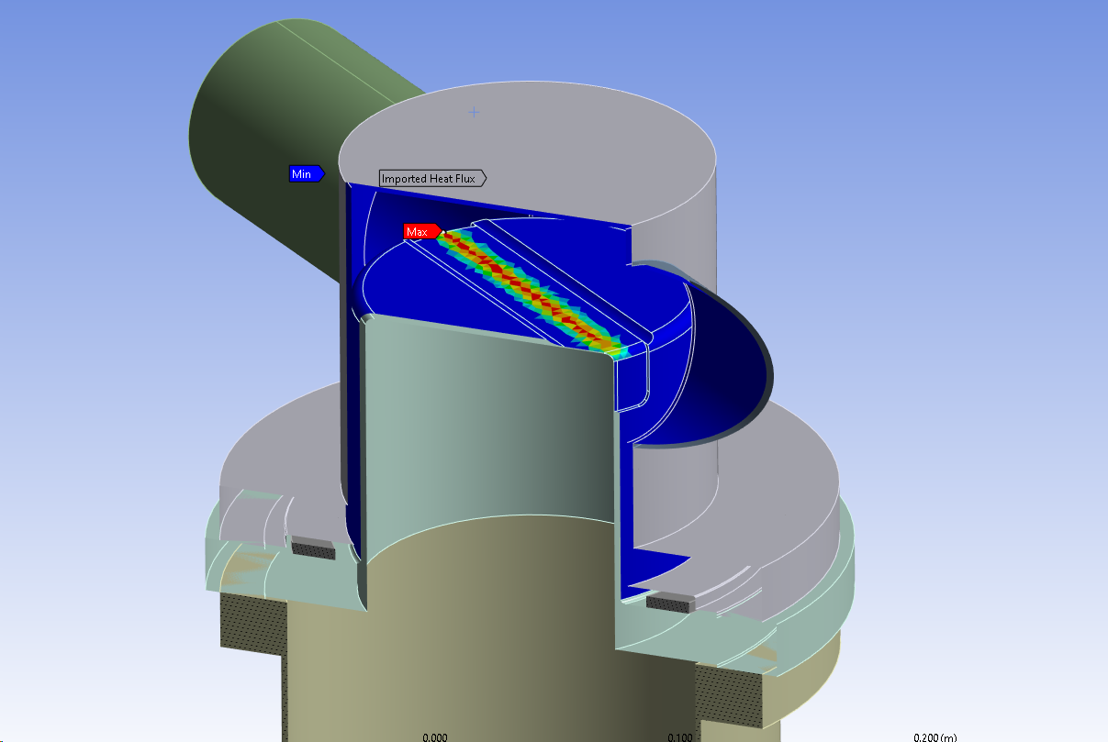
Power loss computations – Power distribution map
The most “dangerous” configuration was studied:
1 mm distance pot-beam
V5.3 or V6
Losses contributions and distribution
 | Average [W] | Max [W]
Total Power on the device | 148 | 160
Power in the ferrite | 126 | 136
Power on the top part of the pot | 14.2 | 15.6
Actual field distribution considered for thermal study
Assumed to be uniformly dissipated in the ferrite ring
Simulations of power lost were performed with:
25ns_2748b_2736_2258_2374_288bpi_12inj
2.3e11 ppb
qGaussian with 1 ns bunch length

Slide 20

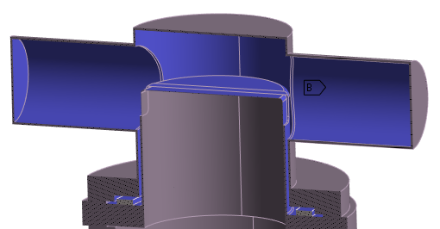
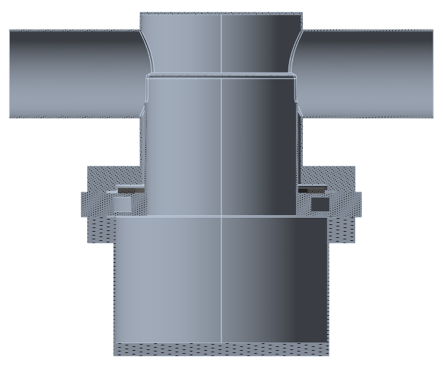
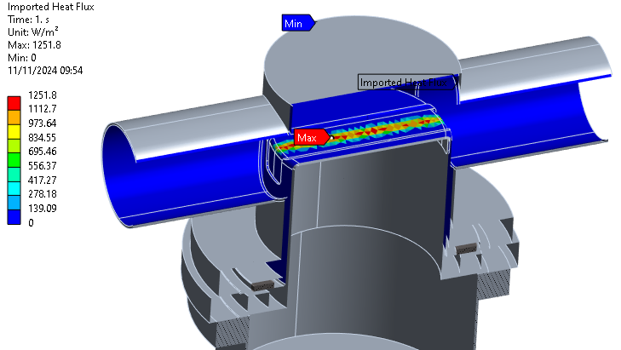
Boundary conditions
Radiation (1 enclosure defined)
Enclosure 1:
OPEN
Steady-state thermal
Natural convection boundary 22 °C, 5 W/m²K
Radiation
136 W power deposited on ferrite
Imported heat flux from the electro-magnetic simulations
22 °C
natural convection 5 W/m²K
Imported heat flux
136 W
Internal heat generation
Forced convection by water at 20 °C
Imported heat flux
Courtesy of Joanna Swieszek

Slide 21
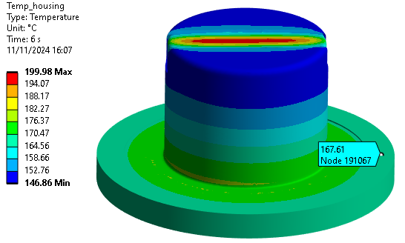
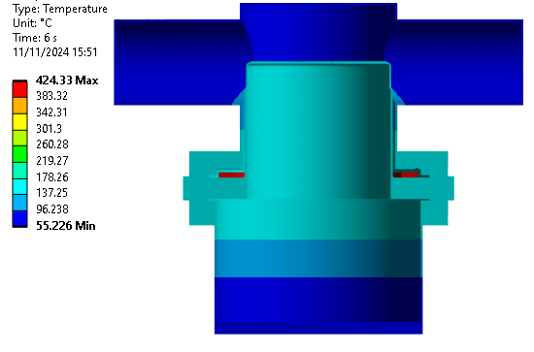
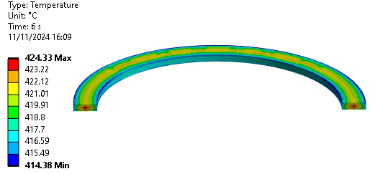
Results, without cooling channel
Steady-state thermal
Temperature in the SS housing
Temparature distribution in the assembly
Max temperature in the coil
Max temp. in the coil: 424 °C
Curie temperature around 375 °C
Courtesy of Joanna Swieszek

Slide 22
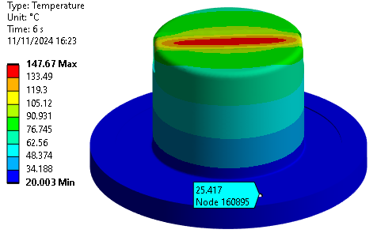
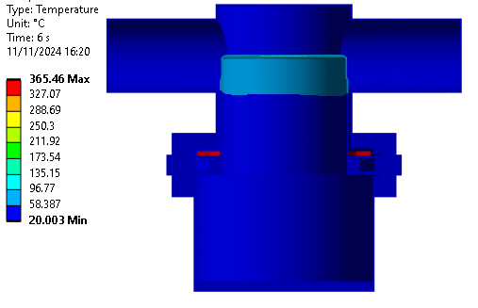
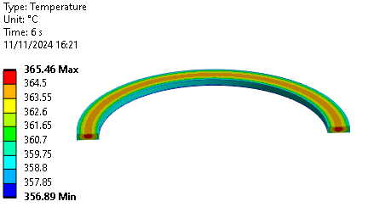
Results, with cooling channel
Steady-state thermal
Temperature in the SS housing
Temparature distribution in the assembly
Max temperature in the coil
Max temp. in the coil: 365 °C (~60 °C difference on the ferrite compared with the solution without cooling)
Curie temperature around 375 °C
Courtesy of Joanna Swieszek

Slide 23
Temperature dependency wrt thermal contact conductance
Thermal contact conductance | Max temperature in the ferrite |  | dT with/without cooling | Max temperature in the housing |  | Max temperature on the contact surface with ferrite
 | without cooling | with cooling |  | without cooling | with cooling | without cooling | with cooling
20 W/m²K | 424 °C | 365 °C | 59 °C | 200 °C | 148 °C | 177 °C | 25 °C
40 W/m²K | 378 °C | 287 °C | 91 °C | 200 °C | 147 °C | 182 °C | 25 °C
100 W/m²K | 304 °C | 168°C | 136 °C | 200 °C | 145 °C | 187 °C | 26 °C
Emissivity: 0.3 for SS 316LN (conservative approach)
20 W/m²K | 464 °C | 403 °C | 61 °C | 233 °C | 166 °C | 182 °C | 25 °C
Improving the contact between the ferrite ring and the steel flange will improve dramatically the situation!
Courtesy of Joanna Swieszek

Slide 24
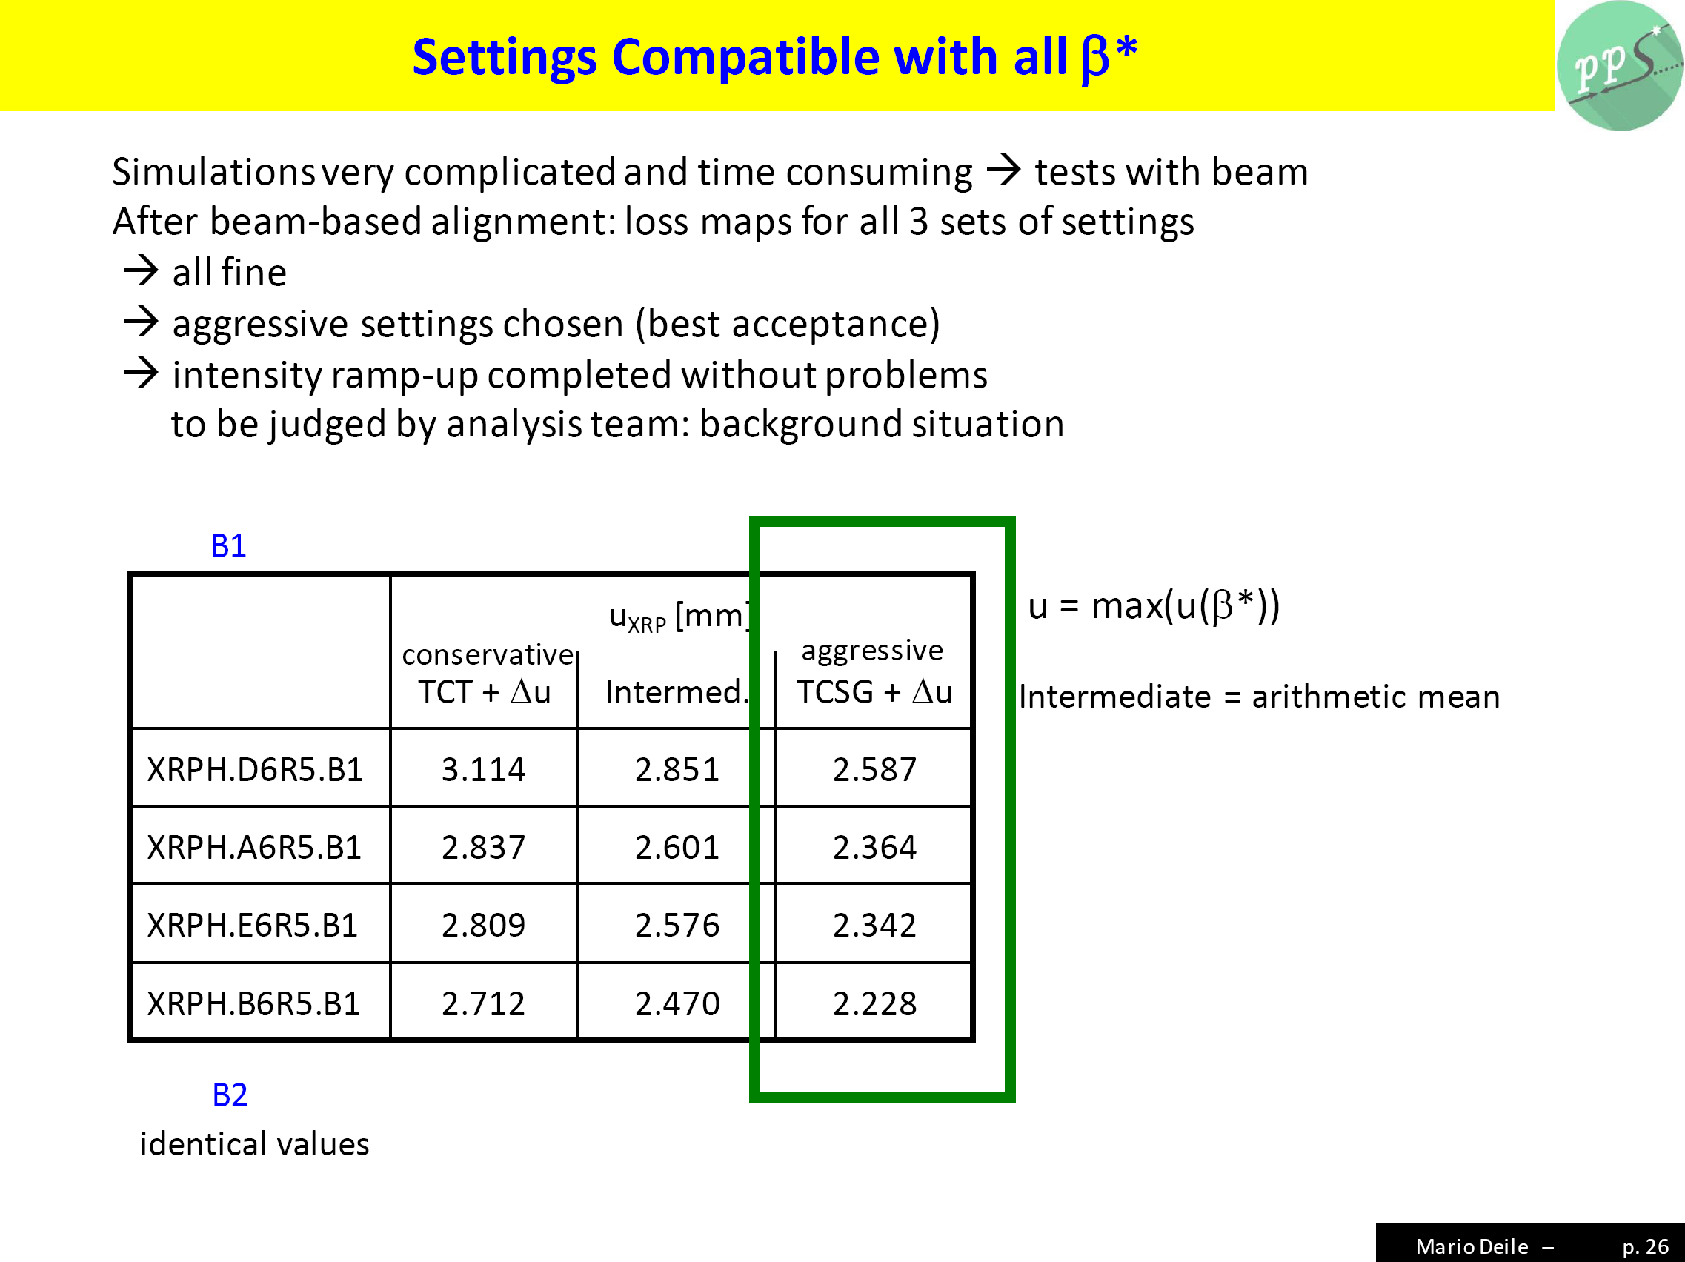
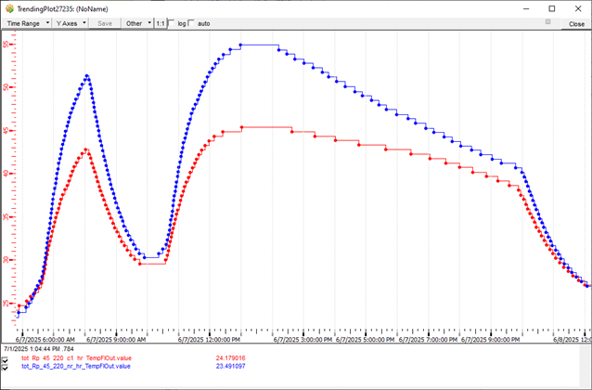
Thermal Study – Comparison with Run 3
Issue raised: even with cooling and good thermal contact, 160 degrees on the ferrite are not acceptable.
However, let’s look at measurements of the temperature on the flanges of the CTPPS during operation in Run 3.
Sensor
somewhere around here
Courtesy of Joanna Swieszek
Nb = 1.6 E11 ppb
With Gaussian Bunch and bl=1.3ns
25ns_2460b_2448_2089_2227_144bpi_20inj
During FILL 10690 →
Pots in ‘aggressive positions’ (thanks to Mario Deile)
55 degrees max temperature measured on flange
2.5mm distance pot-beam for impedance simulations
(Thermal data from Alexander Kurepin)

Slide 25
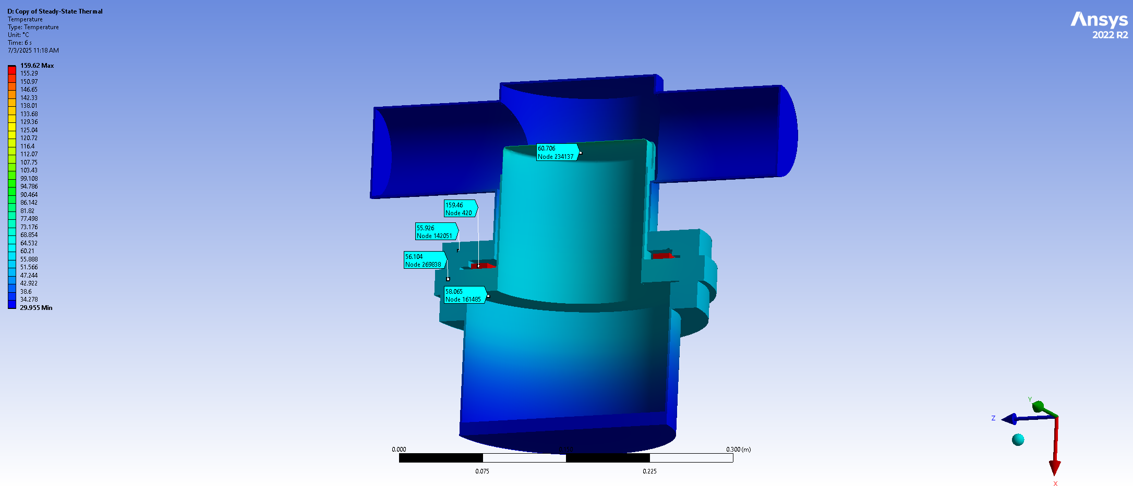
Thermal Study – Comparison with Run 3
Issue raised: even with cooling and good thermal contact, 160 degrees on the ferrite are not acceptable.
However, let’s look at measurements of the temperature on the flanges of the CTPPS during operation in Run 3.
Nb = 1.6 E11 ppb
With Gaussian Bunch and bl=1.3ns
25ns_2460b_2448_2089_2227_144bpi_20inj
During FILL 10690 →
Total power on the ferrite 28 W
From these computations we reached over 100 degrees on the ferrite in 2025

Slide 26
Need for in-vacuum temperature monitoring
Gap between the temperature measured on the flange and the actual ferrite temperature
In the order of hundreds of degrees
Knowing the actual ferrite temperature:
  Info on target max temperature to assume for PPS2 design
  Estimated temperatures of ferrite over 100 degrees already in 2025!
  Possibility of monitoring during operation
Courtesy of Joanna Swieszek
Fiber Optic Sensing with Fiber Bragg Grating:
Minimal dimension
Perfect for the temperature range
Radiation robustness
In-vacuum operation (in steel capillary)
Already widely and successfully used in CMS
Minimal modifications to the design
Or naked fiber with possible interesting R&D activity

Slide 27

In-vacuum temperature monitoring needs
Technical competences:
Expertise and experience of CMS team and UNINA Optopowerlab
Full availability for a collaboration and further discussions!
Infrastructures:
Availability of resources from CMS side for testing:
  Optical fibers are already in CMS and extending toward PPS (in case it is not difficult to extend even more)
Interrogation system from CMS can host another channel!
              Optical fiber extending to PPS stations
Readout system
Selection and installation of the sensor
Minimal R&D for sensor’s placing in PPS
              E.g. inserting and brazing a steel capillary in the flange

Slide 28
Outline
CTPPS Roman Pots
1.1 Introduction
1.2 PPS2: upgrade for HL LHC
Longitudinal Impedance Studies
2.1 Introduction and preliminary studies
2.2 Longitudinal Impedance Study
2.3 Power loss study
2.4 Thermal study
Transverse Impedance Studies
Conclusions

Slide 29
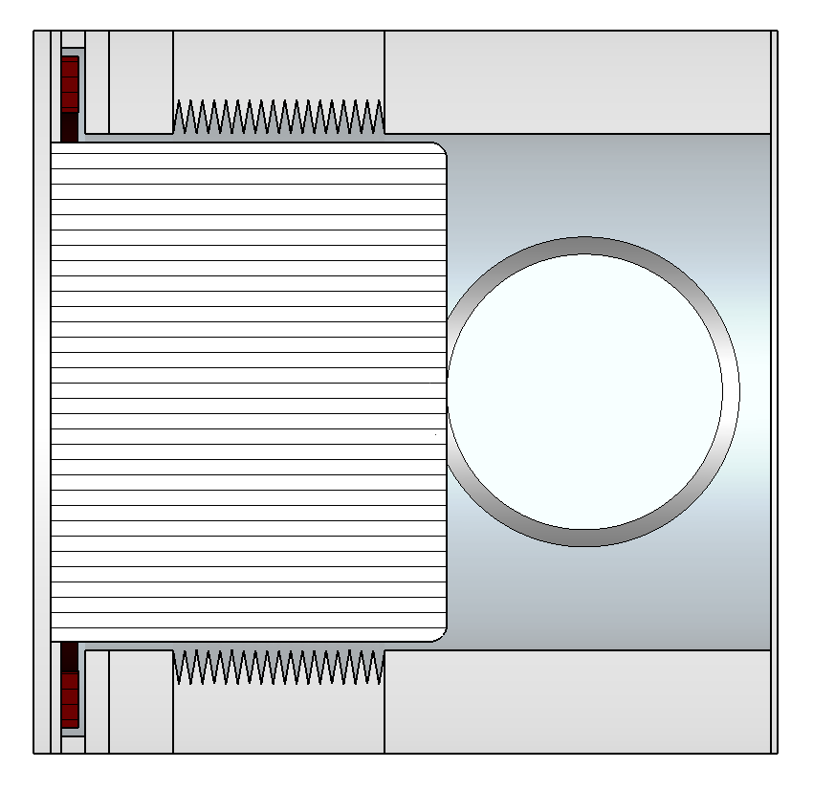







Transverse Impedance Studies
Dipolar
$$40mm$$
$$Z_{x}^{dip}= \frac{−(Z_{x}(x_{off})−Z_{x}(x_{off}=0))}{x_{off}}$$
Beam
Integration path
$$y_{off}$$
$$x_{off}$$
$$Z_{y}^{dip}= \frac{−(Z_{y}(y_{off})−Z_{y}(y_{off}=0))}{y_{off}}$$
Quadrupolar
$$40mm$$
$$Z_{x}^{quad}= \frac{−(Z_{x}(x_{off})−Z_{x}(x_{off}=0))}{x_{off}}$$
Beam
Integration path
$$y_{off}$$
$$x_{off}$$
y
$$Z_{y}^{quad}= \frac{−(Z_{y}(y_{off})−Z_{y}(y_{off}=0))}{y_{off}}$$
z
x

Slide 30
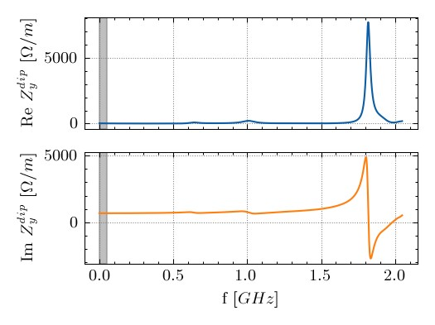
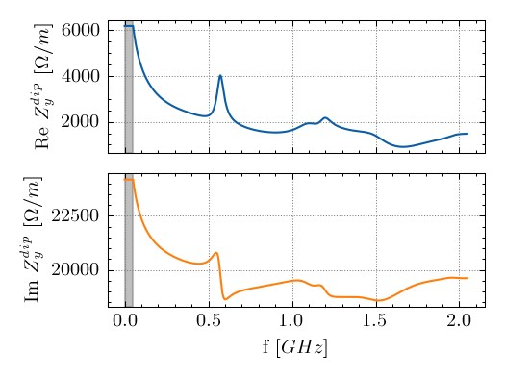
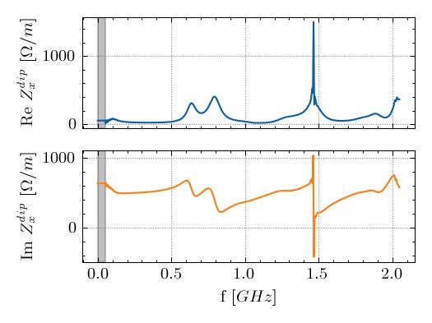
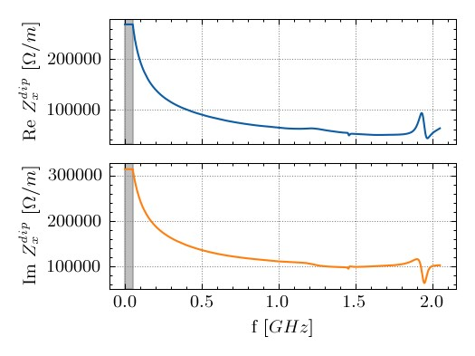
V4 - Dipolar Impedance Curves:
Parking 40 mm
Operational 1 mm

Slide 31
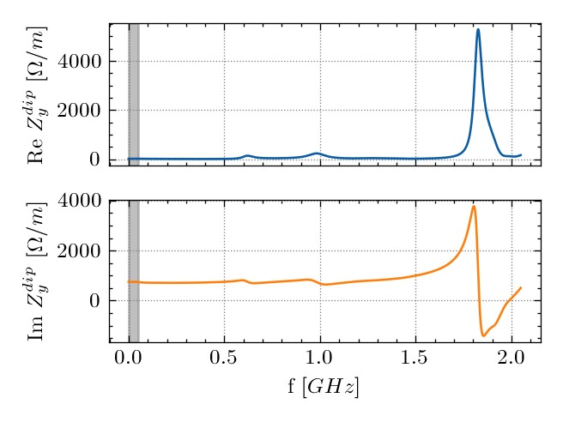
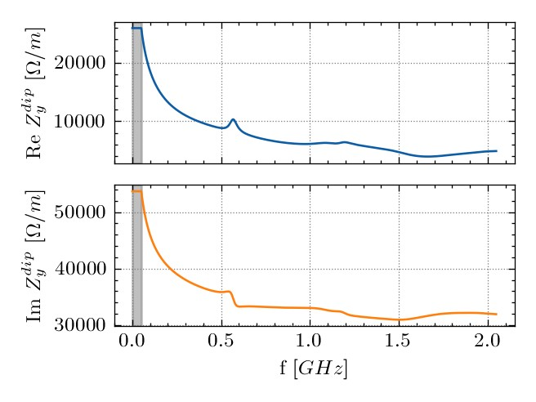
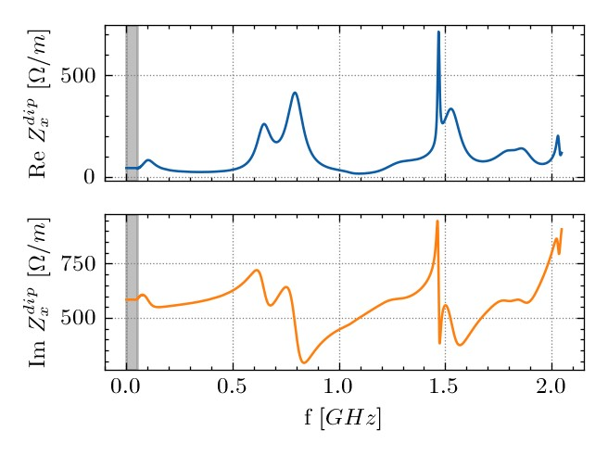
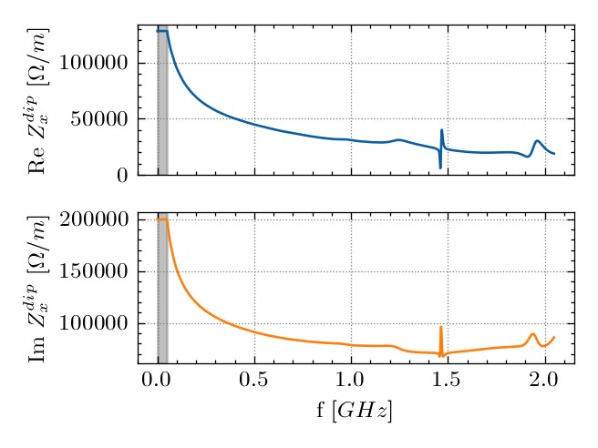
V5.3/V6 - Dipolar Impedance Curves:
Parking 40 mm
Operational 1 mm

Slide 32

HL-LHC Roman Pot (PPS2): scenarios
Courtesy of Chiara Antuono
PPS2s operate in different scenarios:
  parking position: to be considered at flat top
    start of levelling ($β^{∗}=1 m$)
    All Pots at 40 mm
  operational position: to be considered during collision
    end of levelling ($β^{∗}=15 cm$)
    Pots in XRP-196 at 7.7 mm
    Pots in XRP-220 at 3 mm
    Pots in XRP-243 at 1 mm
Stability assessment usually done only at flat top
Maximum increase of octupolar threshold in x: < 0.5%
Maximum increase of octupolar threshold in y: 0.8%
Given the presence of:
12 non-colliding bunches
Non negligible impedance of PPS2s
stability assessment performed also during collision

Slide 33
Outline
CTPPS Roman Pots
1.1 Introduction
1.2 PPS2: upgrade for HL LHC
Longitudinal Impedance Studies
2.1 Introduction and preliminary studies
2.2 Longitudinal Impedance Study
2.3 Power loss study
2.4 Thermal study
Transverse Impedance Studies
Conclusions

Slide 34
Conclusions
CTPPS Roman Pots Studies for PPS2 (HL LHC upgrade) have been performed with different pot design (not all of them were shown here)
With 1 mm distance pot-beam, there is risk of overheating the ferrite ring!
Possible solutions:
2.1 Increase thermal contact between ferrite and steel flange,
2.2 Increase water cooling flow
2.3 Need for temperature measurements of the ferrite in-vacuum
Still, this is not considering the detectors and electronics warming up
Transverse Impedance is not an issue since the device is inserted only when stable beam is declared. More considerations on non-colliding bunches are under study.

Slide 35

Thanks for your attention!
101st Impedance Working Group
CERN, Geneva, Switzerland
15 July 2025

Slide 36
Backup
101st Impedance Working Group
CERN, Geneva, Switzerland
15 July 2025

Slide 37

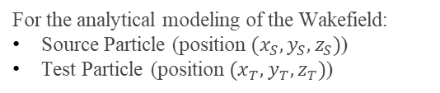





What is the beam-coupling impedance (pt 1)
$$y$$
For the analytical modeling of the Wakefield:
Source Particle (position $(x_{S},y_{S},z_{S})$)
Test Particle (position $(x_{T},y_{T},z_{T})$)
$$x$$
$$q_{s}$$
$$z$$
$$O$$
$$z$$

Slide 38
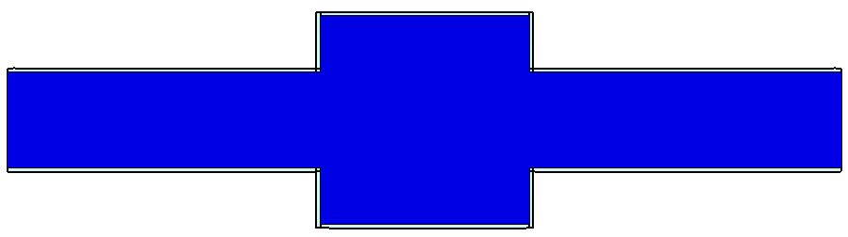

What is the beam-coupling impedance (pt 1)
$$y$$
For the analytical modeling of the Wakefield:
Source Particle (position $(x_{S},y_{S},z_{S})$)
Test Particle (position $(x_{T},y_{T},z_{T})$)
$$x$$
$$q_{T}$$
$$z$$
$$O$$
$$z$$

Slide 39
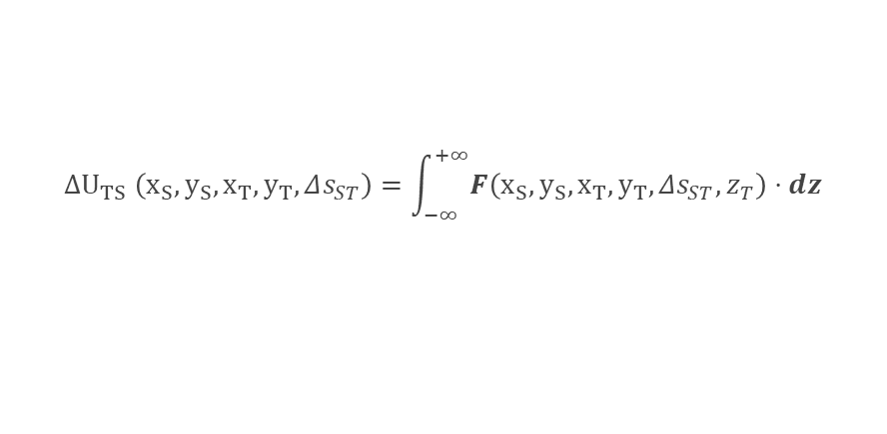

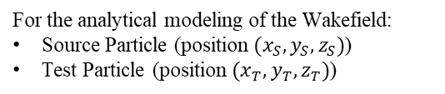
What is the beam-coupling impedance (pt 1)
$$y$$
For the analytical modeling of the Wakefield:
Source Particle (position $(x_{S},y_{S},z_{S})$)
Test Particle (position $(x_{T},y_{T},z_{T})$)
$$x$$
$$q_{T}$$
$$q_{s}$$
$$z$$
$$O$$
$$z$$
$$Δs_{ST}$$
Energy loss/gained by a test charge behind a source charge:
$$ΔU_{TS} \left(x_{S}, y_{S},x_{T},y_{T},Δs_{ST}\right)=\int_{−∞}^{+∞}{F\left(x_{S}, y_{S},x_{T},y_{T},Δs_{ST},z_{T}\right)⋅dz}$$
Longitudinal Wake Function:
$$w_{z} \left(x_{S}, y_{S},x_{T},y_{T},Δs_{ST}\right)=\frac{ΔU_{TS} \left(x_{S}, y_{S},x_{T},y_{T},Δs_{ST}\right)}{q_{S}q_{T}}$$
Same analysis can be made with transverse kicks ($F_{x}, F_{y}$) leading to transverse Impedance studies.

Slide 40
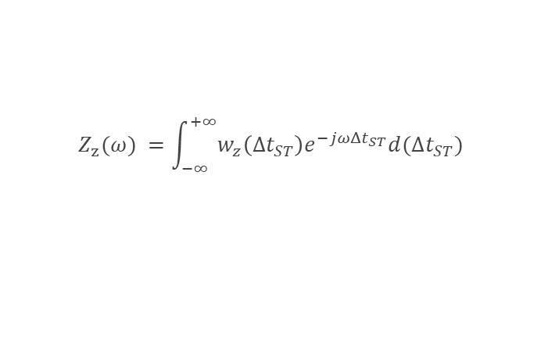
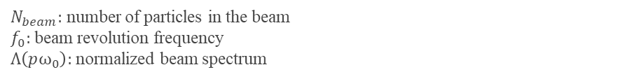

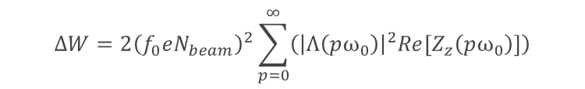
What is the beam-coupling impedance (pt 2)
The Longitudinal Wake Impedance is the Fourier Transform of the longitudinal Wake Function.
$$Z_{z}(ω) =\int_{−∞}^{+∞}{w_{z}\left(Δt_{ST}\right)e^{−jωΔt_{ST}}d(Δt_{ST})}$$
$Δt_{ST}=\frac{Δs_{ST}}{v}$,
With $v$ the speed of the particle
Advantages:
Easier to consider resonant modes of the structure.
Modeling of instabilities due to impedance (longitudinal and transverse).
Convenient analytical expression of the dissipated power (longitudinal).
$$ΔW=2{\left(f_{0}eN_{beam}\right)}^{2}\sum_{p=0}^{∞}{\left({\left|Λ\left(pω_{0}\right)\right|}^{2}Re\left[Z_{z}\left(pω_{0}\right)\right]\right)}$$
$N_{beam}:$ number of particles in the beam
$f_{0}:$beam revolution frequency
$Λ\left(pω_{0}\right):$ normalized beam spectrum

Slide 41


Model Order Reduction
The model used for EM simulations is a simplified version of the complete one.
No flanges
No Vacuum Pipe
Metal “filled” (Stainless Steel 316LN ($1.32e6 S/m$))
Simplified housing of the Ferrite Ring
V4, Distance beam-pot $1mm$

Slide 42

Model Order Reduction
The model used for EM simulations is a simplified version of the complete one.
No flanges
No Vacuum Pipe
Metal “filled” (Stainless Steel 316LN ($1.32e6 S/m$))
Simplified housing of the Ferrite Ring

Slide 43


Simulations plan
Preliminary:
Mesh consistency study (check convergence of the mesh)
Model consistency study (check agreement with two solvers: Eigenmode and Wakefield)
V4, Distance beam-pot $1mm$, without Ferrite Ring

Slide 44

Version 6 – Measurements Zz 1 mm
H:\user\l\lsito\CTPPS\V6\Measurements\Longitudinal

Slide 45


Version 6 – Measurements Zz 3.3 mm
H:\user\l\lsito\CTPPS\V6\Measurements\Longitudinal

Slide 46


Version 6 – Measurements Zz 7.7 mm
H:\user\l\lsito\CTPPS\V6\Measurements\Longitudinal

Slide 47


Version 6 – Measurements Zz 40 mm
H:\user\l\lsito\CTPPS\V6\Measurements\Longitudinal

Slide 48



Model 4 – Impedance curves and power loss
Varying the distance between beam and the top side of the pot (the parameter is called dB)
Beam-pot distance increasing:
Overall, as expected, the peaks are getting lower and broader.
Peaks at higher frequencies (1.5 and 2 GHz) are shifting toward higher frequencies.
Peaks below 1.4 GHz are shifting toward lower frequencies.
Simulations of power lost were performed with:
25ns_2748b_2736_2258_2374_288bpi_12inj.csv
1.63e11 ppb
1.2 ns bunch length
Simulations of power lost were performed with:
25ns_2748b_2736_2258_2374_288bpi_12inj.csv
2.3e11 ppb
1.2 ns bunch length
Eos/user/l/lsito/CTPPS/ThermalStudies_2023/V4_ZLongitudinal_Sweep

Slide 49


Model 5.3 – Impedance curves and power loss
Varying the distance between beam and the top side of the pot (the parameter is called dB)
Beam-pot distance increasing:
Overall, as expected, the peaks are getting lower and broader.
Peaks at higher frequencies (1.5 and 2 GHz) are shifting toward higher frequencies.
Peaks below 1.4 GHz are shifting toward lower frequencies.
Peak above 2 GHz shift lower in frequency!
Simulations of power lost were performed with:
25ns_2748b_2736_2258_2374_288bpi_12inj.csv
2.3e11 ppb
1.2 ns bunch length
How do V4 and V5.3 compare in terms of dissipated power?
(Same beam parameter as the plot on the left)
Eos/user/l/lsito/CTPPS/ThermalStudies_2023/V4_ZLongitudinal_Sweep

Slide 50


Model 5.3
Varying the distance between beam and the top side of the pot (the parameter is called dB)
Eos/user/l/lsito/CTPPS/ThermalStudies_2023/V4_ZLongitudinal_Sweep
Now, simulations of power lost were performed with:
25ns_2748b_2736_2258_2374_288bpi_12inj.csv (This filling scheme)
2.3e11 ppb
1.2 ns bunch length

Slide 51



Power loss computations with bunch length = 1 ns
Varying the distance between beam and the top side of the pot (the parameter is called dB)
Now, simulations of power lost were performed with:
25ns_2748b_2736_2258_2374_288bpi_12inj.csv (This filling scheme)
2.3e11 ppb
1 ns bunch length
V4
V5.3
180.94 W
182.3 W

Slide 52



Version 6 – No Radiation cooling, bad thermal contact
Convection: 4 W/m^2 K
 | Average [W] | Max [W]
Total Power on the device | 148 | 160
Power in the ferrite | 126 | 136
Power on the top part of the pot | 14.2 | 15.6

Slide 53



Transverse Impedance Curves
Parking position with 40 mm distance pot-beam
Operational position with 1 mm distance pot-beam
y
z
x
$$40mm$$

