Slide 1
UK Updates Global CCCM 18 Jul25
Niklas Templeton on behalf of UK WP4 team

Slide 2
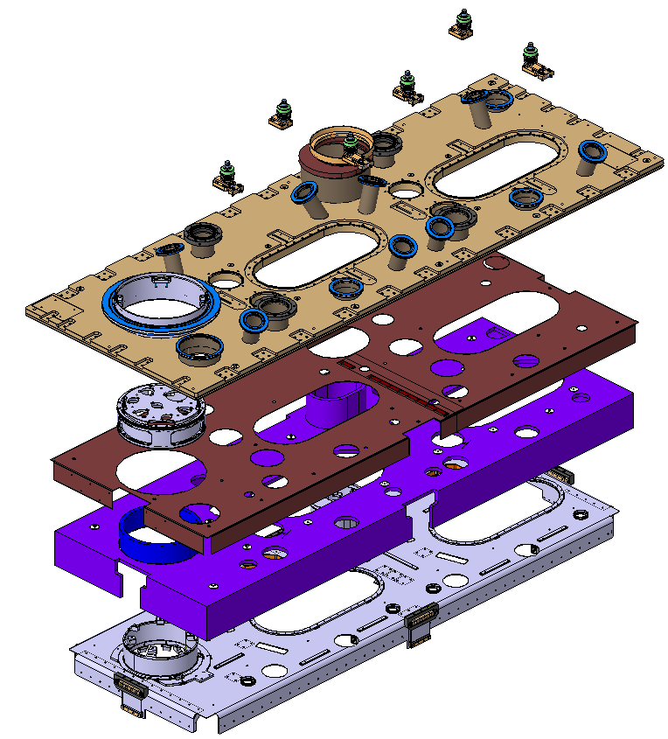
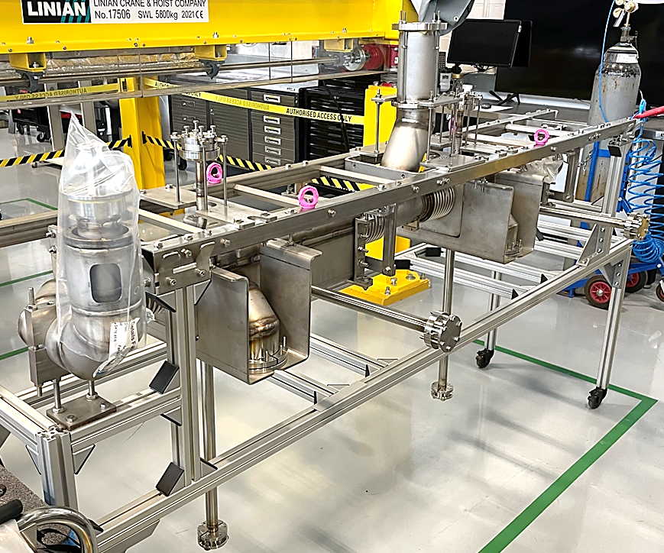
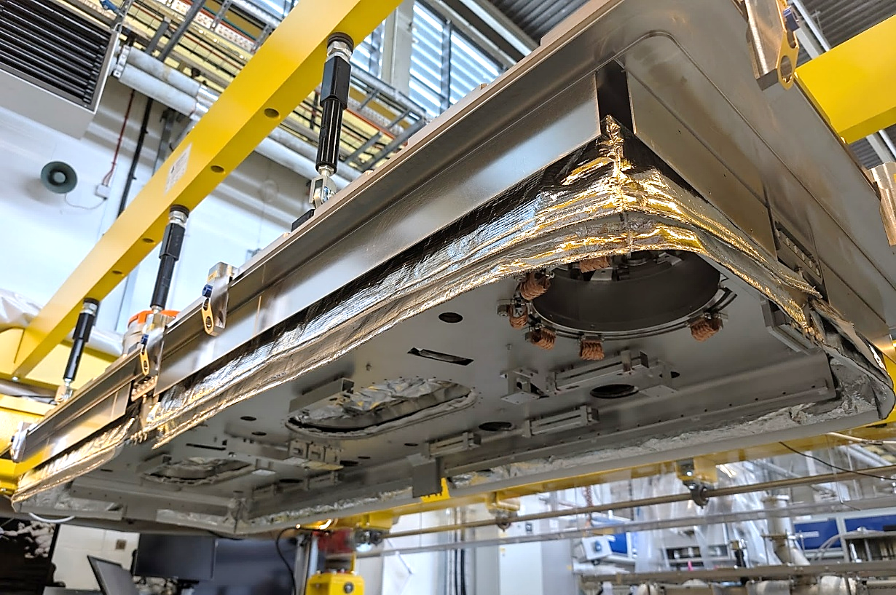
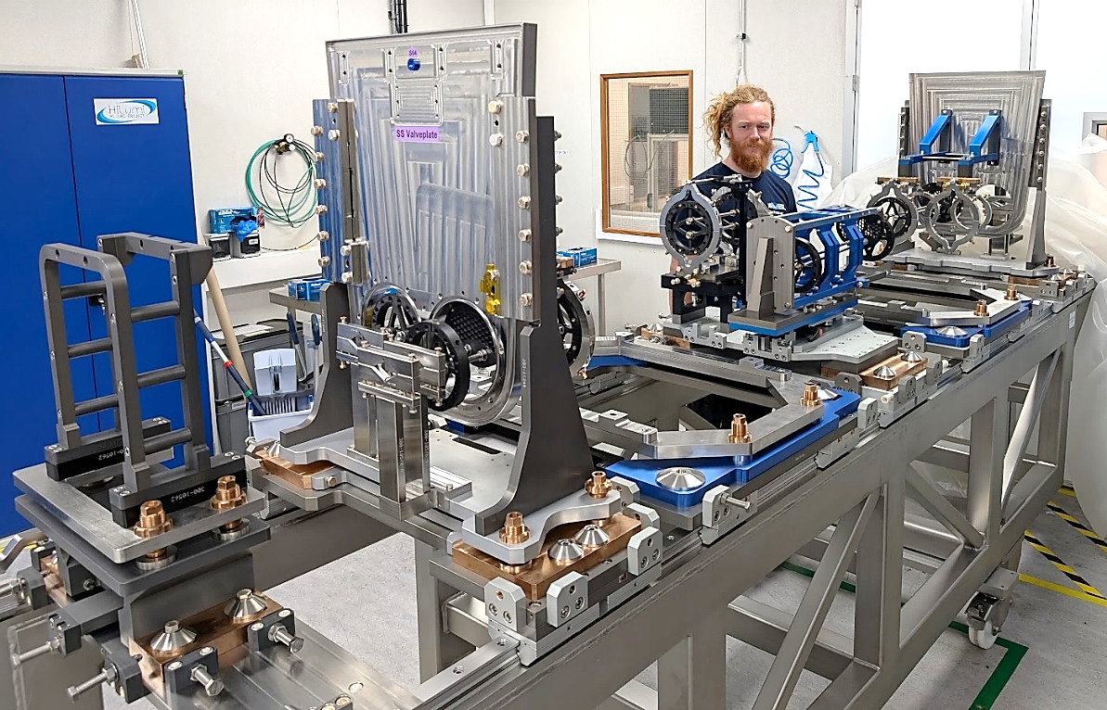
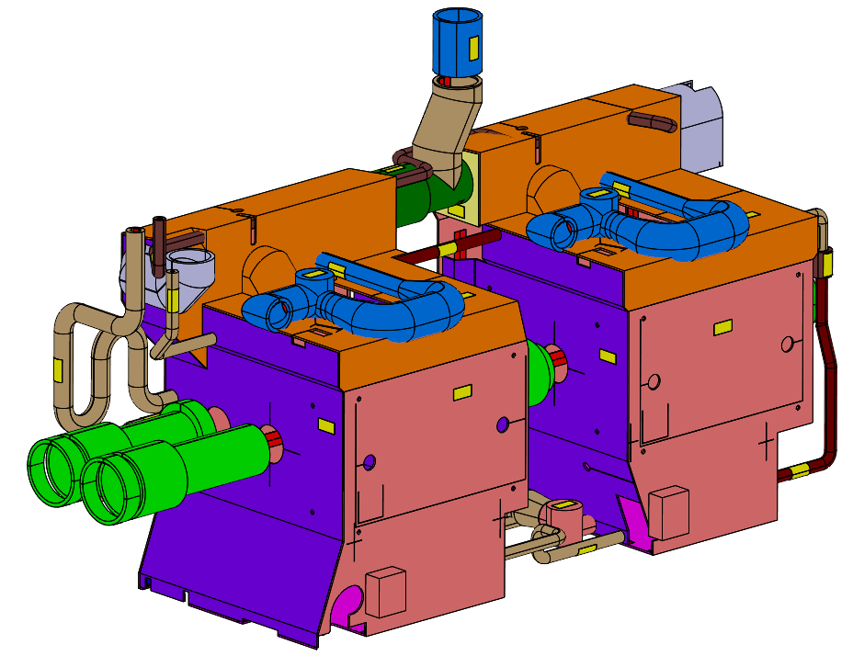
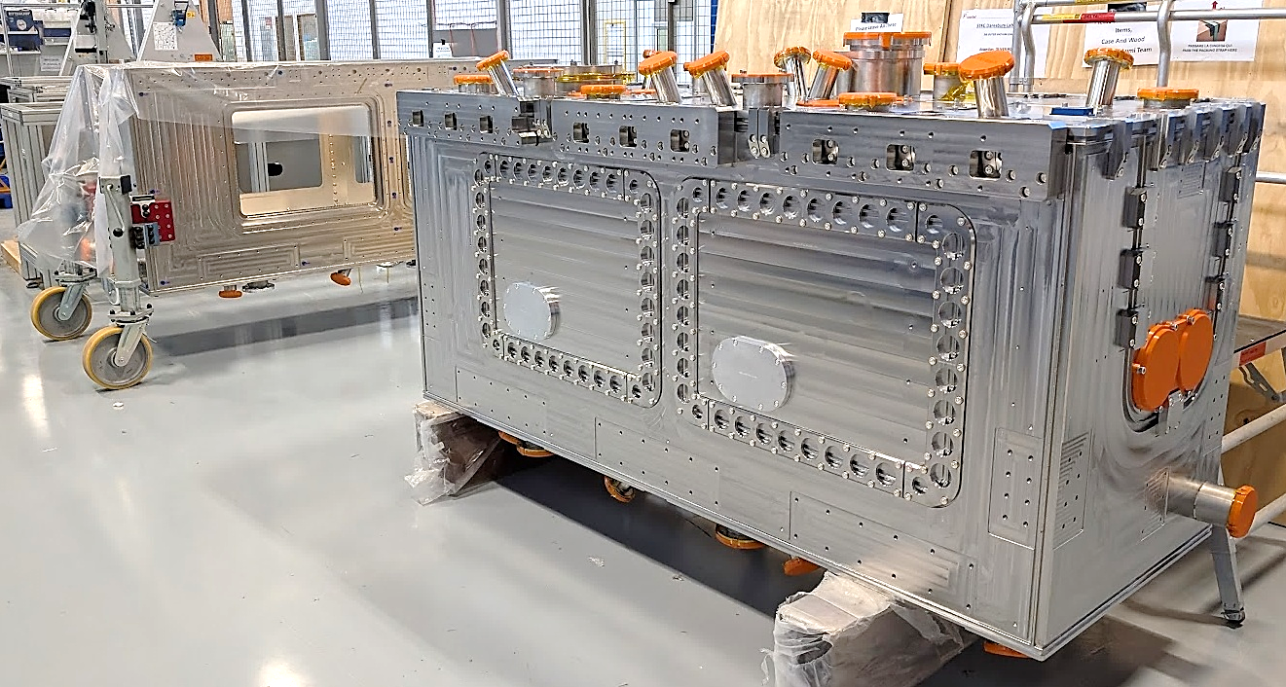
Technical Updates
Bi phase received!!!
Some minor NCs (next slide)
Top plate pre-assembly complete
2K MLI received
OVC#2 received
Cleanroom refurb complete – certification booked late-Aug
CM3 string tooling ready
Top Plate Gantry Assembly
Bi Phase Received
CM3 String Tooling Ready
2K MLI received
OVC#2

Slide 3
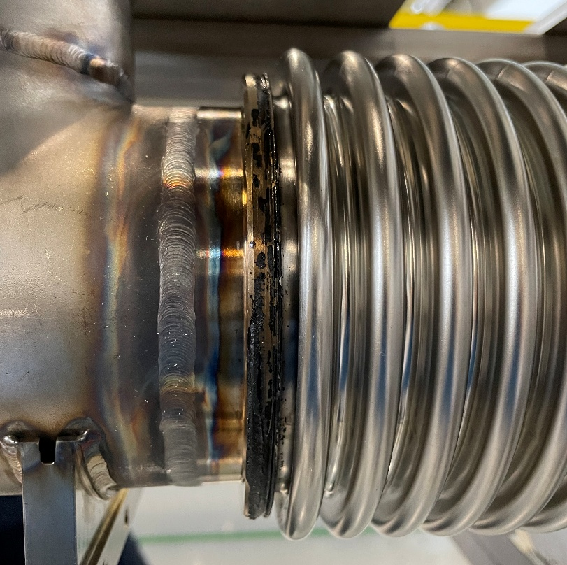
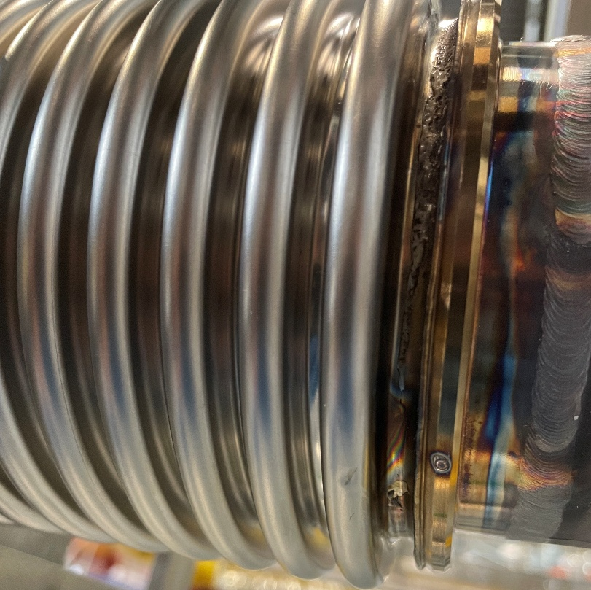
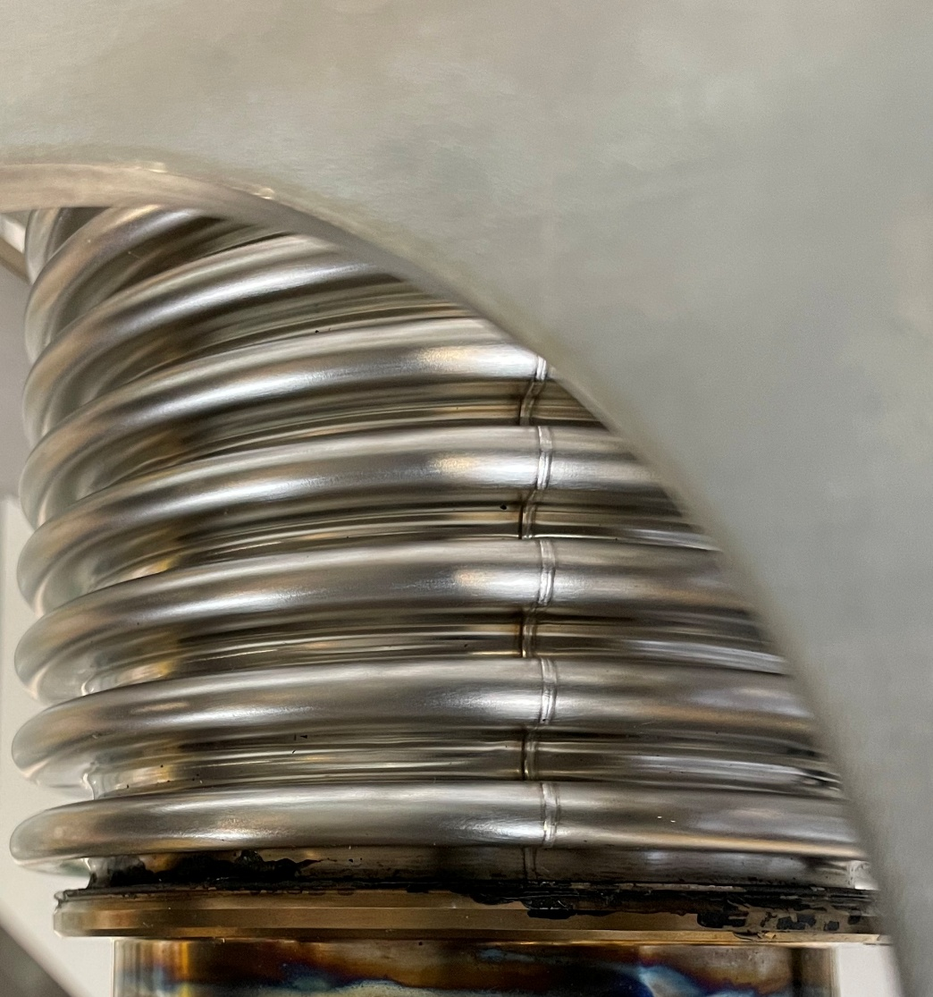
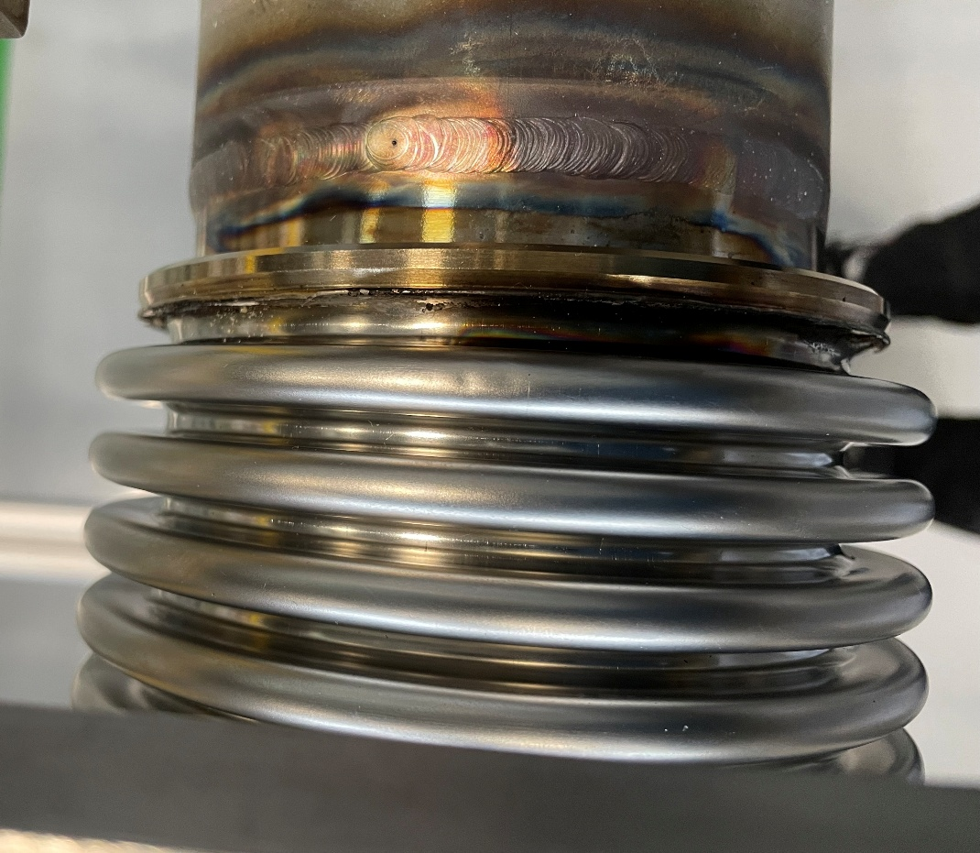
Bi Phase Incoming Inspection
Bellows covers left on for final welds – melted plastic residue left behind
Some welds not cleaned (discolouration)
Tooling loosened during transport
Small-shallow bellows dent discovered

Slide 4
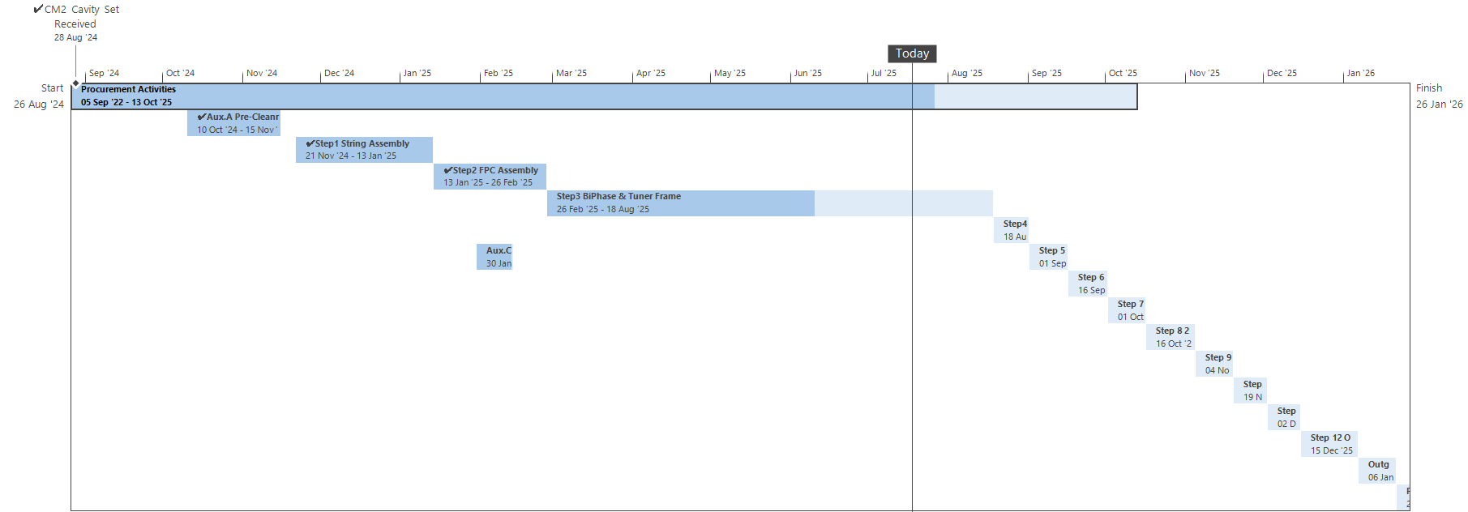
CM2 Schedule (Jul25)
No delays since May update
Challenges
Many survey & alignment activities
Particularly for CM2
Much more than RFD
Complex requirements
Time to perform, report, review can be weeks not days
Specialist resource co-ordination & availability
STFC welder, CERN specialist visits, STFC Cryo & Vac Eng’s
Other projects, leave, conferences…

Slide 5
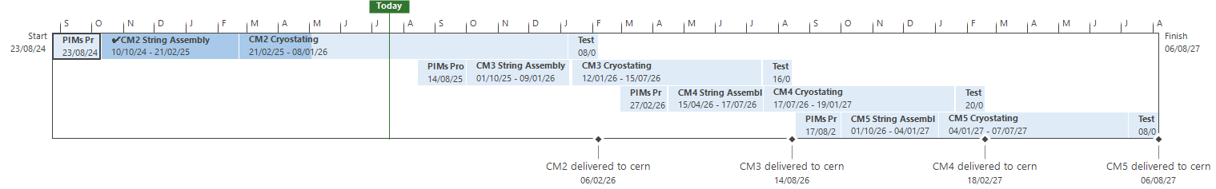
CM3-5 Planning (Jul25)
Cavity delivery dates: WP4_Master_Planning_June_2025_v1.7
Assuming 5 build technicians – currently 3.5
draft for discussion
draft for discussion

Slide 6

Management & Oversight
Graeme Burt
HL-LHC-UK PM
Anna Vikhoreva Project Support
Ian Lazarus
STFC Sponsor
Phil Atkinson Technical Oversight
Paul Hindley Technician Manager
*simplified representation – does not reflect pay band & line management structure
Crab Cavity Cryomodules
Ed Jordan
DAPT Lead
WP Lead
Nik Templeton
Andy Blackett-May
IQT Lead
Luke Bladen
TE Lead
Ivan
Cryo Engineer
Ollie
Vac Engineer
John
Welder
Abi
Technician
Roy
Engineering Works
Kavi Grad Engineer
David Undergrad Engineer
Carlos Granjeiro
QAWL Lead
Susan Technician
Matty Technician
Stuart
Vac Engineer
Dan
Design Engineer
Luke F Grad Engineer
Design, Assembly Procedures & Tooling
Quality Assurance, Welding & Logistics
Instrumentation, Qualification & Testing
Technical Engineering
Moving to DUNE
Transitioned to 50%
Departed
Abi Backfill
Back to DAPT (50%)
Shared Specialist Resources
Outside
Manufacture
In-House Manufacture
Vacuum
Processing
Riggers
Metrology
Logistics

Slide 7
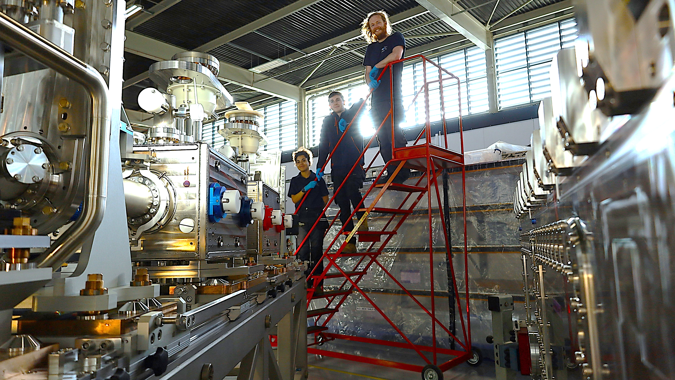





Thanks! Questions?

