Slide 1
Using the pyAT based software: https://gitlab.esrf.fr/BeamDynamics/commissioningsimulations
Data in:
/machfs/liuzzo/FCC/92a_107/Errors_refresh_2025_quads/FCC_92a_107_corbpm_quad_st_ErrQS_6D_30um_0umIP_CorCorLoc_phase
/machfs/liuzzo/FCC/92a_107/Errors_refresh_2025/FCC_92a_107_corbpm_sext_st_or_ErrQS_6D_30um_0umIP_CorCorLoc_phase_lessdisp_moreeig
FCC-ee LCC optics tuning
correctors/bpms at all ARC sextupoles
correctors/bpms at all ARC quadrupoles
S. Liuzzo, K. Andre. S. White, ESRF
P. Raimondi CERN

Slide 2
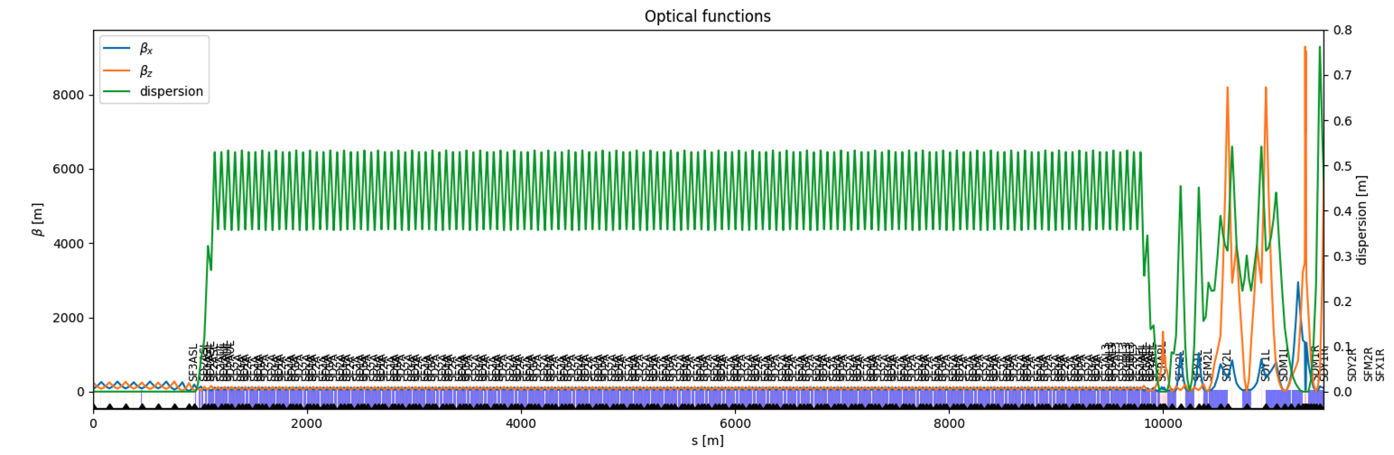
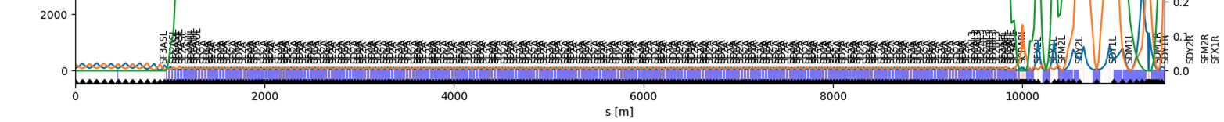
LCC optics commissioning simulations
Quad and Sext ARCs errors: 30um (nothing else).
In the IR correctors/BPMS have the same locations.
Correctors/BPM placed at all arc quadrupoles or all sextupoles (2 cases)
@ sextupoles
@ quadrupoles

Slide 3
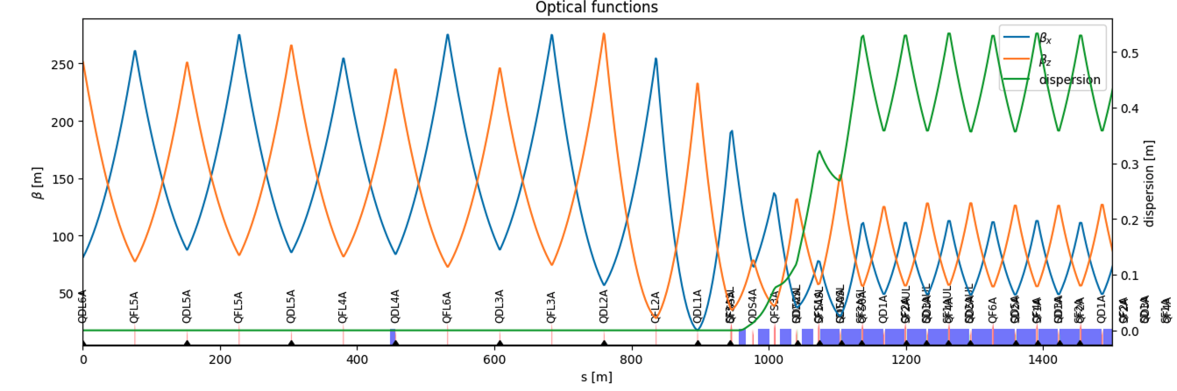
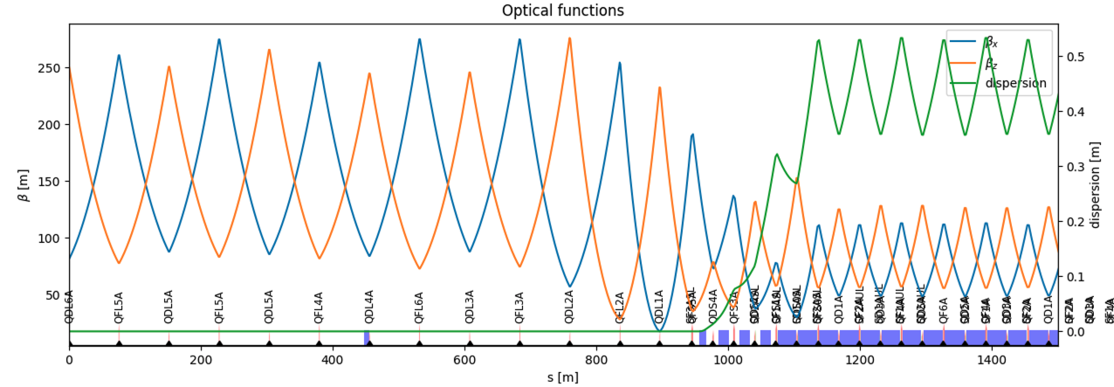
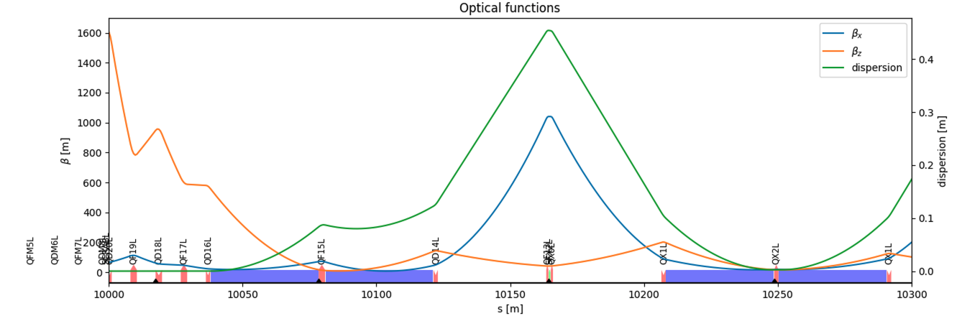
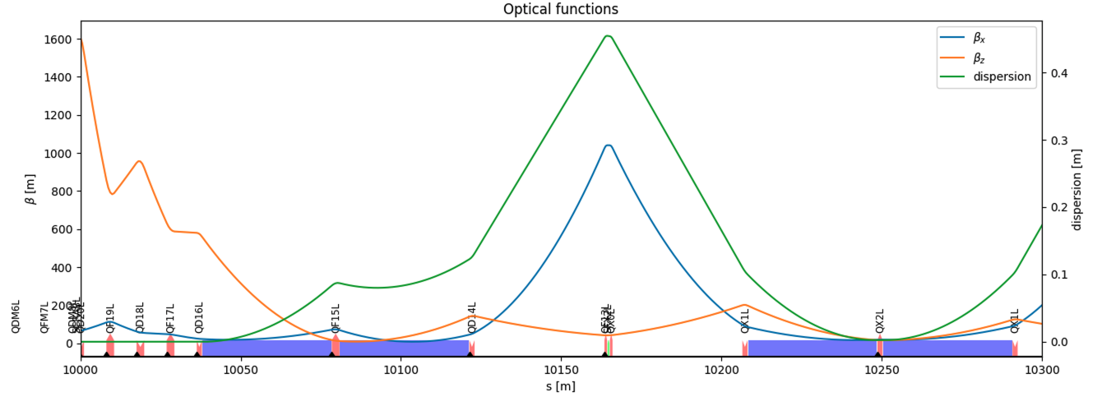
Number of correctors/BPMs
Cor (H, V, Skew): 2032 elements
bpms: 2032 elements
Quad correctors in quadrupoles (2616)
Cor (H, V, Skew): 2616 elements
bpms: 2616 elements
Quad correctors in quadrupoles (2616)

Slide 4
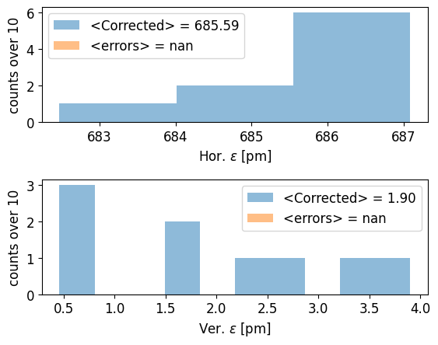
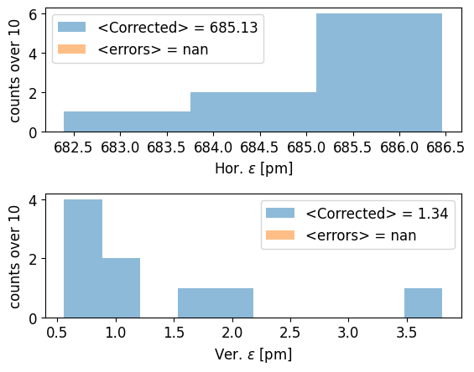
Commissioning sequence results
<rms>_{10seeds} | Cor/BPM @ sextupoles |  | Cor/BPM @ quadrupoles
 | H | V | H | V
orbit | 25μm | 7μm | 24μm | 6μm
tune | 0.2 | 0.29 | 0.2 | 0.29
dispersion | 0.12mm | 0.05mm | 0.10mm | 0.05mm
beta-beating | 0.03% | 0.03% | 0.03% | 0.03%
emittance | 685.59 | 1.90 (0.3%) | 685.13 | 1.34 (0.2%)
For sextupole case, one more stage in orbit correction (100*, 200, 1000 eig)

Slide 5
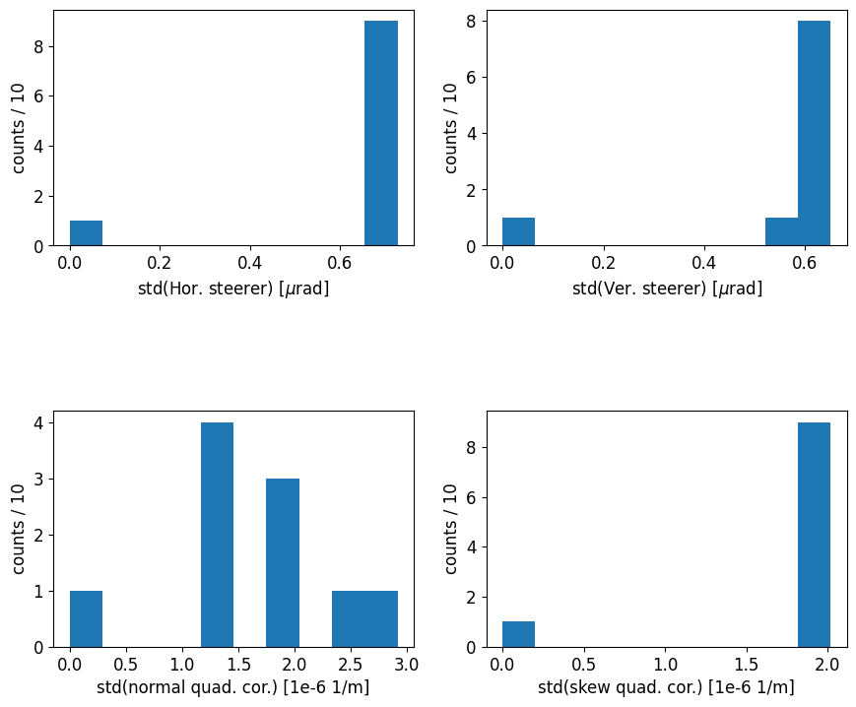
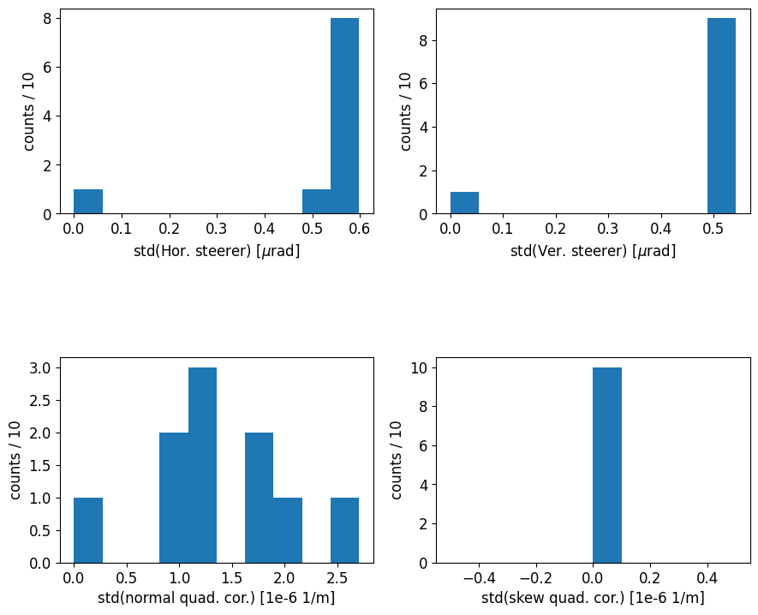
Correctors strengths after sequence results
Max(rms)_{10seeds} | Cor/BPM @ sextupoles |  | Cor/BPM @ quadrupoles
 | Normal | Skew | Normal | Skew
steerers | 0.7 μrad | 0.6 μrad | 0.6 μrad | 0.5 μrad
quadrupoles | 3e-6 1/m | 2e-6 1/m | 2.5 e-6 1/m | <0.1e-6 1/m
Long quadrupoles
For sextupole case, one more stage in orbit correction (100*, 200, 1000 eig)

Slide 6
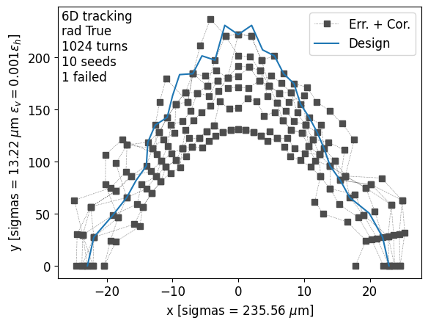
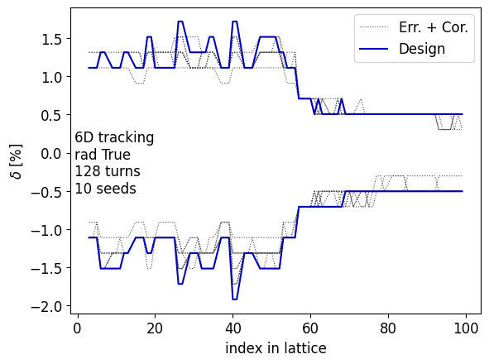
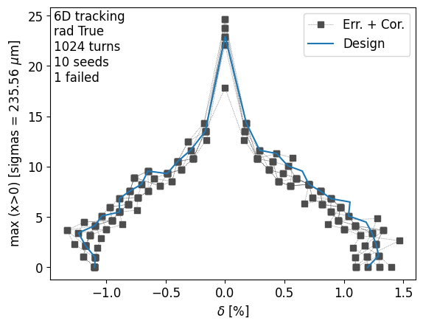
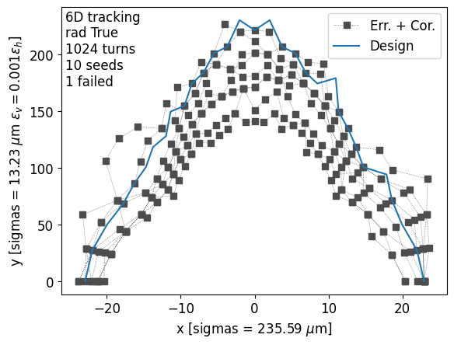
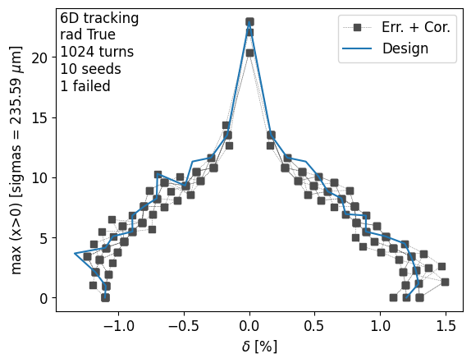
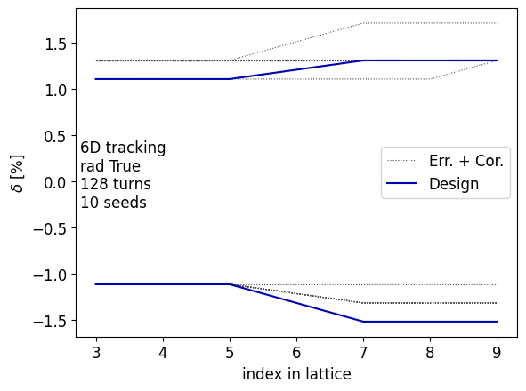
Dynamic apertures and MA for sextupoles
Dynamic apertures and MA for Quadrupoles

Slide 7
Girders
I think that adding in quadrature magnets and girder errors is not realistic. Once the machine is built, the rms alignment errors computed respect to a smooth curve following the actual position of the machine will likely by 30-50 um. And if the smooth curve is sufficiently smooth and low amplitude (likely several mm), then it will have no effect on the beam dynamics, accounting for few um between consecutive magnets.
What I can add instead of girder errors are smooth closed waves of errors of some amplitude summing a few low frequencies.

