Slide 1

ECR/Documents for Information and Approval
Giulia Romagnoli and Natalya Kahn for BE-EA, 2025-07-15
EA Documents - Agile Board - CERN Central Jira

Slide 2
LIST OF DOCUMENTS for Info
FOR INFORMATION EATM
Summary | Reporter | EA Projects | EDMS number | EDMS Status
Go/No-Go criteria for the installation of the new AD electron cooler | Adriana Rossi | AD | 3124439 - AD-LNT-ES-0006 | Engineering Check
AFT fault Analysis : North Area and East Area faults between 2021-2024 | Paraskevi Alexaki | North Area, NA-CONS | 3227096 - SPSX-O-RPT-0003 | Released
BOREAL Converters List in TT20 and North Area | Ivan Josifovic | North Area, NA-CONS | 3180776 - SPSX-E-LST-0035 | Under Approval
POLARIS Converters List in TT20 and North Area | Ivan Josifovic | North Area, NA-CONS | 2801752 - SPSX-E-LST-0048 | Under Approval
Power converter requirements for North Area interlocking | Antoine Colinet | North Area, NA-CONS | 3253361 - SPSX-R-SPC-0003 | Engineering Check
Functional Specification for the XCED Gas System | Krystian Sidorowski | North Area, NA-CONS | 3320907 - SPSX-B-SPC-0006 | Engineering Check

Slide 3
LIST OF DOCs for FUTURE APPROVAL
ECR INFO/FUTURE APPROVAL EATM
Summary | Reporter | EA Projects | EDMS number | EDMS Status
AMS Installation on T09 Beamline | Dipanwita Banerjee | East Area | 3286847 – PSZ-X-EC-0001 | In work
Removal of Four Power Converters | Sven de Man | AD | 3316808 – AD-R-EC-0007 | Engineering check
Installation of a New Hydrogen Buffer outside EHN1 for the NA61/SHINE Experiment | Bartosz Maksiak | North Area | 3197663 – SPSX-J-EC-0009 | Engineering check
DRD1 Test Facility | Eraldo Oliveri | North Area |  | In work
Modification of PPE 156 area in H6 beamline | Laurie Nevay | North Area |  | In work
Displacement of P42 BLMs | Laurie Nevay | North Area |  | In work
Magnets in PPE146 | Laurie Nevay | North Area |  | In work
Lifting Table for GIF Pre-Dump (XTDVs in PPE144) | Miguel Santos | North Area |  | In work
PPE118/128 Shielding Modification for Better Crane Access to TT82 | Sylvain Girod | North Area | 3317569 – SPSX-J-EC-0014 | In work
HI-ECN3 Transfer Trolley | Roberto Rinaldesi | North Area, HI-ECN3 | 3237347 – SPSX-H-EC-0002 | In work
NA-CONS Fire-Resistant Partitions 3 - Partitions #09, #10, #11, #12, #13, #14, #17 and #33 | Adem Kaymak | North Area, NA-CONS | 3286649 – SPSX-SF-EC-0017 | Engineering check

Slide 4
LIST OF DOCs for FUTURE APPROVAL
ECR INFO/FUTURE APPROVAL EATM
Summary | Reporter | EA Projects | EDMS number | EDMS Status
Asset Replacement Request – Valve replacement – secteur LNE.VVGAG.0340 | Alexandre Sinturel | AD |  | In work
Asset Replacement Request - EN-EL - BA80 starpoint installation | Jeremy Blanc | North Area, NA-CONS | 3318127 – SPSX-ED-EC-0002 | Engineering check
Asset Replacement Request - Starpoint installation in BA80 during YETS 25-26 (IT-CS) | Christian Burlet | North Area, NA-CONS | 3314109 – SPSX-ED-EC-0001 | Under Approval
User Requirements for the Refurbishment of the MTS Magnets of the T2 Target Station | Nikos Charitonidis | North Area | 3316797 - SPSX-M-ES-0004 | Engineering check

Slide 5
LIST OF DOCs for APPROVAL
ECR APPROVAL EATM
Summary | Reporter | EA Projects | EDMS number | EDMS Status
Production/Installation of a New Access Gangway to TELMAX/ASACUSA Platforms | Francois Butin | AD | 3307640 – AD-LJ-EC-0028 | Under Approval
MDX Magnet Installation for User Set-Up in T10 | Maarten Van Dijk | East Area | 3212841 – PSZ-M-EC-0002 | Under Approval
GIF++ Bunker Extension in Phase 2 | Martin Jaekel | North Area | 3223563 – SPSX-J-EC-0011 | Under Approval
Temporary Installation of Two XBPFs in M2 for Beam Divergence Measurement | Inaki Ortega Ruiz | North Area | 3313838 – SPSX-B-EC-0020 | Under Approval
Small Modifications to the Instrumentation in PPE134 | Nikos Charitonidis | North Area | 3252972 – SPSX-L-EC-0011 | Under Approval
Re-installation of XCED Detector on H6 Beamline in PPE136 | Miguel Santos | North Area | 3286149 – SPSX-B-EC-0018 | Under Approval
BA81 Extension Ventilation | Jani Lehtinen | North Area, NA-CONS | 3156846 – SPSX-U-EC-0002 | Under Approval
BA80 Power Converters for NA-CONS and the HI-ECN3 Bump Magnets | Ivan Josifovic | North Area, NA-CONS, HI-ECN3 | 3164018 – SPSX-R-EC-0001 | Under Approval

Slide 6
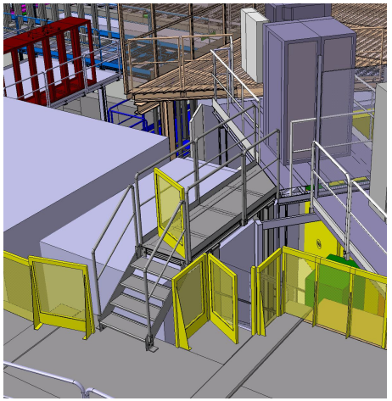
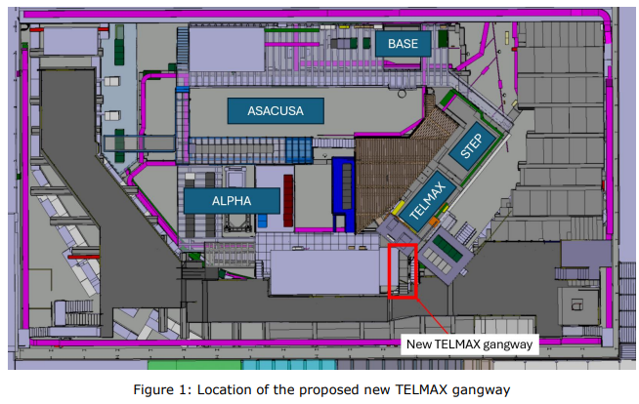
ECR Under Approval
AD-LJ-EC-0028
Version 0.2
Production/Installation of a New Access Gangway to TELMAX/ASACUSA Platforms
By Francois Butin
This ECR describes the request for the production and installation of new access gangway leading to the TELMAX and ASACUSA platforms.
The platform over the ASACUSA and TELMAX areas is used for temporary storage as well as access for the BASE-STEP gas supply system. Access is not ideal at the moment, and there is one emergency exit (via a vertical ladder).
The new gangway will ease movement and evacuation. It will be easily removable and reinstallable.

Slide 7
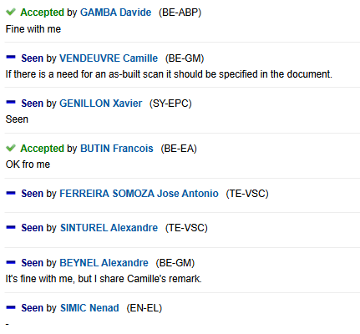
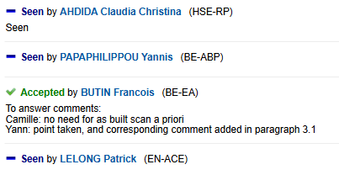

ECR Under Approval
AD-LJ-EC-0028
Version 0.2
Production/Installation of a New Access Gangway to TELMAX/ASACUSA Platforms
By Francois Butin
Seeking approval from EATM

Slide 8
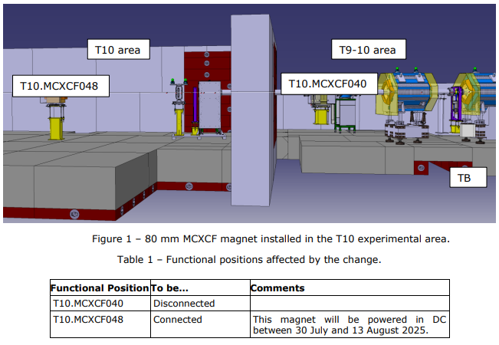
ECR Under Approval
PSZ-M-EC-0002
Version 0.2
MDX Magnet Installation for User Set-Up in T10
By Maarten Van Dijk
This ECR describes the installation of a horizontally deflecting 80 mm aperture MCXCF dipole magnet in the T10 experimental area between 30 July and 13 August 2025.
A MCXCF magnet with 80 mm aperture will be installed in the T10 experimental area.
The power supply, RPAEJ.251.T10.RDHZ040, is currently connected via the Terminal Box RJ-RCXCF040=157 to the magnet T10.MCXCF040 in pulsed mode. The DC cables from the Terminal Box shall be connected to the newly installed magnet T10.MCXCF048 to be powered in DC mode and the busbar will be switched inside the Terminal Box.

Slide 9
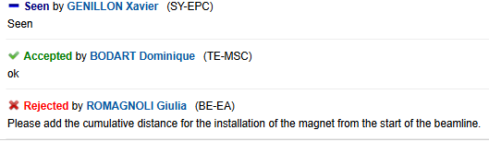
ECR Under Approval
PSZ-M-EC-0002
Version 0.2
MDX Magnet Installation for User Set-Up in T10
By Maarten Van Dijk
Seeking approval from EATM

Slide 10
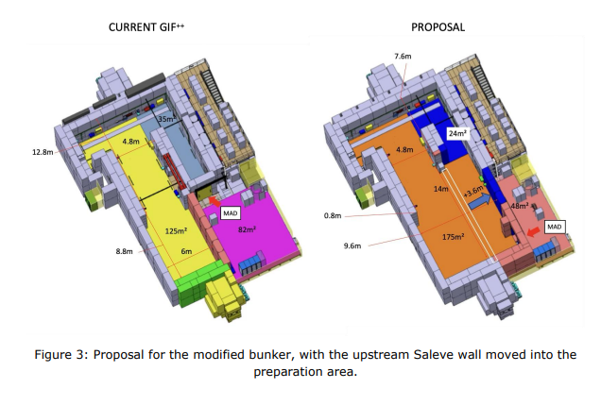
ECR Under Approval
SPSX-J-EC-0011
Version 0.2
GIF++ Bunker Extension in Phase 2
By Martin Jaekel
This document describes the conversion of part of the GIF++ preparation area to extend the irradiation bunker.
The extension would resolve:
Limits on detector size due to the current layout
Shadowing of the gamma field for detectors further away from the irradiator
A bottleneck due to the existing layout that causes difficulties transporting chambers
Activities discussed in this ECR:
Modification of the false floor
Access door relocation
Access system modification
Electrical distribution relocation
Relocation of local gas distribution panels
Relocation of cable trays
Relocation of user racks
Update RP simulation
Relocation of air-ventilation duct
Extension of smoke detection system

Slide 11
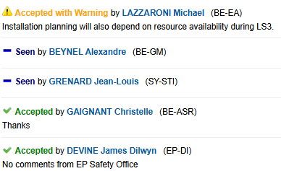
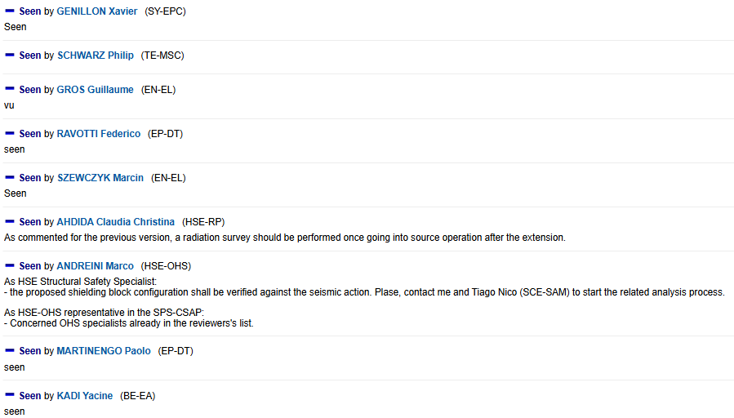
ECR Under Approval
SPSX-J-EC-0011
Version 0.2
GIF++ Bunker Extension in Phase 2
By Martin Jaekel
Seeking approval from EATM

Slide 12
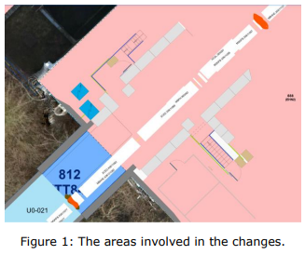
ECR Under Approval
SPSX-B-EC-0020
Version 0.2
Temporary Installation of Two XBPFs in M2 for Beam Divergence Measurement
By Inaki Ortega Ruiz
This ECR describes the temporary replacement of XFFV.X0611078 and XFFV.X0611099 with XBPF prototypes.
Disconnect the XFFV.X0611078 and the XFFV.X0611099 from vacuum.
Replace XFFV.X0611078 and XFFV.X0611099 with the new North Area XBPF prototypes, then reconnect to the beamline vacuum.
Connect the pneumatic systems of the new XBPFs to the M2 compressed air line.
Pull one optical fibre per XBPF to barrack HNB201 for communication between the XBPF and the VME electronics (to be done by SY-BI).
Move a VME crate to HNB201 for control and acquisition, and deploy the BXBPF FESA classes.
Once the measurements have been completed, the system will be restored to its original configuration, and the optical fibres will be removed.
The plan is to revert to the previous state on 13 August 2025.

Slide 13
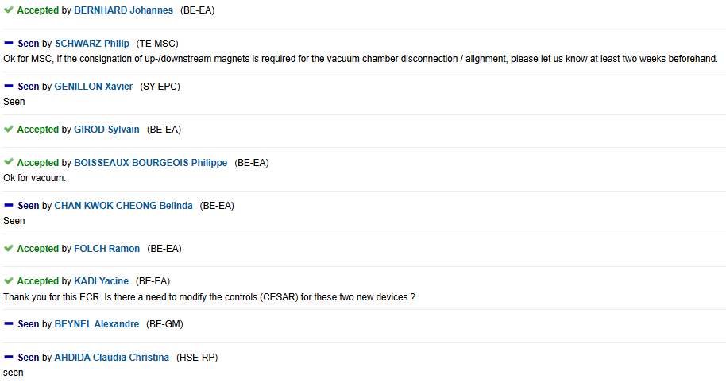
ECR Under Approval
SPSX-B-EC-0020
Version 0.2
Temporary Installation of Two XBPFs in M2 for Beam Divergence Measurement
By Inaki Ortega Ruiz
Seeking approval from EATM

Slide 14
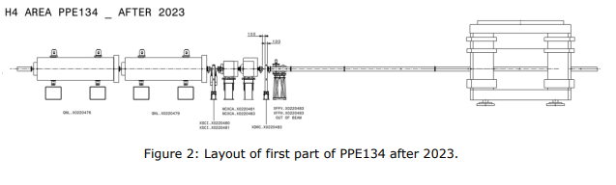
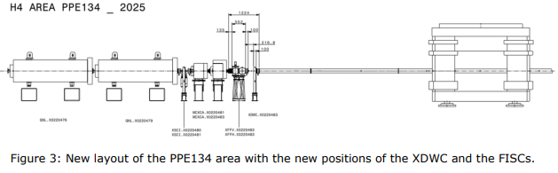
ECR Under Approval
SPSX-L-EC-0011
Version 0.2
Small Modifications to the Instrumentation in PPE134
By Nikos Charitonidis
This ECR proposes a small modification to the layout of the zone upstream of the GOLIATH magnet.
The XFFV.X0220483 and XFFH.X0220483 will be moved upstream the XDWC.X022483
The XFFV.X0220483 and XFFH.X0220483 will be connected directly to the vacuum of the line
This will facilitate installation and reduce intervention time in the zone for BE-EA, SY-BI and EN-HE.

Slide 15
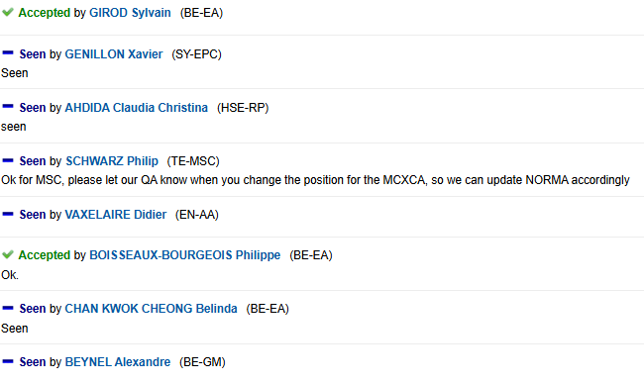
ECR Under Approval
SPSX-L-EC-0011
Version 0.2
Small Modifications to the Instrumentation in PPE134
By Nikos Charitonidis
Seeking approval from EATM

Slide 16
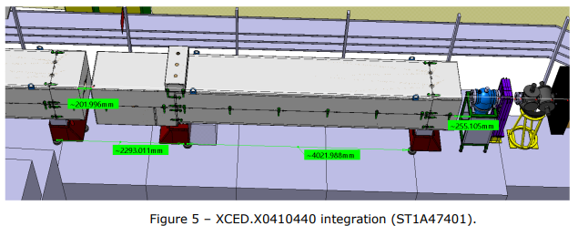
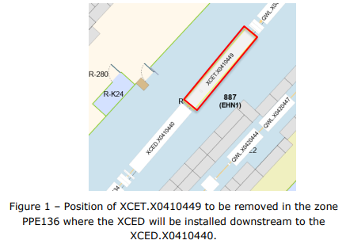
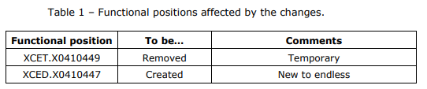
ECR Under Approval
SPSX-B-EC-0018
Version 0.3
Re-installation of XCED Detector on H6 Beamline in PPE136
By Miguel Santos
This ECR describes changes necessary for the installation of a second XCED in PPE136.
XCET.X0410449 will be removed from the beamline (done)
XCED supports will be installed in the new position XCED.X0410447 and the markings moved (done)
The new XCED detector will be installed in the new position XCED.X0410447 (done)
New cabling for powering, control and acquisition of the XCED will be done (temporary cabling – September 2025; full recabling and completion of works in YETS 25/26)

Slide 17
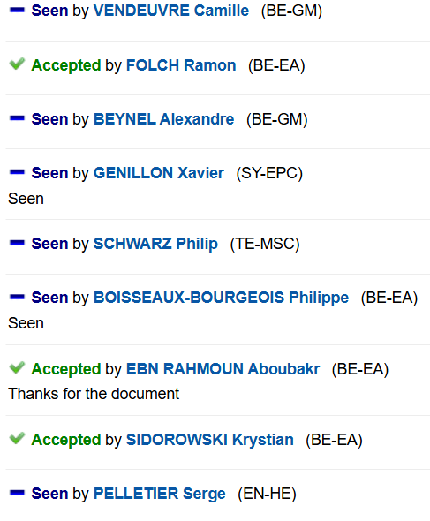
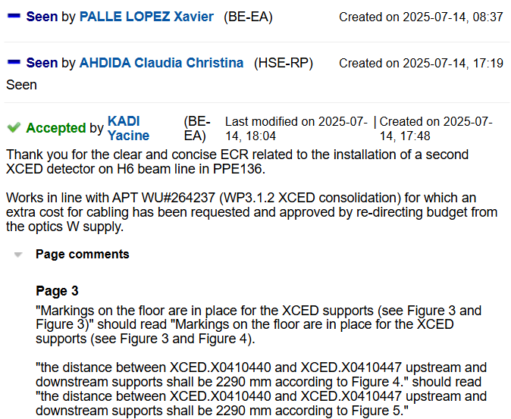
ECR Under Approval
SPSX-B-EC-0018
Version 0.3
Re-installation of XCED Detector on H6 Beamline in PPE136
By Miguel Santos
Seeking approval from EATM

Slide 18
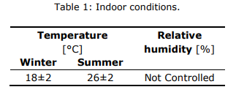
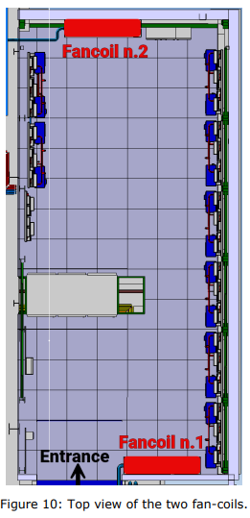
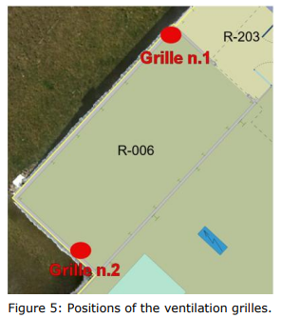
ECR Under Approval
SPSX-U-EC-0002
Version 0.3
Ventilation for the BA81 Extension
By Jani Lehtinen
This document describes the new cooling system for the BA81 extension (890/R-006) which will host the fire detection equipment.
This document describes the new cooling system for the BA81 extension (890/R-006) which will host the fire detection equipment.
Table 1 shows the user requirements. To achieve them, the following will be added:
Two ventilation grilles
Two fan-coils (powered by an EN-EL electrical cubicle)
An analogic temperature sensor shall be installed in the new extension and shall be connected to the existing BA81 ventilation unit control cubicle (UACW2-00250).

Slide 19
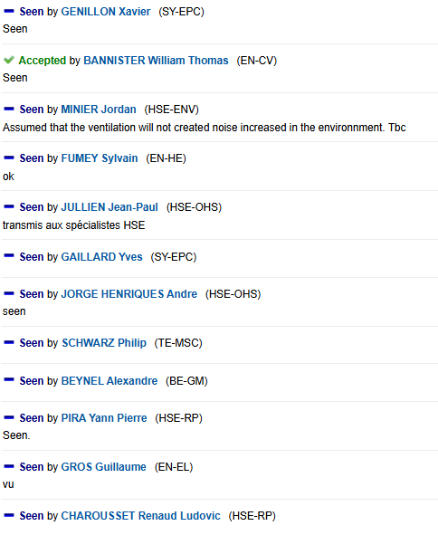
ECR Under Approval
SPSX-U-EC-0002
Version 0.3
Ventilation for the BA81 Extension
By Jani Lehtinen
Seeking approval from EATM

Slide 20
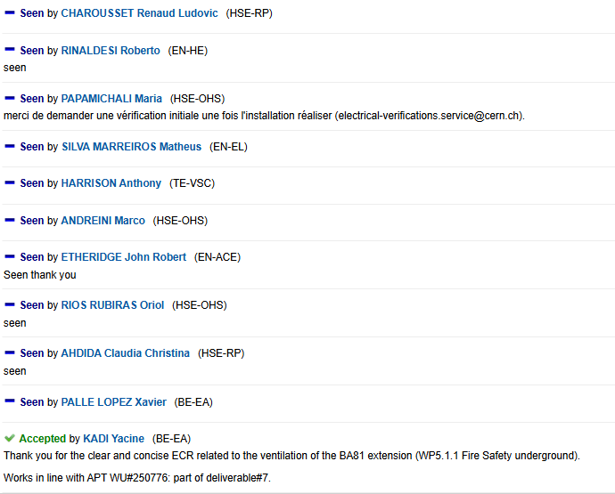
ECR Under Approval
SPSX-U-EC-0002
Version 0.3
Ventilation for the BA81 Extension
By Jani Lehtinen
Seeking approval from EATM

Slide 21
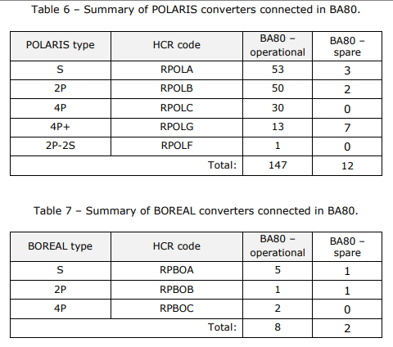
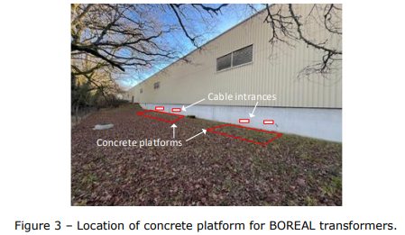
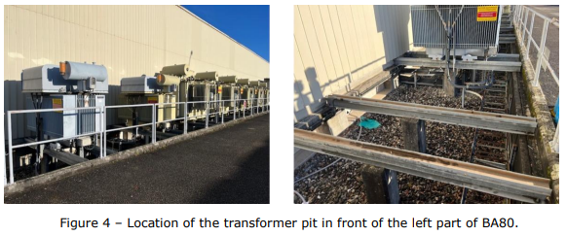
ECR Under Approval
SPSX-R-EC-0001
Version 0.2
BA80 Power Converters for NA-CONS and the HI-ECN3 Bump Magnets
By Ivan Josifovic, Yves Gaillard
This document details the replacement of the BA80 power converters with new POLARIS and BOREAL ones during LS3. It also covers the installation of POLARIS for the additional bump circuits in TCC2 for the High-Intensity ECN3 project.
This document covers:
POLARIS installation parameters
BOREAL installation parameters, inside and outside BA80, including the concrete platforms to be built.
Beam interlock system racks

Slide 22
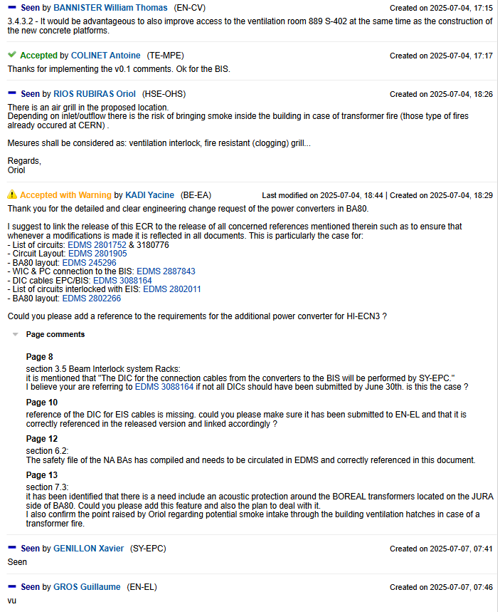
ECR Under Approval
SPSX-R-EC-0001
Version 0.2
BA80 Power Converters for NA-CONS and the HI-ECN3 Bump Magnets
By Ivan Josifovic, Yves Gaillard
Seeking approval from EATM

Slide 23
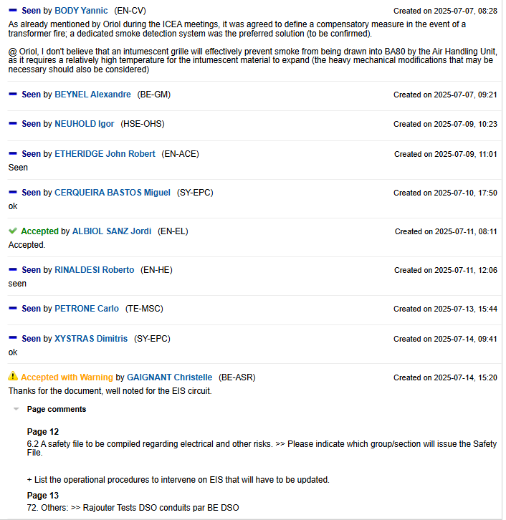
ECR Under Approval
SPSX-R-EC-0001
Version 0.2
BA80 Power Converters for NA-CONS and the HI-ECN3 Bump Magnets
By Ivan Josifovic, Yves Gaillard
Seeking approval from EATM

Slide 24
Thank you!

