Slide 1
QNL.X0430064 post-mortem
TE-MSC
Philip Schwarz, Cyril Cot
15.07.2025

Slide 2
Incident and inspection timeline
05.06.2025:
  CCC informed that circuit connected to QNL.X0430069 tripped due to “coil-temp” (“CT”) fault
  SY-EPC First line intervened on the converter, confirming that the fault is coming from the circuit
  TE-MSC confirmed that the fault was present along the interlock circuit (patch panel) and coming from TCC2
  Multiple resets were attempted during the following hours (indicator for cooling problem), unsuccessfully
  Access was planned for the next day
06.06.2025:
  In the morning, it was possible to reset the fault prior to intervention in the tunnel
  This indicates that the circuit closed any time during the night from 05.06. – 06.06.
  Nevertheless, access was granted and the magnet inspected (5 – 6 mSv/h ambience) visually – without indication

Slide 3
Incident and inspection timeline
06.06.2025 (continued):
  The magnet was restarted and operated at -290 A
  It tripped again after 5 minutes, suggesting a cooling issue
  Verification that valve was fully open, including regulation valve - everything in order
  Thermal inspection of the cooling hoses during operation (see table, courtesy M. Brugger)
07.06.2025:
  Night passed without incident – physics continued
Time |  | Status | Current | Rest of NA | T in | T out | Comments
18:45 | 0' | Cycled | -320A | off |  | 34 | started w/o initial picture (all NA off)
 | +20' | Cycled | -320A | off |  | 34.7 | no fault
 | +30' | Cycled | -320A | off |  |  | no fault
19:18 | 0' | STDBY | 0 | off |  |  | stopped to see cooldown
19:30 | +12' | STDBY | 0 | off |  | 26
19:45 | 0' | DC | -320A | off |  |  | restarted in DC
 | +10' | DC | -320A | off |  | 37.4
19:56 |  | DC | -320A | off |  |  | SHORT TIME (some seconds!) SWITCHED TO ECO
20:03 | +18' |  |  |  |  |  | still no fault
20:04 |  | DC | -320A | all lines on
20:25 |  | DC | -320A | all lines on |  |  | still no fault
20:32 |  | DC | -320A | all lines on |  |  | all remains ok -> we decide to leave as is until morning

Slide 4
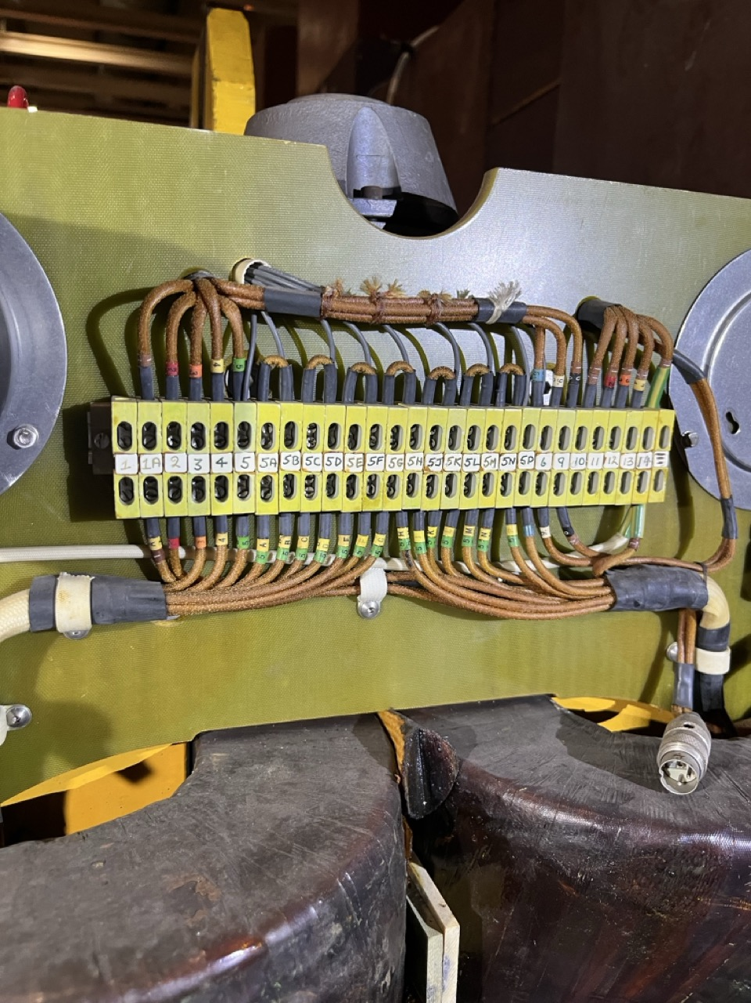
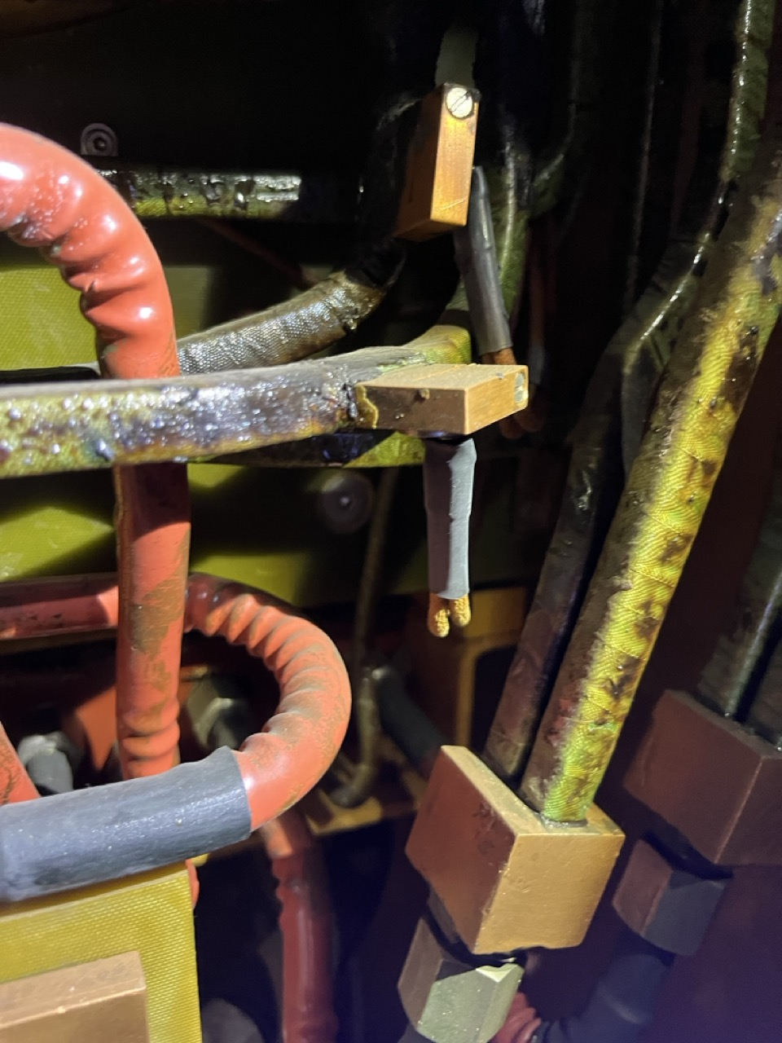
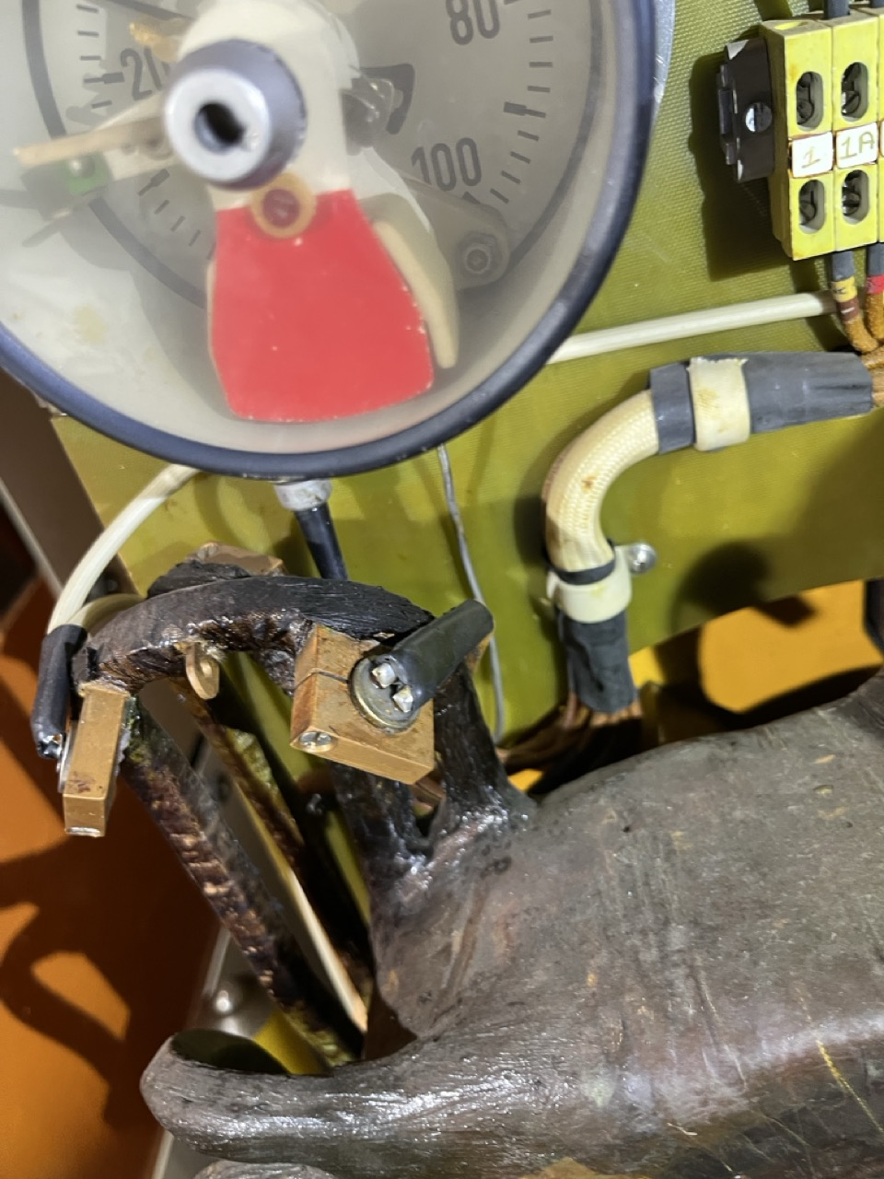
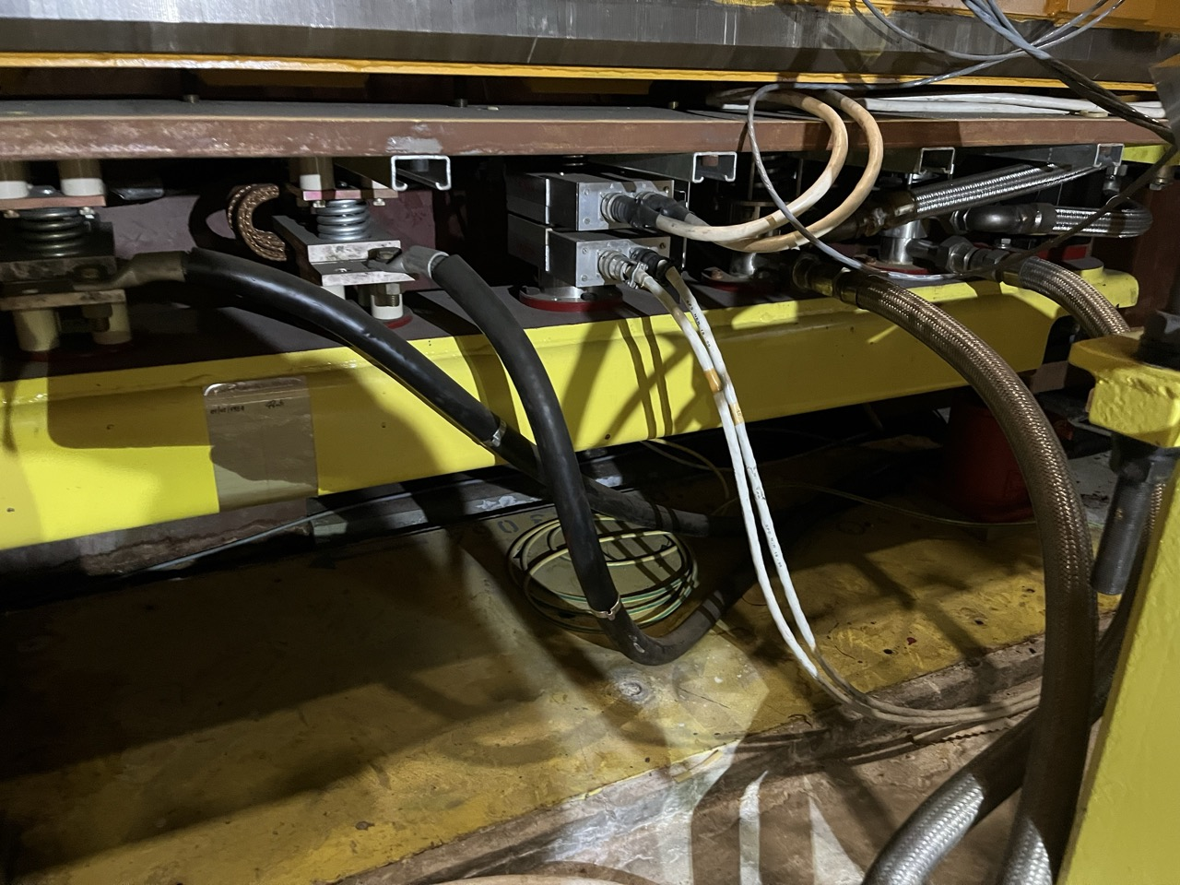
Incident and inspection timeline
03.07.2025:
  Operation continued without incident
  Profiting from the planned MD for the NA ion operation and the accumulated radiation cooldown, access was prepared on the 03.07.2025 to remove the covers and inspect the magnet visually
  No obvious signs of degradation were found

Slide 5
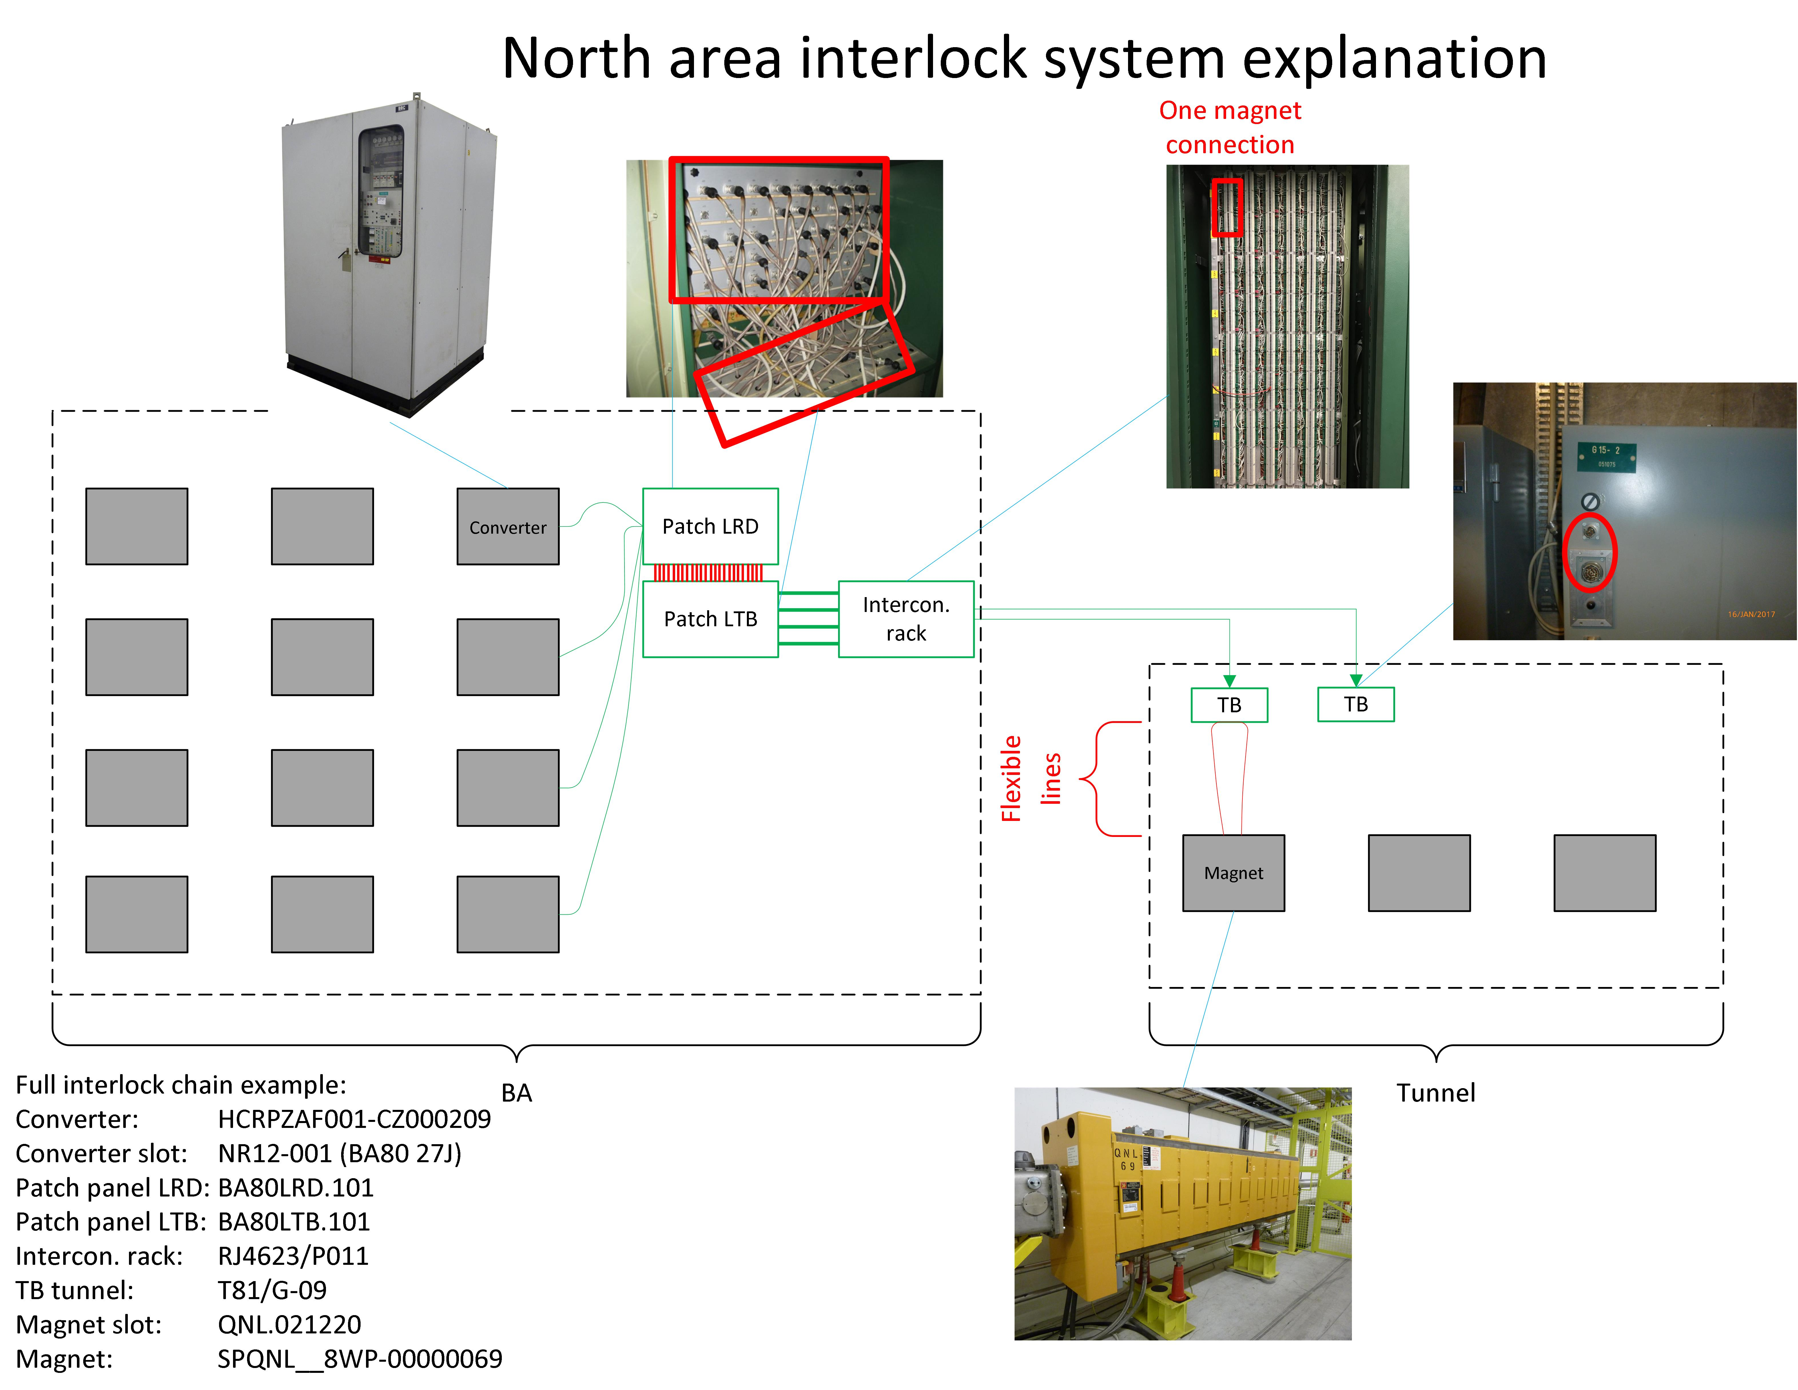
Situation now and future actions
Multiple hypotheses:
  Temporary blockage of cooling circuit that disappeared without intervention
  Connectivity problem (cable or connector) somewhere in the interlock chain magnet -> TB -> interconnection rack -> patch panel -> converter
  Fact that fault was non-resettable for several hours initially suggests rather the latter
Future actions:
  Preparation of a spare QNL on plug-in base in case it is a magnet problem
  Thorough cable inspection should the problem re-appear

Slide 6
Questions?
Thanks to all involved groups for their support!

