Slide 1
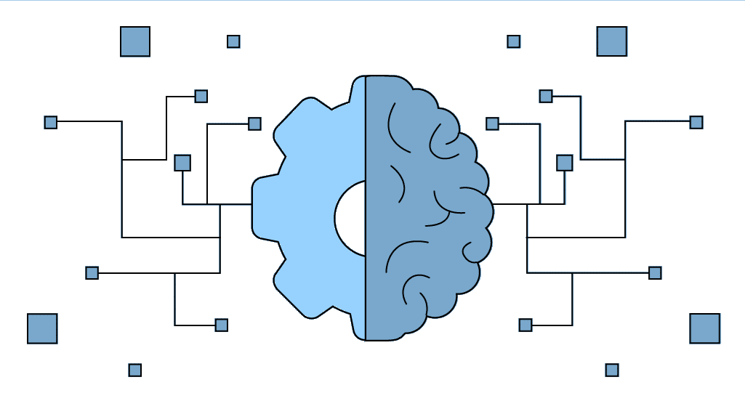
𝕄𝔸ℂℍ𝕀ℕ𝔼 𝕃𝔼𝔸ℝℕ𝕀ℕ𝔾
(HEP oriented)
Arantza Oyanguren (IFIC - Valencia)
TESHEP July 2025, Stará Lesná, Slovakia

Slide 2
Contents
• Introduction & Concepts
• Supervised Learning:
- Regression
- Classification
• Unsupervised Learning
- Clustering
• Neural Networks
• Reinforcement Learning
• Conclusions

Slide 3


Introduction & concepts

Slide 4
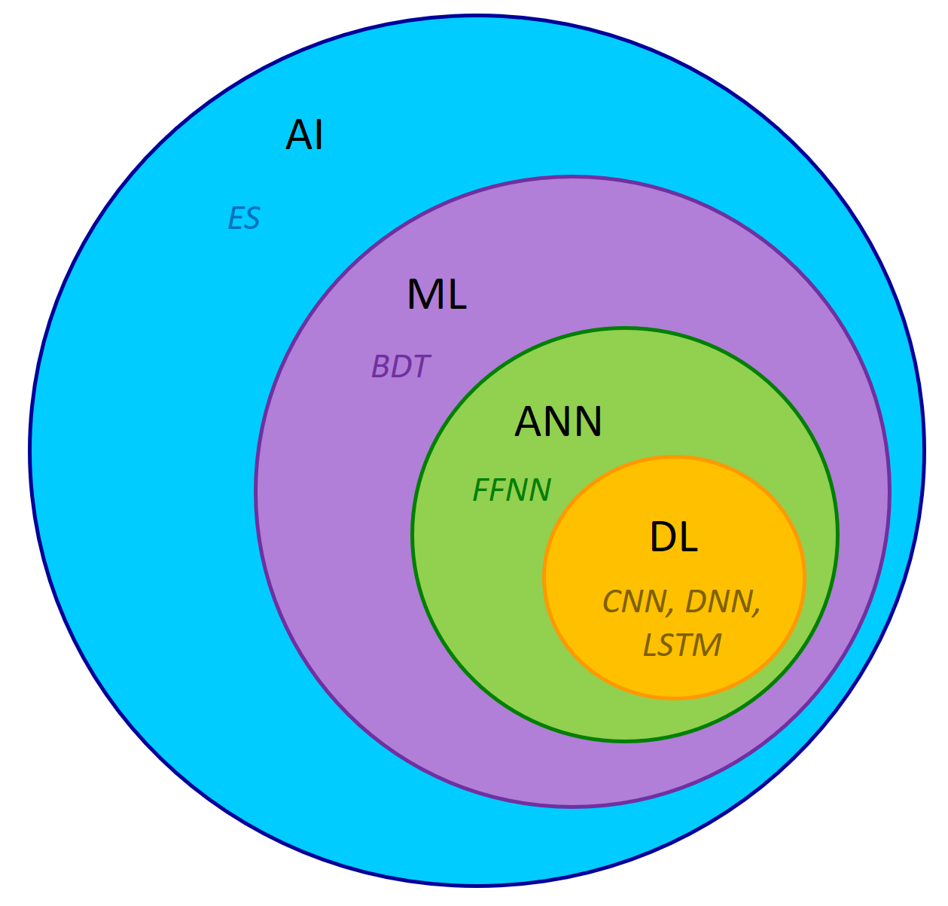
Introduction
• What Machine Learning is ?
A subset of artificial intelligence (AI): machine learning (ML) deals with the study and use of data and algorithms that mimic how humans learn. This helps machines gradually improve their accuracy.
It estimates new output values by using historical data as input.
• Artificial Intelligence (AI)
- Expert Systems (ES)
• Machine learning (ML)
- Boosted Decision Trees (BDT)
• Artificial Neural Network (ANN)
- Feedforward Neural Network (FFNN)
• Deep Learning (DL)
- Convolutional Neural Network (CNN),
- Deep Neural Network (DNN),
- Long short-term memory (LSTM)

Slide 5


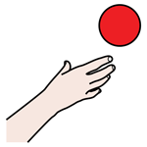
Introduction
• Why Machine Learning ?
The problem
The tools
The wish
- Identification
- Classification
- Anomaly detection
- Selection
- Generation
- Big data
- Computing power
- New architectures
- Improved algorithms
- Open-source code
- Fast response
- High performance
- Unbiased
- Sustainable

Slide 6
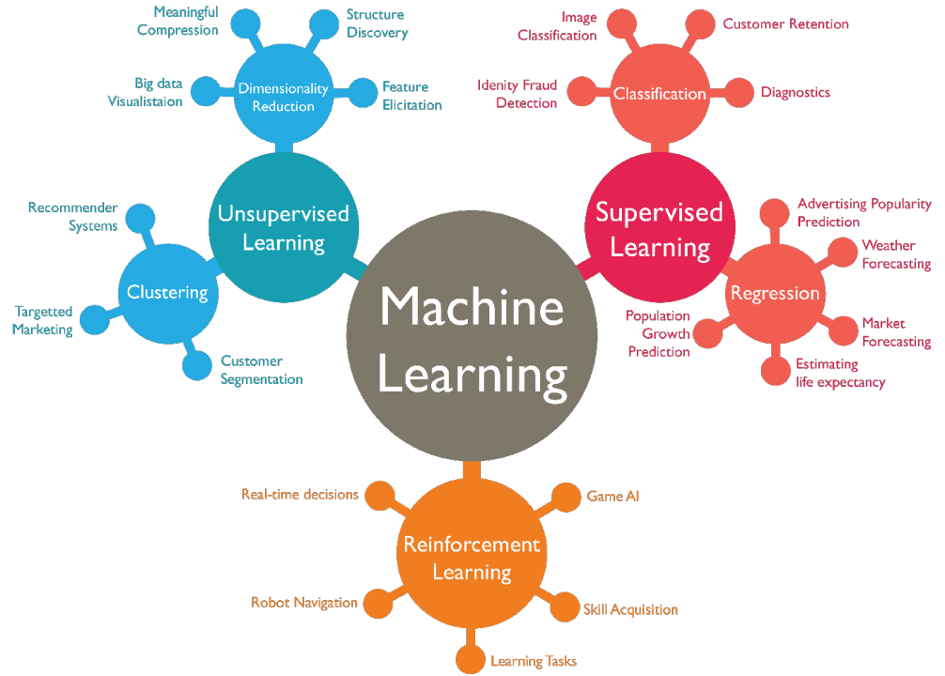
Introduction
• How to learn without explicitly being programed ?

Slide 7
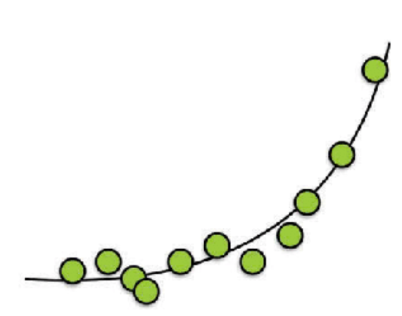
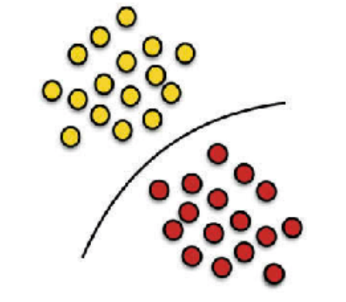
Machine Learning
• How to learn without explicitly being programed ?
Supervised learning: the data is labeled in the way that we give inputs to the learning system and tell it which specific outputs should be associated to the inputs. I.e., the goal is to learn a mapping from inputs to outputs.
Examples:
Regression (weather prediction) and classification (image classification)
The output comes in a large finite ordered or continuous set
The output comes in a small finite set

Slide 8
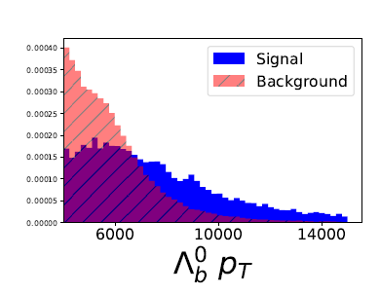
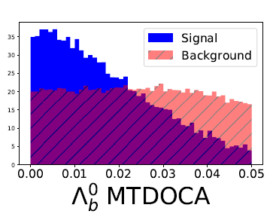
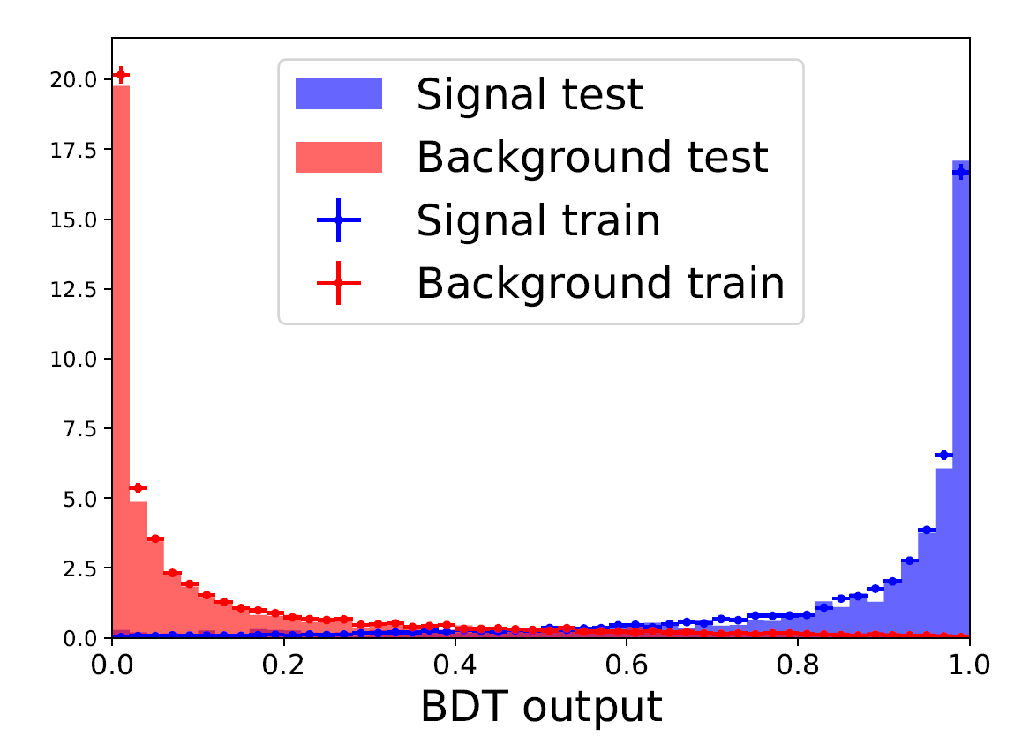
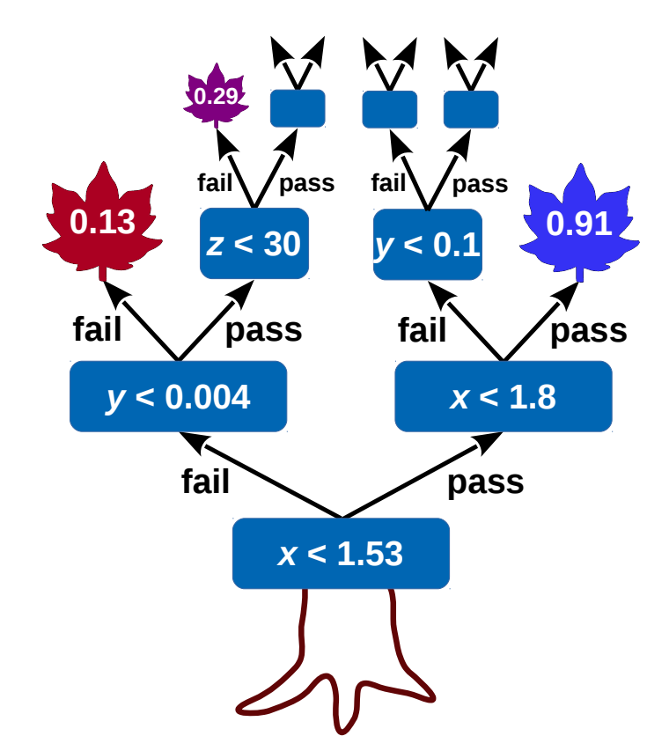
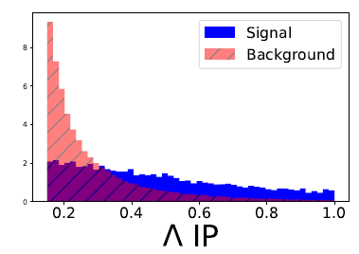
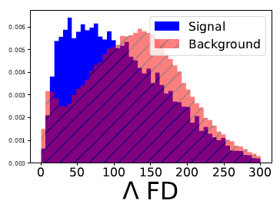
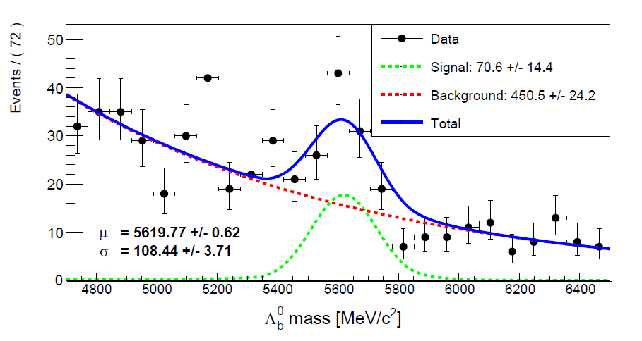
Machine Learning
• Supervised learning
Boosted Decision Trees (BDT) to separate signal and background sources (Ex: LHCb)
arXiv:2206.09645
(MeV)
(mm)
(mm)
(mm)
Observation of the Λ_{b}→Λγ decay channel:
Ex: XGBoost
[CERN-THESIS-2020-404]

Slide 9
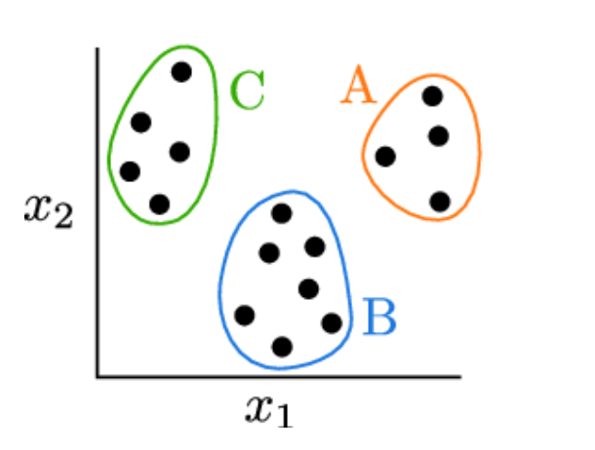
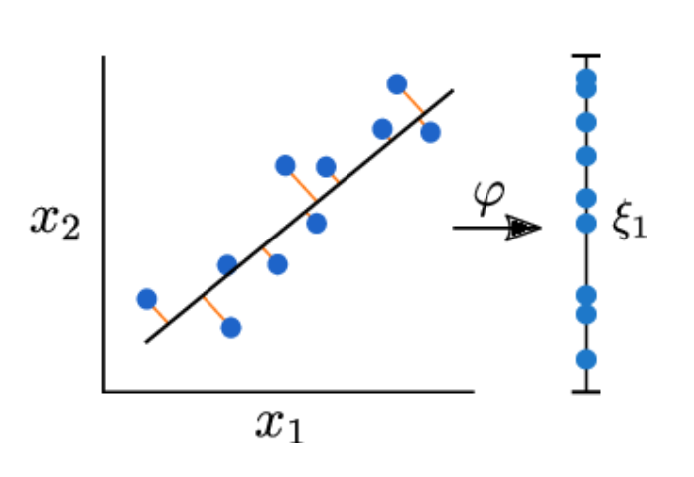
Machine Learning
• How to learn without explicitly being programed ?
Unsupervised learning: the input data is not labelled, the learning system has to find some patterns or structures inherent in it.
Examples:
Clustering (recommendation systems) and dimensionality reduction (structure discovery)
The output is characterized by group-labels and centroids
Simplified output with the most important patterns and information from the original data
In clustering and dimensionality reduction, the characteristics of the outputs differ based on the objectives and methods used:
Clustering:
Output Characteristics:
  Cluster Assignments: The primary output is a label or assignment for each data point indicating the cluster it belongs to. This label is often an integer corresponding to a specific cluster.
  Number of Clusters: The algorithm typically produces a specified or computed number of clusters, depending on the method used (e.g., k-means, hierarchical clustering).
  Cluster Centroids (or Medoids): Some clustering methods, like k-means, also output the centroids or representative points of each cluster.
  Cluster Boundaries: In some methods (e.g., hierarchical clustering), you might also have a dendrogram or hierarchical tree structure showing the nested groupings of clusters.
  Cluster Quality Metrics: Outputs may include metrics such as within-cluster sum of squares, silhouette score, or other indicators of clustering quality.
Dimensionality Reduction:
Output Characteristics:
  Reduced-Dimensionality Representation: The output is a transformed dataset with fewer dimensions than the original. For example, if you reduce a dataset from 100 dimensions to 2 dimensions, the output will have 2 dimensions per data point.
  Principal Components (in PCA): In methods like Principal Component Analysis (PCA), the output includes principal components, which are the directions in the data that maximize variance.
  Variance Explained (in PCA): The output may also include the proportion of variance explained by each of the principal components.
  Embedded Coordinates (in techniques like t-SNE or UMAP): For visualization-focused dimensionality reduction techniques, the output is a set of coordinates in 2D or 3D space that represent the original high-dimensional data.
  Transformation Matrix (in Linear Methods): Some techniques provide a transformation matrix that can be used to project new data points into the reduced space.
In summary, clustering outputs typically involve cluster labels and centroids, while dimensionality reduction outputs focus on a lower-dimensional representation of the data, often along with information about the transformation or variance explained.

Slide 10
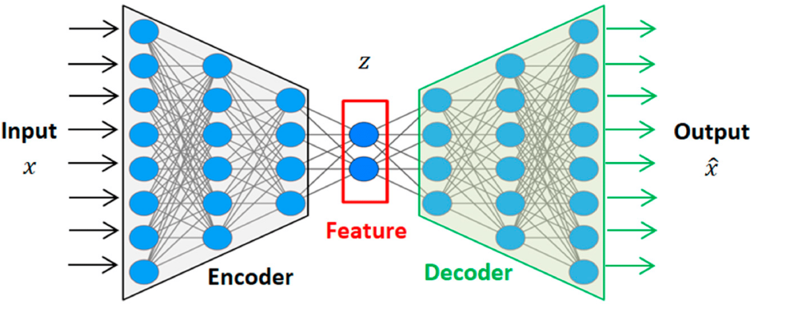
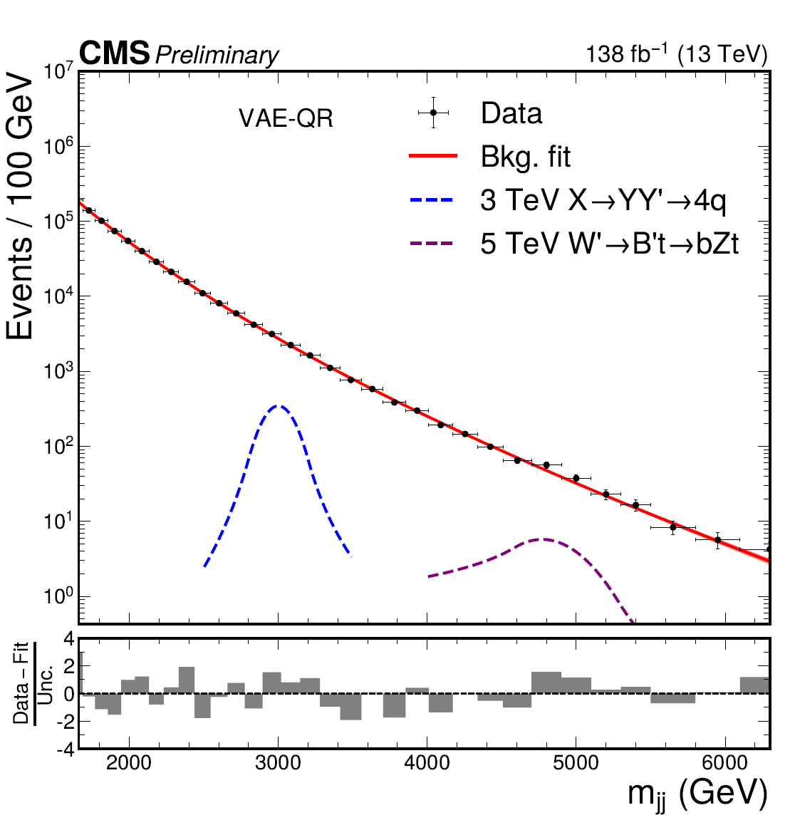
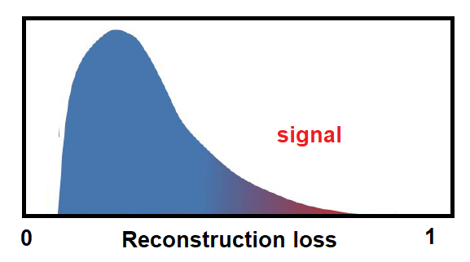
Machine Learning
• Unsupervised learning
Autoencoders for Anomaly Detection (Ex: VAE at CMS experiment)
Searching anomalies in di-jet resonances.
Training on background-dominated samples.
The difference between the original and reconst-ructed data can be used as an effective anomaly score.
[CMS-PAS-EXO-22-026]

Slide 11
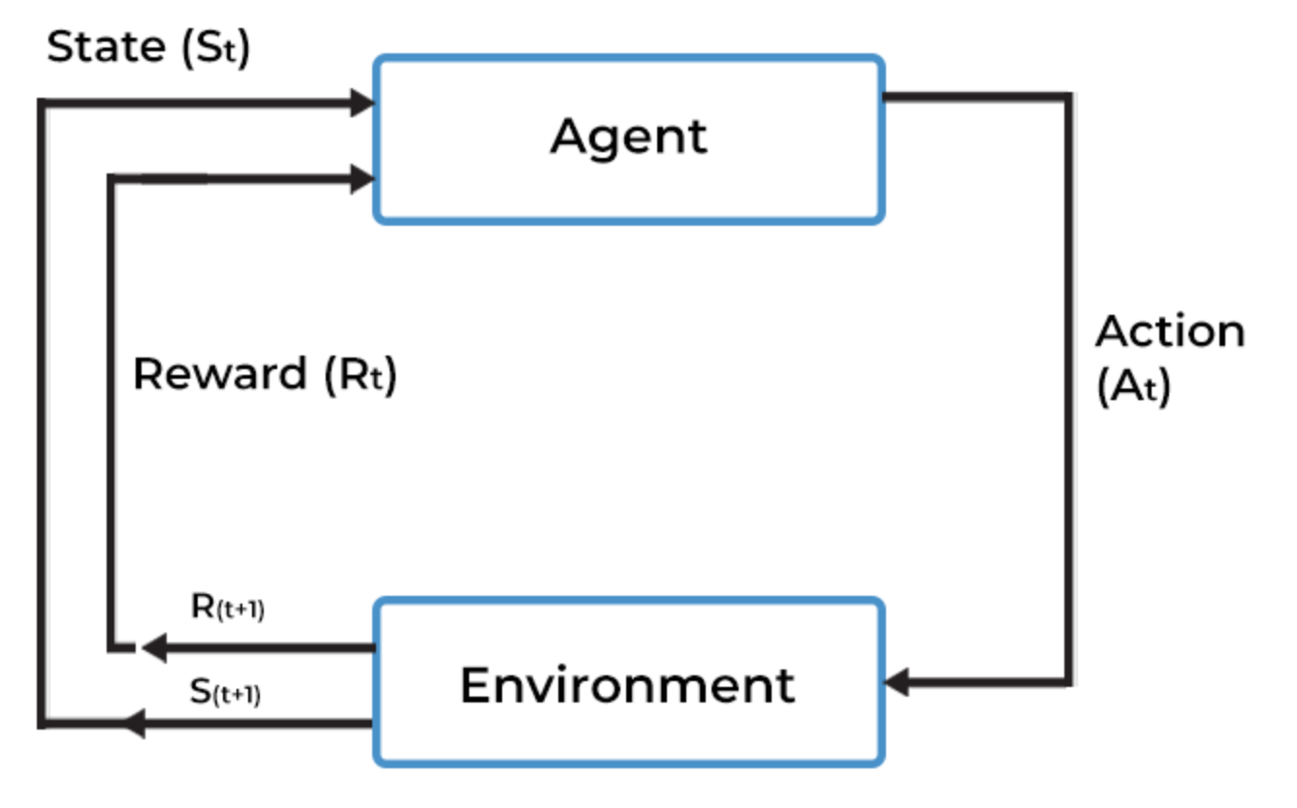
Machine Learning
• How to learn without explicitly being programed ?
Reinforcement learning: the learning system has to learn a mapping from input values to output values without being supervised. The idea is that an agent learns to make decisions by interacting with the environment. The agent takes actions and receives feedback in the form of rewards or penalties.
Examples: Natural language processing, robot navigation, autonomous driving…
(algorithms can be model-free or model-based)
Agent
Environment
The output is a policy, i.e., a set of rules or a strategy to maximize cumulative rewards over time.

Slide 12
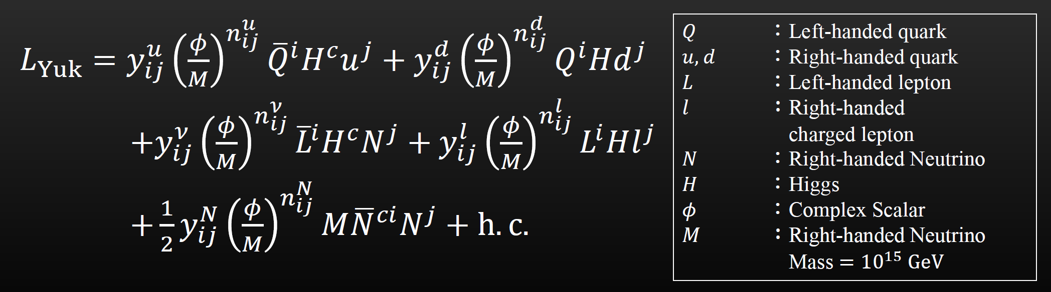
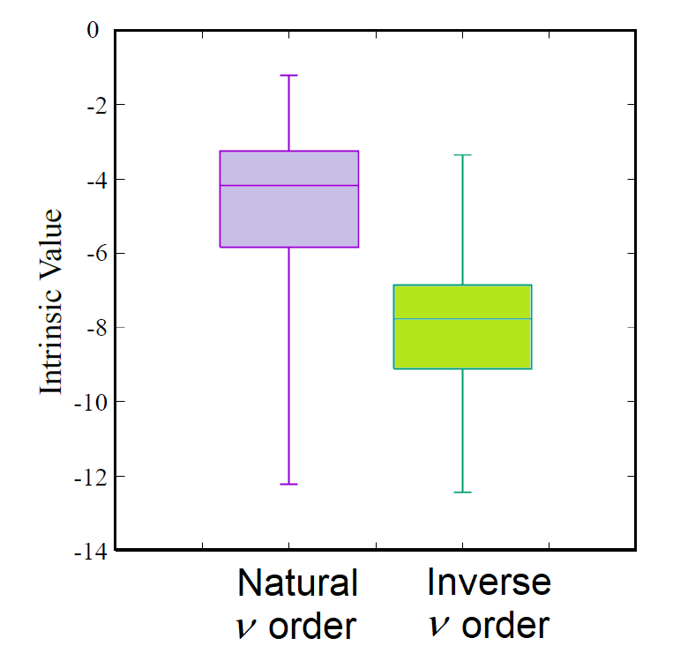
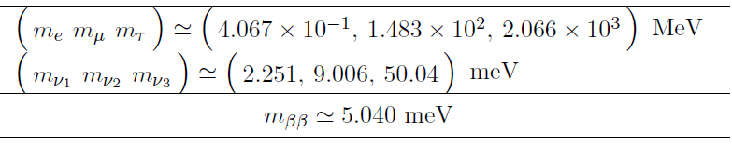
Machine Learning
• Reinforcement learning
Deep Q-Network (DQN) to explore the flavor structure of quarks and leptons
Yukawa lagrangian with Froggatt-Nielsen Model:
[JHEP12(2023)021]
→ The agent gets points when the masses of particles and the mixing matrix are close to the experimental values.
RL predicts a natural ordering for neutrino masses!

Slide 13
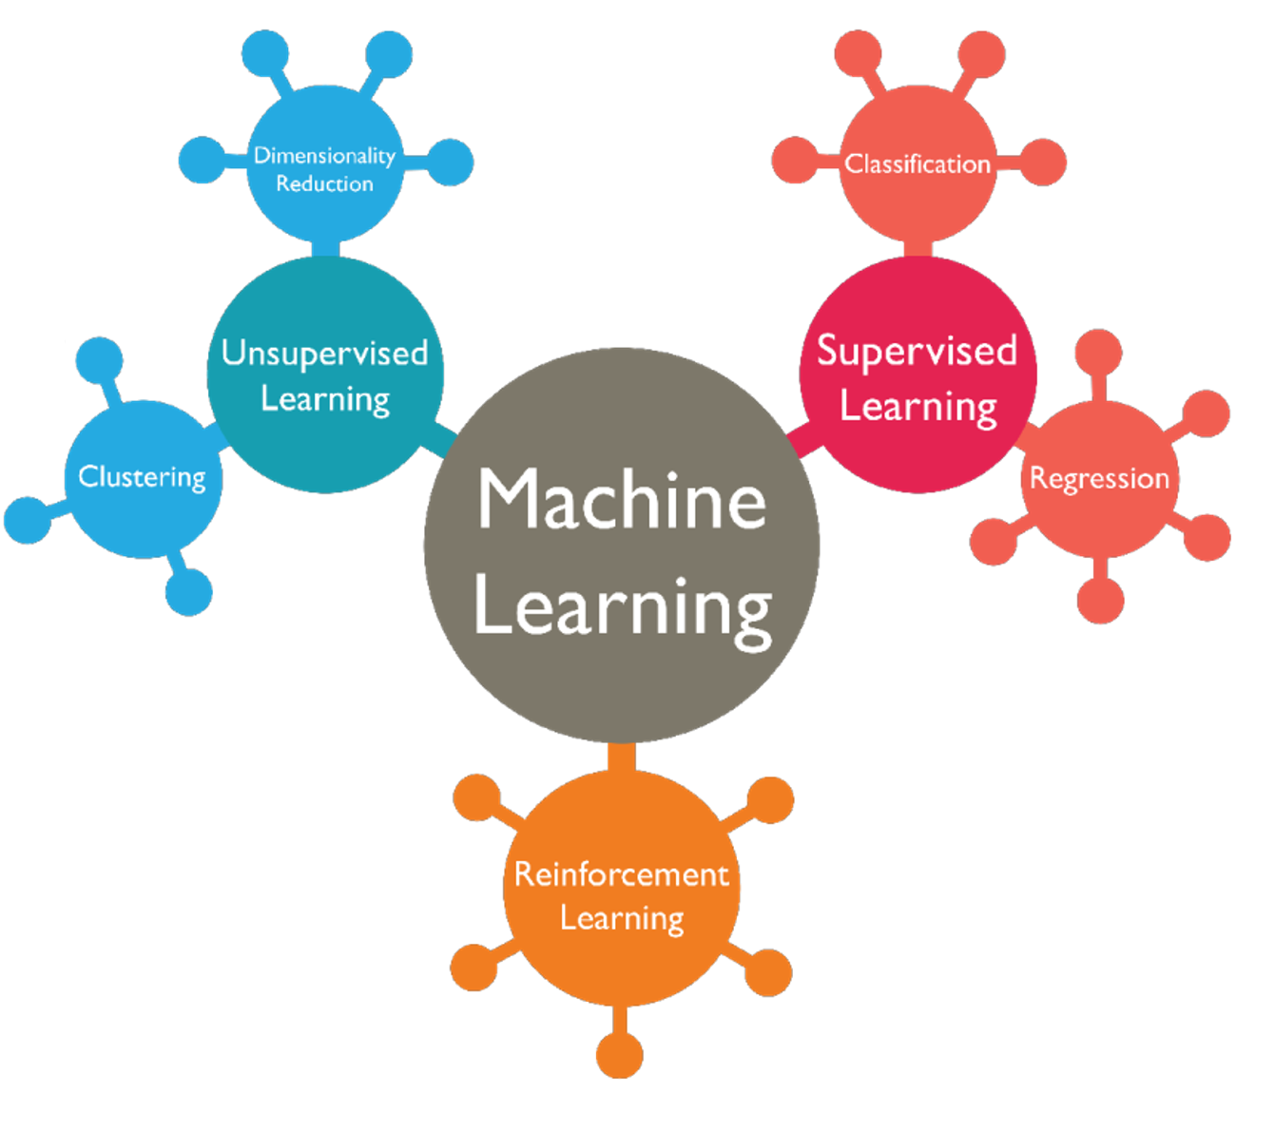
Machine Learning
• In HEP:
Jet
substructure
Noise
reduction
Pattern recognition
Calibration
Background subtraction
Jet isolation
Anomaly detection
Data monitoring
Pile-up mitigation
Jet clustering
Event reconstruction
Hadronic
showers
generation
Detector calibration
Matrix
elements
Particle
Identification
Detector simulation
Model building
Flavour structure
Accelerator
optimization
Quantum
Simulation
Detector design
See https://iml-wg.github.io/HEPML-LivingReview/

Slide 14
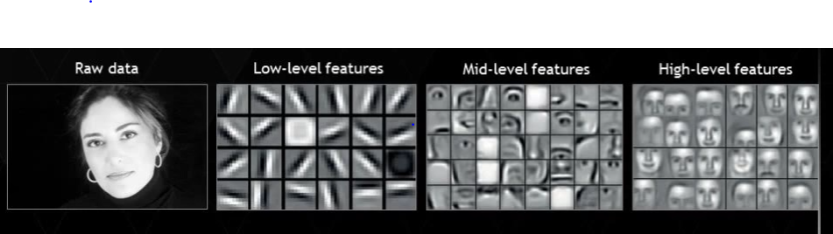
Concepts
• UNDERLYING FEATURES
Data, features and labels
Raw data
Low level attributes -------------------------------------------------- High level attributes
Lines & edges
Noses, mouths & ears
Facial structure

Slide 15
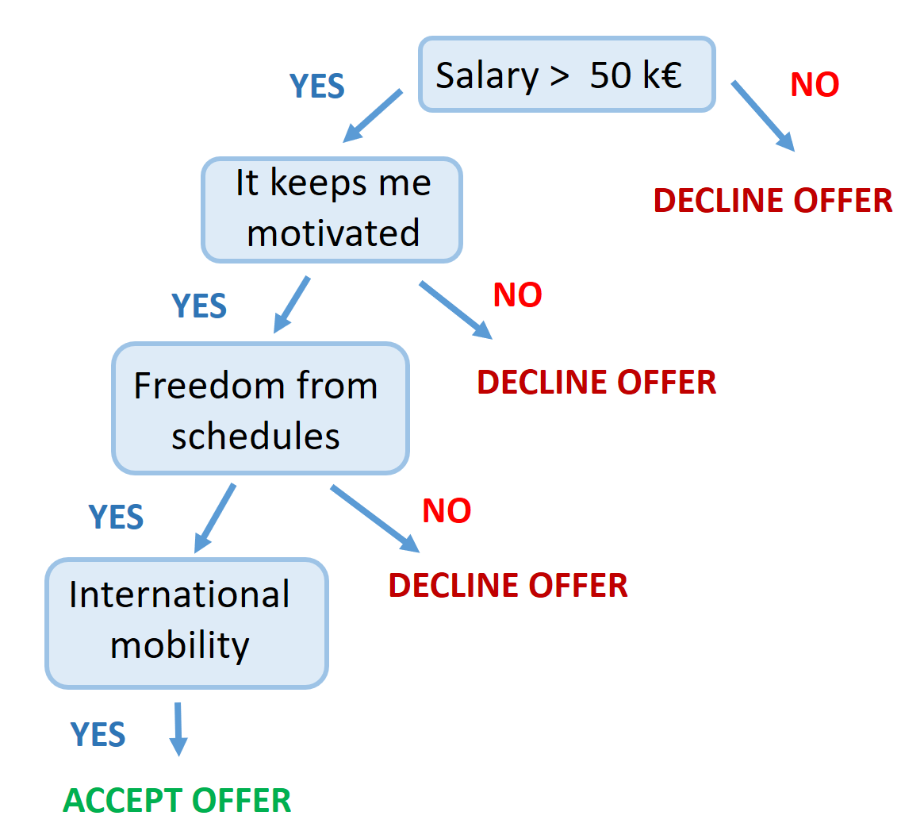
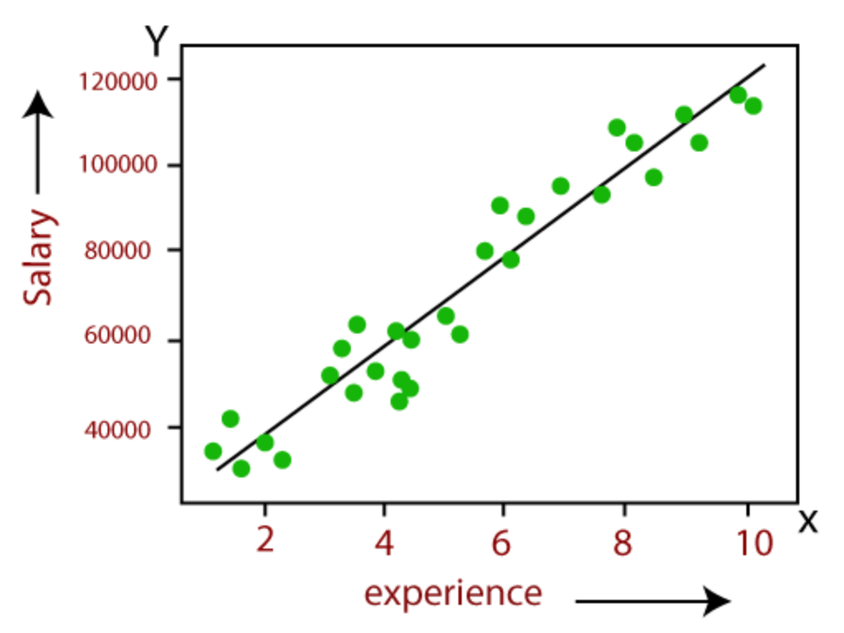
Concepts
• MODELS
A model is a mathematical representation of the relationship between features and labels. It's created by applying a machine learning algorithm to the training data. The model is able to make predictions or decisions based on new, unseen data.
Ex: a decision tree classifies inputs into different categories.
Ex: a linear regression model
predicts a continuous output.
Parameters: internal variables that are learned from data (ex: slope)
Hyperparameters: characterize the learning process (ex: number of nodes)

Slide 16
Concepts
• TRAINING, VALIDATION AND TEST DATA
Training Data: The portion of the dataset used to fit the model, allowing it to learn patterns and relationships within the data.
Validation Data: A data subset to tune model hyperparameters and assess model performance during training, helping to prevent overfitting.
Test Data: The final subset of the dataset used to evaluate the model's performance after training and validation, providing an unbiased assessment of its generalization to new, unseen data.
Training 60-75%
Validation 15-20%
Test 15-20%

Slide 17
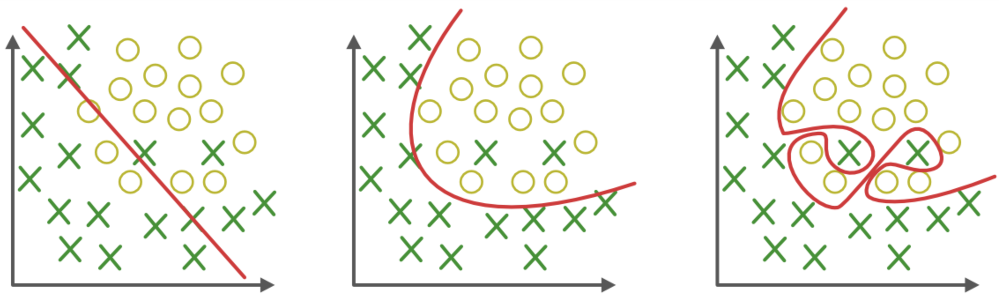
Concepts
• GENERALIZATION
The ability of a model to perform well on new, unseen data.
We want a model that avoids both underfitting (failing to capture the data's structure) and overfitting (being too tailored to the training data).
underfitting
proper fitting
overfitting
Too simple model
Insufficient training
Poor feature selection
High regularization (penalty term)
Incorrect model assumptions
Too complex model
Excessive training
Too many features
Low regularization (penalty term)
Insufficient training data

Slide 18
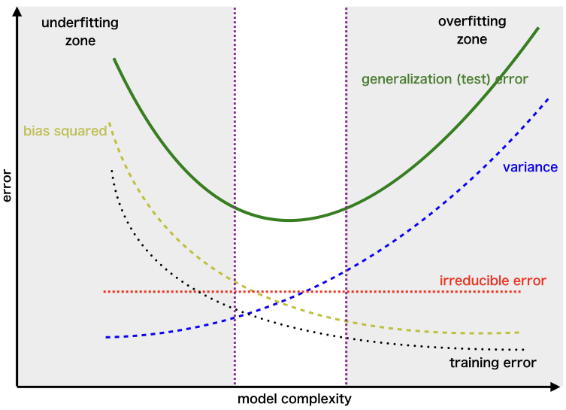
Concepts
• INTERPRETABILITY & EXPLAINABILITY
We want to comprehend the decisions or predictions made by a model (cause-and-effect), and provide, for complex models, a clear explanation for why the model made them.
Bias: deviation from the real value introduced by approximating a problem with a simplified model.
→ High bias implies that the model is too simple and fails to capture the underlying patterns in the data, leading to underfitting.
Variance: deviation from the real value due to the model's sensitivity to small fluctuations in the training data.
→ High variance implies that the model is too complex and captures noise along with the underlying patterns, leading to overfitting.

Slide 19

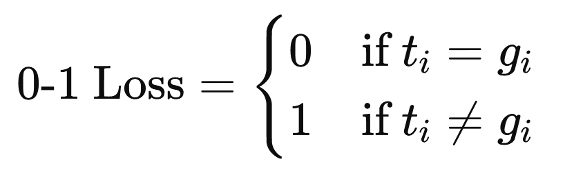
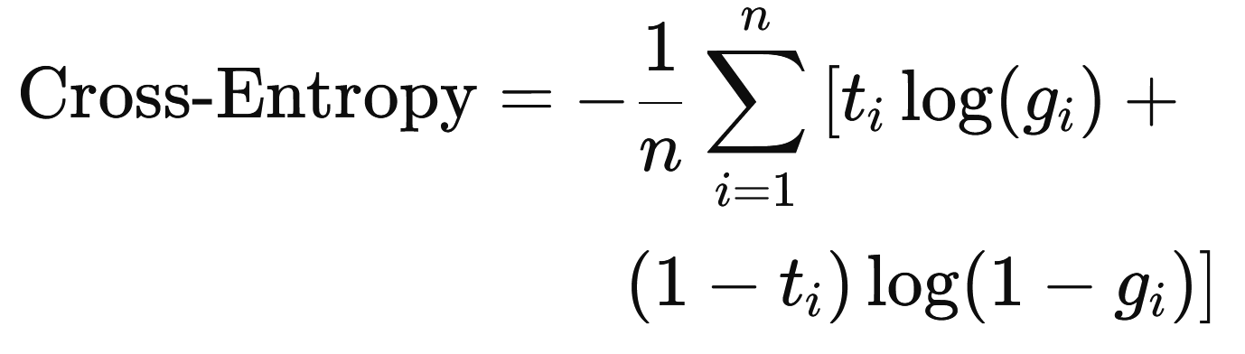
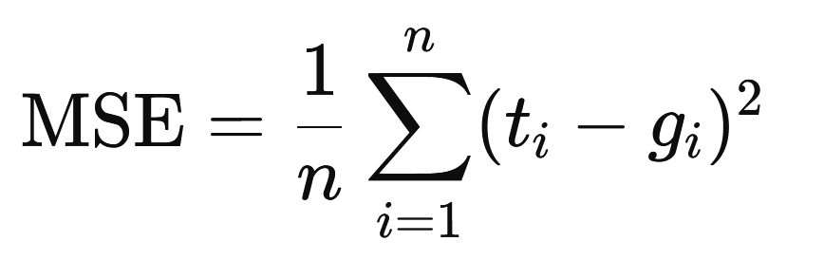
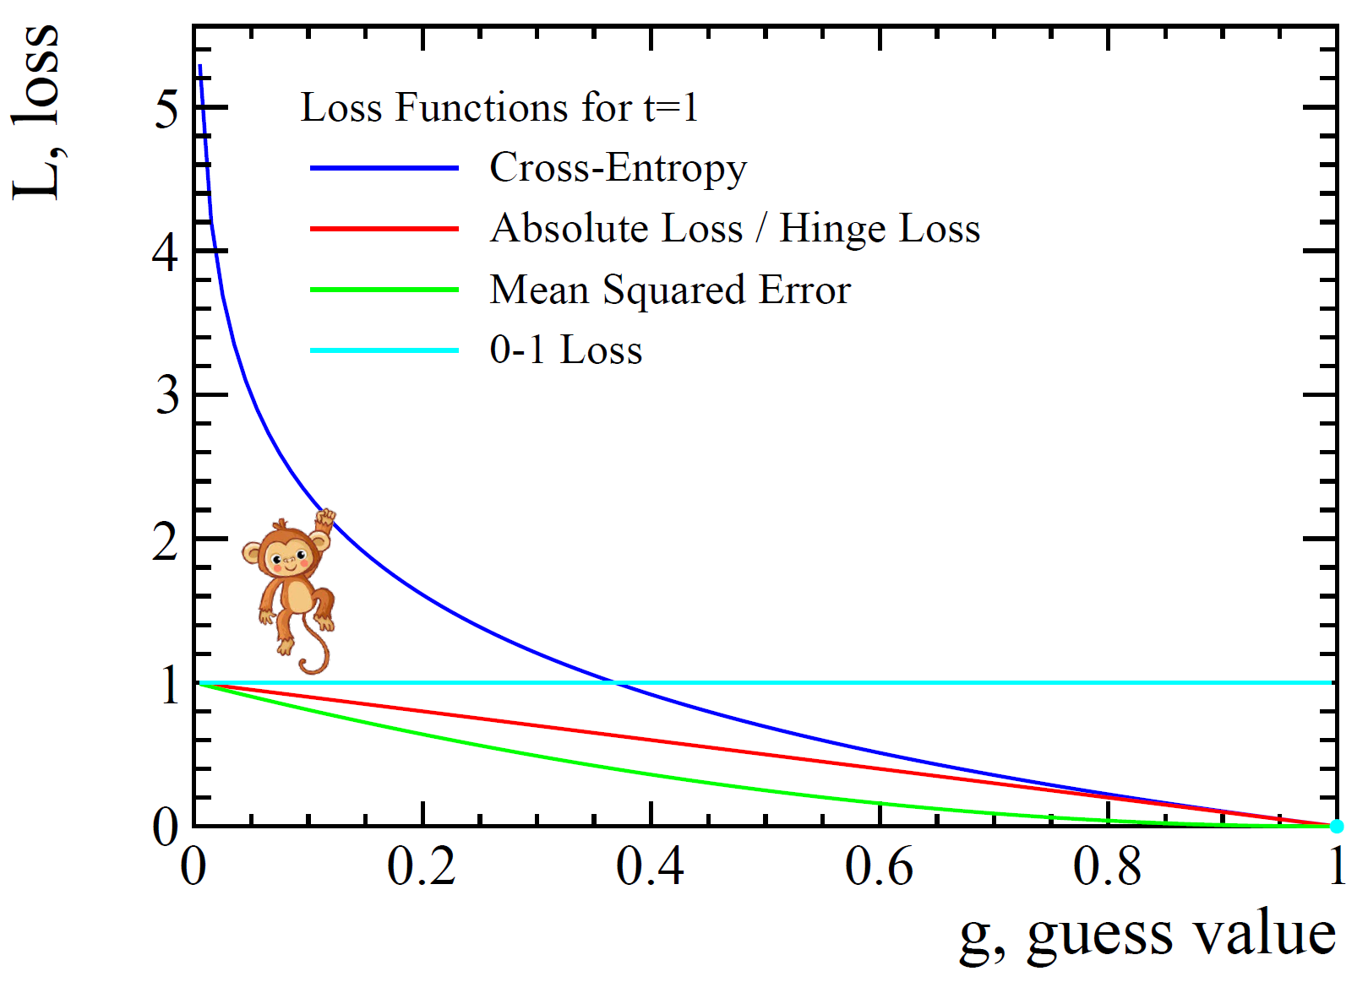
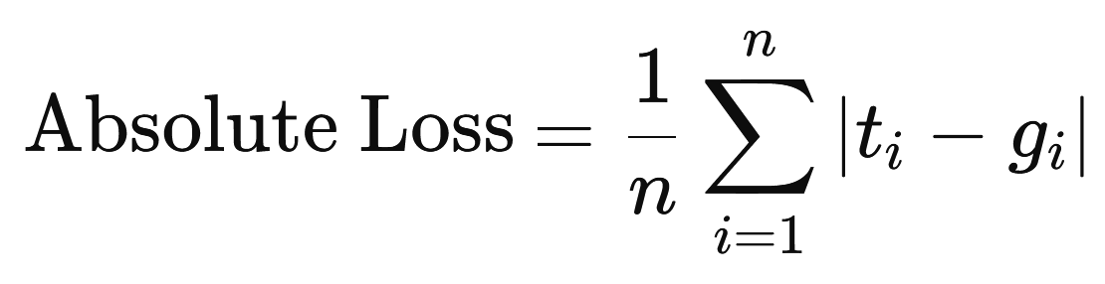
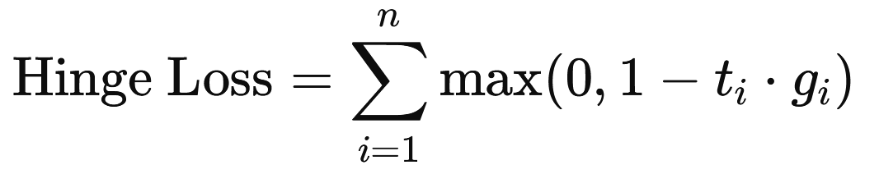
Concepts
• SCORES & PENALTIES
Models are evaluated not just on how well they score in making
predictions, but also on how they're penalized for errors.
Loss function L(g,t) : penalizes a wrong decision g (guess) when the answer is t (true).

Slide 20
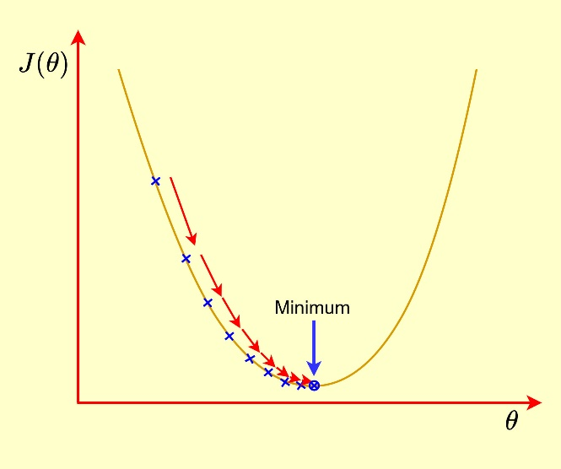
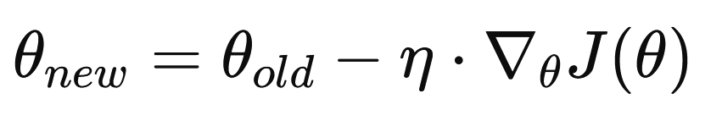
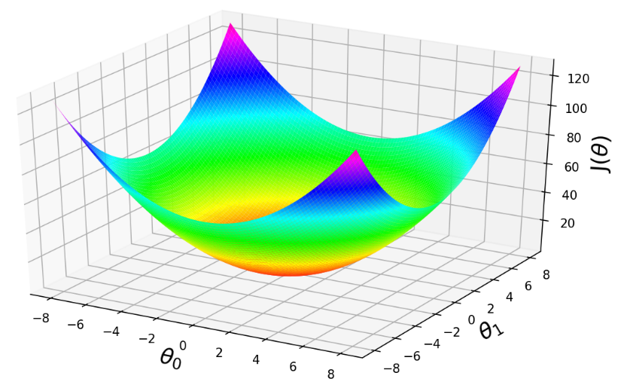

Concepts
• GRADIENT DESCENT
It is an optimization procedure to minimize the error or loss of machine learning algorithms
1- Initialize the parameters ($θ$) of the model
2- Compute the gradient (i.e., partial derivatives of the loss (J) with respect to each parameter)
η
3- Update the parameters adjusting them through the learning rate η (a fraction of the gradient)
4- Iterate until the algorithm converges in a minimum
Note that the learning rate η governs the convergence:
→ if it is too small, the optimization will be too slow
→ if it is too large, it can skip the minimum

Slide 21
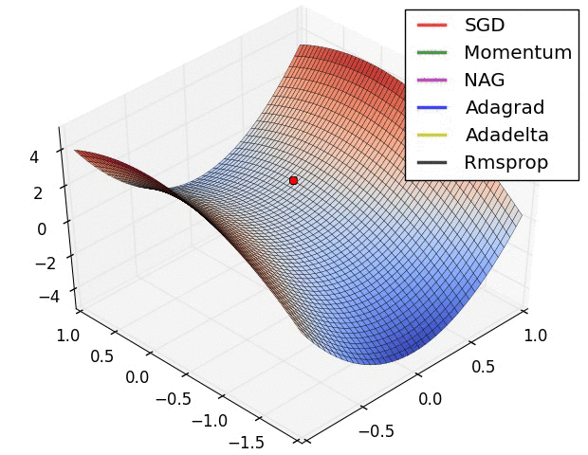
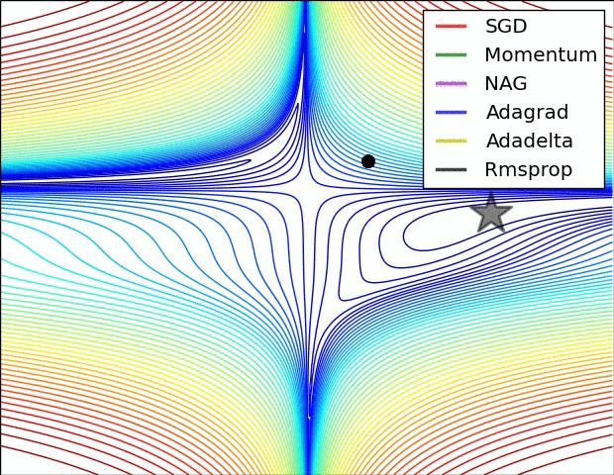
Concepts
→ Some examples of Gradient Descent-based algorithms:
Batch Gradient Descent (BGD): Uses the entire dataset to compute the gradient at each step.
Stochastic Gradient Descent (SGD): Uses one sample at a time, updating parameters more frequently.
Momentum; NAG: Use a cumulative function “velocity” of the gradient to improve SGD.
Adagrad; Adadelta: Adaptive learning rate depending of some parameters.
RMSprop (Root Mean Square Propagation) also adaptive, but simpler way to compute gradients.
https://cs231n.github.io/neural-networks-3/
[arXiv:1609.04747v2]

Slide 22
Concepts
• In summary: machine learning workflow
Model
Loss
Optimization
Data
Best model
Training algorithm
New data
Validation

Slide 23
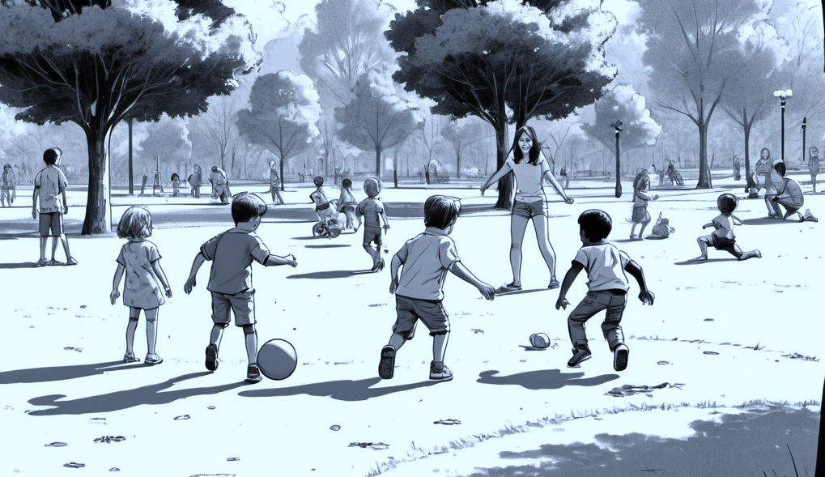
Supervised Learning

Slide 24

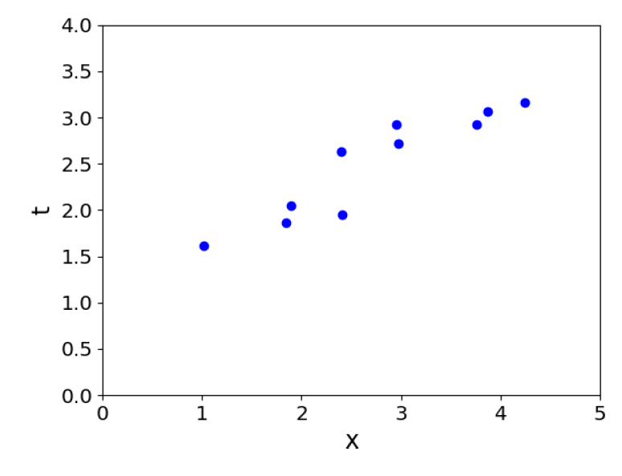
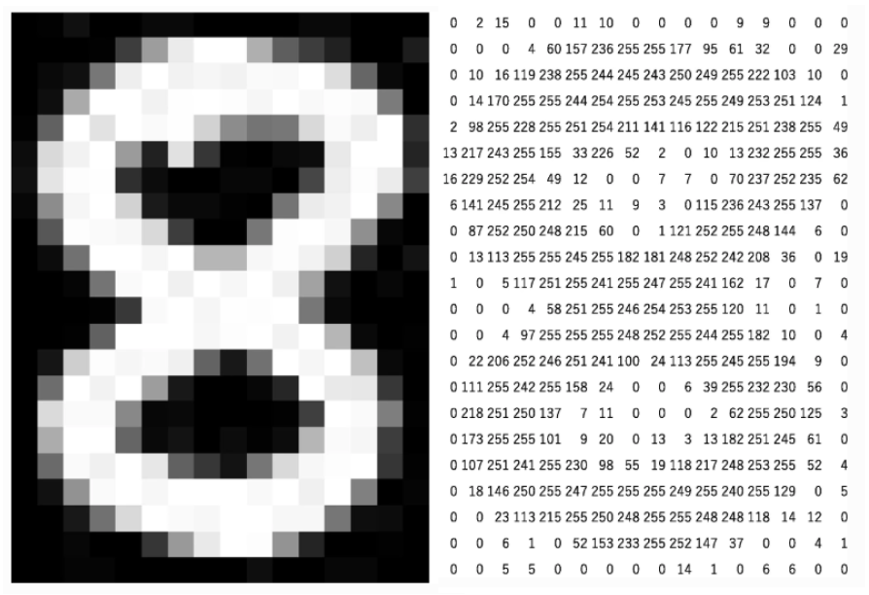
Supervised learning
• The training set consists of inputs and corresponding labels.
• REGRESSION
1) The training set consists of a collection of pairs of an input vector x ∈ R^{d} and its corresponding target, or label, t (note that x can be any input vector including songs, images, etc…). The output is a continuous or finite set.
2) Our model can be of the type y = wx + b
w ≡ weight
b ≡ bias
Parameters of the model

Slide 25
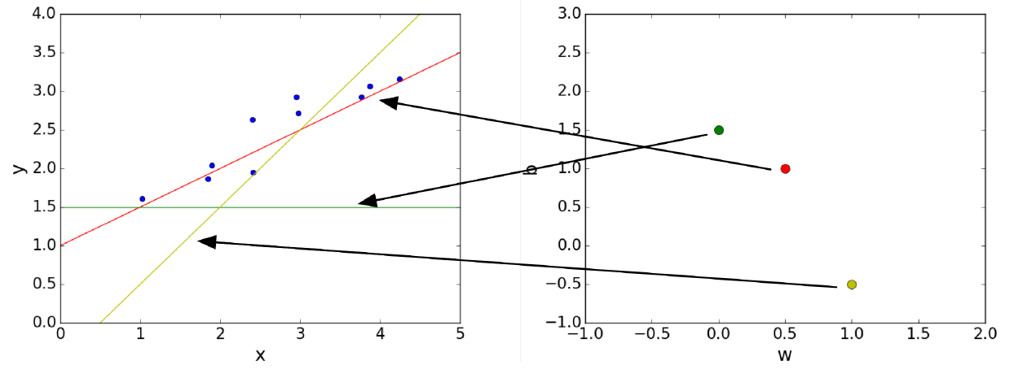
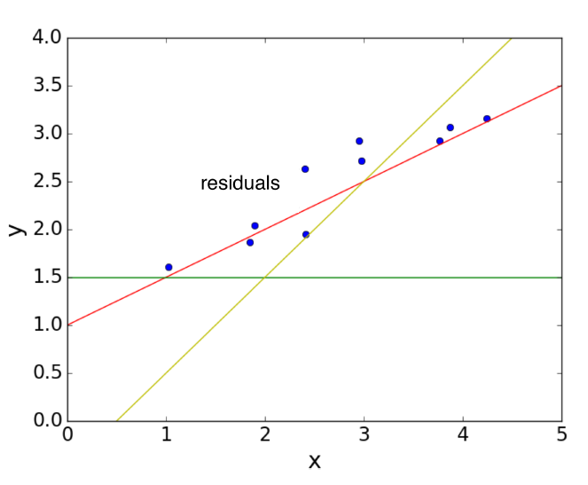

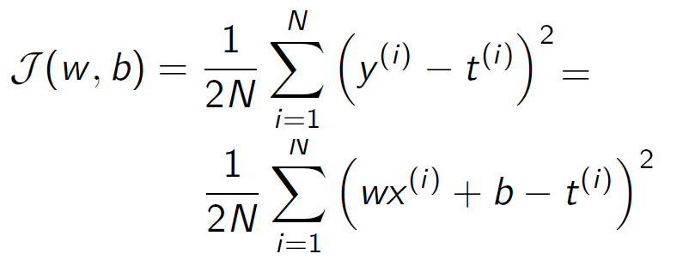
Supervised learning
3) We define a space of weights and bias, which give us y predictions
4) We aim to find the best model parameters by minimizing the lost function
(or cost function ≡ averaged lost function over all training samples)
Using a MSE (Minimum Squared Error) :

Slide 26
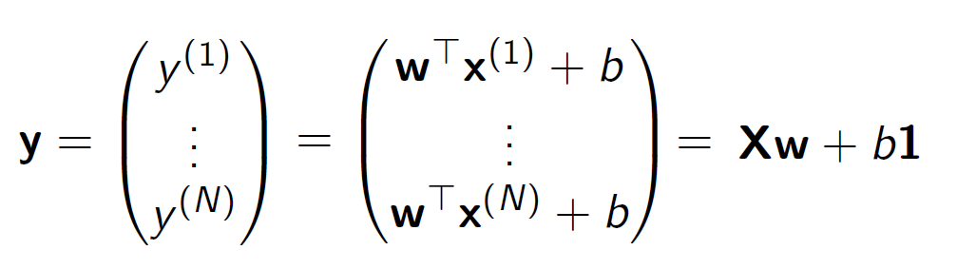
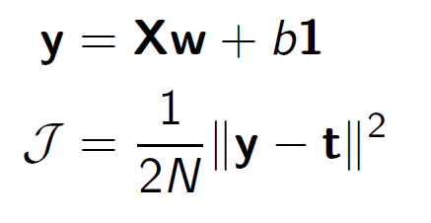
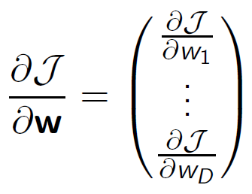
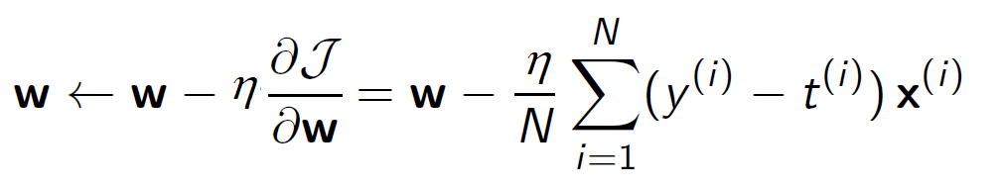
Supervised learning
5) Since we usually have an input vector with multiple variables, we can use vectorial notation:
With the cost function:
6) We minimize the gradient through the learning rate η
to extract the model parameters.
(over all data sample)

Slide 27
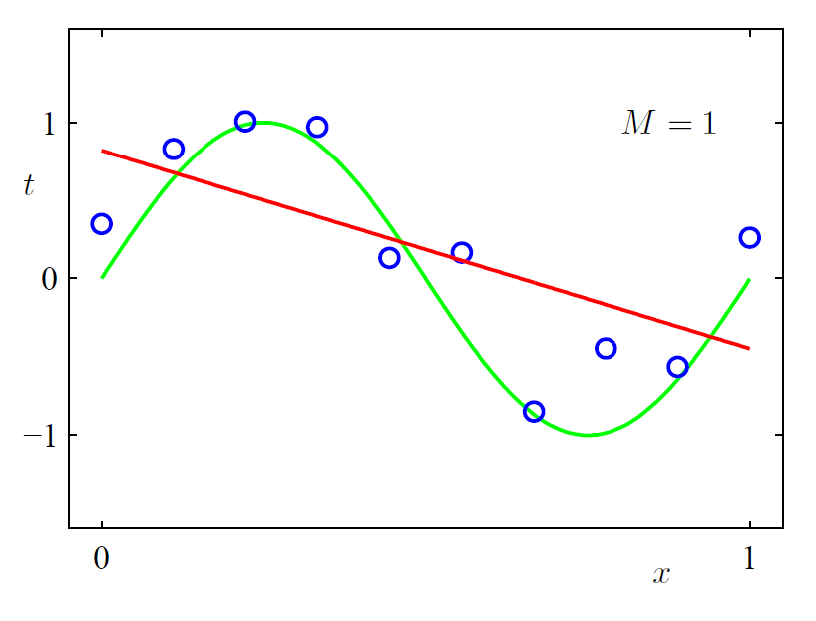



Supervised learning
7) Now we try with a new data sample … it is not just a question of minimization,
but to choose the best weights and the best hyperparameters of the model.
Underfitting
Overfitting
Regularization: a penalty term, depending on the weights, which helps to find
the better model description (it aims to keep small the squared norm of weights):
8) The cost function becomes:
( λ is an hyperparameter,
to be tuned)

Slide 28



Supervised learning
• CLASSIFICATION
1) The training set consists of a collection of pairs of an input vector x ∈ R^{d} and its corresponding target, or label, t (note that x can be any input vector including songs, images, etc…). The target variable is discrete (classes).
Classes are separated by decision boundaries.
x₂
x₂
x₁
x₁
Binary classification
Multiclass classification
Multilabel
classification
Imbalanced
classification

Slide 29
Supervised learning
2) Classification models:
- Logistic Regression: A linear model for binary classification.
- Decision Trees: It splits the feature space into regions by making a series of decisions.
- Gradient Boosting Machines (GBMs): It builds decision trees sequentially.
- Support Vector Machines (SVM): It finds the hyperplane that best separates the classes.
- k-Nearest Neighbors (k-NN): A non-parametric method that classifies instances based on the majority class among the k-nearest neighbors.
- Naive Bayes: A probabilistic classifier based on applying Bayes' theorem with strong independence assumptions between the features.
- Neural Networks: Models inspired by the human brain, particularly powerful in handling complex classification tasks.
- Random Forests: An ensemble method using multiple decision trees to improve classification accuracy.

Slide 30



Supervised learning
• K-Nearest Neighbors (NN): it is a non-parametric method:
Given a vector x to classify →
We need to find the nearest input vector to x in the training set and copy its label.
x₂
x₂
x₁
x₁
K = 1
K = 2
→ Small k gives fine tuning but can cause overfitting
→ Large k implies coarse tuning but can led to underfitting

Slide 31


Supervised learning
• Decision tree models: make predictions by recursively splitting on different
attributes according to a tree structure.
★ One can combine multiple models or decision trees in an ensemble.
?
Is it red ?
Bootstrapping: creation of multiple data subsets by randomly sampling with replacements from the original dataset.
Random Splits: division of data randomly into different parts or subsets.
Bagging (Bootstrap Aggregating):
multiple models are trained independently on different bootstrapped data subsets.
NO
YES
Has leaves?
Rounded shape?
YES
NO
YES
NO
- Internal nodes test the attributes
- Attribute values are separated by branches
- Leaf nodes are output values
Random forests: bagging + random splits

Slide 32


Supervised learning
• Metrics for Classification:
Several figures of merit are defined according to the confusion matrix
[DOI: 10.3390/s18061803]

Slide 33

Supervised learning
The ROC figure of merit is typically quantified using the Area Under the ROC Curve (AUC-ROC), which gives a single scalar value representing the model’s overall ability to discriminate between positive and negative classes.

Slide 34

Unsupervised Learning
Unsupervised Learning

Slide 35



Unsupervised learning
• The training sample is not labelled, the model has to find the latent structure underlying the data.
• CLUSTERING
Meaningful grouping of data according to their similarities.
The goal: to find the clusters that minimize or maximize an objective function.

Slide 36




Unsupervised learning
K-means algorithm:
The data belongs to K classes or patterns, in the way that the variance within them
is as small as possible.
x₂
1- assign an initial cluster to each data
x₁
We have to find cluster centers (m) or centroid and make assignments (r_{K}) for each data point x^{(n)}
2- Recompute the cluster center
according to the gravity center

Slide 37


Unsupervised learning
K-means algorithm:
Optimization:
https://code-specialist.com/python/k-means-algorithm

Slide 38

Unsupervised learning
DBSCAN (Density-Based Spatial Clustering of Applications with Noise)
It groups data points based on their density. It allow to identify outliers/noise points that do not fit any cluster (good for anomaly detection).
https://github.com/NSHipster/DBSCAN
As compare to k-means, it is not needed to specify a number of clusters. DBSCAN can discover clusters of any arbitrary shape.

Slide 39
Unsupervised learning
• Data points are searched for into dense regions and
separated by not-so-dense regions.
MinPoints=3
Core Point: At least MinPts points in its neighborhood, defined by a radius ε.
Border Point: Its neighborhood contains less than MinPts data points, or it is within ε-distance from a core point.
Outlier Point: It is not a core point, and is not close enough to be reachable from a core point.
ε
outlier
border
core
Algorithm procedure:
1) Arbitrarily pick up a point in the dataset (until all points have been visited).
2) If there are at least MinPts points within a radius (ε) to the point then we consider all these points to be part of the same cluster.
3) The clusters are then expanded by recursively repeating the neighborhood calculation for each neighboring point.

Slide 40


Unsupervised learning
• Grouping is usually made by using the Euclidean
https://www.kdnuggets.com/2020/04/dbscan-clustering-algorithm-machine-learning.html

Slide 41

Neural Networks

Slide 42


Neural Networks
Biological inspiration:
There are approximately 100 billion neurons in a mature human brain, each of them connected and communicating with other 10K neurons.
The basic computational unit in a neural network is the neuron
[www.moleculardevices.com]
Neurons receive electric input signals and accumulate voltage, firing spiking responses after some threshold.

Slide 43


Neural Networks
• PERCEPTRON
It is a mathematical model of a biological neuron. While in actual neurons the dendrite receives electrical signals from the axons of other neurons, in the perceptron these electrical signals are represented as numerical values.
The activation function is responsible for making the nodes 'fire'. It processes the input signal (data features) through a mathematical transformation, checks if the value of the weighted sum of inputs crosses a threshold, and if it does, provides an output.

Slide 44


Neural Networks
Activation functions:

Slide 45






Neural Networks
The purpose of the activation function is to introduce non-linearities, enabling the network to learn and model complex patterns:
Linear = coffee + sugar
Non-linear = yeast + dough
x₁
x₁
[A. Amini (MIT)]
x₂
x₂

Slide 46


Neural Networks
The purpose of the activation function is to introduce non-linearities, enabling the network to learn and model complex patterns:
Linear = coffee + sugar
Non-linear = yeast + dough
• Ridge Functions: Linear transformations followed by non-linearity (ex: Sigmoid, ReLU).
• Radial Functions: Symmetric functions based on distance from a center.
• Fold Functions: Non-linear mappings with sharp transitions (ex: Step function).
They can be saturating or non-saturating

Slide 47
Neural Networks
• Neurons are grouped together into layers:
1st hidden layer
2nd hidden layer
Input layer
output layer
h₁
h₁
(1)
(2)
x₁
y₁
h₂
h₂
(1)
(2)
x₂
y₂
h₃
h₃
(1)
(2)
connections
NN depth
→ This gives a feed-forward neural network (FFNN).
→ If all input units are connected to all output units: fully connected FCNN
(multilayer perceptron)

Slide 48









Neural Networks
• Backpropagation: in the training period try to find the network weights w_{i} that achieve the lowest loss by using the gradient descent
★ We want to minimize dL/dw
η ≡ learning rate
w₁
w₂

Slide 49

Neural Networks
[arXiv:2105.04026v2]
Ex: 2D projection of the loss landscape of 4 layers-NN with a ReLU activation function

Slide 50





(in practice, it is a modification of the ADAM algorithm that prevents the learning rate to increase to quickly)
Neural Networks
• Optimizers: w_{t} are the weights at time step t, η the learning rate, ∇ and g represent
the gradient, β₁ and β₂ are decay rate coefficients and ε a protection parameter:
RMSProp
Momentum
Stochastic Gradient
Descent (SGD)
ADAM
AMSGrad
[arXiv:1904.09237]

Slide 51






Neural Networks
• Types of neural networks:
[10.20944/preprints202309.1149]

Slide 52





Neural Networks
• A successful (high impact!)
example at LHCb:
A fast FNN implemented on GPUs (30MHz rate)
True track
In the SM
Ghost track
And BSM
[Eur.Phys.J.C 84 (2024)6, 608]
[Com. Soft. Big. Sci. 9,10 (2025)]

Slide 53








Machine Learning Libraries
• Data processing: pandas, NumPy
• Machine learning: scikit-learn
• Deep learning: PyTorch, TensorFlow, Keras
• Visualization: seaborn, matplotlib
https://pandas.pydata.org/
https://numpy.org/
https://scikit-learn.org
https://pytorch.org/
https://www.tensorflow.org
https://keras.io/
https://seaborn.pydata.org/
https://matplotlib.org/

Slide 54

Thanks!

Slide 55
Additional info

Slide 56
Supervised Learning

Slide 57

Supervised learning
• Support Vector Machines (SVM): The idea is to find the best hyperplane that separates two classes by maximizing the distance to the closest point from either class, i.e., maximize the margin of the classifier.
Support vectors
y = w^{T}x+b
y_{i} = w_{i}^{T}x+b_{i}
Margin
Hyperplane: decision boundaries aiming to classifying the data points.
Support Vectors: nearest data points to the hyperplane.
Margin: the gap between the hyperplane and the support vectors.
Kernel function: functions used to determine the shape of the hyperplane and decision boundary.

Slide 58



Supervised learning
y = w^{T}x+b
The hyperparameter C adjusts the margin:
a large C value narrows the margin for minimal misclassification
a small C value widens it, allowing for more misclassified data
One can use the slack variable ξ, including off-margin points and letting the classification to be more flexible.
ξ_{i}
margin
One can then constrain or penalize the total amount of slack.
Penalty term :
(Hinge loss)

Slide 59
Unsupervised Learning
Unsupervised Learning

Slide 60

Unsupervised learning
• DIMENSIONALITY REDUCTION
→ The idea is to reduce the number of features or variables in a dataset while retaining as much important information as possible. The goal of dimensionality reduction is to simplify the data while preserving the relevant information.
Principal Component Analysis (PCA)
Using the input variables and their covariance matrix, a new set of uncorrelated variables called principal components (PCs) is created via an orthogonal transformation of the original dataset → aiming for an easier learning and visualization.

Slide 61



Unsupervised learning
1) Using all the data points we find
the mean values of the variables
(μ_{x1}; μ_{x2}) and the covariance matrix Σ
2) We calculate the eigenvectors of the coariance matrix, and get the direction vectors (φ₁ and φ₂).
3) We create a transformation matrix of the type p_{φ} = (p_{x}- μ_{x}) Φ
4) The Principal Components are the k eigenvectors with the highest values.
[Ref]
Ex: 256 galaxies described 512-dimensional feature vectors

Slide 62
Neural Networks

Slide 63
Unsupervised learning + NN
• AUTOENCODERS
A neural network architecture designed to efficiently compress (encode) input data down to its essential features, then reconstruct (decode) the original input from this compressed representation.
linear dimensional reduction
non-linear dimensional reduction
Real data
PCA (30D)
Autoencoder (30D)

Slide 64



Unsupervised learning + NN
The learning objective is to minimize the difference between the original input data and the reconstructed data produced by the network.
data expectation
NN parameters
(w_{i} ,b_{i})
, with D and E the decoding and encoding functions

Slide 65


Un/supervised learning + NN
• TRANSFORMERS
Transformers are made up of encoders and decoders, but have a key ingredient: the attention
 | [arXiv:1706.03762]
→ They are a foundational model in natural language processing (NLP)
Attention
attention score:
computes how relevant is
the i position of the input to
this current hidden output
NN states from previous layer
Attention enables the model to dynamically prioritize relevant information by weighing the importance of different parts of the input, transformed in embedding vectors.
Transformers are very new and students are interested to learn on them
Transformers are very new and students are interested to learn on them
0.1
0.1
0.05 0.05 0.05 0.2 0.2 0.05 0.1 0.05 0.1

Slide 66




Un/supervised learning + NN
Having 𝑄, 𝐾, 𝑉 inputs ∈ ℝ^{Txd}) (“queries”, “keys”, “values”),
we can have multi-head attention (j) projecting the input vectors
in multiple subspaces:
It provides a set of contextualized embeddings that
can be used as input in a FNN for further processing

Slide 67

Un/supervised learning + NN
LLaMA (Large Language Model Meta AI): Natural Language Processing (NLP)
research, low-resource deployment, experimentation with large models.
ChatGPT (Generative Pre-trained Transformer): Chatbots, virtual assistants,
code generation, tutoring, content creation, etc.
BLOOM (BigScience Large Open-science Open-access Multilingual Language Model):
text generation, translation, code generation, language research across
multiple languages.
BERT (Bidirectional Encoder Representations from Transformers): text classification, question answering,
named entity recognition (NER), text summarization, and translation.
Falcon: text generation, text summarization, translation, sentiment analysis, question answering,
conversational agents, and research and development in NLP
SAM (Segment Anything Model) and ViT (Vision Transformer): image segmentation and recognition tasks.

Slide 68

Reinforcement Learning

Slide 69

Reinforcement learning
• It is not only a leaning process over time, but a taking decision system
Agent: Entity learning about the environment and making decisions. We need to specify a learning algorithm for the agent that allows it to learn a policy (π).
Environment: Everything outside the agent, including other agents.
Policy (π): it tells the agent what action to take in a given state.
State: A representation of the environment. At time step t, the agent is in state S_{t} ∈ S, where S is the set of all possible states.
Action (A): At time step t, an agent takes an action A_{t} ∈ A(t_{s}) where A(t_{s}) is the set of actions available in state S_{t}.
Rewards: Numerical quantities that represent feedback from the environment that an agent tries to maximize.

Slide 70




Reinforcement learning
Environment:
tic tac toe board
State S_{t}
Reward r_{t+1} = -1
Action A(S_{t})

Slide 71




Reinforcement learning
• The Q-value is the expected reward of taking action A in state S
and then continuing according to the policy π.
reward
at t+1
Initial state and action
Discount factor ∈(0,1), which reduces the weight of future rewards
Expectation
(average over time/trials)
The learning process consists of finding the optimal policy by iteratively updating Q-values for each state-action pair:
best possible action
$$ $$
$$ $$
learning rate (controls how much new information overrides old information)

Slide 72
Underlying hardware and libraries

Slide 73





Underlying hardware
Any ML technique depends on the hardware platform where is executed:
Use more than one kind of processor or cores to maximize performance or
energy efficiency (specially important for training).
→ Exploit the high level of parallelism to handle particular tasks.
Graphic Processor Units (GPUs)
Field Programmable Gate Arrays (FPGAs)
Multicore processors, highly commercial
High throughput
Ideal for data –intensive parallelizable applications
Programmable and flexible devices
Low latency
Low power consumption
Ideal for compute- and data-intensive workloads

Slide 74


Underlying hardware
Gen. Inst.
CP1600 +
Standard
Television
Interface Chip
AMD
Ryzen Zen 2 +
RDNA-2

Slide 75


Underlying hardware
Artemisa: https://artemisa.ific.uv.es/web/
ARTificial Environment for ML and Innovation in Scientific Advanced Computing

Slide 76


Underlying hardware
BE RESPONSIBLE
• Last words on power consumption…
Ex: A random forest consumes x 2 energy as compared to AdaBoost

Slide 77



Underlying hardware
BE RESPONSIBLE
• Last words on power consumption…
Ex: A random forest consumes x 2 energy as compared to AdaBoost
Energy consumption is fully correlated to with throughput but it also depends
on the hardware utilization:
(unofficial)
16M events
16M events

